Slide 1

Economic Geography
4 – Transport and location
Port & the City
121EC
A.Y. 2019/2020
Dr. Giuseppe Borruso
Department of Economics, Business, Mathematics and Statistics
University of Trieste
E-mail. giuseppe.borruso@econ.units.it
Ph. +39 040 558 7008
Skype: giuseppe.borruso
Notes:
Slides with (*) in footnotes have been modified by Jean-Paul Rodrigue materials. (see copyright). I have modified and elaborated materials in order to be suitable for the current course.
Copyright © 1998-2010, Dr. Jean-Paul Rodrigue, Dept. of Global Studies & Geography, Hofstra University. For personal or classroom use ONLY.

Slide 2
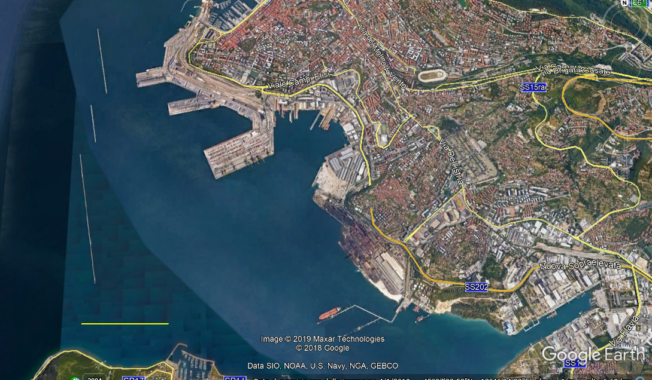
A port today – the Port of Trieste
N
1 000 m

Slide 3
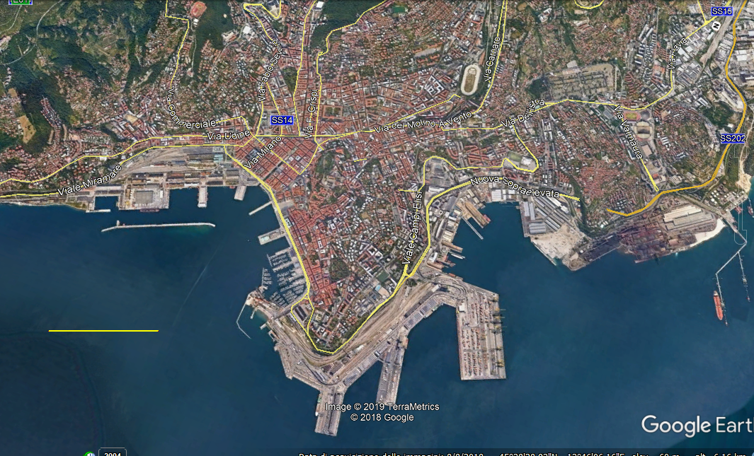
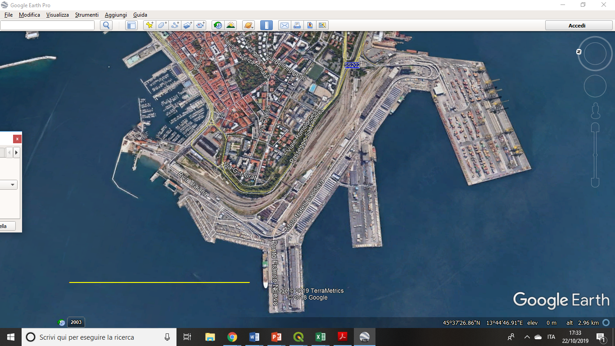
A port today – the City and Port of Trieste
1 000 m
N

Slide 4
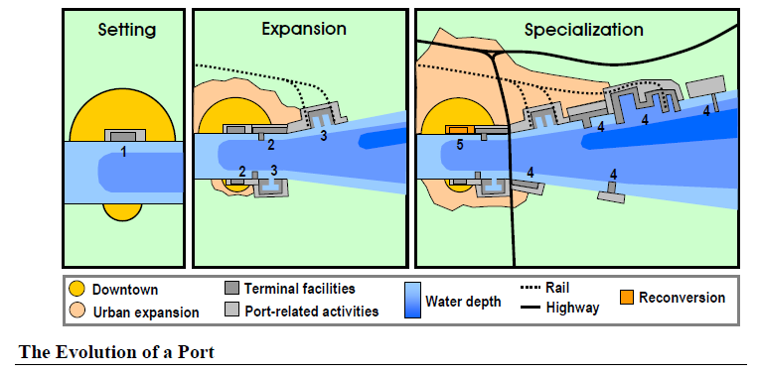
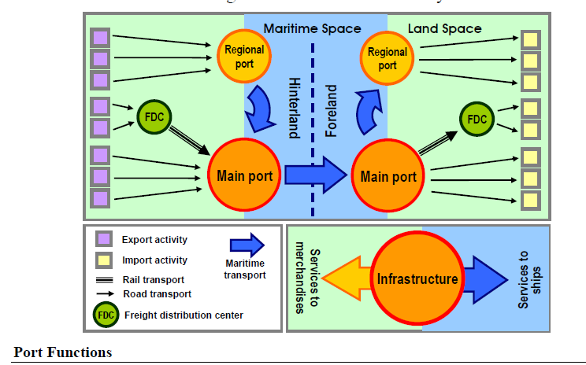
Evolutions
– city and port

Slide 5
A port today – the City and Port of Trieste
1 000 m
N

Slide 6
N
1 000 m
Rail infrastructure (station; maneuvers; shunting)
(excluding rail trunks in piers)

Slide 7
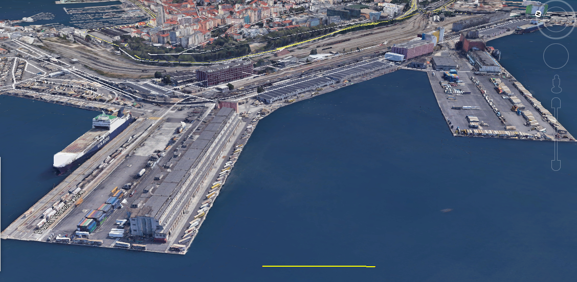
Molo V & VII (Piers 5th & 6th) – Multipurpose terminals
Warehouses
Quays
Semitrailers
Containers
Rail track – Ro-La (Rollande Landstrasse)
(300 m ca)
100 m

Slide 8
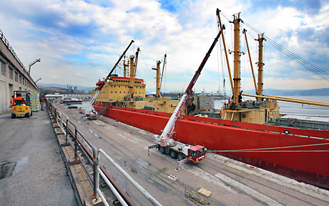
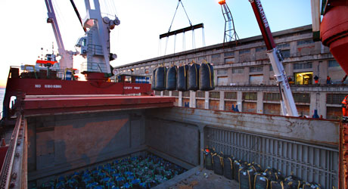
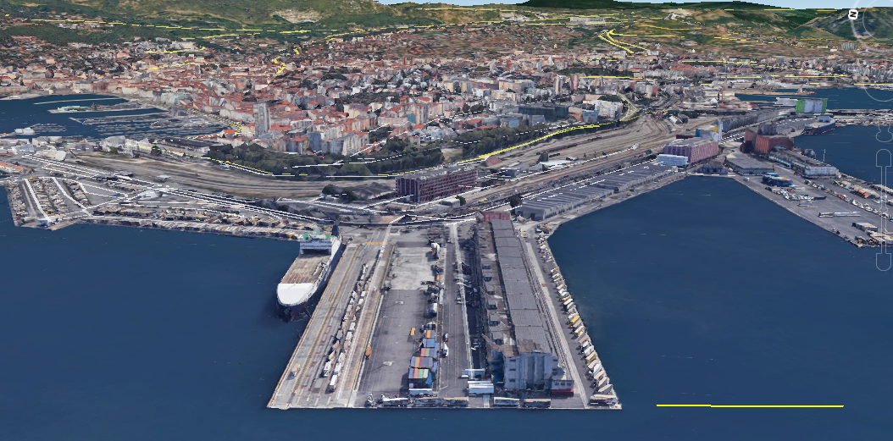
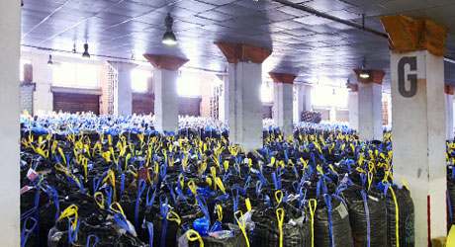
Molo V (Pier 5th)
Samer Seaports & Terminals (Ro-Ro)
Terminal Frutta (Fruit Terminal)
Quay &
warehouse
Dry bulk
carrier
100 m
Dedicated
warehouses
Ro-Ro Terminal
Fruit Terminal

Slide 9
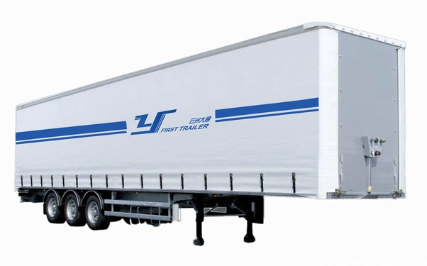
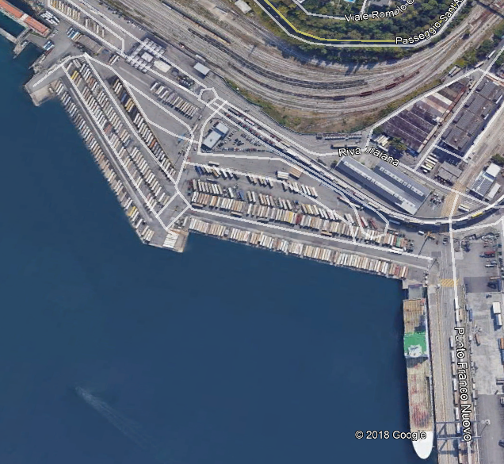
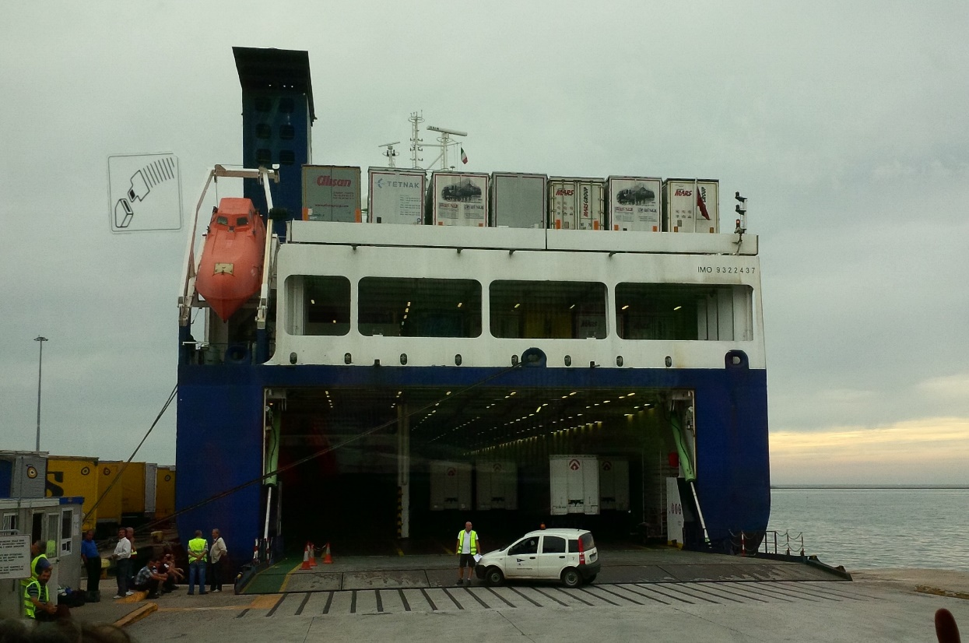
Ro-Ro Ferry Terminals and transport means
Semitrailer
Ro-Ro Ferry
Ro-Ro Terminal

Slide 10
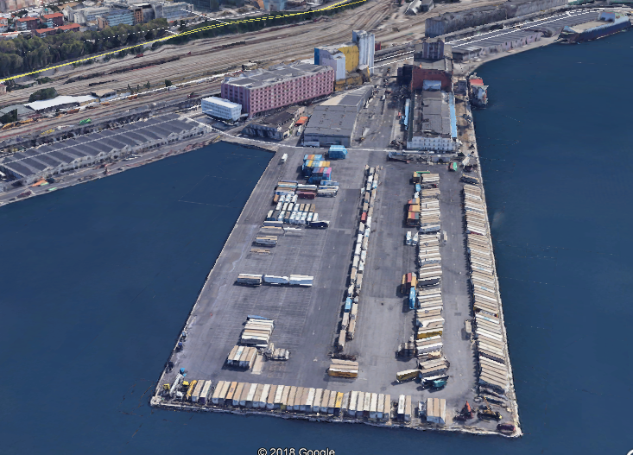
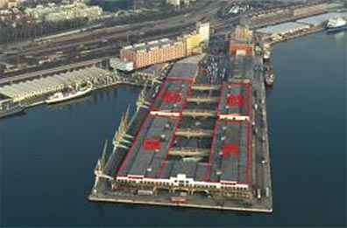
Molo VI (Pier 6th)
Francesco Parisi (Europa Multipurpose Terminals) – Ekol
Terminal Cereali (Cereals Terminal)
From old warehouses…..
…to modern quays

Slide 11
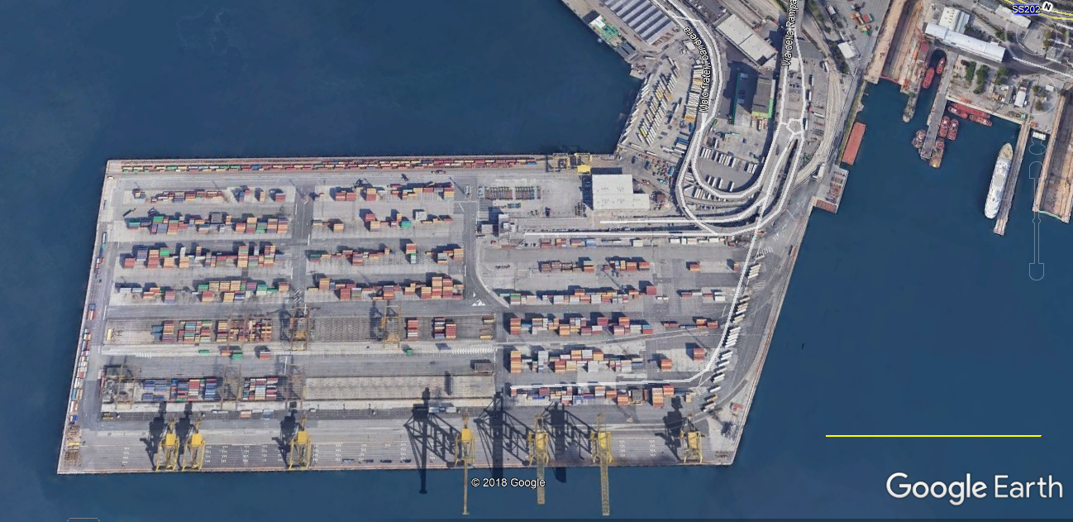
Container terminal «Molo VII» (7th Pier)
Rail track – Ro-La (Rollande Landstrasse)
500 m
Containers
(piled)
N
Semi-trailers
250 m
Cranes

Slide 12
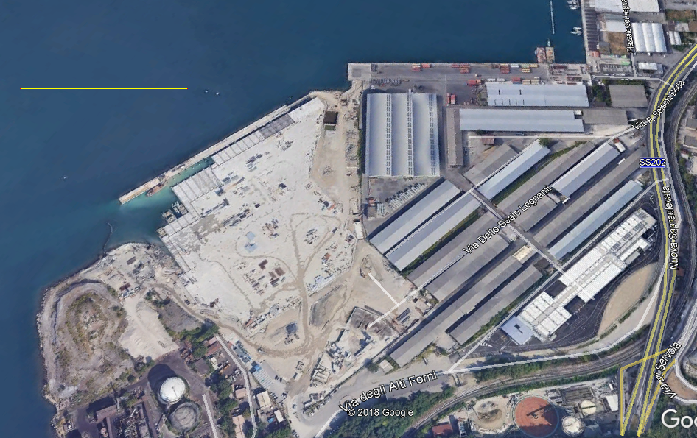
Multipurpose platform Wood Terminal
(Ro-Ro / containers)
250 m
N

Slide 13
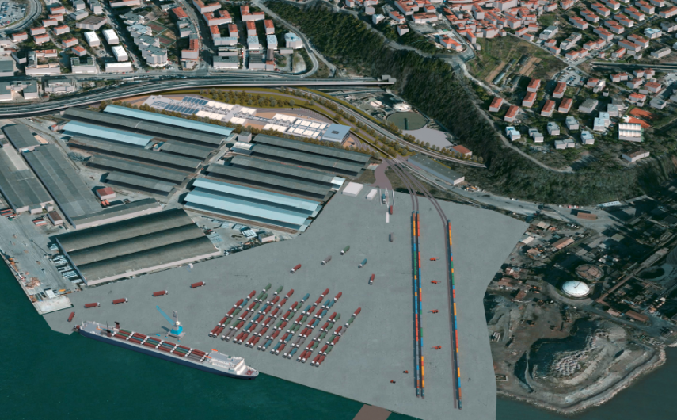
Logistic platform – planned

Slide 14
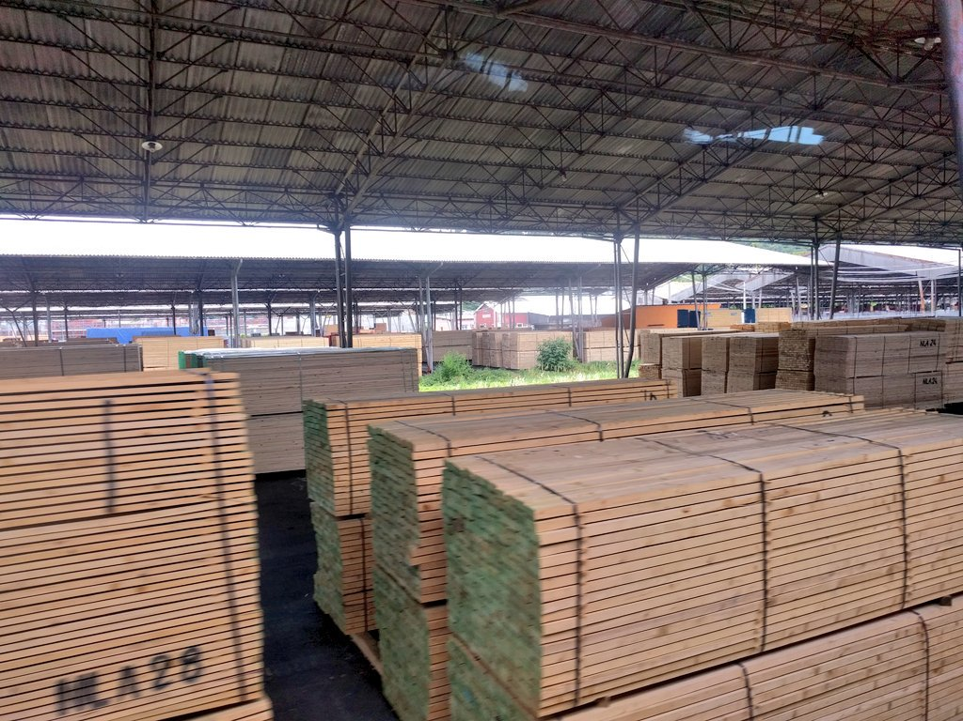
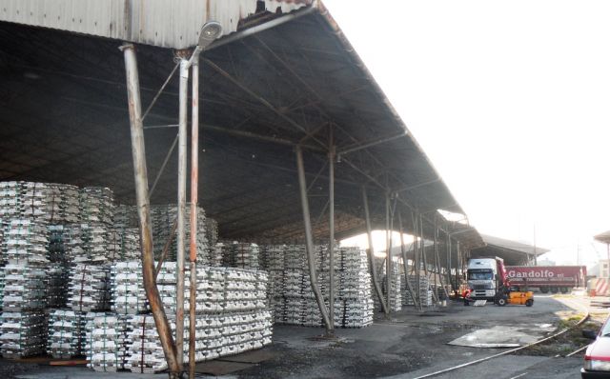
Wood Terminal
Wood and not only wood….
….non ferrous metals

Slide 15
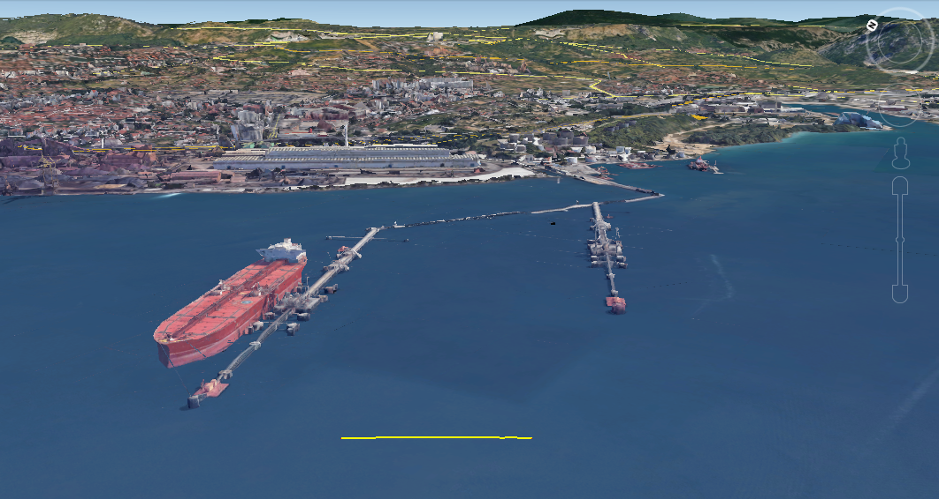
SIOT Terminal - Transalpine Pipeline
300 m
100 m

Slide 16
Largest Ships by Category
MSC Oscar (2015)
LOA: 394 m
Beam: 59 m
Draft: 16 m
TEU: 19,224
Containership
TI Europe (2003)
LOA: 380 m
Beam: 68 m
Draft: 24.5 m
DWT: 442,000 t
Ultra Large
Crude Carrier
LOA: 362 m
Beam: 65 m
Draft: 23 m
DWT: 402,000 t
MS Ore Brazil (2011)
Bulk Carrier
Oasis of the Seas (2009)
LOA: 362 m
Beam: 60.5 m
Draft: 9.3 m
Passengers: 5,400
Cruise Ship

Slide 17
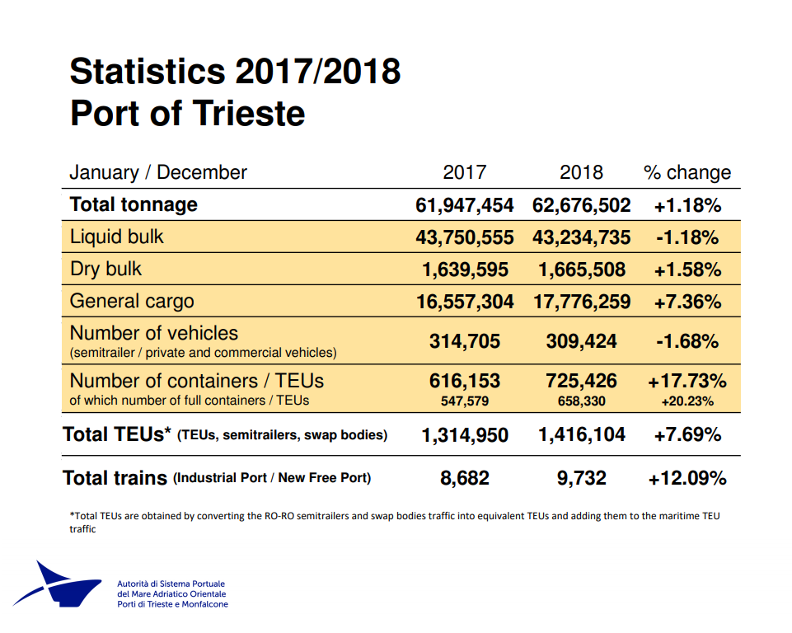
https://www.porto.trieste.it/wp-content/uploads/2019/02/Sintesi_Statistiche_-ESPO_Gennaio-Dicembre_2018-NV-modalit%c3%a0-compatibilit%c3%a0.pdf

Slide 18
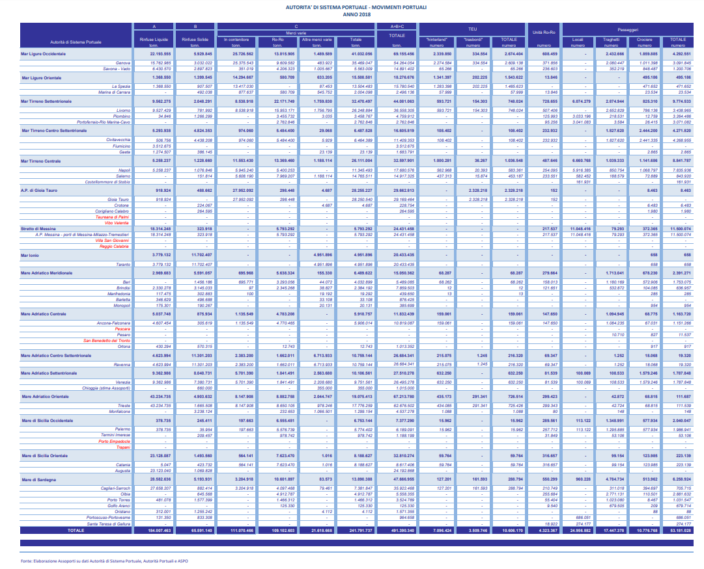
Italian port statistics
http://www.assoporti.it/media/4305/adsp_movimenti_portuali_2018_agg_18aprile2019.pdf

