Slide 1


Slide 2
Historically, the best that forecasters have been able to do consistently is recognize that we’re in a recession once we’re in one,” said Tara Sinclair, an economist at George Washington University. “The dream of an early warning system is still a dream that we’re working on.”
Always after the monetary roaring seasons, depressions unavoidable pop ups!

Slide 3
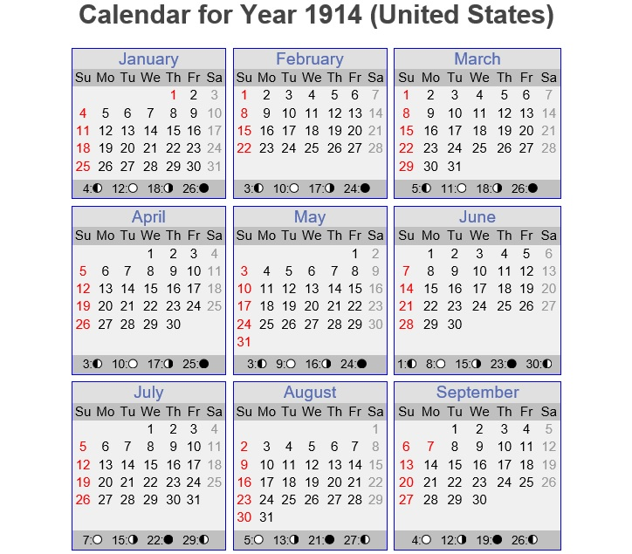

Slide 4

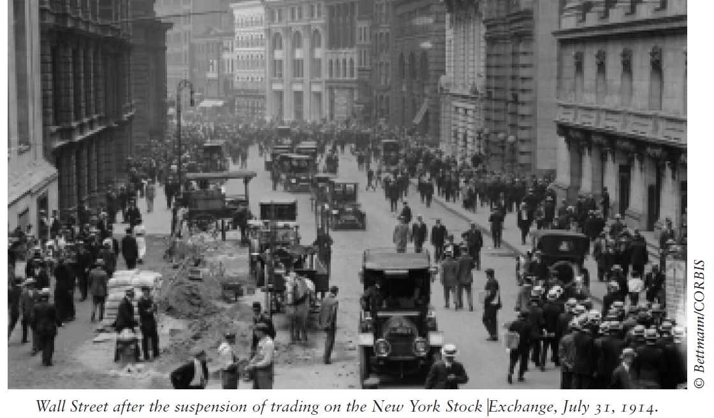

Slide 5
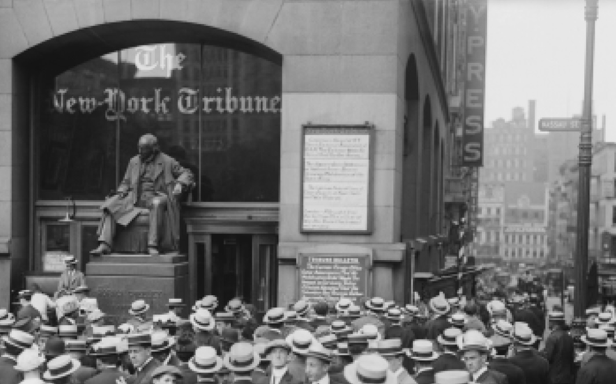

Slide 6
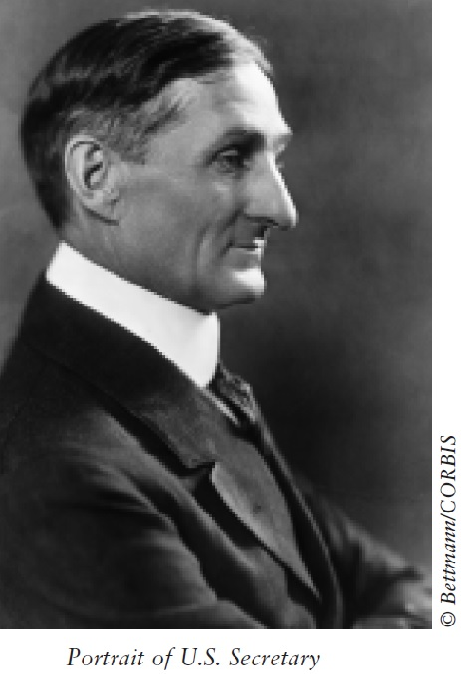

Slide 7
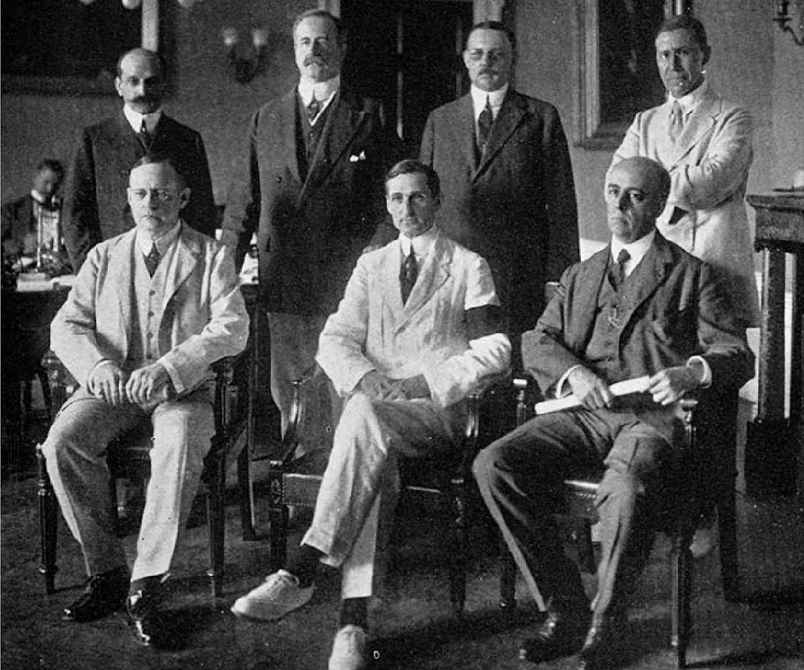

Slide 8
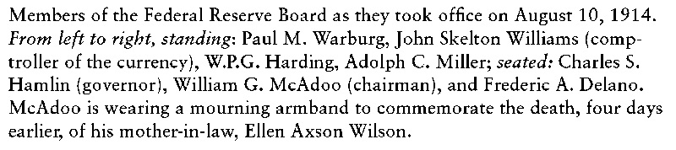
First Federal Council Board

Slide 9
The prologue and the misunderstandings

Slide 10
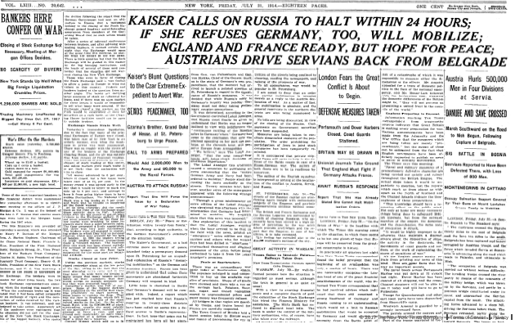

Slide 11
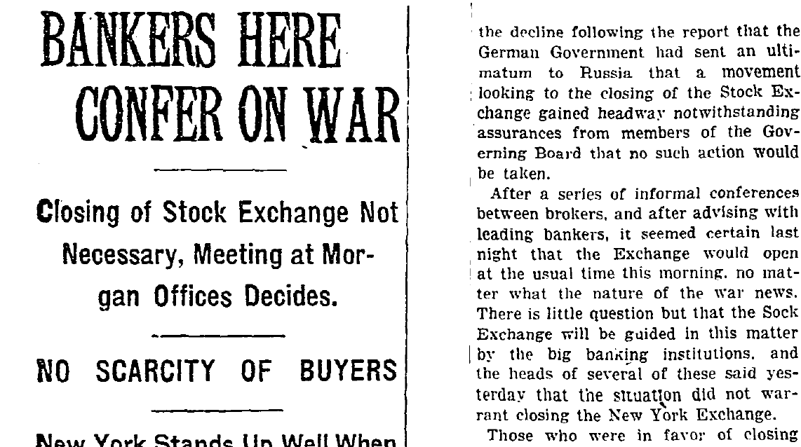

Slide 13
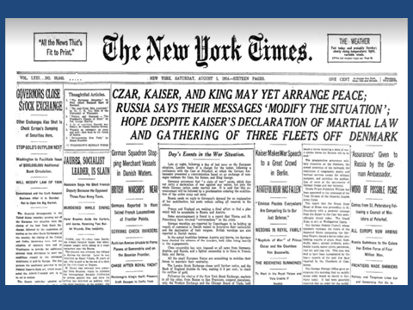

Slide 18
THE ALDRICH-VREELAND ACT
Congress passed the Emergency Currency Act modeled on these principles, and it was signed into law May 30, 1908. The act is commonly known as the Aldrich-Vreeland Act after its sponsors.
The Aldrich-Vreeland Act provided a mechanism that would permit banks to use securities other than U. S. government bonds to obtain short-term increases in their circulations. Two types of entities could apply for the additional currency: (1) groups of at least 10 banks formed into national currency associations and (2) individual banks.
National currency associations were authorized to accept securities from a member bank and then to apply to the Comptroller of the Currency for additional circulation for that member bank.
The total amount of emergency currency that could be issued under this act was set at $500,000,000. This amount was subsequently raised to over $1 billion by a hastily passed amendment dated August 4, 1914, immediately following the outbreak of World War I in Europe.

Slide 19
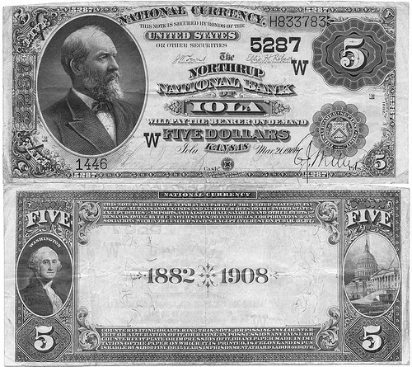

Slide 20
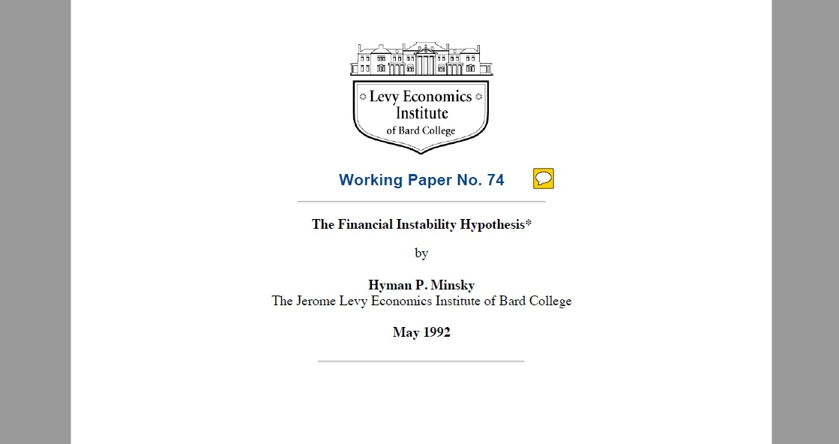

Slide 21
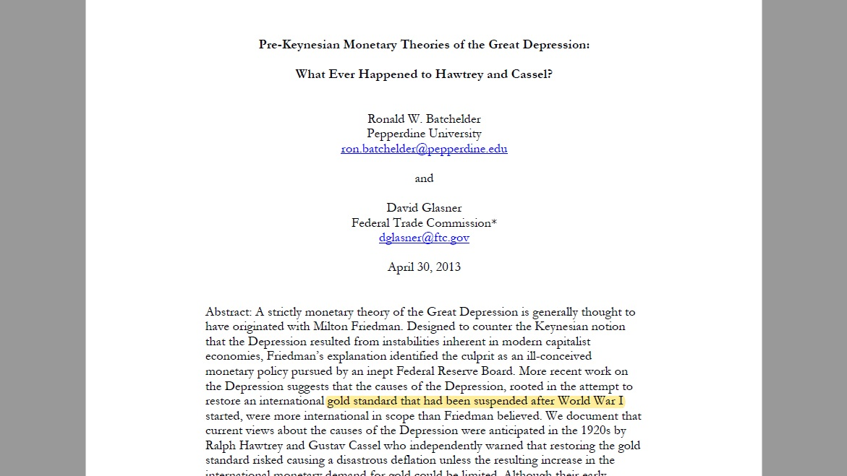

Slide 25
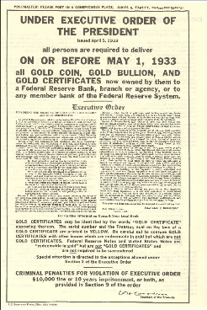

Slide 26
"We will not have any more crashes in our time."
- John Maynard Keynes in 1927
"I cannot help but raise a dissenting voice to statements that we are living in a fool's paradise, and that prosperity in this country must necessarily diminish and recede in - Myron E. Forbes, President, Pierce Arrow Motor Car Co., January 12, 1928
"No Congress of the United States ever assembled, on surveying the state of the Union, has met with a more pleasing prospect than that which appears at the present time. In the domestic field there is tranquility and contentment...and the highest record of years of prosperity. In the foreign field there is peace, the goodwill which comes from mutual understanding."
- Calvin Coolidge December 4, 1928
"There may be a recession in stock prices, but not anything in the nature of a crash."
- Irving Fisher, leading U.S. economist , New York Times, Sept. 5, 1929

Slide 27
"Stock prices have reached what looks like a permanently high plateau. I do not feel there will be soon if ever a 50 or 60 point break from present levels, such as (bears) have predicted. I expect to see the stock market a good deal higher within a few months."- Irving Fisher, Ph.D. in economics, Oct. 17, 1929
"This crash is not going to have much effect on business."
- Arthur Reynolds, Chairman of Continental Illinois Bank of Chicago, October 24, 1929
"There will be no repetition of the break of yesterday... I have no fear of another comparable decline."- Arthur W. Loasby (President of the Equitable Trust Company), quoted in NYT, Friday, October 25, 1929
"We feel that fundamentally Wall Street is sound, and that for people who can afford to pay for them outright, good stocks are cheap at these prices."
- Goodbody and Company market-letter quoted in The New York Times, Friday, October 25, 1929

Slide 28
"This is the time to buy stocks. This is the time to recall the words of the late J. P. Morgan... that any man who is bearish on America will go broke. Within a few days there is likely to be a bear panic rather than a bull panic. Many of the low prices as a result of this hysterical selling are not likely to be reached again in many years."
- R. W. McNeel, market analyst, as quoted in the New York Herald Tribune, October 30, 1929
"Buying of sound, seasoned issues now will not be regretted"
- E. A. Pearce market letter quoted in the New York Herald Tribune, October 30, 1929
"Some pretty intelligent people are now buying stocks... Unless we are to have a panic -- which no one seriously believes, stocks have hit bottom."
- R. W. McNeal, financial analyst in October 1929

Slide 29
"The decline is in paper values, not in tangible goods and services...America is now in the eighth year of prosperity as commercially defined. The former great periods of prosperity in America averaged eleven years. On this basis we now have three more years to go before the tailspin."- Stuart Chase (American economist and author), NY Herald Tribune, November 1, 1929
"Hysteria has now disappeared from Wall Street.“ - The Times of London, November 2, 1929
"The Wall Street crash doesn't mean that there will be any general or serious business depression... For six years American business has been diverting a substantial part of its attention, its energies and its resources on the speculative game... Now that irrelevant, alien and hazardous adventure is over. Business has come home again, back to its job, providentially unscathed, sound in wind and limb, financially stronger than ever before." - Business Week, November 2, 1929
"...despite its severity, we believe that the slump in stock prices will prove an intermediate movement and not the precursor of a business depression such as would entail prolonged further liquidation...“ - Harvard Economic Society (HES), November 2, 1929

Slide 30
"... a serious depression seems improbable; [we expect] recovery of business next spring, with further improvement in the fall." - HES, November 10, 1929
"The end of the decline of the Stock Market will probably not be long, only a few more days at most." - Irving Fisher, Professor of Economics at Yale University, November 14, 1929
"In most of the cities and towns of this country, this Wall Street panic will have no effect.“ - Paul Block (President of the Block newspaper chain), editorial, November 15, 1929
"Financial storm definitely passed.“ - Bernard Baruch, cablegram to Winston Churchill, November 15, 1929

Slide 31
"I see nothing in the present situation that is either menacing or warrants pessimism... I have every confidence that there will be a revival of activity in the spring, and that during this coming year the country will make steady progress."
- Andrew W. Mellon, U.S. Secretary of the Treasury December 31, 1929
"I am convinced that through these measures we have reestablished confidence."
- Herbert Hoover, December 1929
10. "1930 will be a splendid employment year."- U.S. Dept. of Labor, New Year's Forecast, December 1929
"For the immediate future, at least, the outlook (stocks) is bright."
- Irving Fisher, Ph.D. in Economics, in early 1930

Slide 32
"...there are indications that the severest phase of the recession is over..."
- Harvard Economic Society (HES) Jan 18, 1930
"There is nothing in the situation to be disturbed about."
- Secretary of the Treasury Andrew Mellon, Feb 1930
"The spring of 1930 marks the end of a period of grave concern...American business is steadily coming back to a normal level of prosperity." - Julius Barnes, head of Hoover's National Business Survey Conference, Mar 16, 1930
"... the outlook continues favorable..." - HES Mar 29, 1930

Slide 33
"... the outlook is favorable..."
- HES Apr 19, 1930
"While the crash only took place six months ago, I am convinced we have now passed through the worst -- and with continued unity of effort we shall rapidly recover. There has been no significant bank or industrial failure. That danger, too, is safely behind us." - Herbert Hoover, President of the United States, May 1, 1930
"...by May or June the spring recovery forecast in our letters of last December and November should clearly be apparent..." - HES May 17, 1930
"Gentleman, you have come sixty days too late. The depression is over.“ - Herbert Hoover, responding to a delegation requesting a public works program to help speed the recovery, June 1930

Slide 34
"... irregular and conflicting movements of business should soon give way to a sustained recovery..."
- HES June 28, 1930
"... the present depression has about spent its force..."
- HES, Aug 30, 1930
"We are now near the end of the declining phase of the depression."
- HES Nov 15, 1930
"Stabilization at [present] levels is clearly possible."
- HES Oct 31, 1931
"All safe deposit boxes in banks or financial institutions have been sealed... and may only be opened in the presence of an agent of the I.R.S."
- President F.D. Roosevelt, 1933
http://www.users.dircon.co.uk/~netking

Slide 35
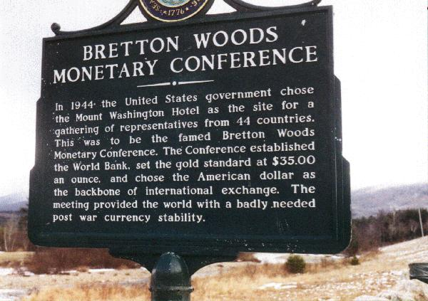

Slide 36
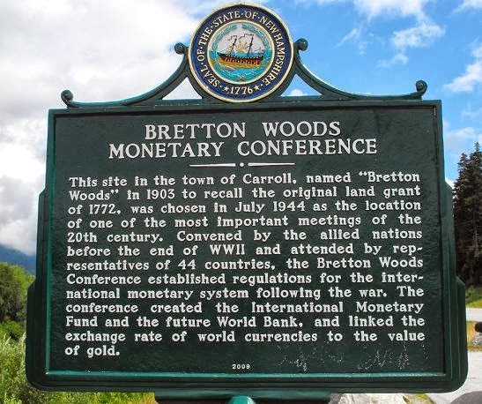

Slide 37
Nixon’s announcement on the 15° August 1971:
"I have directed Secretary Connally to suspend temporarily the convertibility of the American dollar except in amounts and conditions determined to be in the interest of monetary stability and in the best interests of the United States”.

Slide 38


Slide 39


Slide 40
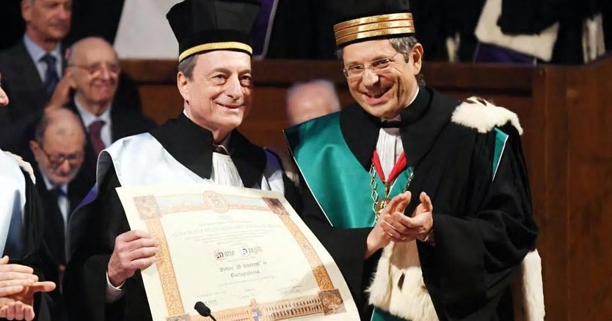

Slide 41
Bank of England Governor King Calls For End of ‘Too
Big To Fail’
By Valentin Schmid On December 11, 2012 @ 12:50 am In Companies | No Comments
Outgoing Bank of England Gov. Sir Mervin King said economic problems are manageable in a New York speech Dec. 10 . He also called for an end of “Too Big to Fail” banks and special interest policies.
“These problems are all manageable. Manageable though they are, they have to be done,” said Sir Mervin King at a luncheon speech before the Economic C lub of New York Dec. 10. He referred to the standard economic problems that a re often addressed by central bankers: A slow economic recovery, banks that are unwilling to lend and structural imbalances in world trade.
Governor of the Bank of England Mervyn King
leaves Downing Street in London in this file
photo. King spoke on Dec. 10 at the Economic
Club of New York and called for an end to ‘Too
Big to Fail’ and special interest politics. (Peter
Macdiarmid/Getty Images)

Slide 42
Having joined t he Bank of England in 1991, King became governor of the world’s oldest central bank in 2003. He retired from the post in July 2013 and Mark Carney of the Bank of Canada is the designated successor.
In one of his last speeches, the outgoing governor certainly did not disappoint the New York audience, with William Dudley of the New York Fed and Glenn Hubbard of Columbia University in attendance.
Often when public officials and politicians have little time of service left, they start to become more outspoken. King, having little to lose with a fully accrued annual pension benefit of $3 18,467, also went beyond the common central banker script. The Fed’s Ben Bernanke or the European Central Bank’s Mario Draghi often dwell on topics such as banks’ unwillingness to lend or the slow recovery, not so King.

Slide 43
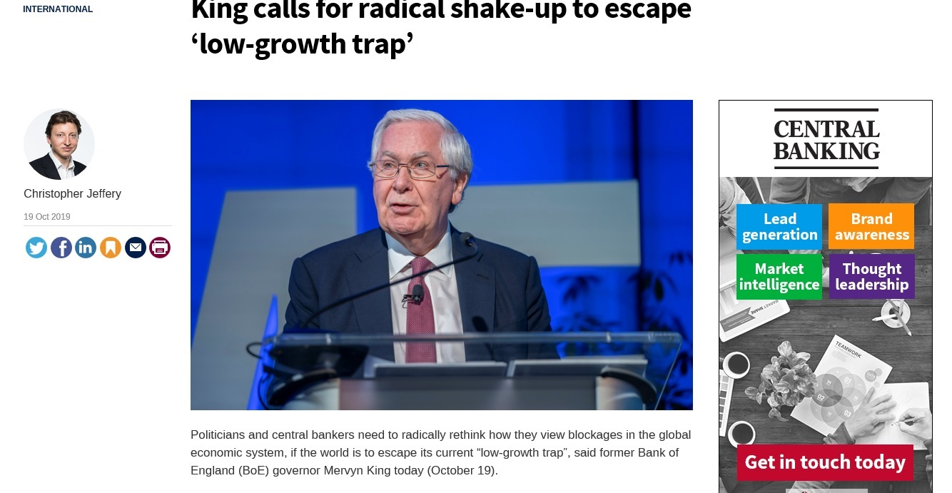

Slide 44
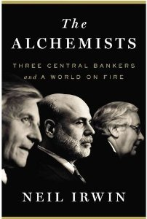

Slide 45
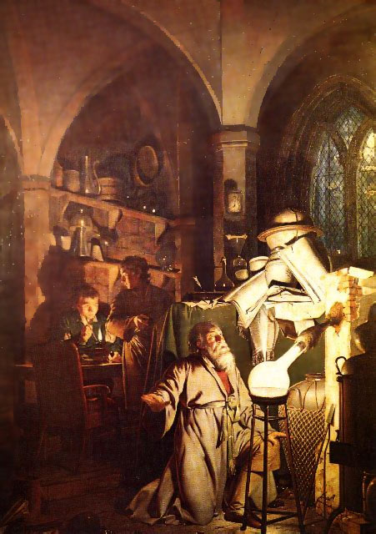
Joseph Wright The Alchemist 1771

Slide 47
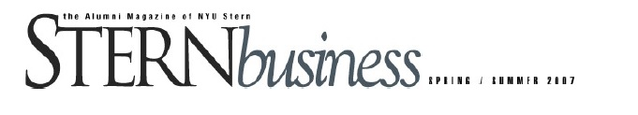
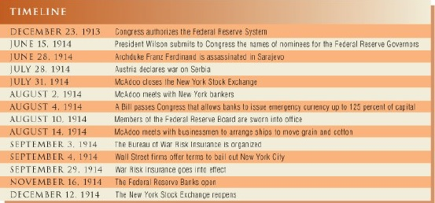
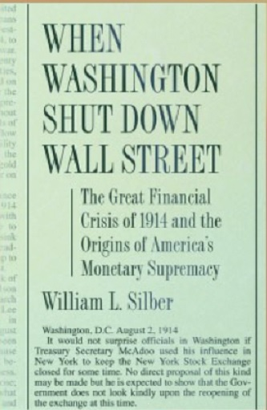

Slide 48
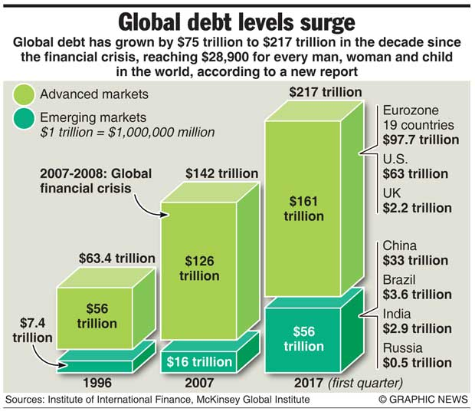

Slide 49
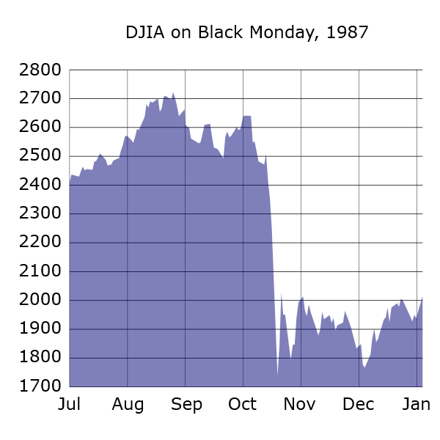

Slide 50
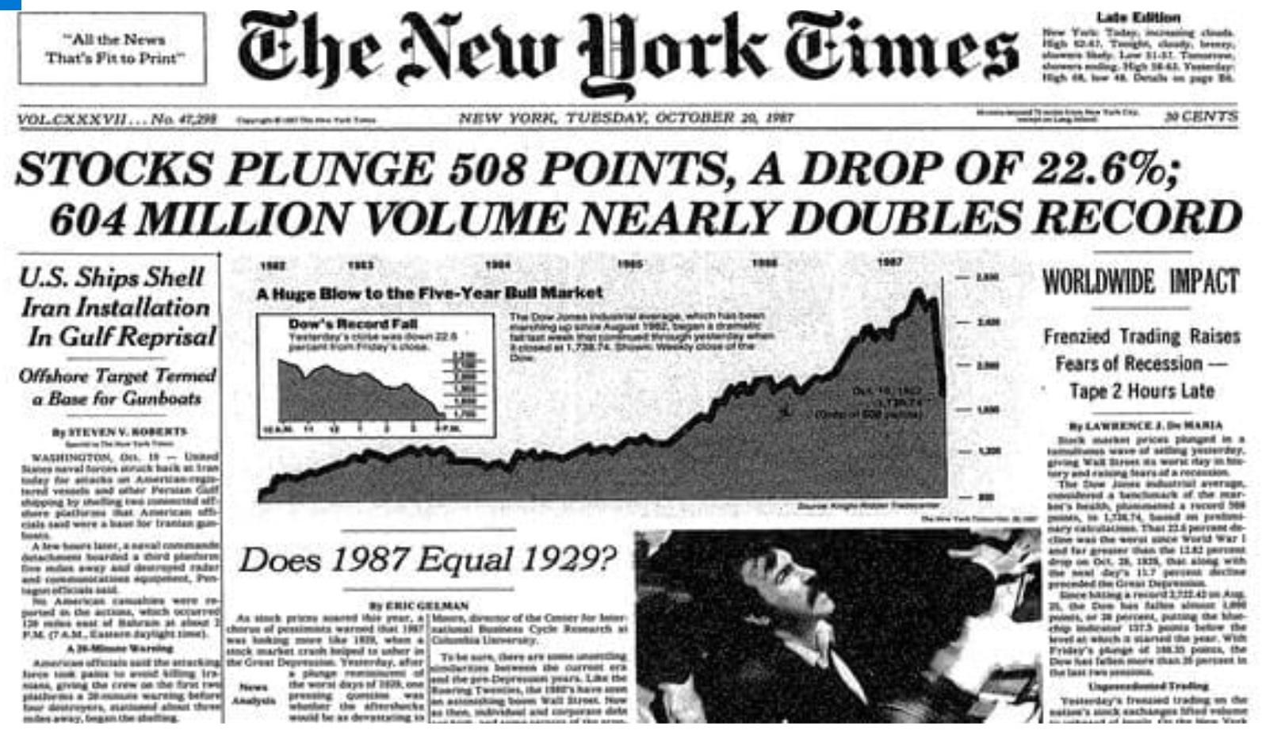

Slide 51
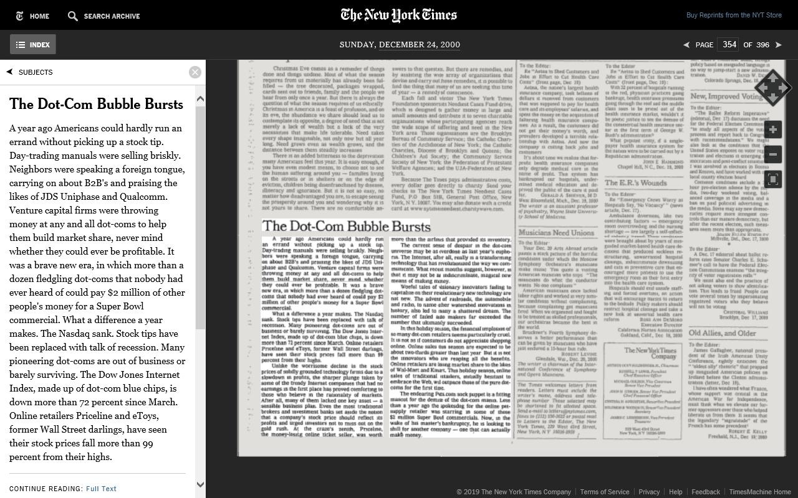

Slide 52
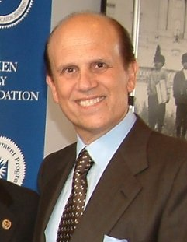
Drexel Burnham Lambert was a major Wall Street investment banking firm, which first rose to prominence and then was forced into bankruptcy in February 1990 by its involvement in illegal activities in the junk bond market, driven by Drexel employee Michael Milken. At its height, it was the fifth-largest investment bank in the United States

Slide 53
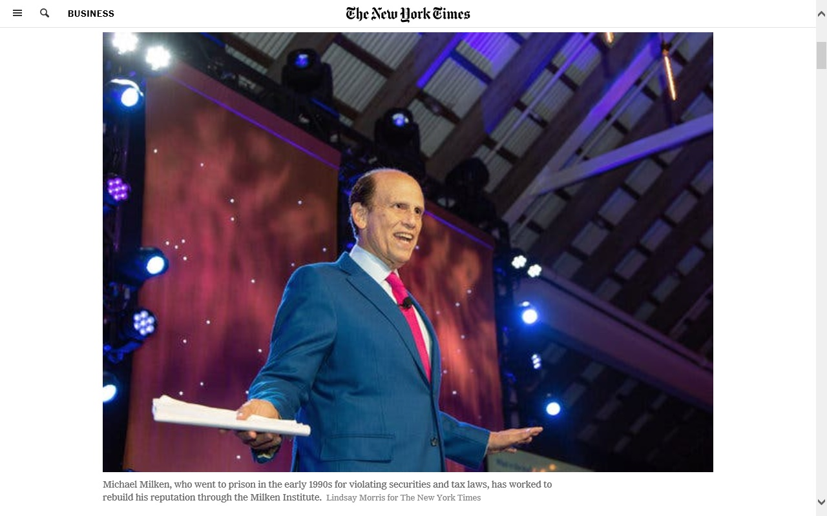

Slide 54
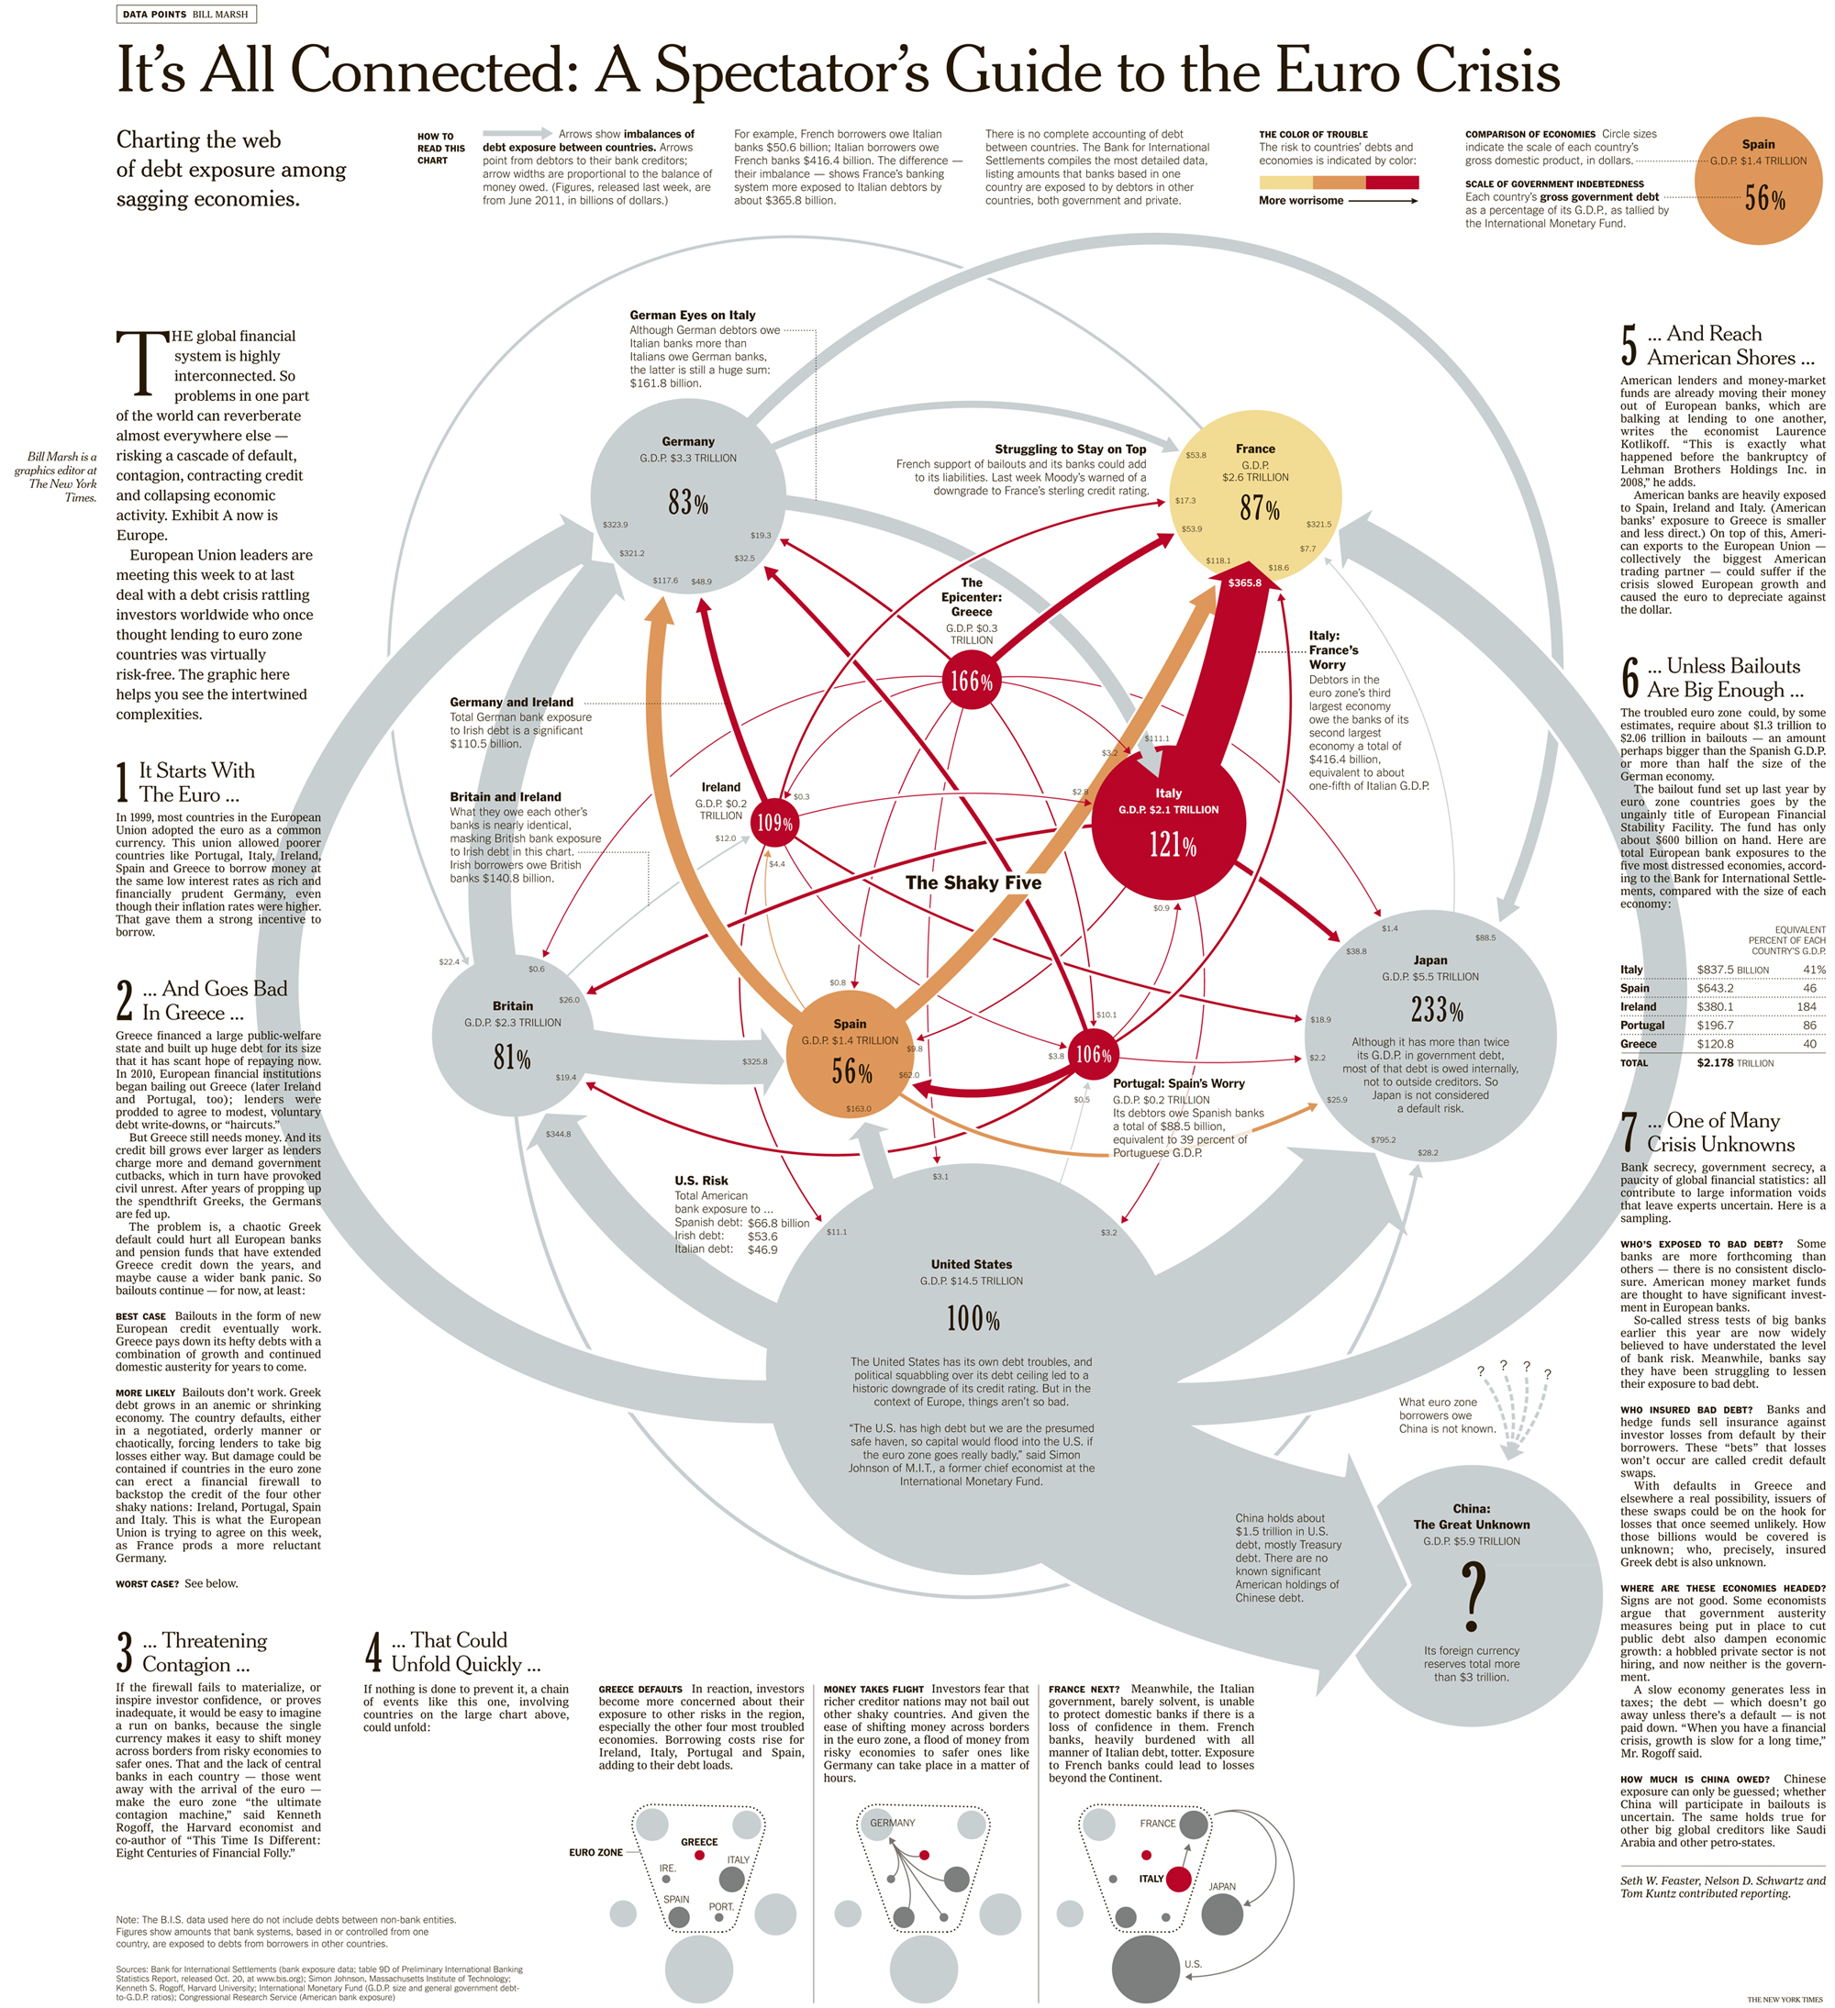
Drexel Burnham Lambert was a major Wall Street investment banking firm, which first rose to prominence and then was forced into bankruptcy in February 1990 by its involvement in illegal activities in the junk bond market, driven by Drexel employee Michael Milken. At its height, it was the fifth-largest investment bank in the United States

Slide 55
Opinion | Op-Ed Contributor
The Original Subprime Crisis
By LOUIS HYMANDEC. 26, 2007
Continue reading the main story Share This Page Continue reading the main story
Cambridge, Mass.
WHILE critics of today’s mortgage crisis call for government intervention to suppress subprime lending, few are aware that government intervention created subprime mortgages in the first place.
The National Housing Act of 1968, part of President Lyndon Johnson’s Great Society, provided government-subsidized loans to expand home ownership for poor Americans. Liberal policymakers hoped that these loans, called Section 235 loans, would enable poor Americans — urban blacks in particular — to buy their own homes.

Slide 56
Under the program, a poor family could obtain a mortgage from a lender for as little as $200 down and pay only a small portion of the interest. If the borrower defaulted, the government paid the balance of the loan. If the borrower made payments on time, the government covered all of the loan’s interest above 1 percent. Homebuyers could borrow up to $24,000, as long as Federal Housing Administration inspectors declared the property to be in sound condition.
By 1971, Congressional and press investigations found the program riddled with fraud. Section 235 accelerated existing white flight by providing poor African-Americans with money to buy out their anxious white neighbors, who in turn accepted below-market prices for their houses. Real estate agents frightened white homeowners with visions of all-black neighborhoods financed by government money, and then pocketed the proceeds from the resulting high home turnover.
Existing homeowners lost their equity, but a canny alliance of brokers, lenders and federal housing inspectors inserted themselves as middlemen between the buyers and the sellers to reap profits. White speculators, often real estate agents themselves, bought houses cheaply from fleeing white homeowners, did superficial renovations and then sold the houses at steep prices to black first-time homeowners.

Slide 57
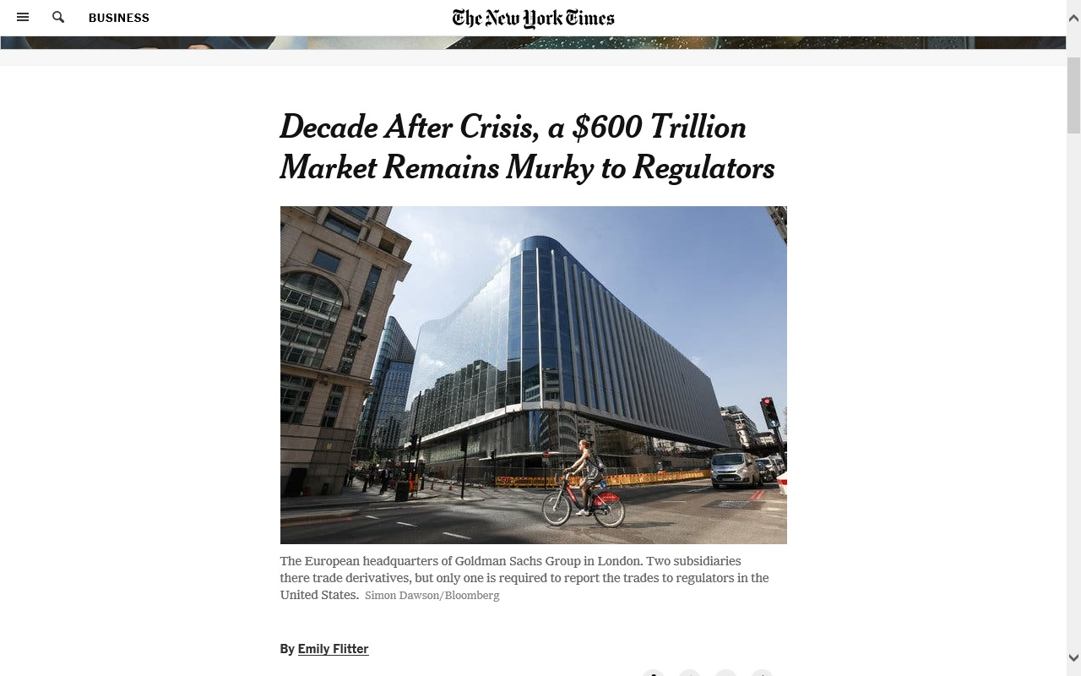

Slide 58
