Slide 1
Contatti
Marco Gerdol
Edificio Q – Stanza 214
Tel. 0405588676
Mail: mgerdol@units.it
Per richieste riguardo agli esami si prega di mettere in copia alle mail anche il Prof. Pallavicini

Slide 2
Programma di massima
Questa parte del corso sarà articolata in 12 lezioni
Nella maggior parte di queste faremo uso di computer con delle semplici applicazioni della genomica, con particolare attenzione all’analisi di dati genomici e trascrittomici
Per comodità tutti i tool che utilizzeremo sono inseriti come moduli operativi in un software commerciale, il CLC Genomics Workbench 11 (prodotto dalla Qiagen)
Ci connetteremo ad un server in remoto che gestirà le sessioni di tutti gli utenti

Slide 3
CALENDARIO DELLE LEZIONI - NOVEMBRE
7/11, ore 14-16/16-18, LEZIONE PRATICA, aula C (ed. M)
12/11, ore 11-13, aula V (ed. A)
13/11, ore 14-16, aula D (ed. A)
14/11, ore 14-16/16-18, LEZIONE PRATICA, aula C (ed. M)
19/11, ore 11-13, aula V (ed. A)
20/11, ore 14-16, aula emiciclo (ed. Q)
21/11, ore 14-16/16-18, LEZIONE PRATICA, aula C (ed. M)

Slide 4
CALENDARIO DELLE LEZIONI - DICEMBRE
3/12, ore 11-13, aula V (ed. A)
4/12, ore 14-16, aula emiciclo (ed. Q)
5/12, ore 14-16/16-18, LEZIONE PRATICA, aula C (ed. M)
10/12, ore 11-13, aula V (ed. A)
11/12, ore 14-16, aula emiciclo (ed. Q) – Pallavicini?
12/12, ore 14-16/16-18, LEZIONE PRATICA, aula C (ed. M)
10/12, ore 11-13, aula V (ed. A) - Pallavicini
19/12, ore 14-16/16-18, LEZIONE PRATICA, aula C (ed. M) - Pallavicini

Slide 5
Materiale didattico e modalità di esame
Tutto il materiale didattico verrà messo a disposizione su Moodle2
Slides riguardanti la parte teorica
Pdf riguardanti i tutorials di alcune parti «pratiche» viste a lezione, in particolare per quanto riguarda le esercitazioni al CLC Genomics Workbench
Esame scritto con domande miste a risposta multipla, vero/falso o semplice completamento

Slide 6
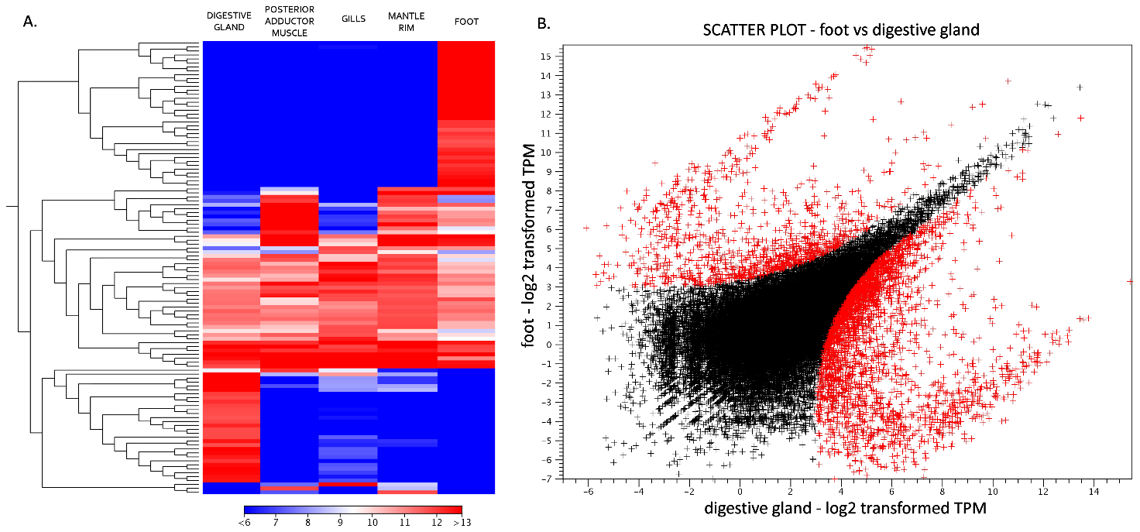
Esempi di domande
L’immagine mostrata sopra è tratta da una recente pubblicazione e riassume alcuni dettagli di un esperimento di espressione genica tramite RNA-seq. Tuttavia alcuni dettagli sono stati volutamente nascosti. La scala colorimetrica della heat map a sinistra indica:
a) La profondità di sequenziamento dei vari campioni.
b) I livelli di espressione di ciascun gene nei vari campioni
c) I p-value di sovra e sotto-espressione per ciascun gene
d) Il numero di falsi positivi per ciascun campione

Slide 7
Esempi di domande
La zero-mode waveguide è una camera di visualizzazione nanofotonica utilizzata dai sequenziatori:
a) SMRT PacBio
b) Illumina
c) 454
d) Nanopore
Gli adattatori sviluppati per la costruzione di librerie Illumina sono chiamati:
a) X adapters
b) Y adapters
c) Blunt End adapters
d) Linkers

Slide 8
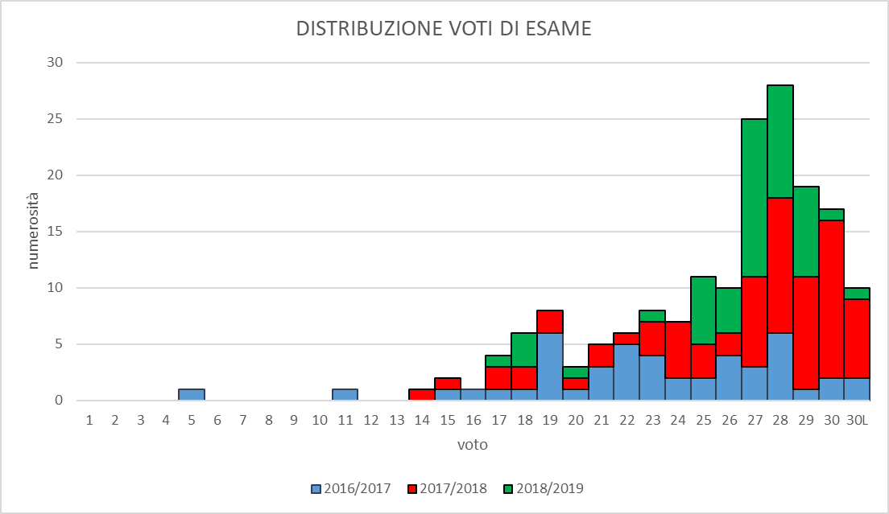
Difficoltà dell’esame

Slide 9

TRIMMING – Why and when?
Trimming is defined as the procedure used to process raw sequencing data and obtain «clean reads»
Raw sequencing outputs can contain errors
Errors in sequencing reads can impair downstream data analysis (e.g. reads do not match the target genome, or introduce errors in the assembly process)
Such errors need to be removed
The trimming procedure needs to be carried out before data analysis
Trimming is a term generally used in gardening and can be translated as «rifinitura» o “spuntatina”

Slide 10
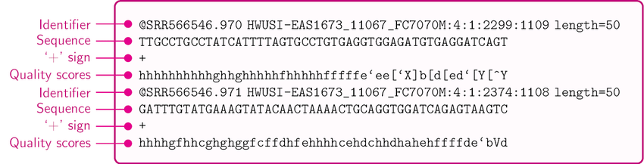
TRIMMING – How?
Sequencing reads are delivered as FASTQ files, i.e. text files like the one displayed here, which contain (i) nucleotide sequence and (ii) quality scores
Quality scores can be read as numeric values and displayed as histograms (this is what the CLC genomics workbench does)
Such values indicate the confidence score for base calling
We can set a minimal threshold for base calling quality -> bases with values below the threshold will be discarded

Slide 11
Some examples
This region shows very low quality, but
the remaining part of the read looks good
This read should be trimmed to discard this part
This is a read with very
low quality… histogram
values are not even visible!
«N» indicates ambiguous
nucleotide that could not be
defined by the sequences
Just a very small part of the
read shows a good quality. It
should be trimmed, but the
residual length will be very short
Some histogram bars are low!
Should we trim or not this
read? It depends on the
quality thresholds we will set.

Slide 12
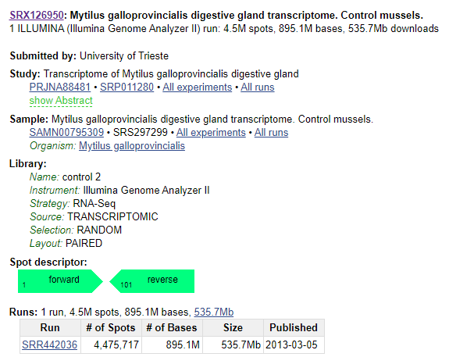
Sequencing data overview
Reading and understanding metadata associated with sequencing datasets
In the raw reads folder you will find a file named “SRR442036_metadata”. Open and inspect it
It contains important information about the dataset we are going to work with today. You can access the same information online at https://www.ncbi.nlm.nih.gov/sra/?term=SRR442036
Sequencing data are usually deposited (by users) in public repositories, such as the NCBI SRA (Sequence Read Archive). Each SRA file should contain all the reads from a single sample. Multiple samples (biological or technical replicates, or different treatments, time points, etc.) are usually grouped together within the same Bioproject.

Slide 13
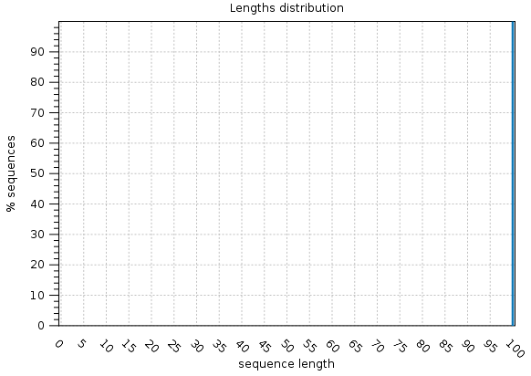
Sequencing data overview
It is often useful to get a broad overview on the quality of sequencing output before performing the trimming, but also after the trimming procedure, to verify the successful use of the trimming procedure and the proper setting of the parameters
Let’s briefly inspect the output of an Illumina run.
The first graph is very straightforward: it plots read length. In this case, before trimming, all reads have the same length (as expected), which is 100 nucleotides, so the histogram reaches 100% at sequence length = 100
This will change after trimming, because some reads will be shortened

Slide 14
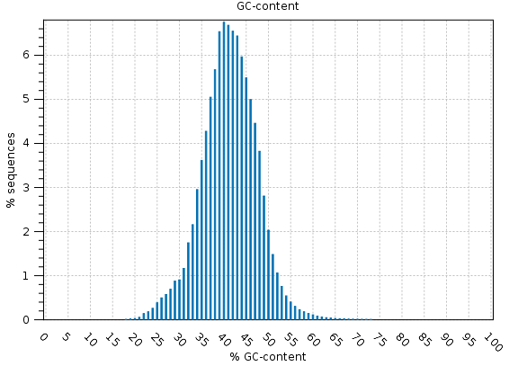
Sequencing data overview
This graph shows the GC content of each read. Usually, this graph shows a Gaussian distribution, with the peak location dependent of the GC content of genome of the target species.
Each genome has its GC content, which may not be 50%! The human genome has a 46,1% GC content, Arabidopsis 36%, Plasmodium falciparum 20%, etc.
This graph shows the nucleotide content at each position of the reads: as the genome (or transcriptome) has been randomly fragmented to produce the reads, we do not expect to see any compositional bias, i.e. the over-representation of certain nucleotides in any given position. In the example at your left, we can notice a compositional bias at the first 15 bases of the reads. This should be removed with the trimming

Slide 15
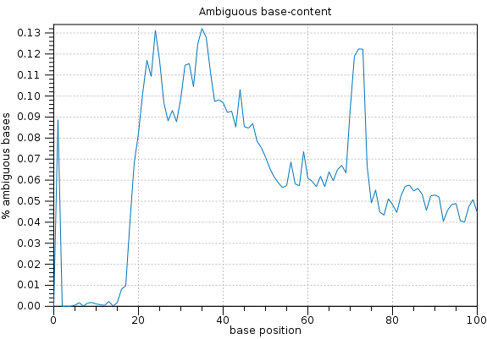
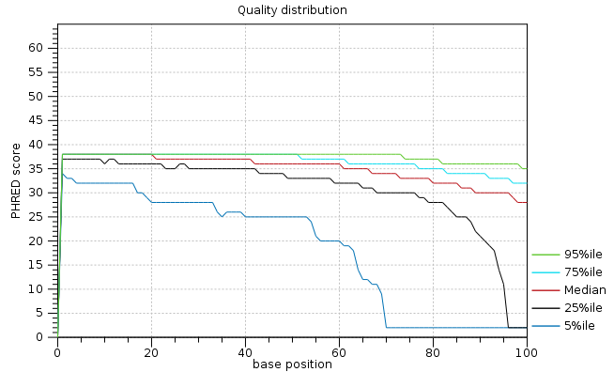
Sequencing data overview
This graph shows the content of ambiguous nucleotides (indicated as «N»), i.e. nucleotides which could not be identified by the sequencer. The graph shows their frequency for each position of the read. The frequency should be usually very low in Illumina reads and their uneven distribution could indicate some issues. In any case, depending on the trimming parameters used, ambiguous nucleotides should disappear after trimming
It is finally important to inspect the quality of nucleotides with respect with read length, as the quality is usually lower in the latests positions of the read.
The graph plots the PHRED quality scores of a given fraction of the reads (e.g. 5% uses the 5% of the reads with the lowest average score). The example at your left shows that, if we take the 95% percentile of the reads with the highest quality, their quality is really good. This is one of the most important steps in the choice of trimming parameters

Slide 16
Trimming by quality
The final goal is to remove all low quality bases and most «Ns» (ambiguous nucleotides), only keeping those we can trust
Quality scores are usually given as PHRED scores, which are linked to the probability of error in base calling (see table)
The CLC Genomics Workbench gives us the opportunity to select the probability threshold
For example, if we set the threshold to 0.1, we tolerate a 10% probability error, and therefore we use a PHRED threshold = 10
A threshold = 0.01 will be more stringent (we only want to keep bases supported by > 99% probability), and therefore we use a PHRED threshold = 20

Slide 17
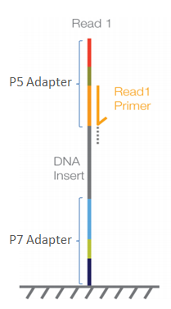
Trimming adapters
But this is not enough! It often happens that residual sequencing adapters are present in some of the reads generated by the sequencing
We need to know the sequences of the primers, adapters and barcodes used for the preparation of the library (this depends on the kit and on the sequencing platform) and create a list that will be used by the trimming tool
The trimming tool searches for such sequences and removes them from the reads -> some reads will be entirely removed, other will be shortened

Slide 18
Trimming adapters
The presence of trimming adapters can be often infererred from the inspection of this graph in the sequencing QC report
Since the reads should result from the random fragmentation of genomes or transcriptomes, we would not expect to observe a compositional bias related to the position of a base in the read
In other words, the frequency of observation of the 4 nucleotides should be constant for the entire length of a read
However, a compositional bias is not always an indication of the presence of residual adapters: in some library preparation protocols fragment ligation is not really random, and fragments with particular nucleotide compositions are sometimes preferred over others
Deviation from expectations, indicates a compositional
bias at the 5’ end of our reads. This may be an adapter to be removed.

Slide 19
Trimming – step-by-step in the CLC Genomics WB
STEP1
Quality trimming
Set quality score threshold
Set maximum number of ambiguous nucleotides (Ns)

Slide 20
Trimming – step-by-step in the CLC Genomics WB
STEP2
Adapter trimming
Look at the library preparation kit you have used
Create a trim adapter list
Select it and have a look at a preview of the number of adapters found in a subset of 1000 reads used for «testing»
Proceed if satisfied, otherwise add additional trim adapters

Slide 21
Trimming – step-by-step in the CLC Genomics WB
STEP3
Additional parameters
In case of the presence of compositional bias at the 3’ or 5’ end, we can choose to remove a given number of nucleotides in ALL reads
Reads too short are not useful: we can set a minimum length threshold and discard all reads shorter than this limit (after low quality bases, ambiguous nucleotides and adapters have been removed

Slide 22
Trimming – final expected outcome
We expect to obtain clean reads, ready for downstream analysis without any further modification
However, keep in mind that reads will be shorter on average, and often in a much lower number than those we originally had (because many of them have been discarded during the trimming procedure)
We need to ask ourselves whether the number of reads we got after the trimming is fine for our downstream application… if the number is too low, we might want to use less stringent parameters and perform a “softer” trimming

