Slide 1

Economic Geography
6 – Location of industrial activities
121EC
A.Y. 2019/2020
Dr. Giuseppe Borruso
Department of Economics, Business, Mathematics and Statistics
University of Trieste
E-mail. giuseppe.borruso@econ.units.it
Ph. +39 040 558 7008
Skype: giuseppe.borruso
Notes:
Slides with (*) in footnotes have been modified by Jean-Paul Rodrigue materials. (v. riferimenti copyright a seguire). I have modified and elaborated materials in order to be suitable for the current course.
Copyright © 1998-2010, Dr. Jean-Paul Rodrigue, Dept. of Global Studies & Geography, Hofstra University. For personal or classroom use ONLY.

Slide 2
Industrial location theory
Weber’s model

Slide 3
Weber’s Theory of industrial location
Weber’s model (Theory of the Location of Industries, 1909)
The location of all input suppliers and market are fixed and firm must choose a location that will minimize the sum of its inbound and outbound transportation costs.
Weberian models are best applied to a manufacturing firm which purchases physical quantities or raw materials, intermediate goods and fuels as inputs and produces some physical quantity of output.
Space is characterized by:
  Uniform interest rate;
  Uniform production costs, wages, rents;
  Uniform and proportional to distance unitary transport costs;
  Resources consisting of:
    Localized materials (mine resources)
    Ubiquitous materials (water)
    Losing weight materials (raw material’s weight is only partially reflected into the final product)
    Net materials (raw material’s weight is totally reflected into the final product)
  The model is aimed at identifying the place where to locate a firm / plant minimizing costs related to places
  =>
  Raw material places
  Energy places
  Market / consumption places

Slide 4
Weber’s model of industrial location
Location on a line
The firm uses one localized input available at a single point S on a featureless plane and sells of its output in a single market located at point M in the same plane
The production technology of the firm yields constant return to scale and allows no input substitution
Transportation costs are a constant times the number of ton-km (no terminal costs; cost per ton-km is the same for input and output; transportation is equal in all directions)
The firm is a price taker that has complete knowledge of all information necessary to accurately calculate transportation costs. Its goal is to choose the location that minimizes its transportation costs.
D - d
d
Material source
Production Facility
Market
S
F
M
X = weight of unit of localized input
t = transport rate in € per ton-km
x = weight of unit of output
D = distance SM
d = distance FM
D
T = tX (D - d) + txd

Slide 5
Weber’s model of industrial location
Assembly, distribution and transport costs
T = tX (D - d) + txd
Assembly cost
Distribution cost
TC
TC
€
€
AC
AC
DC
DC
S
M
S
M
Assembly, distribution and total transportation cost for X>x
Assembly, distribution and total transportation cost for X<x

Slide 6
Weber’s model of industrial location
P₂
M₁
M₁= Raw material
M₂ = Fuel (Energy)
C = Market
α₁
p₂
p₁
α₃
α₂
P₃
p₃
P₁
Triangle
of weights
β₁
F
β₂
Locational Triangle
β₃
M₂
C

Slide 7
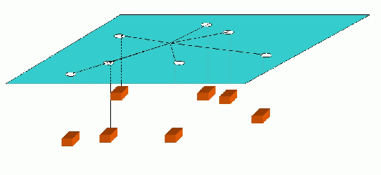
Alternatives: the Varignon Machine
The idea is to take a board and drill holes through all the points. Next, we hang a weight through each hole using a string. We tie all the strings together at one point above the board, and let the system balance itself out. Under unreasonable physical assumptions (i.e., no friction, etc) the knot will be located at the one median. It is intuitively clear why this is the solution, and a formal proof is easy. Interestingly, this machine was supposedly used in real life to solve the problem in some cases.

Slide 8
Weber’s model of industrial location
From to
Isotims
  Curves with same transport cost
Isodapane
  Curves with same TOTAL transport cost

Slide 9
Building of the 15.000 € isodapane from isotims referred to N and M
16.000 €
14.000 €
12.000 €
10.000 €
8.000 €
6.000 €
4.000 €
2.000 €
N
M
1.000 €
2.000 €
3.000 €
4.000 €
5.000 €
6.000 €
7.000 €
9.000 €
11.000 €

Slide 10
Building of the 15.000 € isodapane from isotims referred to N and M
16.000 €
14.000 €
12.000 €
10.000 €
8.000 €
6.000 €
4.000 €
2.000 €
N
M
1.000 €
2.000 €
3.000 €
4.000 €
5.000 €
6.000 €
7.000 €
9.000 €
11.000 €

Slide 11
1.000 €
1.000 €
2.000 €
2.000 €
3.000 €
3.000 €
4.000 €
4.000 €
1.000 €
Building of the 8.000 € isodapane from isotims referred to A, B and C
(transport costs =)
2.000 €
3.000 €
4.000 €

Slide 12
7.000 €
6.000 €
3.000 €
4.000 €
2.000 €
1.000 €
2.000 €
B
A
C
1.000 €
Building of the 8.000 € isodapane from isotims referred to A, B and C
(different transport costs)
2.000 €
3.000 €
4.000 €

Slide 13
Weber’s model of industrial location
M₁
Weber choice according to a comparison of saving in workforce and increased transport costs, (critical isodapane)
(Points having higher transport costs equal to savings obtainable with lower workforce costs in locations Li)
L₂
L₁
β₁
F
β₂
β₃
M₂
C

Slide 14
1.000 €
1.000 €
2.000 €
2.000 €
3.000 €
3.000 €
4.000 €
4.000 €
1.000 €
2.000 €
3.000 €
4.000 €

Slide 15
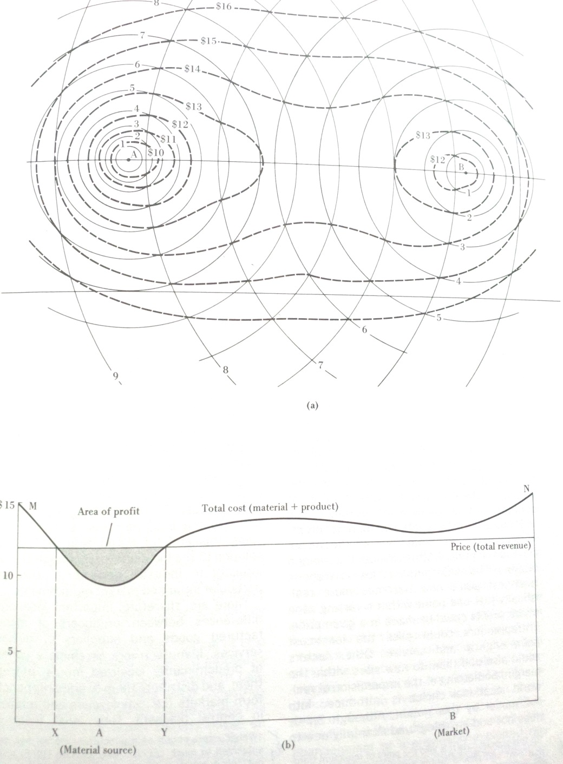
Smith ‘satisfactory solutions’
Isodapane concept
Developed by Weber
Weber’s isodapane is defined as a line of equal transport cost
For Smiths the isodapanes are ‘cost isopleths’ or ‘cost contours’ = lines of equal transport cost.
Space-cost curve = a section drawn through the cost-contour map.
The lowest point is the least cost location
Spatial margins of profitability =>
Manufactured product sold at same price in space
Points within the price envelop will host optimal (satisfactory) solutions
Transport-cost surface (a) and space-cost curve (b)

Slide 16
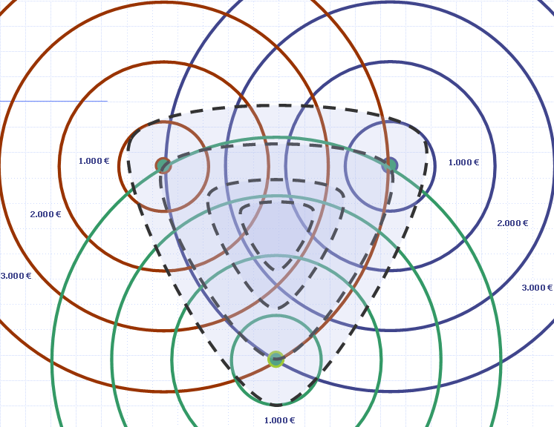
Smith
‘satisfactory solutions’
C
A
a)
Transport – cost surface (a)
and space-cost curve (b)
B
Costs
Price
Area of profit
b)
Least cost
location
M
O
N
Distances

Slide 17
The main elements and trends of location
Author
Production functions
Principle
Technology
Weber
Production costs
±
(homogeneous, exogenus,
externalities
space
Transport
Locational
(pareto optimum)
Substantially stable)
±
(ininfluential)
±
(isotropic)
±
(physical distance)
Triangle
Weber
Production costs
Technology
externalities
space
Transport
+
(Economies of scale)
±
(variable, endogenous)
±
(highly
influential)
±
(territory)
±
(physical distance)
Critical
isodapane
Mashall
Production costs
Technology
externalities
Transport
Smith
(Economies of scale)
±
(not explicitly
considered)
±
(not
±
space
±
(Functional distance)
Isocost curves
Explicitly
considered)
(territor)
Maximum profit
Production costs
Technology
space
Perroux
(Maximization of
±
(homogeneos
±
externalities
±
(Gravitational pole)
±
Transport
Isocost curves
economies of scale)
Low skills)
(ininfluential)
(Hoover model)
Maximum profit
Production costs
Technology (variable and
externalities
space
Transport
Diamond of
Porter
(competitive
±
Highlly specialized)
±
(highly
influential)
±
(spatial
system)
±
(Hoover model)
competition
advantages)

Slide 18
References
CONTI S., Geografia Economica, Torino, Utet, 1996
Porter, M. 1990. The competitive Advantage of Nations. New York: The Free Press.
Porter, M.E. 1998. Clusters and the new economics of competition. Harvard Business Review 76 (6): 77-90.
Porter, M.E. 2000. Location, competition, and economic development: Local clusters in a global economy. Economic Development Quarterly 14 (1): 15-34.
Weber, A. 1929. Theory of the Location of Industries. Trans. Friedrich, C. J. Chicago: University of Chicago Press.
Hoover, E. M. 1937. Location Theory and the Shoe and Leather Industries. Cambridge, MA: Harvard University Press.
Hoover, E.M. 1948. The Location of Economic Activity. New York: McGraw Hill.
Isard, W., Schooler, E. and Vietoricz, T. 1959. Industrial Complex Analysis and Regional Development. New York: John Wiley.
Keeble, D. and Wilkinson, F. (Eds.) 2000. High-Technology Clusters, Networking and Collective Learning in Europe. Aldershot: Ashgate
Krugman, P. 1991. Geography and Trade. Cambridge: MIT Press.
Krugman, P. 1995. Development, geography, and economic theory. Cambridge: MIT Press.
Krugman, P. and Venables, A.J. 1996. Integration, specialization, and adjustment. European Economic Review 40 (3-5): 959-967.
Marshall, A. 1890. Principles of Economics. London: Macmillan.

