Slide 1
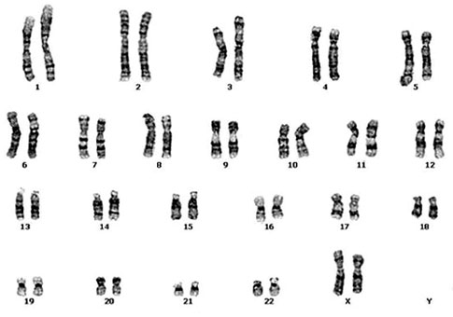
READ MAPPING – Why and when?
Mapping is the process used to align reads to a reference genome or transcriptome
This is based on the detection of sequence similarity between the read and its potential target(s)
Any given read is mapped only if it achieves well-defined similarity thresholds
The concept behind read mapping is similar to BLAST: detect significant similarities and register the coordinates, relative to the reference sequence
???
ATTGATTATTAGCGCTCGCCCTACCCT
Which chromosome?
Which gene?
Which specific position?

Slide 2
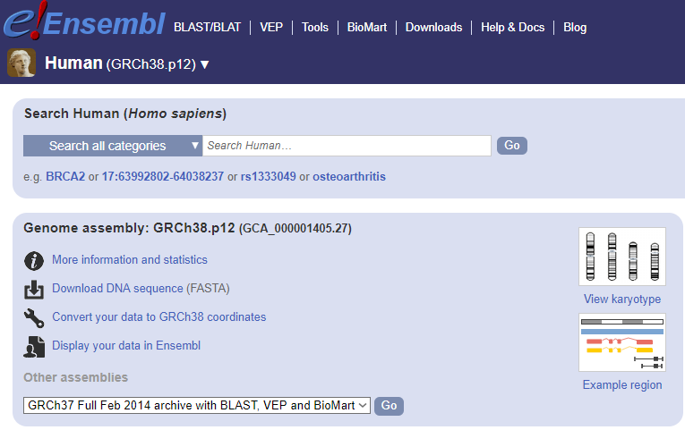
READ MAPPING – The reference
Mapping is carried out using an input (sequencing reads, usually «clean reads» obtained after trimming)
The reference can be a transcriptome (if a genome is not available, e.g. whenever you are working on a non-model organism)
Most often, the reference is a genome, previously de novo assembled
The reference genome needs to be annotated, i.e. it contains information about the coordinates of genes, introns, exons, etc.
Reference genomes are usually available in public repositories, such as Ensembl or NCBI genome.
See for example:
https://www.ensembl.org/

Slide 3
READ MAPPING – How?
Reads are compared with the reference, i.e. they are aligned
We need to set a similarity threshold
In the CLC Genomics workbench the two key parameters are length fraction and similarity fraction: together, they define the stringency of the read mapping procedure
The range from 0 to 1 (or from 0% to 100%). The higher they are set, the more stringent the mapping will be -> a lower number of differences between the read and the reference (= polymorphisms, mutations, etc.) will be tolerated
MAPPING STRINGENCY
LENGTH FRACTION – SIMILARITY FRACTION
0 0.1 0.2 0.3 0.4 0.5 0.6 0.7 0.8 0.9 1

Slide 4
READ MAPPING – How?
Similarity fraction: how similar the read and the reference need to be? 0.95 = >95% identical, 0.8 = >80% identical, etc.
Length fraction: more complex… this indicates the % of read length where the similarity fraction is calculated. 0.95 = similarity fraction is calculated over 95% of read length (e.g. if a read is 100bp long, similarity fraction is calculated on 95 nucleotides out of 100
A practical example: let’s take 50 bp long reads with the following mapping parameters:
Length fraction = 0.9
Similarity fraction = 1
At least 90% of the read length (= 45 nucleotides out of 50) need to be 100% identical to the reference sequence

Slide 5
READ MAPPING – How?
Example 1: read is mapped: 49 identical nucleotides out of 50 in total. The only SNP is located at the end of the read, so we have a continuous stretch of 45 identical nucleotides and the 0.9 length fraction is satisfied
Reference ATCGCGCTGCGTCGTTTGACTATCTCATCTTTCCCCATATATAGTCTAGC
|||||||||||||||||||||||||||||||||||||||||||||| |||
Read ATCGCGCTGCGTCGTTTGACTATCTCATCTTTCCCCATATATAGTCGAGC
Reference ATCGCGCTGCGTCGTTTGACTATCTCATCTTTCCCCATATATAGTCTAGC
||||||||||||||||||||||||| ||||||||||||||||||||||||
Read ATCGCGCTGCGTCGTTTGACTATCTTATCTTTCCCCATATATAGTCTAGC
Example 2: read is not mapped: still 49 identical nucleotides out of 50 in total. The only SNP is located in the middle of the read, so we do not have a continuous stretch of 45 identical nucleotides and the 0.9 length fraction is NOT satisfied

Slide 6
READ MAPPING – How?
The two parameters need to be combined in order to allow the desired amount of sequence divergence between the reference and the reads
This is due to many factors: possible presence of sequencing errors (their frequency depends on the sequencing platform): obviously these need to be tolerated -> too much stringency will avoid the mapping of reads containing errors
SNPs and natural inter-individual sequence variation: the reference (genome or transcriptome) is usually derived from a single individual. All individuals within a species or a population are characterized by a certain degree of sequence variation. Each individual, in diploid species, also potentially possess two variants for each genomic location (derived from the two homologous chromosomes -> allelic variants). Too much stringency will not enable the mapping of reads in regions containing such variants

Slide 7
READ MAPPING – How?
The downside: if we set the mapping parameters in a very permissive way, reads may be mapped on multiple locations (ambiguous mapping)
For example, reads may be mapped in a non-specific way on paralogous genes. The problem becomes a relevant issue for short, single-end Illumina reads
We need to think about which is the expected amount of variation (between the reads and the reference based on:
The sequencing platform used and the expected error rate
The genetic landscape of the species of interest (e.g. heterozygosity, ploidy)
The aim of the analysis (i.e. gene expression, resequencing, SNP detection?

Slide 8
READ MAPPING – Why?
A lot of genomic applications of NGS depend on a read mapping step
-RNA-sequencing: to calculate gene expression levels
-Whole genome resequencing: to detect structural variants, SNPs, indels
-Bisulfite sequencing: to detect hyper-methylated regions
-ChIP-seq: to detect regions recognized by specific chromatin-binding proteins (e.g. transcription factors, transcriptional repressors, etc.)
-Cancer genomics: to detect somatic mutations
Each of these applications requires the use of slightly different (more or less stringent) mapping parameters, as the goals are different and require a different interpretation of results

Slide 9
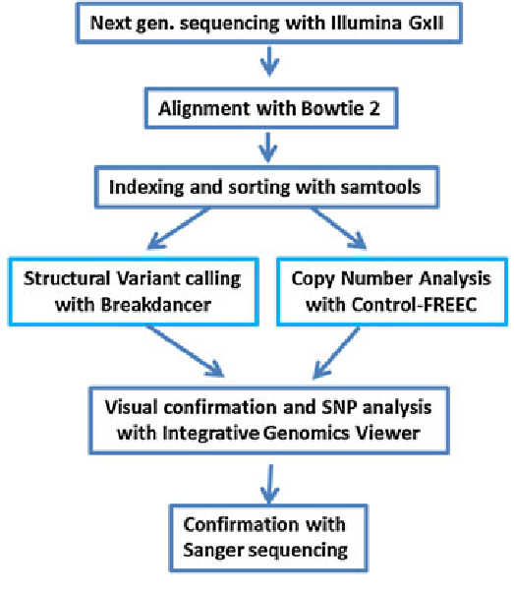
An example – whole genome resequencing
Whole genome resequencing is used to detect variants compared to the reference genome
Many biomedical applications: detections of SNPs or indels associated with disease. Population genetics for the detection of phenotypic variants.
Highly useful also to detect gene copy number variation (often important in oncology)
Sequencing coverage needs to be appropriate -> high enough to discriminate between sequencing errors and real variants
How many variants do we expect to detect? In human, ploidy = 2n, so we can either expect 100% concordant reads or a 50%-50% distribution between two variants

Slide 10
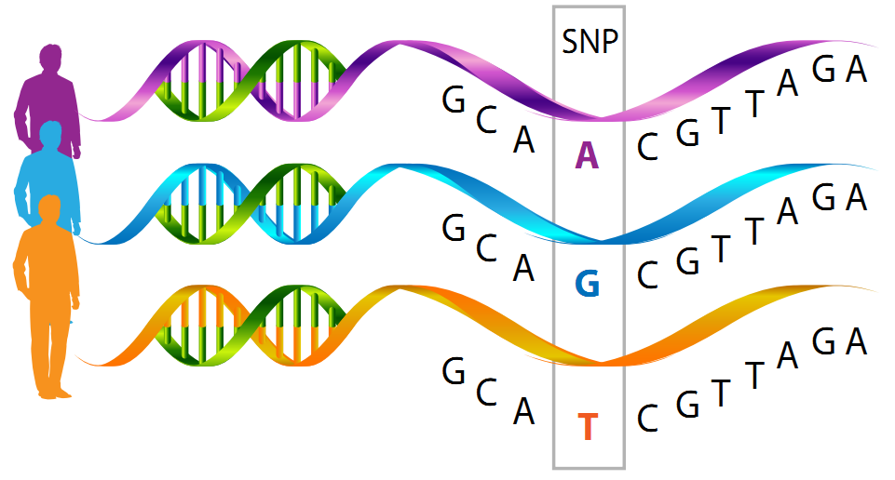
Variant calling made easy
Let’s consider the example at the right hand side. The reference human genome, in a given position, reads «A»
However, some SNPs are known from literature for this position: G and T. This information is deposited in dedicated databases, such as ClinVar at NCBI
A SNP can be pathogenic or not depending on whether it is synonymous or not-synonymous (i.e. does the encoded aa changes?), its location (5’ or 3’ UTR, coding sequence?) and the structural effects on the protein

Slide 11
Variant calling made easy
In the aforementioned example, let’s imagine to have carried out whole genome resequencing with 100X coverage on an Illumina platform (the error rate is very low)
What situations could we theoretically observe (assuming absence of errors)?
Homozygosity: 100% reads contain A, G or T
Heterozygosity: 50% reads containg one nucleotide and 50% reads contain another one (i.e. 50% A and 50% G, 50% A and 50% T, or 50%G and 50% T).
Since sequencing errors are possible we could observe, for example, 99% A and 1% G -> this is very likely to be a sequencing error -> it is useful to set a minimum % for any given observed SNPs. The expected situation should be close to 50%-50% if a locus is heterozygous
N.B.: This is not valid for tetraploid (4n) organisms! In this case we could expect to see 3, or even 4 variants at the same time (with frequencies 50%-25%-25% or 25%-25%-25%-25%).
In case of somatic mutations, SNPs can be present at lower rates (because they are just present in a limited number of mutated cells, very important in oncology!)

Slide 12
Particular cases – when a proper setting of parameters is crucial
A particular example is provided by the analysis of bisulfite sequencing data (epigenomics analysis). The bisulfite treatment converts non-methylated cytosine to uracile
This will result in the generation of reads with multiple artificial SNPs compared to the reference genome (i.e. in each position where non-methylated cytosines were present
Two issues: the first one is linked with the need for permissive mapping thresholds
The second one is linked with the interpretation of results: since not all cells are equally methylated, the frequency of observation of methylated sites has nothing to do with ploidy: no need to set minimal frequency thresholds
For details about how a bisulfite sequencing analysis works, see the tutorial «Bisulfite sequencing». This tutorial has not been performed in the classroom, so no need to go too much in detail

Slide 13
An alternative approach: pseudocounts
In some particular cases, when we are not interested in detecting SNPs and other variants, but we just need to have a rough idea about the number of reads that match a given reference sequence (usually in RNA-seq experiments), we can use a faster and computationally less demanding method
Salmon and Kallisto are two popular methods, based on the idea of lightweight algorithms: they require a reference transcriptome and reads as an input, but they do not perform full alignments
These can be considered as quasi-alignment methods, which do not generate real read counts, but rather pseudocounts
Both the reference and the sample of reads are used to build k-mer indexes of a given size: the algorithm looks up for perfect matches between read k-mers and k-mers found in the reference transcriptome
PROS: very fast methods, usuful for gene expression studies

