Slide 1
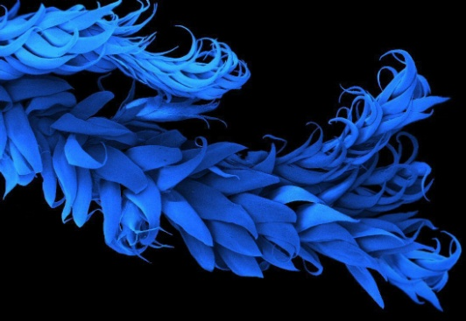
The basic of (bio)-accumulation processes in lichens and mosses
1) particles entrapping (adsorbed onto the thallus surface or within intercellular spaces);
2) extracellular ionic binding (mainly at cell wall level, secondarily at cell membrane level);
3) intracellular ionic binding.

Slide 2
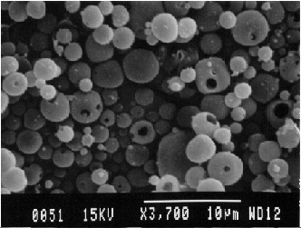
Particle trapping
Lichens and mosses effectively trap airborne particulate matter both from natural sources (e.g. soil, volcanic eruptions, sea salt aerosols, wils forest fires) and anthropogenic sources (mining, smelting, combustion of fossil fuels, incineration of refuse, cement production, etc.).
Particulate material within a lichen thallus consisting of unaltered particles ranging from sub µm to >100 µm.

Slide 3
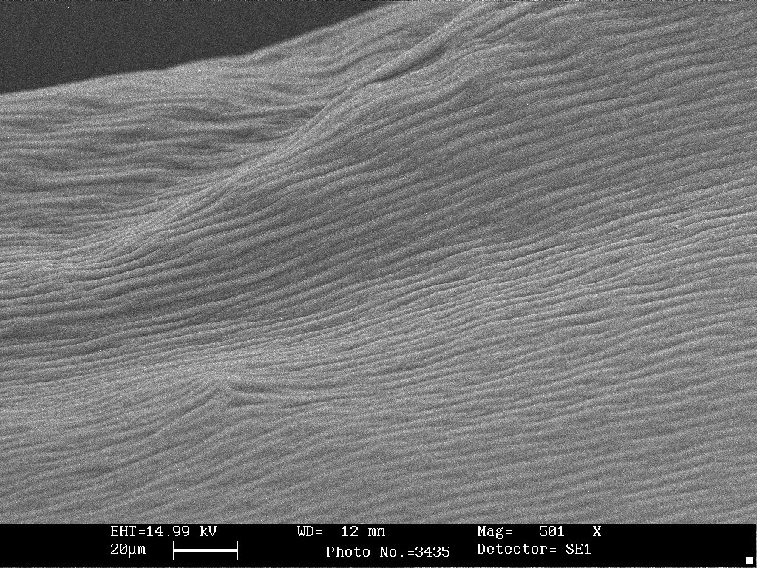
Washing the material before the analysis can remove part of the particulate matter.
pre-esposure
Al
Pre-washed
Post-w.
μg g⁻¹ peso secco
Fe
post-esposure
Lower element content is observed after washing in distilled water

Slide 4

The particulate entrapped on the outer surface, or present within the thallus may be partially or totally solubilised by the metabolic excretions (see below) and CO₂ released by the living organisms with respiration, or by the low pH of single rain events, not particularly rare in polluted areas. In this way, some of the substances become available in ionic form.

Slide 5
The extracellular binding of cations
It is caused by apoplastic (=of the cell wall) components. In lichens, the mycobiont plays the most important role because the biomass of the photobiont in a chlorolichen is generally negligible (<10%).
Cations may bind to extracellular exchange sites. The process is accompanied by a release of protons, and therefore it is pH-sensitive: it is rapid, passive, and reversible. It may increase with cell death, presumably by exposing exchange sites previously protected by the cell membrane.
Ions are bound to a variety of functional groups including hydroxyl, phosphate, amine and sulphydril groups, according to the different affinity for the proton donor element (O,N,S).

Slide 6
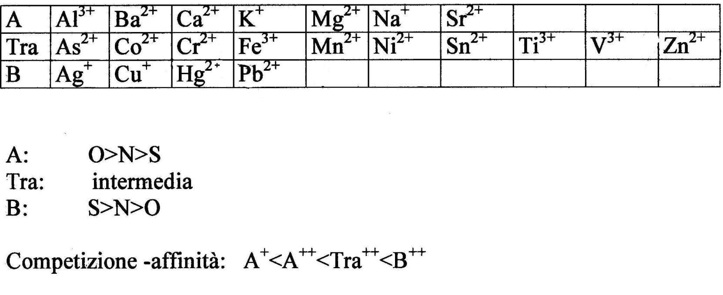
Metal ions are classified according to their ligand binding affinities and to their charge/radius ratio. There are three main classes: A, B and “borderline”.
The reversebility of cation binding has important implications for bioaccumulation, such as the predictable replacement of one element by another, or the competition between different ions. As a consequence, the content of elements bound to exchange sites mainly reflects recent atmospheric deposition.

Slide 7
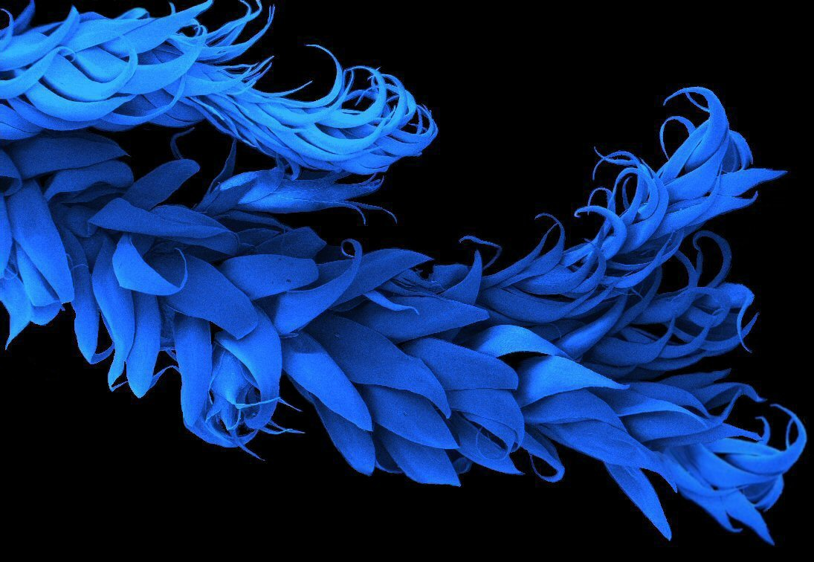
  The extracellular binding of cations plays an important role in the de-toxification of the cell.
  The sequestration of potentially toxic elements in a compartment separated from the cytoplasmatic components reduces bioavailability and increases the biotolerance the the contaminants.

Slide 8
In lichens, the apoplastic components involved in extracellular ionic binding of lichens are the following four:
1) molecules of the cell wall and matrices cementing the walls
2) organic acids secreted by the mycobiont
3) lichen substances
4) melanins
In mosses, only the first component is active or really important.

Slide 9
1) molecules of the cell wall and matrices cementing the walls
The most important are hydrophilic, acid polysaccharids negatively charged for the presence of carbossilic group that are ionized (pH- dependent!); the charges are periodically disposed along the chain. They are the larger component available for binding cations, both in term of weight, than in term of available free surface.

Slide 10
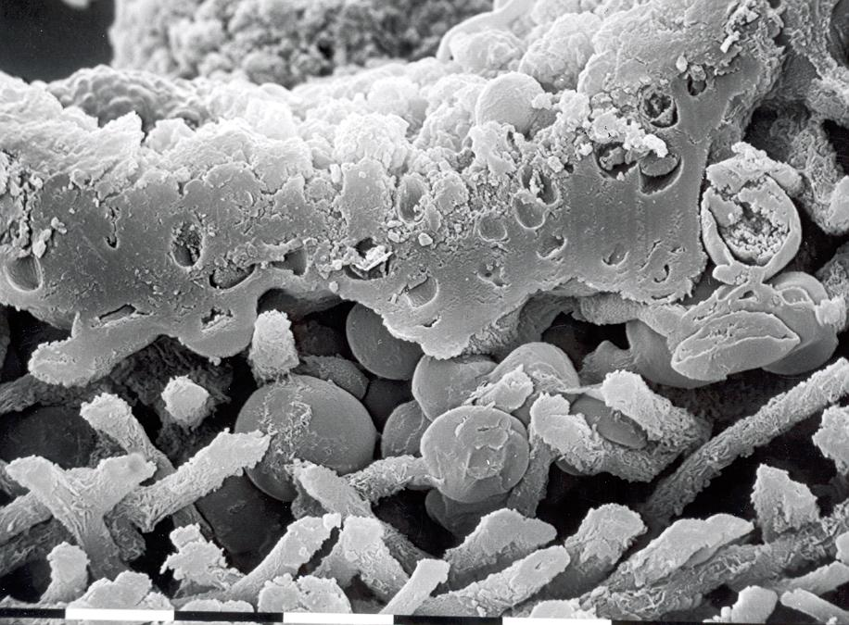

Slide 11
Glycosaminoglycans (mucopolysaccharides) are polymers of repeating disaccharides.
Within the disaccharides, the sugars tend to be modified, with acidic groups, amino groups, sulfated hydroxyl and amino groups, etc.
Glycosaminoglycans tend to be negatively charged, because of the prevalence of acidic groups.

Slide 12
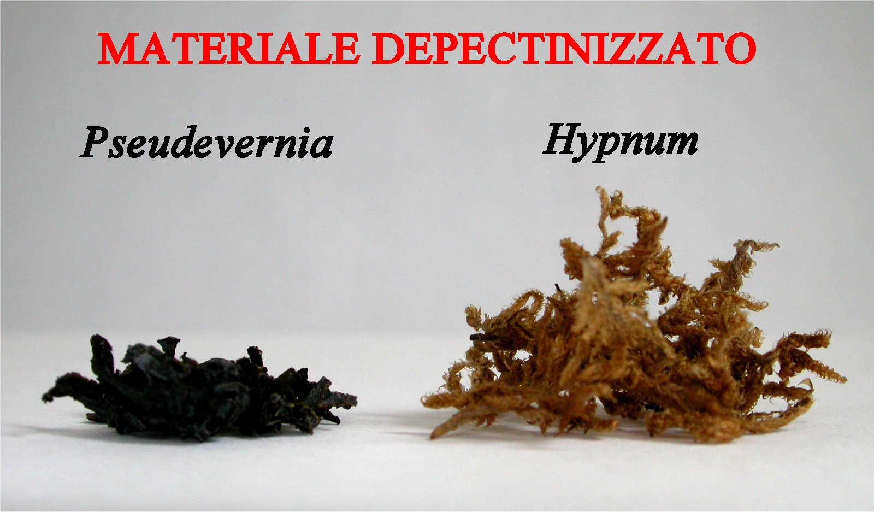
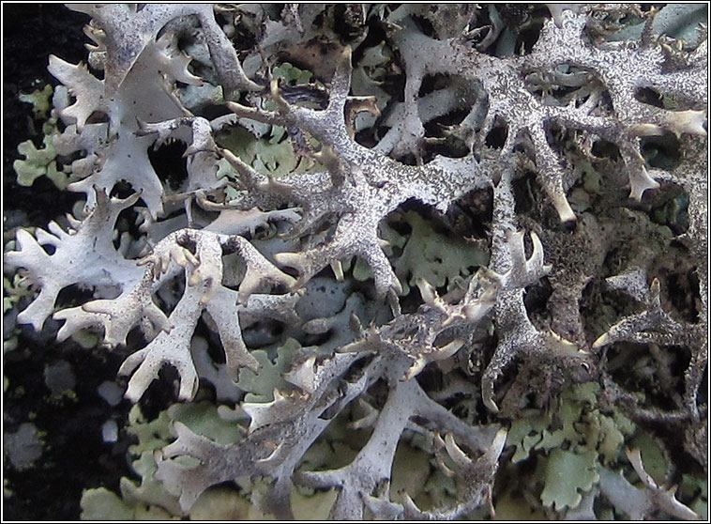
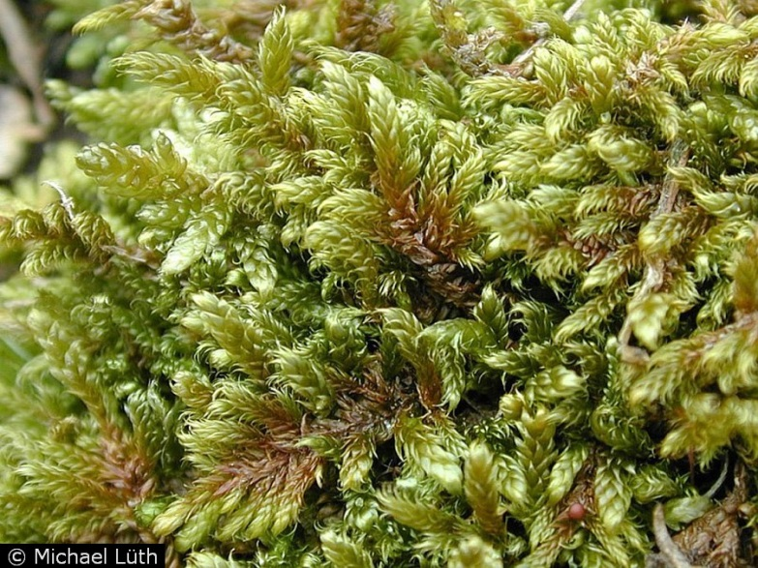

Slide 13
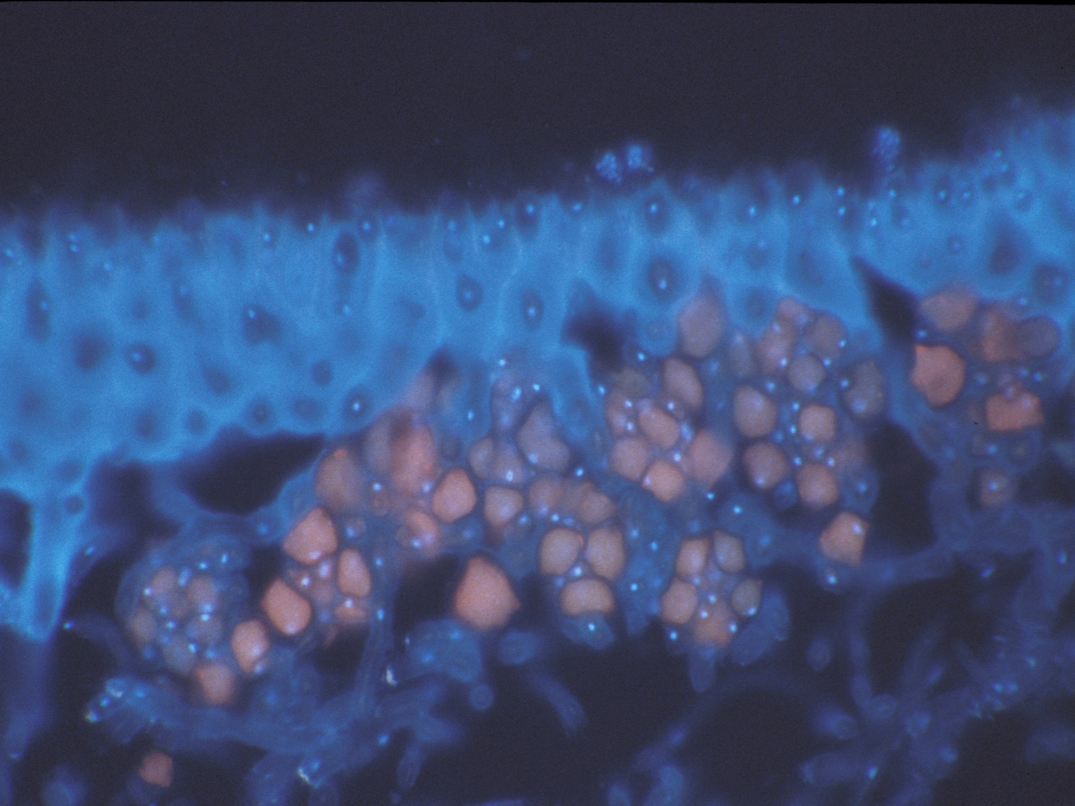
DAPI (4'-6diamidin-2-phenil-indol) in UV-A excitation light (BP 340-380) Technovit-encasted sections - DAPI was used to stain nuclei, being specific for double-stranded DNA; also cell walls may appear whitish.

Slide 14
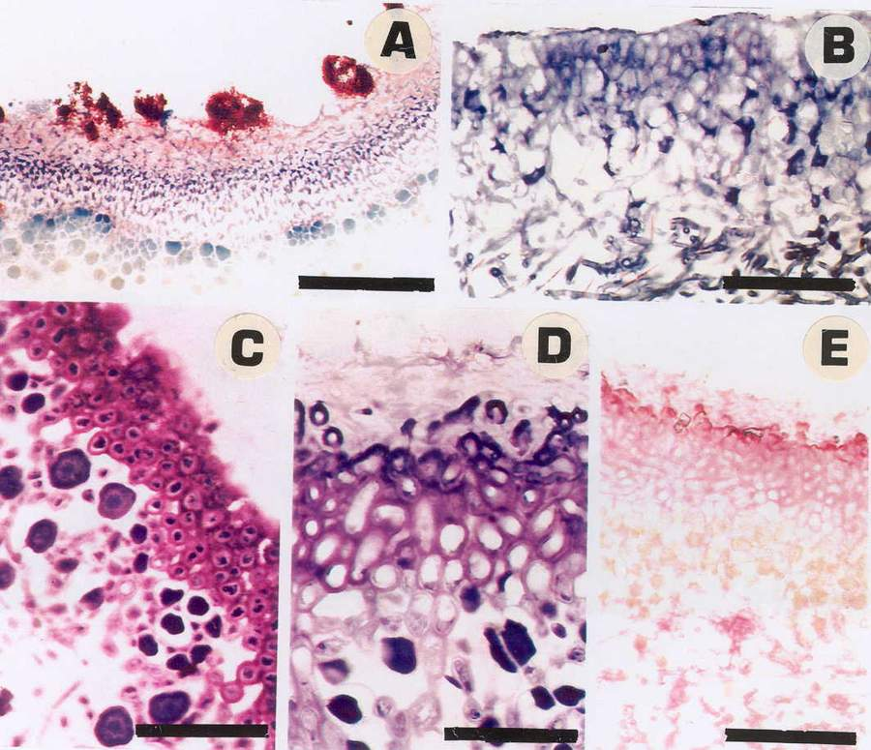
Componenti di parete e di matrice cementanti le pareti fungine
A. Parmelia sulcata, colorazione per il Ca; B,C,D. Colorazione TBO ortocromatica, metacromatica, moderatamente metacromatica; E. Colorazione PAS per polisaccaridi. (Da Giordani et al. 2003, Lichenologist).
Notes:
Le componenti apoplastiche sono:
• componenti di parete e di matrice cementante le pareti fungine:
• componenti di interfaccia parete-membrana: si tratta di proteine in cui gli elementi donatori sono l’N amminico e lo S dei gruppi sulfidrilici della cisteina. Sono ipotizzati essere coinvolti nella complessazione, ma di difficile distinzione da analoghi ligandi proteici intracellulari.
• prodotti del metabolismo secondario del fungo: acidi organici secreti dal fungo:

Slide 15
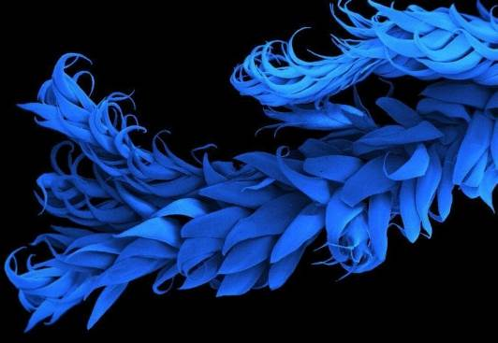
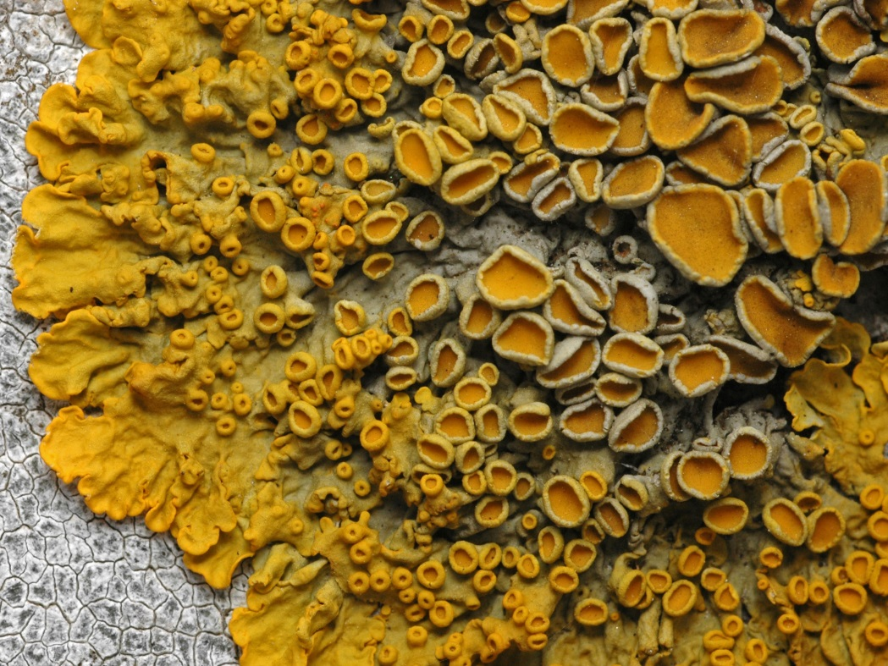
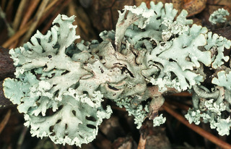
Sarret et al. (1998) demostrated that in Xanthoria parietina Zn e Pb are mainly bound to these substances.
Similar results were obtained for Mn in Hypogymnia physodes (Paul et al. 2003).

Slide 16
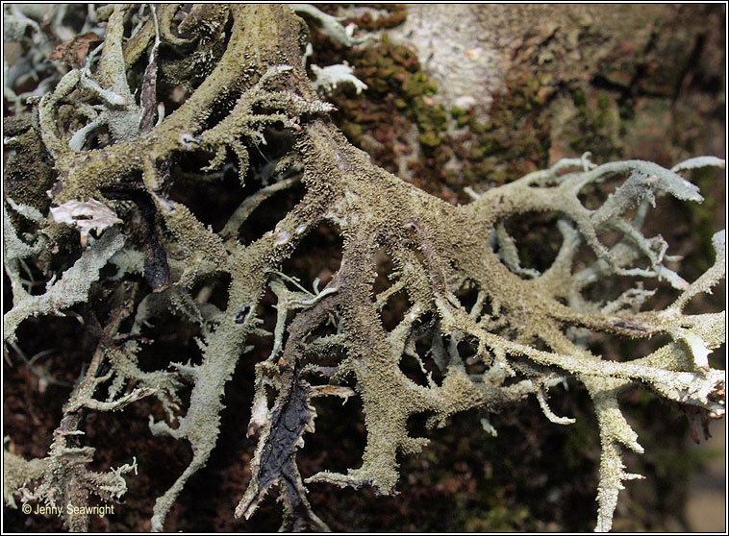
In Pseudevernia furfuracea several positively charged ions (Cd²⁺, Cu²⁺, Fe³⁺, Fe²⁺, Mn²⁺, Ni²⁺, Pb²⁺, Zn²⁺) can be bound to the cell wall components (see later) (Rinino et al. 2005).

Slide 17
2) organic acids secreted by the mycobiont
Several organic acid are actively secreted by the mycobiont: malic, citric, malonic, oxalic acids among others.
COOH
COOH
Oxalic acid
Oxalic acid plays a particular role because it forms poorly soluble salts with several elements, such as Ca, Mg, Fe, Pb, Cd, Co, Mn, Sr, and Zn.
The excretion of oxalic acid by the mycobiont warrants the immobilization of soluble toxic metals. The derived metal oxalates precipitate in the medulla or, more rarely, in the cortex, forming spectacular deposits of crystals, often coloured.

Slide 18
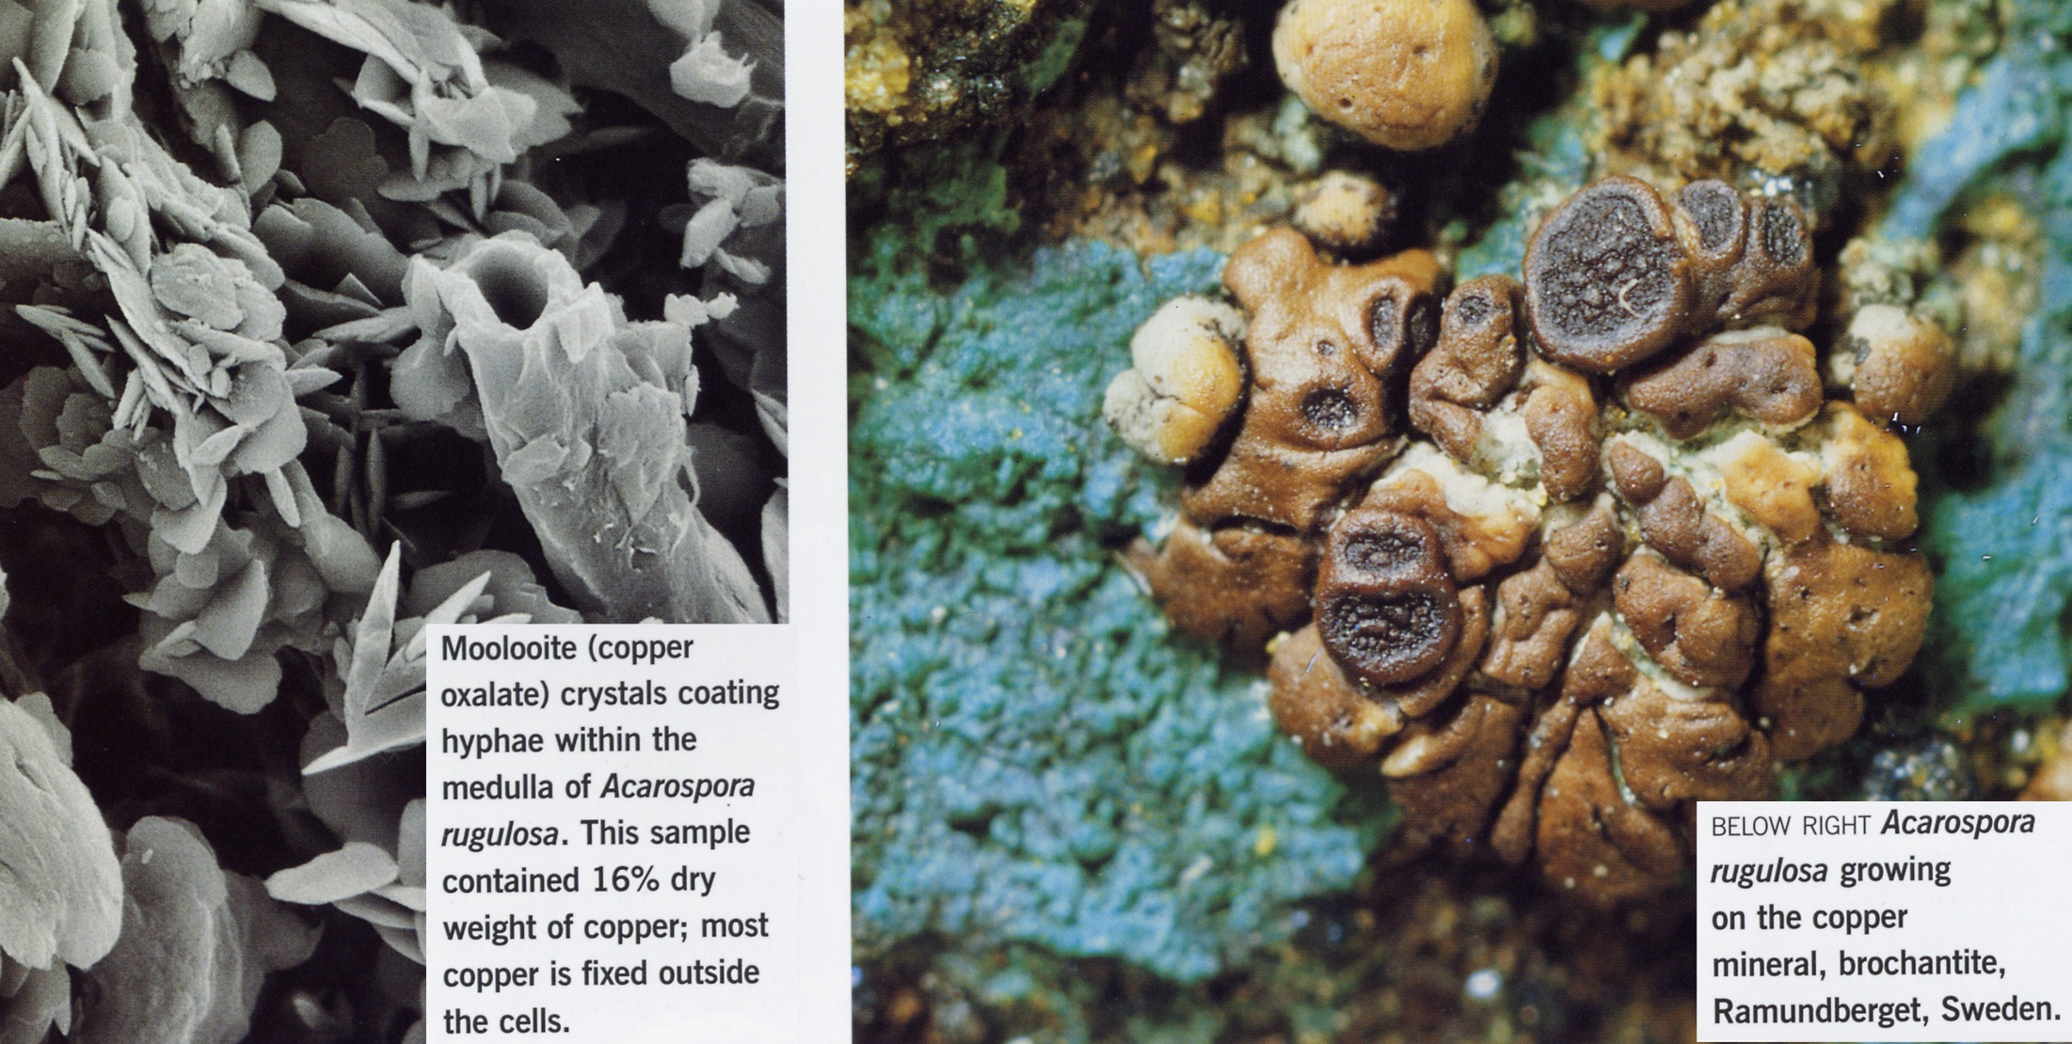

Slide 19
Sarret et al. (1998) demonstrated that in Diploschistes muscorum, a species known as hyperaccumulator of Zn, c. 90% of the total weight of this metal is bound with oxalates. In this lichen the production and secretion of oxalic acid increase with the exposure to the metal, as it happens when the thallus grows on a rock rich in Zn.
This increase is due to the oxidative stress derived from the noxious action of Zn ions, similar to that of other heavy metals.
As a first answer of detoxification, the organism increase the production of antioxidants, the most important being abscorbic acid. Oxalic acid derives from the direct degradation of abscorbic acid.

Slide 20
3) lichen substances
These belong to chemically diverse classes of compounds - including aromatic compounds such as depsides, depsidones, and carotenoids - produced by the mycobiont.
Some of them have oxydrilic and carboxilic groups that can bind cations.
They are present in crystalline and pseudocrystalline forms in the cortical and medullary apoplast; they have a very low solubility in water, that depends on the number of hydrophilic functional groups.

Slide 21
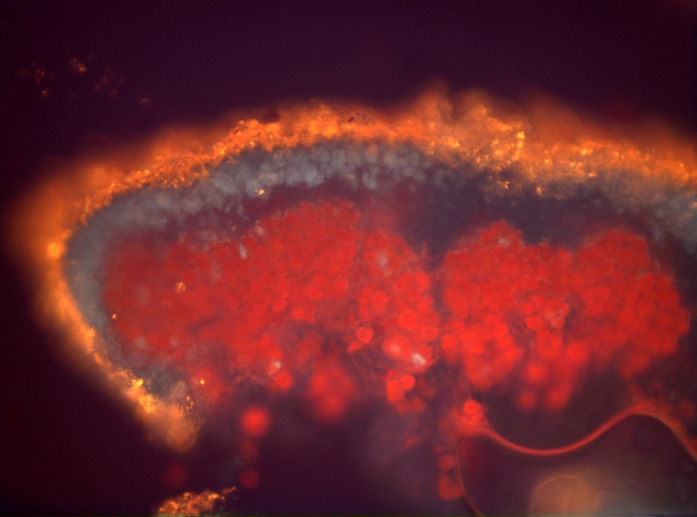
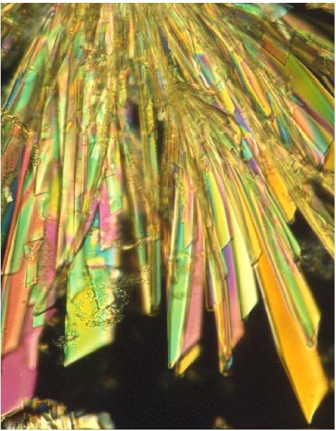
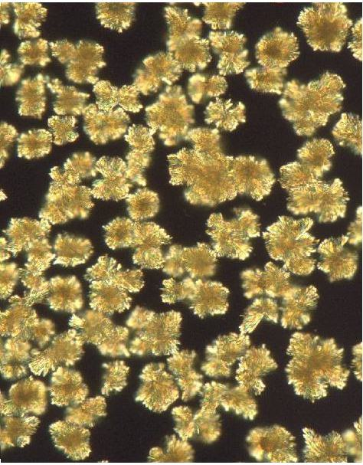
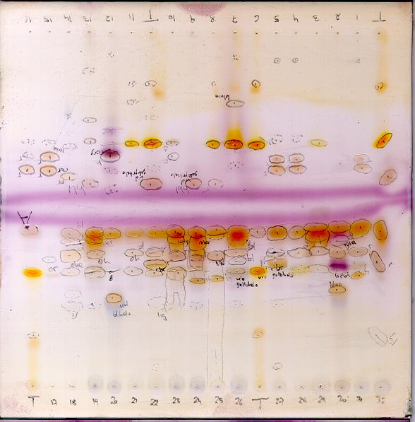
Acido lecanorico
Acido giroforico

Slide 22
Al momento attuale si conoscono circa un migliaio di composti, che vengono prodotti dal micobionte (se opportunamente sollecitato, anche in assenza del fotobionte), con molteplici funzioni:
impermeabilizzazione delle pareti;
antimicrobici per certe classi di batteri e altri funghi;
deterrenti contro gli animali erbivori ⁽¹⁾;
protezione radiazione UV e luminosa per mico- e fotobionte;
chelazione di ioni metallici.
⁽¹⁾ Benesperi R. & Tretiach M., 2004. Differential land snails damages to selected species of the lichen genus Peltigera. Biochem. Syst. Ecol., 32:127-138.

Slide 23
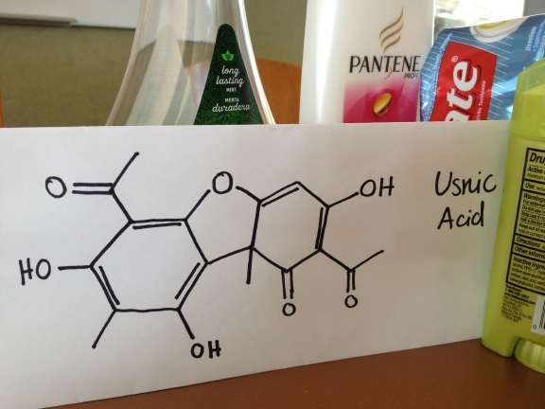
L'acido usnico viene utilizzato come ingrediente di creme, polveri, dentifrici, collutori, deodoranti, shampoo per capelli e prodotti per la protezione solare. In alcuni di questi preparati, la molecola viene impiegata come principio attivo, in altri come conservante (=antibatterico e antimicotico).
L'acido usnico viene anche commercializzati negli Stati Uniti ed in molti paesi europei come sostanza naturale utile a scopo dimagrante [“ Lipokinetix “], ma ci sono serie indicazioni negative, essendo stato associato a numerosi casi di epatite acuta, talvolta fulminante, in alcuni casi esitata anche in trapianti di fegato.

Slide 24
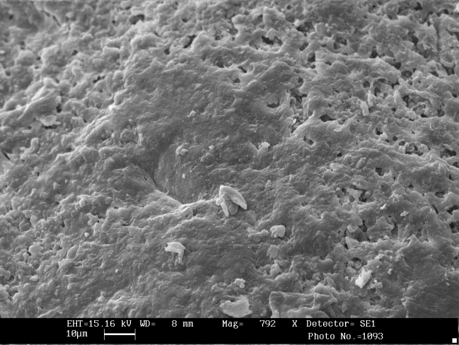
After acetone washing

Slide 25
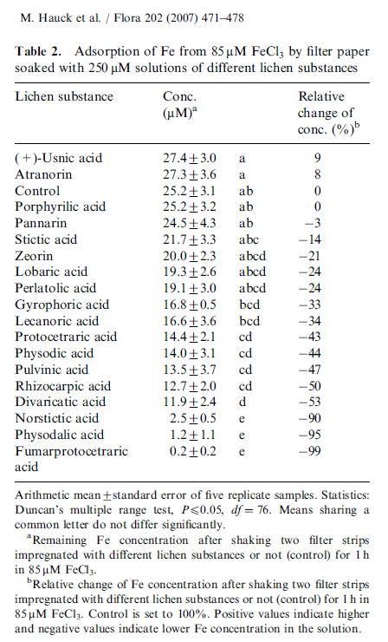
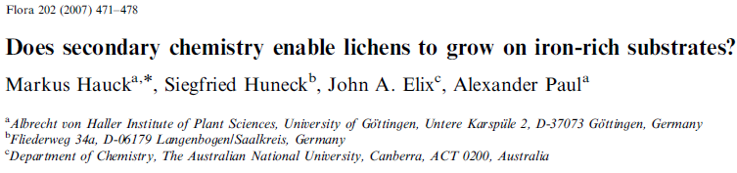

Slide 26
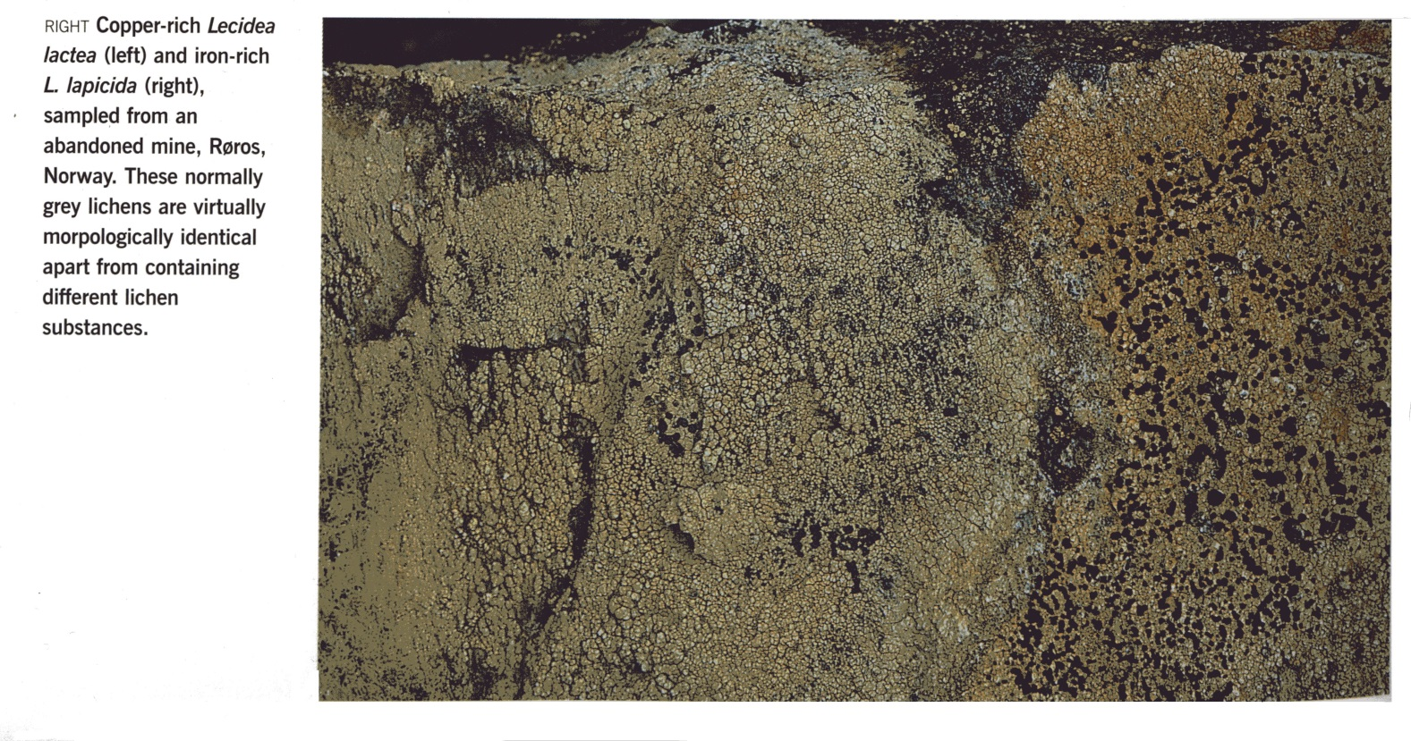
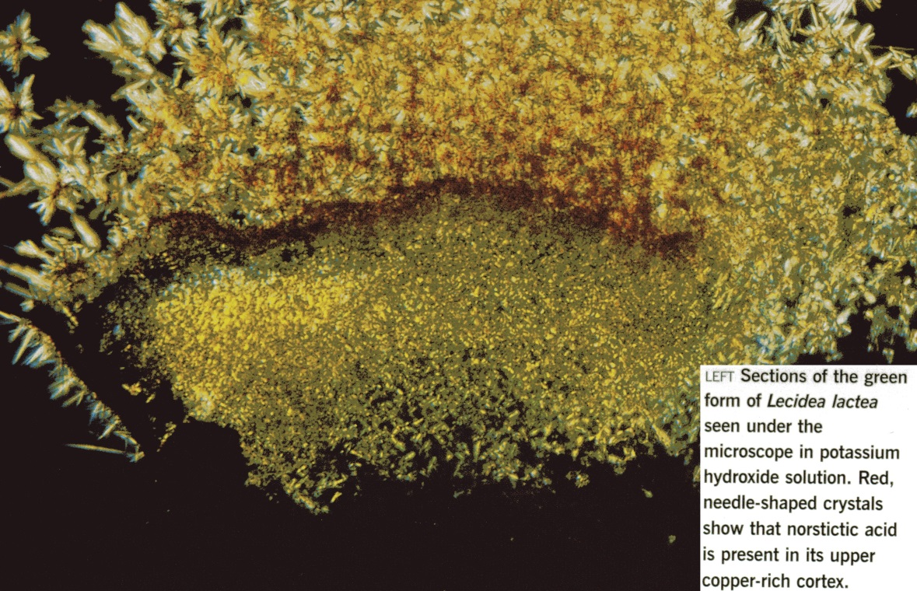

Slide 27
BUT… Several authors suggest that thalli of Parmelia and Parmotrema rinsed in 99,9% grade acetone, a substance that dissolves the majority of lichen compounds, increase in their bioaccumulation capability.

