Slide 1
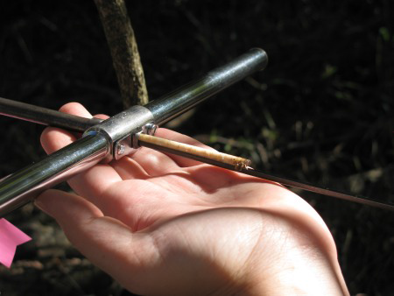
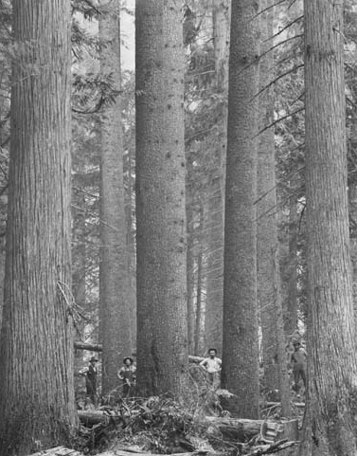
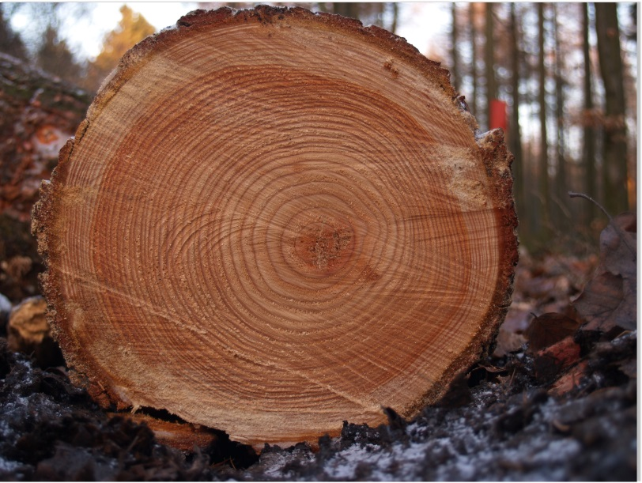

Slide 2
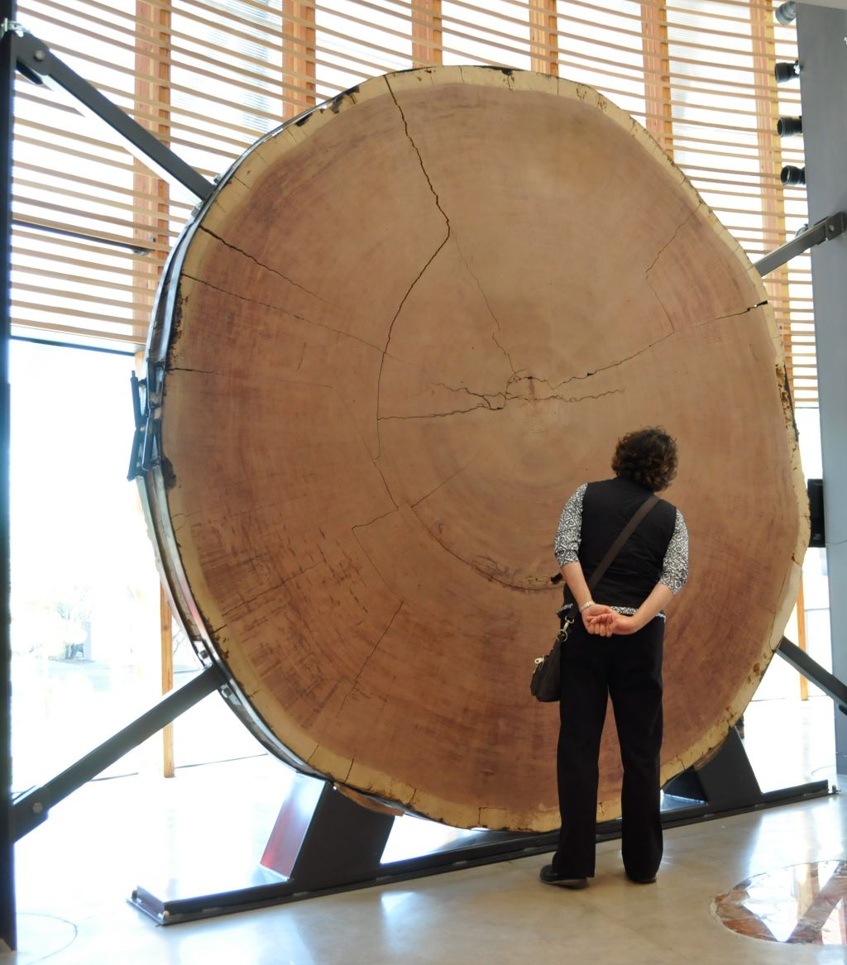
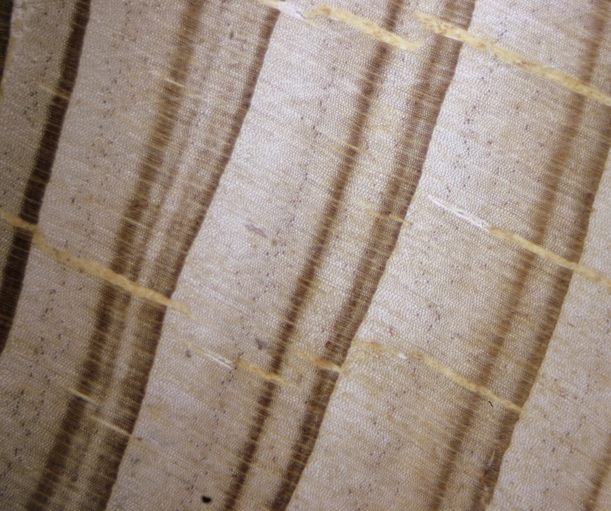

Slide 3
Trace Elements in Tree Rings: Evidence of Recent and
Historical Air Pollution
C. F. Baes III and S. B. McLaughlin
Science, 1984
• Annual growth rinks from short-leaf pine trees in the Great Smoky Mountains National Park show suppressed growth and increased iron content between 1863 and 1912, a period of smelting activity and large sulfur dioxide releases at Copperhill, Tennessee, 88 kilometers upwind.
• Similar growth suppression and increases of iron and other metals were found in rings formed in the past 20 to 25 years, a period when regional fossil fuel combustion emissions increased about 200 percent.
• Metals concentrations in phloem and cambium are high, but whether they exceed toxic thresholds for these tissues is not known.

Slide 4
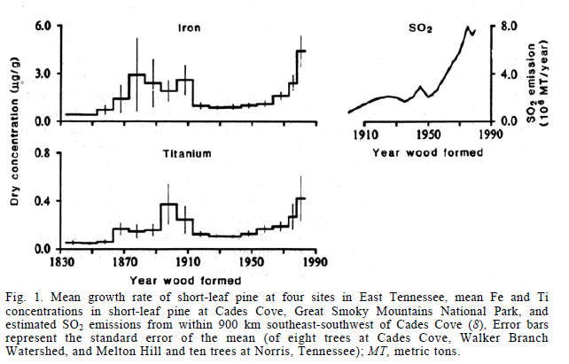

Slide 5
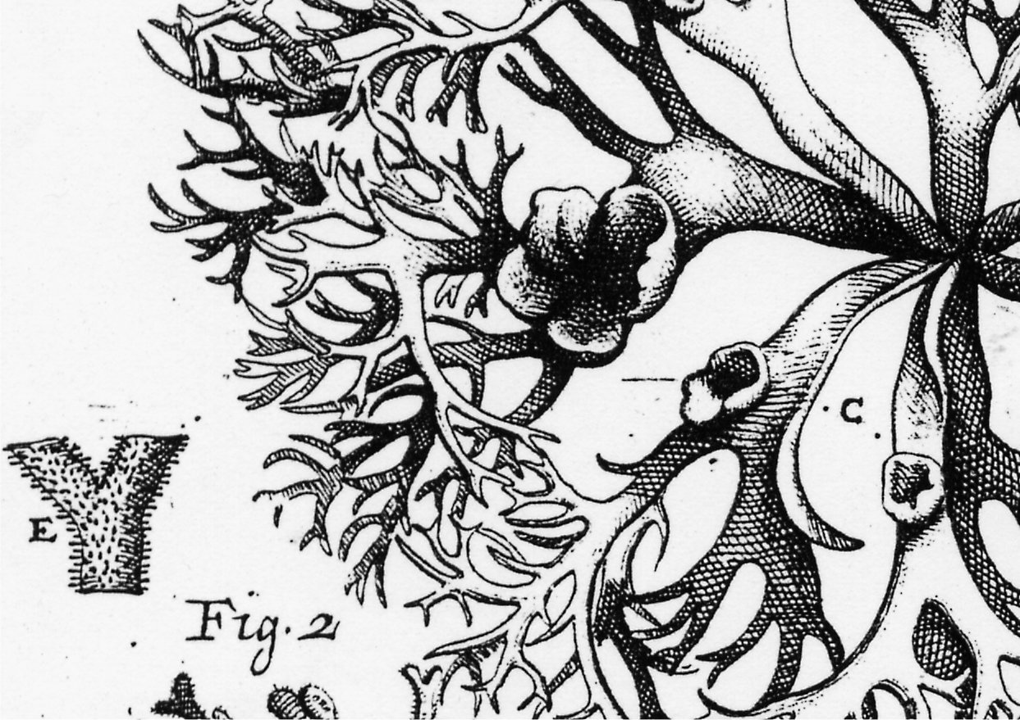
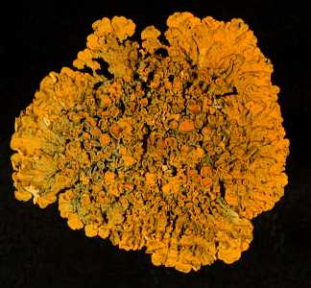
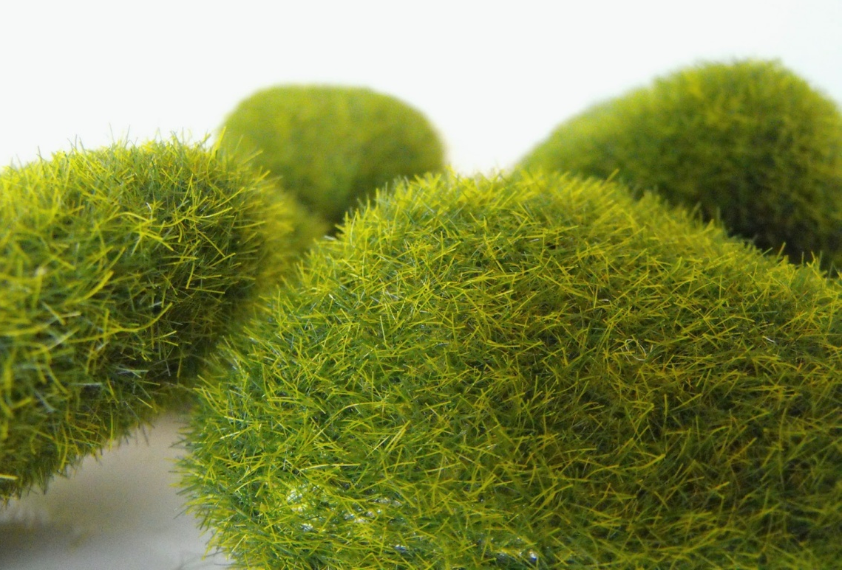
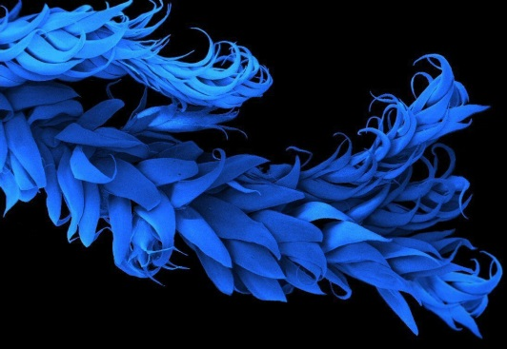
Lichens and mosses are among the organisms most frequently used in bioaccumulation studies.

Slide 6
Hundreds of studies carried out over the last 30 years confirm that the chemical composition of lichens and mosses largely reflects the availability of elements in the environment, because these organisms behave as long-living collectors of persistent atmospheric pollutants, such as trace metals, fluorine and radionuclides.

Slide 7
Queste crittogame possiedono caratteristiche peculiari che le rendono adatti all'impiego come bioaccumulatori:
gli scambi con l'atmosfera interessano tutta la superficie;
hanno spesso una micromorfologia particolarmente atta a favorire i processi di intrappolamento delle particelle;
mostrano in genere buona resistenza agli stress ambientali;
le specie hanno ampi areali di distribuzione, e i due gruppi di organismi sono praticamente ubiquitari, riuscendo a crescere ovunque salvo condizioni di inquinamento che ne impediscano lo sviluppo;
hanno accrescimento in genere lento e notevole longevità;
le parti che compongono il loro corpo (“tallo”) sono in genere persistenti.

Slide 8
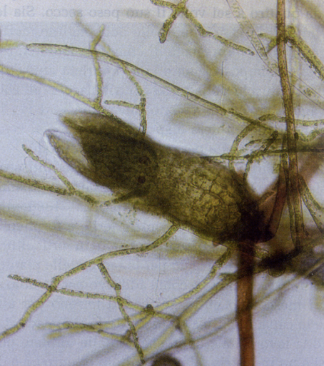
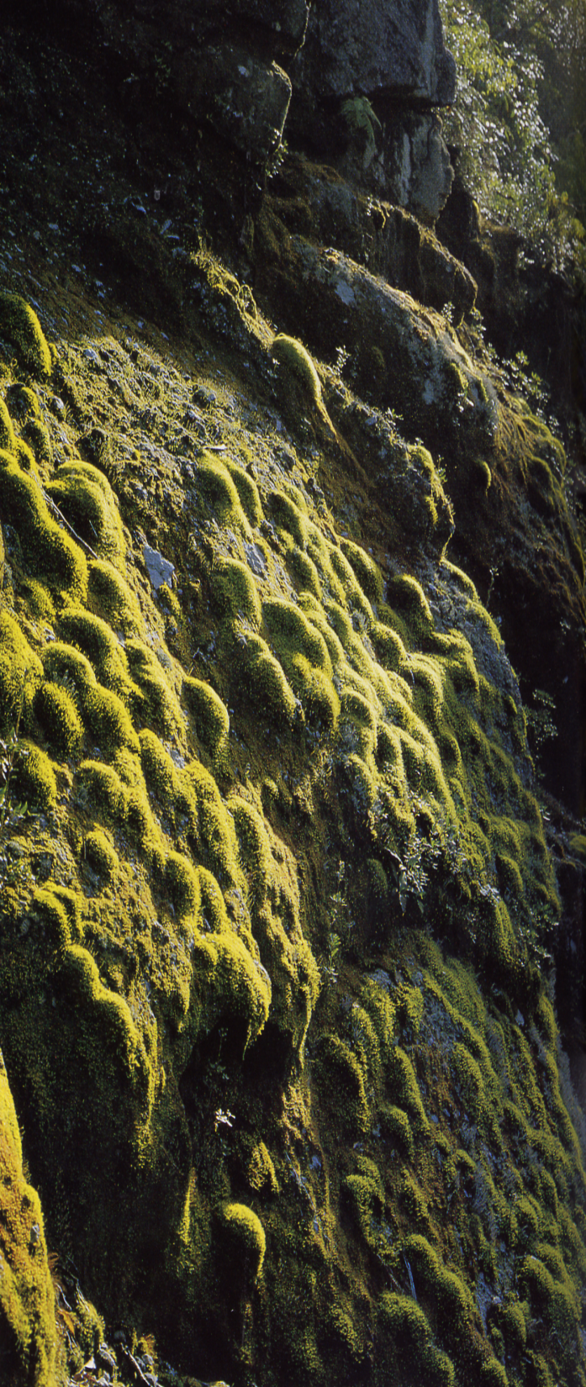
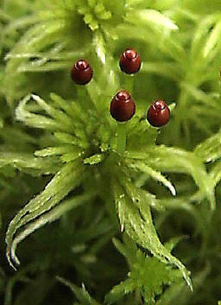
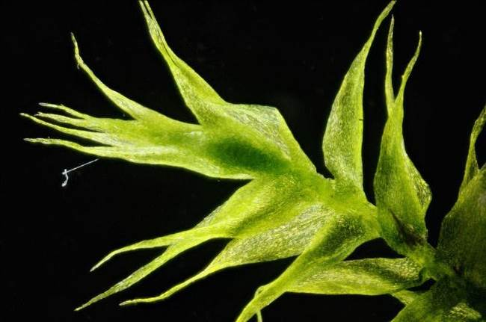
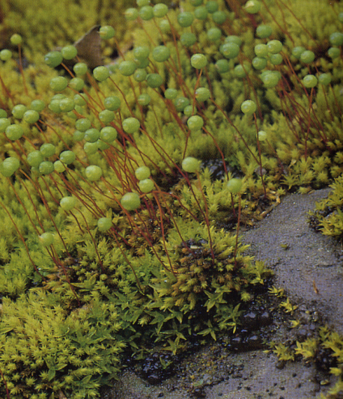
BRYOPHYTA
Anthocerotopsida, c. 100 spp.
Marchantiopsida (=Hepaticae, epatiche), 8.000 spp.
Bryopsida (=Musci, muschi),
16.000 spp.

Slide 9
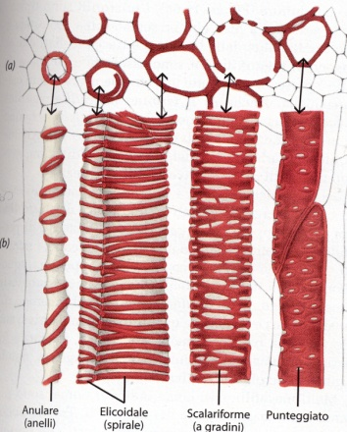
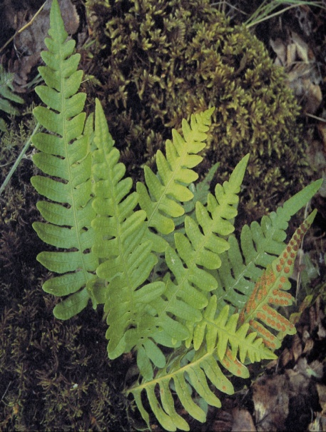
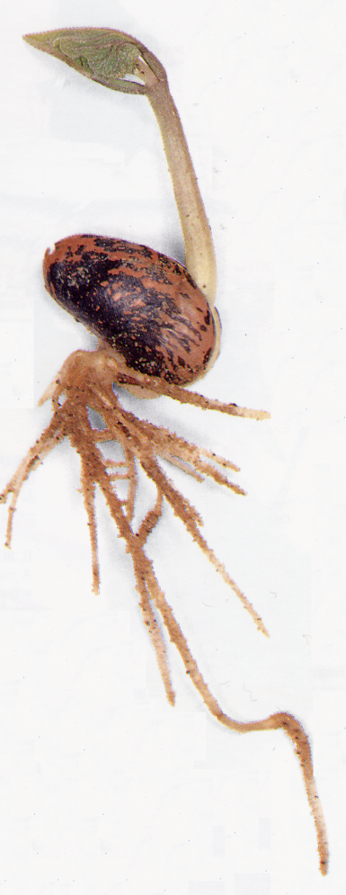
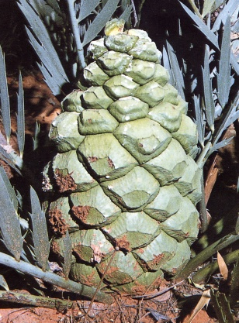
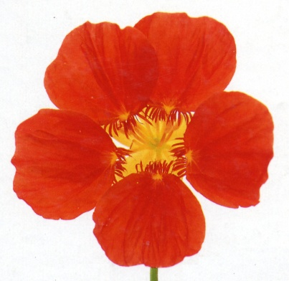
TRACHEOFITE
BRIOFITE
o cormofite (struttura a cormo, formato da vere foglie, caule e radici)
SPERMATOFITE
PTERIDOFITE
“piante con seme”
crittogame
vascolari
Gimnosperme
Angiosperme
“a seme nudo”
“a seme protetto”

Slide 10

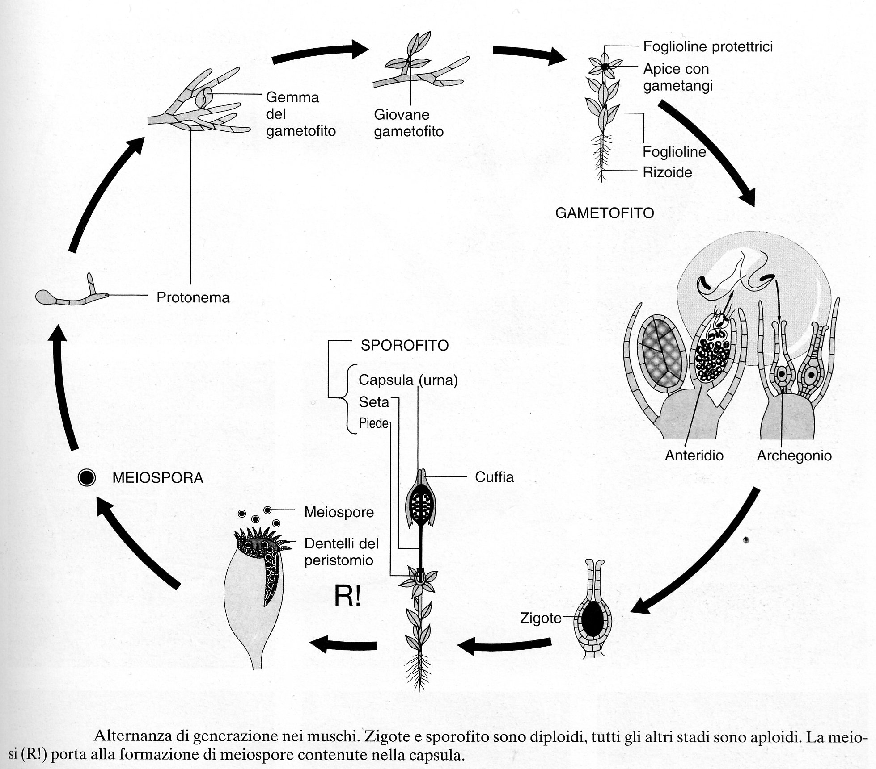


Slide 11
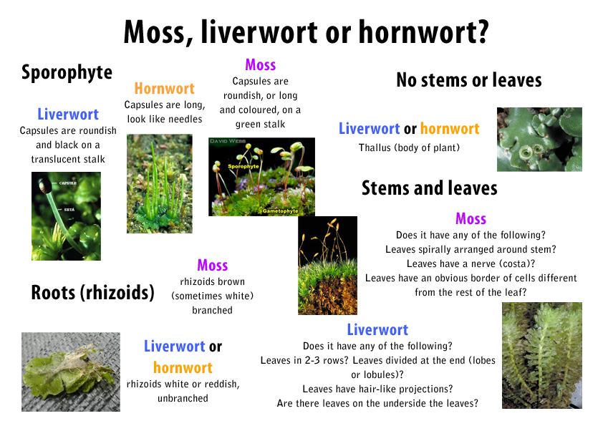

Slide 12
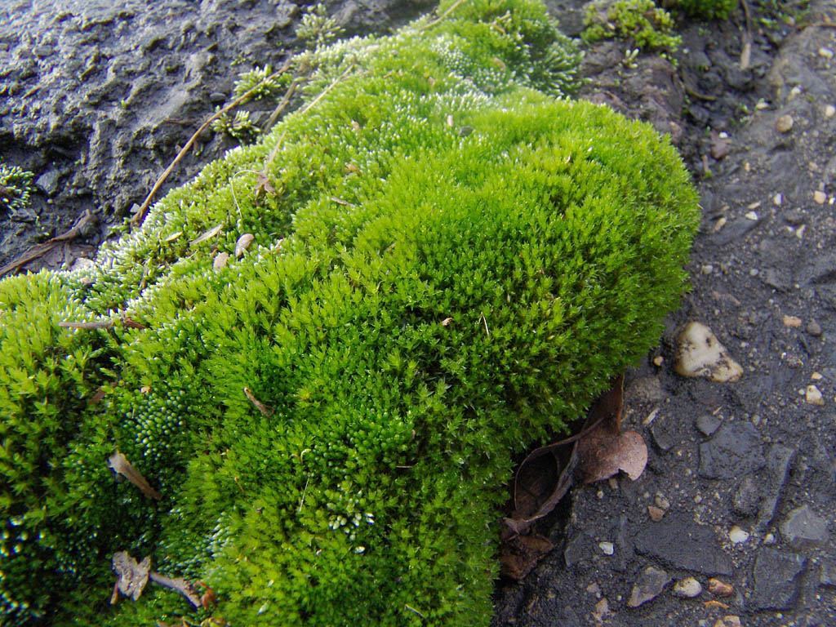
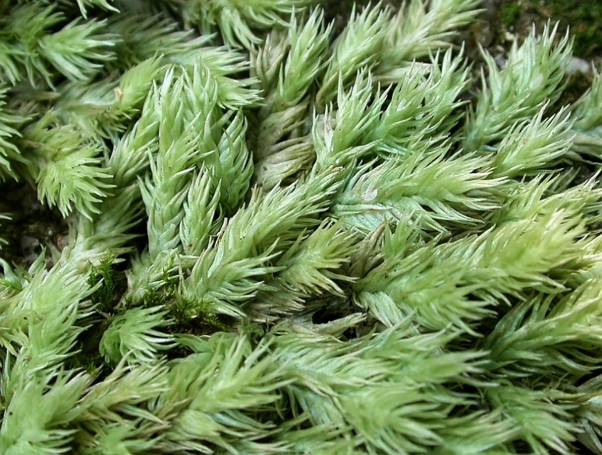
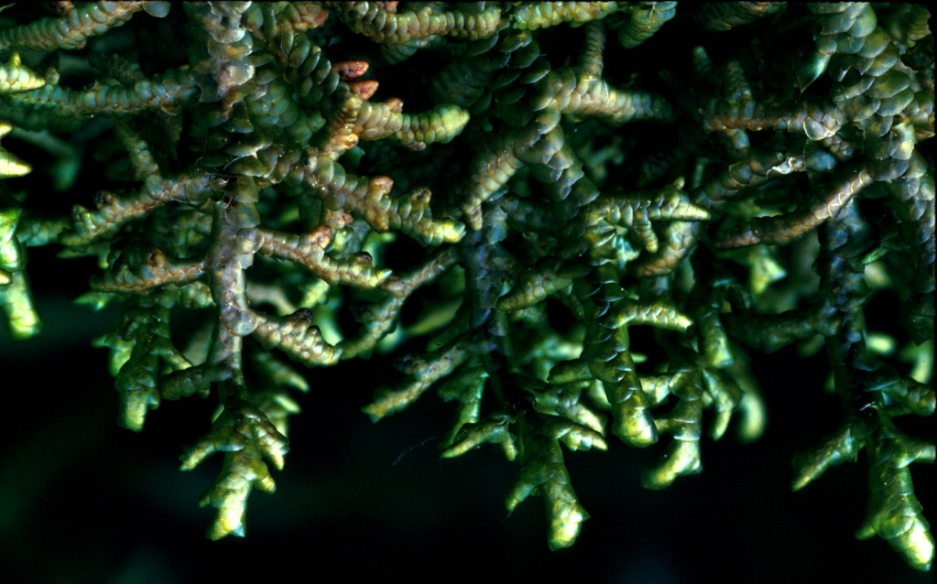
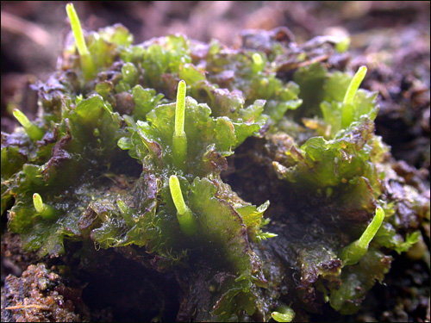
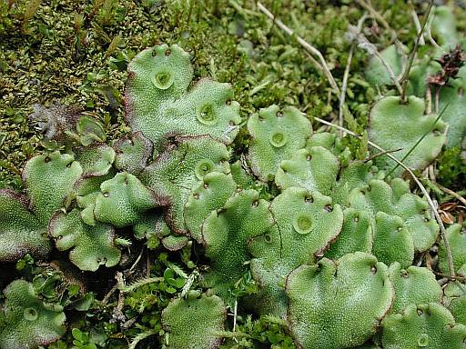
“Briofite”

Slide 13
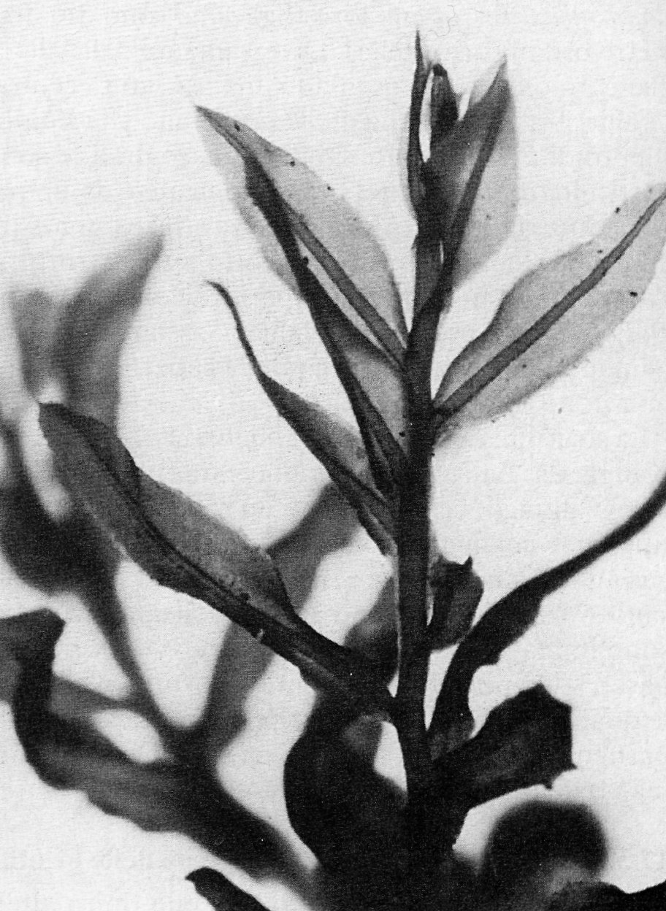
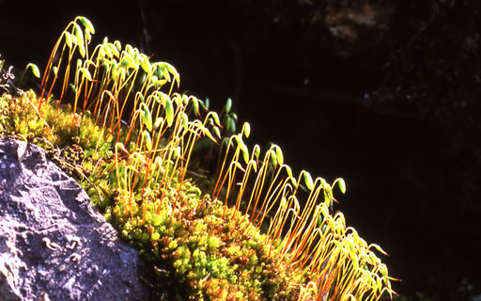
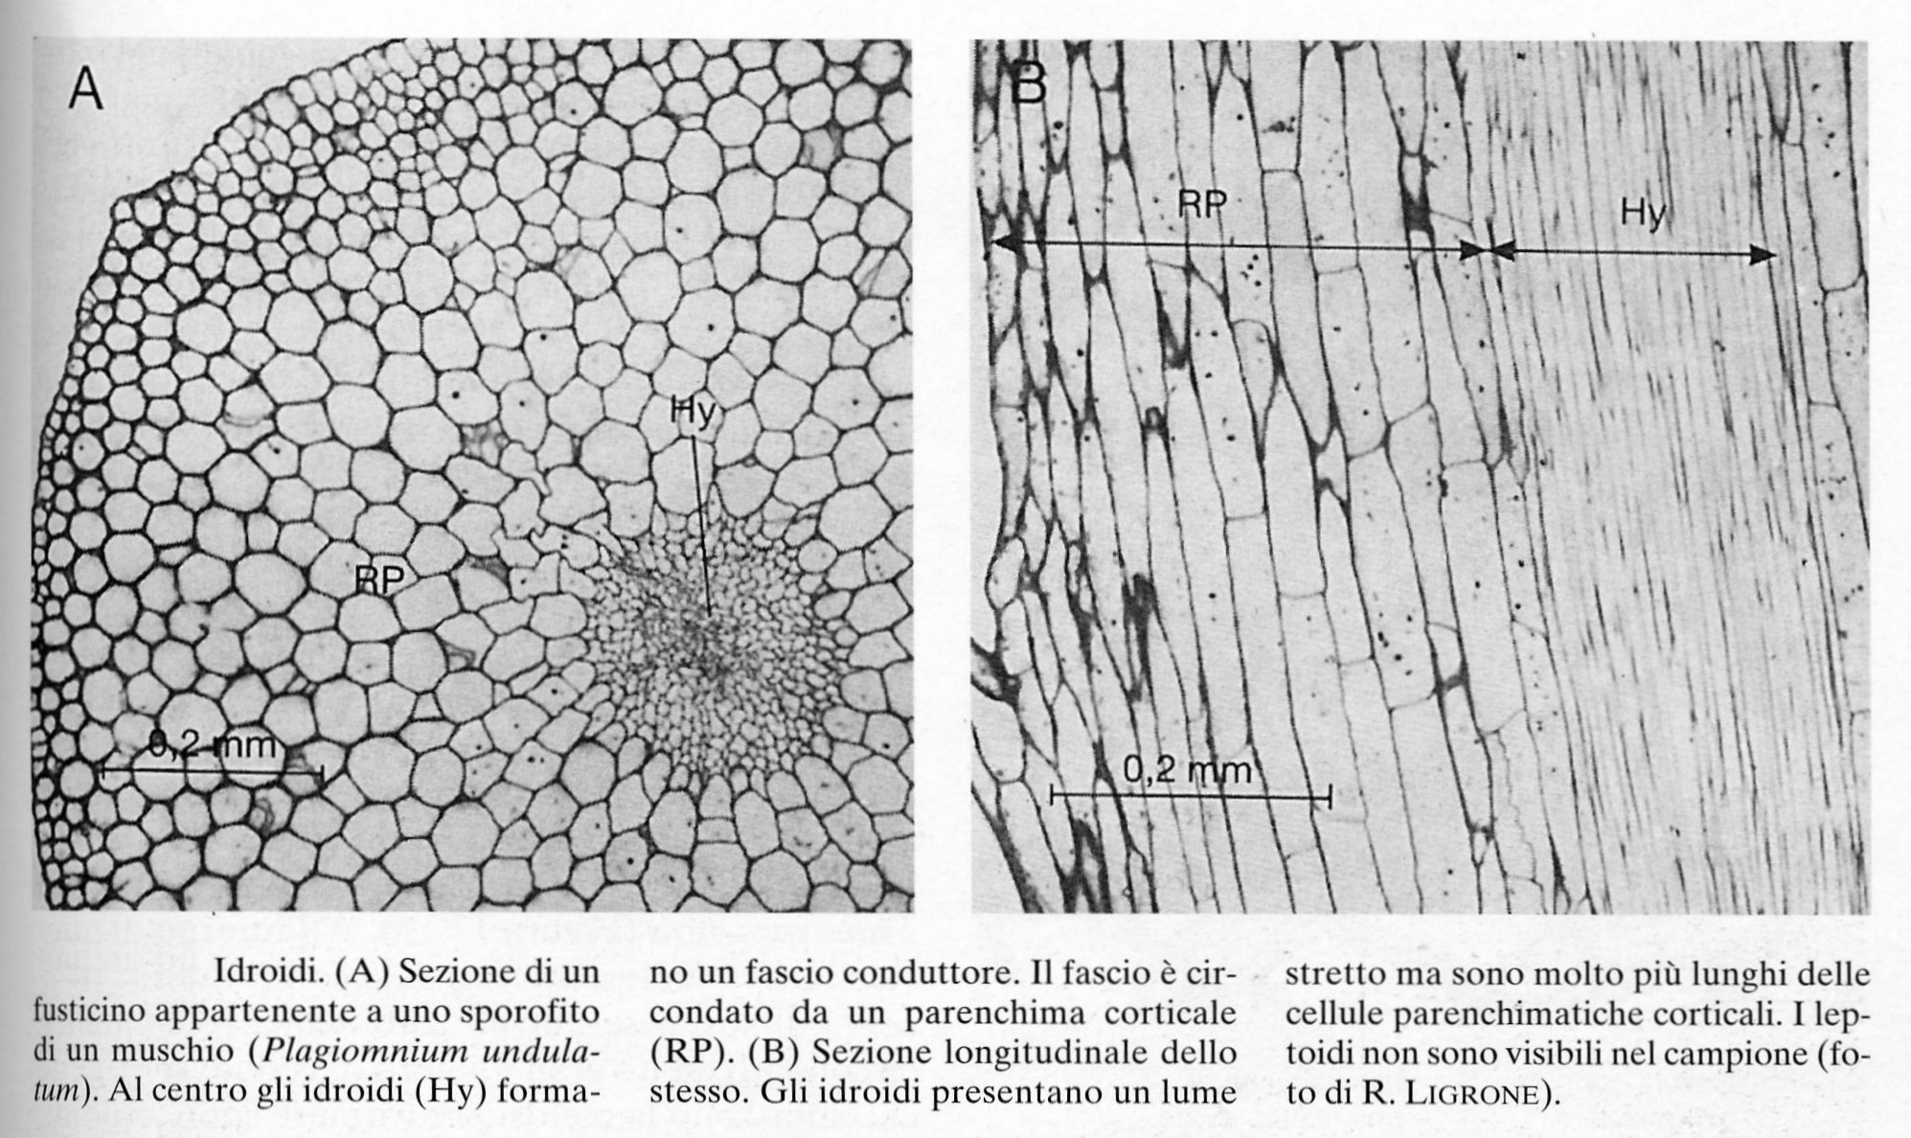

Slide 14
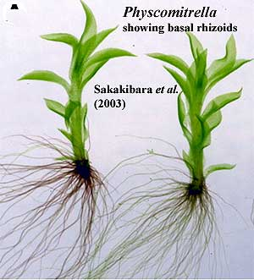
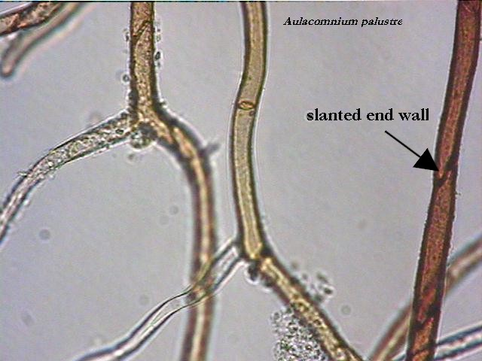

Slide 15
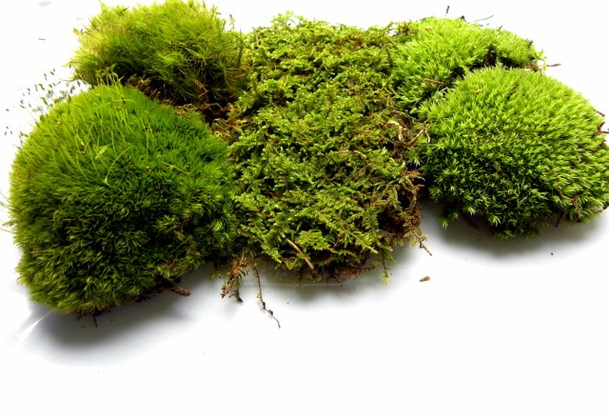
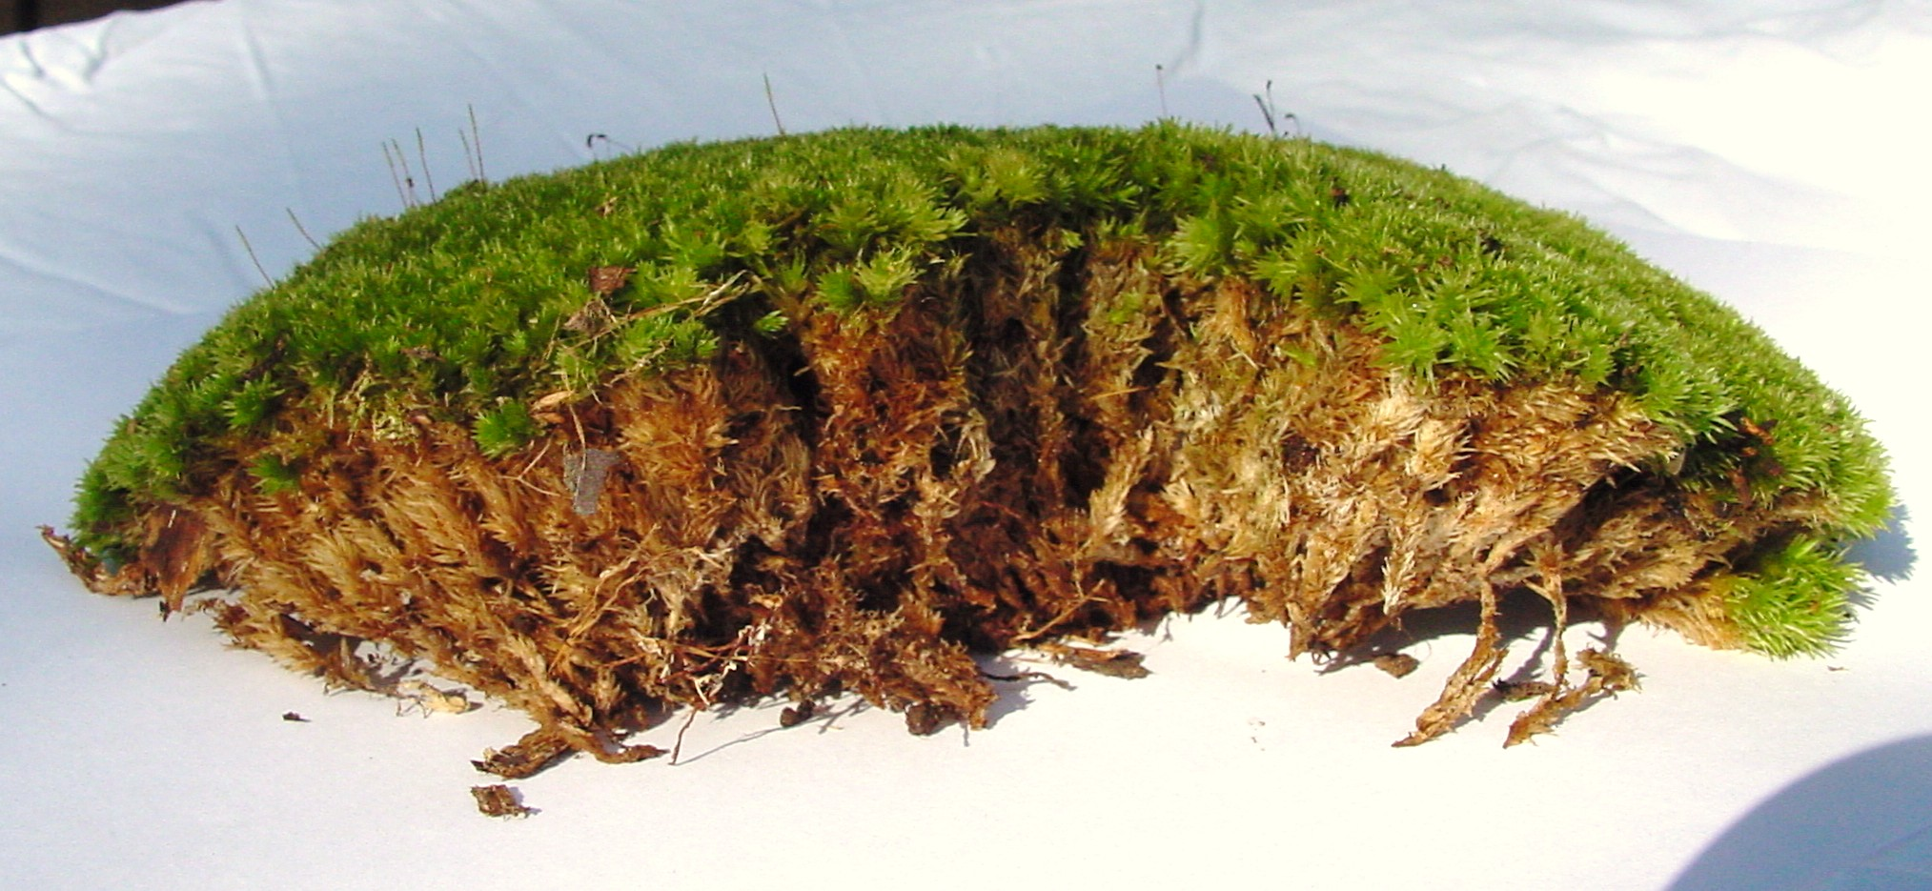

Slide 16
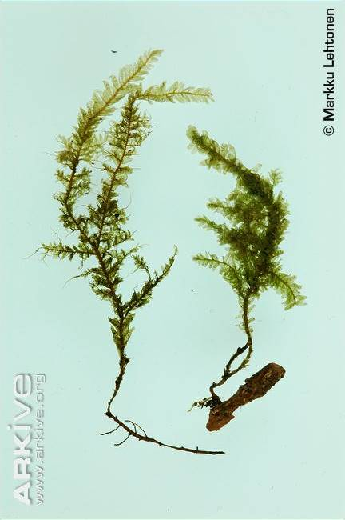

Slide 17
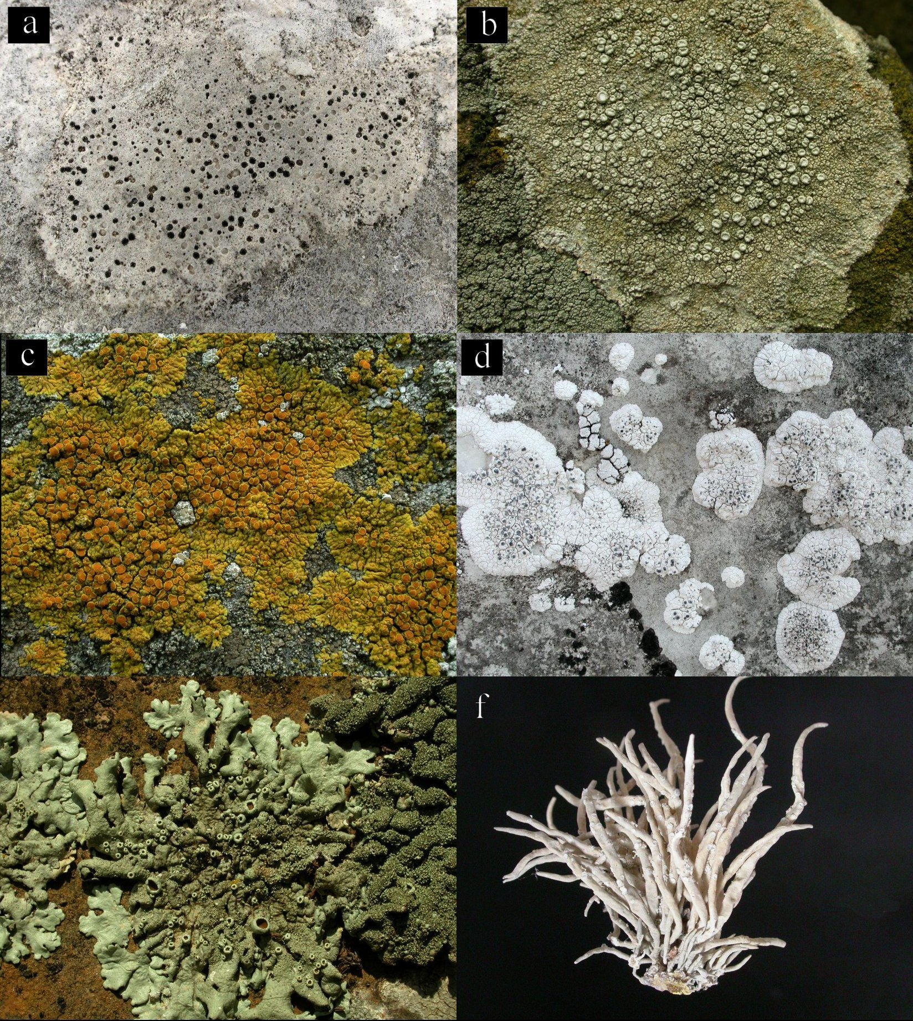
Un’ulteriore forma particolarissima di biotrofia è rappresentata dalla simbiosi lichenica, formata soprattutto da funghi ascomiceti (c.99% delle specie) con alcune alghe, soprattutto verdi, e cianobatteri.

Slide 18
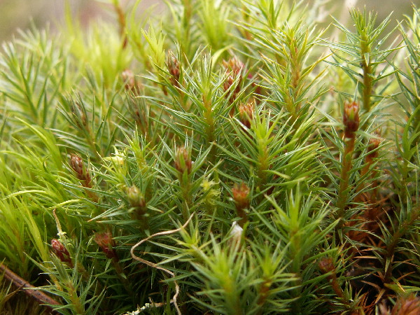
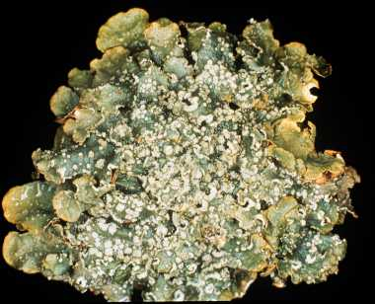
Lichens and mosses are perennial, and are active for most of the year, and particularly in winter, when pollution is higher

Slide 19
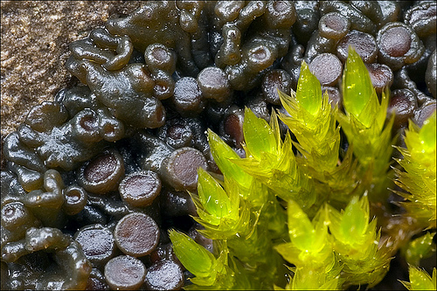
“Homoiochlorophyllous poikylohydric”
TOLLERANTI AL DISSECCAMENTO

Slide 20
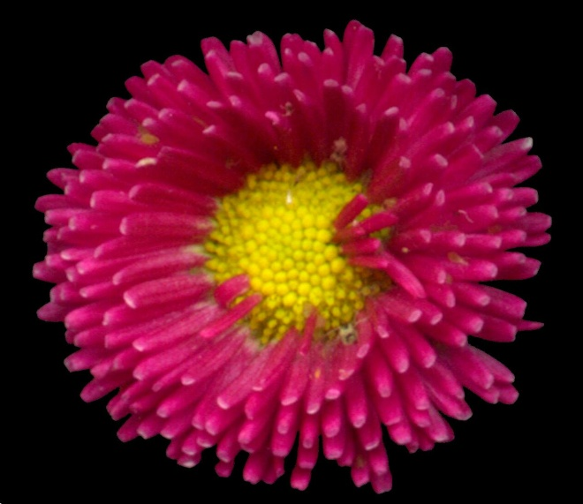
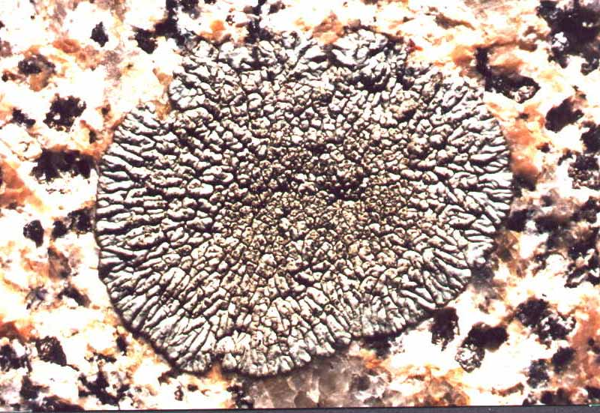
WATER STATUS
Most
vascular plants are homoiohydric and endohydric
Lichens, the majority of mosses, some ferns and a few vascular plants are poikilohydric and ectohydric

Slide 22
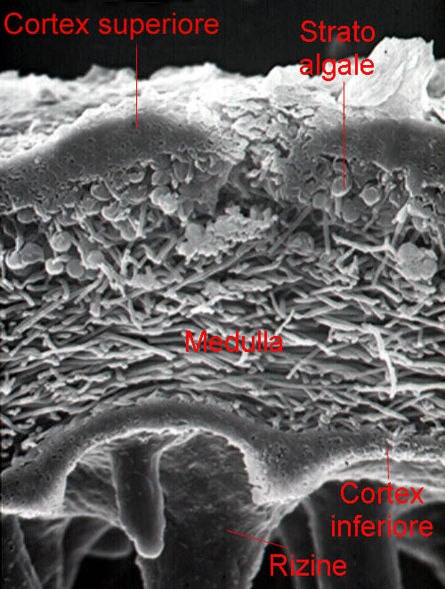
Lichens and mosses lack specific organs for absorbing water from the substratum, depending mostly from the atmosphere for their water and mineral uptake. Lichens also lack a protective outer cuticle, present in the mosses, but with specific characteristics which distinguish it from the cuticle of seed plants.
This means that lichens and mosses have a remarkable ability to rehydrate and resume normal metabolic functions following periods of desiccation, although in the dry state cell membranes become partially leaky due to loss of integrity.

Slide 23
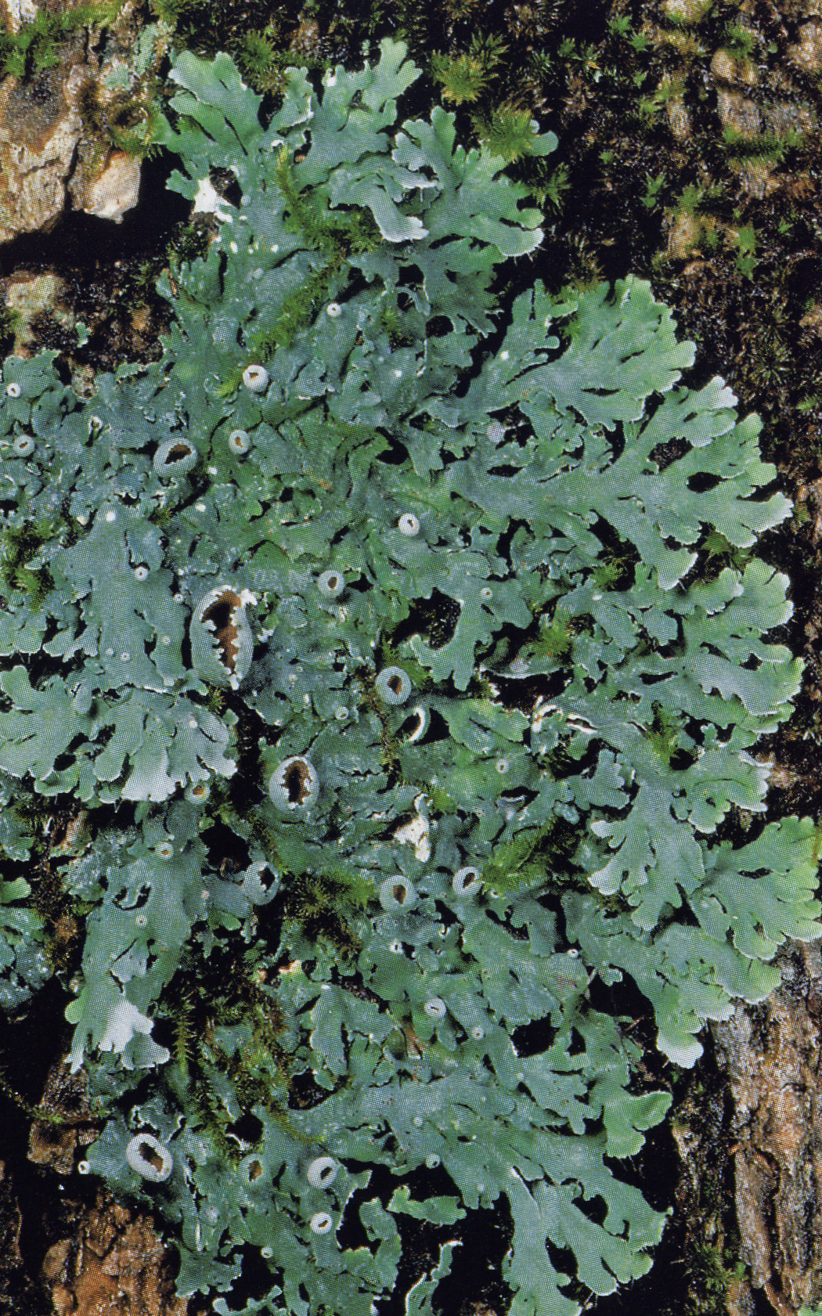
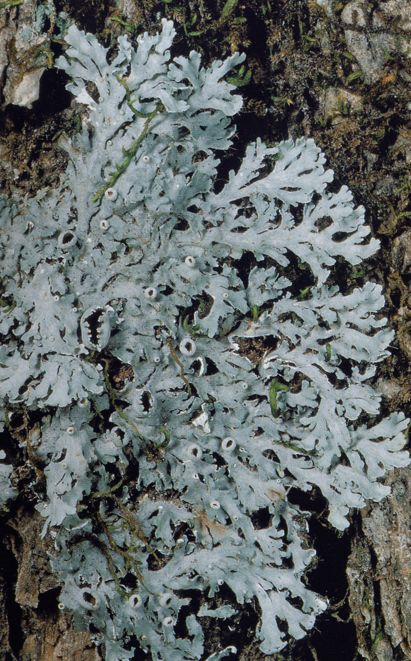
bagnato
secco

Slide 24
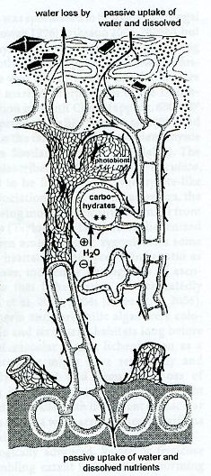
Tranne che per quelle poche specie intolleranti al disseccamento, i ripetuti cicli “secco-umido” sono fondamentali per la sopravvivenza della simbiosi, in quanto permettono lo scambio di sostanze tra i due (o più) partner.
IDROFILO
Parete con sottile strato idrofobico di natura proteica
IDROFOBICO
(micobionte)
Metaboliti secondari in cristalli sulla superficie della parete
IDROFILO
Honegger R., 1997. Plant relationships, pp. 209-221.

Slide 25
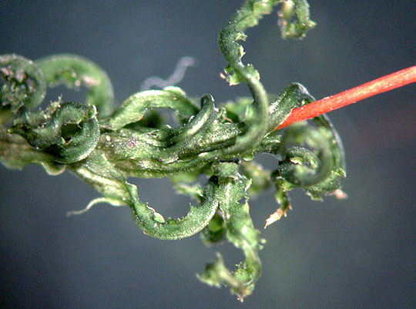
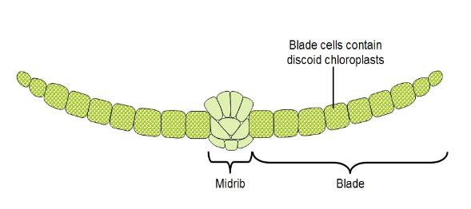
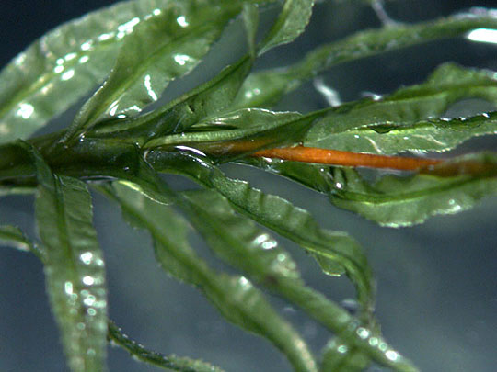

Slide 26
Cuticola o non cuticola?
A multi-layered cuticle is present on the calyptra of F. hygrometrica, with the features observed in vascular plants.
Investigating the Leaf Cuticle of the Moss Physcomitrella patens.
By Eric John Ricci, Rhode Island College
Renault et al. (2017). A phenol-enriched cuticle is ancestral to lignin evolution in land plants. Nature Communications 8, Article nr: 14713 doi:10.1038/ncomms14713
From the Abstract: “This pathway […] controls the synthesis of the moss cuticle, which prevents desiccation […]”

Slide 27
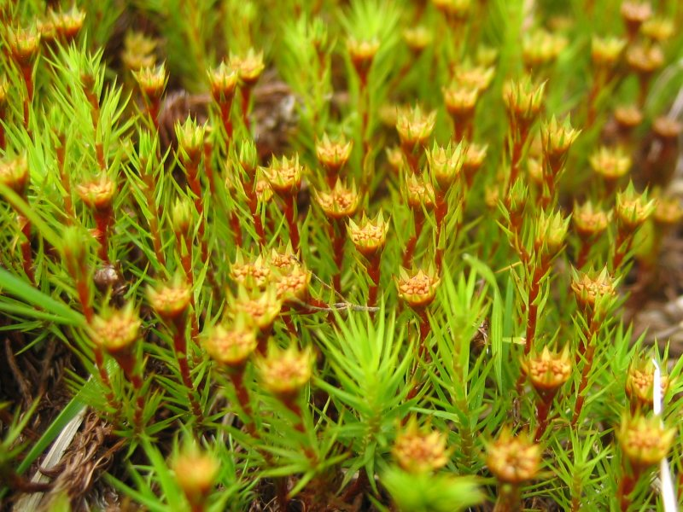
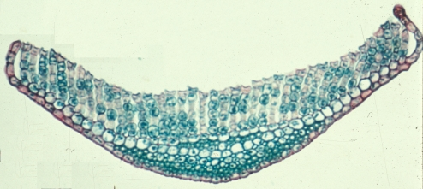

Slide 28




Leucobryum glaucum

Slide 29






Slide 30




Slide 31






Slide 32
The basic of (bio)-accumulation processes in lichens and mosses
Particles, normally present in the atmosphere or incremented by human activities, arrive to lichens and mosses in two not mutually exclusive forms: dry and wet depositions. The latter are particularly important for lichens and mosses, because they are highly hygroscopic.
Whatever the way of arrival, three different modalities of immobilization are known to occur in lichens and mosses, which can explain their bioaccumulation capacity:

Slide 33

1) particles entrapping (adsorbed onto the thallus surface or within intercellular spaces);
2) extracellular ionic binding (mainly at cell wall level, secondarily at cell membrane level);
3) intracellular ionic binding.
These modalities are qualitativavely and quantitatively different among species, and this can explain why some species are more tolerant than others to pollutants, and why some are more strong bioaccumulators than others.

Slide 34

Particle trapping
Lichens and mosses effectively trap airborne particulate matter both from natural sources (e.g. soil, volcanic eruptions, sea salt aerosols, wils forest fires) and anthropogenic sources (mining, smelting, combustion of fossil fuels, incineration of refuse, cement production, etc.).
Particulate material within a lichen thallus consisting of unaltered particles ranging from sub µm to >100 µm.

Slide 35



Particulate matter can be observed onto the thallus surface or within intercellular spaces.

Slide 36

Washing the material before the analysis can remove part of the particulate matter.
pre-esposure
Al
Pre-washed
Post-w.
μg g⁻¹ peso secco
Fe
post-esposure
Lower element content is observed after washing in distilled water

Slide 37



Interception is increased by the thallus growth form and by the nature of the surfaces.
In lichens, in the series crustose→ foliose → fruticose there is a strong increase in the external surface in contact with the atmosphere.

Slide 38


Slide 39

The interception of particulate matter is increased by rough, irregular surfaces: in lichens, interception is intuitively higher when the thallus produces vegetative or reproductive structures, or when it is covered by a layer of small crystals, produced by the metabolic activity of the mycobiont.
A good example of structures increasing interception are the isidia of Pseudevernia furfuracea.

Slide 40


Pruina: superficial crystals of calcium oxalates

Slide 41


Pruina: superficial crystals of Ca oxalates
Whewellite (COM)
Weddellite (COD)
Notes:
Questi per la notevole rugosità della superficie che determinano, favoriscono l’intercettazione del particolato, sia integri sia con le forme di dissoluzione tipiche di una delle due forme cristalline.
Sulla superficie dei licheni possono trovarsi cristalli di varie forme e dimensioni costituiti da ossalato di calcio idrato, organizzato in due forme minerali, la weddellite e la whewellite.
la weddellite è ossalato di calcio Monoidrato,
la whewellite.

Slide 42
The penetration within the thallus, that can be verify by SEM coupled with X-ray microdiffractometry (Garty 2000), is favoured by any structure that interrupt the surface, such as pseudocyphellae, pores, soralia, and breakings; the latters can be traumatic, or arranged for the dispersion of isidia, blastidia, phyllidia, schizidia.

Slide 43

Soredia

Slide 44




Slide 45




Slide 46


Slide 47
The particulate entrapped on the outer surface, or present within the thallus may be partially or totally solubilised by the metabolic excretions (see below) and CO₂ released by the living organisms with respiration, or by the low pH of single rain events, not particularly rare in polluted areas. In this way, some of the substances become available in ionic form.

