Slide 1
CALENDARIO DELLE LEZIONI - NOVEMBRE
19/11, ore 11-13, aula V (ed. A)
20/11, ore 14-16, aula emiciclo (ed. Q)
21/11, ore 14-16/16-18, LEZIONE PRATICA, aula C (ed. M)
NESSUNA LEZIONE NELLA SETTIMANA DEL 25-29/11

Slide 2
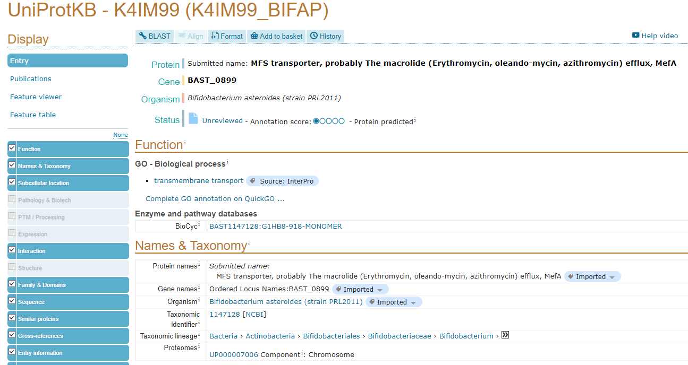
ANNOTATION: AN EXAMPLE
Let’s examine this example entry, taken from the UniProt protein sequence database
https://www.uniprot.org/uniprot/K4IM99
This is just one of the many sequence databases available. UniProt is specifically used for protein data, whereas GenBank is used for nucleotide data
Annotations are placed under different sections (e.g. Function, Names & taxonomy, ecc).

Slide 3
CALENDARIO DELLE LEZIONI - DICEMBRE
3/12, ore 11-13, aula V (ed. A)
4/12, ore 14-16, aula emiciclo (ed. Q)
5/12, ore 14-16/16-18, LEZIONE PRATICA, aula C (ed. M)
10/12, ore 11-13, aula V (ed. A)
11/12, ore 14-16, aula emiciclo (ed. Q) – Pallavicini?
12/12, ore 14-16/16-18, LEZIONE PRATICA, aula C (ed. M)
10/12, ore 11-13, aula V (ed. A) - Pallavicini
19/12, ore 14-16/16-18, LEZIONE PRATICA, aula C (ed. M) - Pallavicini

Slide 4
SEQUENCE ANNOTATION
Assigning one or more attributes to a sequence (functional annotation)
Assigning such attributes coordinates relative to a reference sequence (structural annotation)
Annotations can be linked to nucleotide (DNA or RNA) sequences or to amino acid (protein) sequences
Altogether the attributes of a sequence make up the annotation
How can sequences be annotated?

Slide 5
ANNOTATION: AN EXAMPLE
By scrolling down, you will find this section, which lists all the transmembrane regions found in this protein
Each of these is linked to a position (coordinates relative to the amino acid sequence) and to a description (very simple in this case, can be much more complex for the annotation of other features)

Slide 6
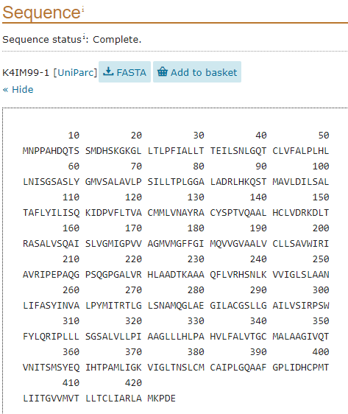
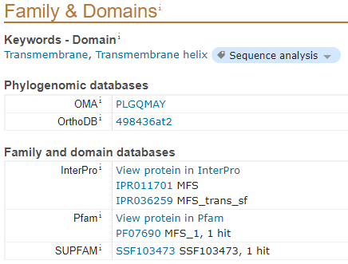
ANNOTATION: AN EXAMPLE
The sequence can be recovered in a FASTA file with a simple click
The sequence is linked to one or more conserved domains (Family & domains)

Slide 7
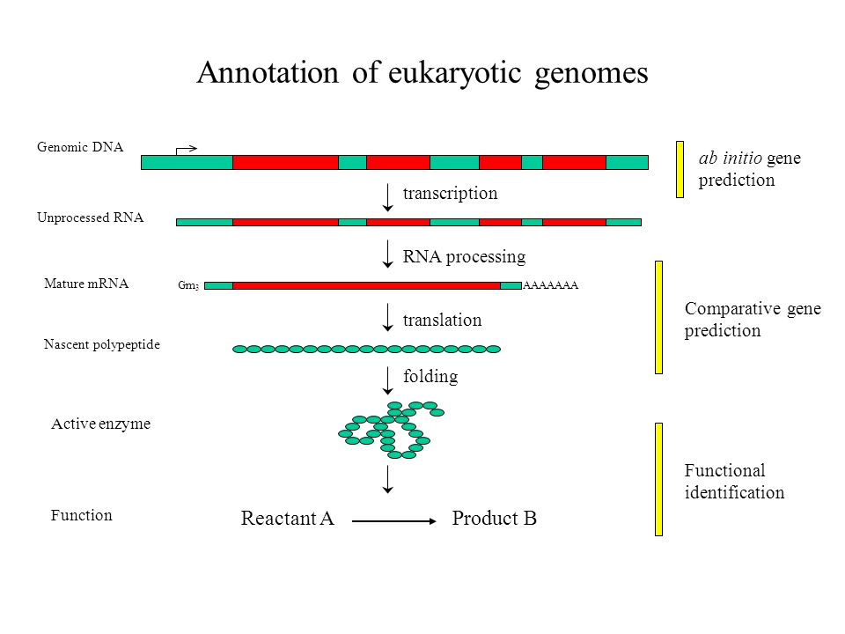
ANNOTATION: NUCLEOTIDE vs PROTEIN SEQUENCE
Annotation can be performed at different levels
The annotation of nucleotide sequence is not as easy as protein sequence!
mRNA and genomic DNA sequences can be divided between coding and non coding regions (i.e. UTRs vs ORFs in mRNA, exons vs introns and intergenic regions in nucleotide sequence)
A gene, the transcribed mRNA(s) and translated proteins can share the same functional annotation, but are obviously characterized by largely different structures and even attributes (e.g. a regulatory region such as a promoter can only be found in gDNA, a phosphorylation signal can be only found in proteins

Slide 8
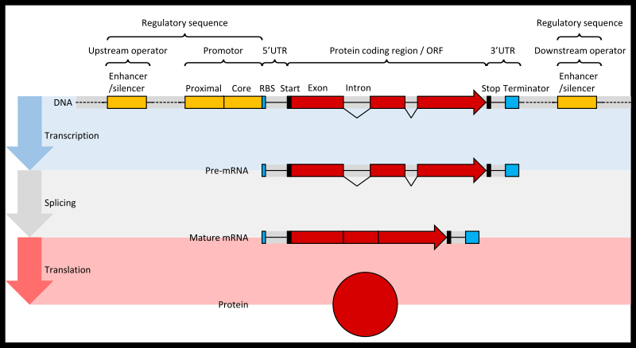
ANNOTATION: A STEP BY STEP SCHEME

Slide 9
GENOME ANNOTATION
Regulatory regions: promoters, enhancers, silencers, etc.
DNA sequence modification (e.g. methylation)
Gene annotations (exons, introns)
mRNA annotations (combination of exons + alternative splicing)
Primary sequence variants (SNPs, MNVs, insertion, deletions, etc.)
mRNA ANNOTATION
5’ UTR
Coding sequence
3’UTR
Splicing variants
N.B. mRNA annotation is usually derived from genome annotation
However, mRNA annotation is also possible when a genome is not available (for example in the case of de novo transcriptome assembly)

Slide 10
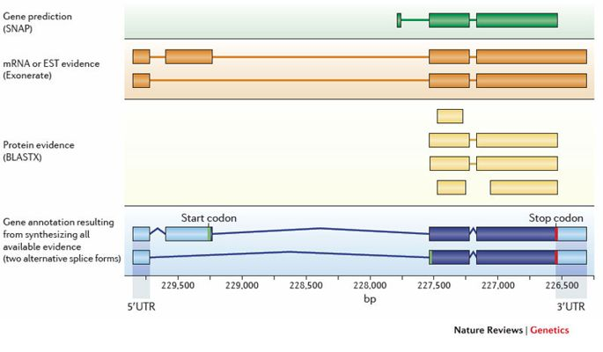
GENE PREDICTION
How are such features predicted?
Combination of 3 lines of evidence:
De novo gene prediction (based on algorithms and the detection of sequence motifs)
Similarity evidence (detected with BLASTx with the comparison against a database of proteins with known function
Alignment with known mRNA molecules (or RNA-seq data)

Slide 11
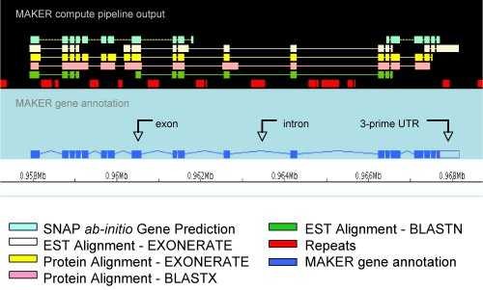
GENE PREDICTON ALGORITHMS
They need to weight-in all evidence in an appropriate way
Score thresholds need to be set -> gene models with a low score will not be annotated
Annotation softwares are quite complex and annotation parameters can be manually set
There is no unique way to annotate genes! Each genome has its own characteristics and issues. For example, splicing donor/acceptor sites can have different consensus sequences, GC% content can vary, introns can have a different length, etc.
Custom methods may be applied to particular target genomes -> prokaryote genome annotation pipelines are much more simple (no introns, no repeats, etc.)

Slide 12
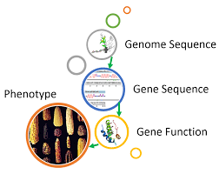
FROM THE STRUCTURAL TO THE FUNCTIONAL ANNOTATION
The annotation pipelines seen so far were focused on the assignment of coordinates to features (= structural annotation)
We need a way to link genes to functions and phenotypes
The functional annotation is based on the comparison between an unknown function and a database containing sequences with known function
All functional annotation methods are based on sequence comparison. Even though new, faster methods are currently being developed (and are, in part, already available), BLAST with its many variants is still the most commonly used method to compare an unknown sequence with a database.
Sequence similarity allows to infer an alleged similar function

Slide 13
BLAST
Acronym for Basic local alignment search tool
BLAST is the most important tool for comparing nucleotide and protein sequences
Input sequence (query) vs database
Can be used online (NCBI BLAST) or locally on your own PC
Database: publicly available (UniprotKB, NCBI Genomes, etc.) or custom (e.g. local database)

Slide 14
Some background
Based on the di Smith-Waterman algorithm, which is used for local alignment
Highly sensitive, so it is optimal for detecting small regions of similarity in sequences with low homology
Encountered a great success in bioinformatics with FASTA and BLAST applications (FASTA was another tool for sequence similarity searches which we will not study in detail)
Based on similarity matrices (PAM o BLOSUM) which assign positive scores to identical or similar amino acids and negative scores to dissimilar amino acids and gaps

Slide 15
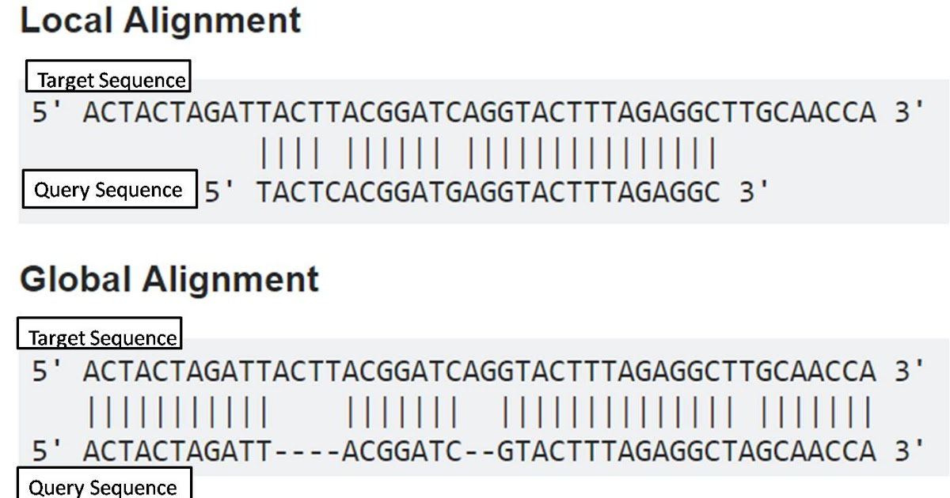
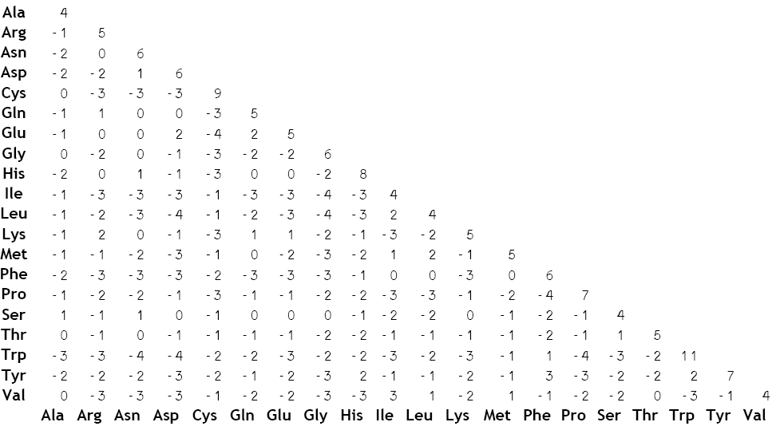
Some basic concepts for bioinformatics noobs
Local vs global alignment
An example can be seen below… which one is the «best» alignment?
We need to thing about what we are mostly interested into
Similarity matrix
Two-entry matrix with positive and negative scores calculated based on the similarity among amino acids (i.e. charge, hydrophobicity, etc.)
Can be of two types, PAM or BLOSUM, and they have a numeric index (e.g. PAM250)

Slide 16
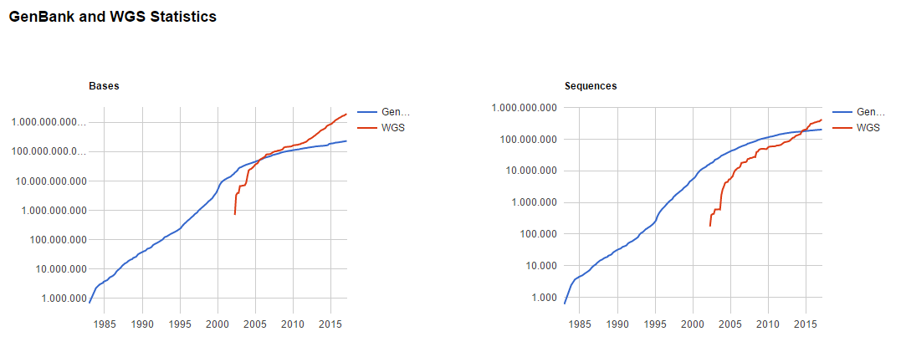
A heuristic approach to sequence alignment
Sequence similarity searches are carried out in enormous databases… we simply can’t expect to evaluate all alignment possibilities
N.B. the graphs below are in Log10 scale!!!

Slide 17
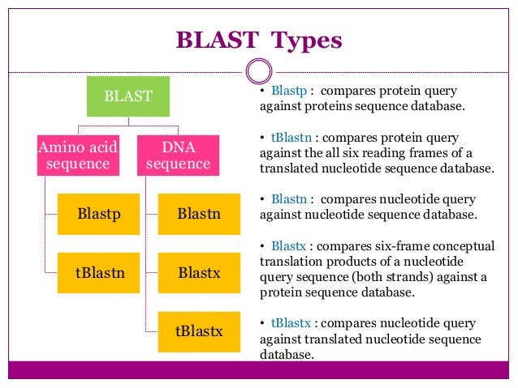

Slide 18
BLAST parameters
Depend on the type of BLAST!
We can limit the database to taxonomical entries (e.g. Metazoa, Bacteria, Homo sapiens, Primates, etc.)
Word size (W): «word» use to nucleate regions of similarity: high W -> higher speed, lower sensitivity; low W: slower speed, higher sentitivity
Substitution matrix: PAM/BLOSUM. In BLASTn match/mismatch
Gap cost: penalties applied to gap existence and extension

Slide 19
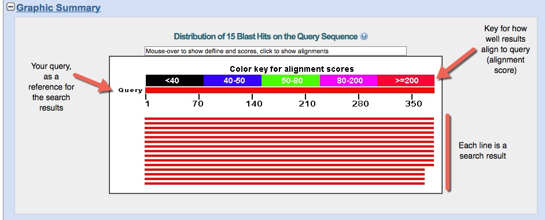
How to intepret BLAST results?
All the parameters mentioned above are combined to give you an e-value: describes the number of hits one can "expect" to see just by chance when searching a database of a particular size

Slide 20
How to intepret BLAST results?
Results will be ordered from the «best» result to the «worst» result, i.e. from the most the least significant hit
Basically, the significance of each hit is evaluated by the alignment score of the alignment between your query sequence (input) and the subject sequence (the hit found in the database)
The lower the e-value, the better the result, i.e. highly significant hits will tend to have an-value = 0 or very close to 0
The e-value depends on the score of the alignment, determined by the similarity between the query and the subject (calculated with a PAM/BLOSUM matrix) and by the length of the alignment

Slide 21
BLAST in genomic studies
Annotation of intron/exon regions: mRNAs (query) vs genome (database)
Functional annotation of genes (by similarity/orthologies): similar genes in different species are likely to encode proteins with similar/identical functions
Gene prediction: annotation of genes by similarity. E.g. The position and intron/exon organization can be inferred by BLASTing human mRNAs vs the orangutan genome
Different applications: metagenomics (OTUs assignment), comparative genomics/phylogenomics and many others!

Slide 22
Be careful with your interpretation! SIMILARITYvs HOMOLOGY
We need to pay attention to the different meaning of these two words in a biological context. They are not synonymous and considering them as such would be a mistake
SIMILARITY: does not imply any hypothesis concerning the reasons behind similarity itself
HOMOLOGY: two sequences are homologous if the share the same phylogenetic ancestry
Biological similarity is often due ti homology, but it can also occurr by chance or be linked to adaptive convergence

Slide 23
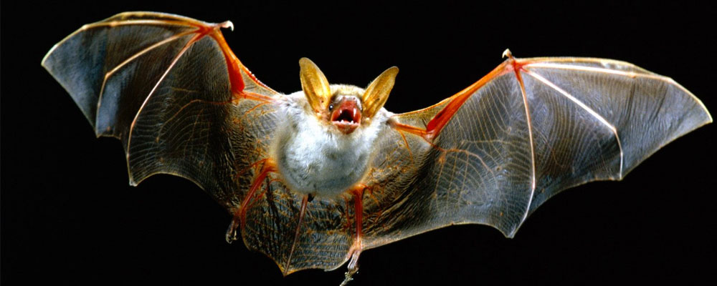
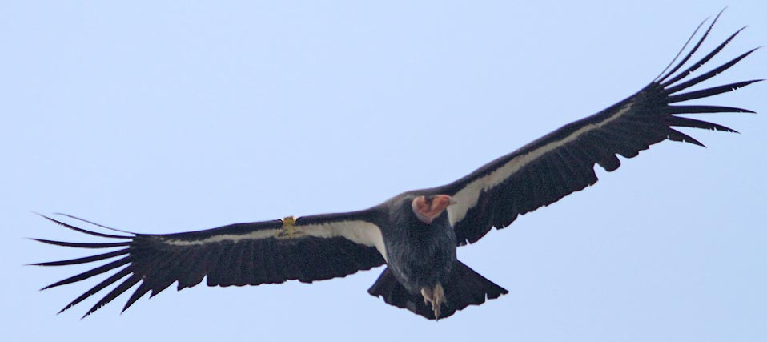
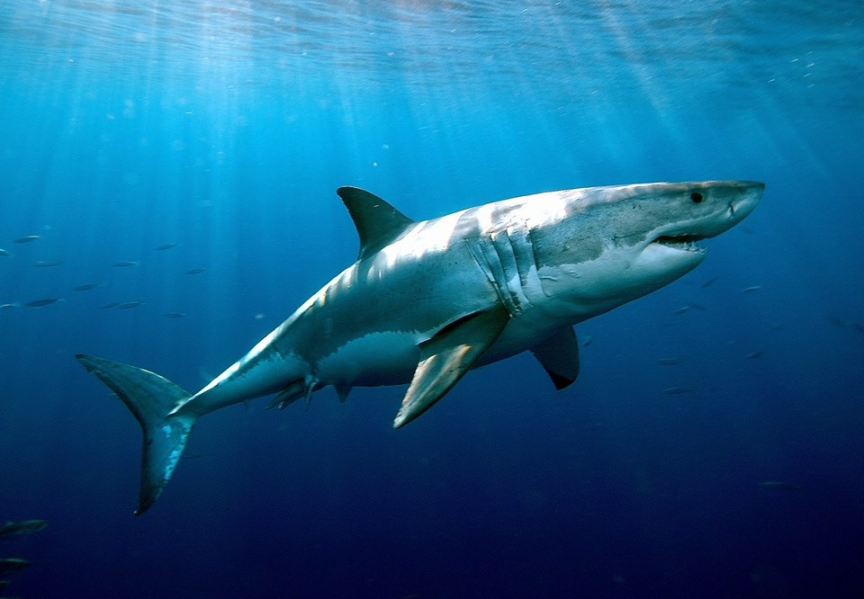
HOMOPLASY: SIMILAR FEATURES WITH INDEPENDENT EVOLUTIONARY ORIGIN (CONVERGENT EVOLUTION)

Slide 24
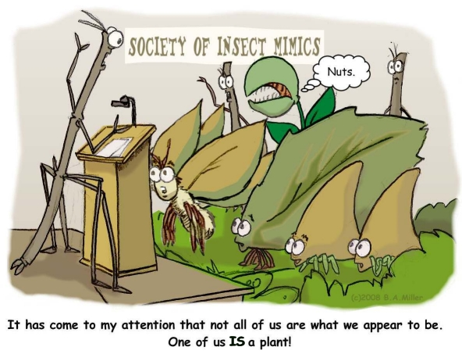
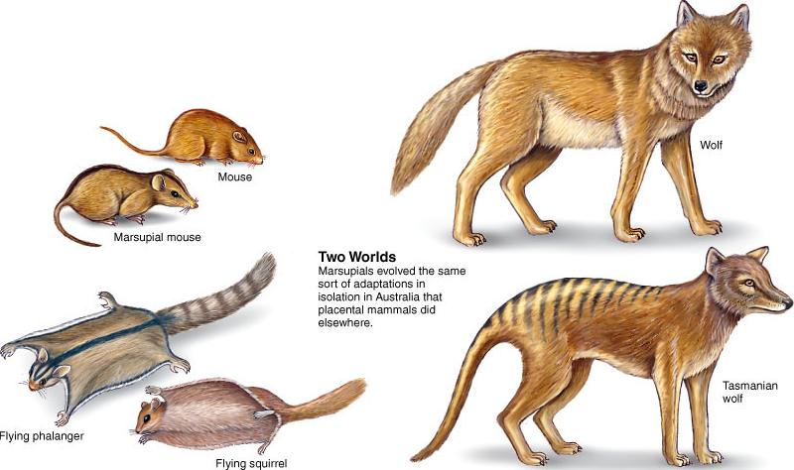
It may be easier to approach these concepts by thinking about species, which will be more familiar to students without a molecular biology background
We need to keep in mind that sequences evolve in parallel with species and, although they can be subject to particular selective pressure, they are strictly linked with the species of origin

Slide 25
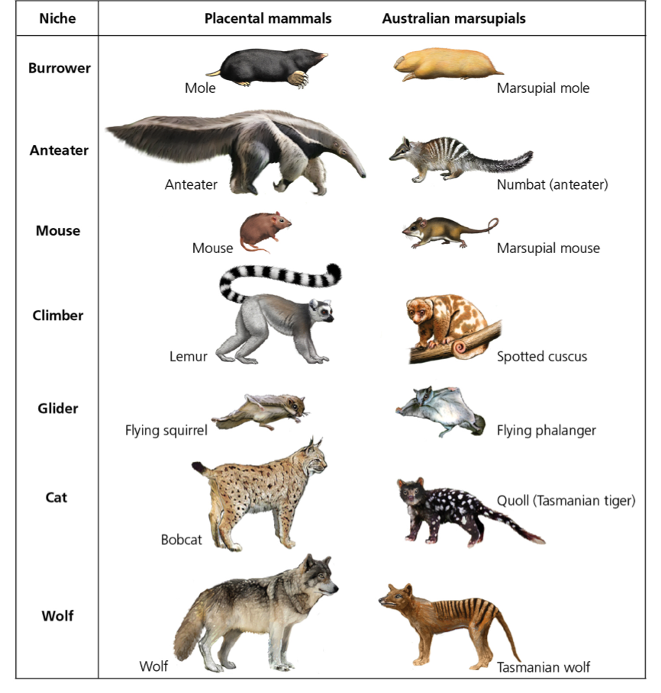
Marsupials represent a great example if we compare them with placental mammals
Although all these lifeforms have been developed morphologically after the split between marsupials and placentals, we can notice extraordinary morphological (and behavioral) similarity between species
The classification of these animals based on simple «similarity» criteria would produce trivial errors as it would probably not identify marsupials as descending from a common ancestor

Slide 26
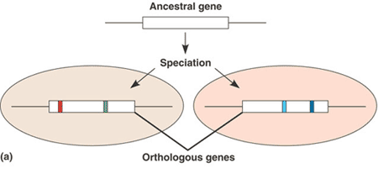
QUANDO DUE SEQUENZE SONO SIMILI, OMOLOGHE, ORTOLOGHE O PARALOGHE?
Nel trattare le sequenze è sempre più corretto utilizzare il termine similarità, in quanto è sempre possibile stabilire quanto due sequenze siano simili, mentre non sempre si può decidere se la similarità sia dovuta ad omologia, a convergenza adattativa, oppure al caso
strutture o sequenze ortologhe in due organismi sono sequenze omologhe che sono evolute dalla stessa caratteristica nel loro ultimo antenato comune ma che non necessariamente mantengono la loro funzione ancestrale.

Slide 27
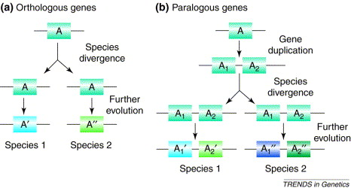
QUANDO DUE SEQUENZE SONO SIMILI, OMOLOGHE, ORTOLOGHE O PARALOGHE?
sequenze omologhe la cui evoluzione riflette invece eventi di duplicazione genica si definiscono paraloghe.
per esempio, la catena alfa dell’ emoglobina e’ un paralogo della catena beta dell’ emoglobina e della mioglobina, dal momento che ambedue si sono evolute dallo stesso gene ancestrale attraverso ripetuti eventi di duplicazione genica.

Slide 28
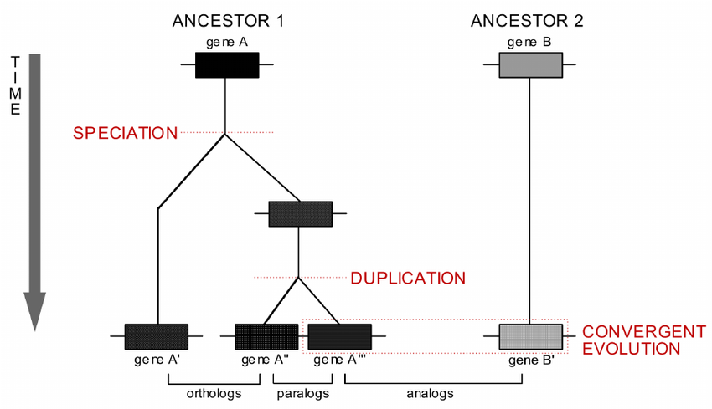
QUANDO DUE SEQUENZE SONO SIMILI, OMOLOGHE, ORTOLOGHE O PARALOGHE?
Ci possono essere casi più complessi in cui, un pò come per le specie ed i loro caratteri morfologici, si osserva similarità di sequenza senza che ci sia un’origine comune da un unica sequenza ancestrale
Possiamo in questo caso parlare di sequenze analoghe, o molto più semplicemente parlare di similarità di sequenza senza omologia

Slide 29
ALCUNI ALTRI IMPORTANTI CONCETTI DA RICORDARE
Tenete bene a mente che la similarità di sequenza non nesessariamente si traduce in similarità funzionale
Spesso due sequenze ortologhe svolgono funzioni leggermente diverse in specie diverse. In caso contrario viene mantenuta anche omologia funzionale
Spesso due sequenze paraloghe svolgono funzioni diverse nello stesso organismo. In caso contrario c’è una ridondanza funzionale.
Molto spesso sequenze con nessuna omologia o scarsa similarità svolgono funzioni molto simili se non addirittura identiche

Slide 30
Inferring functions from BLAST
Based on what has been said so far about similarity and homology, it becomes obvious that two sequences sharing some degree of homology share a common origin from an ancestral sequence -> they originally shared a similar function
But how much confidence can we have about the fact that they do share the same (or a similar) function at the present time?
Once again, this is arbitrary, and it depends on similarity thresholds, that need to be reasonably set by the user
The higher the similarity (and the lower the e-value) the more trustworthy an annotation will be

Slide 31
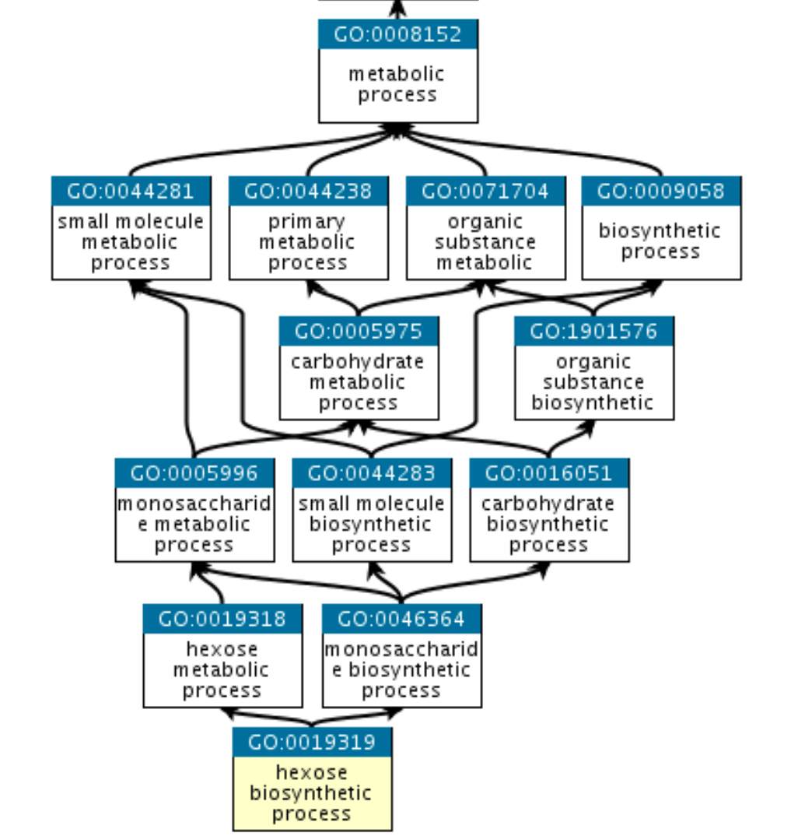
Types of functional annotation
Gene Ontology: broad functional categories – (i) Cellular Component (ii) molecular function (iii) biological process
Organized on different levels, with a father/child scheme
Very useful for «model» organisms, but somewhat inaccurate for non-model species (e.g. strong bias towards mouse/human)

Slide 32
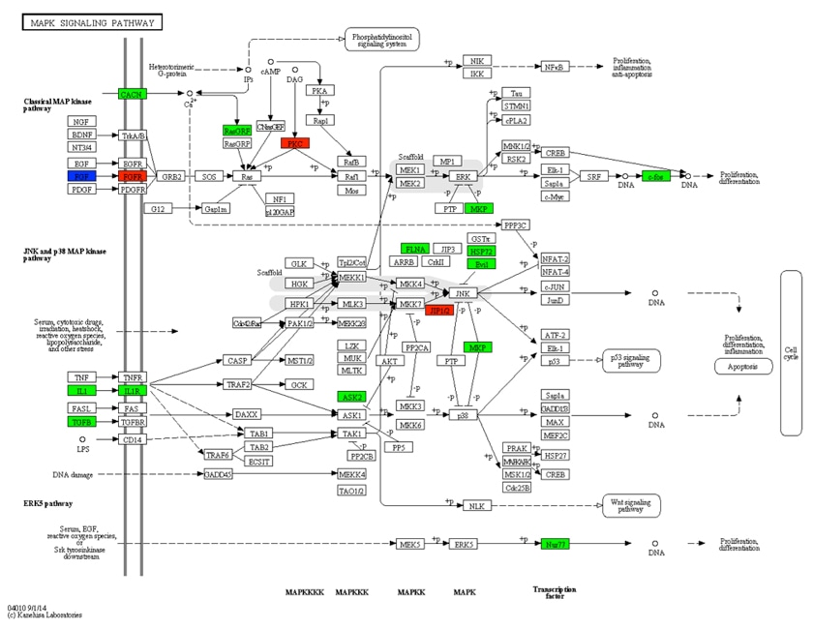
Types of functional annotation
KEGG: «metabolic» annotation
Sequences are included in complex regulatory networks
Genes (and proteins) can be assigned Enzyme Commission (EC) annotations, which have a strong biochemical meaning

