Slide 1
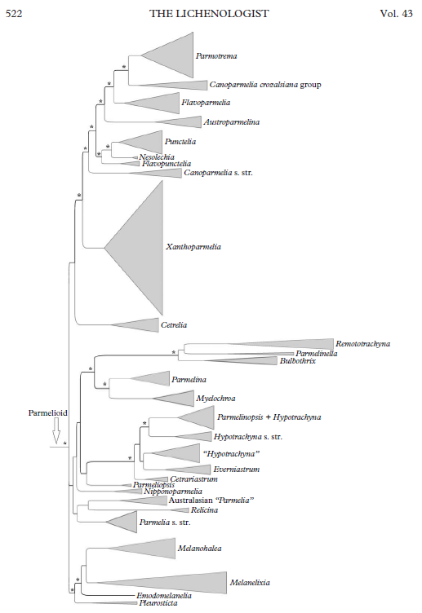
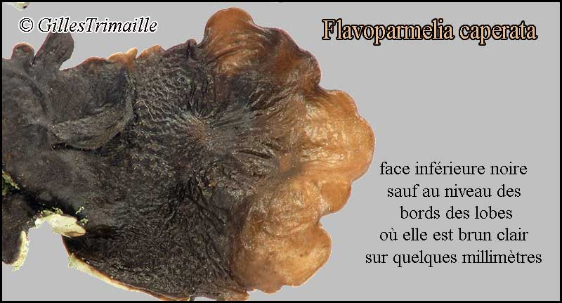
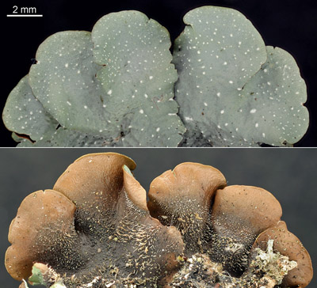
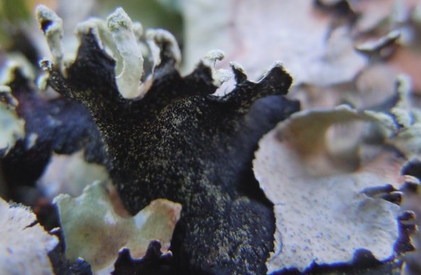
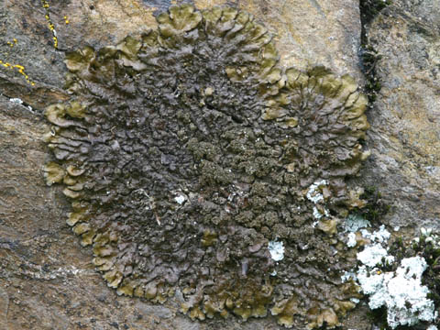
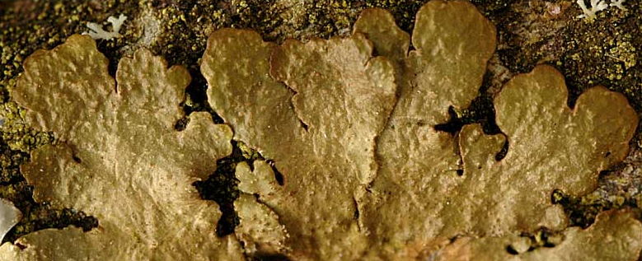
2) Melanins
Parmotrema
Flavoparmelia
Punctelia
Xanthoparmelia
“Atranorin and usnic acids are the compounds responsible for the grey and yellow green upper surface, respectively, in parmelioid lichens. Likewise, brown to almost black surfaces are due to melanins.”.
Melanelixia
Crespo, A., Divakar, P. K., & Hawksworth, D. L. (2011). Generic concepts in parmelioid lichens, and the phylogenetic value of characters used in their circumscription. The Lichenologist, 43, 511-535.

Slide 2
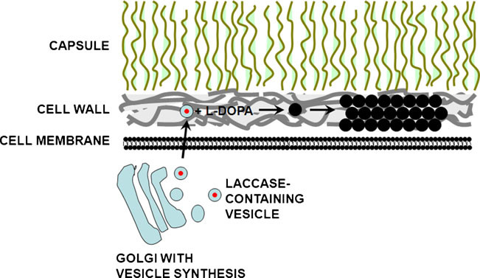
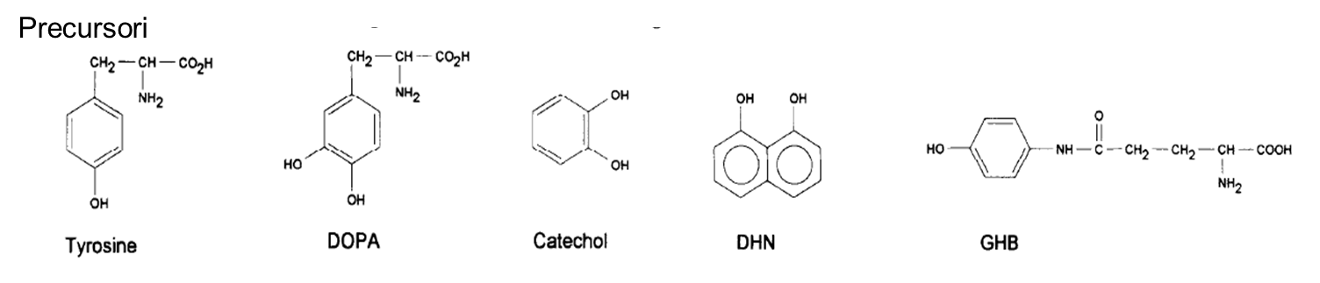
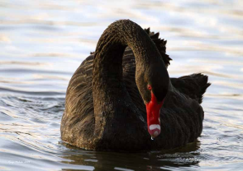
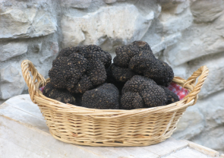
Eumelanine
Allomelanine
Eisenman, H. C., & Casadevall, A. (2012). Synthesis and assembly of fungal melanin. Applied microbiology and biotechnology, 93, 931-940.
Heterogeneous melanins: in fungi they are biosynthesise in the extracellular medium through an auto-polymerization process of intracellular melanin precursors (e.g. DHN-melanins) with other extracellular phenolic compounds produced by surrounding organisms.
Most of the epigeic and epilithic lichens of the order Peltigerales were found to possess both laccase and tyrosinase activities; the lichens of the order Lecanorales possessed only laccase activity, which was an order of magnitude lower than that of Peltigerales.
Zavarzina, A. G., & Zavarzin, A. A. (2006). Laccase and tyrosinase activities in lichens. Microbiology, 75, 546-556.

Slide 3
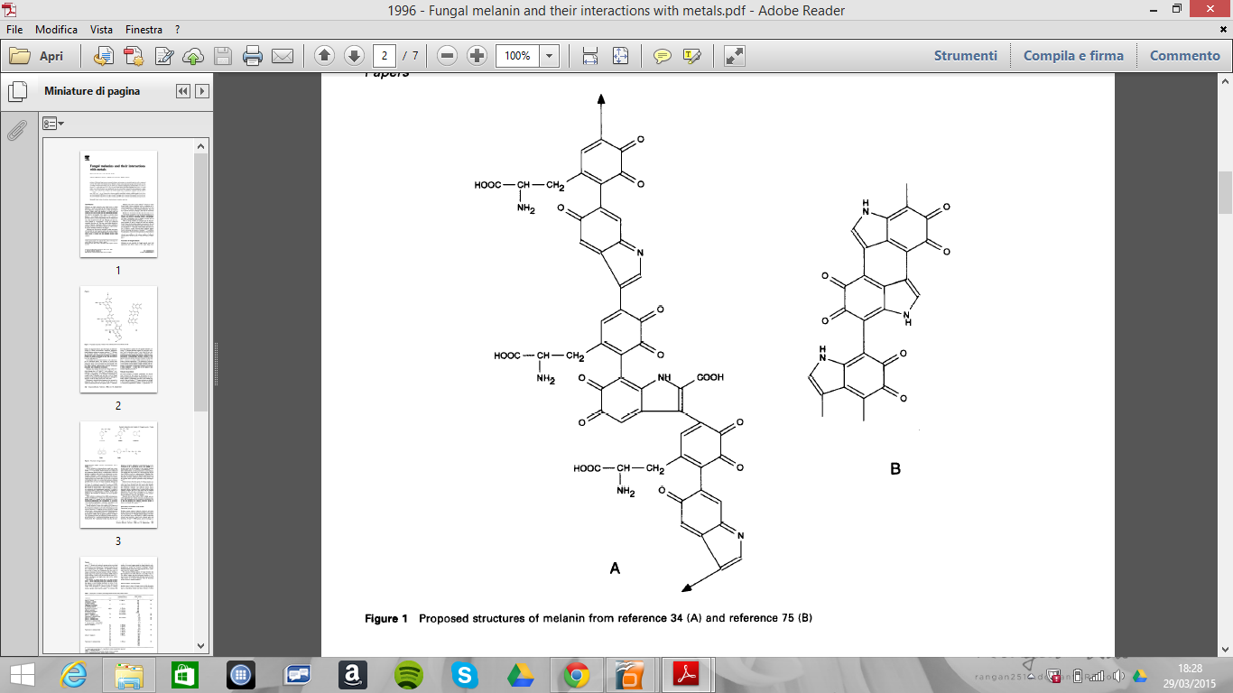
Melanins can be composed by several molecular components such as: phenolic units, proteins, carbohydrates, alifatic hydrocarbons and fatty scids
Saiz-Jimenez C, Shafizadeh F (1984) Iron and copper binding by fungal phenolic polymers: an electron spin resonance study. Curr Microbiol, 10, 281-286
Water-insoluble
Resistance to biodegradable
Antimicrobial properties
Icrease the cell-wall rigidity
Complexation of metal ion
Fogarty, R. V., & Tobin, J. M. (1996). Fungal melanins and their interactions with metals. Enzyme and Microbial Technology, 19, 311-317.

Slide 4
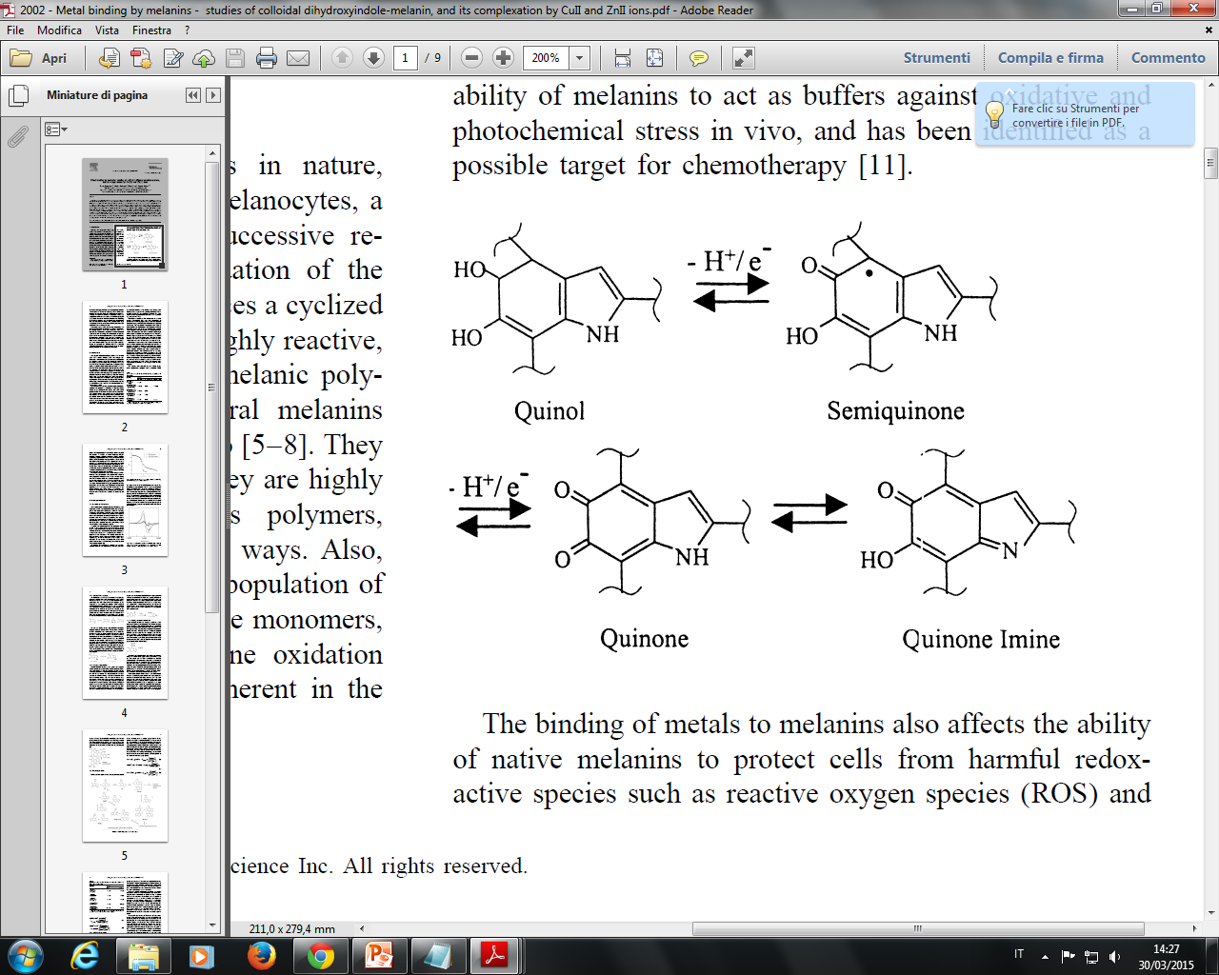
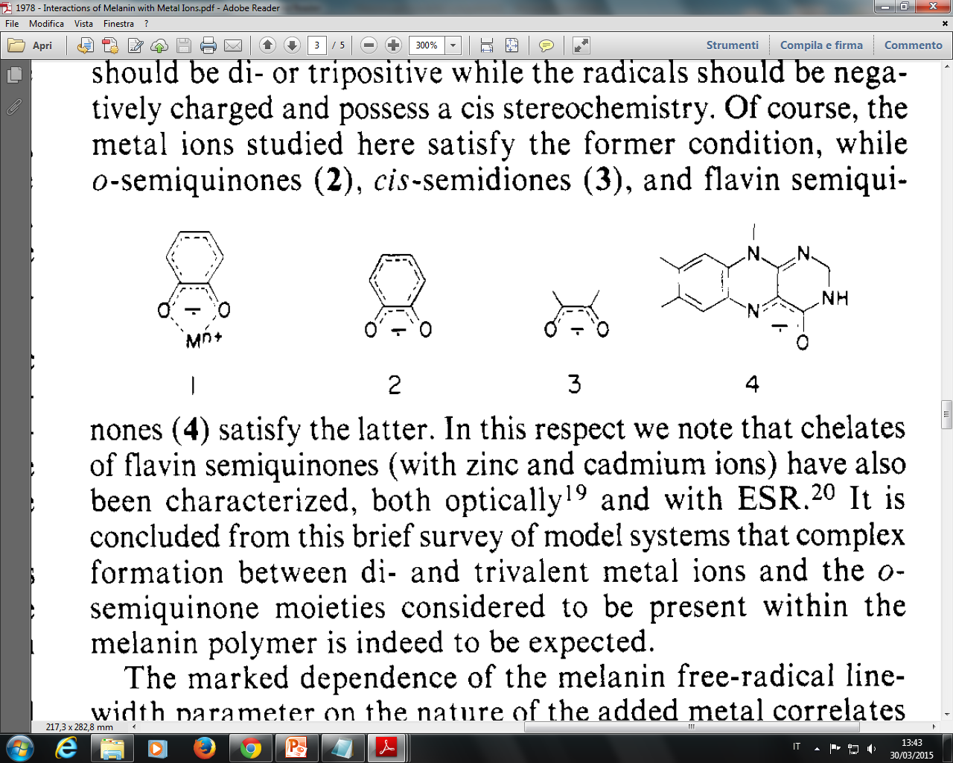
Eumelanins
Szpoganicz, B., Gidanian, S., Kong, P., & Farmer, P. (2002). Metal binding by melanins: studies of colloidal dihydroxyindole-melanin, and its complexation by Cu (II) and Zn (II) ions. Journal of inorganic biochemistry, 89, 45-53.
o-benzosemiquinone
cis-semiquinone
o-semidione
flavin semiquinone
Felix, C. C., Hyde, J. S., Sarna, T., & Sealy, R. C. (1978). Interactions of melanin with metal ions. Electron spin resonance evidence for chelate complexes of metal ions with free radicals. Journal of the American Chemical Society, 100, 3922-3926.

Slide 5
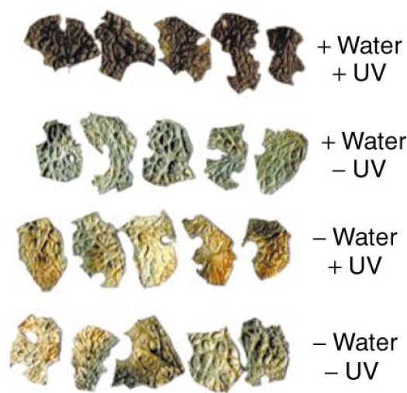
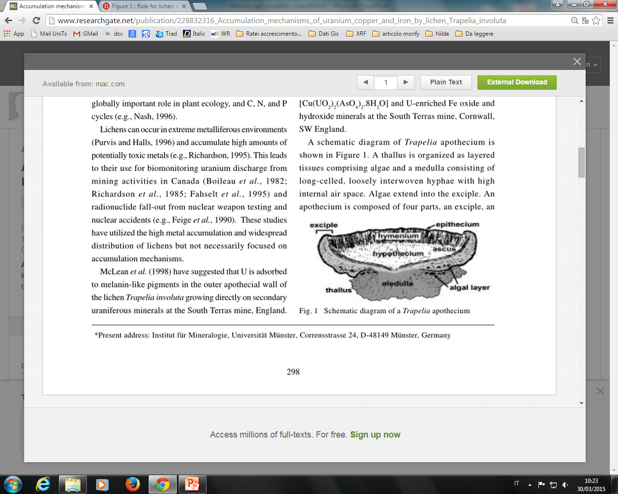
In lichens, melanogenis can occur during thallus ageing (e.g. lower cortex) or at specific hyphal layers involved in reproduction structure (e.g. exciple).
Melanin synthesis can be induced by environmental stress such as high solar irradiation.
Kasama, T., Murakami, T., & Ohnuki, T. (2003). Accumulation mechanisms of uranium, copper and iron by lichen Trapelia involuta. In Proceedings of the 8th International Symposium on Biomineralization (pp. 298-301).
Solhaug, K. A., Gauslaa, Y., Nybakken, L., & Bilger, W. (2003). UV‐induction of sun‐screening pigments in lichens. New Phytologist, 158, 91-100.

Slide 6
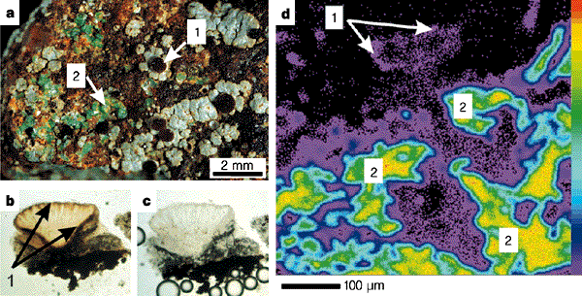
Melanin-metal ions interactions
Lichen concentrating Uranium. a, Trapelia involuta (1) with dark brown apothecia growing on metazeunerite (Cu(UO₂)₂(AsO₄)₂.8H₂O) (2); b, transverse section of T. involuta apothecia showing pigmented wall, without treatment with sodium hypochlorite; c, the same section with wall decolorized by irrigation with sodium hypochlorite; d, X-ray element map showing uranium accumulation (1) in apothecia wall of T. involuta growing on metazeunerite (2).
McLean, J., Purvis, O. W., Williamson, B. J., & Bailey, E. H. (1998). Role for lichen melanins in uranium remediation. Nature, 391, 649-650.

Slide 7
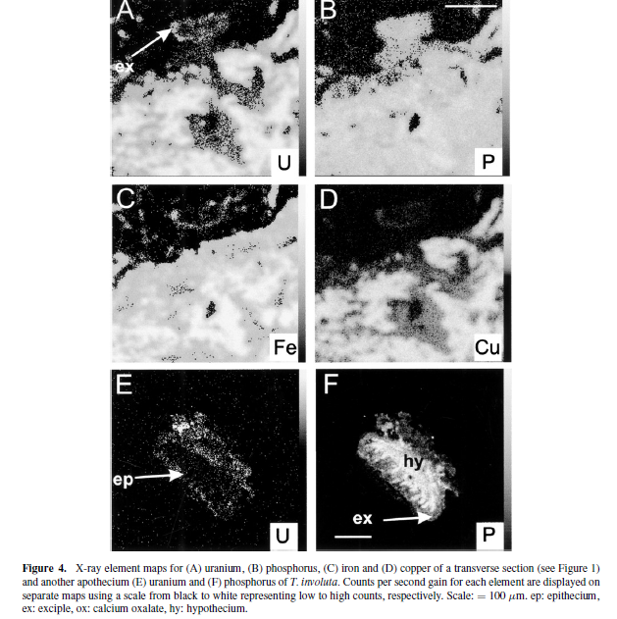
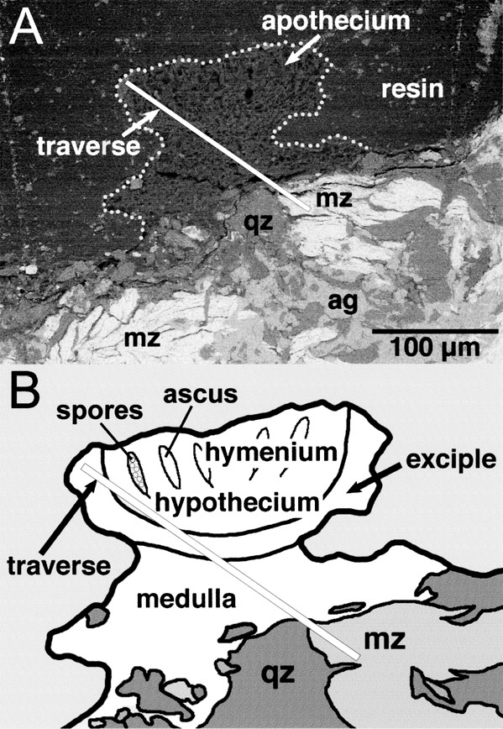
Melanin-metal ions interactions
0
Purvis, O. W., Bailey, E. H., McLean, J., Kasama, T., & Williamson, B. J. (2004). Uranium biosorption by the lichen Trapelia involuta at a uranium mine. Geomicrobiology Journal, 21(3), 159-167.

Slide 8

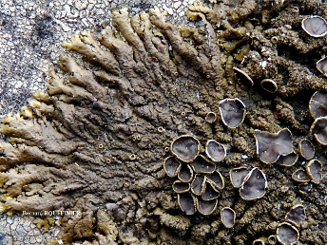
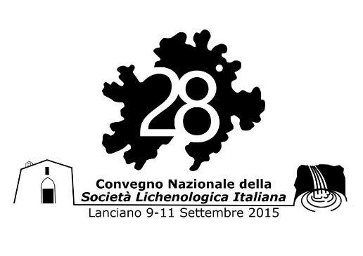




Which is the influence of melanin-like compounds in trace element accumulation?
1) MELANISATION AFFECTS THE CONTENT OF SELECTED ELEMENTS IN PARMELIOID LICHENS
Fortuna L, Baracchini E, Adami G, Tretiach M - 2017
J Chem Ecol
published on J Chem Ecol

Slide 9
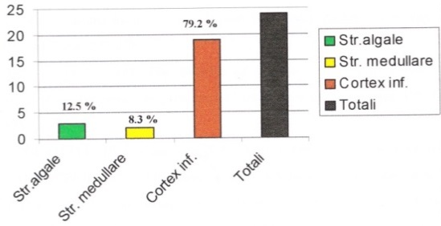
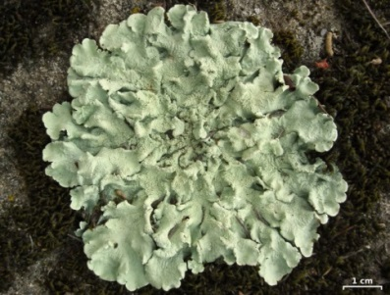
MELANISATION AFFECTS THE CONTENT OF SELECTED ELEMENTS IN PARMELIOID LICHENS
Introduction and scope
Previous data:
Flavoparmelia caperata (L.) Hale
Andreussi, S. (2000). Bioaccumulo di metalli in traccia nei licheni. Applicazione e metodologie. Tesi di laurea, Università degli Studi di Ferrara, Facoltà di Scienze Matematiche, Fisiche e Naturali, Corso di laurea in Scienze Biologiche, rel. P. L. Nimis. (ined.)
Scope: evaluate the differences among the micronutrients (Fe, Mn e Zn) contents of 10 lichen species (7 parmelioid species), characterized by a different degree of melanisation in their cortices.

Slide 10
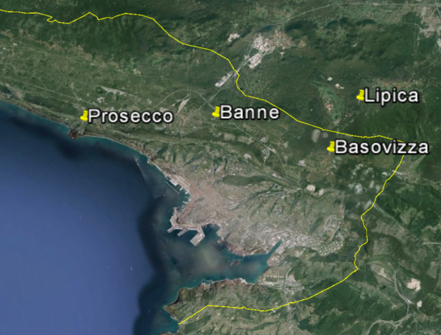
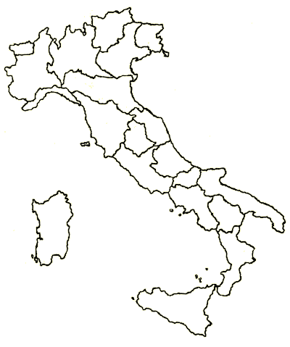
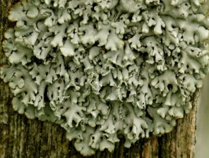
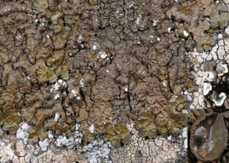
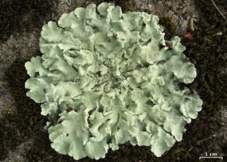
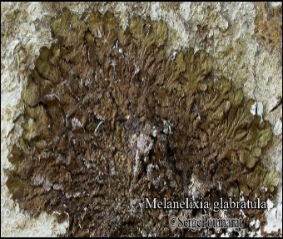
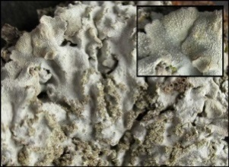
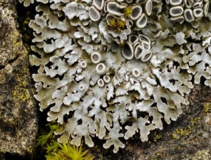
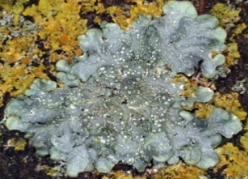
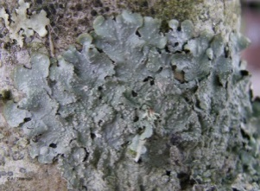
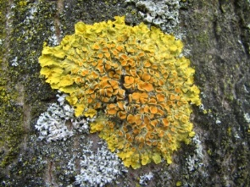
MELANISATION AFFECTS THE CONTENT OF SELECTED ELEMENTS IN PARMELIOID LICHENS
Material and methods – Species selection
1
1: Hypogymnia physodes
2
3
4
6
7
2: Xanthoparmelia loxodes
5
8
9
3: Flavoparmelia caperata
4: Melanelixia glabratula
5: Punctelia borreri
6: Physconia grisea
7: Physconia distorta
8: Punctelia subrudecta
9: Xanthoria parietina
Blue and red text refer to species belonging to the family of Parmeliaceae and to the order of Teloschistales, respectively.

Slide 11






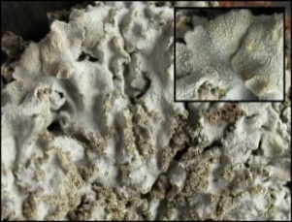
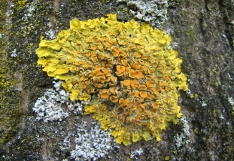
MELANISATION AFFECTS THE CONTENT OF SELECTED ELEMENTS IN PARMELIOID LICHENS
Material and methods – Species selection
Selection of 9 species whose external surfaces were characterised by a different degree of melanisation
Two-side heavily melanised
X. loxodes
M. glabratula
Ph. distorta
One-side heavily melanised
F. caperata
H. physodes
P. borreri
One-side lightly melanised
P. subrudecta
Ph. grisea
Non-melanised
X. parietina

Slide 12
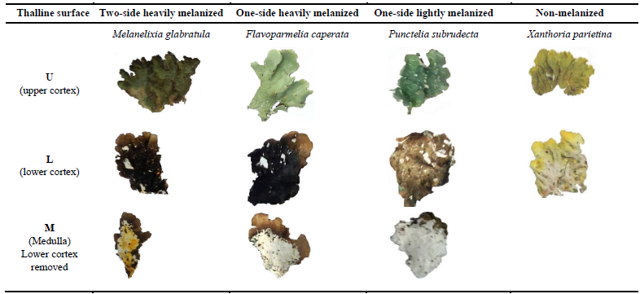
MELANISATION AFFECTS THE CONTENT OF SELECTED ELEMENTS IN PARMELIOID LICHENS
Material and methods – Example of degree of melanisation
Fortuna, L., Baracchini, E., Adami, G., & Tretiach, M. (2017). Melanization Affects the Content of Selected Elements in Parmelioid Lichens. Journal of chemical ecology, 43(11-12), 1086-1096.

Slide 13
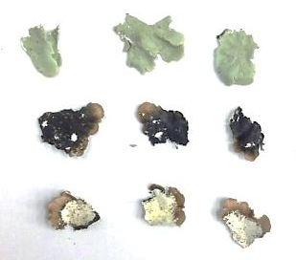
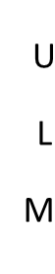
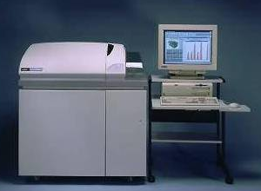
MELANISATION AFFECTS THE CONTENT OF SELECTED ELEMENTS IN PARMELIOID LICHENS
Material and methods – Chemical analyses
1) ED µ-XRF (relative abundance of Ca, K, Fe, Mn, S, Zn)
2) ICP-AES (concentration of Ca, K, Fe, Mn, Zn)
U + L
M’
3) Sequential Elution Technique (SET)
Intercellular (A): H₂0
Extracellular (B): Na₂-EDTA
Intracellular (C): HNO₃
Residual (D): HNO₃+H₂0₂+HF

Slide 14
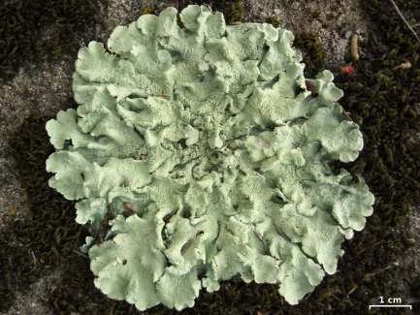
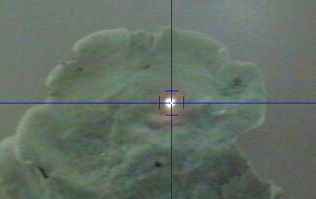
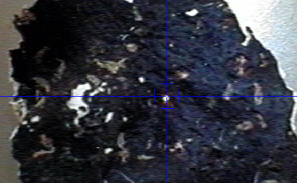
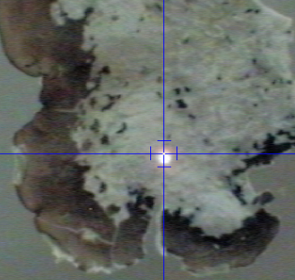
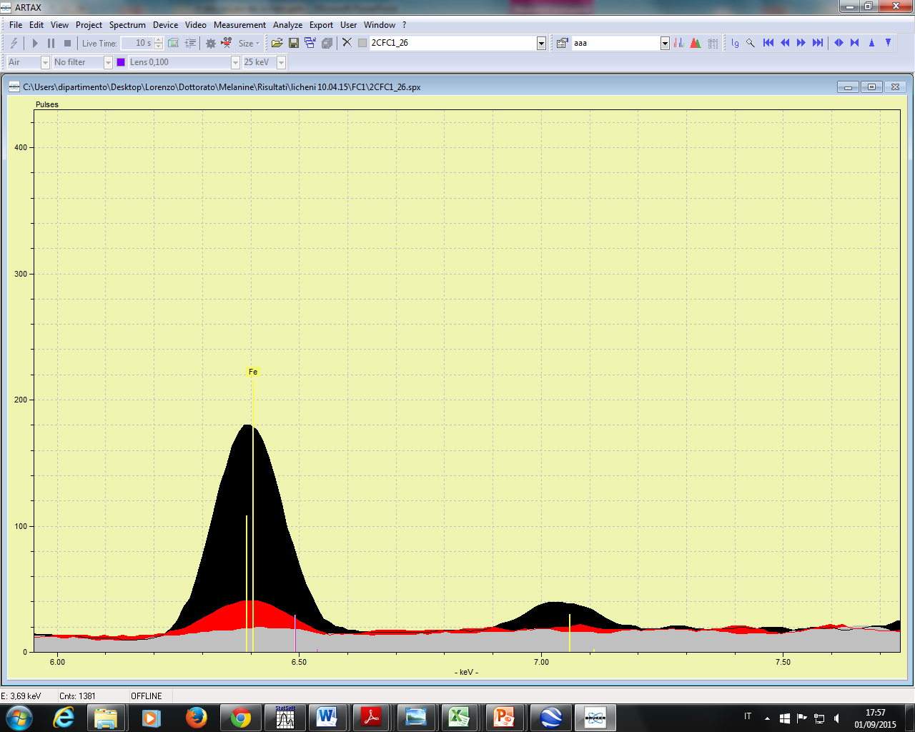
MELANISATION AFFECTS THE CONTENT OF SELECTED ELEMENTS IN PARMELIOID LICHENS
Material and methods – Semi-quantiative chemical analyses
Energy Dispersive µ X-ray Fluorescence (ED µ-XRF)
The elemental content of each thalline surface (sample U: Upper cortex; M: Medulla; L: Lower cortex) has been measured with a semi-quantitative techniques.

Slide 15
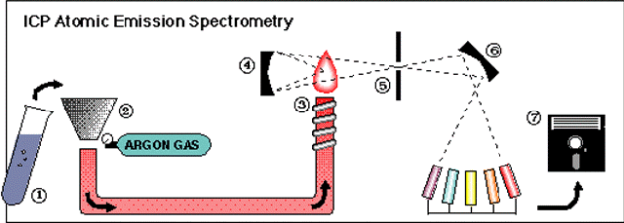
MELANISATION AFFECTS THE CONTENT OF SELECTED ELEMENTS IN PARMELIOID LICHENS
Material and methods – Quantitative chemical analyses
After ED µ-XRF measurements lobe samples has been reorganised in two series of samples with (U+L samples) or without melanised lower cortex (M’ samples), respectively. These samples was analysed with ICP-AES.
U + L
M’
Inductively Coupled Plasma Atomic Emission Spectrometry (ICP-AES)
“(1) aqueous sample is pumped and (2) atomized with argon gas into the (3) hot plasma. The sample is excited, emitting light wavelengths characteristic of its elements. (4) A mirror reflects the light through the (5) entrance slit of the spectrometer onto a (6) grating that separates the element wavelengths onto (7) photomultiplier detectors.”

Slide 16
MELANISATION AFFECTS THE CONTENT OF SELECTED ELEMENTS IN PARMELIOID LICHENS
Material and methods – Chemical analyses
Sequential Elution Technique (SET)
A – Intercellular: H₂0 (10 mL)
B – Extracellular: Na₂-EDTA (10 mL; 20 mM)
C – Intracellular: HNO₃ (10 mL; 1M)
D – Residual: HNO₃+H₂0₂+HF
M. glabratula
P. subrudecta
~ 100 mg
Thermic treatment
80°C 24h
Acid mineralization
H₂0
Na₂-
EDTA
HNO₃
A
B
C
D
Acid mineralization
ICP analyses

Slide 17
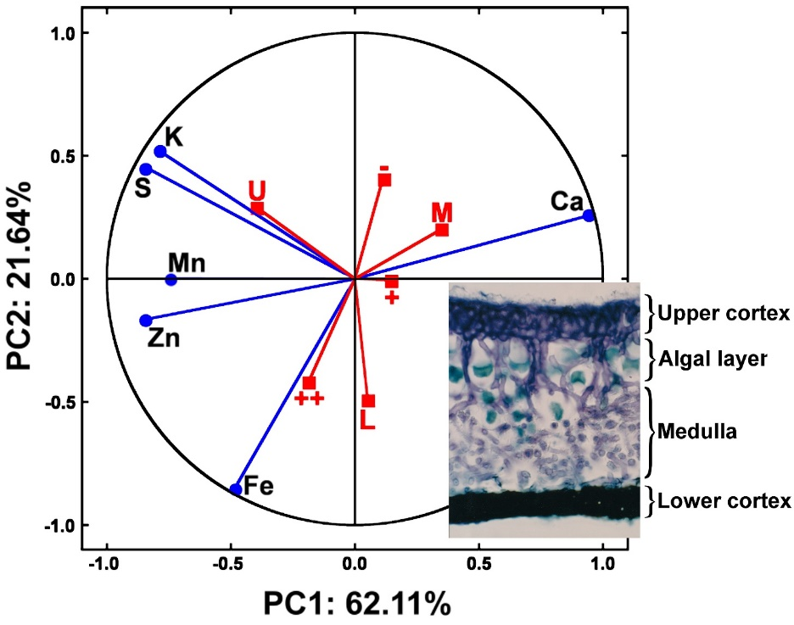
MELANISATION AFFECTS THE CONTENT OF SELECTED ELEMENTS IN PARMELIOID LICHENS
Result – ED-µXRF analyses on Parmeliaceae species
ED µ-XRF
++
+
-
U
M
L

Slide 18
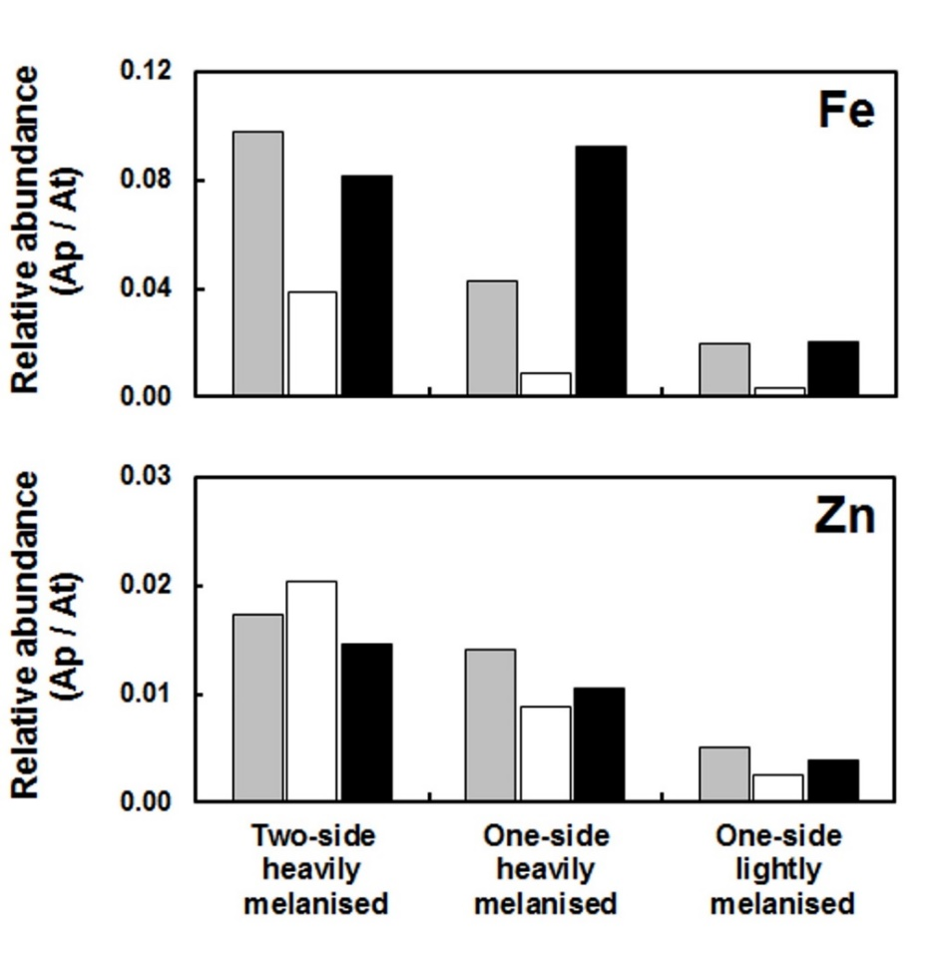
MELANISATION AFFECTS THE CONTENT OF SELECTED ELEMENTS IN PARMELIOID LICHENS
Result – ED-µXRF analyses on Parmeliaceae species
ED µ-XRF
U
M
L

Slide 19
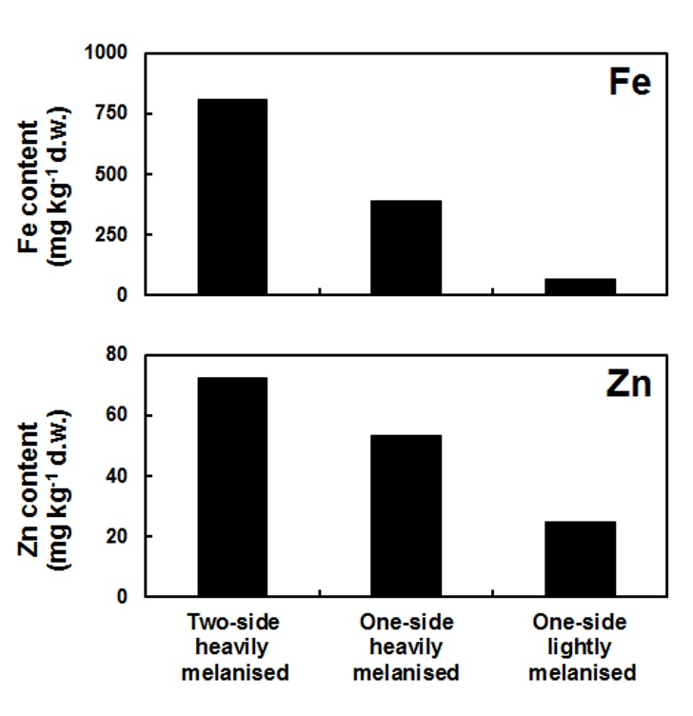
MELANISATION AFFECTS THE CONTENT OF SELECTED ELEMENTS IN PARMELIOID LICHENS
Result – ICP-AES analyses on Parmeliaceae species
ED µ-XRF
ICP-AES

Slide 20
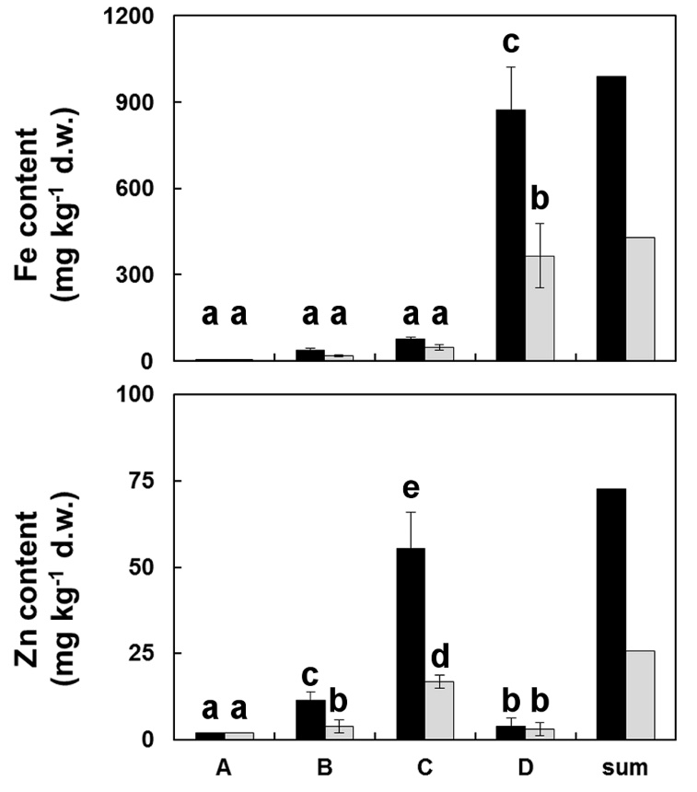
MELANISATION AFFECTS THE CONTENT OF SELECTED ELEMENTS IN PARMELIOID LICHENS
Result – SET
P. subrudecta (one-side lightly melanised)
M. glabratula (two-side heavily melanised)
The trends of the concentrations of Fe and Zn measured in the four fractions were similar in both species.
In the mutual comparison, the highly two-side heavily melanised M. glabratula contained more Fe and Zn than the one-side lightly melanised P. subrudecta.
H₂0
Na₂-
EDTA
HNO₃

Slide 21
MELANISATION AFFECTS THE CONTENT OF SELECTED ELEMENTS IN PARMELIOID LICHENS
Conclusion
Heavily melanised species of foliose lichens are characterized by higher content of Fe and Zn when compared with lightly melanised ones.
In the context of lichen biomonitoring survey, lichen samples should be composed by lichen material with a homogeneous degree of melanisation
Melanins could effectively improve Zn retention in the extracellular fraction of the melanised thalline surface(s), thus increasing the intracellular fraction, not only of the cells close to the melanised cortical layers but of the whole thallus
Melanised thalline surfaces might act as a reservoir pool of Fe to be assimilated by the mycobiont at a later stage.

Slide 22
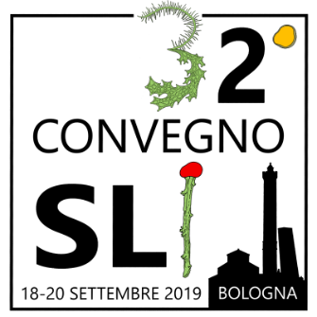



Which is the role of melanin-like compounds in parmelioid lichens?
2) MELANIZATION IN PARMELIOID LICHENS AS A PASSIVE DEFENSE MECHANISM AGAINST MICROBIOLOGICAL DEGRADATION
Fortuna L.¹*, Ongaro S.¹, Foscari A.² , Incerti G.², Martellos S.¹, Tretiach M.¹
¹Dipartimento di Scienze della Vita, Università di Trieste, via L. Giorgieri, 10, 34127 Trieste
²Dipartimento di Scienze Agroalimentari, Ambientali e Animali, Università di Udine, via delle Scienze, 206, 33100 Udine

Slide 23




Scope
We hypothesized that the heavily melanized lower cortex of Hypogymnia physodes (L.) Nyl. (Parmeliaceae) could act as a passive defense mechanism against degradation processes.
Hypogymnia physodes
Burial experiment
Samples of H. physodes with or without melanised lower cortex were devitalized by heat shock treatment, enveloped in plastic mesh of 50 µm and burried in plastic vessels containing two type of forest soils.
Lower cortex removal from 50% of samples .
Devitalization by heat shock treatment (60°C for 24 h).

Slide 24


Soil sample pre-treatment
Sieving at 3 mm and oven drying at 40°C for 4 days.
Hydration up to 30% on dry mass basis .
Overall were prepare 80 samples, 60 of them were buried in controlled condition in the two forest soils for different times according to the following experimental design.
 | Chestnut soil forest |  |  | Spruce soil forest
 | M+ | M- |  | M+ | M-
T0 | 5 | 5 |  | 5 | 5
T1 | 5 | 5 |  | 5 | 5
T2 | 5 | 5 |  | 5 | 5
T3 | 5 | 5 |  | 5 | 5

Slide 25
Data collection
Lichen degradation, soil water potential and the content of both carbon and nitrogen in lichen samples were measured every 50 days (T1-T3)
Water potential and Relative Water Content (RWC%) of both chestnut and spruce soil forest were assessed with a dew point meter.
Lichen degradation: 5 M+ and M- samples were retrieved from the vessels, dried for 48h over silica and then reweighed. Lichen degradation was expressed as relative difference with the initial weight (mass loss%).
Carbon and nitrogen analysis: three out of the five samples were analysed with a CHN analyser (Elementar Vario Micro) after being pulverized with a mixer mill.

Slide 26

Experimental conditions during the burial experiment
T1
T2
T3
RWC %
days
RWC% of chestnut and spruce forest soils.

Slide 27

Lichen samples showed a significant biomass loss and a C/N decrease throughout the experiment in all treatment combinations. Independently of the soil forest type, mass loss was higher in M- samples (-15%). Difference between the C/N ratio was higher in samples buried in chestnut forest soil (~40%) than the others (~5%). At each retrieval time, M- samples were more fragmented than M+ ones.
This coupled with biomass loss measurements, clearly indicate that a melanized lower cortex is more resistant to degradation processes.

Slide 28
Which is the influence of melanin-like compounds in trace element accumulation?
2) MELANIZATION IN PARMELIOID LICHENS AS A PASSIVE DEFENSE MECHANISM AGAINST MICROBIOLOGICAL DEGRADATION
Fortuna L.¹*, Ongaro S.¹, Foscari A.² , Incerti G.², Martellos S.¹, Tretiach M.¹
¹Dipartimento di Scienze della Vita, Università di Trieste, via L. Giorgieri, 10, 34127 Trieste
²Dipartimento di Scienze Agroalimentari, Ambientali e Animali, Università di Udine, via delle Scienze, 206, 33100 Udine

Slide 29
Scope
We hypothesized that the heavily melanized lower cortex of Hypogymnia physodes (L.) Nyl. (Parmeliaceae) could act as a passive defense mechanism against degradation processes.
Hypogymnia physodes
Spectrophotometric assay
Samples of H. physodes with or without melanised lower cortex were devitalized by heat shock treatment and then soaked in aqueous solution of H₂O₂ 12.5 µM.
The consumption of H₂O₂ in the acqueous solution was assed with a spectrophotometric assay based on the use of the AMPLEX RED ® reagent, which react with H₂O₂ molecules in a ratio 1:1.

Slide 30
What we observed:
Samples equipped with the melanised lower cortex consume more H2O2 than the other samples. Probably the lichen melanins are involved in protecting lichen thallus by microbial attacks.

