Slide 1
GENOME BROWSERS
In the previous lection we have talked about sequence annotation (functional and structural)
However, genomes are large and complex and visualizing this information is not easy
You need to imagine that the raw annotation information, by itself, can be contained in a text file, which could include positional information (coordinates relative to the reference genome) and different features (e.g. annotation type – gene, mRNA, intron/exon, variant, UTR, etc.)
Genome browsers are tools that enable an integration of sequence and annotations, making this information available to a graphical user-friendly interface
N.B. Here we will only study examples of genome browsers, but keep in mind that visualization tools based on similar concepts can be also developed for the visualization of transcriptomics and proteomics data

Slide 2
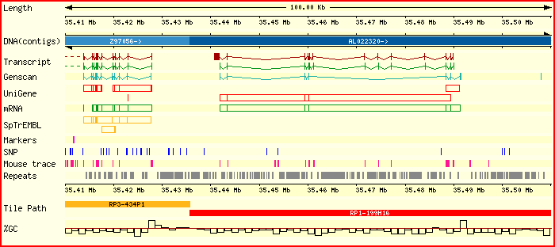
But how can we efficiently represent in a graphically informative way a genome of over 3 billion base pairs?
Jim Kent, one of the best genome scientists in the world, describing in a press conference the human genome:
«Well, it has a lot of G, C, A and Ts”
This is true: without annotation, genome data will not tell us much about the functional significance of nucleotides

Slide 3
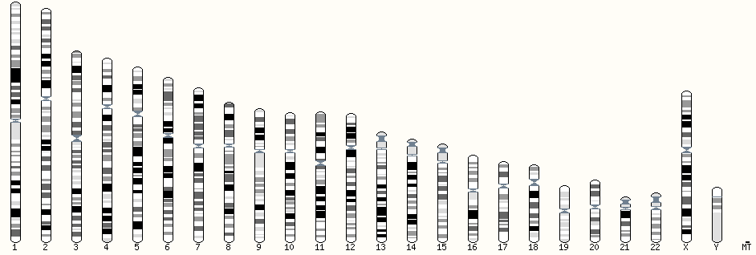
The human genome contains an enormous amount of information…
The genome assembly in Ensembl is currently 3,609,003,417 base pairs
It includes 20,418 protein-coding genes, 22,107 non-coding genes and 15,195 pseudogenes, with over 200,000 transcripts!

Slide 4
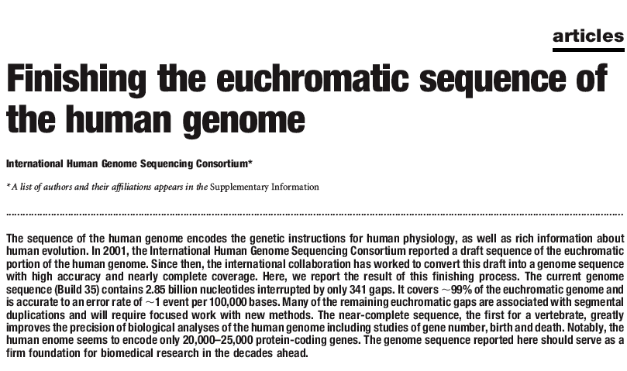
The product of many years of work cannot lead to results that are easily accessible to the «casual user», who might not be an expert in big data and bioinformatics
Genome Browsers have been developed to:
Explore chromosomal regions
Explore regulatory regions flanking genes (i.e. promoters, enhancers, etc.)
Perform searches (using keywords and/or positional coordinates) at the whole-genome scale
Stydy genome architecture
Comparing genome architecture n different organisms (comparative genomics)

Slide 5
GENOME BROWSERS – AVAILABILITY
ENSEMBL – the example we are going to explore in the bioinformatics lab
http://www.ensembl.org/index.html
2) UCSC genome Browser Gateway
https://genome-euro.ucsc.edu/cgi-bin/hgGateway?
3) NCBI Genome Data Viewer
https://www.ncbi.nlm.nih.gov/genome/gdv/
4) Custom genome browser, usually linked to specific genome sequencing project and dedicated to target species

Slide 6
WHAT KIND OF INFO ARE AVAILABLE IN A GENOME BROWSER?
«BASIC» ANNOTATIONS, LINKED TO COORDINATES, WITH RESPECT WITH A GIVEN CHROMOSOME
Genes (introns, exons, 5’ and 3’ UTR)
Transcripts (including alternative splicing isoforms, with CDS and UTR details)
Non-coding RNAs (rRNA, tRNA, lncRNAs, ecc.)
Pseudogenes
Link to additional information (e.g. to a page with details about the protein encoded by a given mRNA)

Slide 7
WHAT KIND OF INFO ARE AVAILABLE IN A GENOME BROWSER?
«ADVANCED» ANNOTATIONS
Cytogenetic information (e.g. chromosome bands)
Genetic variants(SNPs, STRs, indels, etc.)
Repeated elements (LINE, SINE, DNA transposons, etc.; these are often «masked» in genomes, i.e. shown as long «N» stretches
Gene expression data (either from microarray or RNA-sequencing experiments)
Alignments with homologous genomic sequences from related species (comparative genomics tools)
And many many more…

Slide 8
ENSEMBL
Joint project from EBI and Wellcome Trust Sanger Institute, launched in 1999 right before the release of the human genome
Initially designed for model organisms genomes
Now includes over 80 genomes, with main focus on vertebrates
Includes man, mouse and zebrafish, among the otehrs
Drosophila, Caenorhabditis and yeast are available as «outgrops»

Slide 9
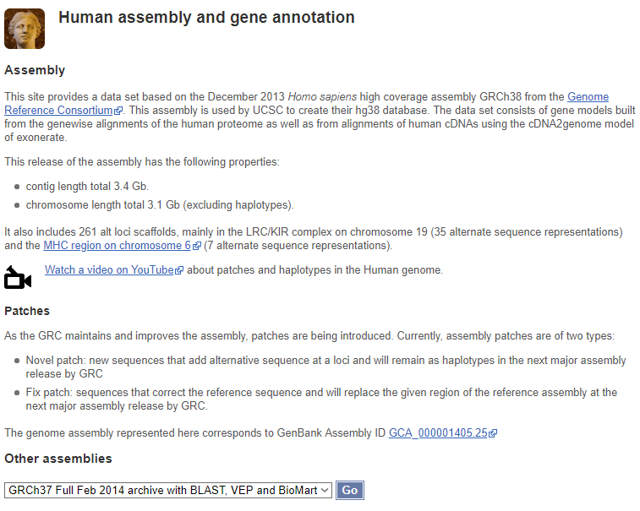
ENSEMBL – SOME NOTES
All Ensembl genomes have been annotated using the same consolidated pipeline (=with the same methodologies), ensuring the same high qualitative standards
Each genome is periodocally updated with new information- Hence, many annotation versions are available, characterized by a different code
The most recent release for the human genome is GRCh38.p12
Each new release may include new or remove previous annotations based on experimental evidence and improved in silico predictions
«More about this genebuild» will tell us much more about the main features of a genome

Slide 10
ANNOTATION MANAGEMENT SYSTEM
Every gene, mRNA, protein and exon has its own internal ID (see the box at the side), which allows their unique identification and linking to other tabs (e.g. a gene will be linked with many separate pages corresponding to the vatious mRNA splicing isoforms)
These IDs also allow internal searching with a user-friendly serch engine
INTERNAL ENSEML ID STRUCTURE
ENSG### Ensembl Gene ID
ENST### Ensembl Transcript ID
ENSP### Ensembl Peptide ID
ENSE### Ensembl Exon ID

Slide 11
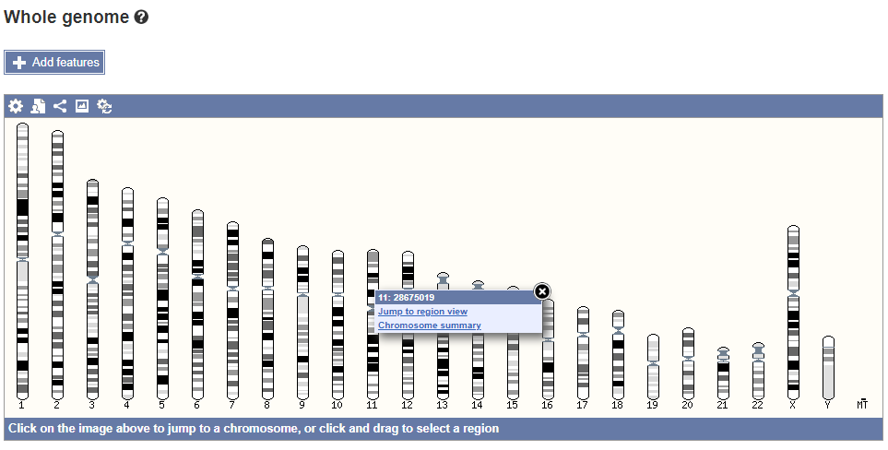
THE FIRST STEPS – GENOME VISUALIZATION
«view karyotype» allows us to inspect single chromosomes through chromosome summary

Slide 12
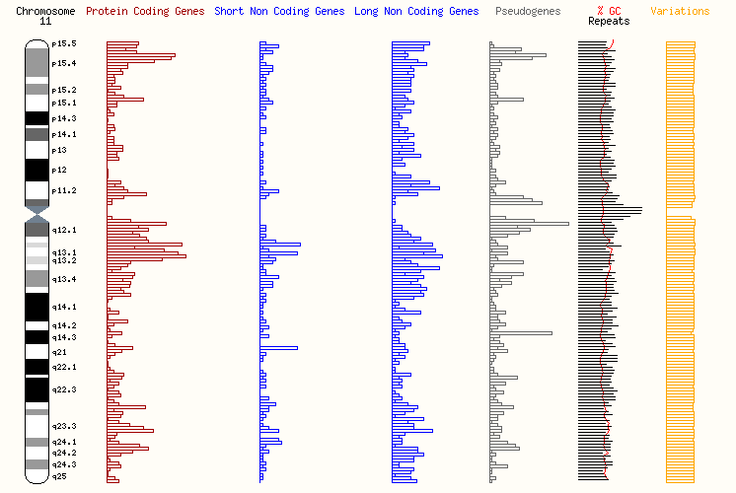
CHROMOSOME SUMMARY (I)
Banding overview
Gene density
Non-coding genes density (long and short)
Pseudogene density
GC content
Genetic variants density

Slide 13
CHROMOSOME SUMMARY (II)
Chromozome size (the size of the entire genome can be found from «more about this genebuild»)
Number of protein-coding and non-coding genes
Number of pseudogenes
Variant density

Slide 14
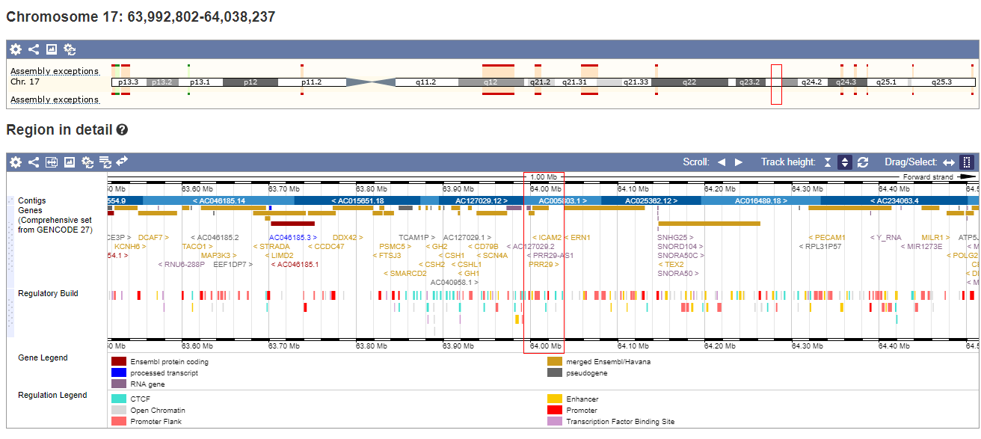
From the home page click on «example region»
What are we looking at? The red box tells us this (long arm of chromosome 17)
This region is zoomed in in the lower part of the graph
We can start to see some annotations, but we do have a second level of zooming-in (second red box)

Slide 15
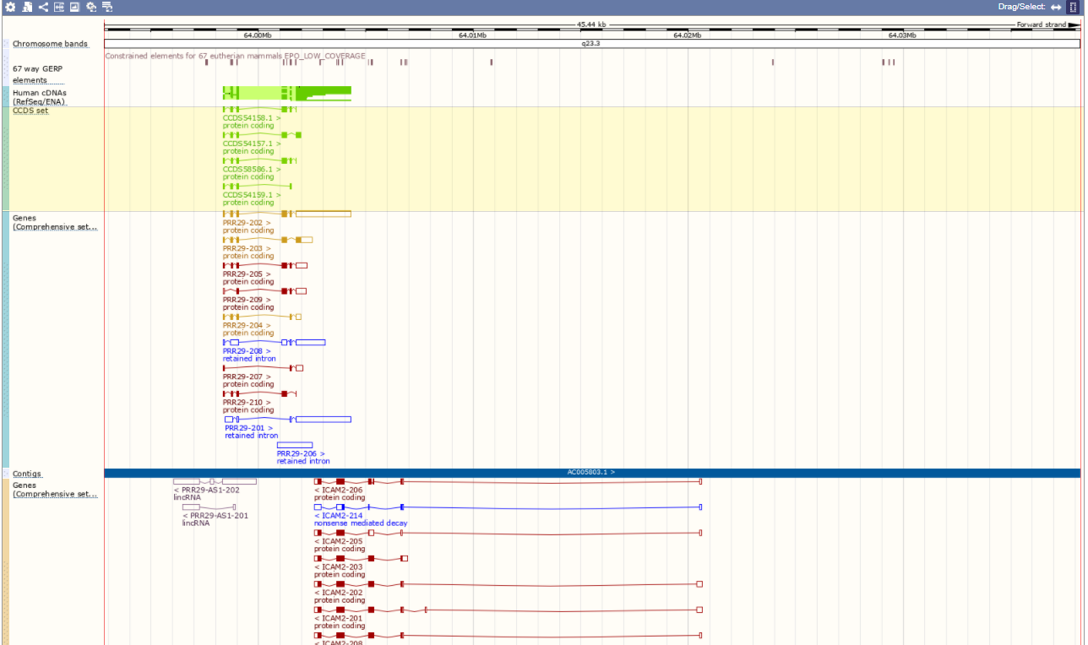
Let’s move below to see the higher level of zoom
GENE PRR29
Splicing variants
GENE ICAM2
Splicing variants
STRAND ORIENTATION + or – shown by > o < symbols
Antisense lncRNA

Slide 16
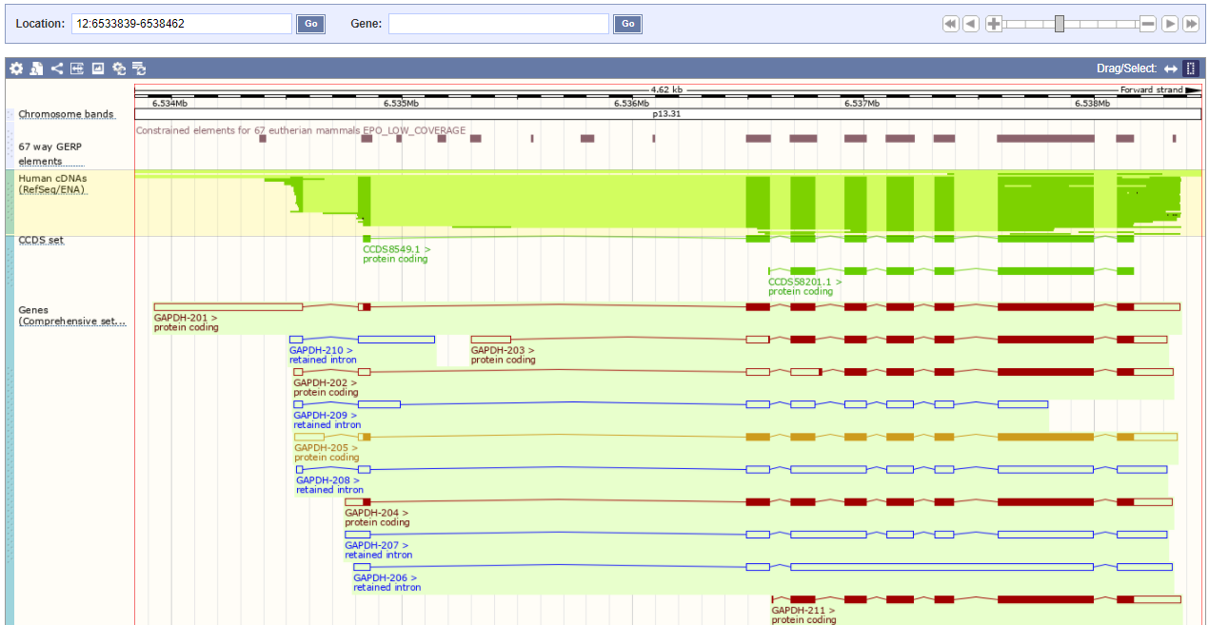
EXAMPE GENE: GAPDH
LOCALIZATION -> #CHROMOSOME: START-END NUCLEOTIDE POSITION
SEARCH BAR
ZOOM IN/OUT
SIDE SCROLL
GENOME COORDINATES
ALIGNMENT WITH KNOWN cDNAs, FOLLOWED BY mRNA ANNOTATIONS
RED AND ORANGE= mRNA ANNOTATED WITH DIFFERENT PREDICTION METHODS (ENSEBML o HAVANA)
BLUE: NON-CODING TRANSCIPTS (aberrant splicing, antisense transcription, etc.)
CDS is indicated by the fully-colored part of the boxes (from the ATG to the STOP codon)
THE «EMPTY» REGIONS are THE UTRs
> And < symbols indicate the coding strand

Slide 17
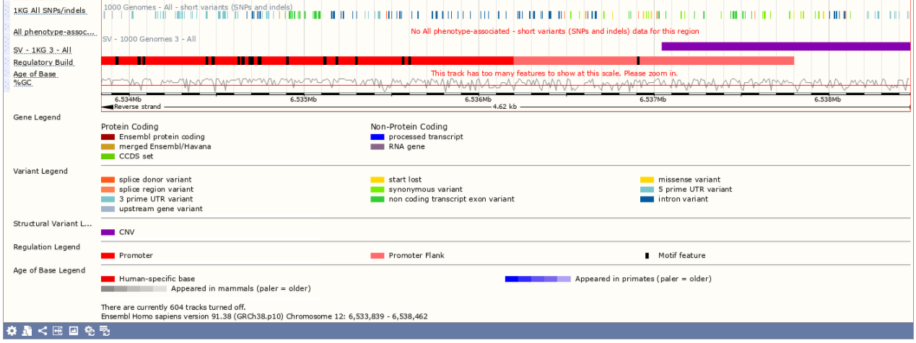
MORE ANNOTATIONS…
The part below displays some additional possibilities
A color legend clarifies the interpretation
SNP/indel map, regulatory elements, GC content, etc.
604 annotation «tracks» are «turned off» and hidden… we could show them by clicking on the gear symbol

Slide 18
TYPES OF ANNOTATION TRAKCS
Beisdes genes and transcripts…
Genetic variants (SNP and indels from genome resequencing projects)
Regulatory build: promoters, enhancers, eyc.
Comparative genomics tools
Each of such elements has its own ID and links to a detailed page

Slide 19
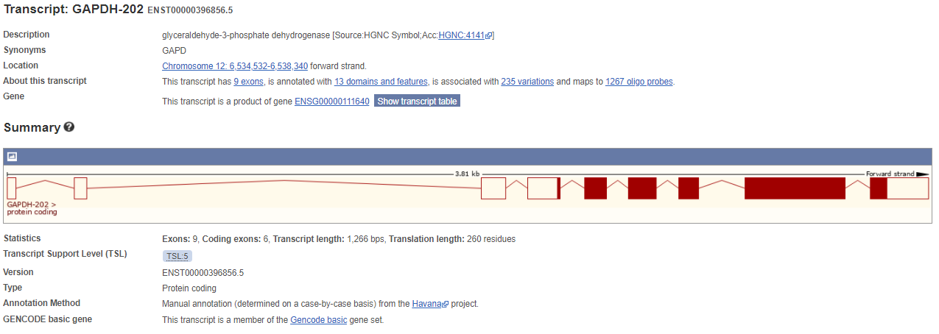
EXAMPLE: a mRNA detailed page
This type of visualization might be useful to study gene organization in detail
Cross references can be found here, linking the mRNA to genetic variants and other information

Slide 20
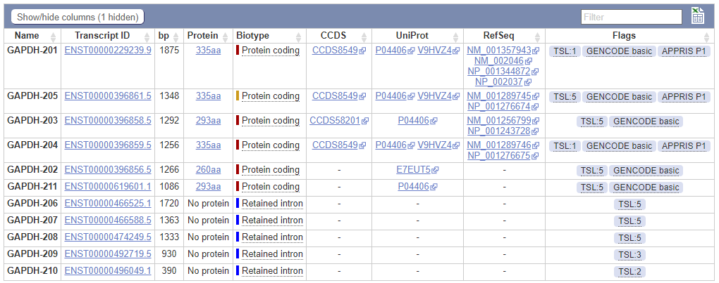
SCHEDA RELATIVA AD UN TRASCRITTO
«transcript table» shows all the alternative splicing isoforms, with their length, info about the encoded proteins and cross-reference to other databases
The Flags colums reports useful information, such as the TLS (transcript support level), which indicates hiw much can we «trust» the correctness of a mRNA annotation (from 1 to 5, with 1 being the highest and 5 being the lowest)

Slide 21
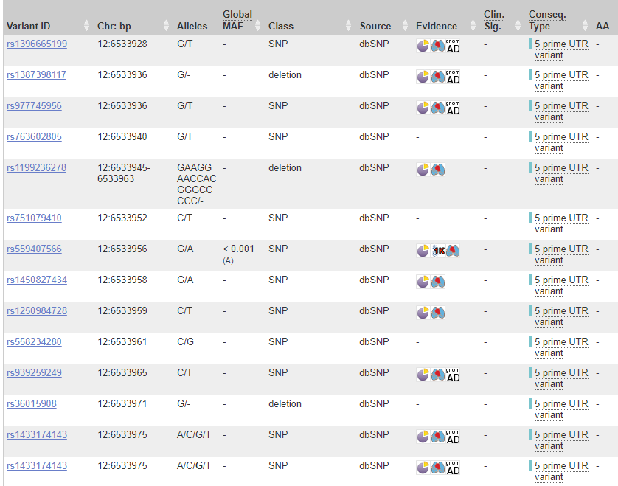
EXPLORING GENETIC VARIATION
Each gene is linked to known genetic variants, under the «variant table» link
The can be SNPs (single nucleotide polymorphsms), deletions or inseryions
Depending on their placement (5’ UTR, 3’ UTR or coding sequence), SNP can be either synonymous or non-synonymous
The variants are often linked with phenotypes or diseases-> «clinical significance» column

Slide 22
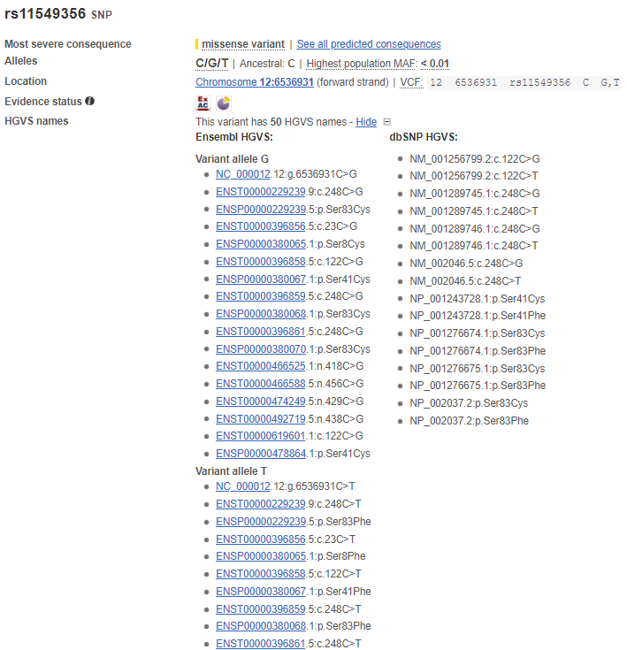
VARIANT DETAILS
Which transcrupts are affected?
Which proteins are effected?
Synonymous or not?
Which frequency does it show in human populations?
Is it associated with phenotypic variation or with a disease?
This page enables us to answer all these questions

Slide 23
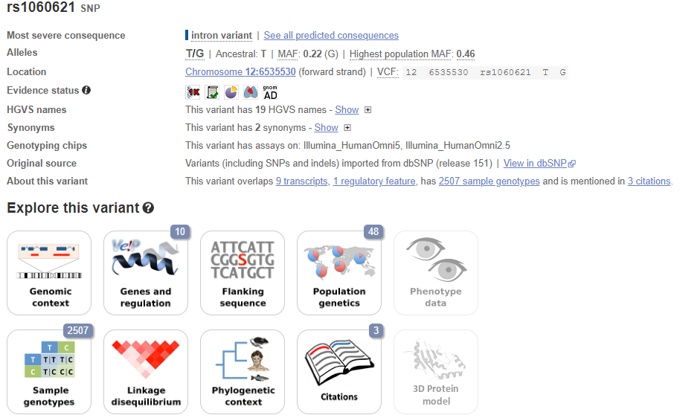
VARIANT DETAILS
Many links can be found below «explore this variant»: these might help to find out additional information
«population genetics» contains data about the frequency of a mutation in the general human population, or in a particular ethnic group
«citations» reports all available papers which report data about a given variant
«genes and regulation» reports the effects on gene expreson and localizes SNPs on mRNAs and proteins

Slide 24
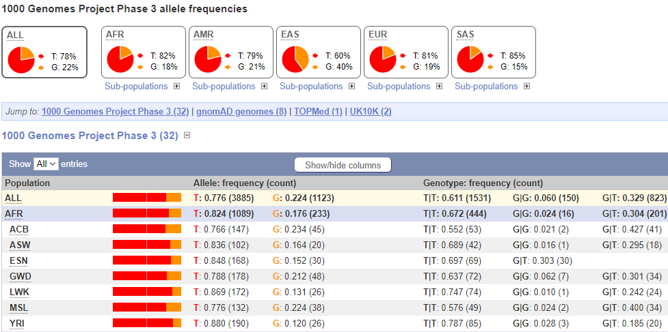
POPULATION GENETICS – ALLELIC AND GENOTYPE FREQUENCIES
Frequency data is organized in pie and histogram charts for the global population and several ethnic groups
These data are derived from whole genome resequencing projects. Both frequencies and absolute numbers are reported
Data derived from projects such as HapMap e 1000 Genomes Project, GnomAD, ecc.
Not all variants have known frequencies! We often do not have frequency data simply because a variant is extremely rare and it has been only descried in a very few cases in scientific literature

