Slide 1
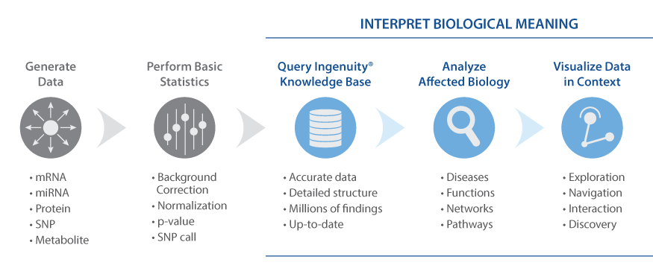

Cosa è Ingenuity Pathway Analysis [IPA]?
Geni/proteine di interesse
Dato un set di geni/protein che sono attivati/repressi…
  Quali sono gli effetti a valle?
    Sul fenotipo di malattie o sulla funzionalità cellulare
  Quali sono i pathway che vengono coinvolti?
  Quali sono gli “upstream regulators” convoilti, cioè cosa scatena gli effetti?
Notes:
What is Ingenuity? What is Ingenuity Pathway Analysis [IPA]?
What IPA is:
For those not familiar, IPA, is a tool created for ’tertiary’ data analysis stage of –omics data- that is when one has already compiled a set of differentially expressed genes or affected proteins or genetic variants and they need to biologically interpret that set- create hypothesis/make sense of it.
[Whether case vs. control or treated vs. untreated. ]
Specifically, the tool allows you to
Leverage current scientific knowledge [stored in our KB] to answer questions like…..
Given a large set of gene/proteins that are activated/inhibited affected
What are likely downstream effects?
disease phenotypes, impact on cell functionality
What specific pathways are likely being affected?
What upstream regulators are involved?

Slide 2
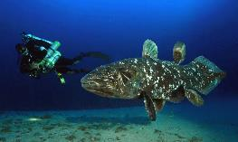
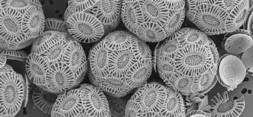

Approccio in un organismo non modello
Nessun genoma disponibile (spesso solo trascrittoma assemblato de novo)
Scarsa conoscienza dei pathway biologici
Letteratura piuttosto limitata
Scarsa omologia di sequenza (e di funzione) con gli organismi modello più vicini
Si utilizza l’approccio visto nella scorsa lezione
Si sfruttano le annotazioni di Geno Ontology (inferiti per similarità di sequenza tramite BLAST) o domini conservati (InterPro/PFAM)
Senza evidenze sperimentali dirette si utilizza un metodo che permette di formulare una «best guess» hypothesis
Test ipergeometrici/gene set enrichment analysis -> permette di identificare le annotazioni sovra-rappresentate rispetto alle attese

Slide 3
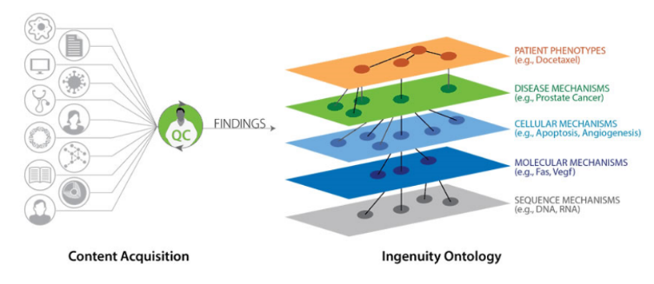
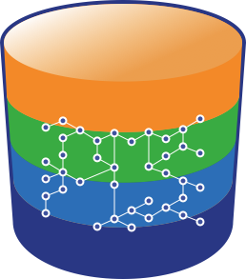

Sfruttamento di uno “knowledgebase” molto ricco
Organizzazione multilivello di dati di letteratura scientifica biomedica -> molto ampia in modello uomo/topo
Literature findings
The Ingenuity Knowledge Base
MD/PhD level curators
Biomedical Ontology
The Ingenuity Ontology
Notes:
[Just to dispel mysticism right off the bat: It does this by using information stored in The Ingenuity Knowledge Base.
This is an in-house DB composed of millions of experimental findings taken from peer-reviewed journals and further curated by MD/PhD level scienstists plus information from commonly used third party databases.
All this information is pulled together to make connections between diseases, genes,drugs/compunds, pathways, and pathway regulators.
Our trained scientists use data from each finding to create a connection between disease phenotypes, pathways, genes/protein, drugs/comopunds. These are all pooled together in to the knowledge base that can be seen as a master network of all the relationships that exist in the literature labelled by the context of the finding [the species it was found in, the experienmental evidemce, etc. ]]
IPA then uses this information to run its predictive aglorithms and the user can directly pull out relevant information.
***
It does this based on the KB and takes advantage fo the fact that each of these relationships in the KB is labelled with the species and experimental systems that the finding came from.
[Just as a refresher or for those who didn’t catch it], the KB is a network constructed from curated peer-reviewed experimental findings that links associated diseases, This master network of all the relationships is labelled by the context of the finding [the species it was found in, the experimental evidemce, etc.

Slide 4
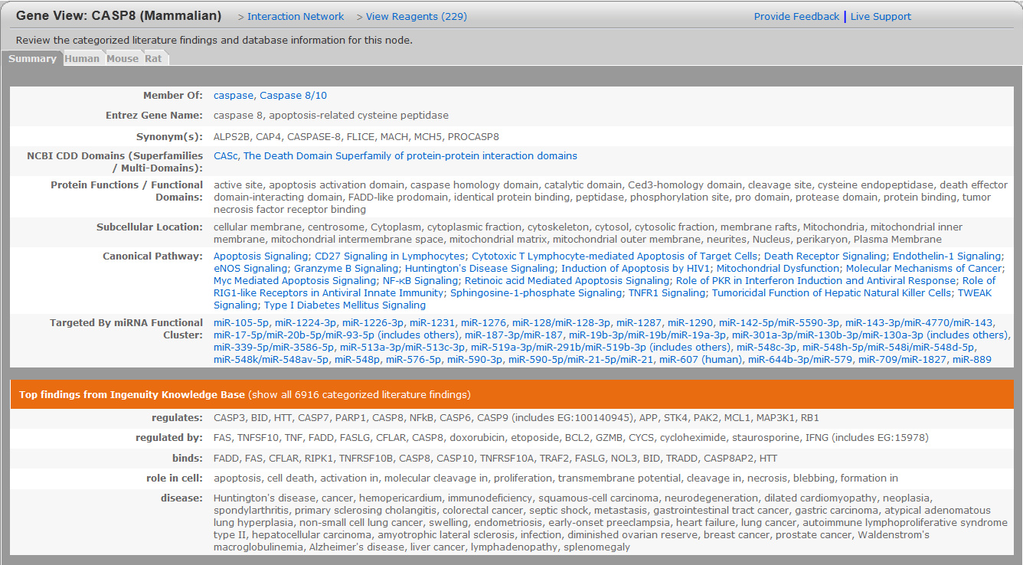
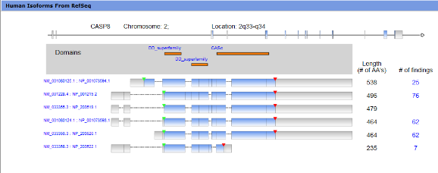
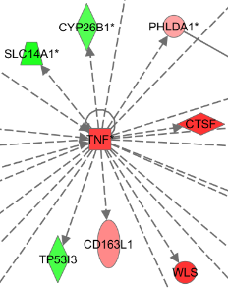
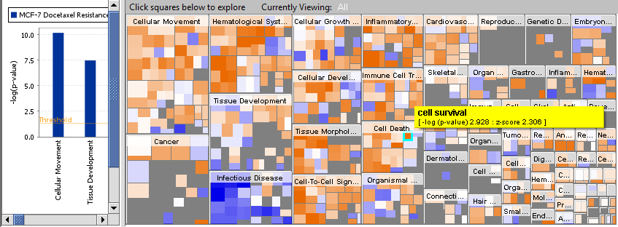
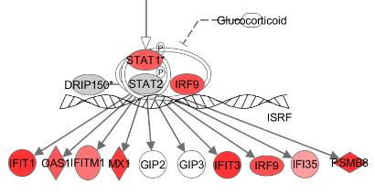
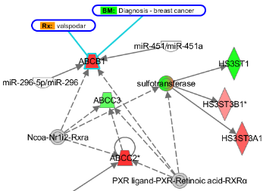
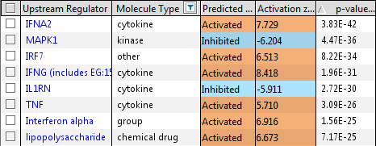
IPA:un tool per l’interpretazione di dati genomici
Gene View Summaries
Gene View Summaries
Human Isoform Views
Human Isoform Views
Interaction Networks
Interaction Networks
Biological Functions
Biological Functions
Canonical Pathways
Canonical Pathways
Upstream Regulator Analysis
Upstream Regulator Analysis
Build & Overlay Tools
Build & Overlay Tools
miRNA-mRNA Relationships
miRNA-mRNA Relationships
Notes:
General: IPA is a suite of tools to answer a variety of questions about your dataset and generate plausible hypothesis from your data.
Large set: IPA is a suite of tools to address these questions in your dataset.

Slide 5


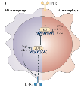
IPA e Network Modello
I network modello servono per:
  Fornire un supporto per organizzare i dati esistenti
  Generare nuove ipotesi sui meccanismi di azione
  Determinare dove dovrebbe essere posto l’accento sulla validazione funzionale dei dati
Dati -omici
Modello computazionale/simulazione
Generazione di
una ipotesi per la verifica sperimentale
Notes:
So, you all are the choir when it comes to the benefits of models and why you are here.
Where can IPA help you in making these models? [So, where does IPA fit in to the modeling workflow- to create data-driven, predictive, and comprehensive computational models.]

Slide 6
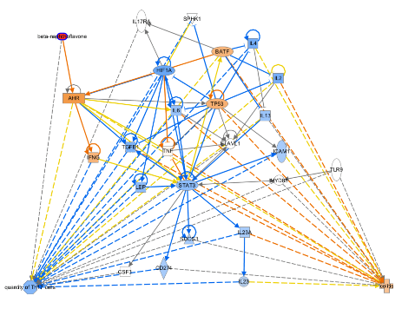
IPA e Network Modello
I network modello servono per:
  Fornire un supporto per organizzare i dati esistenti
  Generare nuove ipotesi sui meccanismi di azione
  Determinare dove dovrebbe essere posto l’accento sulla validazione funzionale dei dati
Notes:
So, you all are the choir when it comes to the benefits of models and why you are here.
Where can IPA help you in making these models? [So, where does IPA fit in to the modeling workflow- to create data-driven, predictive, and comprehensive computational models.]

Slide 7
Peer-reviewed publications citing IPA
20,000+ Published Studies Citing IPA
Sorted by Research Area
Notes:
IPA is an established tool in a variety of research areas having been cited in over 10k peer reviewed studiesany many different fields

Slide 8
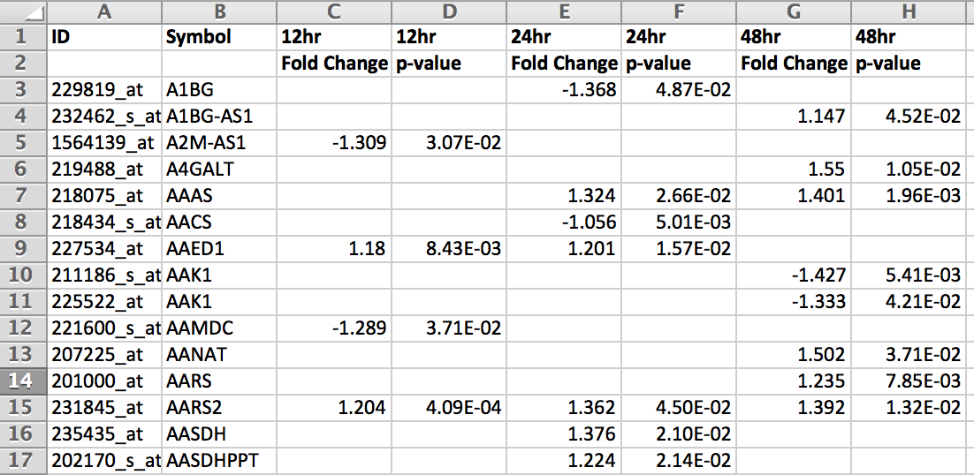
Dati di input
  Formati molto semplici che contengono i nomi dei geni e le osservazioni
    In format Excel
    In un qualsiasi altro format tabulare
  Posso facilmente trasferire i miei dati di osservazione da un esperimento di RNA-sequencing ad esempio (CLC Genomics Workbench), di microarray, ecc.
  Fondamentalmente servono dati di Fold change e p-value

Slide 9
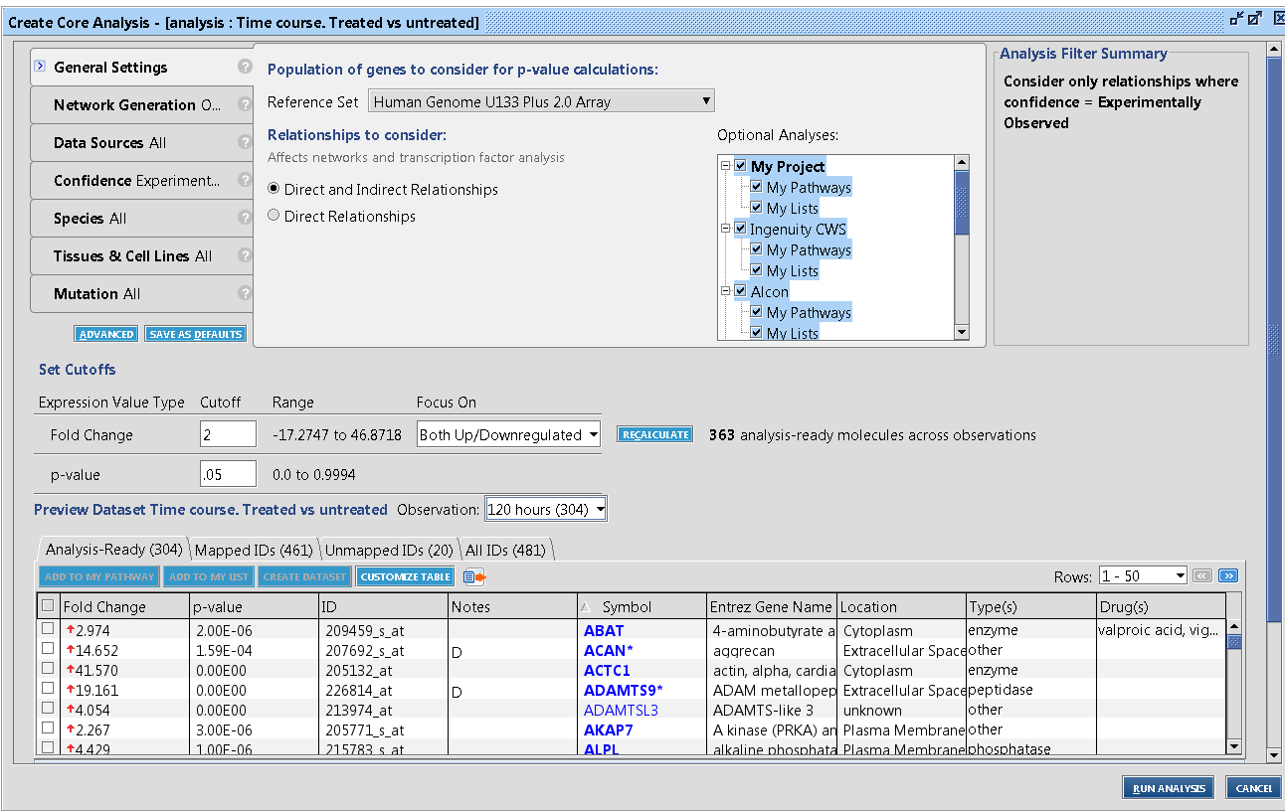
Impostare una “core analysis”
E’ possibile utilizzare diversi “filtri” per interrogare soltanto I database di nostro interesse
E’ possibile settare delle soglie (di FC o p-value) per l’analisi
Notes:
At setup the user has the option to filter the KB findings to be used.
Options include
Species [mouse, rate human] specific tissues or cell lines to include or EXCLUDE
Here is the dataset with the values, if had other measurements corrected vs. uncorrected or RPKM fo rRNAseq..

Slide 10
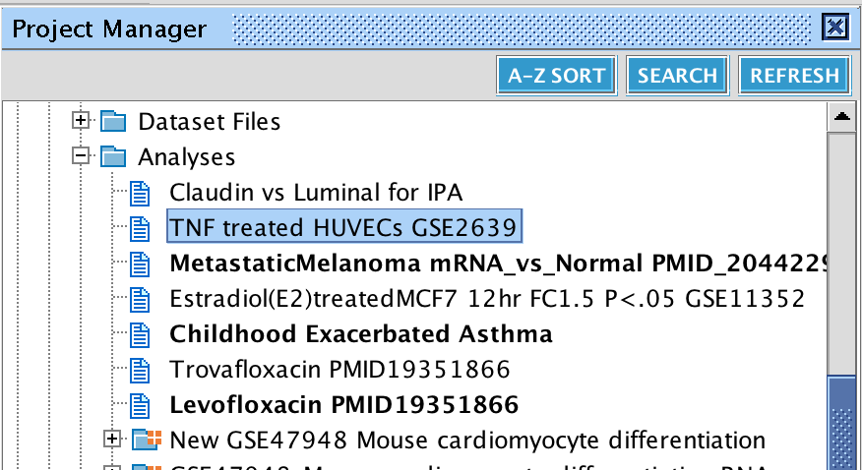
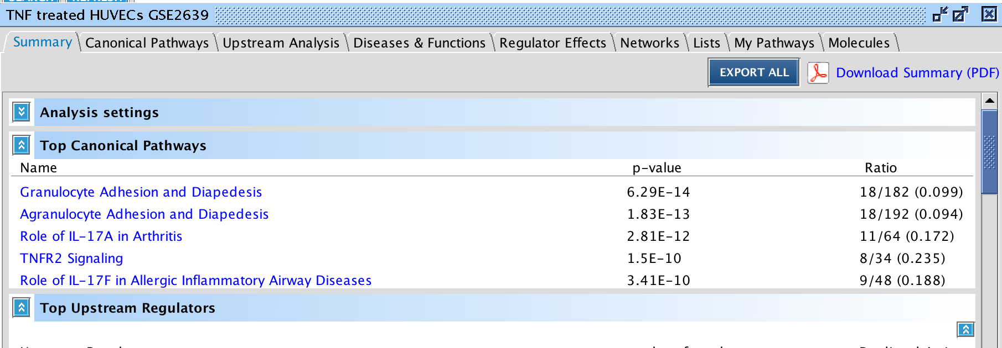
Risultati di una Core Analysis
I risultati vengono salvati in cartelle come nel CLC Genomics Workbench.
Una core analysis, come vedremo, è composta da diverse analisi indipendenti
Notes:
5 minute Core Overview
When finished the report is available in your account. When you open the analysis that has multiple tabs, each is a separate analysis that has been done automatically.

Slide 11
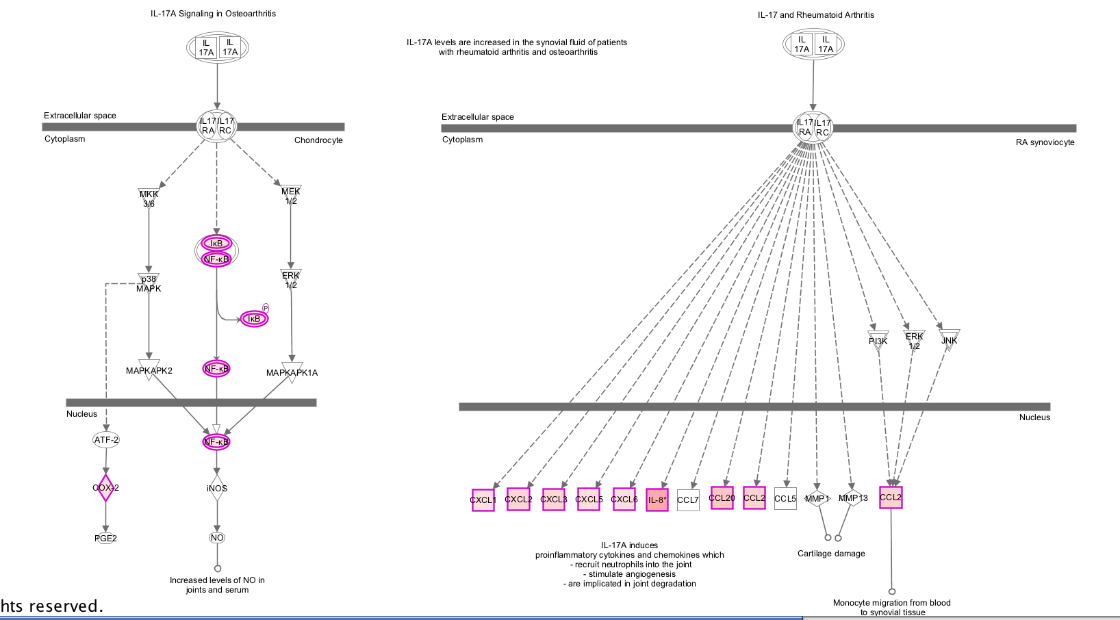
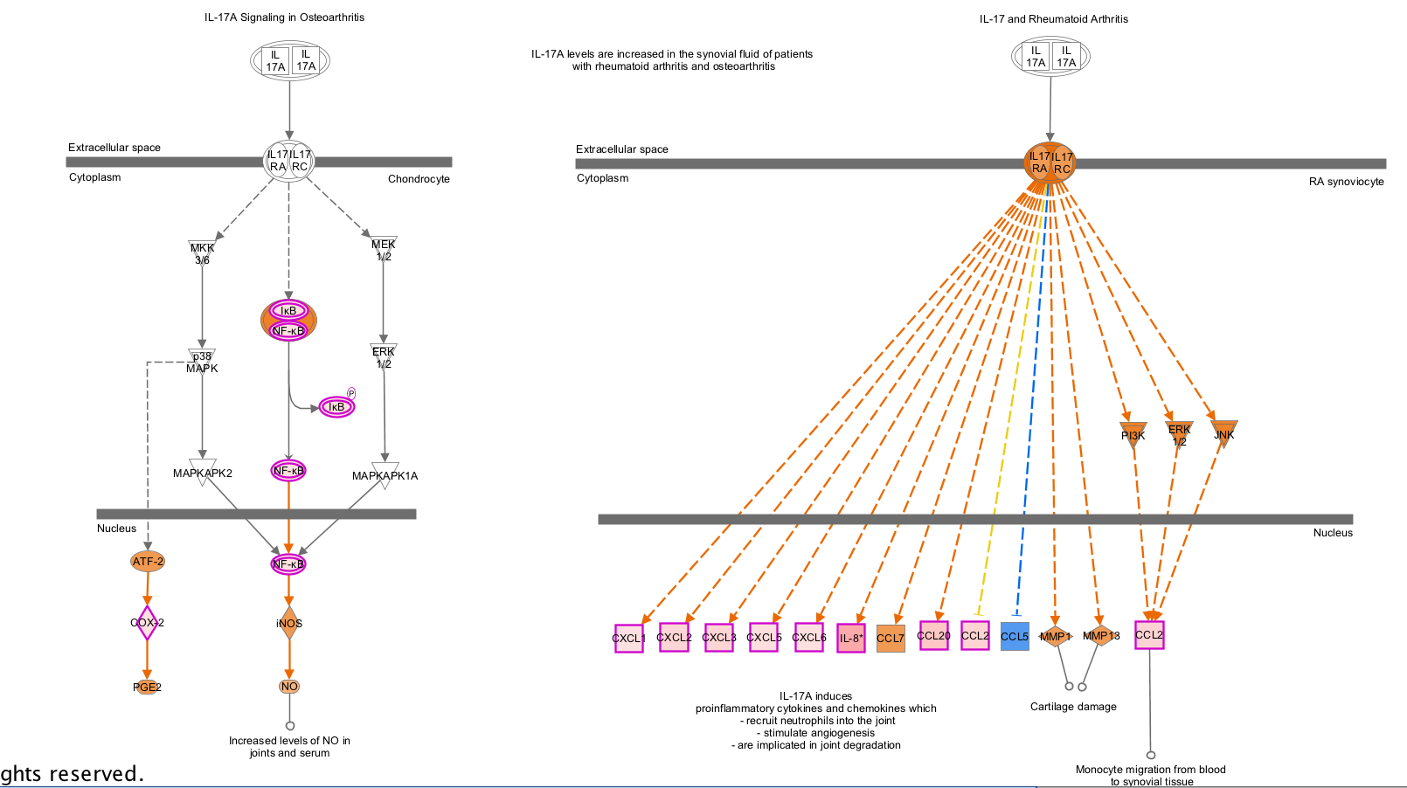
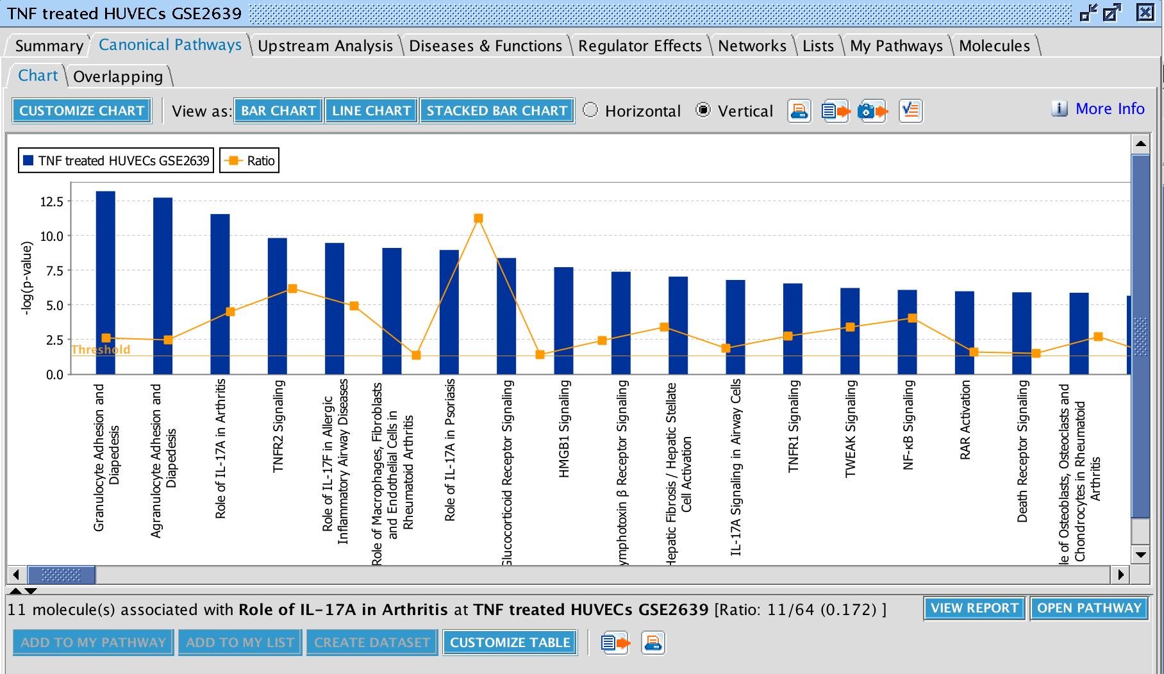
Canonical Pathway Analysis
  Rivela quali sono I pathway biologici arricchiti nel subset di geni differenzialmente espressi
  Concettualmente simile ad un test ipergeometrico ma permette la visualizzazione grafica del pathway e restituisce uno z-score (negativo = repression, positivo = attivazione)
Notes:
Where one can access all the genes that map to the any given pathway and even
View expression data overlayed on to pathway,
Canonical pathways: Role of IL17A in Arthritis
See that this is a S&E window, so can…
Can even predict the expression values of unmeasured genes.

Slide 12
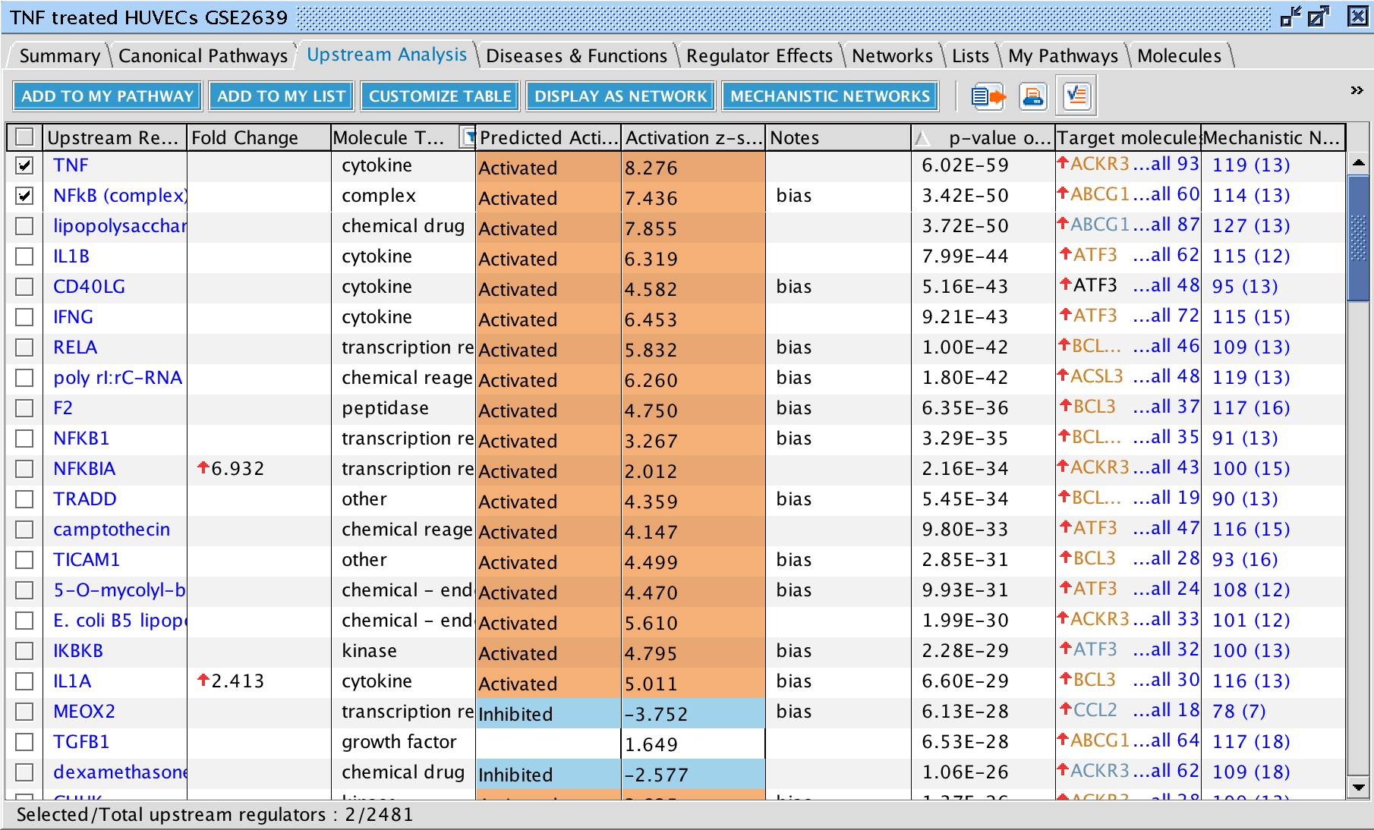
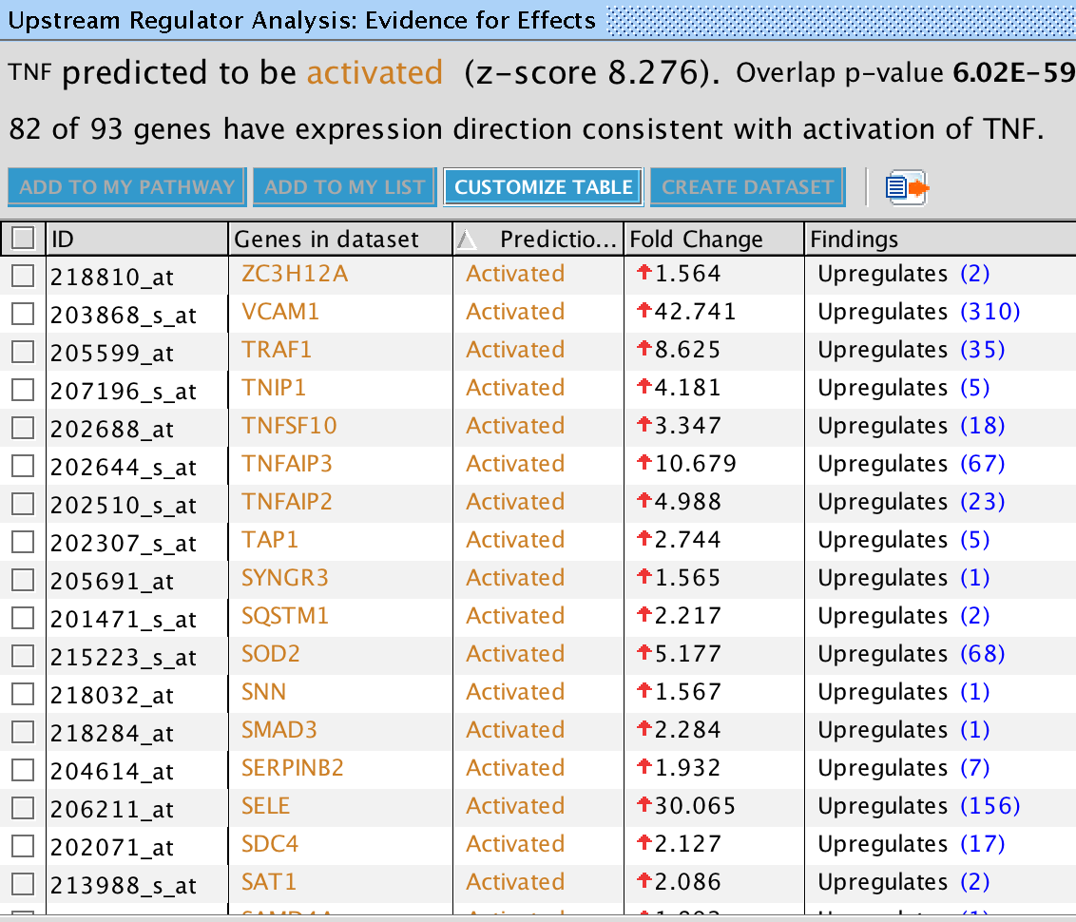
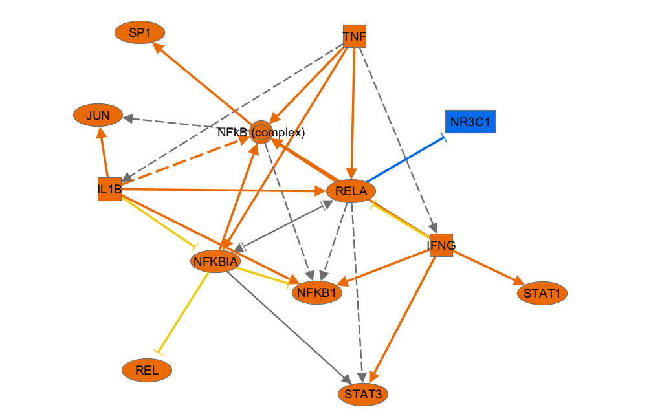
Upstream Regulator Analysis
Identifica i più probabili regolatori a monte (geni o molecule)
Notes:
Next an Upstream Analysis returns a table of upstream factors- TF, microRNAs, compunds, biological drugs that are predicted to be involved
-As well as whether act/inh depending on expression of its known tgt genes in your set.
-This is very unique to IPA and only possible with our KB.
Not exciting that TNF coming up, but also give Mechanistic Network.
Here one can also access a network of how each predicted regulator interacts with other regulators likely to be involved to answer the question: ‘’ How might the upstream molecule drive the observed expression changes?’ in the molecules it does target in my dataset?
This is done by finding other regulators that significant overlap in target genes in your dataset and reporting their relationships based on current literature.
One click can get for any upstream regulator
Add target molecules

Slide 13
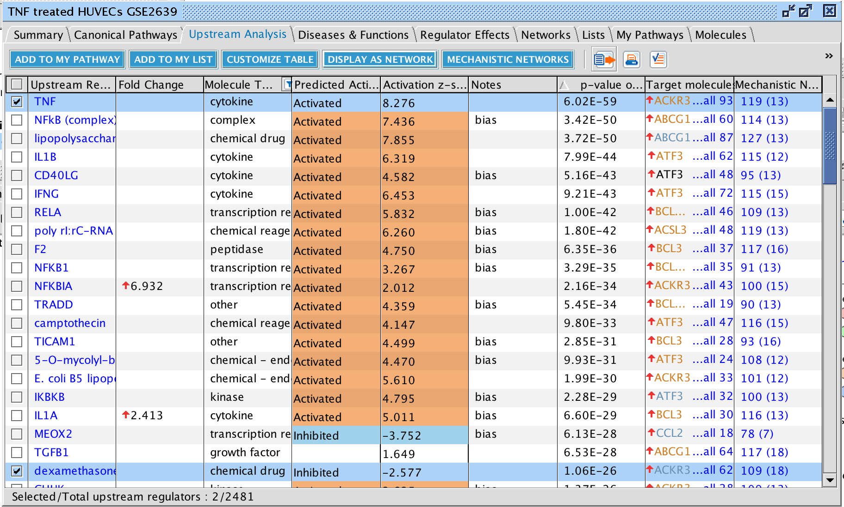
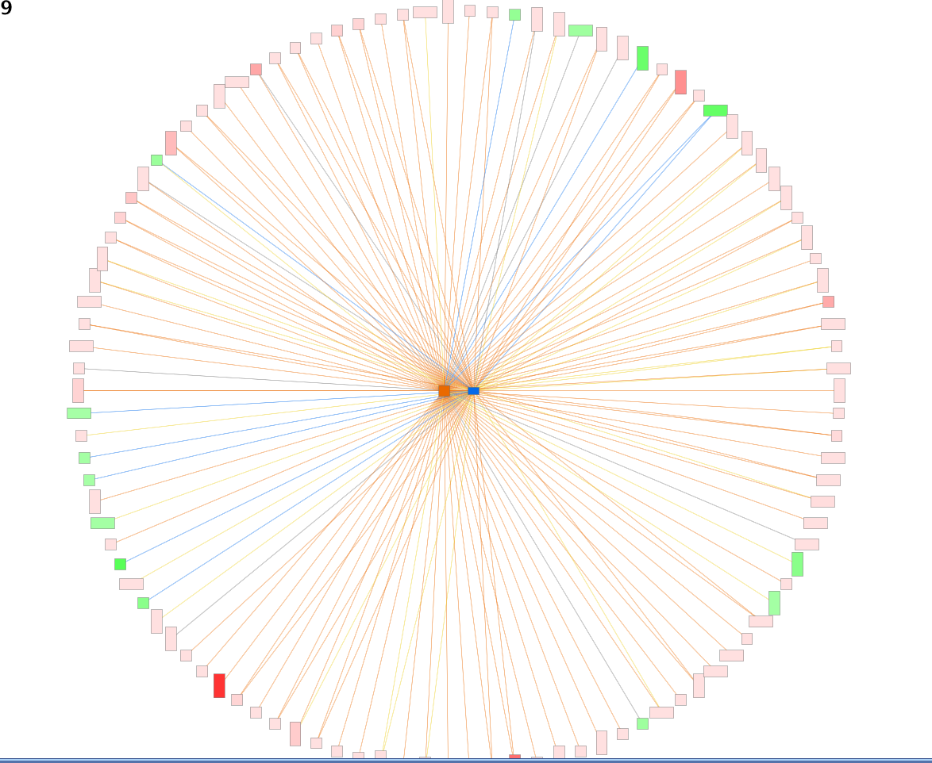
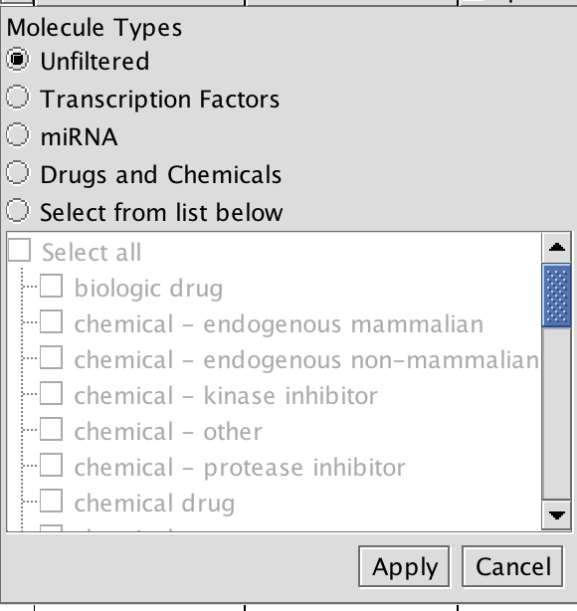
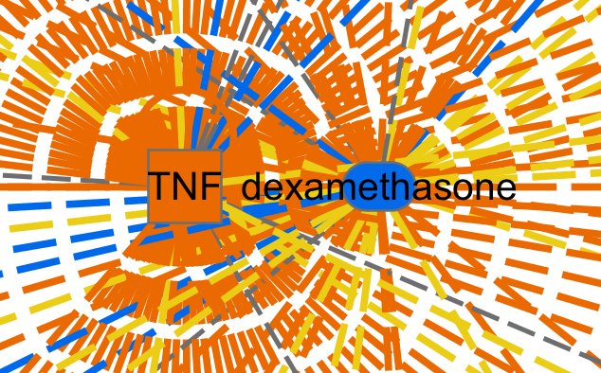
Upstream Regulator Analysis
Identifica Ii più probabili regolatori a monte (geni o molecole)
Notes:
Filter: Not so interested that TNF comes up, but what drugs would have a similar or opposite effect?
Or which TF’s is it acting through? Orr wihc microRNAs may be involved?
Also note that can open any of these in a S&E window.
Then if see something interesting, can see what affects and build a network of molecules IN your datasets.

Slide 14
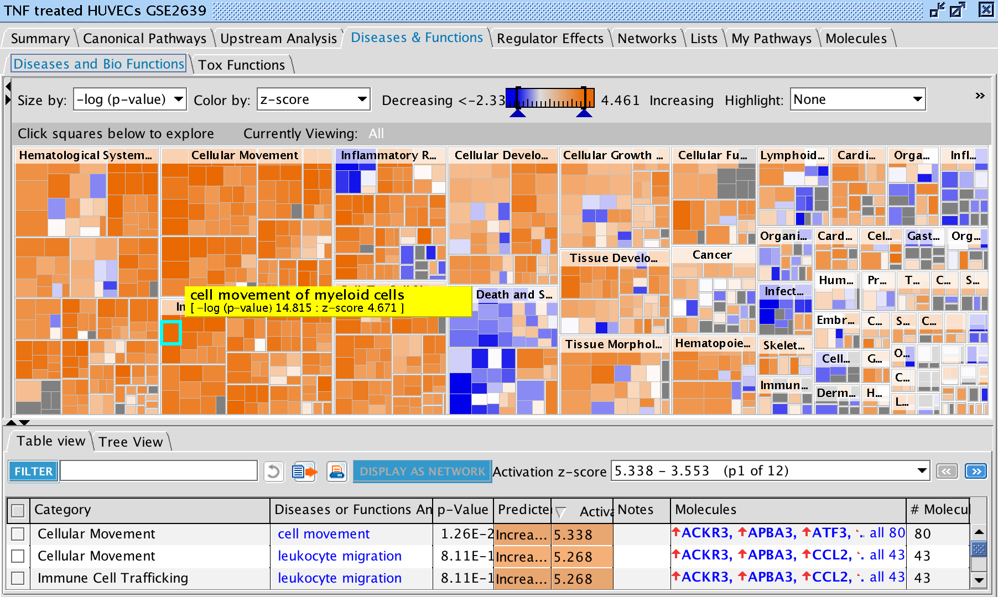
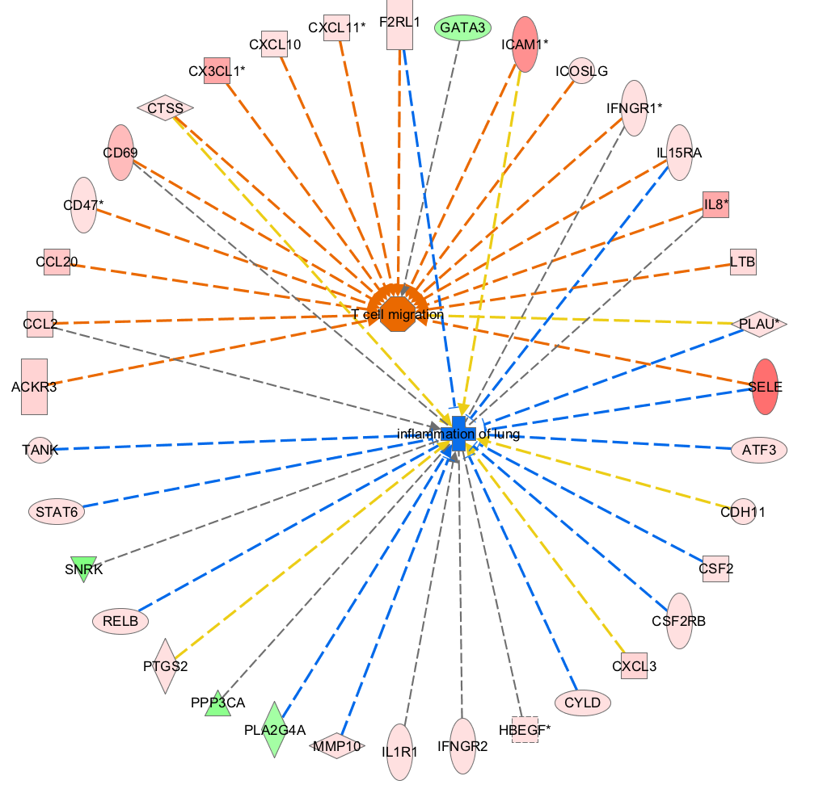
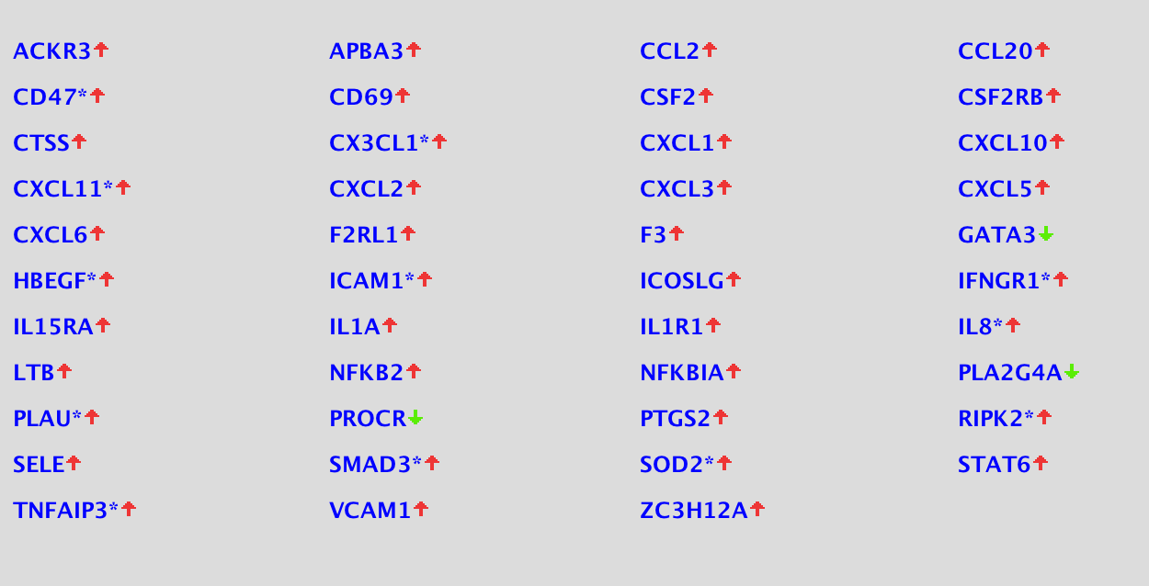
Downstream: Malattie e funzioni
Interpreta gli effetti “a valle”
Notes:
Predict what downstream phenotypes might occur in your system bases on disease/functions that are enriched in your set and whether they are increased or decreased
Again, based on pattern matching with the genes for which experimental evidence has linked them to the phenotype.
Then with one click see how the genes are reported to affect the phenotype in a search and explore window.
DS: construct from one DS effect, the genes you can measure and preliminary predicted perturbation effect
-With heatmap, get a global sense of what is happening.
-Increase in immune cell trafficking.
Interesting that see decrease in organ inflammation
May be tempted to look for which upstream regulator here have targets in this part of the transcriptome that could lead to increased immune cell trafficking…

Slide 15
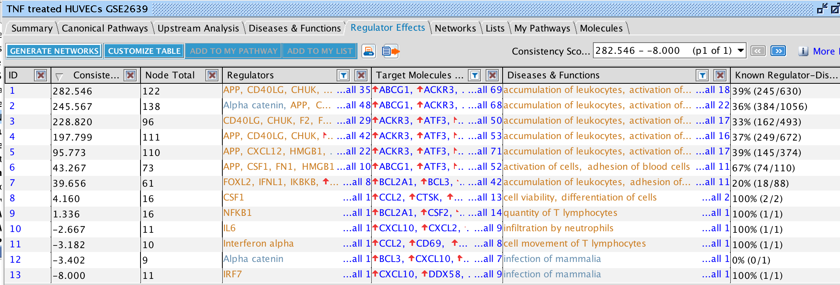
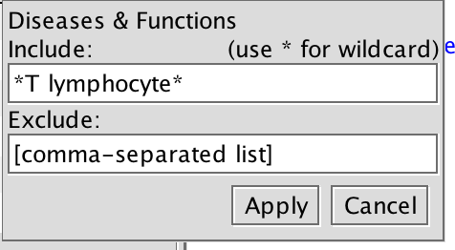
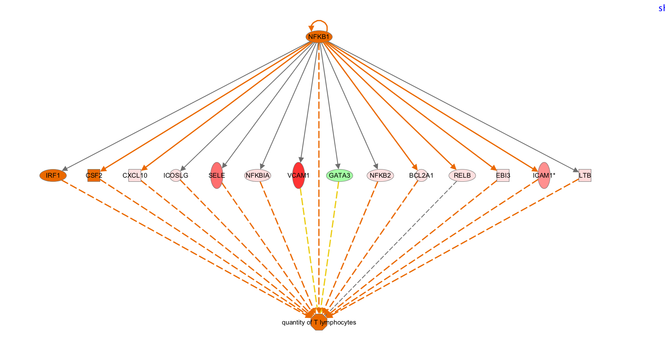
Effetti di regolazione
Gli upstream regulators probabilmente in qualche modo sono responsabili degli effetti osservati “a valle”
Score
Regulators
Targets
Diseases & Functions
Ingenuity Pathway Analysis – Finding The Connections
Notes:
Finally, identify which of the upstream regulators predicted to be involved are causing which predicted downstream effect. Each row in this table is such a network
Reg effects: Any of the wiring diagrams reported. Specify the type of network want
Search for *T lymphocytes*, sort by % known, take the top
Way in which TNF treatment leads to these cells expressing genes associated with incrased quanityt of T lumphocytes in tissue

Slide 16
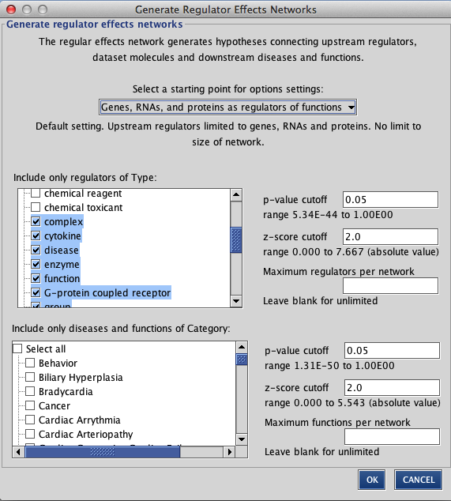

Effetti di regolazione
Gli upstream regulators probabilmente in qualche modo sono responsabili degli effetti osservati “a valle”
Score
Regulators
Targets
Diseases & Functions
Ingenuity Pathway Analysis – Finding The Connections
Notes:
, and the algorithm can be customized to ask your specific question- Only look for transcription factor may be affecting DS effects associated with Cardia Arrythmia..

Slide 17
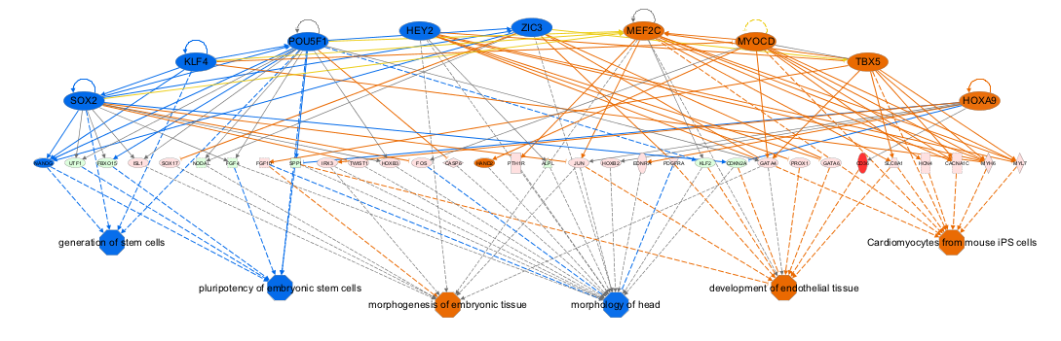
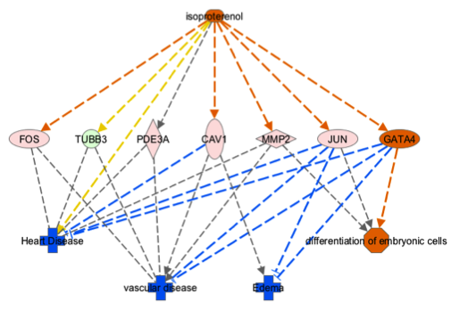
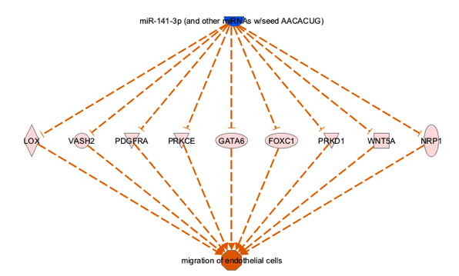
Il concetto di“Regulator Effects”
Fattori di trascrizione ed effetti funzionali
Molecole come regolatori di funzioni
miRNA come regolatori di funzioni
Notes:
Allowing you to decide what sort of networks you want to be reported to you.

Slide 18
Una visione d’insieme
Pathway canonici
Upstream Regulators
Malattie e funzioni
Network di regolazione di funzioni
Notes:
So, now we will poke around in the tool together to use these features of the core analysis to construct a network

Slide 19
Come funziona una Upstream Analysis
Permette di spiegare in modo razionale i cambiamenti di gene expression
Upstream Regulators
Mechanistic Network
A
Upstream Regulator
A
Upstream Regulator
Upstream Regulator:TF
B
Targets nel dataset
C’è un overlap significativo nella regolazione!
Causal Networks
Master Regulator
C
Scoring
C’è una connessione causale tra master regulator, regolatori intermedi e target (geni differenzialmente espressi)
TF

Slide 20

Mechanistic Network Algorithm
Come viene creato un network? Un algoritmo cerca le maggiori aree di sovrapposizione tra I target di un upstream regulator ed I target di altri upstream regulators a valle del primo
La molecola A probabilmente opera a monte della molecola B
In questo caso è meno probabile che I due regolatori facciano parte dello stesso network
A
A
B
B
6 su 7 target sono condivisi dai due regolatori, ma A regola B
Solo 1 su 7 target sono condivisi dai due regolatori

Slide 21
Calcolo deui Regulator effects
Hypotheses for how activated or inhibited upstream regulators cause downstream effects on biology
Upstream Regulators
Regulator Effect più semplice
A
A
Algoritmo
Prima iterazione
Targets nel database
Disease or Function
Mostra la connessione tra upstream regulator e funzione/malattia attraverso I target (geni differenzialmente espressi)
Disease or Function
Downstream Effects Analysis
I network con relazioni causali consistenti ottengono uno score migliore
L’algoritmo opera iterativamente per riunire eventuali altri regolatori con malattie/funzioni
Notes:
Specifically it looks for DS effects and Urs with a significant overlap in target molecules and whose edges are most consistent with the data- fewest yellow edges
A UR may ultimately be predicted to be activated even if X/Y of its target gene states in the data are not concordant with this. The network of them together would be penalized. Similarly some of THESE downstream edges may be inconsistent in that Dis/Fn is ultimately predicted to be increased/decreased, eventhough Q/Y target genes measued state is not consistent with that.

Slide 22

Alternative ad IPA - iPathwayGuide
iPathwayGuide è uno strumento sviluppato più recentemente ad IPA da parte di Advaita Bioinformatics, che permette di effettuare delle analisi simili
Può essere combinato con alti tools come iVariantGuide (per analisi di varianti genetiche, ed iBioGuide, che connette geni, miRNA e malattie

Slide 23
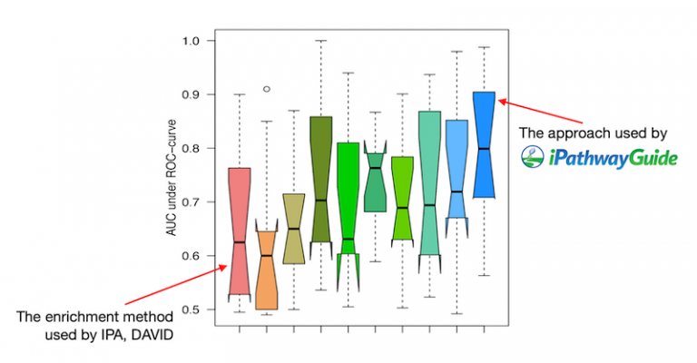
Alternative ad IPA - iPathwayGuide
iPathwayGuide utilizza uno strumento statistico leggermente diverso dal gene set enrichment di cui abbiamo precedentemente parlato (usato anche da IPA), cioè un cosiddetto «topology based method» (TBM). La differenza fondamentale tra i due metodi è che i metodi non-topology based trattano tutti i geni come membri di una «lista» in cui tutti i geni hanno lo stesso peso, mentre i metodi topology-based considerano anche la posizione nel pathway e ne possono dunque calcolare il peso o impatto
Un recente studio ha dimostrato una migliore performance dei metodi TBM nell’applicazione a dataset reali

Slide 24
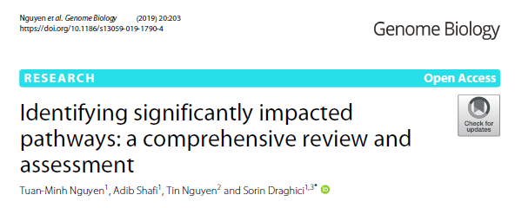
Quale è il metodo «migliore»?
“Overall, the result shows that no method is perfect. In general, TB methods appear to perform better than non-TB methods. This is somewhat expected since the TB methods take into consideration the structure of the pathway which is meant to describe the underlying phenomena. We also discover that most, if not all, listed approaches are biased and can produce skewed results under the null.”

Slide 25
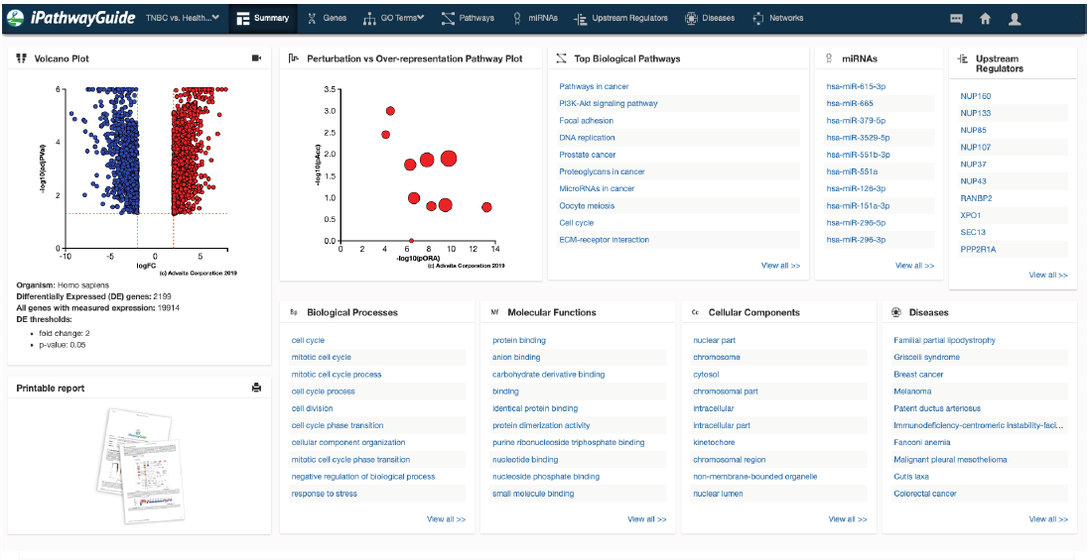
IPG – alcuni esempi
Esempio del main summary di un’analisi

Slide 26
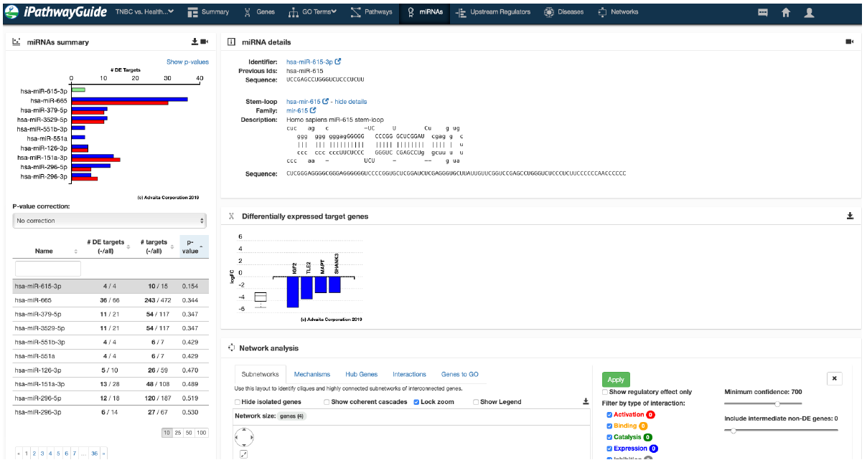
IPG – alcuni esempi
Predizione dei miRNA coinvolti nella regolazione dell’espressione genica

Slide 27
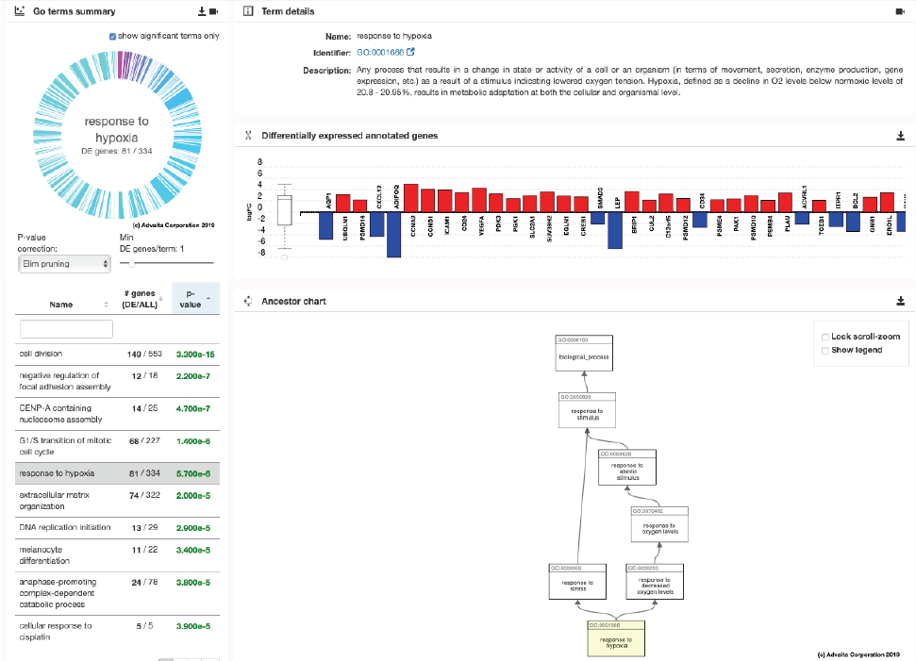
IPG – alcuni esempi
Esplorazione dei processi biologici alterati (Gene Ontology)

Slide 28
IPG – alcuni esempi
Esplorazione dei network di regolazione

Slide 29
IPG – alcuni esempi
Analisi dei regolatori upstream
Attivatori e repressori dell’espressione genica che mostrano il miglior grado di sovrapposizione con i DEG

Slide 30
IPG – alcuni esempi
Disease analysis: come possono essere rapportati i DEG,gli upstream regulators predetti ed i network di regolazione identificati allo sviluppo di patologie?

Slide 31
Più informazioni possono essere trovate, assieme a molti esempi pratici, nei due file pdf disponibili su Moodle, che mostrano:
Un esempio di un analisi completa effettuata con Ingenuity Pathway Analysis
Un esempio di un’analisi completa effettuata con iPathwayGuide

