Slide 1
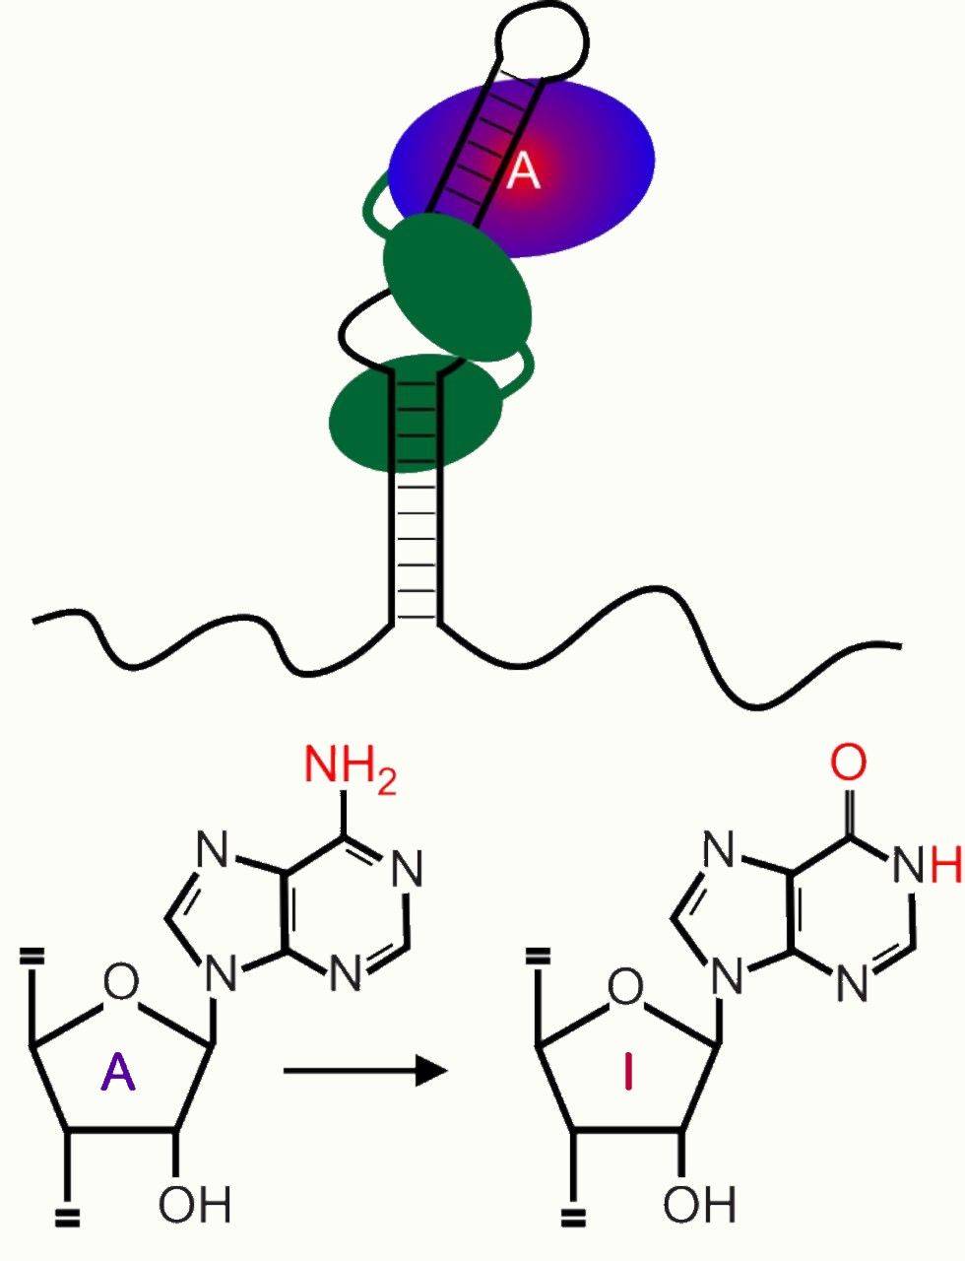
A-to-I RNA Editing
C. Tucci C. Danubio M. Tonetti

Slide 2
A-to-I RNA editing is catalysed by ADAR enzymes
A-to-I RNA editing is the most common in Metazoa and is performed by ADAR enzymes’ family;
In mammals, three members of this family are encoded: p150 and p110 ADAR1 isoforms, ADAR2 and ADAR3;
ADAR enzymes contain a C-terminal deaminase domain and 3 or 2 dsRNA binding domain;
ADAR1 isoforms contain 1 or 2 Z-DNA binding domain.

Slide 3
ADAR enzymes act on dsRNA
Coding and non-coding RNA molecules transcribed from the genome may form double-stranded RNA secondary structure;
ADAR enzymes recognize this structure both with deaminase and dsRNA binding domains;
ADAR editing can have a series of consequences: let’s check them out in the next slide!

Slide 4
Recoding and non-recoding ADAR activity
ADAR recoding activity lead to novel protein isoforms altering aminoacids;
ADAR recoding activity lead to novel protein isoforms altering splicing process;
ADAR non-recoding activity can modify 3’ UTR of mRNAs in order to alter their binding by miRNAs;
ADAR non-recoding activity can act on miRNAs altering the set of mRNAs that are regulated by them;
ADAR non-recoding activity can inhibit circRNA biogenesis.

Slide 5
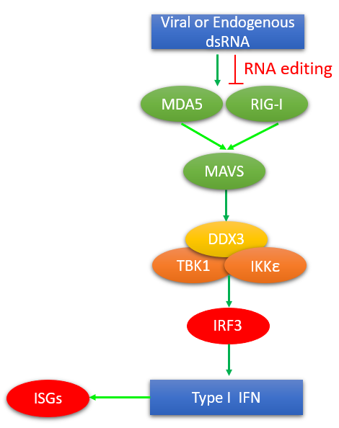
ADAR activity prevents MDA5 directed cytosolic innate immune response
Viral dsRNA structures are recognized by MDA5 and RIG-I;
MDA5 and RIG-I activate MAVS through a domain interaction;
MAVS undergo dimerization and recruit TBK1-IKKε-DDX3 complex;
TBK1 and IKKε phosphorylate IRF3;
IRF3 induce type I IFN expression;
IFN stimulate the expression of genes that lead to RNA degradation and apoptosis;
ADAR enzymes disrupts endogenous dsRNA trough editing in order to abolish the elimination of healthy cells.

Slide 6
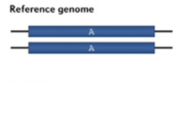
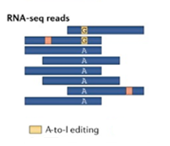
Detection of RNA editing sites
A-to-I RNA editing sites are detected as adenosine-to-guanosine (A to G) mismatches among reference genome and RNA-seq reads;

Slide 7
Recoding in repetitive elements
Mobile Elements (ME) are the source of repeated sequences that form dsRNA structures
Repeats families vary across lineages
ADAR response to MEs: promotes genome evolution creates novel recoding sites allows ME exonization
Alu can become cis-acting sequences (EIE) selectively inducing distant sites editing
EIE recruit a high density of ADAR molecules (higher local concentration)
Cis-acting elements are also the ADAR binding sequence
Positive correlation between editing level divergence and species divergence time

Slide 8
Recoding in repetitive elements
Mobile Elements (ME) are the source of repeated sequences that form dsRNA structures
Repeats families vary across lineages
ADAR response to MEs: promotes genome evolution creates novel recoding sites allows ME exonization
Alu can become cis-acting sequences (EIE) selectively inducing distant sites editing
EIE recruit a high density of ADAR molecules (higher local concentration)
Cis-acting elements are also the ADAR binding sequence
Positive correlation between editing level divergence and species divergence time

Slide 9
Recoding in repetitive elements
Mobile Elements (ME) are the source of repeated sequences that form dsRNA structures
Repeats families vary across lineages
ADAR response to MEs: promotes genome evolution creates novel recoding sites allows ME exonization
Alu can become cis-acting sequences (EIE) selectively inducing distant sites editing
EIE recruit a high density of ADAR molecules (higher local concentration)
Cis-acting elements are also the ADAR binding sequence
Positive correlation between editing level divergence and species divergence time

Slide 10
Recoding in repetitive elements
Mobile Elements (ME) are the source of repeated sequences that form dsRNA structures
Repeats families vary across lineages
ADAR response to MEs: promotes genome evolution creates novel recoding sites allows ME exonization
Alu can become cis-acting sequences (EIE) selectively inducing distant sites editing
EIE recruit a high density of ADAR molecules (higher local concentration)
Cis-acting elements are also the ADAR binding sequence
Positive correlation between editing level divergence and species divergence time

Slide 11
Recoding in repetitive elements
Mobile Elements (ME) are the source of repeated sequences that form dsRNA structures
Repeats families vary across lineages
ADAR response to MEs: promotes genome evolution creates novel recoding sites allows ME exonization
Alu can become cis-acting sequences (EIE) selectively inducing distant sites editing
EIE recruit a high density of ADAR molecules (higher local concentration)
Cis-acting elements are also the ADAR binding sequence
Positive correlation between editing level divergence and species divergence time

Slide 12
The NARF4 recoding example
This Ale-exonization is editing-dependent and leads to recoding (column 2)
Proof that NARF4 exonization is evolutionarily fixed: no change in E1 editing upon NMD inhibition (puromycine) even if there is a STOP codon so this premature stop codon is aways recoded
Editing sites of Alu element itself regulate Alu-exon inclusion
Differentially regulated (Brain)

Slide 13
The NARF4 recoding example
This Ale-exonization is editing-dependent and leads to recoding (column 2)
Proof that NARF4 exonization is evolutionarily fixed: no change in E1 editing upon NMD inhibition (puromycine) even if there is a STOP codon so this premature stop codon is aways recoded
Editing sites of Alu element itself regulate Alu-exon inclusion
Differentially regulated (Brain)

Slide 14
The NARF4 recoding example
This Ale-exonization is editing-dependent and leads to recoding (column 2)
Proof that NARF4 exonization is evolutionarily fixed: no change in E1 editing upon NMD inhibition (puromycine) even if there is a STOP codon so this premature stop codon is aways recoded
Editing sites of Alu element itself regulate Alu-exon inclusion
Differentially regulated (Brain)

Slide 15
The NARF4 recoding example
This Ale-exonization is editing-dependent and leads to recoding (column 2)
Proof that NARF4 exonization is evolutionarily fixed: no change in E1 editing upon NMD inhibition (puromycine) even if there is a STOP codon so this premature stop codon is aways recoded
Editing sites of Alu element itself regulate Alu-exon inclusion
Differentially regulated (Brain)

Slide 16
RSs are lineage-specific while their editing levels are specie-specific
ESs are conserved across different species of Drosophila, Cephalopods, Mammals…
Conserved sites are lineage-specific (cis-regulation is specie-specific)
Conserved sites are enriched for non-synonoimous substitution: so positive selection happened
All this suggests that RSs were exapted: RSs had a different function in ancestral genes

Slide 17
RSs are lineage-specific while their editing levels are specie-specific
ESs are conserved across different species of Drosophila, Cephalopods, Mammals…
Conserved sites are lineage-specific (cis-regulation is specie-specific)
Conserved sites are enriched for non-synonoimous substitution: so positive selection happened
All this suggests that RSs were exapted: RSs had a different function in ancestral genes

Slide 18
Recoding: a constraining advantage
Recoding → Wider adaptation capability through: → More diverse range of proteins → Adjusting the transcriptome instead of the genome sequences
Not all recoding sites are edited while there are multiple editing sites in every mRNA: → Combinatorial Repertoire depends on: tissue identity developmental-stage
RNA-editing is a heritable mechanism for protein diversification
There is an evolutionary constraint on genomic regions encoding for dsRNA structures

Slide 19
Recoding: a constraining advantage
Recoding → Wider adaptation capability through: → More diverse range of proteins → Adjusting the transcriptome instead of the genome sequences
Not all recoding sites are edited while there are multiple editing sites in every mRNA: → Combinatorial Repertoire depends on: tissue identity developmental-stage
RNA-editing is a heritable mechanism for protein diversification
There is an evolutionary constraint on genomic regions encoding for dsRNA structures

Slide 20
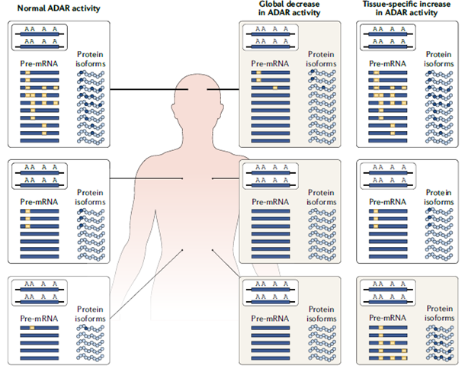
RNA editing regulation
Editing levels are regulated by 3 factors:
Structural motifs surrounding each specific editing site
depends from its encoded genome sequence => effects are the same regardless of the cell type
Expression level of ADAR proteins
ADAR expression could be different in different tissues and in different conditions => dynamic regulation of editing levels
Level of ADAR regulators
ADAR regulators mainly affect editing globally but probably do not allow for site-specific control of editing levels

Slide 21
Altered RNA editing and RNA mutations
Altered editing could be due to:
Changes in the level of recoding at known sites
Creation of novel disease-specific recoding events
Creation of novel editing-assisted splicing events
Modified editing patterns of circRNAs, miRNAs and their targets
Genomic mutations:
Are present in every cell
Genomic variability limited to two isoforms
RNA mutations:
mutant transcripts may be expressed only under certain conditions, at a specific stage of a disease or in certain cells or tissues
combination of different isoforms

Slide 22
Altered RNA editing and autoimmune disorders
Recoding activity is very high in the thymus
Number of hyper-edited sites (A to I) in each tissue sample
mTEC^{hi} cells demonstrated a number of sites per million aligned reads comparable to the number observed in the brain.
cTECs had a high number of unique hyper-editing sites but less than the number that was detected in mTECs
Editing ratio within each sample
brain showed the highest ratio of edited sites (0.44), followed by mTEC (0.31) and cTEC (0.29).
Adar1 expression levels in mTEC^{hi} and cTEC samples were comparable to the level in the brain tissue, whereas Adar2 expression levels were significantly higher in the brain.
mTECs = medullary thymic epithelial cells, cTEC = cortical thymic epithelial cells , mTEC^{lo} = immature mTEC population, mTEC^{hi} = mature mTEC population, AireKO = Aire-deficient mTEC^{hi} population, impaired in promiscuous gene expression

Slide 23
A-to-I RNA editing plays a physiological role in neuronal function
Serotonin 5HT_{2C} receptor
RNA editing reduced G protein coupling and this leads to downstream signalling.
AMPA GluA2, GluK1, GluK2 subunits
RNA editing renders the receptors impermeable to Ca²⁺. The edited subunits are also retained in the endoplasmic reticulum compared to the respective unedited isoforms.
GABA_{A} α3 subunit
Edited receptors are preferentially degraded in the lysosome, thereby regulating the stability of the receptor at the surface.

Slide 24
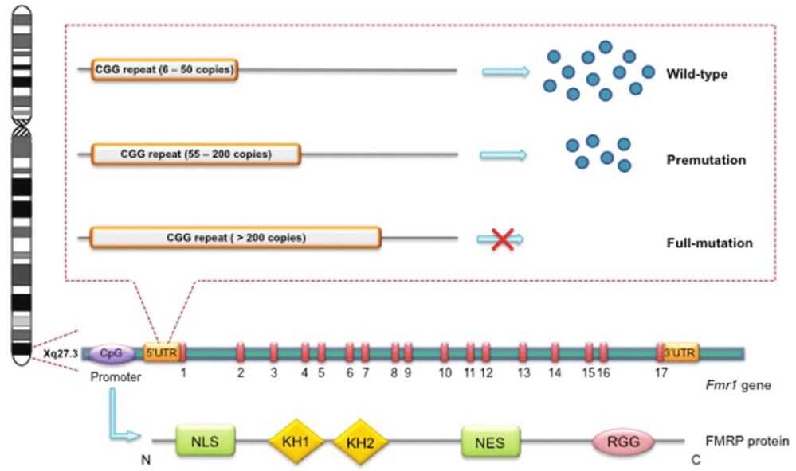
FMR1 gene and Fmrp protein in Fragile X syndrome
Etiology: expansion of 200-800 CGG trinucleotides in the 5’ UTR of FMR1 gene;
Consequence of mutation: loss of function of FMRP due to its lack of expression;
NLS: nuclear localization signal; KH1/2: RNA binding domains; NES: nuclear export signal; RGG: RNA binding domain.
Fmrp represses translation and trafficking of synaptic proteins, affecting synaptic plasticity.

Slide 25
Authors’ rationale
What authors already know
Biological question
Authors’ answers
In mouse, drosophila and adult zebrafish models, Fmrp loss causes neurological and behavioral defects typical of FXS;
In mouse, drosophila and adult zebrafish models, ADAR loss causes neurological defects;
In drosophila, fmrp interacts with ADAR;
Could RNA editing play a role in Fragile X Syndrome?
Validation of fmr1 -/- zebrafish larvae as model system
Detection of synaptic alterations in fmr1 -/- zebrafish larvae’s brain;
Detection of fmrp-ADAR2 interaction in fmr1 -/- zebrafish larvae;
Detection of differentially edited sites of synaptic proteins mRNAs in fmr1-/- zebrafish larvae

Slide 26
Increased expression of Fmrp-target genes in fmr1 -/- larvae
C>T transition result in a premature stop codon and truncated protein;
Whole mount ISH assays show the spatial expression of mtor, sash1 and tin1 in 6dpf WT larvae;
Increased mRNA expression of mtor, sash1 and tin1 in 6 dpf fmr1 -/- larvae;
Western blot shows an increase in the expression of mTor in fmr1 -/- zebrafish brain tissue.

Slide 27
Hyperlocomotor in fmr1 -/- larvae
Fmr1 -/- larvae are hyperactive during both day and night compared to WT larvae;
Average locomotor total activity (cm/min) during both day and night for 6 dpf fmr1 -/- and WT larve;
Fmr1 -/- larvae are hyperactive after dark to light transition compared to WT larvae;
Average locomotor total activity (cm/min) during 30-min light/dark cycles for 6dpf fmr1 -/- and WT larvae;
Average locomotor total activity (cm/min) by comparing 5 min after and before the transition for 6dp fmr1 -/- and WT larvae.

Slide 28
Motor noeurons alterations in fmr-/- larvae
Q: Hyperlocomotor activity due to?
H: Alterations in motor neurons
Motoneurons labelling: → Fmrp1 stabilizes arborization of motor neurons
MN synapse density quantification: → Fmrp1 loss increases synaptic density
Since Fmrp1 inhibit translation of synaptig genes:
A: → Fmrp1 regulates axonal arborization and structure of synapse in cholinergic neurons
Notes:
This group decided to analyze different kinds of neurons’ morphology changes between wt and fmr-/- zf to better understand the cause of hyperlocomotor activity phenotype, and the abnormal response to dark-to-light stimuli. Thereby they studied motor neurons, sensory neurons and also glutamatergic neurons. Motor neurons were labelled and quantification total arbor length and average number of branches were measured. These analyses showed a statistically significative difference between wt and fmr-/- embryos Considering that fmrp1 inhibits synaptic genes translation they concluded that it stabilizes arborization through synapse regulation.

Slide 29
Motor noeurons alterations in fmr-/- larvae
Q: Hyperlocomotor activity due to?
H: Alterations in motor neurons
Motoneurons labelling: → Fmrp1 stabilizes arborization of motor neurons
MN synapse density quantification: → Fmrp1 loss increases synaptic density
Since Fmrp1 inhibit translation of synaptig genes:
A: → Fmrp1 regulates axonal arborization and structure of synapse in cholinergic neurons
Notes:
This group decided to analyze different kinds of neurons’ morphology changes between wt and fmr-/- zf to better understand the cause of hyperlocomotor activity phenotype, and the abnormal response to dark-to-light stimuli. Thereby they studied motor neurons, sensory neurons and also glutamatergic neurons. Motor neurons were labelled and quantification total arbor length and average number of branches were measured. These analyses showed a statistically significative difference between wt and fmr-/- embryos Considering that fmrp1 inhibits synaptic genes translation they concluded that it stabilizes arborization through synapse regulation.

Slide 30
Sensory and Glutamatergic neurons alterations
Q: Abnormal response to dark-to light transitions due to?
H: Alterations in sensory neurons
Rohon-Beard neurons labelling: → Fmrp1 does not regulate synapse density
RB synapse density quantification: → Fmrp1 reguates axon branching
Q: Since mGluR regulates Fmrp1 function…
H: Alterations in Glutamatergic neurons
Hcrt synapse density quantification: → Synaptic density did vary
A: → Fmrp1 loss increases axon branching in glutamatergic and cholinergic neurons
Notes:
Since the zf larvae exhibited abnormal responses to dark-to-light stimuli they hypothesized that sensory neural network coul’ve been affected by fmrp1 loss. Rohob-Beard senrory neurons labelling was carried out to identify and quantify the number of puncta. The analysis showed a significant increase in arborization yet this difference was not satistically significant in puncta along the axonal branches change. So they concluded again that fmrp1 has a somekind of role also in sensory neurons.
The autors recalled how fmrp1 function is regulated by mGluR so they analized glutamatergic hypocretin/orexin neurons, these hypothalamic neurons were involved in behaviour-regulating neuronal circuits. In these circuits mGluR plays an important role in regulating LTP and LTD genes that are involved in memory and behaviour. The analysis showed that lack of fmrp1 increase in synapse formation.
Taking these results altogether they concluded that fmrp1 regulates synapse density of glutamatergic and cholinergic neurons.

Slide 31
Sensory and Glutamatergic neurons alterations
Q: Abnormal response to dark-to light transitions due to?
H: Alterations in sensory neurons
Rohon-Beard neurons labelling: → Fmrp1 does not regulate synapse density
RB synapse density quantification: → Fmrp1 reguates axon branching
Q: Since mGluR regulates Fmrp1 function…
H: Alterations in Glutamatergic neurons
Hcrt synapse density quantification: → Synaptic density did vary
A: → Fmrp1 loss increases axon branching in glutamatergic and cholinergic neurons
Notes:
Since the zf larvae exhibited abnormal responses to dark-to-light stimuli they hypothesized that sensory neural network coul’ve been affected by fmrp1 loss. Rohob-Beard senrory neurons labelling was carried out to identify and quantify the number of puncta. The analysis showed a significant increase in arborization yet this difference was not satistically significant in puncta along the axonal branches change. So they concluded again that fmrp1 has a somekind of role also in sensory neurons.
The autors recalled how fmrp1 function is regulated by mGluR so they analized glutamatergic hypocretin/orexin neurons, these hypothalamic neurons were involved in behaviour-regulating neuronal circuits. In these circuits mGluR plays an important role in regulating LTP and LTD genes that are involved in memory and behaviour. The analysis showed that lack of fmrp1 increase in synapse formation.
Taking these results altogether they concluded that fmrp1 regulates synapse density of glutamatergic and cholinergic neurons.

Slide 32
Adar genes in zebrafish
Phylogenetic tree of zebrafish and human Adar proteins sequences
zebrafish genome encodes 4 adar genes
zebrafish Adar proteins converge into 3 distinct clusters
human Adar2 has 2 zebrafish orthologs
Sequence and motif distribution of Adar proteins in zebrafish and humans
all zebrafish Adar enzymes share common domain architecture with adenosine deaminase domain (white) and double-stranded RNA binding motif (black).

Slide 33
Spatial expression of adar genes in zebrafish
In situ hybridization (ISH) in WT zebrafish shows the spatial expression pattern of all 4 adar genes in 2 dpf and 6 dpf
At 2 dpf, all adars were primarily expressed in the brain and spinal cord
At 6 dpf, adar transcripts were strongly expressed in the brain.

Slide 34
Zebrafish Fmrp and Adar2a proteins interact
Co-immunoprecipitation (Co-IP)
Transfection of HEK293T cells with constructs that expressed the zebrafish Adar2a and Fmrp proteins tagged with EGFP and MYC, respectively.
Extracts from HEK293T cell expressing EGFP-Adar2a and MYC-Fmrp were used to immunoprecipitate the proteins with anti-actin, anti-MYC, or anti-EGFP antibodies.
Proteins were purified from the complexes, separated by SDS-PAGE, blotted onto nitrocellulose membranes and reacted with EGFP, anti-MYC or anti-Actin antibodies (S).
Fmrp was purified with Adar2a and vice versa. In contrast, actin did not pull down with either Fmrp or Adar2a

Slide 35
Fmrp protein can bind adar1 mRNA
Computational sequence homology of RNA recognition elements (RREs) in the CDS of zebrafish adar1 and adar2 genes
40 sequences were mapped to the CDS of adar1
2 sequences were mapped to the CDS of adar2 (U)
RNA immunoprecipitation assays
Transfection of HEK293T cells with the zebrafish MYC-Fmrp construct
RNA extraction from the cells and anti-MYC or anti-Actin antibodies were used to pull down specific protein-mRNA complexes
Coprecipitated RNAs were isolated and cDNA was amplified.
adar1 mRNA was identified in cells precipitated with an anti-MYC antibody but not in cells precipitated with an anti-Actin antibody.

Slide 36
Effect of Fmrp on adar mRNA and Adar2 protein expression levels
qRT-PCR in 6 dpf fmr1-/- and WT larvae
adar1: WT = 0.834, fmr1-/- = 3.102;
adar2a: WT = 1.03667, fmr1-/- = 2.2900
adar2b: WT = 0.9752, fmr1-/- = 1.48804
adar3: WT = 1.0098, fmr1 /- = 1.24590
Western blot of Adar2 in fmr1-/- and WT brains
30% increase in Adar2 protein expression levels in mutant brains compared with WT brains (X).

Slide 37
Global extent of RNA editing sites in zebrafish
RNA-seq datasets from 17 samples covering 8 different developmental stages and analysis by a bioinformatic pipeline
A total of approximately 350,000 DNA-RNA mismatches were identified, 93% of which are A-to-G mismatches (A).
Analysis of the sequence adjacent to HE sites in zebrafish, human and mice
‘G’ is the underrepresented nucleotide at position -1 respect A-to-G mismatch in all species
In zebrafish, G’ is represented at position -1 only in 8.4% of -1 respect A-to-G mismatch of whole transcriptome and in 11.4% -1 respect A-to-G mismatch present in exons.

Slide 38
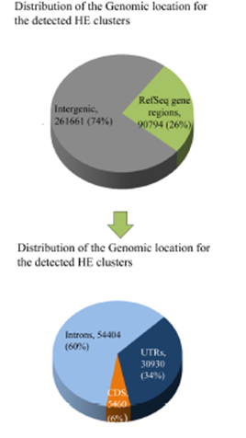
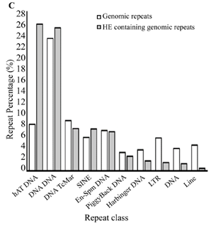
A-to-G mismatches are RNA editing sites
76% of the clustered sites are in repeat sequences.
25% of all editing sites in repeat sequences is located in the DNA hAT repeat family, which occupies about 8% of the zebrafish genome.
ANGEL and TDR19 fold into stable dsRNA structures with paliandrome traits that enamble Adar binding.

Slide 39
Finding altered editing levels within gene transcripts in fmr1-/- larvae
48 evolutionary conserved ESs between mammals and z.f. were analyzed
48 samples of fmr-/- or WT larvae were used in a double mmPCR approach to amplify on ly target sites.
Reads were filtered through selection criteria:
target regions in at least 75% of samples
coverage of site: at least 400 reads
G/(A+G) ratio at least 2%
62 editing sites met the criteria
10 underwent statistically significant differential editing and7 belong to 4 synaptic genes cacna1a Calcium channel grik2 ionotropic glutamate r. kainate2 gria4b AMPA r. subunit 4b gria3b AMPA r. subunit 3b
Notes:
Since elevated levels of ADAR2 protein were found in the CNS of fmrp-/- larvae and since authors found clustered editing sites in ZF they wanted to find which neuronal genes underwent differential editing upon fmrp1 activity was absent. So they selected 48 conserved editing sites in both zebrafish and humans. They amplified only target sequences with target-specific tagged fusion primers in a two-step PCR strategy in which a fraction of each of the 48 mRNA samples from zebrafish reacted with each of the 48 different tagged fusion primer solutions. So that 48 mini libraries from each sample were created and only the targeted editing sites were amplified. The second PCR reaction amplified only the targeted sequences and attached barcode sequences to each sample and adaptor sequences needed for the Ion Torrent Sequencing reactions.
Before analyzing the results a Correlation Test was performed to asses that editing levels were not altered due to altered transcription levels.
Upon sequencing the results were filtered out according to 3 criteria: all sites had to be present in at least 36 out of the 48 samples, each site had to account for at least 400 reads and G/(A+G) ratio had to be at least 2%. Only 10 sites that fitted these requirements were differentially edited in a statistically significant way and of these ones 7 belong to 4 synaptic genes which are: Calcium channel, ionotropic kainite glutamate receptor and two AMPA glutamate receptor.

Slide 40
Finding altered editing levels within gene transcripts in fmr1-/- larvae
48 evolutionary conserved ESs between mammals and z.f. were analyzed
48 samples of fmr-/- or WT larvae were used in a double mmPCR approach to amplify on ly target sites.
Reads were filtered through selection criteria:
target regions in at least 75% of samples
coverage of site: at least 400 reads
G/(A+G) ratio at least 2%
62 editing sites met the criteria
10 underwent statistically significant differential editing and7 belong to 4 synaptic genes cacna1a Calcium channel grik2 ionotropic glutamate r. kainate2 gria4b AMPA r. subunit 4b gria3b AMPA r. subunit 3b
Notes:
Since elevated levels of ADAR2 protein were found in the CNS of fmrp-/- larvae and since authors found clustered editing sites in ZF they wanted to find which neuronal genes underwent differential editing upon fmrp1 activity was absent. So they selected 48 conserved editing sites in both zebrafish and humans. They amplified only target sequences with target-specific tagged fusion primers in a two-step PCR strategy in which a fraction of each of the 48 mRNA samples from zebrafish reacted with each of the 48 different tagged fusion primer solutions. So that 48 mini libraries from each sample were created and only the targeted editing sites were amplified. The second PCR reaction amplified only the targeted sequences and attached barcode sequences to each sample and adaptor sequences needed for the Ion Torrent Sequencing reactions.
Before analyzing the results a Correlation Test was performed to asses that editing levels were not altered due to altered transcription levels.
Upon sequencing the results were filtered out according to 3 criteria: all sites had to be present in at least 36 out of the 48 samples, each site had to account for at least 400 reads and G/(A+G) ratio had to be at least 2%. Only 10 sites that fitted these requirements were differentially edited in a statistically significant way and of these ones 7 belong to 4 synaptic genes which are: Calcium channel, ionotropic kainite glutamate receptor and two AMPA glutamate receptor.

Slide 41
Finding altered editing levels within gene transcripts in fmr1-/- larvae
48 evolutionary conserved ESs between mammals and z.f. were analyzed
48 samples of fmr-/- or WT larvae were used in a double mmPCR approach to amplify on ly target sites.
Reads were filtered through selection criteria:
target regions in at least 75% of samples
coverage of site: at least 400 reads
G/(A+G) ratio at least 2%
62 editing sites met the criteria
10 underwent statistically significant differential editing and7 belong to 4 synaptic genes cacna1a Calcium channel grik2 ionotropic glutamate r. kainate2 gria4b AMPA r. subunit 4b gria3b AMPA r. subunit 3b
Notes:
Since elevated levels of ADAR2 protein were found in the CNS of fmrp-/- larvae and since authors found clustered editing sites in ZF they wanted to find which neuronal genes underwent differential editing upon fmrp1 activity was absent. So they selected 48 conserved editing sites in both zebrafish and humans. They amplified only target sequences with target-specific tagged fusion primers in a two-step PCR strategy in which a fraction of each of the 48 mRNA samples from zebrafish reacted with each of the 48 different tagged fusion primer solutions. So that 48 mini libraries from each sample were created and only the targeted editing sites were amplified. The second PCR reaction amplified only the targeted sequences and attached barcode sequences to each sample and adaptor sequences needed for the Ion Torrent Sequencing reactions.
Before analyzing the results a Correlation Test was performed to asses that editing levels were not altered due to altered transcription levels.
Upon sequencing the results were filtered out according to 3 criteria: all sites had to be present in at least 36 out of the 48 samples, each site had to account for at least 400 reads and G/(A+G) ratio had to be at least 2%. Only 10 sites that fitted these requirements were differentially edited in a statistically significant way and of these ones 7 belong to 4 synaptic genes which are: Calcium channel, ionotropic kainite glutamate receptor and two AMPA glutamate receptor.

Slide 42
Finding altered editing levels within gene transcripts in fmr1-/- larvae
48 evolutionary conserved ESs between mammals and z.f. were analyzed
48 samples of fmr-/- or WT larvae were used in a double mmPCR approach to amplify on ly target sites.
Reads were filtered through selection criteria:
target regions in at least 75% of samples
coverage of site: at least 400 reads
G/(A+G) ratio at least 2%
62 editing sites met the criteria
10 underwent statistically significant differential editing and7 belong to 4 synaptic genes cacna1a Calcium channel grik2 ionotropic glutamate r. kainate2 gria4b AMPA r. subunit 4b gria3b AMPA r. subunit 3b
Notes:
Since elevated levels of ADAR2 protein were found in the CNS of fmrp-/- larvae and since authors found clustered editing sites in ZF they wanted to find which neuronal genes underwent differential editing upon fmrp1 activity was absent. So they selected 48 conserved editing sites in both zebrafish and humans. They amplified only target sequences with target-specific tagged fusion primers in a two-step PCR strategy in which a fraction of each of the 48 mRNA samples from zebrafish reacted with each of the 48 different tagged fusion primer solutions. So that 48 mini libraries from each sample were created and only the targeted editing sites were amplified. The second PCR reaction amplified only the targeted sequences and attached barcode sequences to each sample and adaptor sequences needed for the Ion Torrent Sequencing reactions.
Before analyzing the results a Correlation Test was performed to asses that editing levels were not altered due to altered transcription levels.
Upon sequencing the results were filtered out according to 3 criteria: all sites had to be present in at least 36 out of the 48 samples, each site had to account for at least 400 reads and G/(A+G) ratio had to be at least 2%. Only 10 sites that fitted these requirements were differentially edited in a statistically significant way and of these ones 7 belong to 4 synaptic genes which are: Calcium channel, ionotropic kainite glutamate receptor and two AMPA glutamate receptor.

Slide 43
Altered editing of synaptic genes
What about editing tissue-specificity? Differential editing of 3 selected representative synapse genes from adult brains was investigated:
In brains are present: Fmrp-dependent and tissue-specific RNA-editing changes
mRNA recoding variants of the same gene:
in clustered sites even small differences in mRNA editing can manifest into different mRNA transcripts
Gria2a mRNA in normal cells is mainly unedited: LR version at the R/G coding site which is close to a splicing site that regulates the flip/flop isoforms (channel kynetics)
Gria3a mRNA in normal cells is mainly present in the edited LR coding site version
Notes:
Since the editing changes in whole fmr1-/- larvae were mild the authors analized the difference in editing level only in brain tissue samples. This analysis was performed only on 3 selected genes that are significantly important in synapse physiology and found out that the editing differences were much higher than usually found when analysing editing levels differences in whole body mRNA and most interestingly they found that 2 of the 3 selected genes exhibited a non significative alteration in the previous mmPCR targeted amplification analysis.
Finally the authors investigated the changes in editing looking at the specific mRNA variants generated by sequence recoding. Their findings showed that gria 2a mRNA was mostly present in the unedited form at the recoding site R/G, while gria 3a gene mRNA was mostly common in the double-edited isoform at the T/A and I/V sites.

Slide 44
Altered editing of synaptic genes
What about editing tissue-specificity? Differential editing of 3 selected representative synapse genes from adult brains was investigated:
In brains are present: Fmrp-dependent and tissue-specific RNA-editing changes
mRNA recoding variants of the same gene:
in clustered sites even small differences in mRNA editing can manifest into different mRNA transcripts
Gria2a mRNA in normal cells is mainly unedited: LR version at the R/G coding site which is close to a splicing site that regulates the flip/flop isoforms (channel kynetics)
Gria3a mRNA in normal cells is mainly present in the edited LR coding site version
Notes:
Since the editing changes in whole fmr1-/- larvae were mild the authors analized the difference in editing level only in brain tissue samples. This analysis was performed only on 3 selected genes that are significantly important in synapse physiology and found out that the editing differences were much higher than usually found when analysing editing levels differences in whole body mRNA and most interestingly they found that 2 of the 3 selected genes exhibited a non significative alteration in the previous mmPCR targeted amplification analysis.
Finally the authors investigated the changes in editing looking at the specific mRNA variants generated by sequence recoding. Their findings showed that gria 2a mRNA was mostly present in the unedited form at the recoding site R/G, while gria 3a gene mRNA was mostly common in the double-edited isoform at the T/A and I/V sites.

Slide 45
Conclusions
Good model system since it enables live imaging, enables single-cell resolution imaging, enables high throughput genetics, has evolutionary conserved brain, has conserved target genes of both ADAR2 and Fmrp1, permits large-scale small-molecules screens
Fmrp1 has a role in synaptic structural plasticity in circuits that regulate locomotor activity, memory and behaviour
Editing levels significantly vary upon fmr1 loss in conserved synaptic neuronal editing targets
ADAR and Fmrp1 interact with each other
Fmrp1 regulates ADAR in ZF while this does not happen in Drosophia
Precise functional relationship between ADAR and FMRP1 is not clear
Causal link between fmrp1 and editing sites causing neuronal circuit-specific deficiencies still need to be found
Overesperession edited and non-edited target genes combined with live-imaging could help determine pathogenesis of FXS symptoms
Notes:
This work showed that zf is a very good model system to study FXS because it is:
… and this work showed that strong functional similarities were mantained between ZF and man, most importantly Fmrp1 showed to have a role in synaptic plsticity, to have conserved downstream regulaed genes, it also interacted with ADAR2 and it showed to regulate ADAR2 expression which is an absent feature in Drosophila models.
Also editing levels were mostly due to ADAR activity and theyinterestconserved synaptic genes and a differential editing level could be detected in those key genes that regulate synaptic plasticity, strenghth, morphology of neurons involved in behavioural networks that are impaired in the FXS.

