Slide 1
Dosage compensation in Mammals
Claudio Antonio Coppola
Giulia Maria Clemenza
Annamaria Regina

Slide 2
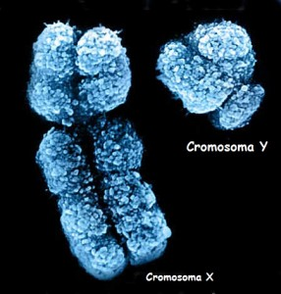
Why is important dosage compensation when you have more than one X Chromosome?
Y Chromosome
How do males survive with only one X chromosome?
Different strategies:
Drosophila: up-regulating expression of X chromosome in the male;
X Chromosome
2. Humans: down-regulating expression of one of the two X chromosomes.

Slide 3
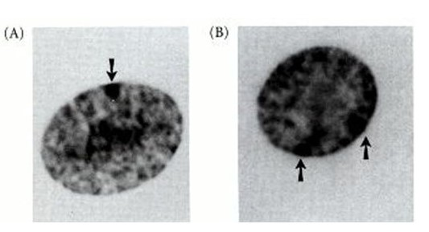
Identification of an inactive X in Mammalian Females
In 1949, Barr and Bertram described a structure called Barr Body;
In 1959, Ohno and collegues showed that this structure was derived from one of the two female X chromosomes;
In 1961, Mary Lion hypothesized that in each female cell one of the two X chromosomes is stably inactived early in blastocyst (20 cells stage);
Studies of X inactivation in human females with multiple copies of X showed that all X chromosomes in excess of one were inactivated (n-1 rules).
The Barr Bodies number changes with the X chromosome number
XX
One Barr Body
XXX
Two Barr Bodies

Slide 4
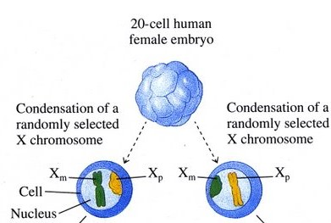
X inactivation is developmentally regulated
Both X chromosomes are active in the early zygote;
Randomly inactivation either the maternal (Xm) or paternal (Xp) X chromosome;
Some genes escape silencing-PAR regions;
The X inactivation is mediated by a single cis-acting switch locus, called X inactivation center (Xic). This locus produced a lncRNA termed Xist.

Slide 5
X inactivation center (Xic)
A region of the X chromosome near the centromere called X inactivation center (XIC) is the control unit;
This region contains the gene for X-inactive specific transcript (Xist).

Slide 6
How is achieved the X chromosome inactivation?
1. Xist is transcribed and binds the X chromosome.
2. Xist RNA spreads over the chromosome and binds itself.

Slide 7
Random X Inactivation: Regulatory elements and Choice
Figure 8. Genes and regulatory elements in the X inactivation-center region. The key region on the mouse X chromosome comprising known elements involved in Xist gene regulation is illustrated, showing noncoding RNA (ncRNA) genes and protein-coding genes. The Xpr region, several hundred kilobases upstream of Xist, has been implicated in trans-interaction of Xic alleles in XX cells and as such is thought to be important for initiation of X inactivation.
Choice: Biased choice can be viewed as tipping the balance between Xist repressors and Xist activators on a given allele.

Slide 8
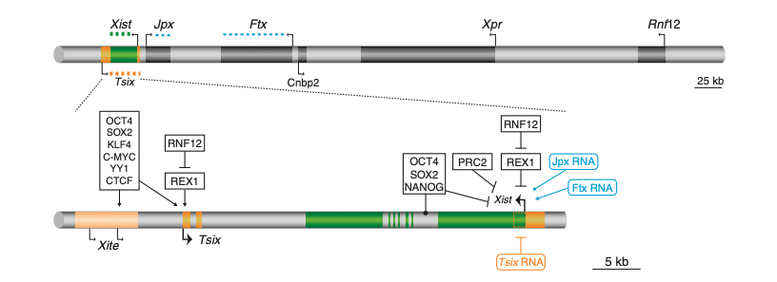
Tsix : is an antisense transcript that repress Xist and suppress levels of the Xist activator Rnf12
Rnf12: mediates a degradation ubiquitin dependent of the pluripotency factor Rex1. This may simultaneously activate Xist and repress Tsix.
Choice: Biased choice can be viewed as tipping the balance between Xist repressors and Xist activators on a given allele.

Slide 9
Xite: is a trascription element that regulate the probability of choice and it functions as Tsix enhancer.
Jpx: is a non-coding RNA that evicts the silencing proteins CTCF from the Xsit locus. A conclusive role for Jpx in Xist activation, though, awaits genetic loss- and gain-of-function studies in mice.
Ftx: is a non-coding RNA implicated in Xist gene activation.
Choice: Biased choice can be viewed as tipping the balance between Xist repressors and Xist activators on a given allele.

Slide 10
The activation of Xist in female cells is Jpx-dependent
mESCs | Heterozygous female | male
Deletion of Jpx | Growth defect and cell death | No marked effect
Over-expression of Jpx | Surviving | /
The activation of Xist in female cells is Ftx-dependent
mESCs | Heterozygous female | male
Deletion of Ftx | Not done, wuold be more informative | Decrease in Xist RNA levels and change its DNA methylation profile

Slide 11
Factors involved in localization of Xist RNA.
Figure 9. Factors involved in X inactivation spread.
YY1 is implicated in tethering Xist RNA (green wavy line) at the site of synthesis (brown circle) and interacting with Xist RNA to facilitate spreading (red circle).
hnRNPU/SAFA also plays a role in localization of Xist RNA in cis, binding to Xist RNA directly.

Slide 12
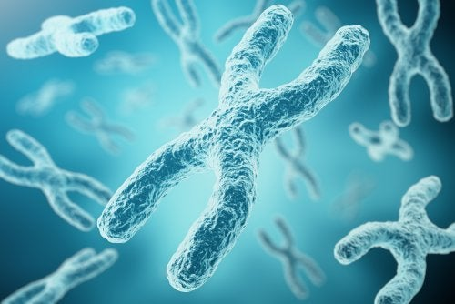
The efficienty of Xist RNA spreading
Overwall configuration of X chromosome territory in 3D
How Xist locus is positioned within the X chromosome territory
Xq13.2

Slide 13
Both, centric heterochromatin and Xi are:
are depleted in H3K4me2 and H3K4me3. This heterochromatin is marked by a specific type of histone modification, such as H3K4me2 and H3K4me3. These modifications make the chromatin transcriptionally inactive.
acetylation, H3K4 are generally thought to be markers of transcriptionally active, or potentially active, chromatin.

Slide 14
Booster Elements Facilitate Spreading of X Inactivation
Summary of characterized DNA methylation, histone modification, and histone changes at a silent gene on Xi. Other chromatin modifications that are enriched on Xi include the histone modifications H3 trimethylated at lysine 27 (H3K27me3) and H2A monoubiquitinated at lysine 119 (H2AK119ub1; Fig. 9B). These modifications are catalyzed by Polycomb repressor complexes.
There is also enrichment of H3K9me3 catalized by histone lysil methyltransferases (KMTs) with protein HPI.
There is NOT significanly level of CpG methylation on Xi than the rest of genome.

Slide 15
The Order of Events That Leads to X Inactivation
Figure 10. The order of events in differentiating XX ES cells. The diagram summarizes the order in which different silencing pathways are integrated during establishment of X inactivation in differentiating XX ES cells.
Two phases during XX ES cell differentiation:
EARLY
TARDIVE

Slide 16
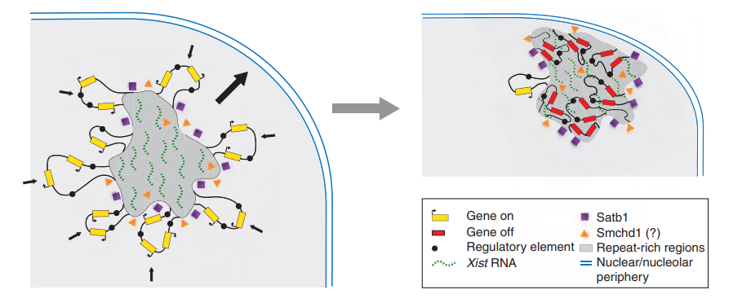
Xist-Mediated Silencing: “Belts and Braces”
Figure 11. As X inactivation proceeds, genes are internalized within the Xist territory with consequent restriction in the mobility of chromosome loops. Establishment of X inactivation is also linked to positioning of the chromosome on the nuclear and/or nucleolar periphery.
Nuclear scaffold factors (SATB1)
Chromosome structure factors (Smchd1)
may play a role in the reorganization of chromosome architecture on Xi.
Conclusion: different pathways contribute differently to silencing of specific genes or subsets of genes on Xi

Slide 17
The bipartite TAD organization of the X-inactivation center ensures opposing developmental regulation of Tsix and Xist
Joke G. van Bemmel, Rafael Galupa, Chris Gard, Nicolas Servant, Christel Picard, James Davies, Anthony James Szempruch, Yinxiu Zhan, Jan J. Żylicz, Elphège P. Nora, Sonia Lameiras, Elzo de Wit, David Gentien, Sylvain Baulande, Luca Giorgetti, Mitchell Guttman, Jim R. Hughes, Douglas R. Higgs, Joost Gribnau & Edith Heard

Slide 18
Abstract
The mouse X-inactivation center (Xic) is organized into two topologically associating domains (TADs) but their role remains elusive
we generated genomic inversions that swap the Xist/Tsix transcriptional unit and place their promoters in each other’s TAD.
We found that this led to a switch in their expression dynamics: Xist became precociously and ectopically upregulated, both in male and female pluripotent cells, while Tsix expression aberrantly persisted during differentiation.
Our study illustrates how the genomic architecture of cis-regulatory landscapes can affect the regulation of mammalian developmental processes.

Slide 19
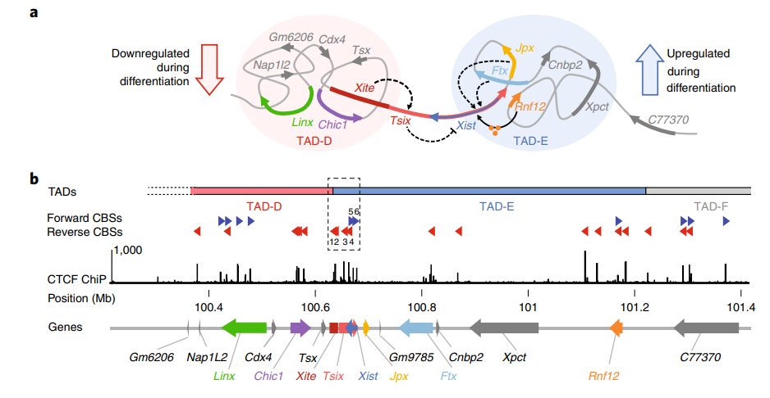
Xist and Tsix adopt opposite transcriptional fates during mESc differentiation: Their promoters lie in separate, adjacent TADs.
Fig.1
Opposite transcriptional fates during mESC differentiation
Tsix promoter interacts with TAD-D sequences
Xist promoter interacts with TAD-E sequences

Slide 20
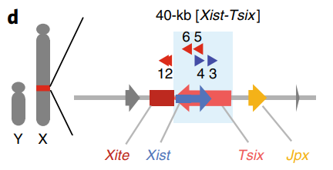
We generated a genomic inversion of Xist/Tsix locus 40 kb
Results:
The promoters switched their interaction preferences from one TAD to the other:
 | Wt cell | Inverted alleles
Tsix promoter interacts with | TAD-D | TAD-E
Xist promoter interacts with | TAD-E | TAD-D

Slide 21
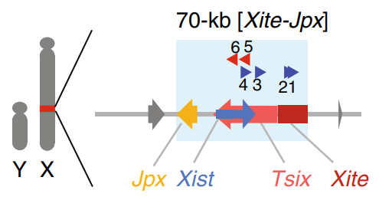
We generated a genomic inversion of Xist/Tsix locus 70 kb:
including their immediately adjacent loci Jpx and Xite
Fig. 2
Results:
The promoters switched their interaction preferences from one TAD to the other. The same results that we saw in 40kb Xist/Tsix inversion.

Slide 22
Xite: is a reported enhancer of Tsix
Jpx: is a co-expressed with Xist during differentiation
Results:
When we do the inversion, the promoters switch their interaction preferences from one TAD to the other.

Slide 23
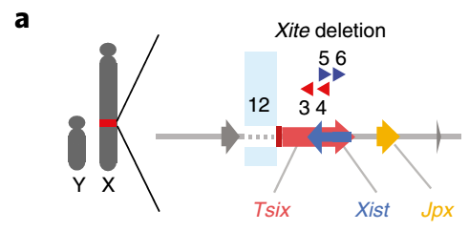
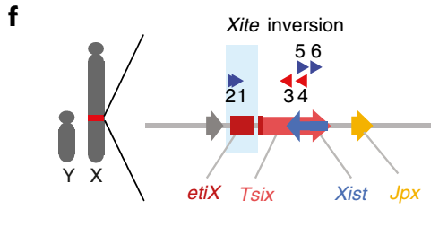
Xite contributes to insulating the Xist/Tsix TADs and establishes a TAD boundary in a orientation-dependent manner
Inversions and delections of the Xite locus
CBSs within Xite have a strong influence on TAD structure and organization.

Slide 24
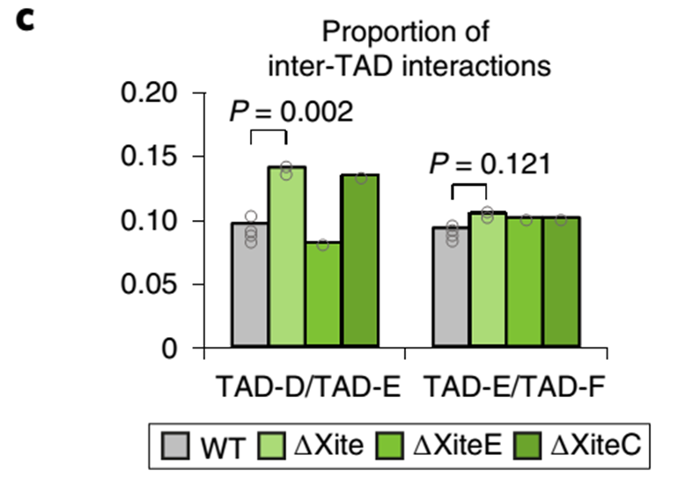
Xite’s elements contributes to insulating the Xist/Tsix TADs
Analysis of the ∆Xite male mESCs revealed a significant increase (45%) in contacts between TAD-D and TAD-E.
To distinguish between the contributions of the XiteE versus XiteC both were each delete alone.
Analysis of ∆XiteC and ∆XiteE male mESCs revealed an increase in contacts between TAD-D and TAD-E only in ∆XiteC mESCs.

Slide 25
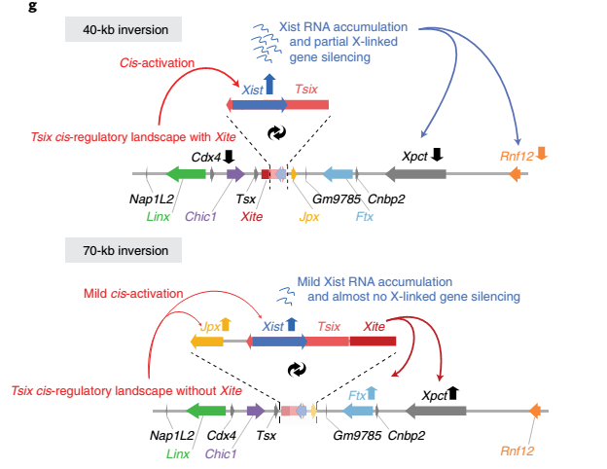
Contributes to Xist and Tsix expression
In both 40-kb (Tsix-Xist) and the 70-kb (Xite-Jpx) inversion:
Expression of Tsix is not significantly affected;
Xist become upregolated when placed within TAD-D.
In 40-kb inversion:
Ftx
Rnf12
are all down-regulated.

Slide 26
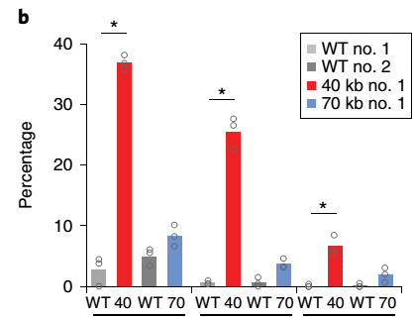
The effect of the previous inversions in Xist expression
Many of the cells harboring the 40-kb inversion (Tsix-Xist) exhibit Xist RNA accumulation;
In the 70-kb inversion (Xite-Jpx), Xist RNA shows abnormal accumulation.
This underlines the importance of the TAD environment for the appropriate transcriptional regulation of Xist.

Slide 27
Perturbed initiation of XCI when inverting the genomic organization of Xist and Tsix.
Figure 5a. Representation of female hybrid mESC lines harboring 3 different inversions. Light blue boxes indicate inverted region.
Figure 5b. Schematic representation of mESC to EpiLSC differentiation and time points analyzed.
Xist/Tsix inversions affect the initiation of XCI and the expression dynamics of Xist and Tsix during differentiation of female mESCs.

Slide 28
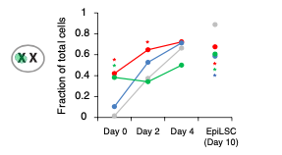
Xist RNA accumulation analyzed by RNA–FISH in female mESC cell lines in which there are inversions of Xist and Tsix genomic organization.
Figure 5c. It has been seen that:
In undifferentiated mESCs harboring the heterozygous or homozygous 40-kb [Tsix-Xist] inversion, we observed abnormal Xist RNA accumulation in ~40 or ~55% of the cells, respectively( day 0 ).
In mESCs harboring the heterozygous 70-kb [Xist-Jpx] inversion, ectopic Xist RNA accumulation was also observed, although in fewer cells (~10%)[ day 0 ].
At day 4, the proportion of cells accumulating Xist RNA on one X chromosomes was equivalent across all cell lines (~70%).
In day 10 EpiLSCs cells harboring an inversion, the percentage of cells with accumulation of Xist was significantly reduced to ~60%, compared to ~90% in wild type.

Slide 29
Pyrosequencing of Xist cDNA to measure allelic Xist expression.
Figure 5d. Allelic quantification of Xist RNA by pyrosequencing. Bars represent the percentage of Xist RNA expressed from the PGK (left) or 129 (right) allele in female mESCs described in Figure 5a.
Xist expression and/or accumulation is impaired during differentiation of female mESC harboring the inversions.

Slide 30
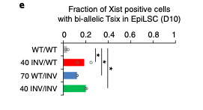
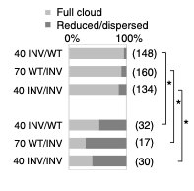
Tsix silencing is impaired when its promoter is exposed to Xist’s regulatory landscape.
Figure 5e. Bi-allelic Tsix expression measured by RNA–FISH in the female cell lines described in Figure 5a. Bars represent mean fraction of Xist-positive cells with bi-allelic Tsix expression.
Exposing Tsix to the regulatory environment that normally belongs to Xist impairs Tsix silencing during differentiation, and leads to the co-occurrence of Xist RNA accumulation and Tsix expression from the same allele.
Figure 5f. Quantification of Xist RNA cloud formation in the female cell lines described in Figure 5a, at day 10 of EpiLSC induction. The correlation between bi-allelic Tsix expression and reduced/dispersed Xist RNA clouds is highly significant.
These results suggest that prolonged Tsix expression might contribute to the reduced levels of Xist RNA during differentiation in the inversions.

Slide 31
Conclusion and discussion
Topological and regulatory environments are critical for the appropriate developmental regulation of Xist and Tsix.
The Xist and Tsix promoters exhibited different behaviors when moved to a new TAD environment.
The appropriate kinetics and allelic regulation of Xist and Tsix during XCI require Xic’s cis-regulatory landscape, but also its spatial partitioning, which prevents exposure of Xist to the cis-regulatory elements within the Tsix TAD and vice versa.
The spatial partitioning of the Xic is an integral part of its definition as the minimal locus necessary and sufficient to trigger XCI. The two Xic TADs serve to (1) insulate Xist physically from frequent cis-regulatory influences of the Tsix TAD in embryonic stem cells (ESCs), (2) provide the required cis-regulatory landscape for Xist to be upregulated during differentiation and (3) shield Tsix from the regulatory influences exerted by the Xist TAD during early differentiation.

Slide 32
Thanks for your attention

