Slide 1
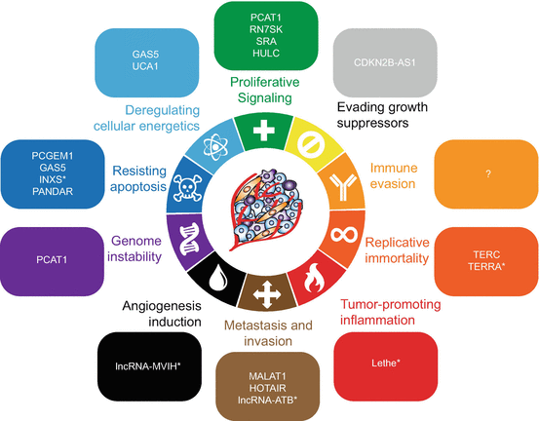
LncRNA in cancer formation and progression: the critical role of Malat1
Fiorino Jessica
Vanini Angelica
Bagnariol Enrico

Slide 2
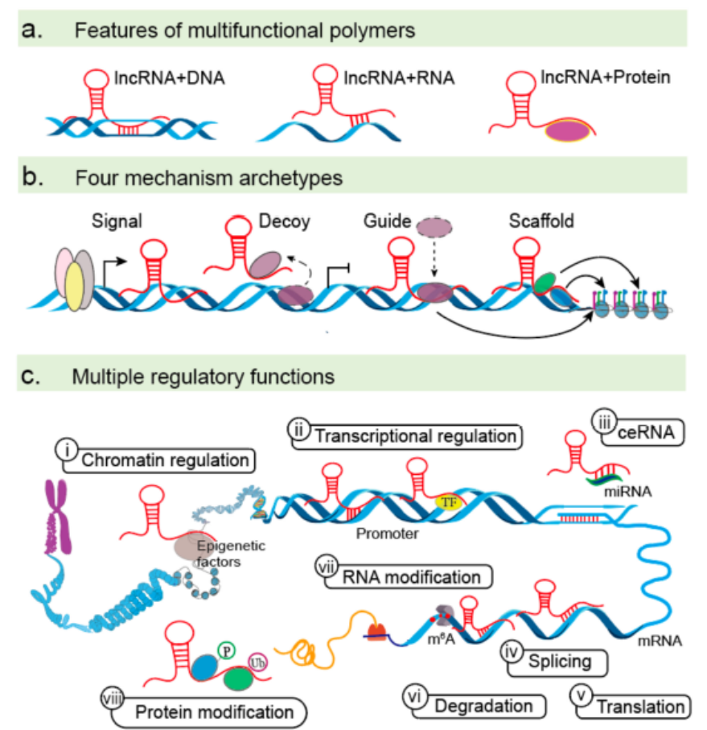
General overview of lncRNA
Genomic alterations in cancer
CNV by indels
Epigenetic silencing or iper-activation
SNP / point mutations
Consequences
Hypo / over -expression
Dysregulation of targets
Mechanisms of action
lncRNA plays an essential role in fine tuning the regulatory network of gene expression
Insights into Biological Role of LncRNAs in Epithelial-Mesenchymal Transition Jun-Ting Cheng, Lingzhi Wang Cells 2019
Notes:
As a coding gene dysregulated in cancer also lncRNA can have the same genomic alteration like …
Epigenetic silencing= ipermetilation

Slide 3
LncRNA in the take-over of hallmarks
Notes:
In the landscape of cancer the presence of lncRNA has been observed in the promotion of all the hallmarks
Now we analize the role of lncrna in the aquisition of hallmarks

Slide 4
Tumor initiation
Susteining proliferative signaling: TP53G1
Tumors: Gastric and colon
Mechanism of action : TF Decoy
  Antisense p53 normally prevents the activation of oncogenes
Genomic alteration: Promoter hypermethylation → Hypoexpression
  Silencing of TP53TG1:
  YBX1 nuclear localization
  activation of growth promoting genes
Dysregulation of TP53TG1 sustain proliferative pathways in cancer cells
Non-coding RNAs, epigenetics, and cancer: tying it all together J. Ferreira, M. Esteller, Springer Nature 2018
Notes:
epigenetic deregulation of lncRNAs is given by a recent study showing that p53- induced lncRNA, TP53TG1, is silenced by promoter hypermethylation in gastric and colon tumors with an associated poor prognosis. Authors showed that TP53TG1 interacts with the DNA/RNA binding protein YBX1, impeding its nuclear localization and preventing the activation of oncogenes. It was suggested that upon cancer-specific silencing of TP53TG1, YBX1 is able to activate growth-promoting genes and create chemoresistance.
The lncRNA TP53TG1 was demonstrated to be repressed by CGI promoter hypermethylation in primary gastric tumors. Functionally, TP53TG1 interacts with YBX1, preventing its nuclear localization and the activation of growthpromoting genes.

Slide 5
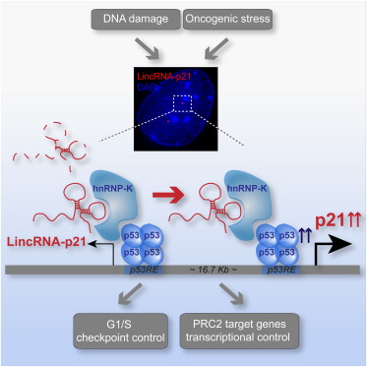
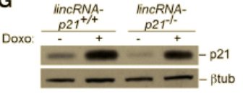
Tumor initiation
Evading growth suppressors: lincRNA-p21
Tumors: lymphoma, CRC
Mechanism of action: protein scaffold
  lincRNA-p21 acts with hnRNP-K as a co-activator for p53 dependent p21 transcription
Genetic alteration: Downregulation
  Impact indirectly on chromatin state of Polycomb target genes and cause
  alterations in G1/S checkpiont
  → decrease p21 expression
  → less induction of senescence
lincRNA-p21 is a key modulator of gene expression in p53 pathway, influencing the activation and the chromatin state of genes through its cis control of p21 expression
LincRNA-p21 activates p21 in cis to promote Polycomb target gene expression and to enforce the G1/S checkpoint, N. Dimitrova et all, Mol Cell. 2014
Notes:
Altera g1/s chekoint perché ci sono bassi livelli di p21→ non viene indotta senscenza

Slide 6
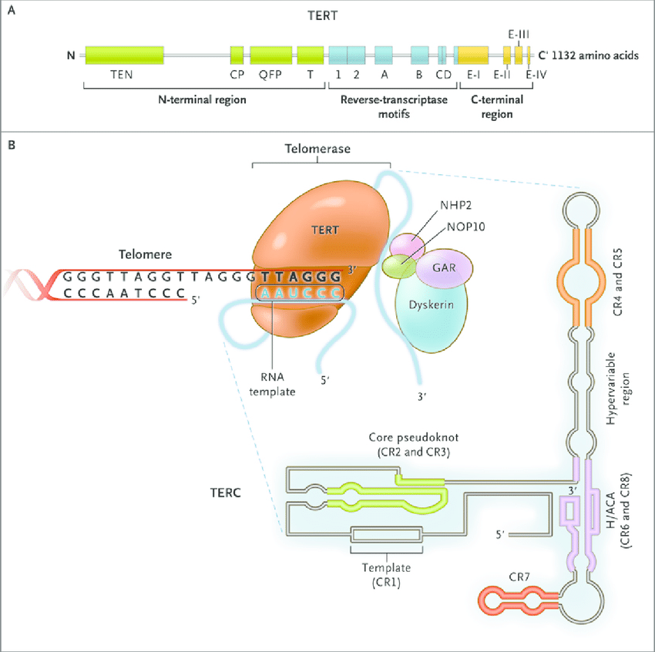
Tumor initiation
Enabling replicative immortality: TERC
Tumors: leukemias
Mechanism of action: guide
  Telomerase is composed by:
  TERT: catalytic component
  TERC: antisense RNA template
  Dyskerin: RNA binding protein
Genetic alteration: locus amplification
  Necessary for cancer cells immoralization
Reactivation of telomerase is link with amplification of hTERT and hTERC genes
Increased copy number of the TERT and TERC telomerase subunit genes in cancer cells Ying Cao,Tracy M. Bryan; Cancer Sci, 2008
Notes:
Increases in copy number are simply random changes that reflect the genetic instability seen in cancers.

Slide 7
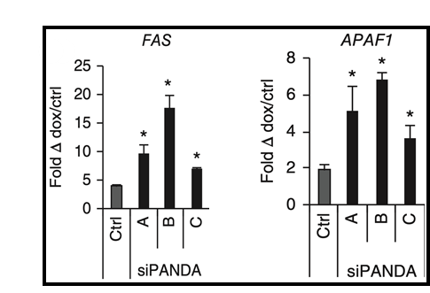
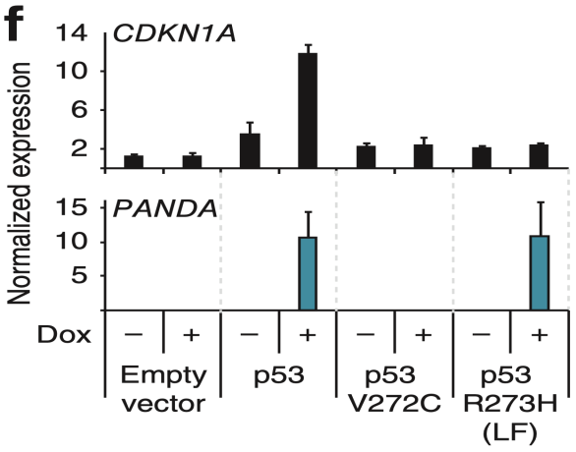
Tumor progression
Resisting cell death: PANDA
DNA damage → p53 → PANDA → p53 stabilization
PANDA downregulates apoptotic genes
  directly
  indirectly by NF-YA inhibition
PANDA does not regulates cell cyle arrest genes like CDKN1A
PANDA promotes anti-apoptotic behavior and, indirectly, cell cycle arrest in certain mutant p53 backgrounds
Hung, T. et al. Extensive and coordinated transcription of noncoding RNAs within cell-cycle promoters. Nat Genet 2011.
Notes:
5′-capped and polyadenylated non-spliced
PANDA downregulates apoptotic genes directly (e.g. APAF1, FAS) indirectly by NF-YA inhibition (e.g. PUMA, NOXA)

Slide 8
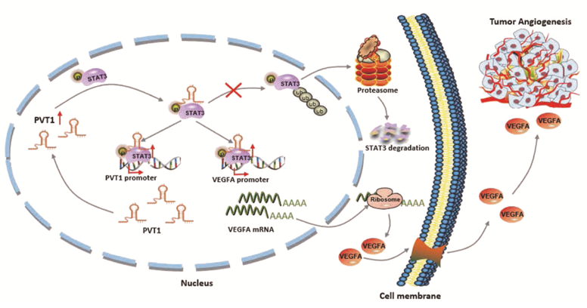
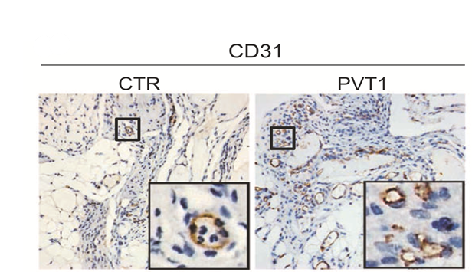
Tumor progression
Angiogenesis: PVT1
Tumors: Gastric cancer
Mechanism of action: stabilizer
  PVT1 binds to pSTAT3 and activate STAT3 signaling pathway
Increase VEGF expression
Genetic alteration: CNV on Myc locus
  Transcription of PVT1 is regulated by Myc oncogene
  overexpression of PVT1
  promotion of angiogenesis
PVT1 enhances angiogenesis through STAT3/VEGFA axis leading to aggressive features
Zhao, J. et al. LncRNA PVT1 promotes angiogenesis via activating the STAT3/VEGFA axis in gastric cancer. Oncogene 2018.
Notes:
Mechanistically, PVT1 directly interacted with the signal transducer activator phospho-STAT3 in the nucleus, and increased its protein stability by protecting it from poly-ubiquitination and proteasome-dependent degradation. The binding of PVT1 activated the STAT3 signalling pathway, and successively elevated VEGFA expression to stimulate angiogenesis

Slide 9
Tumor progression
Inducing invasion and metastasis: HOTAIR
Tumors: most aggressive ones
Mechanism of action:
scaffold
ceRNA
In esophageal cancer, HOTAIR sequestrates miR-148a, which de-represses Snail2, and promotes EMT
Genetic alteration: locus amplification
Non-coding RNAs, epigenetics, and cancer: tying it all together J. Ferreira, M. Esteller, Springer Nature 2018
Notes:
a. Left: In cancer, HBXIP interacts with c-Myc and recruits HOTAIR together with LSD1 (mediates the transient demethylation of H3K4me2). The complex c- Myc/HBXIP/Hotair/LSD1 is responsible for c-Myc transcriptional activation. a, Right: HOTAIR can also serve as a scaffold for PRC2 complex promoting H3K27me3 in the promoter region of WIF-1, which is an inhibitor of the Wnt/β-catenin signaling pathway. The epigenetic silencing of WIF-1 associates with the activation of the WNT-β-catenin pathway.
b. Additionally, HOTAIR not only regulates chromatin dynamics but also influences gene expression posttranscriptionally. This lncRNA acts as a ceRNA

Slide 10
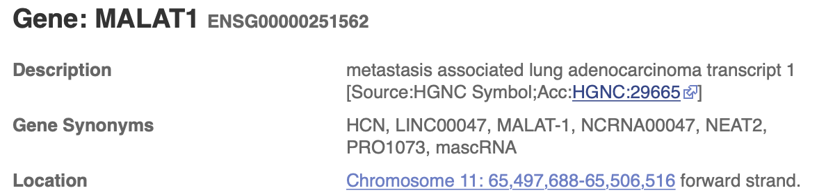
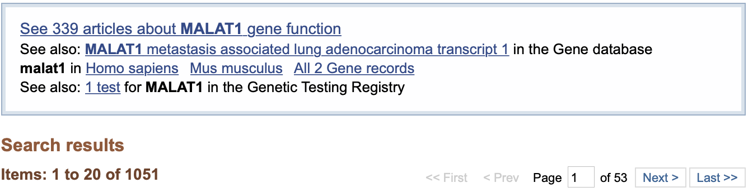
MALAT1 as an oncogene
Upregulation of MALAT1 is observed in various types of cancer:
lung cancer 7
bladder carcinoma 2
breast cancer 3
cervical cancer 4
ovarian cancer 1
colorectal cancer 3
endometrial cancer 1
esophageal cancer3
gastric cancer 1
hepatocellular carcinoma 2
melanoma
multiple myeloma
neuroblastoma osteosarcoma
prostate cancer
renal cell carcinoma
..
http://www.ensembl.org; https://www.ncbi.nlm.nih.gov/pubmed ; Yoshimoto et al. - 2016 - MALAT1 long non-coding RNA in cancer
Notes:
Genetic background:
Intergenic (lincRNA) → random seq
Overlapping:
Sense → decoy
Antisense → stabilization
Exonic/intronic→ reg. timing
Same/different promoter → reg. space
Mechanisms:
Base paring → decoy (miRNA, RBP)
→ mRNA stabilization
Secondary structures → decoy (TF)
→ scaffold
Both → guide (TF, ChRem)
Interacting partners:
Proteins (TF, Chr.Rem., Rec)
Various RNA species
Chromatin

Slide 11
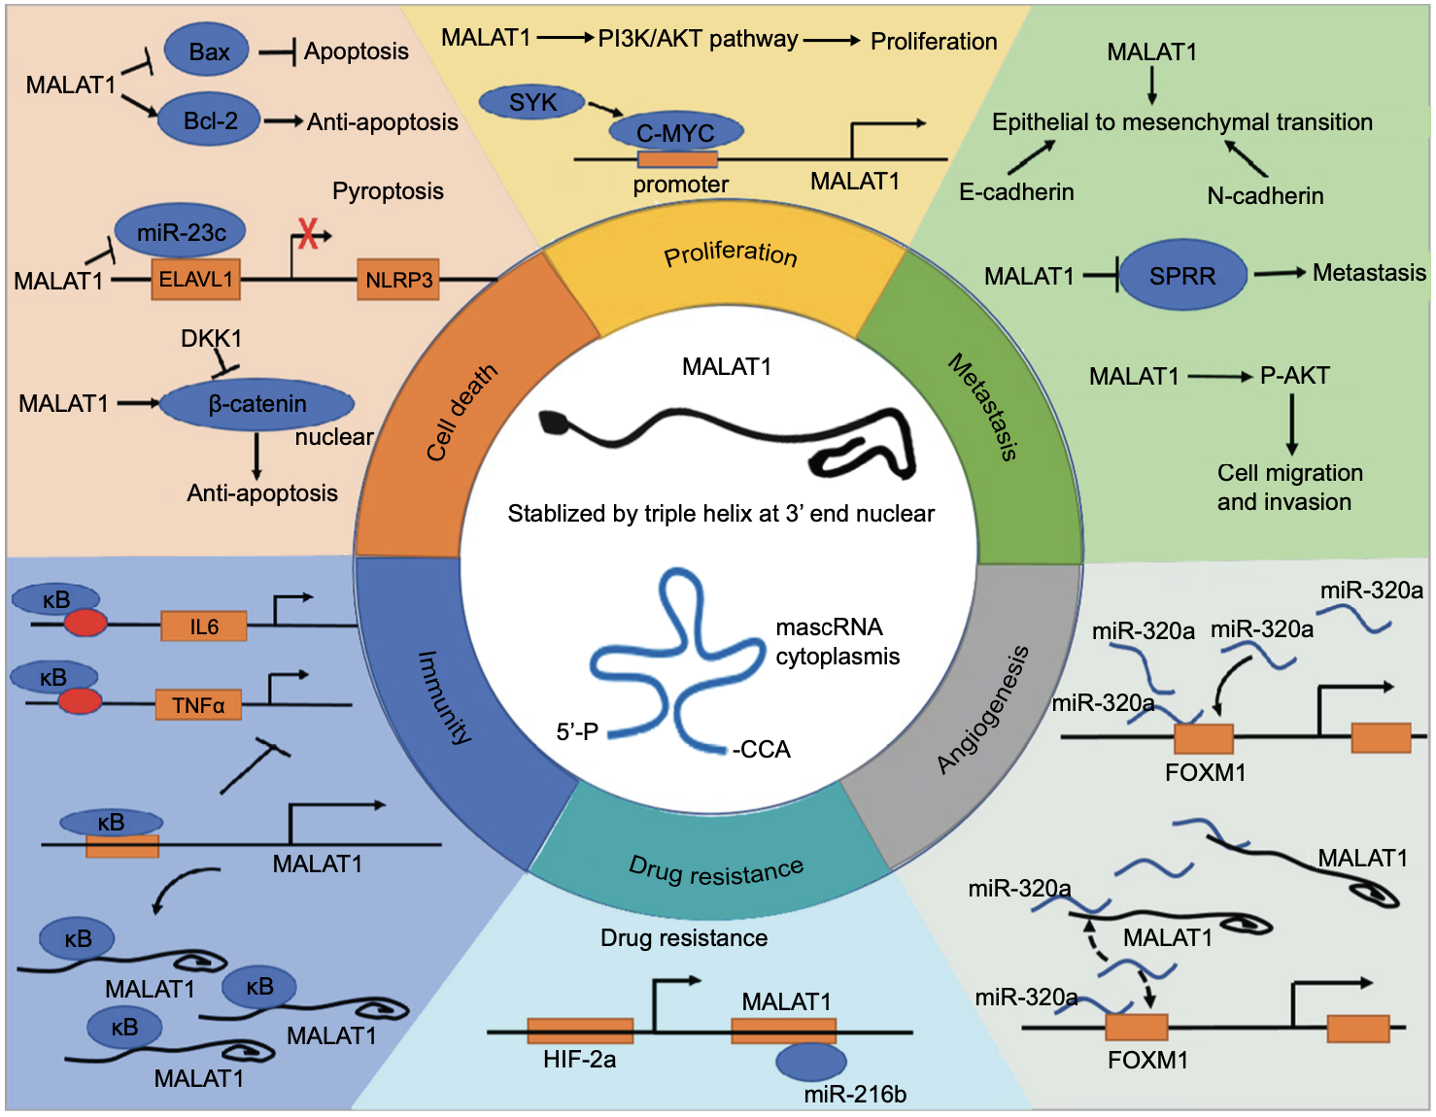
MALAT1 as an oncogene
Ref image: Li, Zhi-Xing,, Guo Wang, e Yuan-Shan Zhu. «MALAT1: A Potential Biomarker in Cancer». Cancer Management and Research Volume 10 (dicembre 2018): 6
Notes:
Genetic background:
Intergenic (lincRNA) → random seq
Overlapping:
Sense → decoy
Antisense → stabilization
Exonic/intronic→ reg. timing
Same/different promoter → reg. space
Mechanisms:
Base paring → decoy (miRNA, RBP)
→ mRNA stabilization
Secondary structures → decoy (TF)
→ scaffold
Both → guide (TF, ChRem)
Interacting partners:
Proteins (TF, Chr.Rem., Rec)
Various RNA species
Chromatin

Slide 12
MALAT1 as an oncogene
Ref image: Li, Zhi-Xing,, Guo Wang, e Yuan-Shan Zhu. «MALAT1: A Potential Biomarker in Cancer». Cancer Management and Research Volume 10 (dicembre 2018): 6
Notes:
Genetic background:
Intergenic (lincRNA) → random seq
Overlapping:
Sense → decoy
Antisense → stabilization
Exonic/intronic→ reg. timing
Same/different promoter → reg. space
Mechanisms:
Base paring → decoy (miRNA, RBP)
→ mRNA stabilization
Secondary structures → decoy (TF)
→ scaffold
Both → guide (TF, ChRem)
Interacting partners:
Proteins (TF, Chr.Rem., Rec)
Various RNA species
Chromatin

Slide 13
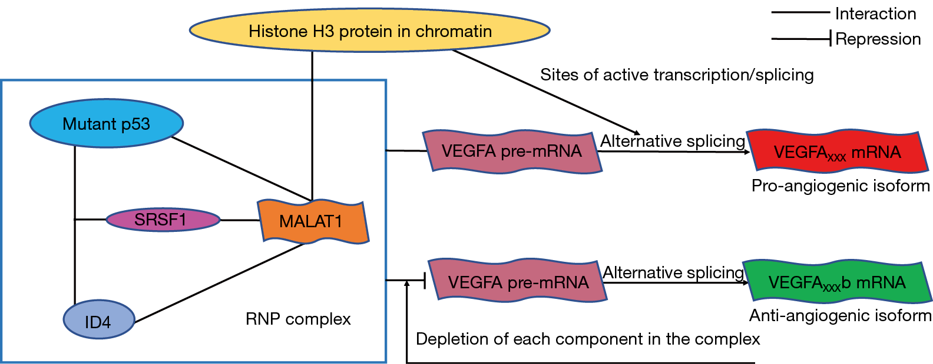
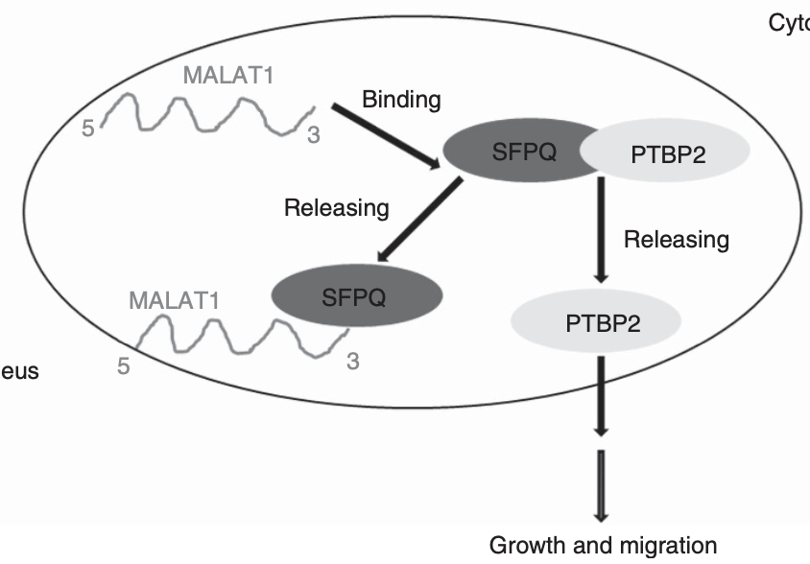
MALAT1: role in cancer metastasis
SPLICING MODULATOR
In breast cancer cells: multiple mutations in the SRSF1-binding sites of MALAT1
Alterating the splicing pattern in a pro-angiogenetic direction (SRSF1 is a proto-oncogene splicing factor)
In various cancer: MALAT1 sequesters SFPQ, a multifunctional RNA-binding protein
promoting growth and migration by the releasing of PTBP2 (PTBP2 is a negative splicing factor that support tumorigenesis)
Genomic alteration: point mutation
Mechanism: protein scaffold
Consequences: alteration of targets’ splicing
Genomic alteration: overexpression
Mechanism: protein decoy
Consequences: alteration of targets’ splicing
Ref image: Li, Zhi-Xing,, Guo Wang, e Yuan-Shan Zhu. «MALAT1: A Potential Biomarker in Cancer». Cancer Management and Research Volume 10 (dicembre 2018): 6
Pruszko M, Milano E, Bicciato S, et al. The mutant p53-ID4 complex controls VEGFA isoforms by recruiting lncRNA MALAT1. EMBO Rep. 2017;18(8):1331–51.
Notes:
Genetic background:
Intergenic (lincRNA) → random seq
Overlapping:
Sense → decoy
Antisense → stabilization
Exonic/intronic→ reg. timing
Same/different promoter → reg. space
Mechanisms:
Base paring → decoy (miRNA, RBP)
→ mRNA stabilization
Secondary structures → decoy (TF)
→ scaffold
Both → guide (TF, ChRem)
Interacting partners:
Proteins (TF, Chr.Rem., Rec)
Various RNA species
Chromatin

Slide 14
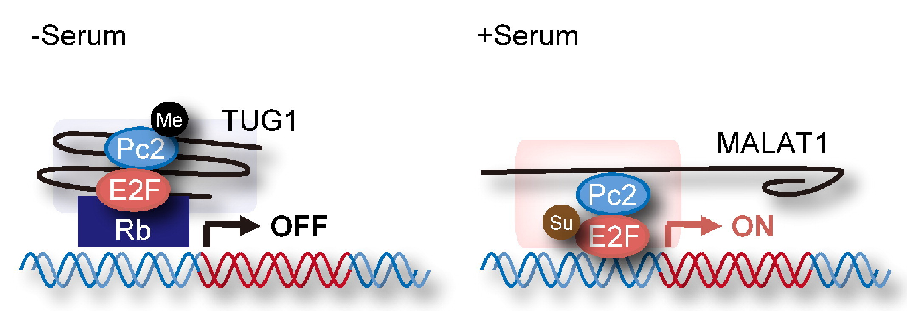
MALAT1: role in cancer metastasis
Polycomb Repressive Complex 2-INTERACTER
In bladder cancer: MALAT1 associates with Suz12, a component of PRC2
induction N-cadherin expression, and concomitant reduction in E-cadherin
(not shown)
In various cancer: binding of MALAT1 to Pc2 unmethylated promotes E2F1 SUMOylation
leading to activation of the growth-control gene program
Genomic alteration: overexpression
Mechanism: chromatin guide
Consequences: dysregulation of gene expression
Genomic alteration: overexpression
Mechanism: p-RNA-p functionalization
Consequences: dysregulation of gene expression
Ref image: Li, Zhi-Xing,, Guo Wang, e Yuan-Shan Zhu. «MALAT1: A Potential Biomarker in Cancer». Cancer Management and Research Volume 10 (dicembre 2018): 6
Notes:
Genetic background:
Intergenic (lincRNA) → random seq
Overlapping:
Sense → decoy
Antisense → stabilization
Exonic/intronic→ reg. timing
Same/different promoter → reg. space
Mechanisms:
Base paring → decoy (miRNA, RBP)
→ mRNA stabilization
Secondary structures → decoy (TF)
→ scaffold
Both → guide (TF, ChRem)
Interacting partners:
Proteins (TF, Chr.Rem., Rec)
Various RNA species
Chromatin

Slide 15
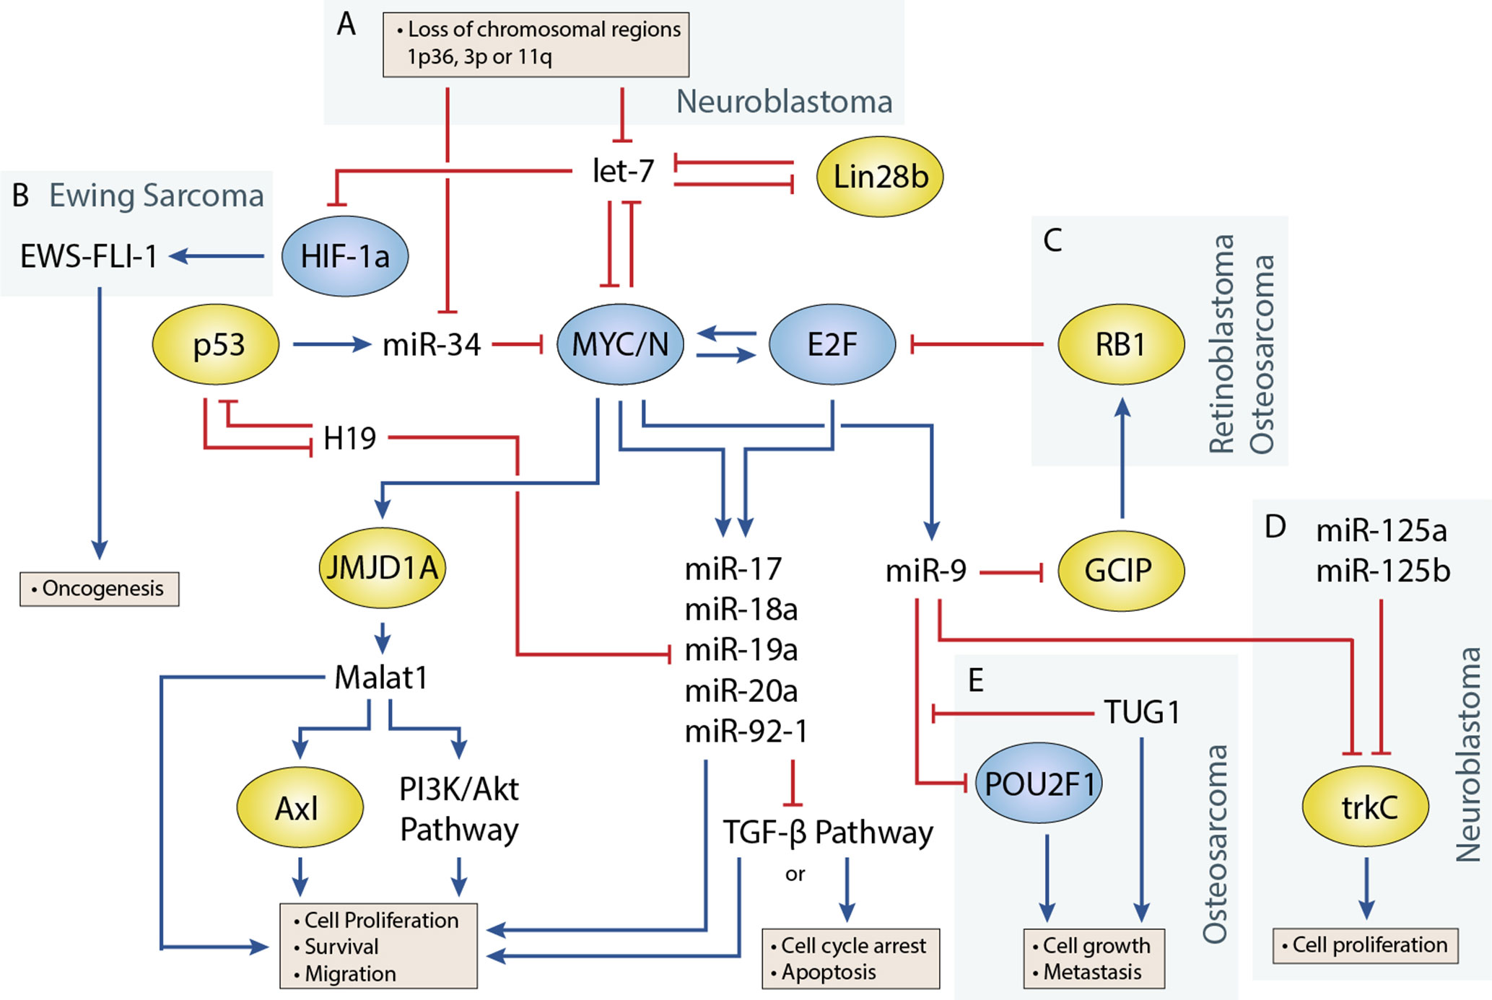
MALAT1: role in cancer metastasis
Competitive endogenous RNA
in A375 melanoma cells: MALAT1 functions as a ceRNA, sponging miR-34 (and others)
miR-34a is directly regulated by p53 (oncosuppressive activity)
Genomic alteration: CNV/up
Mechanism: miRNA sponge (ceRNA)
Consequences: upregulation of miRNA-targets (i.e. c-Myc)
Ref image: Li, Zhi-Xing,, Guo Wang, e Yuan-Shan Zhu. «MALAT1: A Potential Biomarker in Cancer». Cancer Management and Research Volume 10 (dicembre 2018): 6
Notes:
Genetic background:
Intergenic (lincRNA) → random seq
Overlapping:
Sense → decoy
Antisense → stabilization
Exonic/intronic→ reg. timing
Same/different promoter → reg. space
Mechanisms:
Base paring → decoy (miRNA, RBP)
→ mRNA stabilization
Secondary structures → decoy (TF)
→ scaffold
Both → guide (TF, ChRem)
Interacting partners:
Proteins (TF, Chr.Rem., Rec)
Various RNA species
Chromatin

Slide 16
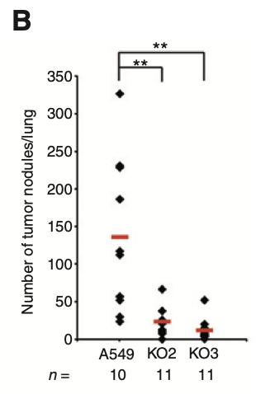
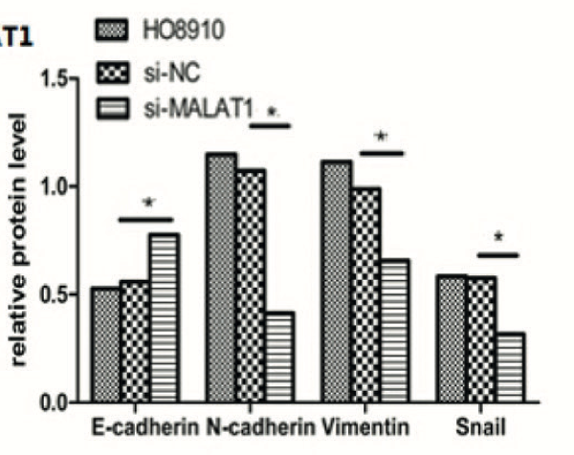
Evidences
MALAT1 in cancer metastasis is primarily modulated by regulating EMT.
In ovarian tumor, an inhibition of MALAT1 has significantly impeded EMT with a decrease in MMP and mesenchymal cell markers.
The tumor burden was drastically reduced in MALAT1 knockout cells (KO2 and KO3) compared with WT control cells.
Ref : Li, Zhi-Xing,, Guo Wang, e Yuan-Shan Zhu. «MALAT1: A Potential Biomarker in Cancer». Cancer Management and Research Volume 10 (2018); Jin, Feng LncRNA MALAT1 promotes proliferation and metastasis in epithelial ovarian cancer via the PI3K-AKT pathway ; 2017, European Review for Medical and Pharmacological Sciences ; Gutschner, Tony et al. “The noncoding RNA MALAT1 is a critical regulator of the metastasis phenotype of lung cancer cells.” Cancer research vol. 73,3 (2013)
Notes:
Genetic background:
Intergenic (lincRNA) → random seq
Overlapping:
Sense → decoy
Antisense → stabilization
Exonic/intronic→ reg. timing
Same/different promoter → reg. space
Mechanisms:
Base paring → decoy (miRNA, RBP)
→ mRNA stabilization
Secondary structures → decoy (TF)
→ scaffold
Both → guide (TF, ChRem)
Interacting partners:
Proteins (TF, Chr.Rem., Rec)
Various RNA species
Chromatin

Slide 17
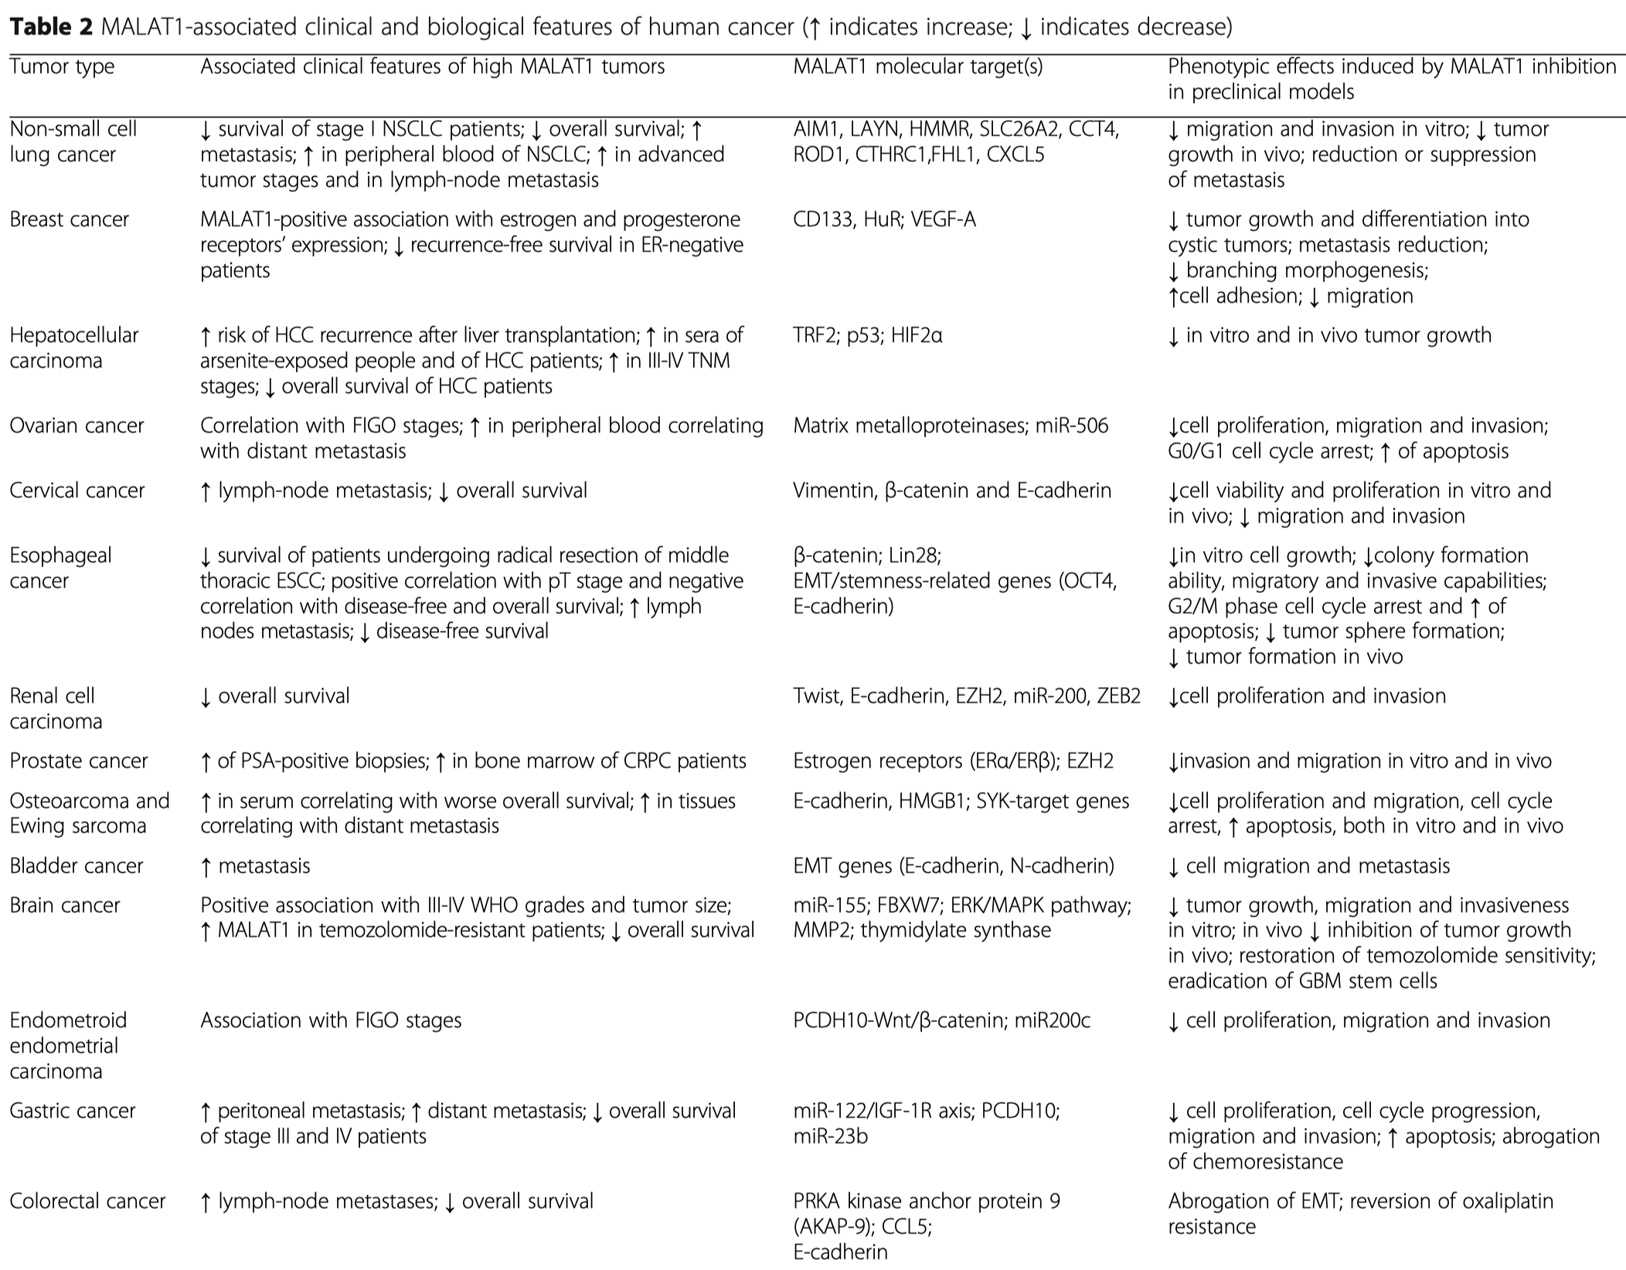
Highly expressed MALAT1
Amodio, N. et al. MALAT1: a druggable long non-coding RNA for targeted anti-cancer approaches. J Hematol Oncol 11, 63 (2018).

Slide 18
Highly expressed MALAT1
Amodio, N. et al. MALAT1: a druggable long non-coding RNA for targeted anti-cancer approaches. J Hematol Oncol 11, 63 (2018).

Slide 19
Highly expressed MALAT1
Amodio, N. et al. MALAT1: a druggable long non-coding RNA for targeted anti-cancer approaches. J Hematol Oncol 11, 63 (2018).

Slide 20

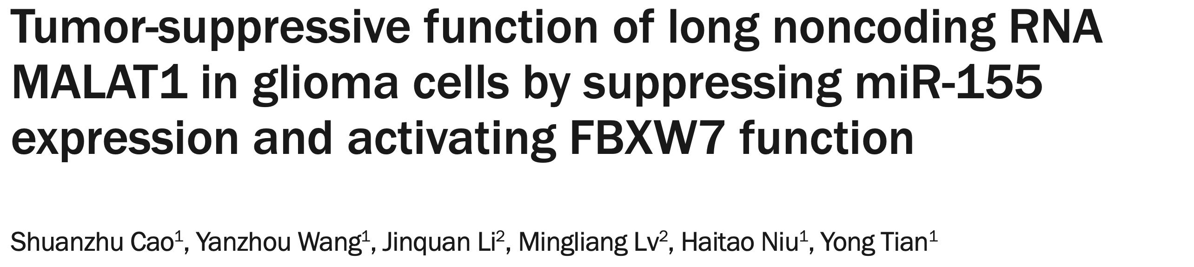
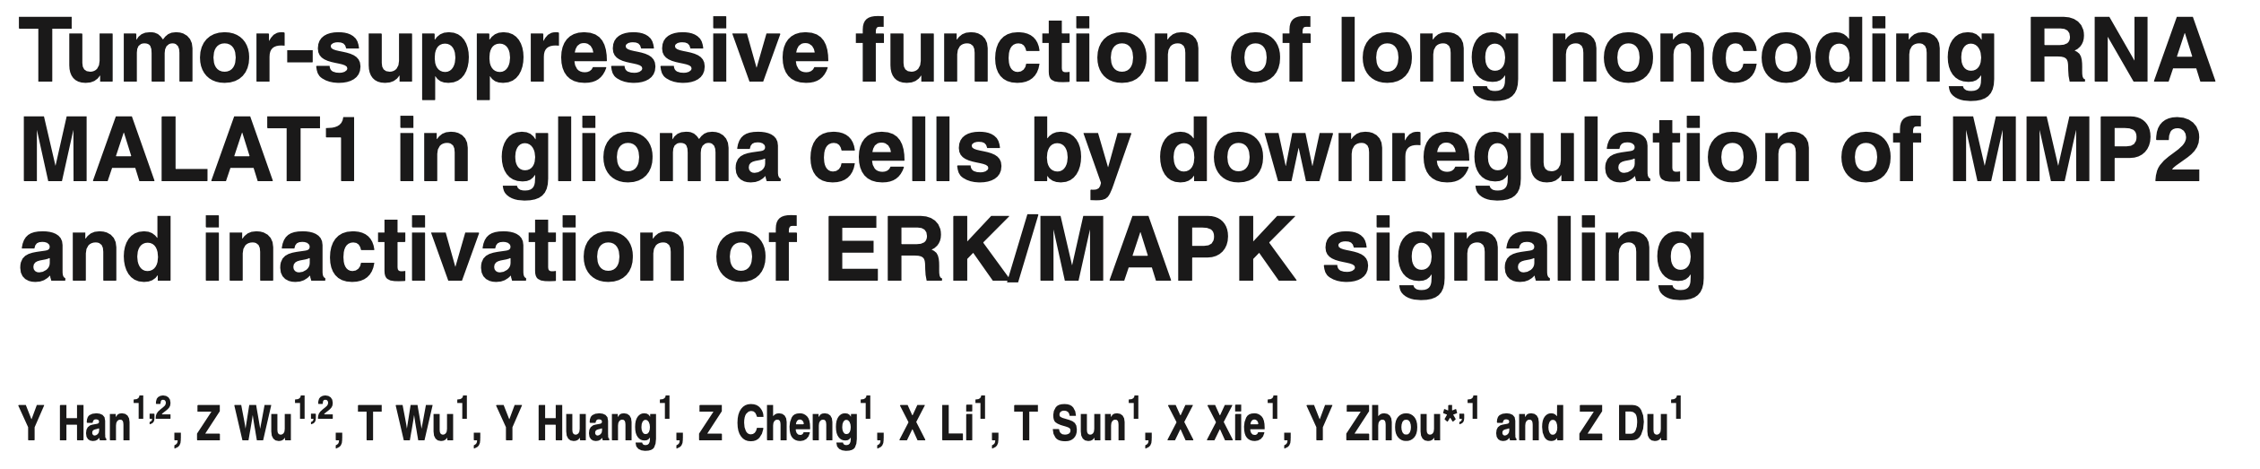
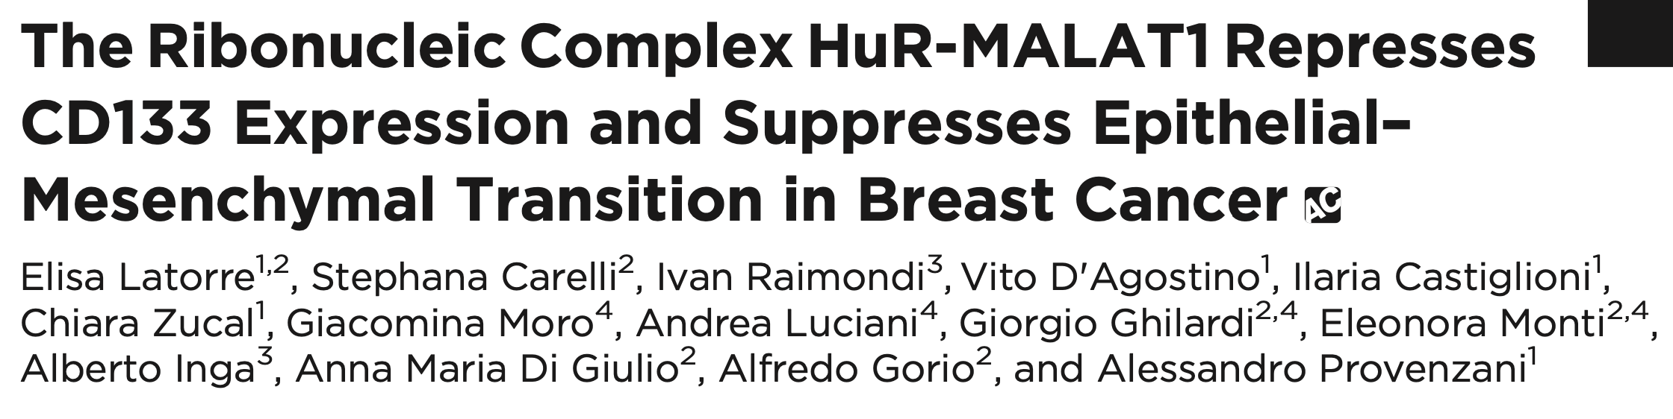

Slide 21
Which can be the reasons of these contradictory results?
Knockdown targets cytoplasmatic RNA → nuclear function
Knockout of huge genomic region → involved neighbor genes
Rescue experiment has never been performed

Slide 22
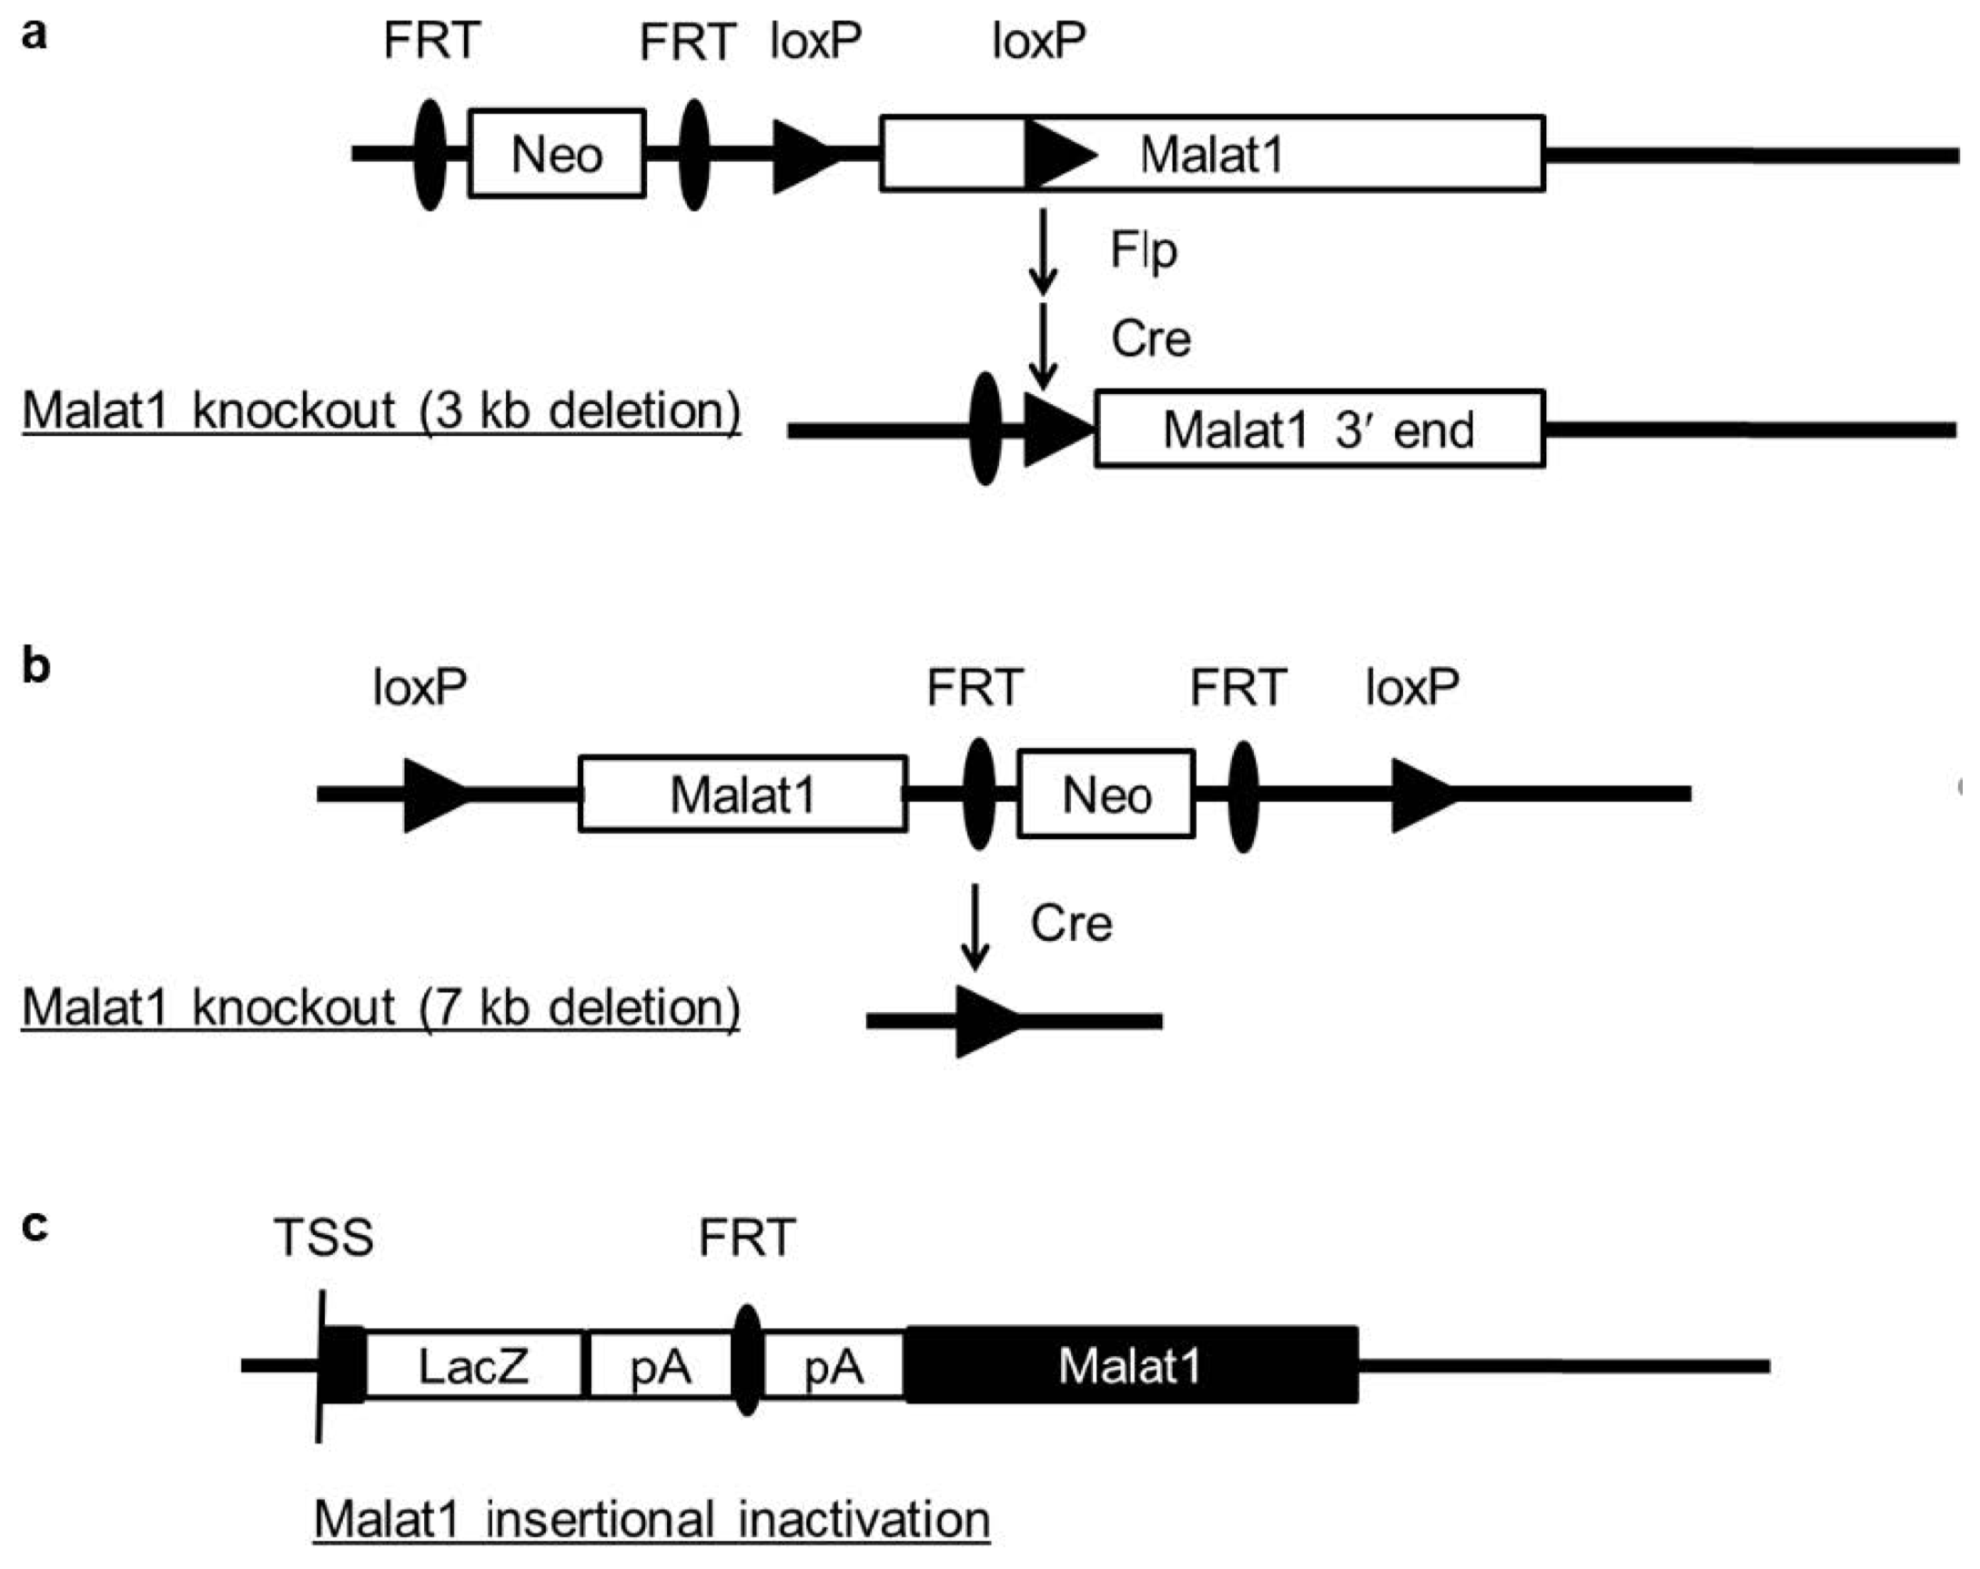
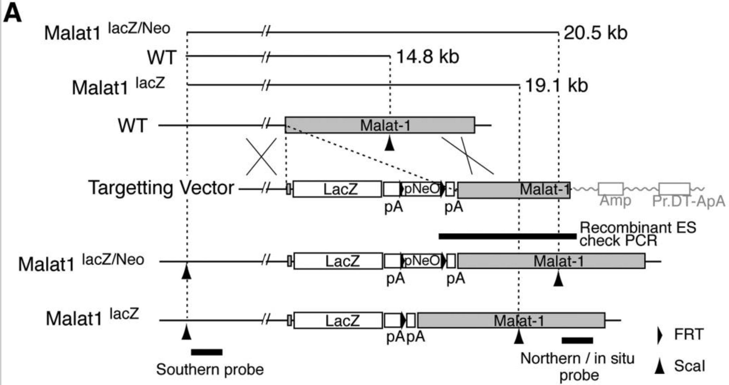

Different targeting approches lead to different phenotypes
Models for constitutive MALAT1 KO:
Gene deletion approches
Genomic contest disrupted
Insertional disruption approches
Genomic contest mantained
Sun, Y. & Ma, L. New Insights into Long Non-Coding RNA MALAT1 in Cancer and Metastasis. Cancers 11, 216 (2019).

Slide 23
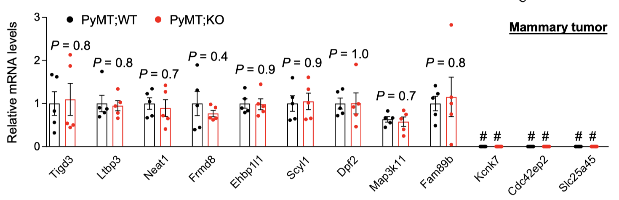
Genetic analyses identify Malat1 as a metastasis suppressor
Breast cancer metastasis mouse model generation:
Insertional mutagenesis of Neo/LacZ cassette
→ Malat1 KO model
MMTV-PyMT transgene (ER⁻, PR⁻, integrin-β1⁻, overexpression ErbB2 and CCND1)
→ Metastatic breast cancer model
Breeded mouse model MMTV-PyMT;Malat1^{-/-}
→ Malat1 KO metastatic breast cancer model
MMTV-PyMT;Malat1^{-/-} recapitulates metastatic breast cancer model

Slide 24
Genetic analyses identify Malat1 as a metastasis suppressor
Breast cancer metastasis mouse model generation:
Insertional mutagenesis of Neo/LacZ cassette
→ Malat1 KO model
MMTV-PyMT transgene (ER⁻, PR⁻, integrin-β1⁻, overexpression ErbB2 and CCND1)
→ Metastatic breast cancer model
Breeded mouse model MMTV-PyMT;Malat1^{-/-}
→ Malat1 KO metastatic breast cancer model
MMTV-PyMT;Malat1^{-/-} recapitulates metastatic breast cancer model

Slide 25
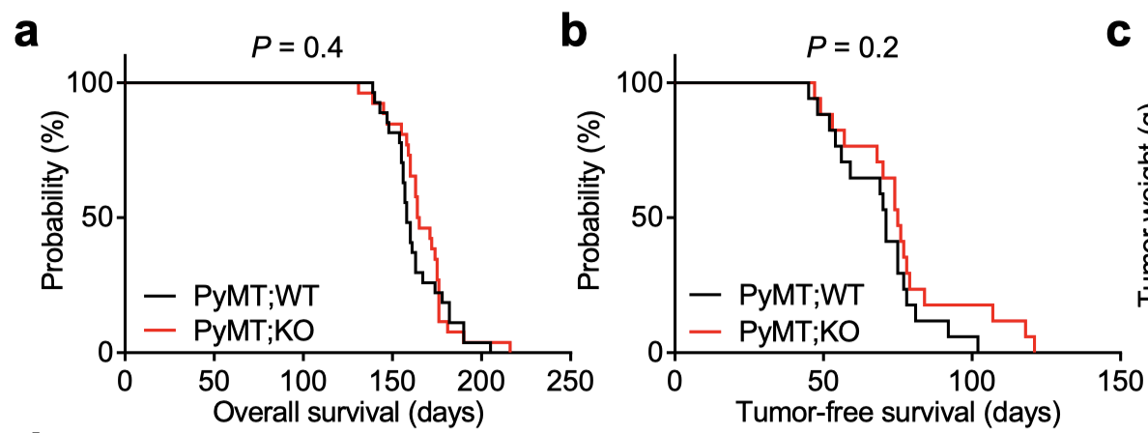
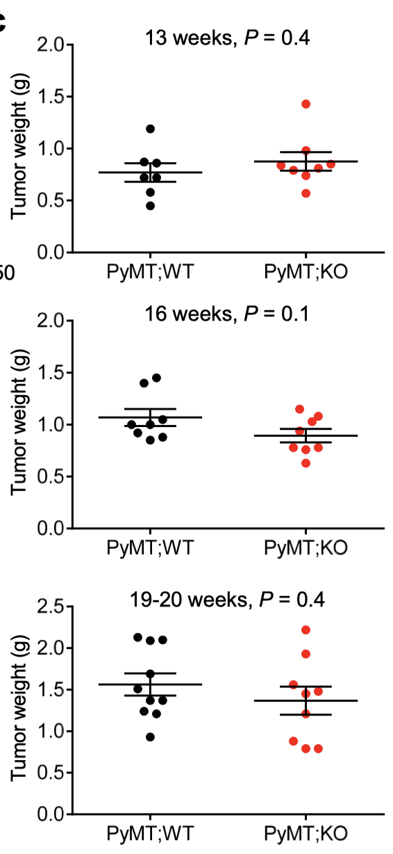
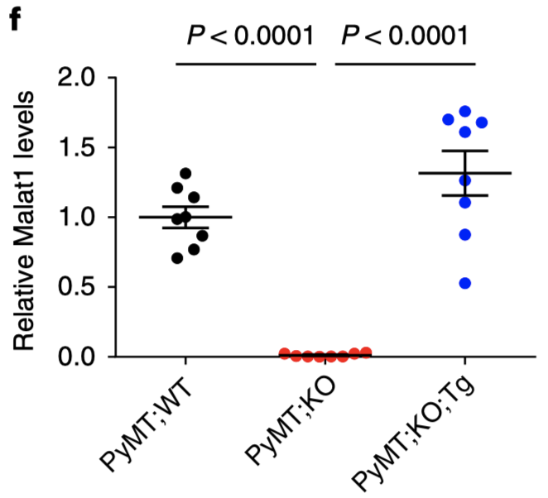
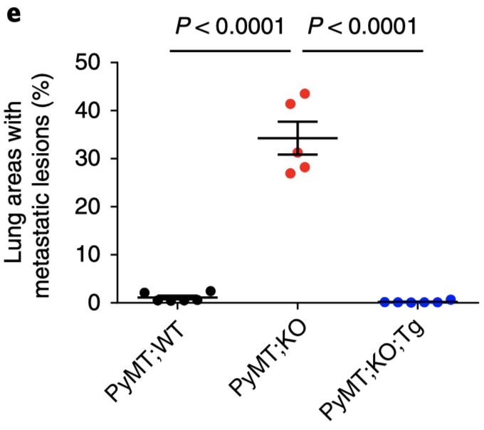
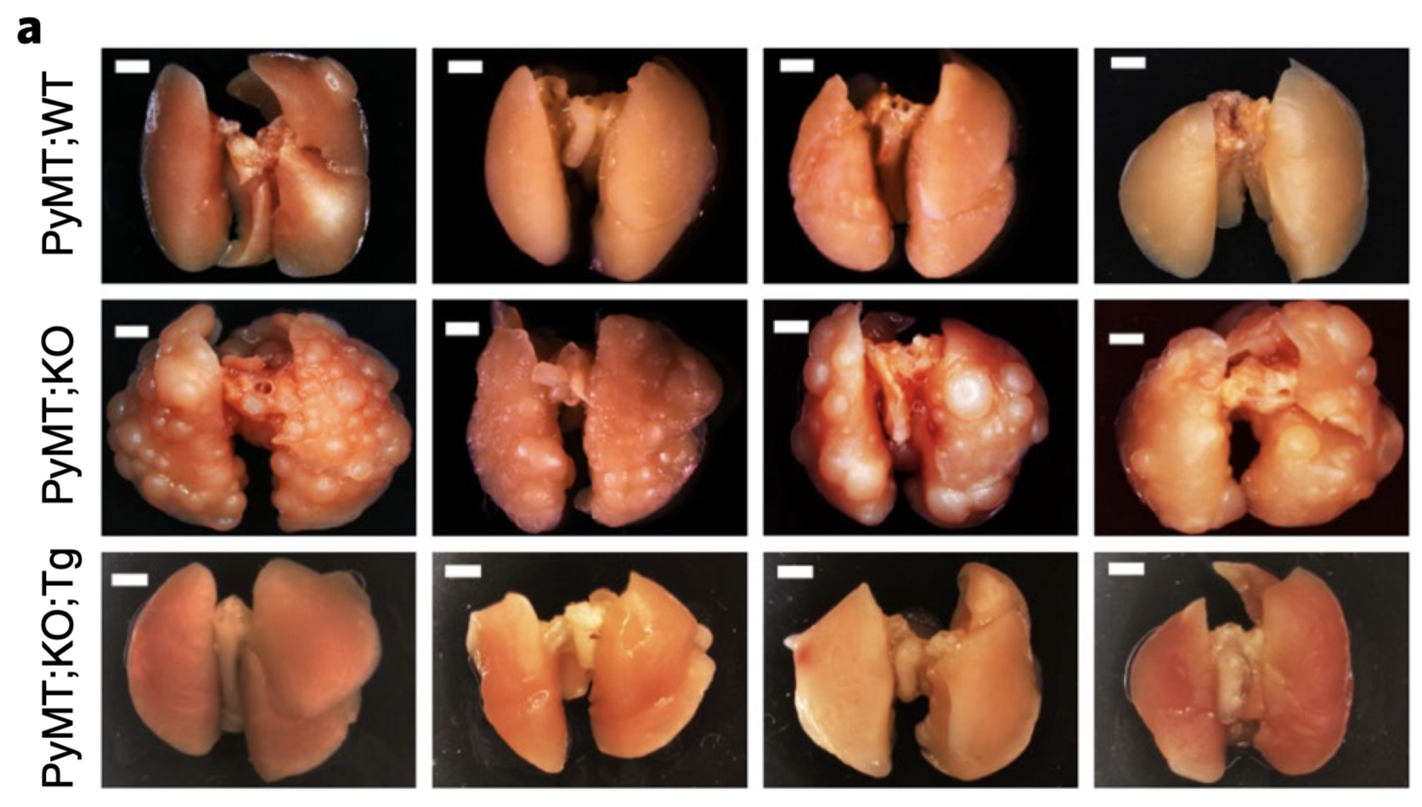

Genetic analyses identify Malat1 as a metastasis suppressor
MMTV-PyMT;WT vs MMTV-PyMT;Malat1^{-/-} mice model:
No significant differences in overall survival and mammary tumor-free survival
MALAT1 KO model showed an increase of metastatic lesions in mice lungs

Slide 26
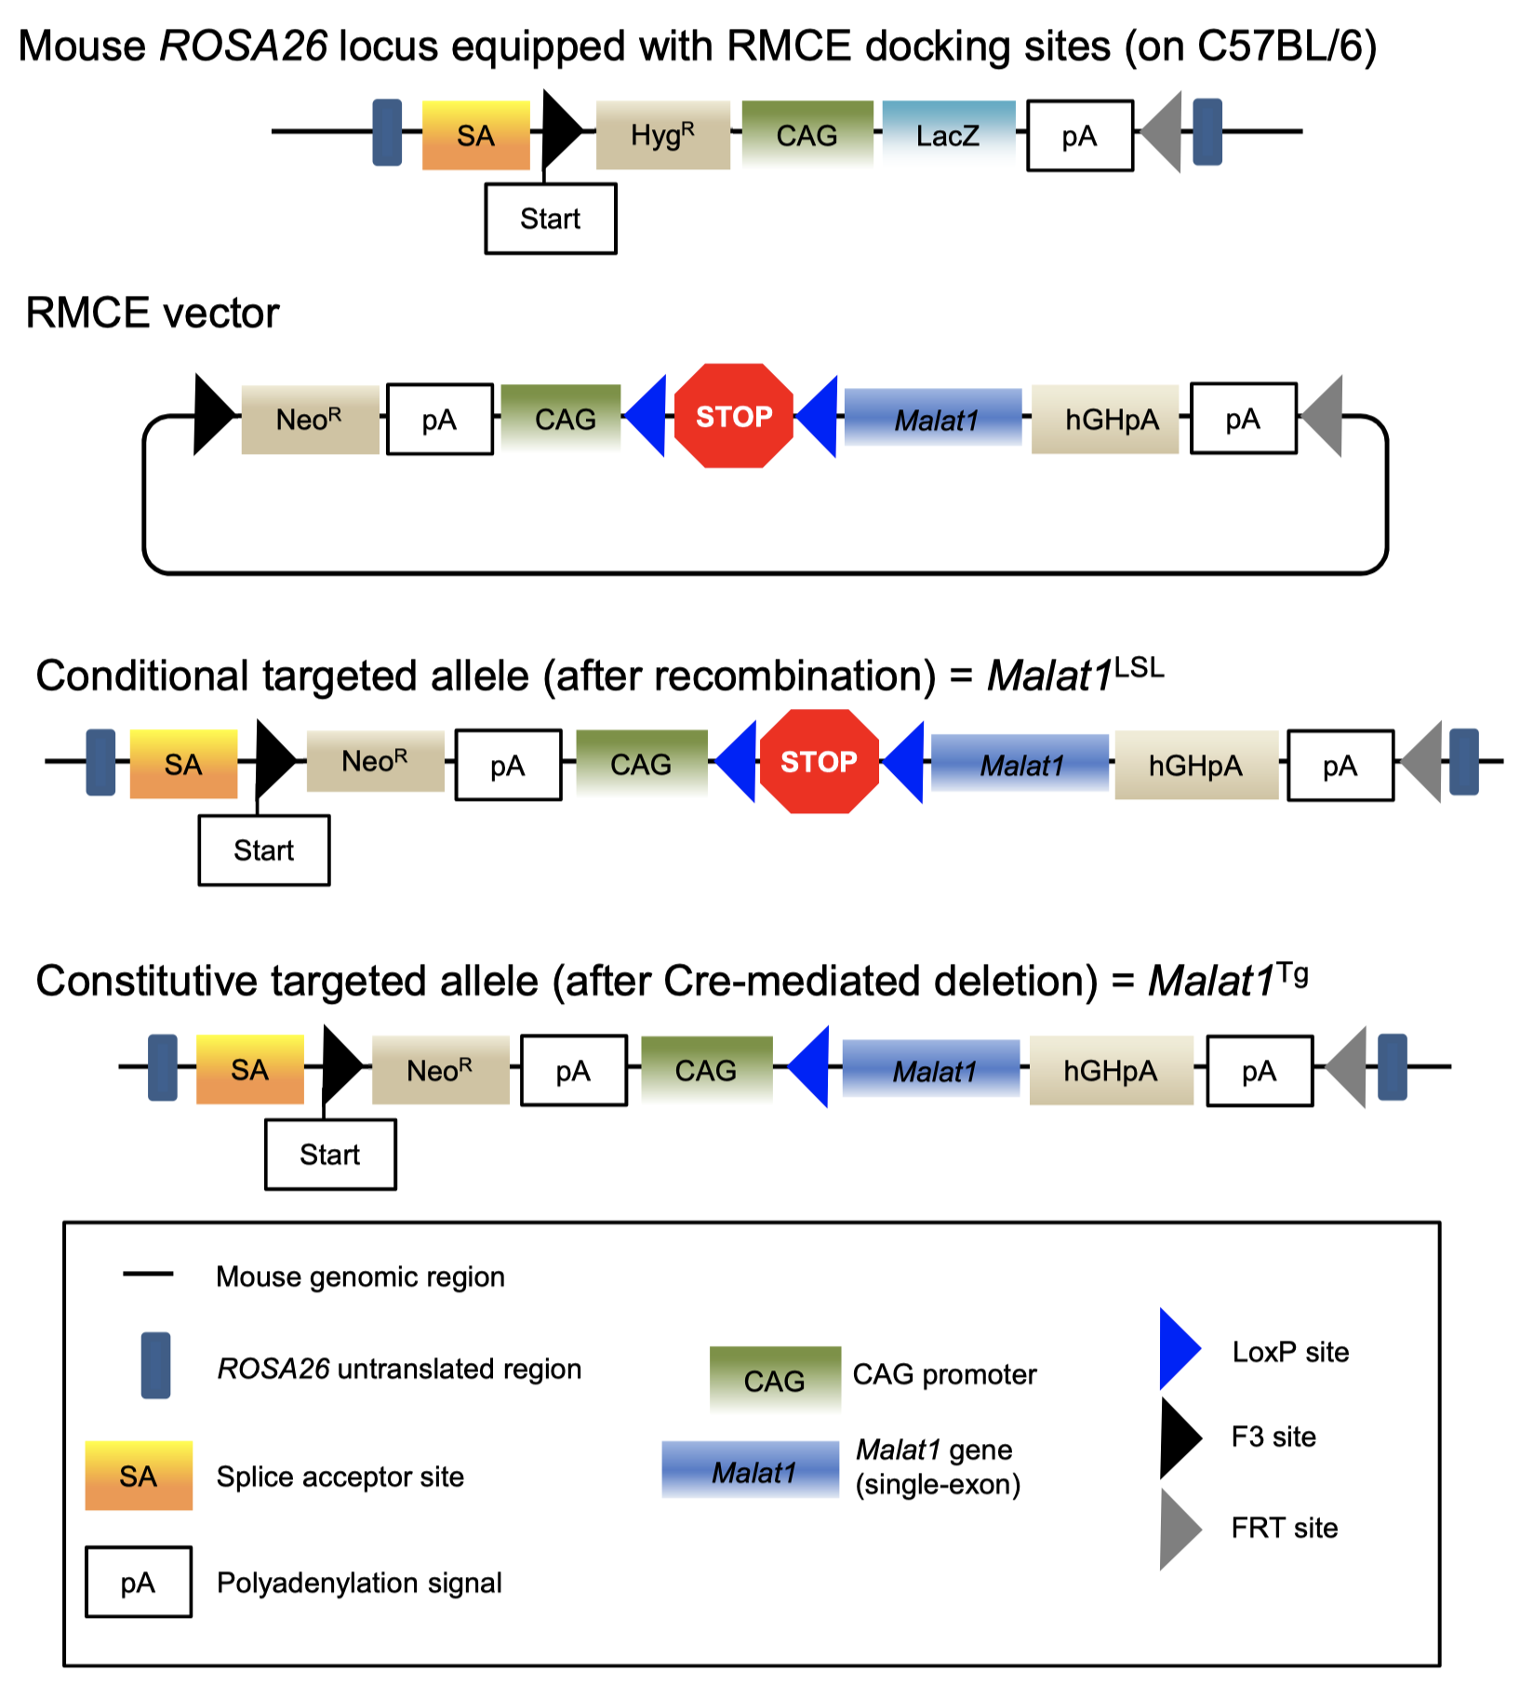
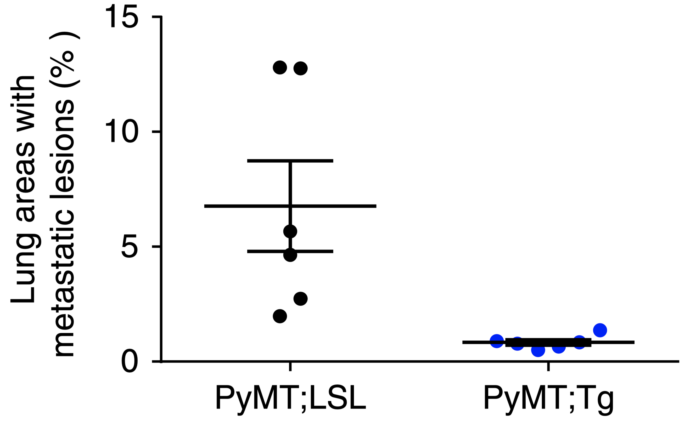
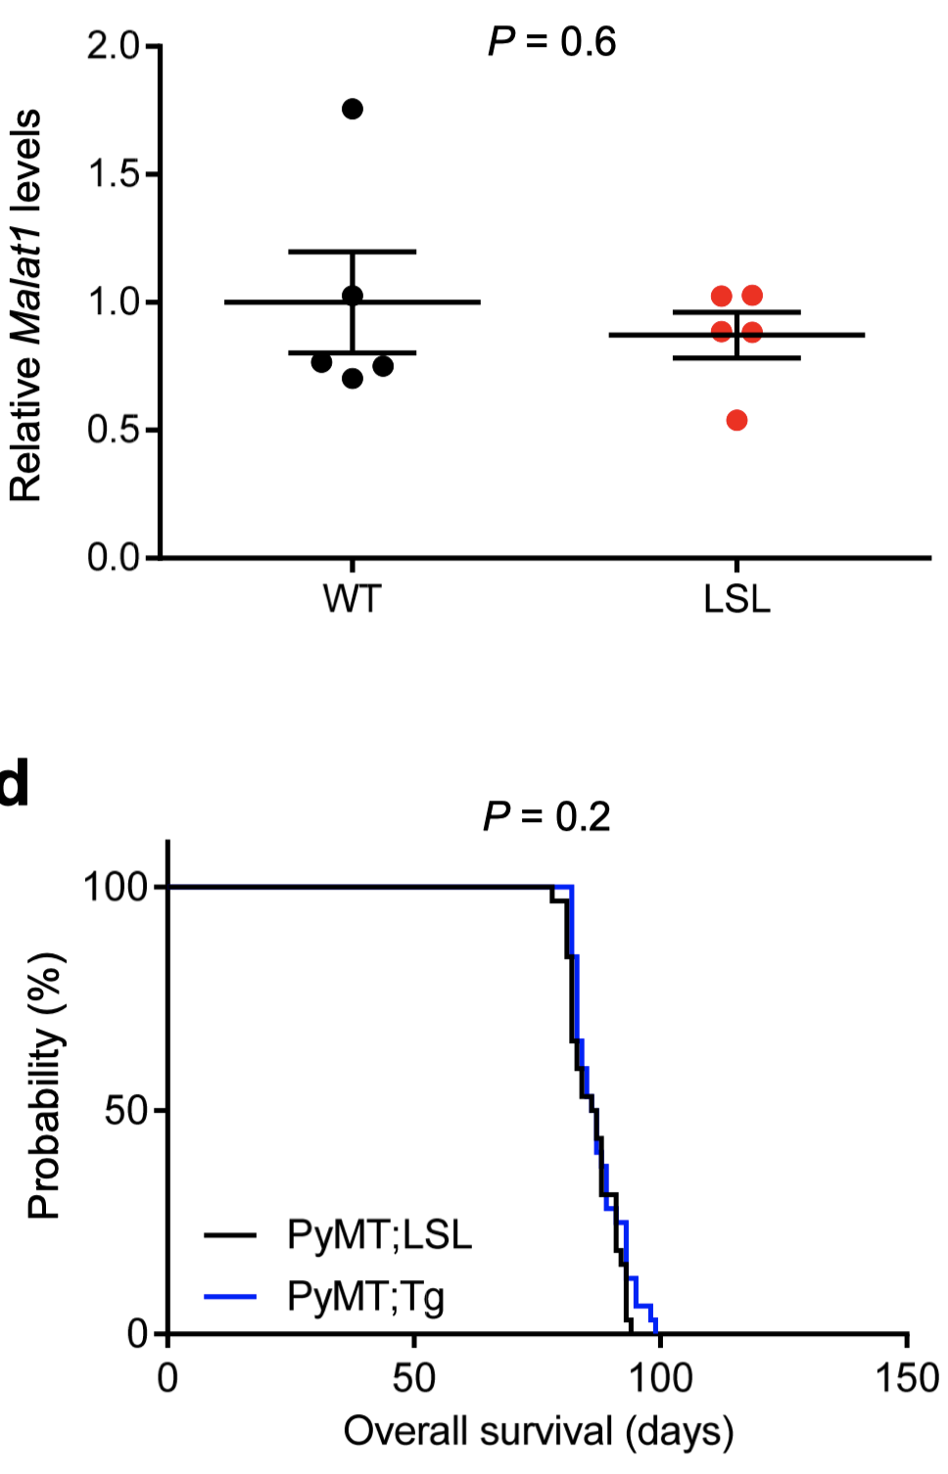
Genetic analyses identify Malat1 as a metastasis suppressor
Malat1 transgenic mice model (Malat1^{Tg}) generation and analysis:
Targeting neutral ROSA26 locus with
«first conditional LSL» MALAT1 cassette
(Malat1^{LSL})
Cre recombination → Malat1 overexpression
(Malat1^{Tg})
Analysis of mice harbour Malat1 cassette
Phenotypic differences are only due to Malat1^{Tg} overexpression and not to ROSA26 manipulation

Slide 27
Genetic analyses identify Malat1 as a metastasis suppressor
Malat1 transgenic mice model (Malat1^{Tg}) generation and analysis:
Targeting neutral ROSA26 locus with
«first conditional LSL» MALAT1 cassette
(Malat1^{LSL})
Cre recombination → Malat1 overexpression
(Malat1^{Tg})
Analysis of mice harbour Malat1 cassette
Phenotypic differences are only due to Malat1^{Tg} overexpression and not to ROSA26 manipulation

Slide 28
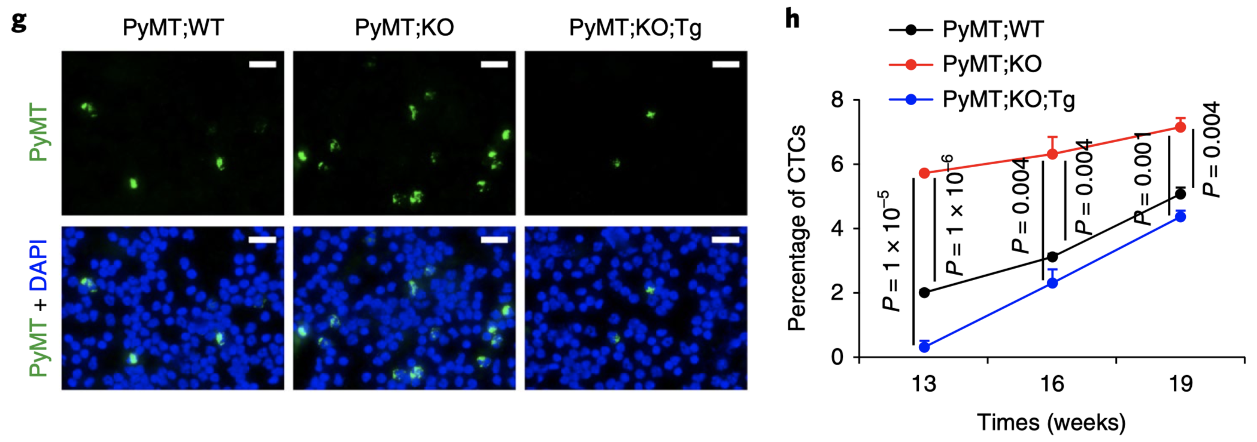
Genetic analyses identify Malat1 as a metastasis suppressor
PyMT;WT vs PyMT;Malat1^{-/-} vs PyMT;Malat1^{-/-};Malat1^{Tg} model:
Observed phenotype was specific to Malat1 lncRNA loss
Malat1 suppresses the dissemination and lung metastasis of mammary tumor models

Slide 29
Genetic analyses identify Malat1 as a metastasis suppressor
PyMT;WT vs PyMT;Malat1^{-/-} vs PyMT;Malat1^{-/-};Malat1^{Tg} model:
Observed phenotype was specific to Malat1 lncRNA loss
Malat1 suppresses the dissemination and lung metastasis of mammary tumor models

Slide 30
Genetic analyses identify Malat1 as a metastasis suppressor
End point for MOUSE MODEL
Collectively, the targeted inactivation, rescue and overexpression of Malat1 in genetic models demonstrate that Malat1 is a breast-cancer lung-metastasis suppressor.

Slide 31
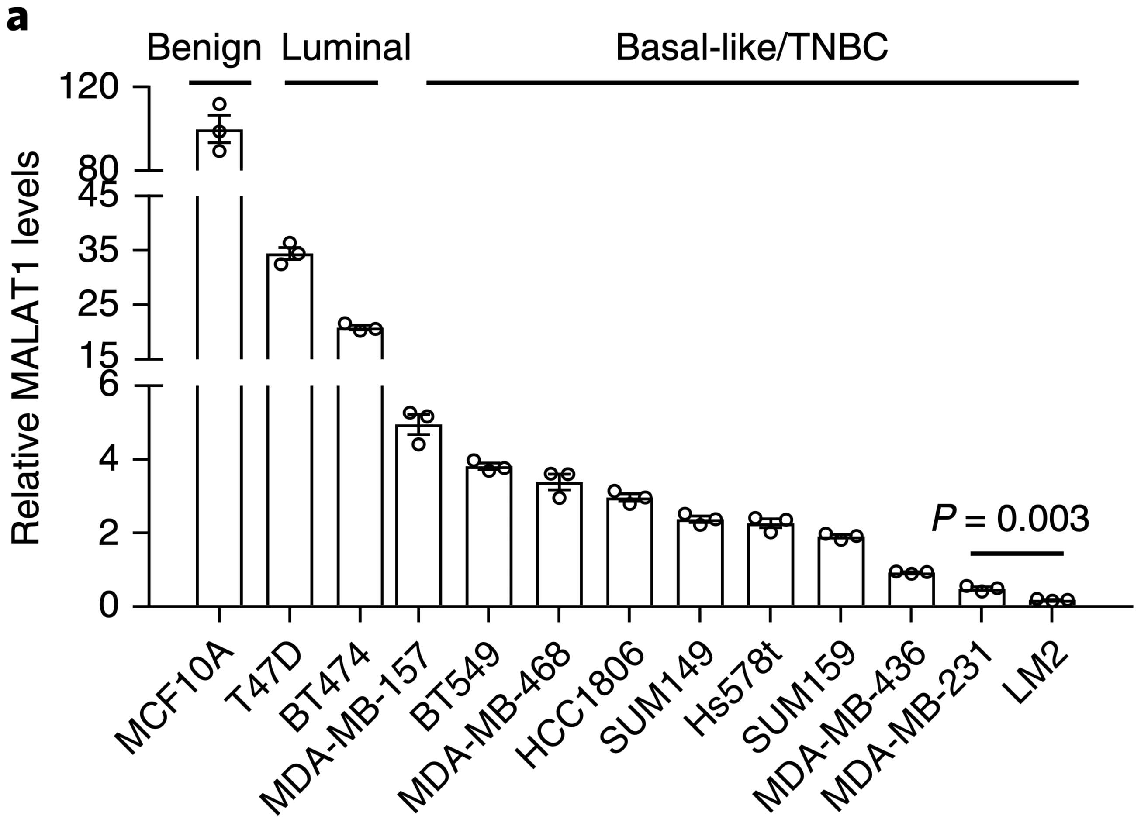
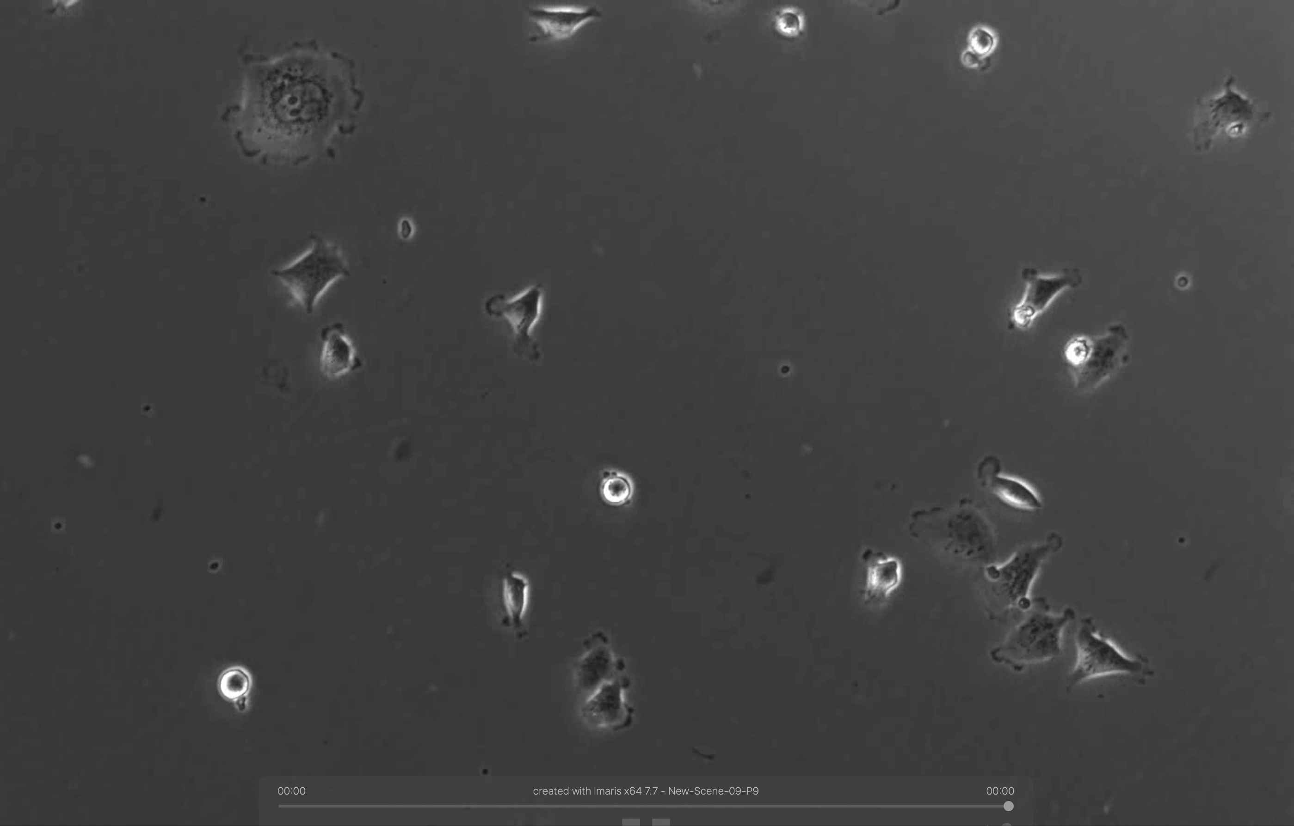
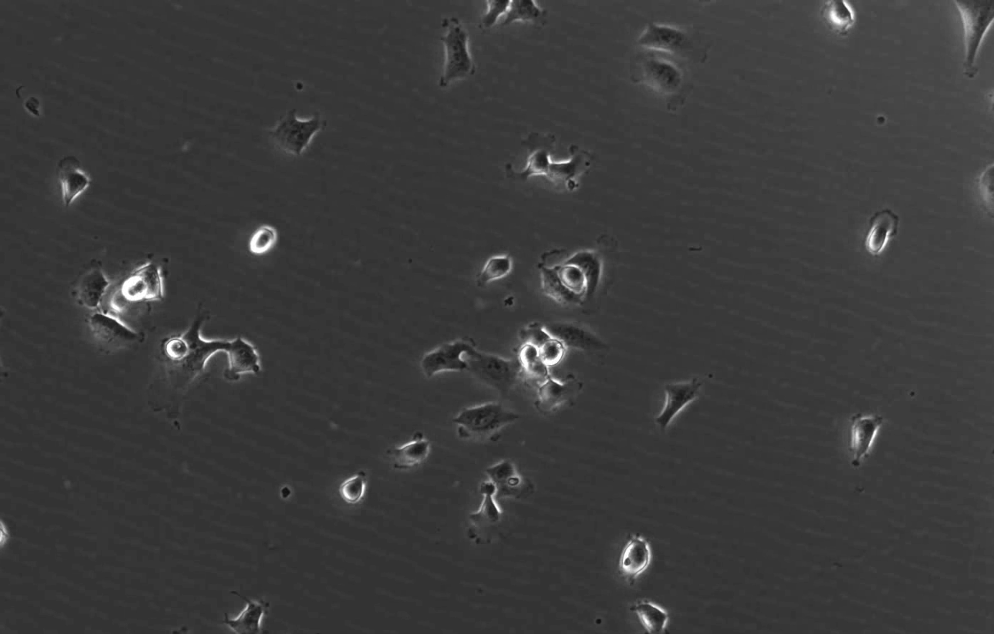
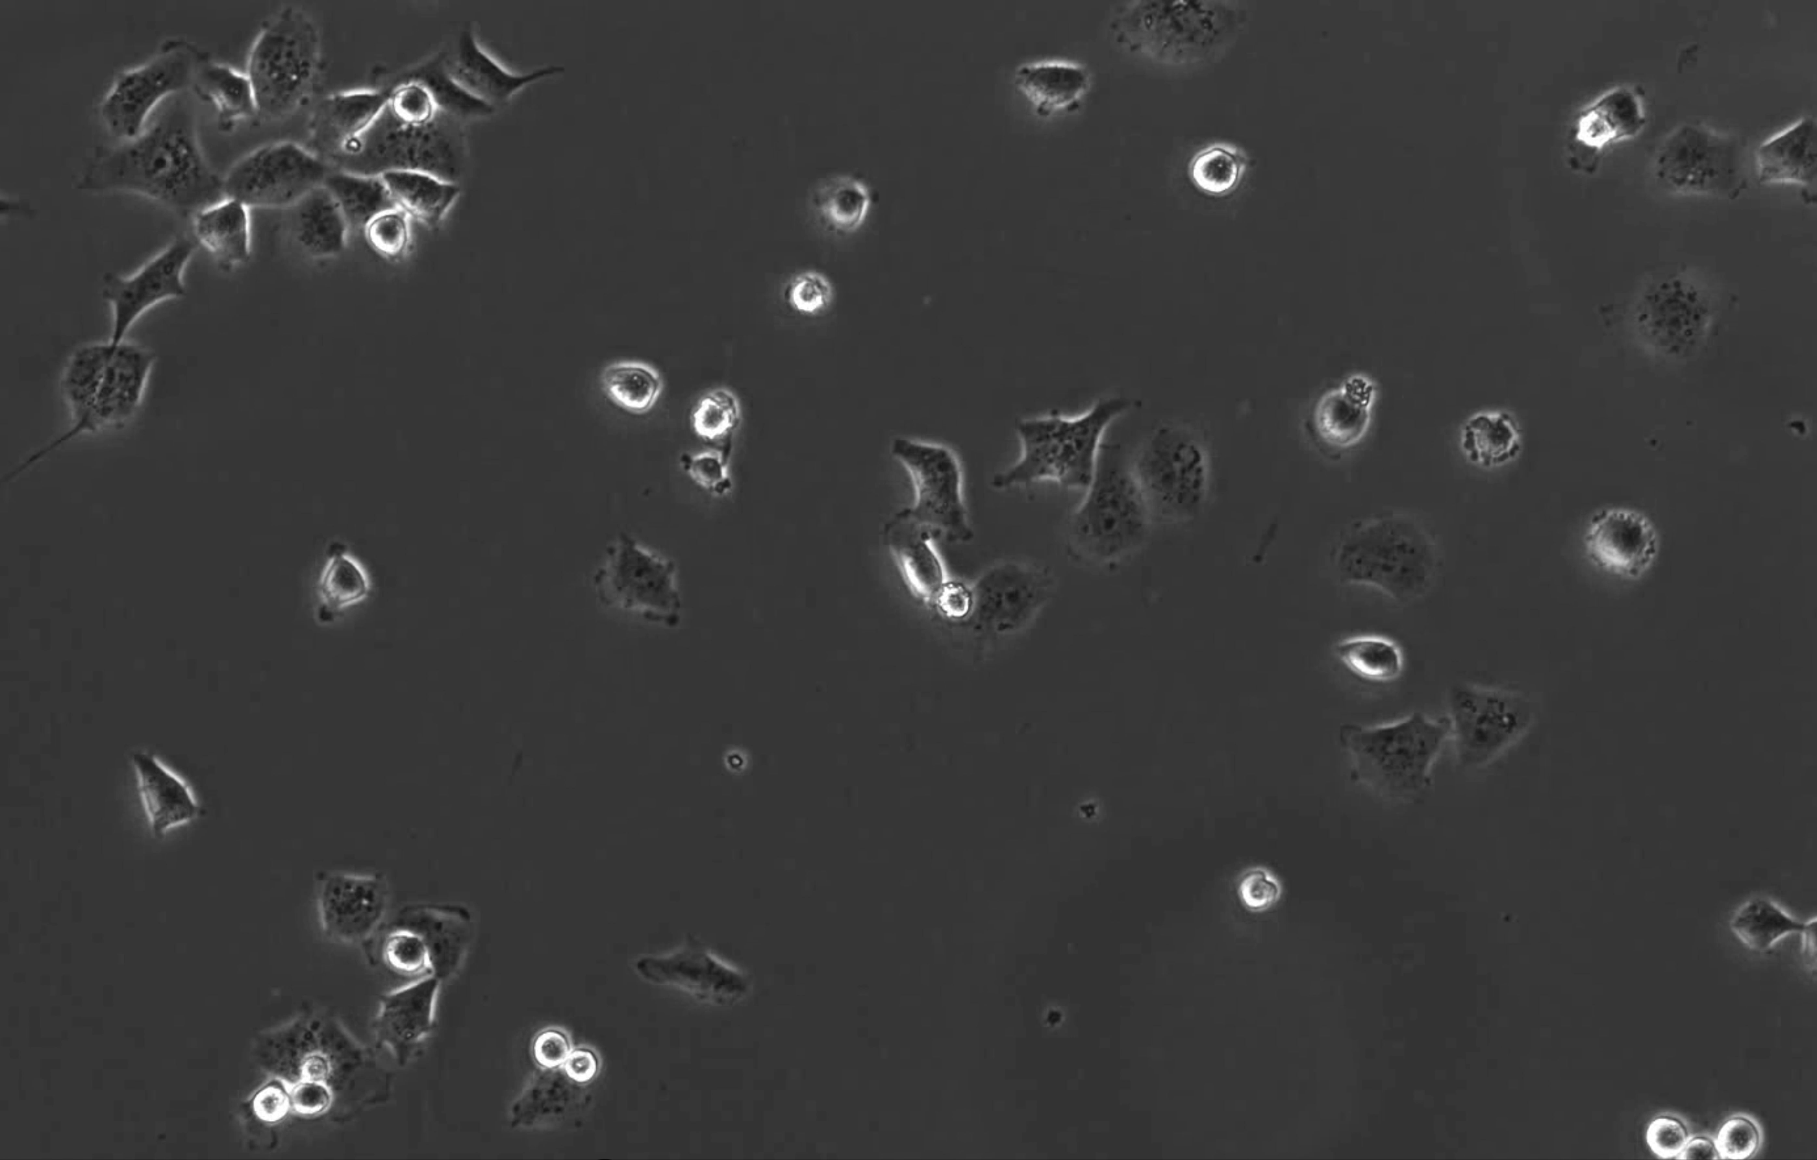
MALAT1 suppresses metastatic ability of breast cancer cells
Cell colture breast model:
MALAT1 levels
High in MCF10A = non–transformed mammary cells
Low in MDA-MB-231 = Breast cancer cell lines
2. MALAT1 KO cells:
increases migratory and invasive ability
increases cells speed
MDA-MB-231
Luciferase expressing
Control (GFP gRNA)
MALAT1-KO
MALAT1-KO + Malat1^{Tg}
Notes:
Fig. 3 | Malat1 inhibits the metastatic ability of breast cancer cells. a, qPCR of MALAT1 in a panel of cell lines. b, MALAT1 levels in luminal (n = 28) and basal/triple-negative (n = 31) breast cancer cell lines available in CCLE. c,d Bioluminescent imaging (c) and quantification of photon flux (d) of NSG mice with intravenous injection of control, MALAT1-knockout, or Malat1-restored MDA-MB-231 cells. Day 0: the day of tumor-cell injection. n = 5 mice per group. e,f, Bioluminescent imaging (e, upper panel), quantification of photon flux (e, lower panel), and H&E staining (f) of the lungs from the mice described in c,d. n = 5 mice per group in panel e. g, Bioluminescent imaging (upper panel) and quantification of photon flux (lower panel) of the lungs from NSG mice with intravenous injection of control (n = 7 mice) or Malat1-overexpressing (n = 8 mice) LM2 cells. h, H&E staining of the lungs described in g. i, Bioluminescent imaging (left panel) and quantification of photon flux (right panel) of the lungs from BALB/c mice injected with control (n = 9 mice) or Malat1overexpressing (n = 10 mice) 4T1 cells. j, Bright-field imaging (upper panel) and number of metastatic nodules (lower panel) in the lungs of mice described in panel i. Statistical significances in panels a, b, d, e, g, i and j were determined by unpaired t-tests. Error bars are s.e.m. Scale bars: f,h, 200 μm; j, 2 mm.

Slide 32
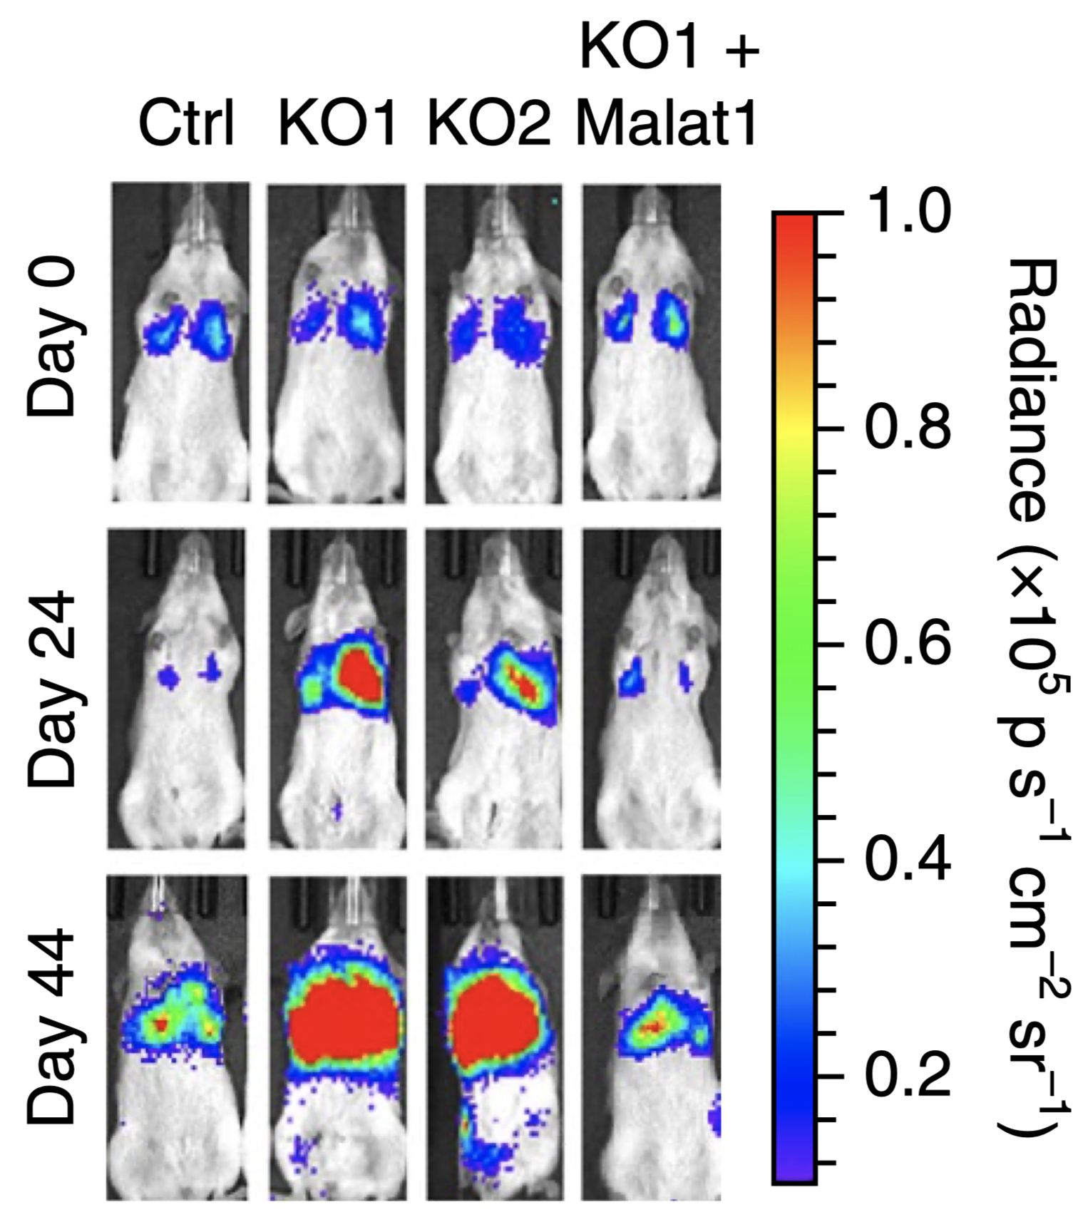
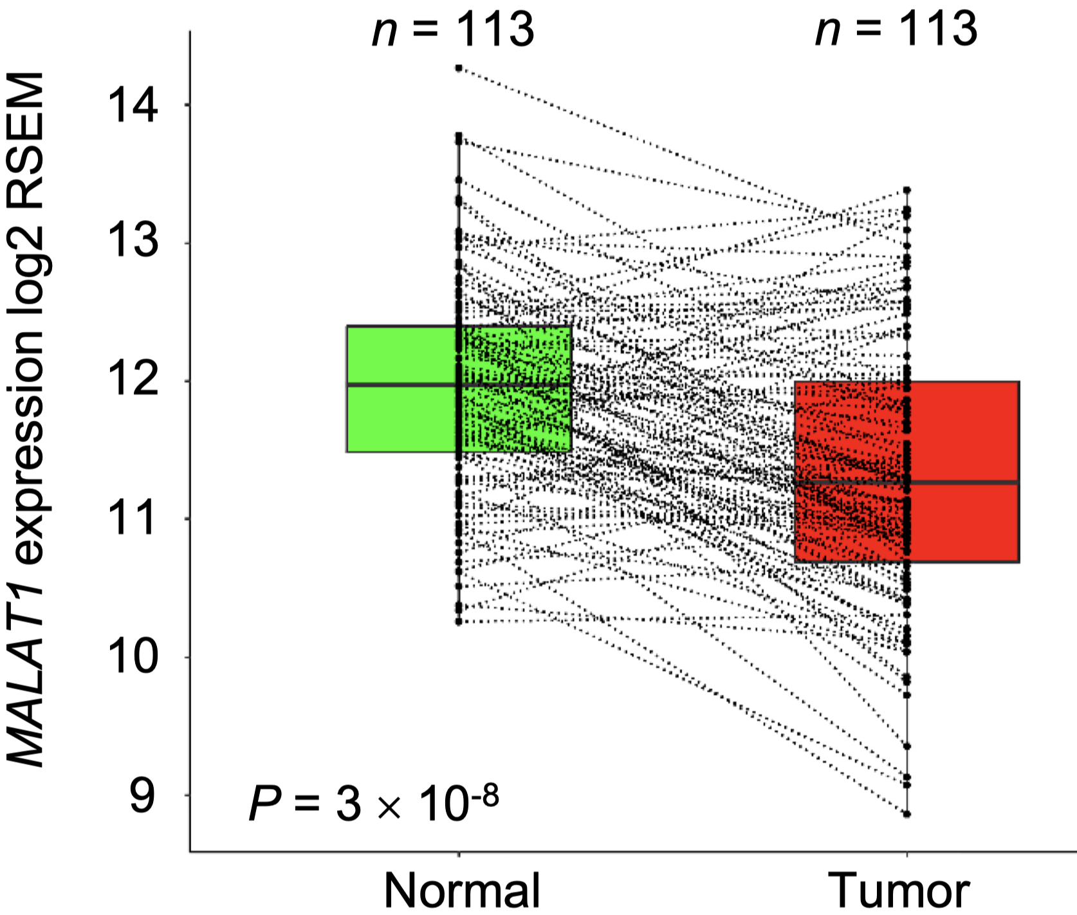
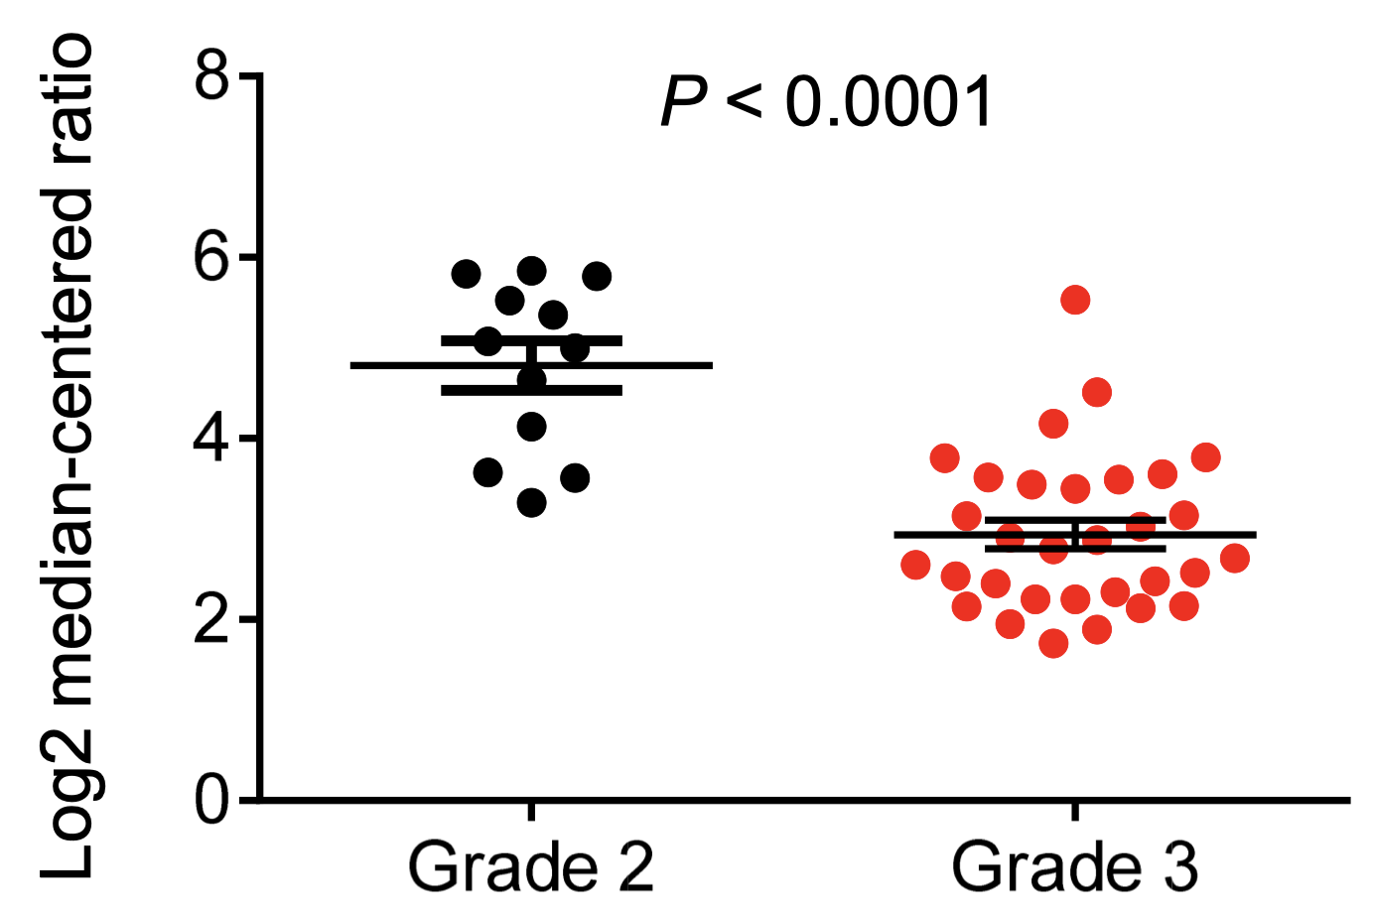
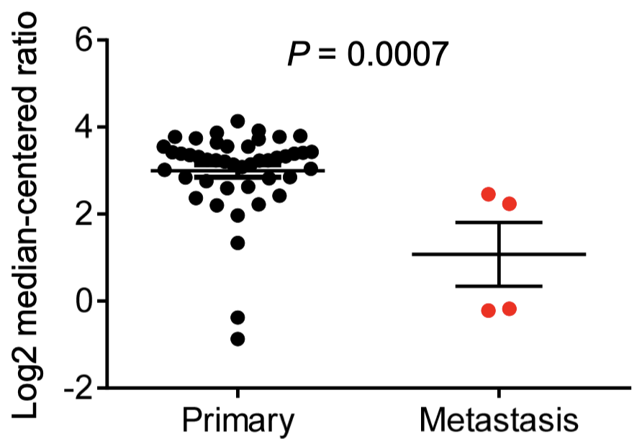
MALAT1 suppresses metastatic ability of breast cancer cells
MDA-MB-231 injection in NSG mice:
  promoted lung metastasis
  effect reversed by Malat1 rescue
Bioinformatic analysis (TCGA and data mining) of MALAT1
expression different breast cancer contest:
  underexpressed in human breast tumors
  underexpressed in higher-grade breast tumors
  underexpressed in metastatic breast tumors
Higher MALAT1 levels are negatively associated with breast cancer progression and metastasis

Slide 33
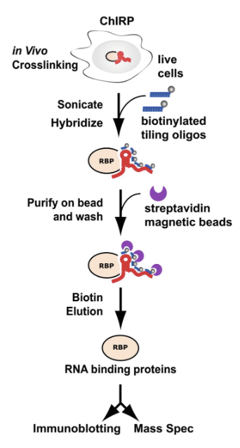
MALAT1 interacts with TEAD-family members
BIG Scientific question: What is the mechanism by which MALAT1 regulates metastasis?
1st goal: identification of its endogenous binding proteins by performing:
Methods: 1. Discovery: RNA pulldown coupled to mass spectrometry (ChIRP-MS). → unbiased
2. Validation: Western blot of ChIRP samples with and w/o Malat1
3. Validation in other models: Pulldown + RTqPCR
ChIRP=Comprehensive identification of RNA-binding proteins by mass spectrometry

Slide 34
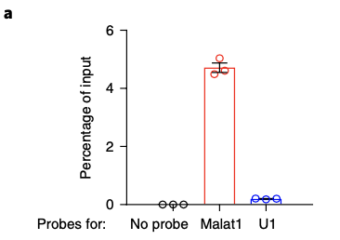
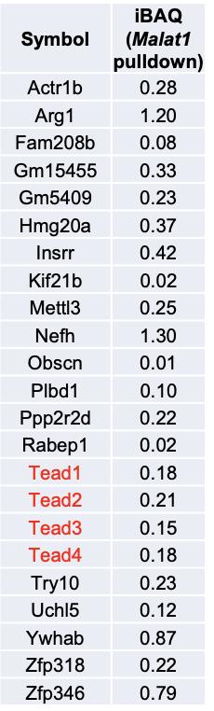
(i) DISCOVERY of MALAT1 interacting partners
MALAT1 interacts with TEAD-family members
4
1. Collection of the tumors from MMTV-PyMT mice and pull down (ChRP) of the endogenous Malat1 lncRNA using mouse Malat1-specific, biotinylated DNA probes and streptavidin beads. (Fig. 4a)
negative controls to validate the specificity of Malat1 pulldown:
DNA probes for U1 nuclear RNA
probe-free
Most of them interacted with both Malat1 and U1
Screening (MS) for proteins specifically bound to Malat1
Exclusion of bound proteins in the 2 negative controls (FigS7a)
Unbiased approach
S7a
All four proteins of Tead family were identified as Malat1’s binding partners

Slide 35
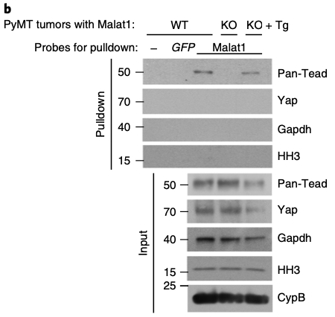
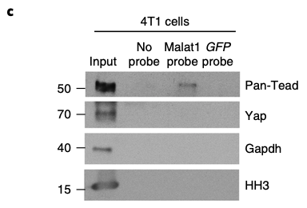
(ii) VALIDATION of MALAT1-TEAD interaction
MALAT1 interacts with TEAD-family members
4
2. Western blot analysis of ChIRP samples, which validated the interaction between endogenous Malat1 and Tead proteins in both PyMT tumors (Fig. 4b) and 4T1 cells (Fig. 4c).
the interaction was abolished in Malat1- null PyMT tumors,
But it was restored in tumors from the MMTV-PyMT; Malat1^{−/−}; Malat1^{Tg} mutants (Fig. 4b),
Immunoblotting shows that:
In both models, Malat1 did not interact with the cytoplasmic marker Gapdh, the nuclear marker histone H3, or the Tead coactivator Yap (Fig. 4b,c)
4
The interaction is Malat1 RNA specific.
Notes:
Genetic background:
Intergenic (lincRNA) → random seq
Overlapping:
Sense → decoy
Antisense → stabilization
Exonic/intronic→ reg. timing
Same/different promoter → reg. space
Mechanisms:
Base paring → decoy (miRNA, RBP)
→ mRNA stabilization
Secondary structures → decoy (TF)
→ scaffold
Both → guide (TF, ChRem)
Interacting partners:
Proteins (TF, Chr.Rem., Rec)
Various RNA species
Chromatin

Slide 36
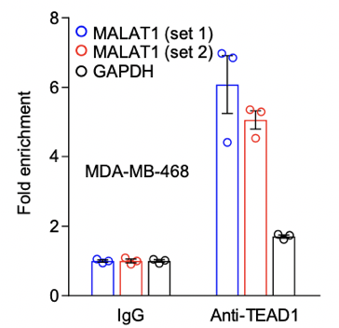
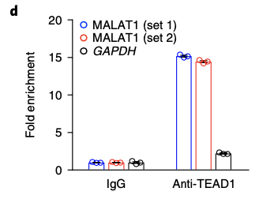
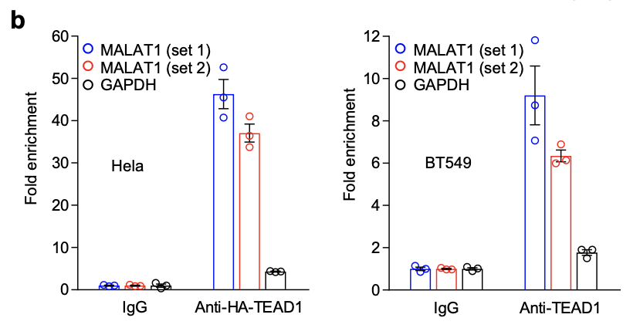
(iii) VALIDATION in other models
MALAT1 interacts with TEAD-family members
4
3. Pull down of TEAD1 protein from cross-linked MDA-MB-231, HeLa, BT549, or MDA-MB-468 human cells and isolation of its associated RNAs.
RT-qPCR analysis show that:
MALAT1 lncRNA was highly enriched in TEAD1 immunoprecipitates (Fig. 4d and Supplementary Fig. 7b).
MDA-MB-231
S7
further corroboration of the result
Notes:
Genetic background:
Intergenic (lincRNA) → random seq
Overlapping:
Sense → decoy
Antisense → stabilization
Exonic/intronic→ reg. timing
Same/different promoter → reg. space
Mechanisms:
Base paring → decoy (miRNA, RBP)
→ mRNA stabilization
Secondary structures → decoy (TF)
→ scaffold
Both → guide (TF, ChRem)
Interacting partners:
Proteins (TF, Chr.Rem., Rec)
Various RNA species
Chromatin

Slide 37
MALAT1 interacts with TEAD-family members
BIG Scientific question: : what is the mechanism by MALAT1 regulates metastasis?
1st goal: identification of its endogenous binding proteins by performing
2nd goal: identification of TEAD-binding regions on MALAT1 and viceversa
Methods: 1. general mapping: in vitro transcription + pulldown
2. Fine mapping: CLIP- qPCR
3. viceversa: Truncation mutants + RNA-Immunoprecipitation
CLIP- qPCR :UV cross-linking-immunoprecipitation and qPCR

Slide 38



(i) General mapping of TEAD-binding regions on Malat1
MALAT1 interacts with TEAD-family members
S7
1. Generation of 6 non-overlapping biotinylated Malat1 fragments (P1–P6; 1.1–1.2kb each) spanning full-length mouse Malat1 by in vitro transcription.
RNA pulldown assay and then immunoblotting show that:
all 6 fragments, but not U1, bound to TEAD proteins. (Fig. 4e and Suppl. Fig. 7c,d)
4
HEK293FT
TEAD-binding sites is distributed diffusely on Malat1 lncRNA
Notes:
Genetic background:
Intergenic (lincRNA) → random seq
Overlapping:
Sense → decoy
Antisense → stabilization
Exonic/intronic→ reg. timing
Same/different promoter → reg. space
Mechanisms:
Base paring → decoy (miRNA, RBP)
→ mRNA stabilization
Secondary structures → decoy (TF)
→ scaffold
Both → guide (TF, ChRem)
Interacting partners:
Proteins (TF, Chr.Rem., Rec)
Various RNA species
Chromatin

Slide 39

(ii) Fine mapping of TEAD-binding regions on Malat1
MALAT1 interacts with TEAD-family members
2. CLIP- qPCR assay using 69 pairs of primers with overlapping 200-bp amplicons
detection of the protected Malat1 RNA segments bound by TEAD1
at a threshold enrichment value of 10, all the six fragments showed at least one major peak
ten major peaks were detected (Fig. 4f)
HeLa
mMalat^{tg}
HA-TEAD1
Malat1 contains multiple TEAD-binding sites
Notes:
Genetic background:
Intergenic (lincRNA) → random seq
Overlapping:
Sense → decoy
Antisense → stabilization
Exonic/intronic→ reg. timing
Same/different promoter → reg. space
Mechanisms:
Base paring → decoy (miRNA, RBP)
→ mRNA stabilization
Secondary structures → decoy (TF)
→ scaffold
Both → guide (TF, ChRem)
Interacting partners:
Proteins (TF, Chr.Rem., Rec)
Various RNA species
Chromatin

Slide 40



(iii) Mapping of MALAT1-binding regions on TEAD1
MALAT1 interacts with TEAD-family members
TEAD1 consists of two functional regions:
NT: TEA domain → DNA binding,
TAD: transactivation domain → YAP binding (Supplementary Fig. 7f)
3. we generated two TEAD1 truncation mutants (Supplementary Fig. 7f,g) and performed RNA immunoprecipitation.
qPCR quantification shows:
Malat1 enrichment in the immunoprecipitates of FL and TAD TEAD1 but not in the NT (Fig. 4g),
HeLa
Malat1 interacts with TEAD1’s transactivation domain
NB: the same domain that mediates the YAP–TEAD1 interaction.
Notes:
Genetic background:
Intergenic (lincRNA) → random seq
Overlapping:
Sense → decoy
Antisense → stabilization
Exonic/intronic→ reg. timing
Same/different promoter → reg. space
Mechanisms:
Base paring → decoy (miRNA, RBP)
→ mRNA stabilization
Secondary structures → decoy (TF)
→ scaffold
Both → guide (TF, ChRem)
Interacting partners:
Proteins (TF, Chr.Rem., Rec)
Various RNA species
Chromatin

Slide 41
MALAT1 inhibits the transcriptional activity of TEAD
Scientific question: what is the mechanism by which MALAT1 regulates TEAD
1st Goal: investigation whether MALAT1 de-localizes or sequesters TEAD
Method: 1. localization: luciferase report assay + immunostaining → no
2. Sequestring: CoIP → si
Notes:
Genetic background:
Intergenic (lincRNA) → random seq
Overlapping:
Sense → decoy
Antisense → stabilization
Exonic/intronic→ reg. timing
Same/different promoter → reg. space
Mechanisms:
Base paring → decoy (miRNA, RBP)
→ mRNA stabilization
Secondary structures → decoy (TF)
→ scaffold
Both → guide (TF, ChRem)
Interacting partners:
Proteins (TF, Chr.Rem., Rec)
Various RNA species
Chromatin

Slide 42



MALAT1 inhibits the transcriptional activity of TEAD
NUCLEAR DELOCALIZATION
TEAD and their coactivators YAP and TAZ promote tumor progression and metastasis through transcriptional activity.
ectopic expression of Malat1 reduced, while knockout of MALAT1 increased, the activity of a TEAD luciferase reporter containing tandem TEAD- binding sites (Fig. 5a,b).
Fractionation assays and immunofluorescent staining demonstrated that:
TEAD proteins were localized exclusively in the nucleus of both control and MALAT1- knockout MDA-MB-231 cells (Supplementary Fig. 7h,i)
HEK293FT
MALAT1 does not affect the nuclear localization of the TEAD proteins
Notes:
Genetic background:
Intergenic (lincRNA) → random seq
Overlapping:
Sense → decoy
Antisense → stabilization
Exonic/intronic→ reg. timing
Same/different promoter → reg. space
Mechanisms:
Base paring → decoy (miRNA, RBP)
→ mRNA stabilization
Secondary structures → decoy (TF)
→ scaffold
Both → guide (TF, ChRem)
Interacting partners:
Proteins (TF, Chr.Rem., Rec)
Various RNA species
Chromatin

Slide 43


MALAT1 inhibits the transcriptional activity of TEAD
TEAD DECOY
MALAT1 RNA is highly abundant, and the TEAD-binding sites are distributed throughout MALAT1
2. Co-immunoprecipitation of TEAD1 and YAP.
Upon Malat1 overexpression, an immunoblotting shows:
a clear reduction in YAP–TEAD1 interaction (Fig. 5c,d).
HEK293FT
MALAT1 sequester TEAD, thereby blocking TEAD’s ability to bind YAP
Notes:
Genetic background:
Intergenic (lincRNA) → random seq
Overlapping:
Sense → decoy
Antisense → stabilization
Exonic/intronic→ reg. timing
Same/different promoter → reg. space
Mechanisms:
Base paring → decoy (miRNA, RBP)
→ mRNA stabilization
Secondary structures → decoy (TF)
→ scaffold
Both → guide (TF, ChRem)
Interacting partners:
Proteins (TF, Chr.Rem., Rec)
Various RNA species
Chromatin

Slide 44
MALAT1 inhibits the transcriptional activity of TEAD
Scientific question: what is the mechanism by which MALAT1 regulates TEAD
1° goal: investigation whether MALAT1 de-localize or sequesters TEAD
2° goal: Investigation on how MALAT1 influences TEAD transcriptional activity on classical target genes (e.g. ANKRD1 CTGF CYRE1)
Methods : 1. promoter occupancy → luciferase assay
2. transcriptional activity → qPCR

Slide 45



MALAT1 inhibits the transcriptional activity of TEAD
Promoter occupancy
Malat not binds yap
To support MALAT1 relationship with TEAD
ChIp-qPCR of YAP-TEAD target genes promoters
Malat1 expression decrease the occupancy of classical target genes promoters by endogenous YAP-TEAD
To exclude MALAT1 impact on YAP activity
Generation of GAL4 DBD-fused YAP constructs
Evaluation of transcriptional activity by GAL4 DBD responsive luciferase reporter
YAP^{FL} and YAP^{TAD} exhibit transcriptional activity
→ No alterations after Malat1 overexpression
HEK293FT
Repression of YAP-TEAD transcriptional activity by Malat1 is TEAD dependent
Notes:
1. LM2 cells
2. To exclude the possibility that malat directly regulates Yap: genetation of TEAD indipendent Yap mutants capable of binding DNA without TEAD
FL full lenght TAD transcription activating domain
Luciferase activity in HEK293FT cells co-transfected with mouse Malat1, GAL4 DBD alone or GAL4 DBD-fused protein (full-length YAP or its transactivation domain), a pG5-luciferase reporter containing 5 GAL4-binding sites, and a Renilla luciferase reporter (for normalization). n = 3 cell culture replicates per group. Results are representative of two independent experiments.
Gal4 is a modular protein consisting of DNA-binding domain and an activted domain

Slide 46


MALAT1 inhibits the transcriptional activity of TEAD
Transcriptional activity
qPCR
Overexpression of Malat1 in LM2 cells downregulates the expression of well known TEAD target genes
qPCR
Malat1-KO PyMT tumor cells show an increase expression of mRNA levels of these classical YAP-TEAD genes
→ This effect is reversed by genetic add-back of Malat1
Malat1 dysregulates TEAD target genes expression
Notes:
Lm2 cells low expression of Malat
livello di promotori c’e una mnor occupazione di TEAD
Ma a livello trascrizionel c’è una disregolazione nell’epressione genica? Si!! Decremento dei livelli di espressione dei well know genes

Slide 47
MALAT1 inhibits the transcriptional activity of TEAD
Scientific question: what is the mechanism by which MALAT1 regulates TEAD
1° goal: investigation whether MALAT1 de-localize or sequesters TEAD
2° goal : Investigation on how MALAT1 influences TEAD transcriptional activity
3° goal : Determination of MALAT1 functional relevance in metastasis
Methods : 1. in vivo → bioluminescent imaging
2. in vitro → immunoblotting, migration and invasion assay

Slide 48
MALAT1 inhibits the transcriptional activity of TEAD
Determination of MALAT1 functional relevance in metastasis
MALAT1
MDA-MB-231
NSG mice
Depletion of TEAD proteins reverses metastasis in vivo
Overexpression of Malat1 decrease migration and invasion in vitro
Malat1 inhibits cell motility and invasivness sequestring TEAD
Notes:
Bioluminescent imaging (h) and photon flux quantification (i) of NSG mice with intravenous injection of control and MALAT1-knockout MDA-MB-231 cells with or without transduction of TEAD shRNA. Day 0, the day of tumor-cell injection. n = 5 mice per group
Risultati immunoblotting da due esperimenti diversi
Immunoblotting of pan-TEAD and CybD in cells transfected with Malat1 in the presence or abscence of TEAD
Migration and invasion
Migration and invasion assays of LM2, BT549, and SUM149 cells transfected with mouse Malat1 in the presence or absence of HA-tagged human TEAD1. n = 3 cell culture replicates per group. Results are representative of two independent experiments.

Slide 49
ITGB4 and VEGFA are TEAD target genes regulated by MALAT1
Scientific question : How Malat1 impact on its downstream target genes involved in metastasis ?
1° goal : Identification of novel Malat1 target genes
Methods : RNA-seq analysis and RT-qPCR

Slide 50


ITGB4 and VEGFA are TEAD target genes regulated by MALAT1
Identification of novel Malat1 target genes
MMTV-PyMT
RNA-seq
Identify nine genes upregulated in Malat1-KO tumors
Itgb4 and vegfa are well estabilish metastasis promoting genes
→ TEAD-YAP are able to interact with Itgb4 and Vegfa promoters
RT-qPCR
Confirm upregulation of Itgb4 and Vegfa mRNA levels upon Malat1-KO PyMT tumors
Malat1 expression inversely correlates with IGTB4 and VEGF expression
Notes:
while reexpression of Mala1 in MMTV-PyMT Malat-/- reversed the induction of expression

Slide 51
ITGB4 and VEGFA are TEAD target genes regulated by MALAT1
Scientific question : How Malat1 impact on its downstream target genes involved in metastasis ?
1° goal : identification of novel Malat1 target genes
Methods : RNA-seq analysis and RT-qPCR
2° goal : Investigate TEAD impact on ITGB4 and VEGFA expression
  Evaluate if the expression of ITGB4 and VEGF is activated by TEAD and if Malat1 opposes it
Methods : 1. TEAD interaction with ITGB4 and VEGF promoters → luciferase assay and ChIP-qPCR
2. Malat1 effect on ITGB4 and VEGFA expression → luciferase assy, ELISA and ChIP-qPCR

Slide 52


ITGB4 and VEGFA are TEAD target genes regulated by MALAT1
TEAD interaction with ITGB4 and VEGF promoters
Luciferase assay:
Test of upstream regulatory regions of human Itgb4 and Vegfa genes
Identification of L7 and V1 as the minimal promoter/enancher regions of ITGB4 and VEGF
ChIP-qPCR
Minimal promoter regions are responsive to TEAD
HEK293FT
TEAD is able to interact with IGTB4 and VEGFA promoters
Notes:
Luciferase activity in HEK293FT cells cotransfected with HA-TEAD1, the ITGB4 (c) or VEGFA (d) luciferase reporter, and a Renilla luciferase reporter (for normalization). n = 3 cell culture replicates per group. Results are representative of two independent experiments
ChIP-qPCR analysis showing the occupancy of ITGB4 (L7, left panel) and VEGFA (V1, right panel) promoters by TEAD1 or YAP. Ectopically expressed HA-TEAD1 and endogenous YAP were immunoprecipitated from Hela cells with or without ectopic expression of Malat1. n = 3 technical replicates per group. Results are representative of two independent experiments

Slide 53
ITGB4 and VEGFA are TEAD target genes regulated by MALAT1
TEAD interaction with ITGB4 and VEGF promoters
Luciferase assay:
Test of upstream regulatory regions of human Itgb4 and Vegfa genes
Identification of L7 and V1 as the minimal promoter/enancher regions of ITGB4 and VEGF
ChIP-qPCR
Minimal promoter regions are responsive to TEAD
HEK293FT
TEAD is able to interact with IGTB4 and VEGFA promoters
Notes:
Luciferase activity in HEK293FT cells cotransfected with HA-TEAD1, the ITGB4 (c) or VEGFA (d) luciferase reporter, and a Renilla luciferase reporter (for normalization). n = 3 cell culture replicates per group. Results are representative of two independent experiments
ChIP-qPCR analysis showing the occupancy of ITGB4 (L7, left panel) and VEGFA (V1, right panel) promoters by TEAD1 or YAP. Ectopically expressed HA-TEAD1 and endogenous YAP were immunoprecipitated from Hela cells with or without ectopic expression of Malat1. n = 3 technical replicates per group. Results are representative of two independent experiments

Slide 54

ITGB4 and VEGFA are TEAD target genes regulated by MALAT1
Malat1 effect on ITGB4 and VEGFA expression
Luciferase assay: luciferase construct containing L7 or V1 region
Overexpression of Malat1 suppresses transcriptional activity of ITGB4 and VEGFA promoters, at the basal level and upon TEAD overexpression
HEK293F
ELISA assay: validation
Secreted VEGFA is upregulated by MALAT1-KO and downregulated by Malat1 overexpression
Malat1 impact on ITGB4 and VEGFA expression
Notes:
Img1 : Results from two indipendent experiments

Slide 55


ITGB4 and VEGFA are TEAD target genes regulated by MALAT1
Malat1 effect on ITGB4 and VEGFA expression
ChIP-qPCR: further validation considering YAP
Malat1 deletion increases the occupancy of ITGB4 and VEGF promoters by TEAD-YAP
MDA-MB-231
Malat1 overexpression reduces the occupancy of ITGB4 and VEGF promoters by TEAD-YAP
IGTB4 and VEGFA are TEAD target genes negatively regulated by MALAT1

Slide 56
Conclusion
Breast cancer metastasis is induced by germline insertional inactivation or somatic knockout of Malat1 without alterations in the expression of adjacent genes
MALAT1 binds and inactivates TEAD impeding its interaction with YAP, thus deregulate the expression of their target genes
MALAT1 acts as a metastatic tumor suppressor

Slide 57
FUTURE PERSPECTIVE?

Slide 58
FUTURE PERSPECTIVE
More detailed analysis about MALAT1 boundary regions
  NO analysis of the impact of neighbour MALAT1 genes
  NO primary cell colture analysis (from breast cancer patient)
More wide visual about the cancer background mutation pattern (e.g. p53 or mutp53)
Dose dependent Malat1
Could nuclear YAP overcome MALAT1-dependent TEAD decoy? (stiffness)

Slide 59


