Slide 1
GENOMIC IMPRINTING REGULATED BY lncRNAs
A. Conci, E. Lucantonio, E. Sabarese
Transcriptomics 2019/20

Slide 2
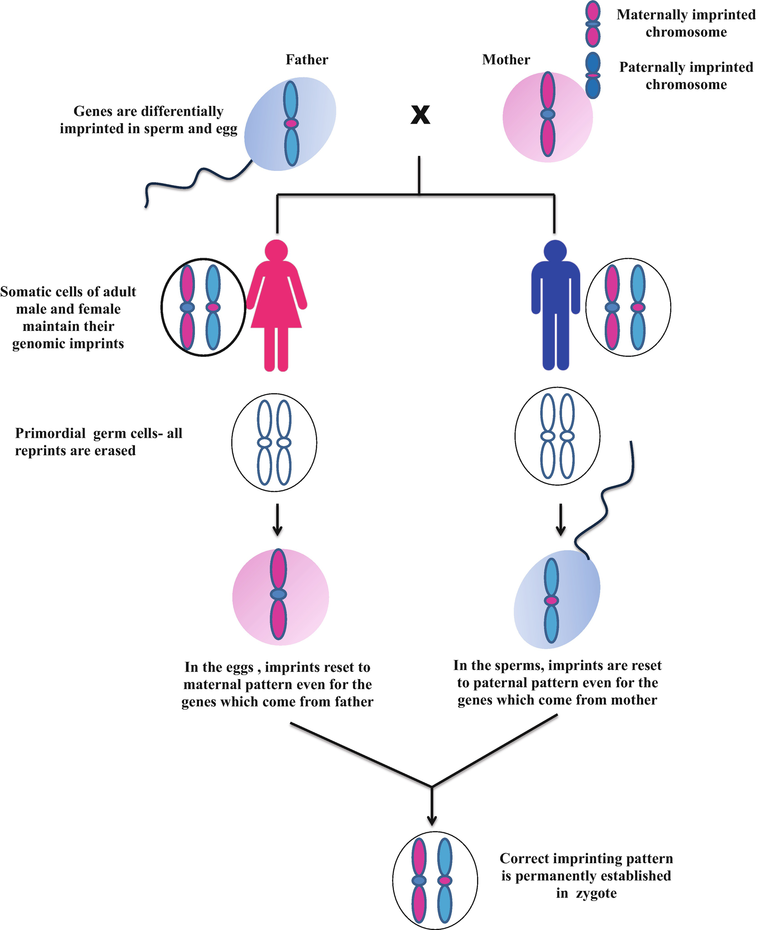
GENOMIC IMPRINTING
Definition: parental-specific gene expression in diploid cells
Epigenetic mechanism
Expression of one parental copy of an imprinted gene and silencing of the other
Displayed in only a few hundred genes
Genomic imprinting ≠ apparent parental-specific expression

Slide 3
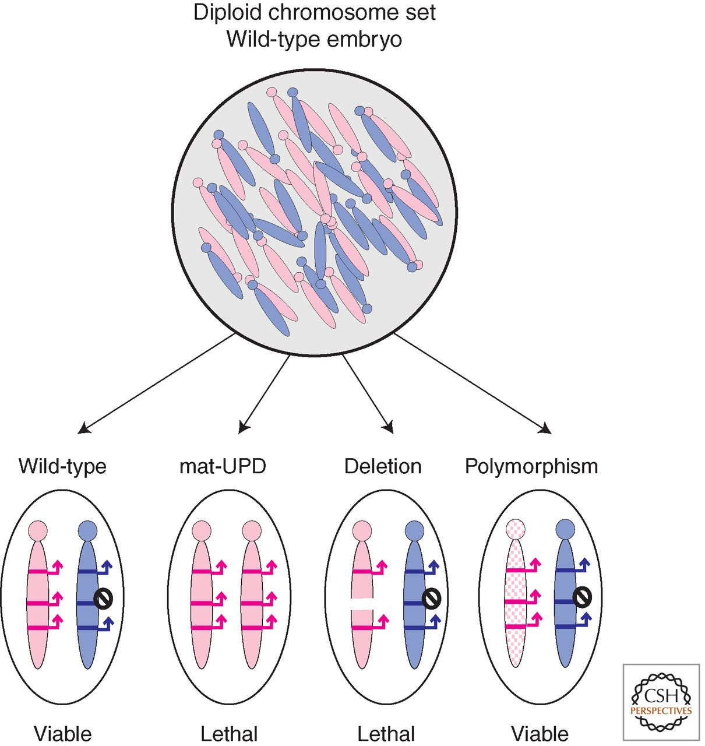
Mouse models to study genomic imprinting that allow the maternal and paternal chromosome to be distinguished
Mouse mutants with translocations
Parental-specific phenotype when certain regions were inherited as uniparental disomy (UPD)
Haploid expression of certain genes needed for normal mouse development
Denise P. Barlow, and Marisa S. Bartolomei Cold Spring Harb Perspect Biol 2014;6:a018382
©2014 by Cold Spring Harbor Laboratory Press
Notes:
Mouse models to study genomic imprinting that allow the maternal and paternal chromosome to be distinguished. Mammals are diploid and inherit a complete chromosome set from the maternal and paternal parent. However, mice can be generated that (1) inherit two copies of a chromosome pair from one parent and no copy from the other parent (known as UPD), (2) inherit a partial chromosomal deletion from one parent and a wild-type chromosome from the other parent, and (3) inherit chromosomes carrying single-nucleotide polymorphisms (known as SNPs) from one parent and a wild-type chromosome from the other parent. Offspring with UPDs or deletions are likely to display lethal phenotypes, whereas SNPs will allow the production of viable offspring.

Slide 4
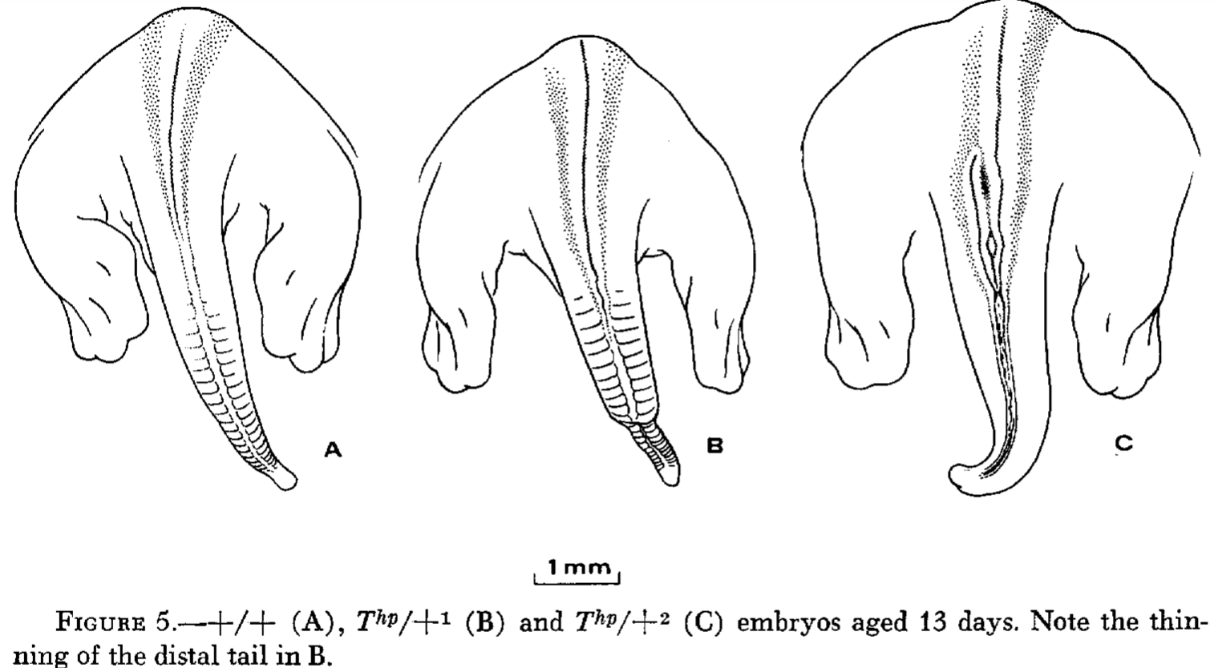
Hairpin-tail mouse model (Thp mouse)
Large deletion on chromosome 17
Maternal deletion → death during development
Paternal deletion → viable and fertile offspring
→ maternal locus normally active, paternal locus inactivated
A. Ruvinskt et al., 1991
Johnson, 1973

Slide 5
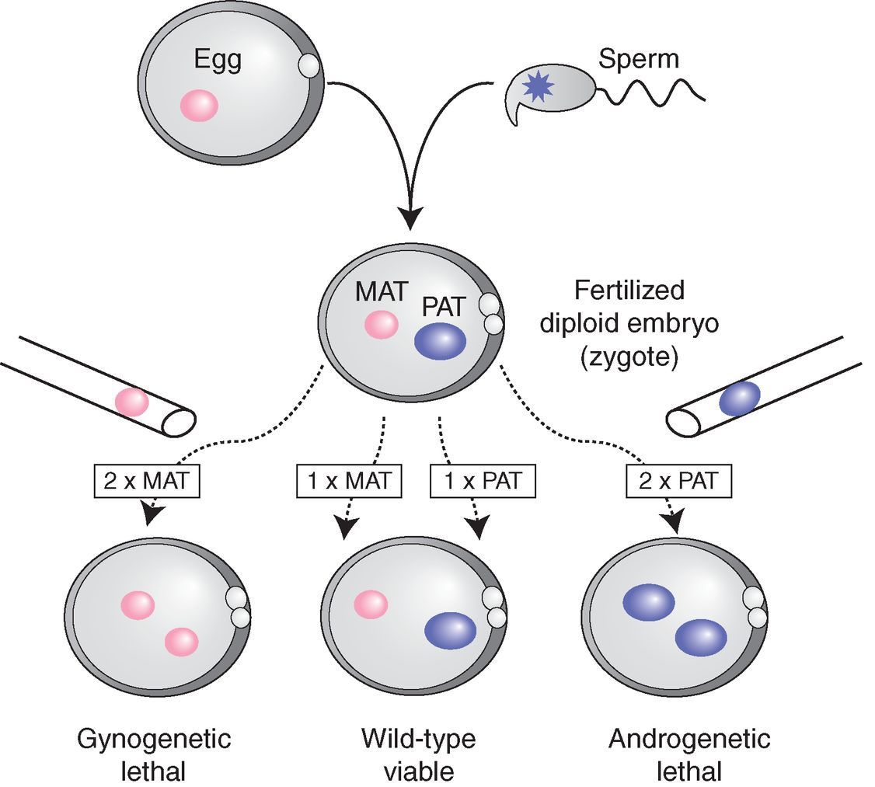
A maternal and paternal genome are needed for mammalian reproduction
Nuclear transfer technique
Generation of uniparental diploid organisms
Gynogenetic embryo → lethal
Androgenetic embryo → lethal
Both parental genomes required for embryogenesis
Denise P. Barlow, and Marisa S. Bartolomei Cold Spring Harb Perspect Biol 2014;6:a018382
Notes:
A maternal and paternal genome are needed for mammalian reproduction. The nuclear transfer technique used micropipettes and high-powered microscopes to remove the male or female nuclei from a newly fertilized egg and place them in various combinations into a second “host” fertilized egg that had already been enucleated, thereby generating anew diploid embryos with two maternal (gynogenetic) or two paternal (androgenetic) genomes or a biparental genome (wild-type). Gynogenetic and androgenetic embryos were lethal at early embryonic stages. Only reconstituted embryos that received both a maternal and paternal nucleus (wild-type) survived to produce living young. These experiments show the necessity for both the maternal and paternal genome in mammalian reproduction, and indicate the two parental genomes express different sets of genes needed for complete embryonic development.

Slide 6
Key features of genomic imprinting in mammals
cis-acting mechanism
A consequence of inheritance, not sex
Imprints are epigenetic modifications acquired by one parental gamete
Imprinted genes are mostly clustered together with a noncoding RNA
Imprints can modify long-range regulatory elements that act on multiple genes
Imprinted genes play a role in mammalian development

Slide 7
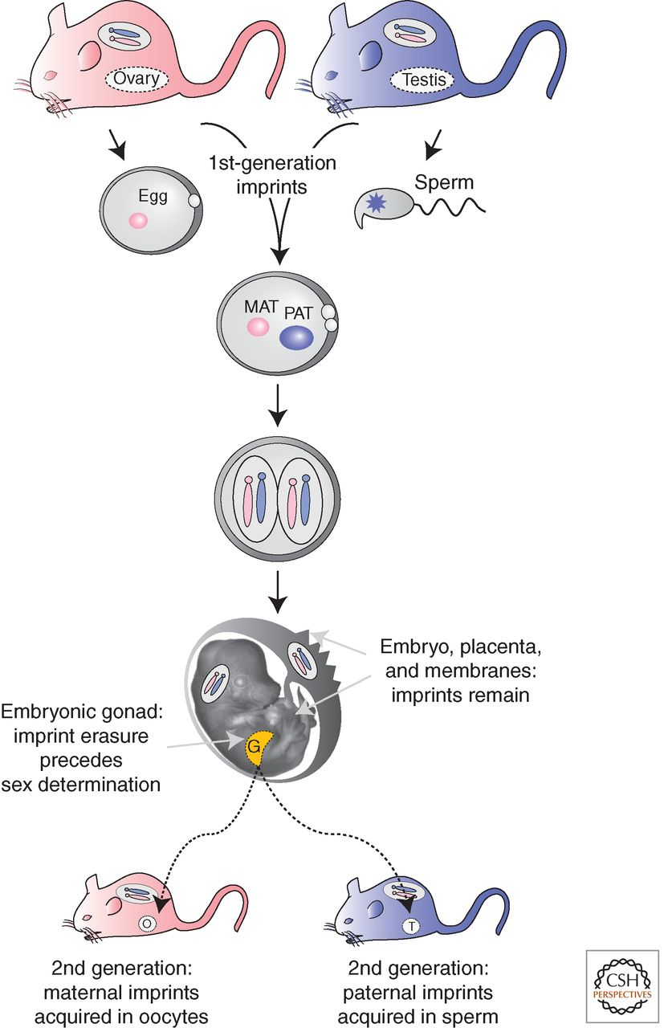
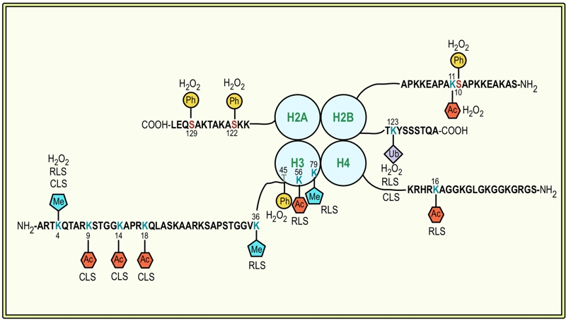
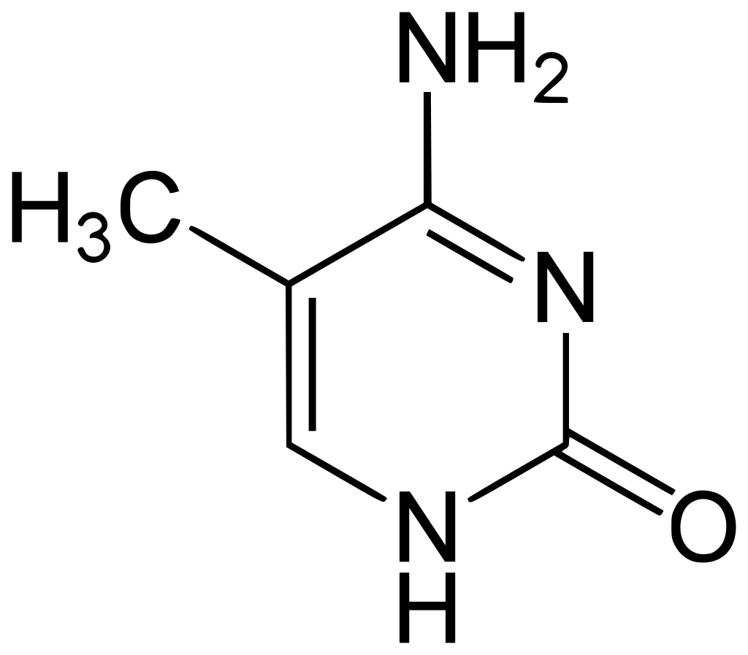
Imprint acquisition and erasure in mammalian development
Histone modifications
Imprints acquired during gametogenesis
Once established they must remain on the same parental chromosome after fertilization
Must be stably inherited through mitosis
Must be erasable, to produce only one type of imprinted gamete
5-methylcytosine functions as the gametic imprint
5-methylcytosine

Slide 8
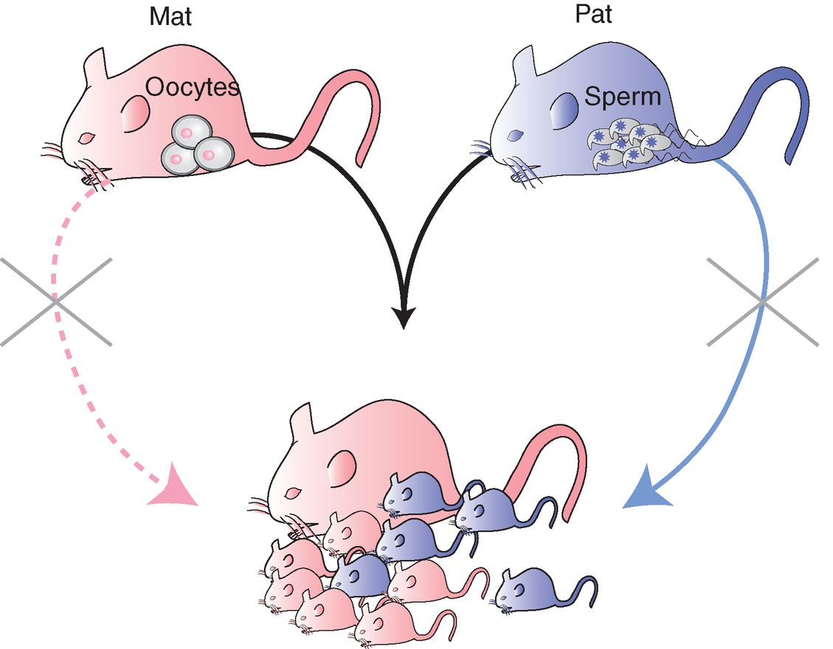
Imprinted genes play a role in mammalian reproduction
Imprinted genes affect growth of the embryo, placenta and the newborn. Some control behavioural or neurological functions
Maternally expressed genes repress growth of the offspring (e.g. Igf2r)
Paternally expressed genes stimulate growth of the offspring (e.g. Igf2)
©2014 by Cold Spring Harbor Laboratory Press
Denise P. Barlow, and Marisa S. Bartolomei Cold Spring Harb Perspect Biol 2014;6:a018382
Notes:
Imprinted genes play a role in mammalian reproduction. Mammals are diploid and reproduction requires fertilization of a haploid female egg by a haploid male sperm to recreate a diploid embryo. Only females are anatomically equipped for reproduction, but they cannot use parthenogenesis to reproduce (the possibility of which is represented by a pink dashed line) because essential imprinted genes needed for fetal growth are imprinted and silenced on maternal chromosomes. These genes are expressed only from paternal chromosomes; thus, both parental genomes are needed for reproduction in mammals. Parthenogenesis is the production of diploid offspring from two copies of the same maternal genome.

Slide 9
Parental conflict
vs. throphoblast defence

Slide 10
Imprinted genes are expressed from one parental allele and are often clustered
Clustered genes spread over 80-3700 kb of DNA
150 imprinted mouse genes, clustered in 16 genomic regions
Contain: ICE, DMR, coding genes and at least one non-coding gene, non-imprinted genes can be present
Imprinted expression controlled by ICE
Cluster examples: Igf2r, Kcnq1, Pws, etc.
Denise P. Barlow, and Marisa S. Bartolomei Cold Spring Harb Perspect Biol 2014;6:a018382
Notes:
Imprinted genes are expressed from one parental allele and often clustered. Most imprinted genes (yellow) are found in clusters that include multiple protein-coding mRNAs (IG) and at least one noncoding RNA (IG-NC). Nonimprinted genes can also be present (NI in gray). The imprinting mechanism is cis acting and imprinted expression is controlled by an imprint control element (ICE) that carries an epigenetic imprint inherited from one parental gamete. One pair of diploid chromosomes is shown: the pink is of maternal origin and the blue of paternal origin. Arrow, expressed gene; slashed circle, repressed gene.

Slide 11
Imprint control element (ICE)
Controls imprinted expression
Carries an inherited epigenetic imprint
Regulates many genes in the cluster
But not all genes of the cluster are regulated by the same element
Loss of ICE leads re-expression of imprinted genes or to loss of expression
Denise P. Barlow, and Marisa S. Bartolomei Cold Spring Harb Perspect Biol 2014;6:a018382
Notes:
Imprinted genes are expressed from one parental allele and often clustered. Most imprinted genes (yellow) are found in clusters that include multiple protein-coding mRNAs (IG) and at least one noncoding RNA (IG-NC). Nonimprinted genes can also be present (NI in gray). The imprinting mechanism is cis acting and imprinted expression is controlled by an imprint control element (ICE) that carries an epigenetic imprint inherited from one parental gamete. One pair of diploid chromosomes is shown: the pink is of maternal origin and the blue of paternal origin. Arrow, expressed gene; slashed circle, repressed gene.

Slide 12
Imprinted genes are mostly clustered with a noncoding RNA
lncRNAs activate or silence protein-coding genes
Possible role of miRNAs and snoRNAs in imprinting , by interacting with lncRNAs
lncRNAs display reciprocal parental-specific expression
DMR can overlap with the lncRNA promoter (e.g. Airn region)
Gene regulation linked to lncRNA transcription.
https://genomebiology.biomedcentral.com/articles/10.1186/s13059-017-1348-2/figures/4

Slide 13
Imprinted expression is regulated by gametic DMRs (G-DMR)
Denise P. Barlow, and Marisa S. Bartolomei Cold Spring Harb Perspect Biol 2014;6:a018382
©2014 by Cold Spring Harbor Laboratory Press
Notes:
Imprinted expression is regulated by gametic DMRs (G-DMR). (Left) The effect of deleting the gametic DMR from the imprinted chromosome (green). (Right) The effect of deleting the G-DMR from the nonimprinted chromosome (yellow). In many imprinted clusters (e.g., Igf2r, Kcnq1, and Dlk1), experimental deletion of the G-DMR only affects the chromosome carrying the nonimprinted G-DMR. This results in a loss of repression of the imprinted protein-coding mRNA genes (IG) and a gain of repression of the imprinted lncRNA gene (IG-NC). Note that in some imprinted clusters (Igf2 and Pws) that are not illustrated here, the methylated G-DMR appears also to be required for expression of some of the imprinted mRNAs in cis. del, deleted DNA; G-DMR, gametic differentially DNA-methylated region; NG, nonimprinted gene; arrow, expressed allele; slashed circle, repressed allele; imprint, epigenetic modification leading to a change in gene expression in cis.

Slide 14
What is methylation?
Modification that covalently adds a methyl group to a cytosine residue in CpG dinucleotides.
It performs two different functions:
imprinting mark silencing of one
parental allele

Slide 15
DMR: Differentially Methylated Regions
It could be:
Gametic DMR
Established during gametogenesis
Somatic DMR
Established after the embryo has become diploid
Parental specific silencing maintaining.
Imprinting mark

Slide 16
Somatic DMRs are relatively rare but have been reported for some imprinted clusters, which suggests that this type of epigenetic modification plays a limited role in maintaining imprinted gene expression
Igf2 cluster has a gametic DMR located 2kb upstream of the H19 lncRNA promoter, methylated only in the paternal gamete and is maintained in all somatic tissues.

Slide 17
The type of perturbations shown for those four imprinted clusters indicates that DNA methylation is generally acting to suppress the action of the gametic DMR.
If methylation is absent, the lncRNA is aberrantly expressed and those genes become repressed on both parental chromosomes.
Igf2, Igf2r, Kcnq1, Dlk1

Slide 18
Maternal DMR
Paternal DMR
Few informations about how it is established, but there are some similarities with the female germline.
-CpG rich
-DNMT3A and DNMT3L methylate a pair of CpG, 8-10 bp apart.
-This spacing is found only in maternally imprinted loci.

Slide 19
One of the most mysterious questions in genomic imprinting is how the DNA methylation marks at imprinted genes escape the genome-wide reprogramming that occurs after fertilization, including the DNA demethylation that occurs in the preimplantation embryo and the subsequent wave of de novo DNA methylation.

Slide 20
GENOMIC IMPRINTING: A MODEL FOR MAMMALIAN EPIGENETIC REGULATION
Studying genomic imprinting has an advantage over other mammalian epigenetic gene regulation models because both the active and inactive parental allele reside in the same nucleus and are exposed to the same transcriptional environment.
The presence of both the active and silent parental allele in the same nucleus makes genomic imprinting an ideal system to study epigenetic gene regulation; but at the same time is necessary to first attribute activity and silencing to the right parental allele.

Slide 23
The Airn lncRNA does not require any DNA elements within its locus to silence distant imprinted genes.
Long non-coding (lnc) RNAs are numerous in the mammalian genome and many have been implicated in gene regulation.
One mode of lncRNA action is to recruit epigenetic silencing to target distant genes on the same chromosome. A well-characterized group of lncRNAs that act in this way to silence genes are imprinted lncRNAs, which are expressed exclusively from either the maternally or paternally inherited chromosome.
One of the best-characterized clusters is the Igf2r and in this study it was examined how the imprinted lncRNA Airn silences genes in the Igf2r imprinted cluster, focusing primarily on silencing of the distant imprinted gene Slc22a3.

Slide 24
Two Airn models
Airn silences imprinted genes in the Igf2r cluster by two different mechanisms:
Airn transcription silences Igf2r by transcription interference that does not require repressive chromatin modifying complexes.
Airn product recruits repressive chromatin modifying complexes and targets them to distant, non-overlapped genes like Slc22a2, Slc22a3 and Pde10a to cause silencing.

Slide 25
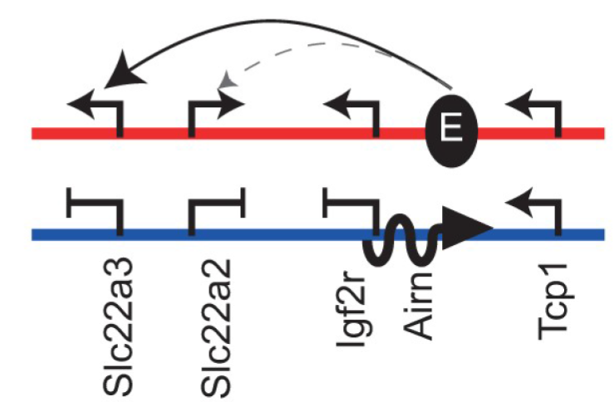
The enhancer interference hypothesis
Airn gene body contains an essential enhancer that interacts with the Slc22a3 (and potentially with the Slc22a2) promoter on the maternal allele, thus activating gene expression.
On the paternal allele, Airn expression prevents this interaction causing imprinted long-range silencing.
MAT
PAT

Slide 26
Chromosome Conformation Capture (3C)
High-throughput technique used to study chromatin structure and to compare interactions on the maternal and paternal alleles.

Slide 27
EXEL genes regulation in extra-embryonic tissues
Slc22a2 and Slc22a3 are extra-embryonic lineage-specific (EXEL) genes.
Visceral Yolk Sac (VYS) endoderm and placenta from Thp mice.

Slide 28
Airn gene body may contain multiple enhancers for Slc22a3
Slc22a3, Slc22a2 and Igf2r expressed from maternal and repressed on paternal allele
Chromosome interactions between Slc22a3 promoter and Airn gene body are enriched on maternal allele
Very low levels of 3C interactions on paternal vs maternal allele
Notes:
1.This indicates that Airn expression blocks these interactions on the paternal allele consistent with the enhancer interference model.
2. truncation of Airn led to an increase in interactions with the whole Airn gene, both for the biallelic comparison (middle) and for the comparison where only the paternal allele was present (bottom). This also indicates that Airn blocks interactions between its gene body and the Slc22a3 promoter, as predicted by the enhancer interference model.

Slide 29
Chromosome interactions are increased in AirnT mice
Imprinted silencing in Igf2r cluster is lost
Higher levels of 3C interactions in AirnT vs wildtype mice
Higher levels of 3C interactions on AirnT paternal alleles vs wildtype paternal alleles
Notes:
1.This indicates that Airn expression blocks these interactions on the paternal allele consistent with the enhancer interference model.
2. truncation of Airn led to an increase in interactions with the whole Airn gene, both for the biallelic comparison (middle) and for the comparison where only the paternal allele was present (bottom). This also indicates that Airn blocks interactions between its gene body and the Slc22a3 promoter, as predicted by the enhancer interference model.

Slide 30
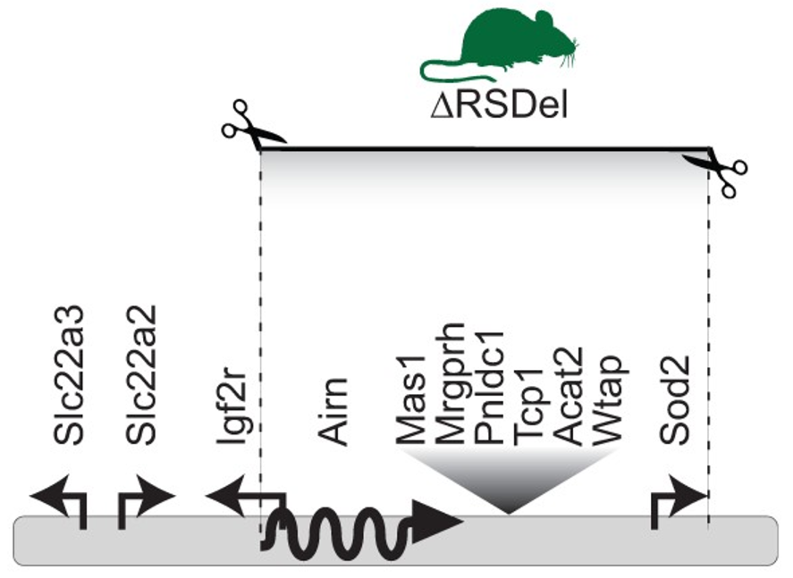
RSDel strain
They bred together the Airn promoter deletion mouse (R2Δ) with a Sod2 exon 3 deletion mouse (Sod2Δ) and the Hprt-Cre mouse.
R2Δ to Sod2Δ deletion includes the entire Airn gene body
Tcp1 (non-imprinted gene) is also within the deletion
Slc22a3 and Slc22a3 are outside the deleted region

Slide 31
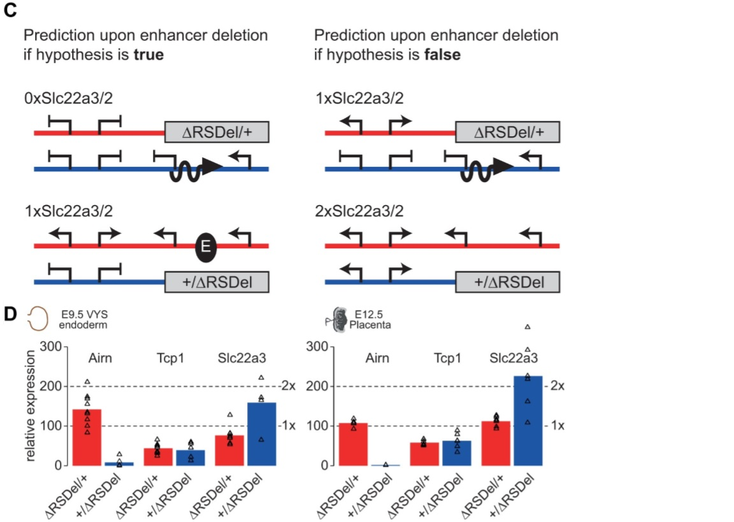
Airn deletion indicates that it contains no essential enhancers for Slc22a3
RT-qPCR expression analysis of RSDel maternal and paternal deletion in VYS endoderm and placenta
The paternal deletion leads to a doubling of Slc22a3 expression, probably due to a loss of imprinted silencing provided by Airn

Slide 32
RNA-seq was performed on VYS endoderm and placenta from RSDel x CAST embryos
Data was subjected to allele-specific expression analysis using Allelome.PRO

Slide 33
RSDel deletion effects on imprinted expression
Maternal RSDel deletion:
does not affect imprinted expression of Slc22a3 and Slc22a2 in VYS endoderm, and Pde10a in placenta,
Airn and Tcp1 are both paternally expressed.
Paternal RSDel deletion:
loss of Slc22a3, Slc22a2 and Pde10a imprinted expression and switch to biallelic expression
loss of Airn expression,
maternal expression of Tcp1

Slide 34
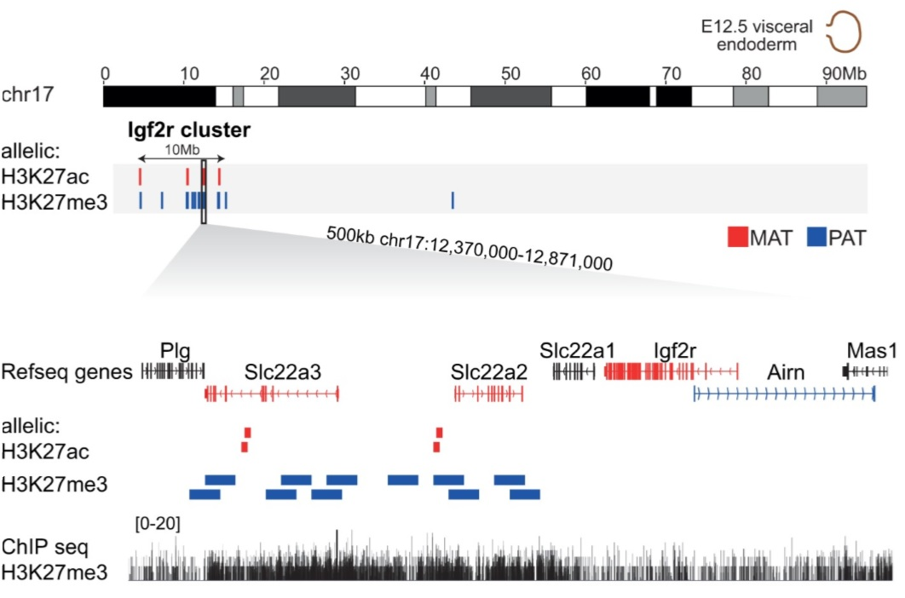
H3K27me3 enrichments over silenced alleles of imprinted genes
Airn recruits EHMT2, PRC1 and PRC2 to distant imprinted genes.
ChIP-seq on VYS endoderm to determine the allele-specific distribution of the H3K27me3 mark.
Broad enrichment of H3K27me3 over the silenced paternal alleles of Slc22a3 and Slc22a2
Focal maternal enrichment of H3K27ac is seen within these genes

Slide 35
Genome-wide analysis results
97% of H3K27me3 enriched windows map to imprinted regions:
Igf2r paternally imprinted cluster shows the greatest number of H3K27me3 enriched windows
Kcnq1 cluster also shows paternal allele enrichment of H3K27me3 over silenced imprinted genes
Sfmbt2 cluster shows the third highest level of H3K27me3 parental allele specific enrichment

Slide 36
H3K27me3 is enriched over the silenced maternal allele of Sfmbt2

Slide 37
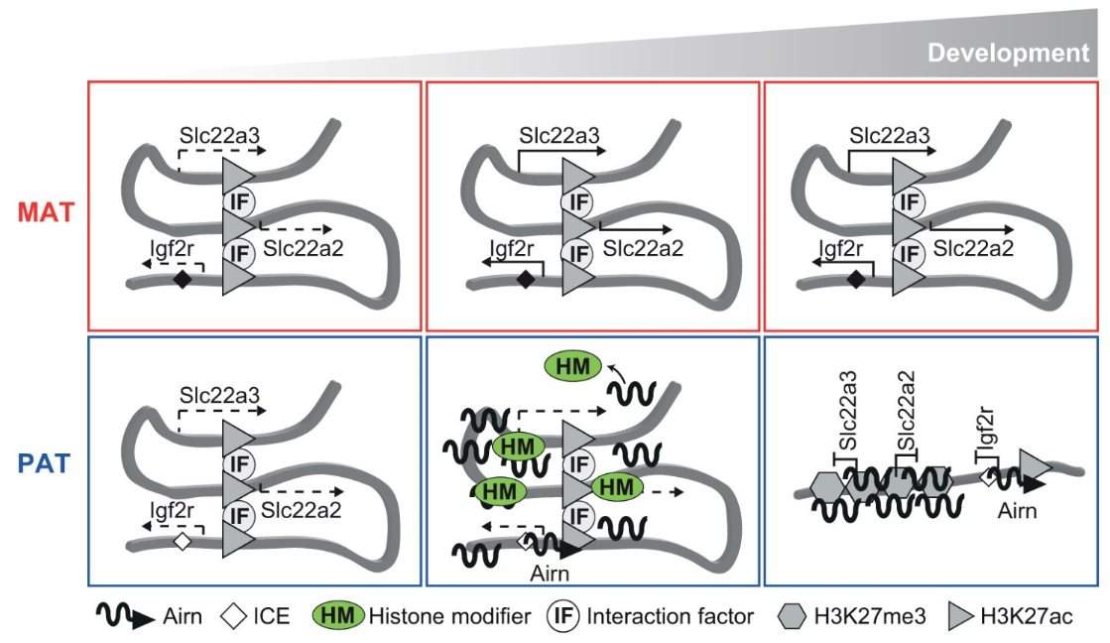
Chromosome conformation guides Airn to silence distant imprinted genes
Chromosomal conformation brings Airn and Slc22a3 and Slc22a2 promoters in close proximity.
As development progresses:
methylation on the maternal allele prevents Airn expression, while Igf2r, Slc22a2 and Slc22a3 are upregulated
Airn is expressed on the unmethylated paternal allele and silences these genes.
Later in development, on the paternal allele the loss of H3K27ac and the compact repressive chromatin domain
maintain silencing of Slc22a2 and Slc22a3, even if chromosome interactions are lost.

Slide 38
Summary
Imprinting is an inherited cis-acting epigenetic mechanism
It acts on gene clusters, containing at least one lncRNA
It regulates embryonic development, behaviour and neurological functions
Airn silences imprinted genes in the Igf2r cluster by:
transcriptional interference
recruitment of repressive chromatin modifying complexes to distant, non-overlapped genes
Chromosome interactions on the active maternal allele between the Airn gene and the Slc22a3 promoter support the enhancer interference hypothesis
Large genomic deletion indicates that Airn contains no essential enhancers for Slc22a3, disproving the enhancer interference model
The establishment of a compact repressive chromatin domain on the paternal allele could be responsible for the silencing of the Slc22a3 promoter

Slide 39
References
Andergassen,D. et al. (2019) The Airn lncRNA does not require any DNA elements within its locus to silence distant imprinted genes. PLOS Genetics, 15(7):e1008268.
Hudson,Q.J. et al. (2011) Extra-embryonic-specific imprinted expression is restricted to defined lineages in the post-implantation embryo. Developmental Biology, 353(2):420-31.
Barlow,D.P. et al. (2014) Genomic Imprinting in Mammals. Cold Spring Harb Perspect Biol, 6:a018382.
Johnson,D.R. et al. (1974) Hairpin-Tail: A case of post-reductional gene action in the mouse egg? Genetics, 76(4):795-805.
Ruvinsky,A. et al. (1991) Functional Analysis of Mutations of Murine Chromosome 17 With the Use of Tertiary Trisomy. Genetics, 127(4):781-8.
Wang,Z. et al. (1994) Regulation of embryonic growth and lysosomal targeting by the imprinted Igf2/Mpr gene. Nature, 372,464-467.
Dekker,J. et al. (2002) Capturing Chromosome Conformation. Science, 295(5558):1306-11.
Pauler,F.M. et al. (2012) Mechanisms of long range silencing by imprinted macro non-coding RNAs.Curr Opin Genet Dev.22(3):283-9

