Slide 1
LncRNAs and resistance of tumors to immunotherapy
Debora Maffeo
Carmela Tangredi
Ilaria Ziccardi

Slide 2
Non-coding RNAs
Cut-off: 200 nucleotides
Small non-coding RNAs
Long non-coding RNAs
Approximately 18000 identified in humans
Splicing
Nuclear organization
Transposon silencing
Inhibition of mRNA translation

Slide 3
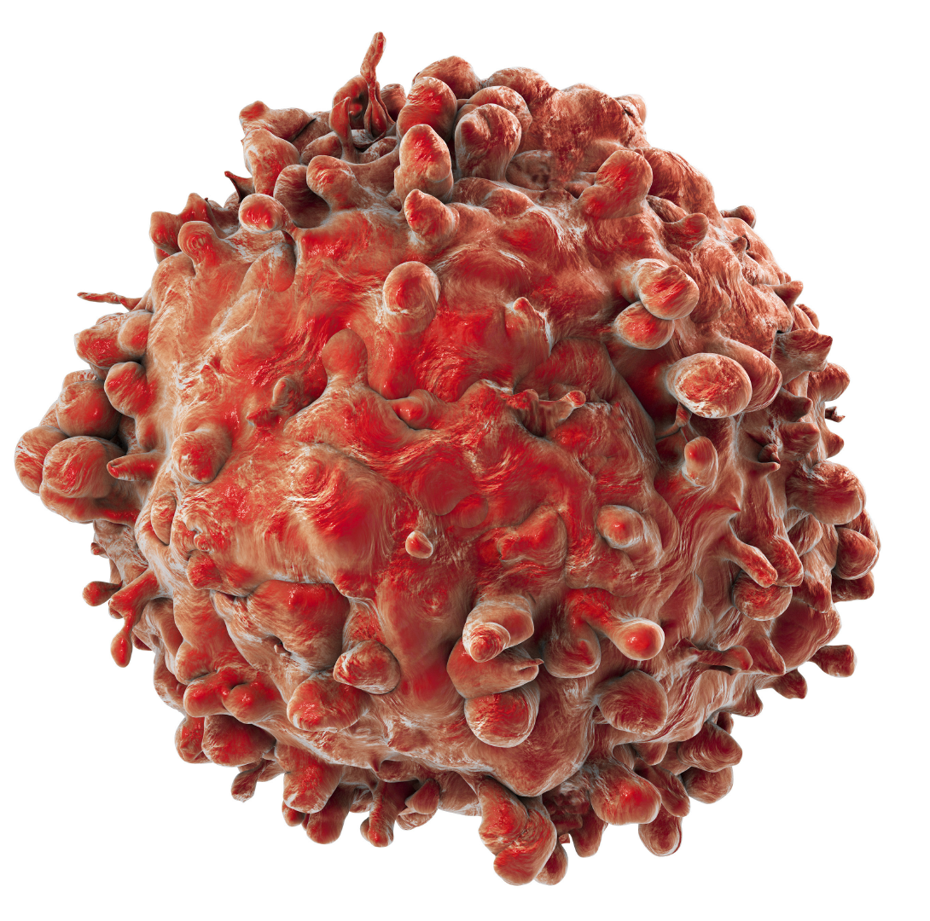
Long non-coding RNAs and cancer
Infiltration into cancer tissues
Antigen presentation
Antigen release
Immune activation
Immune cell migration
Killing of cancer cells
Poor prognosis
Resistance to treatment

Slide 4
Long non-coding RNAs and immunity
Regulation of immune cell differentiation and functions
Response to physiological and pathological stimuli

Slide 5
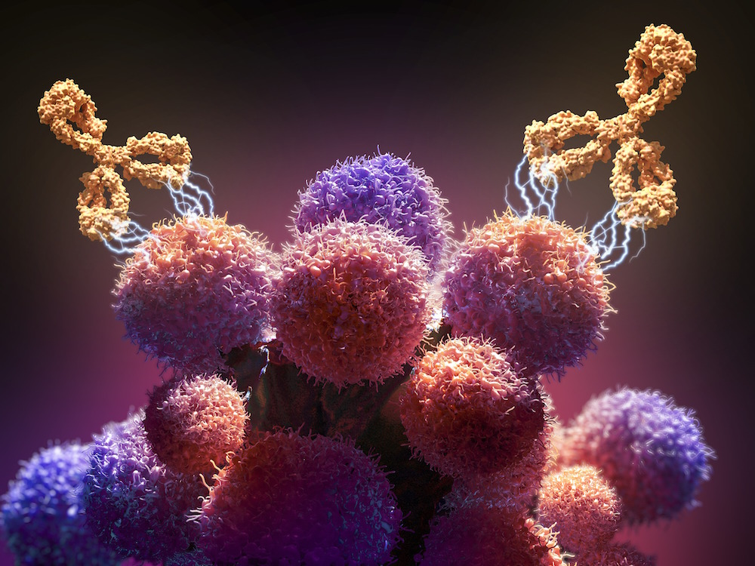
Cancer immunotherapy…
Therapeutic approach characterized by the activation of the immune system to induce tumor immune surveillance or to reverse the tumor immune escape
Active immunotherapy
Passive immunotherapy

Slide 6
… and resistance mechanisms
Intrinsic mechanisms
Adaptive mechanisms
Acquired mechanisms

Slide 7
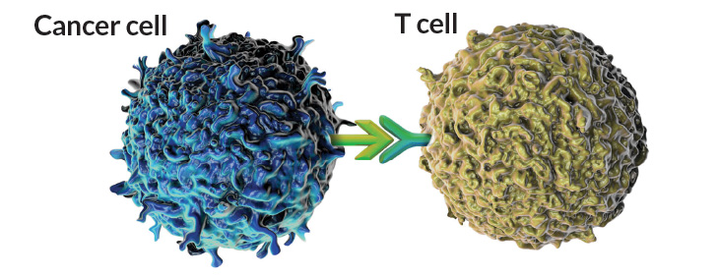
Immune checkpoints
Surface molecules implicated in regulating immune response under normal and pathological conditions
Cancer cells can bypass this immunosurveillance leading to progression and possible malignancy of cancer cells
Dysregulation of the immune checkpoints is mediated by interaction between T cells, APCs and cancer cells

Slide 8
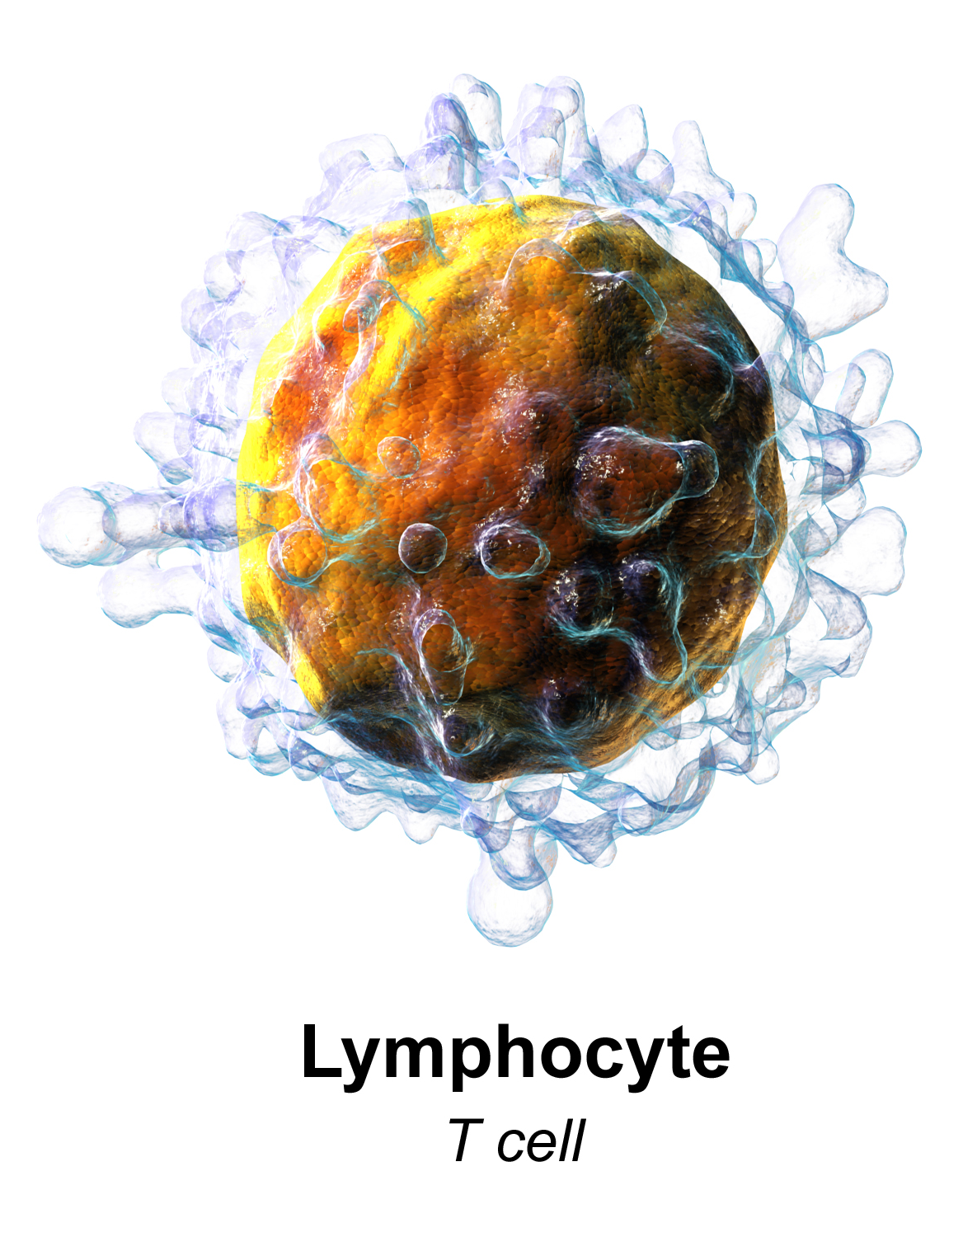
CTLA4
Cytotoxic T Lymphocyte-Associated protein 4 binds B7 on APCs inhibiting T cell activation and acting as an immune checkpoint

Slide 9
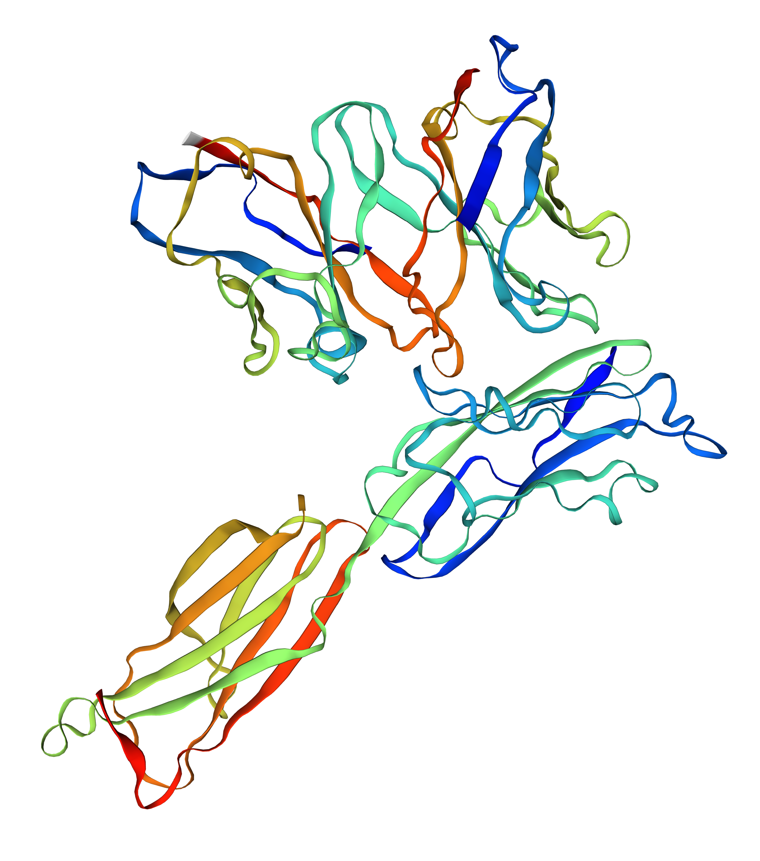
PD-1
Programmed cell Death protein 1 acts as a negative regulator of the immune system to maintain homeostasis by suppressing inflammatory activity and supporting tumor escape
PD-L1
PD-L2

Slide 10
“Hot” tumors
The tumor has already been infiltrated by T cells rushing to fight against cancer cells
The immune system has already recognized the cancer and is working to fight it
High mutational load and production of neoantigens on the cancer cells surface

Slide 11
“Cold” tumors
The tumor has not been yet infiltrated by T cells
The immune response is not working
The microenvironment contains blood vessels, structural elements and specialized immune cells such as MDSCs and T regulatory cells

Slide 12
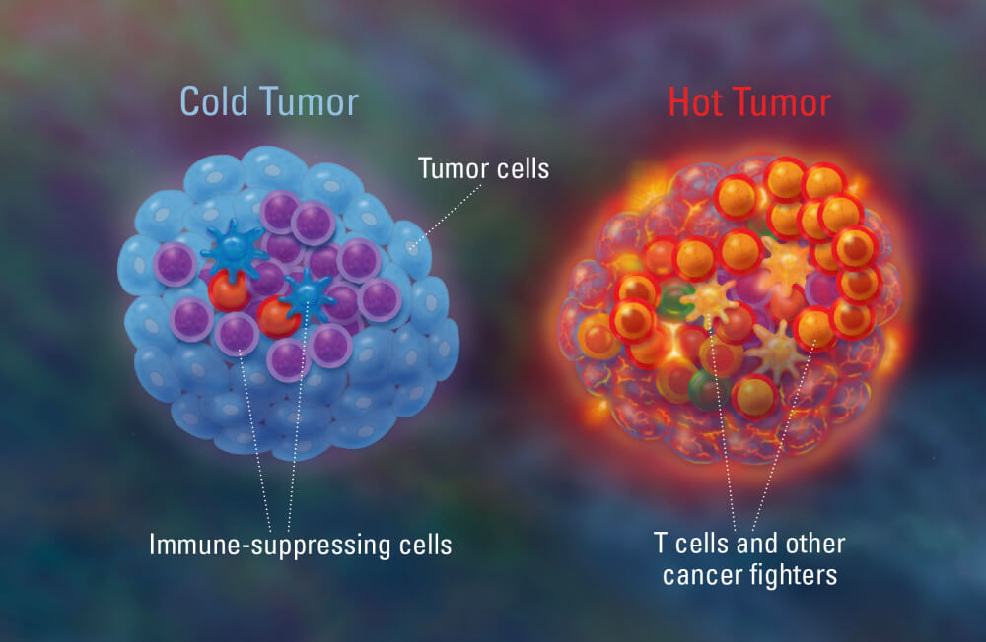
Hot and cold tumors
Pancreatic cancer
Breast cancer
Ovarian cancer
Prostate cancer
Glioblastoma
Melanoma
Bladder cancer
Kidney cancer
Head and neck cancer
Non-small cell lung cancer

Slide 14
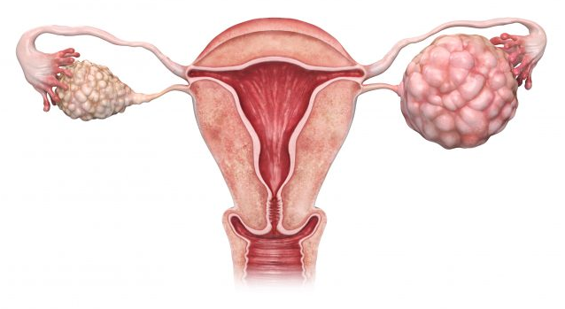
Long non-coding RNA HOTTIP and immune escape in ovarian cancer cells
The progression of OC has been suggested to be closely associated with lncRNAs and HOTTIP may affect OC involving the regulation of IL-6 and PD-L1

Slide 15
Long non-coding RNA HOTTIP and immune escape in ovarian cancer cells
A) OC patients presented with a greater number of neutrophils relative to normal controls
B) PD-L1 expression in infiltrated neutrophils was elevated in comparison to that of the neutrophils from peripheral blood

Slide 16
Long non-coding RNA HOTTIP and immune escape in ovarian cancer cells
C) Abnormal expression of IL-6 in OC patients resulted in higher expression of PD-L1 in infiltrated neutrophils

Slide 17
Long non-coding RNA HOTTIP and immune escape in ovarian cancer cells
D) Neutrophils are accumulated in the OC tissues compared to normal fallopian tube fimbriae tissues

Slide 18
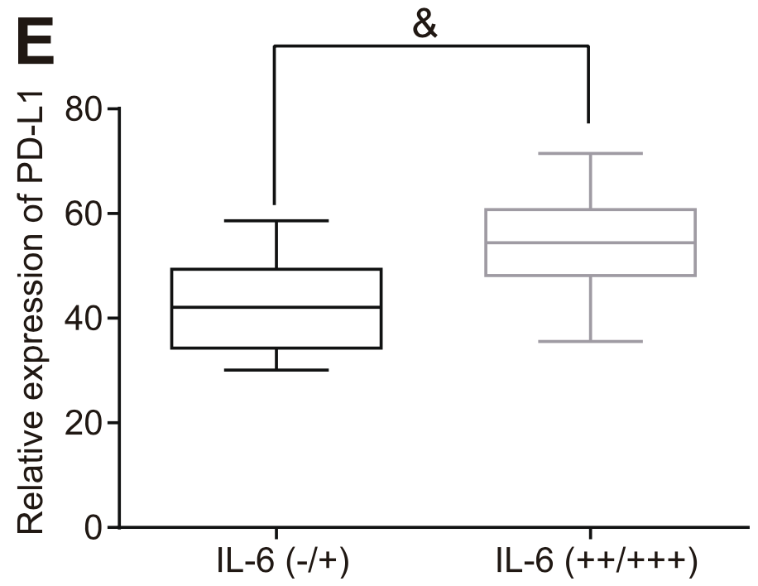
Long non-coding RNA HOTTIP and immune escape in ovarian cancer cells
E) There is a positive relation between IL-6 expression in OC tissues and PD-L1 expression in infiltrated neutrophils
Conclusion: IL-6 is highly expressed in OC tissues and positively associated with PD-L1 in neutrophils

Slide 19
Long non-coding RNA HOTTIP and immune escape in ovarian cancer cells
A) IL-6 could promote the extent of STAT3 phosphorylation and increase expression of PD-L1 in neutrophils

Slide 20
Long non-coding RNA HOTTIP and immune escape in ovarian cancer cells
B) Expression of IL-6 in SKOV3 and OVCAR3 cells are higher than that in Hey-A8 cells

Slide 21
Long non-coding RNA HOTTIP and immune escape in ovarian cancer cells
C) OC cells with higher expression of IL-6 induced PD-L1 expression in neutrophils

Slide 22
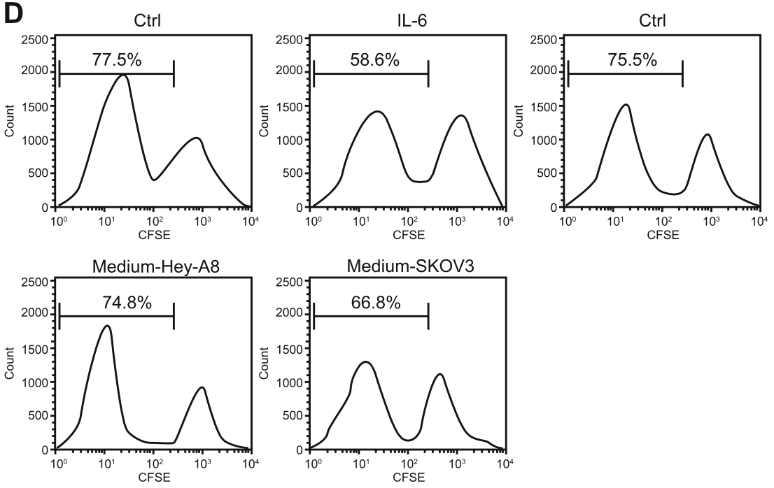
Long non-coding RNA HOTTIP and immune escape in ovarian cancer cells
D) Proliferation of T cells co-cultured with neutrophils pretreated IL-6 was diminished

Slide 23
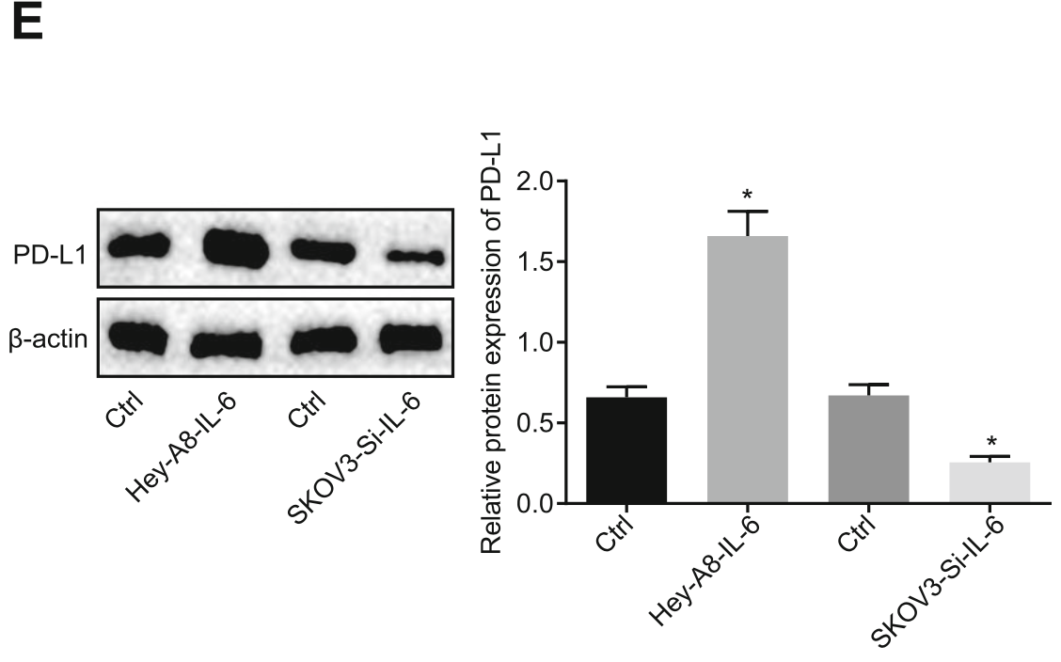
Long non-coding RNA HOTTIP and immune escape in ovarian cancer cells
E) OC cells upregulated PD-L1 expression in neutrophils by secreting IL-6, thus inhibiting cell proliferation
Conclusion: OC cells secret IL-6 to activate the STAT3/PD-L1 pathway in neutrophils and repress T cell proliferation

Slide 24
Long non-coding RNA HOTTIP and immune escape in ovarian cancer cells
HOTTIP may promote IL-6 transcription by binding to c-jun and is predominantly localized in nucleus

Slide 25
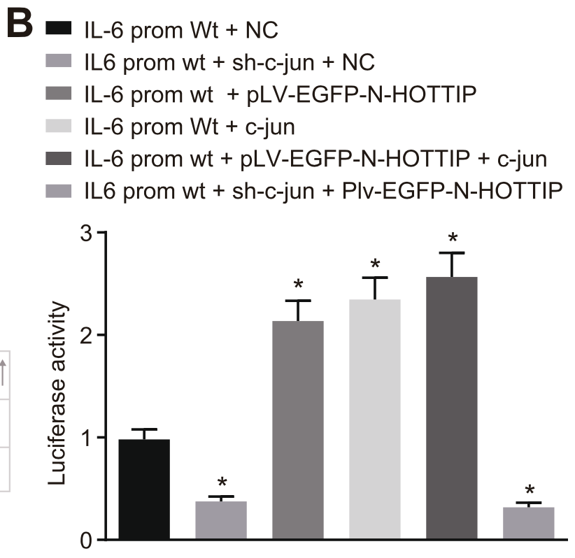
Long non-coding RNA HOTTIP and immune escape in ovarian cancer cells
B) Both c-jun and HOTTIP could increase the activity of IL-6 promoter

Slide 26
Long non-coding RNA HOTTIP and immune escape in ovarian cancer cells
C) HOTTIP enhances the binding of c-jun and IL-6 promoter

Slide 27
Long non-coding RNA HOTTIP and immune escape in ovarian cancer cells
D) There is an interaction between c-jun and HOTTIP
E) HOTTIP can promote expression of IL-6
Conclusion: HOTTIP promotes IL-6 transcription by regulating transcription factor c-jun

Slide 28
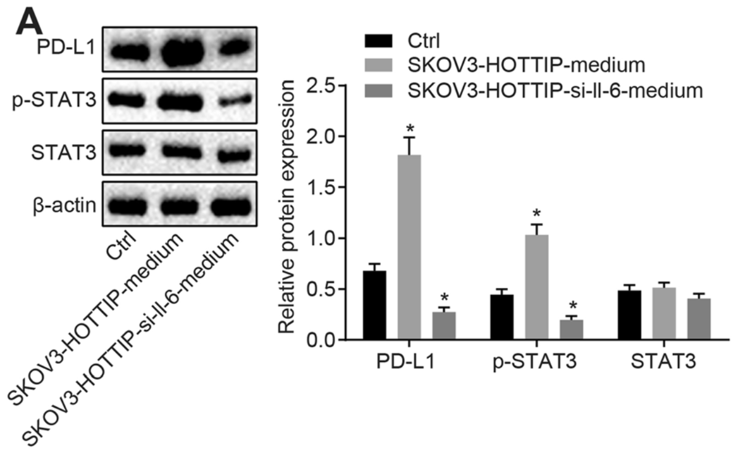
Long non-coding RNA HOTTIP and immune escape in ovarian cancer cells
A) Protein expression of PD-L1 and the extent of STAT3 phosphorylation were elevated in neutrophils treated with SKOV3 cell culture medium. HOTTIP augmented PD-L1 expression in neutrophils mainly through IL-6

Slide 29
Long non-coding RNA HOTTIP and immune escape in ovarian cancer cells
B) Proliferation of T cells was repressed by neutrophils cultured with SKOV3 cell culture medium
Conclusion: HOTTIP exerted a promoting role in neutrophils induced inhibition of T cell proliferation by promoting IL-6 in OC cells

Slide 30
Long non-coding RNA HOTTIP and immune escape in ovarian cancer cells

Slide 31
Long non-coding RNA HOTTIP and immune escape in ovarian cancer cells
A) No significant difference is visible in body weight upon different treatments
B) Tumor volume of mice injected with neutrophils treated with SKOV3 cells overexpressing HOTTIP is much heavier than that in neutrophils treated with normal SKOV3 cells

Slide 32
Long non-coding RNA HOTTIP and immune escape in ovarian cancer cells
C) Decline of the infiltrated CD3⁺ T cells is observed in mice injected with neutrophils added with SKOV3 cells overexpressing HOTTIP, while CD3⁺ T cells increased following the addition of PD-L1 antibody

Slide 33
Long non-coding RNA HOTTIP and immune escape in ovarian cancer cells
D) The expression of IFN-γ in CD3⁺ T cells is relatively lower in neutrophils added with SKOV3 cells overexpressing HOTTIP, while the results is restored by adding PD-L1 antibody
Conclusion: HOTTIP could promote the expression of PD-L1 in neutrophils, while suppressing T cell immunity in vivo

Slide 34
Long non-coding RNA HOTTIP and immune escape in ovarian cancer cells
A) HOTTIP expression is elevated in OC tissues relative to that in normal fallopian tube fimbriae tissues

Slide 35
Long non-coding RNA HOTTIP and immune escape in ovarian cancer cells
B) The overall survival of patients with higher expression of HOTTIP is far shorter than that of OC patients with lower HOTTIP expression

Slide 36
Long non-coding RNA HOTTIP and immune escape in ovarian cancer cells
Conclusion: There is a strong and positive correlation between HOTTIP expression and PD-L1 expression in neutrophils

Slide 37
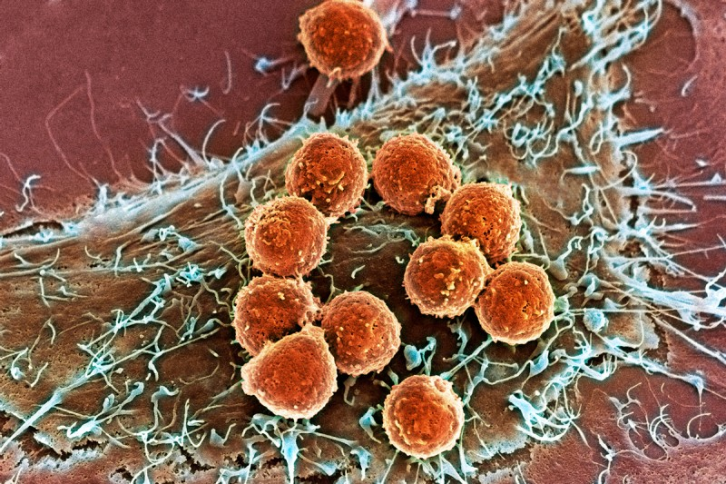
Discussion
IL-6 is highly expressed in OC tissues and positively associated with PD-L1 in neutrophils
HOTTIP is highly expressed in OC tissue samples
HOTTIP could elicit the secretion of IL-6 and upregulate PD-L1 expression in neutrophils

Slide 38
Discussion
OC cells secret IL-6 to activate STAT3/PD-L1 pathway in neutrophils and repress T cell proliferation
IL-6 abrogates T cell proliferation by promoting the extent of STAT3 phosphorylation through the enhancement of PD-L1 expression in neutrophils

Slide 39
Discussion
HOTTIP promotes IL-6 transcription by regulating transcription factor c-jun
JNKs bind and phosphorylate c-jun within its transcriptional activation domain
JNKs play a role in T cell differentiation and the cellular apoptosis pathway
MALAT1 suppresses the phosphorylation of JNK1 and has a key role in development of OC

Slide 40
Discussion
Upregulation of HOTTIP increase IL-6 dependent PD-L1 expression and inhibits T cell-mediated tumor immunotherapy
Enhanced HOTTIP has been observed to elevate PD-L1 expression and results in increased immunosuppression

Slide 41
Discussion
High expression of HOTTIP enhance expression and secretion of IL-6 from OC cells by promoting the transcription of IL-6
IL-6 stimulates PD-L1 expression by binding to the IL-6 receptor on the surface of neutrophils around the cancer cells and activates the STAT3 pathway
The increased expression of PD-L1 on the surface of neutrophils inhibits the activity of T cells, which further promotes apoptosis, thus facilitating the immune escape of OC cells

Slide 42
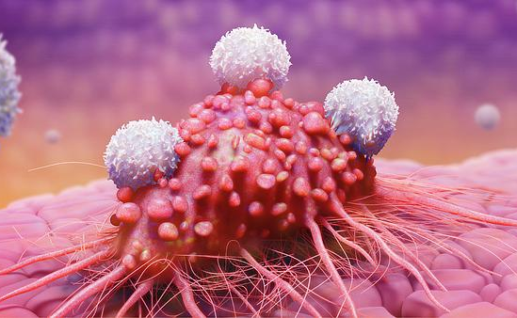
Conclusion
HOTTIP can potentially accelerate immune escape of OC cells via enhancement of IL-6-dependent PD-L1 expression
This presents a novel mechanism for the role of HOTTIP in regulating immune escape of OC cells and provides a potential target for OC therapy
Future perspectives: further studies based on the syngeneic model that is more ideal to demonstrate antitumor immune response to explain the specific underlying mechanism by which HOTTIP/IL-6/PD-L1 network influences the overall survival

Slide 43
Future perspectives in the use of ICIs
Strategies improving the efficacy of these therapies is essential for unresponsive patients or those with acquired immune resistance
Epigenetic modulators can influence the tumor microenvironment and the use of epigenetic drugs can sensitize cells to immunotherapeutic responses

Slide 44
Future perspectives in the use of lncRNAs
The use of lncRNAs as a tool in cancer immunotherapy needs further exploration of epigenetic regulators
Recent advances in epigenetic research could lead to the identification of additional lncRNAs potentially associated with tumor immunity
Isolation of immune subsets from patients through the course of treatment in conjunction with transcriptome and functional investigation might shed some light on the precise role of lncRNAs in this process

Slide 45
Thanks for listening!

