Slide 1
Drug development

Slide 2
For cancer patients, Life expectancy continues to improve the use of innovative medicines has made major contribution to recent advances
From 2000 – 2009, an improvement in population weighted mean life expectancy at birth of 1.74 years was seen across 30 OECD countries.
Innovative medicines are estimated to have contributed to 73% of this improvement once other factors are taken into account (e.g. income, education, immunization, reduction in risk factors, health system access).
Source: Lichtenberg, F: Pharmaceutical innovation and longevity growth in 30 developing OECD and high-income countries, 2000 - 2009 (2012)

Slide 3
Medicines are some of the most powerful tools in
treating and curing deadly diseases
Hepatitis C Virus (HCV)
HCV, which is the leading cause of liver transplants and the reason liver cancer is on the rise, is now curable in more than 90% of treated patients with only 8-12 weeks of treatment.
+133% cure rate increase for patients in Europe²
15 million
people are living with Hepatitis C in Europe¹
8-12 Weeks*
12 Weeks*
24-48 Weeks*
48 Weeks*
95-96%
cure rate
90%
cure rate
63-80%
cure rate
41%
cure rate
1st generation (1999-2010) Interferon and Ribavarin (IFN-R) Injection | 2nd generation (2011-2013) Protease Inhibitors w/ IFN Injection | 3rd generation (2013-2014) Polymerase Inhibitors w/ IFN Injection | 4th generation (2014-2015) Oral Combination Therapies
Es. sofosbuvir
* Treatment duration.
Note: EMA approval dates. Cure rates are based on the results of clinical trials reported by the US Food and Drug Administration (FDA) for different drugs against Hepatitis C.
Source: Health Advances analysis; ¹Hope 2014 Prevalence and estimation of hepatitis B and C infections in the WHO European region Epidemiol Infect; European Medicines Agency (EMA) website; ²EFPIA 2015 Health & Growth Evidence Compendia analysis of PhRMA 2014 25 Years of Progress Against Hepatitis C and PhRMA 2015 Pharma Profile.

Slide 4
Medcines are transforming outcomes for
patients living with chronic disease
 | Cardiovascular Disease In Europe, biopharmaceutical companies are currently developing 172 medicines* to treat heart disease, stroke and other cardiovascular diseases.¹ New PCSK9 inhibitors have revolutionized therapy for high cholesterol. Between 2000 and 2012, the death rate from cardiovascular disease fell 37% in the EU5, 27% in Japan, and 5% in Mexico.²
 | Diabetes Between 2000 and 2012, new therapies contributed to a 48% and 31% decline in the diabetes death rate in Korea and Canada, respectively.²
 | Rheumatoid Arthritis The recent introduction of disease-modifying therapies has dramatically improved the lives of patients and caregivers by slowing and sometimes even reversing negative physical symptoms of the disease.³
Death rates for
non-communicable diseases declined nearly 20%
in the EU5, Australia, Canada, and Japan from 2000 to 2012²
Inibitori PCSK9 = evolocumab
Inibitori TNFalfa = adalimumab
* Medicines in Phase I through III of development.
Note: The 4 main types of non-communicable diseases, also known as chronic diseases, defined by WHO are cardiovascular diseases (e.g. heart attacks and stroke), cancers, chronic respiratory diseases (e.g. chronic obstructed pulmonary disease and asthma) and diabetes.
Source: Health Advances analysis; ¹PharmaProjects (accessed February 2016); ²WHO Mortality Database (accessed February 2016); ³PhRMA 2015 Pharma Profile.

Slide 5
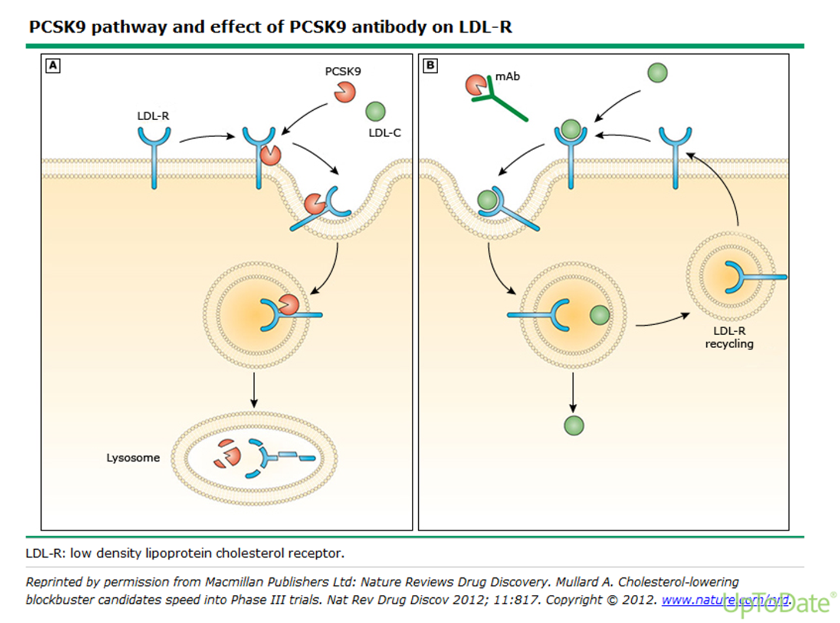
Anti-PCSK9 (evolocumab): meccanismo d’azione

Slide 6
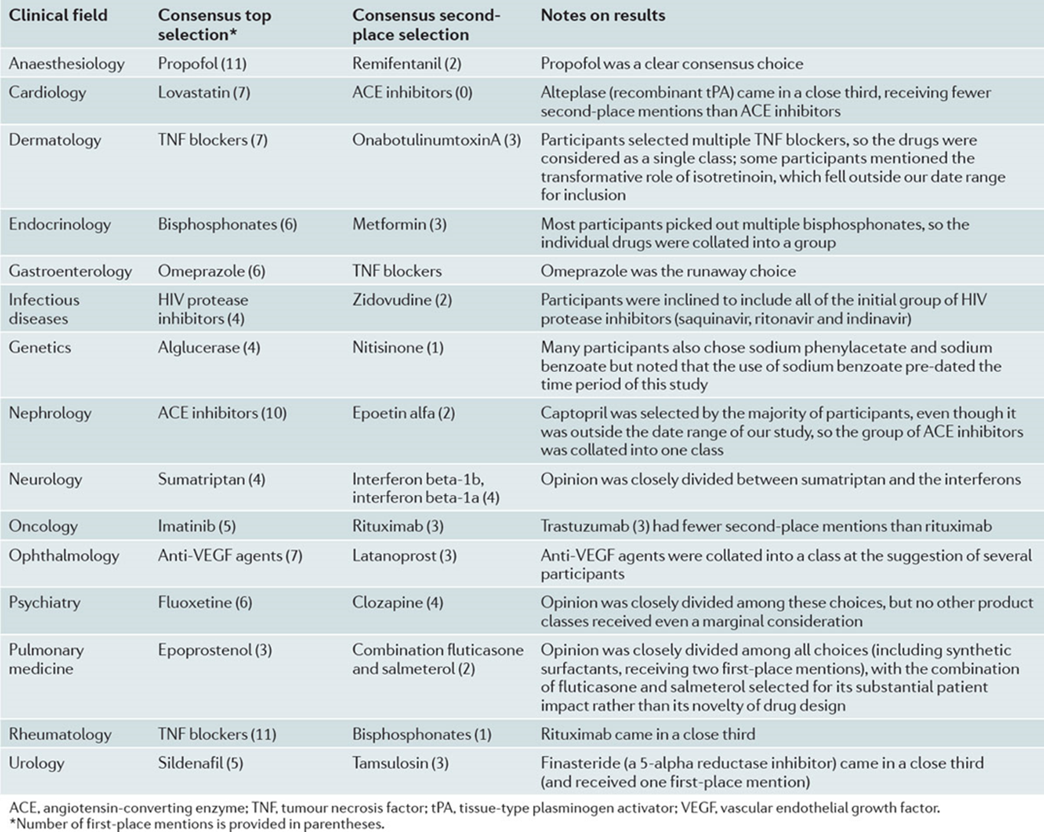
Top ten drugs by sales globally in 2017 and 2018
adalimumab
lenalidomide
pembrolizumab
trastuzumab
bevacizumab
rituximab
nivolumab
apixaban
pneumococcal vaccine
ustekinumab
Urquhart L. Nat Rev Drug Discov 2019

Slide 7
An Improved Understanding of Disease and Personalized Medicines Have Resulted in
increased patient survival
Advances in personalized medicine have improved the outlook for patients with blood cancers in Europe¹
Improved Understanding of the Disease
60 YEARS AGO
50 YEARS AGO
40 YEARS AGO
TODAY
“Disease of the Blood”
Chronic Leukemia
Acute Leukemia
Pre-leukemia
Indolent Lymphoma
Aggressive Lymphoma
~40 unique Leukemia types identified
~50 unique Lymphoma types identified
Leukemia
Lymphoma
Today, 230 medicines* ²
are in development for blood cancers in Europe
A greater understanding of the molecular basis of disease has transformed what was once known collectively as “disease of the blood,” into multiple subtypes of leukemia and lymphomas, which can be targeted by personalized medicines
Chronic Lymphocytic Leukemia 5 year survival rates have grown to 70%³
Hodgkin’s Lymphoma
5 year survival rates have grown to 80%³
* Medicines in phases I through III for the treatment of all types of leukemia and lymphoma.
Source: Health Advances analysis; ¹PhRMA 2015 Value of Personalized Medicine; ²PharmaProjects (accessed February 2016); ³Cancer Survival in Europe Eurocare 5 Database 2000-2007.

Slide 8
Disease Diagnosis enables a targeted approach to personalised medicines that has Resulted in
decreased death rates from cancer
The evolution of molecular characterization and targeted therapeutics has led to a decrease in the average lung cancer death rate in the United Kingdom by 37% since 1980
Age-standardized death rates per 100,000 world standard population over time¹
45.1 deaths per 100,000
32.6 deaths per 100,000
30.5 deaths per 100,000
28.4 deaths per 100,000
1980
2000
2007
2012
Adenocarcinoma
0 identified
1 identified
5 identified
12 identified
Identified Mutations/Rearrangements over Time^{2,3}
Note: WHO Mortality Database age-standardized death rates per 100,000 for malignant neoplasm of trachea, bronchus and lung.
Source: Health Advances analysis; ¹WHO Mortality Database (accessed February 2016); ²My Cancer Genome website – Molecular Profiling of Lung Cancer; ³Pao 2012 Chipping away at the lung cancer genome Nat Med.

Slide 9
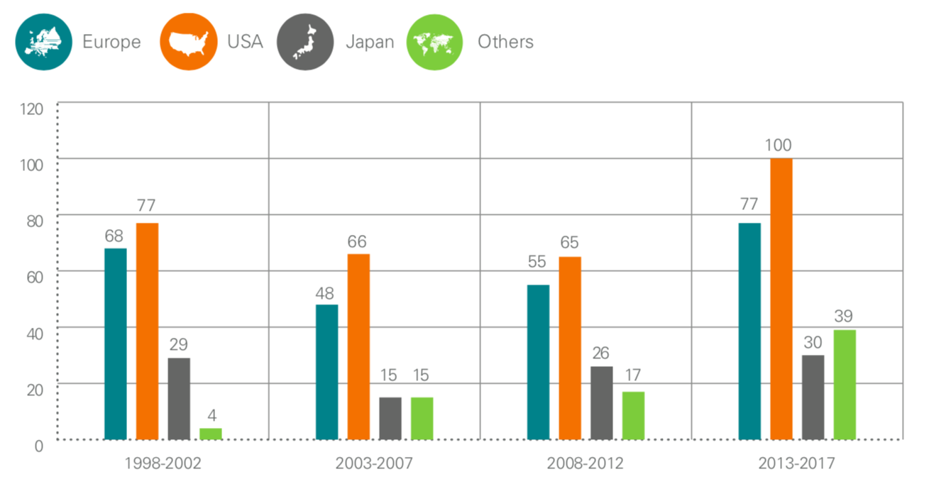
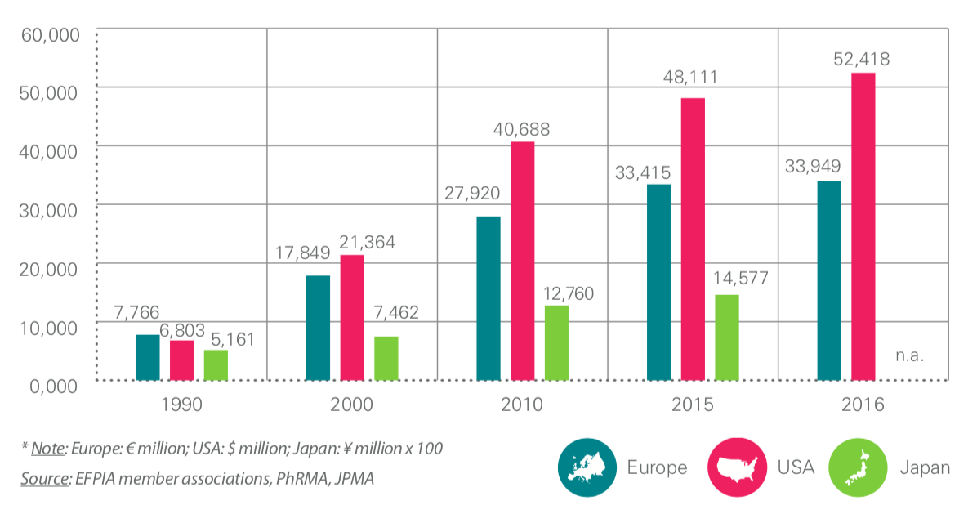
Number of new chemical and biological pharmaceutical enthities
Pharmaceutical R&D expenditure in Europe, USA and Japan (million of national currency units*), 1990-2016
https://www.efpia.eu/publications/data-center/the-pharma-industry-in-figures-rd/new-chemical-or-biological-entities/
https://www.efpia.eu/publications/data-center/the-pharma-industry-in-figures-rd/pharmaceutical-rd-expenditure-in-europe-usa-and-japan/

Slide 10
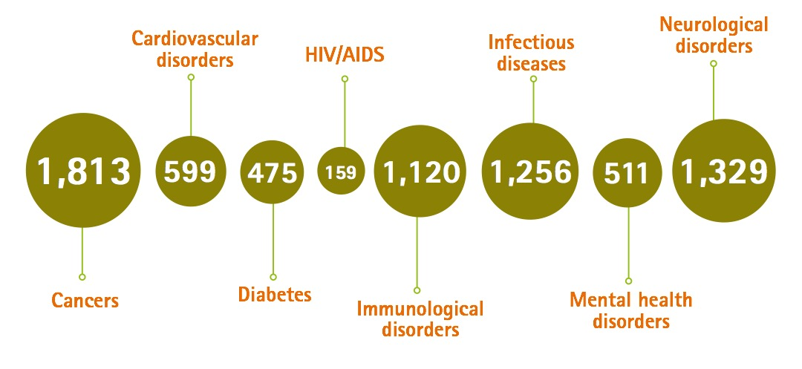
With over 7000 medicines in development, the exciting new wave of medical innovation will play a key role in
addressing the challenges faced by patients and healthcare systems
Source: Health Advances analysis; Adis R&D Insight Database. March 2015, compiled by PhRMA

Slide 11
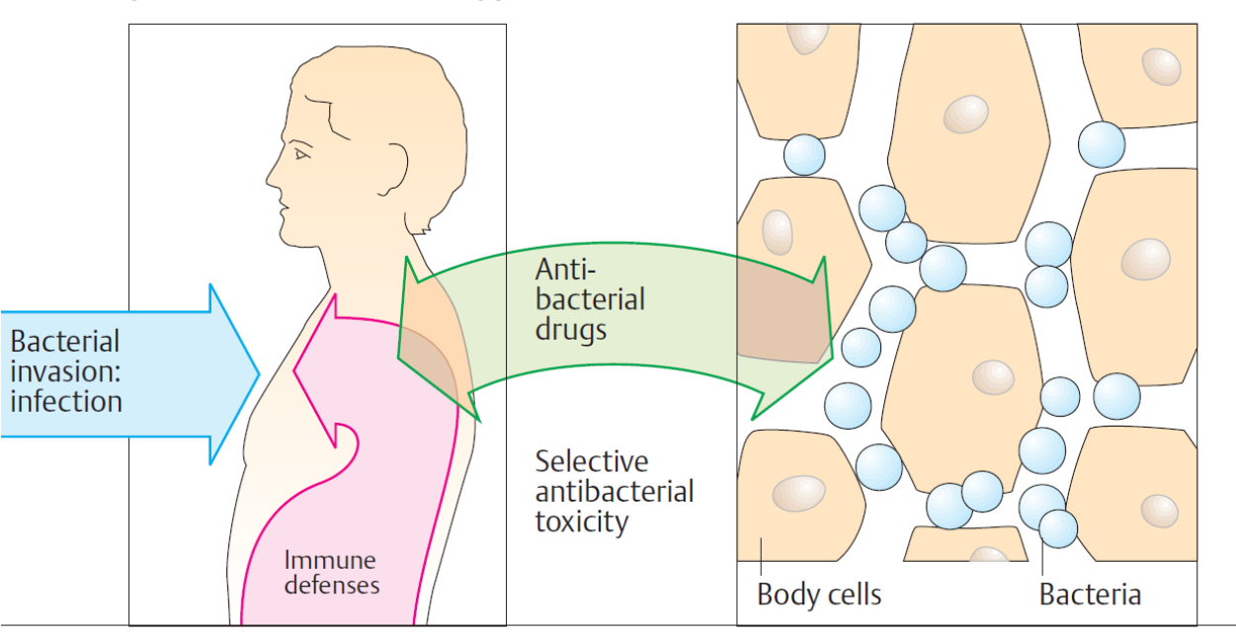
Antibiotici (antibatterici)
Farmaci antimicrobici utilizzati per il trattamento e la prevenzione delle infezioni batteriche
Differiscono fra loro per:
- caratteristiche chimico-fisiche e proprietà farmacologiche;
- spettro di attività antibatterica;
- meccanismo d’azione.

Slide 12
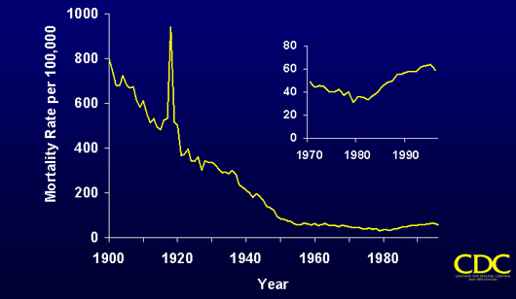
La scoperta e l’impiego degli antibiotici uniti a migliorate condizioni igienico- sanitarie hanno contribuito a ridurre enormemente la mortalità per malattie infettive…..ma
Mortalità per malattie infettive negli USA
First use of Penicillin

Slide 13
L’efficacia degli antibiotici si sta riducendo a causa dell’insorgenza di resistenza

Slide 14
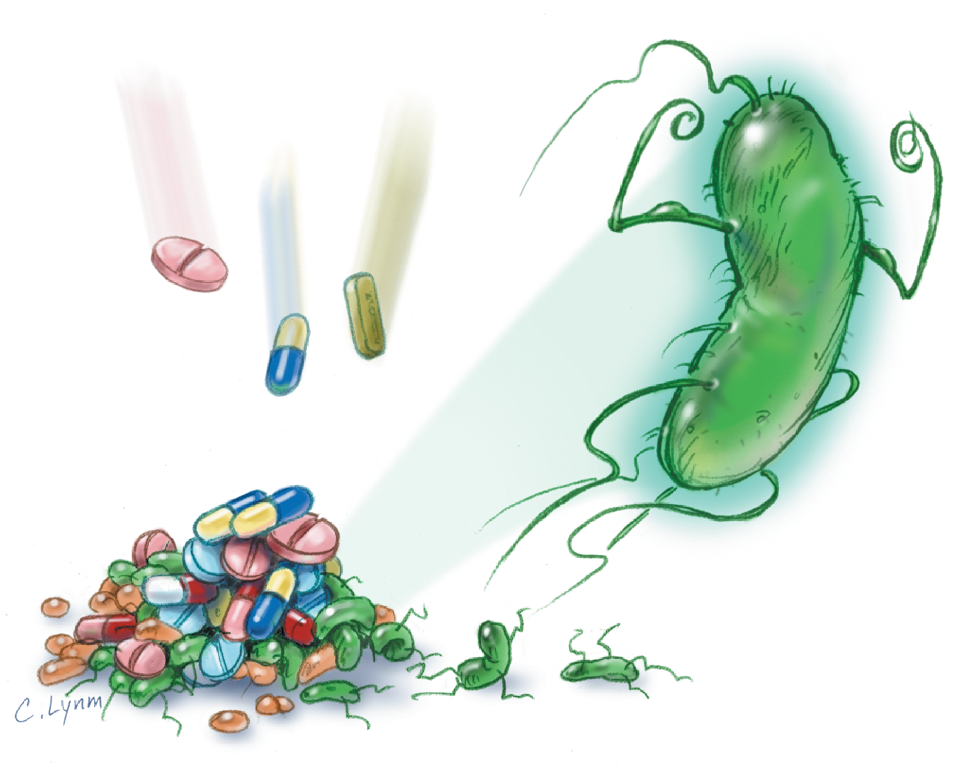
Meccanismi antibiotico resistenza
- Espressione enzimi che degradano gli antibiotici.
- Alterazioni dei bersagli molecolari.
- Meccanismi di trasporto
- Sviluppo di una via metabolica alternativa.

Slide 15
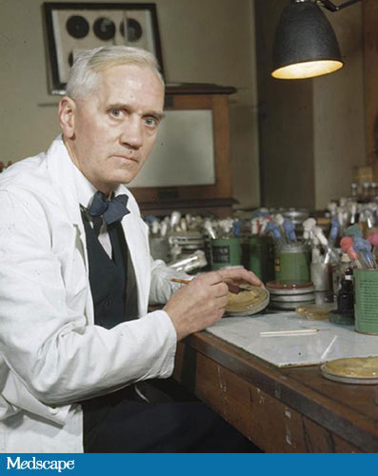
Gli antibiotici hanno rappresentato un fondamentale passo avanti nel promuovere e garantire la salute dei bambini e degli adulti, questi farmaci hanno tuttavia svantaggi significativi.
Comparsa di resistenze
In 1945, Alexander Fleming, the discoverer of penicillin, warned the public that doctors were abusing penicillin by using it in patients who did not need it. He said, "In such cases, the thoughtless person playing with penicillin is morally responsible for the death of the man who finally succumbs to infection with the penicillin-resistant organism. I hope this evil can be averted.”
[Fleming A. Penicillin's finder assays its future. New York Times. 1945 June 26:21.]

Slide 16
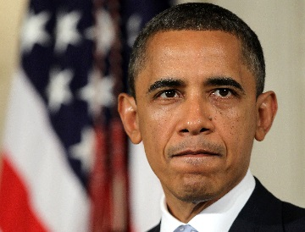
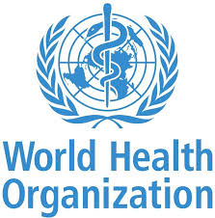
Il problema delle resistenze è un’emergenza globale
Settembre 2014
Barak Obama
istituisce una task force
per il controllo delle resistenze batteriche
U.K. – Ministero della sanità
Le resistenze sono un pericolo simile al terrorismo e riscaldamento globale.
7 aprile 2015
Il Regno Unito lancia un allarme:
Se le resistenze continueranno ad aumentare si stimano solo in Inghilterra 80.000 morti
21 settembre 2016
“senza un’azione urgente e coordinata il mondo verrà governato da un’era post-antibiotica in cui infezioni comuni, trattate con successo per decenni, potranno di nuovo uccidere”
K. Fukuda
Vicedirettore dell’OMS per la sicurezza sanitaria
Giugno 2015
al G7 in Germania si discute sull’antibiotico-resistenza.

Slide 17
La resistenza agli antimicrobici (AMR) è riconosciuta come una minaccia globale
Mortalità annuale
amr-review.org

Slide 18
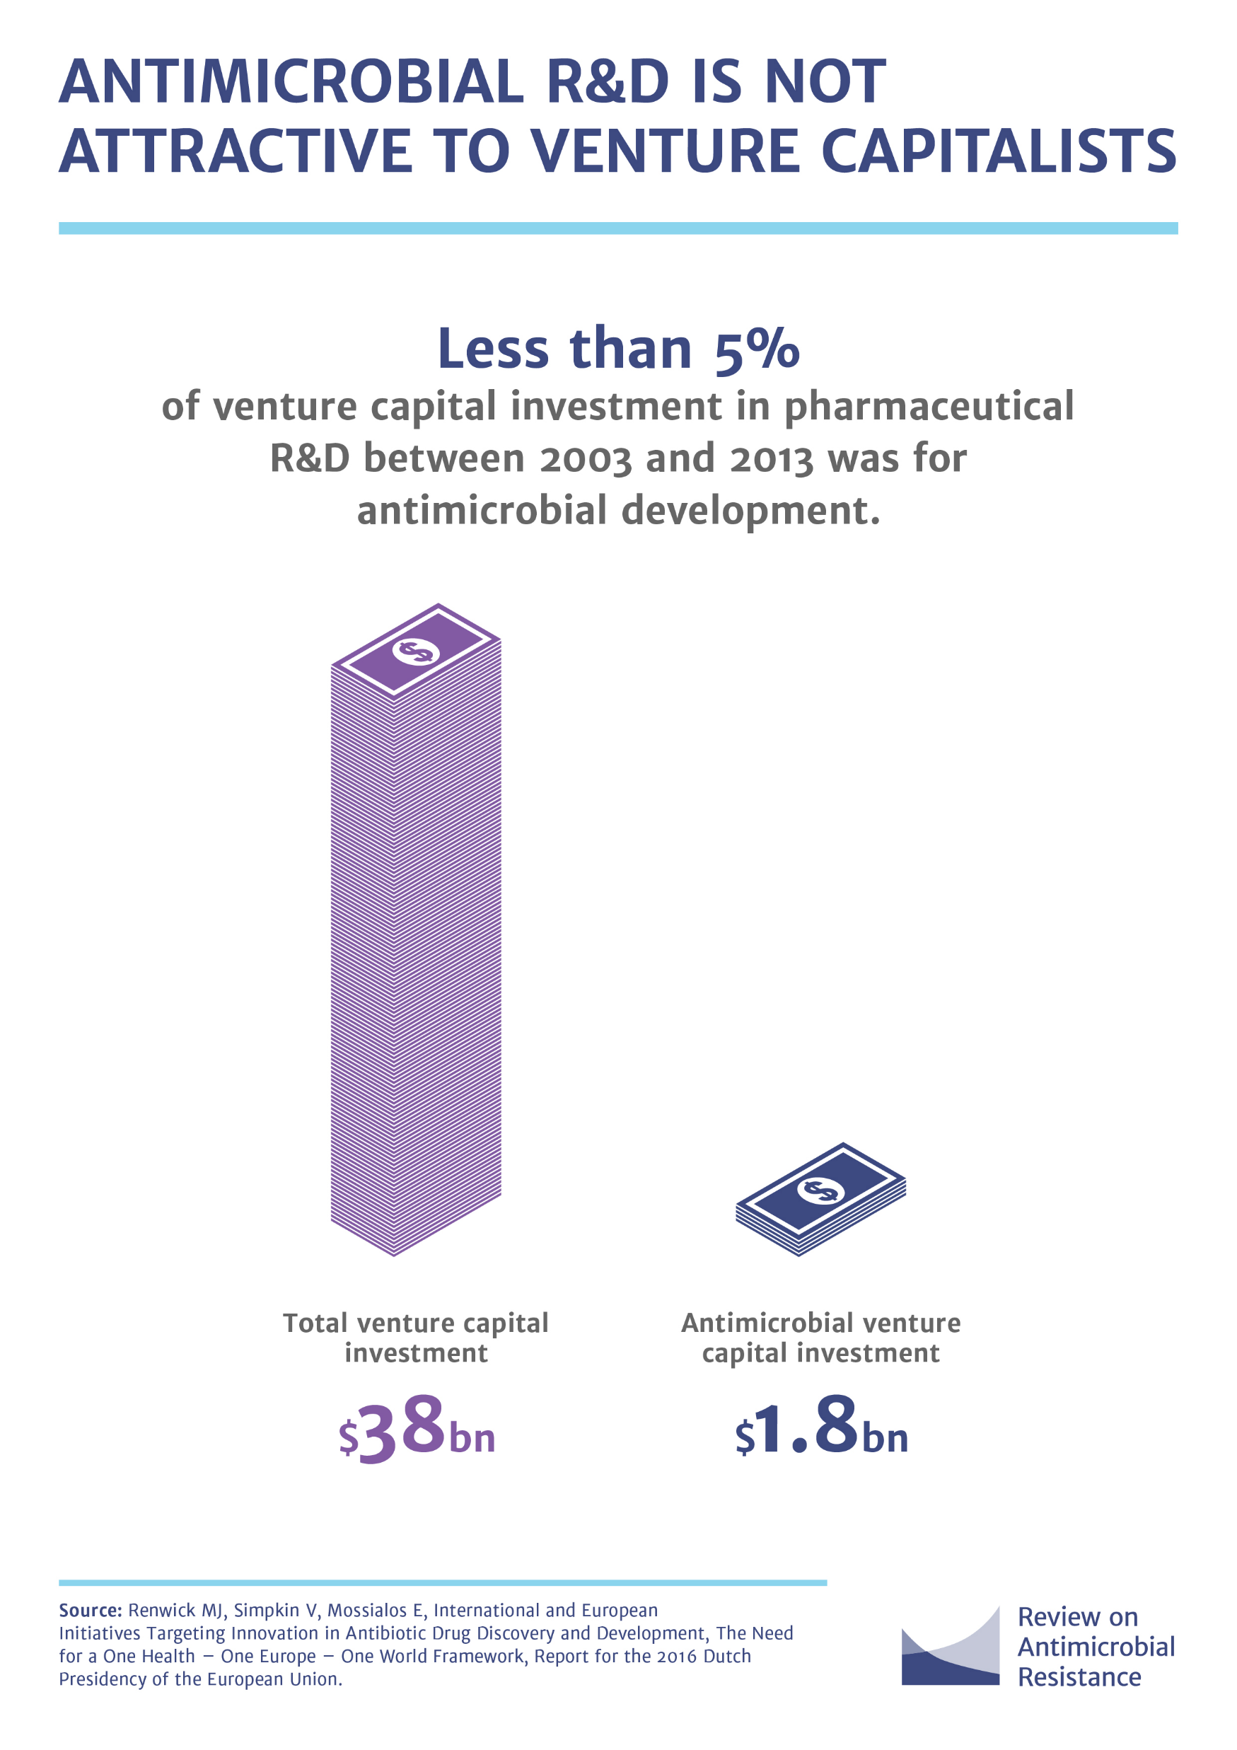
NUOVE CLASSI DI ANTIBIOTICI DIFFICILMENTE SARANNO DISPONIBILI NEL BREVE TERMINE

Slide 19
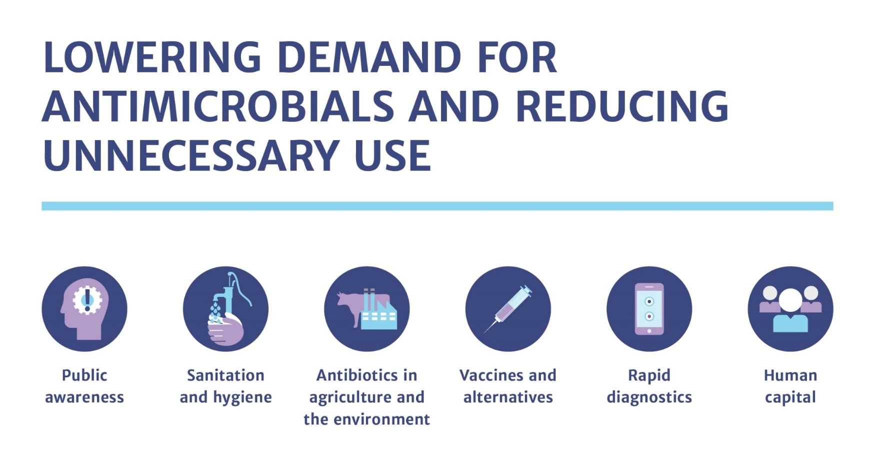
E’ IMPOTANTE RIDURRE LA RICHIESTA DI ANTIMICROBICI E RIDURRE IL LORO USO NON NECESSARIO
amr-review.org

Slide 20
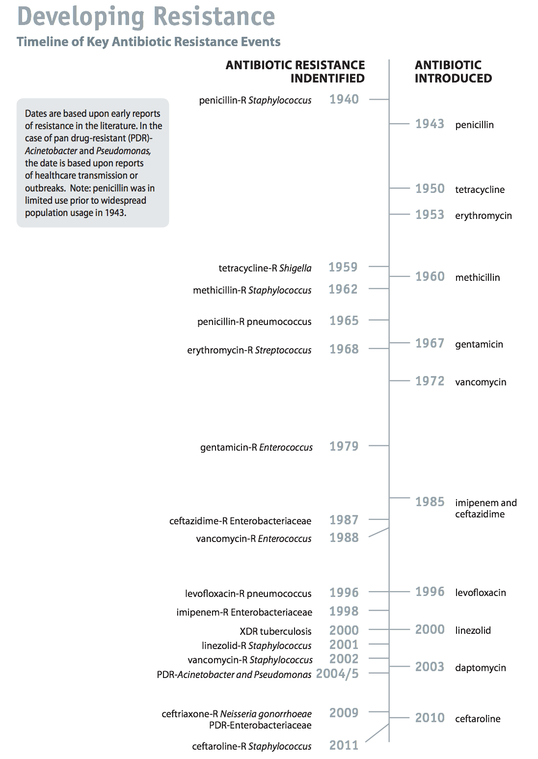

Slide 21
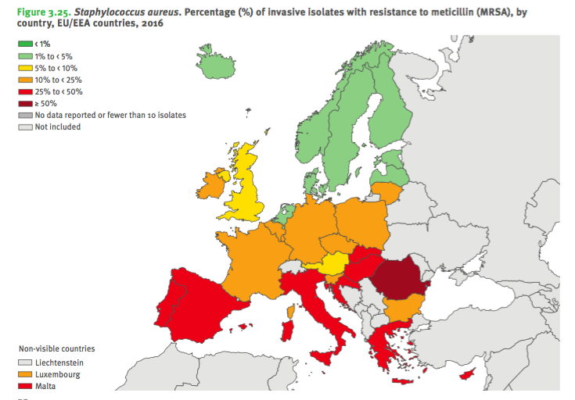
In Europa 33000 morti all’anno associati a resistenza agli antibiotici e circa un terzo avvengono in Italia (https://www.facebook.com/siffarmacologia/videos/2544206975632473/?fref=ts)

Slide 22
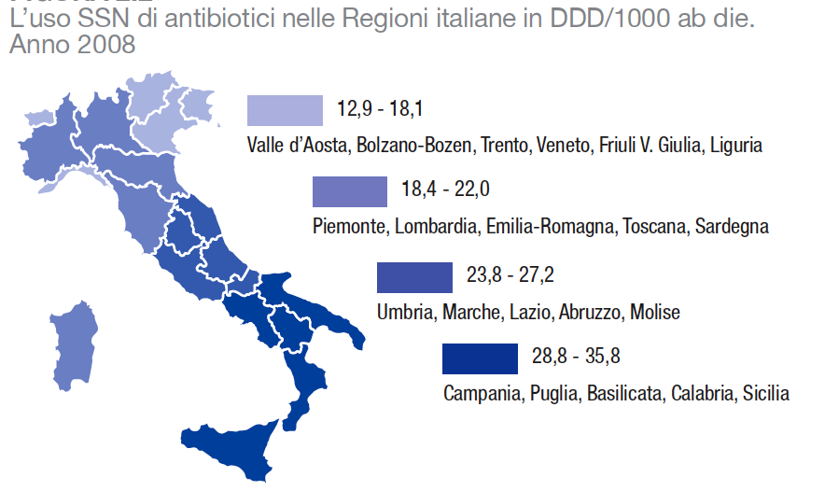
AIFA – Rapporto sull’uso dei farmaci antibiotici, 2009

Slide 23
Interventi per prevenire o diminuire la resistenza batterica (CDC)
Utilizzo appropriato delle vaccinazioni
Impiego giudizioso e attento di cateteri fissi
Coinvolgimento precoce di esperti di malattie infettive
Scelta della terapia sulla base della sensibilità locale dei diversi farmaci
Impiego di opportune tecniche antisettiche
Uso appropriato della profilassi negli interventi chirurgici
Procedure di controllo dell’infezione e isolamento
Attenzione costante all’igiene delle mani

Slide 24
Impiego errato degli antibiotici
Uso empirico e/o impiego in infezioni virali
Utilizzo di farmaci a largo spettro
Profilassi prolungata
Mancato completamento del regime terapeutico
Fiducia inappropriata nella sola chemioterapia
Posologia e modalità di somministrazione inadeguate

Slide 25
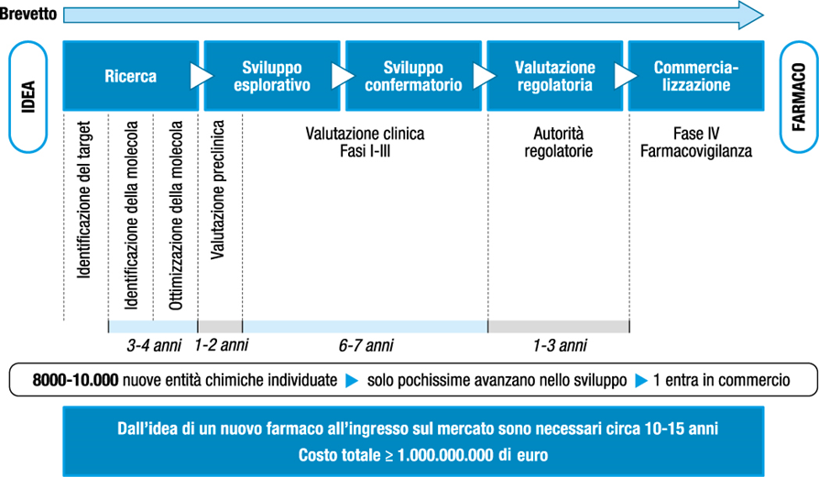

Slide 26
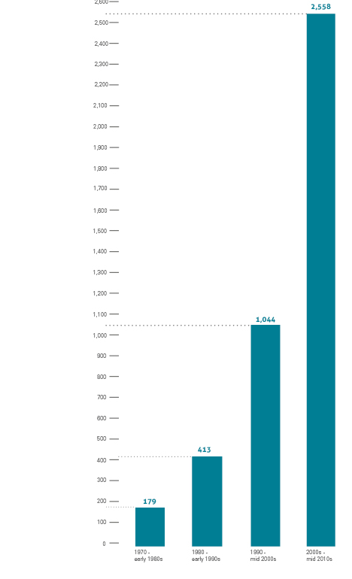

Milioni di $
Figura 7.2 Il processo di Ricerca & Sviluppo.

