Slide 1
Power BI

Slide 3
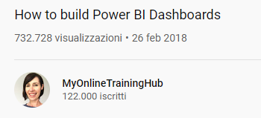
Tutorials
https://www.youtube.com/watch?v=BsXliHbOFDM
https://www.youtube.com/watch?v=AGrl-H87pRU

