Slide 1
SINTERING PROCESS
Silvia Dalla Marta
(dal corso di Scienza e tecnologia dei materiali ceramici prof. V. Sergo)

Slide 2
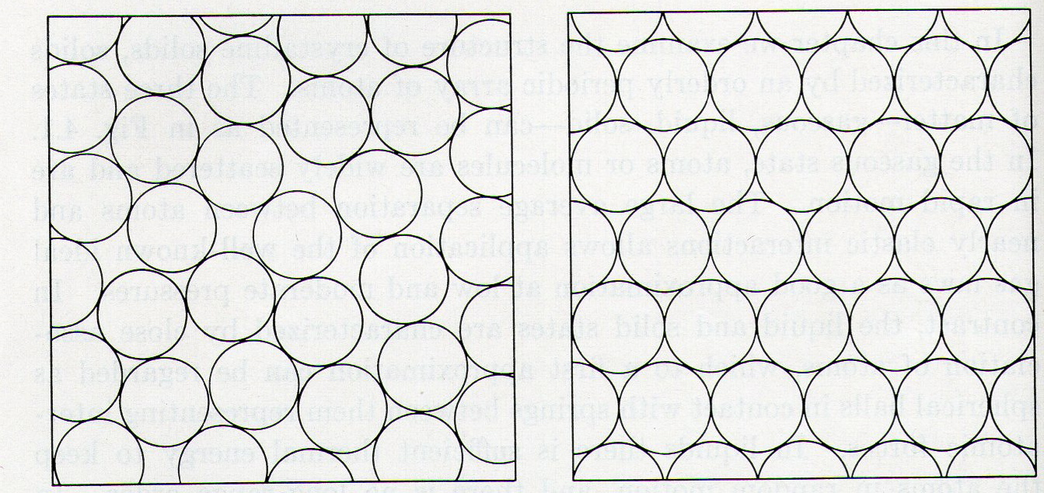
It is a thermal process of microstructural rearrangement in which the particles of powder are compacted and the porosity decreases to form a dense piece of ceramic.
monodisperse powder fcc or hcp: PF=74.5%
ceramic matherial with porosity:
before sintering

Slide 3
WHY DO YOU HAVE TO SINTER A PIECE OF CERAMIC AFTER FORMATURE?
The absence of defects and porosity is very important for the
mechanical properties:
K: the parameter for the determination of the stress at the tip of the crack.
y: dimensionless constant that depends on defect’s geometry and load
c: length of defect (m)
For the polycrystalline alumina:
In ceramics materials these values are very low compared to metals.
A very small defect or porosity lead to failure during an application of stress.

Slide 4
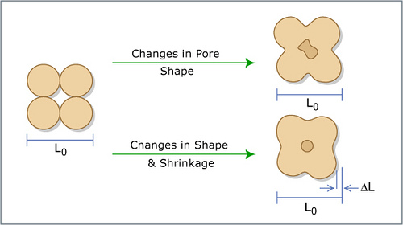

Slide 5
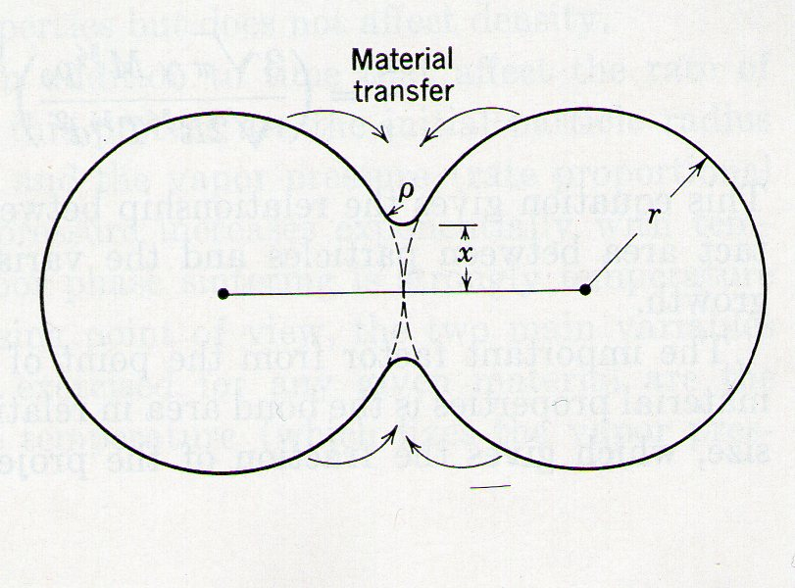
Considering two particles of ceramic material in contact with each other:
BEFORE SINTERING:
powder compact united by weaks Van der Waals forces
individual grains separated by 25-60% of volume porosity
concave zone
convex zone
The atoms in a convex zone tend to migrate in a concave zone in according to a diffusion process actived by temperature.

Slide 6
DIFFUSION PROCESS
Thermodinamically favored
kinetically slow
FICK’S LAW (1D):
Diffusion coefficient:
In order of kinetics to be fast enough for microstructural rearrangment to occur in short time, the sintering temperature must be:

Slide 7

SINTERING MECHANISMS
SURFACE DIFFUSION
VAPOR TRANSPORT
BULK DIFFUSION
GRAIN BOUNDARY DIFFUSION
densification
decrease of the distance between particle centres
NO densification
thinning of the particles

Slide 8
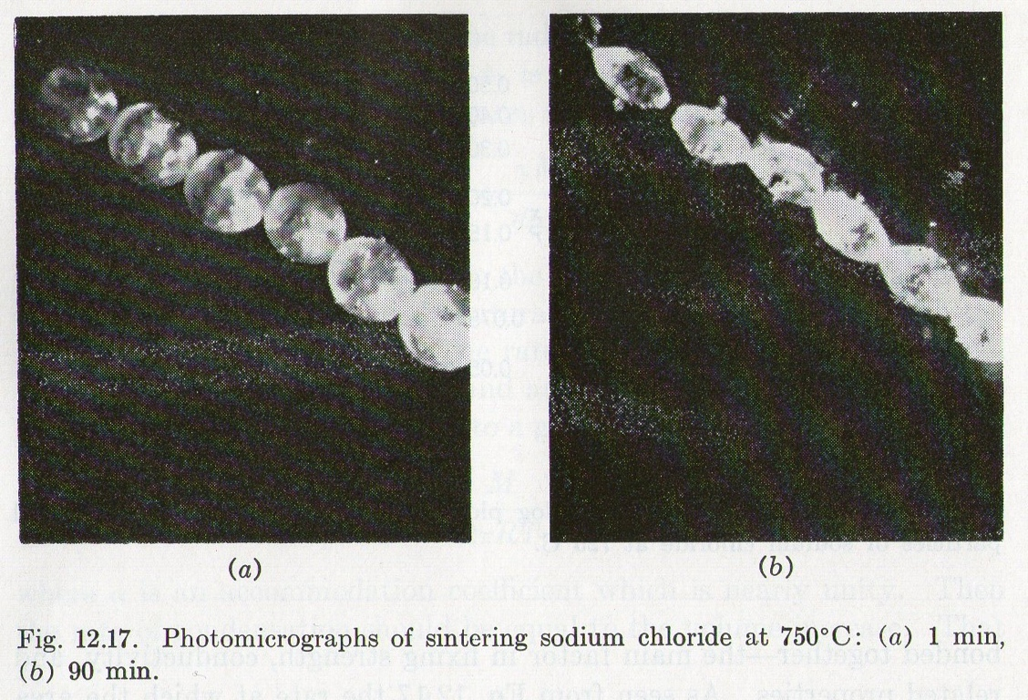
Thinning due to vapor phase matherial transfer:

Slide 9
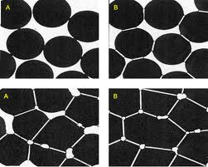
DENSIFICATION:
atoms migration in the neck zone
pores disappearence
obtaining straight grain boundaries
same chemical potential
thermodynamically stable

Slide 10
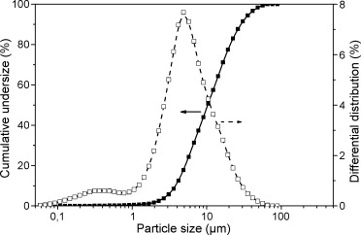
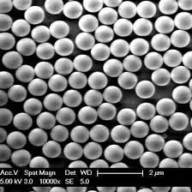
Monodispersed powder: rare and expensive!
More frequent:
Grain size distribution!

Slide 11
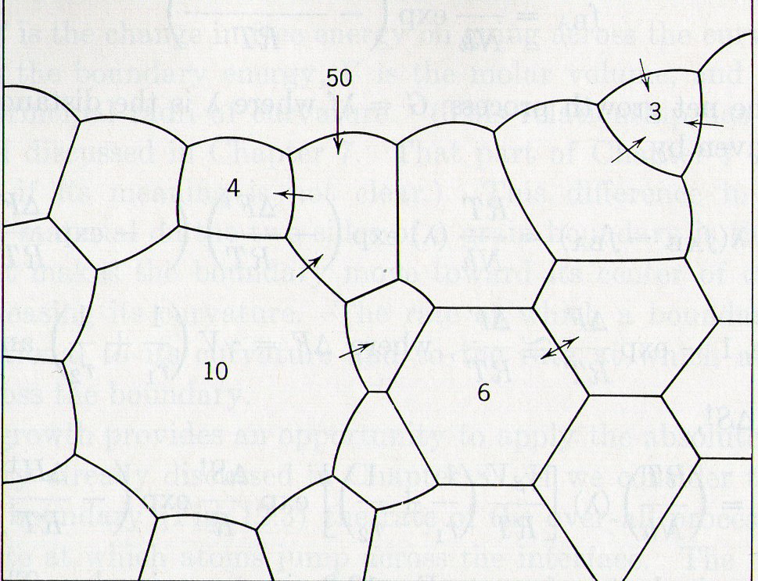
Since grain boundaries migrate toward their centre of curvature, grains with more than 6 sides tend to incorporate grains with less than 6 sides.
SECONDARY ABNORMAL OF BOUNDARY

Slide 12
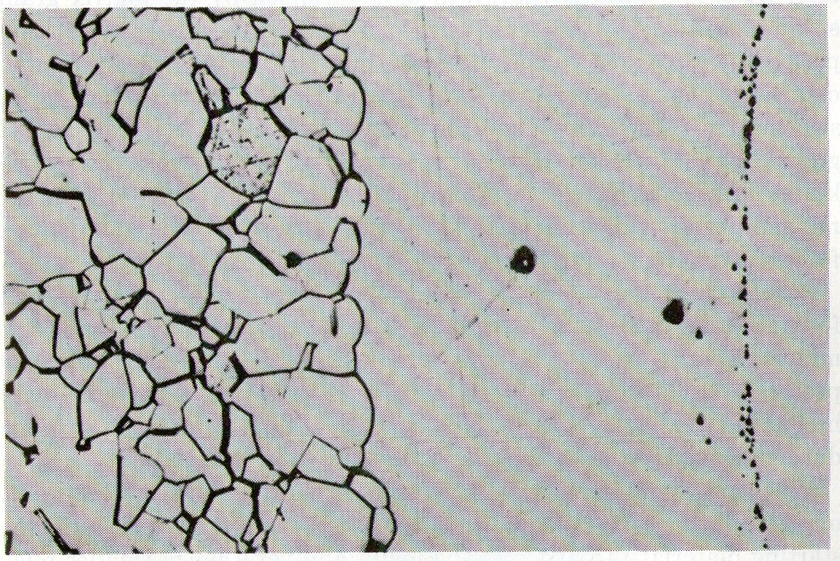
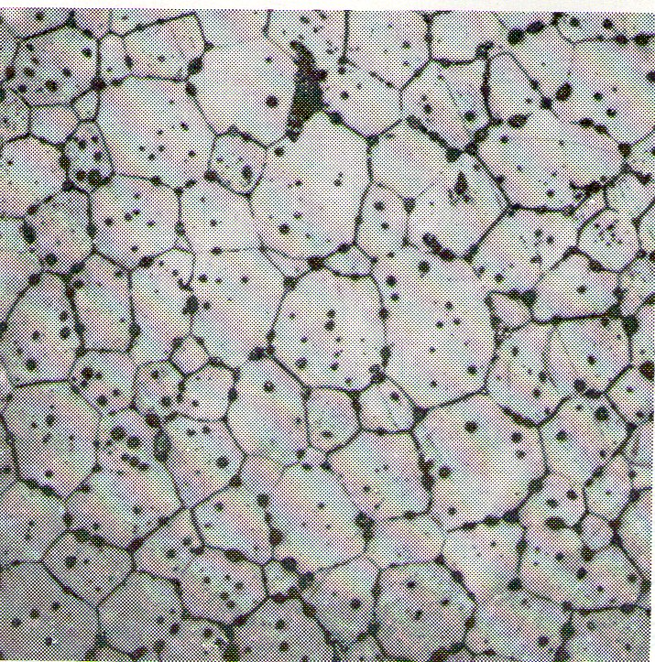
Growth of a large Al2O3 crystal into a matrix of uniformly sized grain.
Polycrystalline flurite CaF2
illustrating normal grain growth

Slide 13
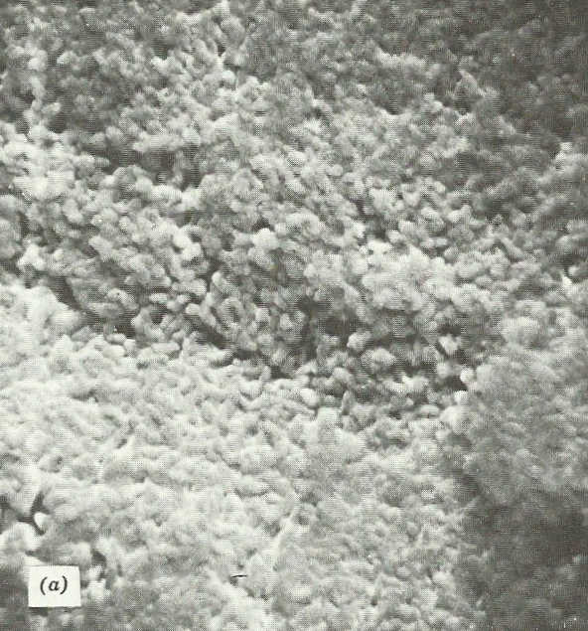
PROGRESSIVE DEVELOPMENT OF MICROSTRUCTURE
IN LUCALOX ALUMINA
a) SEM of initial particles befor sintering (5000x)

Slide 14
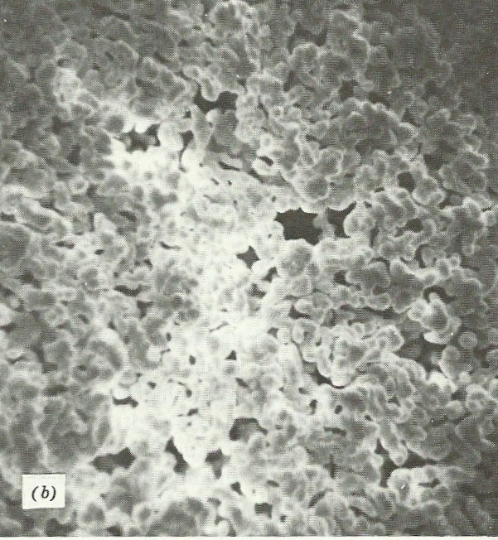
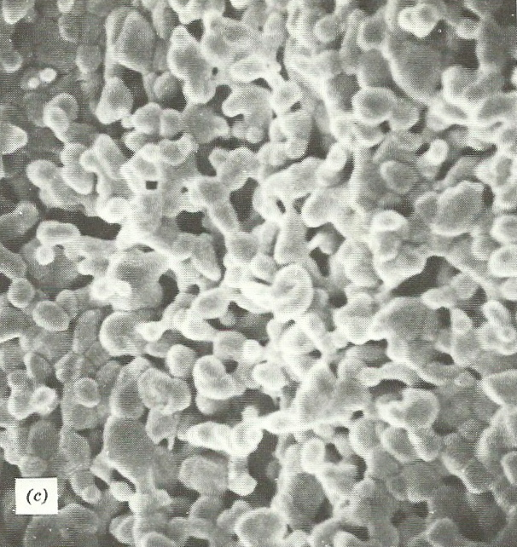
b) SEM of particles after1minute at 1700°C (5000x)
c) SEM of particles after 2 minutes at 1700°C (5000x)

Slide 15
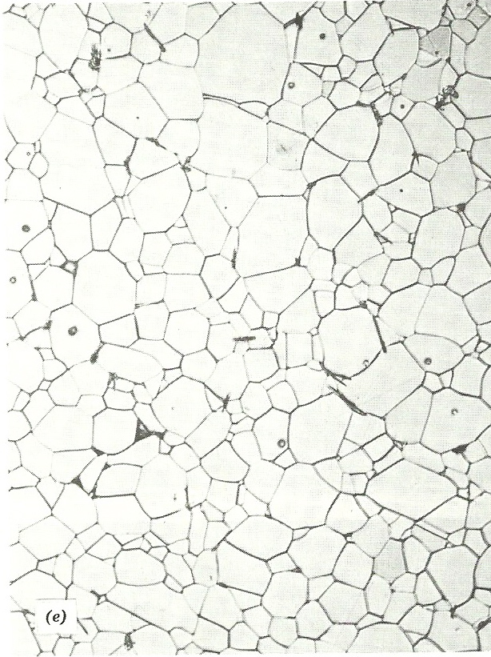
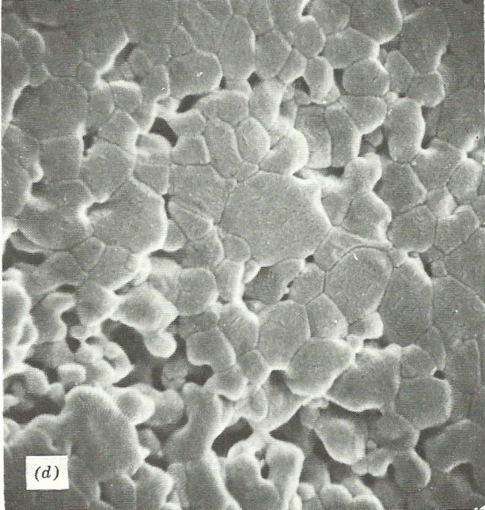
d) SEM of particles after 6 minutes at 1700°C (5000x)
e) SEM of the final microstructure that is nearly porefree, with only a few pores located within grains (500x)

Slide 16
PRESSURE DIFFERENCE ACROSS A CURVED SURFACE
The differences in the curvature of surface, causes a pressure difference in the various part of system, that leads to atoms transport.
At the surface of the particle there is a positive radius of curvature, so that the vapour pressure is larger than would be observed in a flat surface.
At the junction between particles there is a NECK whith a small negative radius of curvatures and a vapour pressure lower than that for the particle itself.

Slide 17
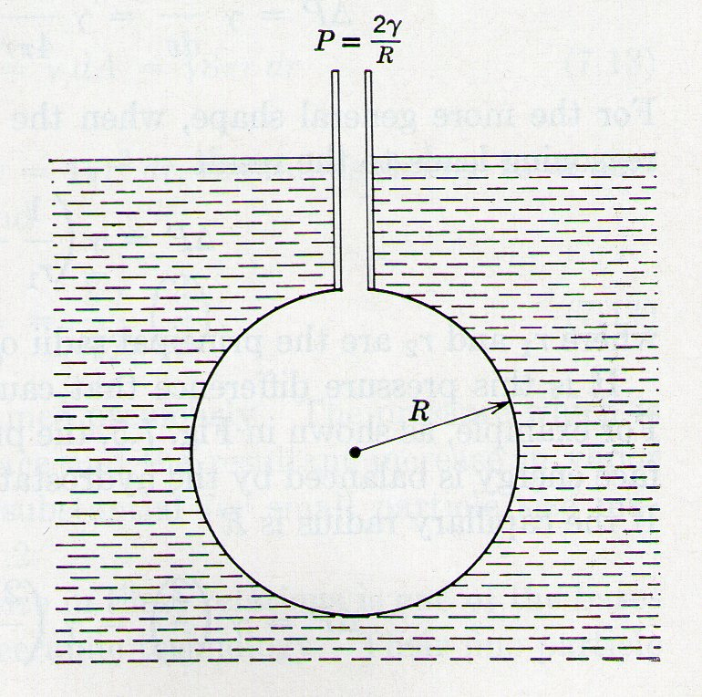
P : Supplementary pressure to create the bubble.
: surface tension
SPHERICAL MODEL:
GENERICALLY:

Slide 18
in equilibrium condition
vapour pressure of water
in a flat liquid-vapour interface
If the liquid-vapour interface is not flat, as in a small drops, the water has a vapour pressure that is larger than that in a flat surface:
: standard vapour pression

Slide 19
ENERGY SURFACE in a densification process in which the only energy is given by radius of curvature:
: molecular volume
: density
: particle radius
: number of particles in a mole of powder
: surface area
:surface energy
: surface tension
: molecular weight

Slide 20
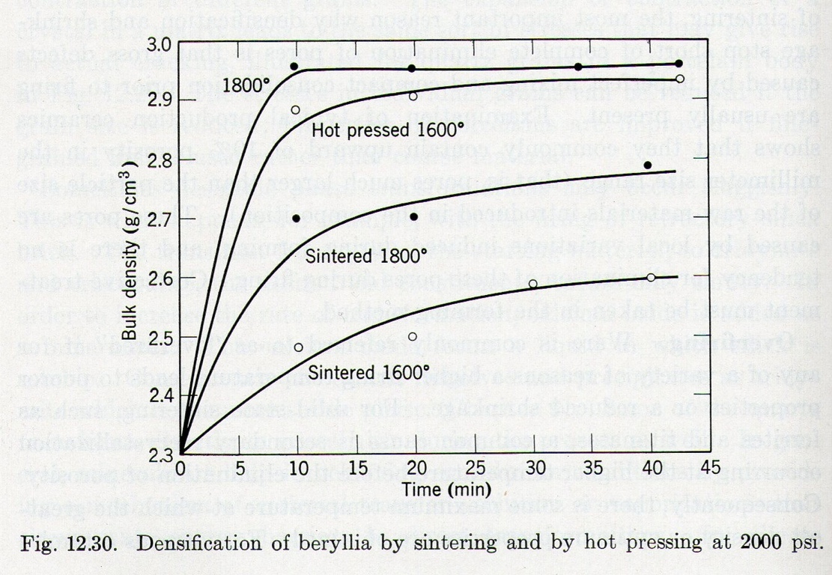
Energy available without added pressure in a sintering pocess of alumina:
Energy available whith added pressure in the same sintering:
Image from Kingery

Slide 21
DIFFUSION AND MOBILITY:
true in the absence of friction:
otherwise:
Einstein’s generalized equation of mobility:
: friction coefficient
: mobility
: diffusion coefficient

Slide 22
KINETIC MODELING OF SINTERING PROCESS
PARAMETERS TO DEFINE THE MODEL:
define a DRIVING FORCE
define the GEOMETRY
define the MECHANISM OF TRANSPORT
STAGES OF THE SINTERING:
INITIAL STAGE : from 50-55% to 75% of TD
INTERMEDIATE STAGE : from 75% to 92% of TD
FINAL STAGE : from 92% to 100% of TD
MODELING

Slide 23
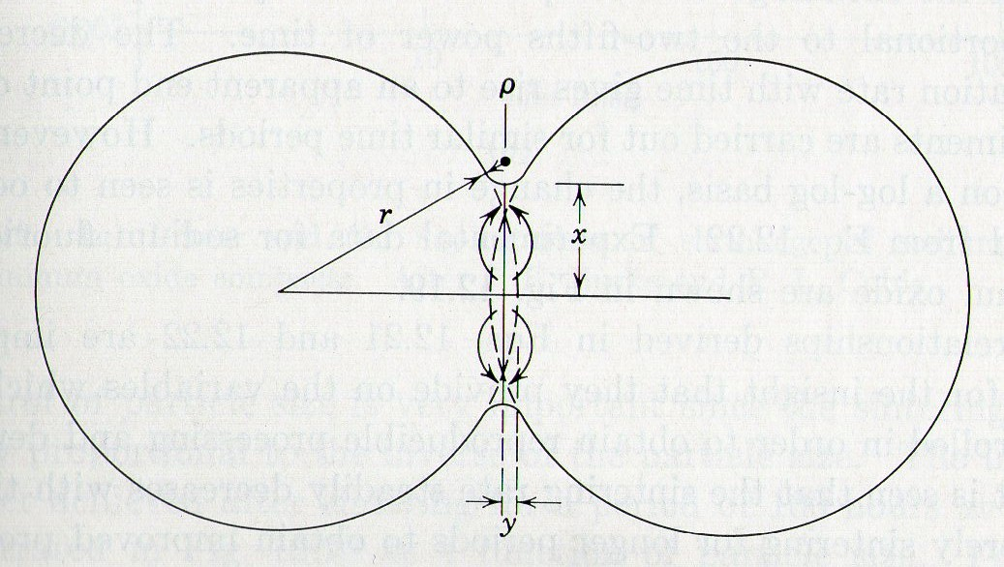
: radius of the neck’s curvature
: radius of particle
: parameter indicated the progress of the sintering
GEOMETRY

Slide 24
FLUX
The material transfer is linked to the flux.
Considering the area through which the transport takes (the neck area):
d : density
MW : molecoular weight
J : flux
Variation of the neck volume based on the increase of the ‘x’ parameter:

Slide 25
FLUX expressed as a DRIVING RORCE
c : concentration
M : mobility of bulk and grain boundary atoms
F : force
Variation of the free energy during the diffusion on the neck area:

Slide 26
integration between 0 and x
t=0, x=0
t: sintering time

Slide 27
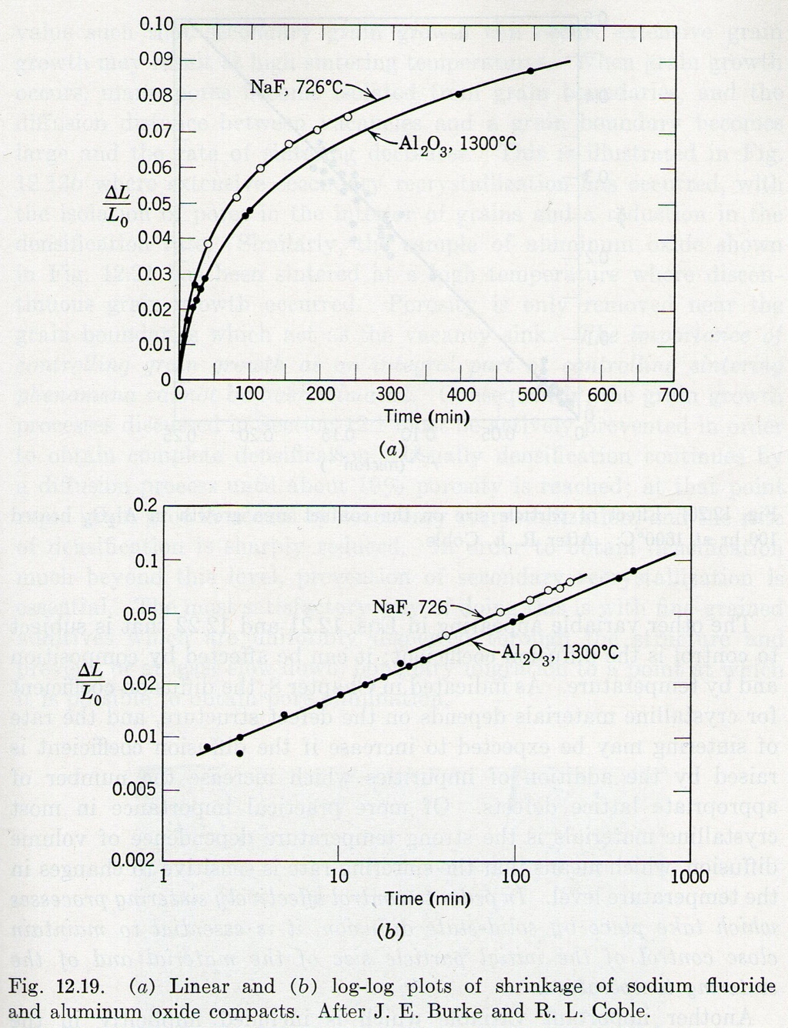
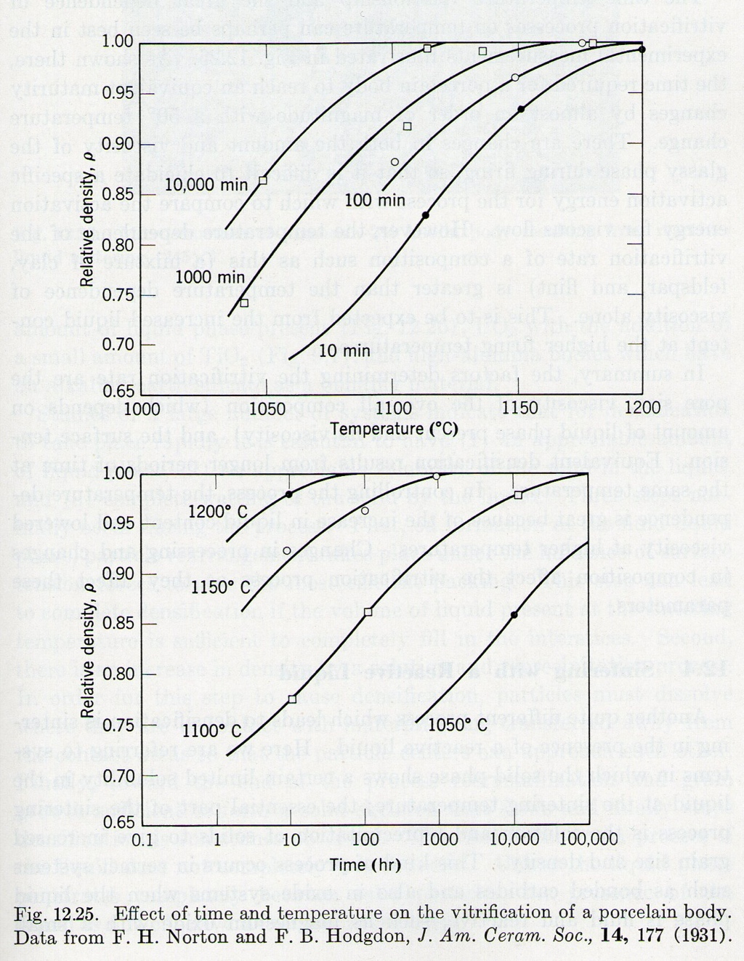
Variation of the volume of the particles in the sintering process during the time:
Variation of the relative density variatung time and temperature:
t
T
The increase of a few degrees in temperature has much more influence on the grain size than the increase of a one order of magnitude of the time

Slide 28
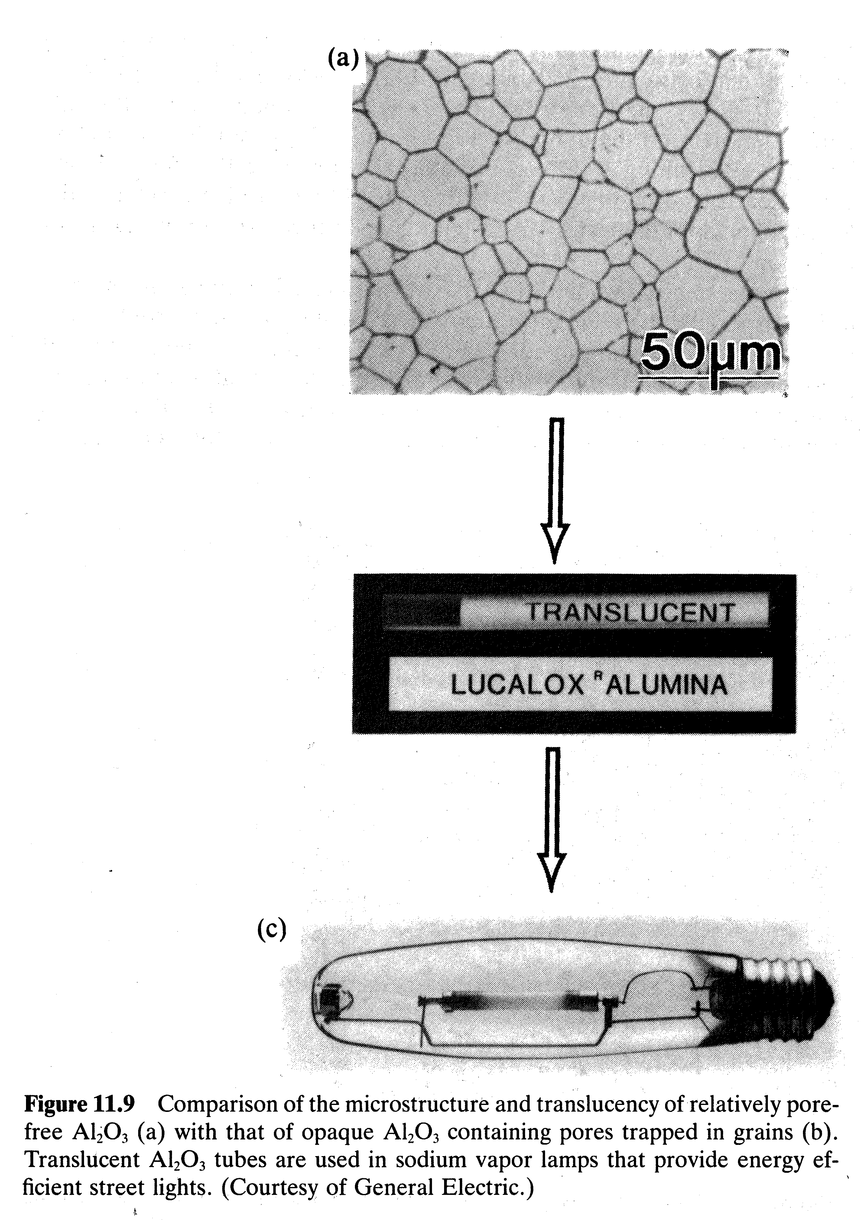

Slide 29
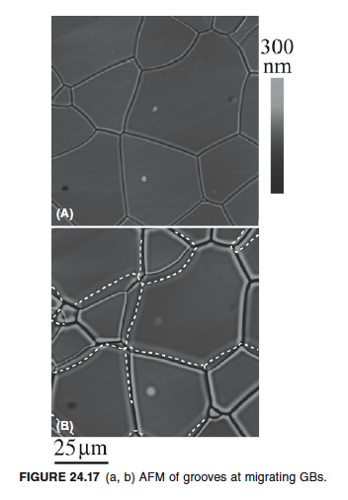
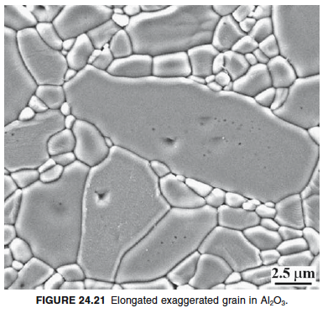

Slide 30
During the growth, the larger grain leaves behind a lot of pores and the piece can not achive the 100% of theoretical density (DT).
To avoid the pore incorporation inside the grain, the speed of grain boudaries must be lower than that of the pores.
Some impurities can segregate on grain boundary (GRAIN BOUNDARY PINNING) slowing the growth and so it’s possible to achive the 100% of DT.
v pore > v grain boundary
v
E.G. :
ALUMINA ‘LUCALOX‘:
polycrystalline Al2O3 - 1% MgO
pore
grain boundary
GS

Slide 31
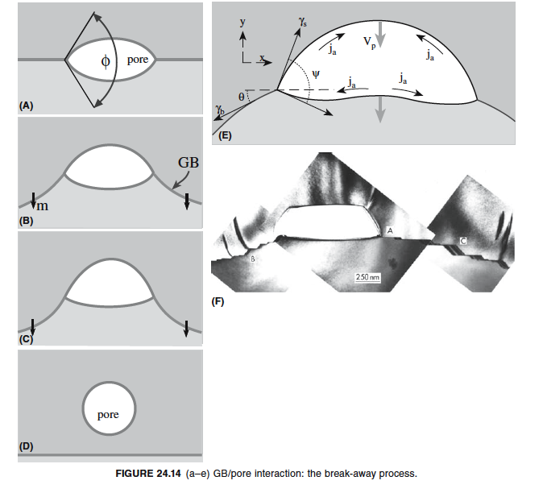

Slide 33
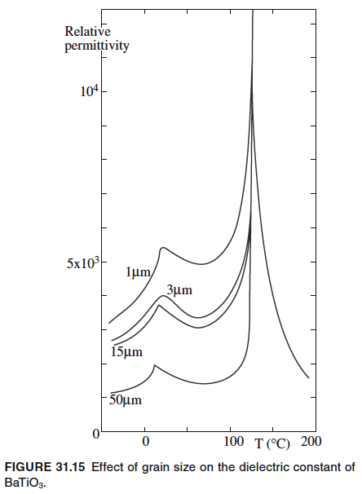
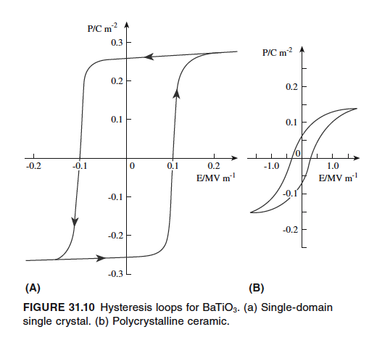

Slide 34
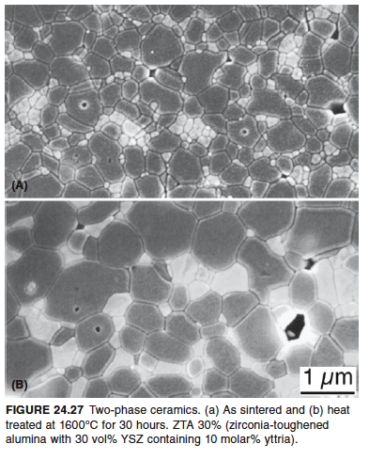

Slide 35

WETTABILITY
Is the ability of a drop of liquid to recline on a solid surface.
Varying the pressur is changed the wettability.
: contact angle
: liquid-vapour interfacial energy
: liquid-solid interfacial energy
: solid-vapour interfacial energy

Slide 36
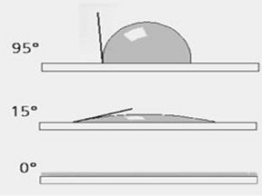
The contact angle specifies the condition for minimum energy, according to the relation:
possible cases:
non-wettability
wettability
spreading

Slide 37
LIQUID PHASE SINTERING
It is the process of adding an additive to the powder which will melt before the ceramic grains.
The metal added, at high temperatures, melt and WET the grains. The intergranulary spaces are such as to have a capillary forces which attract the grain one another.
( By lowering the temperature, the amorphous phase does not wet the grains anymore and ritires in triple junctions.)
(This gives good mechanical proprieties.)
E.G. : WIDIA ( 93% WC in a Co matrix).

Slide 38
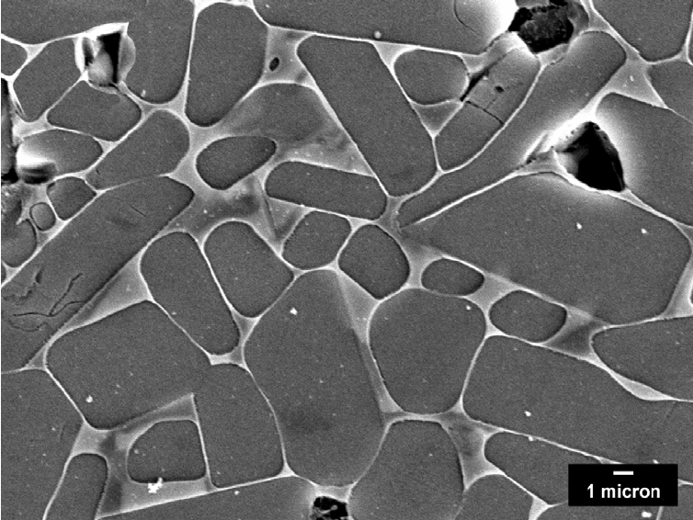
Liquid phase sintered SiC

Slide 39
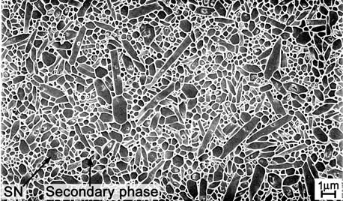
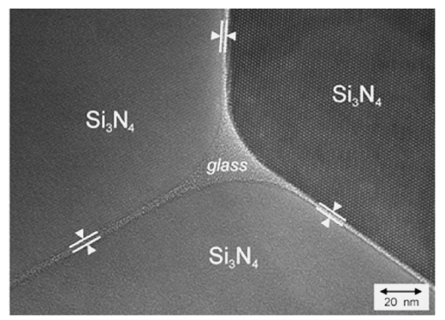
Liquid phase sintered Si₃N₄

Slide 40
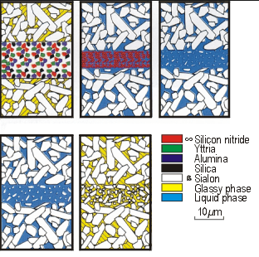
Lquid phase sintered SiAlON

Slide 41
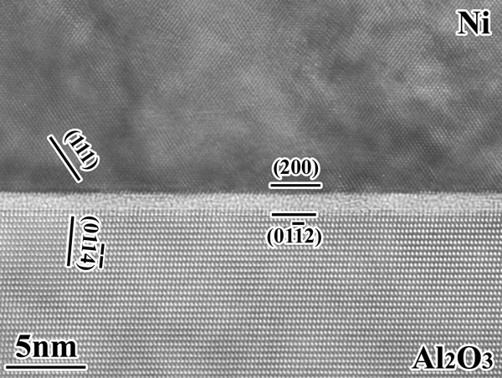

Slide 42
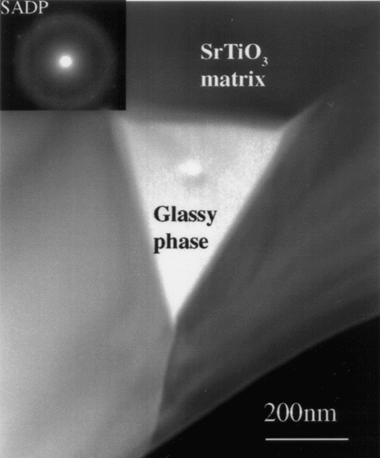

Slide 43
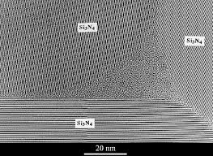

Slide 44
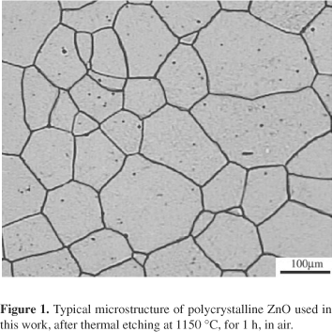

Slide 45
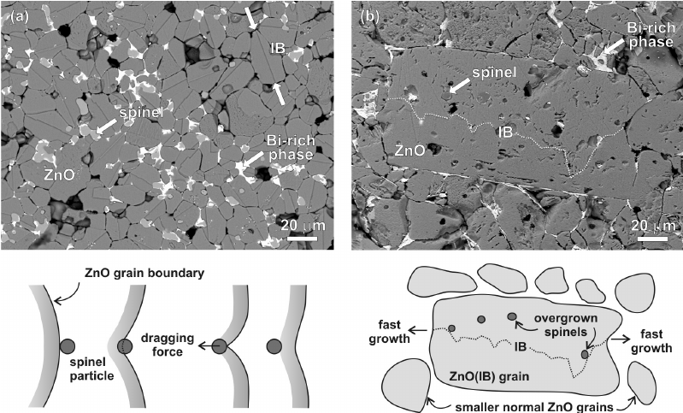

Slide 46
PROCEDURE FOR THE SINTERING PROCESS
Determination of the Tm Tsintering = 2/3 Tm E.G. : Al2O3 Tm =2400°C Tsintering = 1600°C
CALCINATION (200°C-300°C under the sintering temperature) E.G. : ZrO2 stabilized by CaO, Y2O3, CeO2
FORMING the ceramic parts
SINTERING

Slide 47
DENSITY DETERMINATION
BY ARCHIMEDE’S PRINCIPLE
D = dry weight
boil the piece for 5 hours
W = wet weight in air
S = wet weight in water suspended
V = external volume of the piece: V = W - S
BULK DENSITY B = D/V
P = apparent porosity P = (W-D)/V

Slide 48
TYPICAL SINTERING TIME-TEMPERATURE PROFILE
T
1400°C
1-10 h
1-5 K/min
2-5 K/min
500°C
1 h
10 K/min
t

Slide 49
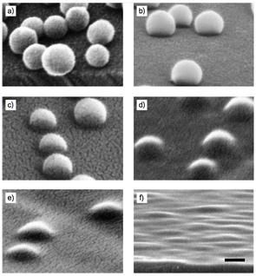

Slide 50
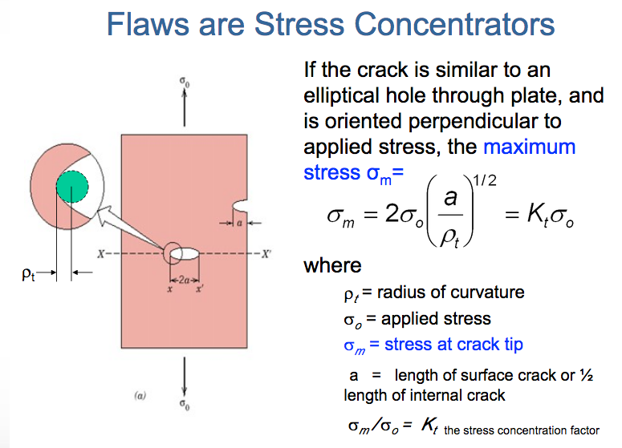

Slide 51
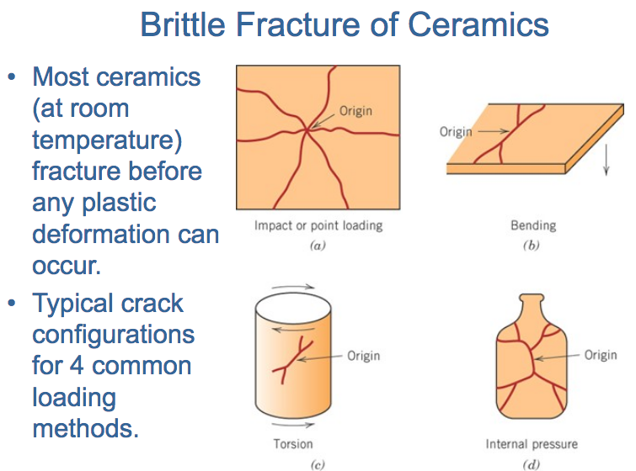

Slide 52
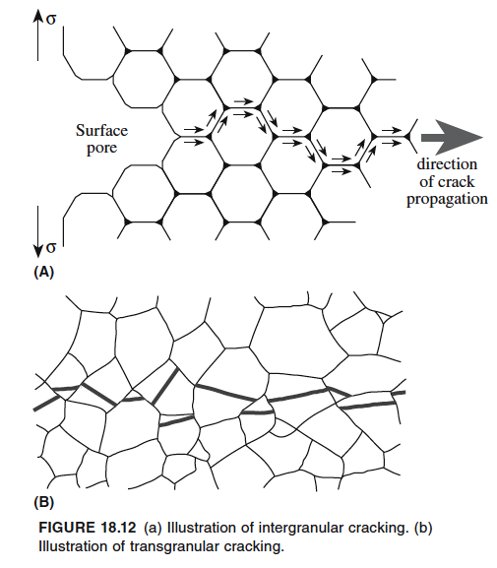
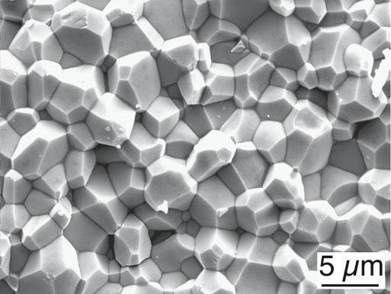
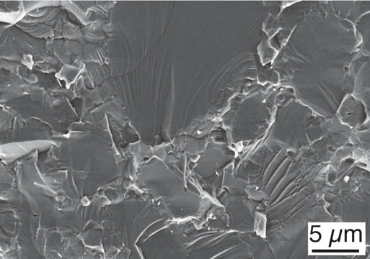
AlN
SiC

Slide 53
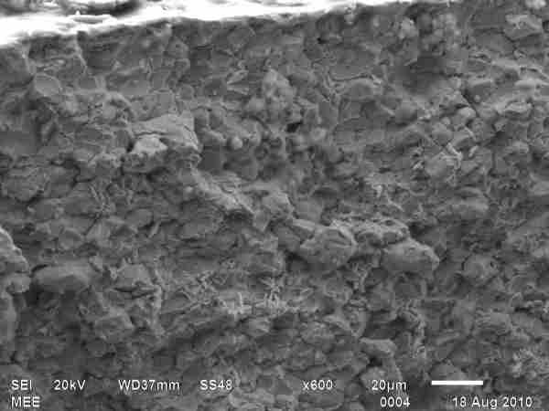
Undistinct features: brittle fracture (SiC)

Slide 54
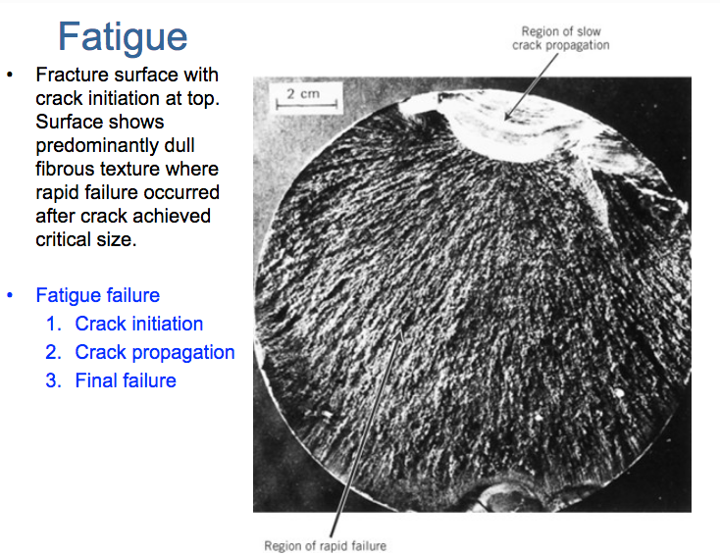

Slide 55
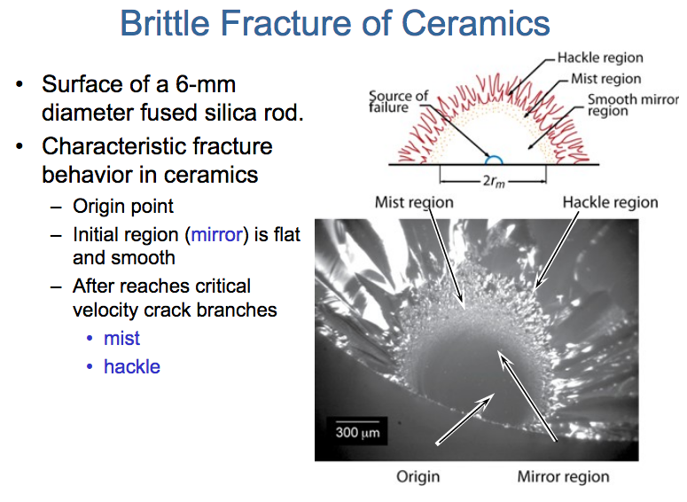

Slide 56
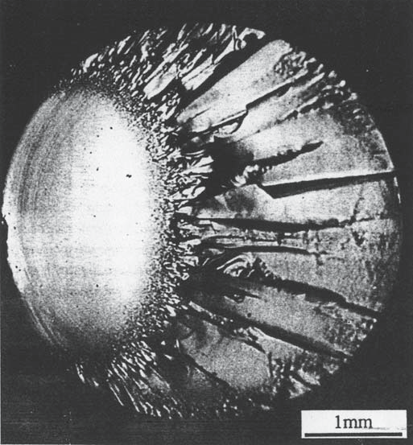
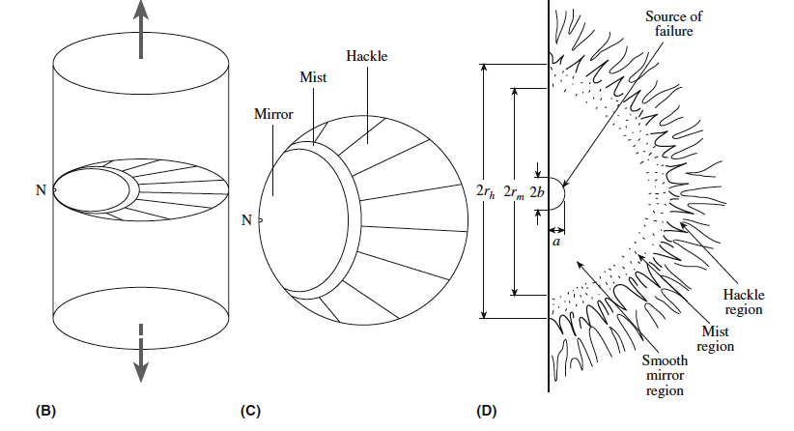

Slide 57
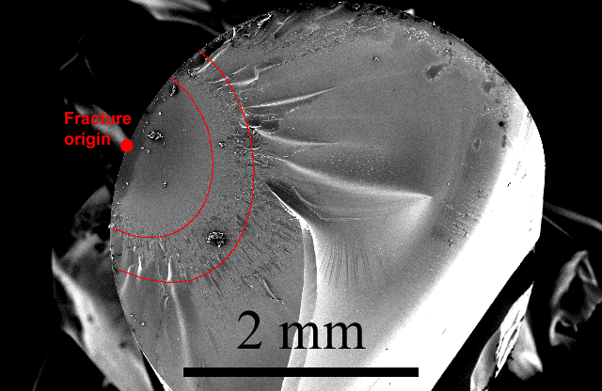
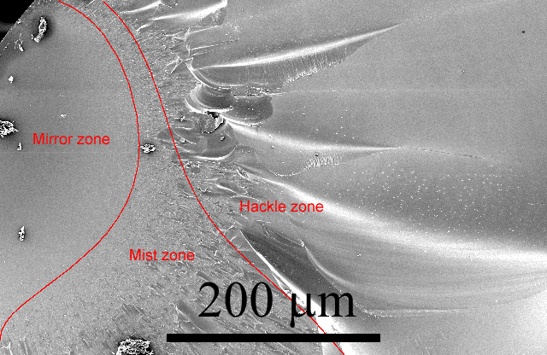
Fracture of glass

Slide 58

Fracture surface of silicon nitride with steel impurity

Slide 59

Fracture surface of lathe machined Silicon nitride

Slide 60

Roadmap for fractography

Slide 61

Roadmap for correcting failure

Slide 62


Toughening by whiskers and fibers

Slide 63
Glass theory
Glasses lack the periodic (long range) order of a crystal
•
Infinite unit cell (no repeating large scale structures)
•
3D network lacking symmetry and periodicity
•
ISOTROPIC: same average packing and properties in all directions
•
Crystals in different directions(see above):
•
different atom packing and so different properties

Slide 64



Slide 65


Slide 66

Pair distribution function of SiO2 glass

Slide 67

Radial distribution function for Si0₂
Si-O
1.62
Si-O 2nd
4.15
O-O
2.65
Si-Si
3.12

Slide 68



Glass structure:
SiO2 quartz compared to SiO2 glass

Slide 69


Slide 70

Zachariasen rules for glass A_{m}O_{n}
An oxygen atom is linked to no more than two glass-forming atoms A.
2) The number of oxygen atoms around each glass-forming atom A is small, perhaps 3 or 4.
3) Among the oxygen-containing polyhedra, a polyhedron cation A shares corners, but no sides or faces.
4) For three-dimensional networks of oxygen-containing polyhedra, at least three corners must be shared.
In general, all four rules should be satisfied for glass formation to occur.
Low coordination numbers, corner-sharing rules imply that glass formation is more likely
with open, low density polyhedral structures.

Slide 71


Slide 72


Slide 73


Slide 74
Elements for glass formation
Formers Modifiers Intermediate
B Sc Ti
Si La Zr
Ge Na Pb
Al K Al
V Rb Th
As Cs

Slide 75


Slide 76

Glass Viscosity and Workability
10⁷ Poise
10⁴ Poise

Slide 77

Pilkington process

Slide 78


Slide 79

Glass bending

Slide 80


Bottle production line
://www.youtube.com/watch?v=k8MmEuvugG4

Slide 81


Dielectrics

Slide 82



Slide 83
Non destructive testing Techniques
Visual inspection
Penetrant dyes
Ultrasonic testing
Radiographic testing
Magnetoscopic testing
Eddy currents

Slide 84

Proof testing:
1) load configuration as similar as possible to service condiction
2) one single test slightly above load/stress values in service

Slide 85


Liquid penetrant dyes

Slide 86

Fluorescent penetrant dye revealed with a Wood lamp

Slide 87

Ultrasonic testing

Slide 88


Slide 89


Slide 90

Radiographic testing

Slide 91

Radiographic testing of two chips

Slide 92



X ray image of C inclusions in Si3N4
X ray image of WC inclusions in Si3N4

Slide 93



Magnetoscopic testing

Slide 94

Eddy current testing

Slide 95


Slide 96

SiC Heat exchanger

Slide 97

Ceramic seal for taps

Slide 98


Sandblast nozzles

Slide 99

Rado watches

Slide 100

SEM fundamentals

Slide 101


Slide 102

E-beam sample intercation

Slide 103


Slide 104


Slide 105
Compositional contrast

Slide 106

Topographycal contrast

Slide 107


Slide 111


Slide 112


