Slide 1


The Cell as a Unit of Health and Disease
Nucleic Acids and Gene Editing
Sergio Crovella
crovelser@gmail.com

Slide 2
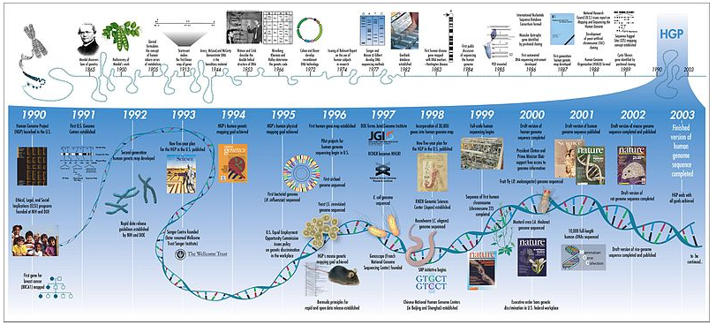
The sequencing of the human genome at the beginning of the 21st century represented a landmark achievement of biomedical science. Since then, the rapidly dropping cost of sequencing and the computational capacity to analyze vast amounts of data promise to revolutionize our understanding of health and disease. At the same time, the emerging information has also revealed a breathtaking level of complexity far beyond the linear sequencing of the genome. The potential for these new powerful tools to expand our understanding of pathogenesis and drive therapeutic innovation excites and inspires scientists and the lay public alike

Slide 3
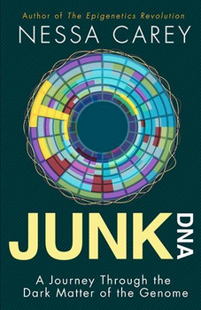
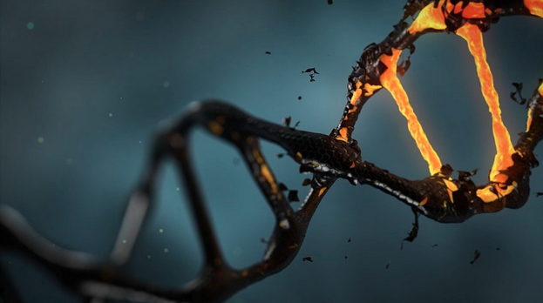
98.5% of the human genome that does not encode proteins. The function of such long stretches of DNA (which has been called the “dark matter” of the genome) was mysterious for many years. However, it is now clear that more than 85% of the human genome is ultimately transcribed, with almost 80% being devoted to the regulation of gene expression. It follows that whereas proteins provide the building blocks and machinery required for assembling cells, tissues, and organisms, it is the noncoding regions of the genome that provide the critical “architectural planning.”

Slide 4
The major classes of functional non–protein-coding DNA sequences found in the human genome include
Promoter and enhancer regions that bind protein transcription factors
Binding sites for proteins that organize and maintain higher order chromatin structures
Noncoding regulatory RNAs. Of the 80% of the genome dedicated to regulatory functions, the vast majority is transcribed into RNAs—micro-RNAs and long noncoding RNAs)—that are never translated into protein, but can regulate gene expression

Slide 5
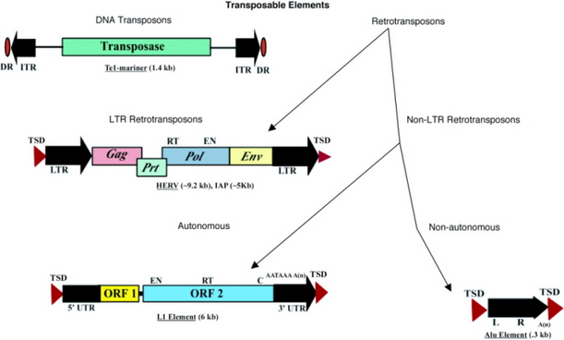
Mobile genetic elements (e.g., transposons). Remarkably, more than one-third of the human genome is composed of such “jumping genes.” These segments can cruise around the genome, and are implicated in gene regulation and chromatin organization.
Special structural regions of DNA, including telomeres (chromosome ends) and centromeres (chromosome “tethers”)

Slide 6
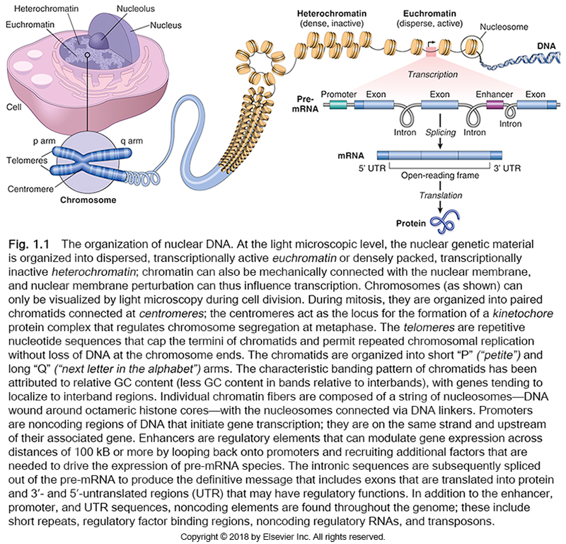

Slide 7
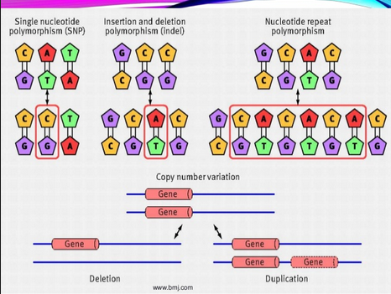
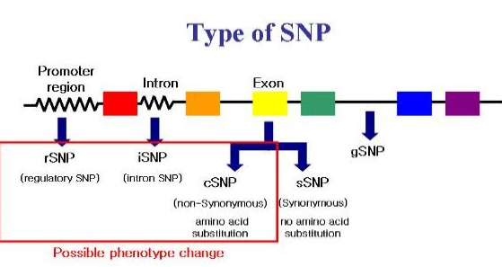
Importantly, many genetic variations (polymorphisms) associated with diseases are located in non–protein-coding regions of the genome. Thus, variation in gene regulation may prove to be more important in disease causation than structural changes in specific proteins. Another surprise that emerged from genome sequencing is that any two humans are typically >99.5% DNA-identical (and are 99% sequence-identical with chimpanzees)! Thus, individual variation, including differential susceptibility to diseases and environmental exposures, is encoded in <0.5% of our DNA (importantly, this still represents about 15 million base pairs).
The two most common forms of DNA variation in the human genome are single-nucleotide polymorphisms (SNPs) and copy number variations (CNVs).

Slide 8
SNPs are variants at single nucleotide positions and are almost always biallelic (only two choices exist at a given site within the population, such as A or T). More than 6 million human SNPs have been identified, with many showing wide variation in frequency in different populations. The following features are worthy of note:
SNPs occur across the genome—within exons, introns, intergenic regions, and coding regions.
Roughly 1% of SNPs occur in coding regions, which is about what would be expected by chance, because coding regions comprise about 1.5% of the genome.
SNPs located in noncoding regions can occur in regulatory elements in the genome, thereby altering gene expression; in such instances the SNP may have a direct influence on disease susceptibility.
SNPs can also be “neutral” variants with no effect on gene function or carrier phenotype.
Even “neutral” SNPs may be useful markers if they happen to be coinherited with a disease-associated gene as a result of physical proximity. In other words, the SNP and the causative genetic factor are in linkage disequilibrium.
The effect of most SNPs on disease susceptibility is weak, and it remains to be seen if the identification of such variants, alone or in combination, can be used to develop effective strategies for disease prediction or prevention.

Slide 9
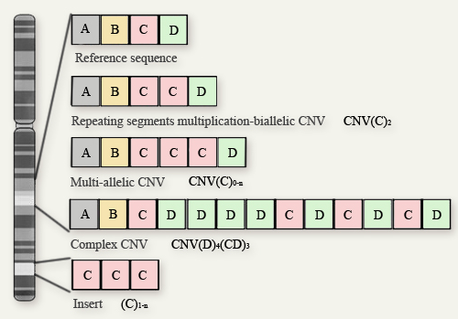
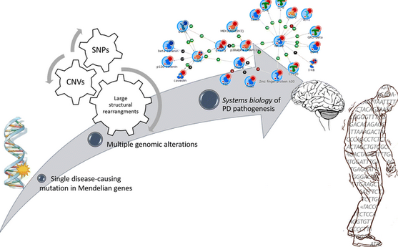
CNVs are a form of genetic variation consisting of different numbers of large contiguous stretches of DNA; these can range from 1000 base pairs to millions of base pairs. In some instances these loci are, like SNPs, biallelic and simply duplicated or deleted in a subset of the population. In other instances there are complex rearrangements of genomic material, with multiple alleles in the human population. CNVs are responsible for several million base pairs of sequence difference between any two individuals. Approximately 50% of CNVs involve gene-coding sequences; thus, CNVs may underlie a large portion of human phenotypic diversity

Slide 10
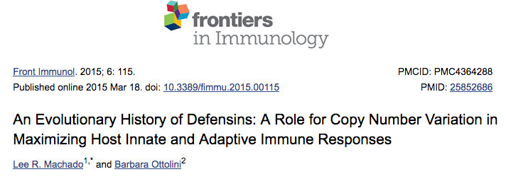
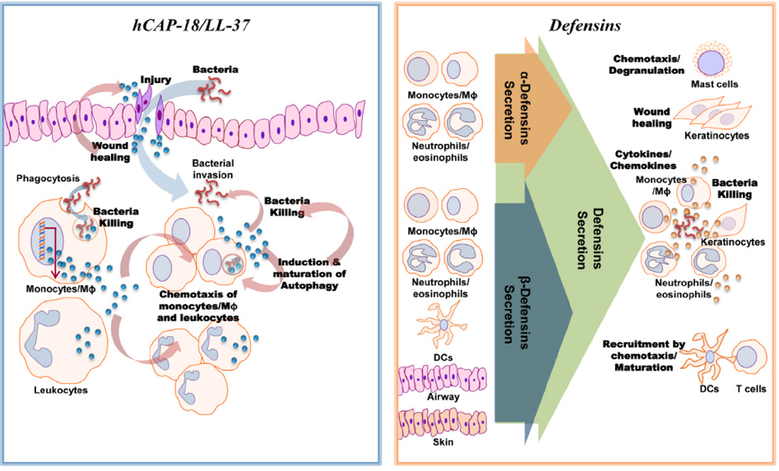

Slide 11
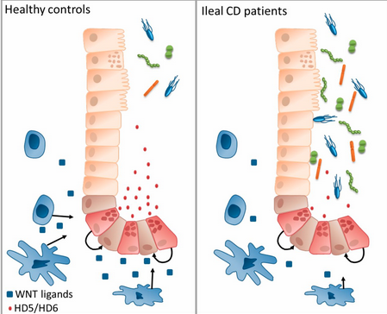
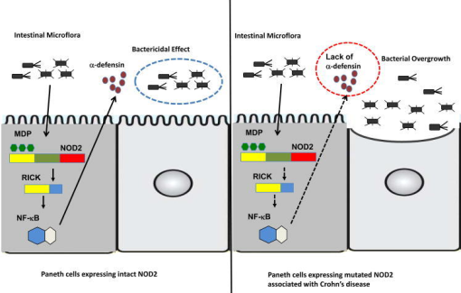

Slide 12
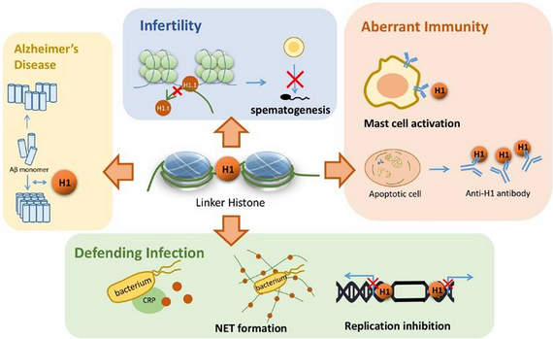
Histone Organization
Even though virtually all cells in the body have the same genetic composition, differentiated cells have distinct structures and functions arising through lineage-specific programs of gene expression.
Such cell type–specific differences in DNA transcription and translation are regulated by epigenetic modifications that consist of several changes that profoundly influence gene expression.

Slide 13
Host of mechanisms that tightly regulate the state of chromatin.
DNA methylation. High levels of DNA methylation in gene regulatory elements typically result in chromatin condensation and transcriptional silencing. Like histone modifications, DNA methylation is tightly regulated by methyltransferases, demethylating enzymes, and methylated-DNA-binding proteins.
Histone modifying factors. Nucleosomes are highly dynamic structures regulated by an array of nuclear proteins and post-translational modifications:

Slide 14
Chromatin remodeling complexes can reposition nucleosomes on DNA, exposing (or obscuring) gene regulatory elements such as promoters.
“Chromatin writer” complexes carry out more than 70 different covalent histone modifications generically denoted as marks. These include methylation, acetylation, and phosphorylation of specific histone amino acid residues: Histone methylation of lysines and arginines is accomplished by specific writer enzymes; methylation of histone lysine residues can lead to transcriptional activation or repression, depending on which histone residue is “marked.” Histone acetylation of lysine residues (occurring through histone acetyl transferases) tends to open up chromatin and increase transcription; histone deacetylases (HDAC) reverse this process, leading to chromatin condensation. Histone phosphorylation of serine residues can variably open or condense chromatin, to increase or decrease transcription, respectively.
Histone marks are reversible through the activity of “chromatin erasers.” Other proteins function as “chromatin readers,” binding histones that bear particular marks and thereby regulating gene expression.

Slide 15
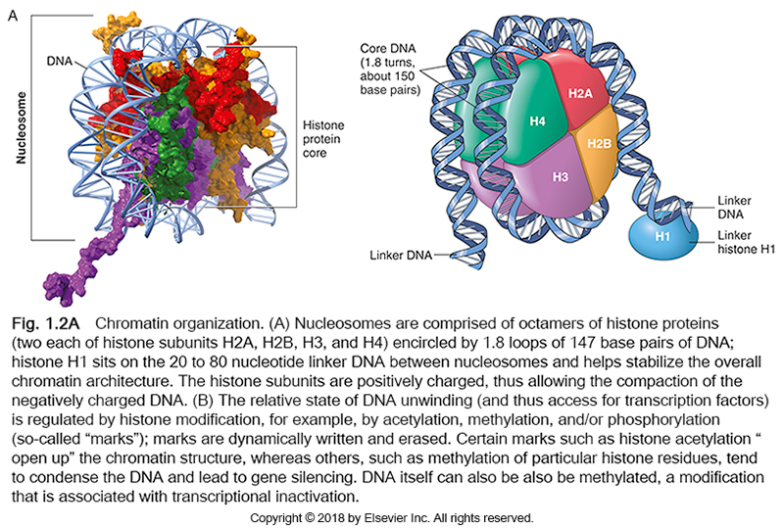

Slide 16
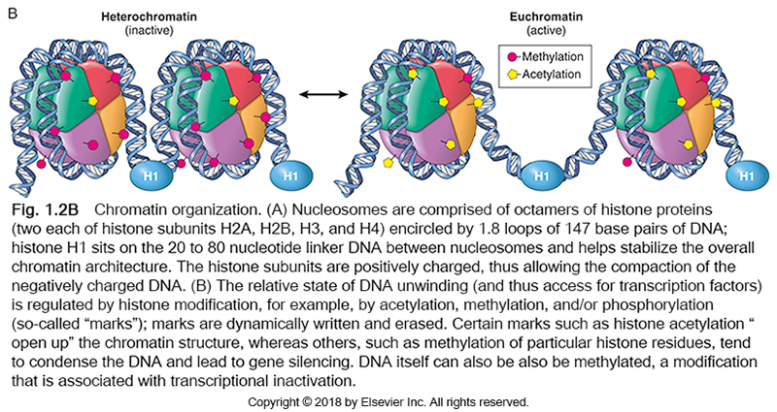

Slide 17
Micro-RNA and Long Noncoding RNA
Another mechanism of gene regulation depends on the functions of noncoding RNAs. As the name implies, these are encoded by genes that are transcribed but not translated.
Although many distinct families of noncoding RNAs exist, only two examples are discussed here: small RNA molecules called microRNAs (6000 miRNA genes) and long noncoding RNAs (30.000 genes) >200 nucleotides in length.

Slide 18
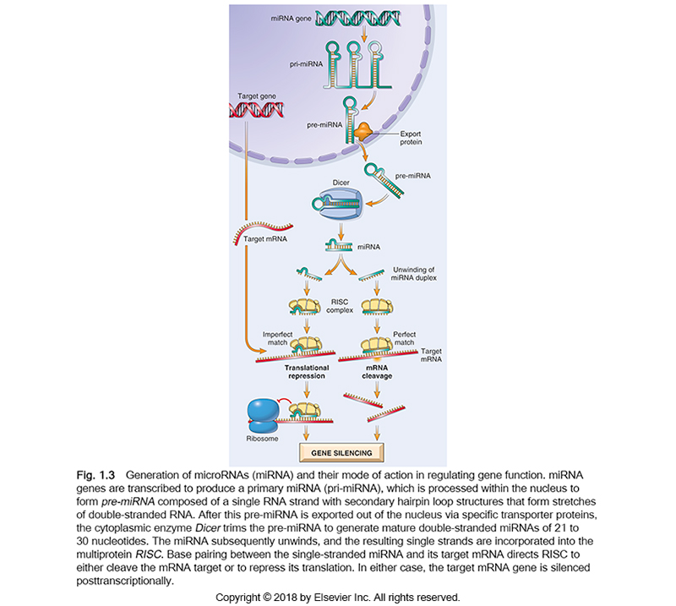

Slide 19
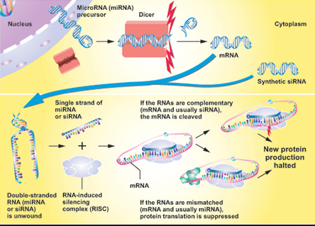
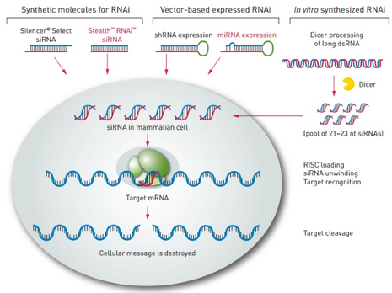
Taking advantage of the same pathway, small interfering RNAs (siRNAs) are short RNA sequences that can be introduced into cells.
These serve as substrates for Dicer and interact with the RISC complex in a manner analogous to endogenous miRNAs.
Synthetic siRNAs that can target specific mRNA species are therefore powerful laboratory tools to study gene function (so-called knockdown technology); they also are promising as therapeutic agents to silence pathogenic genes, e.g., oncogenes involved in neoplastic transformation.

Slide 20
Long noncoding RNA (lncRNA)
The human genome also contains a very large number of lncRNAs—at least 30,000, with the total number potentially exceeding coding mRNAs by 10- to 20-fold. lncRNAs modulate gene expression in many ways; for example, they can bind to regions of chromatin, restricting RNA polymerase access to coding genes within the region.
The best-known example of a repressive function involves XIST, which is transcribed from the X chromosome and plays an essential role in physiologic X chromosome inactivation. XIST itself escapes X inactivation, but forms a repressive “cloak” on the X chromosome from which it is transcribed, resulting in gene silencing.
Conversely, it has been appreciated that many enhancers are sites of lncRNA synthesis, with the lncRNAs expanding transcription from gene promoters through a variety of mechanisms. Ongoing studies are exploring the role of lncRNAs in diseases like atherosclerosis and cancer.

Slide 21
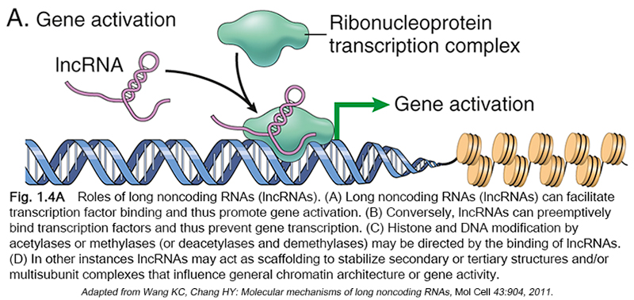

Slide 22
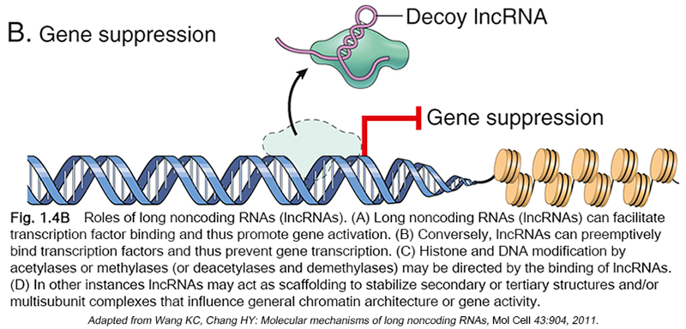

Slide 23
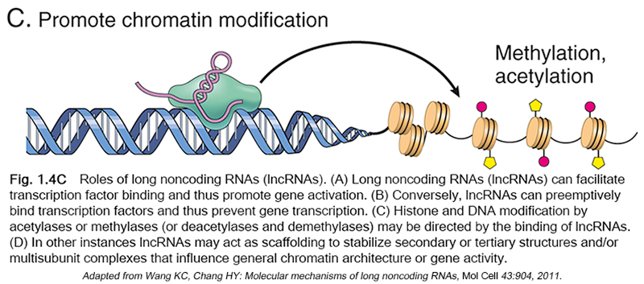

Slide 24
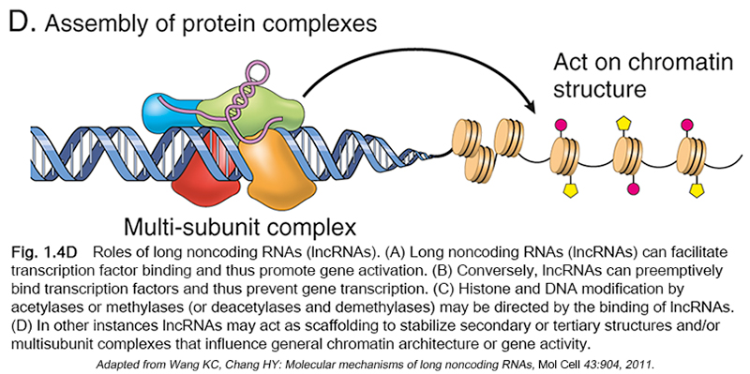

Slide 25
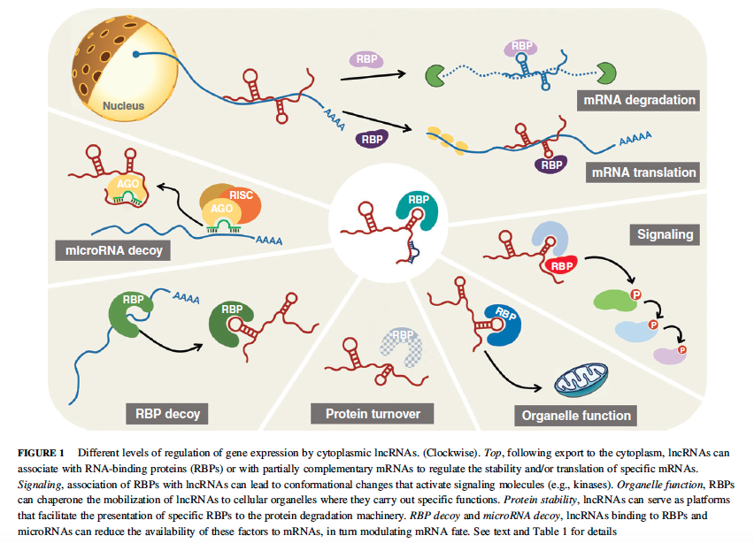

Slide 26
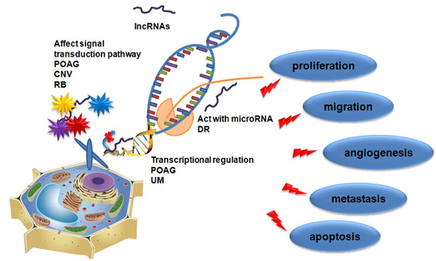
lncRNA neoplasia

Slide 27
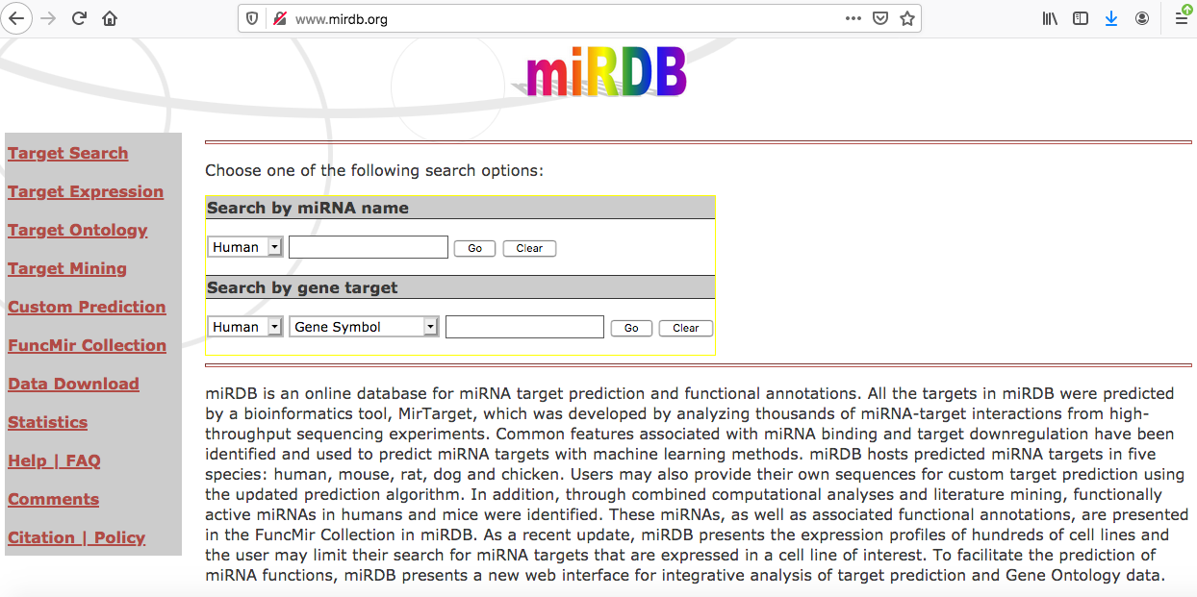
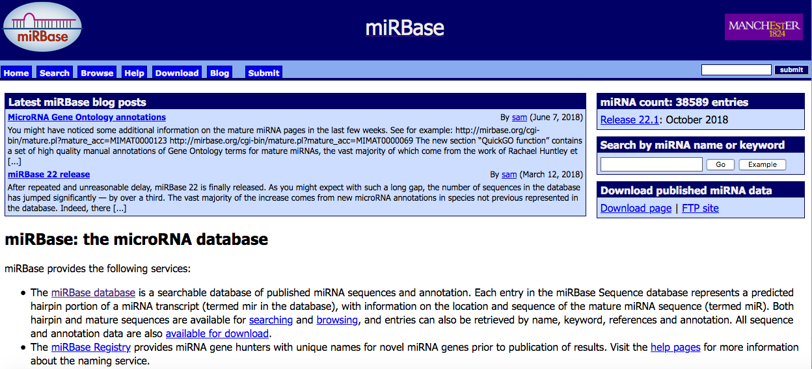

Slide 28
Gene Editing
Exciting new developments that permit exquisitely specific genome editing stand to usher in an era of molecular revolution.
These advances come from a wholly unexpected source: the discovery of clustered regularly interspaced short palindromic repeats (CRISPRs) and Cas (or CRISPR-associated genes). These are linked genetic elements that endow prokaryotes with a form of acquired immunity to phages and plasmids.
Bacteria use this system to sample the DNA of infecting agents, incorporating it into the host genome as CRISPRs. CRISPRs are transcribed and processed into an RNA sequence that binds and directs the nuclease Cas9 to a sequences (e.g., a phage), leading to its cleavage and the destruction of the phage. Gene editing repurposes this process by using artificial guide RNAs (gRNAs) that bind Cas9 and are complementary to a DNA sequence of interest. Once directed to the target sequence by the gRNA, Cas9 induces double-strand DNA breaks.

Slide 29
Repair of the resulting highly specific cleavage sites can lead to somewhat random disruptive mutations in the targeted sequences (through nonhomologous end joining [NHEJ]), or the precise introduction of new sequences of interest (by homologous recombination).
Both the gRNAs and the Cas9 enzyme can be delivered to cells with a single easy-to-build plasmid.
However, the real beauty of the system (and the excitement about its genetic engineering potential) comes from its impressive flexibility and specificity, which is substantially better than other previous editing systems.
Applications include inserting specific mutations into the genomes of cells to model cancers and other diseases, and rapidly generating transgenic animals from edited embryonic stem cells. On the flip side, it now is feasible to selectively “correct” mutations that cause hereditable disease, or—perhaps more worrisome—to just eliminate less “desirable” traits. Predictably, the technology has inspired a vigorous debate regarding its application

Slide 30
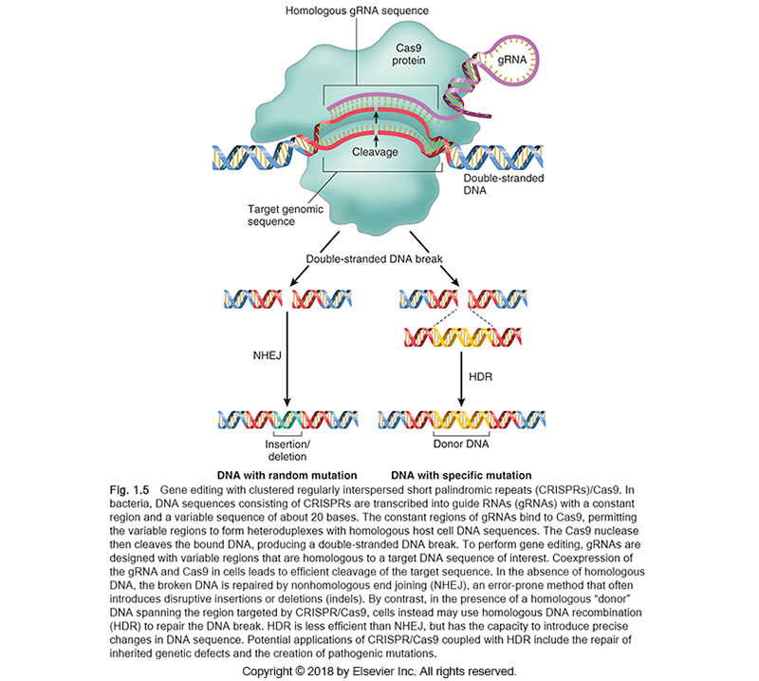

Slide 31
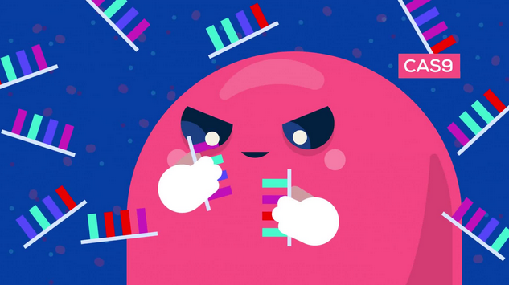
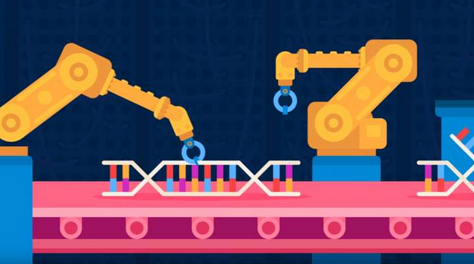
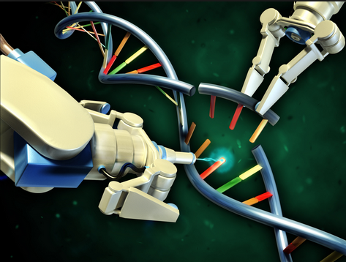
Genome Editing
Zinc Finger Nuclease
CRISPR/Cas9
genetic engineering

Slide 32
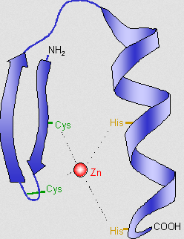
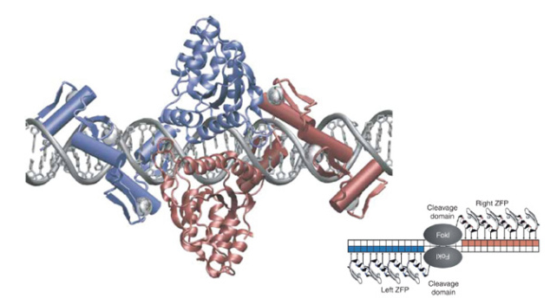
ZINC Finger Nuclease
Architecture

Slide 33
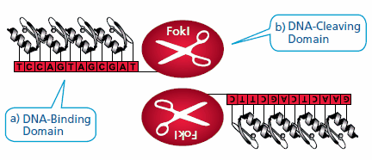
Zinc Finger Nucleases: Highly Specific ‘Genomic Scissors’
a) A DNA-binding domain comprised of a chain of two-finger modules, each recognizing a unique hexamer (6 bp) sequence of DNA. Two-finger modules are stitched together to form a Zinc Finger Protein, each with specificity of > 12 bp.
b) A DNA-cleaving domain comprised of the nuclease domain of FokI. When a pair of ZFNs binds adjacent sites on DNA with the correct orientation and spacing, a highly-specific pair of ‘genomic scissors’ is created.

Slide 34
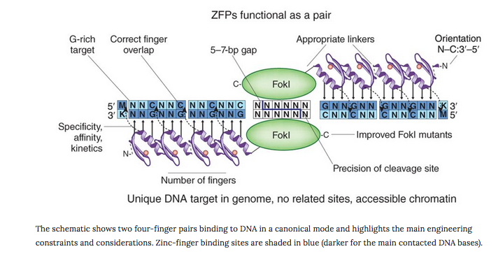

Slide 35
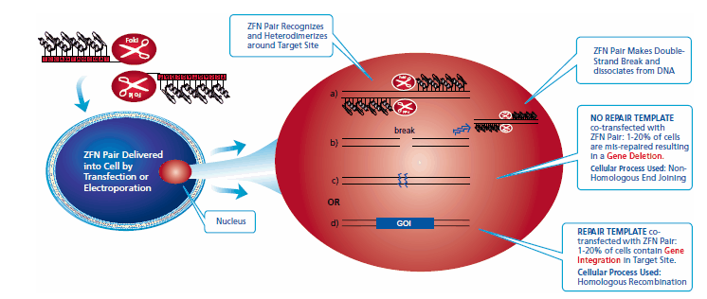
ZFN-mediated Targeted Genome Editing
ZFN-mediated genome editing takes place in the nucleus when a pair of ZFNs targeting the user’s gene of interest (GOI) is delivered transiently into a cell line, either by transfection or electroporation.

Slide 36
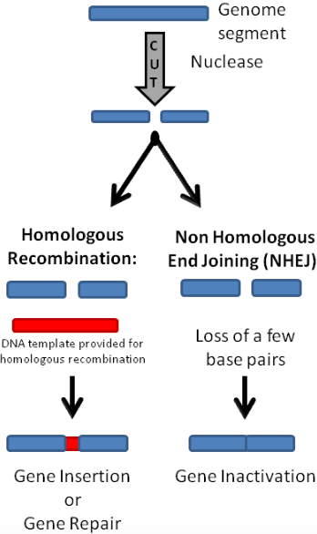
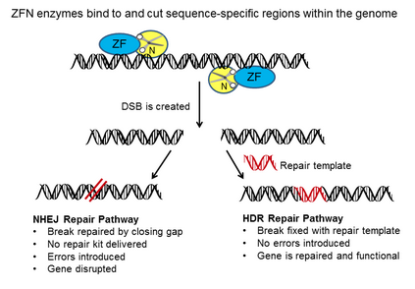

Slide 37
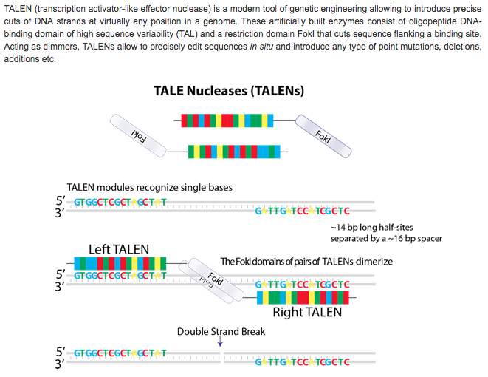

Slide 38
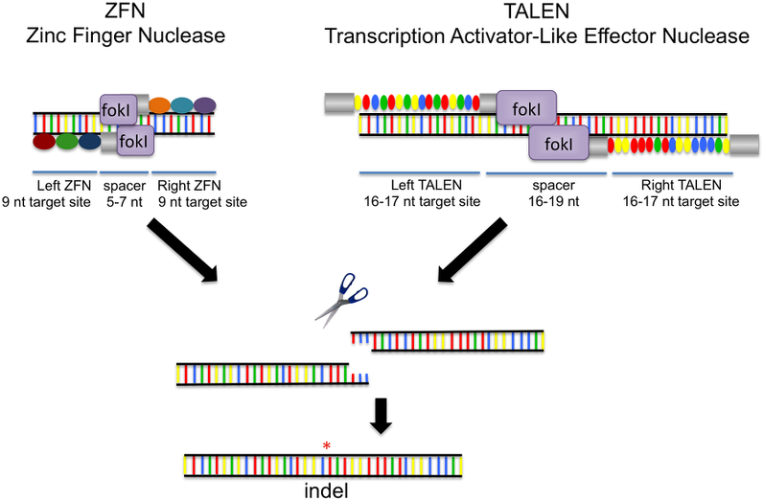
Zinc Finger Nucleases (ZFN) and Transcription Activator-Like Effector Nucleases (TALEN) bind target DNA sequences to direct a fok1 nuclease domain to cut the DNA. Both ZFNs and TALENS have multiple DNA binding domains linked in series to create an array. The arrays each bind a separate half-site sequence, and a dimeric fok1 nuclease cleaves the DNA within what is referred to as the spacer region. These engineered nucleases frequently induce breaks that are repaired via Non Homologous End Joining (NHEJ), which is error-prone and can result in insertion or deletion of a few bases, creating an indel.

Slide 39




ZFN and TALEN

Slide 40
To do precise genetic engineering we need to be able to find and specifically modify regions of DNA
But the human genome has 3,000,000,000 base pairs so how are we going to find a 20 base pair region in this huge sea of DNA ?

Slide 41
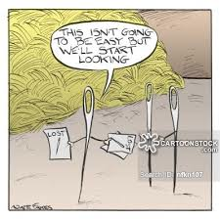
Its like finding a needle in a haystack

Slide 42

But we can find needles in haystacks if we use the right methods
Method 1 - Random

Slide 43

But we can find needles in haystacks if we use the right methods
Method 2 - Targeted

Slide 44
But we can find needles in haystacks if we use the right methods
Method 2 - Targeted
I would have used CRISPR/Cas9 myself.

Slide 45
What is CRISPR ?
It is a very efficient method of genetic engineering that allows precision cutting and rearranging DNA in pretty much any way we want i.e we are now truly in a new age of genetic engineering.
Unlike transgenic techniques (which leave foreign DNA behind in the genome) the CRISPR method leaves no evidence in the genome that the engineering ever happened.

Slide 46
Way back scientists noticed that about 40% of bacteria species contain 29bp palindromic repeats sequences in them – what did they do ?
Palindromic repeats (i.e. this is the same DNA sequence repeated in different places)

Slide 47
CRISPR stand for“Clustered Regularly Interspaced Short Palindromic Repeats”

Slide 48
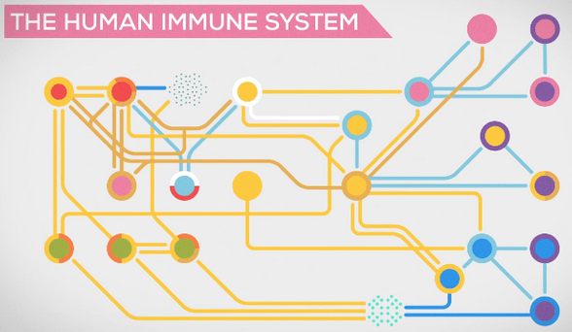
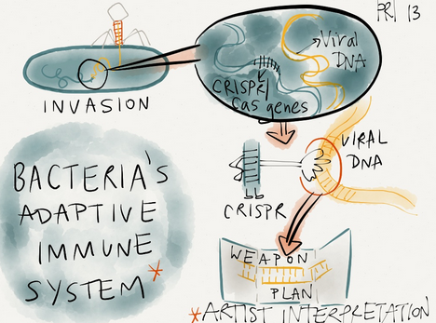
We now know that this area of the bacterial genome contains an “adaptive immune system” for bacteria, particularly against bacteriophages (Bacteriophages are DNA viruses)

Slide 49
Question: How do bacteria survive the onslaught of bacteriophages ?
1. The classical defense most bacteria have is the restriction endonuclease system. This is a bit of a shotgun approach.
2. 40% of bacteria have a highly targeted adaptive immune system that uses mechanisms found in DNA in the CRISPR region of the genome to grab bits of the DNA of bacteriophages. These are used as a guidance system to take DNA cutting enzymes that the bacteria makes and target these specifically to the bacteriophages DNA and chop it up and so destroy the bacteriophage while leaving the bacteria’s DNA intact.

Slide 50
What else is in the CRISPR locus ?
Shorts palindromic repeats (i.e. this is the same DNA sequence repeated in different places). These are part of the bacterial genome
Diagram of CRISPR
locus in bacterial
genome
These bits are derived from bacteriophage genome and each one is different and these provide the guidance system for the adaptive immune system

Slide 51
But wait
………… there’s more
There are several other important regions of the bacterial DNA that are also always associated with the CRISPR locus and these provide the means for the palindromic repeat and the bacteriophage DNA sequences to actually destroy the bacteriophage.
These are called CRISPR Associated Sequences i.e. Cas genes .

Slide 52
How does this genetic material in CRISPR locus then manage to kill bacteria ?
The system can be slighty different in different types of bacteria but the best studies one is Streptococcus pyogenes so we will focus on that one
For the sake of simplicity lets focus on the 2 Cas genes most importantfor genetic engineering;
Codes for a protein that is a nuclease that cuts DNA but only if it is given a very specific set of signals to do so (otherwise it would potentially damage the bacteria’s own DNA). The most common one used in genetic engineering approaches is called Cas9
Codes for a very specific piece of RNA that will help in the process of ensuring the whole process only cuts bacteriophage DNA
For now lets not worry about the other genes in the Cas locus

Slide 53
What is the S. Pyogenes CRISPR/Cas9 system
3 different RNAs generated but only one of these goes on to make a protein.
tracRNA
Cas9 mRNA
guideRNA
Cas9
protein
1 protein generated

Slide 54
What is Cas9 ?
Cas9 is an endonuclease that can cut double stranded DNA
Cas 9 is only activated when the tracRNA and the guide RNA are associated with it (i.e it is a nucleoprotein). Imagine this a bit like the fail safe mechanism they use to prevent accidental launch of nuclear missiles where 2 people have to insert keys at exactly the same times
In fact the tracRNA and the guide RNA have a short overlapping sequence that means they actually have to bind to each other in this complex for this to work properly
Active Cas9

Slide 55

How is Cas9 activated ?
Cas9 is only activated when the tracRNA and the guide RNA are associated with it (i.e it is a nucleoprotein). Imagine this a bit like the fail safe mechanism they use to prevent accidental launch of nuclear missiles where 2 people have to insert keys at exactly the same times
In fact the tracRNA and the guide RNA have a short overlapping sequence that means they actually have to bind to each other in this complex for this to work properly
Active Cas9

Slide 56
How does Cas9 work ?
Cas9 has a channel that DNA can fit into.
It scans the DNA looking for sequence that match the guide sequence
Active Cas9

Slide 57
How does Cas9 work ?
Cas9 has a channel that DNA can fit into.
It scans the DNA looking for sequence that match the guide sequence
Active Cas9

Slide 58
How does Cas9 work ?
Cas9 has a channel that DNA can fit into.
It scans the DNA looking for sequence that match the guide sequence
Active Cas9

Slide 59
How does Cas9 work ?
When a DNA sequence complementary to the guide RNA is found the scanning stops
Active Cas9

Slide 60

How does Cas9 work ?
When a DNA sequence complementary to the guide RNA is found the scanning stops

Slide 61
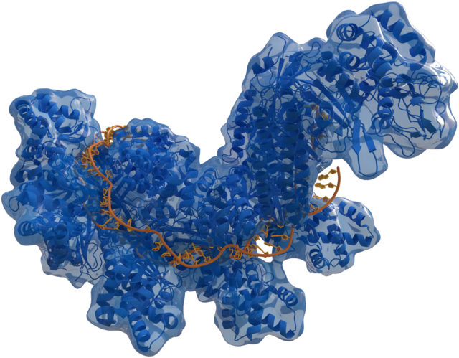
Structure of DNA bound to a Cas enzyme

Slide 62

Completely irrelevant aside

Slide 63
How does Cas9 work ?
There is one additional check
In this check the part of the RNA that came from the palindromic repeats of the bacteria has to also have a a very short piece of RNA that is complementary to bit of the bacteriophage DNA. This is called the PAM sequence (Protospacer Adjacent Motif)
For Staph Pyogenes this needs a GG sequence
Only when all this happens and we have the guide RNA bound do we have a fully active enzyme.
PAM Sequence
Active Cas9
Active Cas9

Slide 64
How does Cas9 work ?
Now the RNA binds to the complementary strand of the DNA and opens up the DNA helix
PAM Sequence
Active Cas9

Slide 65

How does Cas9 work ?
Now the bacteriophages DNA gets cut very close to the PAM site
PAM Sequence
Active Cas9

Slide 66
How does Cas9 work ?
Now the bacteriophages DNA gets cut very close to the PAM site
PAM Sequence
Active Cas9

Slide 67
Now the bacteriophages DNA gets cut very close to the PAM site so now it looks like this and the bacteriophage is essentially dead
PAM Sequence
Active Cas9

Slide 68
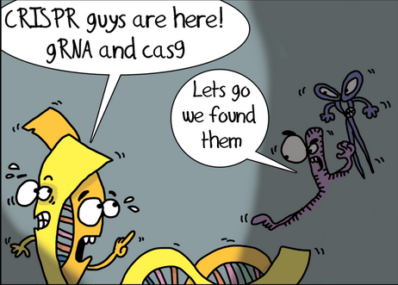
Features of the CRISPR/Cas9 system
Its highly specific
Tightly regulated
Highly efficient
i.e. ALL THE THINGS YOU WANT IN A GENETIC ENGINEERING TOOL

Slide 69
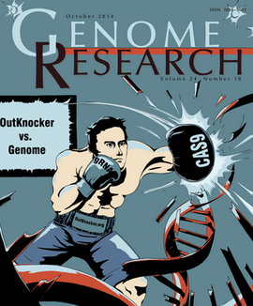
How can we use CRISPR/Cas9 for genetic engineering?
Some clever people found you could combine the guide RNA and the tracRNA together into one artificial RNA called a single guide RNA (sgRNA).
Active Cas9

Slide 70
How can we use CRISPR/Cas9 for genetic engineering?
This means we can artificially make a sgRNA that can be designed to target any part of the genome (as long as it has an appropriate PAM sequence nearby)
All we have to do is artificially express the Cas9 and the sgRNA together and hey presto you can cut DNA anywhere you want pretty much
Any DNA
Active Cas9

Slide 71
How can we use CRISPR/Cas9 for genetic engineering?
We can put two different sgRNA into the same protein and cut at 2 places in the genome we can cut out large regions of DNA
Any DNA
Active Cas9

Slide 72
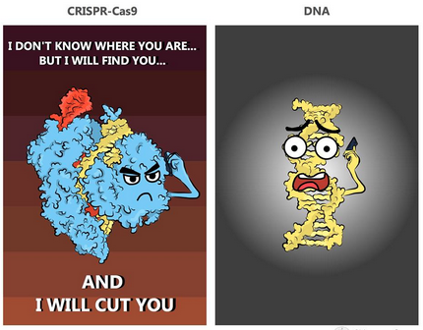
This allows us to selectively “knock out” regions of the genome

Slide 73
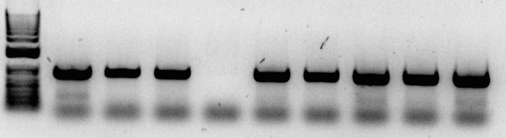
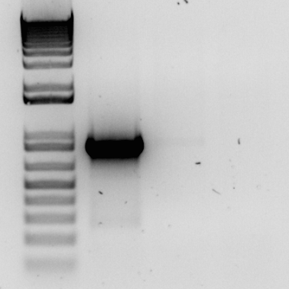
Here is an example of PCR of the VEGFA gene of melanoma cells where we have tried to use CRISPR to “knockout the VEGFA gene (achieved in clone 13)
Single cell clones (NZM37)
NZM 37
WT
20
28
1KB+
5
8
13
23
24
25
NZM 37
WT
1KB+
13
13
Repeat PCR

Slide 74
We can also use CRISPR/Cas9 to “knockin” bits of DNA
If we make an artificial piece of DNA that is identical to the cleaved region of DNA then when the cell tries to repair its own chromasomal DNA it will sometimes accidentally incorporate this into its own DNA by homologous recombination
*
*

Slide 75
How can we use CRISPR/Cas9 for genetic engineering?
Now the artificially produced piece of DNA is “knocked in” to the genome
*
*

Slide 76
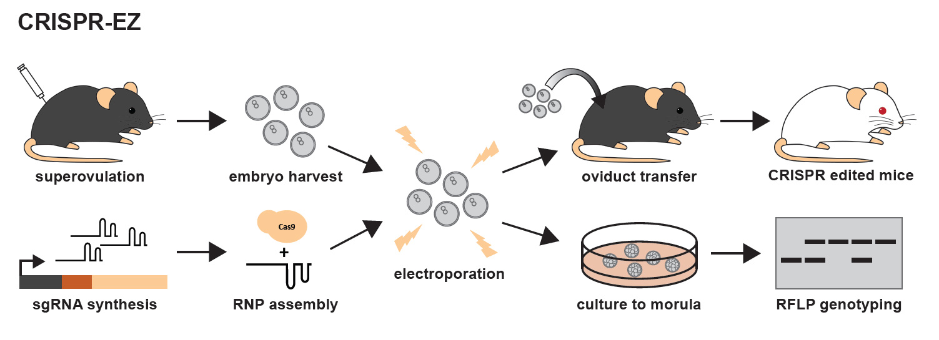
Making mice where genes are knocked out is now super easy and cheap
CRISPR Edited
Some of the offspring will hopefully be CRISPR edited

Slide 77
CRISPR/Cas9 can also be used to switch on or off genes
Uses a mutant Cas9 that can bind everything but can’t cut DNA
This means it locks on tightly to the DNA that matches the guide sequence
An example of how this can be used is by having a big Cas9 protein sitting at say a transcription factor binding site we can block the transcription factor from coming into the gene promoter so switch off the expression of that specific gene in a highly targeted way.
Mutant Cas9
that can bind everything but can’t cut DNA
Transcription
factor
Gene promoter DNA

Slide 78
CRISPR/Cas9 can also be used to switch on or off genes
Uses a mutant Cas9 that can bind everything but can’t cut DNA
This means it locks on tightly to the DNA that matches the guide sequence
An example of how this can be used is by having a big Cas9 protein sitting at say a transcription factor binding site we can block the transcription factor from coming into the gene promoter so switch off the expression of that specific gene in a highly targeted way.
Transcription
factor
Mutant Cas9
that can bind everything but can’t cut DNA
Gene promoter DNA

Slide 79



Slide 80



