Slide 1
Cell Injury

Slide 2
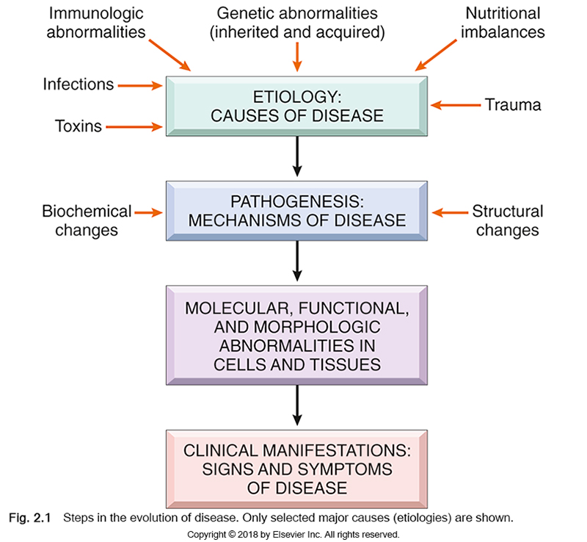
Overview of Cellular Responses to Stress and Noxious Stimuli

Slide 3
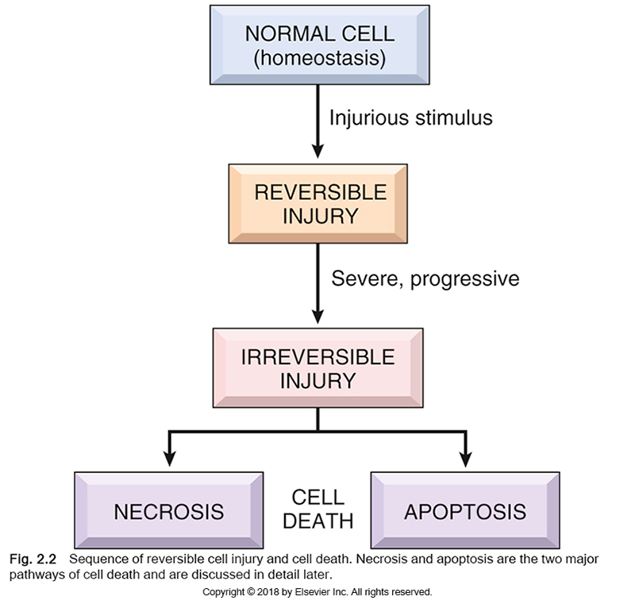
Sequence of reversible cell injury and cell death. Necrosis and apoptosis are the two major pathways of cell death

Slide 4
Causes of Cell Injury
The causes of cell injury span a range from gross physical trauma, such as after a motor vehicle accident, to a single gene defect that results in a nonfunctional enzyme in a specific metabolic disease. Most injurious stimuli can be grouped into the following categories.
Hypoxia and ischemia. Hypoxia, which refers to oxygen deficiency, and ischemia, which means reduced blood supply, are among the most common causes of cell injury. Both deprive tissues of oxygen, and ischemia, in addition, results in a deficiency of essential nutrients and a build up of toxic metabolites. The most common cause of hypoxia is ischemia resulting from an arterial obstruction, but oxygen deficiency also can result from inadequate oxygenation of the blood, as in a variety of diseases affecting the lung, or from reduction in the oxygen-carrying capacity of the blood, as with anemia of any cause, and carbon monoxide (CO) poisoning.

Slide 5
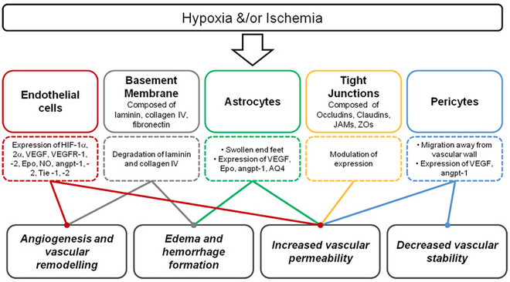

Slide 6
Toxins. Potentially toxic agents are encountered daily in the environment; these include air pollutants, insecticides, CO, asbestos, cigarette smoke, ethanol, and drugs. Many drugs in therapeutic doses can cause cell or tissue injury in a susceptible patient or in many individuals if used excessively or inappropriately. Even innocuous substances, such as glucose, salt, water and oxygen, can be toxic.
Infectious agents. All types of disease-causing pathogens, including viruses, bacteria, fungi, and protozoans, injure cells. The mechanisms of cell injury caused by these diverse agents.
Immunologic reactions. Although the immune system defends the body against pathogenic microbes, immune reactions also can result in cell and tissue injury. Examples are autoimmune reactions against one’s own tissues, allergic reactions against environmental substances, and excessive or chronic immune responses to microbes. In all of these situations, immune responses elicit inflammatory reactions, which are often the cause of damage to cells and tissues.

Slide 7
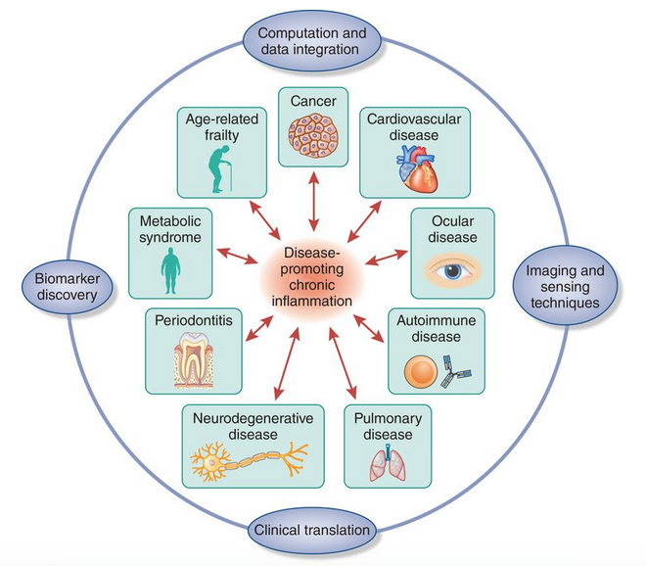

Slide 8
Genetic abnormalities. Genetic aberrations can result in pathologic changes as conspicuous as the congenital malformations associated with Down syndrome or as subtle as the single amino acid substitution in hemoglobin giving rise to sickle cell anemia. Genetic defects may cause cell injury as a consequence of deficiency of functional proteins, such as enzymes in inborn errors of metabolism, or accumulation of damaged DNA or misfolded proteins, both of which trigger cell death when they are beyond repair.
Nutritional imbalances. Protein–calorie insufficiency among impoverished populations remains a major cause of cell injury, and specific vitamin deficiencies are not uncommon even in developed countries with high standards of living. Ironically, excessive dietary intake may result in obesity and also is an important underlying factor in many diseases, such as type 2 diabetes mellitus and atherosclerosis.
Physical agents. Trauma, extremes of temperature, radiation, electric shock, and sudden changes in atmospheric pressure all have wide-ranging effects on cells/
Aging. Cellular senescence results in a diminished ability of cells to respond to stress and, eventually, the death of cells and of the organism.

Slide 9
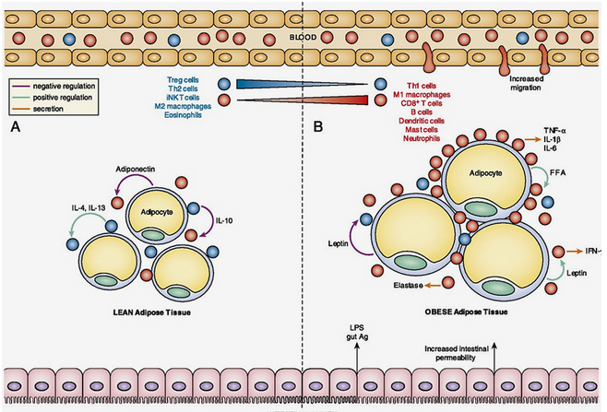

Slide 10
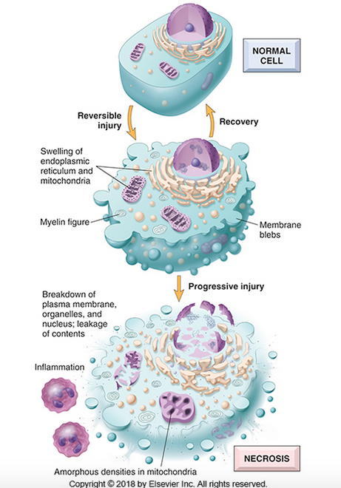
Reversible cell injury and necrosis
The principal cellular alterations that characterize reversible cell injury and necrosis are illustrated. By convention, reversible injury is considered to culminate in necrosis if the injurious stimulus is not removed.
In reversible injury, cells and intracellular organelles typically become swollen because they take in water as a result of the failure of energy-dependent ion pumps in the plasma membrane, leading to an inability to maintain ionic and fluid homeostasis. In some forms of injury, degenerated organelles and lipids may accumulate inside the injured cells.

Slide 11
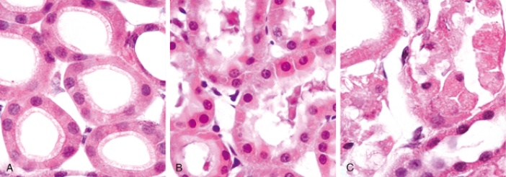
Morphologic changes in reversible and irreversible cell injury (necrosis). (A) Normal kidney tubules with viable epithelial cells. (B) Early (reversible) ischemic injury showing surface blebs, increased eosinophilia of cytoplasm, and swelling of occasional cells. (C) Necrotic (irreversible) injury of epithelial cells, with loss of nuclei and fragmentation of cells and leakage of contents.

Slide 12
In some situations, potentially injurious insults induce specific alterations in cellular organelles, such as the ER. The smooth ER is involved in the metabolism of various chemicals, and cells exposed to these chemicals show hypertrophy of the ER as an adaptive response that may have important functional consequences. For instance, many drugs, including barbiturates, which were commonly used as sedatives in the past and are still used as a treatment for some forms of epilepsy, are metabolized in the liver by the cytochrome P-450 mixed-function oxidase system found in the smooth ER.

Slide 13
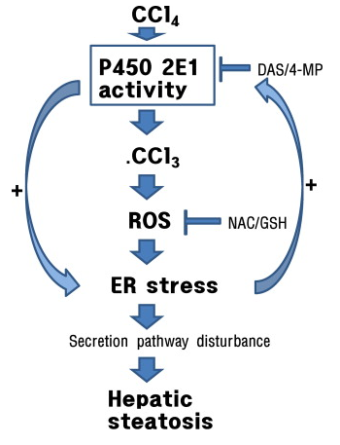
Protracted use of barbiturates leads to a state of tolerance, marked by the need to use increasing doses of the drug to achieve the same effect. This adaptation stems from hypertrophy (an increase in volume) of the smooth ER of hepatocytes and a consequent increase in P-450 enzymatic activity. P-450–mediated modification of compounds sometimes leads to their detoxification, but in other instances converts them into a dangerous toxin; one such example involves carbon tetrachloride (CCl4).
Cells adapted to one drug demonstrate an increased capacity to metabolize other compounds handled by the same system. Thus, if patients taking phenobarbital for epilepsy increase their alcohol intake, they may experience a drop in blood concentration of the anti-seizure medication to subtherapeutic levels because of smooth ER hypertrophy in response to the alcohol.

Slide 14
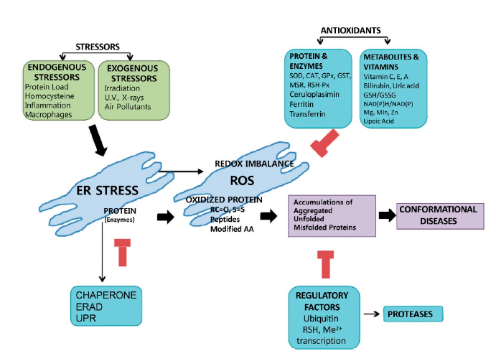

Slide 15
With persistent or excessive noxious exposures, injured cells pass a nebulous “point of no return” and undergo cell death. The clinical relevance of defining this transition point is obvious—if the biochemical and molecular changes that predict cell death can be identified, it may be possible to devise strategies for preventing the transition from reversible to irreversible cell injury. Although there are no definitive morphologic or biochemical correlates of irreversibility, it is consistently characterized by three phenomena: the inability to restore mitochondrial function (oxidative phosphorylation and adenosine triphosphate [ATP] generation) even after resolution of the original injury; the loss of structure and functions of the plasma membrane and intracellular membranes; and the loss of DNA and chromatin structural integrity. Injury to lysosomal membranes results in the enzymatic dissolution of the injured cell, which is the culmination of necrosis.

Slide 16
Cell Death
When cells are injured they die by different mechanisms, depending on the nature and severity of the insult.
It is important to point out that cellular function may be lost long before cell death occurs, and that the morphologic changes of cell injury (or death) lag far behind loss of function and viability. For example, myocardial cells become noncontractile after 1 to 2 minutes of ischemia, but may not die until 20 to 30 minutes of ischemia have elapsed. Morphologic features indicative of the death of ischemic myocytes appear by electron microscopy within 2 to 3 hours after the death of the cells, but are not evident by light microscopy until 6 to 12 hours later.

Slide 17
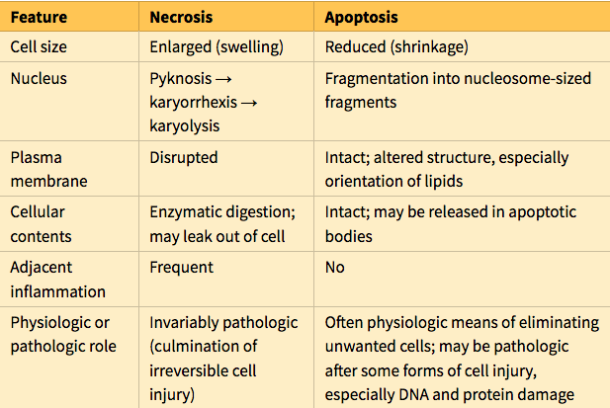

Slide 18
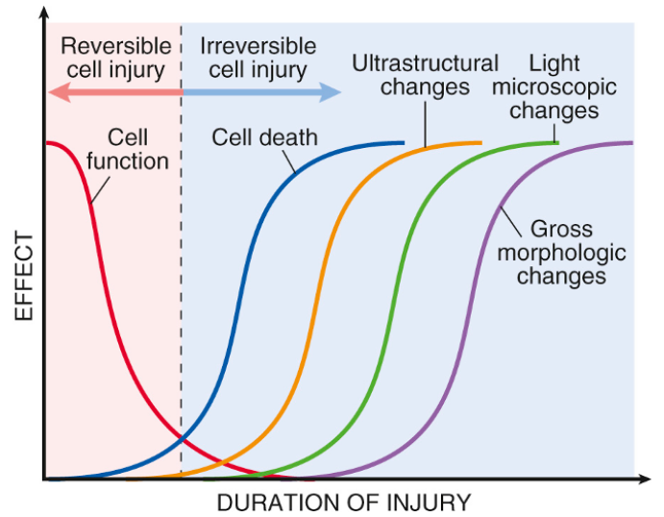
The relationship among cellular function, cell death, and the morphologic changes of cell injury. Note that cells may rapidly become nonfunctional after the onset of injury, although they are still viable, with potentially reversible damage; with a longer duration of injury, irreversible injury and cell death may result. Note also that cell death typically precedes ultrastructural, light microscopic, and grossly visible morphologic changes.

Slide 19
Necrosis
Necrosis is a form of cell death in which cellular membranes fall apart, and cellular enzymes leak out and ultimately digest the cell.
Necrosis elicits a local host reaction, called inflammation, that is induced by substances released from dead cells and which serves to eliminate the debris and start the subsequent repair. The enzymes responsible for digestion of the cell are derived from lysosomes and may come from the dying cells themselves or from leukocytes recruited as part of the inflammatory reaction.
Necrosis often is the culmination of reversible cell injury that cannot be corrected.

Slide 20
Cytoplasmic changes. Necrotic cells show increased eosinophilia (i.e., they are stained red by the dye eosin—the E in the hematoxylin and eosin [H&E] stain), attributable partly to increased binding of eosin to denatured cytoplasmic proteins and partly to loss of basophilic ribonucleic acid (RNA) in the cytoplasm (basophilia stems from binding of the blue dye hematoxylin—the H in “H&E”). Compared with viable cells, the cell may have a glassy, homogeneous appearance, mostly because of the loss of lighter staining glycogen particles. Myelin figures are more prominent in necrotic cells than in cells with reversible injury. When enzymes have digested cytoplasmic organelles, the cytoplasm becomes vacuolated and appears “moth-eaten.”

Slide 21
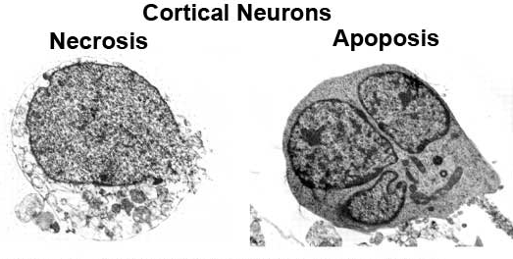
By electron microscopy, necrotic cells are characterized by discontinuities in plasma and organelle membranes, marked dilation of mitochondria associated with the appearance of large amorphous intramitrochondrial densities, disruption of lysosomes, and intracytoplasmic myelin figures.

Slide 22
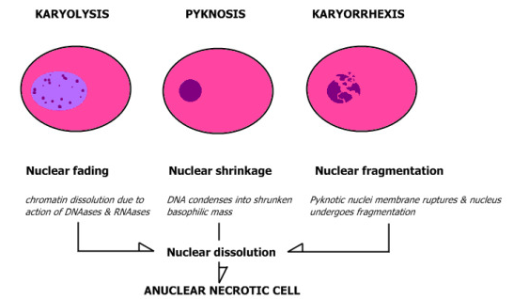
Nuclear changes. Nuclear changes assume one of three patterns, all resulting from a breakdown of DNA and chromatin. Pyknosis is characterized by nuclear shrinkage and increased basophilia; the DNA condenses into a dark shrunken mass. The pyknotic nucleus can undergo fragmentation; this change is called karyorrhexis. Ultimately, the nucleus may undergo karyolysis, in which the basophilia fades because of digestion of DNA by deoxyribonuclease (DNase) activity. In 1 to 2 days, the nucleus in a dead cell may completely disappear.

Slide 23
Fates of necrotic cells
Necrotic cells may persist for some time or may be digested by enzymes and disappear. Dead cells may be replaced by myelin figures, which are either phagocytosed by other cells or further degraded into fatty acids. These fatty acids bind calcium salts, which may result in the dead cells ultimately becoming calcified.
Morphologic Patterns of Tissue Necrosis
In severe pathologic conditions, large areas of a tissue or even entire orgrans may undergo necrosis. This may happen in association with marked ischemia, infections, and certain inflammatory reactions. There are several morphologically distinct patterns of tissue necrosis that may provide etiologic clues. Although the terms that describe these patterns do not reflect underlying mechanisms, such terms are commonly used and their implications are understood by pathologists and clinicians.

Slide 24
Coagulative necrosis is a form of necrosis in which the underlying tissue architecture is preserved for at least several days after death of cells in the tissue.
The affected tissues take on a firm texture. Presumably the injury denatures not only structural proteins but also enzymes, thereby blocking the proteolysis of the dead cells; as a result, eosinophilic, anucleate cells may persist for days or weeks.
Leukocytes are recruited to the site of necrosis, and the dead cells are ultimately digested by the action of lysosomal enzymes of the leukocytes. The cellular debris is then removed by phagocytosis mediated primarily by infiltrating neutrophils and macrophages.
Coagulative necrosis is characteristic of infarcts (areas of necrosis caused by ischemia) in all solid organs except the brain.

Slide 25
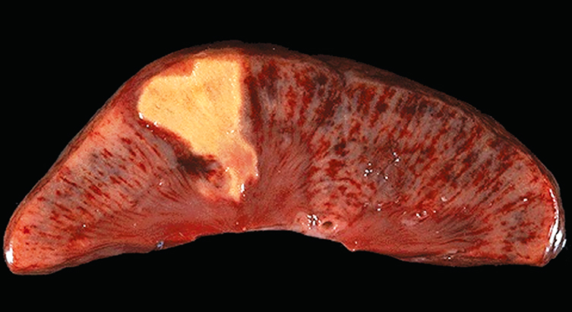
Coagulative necrosis. (A) A wedge-shaped kidney infarct (yellow) with preservation of the outlines.

Slide 26
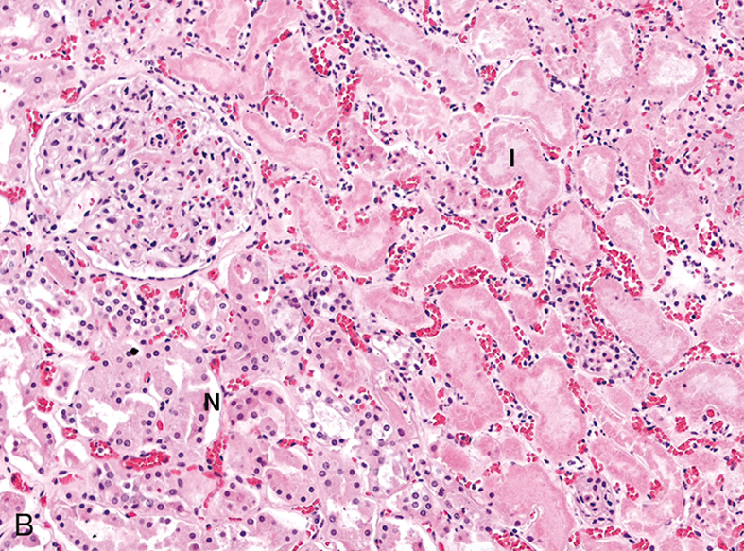
Microscopic view of the edge of the infarct, with normal kidney (N) and necrotic cells in the infarct (I). The necrotic cells show preserved outlines with loss of nuclei, and an inflammatory infiltrate is present (difficult to discern at this magnification)

Slide 27
Liquefactive necrosis is seen in focal bacterial and, occasionally, fungal infections because microbes stimulate rapid accumulation of inflammatory cells, and the enzymes of leukocytes digest (“liquefy”) the tissue. For obscure reasons, hypoxic death of cells within the central nervous system often evokes liquefactive necrosis.
Whatever the pathogenesis, the dead cells are completely digested, transforming the tissue into a viscous liquid that is eventually removed by phagocytes. If the process is initiated by acute inflammation, as in a bacterial infection, the material is frequently creamy yellow and is called pus

Slide 28
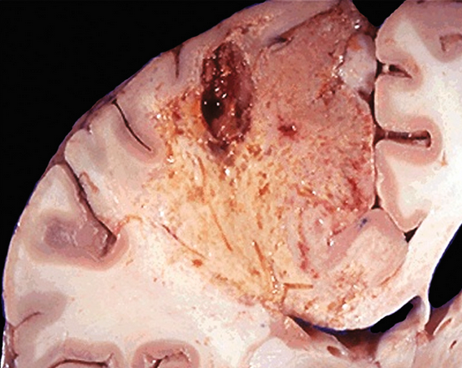
Liquefactive necrosis. An infarct in the brain shows dissolution of the tissue.

Slide 29
Although gangrenous necrosis is not a distinctive pattern of cell death, the term is still commonly used in clinical practice.
It usually refers to the condition of a limb (generally the lower leg) that has lost its blood supply and has undergone coagulative necrosis involving multiple tissue layers.
When bacterial infection is superimposed, the morphologic appearance changes to liquefactive necrosis because of the destructive contents of the bacteria and the attracted leukocytes (resulting in so-called “wet gangrene”).

Slide 30
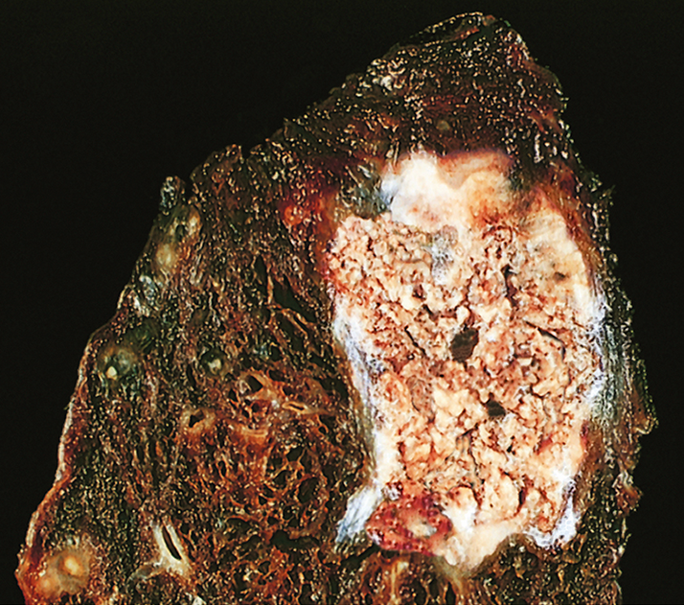
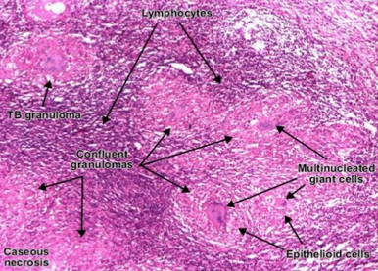
Caseous necrosis is most often encountered in foci of tuberculous infection. Caseous means “cheeselike,” referring to the friable yellow-white appearance of the area of necrosis on gross examination.
On microscopic examination, the necrotic focus appears as a collection of fragmented or lysed cells with an amorphous granular pink appearance in H&E-stained tissue sections. Unlike coagulative necrosis, the tissue architecture is completely obliterated and cellular outlines cannot be discerned. Caseous necrosis is often surrounded by a collection of macrophages and other inflammatory cells; this appearance is characteristic of a nodular inflammatory lesion called a granuloma

Slide 31
Fat necrosis refers to focal areas of fat destruction, typically resulting from the release of activated pancreatic lipases into the substance of the pancreas and the peritoneal cavity.
This occurs in the calamitous abdominal emergency known as acute pancreatitis. In this disorder, pancreatic enzymes that have leaked out of acinar cells and ducts liquefy the membranes of fat cells in the peritoneum, and lipases split the triglyceride esters contained within fat cells.
The released fatty acids combine with calcium to produce grossly visible chalky white areas (fat saponification), which enable the surgeon and the pathologist to identify the lesions . On histologic examination, the foci of necrosis contain shadowy outlines of necrotic fat cells surrounded by basophilic calcium deposits and an inflammatory reaction.

Slide 32
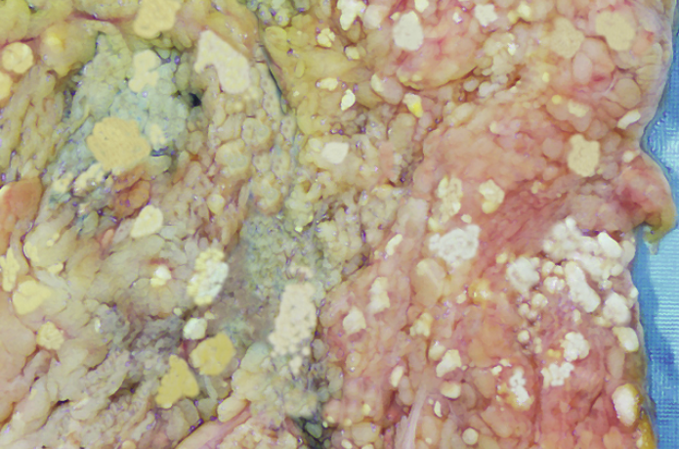
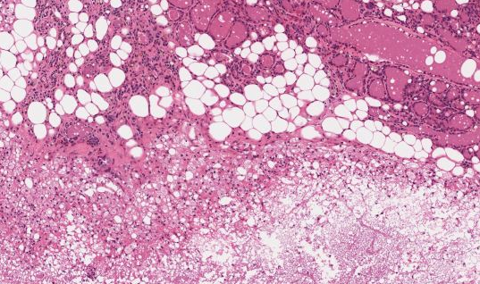
Fat necrosis in acute pancreatitis. The areas of white chalky deposits represent foci of fat necrosis with calcium soap formation (saponification) at sites of lipid breakdown in the mesentery.
Histologically, fat necrosis appears as foci of shadowy outlines of necrotic adipose cells, with basophilic calcium deposits and surrounded by inflammatory reactions.

Slide 33
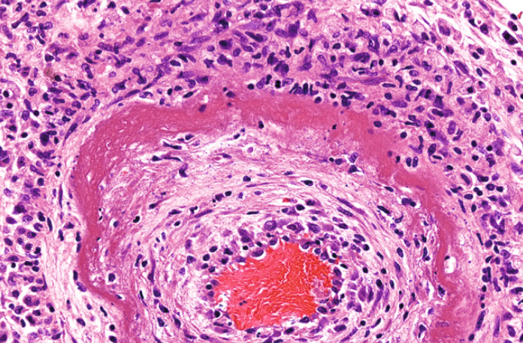
Fibrinoid necrosis is a special form of necrosis. It usually occurs in immune reactions in which complexes of antigens and antibodies are deposited in the walls of blood vessels, but it also may occur in severe hypertension. Deposited immune complexes and plasma proteins that leak into the wall of damaged vessels produce a bright pink, amorphous appearance on H&E preparations called fibrinoid (fibrinlike) by pathologists. This type of necrosis is seen in immunologically mediated diseases (e.g., polyarteritis nodosa)
Fibrinoid necrosis in an artery in a patient with polyarteritis nodosa. The wall of the artery shows a circumferential bright pink area of necrosis with protein deposition and inflammation.

Slide 34
Leakage of intracellular proteins through the damaged cell membrane and ultimately into the circulation provides a means of detecting tissue-specific necrosis using blood or serum samples.
Cardiac muscle, for example, contains a unique isoform of the enzyme creatine kinase and of the contractile protein troponin, whereas hepatic bile duct epithelium contains the enzyme alkaline phosphatase, and hepatocytes contain transaminases.
Irreversible injury and cell death in these tissues elevate the serum levels of these proteins, which makes them clinically useful markers of tissue damage

Slide 35
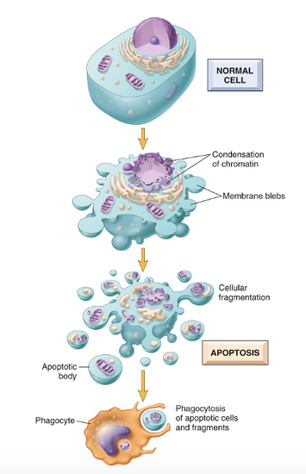
Apoptosis
Apoptosis is a pathway of cell death in which cells activate enzymes that degrade the cells’ own nuclear DNA and nuclear and cytoplasmic proteins. Fragments of the apoptotic cells then break off, giving the appearance that is responsible for the name (apoptosis, “falling off”).
The plasma membrane of the apoptotic cell remains intact, but the membrane is altered in such a way that the fragments, called apoptotic bodies, become highly “edible,” leading to their rapid consumption by phagocytes.
The dead cell and its fragments are cleared with little leakage of cellular contents, so apoptotic cell death does not elicit an inflammatory reaction. Thus, apoptosis differs in many respects from necrosis

Slide 36
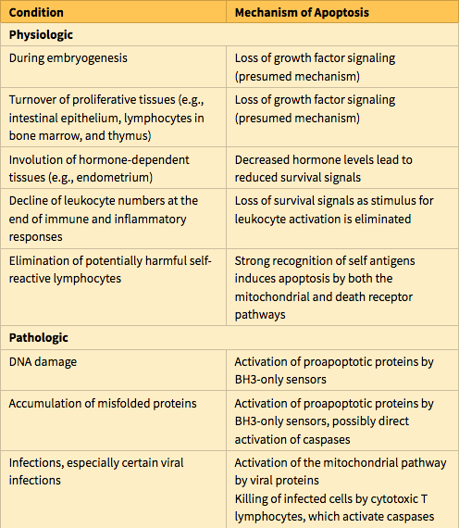
Apoptosis occurs in many normal situations and serves to eliminate potentially harmful cells and cells that have outlived their usefulness. It also occurs as a pathologic event when cells are damaged, especially when the damage affects the cell’s DNA or proteins; thus, the irreparably damaged cell is eliminated.

Slide 37
Mechanisms of Apoptosis
Apoptosis is regulated by biochemical pathways that control the balance of death- and survival-inducing signals and ultimately the activation of enzymes called caspases. Caspases were so named because they are cysteine proteases that cleave proteins after aspartic acid residues. Two distinct pathways converge on caspase activation: the mitochondrial pathway and the death receptor pathway. Although these pathways can intersect, they are generally induced under different conditions, involve different molecules, and serve distinct roles in physiology and disease. The end result of apoptotic cell death is the clearance of apoptotic bodies by phagocytes.

Slide 38
The mitochondrial (intrinsic) pathway seems to be responsible for apoptosis in most physiologic and pathologic situations. Mitochondria contain several proteins that are capable of inducing apoptosis, including cytochrome c. When mitochondrial membranes become permeable, cytochrome c leaks out into the cytoplasm, triggering caspase activation and apoptotic death. A family of more than 20 proteins, the prototype of which is Bcl-2, controls the permeability of mitochondria. In healthy cells, Bcl-2 and the related protein Bcl-xL, which are produced in response to growth factors and other stimuli, maintain the integrity of mitochondrial membranes, in large part by holding two proapoptotic members of the family, Bax and Bak, in check.

Slide 39
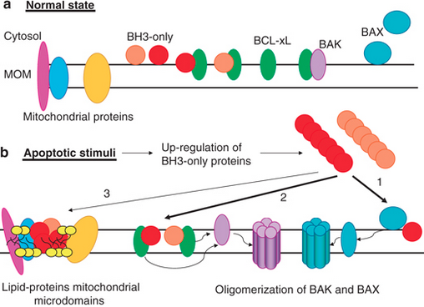
When cells are deprived of growth factors and survival signals, or are exposed to agents that damage DNA, or accumulate unacceptable amounts of misfolded proteins, a number of sensors are activated. These sensors are called BH3 proteins because they contan the third domain seen in Bcl-family proteins. They in turn shift this delicate, life-sustaining balance in favor of pro-apoptotic Bak and Bax. As a result, Bak and Bax dimerize, insert into the mitochondrial membrane, and form channels through which cytochrome c and other mitochondrial proteins escape into the cytosol. After cytochrome c enters the cytosol, it, together with certain cofactors, activates caspase-9. The net result is the activation of a caspase cascade, ultimately leading to nuclear fragmentation and formation of apoptotic bodies.

Slide 40
The death receptor (extrinsic) pathway of apoptosis.
Many cells express surface molecules, called death receptors, that trigger apoptosis. Most of these are members of the tumor necrosis factor (TNF) receptor family, which contain in their cytoplasmic regions a conserved “death domain,” so named because it mediates interaction with other proteins involved in cell death. The prototypic death receptors are the type I TNF receptor and Fas (CD95). Fas ligand (FasL) is a membrane protein expressed mainly on activated T lymphocytes. When these T cells recognize Fas-expressing targets, Fas molecules are crosslinked by FasL and bind adaptor proteins via the death domain. These then recruit and activate caspase-8, which, in turn, activates downstream caspases. The death receptor pathway is involved in the elimination of self-reactive lymphocytes and in the killing of target cells by some cytotoxic T lymphocytes (CTLs) that express FasL.
In either pathway, after caspase-9 or caspase-8 is activated, it cleaves and thereby activates additional caspases that cleave numerous targets and ultimately activate enzymes that degrade the cells’ proteins and nucleus. The end result is the characteristic cellular fragmentation of apoptosis.

Slide 41
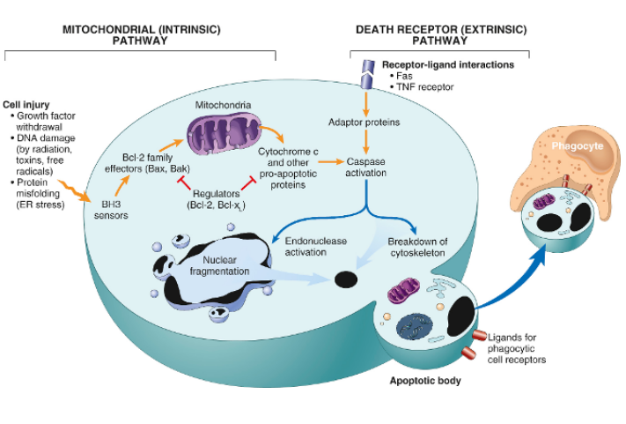
Mechanisms of apoptosis. The two pathways of apoptosis differ in their induction and regulation, and both culminate in the activation of caspases. In the mitochondrial pathway, BH3-only proteins, which are related to members of the Bcl-2 family, sense a lack of survival signals or DNA or protein damage.
These BH3-only proteins activate effector molecules that increase mitochondrial permeability. In concert with a deficiency of Bcl-2 and other proteins that maintain mitochondrial permeability, the mitochondria become leaky and various substances, such as cytochrome c, enter the cytosol and activate caspases. Activated caspases induce the changes that culminate in cell death and fragmentation. In the death receptor pathway, signals from plasma membrane receptors lead to the assembly of adaptor proteins into a “death-inducing signaling complex,” which activates caspases, and the end result is the same.

Slide 42
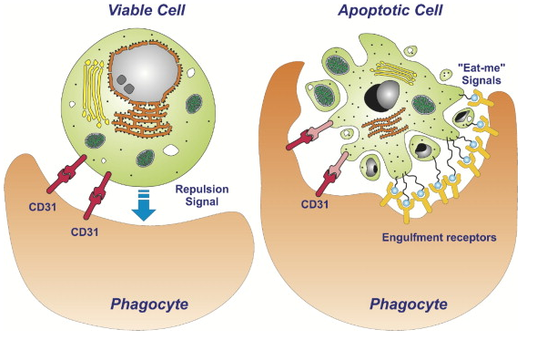
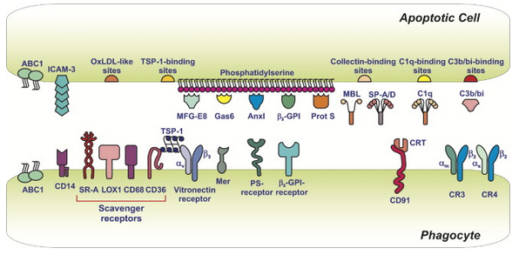
Clearance of apoptotic cells. Apoptotic cells and their fragments entice phagocytes by producing a number of “eat-me” signals. For instance, in normal cells, phosphatidylserine is present on the inner leaflet of the plasma membrane, but in apoptotic cells this phospholipid “flips” to the outer leaflet, where it is recognized by tissue macrophages, leading to phagocytosis of the apoptotic cells. Cells that are dying by apoptosis also secrete soluble factors that recruit phagocytes. The plasma membrane alterations and secreted proteins facilitate prompt clearance of the dead cells before the cells undergo membrane damage and release their contents (which can induce inflammation). Numerous macrophage receptors have been shown to be involved in the binding and engulfment of apoptotic cells. The phagocytosis of apoptotic cells is so efficient that dead cells disappear without leaving a trace, and inflammation is virtually absent.

Slide 43
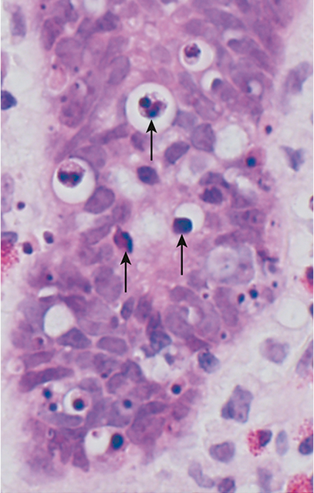
Morphologic appearance of apoptotic cells. Apoptotic cells (some indicated by arrows) in colonic epithelium are shown. (Some preparative regimens for colonoscopy may induce apoptosis in epithelial cells, which explains the presence of dead cells in this biopsy.)
Note the fragmented nuclei with condensed chromatin and the shrunken cell bodies, some with pieces falling off.

Slide 44
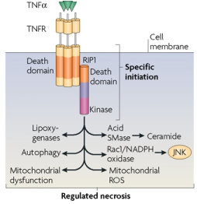
This form of cell death is initiated by engagement of TNF receptors as well as other, poorly defined triggers. Unlike the extrinsic pathway of apoptosis, which also is downstream of TNF receptors, in necroptosis, kinases called receptor-interacting protein (RIP) kinases are activated, initiating a series of events that result in the dissolution of the cell, much like necrosis. The name necroptosis implies that there are features of both necrosis and apoptosis. Some infections are believed to kill cells by this pathway, and it has been hypothesized to play a role in ischemic injury and other pathologic situations, especially those associated with inflammatory reactions in which the cytokine TNF is produced.
Necroptosis

Slide 45
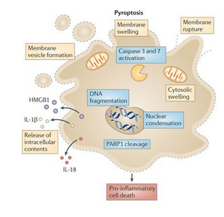
Pyroptosis
This form of cell death is associated with activation of a cytosolic danger-sensing protein complex called the inflammasome. The net result of inflammasome activation is the activation of caspases, some of which induce the production of cytokines that induce inflammation, often manifested by fever, and others trigger apoptosis. Thus, apoptosis and inflammation coexist. The name pyroptosis stems from the association of apoptosis with fever (Greek, pyro = fire). It is thought to be one mechanism by which some infectious microbes cause the death of infected cells.

Slide 46
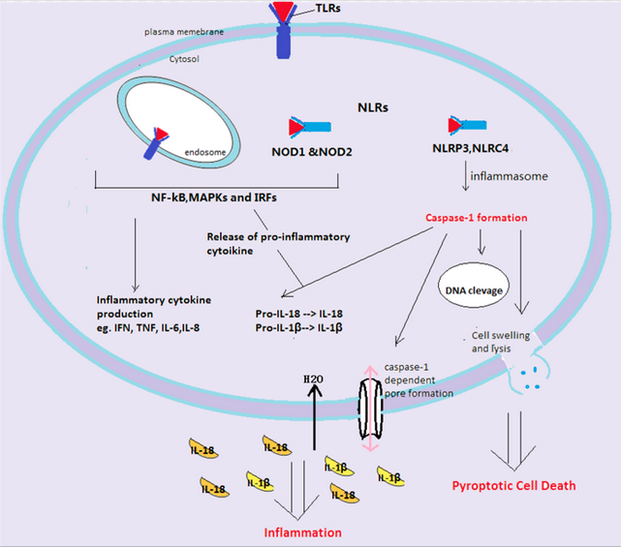

Slide 47
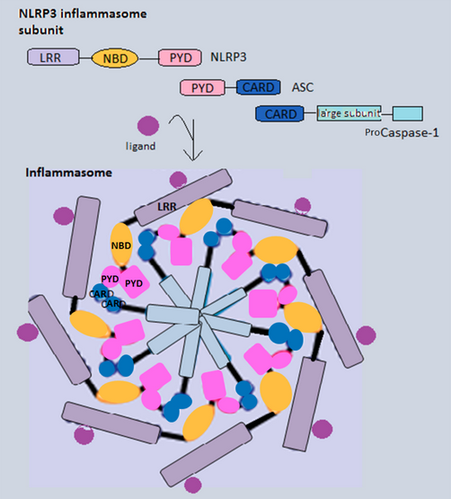
Caspase-1 activation
The crucial enzyme required in the stimulation of the downstream pathway is caspase-1, which is located inside the cells. Caspase-1 was known as an interleukin-1β converting enzyme, as it was first discovered in association with the cleavage of pro-IL-1β. The pro-caspase-1 with a 10-kDa CARD domain will be recruited by various inflammasome. Similar to other caspases, caspase-1 starts off as an inactive precursor called zymogen.
The caspase-1 enzymes become activated when they oligomerize and form tetramers. This process is spontaneous due to the fact that everything in the inflammasome is in close proximity with each other. The cysteine-cleaved enzyme will not only cause cell death but is also responsible for the cleavage of the pro-inflammatory cytokines IL-1β and IL-18. The cytokines, once processed, will be in their biologically active form ready to be released from the host cells. The development of efficient adaptive immune responses depends on the recruitment and activation of the immune cells by inflammatory cytokines.

Slide 48
