Slide 1
Mechanisms of Inflammation

Slide 2
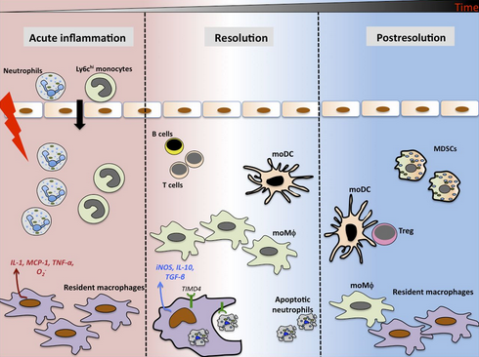
Inflammation is a response of vascularized tissues to infections and tissue damage that brings cells and molecules of host defense from the circulation to the sites where they are needed, to eliminate the offending agents.
Although in common medical and lay parlance, inflammation suggests a harmful reaction, it is actually a protective response that is essential for survival. It serves to rid the host of both the initial cause of cell injury (e.g., microbes, toxins) and the consequences of such injury (e.g., necrotic cells and tissues). The mediators of defense include phagocytic leukocytes, antibodies, and complement proteins.

Slide 3
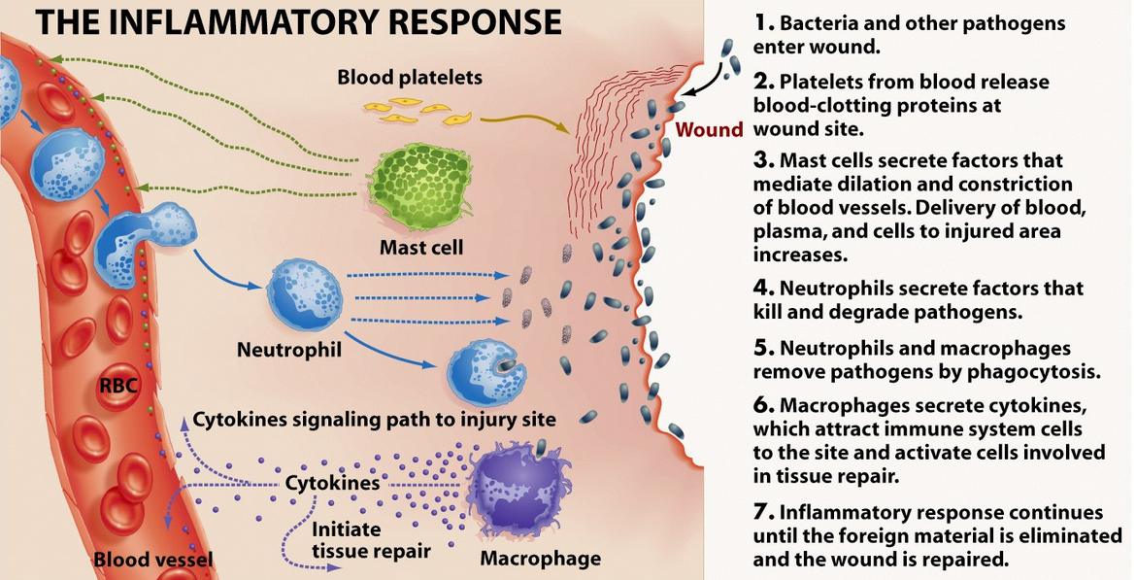
Most of these normally circulate in the blood, where they are sequestered so they cannot damage normal tissues but can be rapidly recruited to any site in the body. Some of the cells involved in inflammatory responses also reside in tissues, where they function as sentinels on the lookout for threats. The process of inflammation delivers leukocytes and proteins to foreign invaders, such as microbes, and to damaged or necrotic tissues, and it activates the recruited cells and molecules, which then function to eliminate the harmful or unwanted substances. Without inflammation, infections would go unchecked, wounds would never heal, and injured tissues might remain permanent festering sores.

Slide 4
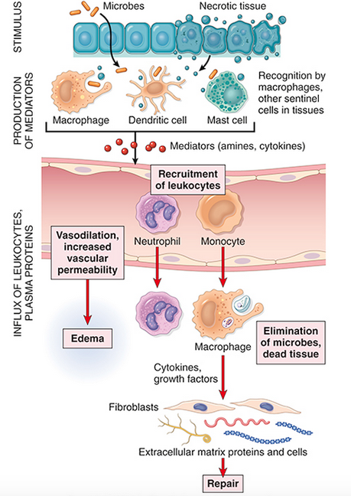
Sequence of events in an inflammatory reaction. Macrophages and other cells in tissues recognize microbes and damaged cells and liberate mediators, which trigger the vascular and cellular reactions of inflammation.

Slide 5
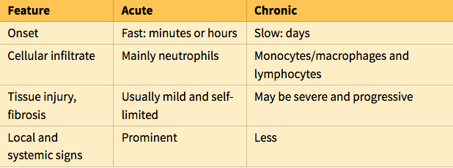
Inflammation may be of two types, acute and chronic . The initial, rapid response to infections and tissue damage is called acute inflammation. It typically develops within minutes or hours and is of short duration, lasting for several hours or a few days. Its main characteristics are the exudation of fluid and plasma proteins (edema) and the emigration of leukocytes, predominantly neutrophils (also called polymorphonuclear leukocytes). When acute inflammation achieves its desired goal of eliminating the offenders, the reaction subsides and residual injury is repaired. But if the initial response fails to clear the stimulus, the reaction progresses to a protracted type of inflammation that is called chronic inflammation.

Slide 6
Inflammation is induced by chemical mediators that are produced by host cells in response to injurious stimuli. When a microbe enters a tissue or the tissue is injured, the presence of the infection or damage is sensed by resident cells, including macrophages, dendritic cells, mast cells, and other cell types. These cells secrete molecules (cytokines and other mediators) that induce and regulate the subsequent inflammatory response.

Slide 7
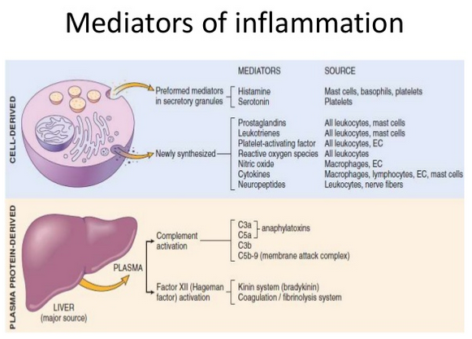
Inflammatory mediators are also produced from plasma proteins that react to the microbes or to products of necrotic cells. Some of these mediators promote the efflux of plasma and the recruitment of circulating leukocytes to the site where the offending agent is located.
Mediators also activate the recruited leukocytes, enhancing their ability to destroy and remove the offending agent.
Understanding the role of chemical mediators is important because most anti-inflammatory drugs target specific mediators.

Slide 8
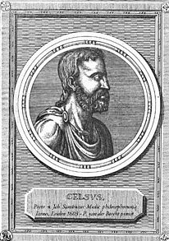
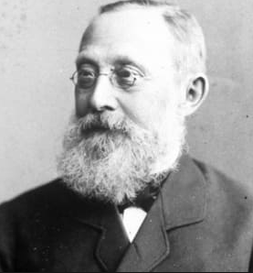
The external manifestations of inflammation, often called its cardinal signs, are heat (calor in Latin), redness (rubor), swelling (tumor), pain (dolor), and loss of function (functio laesa). The first four of these were described more than 2000 years ago by a Roman encyclopedist named Celsus, who wrote the then-famous text De Medicina, and the fifth was added in the late 19th century by Rudolf Virchow, known as the “father of modern pathology.” These manifestations occur as consequences of the vascular changes and leukocyte recruitment and activation

Slide 9
Although normally protective, in some situations, the inflammatory reaction becomes the cause of disease, and the damage it produces is its dominant feature. For example, inflammatory reactions to infections are often accompanied by local tissue damage and its associated signs and symptoms (e.g., pain and functional impairment). Typically, however, these harmful consequences are self-limited and resolve as the inflammation abates, leaving little or no permanent damage.
In contrast, there are many diseases in which the inflammatory reaction is misdirected (e.g., against self tissues in autoimmune diseases), occurs against normally harmless environmental substances that evoke an immune response (e.g., in allergies), or is excessively prolonged (e.g., in infections by microbes that resist eradication).

Slide 10
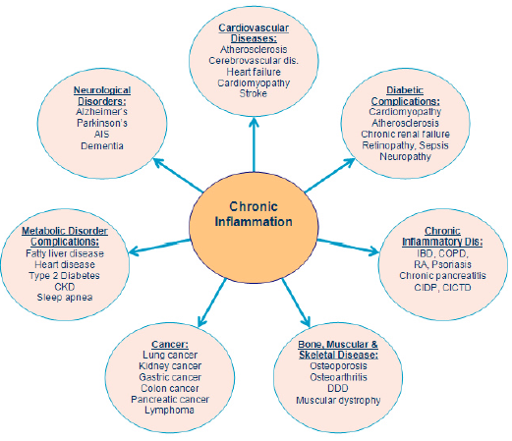

Slide 11
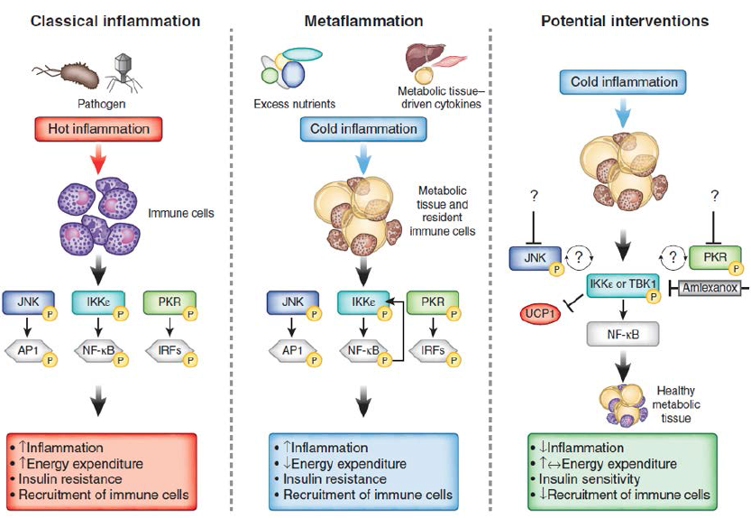

Slide 12
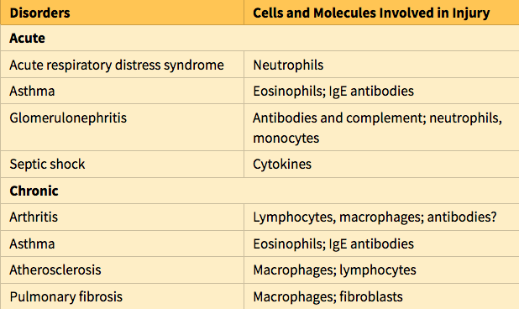
Inflammatory reactions underlie common chronic diseases, such as rheumatoid arthritis, atherosclerosis, and lung fibrosis, as well as life-threatening hypersensitivity reactions to insect bites, drugs, and toxins. For this reason our pharmacies abound with anti-inflammatory drugs, which ideally would control the harmful sequelae of inflammation yet not interfere with its beneficial effects. In fact, inflammation may contribute to a variety of diseases that are thought to be primarily metabolic, degenerative, or genetic disorders, such as type 2 diabetes, Alzheimer disease, and cancer.”
Hence, anti-inflammatory drugs may well have a broader role than currently indicated. In recognition of the wide-ranging harmful consequences of inflammation, the lay press has rather melodramatically referred to it as “the silent killer.

Slide 13
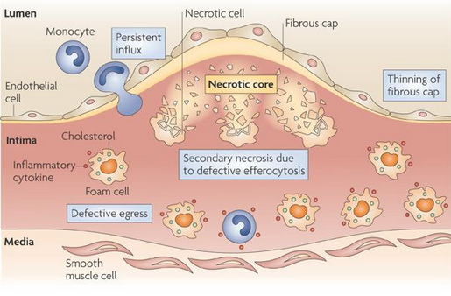
Not only excessive inflammation but also defective inflammation is responsible for serious illness. Too little inflammation, which is typically manifested by increased susceptibility to infections, is most often caused by a reduced number of leukocytes resulting from replacement of the bone marrow by cancers and suppression of the marrow by therapies for cancer and graft rejection.
Recall that leukocytes, the cells of the inflammatory response, arise from progenitors in the bone marrow, hence any compromise of marrow function will diminish the generation of mature leukocytes. Inherited genetic abnormalities of leukocyte function are rare disorders but they provide valuable information about the mechanisms of leukocyte responses.

Slide 14
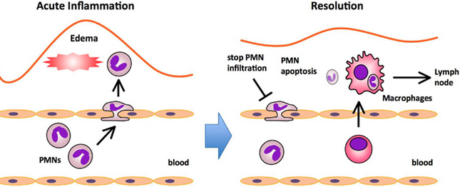
Inflammation is terminated when the offending agent is eliminated. The reaction resolves because mediators are broken down and dissipated, and leukocytes have short life spans in tissues. In addition, anti-inflammatory mechanisms are activated, serving to control the response and prevent it from causing excessive damage to the host. After inflammation has achieved its goal of eliminating the offending agents, it sets into motion the process of tissue repair. Repair consists of a series of events that heal damaged tissue. In this process, the injured tissue is replaced through regeneration of surviving cells and filling of residual defects with connective tissue (scarring).

Slide 15
Causes of Inflammation
Infections (bacterial, viral, fungal, parasitic) and microbial toxins are among the most common and medically important causes of inflammation. Different infectious pathogens elicit distinct inflammatory responses, from mild acute inflammation that causes little or no lasting damage and successfully eradicates the infection, to severe systemic reactions that can be fatal, to prolonged chronic reactions that cause extensive tissue injury. The morphologic pattern of the response can be useful in identifying its etiology.
Tissue necrosis elicits inflammation regardless of the cause of cell death, which may include ischemia (reduced blood flow, the cause of myocardial infarction), trauma, and physical and chemical injury (e.g., thermal injury, as in burns or frostbite; irradiation; exposure to some environmental chemicals). Several molecules released from necrotic cells are known to trigger inflammation.

Slide 16
Foreign bodies (splinters, dirt, sutures) may elicit inflammation by themselves or because they cause traumatic tissue injury or carry microbes. Even some endogenous substances stimulate potentially harmful inflammation if large amounts are deposited in tissues; such substances include urate crystals (in the disease gout), and cholesterol crystals (in atherosclerosis)
Immune reactions (also called hypersensitivity) are reactions in which the normally protective immune system damages the individual’s own tissues. The injurious immune responses may be directed against self antigens, causing autoimmune diseases, or may be inappropriate reactions against environmental substances, as in allergies, or against microbes. Inflammation is a major cause of tissue injury in these diseases.
Because the stimuli for the inflammatory responses in autoimmune and allergic diseases (self and environmental antigens) cannot be eliminated, these reactions tend to be persistent and difficult to cure, are often associated with chronic inflammation, and are important causes of morbidity and mortality.

Slide 17
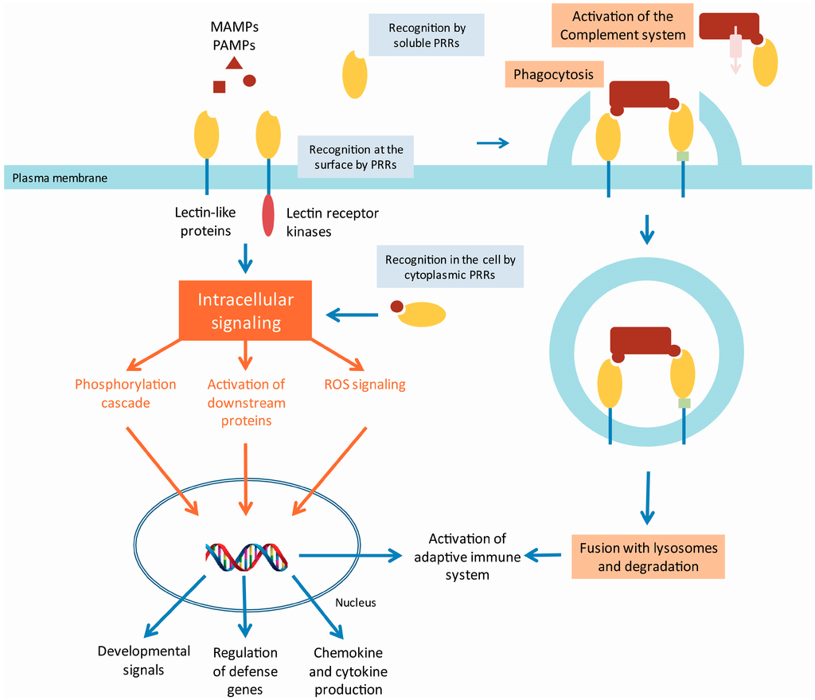
Recognition of Microbes and Damaged Cells
The first step in inflammatory responses is the recognition of microbes and necrotic cells by cellular receptors and circulating proteins.
The cells and receptors that recognize invaders evolved as adaptations of multicellular organisms to the presence of microbes in the environment, and the responses they trigger are critical for survival.

Slide 18
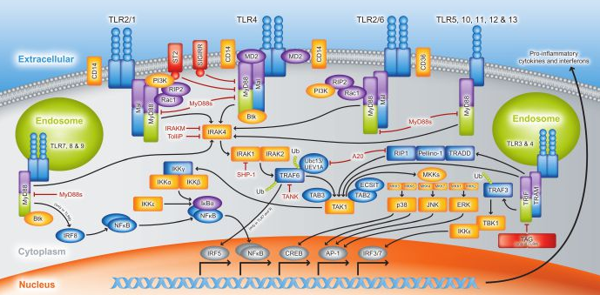
Cellular receptors for microbes
Phagocytes, dendritic cells (cells in epithelia and all tissues whose function is to capture microbes), and many other cells express receptors that detect the presence of infectious pathogens. The best defined of these receptors belong to the family of Toll-like receptors (TLRs), which are named for the founding member, Toll, a gene that was discovered in Drosophila. TLRs are located in plasma membranes and endosomes, so they are able to detect extracellular and ingested microbes. Other microbial sensors are present in the cytoplasm of cells. TLRs recognize motifs common to many microbes, often called pathogen-associated molecular patterns (PAMPs). Recognition of microbes by these receptors stimulates the production and expression of a number of secreted and membrane proteins. These proteins include cytokines that induce inflammation, anti-viral cytokines (interferons), and cytokines and membrane proteins that promote lymphocyte activation and even more potent immune responses.

Slide 19
Sensors of cell damage
All cells have cytosolic receptors that recognize molecules that are liberated or altered as a consequence of cell damage, and are hence appropriately called damage-associated molecular patterns (DAMPs).
These molecules include uric acid (a product of DNA breakdown), ATP (released from damaged mitochondria), reduced intracellular K+ concentrations (reflecting loss of ions because of plasma membrane injury), DNA (when it is released into the cytoplasm and not sequestered in nuclei, as it should be normally), and many others.

Slide 20
The receptors activate a multiprotein cytosolic complex called the inflammasome, which induces the production of the cytokine interleukin-1 (IL-1). IL-1 recruits leukocytes and thus induces inflammation.
Gain-of-function mutations in the cytosolic receptors are the cause of rare diseases known as autoinflammatory syndromes that are characterized by spontaneous inflammation; IL-1 antagonists are effective treatments for these disorders. The inflammasome also has been implicated in inflammatory reactions to urate crystals (the cause of gout), cholesterol crystals (in atherosclerosis), lipids (in metabolic syndrome and obesity-associated diabetes), and amyloid deposits in the brain (in Alzheimer disease).

Slide 21
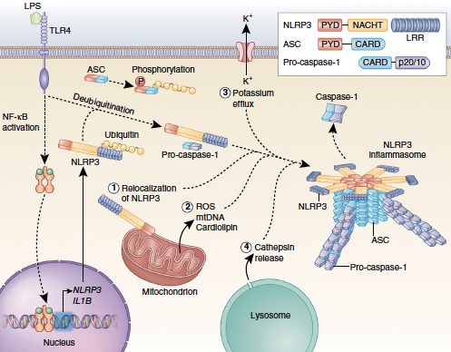

Slide 22
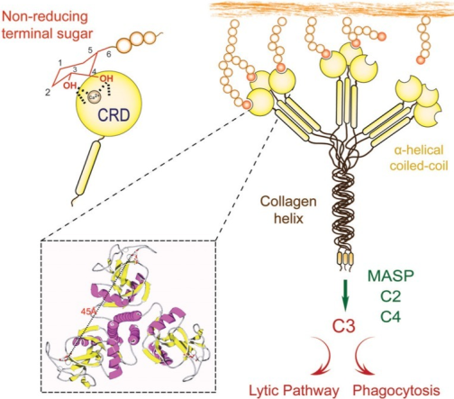
Circulating proteins
Several plasma proteins recognize microbes and function to destroy blood-borne microbes and to stimulate inflammation at tissue sites of infection. The complement system reacts against microbes and produces mediators of inflammation.
A circulating protein called mannose-binding lectin recognizes microbial sugars and promotes ingestion of microbes and activation of the complement system. Other proteins called collectins also bind to microbes and promote their phagocytosis.

Slide 23
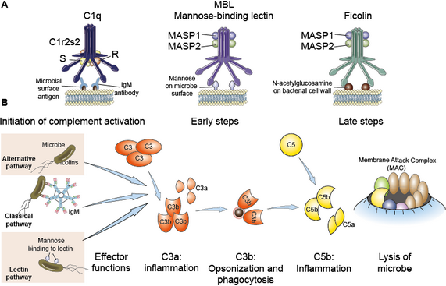
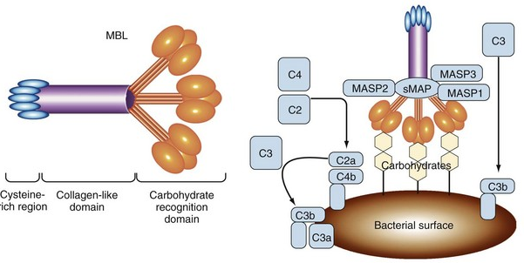

Slide 24
Acute Inflammation
Acute inflammation has three major components: (1) dilation of small vessels, leading to an increase in blood flow, (2) increased permeability of the microvasculature, enabling plasma proteins and leukocytes to leave the circulation, and (3) emigration of the leukocytes from the microcirculation, their accumulation in the focus of injury, and their activation to eliminate the offending agent.
When an injurious agent, such as an infectious microbe or dead cells, is encountered, phagocytes that reside in all tissues try to eliminate these agents. At the same time, phagocytes and other sentinel cells in the tissues recognize the presence of the foreign or abnormal substance and react by liberating soluble molecules that mediate inflammation. Some of these mediators act on small blood vessels in the vicinity and promote the efflux of plasma and the recruitment of circulating leukocytes to the site where the offending agent is located.

Slide 25
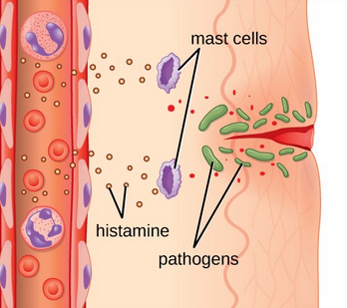
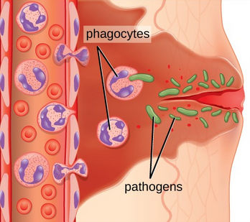
Reactions of Blood Vessels in Acute Inflammation
The vascular reactions of acute inflammation consist of changes in the flow of blood and the permeability of vessels, both designed to maximize the movement of plasma proteins and leukocytes out of the circulation and into the site of infection or injury

Slide 26
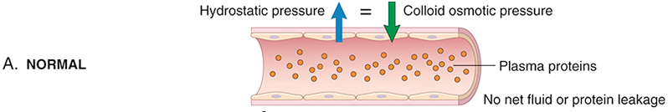
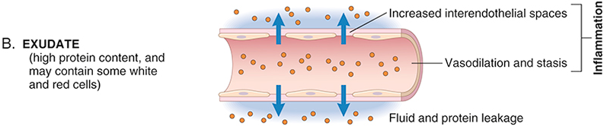
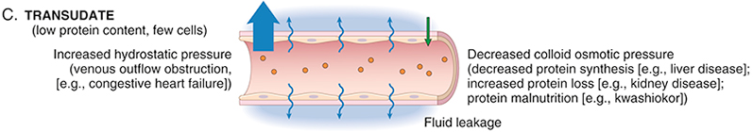
Formation of exudates and transudates. (A) Normal hydrostatic pressure (blue arrow) is about 32 mm Hg at the arterial end of a capillary bed and 12 mm Hg at the venous end; the mean colloid osmotic pressure of tissues is approximately 25 mm Hg (green arrow), which is equal to the mean capillary pressure. Therefore, the net flow of fluid across the vascular bed is almost nil. (B) An exudate is formed in inflammation because vascular permeability increases as a result of retraction of endothelial cells, creating spaces through which fluid and proteins can pass. (C) A transudate is formed when fluid leaks out because of increased hydrostatic pressure or decreased osmotic pressure.

Slide 27
Changes in Vascular Flow and Caliber
Vasodilation is induced by the action of several mediators, notably histamine, on vascular smooth muscle. It is one of the earliest manifestations of acute inflammation, and may be preceded by transient vasoconstriction. Vasodilation first involves the arterioles and then leads to the opening of new capillary beds in the area. The result is increased blood flow, which is the cause of heat and redness (erythema) at the site of inflammation.
Vasodilation is quickly followed by increased permeability of the microvasculature, with the outpouring of protein-rich fluid (an exudate) into the extravascular tissues.

Slide 28
The loss of fluid and increased vessel diameter lead to slower blood flow, concentration of red cells in small vessels, and increased viscosity of the blood. These changes result in stasis of blood flow, engorgement of small vessels jammed with slowly moving red cells, seen histologically as vascular congestion and externally as localized redness (erythema) of the involved tissue.
As stasis develops, blood leukocytes, principally neutrophils, accumulate along the vascular endothelium. At the same time endothelial cells are activated by mediators produced at sites of infection and tissue damage, and express increased levels of adhesion molecules. Leukocytes then adhere to the endothelium, and soon afterward they migrate through the vascular wall into the interstitial tissue,

Slide 29
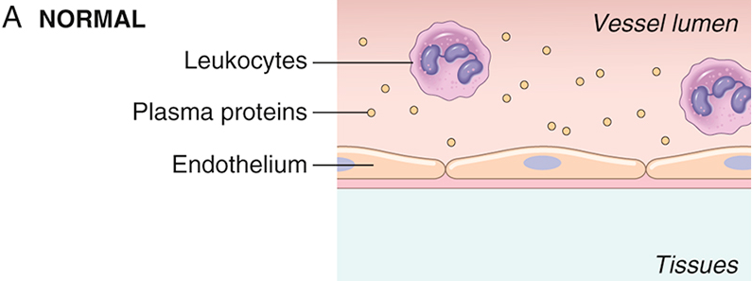
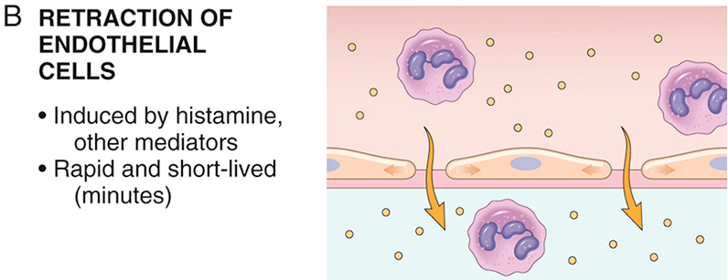
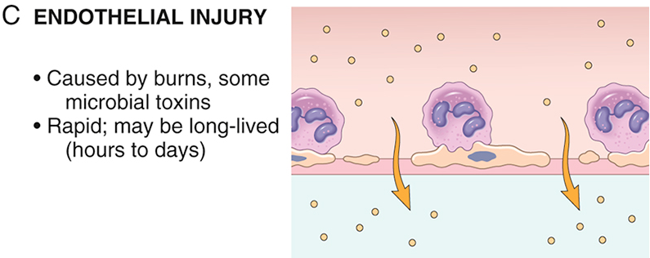
Principal mechanisms of increased vascular permeability in inflammation and their features and underlying causes.

Slide 30
Responses of Lymphatic Vessels and Lymph Nodes
In addition to blood vessels, lymphatic vessels also participate in acute inflammation. The system of lymphatics and lymph nodes filters and polices the extravascular fluids.
Lymphatics drain the small amount of extravascular fluid that seeps out of capillaries under normal circumstances. In inflammation, lymph flow is increased to help drain edema fluid that accumulates because of increased vascular permeability. In addition to fluid, leukocytes and cell debris, as well as microbes, may find their way into lymph. Lymphatic vessels, like blood vessels, proliferate during inflammatory reactions to handle the increased load.

Slide 31
The lymphatics may become secondarily inflamed (lymphangitis), as may the draining lymph nodes (lymphadenitis). Inflamed lymph nodes are often enlarged because of increased cellularity.
This constellation of pathologic changes is termed reactive, or inflammatory, lymphadenitis. For clinicians the presence of red streaks near a skin wound is a telltale sign of an infection in the wound. This streaking follows the course of the lymphatic channels and indicates the presence of lymphangitis; it may be accompanied by painful enlargement of the draining lymph nodes, indicating lymphadenitis.

Slide 32
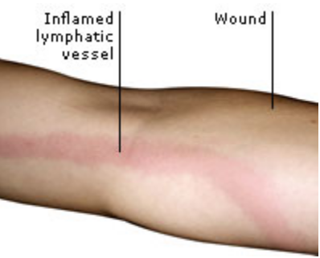
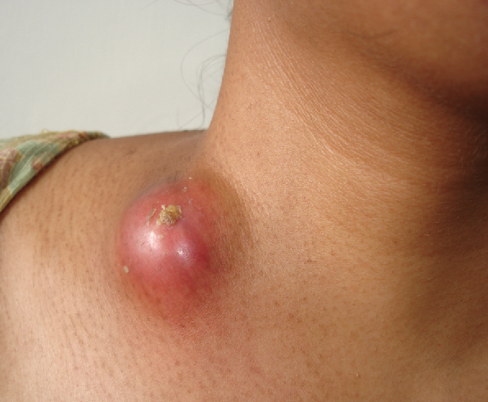
lymphangitis
lymphadenitis

Slide 33
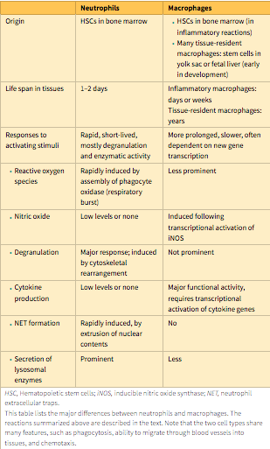
Leukocyte Recruitment to Sites of Inflammation
Leukocytes that are recruited to sites of inflammation perform the key function of eliminating the offending agents. The most important leukocytes in typical inflammatory reactions are the ones capable of phagocytosis, namely, neutrophils and macrophages. Neutrophils are produced in the bone marrow and rapidly recruited to sites of inflammation. Macrophages are slower responders. The principal functions of these cell types differ in subtle but important ways—neutrophils use cytoskeletal rearrangements and enzyme assembly to mount rapid, transient responses, whereas macrophages, being long-lived, make slower but more prolonged responses that often rely on new gene transcription

Slide 34
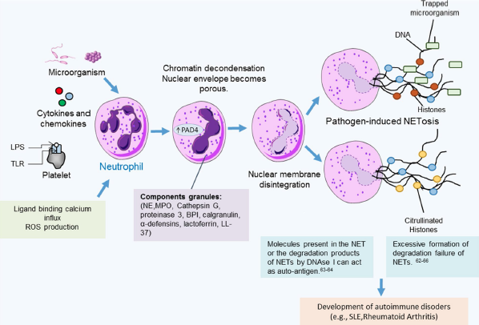

Slide 35
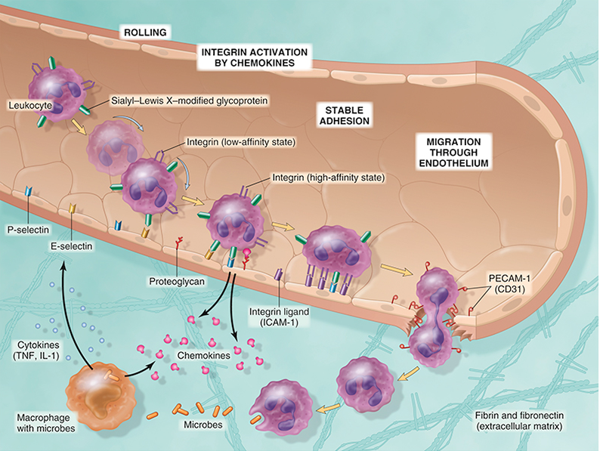
The multistep process of leukocyte migration through blood vessels, shown here for neutrophils. The leukocytes first roll, then become activated and adhere to endothelium, then transmigrate across the endothelium, pierce the basement membrane, and move toward chemoattractants emanating from the source of injury. Different molecules play predominant roles at each step of this process: selectins in rolling
chemokines (usually displayed bound to proteoglycans) in activating the neutrophils to increase avidity of integrins; integrins in firm adhesion; and CD31 (PECAM-1) in transmigration. ICAM-1, Intercellular adhesion molecule-1; PECAM-1 (CD31), platelet endothelial cell adhesion molecule-1; TNF, tumor necrosis factor.

Slide 36
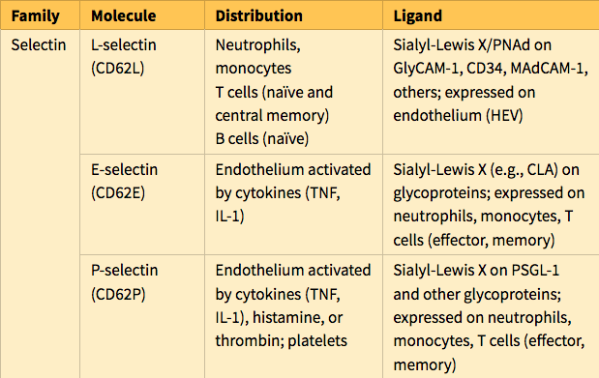
Endothelial and Leukocyte Adhesion Molecules

Slide 37
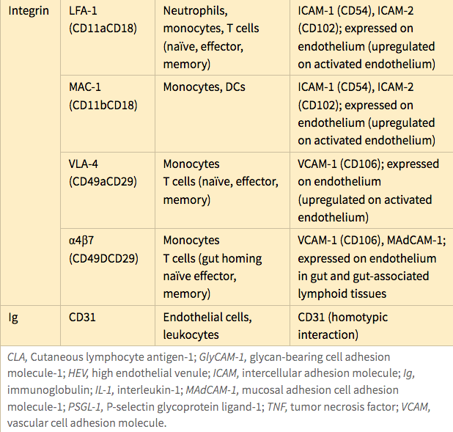

Slide 38
Leukocyte Migration through Endothelium
After being arrested on the endothelial surface, leukocytes migrate through the vessel wall primarily by squeezing between cells at intercellular junctions. This extravasation of leukocytes, called transmigration, occurs mainly in postcapillary venules, the site at which there is maximal retraction of endothelial cells.
Further movement of leukocytes is driven by chemokines produced in extravascular tissues, which stimulate leukocytes to travel along a chemical gradient.
In addition, platelet endothelial cell adhesion molecule-1 (PECAM-1) (also called CD31), an adhesion molecule of the immunoglobulin (Ig) superfamily expressed on leukocytes and endothelial cells, mediates the binding events needed for leukocytes to traverse the endothelium. After traversing the endothelium, leukocytes pierce the basement membrane, probably by secreting collagenases, and they enter the extravascular tissue. Typically, the vessel wall is not injured during leukocyte transmigration.

Slide 39
Chemotaxis of Leukocytes
After exiting the circulation, leukocytes move in the tissues toward the site of injury by a process called chemotaxis, which is defined as locomotion along a chemical gradient. Both exogenous and endogenous substances can act as chemoattractants, including the following:
Bacterial products, particularly peptides with N-formylmethionine termini
Cytokines, especially those of the chemokine family
Components of the complement system, particularly C5a
Products of the lipoxygenase pathway of arachidonic acid (AA) metabolism, particularly leukotriene B4 (LTB4)

Slide 40
These chemoattractants are produced by microbes and by host cells in response to infections and tissue damage and during immunologic reactions.
All act by binding to seven-transmembrane G protein-coupled receptors on the surface of leukocytes.
Signals initiated from these receptors activate second messengers that induce polymerization of actin, resulting in increased amounts at the leading edge of the cell and localization of myosin filaments at the back. The leukocyte moves by extending filopodia that pull the back of the cell in the direction of extension, much like the front wheels pull an automobile with front-wheel drive. The net result is that leukocytes migrate toward the inflammatory stimulus in the direction of the locally produced chemoattractants.

Slide 41
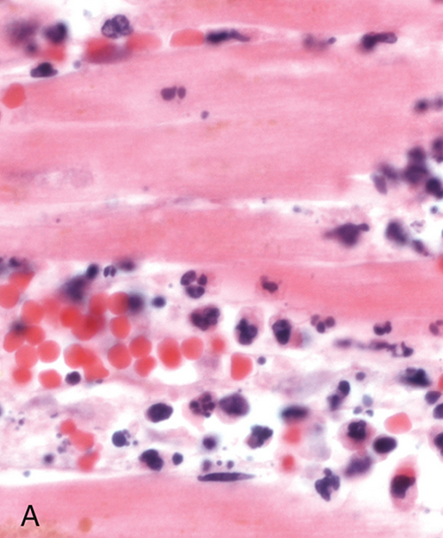
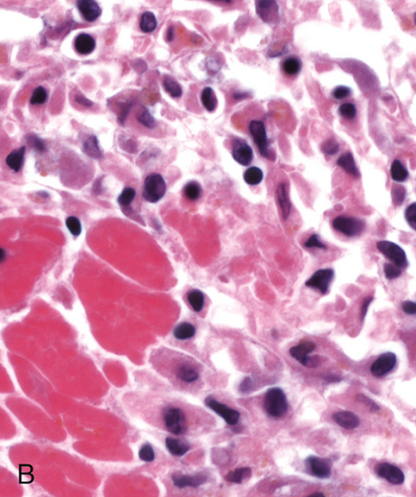
Nature of leukocyte infiltrates in inflammatory reactions. The photomicrographs show an inflammatory reaction in the myocardium after ischemic necrosis (infarction). (A) Early (neutrophilic) infiltrates and congested blood vessels. (B) Later (mononuclear) cellular infiltrates

Slide 42
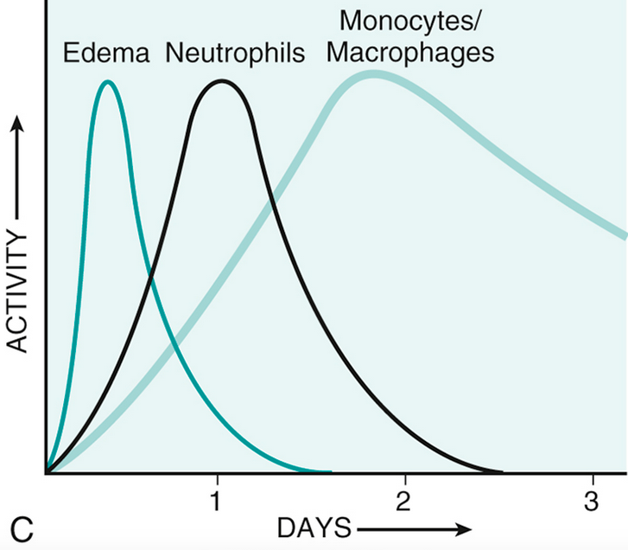
(C) The approximate kinetics of edema and cellular infiltration. For simplicity, edema is shown as an acute transient response, although secondary waves of delayed edema and neutrophil infiltration also can occur.

Slide 43
Intracellular Destruction of Microbes and Debris
The killing of microbes and the destruction of ingested materials are accomplished by reactive oxygen species (ROS, also called reactive oxygen intermediates), reactive nitrogen species, mainly derived from nitric oxide (NO), and lysosomal enzymes

Slide 44
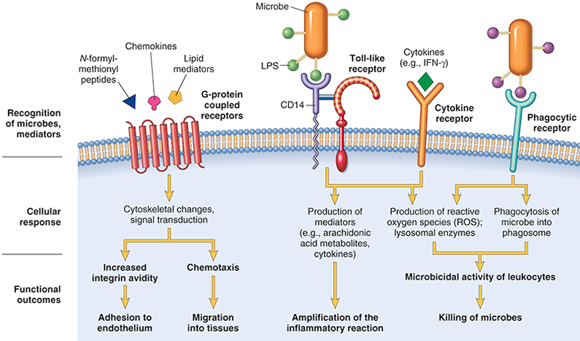
Leukocyte activation. Various types of leukocyte cell surface receptors recognize different agonists. Once stimulated, the receptors initiate responses that mediate leukocyte functions. Only some receptors are depicted. LPS first binds to a circulating LPS-binding protein (not shown). IFN-γ, Interferon-γ; LPS, lipopolysaccharide

Slide 45
Phagocytosis and intracellular destruction of microbes
(A) Phagocytosis of a particle (e.g., a bacterium) involves binding to receptors on the leukocyte membrane, engulfment, and fusion of the phagocytic vacuoles with lysosomes. This is followed by destruction of ingested particles within the phagolysosomes by lysosomal enzymes and by reactive oxygen and nitrogen species.
(B) In activated phagocytes, cytoplasmic components of the phagocyte oxidase enzyme assemble in the membrane of the phagosome to form the active enzyme, which catalyzes the conversion of oxygen into superoxide and H₂O₂. Myeloperoxidase, present in the granules of neutrophils, converts H₂O₂ to hypochlorite.
(C) Microbicidal reactive oxygen species (ROS) and nitric oxide (NO) kill ingested microbes. During phagocytosis, granule contents may be released into extracellular tissues. iNOS, Inducible NO synthase; MPO, myeloperoxidase; ROS, reactive oxygen species

Slide 46
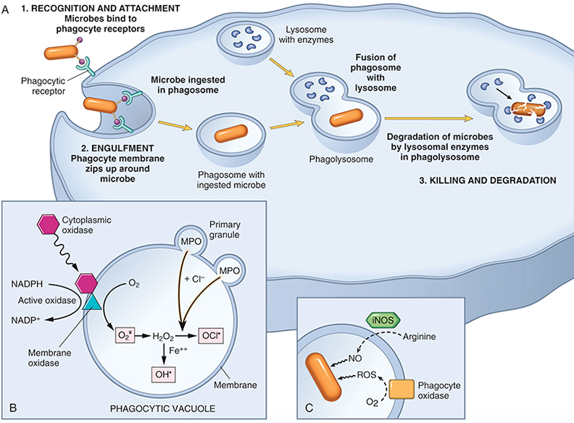

Slide 47
Granule Enzymes and Other Proteins
Neutrophils and monocytes contain granules packed with enzymes and anti-microbial proteins that degrade microbes and dead tissues and may contribute to tissue damage.
These granules are actively secretory and thus distinct from classical lysosomes. Neutrophils have two main types of granules. The smaller specific (or secondary) granules contain lysozyme, collagenase, gelatinase, lactoferrin, plasminogen activator, histaminase, and alkaline phosphatase. The larger azurophil (or primary) granules contain MPO, bactericidal factors (such as defensins), acid hydrolases, and a variety of neutral proteases (elastase, cathepsin G, nonspecific collagenases, proteinase 3). Phagocytic vesicles containing engulfed material may fuse with these granules (and with lysosomes), and the ingested materials are destroyed. In addition, both types of granules also undergo exocytosis (degranulation), leading to the extracellular release of granule contents.

Slide 48
Different granule enzymes serve different functions. Acid proteases degrade bacteria and debris within phagolysosomes, which are acidified by membrane-bound proton pumps. Neutral proteases are capable of degrading various extracellular components, such as collagen, basement membrane, fibrin, elastin, and cartilage, resulting in the tissue destruction that accompanies inflammatory processes. Neutrophil elastase combats infections by degrading virulence factors of bacteria. Macrophages also contain acid hydrolases, collagenase, elastase, phospholipase, and plasminogen activator.
Because of the destructive effects of granule enzymes, the initial leukocytic infiltration, if unchecked, can potentiate further inflammation by damaging tissues. These harmful proteases, however, are normally controlled by a system of anti-proteases in the serum and tissue fluids. Foremost among these is α1-anti-trypsin, which is the major inhibitor of neutrophil elastase. A deficiency of these inhibitors may lead to sustained action of leukocyte proteases, as is the case in patients with α1-anti-trypsin deficiency

Slide 49
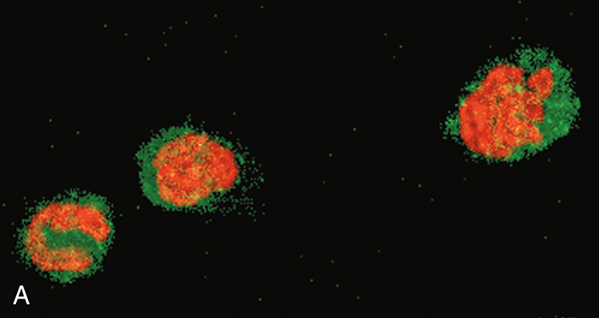
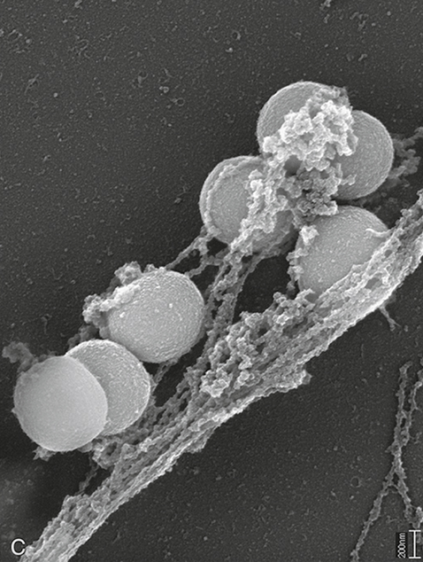
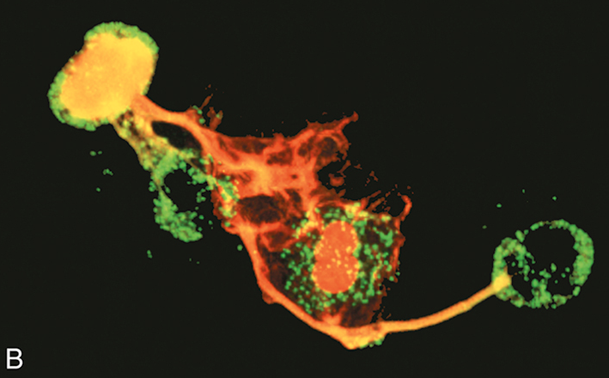
Neutrophil extracellular traps (NETs). Neutrophil extracellular traps (NETs) are extracellular fibrillar networks that concentrate anti-microbial substances at sites of infection and prevent the spread of the microbes by trapping them in the fibrils.
(A) Healthy neutrophils with nuclei stained red and cytoplasm green. (B) Release of nuclear material from neutrophils (note that two have lost their nuclei), forming extracellular traps. (C) An electron micrograph of bacteria (staphylococci) trapped in NETs.

Slide 50
Termination of the Acute Inflammatory Response
Such a powerful system of host defense, with its inherent capacity to cause tissue injury, needs tight controls to minimize damage. In part, inflammation declines after the offending agents are removed simply because the mediators of inflammation are produced in rapid bursts, only as long as the stimulus persists, have short half-lives, and are degraded after their release. Neutrophils also have short half-lives in tissues and die by apoptosis within hours to a day or two after leaving the blood.
In addition, as inflammation develops, the process itself triggers a variety of stop signals that actively terminate the reaction. These active termination mechanisms include a switch in the type of arachidonic acid metabolite produced, from proinflammatory leukotrienes to anti-inflammatory lipoxins, and the liberation of anti-inflammatory cytokines, including transforming growth factor-β (TGF-β) and IL-10, from macrophages and other cells.
Other control mechanisms that have been demonstrated experimentally include neural impulses (cholinergic discharge), which inhibit the production of TNF in macrophages.

Slide 51
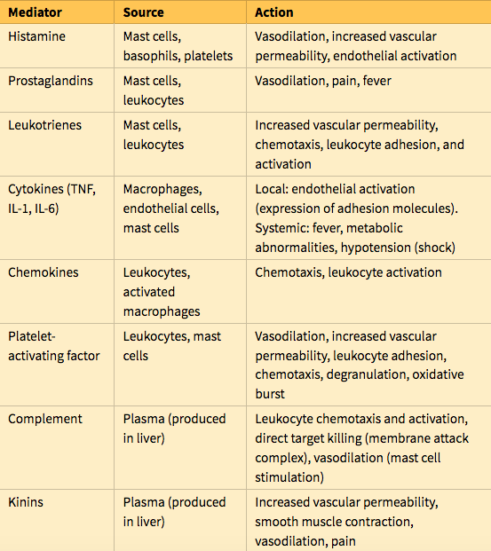
Mediators of Inflammation
The mediators of inflammation are the substances that initiate and regulate inflammatory reactions
The most important mediators of acute inflammation are vasoactive amines, lipid products (prostaglandins and leukotrienes), cytokines (including chemokines), and products of complement activation

Slide 52
Vasoactive Amines: Histamine and Serotonin
The two major vasoactive amines, so named because they have important actions on blood vessels, are histamine and serotonin.
They are stored as preformed molecules in cells and are therefore among the first mediators to be released during inflammation. The richest sources of histamine are mast cells, which are normally present in the connective tissue adjacent to blood vessels.
Histamine also is found in blood basophils and platelets. It is stored in mast cell granules and is released by degranulation in response to a variety of stimuli, including (1) physical injury, such as trauma, cold, or heat, by unknown mechanisms; (2) binding of antibodies to mast cells, which underlies immediate hypersensitivity (allergic) reactions; and (3) products of complement called anaphylatoxins (C3a and C5a).
Antibodies and complement products bind to specific receptors on mast cells and trigger signaling pathways that induce rapid degranulation. Neuropeptides (e.g., substance P) and cytokines (IL-1, IL-8) also may trigger release of histamine.

Slide 53
Histamine causes dilation of arterioles and increases the permeability of venules.
Histamine is considered the principal mediator of the immediate transient phase of increased vascular permeability, producing interendothelial gaps in postcapillary venules, as discussed earlier.
Its vasoactive effects are mediated mainly via binding to receptors, called H1 receptors, on microvascular endothelial cells. The antihistamine drugs that are commonly used to treat some inflammatory reactions, such as allergies, are H1 receptor antagonists that bind to and block the receptor. Histamine also causes contraction of some smooth muscles, but leukotrienes, described later, are much more potent and relevant for causing spasms of bronchial muscles, for example, in asthma.
Serotonin (5-hydroxytryptamine) is a preformed vasoactive mediator present in platelets and certain neuroendocrine cells, such as in the gastrointestinal tract, and in mast cells in rodents but not humans. Its primary function is as a neurotransmitter in the gastrointestinal tract. It also is a vasoconstrictor, but the importance of this action in inflammation is unclear.

Slide 54
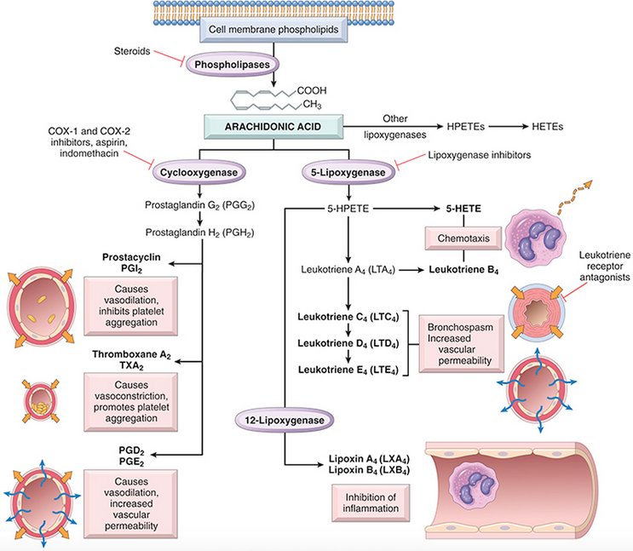
Arachidonic acid is a 20-carbon polyunsaturated fatty acid that is derived from dietary sources or by conversion from the essential fatty acid linoleic acid
Production of AA metabolites and their roles in inflammation. Clinically useful antagonists of different enzymes and receptors are indicated in red.
While leukotriene receptor antagonists inhibit all actions of leukotrienes, they are used in the clinic to treat asthma, as shown. COX-1, COX-2, Cyclooxygenase 1 and 2; HETE, hydroxyeicosatetraenoic acid; HPETE, hydroperoxyeicosatetraenoic acid

Slide 55
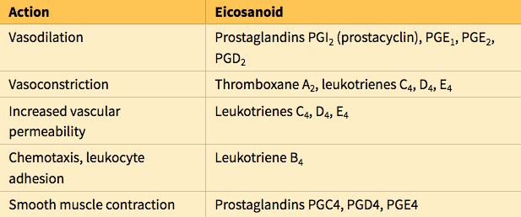
Principal Actions of Arachidonic Acid Metabolites in Inflammation

Slide 56
Prostaglandins
Prostaglandins (PGs) are produced by mast cells, macrophages, endothelial cells, and many other cell types, and are involved in the vascular and systemic reactions of inflammation. They are generated by the actions of two cyclooxygenases called COX-1 and COX-2.
COX-1 is produced in response to inflammatory stimuli and also is constitutively expressed in most tissues, where it may serve a homeostatic function (e.g., fluid and electrolyte balance in the kidneys, cytoprotection in the gastrointestinal tract).
COX-2 is induced by inflammatory stimuli and thus generates the PGs that are involved in inflammatory reactions, but it is low or absent in most normal tissues.
Prostaglandins are named based on structural features coded by a letter (e.g., PGD, PGE, PGF, PGG, and PGH) and a subscript numeral (e.g., 1, 2), which indicates the number of double bonds in the compound. The most important prostaglandins in inflammation are PGE2, PGD2, PGF2a, PGI2 (prostacyclin), and TXA2 (thromboxane A2), each of which is derived by the action of a specific enzyme on an intermediate in the pathway. Some of these enzymes have restricted tissue distribution and functions.

Slide 57
Leukotrienes
Leukotrienes are produced in leukocytes and mast cells by the action of lipoxygenase and are involved in vascular and smooth muscle reactions and leukocyte recruitment.
The synthesis of leukotrienes involves multiple steps, the first of which generates leukotriene A4 (LTA4), which in turn gives rise to LTB4 or LTC4. LTB4 is produced by neutrophils and some macrophages, and is a potent chemotactic agent and activator of neutrophils, causing aggregation and adhesion of the cells to venular endothelium, generation of ROS, and release of lysosomal enzymes.
The cysteinyl-containing leukotriene LTC4 and its metabolites, LTD4 and LTE4, are produced mainly in mast cells and cause intense vasoconstriction, bronchospasm (important in asthma), and increased permeability of venules.

Slide 58
Lipoxins
Lipoxins also are generated from arachidonic acid by the lipoxygenase pathway, but unlike prostaglandins and leukotrienes, the lipoxins suppress inflammation by inhibiting the recruitment of leukocytes.
They inhibit neutrophil chemotaxis and adhesion to endothelium. They also are unusual in that two cell populations are required for the transcellular biosynthesis of these mediators.
Leukocytes, particularly neutrophils, produce intermediates in lipoxin synthesis, and these are converted to lipoxins by platelets interacting with the leukocytes

Slide 59
Cyclooxygenase inhibitors include aspirin and other nonsteroidal anti-inflammatory drugs (NSAIDs), such as ibuprofen. They inhibit both COX-1 and COX-2 and thus block all prostaglandin synthesis (hence their efficacy in treating pain and fever); aspirin does this by irreversibly inactivating cyclooxygenases.
Pharmacologic Inhibitors of Prostaglandins and Leukotrienes
Lipoxygenase inhibitors. 5-lipoxygenase is not affected by NSAIDs, and many new inhibitors of this enzyme pathway have been developed. Pharmacologic agents that inhibit leukotriene production (e.g., zileuton) are useful in the treatment of asthma.
Corticosteroids are broad-spectrum anti-inflammatory agents that reduce the transcription of genes encoding COX-2, phospholipase A2, proinflammatory cytokines (e.g., IL-1 and TNF), and iNOS.
Leukotriene receptor antagonists block leukotriene receptors and prevent the actions of the leukotrienes. These drugs (e.g., Montelukast) are useful in the treatment of asthma.

Slide 60
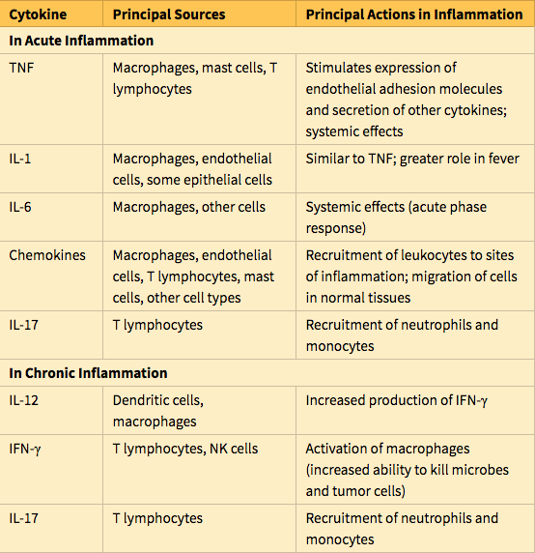
Cytokines and Chemokines
Cytokines are proteins secreted by many cell types (principally activated lymphocytes, macrophages, and dendritic cells, but also endothelial, epithelial, and connective tissue cells) that mediate and regulate immune and inflammatory reactions.

Slide 61
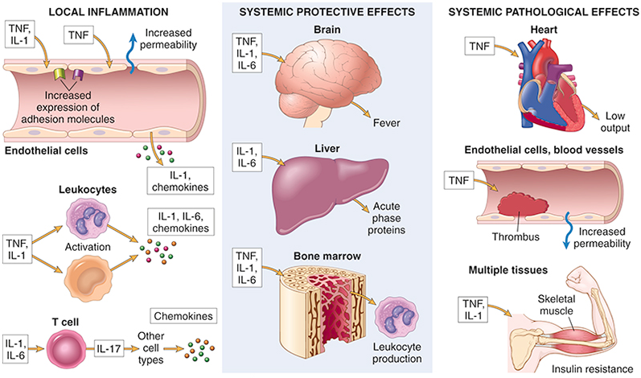
Major roles of cytokines in acute inflammation. PDGF, Platelet-derived growth factor; PGE, prostaglandin E; PGI, prostaglandin I.

Slide 62
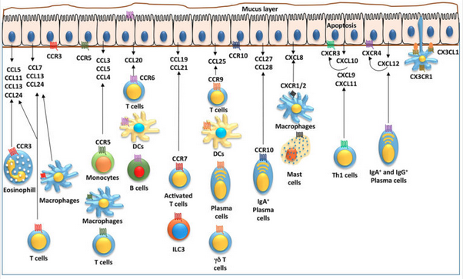
Chemokines
Chemokines are a family of small (8–10 kD) proteins that act primarily as chemoattractants for specific types of leukocytes. About 40 different chemokines and 20 different receptors for chemokines have been identified. They are classified into four major groups, according to the arrangement of cysteine (C) residues in the proteins:

Slide 63
C-X-C chemokines have one amino acid residue separating the first two of the four conserved cysteines. These chemokines act primarily on neutrophils. IL-8 (now called CXCL8) is typical of this group. It is secreted by activated macrophages, endothelial cells, and other cell types, and causes activation and chemotaxis of neutrophils, with limited activity on monocytes and eosinophils. Its most important inducers are microbial products and cytokines, mainly IL-1 and TNF.
C-C chemokines have the first two conserved cysteine residues adjacent. The C-C chemokines, which include monocyte chemoattractant protein (MCP-1, CCL2), eotaxin (CCL11), and macrophage inflammatory protein-1α (MIP-1α, CCL3), mainly serve as chemoattractants for monocytes, eosinophils, basophils, and lymphocytes. Although most of the chemokines in this class have overlapping actions, eotaxin selectively recruits eosinophils.

Slide 64
C chemokines lack the first and third of the four conserved cysteines. The C chemokines (e.g., lymphotactin, XCL1) are relatively specific for lymphocytes.
CX3C chemokines contain three amino acids between the first two cysteines. The only known member of this class is called fractalkine (CX3CL1). This chemokine exists in two forms: a cell surface-bound protein induced on endothelial cells by inflammatory cytokines that promotes strong adhesion of monocytes and T cells, and a soluble form, derived by proteolysis of the membrane-bound protein, that has potent chemoattractant activity for the same cells.
Chemokines functions
Acute inflammation. Most chemokines stimulate leukocyte attachment to endothelium by acting on leukocytes to increase the affinity of integrins, and also serve as chemoattractants, thereby guiding leukocytes to sites of infection or tissue damage. Because they mediate aspects of the inflammatory reaction, they are sometimes called inflammatory chemokines. Their production is induced by microbes and other stimuli.
Maintenance of tissue architecture. Some chemokines are produced constitutively by stromal cells in tissues and are sometimes called homeostatic chemokines. These organize various cell types in different anatomic regions of the tissues, such as T and B lymphocytes in discrete areas of the spleen and lymph nodes.

Slide 65
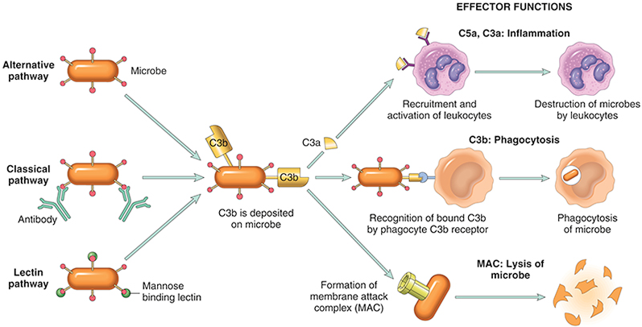
The activation and functions of the complement system. Activation of complement by different pathways leads to cleavage of C3. The functions of the complement system are mediated by breakdown products of C3 and other complement proteins, and by the membrane attack complex (MAC).

Slide 66
The activation of complement is tightly controlled by cell-associated and circulating regulatory proteins.
C1 inhibitor blocks the activation of C1, the first protein of the classical complement pathway. Inherited deficiency of this inhibitor is the cause of hereditary angioedema
Decay accelerating factor (DAF) and CD59 are two proteins that are linked to plasma membranes by a glycophosphatidyl (GPI) anchor. DAF prevents formation of C3 convertases and CD59 inhibits formation of the MAC. An acquired deficiency of the enzyme that creates GPI anchors leads to deficiency of these regulators and excessive complement activation and lysis of red cells (which are sensitive to complement-mediated cell lysis). This gives rise to a disease called paroxysmal nocturnal hemoglobinuria (PNH).
Other complement regulatory proteins proteolytically cleave active complement components. For instance, Factor H is a plasma protein that serves as a cofactor for the proteolysis of the C3 convertase; its deficiency results in excessive complement activation. Mutations in Factor H are associated with a kidney disease called the hemolytic uremic syndrome, as well as increased permeability of retinal vessels in wet macular degeneration of the eye.

Slide 67
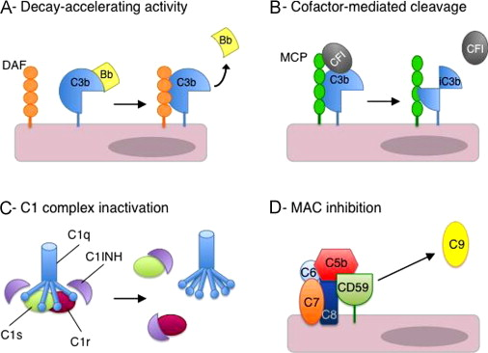
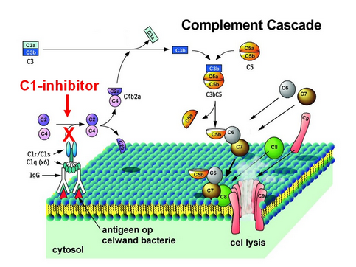

Slide 68


Slide 69



Slide 70

Role of Mediators in Different Reactions of Inflammation

