Slide 1
Diseases of the Immune System
Basic concepts of immunology

Slide 2
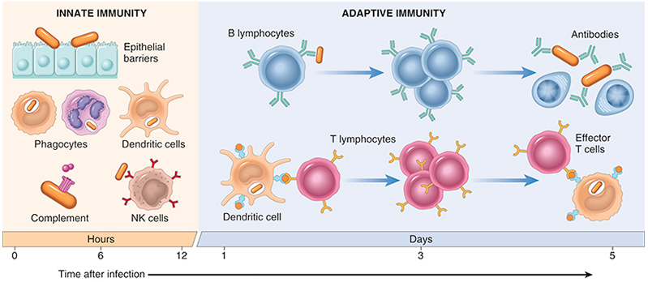
The principal components and kinetics of response of the innate and adaptive immune systems.

Slide 3
Toll-Like Receptors
The best known of the pattern recognition receptors are the Toll-like receptors (TLRs).
There are 10 TLRs in mammals that recognize a wide range of microbial molecules.
The plasma membrane TLRs recognize bacterial products such as lipopolysaccharide (LPS), and endosomal TLRs recognize viral and bacterial RNA and DNA.
Recognition of microbes by these receptors activates transcription factors that stimulate the production of several secreted and membrane proteins, including mediators of inflammation, anti-viral cytokines (interferons), and proteins that promote lymphocyte activation and the even more potent adaptive immune responses.

Slide 4
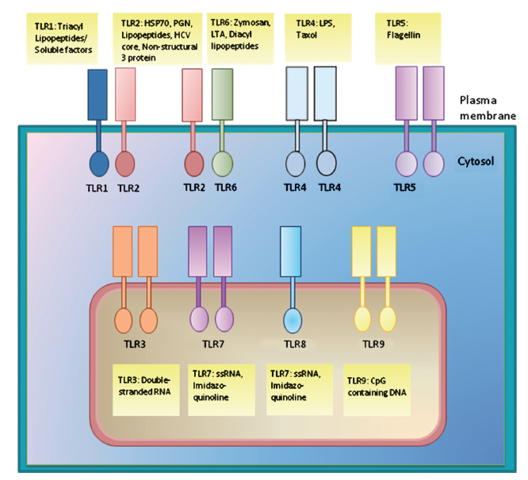

Slide 5
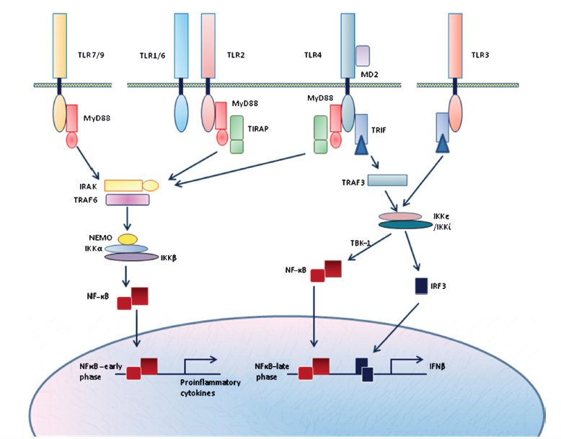

Slide 6
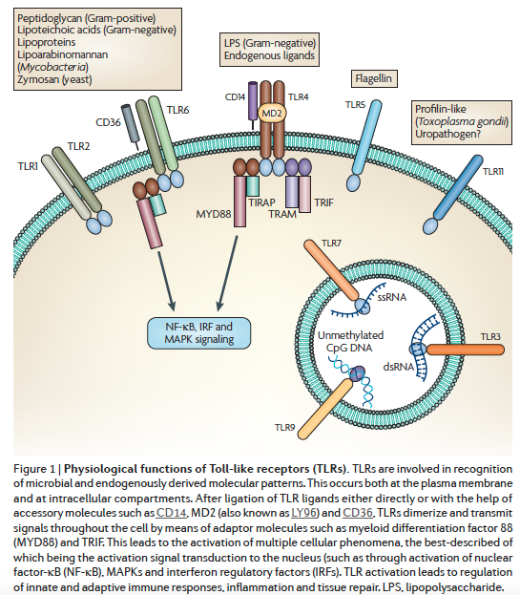

Slide 7
NOD-like receptors (NLRs) are cytosolic receptors named after the founding members NOD-1 and NOD-2.
They recognize a wide variety of substances, including products of necrotic cells (e.g., uric acid and released ATP), ion disturbances (e.g., loss of K+), and some microbial products. How this family of sensors detects so many diverse signs of danger or damage is not known.
Several of the NLRs signal via a cytosolic multiprotein complex called the inflammasome, which activates an enzyme (caspase-1) that cleaves a precursor form of the cytokine interleukin-1 (IL-1) to generate the biologically active form. IL-1 is a mediator of inflammation that recruits leukocytes and induces fever.

Slide 8
Gain-of-function mutations in one of the NLRs result in periodic fever syndromes, called autoinflammatory syndromes, which respond very well to treatment with IL-1 antagonists.
The NLR-inflammasome pathway also may play a role in a number of chronic disorders marked by inflammation. For example, recognition of urate crystals by a class of NLRs underlies the inflammation associated with gout.
These receptors may detect and respond to lipids and cholesterol crystals that are deposited in abnormally large amounts in tissues; the resulting inflammation may contribute to obesity-associated type 2 diabetes and atherosclerosis, respectively.

Slide 9
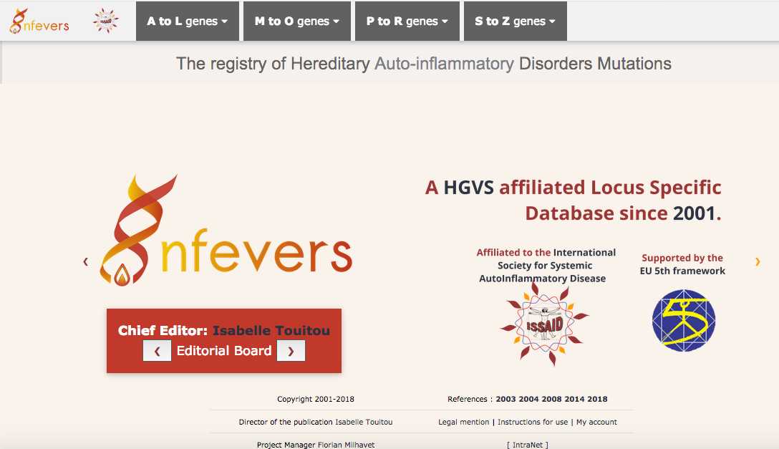
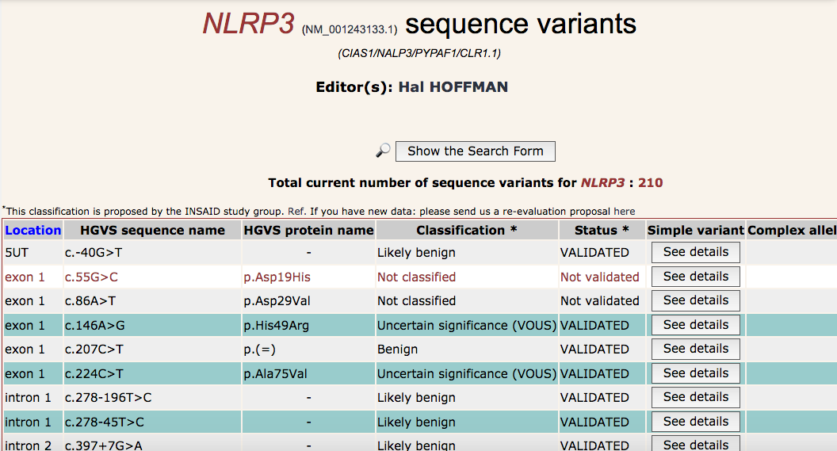

Slide 10
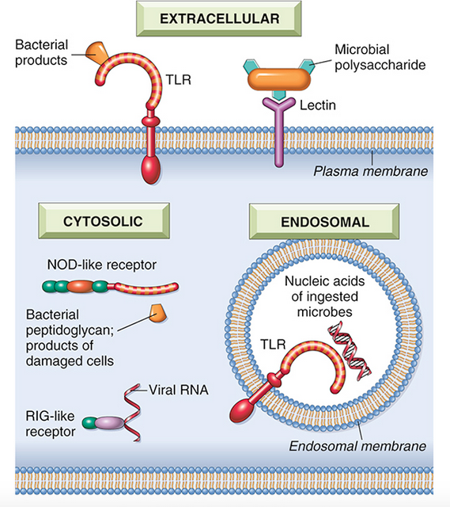
Cellular receptors for microbes and products of cell injury. Phagocytes, dendritic cells, and many types of epithelial cells express different classes of receptors that sense the presence of microbes and dead cells. Toll-like receptors (TLRs) located in different cellular compartments, as well as other cytoplasmic and plasma membrane receptors, recognize products of different classes of microbes. The major classes of innate immune receptors are TLRs, NOD-like receptors in the cytosol (NLRs), C-type lectin receptors, RIG-like receptors for viral RNA, named after the founding member RIG-I, and cytosolic DNA sensors.

Slide 11
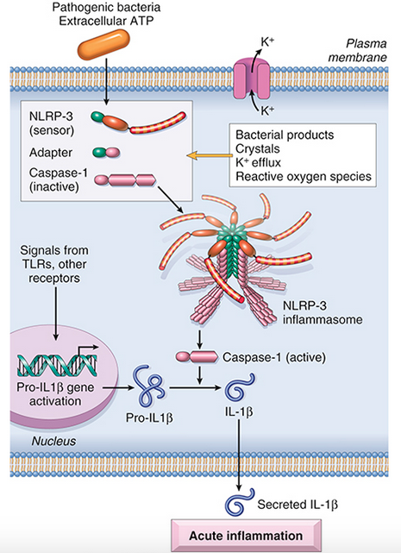
The inflammasome.
The inflammasome is a protein complex that recognizes products of dead cells and some microbes and induces the secretion of biologically active interleukin-1. It is a complex of multiple copies of a sensor protein (a leucine-rich protein called NLRP3), an adapter, and the enzyme caspase-1, which is converted from an inactive to an active form. The structure of the inflammasome as shown is simplified from known crystal structures. The formation of the inflammasome complex proceeds by a prion-like mechanism of propagation, in which one protein altered by activation induces conformational changes in other proteins of the same type. The net result is the activation and assembly of a large number of identical polypeptides, forming filament-like bundles of adapters and enzymes.

Slide 12


Slide 13
Reactions of Innate Immunity
The innate immune system provides host defense by the following two main reactions:
Inflammation. Cytokines and products of complement activation, as well as other mediators, are produced during innate immune reactions and trigger the vascular and cellular components of inflammation. The recruited leukocytes destroy pathogens and ingest and eliminate damaged cells.
Anti-viral defense. Type I interferons produced in response to viruses act on infected and uninfected cells and activate enzymes that degrade viral nucleic acids and inhibit viral replication.

Slide 14
Cells and Tissues of the Immune System
The cells of the immune system consist of lymphocytes, most of which have specific receptors for antigens and mount adaptive immune responses; specialized APCs, which capture and display microbial and other antigens to the lymphocytes; and various effector cells, whose function is to eliminate microbes and other antigens. Some of the remarkable features of the immune system are the expression of highly diverse and specific antigen receptors on B and T cells, the specialization of the cells that that enable them to perform many different functions, and the precise control mechanisms that permit useful responses when needed and prevent potentially harmful ones.

Slide 15
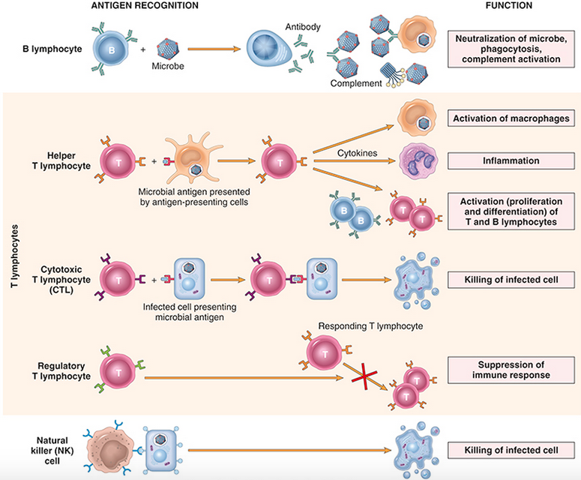
The principal classes of lymphocytes and their functions. B lymphocytes and T lymphocytes are cells of adaptive immunity, and natural killer (NK) cells are cells of innate immunity. Several more classes of lymphocytes have been identified, including NK-T cells and so-called “innate lymphoid cells” (ILCs); the functions of these cells are not established.

Slide 16
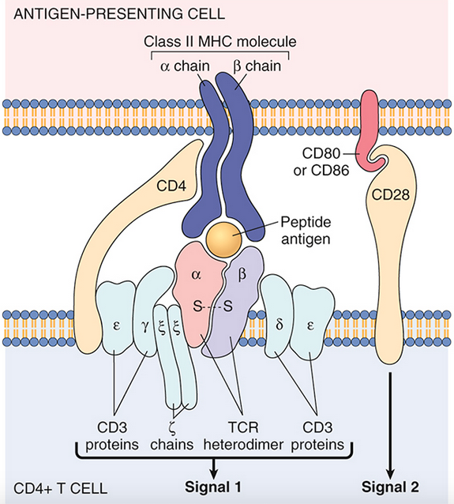
The T-cell receptor (TCR) complex and other molecules involved in T-cell activation. The TCR heterodimer, consisting of an α chain and a β chain, recognizes antigen (in the form of peptide-MHC complexes expressed on antigen-presenting cells), and the linked CD3 complex and ζ chains initiate activating signals. CD4 and CD28 are also involved in T-cell activation. (Note that some T cells express CD8 and not CD4; these molecules serve analogous roles.) The sizes of the molecules are not drawn to scale. MHC, Major histocompatibility complex.

Slide 17
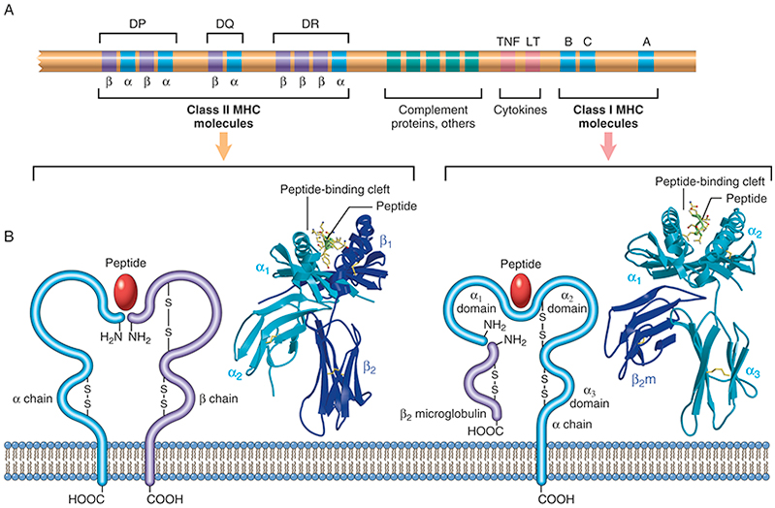
The human leukocyte antigen (HLA) complex and the structure of HLA molecules. (A) The location of genes in the HLA complex. The relative locations, sizes, and distances between genes are not to scale. Genes that encode several proteins involved in antigen processing (the TAP transporter, components of the proteasome, and HLA-DM) are located in the class II region (not shown). (B) Schematic diagrams and crystal structures of class I and class II HLA molecules.

Slide 18
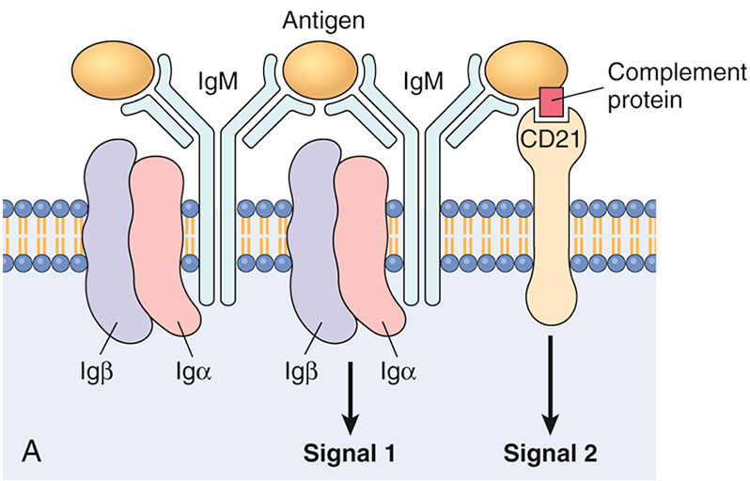
Structure of antibodies and the B-cell antigen receptor. (A) The B-cell antigen receptor complex is composed of membrane immunoglobulin M (IgM; or IgD, not shown), which recognizes antigens, and the associated signaling proteins Igα and Igβ. CD21 is a receptor for a complement component that also promotes B-cell activation.

Slide 19
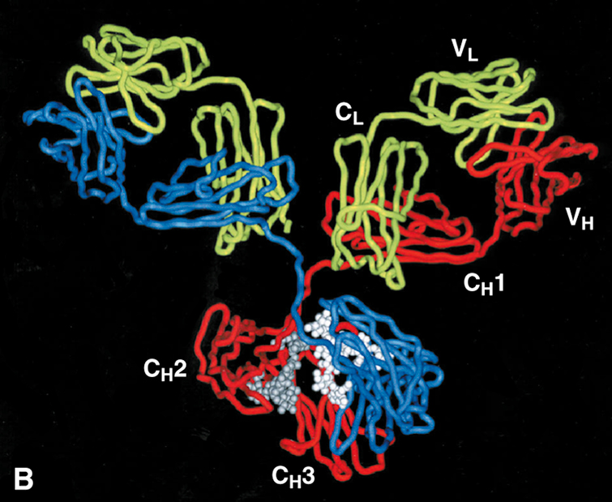
B) Crystal structure of a secreted IgG molecule, showing the arrangement of the variable (V) and constant (C) regions of the heavy (H) and light (L) chains.

Slide 20
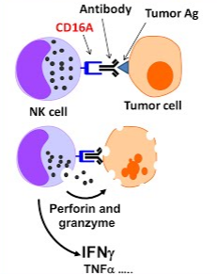
NK cells are lymphocytes that arise from the same common lymphoid progenitor that gives rise to T lymphocytes and B lymphocytes. However, NK cells are innate immune cells, as they are functional without prior activation and do not express highly variable and clonally distributed receptors for antigens. Instead, NK cells have two types of receptors—inhibitory and activating. Inhibitory receptors recognize self class I MHC molecules, which are expressed on all healthy cells, whereas activating receptors recognize molecules that are expressed or upregulated on stressed or infected cells. Normally, the effects of inhibitory receptors dominate over those of activating receptors, preventing spontaneous activation of the NK cells. Infections (especially viral infections) and stress are associated with reduced expression of class I MHC molecules and increased expression of proteins that engage activating receptors. The net result is that the NK cells are activated and the infected or stressed cells are killed and eliminated. NK cells also secrete cytokines such as interferon-γ (IFN-γ), which activates macrophages to destroy ingested microbes, and thus NK cells provide early defense against intracellular microbial infections.

Slide 21
Innate lymphoid cells (ILCs) are populations of lymphocytes that lack TCRs but produce cytokines similar to those that are made by T cells.
They are classified into three groups, which produce IFN-γ, IL-5, or IL-17, cytokines that are characteristic of TH1, TH2, and TH17 subsets of T cells.
NK cells are related to group 1 ILCs based on their production of IFN-γ, a cytokine also made by TH1 cells. Because ILCs mostly reside in tissues, they are thought to provide early defense against infections in the tissues, before T cells are activated and can migrate into tissues. ILCs also may be early participants in inflammatory diseases.

Slide 22
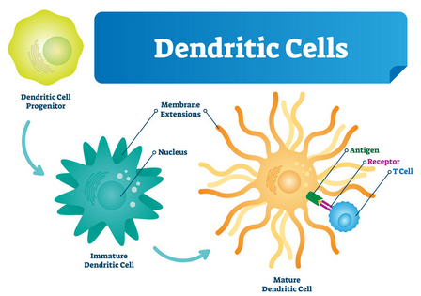
Dendritic Cells
Dendritic cells (DCs) are the most important antigen-presenting cells for initiating T-cell responses against protein antigens. These cells have numerous fine cytoplasmic processes that resemble dendrites, from which they derive their name. Several features of DCs account for their key role in antigen capture and presentation.
These cells are located at the right place to capture antigens—under epithelia, the common site of entry of microbes and foreign antigens, and in the interstitia of all tissues, where antigens may be produced. DCs within the epidermis are called Langerhans cells.
DCs express many receptors for capturing and responding to microbes (and other antigens), including TLRs and C-type lectin receptors.
In response to microbes, DCs are recruited to the T-cell zones of lymphoid organs, where they are ideally positioned to present antigens to T cells.
DCs express high levels of MHC and other molecules needed for antigen presentation and activation of T cells.

Slide 23
One subset of DCs is called plasmacytoid DCs because of their resemblance to plasma cells. These cells are present in the blood and lymphoid organs, and are major sources of the anti-viral cytokine type I interferon, produced in response to many viruses.
A second type of cell with dendritic morphology is present in the germinal centers of lymphoid follicles in the spleen and lymph nodes and is called the follicular dendritic cell (FDC). These cells bear Fc receptors for IgG and receptors for C3b and can trap antigen bound to antibodies or complement proteins. These cells display antigens to B lymphocytes in lymphoid follicles and promote antibody responses, but are not involved in capturing antigens for display to T cells.

Slide 24
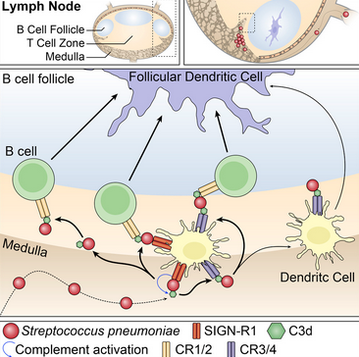
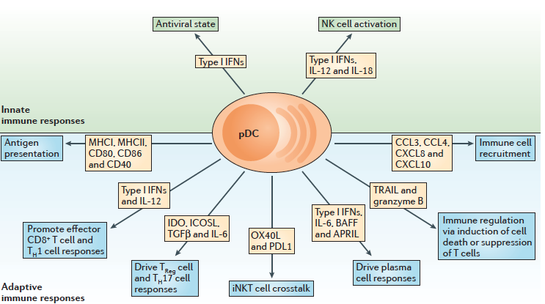

Slide 25
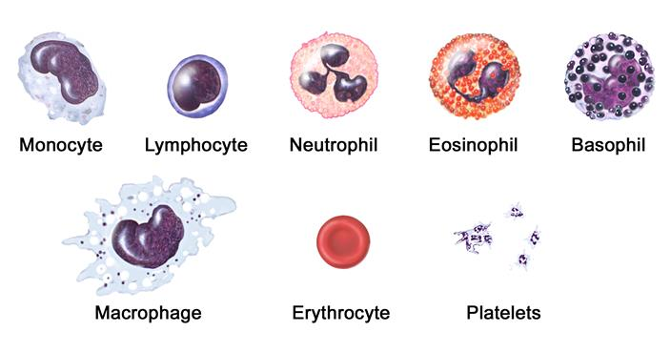
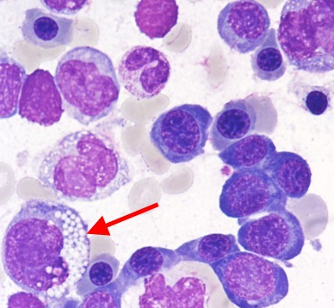
Macrophages ingest microbes and other particulate antigens and display peptides for recognition by T lymphocytes. These T cells in turn activate the macrophages to kill the microbes, the central reaction of cell-mediated immunity. B cells present peptides to helper T cells and receive signals that stimulate antibody responses to protein antigens, critical steps in humoral immune responses

Slide 26
Lymphoid Tissues
The tissues of the immune system consist of the generative (also called primary, or central) lymphoid organs, in which T lymphocytes and B lymphocytes mature and become competent to respond to antigens, and the peripheral (or secondary) lymphoid organs, in which adaptive immune responses to microbes are initiated. The principal generative lymphoid organs are the thymus, where T cells develop, and the bone marrow, the site of production of all blood cells and where B lymphocytes mature.

Slide 27
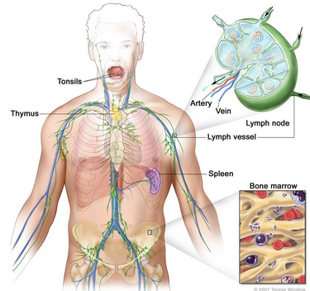
Lymph nodes are encapsulated, highly organized collections of lymphoid cells and innate immune cells that are located along lymphatic channels throughout the body. As lymph passes through lymph nodes, resident APCs are able to sample antigens that are carried to the node in lymph derived from the interstitial fluids of tissues.
In addition, DCs transport antigens from nearby epithelial surfaces and tissues by migrating through lymphatic vessels to the lymph nodes. Thus, antigens (e.g., of microbes that enter through epithelia or colonize tissues) become concentrated in draining lymph nodes.

Slide 28
The spleen has an important role in immune responses to bloodborne antigens. Blood entering the spleen flows through a network of sinusoids, which enables the trapping of bloodborne antigens by resident DCs and macrophages.
The cutaneous and mucosal lymphoid systems are located under the epithelia of the skin and the gastrointestinal and respiratory tracts, respectively. They respond to antigens that enter through breaches in the epithelium.
Pharyngeal tonsils and Peyer’s patches of the intestine are two anatomically defined mucosal lymphoid tissues. The large number of lymphocytes in mucosal organs (second only to lymph nodes) reflects the huge surface area of these organs.

Slide 29
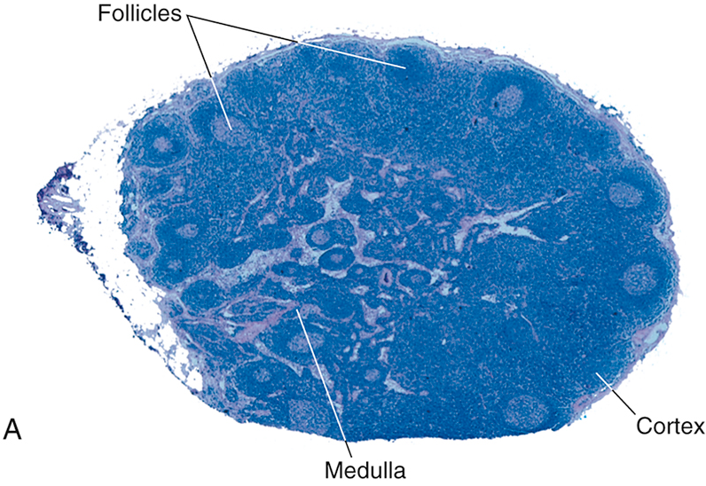
Morphology of a lymph node. (A) The histology of a lymph node, with an outer cortex containing follicles and an inner medulla.

Slide 30
Within the peripheral lymphoid organs, T lymphocytes and B lymphocytes are segregated into different regions.
In lymph nodes, the B cells are concentrated in discrete structures, called follicles, located around the periphery, or cortex, of each node. If the B cells in a follicle have recently responded to an antigen, the follicle develops a central pale-staining region called a germinal center. The T lymphocytes are concentrated in the parafollicular cortex. The follicles contain the FDCs that are involved in the activation of B cells, and the paracortex contains the DCs that present antigens to T lymphocytes. In the spleen, T lymphocytes are concentrated in periarteriolar lymphoid sheaths surrounding small arterioles, and B cells reside in the follicles.

Slide 31
Lymphocytes constantly travel between tissues and home to particular sites.
Naive lymphocytes circulate through peripheral lymphoid organs where antigens are concentrated and immune responses are initiated, and effector lymphocytes migrate to sites of infection.
The process of lymphocyte recirculation is most important for T cells, because naïve T cells have to “patrol” widely distributed peripheral lymphoid organs to find antigens, and effector T cells have to home to sites of infection to eliminate microbes. In contrast, plasma cells do not need to migrate to sites of infection because they secrete antibodies that are transported via the blood and lymph to distant tissues.

Slide 32
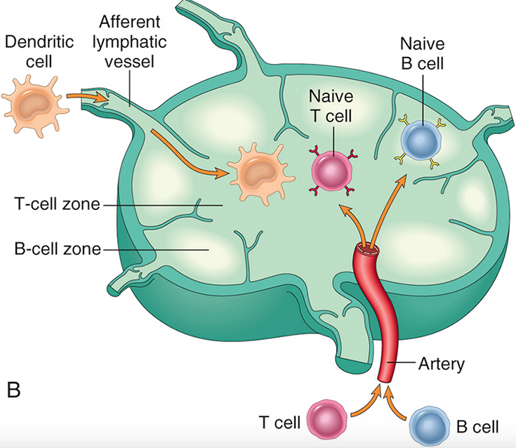
(B) The segregation of B cells and T cells in different regions of the lymph node, illustrated schematically.

Slide 33
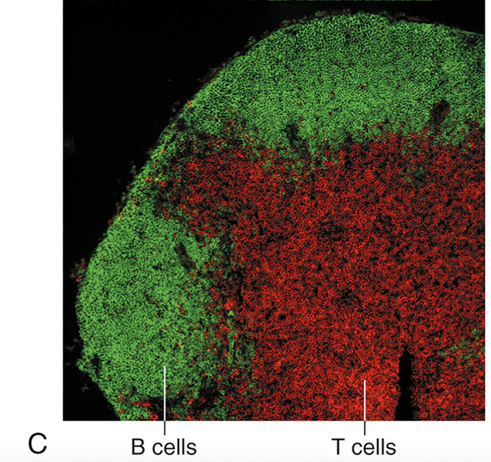
(C) The location of B cells (stained green, using the immunofluorescence technique) and T cells (stained red) in a lymph node.

Slide 34
Cytokines: Messenger Molecules of the Immune System
In innate immune responses, cytokines are produced rapidly after microbes and other stimuli are encountered, and function to induce inflammation and inhibit virus replication. These cytokines include TNF, IL-1, IL-12, type I IFNs, IFN-γ, and chemokines. Their major sources are macrophages, DCs, ILCs, and NK cells, but endothelial and epithelial cells also can produce them.
In adaptive immune responses, cytokines are produced principally by CD4+ T lymphocytes activated by antigen and other signals, and function to promote lymphocyte proliferation and differentiation and to activate effector cells. The main ones in this group are IL-2, IL-4, IL-5, IL-17, and IFN-γ; their roles in immune responses are described later. Some cytokines serve mainly to limit and terminate immune responses; these include TGF-β and IL-10.

Slide 35
Some cytokines stimulate hematopoiesis and are called colony-stimulating factors because they stimulate formation of blood cell colonies from bone marrow progenitors.
Their functions are to increase leukocyte numbers during immune and inflammatory responses, and to replace leukocytes that are consumed during such responses. They are produced by marrow stromal cells, T lymphocytes, macrophages, and other cells. Examples include GM-CSF and IL-7.

Slide 37
Cell-mediated immunity
Dendritic cells (DCs) capture microbial antigens from epithelia and tissues and transport the antigens to lymph nodes. During this process, the DCs mature, and express high levels of MHC molecules and costimulators.
Naïve T cells recognize MHC-associated peptide antigens displayed on DCs. The T cells are activated to proliferate and to differentiate into effector and memory cells, which migrate to sites of infection and serve various functions in cell-mediated immunity.
CD4+ effector T cells of the TH1 subset recognize the antigens of microbes ingested by phagocytes, and activate the phagocytes to kill the microbes; other subsets of effector cells enhance leukocyte recruitment and stimulate different types of immune responses.
CD8+ cytotoxic T lymphocytes (CTLs) kill infected cells harboring microbes in the cytoplasm. Some activated T cells remain in the lymphoid organs and help B cells to produce antibodies, and some T cells differentiate into long-lived memory cells. APC, Antigen-presenting cell.

Slide 38
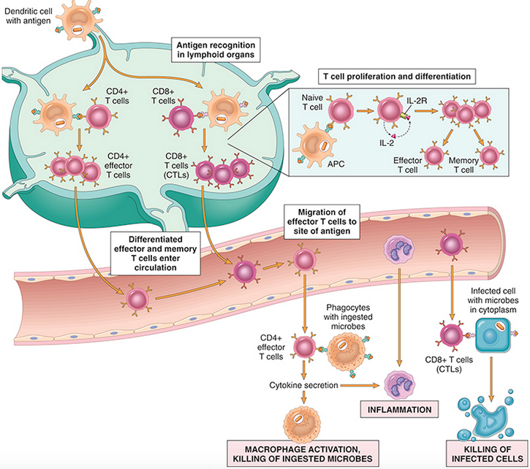

Slide 39
In the case of immunization with a protein antigen, as in a vaccine, a microbial mimic called an adjuvant that stimulates innate immune responses is given with the antigen.
During the innate response, the microbe or adjuvant activates APCs to express molecules called costimulators and to secrete cytokines that stimulate the proliferation and differentiation of T lymphocytes.
The principal costimulators for T cells are the B7 proteins (CD80 and CD86), which are expressed on APCs and are recognized by the CD28 receptor on naïve T cells. Antigen (“signal 1”) and costimulatory molecules produced during innate immune responses to microbes (“signal 2”) function cooperatively to activate antigen-specific lymphocytes. The requirement for microbe-triggered signal 2 ensures that the adaptive immune response is induced by microbes and not by harmless substances.
In immune responses to tumors and transplants, “signal 2” may be provided by substances released from necrotic cells (the damage-associated molecular patterns).

Slide 40
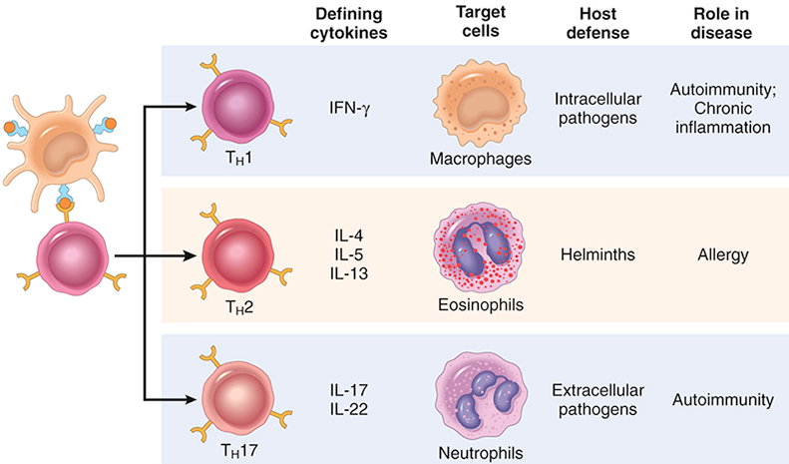
Subsets of helper T (TH) cells. In response to stimuli (mainly cytokines) present at the time of antigen recognition, naive CD4+ T cells may differentiate into populations of effector cells that produce distinct sets of cytokines that act on different cells (indicated as target cells) and mediate different functions. The roles of these subsets in host defense and immunologic diseases are summarized. These populations may be capable of converting from one to another. Some activated T cells produce multiple cytokines and do not fall into a distinct subset.

Slide 41
The responses of T cells are regulated by a balance between costimulatory and inhibitory receptors. The major costimulatory receptor is CD28, mentioned earlier as the molecule that recognizes B7 ligands on APCs and provides second signals that work together with antigen recognition. Other proteins of the CD28 family include two “coinhibitory” receptors, CTLA-4 and PD-1, which block signals from the TCR and from CD28 and thus terminate T cell responses. Blocking these coinhibitors has proved to be a powerful approach for enhancing anti-tumor immune responses.

Slide 42
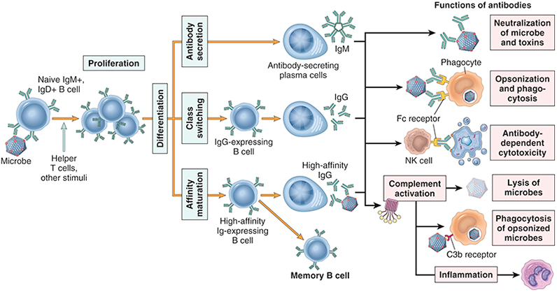
Humoral immunity. Naive B lymphocytes recognize antigens, and under the influence of Th cells and other stimuli (not shown), the B cells are activated to proliferate and to differentiate into antibody-secreting plasma cells. Some of the activated B cells undergo heavy-chain class switching and affinity maturation, and some become long-lived memory cells. Antibodies of different heavy-chain classes (isotypes) perform different effector functions, shown on the right. Note that the antibodies shown are IgG; these and IgM activate complement; and the specialized functions of IgA (mucosal immunity) and IgE (mast cell and eosinophil activation)

Slide 43
The humoral immune response combats microbes in numerous ways
Antibodies bind to microbes and prevent them from infecting cells, thereby neutralizing the microbes.
IgG antibodies coat (opsonize) microbes and target them for phagocytosis, since phagocytes (neutrophils and macrophages) express receptors for the Fc tails of IgG molecules.
IgG and IgM activate the complement system by the classical pathway, and complement products promote phagocytosis and destruction of microbes.
IgA is secreted in mucosal tissues and neutralizes microbes in the lumens of the respiratory and gastrointestinal tracts (and other mucosal tissues).
IgG is actively transported across the placenta and protects the newborn until the immune system becomes mature. This is a form of passive immunity.
IgE coats helminthic parasites and functions with mast cells and eosinophils to kill them.

