Slide 1
Transplants and Immunodeficiencies

Slide 2
Rejection of Transplants
A major barrier to transplantation is the process of rejection, in which the recipient’s immune system recognizes the graft as foreign and attacks it. The key to successful transplantation has been the development of therapies that prevent or minimize rejection. Transplant rejection is discussed because it involves several of the immunologic reactions that underlie immune-mediated inflammatory diseases.
Recognition and Rejection of Allografts
Rejection is a process in which T lymphocytes and antibodies produced against graft antigens react against and destroy the grafts.

Slide 3
The major antigenic differences between a donor and recipient that result in rejection of transplants are differences in HLA alleles.
Grafts exchanged between individuals of the same species are called allografts. Because HLA genes are highly polymorphic, there are always some differences between individuals (except, of course, identical twins). Following transplantation, the recipient’s T cells recognize donor antigens from the graft (the allogeneic antigens, or alloantigens) by two pathways. The graft antigens are either presented directly to recipient T cells by graft APCs, or the graft antigens are picked up by host APCs, processed (like any other foreign antigen), and presented to host T cells.
These are called the direct and indirect pathways of recognition of alloantigens. Both lead to the activation of CD8+ T cells, which develop into CTLs, and CD4+ T cells, which become cytokine-producing effector cells, mainly TH1 cells.
The direct pathway may be most important for CTL-mediated acute rejection, and the indirect pathway may play a greater role in chronic rejection.
The frequency of T cells that can recognize the foreign antigens in a graft is much higher than the frequency of T cells specific for any microbe. For this reason, immune responses to allografts are stronger than responses to pathogens. Predictably, these strong reactions can destroy grafts rapidly, and their control requires powerful immunosuppressive agents.

Slide 4
Graft rejection is classified into hyperacute, acute, and chronic, on the basis of clinical and pathologic features.
This classification was devised by nephrologists and pathologists based on rejection of kidney allografts, and has stood the test of time remarkably well. Each type of rejection is mediated by a particular kind of immune response.
Hyperacute rejection is mediated by preformed antibodies specific for antigens on graft endothelial cells. The preformed antibodies may be natural IgM antibodies specific for blood group antigens, or may be antibodies specific for allogeneic MHC molecules that were induced by prior exposure through blood transfusions, pregnancy, or organ transplantation. Immediately after the graft is implanted and blood flow is restored, the antibodies bind to antigens on the graft endothelium and activate the complement and clotting systems, leading to endothelial injury, thrombus formation, and ischemic necrosis of the graft. Hyperacute rejection is not a common problem, because every donor and recipient are matched for blood type and potential recipients are tested for antibodies against the cells of the prospective donor, a test called a cross-match.

Slide 5
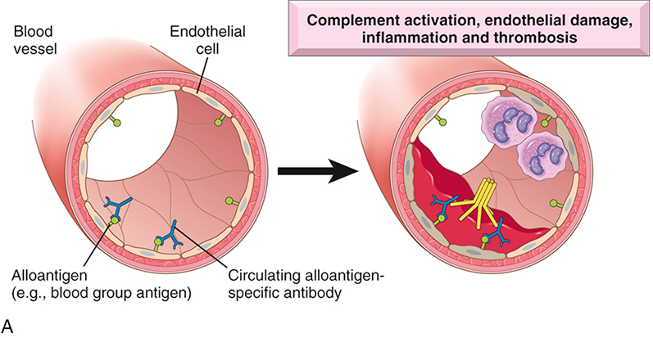
Hyperacute rejection. (A) Deposition of antibody on endothelium and activation of complement causes thrombosis.

Slide 6
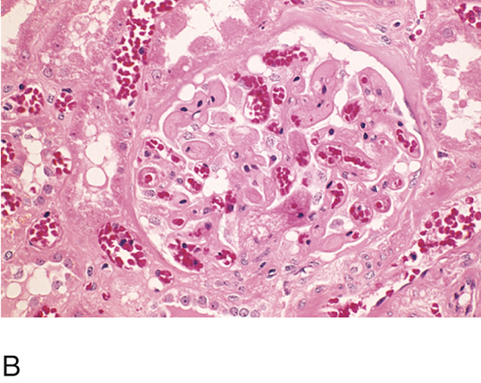
(B) Hyperacute rejection of a kidney allograft showing platelet fibrin thrombi and severe ischemic injury in a glomerulus.

Slide 7
Acute rejection is mediated by T cells and antibodies that are activated by alloantigens in the graft. It occurs within days or weeks after transplantation, and is the principal cause of early graft failure. It also may appear suddenly months or even years later, after immunosuppression is tapered or terminated. Based on the role of T cells or antibodies, acute rejection is divided into two types, although in most rejecting grafts, both patterns are present.
In acute cellular rejection, CD8+ CTLs may directly destroy graft cells, or CD4+ cells secrete cytokines and induce inflammation, which damages the graft. T cells also may react against graft vessels, leading to vascular damage. Current immunosuppressive therapy is designed mainly to prevent and reduce acute rejection by blocking the activation of alloreactive T cells.

Slide 8
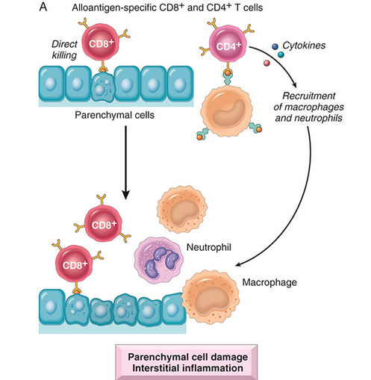
Acute cellular rejection. (A) Destruction of graft cells by T cells. Acute T cell–mediated rejection involves direct killing of graft cells by CD8+ CTLs and inflammation caused by cytokines produced by CD4 T cells.

Slide 9
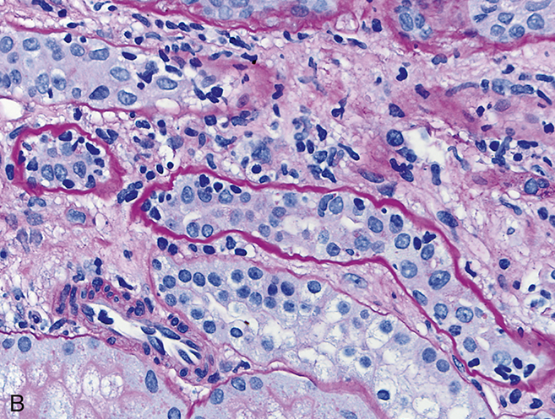
(B) Acute cellular rejection of a kidney graft, manifested by inflammatory cells in the interstitium and between epithelial cells of the tubules (tubulitis). Collapsed tubules are outlined by wavy basement membranes.

Slide 10
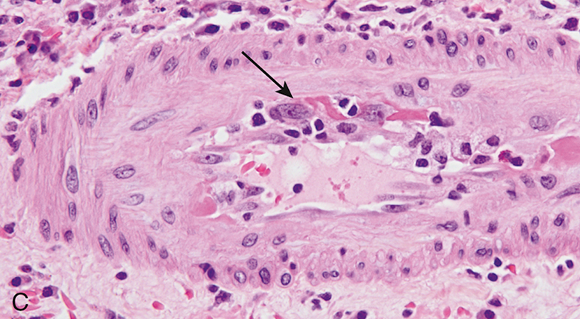
(C) Rejection vasculitis in a kidney graft. An arteriole is shown with inflammatory cells attacking and undermining the endothelium (endotheliitis) (arrow).

Slide 11
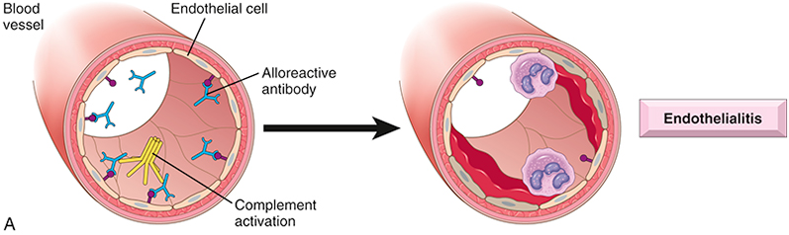
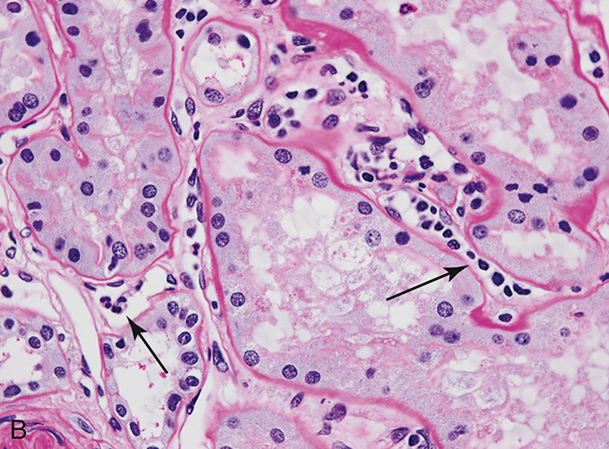
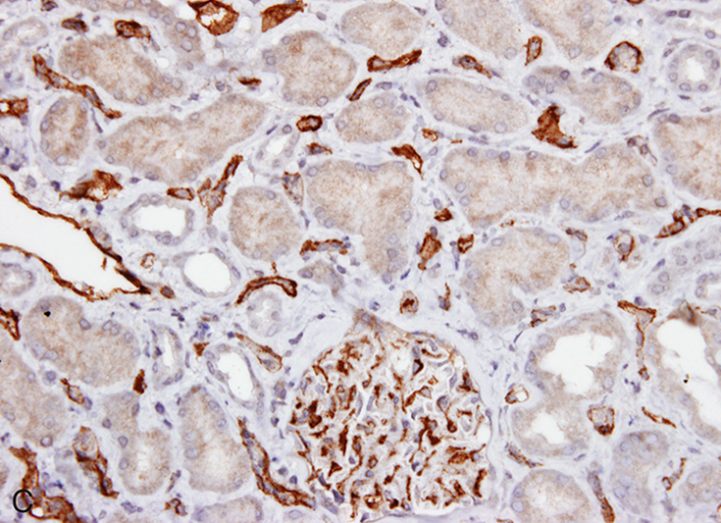
Acute antibody-mediated (humoral) rejection. (A) Graft damage caused by antibody deposition in vessels. (B) Light micrograph showing inflammation (capillaritis) in peritubular capillaries (arrows) in a kidney graft. (C) Immunoperoxidase stain shows C4d deposition in peritubular capillaries and a glomerulus.

Slide 12
Chronic rejection is an indolent form of graft damage that occurs over months or years, leading to progressive loss of graft function. Chronic rejection manifests as interstitial fibrosis and gradual narrowing of graft blood vessels (graft arteriosclerosis). In both lesions, the culprits are believed to be T cells that react against graft alloantigens and secrete cytokines, which stimulate the proliferation and activities of fibroblasts and vascular smooth muscle cells in the graft. Alloantibodies also contribute to chronic rejection. Although treatments to prevent or curtail acute rejection have steadily improved, leading to longer than 1-year survival of transplants, chronic rejection is refractory to most therapies and is becoming the principal cause of graft failure.

Slide 13
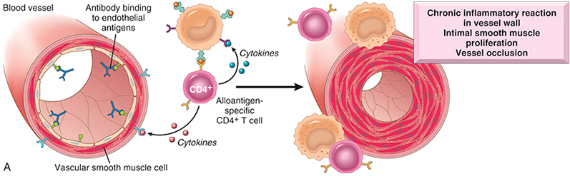
Chronic rejection. (A) Graft arteriosclerosis caused by T-cell cytokines and antibody deposition.

Slide 14
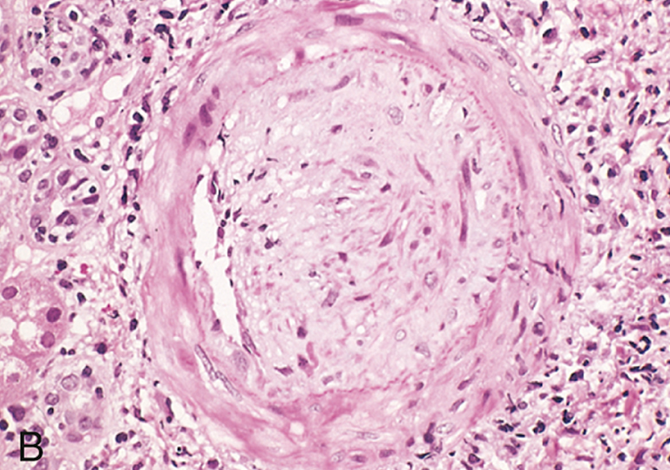
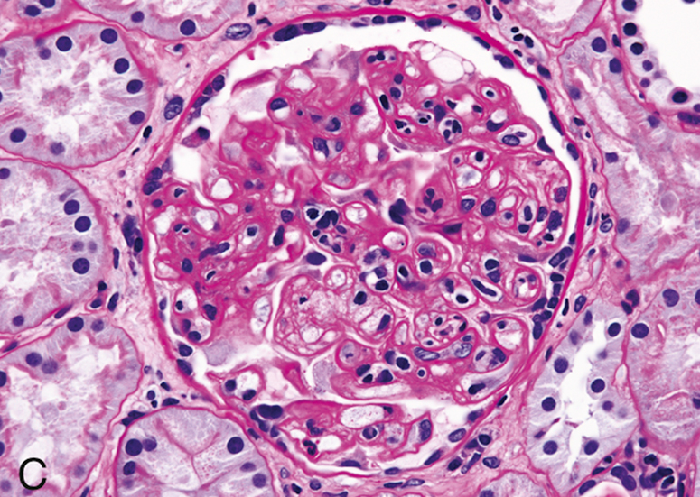
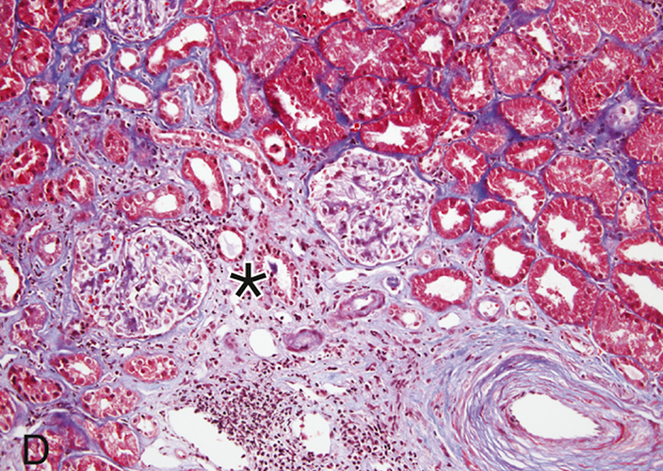
(B) Graft arteriosclerosis in a cardiac transplant. (C) Transplant glomerulopathy, the characteristic manifestation of chronic antibody-mediated rejection in the kidney. The glomerulus shows inflammatory cells within the capillary loops (glomerulitis), accumulation of mesangial matrix, and duplication of the capillary basement membrane. (D) Interstitial fibrosis and tubular atrophy, resulting from arteriosclerosis of arteries and arterioles in a chronically rejecting kidney allograft. In this trichrome stain, the blue area (asterisk) shows fibrosis, contrasted with the normal kidney (top right).

Slide 15
Immunosuppression of the recipient is a necessity in all organ transplantation, except in the case of identical twins.
At present, drugs such as cyclosporine, the related FK506, mofetil mycophenolate (MMF), rapamycin, azathioprine, corticosteroids, anti-thymocyte globulin, and monoclonal antibodies (e.g., monoclonal anti-CD3) are used.
Cyclosporine and FK506 suppress T cell–mediated immunity by inhibiting transcription of cytokine genes, in particular, the gene for IL-2.
Suppression of the immune system results in increased susceptibility to opportunistic fungal, viral, and other infections. Reactivation of latent viruses, such as cytomegalovirus (CMV) and polyoma virus, are frequent complications. Immunosuppressed patients also are at increased risk for developing virus-induced tumors, such as Epstein-Barr virus (EBV)–induced lymphomas and human papillomavirus (HPV)–induced squamous cell carcinomas.
To circumvent the untoward effects of immunosuppression, much effort is being devoted to induce donor-specific tolerance in host T cells. One strategy is to prevent host T cells from receiving costimulatory signals from donor DCs during the initial phase of sensitization. This can be accomplished by administration of agents that block the interaction of the B7 molecules on the DCs of the graft and the CD28 receptor on host T cells, which, by interrupting the second signal for T cell activation, induces either T cell apoptosis or anergy.

Slide 16
Transplantation of Hematopoietic Stem Cells
Use of hematopoietic stem cell (HSC) transplants for hematologic malignancies, bone marrow failure syndromes (such as aplastic anemia), and disorders caused by inherited HSC defects (such as sickle cell anemia, thalassemia, and immunodeficiency states) is increasing in number each year.
Transplantation of genetically “reengineered” hematopoietic stem cells obtained from affected patients may be useful in treating inherited forms of immunodeficiency. Historically, HSCs were obtained from the bone marrow, but now they usually are harvested from peripheral blood after they are mobilized from the bone marrow by administration of hematopoietic growth factors, or from the umbilical cord blood of newborn infants, a rich source of HSCs.
In most of the conditions in which HSC transplantation is indicated, the recipient is irradiated or treated with chemotherapy to destroy the immune system (and sometimes, cancer cells) and to “open up” niches in the microenvironment of the marrow that nurture HSCs, thus allowing the transplanted HSCs to engraft. Two major problems complicate this form of transplantation and distinguish it from solid organ transplants: graft-versus-host disease and immune deficiency.

Slide 17
GVHD occurs when immunologically competent cells or their precursors are transplanted into immunologically crippled recipients, and the transferred cells recognize alloantigens in the host and attack host tissues.
It is seen most commonly in the setting of HSC transplantation but, rarely, may occur following transplantation of solid organs rich in lymphoid cells (e.g., the liver). On receiving allogeneic HSCs, an immunologically compromised host cannot reject the graft, but T cells present in the donor graft perceive the host’s tissue as foreign and react against it. This results in the activation of donor CD4+ and CD8+ T cells, ultimately causing inflammation and killing recipient cells. To try to minimize GVHD, HSC transplants are done between donor and recipient that are carefully HLA-matched using precise DNA sequencing–based methods.
Acute GVHD (occurring days to weeks after transplantation) causes epithelial cell necrosis in three principal target organs: liver, skin, and gut. Destruction of small bile ducts gives rise to jaundice, and mucosal ulceration of the gut results in bloody diarrhea. Cutaneous involvement manifests as a rash, which characteristically appears first on the neck, ears, and palms of the hands and soles of the feet and then becomes generalized.
Chronic GVHD may follow the acute syndrome or may occur insidiously. Patients develop skin lesions resembling those of systemic sclerosis and manifestations mimicking other autoimmune disorders.

Slide 18
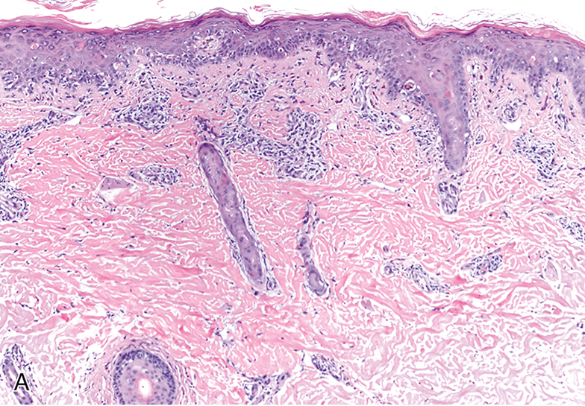
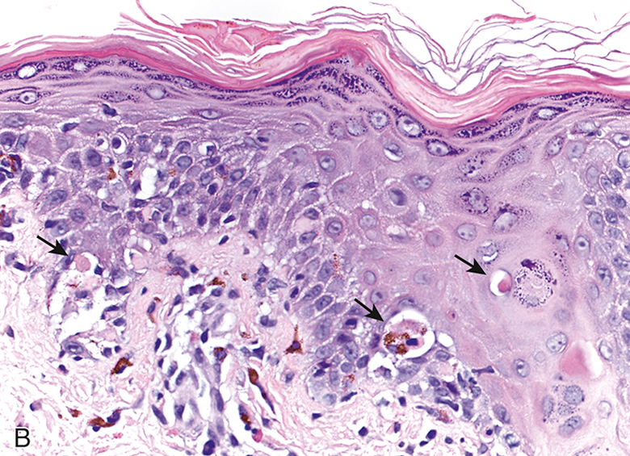
Acute graft-versus-host disease (GVHD) involving the skin. (A) Patchy epithelial cell death and dermal infiltrates of mononuclear cells (lymphocytes and macrophages). (B) Focally dead epithelial cells (arrows).

Slide 19
Primary (Inherited) Immunodeficiencies
Primary immunodeficiency diseases are inherited genetic disorders that impair mechanisms of innate immunity (phagocytes, NK cells, or complement) or the humoral and/or cellular arms of adaptive immunity (mediated by B lymphocytes and T lymphocytes, respectively).
These immunodeficiencies are usually detected in infancy, between 6 months and 2 years of age, the telltale signs being susceptibility to recurrent infections.
With advances in genetic analyses, the mutations responsible for many of these diseases are now known.

Slide 20
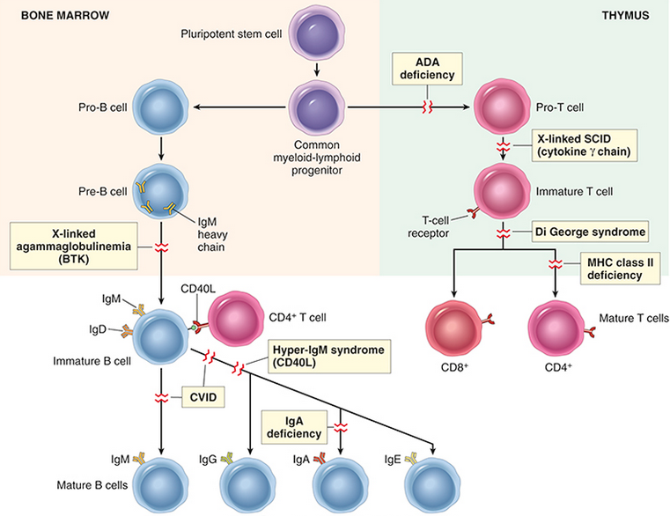
Primary immune deficiency diseases. Principal pathways of lymphocyte development and the blocks in these pathways in selected primary immune deficiency diseases. The affected genes are indicated in parentheses for some of the disorders. ADA, Adenosine deaminase; CD40L, CD40 ligand (also known as CD154); CVID, common variable immunodeficiency; SCID, severe combined immunodeficiency.

Slide 21
Severe combined immunodeficiency (SCID) spans a constellation of genetically distinct syndromes, all having in common impaired development of mature T lymphocytes and/or B lymphocytes and defects in both humoral and cell-mediated immunity.
Affected infants present with thrush (oral candidiasis), severe diaper rash, and failure to thrive. Some infants develop a generalized rash shortly after birth because maternal T cells are transferred across the placenta and attack the fetus, causing GVHD.
Children with SCID are extremely susceptible to recurrent, severe infections by a wide range of pathogens, including Candida albicans, Pneumocystis jiroveci, Pseudomonas, cytomegalovirus, varicella, and a whole host of bacteria. Without HSC transplantation, death occurs within the first year of life. The overall prevalence of the disease is approximately 1 in 65,000 to 1 in 100,000, but it is 20 to 30 times more frequent in some Native American populations.
Despite the common clinical manifestations, of different forms of SCID the underlying defects are quite varied. Often, the defect resides in the T-cell compartment, with a secondary impairment of humoral immunity. Two major forms are described.

Slide 22
X-linked SCID. Approximately half of the cases of SCID are X-linked; these are caused by mutations in the gene encoding the common γ (γc) chain shared by the receptors for the cytokines IL-2, IL-4, IL-7, IL-9, and IL-15. Of these cytokines, defective IL-7 signaling is the most important underlying basis of SCID because this cytokine is responsible for stimulating the survival and expansion of immature B and T cell precursors in the generative lymphoid organs.
Autosomal recessive SCID. Another 40% to 50% of SCID cases follow autosomal recessive pattern of inheritance, with approximately half of these caused by mutations in adenosine deaminase (ADA), an enzyme involved in purine metabolism. ADA deficiency results in accumulation of adenosine and deoxyadenosine triphosphate metabolites, which inhibit DNA synthesis and are toxic to lymphocytes. Other autosomal recessive forms of SCID result variously from defects in another purine metabolic pathway, primary failure of class II MHC expression, or mutations in genes encoding the recombinase responsible for the rearrangement of lymphocyte antigen-receptor genes.

Slide 23
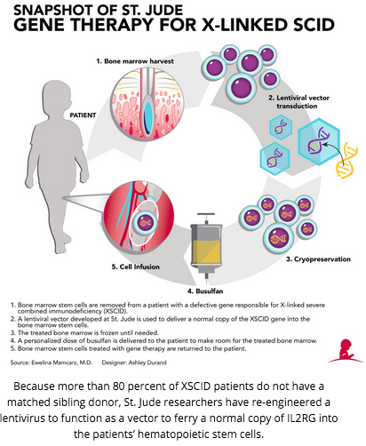
Currently, HSC transplantation is the mainstay of treatment.
X-linked SCID is the first disease in which gene therapy has been successful. For gene therapy, a normal γc gene is expressed using a viral vector in HSCs taken from patients, and the cells are then transplanted back into the patients. The clinical experience is small, but some patients have shown reconstitution of their immune systems for several years after therapy. Unfortunately, however, about 20% of patients receiving a first-generation viral vector developed T cell acute lymphoblastic leukemia (T-ALL), highlighting the dangers of this particular approach to gene therapy.

Slide 24
X-Linked Agammaglobulinemia
X-linked agammaglobulinemia (XLA), or Bruton disease, is characterized by the failure of pre–B cells to differentiate into mature B cells and, as the name implies, a resultant absence of antibodies (gamma globulin) in the blood.
It is one of the more common forms of primary immunodeficiency, occurring at a frequency of about 1 in 100,000 male infants. During normal B-cell maturation, immunoglobulin (Ig) heavy chain genes are rearranged first, followed by light chain genes. At each stage, signals are received from the expressed components of the antigen receptor that drive maturation to the next stage; these signals act as quality controls, to ensure that the correct receptor proteins are being produced.
In XLA, B-cell maturation stops after the initial heavy chain gene rearrangement because of mutations in a tyrosine kinase that is associated with the pre–B-cell receptor and is involved in pre-B-cell signal transduction. This kinase is called Bruton tyrosine kinase (BTK). When BTK is nonfunctional, the pre–B-cell receptor cannot signal the cells to proceed along the maturation pathway. As a result, Ig light chains are not produced, and the complete Ig molecule containing heavy and light chains cannot be assembled and transported to the cell membrane, although free heavy chains can be found in the cytoplasm. Because the BTK gene is on the X chromosome, the disorder is only seen in males. Sporadic cases with the same features have been described in females, possibly due to mutations in other genes that function in the same pathway.

Slide 25
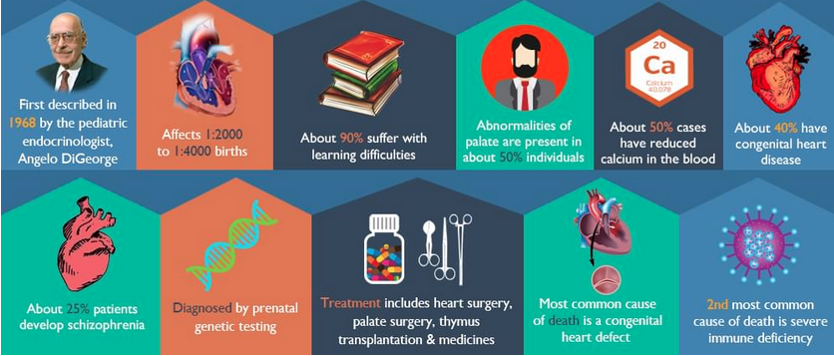
DiGeorge syndrome is caused by a congenital defect in thymic development resulting in deficient T-cell maturation. T cells are absent in the lymph nodes, spleen, and peripheral blood, and infants with this defect are extremely vulnerable to viral, fungal, and protozoal infections. Patients also are susceptible to infection with intracellular bacteria, because of defective T cell–mediated immunity. B cells and serum immunoglobulins are generally unaffected.
The disorder is a consequence of a developmental malformation affecting the third and fourth pharyngeal pouches, structures that give rise to the thymus, parathyroid glands, and portions of the face and aortic arch. Thus, in addition to the thymic and T-cell defects, there may be parathyroid gland hypoplasia, resulting in hypocalcemic tetany, as well as additional midline developmental abnormalities. In 90% of cases of DiGeorge syndrome, there is a deletion affecting chromosomal region 22q11. Transplantation of thymic tissue has successfully treated some affected infants. In patients with partial defects, immunity may improve spontaneously with age.

Slide 26
Hyper-IgM Syndrome. This disease is characterized by the production of normal (or even supranormal) levels of IgM antibodies and decreased levels of the IgG, IgA, and IgE isotypes; the underlying defect is an inability of T cells to activate B cells
Many of the functions of CD4+ helper T cells require the engagement of CD40 on B cells, macrophages, and dendritic cells by CD40L (also called CD154) expressed on antigen-activated T cells. This interaction triggers Ig class switching and affinity maturation in the B cells, and stimulates the microbicidal functions of macrophages. Approximately 70% of individuals with hyper-IgM syndrome have the X-linked form of the disease, caused by mutations in the gene encoding CD40L located on Xq26. In the remaining patients, the disease is inherited in an autosomal recessive pattern caused by loss-of-function mutations involving either CD40 or an enzyme called activation-induced cytidine deaminase (AID), a DNA-editing enzyme that is required for Ig class switching and affinity maturation.
Patients present with recurrent pyogenic infections because of low levels of opsonizing IgG antibodies. Those with CD40L mutations also are susceptible to pneumonia caused by the intracellular organism Pneumocystis jiroveci, because CD40L-mediated macrophage activation, a key reaction of cell-mediated immunity, is compromised. Occasionally, the IgM antibodies react with blood cells, giving rise to autoimmune hemolytic anemia, thrombocytopenia, and neutropenia. In older patients, there may be a proliferation of IgM-producing plasma cells that infiltrate the mucosa of the gastrointestinal tract.

Slide 27
Common Variable Immunodeficiency
This relatively frequent but poorly defined entity encompasses a heterogeneous group of disorders in which the common feature is hypogammaglobulinemia, generally affecting all the antibody classes but sometimes only IgG. The diagnosis of common variable immunodeficiency is based on exclusion of other well-defined causes of decreased antibody production. The estimated prevalence is about 1 in 50,000.
Although most patients have normal numbers of mature B cells, plasma cells are absent, suggesting a block in B-cell differentiation. In keeping with this idea, B cell areas of the lymphoid tissues (i.e., lymphoid follicles in nodes, spleen, and gut) tend to be hyperplastic. The enlargement of B cell areas may reflect incomplete activation, such that B cells can proliferate in response to antigen but do not differentiate into antibody-producing plasma cells.
The defective antibody production has been variably attributed to intrinsic B-cell defects, deficient T-cell help, or excessive T-cell suppressive activity. Paradoxically, these patients are prone to develop a variety of autoimmune disorders (hemolytic anemia, pernicious anemia) as well as lymphoid tumors. Common variable immunodeficiency may be genetic or acquired. Different genetic causes have been discovered, including mutations in a receptor for BAFF, a cytokine that promotes the survival and differentiation of B cells, and in a molecule called ICOS (inducible costimulator), a homologue of CD28 that contributes to the function of T follicular helper cells.

Slide 28
Isolated IgA Deficiency
This is the most common primary immune deficiency disease, affecting about 1 in 700 whites. As noted previously, IgA is the major immunoglobulin in mucosal secretions and is thus involved in defending the airways and the gastrointestinal tract. Weakened mucosal defenses due to IgA deficiency predispose patients to recurrent sinopulmonary infections and diarrhea. There also is a significant (but unexplained) association with autoimmune diseases. The pathogenesis of IgA deficiency seems to involve a block in the terminal differentiation of IgA-secreting B cells to plasma cells; IgM and IgG subclasses of antibodies are present in normal or even supranormal levels. The molecular basis for this defect is not understood.
Other Defects in Lymphocyte Activation
Many rare cases of lymphocyte activation defects have been described that affect antigen receptor signaling and various biochemical pathways. Defects in TH1 responses are associated with atypical mycobacterial infections, and defective TH17 responses are the cause of chronic mucocutaneous candidiasis as well as bacterial infections of the skin (a disorder called Job syndrome).

Slide 29
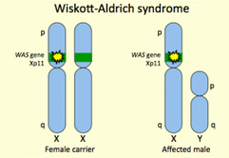
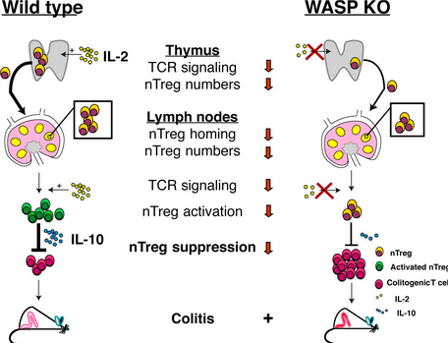
Immunodeficiencies Associated with Systemic Diseases
Wiskott-Aldrich syndrome is an X-linked disease characterized by thrombocytopenia, eczema, and a marked vulnerability to recurrent infection that results in early death. The thymus is normal, at least early in the disease course, but there is progressive loss of T lymphocytes from the blood and the T cell zones (paracortical areas) of lymph nodes, with variable defects in cellular immunity. Patients do not make antibodies to polysaccharide antigens, and the response to protein antigens is poor. IgM levels in the serum are low, but levels of IgG are usually normal and, paradoxically, IgA and IgE are often elevated. The syndrome is caused by mutations in an X-linked gene encoding Wiskott-Aldrich syndrome protein (WASP). WASP belongs to a family of signaling proteins that link membrane receptors, such as antigen receptors, to cytoskeletal elements. The WASP protein is involved in cytoskeleton-dependent responses, including cell migration and signal transduction, but how this contributes to the functions of lymphocytes and platelets is unclear. The only treatment is HSC transplantation

Slide 30
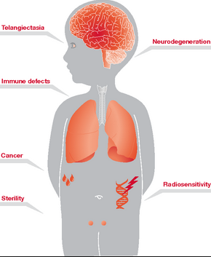
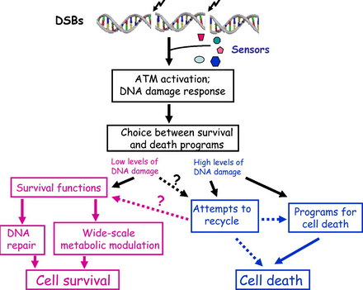
Ataxia telangiectasia is an autosomal-recessive disorder characterized by abnormal gait (ataxia), vascular malformations (telangiectases), neurologic deficits, increased incidence of tumors, and immunodeficiency. The immunologic defects are of variable severity and may affect both B cells and T cells. The most prominent humoral immune abnormalities are defective production of isotype-switched antibodies, mainly IgA and IgG2. The T-cell defects are usually less pronounced, and may be associated with thymic hypoplasia. Patients experience upper and lower respiratory tract bacterial infections, multiple autoimmune phenomena, and increasingly frequent cancers, particularly lymphoid tumors, with advancing age. The gene responsible for this disorder encodes a protein called ATM (ataxia telangiectasia mutated), a sensor of DNA damage that activates cell cycle checkpoints and apoptosis in cells with damaged DNA. Lack of ATM also leads to abnormalities in antigen gene recombination (and therefore defects in the generation of antigen receptors) and abnormal antibody isotype switching.

Slide 31
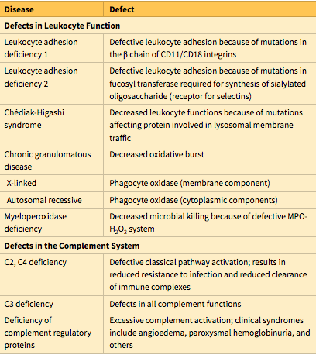
Common Inherited Immune Deficiencies of Phagocytic Leukocytes and the Complement System
Leukocyte adhesion deficiencies (LADs) stem from inherited defects in adhesion molecules that impair leukocyte recruitment to sites of infection, resulting in recurrent bacterial infections. LAD1 is caused by defects in the β2 chain that is shared by the integrins LFA-1 and Mac-1, while LAD2 is caused by a defect in a fucosyl transferase that is required to synthesize functional sialyl-Lewis X, the ligand for E- and P-selectins.

Slide 32
Chronic granulomatous disease results from inherited defects in the genes encoding components of phagocyte oxidase, the phagolysosomal enzyme that generates ROS such as superoxide, resulting in defective bacterial killing and susceptibility to recurrent bacterial infection. The name of this disease comes from the macrophage-rich chronic inflammatory reaction that appears at sites of infection if the initial neutrophil defense is inadequate. These collections of activated macrophages form granulomas in an effort to wall off the microbes.
Chédiak-Higashi syndrome is characterized by defective fusion of phagosomes and lysosomes, resulting in defective phagocyte function and susceptibility to infections. The main leukocyte abnormalities are neutropenia, defective degranulation, and delayed microbial killing. The affected leukocytes contain giant granules, which are readily seen in peripheral blood smears and are thought to result from aberrant phagolysosome fusion. In addition, there are abnormalities in melanocytes (leading to albinism), cells of the nervous system (associated with nerve defects), and platelets (causing bleeding disorders). The gene associated with this disorder encodes a large cytosolic protein called LYST, which is believed to regulate lysosomal trafficking.
TLR defects are rare but informative. Mutations in TLR3, a receptor for viral RNA, result in recurrent herpes simplex encephalitis, and mutations in MYD88, an adaptor protein needed for signaling downstream of multiple TLRs, are associated with destructive bacterial pneumonias.

Slide 33
Deficiency of several complement components have been described, with C2 deficiency being the most common.
Deficiencies of C2 or C4, early components of the classical pathway, are associated with increased bacterial or viral infections; however, many patients are asymptomatic, presumably because the alternative complement pathway is able to control most infections. Surprisingly, in some patients with C2, C4, or C1q deficiency, the dominant manifestation is an SLE-like autoimmune disease, possibly because these factors are involved in clearance of immune complexes. Deficiency of C3 is rare. It is associated with severe pyogenic infections as well as immune complex–mediated glomerulonephritis. Deficiency of the late components C5 to C9 results in increased susceptibility to recurrent neisserial (gonococcal and meningococcal) infections, as Neisseria bacteria have thin cell walls and are especially susceptible to the lytic actions of complement.
Defects in complement regulatory proteins result in excessive inflammation or cell injury. A deficiency of C1 inhibitor (C1 INH) gives rise to an autosomal dominant disorder called hereditary angioedema, C1 INH is an inhibitor of many proteases, including kallikrein and coagulation factor XII, both of which are involved in the production of vasoactive peptides such as bradykinin. Therefore, defective C1 INH activity leads to over-production of bradykinin, which is a potent vasodilator. Affected patients have episodes of edema affecting skin and mucosal surfaces such as the larynx and the gastrointestinal tract.

Slide 34
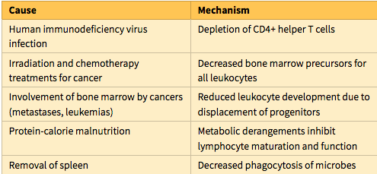
Secondary (Acquired) Immunodeficiencies
Secondary (acquired) immune deficiencies may be encountered in individuals with cancer, diabetes and other metabolic diseases, malnutrition, chronic infection, and in patients receiving chemotherapy or radiation therapy for cancer, or immunosuppressive drugs to prevent graft rejection or to treat autoimmune diseases. As a group, the secondary immune deficiencies are more common than the disorders of primary genetic origin. The most important secondary immune deficiency disease, AIDS, which has become one of the great scourges of humankind.

Slide 35
AIDS is a disease caused by the retrovirus human immunodeficiency virus (HIV) and is characterized by profound immunosuppression that leads to opportunistic infections, secondary neoplasms, and neurologic manifestations.
Although AIDS was first recognized as a distinct entity as recently as the 1980s, it has become one of the most devastating afflictions in history. Of the estimated 36 million HIV-infected individuals worldwide, about 70% are in Africa and 20% in Asia. More than 25 million deaths are attributable to HIV/AIDS, with 1 to 2 million deaths annually.
Effective anti-retroviral drugs have been developed, but the infection continues to spread in parts of the world where these therapies are not widely available, and in some African countries, more than 30% of the population is HIV infected.Despite the remarkable progress in drug therapy of AIDS, cure is still a distant goal.
The advent of these drugs also raises its own tragic concern; because more individuals are living with HIV, the risk of spreading the infection will increase if vigilance is relaxed.

Slide 36
Epidemiologic studies in the United States have identified five groups of adults at high risk for developing AIDS.
Homosexual or bisexual men constitute the largest group, accounting for about 50% of the reported cases. This includes about 5% who also are intravenous drug abusers.
Heterosexual contacts of members of other high-risk groups constituted about 20% of infections from 2001 to 2004. In Africa and Asia, this is by far the largest group of patients with new infections, most of which occur in women who are infected by male partners.
Intravenous drug abusers with no previous history of homosexuality represented about 20% of infected individuals and 9% of new cases in 2009.
Surviving hemophiliacs, especially those who received large amounts of factor VIII or factor IX concentrates before 1985, make up about 0.5% of all cases.
Other recipients of HIV-infected whole blood or components (e.g., platelets, plasma) account for about 1% of patients.
HIV infection of the newborn. Close to 2% of all AIDS cases occur in this pediatric population. The vast majority acquires the infection by transmission of the virus from mother to child (discussed later).
In approximately 5% of cases, the risk factors cannot be determined.

Slide 37
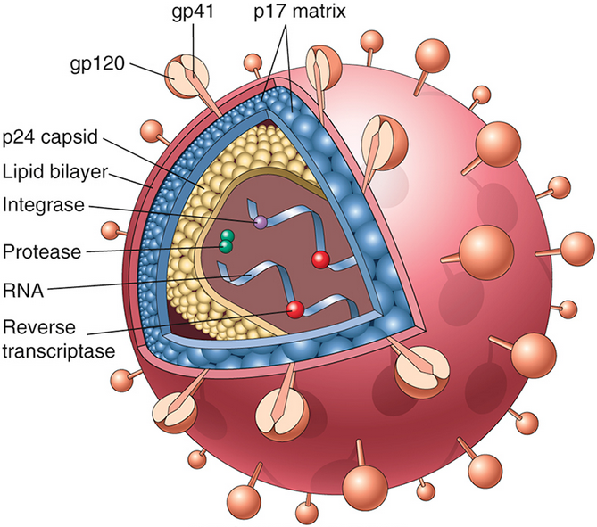
The structure of the human immunodeficiency virus (HIV)-1 virion. The viral particle is covered by a lipid bilayer derived from the host cell and studded with viral glycoproteins gp41 and gp120.
The HIV-1 RNA genome contains the gag, pol, and env genes, which are typical of retroviruses. The products of the gag and pol genes are large precursor proteins that are cleaved by the viral protease to yield the mature proteins. In addition to these three standard retroviral genes, HIV contains several accessory genes, including tat, rev, vif, nef, vpr, and vpu, which regulate the synthesis and assembly of infectious viral particles and the pathogenicity of the virus.

Slide 38
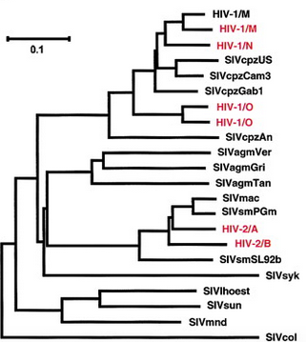
Molecular analysis of different HIV-1 isolates has revealed considerable variability in certain parts of the viral genome, mostly within sequences that encode particular regions of the envelope glycoproteins. Because the antibody response against HIV-1 is targeted against its envelope, such variability poses problems for the development of a single-antigen vaccine.
Based on genetic variation, HIV-1 can be divided into three subgroups, designated M (major), O (outlier), and N (neither M nor O). Group M viruses are the most common form worldwide, and they are further divided into several subtypes, or clades, designated A through K. Various subtypes differ in their geographic distribution; for example, subtype B is the most common form in western Europe and the United States, whereas subtype E is the most common clade in Thailand. Currently, clade C is the fastest spreading clade worldwide, being present in India, Ethiopia, and Southern Africa.

Slide 39
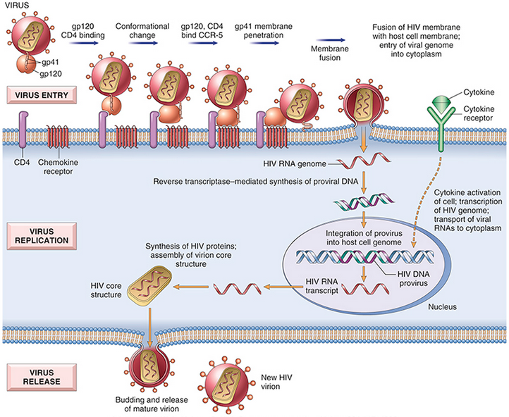

Slide 40
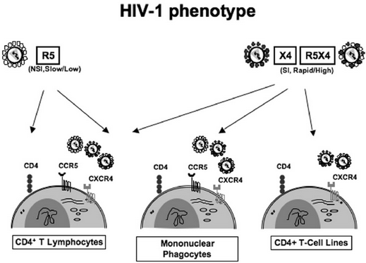

Slide 41
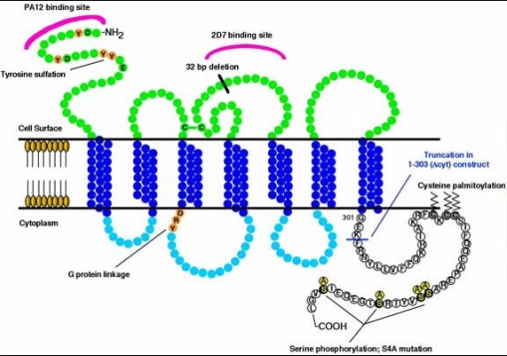
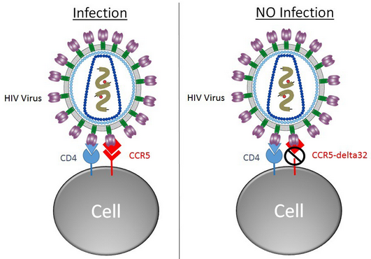
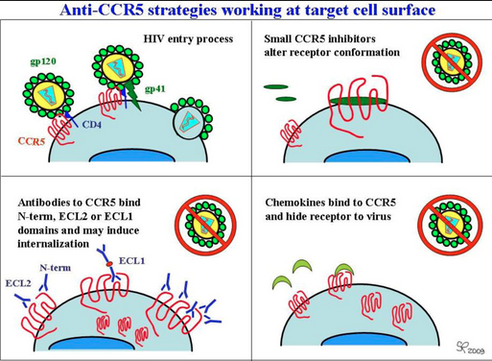
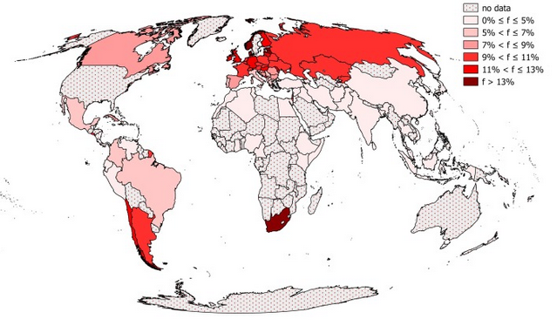

Slide 42
Completion of the viral life cycle in latently infected cells occurs only after cell activation, and in the case of most CD4+ T cells, virus activation results in death of the infected cells.
Activation of T cells by antigens or cytokines upregulates several transcription factors, including NF-κB, which moves from the cytosol into the nucleus. In the nucleus, NF-κB binds to regulatory sequences within several genes, including genes for cytokines and other immune mediators, promoting their transcription. The long-terminal-repeat sequences that flank the HIV genome also contain NF-κB–binding sites, so binding of the transcription factor activates viral gene expression. Imagine now a latently infected CD4+ cell that encounters an environmental antigen. Induction of NF-κB in such a cell (a physiologic response) activates the transcription of HIV proviral DNA (a pathologic outcome) and leads ultimately to the production of virions and to cell death. Furthermore, TNF and other cytokines produced by activated macrophages also stimulate NF-κB activity and thus lead to production of HIV RNA. Thus, it seems that HIV thrives when the host T cells and macrophages are physiologically activated, a situation that can be described as “subversion from within.” Such activation in vivo may result from antigenic stimulation by HIV itself or by other infecting microorganisms. HIV-positive individuals are at increased risk for recurrent infections, which leads to increased lymphocyte activation and production of proinflammatory cytokines. These, in turn, stimulate more HIV production, loss of additional CD4+ T cells, and more infections. Thus, it is easy to see how HIV infection sets up a vicious cycle that culminates in inexorable destruction of the immune system.

Slide 43
Mechanism of T-Cell Depletion in HIV Infection
Loss of CD4+ T cells is mainly caused by the direct cytopathic effects of the replicating virus.
In addition to direct killing of cells by the virus, other mechanisms may contribute to the loss or functional impairment of T cells:
Chronic activation of uninfected cells, responding to HIV itself or to infections that are common in individuals with AIDS, leading to apoptosis of these cells.
HIV infection of cells in lymphoid organs (spleen, lymph nodes, tonsils) causing progressive destruction of the architecture and cellular composition of lymphoid tissues.
Fusion of infected and uninfected cells, leading to formation of syncytia (giant cells). In tissue culture the gp120 expressed on productively infected cells binds to CD4 molecules on uninfected T cells, followed by cell fusion. Fused cells usually die within a few hours.
Qualitative defects in T cell function. Even in asymptomatic HIV-infected individuals, defects have been reported, including a reduction in antigen-induced T cell proliferation, a decrease in T_{H}1-type responses relative to the T_{H}2 type, defects in intracellular signaling, and many more. The loss of T_{H}1 responses results in a profound deficiency in cell-mediated immunity. There also is a selective loss of the memory subset of CD4+ helper T cells early in the course of disease, which explains poor recall responses to previously encountered antigens.

Slide 44
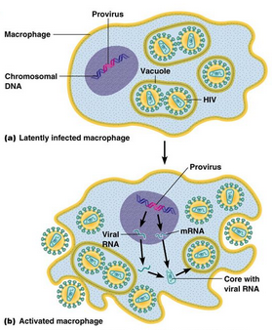
HIV Infection of Non–T Immune Cells
In addition to infection and loss of CD4+ T cells, infection of macrophages and DCs also is important in the pathogenesis of HIV infection.
Macrophages
Similar to T cells, most macrophages infected by HIV are found in tissues, and in certain tissues, such as the lungs and brain, as many as 10% to 50% of macrophages are infected. Although cell division is required for nuclear entry and replication of most retroviruses, HIV-1 can infect and multiply in terminally differentiated nondividing macrophages, which may contain large numbers of virus particles.
Even though macrophages allow viral replication, they are quite resistant to the cytopathic effects of HIV, in contrast to CD4+ T cells. Thus, macrophages may be reservoirs of infection, and in late stages of HIV infection, when CD4+ T-cell numbers decline greatly, macrophages may be an important site of continued viral replication.

Slide 45
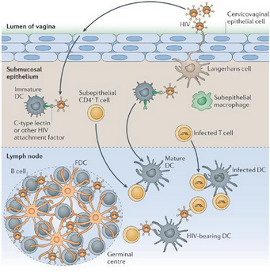
Dendritic Cells
Mucosal DCs may be infected by the virus and transport it to regional lymph nodes, where the virus is transmitted to CD4+ T cells. Follicular DCs in the germinal centers of lymph nodes also are potential reservoirs of HIV. Although some follicular DCs may be susceptible to HIV infection, most virus particles are found on the surface of their dendritic processes.
B Cell Function in HIV Infection
Although B cells cannot be infected by HIV, they may show profound abnormalities. Paradoxically, there is spontaneous B-cell activation and hypergammaglobulinemia in association with an inability to mount antibody responses to newly encountered antigens. The defective antibody responses may be due to lack of T-cell help as well as acquired defects in B cells.

Slide 46
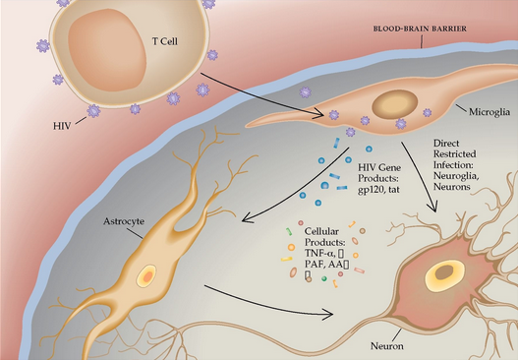
Like the lymphoid system, the nervous system is a target of HIV infection. Macrophages and microglia, cells in the CNS that belong to the macrophage lineage, are the predominant cell types in the brain that are infected with HIV. It is believed that HIV is carried into the brain by infected monocytes. In keeping with this, the HIV isolates from the brain are almost exclusively M-tropic. The mechanism of HIV-induced damage of the brain, however, remains obscure.
Because neurons are not infected and the extent of neuropathologic changes is often less than might be expected from the severity of neurologic symptoms, most clinicians believe that the neurologic deficit is caused indirectly by viral products and by soluble factors produced by infected microglia, such as the cytokines IL-1, TNF, and IL-6.

Slide 47
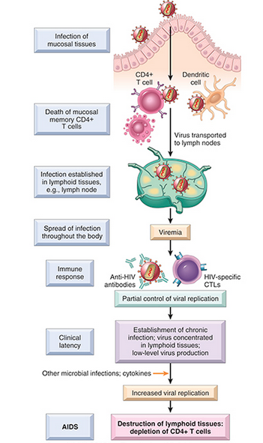
Pathogenesis of HIV-1 infection
The initial infection starts in mucosal tissues, involving mainly memory CD4+ T cells and dendritic cells, and spreads to lymph nodes. Viral replication leads to viremia and widespread seeding of lymphoid tissue. The viremia is controlled by the host immune response, and the patient then enters a phase of clinical latency. During this phase, viral replication in both T cells and macrophages continues unabated, but there is some immune containment of virus. A gradual erosion of CD4+ cells continues, and, ultimately, CD4+ T-cell numbers decline and the patient develops clinical symptoms of full-blown AIDS.

Slide 48
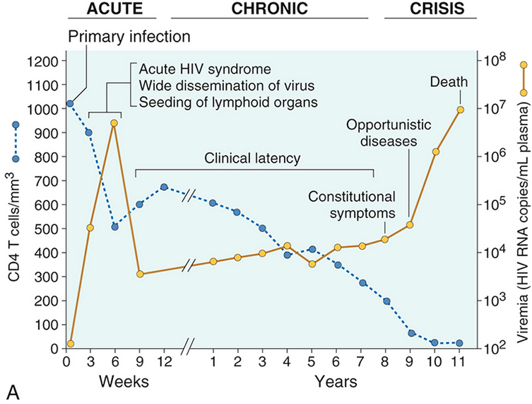
Clinical course of HIV infection. (A) During the early period after primary infection, there is dissemination of virus, development of an immune response to HIV, and often an acute viral syndrome. During the period of clinical latency, viral replication continues and the CD4+ T-cell count gradually decreases, until it reaches a critical level below which there is a substantial risk for AIDS-associated diseases

Slide 49
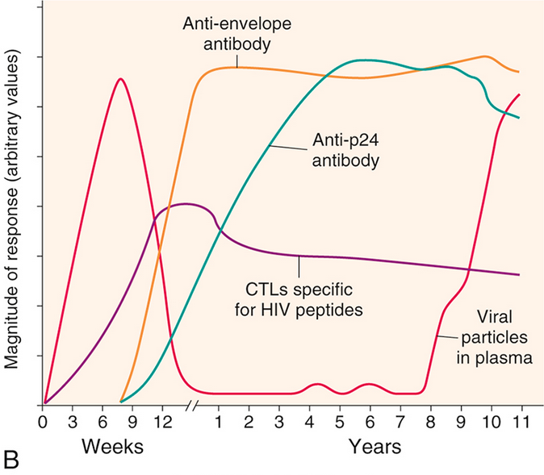
B) Immune response to HIV infection. A cytotoxic T-lymphocyte (CTL) response to HIV is detectable by 2 to 3 weeks after the initial infection, and it peaks by 9 to 12 weeks. Marked expansion of virus-specific CD8+ T-cell clones occurs during this time, and up to 10% of a patient's CTLs may be HIV specific at 12 weeks. The humoral immune response to HIV peaks at about 12 weeks.

Slide 50
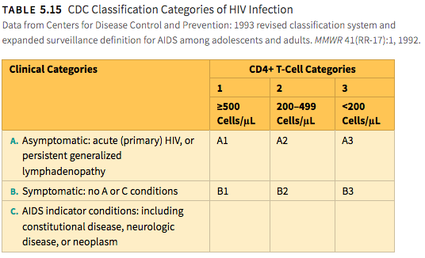

Slide 51
Oportunistic infections
Approximately 15% to 30% of untreated HIV-infected individuals develop pneumonia caused by the fungus Pneumocystis jiroveci at some time during the course of the disease. Before the advent of HAART, this infection was the presenting feature in about 20% of cases, but the incidence is much less in patients who respond to HAART.
Candidiasis is the most common fungal infection in patients with AIDS, and infection of the oral cavity, vagina, and esophagus are its most common clinical manifestations. In HIV-infected individuals, oral candidiasis is a sign of immunologic decompensation, and often heralds the transition to AIDS. Invasive candidiasis is infrequent in patients with AIDS, and it usually occurs when there is drug-induced neutropenia or use of indwelling catheters.
Cytomegalovirus (CMV) may cause disseminated disease, but more commonly affects the eye and gastrointestinal tract. Chorioretinitis used to be seen in approximately 25% of patients, but has decreased dramatically after the initiation of HAART. CMV retinitis occurs almost exclusively in patients with CD4+ T cell counts less than 50 per microliter. Gastrointestinal CMV infection, seen in 5% to 10% of cases, manifests as esophagitis and colitis, the latter associated with multiple mucosal ulcerations.

Slide 52
Disseminated bacterial infection with nontuberculous, or atypical, mycobacteria (mainly Mycobacterium avium-intracellulare) also occurs late, in the setting of severe immunosuppression. Coincident with the AIDS epidemic, the incidence of tuberculosis has risen dramatically. Worldwide, almost one third of all deaths in AIDS patients are attributable to tuberculosis, but this complication remains uncommon in the United States. Both reactivation of latent pulmonary disease and new primary infection contribute to this toll. As with tuberculosis in other settings, the infection may be confined to lungs or may involve multiple organs. Most worrisome are reports indicating that a growing number of isolates are resistant to multiple anti-mycobacterial drugs.
Cryptococcosis occurs in about 10% of AIDS patients. As in other settings with immunosuppression, meningitis is the major clinical manifestation of cryptococcosis. Toxoplasma gondii, another frequent invader of the CNS in AIDS, causes encephalitis and is responsible for 50% of all mass lesions in the CNS.
JC virus, a human papovavirus, is another important cause of CNS infections in HIV-infected patients. It causes progressive multifocal leukoencephalopathy. Herpes simplex virus infection is manifested by mucocutaneous ulcerations involving the mouth, esophagus, external genitalia, and perianal region. Persistent diarrhea, which is common in untreated patients with advanced AIDS, is often caused by infections with protozoans or enteric bacteria.

Slide 53
Kaposi sarcoma (KS) is one of the most common tumors
The lesions of KS are characterized by a proliferation of spindle-shaped cells that express markers of both endothelial cells (vascular or lymphatic) and smooth muscle cells. In addition, KS lesions contain chronic inflammatory cell infiltrates. Many of the features of KS suggest that it is not a malignant tumor (despite its ominous name).
There is compelling evidence that KS is caused by the KS herpesvirus (KSHV), also called human herpesvirus 8 (HHV8). Exactly how KSHV infection leads to KS is still unclear.
Like other herpesviruses, KSHV establishes latent infection, during which several proteins are produced with potential roles in stimulating spindle cell proliferation and preventing apoptosis. These include a viral homologue of the cell cycle regulator cyclin D (an oncogene) and several inhibitors of p53 (a key tumor suppressor gene), both of which have been implicated in tumor development.
The spindle cells produce proinflammatory and angiogenic factors, which recruit the inflammatory and neovascular components of the lesion, and the latter components supply signals that aid in spindle cell survival and growth. However, KSHV infection, while necessary for KS development, is not sufficient, and additional cofactors are needed. In the AIDS-related form, that cofactor is clearly HIV. HIV-mediated immune suppression may aid in widespread dissemination of KSHV in the host.

Slide 54
Lymphomas
Lymphoma occurs at a markedly increased rate in individuals with AIDS, making it another AIDS-defining tumor. Roughly 5% of AIDS patients present with lymphoma, and approximately another 5% develop lymphoma during their subsequent course. Even in the era of anti-retroviral therapy, lymphoma continues to occur in HIV-infected individuals at an incidence that is at least 10-fold greater than the population average.
Tumors Induced by Oncogenic Viruses. T-cell immunity is required to restrain the proliferation of B cells latently infected with oncogenic viruses such as EBV and KSHV. With the appearance of severe T-cell depletion in the course of HIV infection, this control is lost, and the infected B cells undergo unchecked proliferation that predispose to mutations and the development of B-cell tumors. As a result, AIDS patients are at high risk for developing aggressive B-cell lymphomas composed of tumor cells infected by oncogenic viruses, particularly EBV. The tumors often occur in extranodal sites, such as the CNS, gut, orbit, and lungs, and elsewhere. AIDS patients also are prone to rare lymphomas that present as malignant effusions (so-called “primary effusion lymphoma”), which are remarkable in that the tumor cells are usually coinfected by both EBV and KSHV, a highly unusual example of cooperativity between two oncogenic viruses.

Slide 55
Germinal Center B-Cell Hyperplasia. The majority of the lymphomas that arise in patients with preserved CD4 T-cell counts are not associated with EBV or KSHV. The increased risk for lymphoma in these patients may be related to the profound germinal center B cell hyperplasia that occurs in HIV infection.
The high level of proliferation and somatic mutations that occur in germinal center B cells set the stage for chromosomal translocations and mutations involving tumor-causing genes. In fact, the aggressive B-cell tumors that arise outside the setting of severe T cell depletion in HIV-infected individuals, such as Burkitt lymphoma and diffuse large B cell lymphoma, often are associated with mutations in oncogenes such as MYC and BCL6 that bear the molecular hallmarks of “mistakes” during the attempted diversification of immunoglobulin genes in germinal center B cells.
Several other EBV-related proliferations also merit mention. Hodgkin lymphoma, an unusual B-cell tumor associated with a pronounced tissue inflammatory response, also occurs at increased frequency in HIV-infected individuals. In virtually all instances of HIV-associated Hodgkin lymphoma, the characteristic tumor cells (Reed-Sternberg cells) are infected with EBV. Many (but not all) HIV patients with Hodgkin lymphoma have low CD4 counts at the time of disease presentation. EBV infection also is responsible for oral hairy leukoplakia (white projections on the tongue), which results from EBV-driven squamous cell proliferation of the oral mucosa.

Slide 56
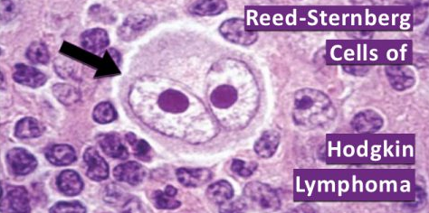

Slide 57
Amyloidosis
Amyloidosis is a condition associated with a number of disorders in which extracellular deposits of fibrillar proteins are responsible for tissue damage and functional compromise. These abnormal fibrils are produced by the aggregation of improperly folded proteins (which are soluble in their normal folded configuration).
The fibrillar deposits bind a wide variety of proteoglycans and glycosaminoglycans, which contain charged sugar groups that give the deposits staining characteristics thought to resemble those of starch (amylose). Therefore, the deposits were called amyloid, a name that is firmly entrenched despite the realization that the deposits are unrelated to starch.

Slide 58
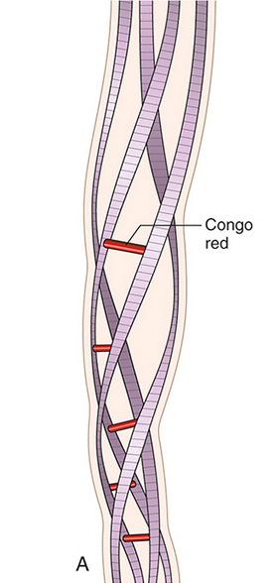
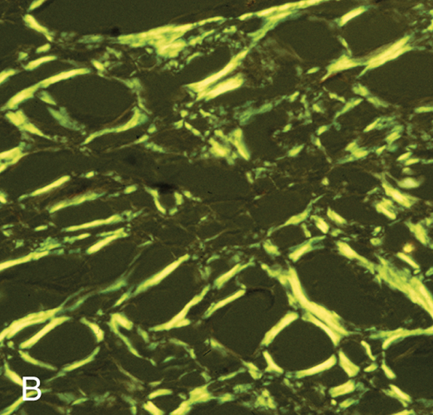
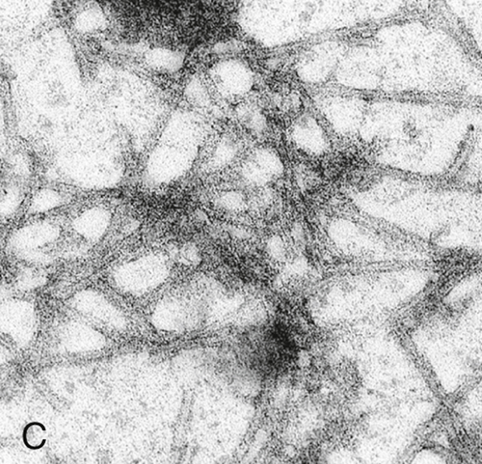
Structure of amyloid. (A) A schematic diagram of an amyloid fiber showing four fibrils (there can be as many as six in each fiber) wound around one another with regularly spaced binding of the Congo red dye. (B) Congo red staining shows apple-green birefringence under polarized light, a diagnostic feature of amyloid. (C) Electron micrograph of 7.5- to 10-nm amyloid fibrils.

Slide 59
The three most common forms of amyloid are the following:
AL (amyloid light chain) amyloid is made up of complete immunoglobulin light chains, the amino-terminal fragments of light chains, or both.
AA (amyloid-associated) amyloid is composed of an 8500-dalton protein derived by proteolysis from a larger precursor in the blood called SAA (serum amyloid-associated) protein, which is synthesized in the liver.
β-amyloid protein (Aβ) is a 4000-dalton peptide that is derived by proteolysis from a much larger transmembrane glycoprotein, called amyloid precursor protein.

Slide 60
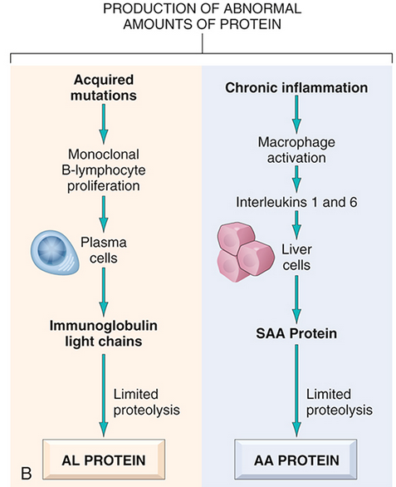
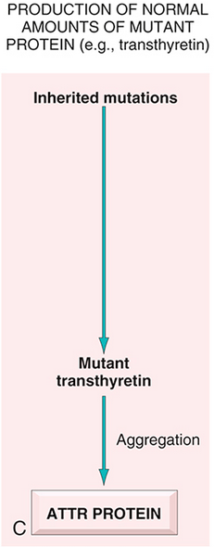
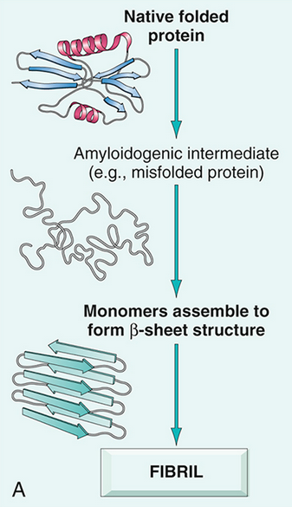
Pathogenesis of amyloidosis. (A) General mechanism of formation of amyloid fibrils. (B) Formation of amyloid from excessive production of proteins prone to misfolding. (C) Formation of amyloid from mutant protein.

Slide 61
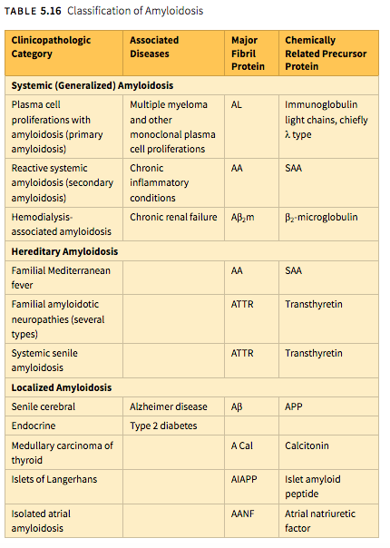

Slide 62
Primary Amyloidosis: Plasma Cell Proliferations Associated with Amyloidosis
Amyloid in this category is of the AL type and is usually systemic in distribution. This is the most common form of amyloidosis, with approximately 2000 to 3000 new cases each year in the United States.
It is caused by a clonal proliferation of plasma cells that synthesize abnormal Ig molecules. The AL type of systemic amyloidosis occurs in 5% to 15% of individuals with multiple myeloma, a plasma-cell tumor characterized by excessive production of free immunoglobulin light chains .
The free, unpaired κ or λ light chains (referred to as Bence Jones protein) are prone to aggregating and depositing in tissues as amyloid. Since the majority of myeloma patients do not develop amyloidosis, however, it is clear that not all free light chains are equally likely to produce amyloid. For unknown reasons, λ light chains are approximately six times more likely to deposit as amyloid than κ light chains.
Most persons with AL amyloid do not have multiple myeloma or any other overt B cell neoplasm; such cases have been traditionally classified as primary amyloidosis, because their clinical features derive solely from the effects of amyloid deposition rather than formation of tumor masses. In virtually all such cases, however, monoclonal immunoglobulins or free light chains, or both, can be found in the blood or urine. Most of these patients also have a modest increase in the number of plasma cells in the bone marrow, which presumably secrete the precursors of AL protein

Slide 63
Reactive Systemic Amyloidosis
The amyloid deposits in this pattern are systemic in distribution and are composed of AA protein. This category was previously referred to as secondary amyloidosis because it is secondary to an associated inflammatory condition.
At one time, tuberculosis, bronchiectasis, and chronic osteomyelitis were the most important underlying conditions, but currently, these conditions frequently resolve with antibiotic treatment and less often lead to amyloidosis.
More commonly now, reactive systemic amyloidosis complicates rheumatoid arthritis, other connective tissue disorders such as ankylosing spondylitis, and inflammatory bowel disease, particularly Crohn disease and ulcerative colitis. Among these, the most frequent associated condition is rheumatoid arthritis.
Amyloidosis is reported to occur in approximately 3% of patients with rheumatoid arthritis and is clinically significant in one half of those affected. Heroin abusers who inject the drug subcutaneously also have a high occurrence rate of generalized AA amyloidosis. The chronic skin infections, which cause the “skin-popping” associated with injection of narcotics, seem to be responsible for the amyloidosis. Reactive systemic amyloidosis also may occur in association with certain cancers, the most common being renal cell carcinoma and Hodgkin lymphoma.

Slide 64
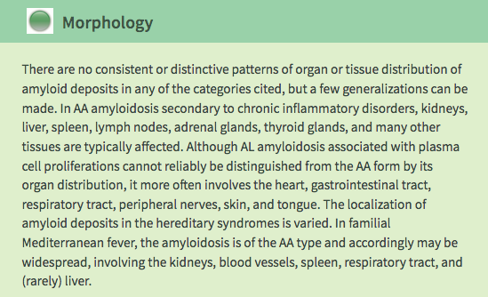

Slide 65
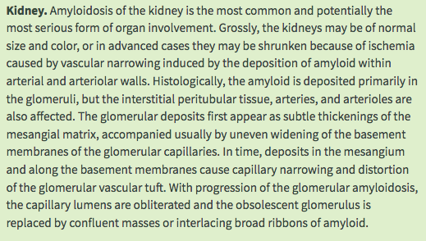

Slide 66
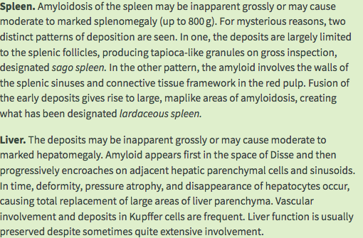

Slide 67
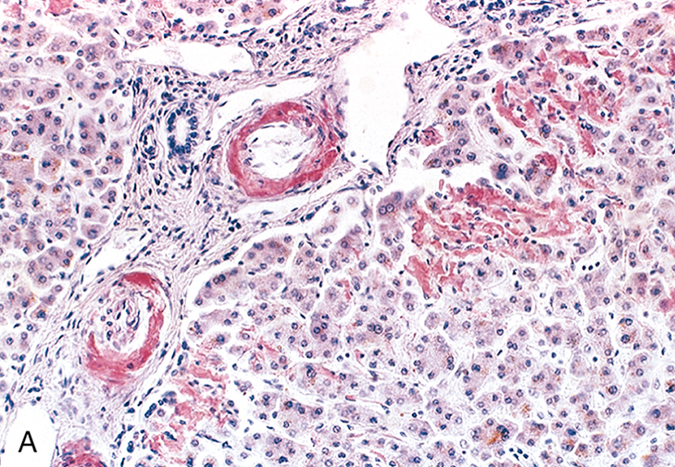

Amyloidosis. (A) A section of liver stained with Congo red reveals pink-red deposits of amyloid in the walls of blood vessels and along sinusoids. (B) Note the yellow-green birefringence of the deposits when observed by a polarizing microscope.

Slide 68
Amyloidosis Clinical Features
The presentation of amyloidosis is broad and depends on the site of amyloid accumulation. The kidney and heart are the most common organs involved.
Amyloid deposition in the kidneys can cause nephrotic syndrome, which results from a reduction in the kidney's ability to filter and hold on to proteins. The nephrotic syndrome occurs with or without elevations in creatinine and blood urea concentration, two biochemical markers of kidney injury. In AA amyloidosis, the kidneys are involved in 91–96% of people, symptoms ranging from protein in the urine to nephrotic syndrome and rarely renal insufficiency.
Amyloid deposition in the heart can cause both diastolic and systolic heart failure. EKG changes may be present, showing low voltage and conduction abnormalities like atrioventricular block or sinus node dysfunction. On echocardiography, the heart shows a restrictive filling pattern, with normal to mildly reduced systolic function. AA amyloidosis usually spares the heart.
People with amyloidosis do not get central nervous system involvement but can develop sensory and autonomic neuropathies. Sensory neuropathy develops in a symmetrical pattern and progresses in a distal to proximal manner. Autonomic neuropathy can present as orthostatic hypotension but may manifest more gradually with nonspecific gastrointestinal symptoms like constipation, nausea, or early satiety.

Slide 69

Skin features of amyloidosis cutis dyschromica. Hyperpigmented and hypopigmented macules on (A) lower legs, (B) back and waist, (C) waist. (D) Individual blisters on upper arm

Slide 70


Accumulation of amyloids in the liver can lead to elevations in serum aminotransferases and alkaline phosphatase, two biomarkers of liver injury, which is seen in about one third of people. Liver enlargement is common. In contrast, spleen enlargement is rare, occurring in 5% of people. Splenic dysfunction, leading to the presence of Howell-Jolly bodies on blood smear, occurs in 24% of people with amyloidosis. Malabsorption is seen in 8.5% of AL amyloidosis and 2.4% of AA amyloidosis. One suggested mechanism for the observed malabsorption is that amyloid deposits in the tips of intestinal villi (fingerlike projections that increase the intestinal area available for absorption of food), begin to erode the functionality of the villi, presenting a sprue-like picture.
A rare development is a susceptibility to bleeding with bruising around the eyes, termed "raccoon-eyes", caused by amyloid deposition in the blood vessels and a reduced activity of thrombin and factor X, two clotting proteins that lose their function after binding with amyloid.

Slide 71
Amyloid deposits in tissue can cause enlargement of structures. Twenty percent of people with AL amyloidosis have a enlarged tongue, that can lead to obstructive sleep apnea, difficulty swallowing, and altered taste. Tongue enlargement does not occur in ATTR or AA amyloidosis.
Enlarged shoulders, "shoulder pad sign", results from amyloid deposition in synovial space. Deposition of amyloid in the throat can cause hoarseness. Aβ2MG amyloidosis (Hemodialysis associated amyloidosis) likes to deposit in synovial tissue, causing chronic synovitis, which can lead to repeated carpal tunnel syndrome.
Both the thyroid and adrenal gland can be infiltrated. It is estimated that 10–20% of individuals with amyloidosis have hypothyroidism. Adrenal infiltration may be harder to appreciate given that its symptoms of orthostatic hypotension and low blood sodium concentration may be attributed to autonomic neuropathy and heart failure.

