Slide 1
Neoplasia Basic Notions

Slide 2
Neoplasia literally means “new growth.” Neoplastic cells are said to be transformed because they continue to replicate, apparently oblivious to the regulatory influences that control normal cells.
Neoplasms therefore enjoy a degree of autonomy and tend to increase in size regardless of their local environment. Their autonomy is by no means complete, however. All neoplasms depend on the host for their nutrition and blood supply. Neoplasms derived from hormone responsive tissues often also require endocrine support, and such dependencies sometimes can be exploited therapeutically.

Slide 3
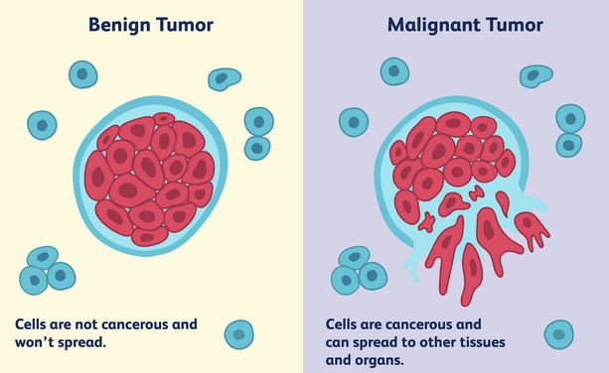
A tumor is said to be benign when its microscopic and gross characteristics are considered to be relatively innocent, implying that it will remain localized and is amenable to local surgical removal.
Malignant, as applied to a neoplasm, implies that the lesion can invade and destroy adjacent structures and spread to distant sites (metastasize) to cause death.

Slide 4
All tumors, benign and malignant, have two basic components:
(1) the parenchyma, made up of transformed or neoplastic cells
(2) the supporting, host-derived, non-neoplastic stroma, made up of connective tissue, blood vessels, and host-derived inflammatory cells. The parenchyma of the neoplasm largely determines its biologic behavior, and it is this component from which the tumor derives its name. The stroma is crucial to the growth of the neoplasm, since it carries the blood supply and provides support for the growth of parenchymal cells. Although the biologic behavior of tumors largely reflects the behavior of the parenchymal cells, there has been a growing realization that stromal cells and neoplastic cells carry on a two-way conversation that influences the growth of the tumor.

Slide 5
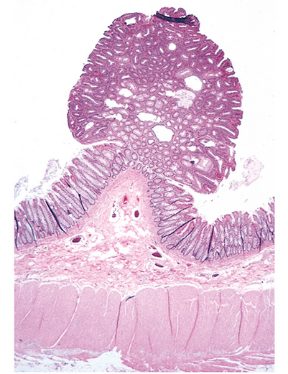
In general, benign tumors are designated by attaching the suffix -oma to the cell type from which the tumor arises. For example, a benign tumor arising in fibrous tissue is a fibroma; a benign cartilaginous tumor is a chondroma. More varied and complex nomenclature is applied to benign epithelial tumors. The term adenoma is generally applied not only to benign epithelial neoplasms that produce glandlike structures, but also to benign epithelial neoplasms that are derived from glands but lack a glandular growth pattern. Thus, a benign epithelial neoplasm arising from renal tubule cells and growing in a glandlike pattern is termed an adenoma, as is a mass of benign epithelial cells that produces no glandular patterns but has its origin in the adrenal cortex. Papillomas are benign epithelial neoplasms, growing on any surface, that produce microscopic or macroscopic fingerlike fronds. A polyp is a mass that projects above a mucosal surface, as in the gut, to form a macroscopically visible structure
Colonic polyp. This glandular tumor is seen projecting into the colonic lumen.
The polyp is attached to the mucosa by a distinct stalk.

Slide 6
Malignant Tumors
The nomenclature of malignant tumors essentially follows that of benign tumors, with certain additions and exceptions.
Malignant neoplasms arising in “solid” mesenchymal tissues or its derivatives are called sarcomas, whereas those arising from the mesenchymal cells of the blood are called leukemias or lymphomas. Sarcomas are designated based on their cell-type composition, which presumably reflects their cell of origin. Thus, a malignant neoplasm comprised of fat-like cells is a liposarcoma, and a malignant neoplasm composed of chondrocyte-like cells is a chondrosarcoma.

Slide 7
While the epithelia of the body are derived from all three germ cell layers, malignant neoplasms of epithelial cells are called carcinomas regardless of the tissue of origin.
Thus, malignant neoplasms arising in the renal tubular epithelium (mesoderm), the skin (ectoderm), and lining epithelium of the gut (endoderm) are all considered carcinomas. Furthermore, mesoderm may give rise to carcinomas (epithelial), sarcomas (mesenchymal), and hematolymphoid tumors (leukemias and lymphomas).
Carcinomas are subdivided further. Carcinomas that grow in a glandular pattern are called adenocarcinomas, and those that produce squamous cells are called squamous cell carcinomas. Sometimes the tissue or organ of origin can be identified, as in the designation of renal cell adenocarcinoma, but it is not uncommon for tumors to show little or no differentiation. Such tumors are referred to as poorly differentiated or undifferentiated carcinoma.

Slide 8
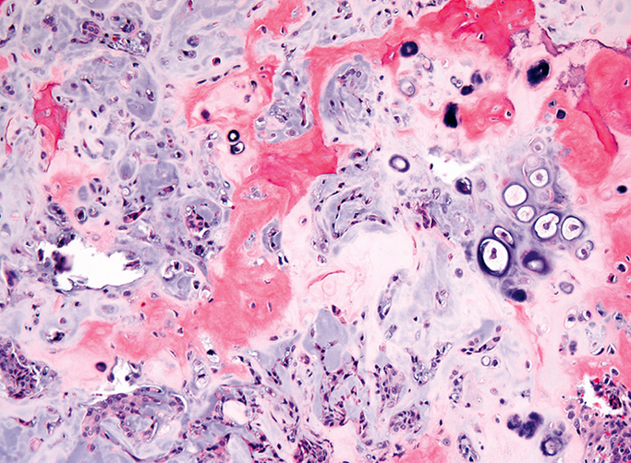
The transformed cells in a neoplasm, whether benign or malignant, usually resemble each other, consistent with their origin from a single transformed progenitor cell. In some unusual instances, however, the tumor cells undergo divergent differentiation, creating so-called “mixed tumors”. Mixed tumors are still of monoclonal origin, but the progenitor cell in such tumors has the capacity to differentiate down more than one lineage. The best example is mixed tumor of salivary gland. These tumors have obvious epithelial components dispersed throughout a fibromyxoid stroma, sometimes harboring islands of cartilage or bone.
Mixed tumor of the parotid gland. Small nests of epithelial cells and myxoid stroma forming cartilage and bone (an unusual feature) are present
All of these diverse elements are thought to derive from a single transformed epithelial progenitor cell, and the preferred designation for these neoplasms is pleomorphic adenoma. Fibroadenoma of the female breast is another common mixed tumor. This benign tumor contains a mixture of proliferating ductal elements (adenoma) embedded in loose fibrous tissue (fibroma). Unlike pleomorphic adenoma, only the fibrous component is neoplastic, but the term fibroadenoma remains in common usage.

Slide 9
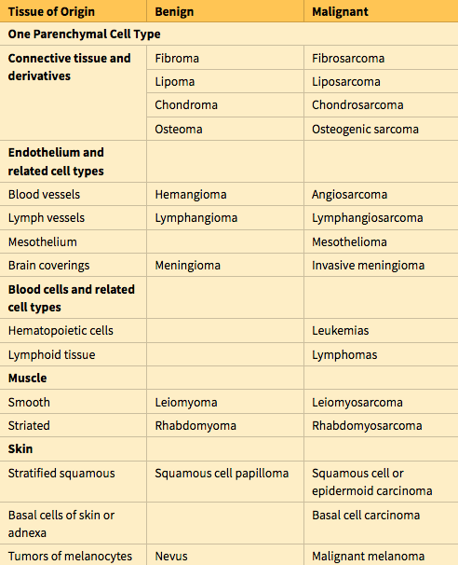

Slide 10
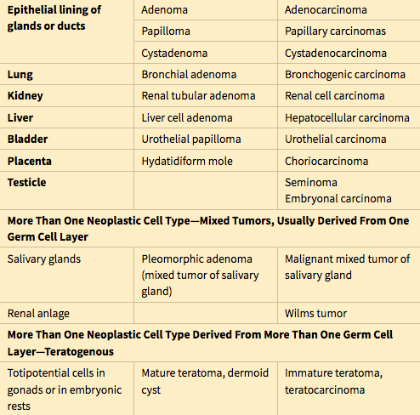
Hamartoma is a mass of disorganized tissue indigenous to the particular site, such as the lung or the liver. While traditionally considered developmental malformations, many hamartomas have clonal chromosomal aberrations that are acquired through somatic mutations and on this basis are now considered to be neoplastic.
Choristoma is a congenital anomaly consisting of a heterotopic nest of cells. For example, a small nodule of well-developed and normally organized pancreatic tissue may be found in the submucosa of the stomach, duodenum, or small intestine. The designation -oma, connoting a neoplasm, imparts to these lesions an undeserved gravity, as they are usually of trivial significance.

Slide 11
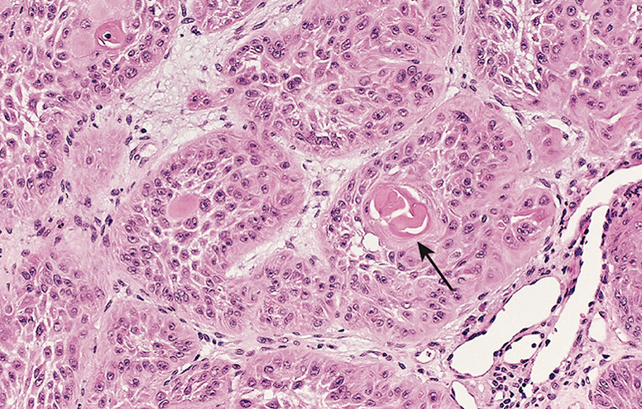
There are three fundamental features by which most benign and malignant tumors can be distinguished: differentiation and anaplasia, local invasion, and metastasis.
Differentiation refers to the extent to which neoplasms resemble their parenchymal cells of origin, both morphologically and functionally; lack of differentiation is called anaplasia.
Well-differentiated squamous cell carcinoma of the skin. The tumor cells are strikingly similar to normal squamous epithelial cells, with intercellular bridges and nests of keratin (arrow).
By contrast, while malignant neoplasms exhibit a wide range of parenchymal cell differentiation, most exhibit morphologic alterations that betray their malignant nature. In well-differentiated cancers, these features may be quite subtle. For example, well-differentiated adenocarcinoma of the thyroid gland may contain normal-appearing follicles, its malignant potential being only revealed by invasion into adjacent tissues or metastasis.
The stroma carrying the blood supply is crucial to the growth of tumors but does not aid in the separation of benign from malignant ones. The amount of stromal connective tissue does, however, determine the consistency of a neoplasm. Certain cancers induce a dense, abundant fibrous stroma (desmoplasia), making them hard, so-called “scirrhous tumors”.

Slide 12
Tumors composed of undifferentiated cells are said to be anaplastic, a feature that is a reliable indicator of malignancy.
The term anaplasia literally means “backward formation”—implying dedifferentiation, or loss of the structural and functional differentiation of normal cells. It is now known, however, that at least some cancers arise from stem cells in tissues; in these tumors, failure of differentiation of transformed stem cells, rather than dedifferentiation of specialized cells, accounts for their anaplastic appearance. Recent studies also indicate that in some cases, dedifferentiation of apparently mature cells occurs during carcinogenesis.

Slide 13
Pleomorphism (i.e., variation in size and shape)
Nuclear abnormalities, consisting of extreme hyperchromatism (dark-staining), variation in nuclear size and shape, or unusually prominent single or multiple nucleoli. Enlargement of nuclei may result in an increased nuclear-to-cytoplasmic ratio that approaches 1 : 1 instead of the normal 1 : 4 or 1 : 6. Nucleoli may attain astounding sizes, sometimes approaching the diameter of normal lymphocytes.
Tumor giant cells may be formed. These are considerably larger than neighboring cells and may possess either one enormous nucleus or several nuclei.
Atypical mitoses, which may be numerous. Anarchic multiple spindles may produce tripolar or quadripolar mitotic figures.
Loss of polarity, such that anaplastic cells lack recognizable patterns of orientation to one another. Such cells may grow in sheets, with total loss of communal structures, such as glands or stratified squamous architecture.

Slide 14
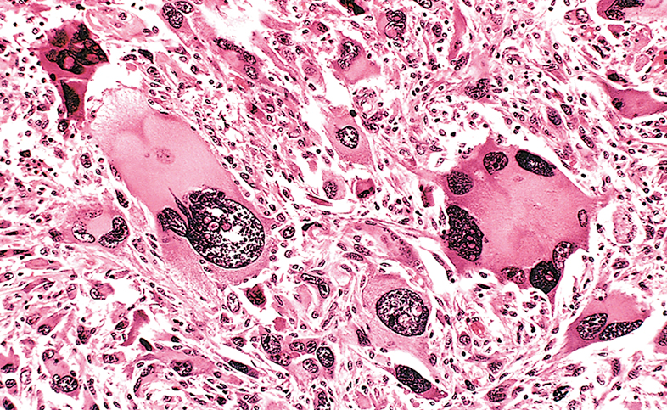
Pleomorphic malignant tumor (rhabdomyosarcoma). Note the marked variation in cell and nuclear sizes, the hyperchromatic nuclei, and the presence of tumor giant cells.

Slide 15
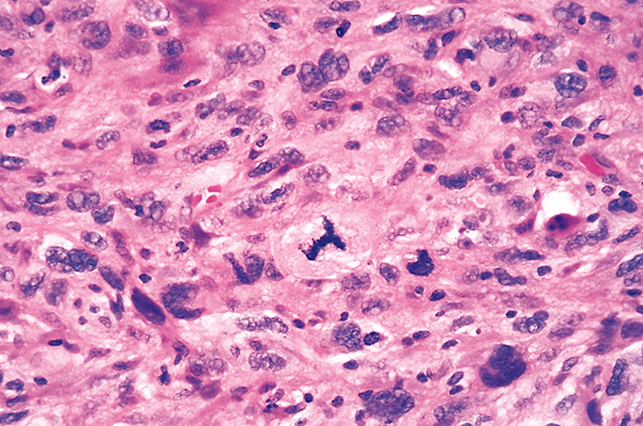
High-power detailed view of anaplastic tumor cells shows cellular and nuclear variation in size and shape. The prominent cell in the center field has an abnormal tripolar spindle.

Slide 16
Well-differentiated tumor cells are likely to retain the functional capabilities of their normal counterparts, whereas anaplastic tumor cells are much less likely to have specialized functional activities.
For example, benign neoplasms and even well-differentiated cancers of endocrine glands frequently elaborate the hormones characteristic of their cell of origin. Similarly, well-differentiated squamous cell carcinomas produce keratin, just as well-differentiated hepatocellular carcinomas secrete bile. In other instances, unanticipated functions emerge. Some cancers may express fetal proteins not produced by comparable cells in the adult. Cancers of nonendocrine origin may produce so-called “ectopic hormones.” For example, certain lung carcinomas may produce adrenocorticotropic hormone (ACTH), parathyroid hormone–like hormone, insulin, glucagon, and others.

Slide 17
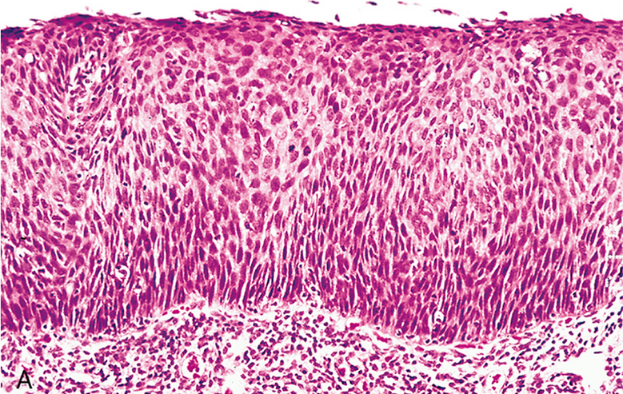
Carcinoma in situ. (A) Low-power view shows that the entire thickness of the epithelium is replaced by atypical dysplastic cells. There is no orderly differentiation of squamous cells. The basement membrane is intact, and there is no tumor in the subepithelial stroma
Dysplastic epithelium is recognized by a loss in the uniformity of individual cells and in their architectural orientation. Dysplastic cells exhibit considerable pleomorphism and often possess abnormally large, hyperchromatic nuclei. Mitotic figures are more abundant than usual and frequently appear in abnormal locations within the epithelium. In dysplastic stratified squamous epithelium, mitoses are not confined to the basal layers, where they normally occur, but may be seen throughout the epithelium. In addition, there is considerable architectural anarchy. For example, the usual progressive maturation of tall cells in the basal layer to flattened squames on the surface may be lost and replaced by a disordered hodgepodge of dark basal-appearing cells. When dysplastic changes are severe and involve the entire thickness of the epithelium, the lesion is referred to as carcinoma in situ, a preinvasive stage of cancer.

Slide 18
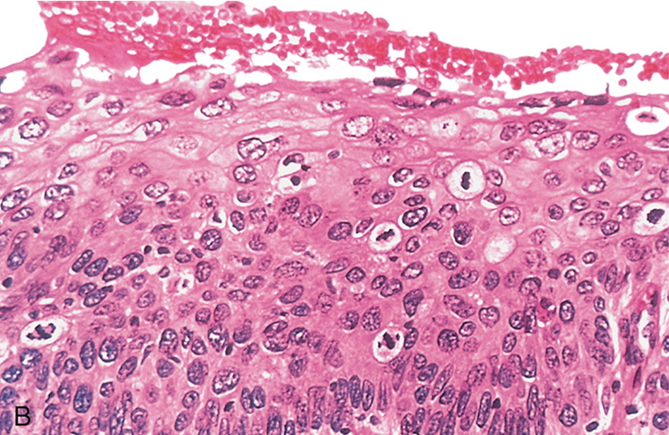
(B) High-power view of another region shows failure of normal differentiation, marked nuclear and cellular pleomorphism, and numerous mitotic figures extending toward the surface. The intact basement membrane (below) is not seen in this section
It is important to appreciate that dysplasia is not synonymous with cancer. Mild to moderate dysplasias that do not involve the entire thickness of the epithelium sometimes regress completely, particularly if inciting causes are removed. However, dysplasia is often noted adjacent to frankly malignant neoplasms (e.g., in cigarette smokers with lung cancer), and in general the presence of dysplasia marks a tissue as being at increased risk for developing an invasive cancer.

Slide 19
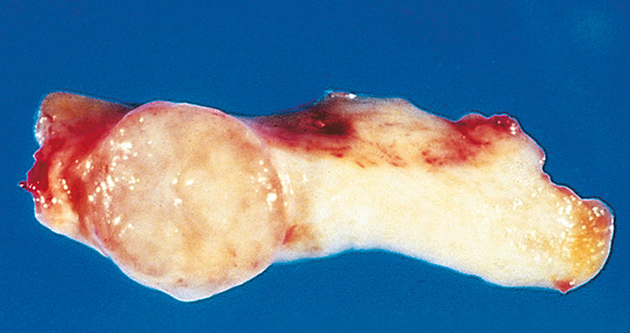
Local Invasion
The growth of cancers is accompanied by progressive infiltration, invasion, and destruction of surrounding tissues, whereas most benign tumors grow as cohesive expansile masses that remain localized to their sites of origin. Because benign tumors grow and expand slowly, they usually develop a rim of compressed fibrous tissue
Fibroadenoma of the breast. The tan-colored, encapsulated small tumor is sharply demarcated from the whiter breast tissue.

Slide 20
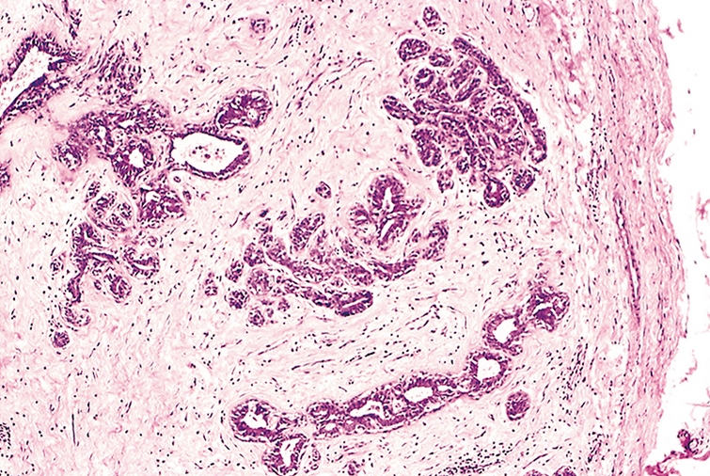
Microscopic view of fibroadenoma of the breast. The fibrous capsule (right) sharply delimits the tumor from the surrounding tissue
This capsule consists largely of extracellular matrix that is deposited by stromal cells such as fibroblasts, which are activated by hypoxic damage to parenchymal cells resulting from compression by the expanding tumor. Encapsulation creates a tissue plane that makes the tumor discrete, moveable (non-fixed), and readily excisable by surgical enucleation. However, it is important to recognize that not all benign neoplasms are encapsulated. For example, the leiomyoma of the uterus is discretely demarcated from the surrounding smooth muscle by a zone of compressed and attenuated normal myometrium, but lacks a capsule. A few benign tumors are neither encapsulated nor discretely defined; lack of demarcation is particularly likely in benign vascular neoplasms such as hemangiomas, which understandably may be difficult to excise. Although encapsulation is the rule in benign tumors, the lack of a capsule does not mean that a tumor is malignant.

Slide 21
Next to the development of metastases, invasiveness is the feature that most reliably distinguishes cancers from benign tumors.
Cancers lack well-defined capsules.
There are instances in which a slowly growing malignant tumor deceptively appears to be encased by the stroma of the surrounding host tissue, but microscopic examination reveals tiny crablike feet penetrating the margin and infiltrating adjacent structures.
This infiltrative mode of growth makes it necessary to remove a wide margin of surrounding normal tissue when surgical excision of a malignant tumor is attempted. Surgical pathologists carefully examine the margins of resected tumors to ensure that they are devoid of cancer cells (clean margins).

Slide 22
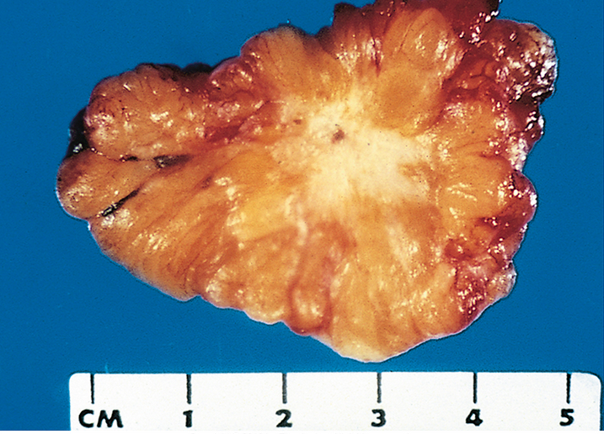
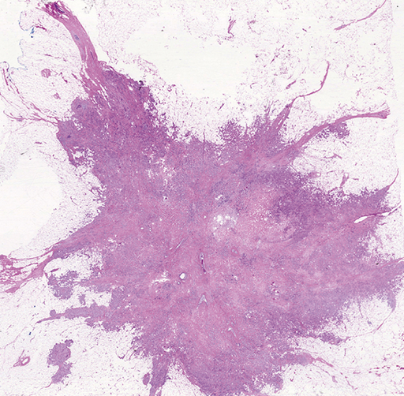
Cut section of invasive ductal carcinoma of the breast. The lesion is retracted, infiltrating the surrounding breast substance, and was stony-hard on palpation.
Microscopic view of breast carcinoma illustrates the invasion of breast stroma and fat by nests and cords of tumor cells. Note the absence of a well-defined capsule.

Slide 23
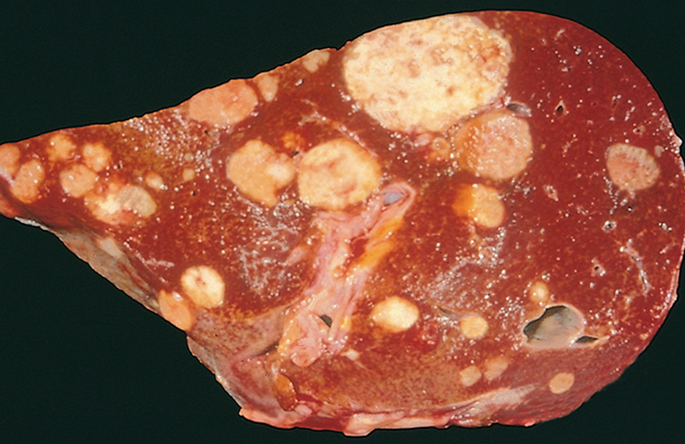
Metastasis
Metastasis is defined by the spread of a tumor to sites that are physically discontinuous with the primary tumor and unequivocally marks a tumor as malignant, as by definition benign neoplasms do not metastasize. The invasiveness of cancers permits them to penetrate into blood vessels, lymphatics, and body cavities, providing opportunities for spread.Overall, approximately 30% of patients with newly diagnosed solid tumors (excluding skin cancers other than melanomas) present with clinically evident metastases. An additional 20% have occult (hidden) metastases at the time of diagnosis.
A liver studded with metastatic cancer.
In general, the more anaplastic and the larger the primary neoplasm, the more likely is metastatic spread, but as with most rules there are exceptions. Extremely small cancers have been known to metastasize; conversely, some large and ominous-looking lesions may not. While all malignant tumors can metastasize, some do so very infrequently. For example, basal cell carcinomas of the skin and most primary tumors of the central nervous system are highly locally invasive but rarely metastasize. It is evident then that the properties of local invasion and metastasis are sometimes separable.

Slide 24
Malignant neoplasms disseminate by one of three pathways: (1) seeding within body cavities, (2) lymphatic spread, or (3) hematogenous spread.
Spread by seeding occurs when neoplasms invade a natural body cavity. This mode of dissemination is particularly characteristic of cancers of the ovary, which often cover the peritoneal surfaces widely.
The implants literally may glaze all peritoneal surfaces and yet not invade the underlying tissues. Here is an instance where the ability to reimplant and grow at sites distant from the primary tumor seems to be separable from the capacity to invade. Neoplasms of the central nervous system, such as a medulloblastoma or ependymoma, may penetrate the cerebral ventricles and be carried by the cerebrospinal fluid to reimplant on the meningeal surfaces, either within the brain or in the spinal cord.

Slide 25
Lymphatic spread is more typical of carcinomas, whereas hematogenous spread is favored by sarcomas.
There are numerous interconnections, however, between the lymphatic and vascular systems, so all forms of cancer may disseminate through either or both systems.
The pattern of lymph node involvement depends principally on the site of the primary neoplasm and the natural pathways of local lymphatic drainage.
Lung carcinomas arising in the respiratory passages metastasize first to the regional bronchial lymph nodes and then to the tracheobronchial and hilar nodes. Carcinoma of the breast usually arises in the upper outer quadrant and first spreads to the axillary nodes. However, medial breast lesions may drain through the chest wall to the nodes along the internal mammary artery. Thereafter, in both instances, the supraclavicular and infraclavicular nodes may be seeded.
In some cases, the cancer cells seem to travel in lymphatic channels within the immediately proximate nodes to be trapped in subsequent lymph nodes, producing so-called “skip metastases.” The cells may traverse all of the lymph nodes ultimately to reach the vascular compartment by way of the thoracic duct.

Slide 26
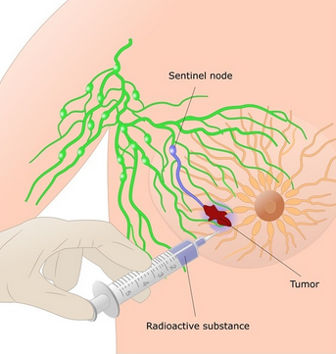
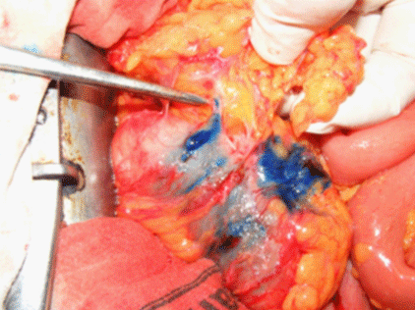
A “sentinel lymph node” is the first regional lymph node that receives lymph flow from a primary tumor. It can be identified by injection of blue dyes or radiolabeled tracers near the primary tumor. Biopsy of sentinel lymph nodes allows determination of the extent of spread of tumor and can be used to plan treatment.
Of note, although enlargement of nodes near a primary neoplasm should arouse concern for metastatic spread, it does not always imply cancerous involvement. The necrotic products of the neoplasm and tumor antigens often evoke immunologic responses in the nodes, such as hyperplasia of the follicles (lymphadenitis) and proliferation of macrophages in the subcapsular sinuses (sinus histiocytosis). Thus, histopathologic verification of tumor within an enlarged lymph node is required.

Slide 27
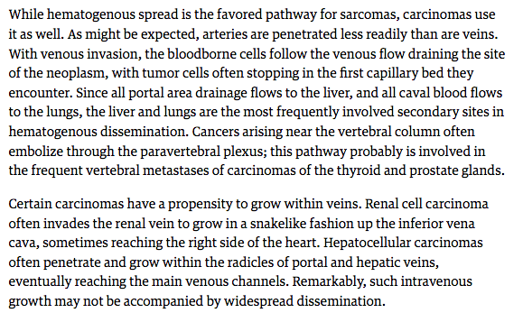

Slide 28
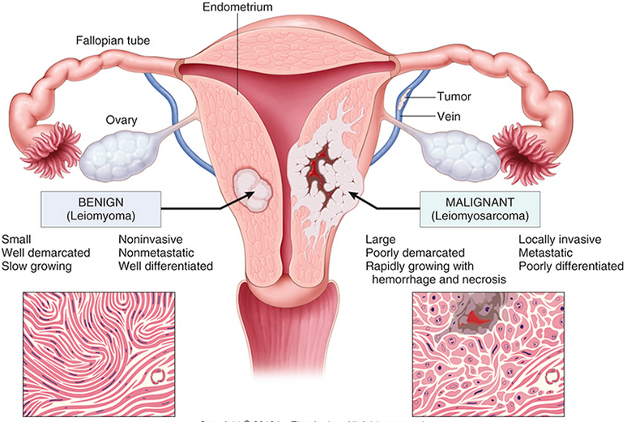
Comparison between a benign tumor of the myometrium (leiomyoma) and a malignant tumor of similar origin (leiomyosarcoma)

Slide 30
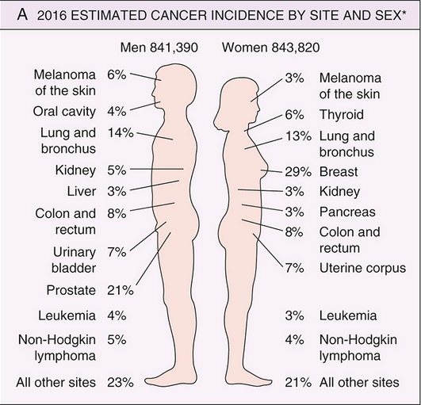
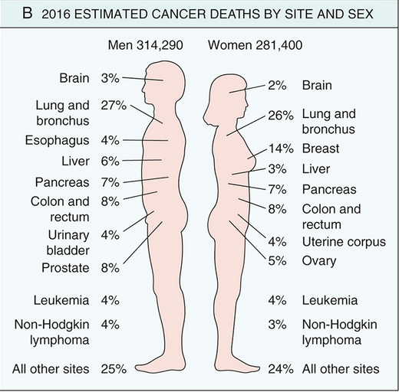
Cancer Incidence
For the year 2012, the World Health Organization (WHO) estimated that there were about 14.1 million new cancer cases worldwide, leading to 8.2 million deaths (approximately 22,500 deaths per day). Moreover, due to increasing population size, by the year 2035 the WHO projects that the numbers of cancer cases and deaths worldwide will increase to 24 million and 14.6 million, respectively (based on current mortality rates).
Additional perspective on the likelihood of developing a specific form of cancer can be gained from national incidence and mortality data. In the United States, it is estimated that the year 2016 will be marked by approximately 1.69 million new cases of cancer and 595,000 cancer deaths.

Slide 31
Environmental Factors
Environmental exposures appear to be the dominant risk factors for many common cancers, suggesting that a high fraction of cancers are potentially preventable.
Diet. Certain features of diet have been implicated as predisposing influences. More broadly, obesity, currently epidemic in the United States, is associated with a modestly increased risk for developing many different cancers.
Smoking. Smoking, particularly of cigarettes, has been implicated in cancer of the mouth, pharynx, larynx, esophagus, pancreas, bladder, and, most significantly, the lung, as 90% of lung cancer deaths are related to smoking.
Alcohol consumption. Alcohol abuse is an independent risk factor for cancers of the oropharynx, larynx, esophagus, and (due to alcoholic cirrhosis) liver. Moreover, alcohol and tobacco smoking synergistically increase the risk for developing cancers of the upper airways and upper digestive tract.
Reproductive history. There is strong evidence that lifelong cumulative exposure to estrogen stimulation, particularly if unopposed by progesterone, increases the risk for developing cancers of the endometrium and breast, both of which are estrogen-responsive tissues.
Infectious agents. It is estimated that infectious agents cause approximately 15% of cancers worldwide.

Slide 32
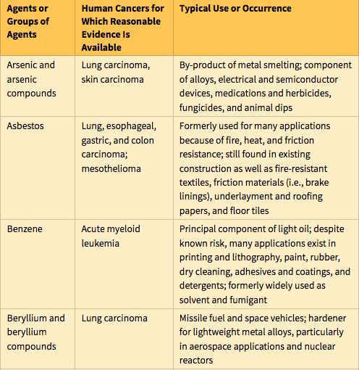
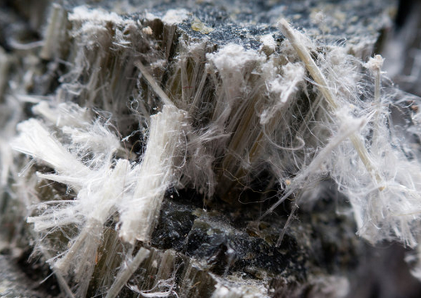
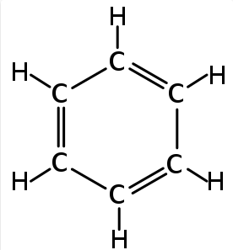
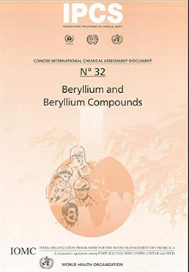

Slide 33
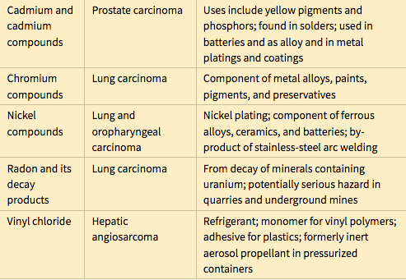
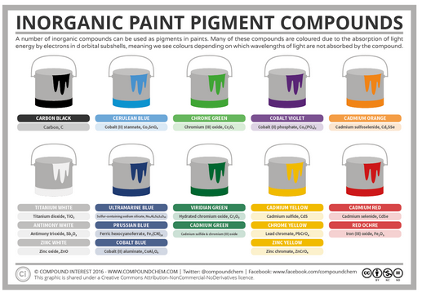

Slide 34
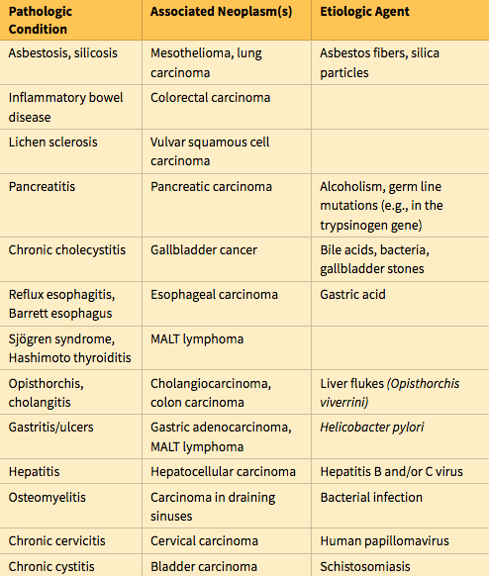
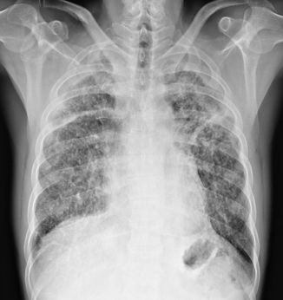

Slide 35
Precursor lesions are localized disturbances of epithelial differentiation that are associated with an elevated risk for developing carcinoma. They may arise secondary to chronic inflammation or hormonal disturbances (in endocrine-sensitive tissues), or may occur spontaneously. Molecular analyses have shown that precursor lesions often possess some of the genetic lesions found in their associated cancers. However, progression to cancer is not inevitable, and it is important to recognize precursor lesions because their removal or reversal lowers cancer risk.
Many different precursor lesions have been described; among the most common are the following:
Squamous metaplasia and dysplasia of bronchial mucosa, seen in in habitual smokers—a risk factor for lung carcinoma
Endometrial hyperplasia and dysplasia, seen in women with unopposed estrogenic stimulation—a risk factor for endometrial carcinoma
Leukoplakia of the oral cavity, vulva, and penis, which may progress to squamous cell carcinoma
Villous adenoma of the colon, associated with a high risk for progression to colorectal carcinoma

Slide 36
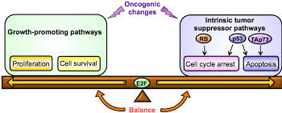
Cancer Genetics
Oncogenes are genes that induce a transformed phenotype when expressed in cells by promoting increased cell growth. A major discovery in cancer was the realization that oncogenes are mutated or overexpressed versions of normal cellular genes, which are called proto-oncogenes. Most oncogenes encode transcription factors, factors that participate in pro-growth signaling pathways, or factors that enhance cell survival. They are considered dominant genes because a mutation involving a single allele is sufficient to produce a pro-oncogenic effect.

Slide 37
Tumor suppressor genes are genes that normally prevent uncontrolled growth and, when mutated or lost from a cell, allow the transformed phenotype to develop. Often both normal alleles of tumor suppressor genes must be damaged for transformation to occur. Tumor suppressor genes can be placed into two general groups, “governors” that act as important brakes on cellular proliferation, and “guardians” that are responsible for sensing genomic damage. Some guardian genes initiate and choreograph a complex “damage control response” that leads to the cessation of proliferation or, if the damage is too great to be repaired, or induce apoptosis.
Genes that regulate apoptosis primarily act by enhancing cell survival, rather than stimulating proliferation per se. Understandably, genes of this class that protect against apoptosis are often overexpressed in cancer cells, whereas those that promote apoptosis tend to be underexpressed or functionally inactivated by mutations.
To this list may now be added genes that regulate interactions between tumor cells and host cells, as these genes are also recurrently mutated or functionally altered in certain cancers. Particularly important are genes that enhance or inhibit recognition of tumors cells by the host immune system.

Slide 38
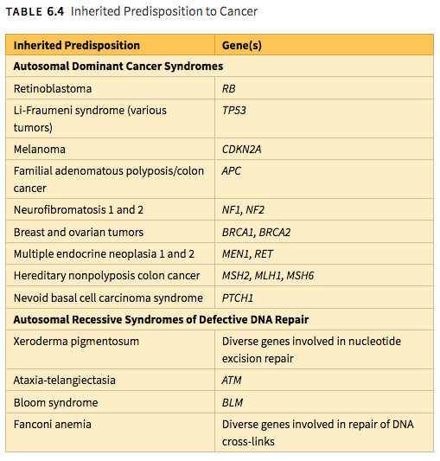

Slide 39
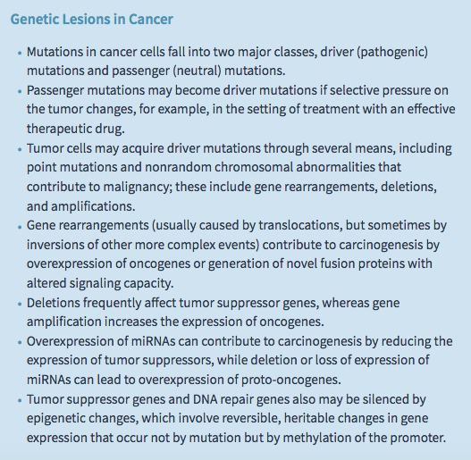

Slide 40
Some gene rearrangements result in overexpression of proto-oncogenes by removing them from their normal regulatory elements and placing them under control of an inappropriate, highly active promoter or enhancer. Two different kinds of B cell lymphoma provide illustrative examples of this mechanism.
In more than 90% of cases of Burkitt lymphoma, the cells have a translocation, usually between chromosomes 8 and 14, that leads to overexpression of the MYC gene on chromosome 8 by juxtaposition with immunoglobulin heavy chain gene regulatory elements on chromosome 14.
In follicular lymphoma, a reciprocal translocation between chromosomes 14 and 18 leads to overexpression of the anti-apoptotic gene, BCL2, on chromosome 18, also driven by immunoglobulin gene regulatory elements.
Other oncogenic gene rearrangements create fusion genes encoding novel chimeric proteins. Most notable is the Philadelphia (Ph) chromosome in chronic myeloid leukemia, consisting of a balanced reciprocal translocation between chromosomes 9 and 22. As a consequence, the derivative chromosome 22 (the Philadelphia chromosome) appears smaller than normal. This cytogenetic change is seen in more than 90% of cases of chronic myeloid leukemia and results in the fusion of portions of the BCR gene on chromosome 22 and the ABL gene on chromosome 9. The few Philadelphia chromosome–negative cases harbor a cryptic (cytogenetically silent) BCR-ABL fusion gene, the presence of which is the sine qua non of chronic myeloid leukemia. BCR-ABL fusion gene encodes a novel tyrosine kinase with potent transforming activity.

Slide 41
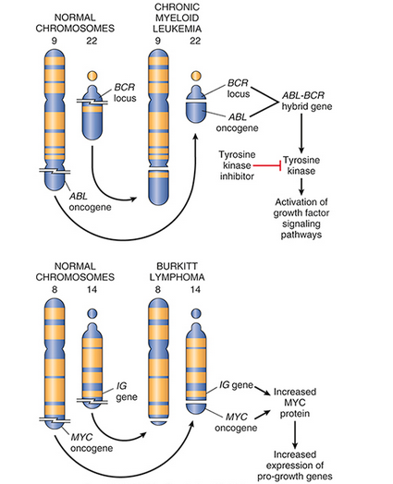

Slide 42
Gene Amplifications
Proto-oncogenes may be converted to oncogenes by gene amplification, with consequent overexpression and hyperactivity of otherwise normal proteins. Such amplification may produce several hundred copies of the gene, a change in copy number that can be readily detected by molecular hybridization with appropriate DNA probes.
In some cases, the amplified genes produce chromosomal changes that can be identified microscopically. Two mutually exclusive patterns are seen: multiple small, extrachromosomal structures called double minutes; and homogeneously staining regions. The latter derive from the insertion of the amplified genes into new chromosomal locations, which may be distant from the normal location of the involved genes; because regions containing amplified genes lack a normal banding pattern, they appear homogeneous in a G-banded karyotype.
Two clinically important examples of amplification involve the NMYC gene in neuroblastoma and the HER2 gene in breast cancers. NMYC is amplified in 25% to 30% of neuroblastomas, and the amplification is associated with poor prognosis. HER2 (also known as ERBB2) amplification occurs in about 20% of breast cancers, and antibody therapy directed against the receptor encoded by the HER2 gene has proved effective in this subset of tumors.

Slide 43
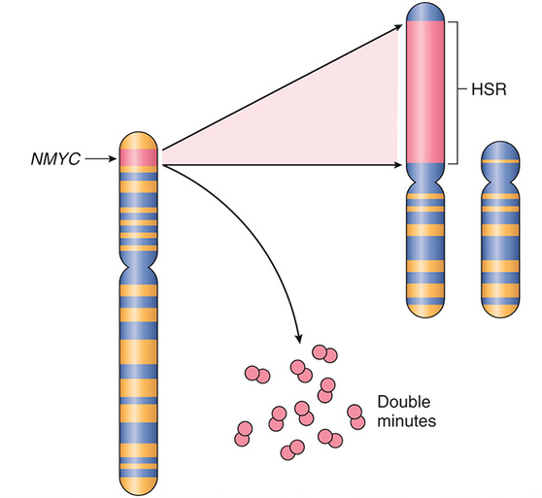
Amplification of the NMYC gene in human neuroblastoma. The NMYC gene, present normally on chromosome 2p, becomes amplified and is seen either as extrachromosomal double minutes or as a chromosomally integrated homogeneous-staining region (HSR). The integration involves other autosomes, such as 4, 9, or 13.

Slide 44
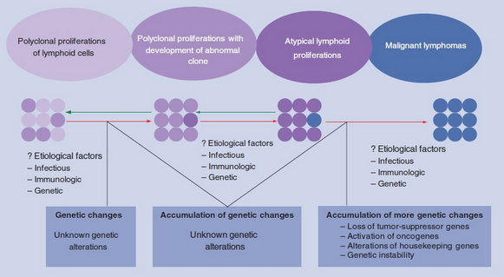
Lymphoid tumors are most commonly associated with recurrent gene rearrangements. This relationship exists because normal lymphocytes express special enzymes that purposefully introduce DNA breaks during the processes of immunoglobulin or T cell receptor gene recombination.
Repair of these DNA breaks is error-prone, and the resulting mistakes sometimes result in gene rearrangements that activate proto-oncogenes.
Two other types of mesenchymal tumors, myeloid neoplasms (acute myeloid leukemias and myeloproliferative disorders) and sarcomas, also frequently possess gene rearrangements. Unlike lymphoid neoplasms, the cause of the DNA breaks that lead to gene rearrangements in myeloid neoplasms and sarcomas is unknown. In general, the rearrangements that are seen in myeloid neoplasms and sarcomas create fusion genes that encode either hyperactive tyrosine kinases (akin to BCR-ABL) or novel oncogenic transcription factors. A well-characterized example of the latter is the (11;22)(q24;q12) translocation in Ewing sarcoma. This rearrangement creates a fusion gene encoding a chimeric oncoprotein composed of portions of two different transcription factors called EWS and FLI1.

Slide 45
Carcinogenesis a multistep process
Beyond tumor initiation from a single founding cell, it is important to recognize that cancers continue to undergo Darwinian selection and therefore continue to evolve. It is well established that during their course cancers generally become more aggressive and acquire greater malignant potential, a phenomenon referred to as tumor progression.
At the molecular level, tumor progression most likely results from mutations that accumulate independently in different cells. Some of these mutations may be lethal, but others may affect the function of cancer genes, thereby making the affected cells more adept at growth, survival, invasion, metastasis, or immune evasion. Due to this selective advantage, subclones that acquire these mutations may come to dominate one area of a tumor, either at the primary site or at sites of metastasis.
As a result of continuing mutation and Darwinian selection, even though malignant tumors are monoclonal in origin they are typically genetically heterogeneous by the time of their clinical presentation. In advanced tumors exhibiting genetic instability, the extent of genetic heterogeneity may be enormous.

Slide 46
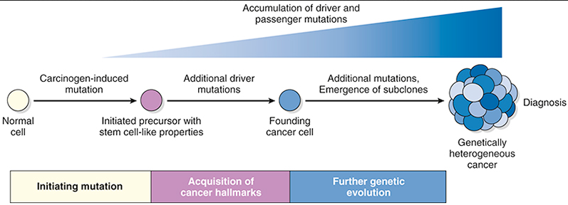
Development of cancer through stepwise accumulation of complementary driver mutations. The order in which various driver mutations occur is usually unknown and may vary from tumor to tumor.

