Slide 1
Hallmarks of cancer

Slide 2
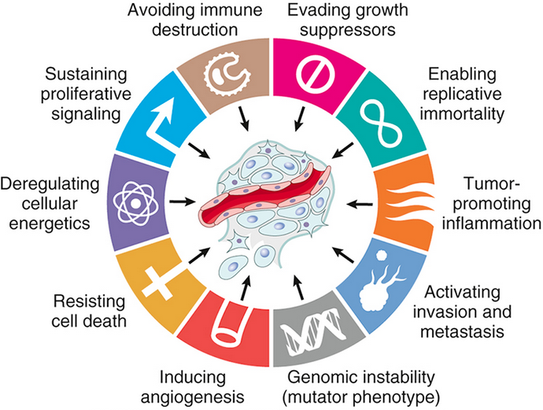
Hallmarks of cancer:
Eight cancer hallmarks and two enabling factors (genomic instability and tumor-promoting inflammation). Most cancer cells acquire these properties during their development, typically due to mutations in critical genes.

Slide 3
The acquisition of the genetic and epigenetic alterations that confer these hallmarks may be accelerated by cancer-promoting inflammation and by genomic instability. These are considered enabling characteristics because they promote cellular transformation and subsequent tumor progression.
Mutations in genes that regulate some or all of these cellular traits are seen in every cancer; accordingly, these traits form the basis of the following discussion of the molecular origins of cancer. Of note, by convention, gene symbols are italicized but their protein products are not (e.g., RB gene and RB protein, TP53 and p53, MYC and MYC).

Slide 4
Self-Sufficiency in Growth Signals
The self-sufficiency in growth that characterizes cancer cells generally stems from gain-of-function mutations that convert proto-oncogenes to oncogenes. Oncogenes encode proteins called oncoproteins that promote cell growth, even in the absence of normal growth-promoting signals. To appreciate how oncogenes drive inappropriate cell growth, it is helpful to review briefly the sequence of events that characterize normal cell proliferation. Under physiologic conditions, cell proliferation can be readily resolved into the following steps:
1. Binding of a growth factor to its specific receptor on the cell membrane
2. Transient and limited activation of the growth factor receptor, which in turn activates several signal-transducing proteins on the inner leaflet of the plasma membrane
3. Transmission of the transduced signal across the cytosol to the nucleus by second messengers or a cascade of signal transduction molecules
4. Induction and activation of nuclear regulatory factors that initiate and regulate DNA transcription and the biosynthesis of other cellular components that are needed for cell division, such as organelles, membrane components, and ribosomes
5. Entry and progression of the cell into the cell cycle, resulting ultimately in cell division

Slide 5
Growth Factors
Cancers may secrete their own growth factors or induce stromal cells to produce growth factors in the tumor microenvironment. Most soluble growth factors are made by one cell type and act on a neighboring cell to stimulate proliferation (paracrine action). Normally, cells that produce the growth factor do not express the cognate receptor, preventing the formation of positive feedback loops within the same cell. This “rule” may be broken by cancer cells in several different ways.
Some cancer cells acquire growth self-sufficiency by acquiring the ability to synthesize the same growth factors to which they are responsive. For example, many glioblastomas secrete platelet-derived growth factor (PDGF) and express the PDGF receptor, and many sarcomas make both transforming growth factor-α (TGF-α) and its receptor. Similar autocrine loops are fairly common in many types of cancer.
Another mechanism by which cancer cells acquire growth self-sufficiency is by interaction with stroma. In some cases, tumor cells send signals to activate normal cells in the supporting stroma, which in turn produce growth factors that promote tumor growth.

Slide 6
Growth Factor Receptors
Some growth factor receptors have an intrinsic tyrosine kinase activity that is activated by growth factor binding, while others signal by stimulating the activity of downstream proteins.
Many of the myriad growth factor receptors function as oncoproteins when they are mutated or if they overexpressed. The best-documented examples of overexpression involve the epidermal growth factor (EGF) receptor family. ERBB1, the EGF receptor, is overexpressed in 80% of squamous cell carcinomas of the lung, 50% or more of glioblastomas, and 80% to 100% of epithelial tumors of the head and neck. As mentioned earlier, the gene encoding a related receptor, HER2 (ERBB2), is amplified in approximately 20% of breast cancers and in a smaller fraction of adenocarcinomas of the lung, ovary, stomach, and salivary glands.

Slide 7
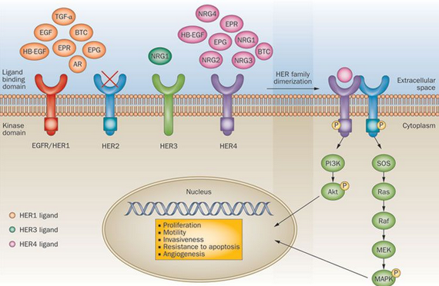
These tumors are exquisitely sensitive to the mitogenic effects of small amounts of growth factors.
The significance of HER2 in the pathogenesis of breast cancers is illustrated dramatically by the clinical benefit derived from blocking the extracellular domain of this receptor with anti-HER2 antibodies, an elegant example of “bench to bedside” medicine.
In other instances, tyrosine kinase activity is stimulated by point mutations or small indels that lead to subtle but functionally important changes in protein structure, or gene rearrangements that create fusion genes encoding chimeric receptors. In each of these cases, the mutated receptors are constitutively active, delivering mitogenic signals to cells even in the absence of growth factors. These types of mutations are most common in leukemias, lymphomas, and certain forms of sarcoma.

Slide 8
Downstream Signal-Transducing Proteins
Cancer cells often acquire growth autonomy as a result of mutations in genes that encode components of signaling pathways downstream of growth factor receptors. The signaling proteins that couple growth factor receptors to their nuclear targets are activated by ligand binding to growth factor receptors. The signals are trasnmitted to the nucleus through various signal transduction molecules. Two important oncoproteins in the category of signaling molecules are RAS and ABL.
RAS
RAS is the most commonly mutated oncogene in human tumors. Approximately 30% of all human tumors contain mutated RAS genes, and the frequency is even higher in some specific cancers (e.g., pancreatic adenocarcinoma). RAS is a member of a family of small G proteins that bind guanosine nucleotides (guanosine triphosphate [GTP] and guanosine diphosphate [GDP]). Signaling by RAS involves the following sequential steps:

Slide 9
Normally, RAS flips back and forth between an excited signal-transmitting state and a quiescent state. RAS is inactive when bound to GDP; stimulation of cells by growth factors such as EGF and PDGF leads to exchange of GDP for GTP and subsequent conformational changes that generate active RAS.
This excited signal-emitting state is short-lived, however, because the intrinsic guanosine triphosphatase (GTPase) activity of RAS hydrolyzes GTP to GDP, releasing a phosphate group and returning the protein to its quiescent GDP-bound state. The GTPase activity of activated RAS is magnified dramatically by a family of GTPase-activating proteins (GAPs), which act as molecular brakes that prevent uncontrolled RAS activation by favoring hydrolysis of GTP to GDP
Activated RAS stimulates downstream regulators of proliferation by several interconnected pathways that converge on the nucleus and alter the expression of genes that regulate growth, such as MYC. An important point is that mutational activation of these signaling intermediates mimics the growth promoting effects of activated RAS.
For example, BRAF, which lies in the so-called “RAF/ERK/MAP kinase pathway” is mutated in more than 60% of melanomas and is associated with unregulated cell proliferation. Mutations of phosphatidly inositol-3 kinase (PI3 kinase) in the PI3K/AKT pathway also occur with high frequency in some tumor types, with similary consequences.

Slide 10
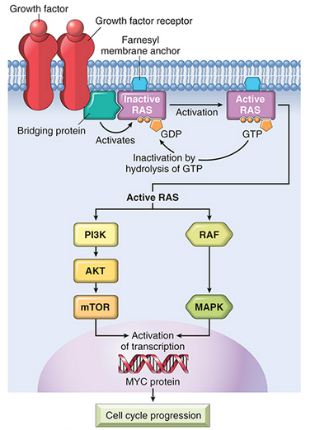
Model for action of RAS. When a normal cell is stimulated through a growth factor receptor, inactive (GDP-bound) RAS is activated to a GTP-bound state. Activated RAS transduces proliferative signals to the nucleus along two pathways: the so-called “RAF/ERK/MAP kinase pathway” and the PI3 kinase/AKT pathway. GDP, Guanosine diphosphate; GTP, guanosine triphosphate; MAP, mitogen-activated protein; PI3, phosphatidylinositol-3.

Slide 11
The crucial role of BCR-ABL in cancer has been confirmed by the dramatic clinical response of patients with chronic myeloid leukemia to BCR-ABL kinase inhibitors.
The prototype of this kind of drug, imatinib mesylate (Gleevec), galvanized interest in design of drugs that target specific molecular lesions found in various cancers (so-called “targeted therapy”). BCR-ABL also is an example of the concept of oncogene addiction, wherein a tumor is profoundly dependent on a single signaling molecule. BCR-ABL fusion gene formation is an early, perhaps initiating, event that drives leukemogenesis. Development of leukemia probably requires other collaborating mutations, but the transformed cell continues to depend on BCR-ABL for signals that mediate growth and survival. BCR-ABL signaling can be seen as the central lodgepole around which the transformed state is “built”. If the lodgepole is removed by inhibition of the BCR-ABL kinase, the structure collapses. In view of this level of dependency, it is not surprising that acquired resistance of tumors to BCR-ABL inhibitors often is due to the outgrowth of a subclone with a mutation in BCR-ABL that prevents binding of the drug to the BCR-ABL protein.

Slide 12
Nuclear Transcription Factors
The ultimate consequence of signaling through oncoproteins such as RAS or ABL is inappropriate and continuous stimulation of nuclear transcription factors that drive the expression of growth-promoting genes. Growth autonomy may thus be a consequence of mutations affecting genes that regulate DNA transcription. A host of oncoproteins, including products of the MYC, MYB, JUN, FOS, and REL oncogenes, function as transcription factors that regulate the expression of growth-promoting genes, such as cyclins. Of these, MYC is involved most commonly in human tumors.
Dysregulation of MYC promotes tumorigenesis by simultaneously promoting the progression of cells through the cell cycle and enhancing alterations in metabolism that support cell growth. MYC primarily functions by activating the transcription of other genes. Genes activated by MYC include several growth-promoting genes, including cyclin-dependent kinases (CDKs), whose products drive cells into the cell cycle and genes that control pathways that produce the building blocks (e.g., amino acids, lipids, nucleotides) that are needed for cell growth and division. Dysregulation of MYC results from a (8;14) translocation in Burkitt lymphoma, a highly aggressive B-cell tumor. MYC also is amplified in breast, colon, lung, and many other cancers, while the related NMYC and LMYC genes are amplified in neuroblastomas and small cell cancers of lung, respectively.

Slide 13
Cyclins and Cyclin-Dependent Kinases
Growth factors transduce signals that stimulate the orderly progression of cells through the various phases of the cell cycle, the process by which cells replicate their DNA in preparation for cell division. Progression of cells through the cell cycle is orchestrated by cyclin-dependent kinases (CDKs), which are activated by binding to cyclins, so called because of the cyclic nature of their production and degradation. The CDK-cyclin complexes phosphorylate crucial target proteins that drive cells forward through the cell cycle. While cyclins arouse the CDKs, CDK inhibitors (CDKIs), of which there are many, silence the CDKs and exert negative control over the cell cycle. Expression of these inhibitors is downregulated by mitogenic signaling pathways, thus promoting the progression of the cell cycle.

Slide 14
There are two main cell cycle checkpoints, one at the G1/S transition and the other at the G2/M transition, each of which is tightly regulated by a balance of growth-promoting and growth-suppressing factors, as well as by sensors of DNA damage.
If activated, these DNA-damage sensors transmit signals that arrest cell cycle progression and, if cell damage cannot be repaired, initiate apoptosis. Once cells pass through the G1/S checkpoint, they are committed to undergo cell division. Understandably, then, defects in the G1/S checkpoint are particularly important in cancer, since these lead directly to increased cell division. Indeed, all cancers appear to have genetic lesions that disable the G1/S checkpoint, causing cells to continually reenter the S phase. For unclear reasons, particular lesions vary widely in frequency across tumor types, but they fall into two major categories.

Slide 15
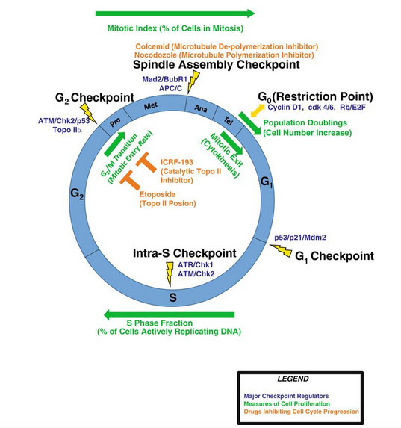

Slide 16
Gain-of-function mutations involving CDK4 or D cyclins. Mishaps increasing the expression of cyclin D or CDK4 are common events in neoplastic transformation. The cyclin D genes are overexpressed in many cancers, including those affecting the breast, esophagus, liver, and a subset of lymphomas and plasma cell tumors. Amplification of the CDK4 gene occurs in melanomas, sarcomas, and glioblastomas. Mutations affecting cyclins B and E and other CDKs also occur, but they are much less frequent than those affecting cyclin D and CDK4.
Loss-of-function mutations involving CDKIs. CDKIs frequently are disabled by mutation or gene silencing in many human malignancies. For example, germline mutations of CDKN2A, a gene that encodes the CDK inhibitor p16, are present in 25% of melanoma-prone kindreds, and acquired deletion or inactivation of CDKN2A is seen in 75% of pancreatic carcinomas, 40% to 70% of glioblastomas, 50% of esophageal cancers and certain leukemias, and 20% of non–small cell lung carcinomas, soft-tissue sarcomas, and bladder cancers.

Slide 17
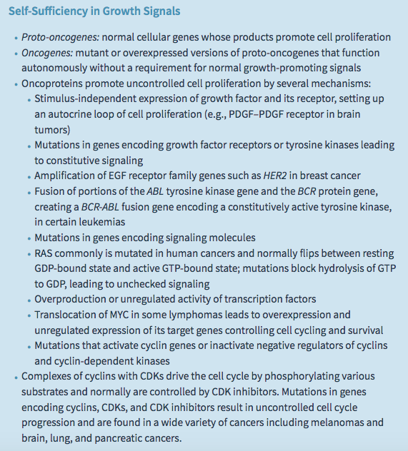

Slide 18
Insensitivity to Growth Inhibitory Signals: Tumor Suppressor genes
In principle, anti-growth signals can prevent cell proliferation by several complementary mechanisms. The signal may cause dividing cells to enter G0 (quiescence), where they remain until external cues prod their reentry into the proliferative pool.
Alternatively, the cells may enter a postmitotic, differentiated pool and lose replicative potential. Nonreplicative senescence, alluded to earlier, is another mechanism of escape from sustained cell growth.

Slide 19
The retinoblastoma gene (RB) was the first tumor suppressor gene to be discovered and is now considered the prototype of this family of cancer genes. As with many advances in medicine, the discovery of tumor suppressor genes was accomplished by the study of a rare disease—in this case, retinoblastoma, an uncommon childhood tumor. Approximately 60% of retinoblastomas are sporadic, while the remaining ones are familial, the predisposition to develop the tumor being transmitted as an autosomal dominant trait. To account for the sporadic and familial occurrence of an identical tumor, Knudson, in 1974, proposed his now famous two-hit hypothesis, which in molecular terms can be stated as follows:
Two mutations (hits) are required to produce retinoblastoma. These involve the RB gene, which has been mapped to chromosomal locus 13q14. Both of the normal alleles of the RB locus must be inactivated (hence the two hits) for the development of retinoblastoma.
In familial cases, children inherit one defective copy of the RB gene in the germ line; the other copy is normal. Retinoblastoma develops when the normal RB gene is lost in retinoblasts as a result of somatic mutation. Because in retinoblastoma families a single germ line mutation is sufficient to transmit disease risk, the trait has an autosomal dominant inheritance pattern.
In sporadic cases, both normal RB alleles are lost by somatic mutation in one of the retinoblasts. The end result is the same: a retinal cell that has lost both of the normal copies of the RB gene becomes cancerous.

Slide 20
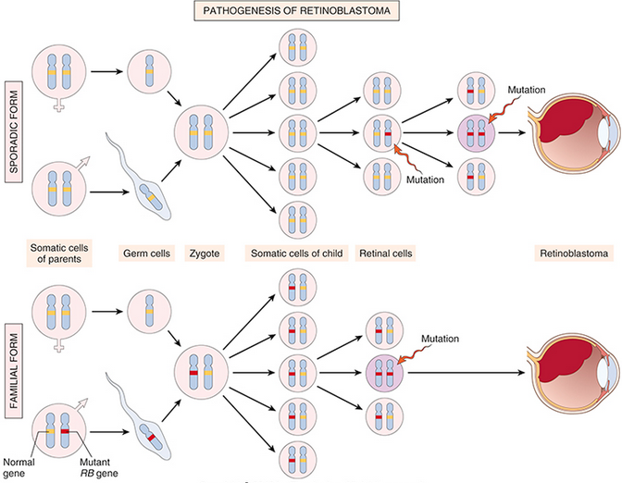
Pathogenesis of retinoblastoma. Two mutations of the RB chromosomal locus, on 13q14, lead to neoplastic proliferation of the retinal cells. In the sporadic form, both RB mutations in the tumor-founding retinal cell are acquired. In the familial form, all somatic cells inherit one mutant RB gene from a carrier parent, and as a result only one additional RB mutation in a retinal cell is required for complete loss of RB function.

Slide 21
The function of the RB protein is to regulate the G1/S checkpoint, the portal through which cells must pass before DNA replication commences.
Although each phase of the cell cycle circuitry is monitored carefully, the transition from G1 to S is an extremely important checkpoint in the cell cycle “clock.” In the G1 phase, diverse signals are integrated to determine whether the cell should progress through the cell cycle, or exit the cell cycle and differentiate. The RB gene product, RB, is a DNA-binding protein that serves as a point of integration for these diverse signals, which ultimately act by altering the phosphorylation state of RB. Specifically, signals that promote cell cycle progression lead to the phosphorylation and inactivation of RB, while those that block cell cycle progression act by maintaining RB in an active hypophosphorylated state.

Slide 22
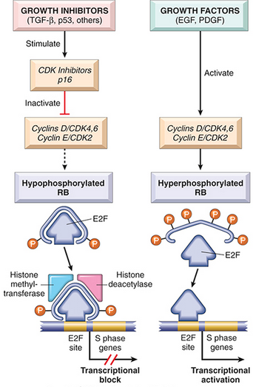
The role of RB in regulating the G1–S checkpoint of the cell cycle. Hypophosphorylated RB in complex with the E2F transcription factors binds to DNA, recruits chromatin remodeling factors (histone deacetylases and histone methyltransferases), and inhibits transcription of genes whose products are required for the S phase of the cell cycle. When RB is phosphorylated by the cyclin D–CDK4, cyclin D–CDK6, and cyclin E–CDK2 complexes, it releases E2F. The latter then activates transcription of S-phase genes. The phosphorylation of RB is inhibited by CDKIs, because they inactivate cyclin-CDK complexes. Virtually all cancer cells show dysregulation of the G1–S checkpoint as a result of mutation in one of four genes that regulate the phosphorylation of RB; these genes are RB, CDK4, cyclin D, and CDKN2A [p16]. EGF, Epidermal growth factor; PDGF, platelet-derived growth factor.

Slide 23
In view of the centrality of RB to the control of the cell cycle, an interesting question is why RB is not mutated in every cancer. In fact, mutations in other genes that control RB phosphorylation can mimic the effect of RB loss and are commonly found in many cancers that have normal RB genes. For example, mutational activation of CDK4 and overexpression of cyclin D favor cell proliferation by facilitating RB phosphorylation and inactivation. Indeed, cyclin D is overexpressed in many tumors because of amplification or translocation of the cyclin D1 gene. Mutational inactivation of genes encoding CDKIs also can drive the cell cycle by removing important brakes on cyclin/CDK activity.
The CDKN2A gene, which encodes the CDK inhibitor p16, is an extremely common target of deletion or mutational inactivation in human tumors.
It is now accepted that loss of normal cell cycle control is central to malignant transformation and that at least one of the four key regulators of the cell cycle (p16, cyclin D, CDK4, RB) is mutated in most human cancers. Notably, in cancers caused by certain oncogenic viruses, this is achieved through direct targeting of RB by viral proteins. For example, the human papillomavirus (HPV) E7 protein binds to the hypophosphorylated form of RB, preventing it from inhibiting the E2F transcription factors. Thus, RB is functionally deleted, leading to uncontrolled growth.

Slide 25
TP53: Guardian of the Genome
The p53-encoding tumor suppressor gene, TP53, is the most commonly mutated gene in human cancer. The p53 protein is a transcription factor that thwarts neoplastic transformation by three interlocking mechanisms:
activation of temporary cell cycle arrest (termed quiescence)
induction of permanent cell cycle arrest (termed senescence)
triggering of programmed cell death (termed apoptosis)
If RB is a “sensor” of external signals, p53 can be viewed as a central monitor of internal stress, directing the stressed cells toward one of these pathways.

Slide 26
A variety of stresses trigger the p53 response pathways, including anoxia, inappropriate pro-growth stimuli (e.g., unbridled MYC or RAS activity), and DNA damage. By managing the DNA damage response, p53 plays a central role in maintaining the integrity of the genome.
In nonstressed, healthy cells, p53 has a short half-life (20 minutes) because of its association with MDM2, a protein that targets p53 for destruction. When the cell is stressed, for example, by an assault on its DNA, “sensors” that include protein kinases such as ATM (ataxia telangiectasia mutated) are activated. These activated sensors catalyze posttranslational modifications in p53 that release it from MDM2, increasing its half-life and enhancing its ability to drive the transcription of target genes. Hundreds of genes whose transcription is triggered by p53 have been found. These genes suppress neoplastic transformation by three mechanisms:

Slide 27
p53-mediated cell cycle arrest may be considered the primordial response to DNA damage . It occurs late in the G1 phase and is caused mainly by p53-dependent transcription of the CDKI gene CDKN1A (p21). The p21 protein inhibits cyclin–CDK complexes and prevents phosphorylation of RB, thereby arresting cells in the G1 phase. Such a pause in cell cycling is welcome, because it gives the cells “breathing time” to repair DNA damage. The p53 protein also induces expression of DNA damage repair genes. If DNA damage is repaired successfully, p53 upregulates transcription of MDM2, leading to its own destruction and relief of the cell cycle block. If the damage cannot be repaired, the cell may enter p53-induced senescence or undergo p53-directed apoptosis.
p53-induced senescence is a form of permanent cell cycle arrest characterized by specific changes in morphology and gene expression that differentiate it from quiescence or reversible cell cycle arrest. Senescence requires activation of p53 and/or Rb and expression of their mediators, such as the CDKIs. The mechanisms of senescence are unclear but seem to involve global chromatin changes, which drastically and permanently alter gene expression.
p53-induced apoptosis of cells with irreversible DNA damage is the ultimate protective mechanism against neoplastic transformation. It is mediated by upregulation of several pro-apoptotic genes, including BAX and PUMA

Slide 28
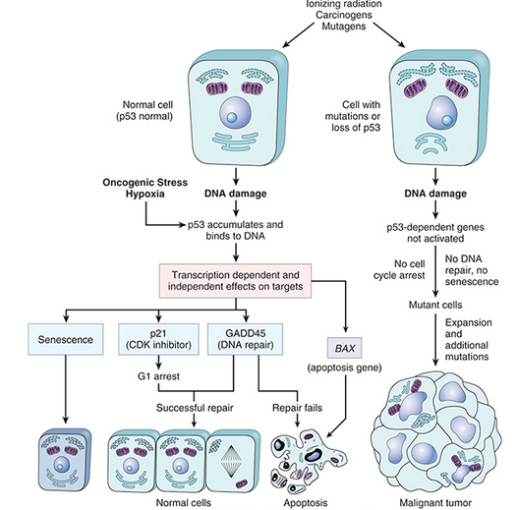
The role of p53 in maintaining the integrity of the genome. Activation of normal p53 by DNA-damaging agents or by hypoxia leads to cell cycle arrest in G1 and induction of DNA repair, by transcriptional upregulation of the cyclin-dependent kinase inhibitor CDKN1A (p21) and the GADD45 genes.
Successful repair of DNA allows cells to proceed with the cell cycle; if DNA repair fails, p53 triggers either apoptosis or senescence. In cells with loss or mutations of TP53, DNA damage does not induce cell cycle arrest or DNA repair, and genetically damaged cells proliferate, giving rise eventually to malignant neoplasms.

Slide 29
Confirming the importance of TP53 in controlling carcinogenesis, more than 70% of human cancers have a defect in this gene, and the remaining malignant neoplasms often have defects in genes upstream or downstream of TP53.
Biallelic abnormalities of the TP53 gene are found in virtually every type of cancer, including carcinomas of the lung, colon, and breast—the three leading causes of cancer deaths. In most cases, mutations affecting both TP53 alleles are acquired in somatic cells. In other tumors, such as certain sarcomas, the TP53 gene is intact but p53 function is lost because of amplification and overexpression of the MDM2 gene, which encodes a potent inhibitor of p53. Less commonly, patients inherit a mutant TP53 allele; the resulting disorder is called the Li-Fraumeni syndrome. As in the case with familial retinoblastoma, inheritance of one mutant TP53 allele predisposes affected individuals to develop malignant tumors because only one additional hit is needed to inactivate the second, normal allele. Patients with the Li-Fraumeni syndrome have a 25-fold greater chance of developing a malignant tumor by 50 years of age compared with the general population. In contrast to tumors developing in patients who inherit a mutant RB allele, the spectrum of tumors that develop in patients with the Li-Fraumeni syndrome is much more varied; the most common types are sarcomas, breast cancer, leukemia, brain tumors, and carcinomas of the adrenal cortex. Compared with individuals diagnosed with sporadic tumors, patients with Li-Fraumeni syndrome develop tumors at a younger age and may develop multiple primary tumors.

Slide 30
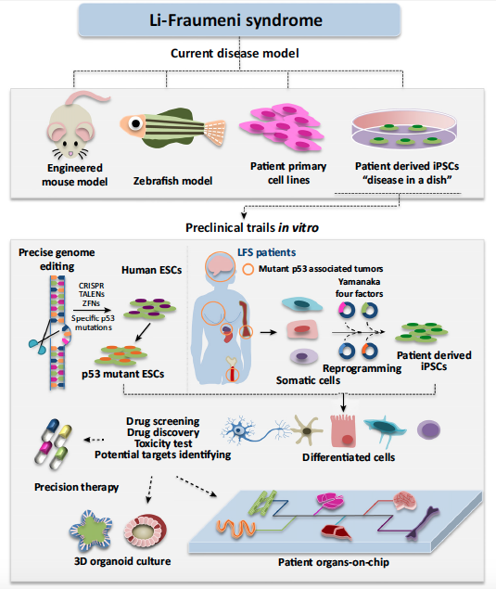

Slide 31
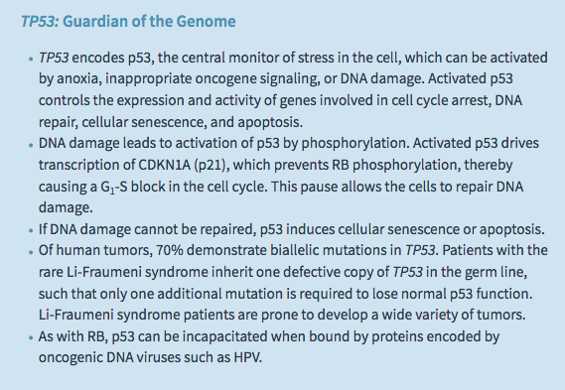

Slide 32
Transforming Growth Factor-β Pathway
In many forms of cancer, the growth-inhibiting effects of the TGF-β pathways are impaired by mutations affecting TGF-β signaling. These mutations may alter the type II TGF-β receptor or SMAD molecules that serve to transduce anti-proliferative signals from the receptor to the nucleus.
Mutations affecting the type II receptor are seen in cancers of the colon, stomach, and endometrium. Mutational inactivation of SMAD4, 1 of the 10 proteins known to be involved in TGF-β signaling, is common in pancreatic cancers. In other cancers, by contrast, loss of TGF-β–mediated growth control occurs at a level downstream of the core TGF-β signaling pathway; for example, there may be loss of p21 expression and/or overexpression of MYC. These tumor cells can then use other elements of the TGF-β–induced program, including immune system suppression or promotion of angiogenesis, to facilitate tumor progression. Thus, TGF-β can function to prevent or promote tumor growth, depending on the state of other genes in the cell. Indeed, in many late-stage tumors, TGF-β signaling activates epithelial-to-mesenchymal transition (EMT), a process that promotes migration, invasion, and metastasis.

Slide 33
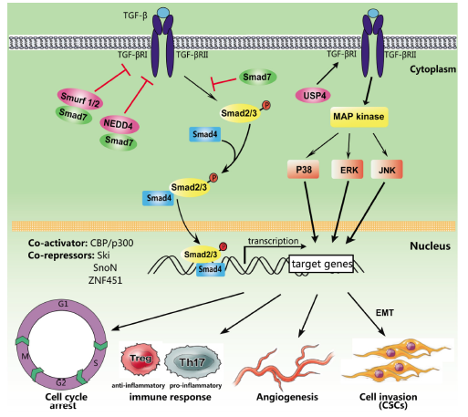

Slide 34
Contact Inhibition, NF2, and APC
When cancer cells are grown in the laboratory, their proliferation fails to be inhibited when they come in contact with each other. This is in sharp contrast to nontransformed cells, which stop proliferating once they form confluent monolayers. The mechanisms that govern contact inhibition are only now being discovered. Cell–cell contacts in many tissues are mediated by homodimeric interactions between transmembrane proteins called cadherins. E-cadherin (E for epithelial) mediates cell–cell contact in epithelial layers. Two mechanisms have been proposed to explain how E-cadherin maintains contact inhibition:

Slide 35
One mechanism is mediated by the tumor suppressor gene NF2. Its product, neurofibromin-2, more commonly called merlin, acts downstream of E-cadherin in a signling pathway that helps fo maintain contact inhibition. Homozygous loss of NF2 is known to cause certain neural tumors, and germ line mutations in NF2 are associated with a tumor-prone hereditary condition called neurofibromatosis type 2.
A second mechanism by which E-cadherin may regulate contact inhibition involves its ability to bind β-catenin, another signaling protein. β-catenin is a key component of the WNT signaling pathway which has broad but as of yet incompletely understood roles in regulating the morphology and organization of epithelial cells lining structures such as the gut.

Slide 36
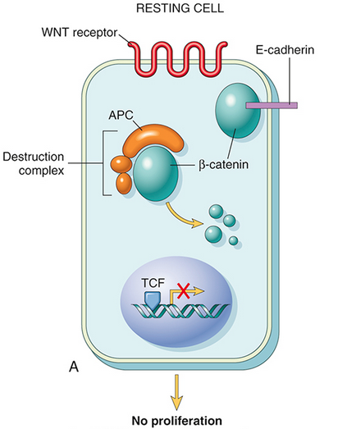
The role of APC in regulating the stability and function of β-catenin.
APC and β-catenin are components of the WNT signaling pathway. (A) In resting cells (not exposed to WNT), β-catenin forms a macromolecular complex containing the APC protein. This complex leads to the destruction of β-catenin, and intracellular levels of β-catenin are low.

Slide 37
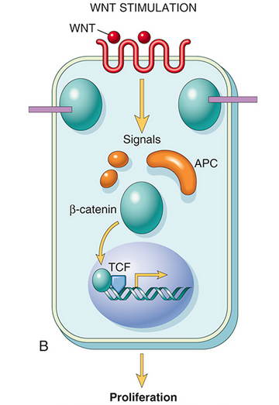
(B) When cells are stimulated by secreted WNT molecules, the destruction complex is deactivated, β-catenin degradation does not occur, and cytoplasmic levels increase. β-Catenin translocates to the nucleus, where it binds to TCF, a transcription factor that activates several genes involved in the cell cycle.

Slide 38
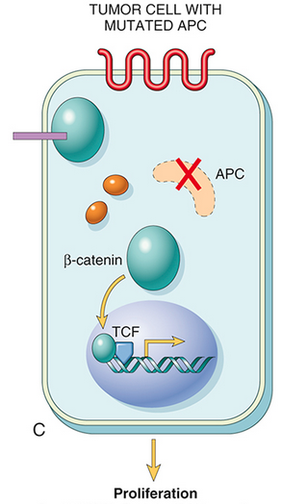
(C) When APC is mutated or absent, the destruction of β-catenin cannot occur. β-Catenin translocates to the nucleus and coactivates genes that promote the cell cycle, and cells behave as if they are under constant stimulation by the WNT pathway.

Slide 39
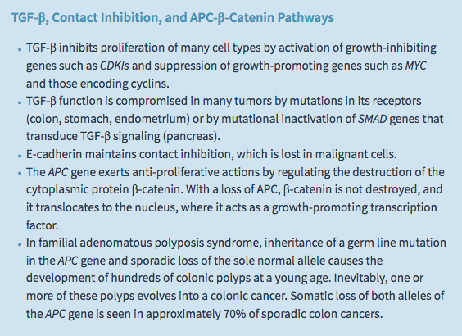

Slide 40
Altered Cellular Metabolism
Even in the presence of ample oxygen, cancer cells demonstrate a distinctive form of cellular metabolism characterized by high levels of glucose uptake and increased conversion of glucose to lactose (fermentation) via the glycolytic pathway. This phenomenon, called the Warburg effect and also known as aerobic glycolysis, has been recognized for many years (indeed, Otto Warburg received the Nobel Prize in 1931 for its discovery).
Clinically, the “glucose-hunger” of tumors is used to visualize tumors via positron emission tomography (PET) scanning, in which patients are injected with 18F-fluorodeoxyglucose, a glucose derivative that is preferentially taken up into tumor cells (as well as normal, actively dividing tissues such as the bone marrow). Most tumors are PET-positive, and rapidly growing ones are markedly so.

Slide 41
The answer to this riddle is simple: Aerobic glycolysis provides rapidly dividing tumor cells with metabolic intermediates that are needed for the synthesis of cellular components, whereas mitochondrial oxidative phosphorylation does not.
The reason growing cells rely on aerobic glycolysis becomes readily apparent when one considers that a growing cell has a strict biosynthetic requirement; it must duplicate all of its cellular components—DNA, RNA, proteins, lipid, and organelles—before it can divide and produce two daughter cells. While oxidative phosphorylation yields abundant ATP, it fails to produce any carbon moieties that can be used to build the cellular components needed for growth (proteins, lipids, and nucleic acids). Even cells that are not actively growing must shunt some metabolic intermediates away from oxidative phosphorylation in order to synthesize macromolecules that are needed for cellular maintenance.

Slide 42
Metabolic reprogramming is produced by signaling cascades downstream of growth factor receptors, the very same pathways that are deregulated by mutations in oncogenes and tumors suppressor genes in cancers. Thus, whereas in rapidly dividing normal cells aerobic glycolysis ceases when the tissue is no longer growing, in cancer cells this reprogramming persists due to the action of oncogenes and the loss of tumor suppressor gene function. important points of cross-talk between pro–growth signaling factors and cellular metabolism:
Growth factor receptor signaling. In addition to transmitting growth signals to the nucleus, signals from growth factor receptors also influence metabolism by upregulating glucose uptake and inhibiting the activity of pyruvate kinase, which catalyzes the last step in the glycolytic pathway, the conversion of phosphoenolpyruvate to pyruvate. This creates a damming effect that leads to the buildup of upstream glycolytic intermediates, which are siphoned off for synthesis of DNA, RNA, and protein.

Slide 43
RAS signaling. Signals downstream of RAS upregulate the activity of glucose transporters and multiple glycolytic enzymes, thus increasing glycolysis; promote shunting of mitochondrial intermediates to pathways leading to lipid biosynthesis; and stimulate factors that are required for protein synthesis.
MYC. As mentioned earlier, pro-growth pathways upregulate expression of the transcription factor MYC, which drives changes in gene expression that support anabolic metabolism and cell growth. Among the MYC-regulated genes are those for several glycolytic enzymes and glutaminase, which is required for mitochondrial utilization of glutamine, a key source of carbon moieties needed for biosynthesis of cellular building blocks.

Slide 44
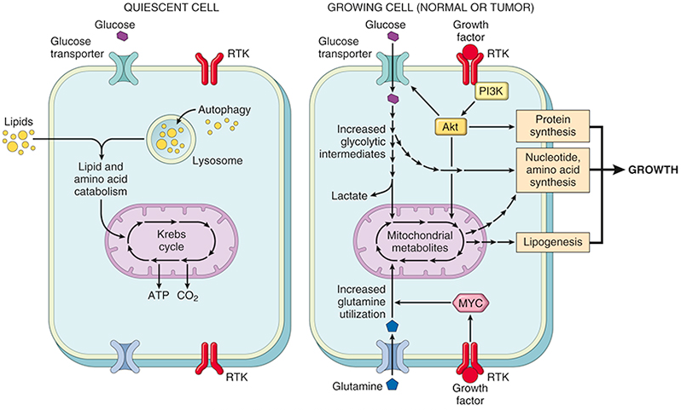
Metabolism and cell growth. Quiescent cells rely mainly on the Krebs cycle for ATP production; if starved, autophagy (self-eating) is induced to provide a source of fuel. When stimulated by growth factors, normal cells markedly upregulate glucose and glutamine uptake, which provide carbon sources for synthesis of nucleotides, proteins, and lipids. In cancers, oncogenic mutations involving growth factor signaling pathways and other key factors such as MYC deregulate these metabolic pathways, an alteration known as the Warburg effect.

Slide 45
Autophagy
Autophagy is a state of severe nutrient deficiency in which cells not only arrest their growth, but also cannibalize their own organelles, proteins, and membranes as carbon sources for energy production.
If this adaptation fails, the cells die. Tumor cells often seem to be able to grow under marginal environmental conditions without triggering autophagy, suggesting that the pathways that induce autophagy are deranged. In keeping with this, several genes that promote autophagy are tumor suppressors. Whether autophagy is always bad from the vantage point of the tumor, however, remains a matter of active investigation and debate. For example, under conditions of severe nutrient deprivation, tumor cells may use autophagy to become “dormant,” a state of metabolic hibernation that allows cells to survive hard times for long periods. Such cells are believed to be resistant to therapies that kill actively dividing cells, and could therefore be responsible for therapeutic failures. Thus, autophagy may be a tumor’s friend or foe depending on how the signaling pathways that regulate it are “wired” in a given tumor.

Slide 46
Oncometabolism
Another surprising group of genetic alterations discovered through tumor genome sequencing studies are mutations in enzymes that participate in the Krebs cycle. Of these, mutations in isocitrate dehydrogenase (IDH) have garnered the most interest, as they have revealed a new mechanism of oncogenesis termed oncometabolism
The proposed steps in the oncogenic pathway involving IDH are as follows:
IDH acquires a mutation that leads to a specific amino acid substitution involving residues in the active site of the enzyme. As a result, the mutated protein loses it ability to function as an isocitrate dehydrogenase and instead acquires a new enzymatic activity that catalyzes the production of 2-hydroxglutarate (2-HG).
2-HG in turn acts as an inhibitor of several other enzymes that are members of the TET family, including TET2.
TET2 is one of several factors that regulate DNA methylation, which you will recall is an epigenetic modification that controls normal gene expression and often goes awry in cancer. According to the model, loss of TET2 activity leads to abnormal patterns of DNA methylation.
Abnormal DNA methylation in turn leads to misexpression of currently unknown cancer genes, which drive cellular transformation and oncogenesis.

Slide 47
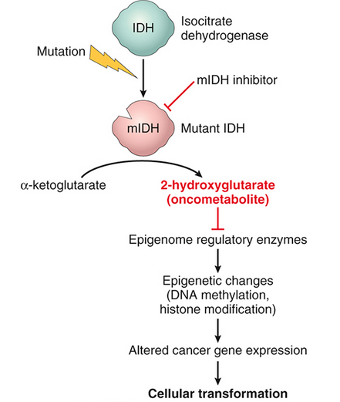
Proposed action of the oncometabolite 2-hydroxyglutarate (2-HG) in cancer cells with mutated isocitrate dehydrogenase (mIDH).

Slide 48
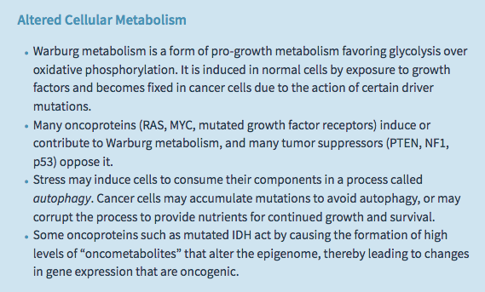
Thus, according to this scenario, mutated IDH acts as an oncoprotein by producing 2-HG, which is considered a prototypical oncometabolite. Oncogenic IDH mutations have now been described in a diverse collection of cancers, including a sizable fraction of cholangiocarcinomas, gliomas, acute myeloid leukemias, and sarcomas. Of clinical significance, because the mutated IDH proteins have an altered structure, it has been possible to develop drugs that inhibit mutated IDH and not the normal IDH enzyme. These drugs are now being tested in cancer patients and have produced encouraging therapeutic responses. This developing story is a remarkable example of how detailed understanding of oncogenic mechanisms can yield entirely new kinds of anti-cancer drugs.

Slide 49
Evasion of Cell Death
Tumor cells frequently contain mutations in genes that regulate apoptosis, making the cells resistant to cell death.
Apoptosis, or regulated cell death, refers to an orderly dismantling of cells into component pieces, which are then efficiently consumed by neighboring cells and professional phagocytes without stimulating inflammation.
You will recall that there are two pathways that lead to apoptosis: the extrinsic pathway, triggered by the death receptors FAS and FAS-ligand; and the intrinsic pathway (also known as the mitochondrial pathway), initiated by perturbations such as loss of growth factors and DNA damage.

Slide 50
Cancer cells are subject to a number of intrinsic stresses that can initiate apoptosis, particularly DNA damage, but also metabolic disturbances stemming from dysregulated growth as well as hypoxia caused by insufficient blood supply.
These stresses are enhanced manyfold when tumors are treated with chemotherapy or radiation therapy, which kill tumor cells by activating the intrinsic pathway of apoptosis. Thus, there is strong selective pressure, both before and during therapy, for cancer cells to develop resistance to intrinsic stresses that may induce apoptosis. Accordingly, evasion of apoptosis by cancer cells occurs mainly by way of acquired mutations and changes in gene expression that disable key components of the intrinsic pathway, or that reset the balance of regulatory factors so as to favor cell survival in the face of intrinsic stresses.

Slide 51
Loss of TP53 function.
TP53 is commonly mutated in cancers at diagnosis, and the frequency of TP53 mutations is even higher in tumors that relapse after therapy. In addition to mutation of TP53, other lesions in cancers impair p53 function indirectly, most notably amplification of MDM2, which encodes an inhibitor of p53. Loss of p53 function prevents the upregulation of PUMA, a pro-apoptotic BH3-only member of the BCL2 family that is a direct target of p53. As a result, cells survive levels of DNA damage and cell stress that otherwise would result in their death.

Slide 52
Overexpression of anti-apoptotic members of the BCL2 family
Overexpression of BCL2 is a common event leading to the protection of tumor cells from apoptosis and occurs through several mechanisms. One of the best understood examples is found follicular lymphoma, a B-cell tumor carrying a characteristic (14;18)(q32;q21) translocation that fuses the BCL2 (located at 18q21) to the transcriptionally active immunoglobulin heavy chain gene (located at 14q32). The resulting overabundance of BCL2 protects lymphocytes from apoptosis and allows them to survive for abnormally long periods, producing a steady accumulation of B lymphocytes that results in lymphadenopathy.
Because BCL2-overexpressing follicular lymphomas arise in large part through reduced cell death rather than explosive cell proliferation, they tend to be indolent (slow-growing). In other tumors such as chronic lymphocytic leukemia, it appears that BCL2 is upregulated because of loss of expression of specific micro-RNAs that normally dampen BCL2 expression. Many other mechanisms leading to overexpression of anti-apoptotic members of the BCL2 family have been described, particularly in the setting of resistance to chemotherapy. For example, amplification of the MCL1 gene is seen in a subset of lung and breast cancers.

Slide 53
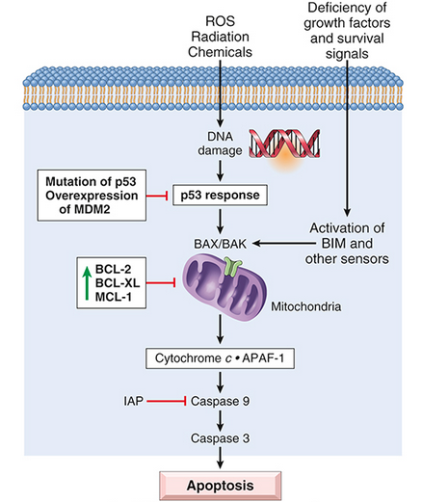
Intrinsic pathway of apoptosis and major mechanisms used by tumor cells to evade cell death. (1) Loss of p53, either through mutation or through antagonism by MDM2. (2) Reduced egress of cytochrome c from mitochondria as a result of upregulation of anti-apoptotic factors such as BCL2, BCL-XL, and MCL-1. IAP, Inhibitor of apoptosis.

Slide 54
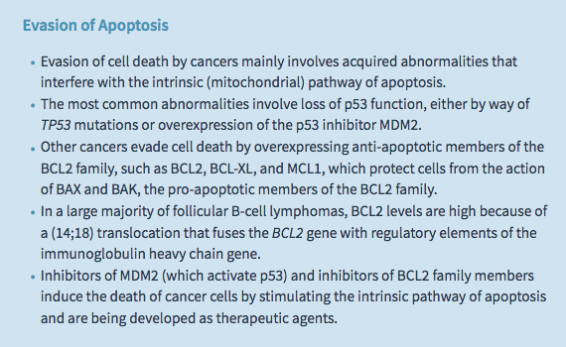

Slide 55
Limitless Replicative Potential (Immortality)
Tumor cells, unlike normal cells, are capable of limitless replication. Most normal human cells have a capacity of at most 70 doublings. Thereafter, the cells lose the ability to divide and enter replicative senescence. This phenomenon has been ascribed to progressive shortening of telomeres at the ends of chromosomes.
Markedly eroded telomeres are recognized by the DNA repair machinery as double-stranded DNA breaks, leading to cell cycle arrest and senescence, mediated by TP53 and RB. In cells in which TP53 or RB mutations are disabled by mutations, the nonhomologous end-joining pathway is activated in a last-ditch effort to save the cell, joining the shortened ends of two chromosomes.
Such an inappropriately activated repair system results in dicentric chromosomes that are pulled apart at anaphase, resulting in new double-stranded DNA breaks. The resulting genomic instability from the repeated bridge–fusion–breakage cycles eventually produces mitotic catastrophe, characterized by massive apoptosis.
It follows that for tumors to acquire the ability to grow indefinitely, loss of growth restraints is not enough; both cellular senescence and mitotic catastrophe must also be avoided

Slide 56
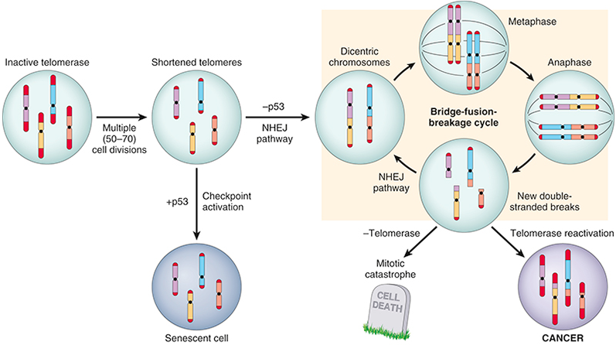
Escape of cells from replicative senescence and mitotic catastrophe caused by telomere shortening.

Slide 57
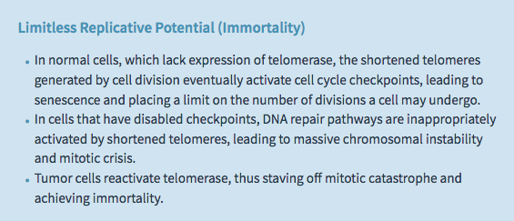

Slide 58
Sustained Angiogenesis
Even if a solid tumor possesses all of the genetic aberrations that are required for malignant transformation, it cannot enlarge beyond 1 to 2 mm in diameter unless it has the capacity to induce angiogenesis.
Like normal tissues, tumors require delivery of oxygen and nutrients and removal of waste products; presumably the 1- to 2-mm zone represents the maximal distance across which oxygen, nutrients, and waste can diffuse to and from blood vessels. Growing cancers stimulate neoangiogenesis, during which vessels sprout from previously existing capillaries.

Slide 59
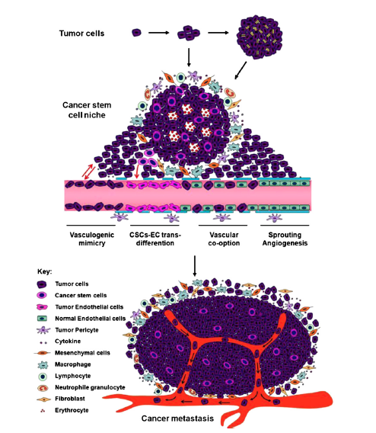
Neovascularization has a dual effect on tumor growth: perfusion supplies needed nutrients and oxygen, and newly formed endothelial cells stimulate the growth of adjacent tumor cells by secreting growth factors, such as insulin-like growth factors (IGFs) and PDGF. While the resulting tumor vasculature is effective at delivering nutrients and removing wastes, it is not entirely normal; the vessels are leaky and dilated, and have a haphazard pattern of connection, features that can be appreciated on angiograms. By permitting tumor cells access to these abnormal vessels, angiogenesis also contributes to metastasis. Angiogenesis is thus an essential facet of malignancy.

Slide 60
The local balance of angiogenic and anti-angiogenic factors is influenced by several factors:
Relative lack of oxygen due to hypoxia stabilizes HIF1α, an oxygen-sensitive transcription factor which then activates the transcription of proangiogenic cytokines such as VEGF. These factors create an angiogenic gradient that stimulates the proliferation of endothelial cells and guides the growth of new vessels toward the tumor.
Mutations involving tumor suppressors and oncogenes in cancers also tilt the balance in favor of angiogenesis. For example, p53 stimulates expression of anti-angiogenic molecules, such as thrombospondin-1, and represses expression of proangiogenic molecules, such as VEGF. Thus, loss of p53 in tumor cells provides a more permissive environment for angiogenesis.
The transcription of VEGF also is influenced by signals from the RAS-MAP kinase pathway, and gain-of-function mutations in RAS or MYC upregulate the production of VEGF. Notably, elevated levels of VEGF can be detected in the serum and urine of a significant fraction of cancer patients.

Slide 61
