Slide 1
Genetic and
Pediatric Diseases

Slide 2
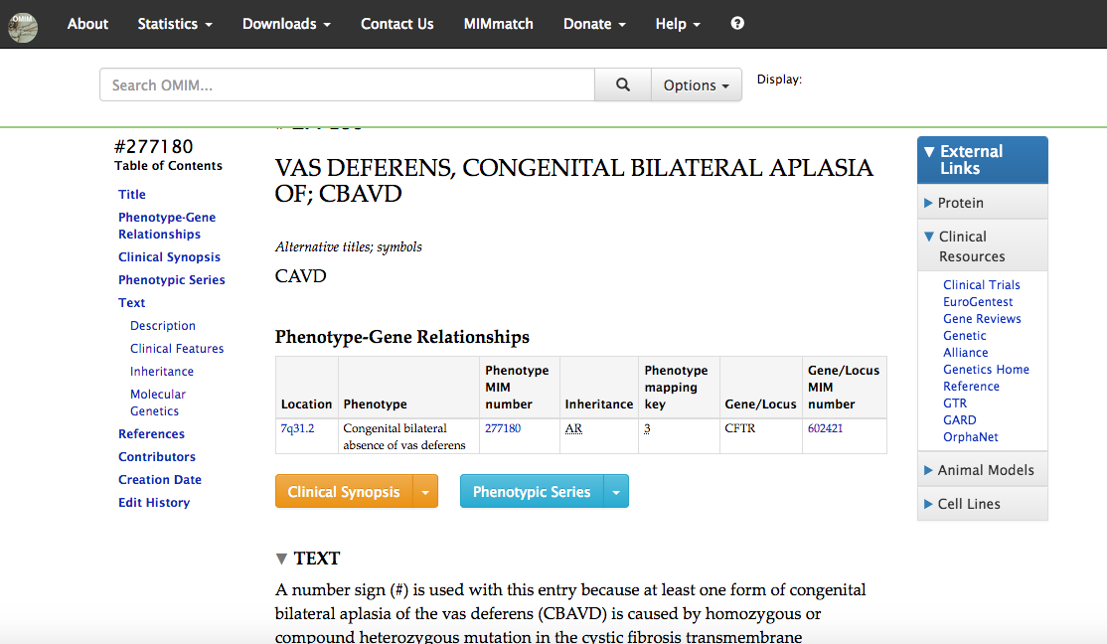
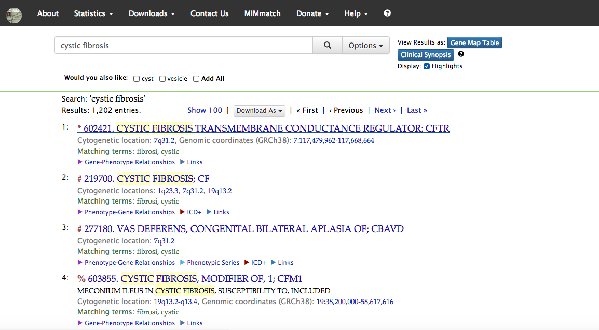
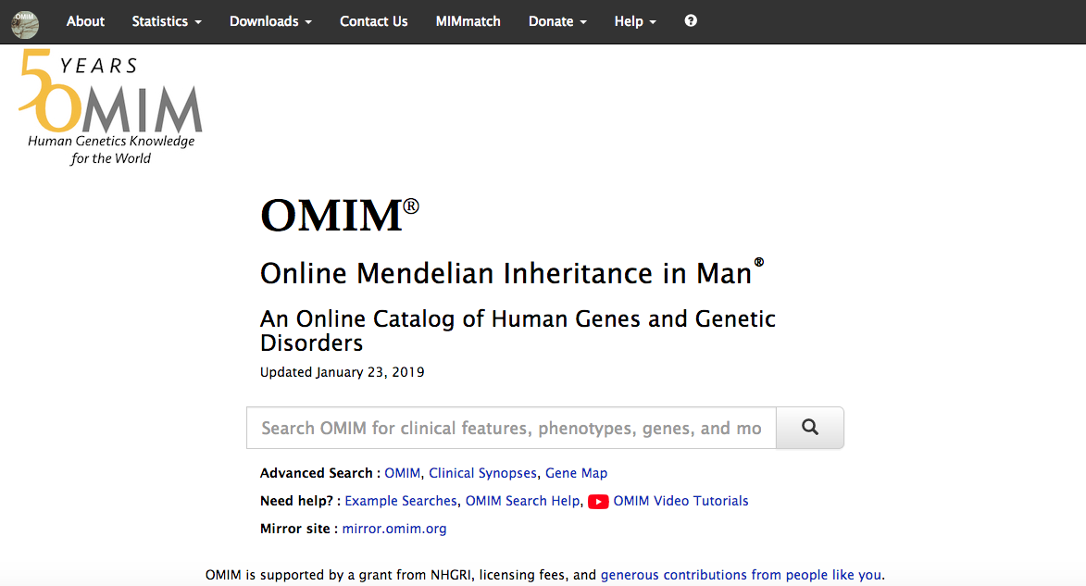
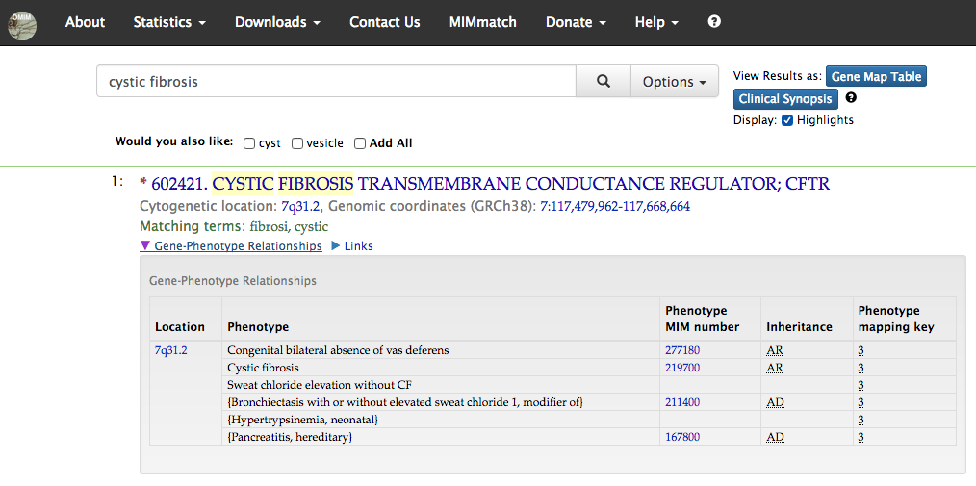

Slide 3
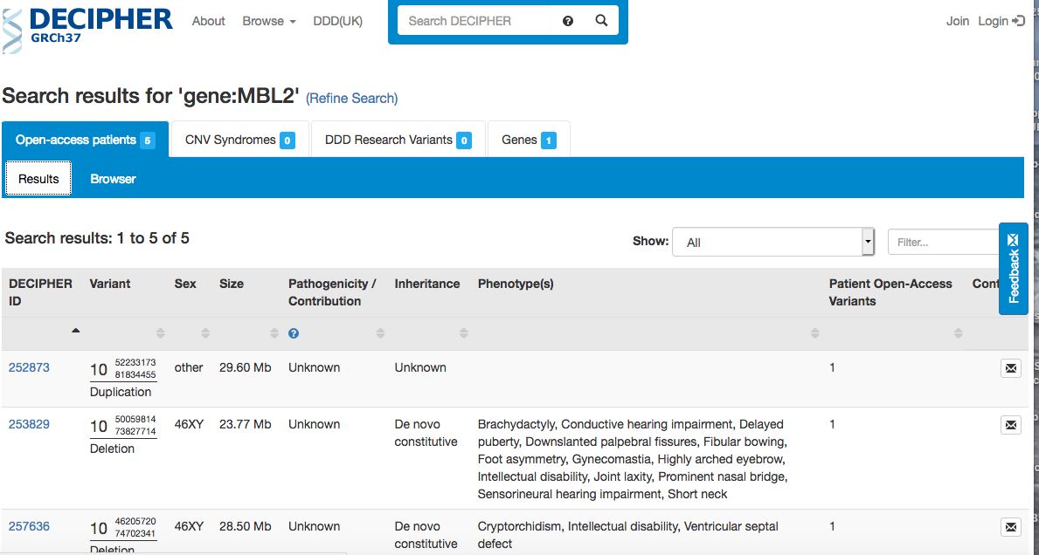

Slide 4
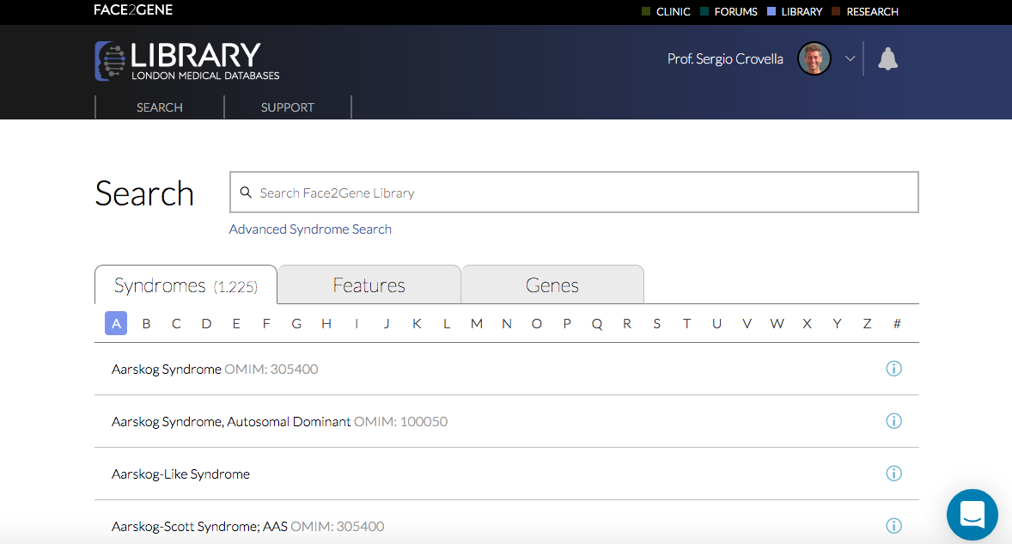
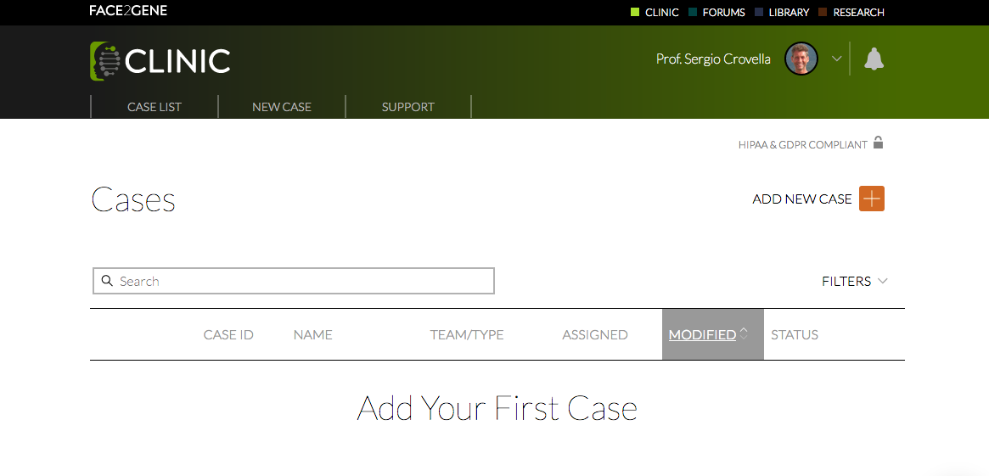

Slide 5
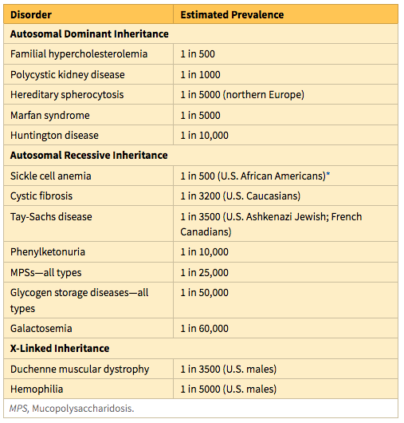

Slide 6
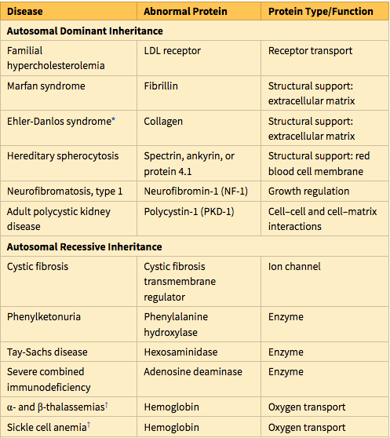

Slide 7
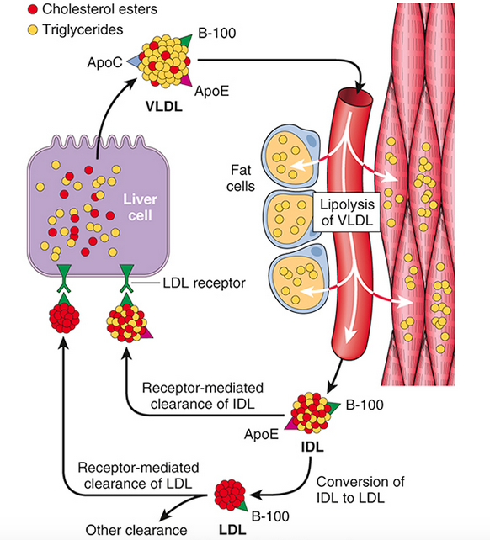
Low-density lipoprotein (LDL) metabolism and the role of the liver in its synthesis and clearance. Lipolysis of very-low-density lipoprotein (VLDL) by lipoprotein lipase in the capillaries releases triglycerides, which are then stored in fat cells and used as a source of energy in skeletal muscles. IDL (intermediate-density lipoprotein) remains in the blood and is taken up by the liver.

Slide 8
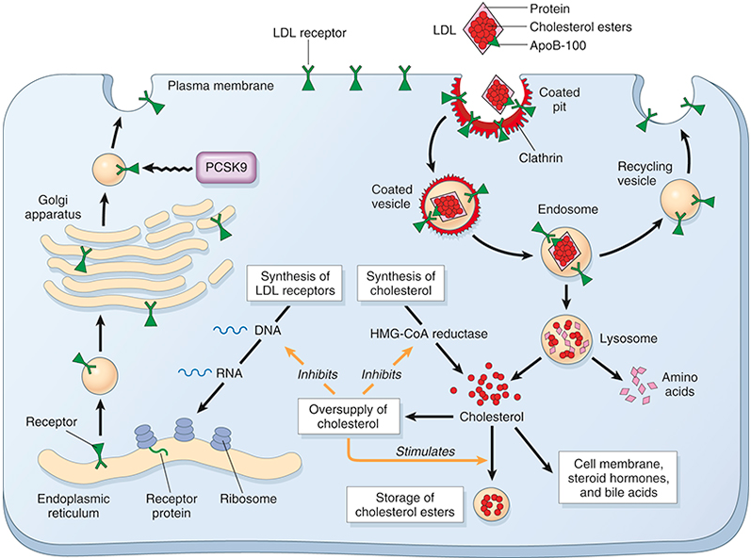
The LDL receptor pathway and regulation of cholesterol metabolism. The yellow arrows show three regulatory functions of free intracellular cholesterol: (1) suppression of cholesterol synthesis by inhibition of HMG-CoA reductase, (2) stimulating the storage of excess cholesterol as esters, and (3) inhibition of synthesis of LDL receptors. PCSK9 causes intracellular degradation of LDL receptors in liver cells, reducing the level of LDL receptors on the cell membrane. HMG-CoA reductase, 3-Hydroxy-3-methylglutaryl–coenzyme A reductase; LDL, low-density lipoprotein; PCSK9, proprotein convertase subtilisin/kexin type 9

Slide 9
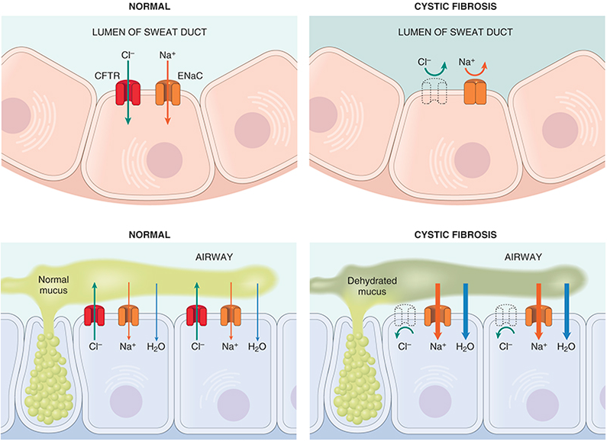
(Top) In CF, a chloride channel defect in the sweat duct causes increased chloride and sodium concentration in sweat. (Bottom) Patients with CF have decreased chloride secretion and increased sodium and water reabsorption in the airways, leading to dehydration of the mucus layer coating epithelial cells, defective mucociliary action, and mucous plugging. CFTR, Cystic fibrosis transmembrane conductance regulator; ENaC, epithelial sodium channel responsible for intracellular sodium conduction.

Slide 10
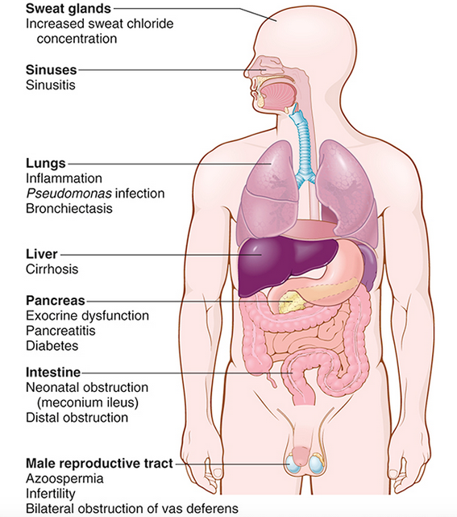

Slide 11
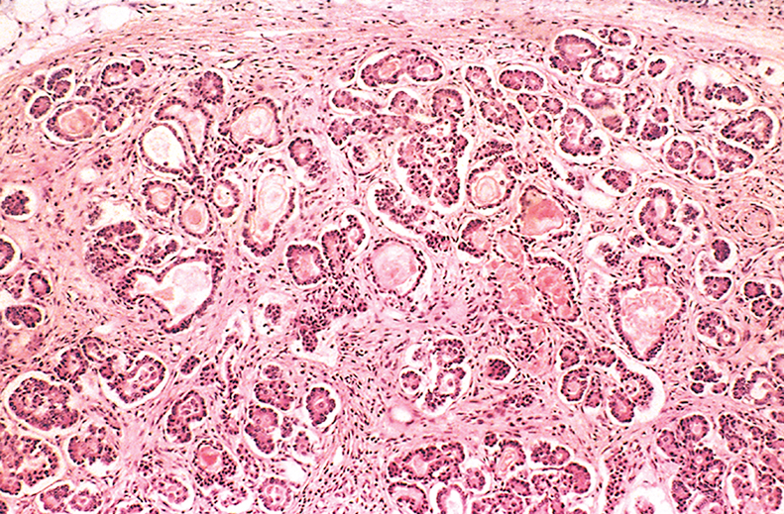
Mild to moderate changes of CF in the pancreas. The ducts are dilated and plugged with eosinophilic mucin, and the parenchymal glands are atrophic and replaced by fibrous tissue.

Slide 12
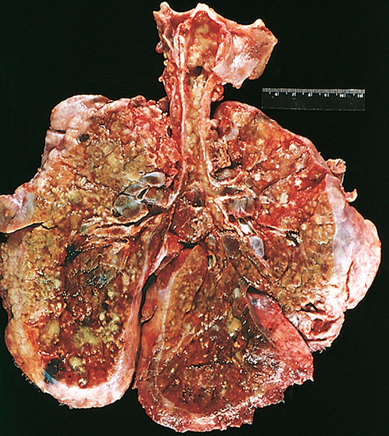
Lungs of a patient who died of cystic fibrosis. Extensive mucous plugging and dilation of the tracheobronchial tree are apparent. The pulmonary parenchyma is consolidated by a combination of both secretions and pneumonia; the greenish discoloration is the product of Pseudomonas infections.

Slide 13
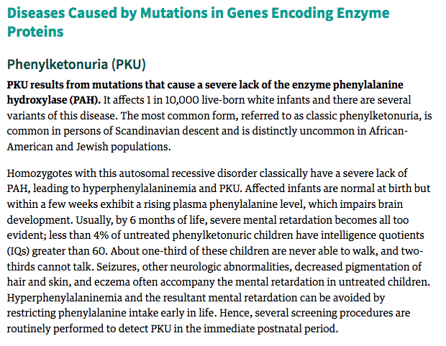

Slide 14
The phenylalanine hydroxylase system. NADH, Nicotinamide adenine dinucleotide, reduced form
The biochemical abnormality in PKU is an inability to convert phenylalanine into tyrosine.

Slide 15
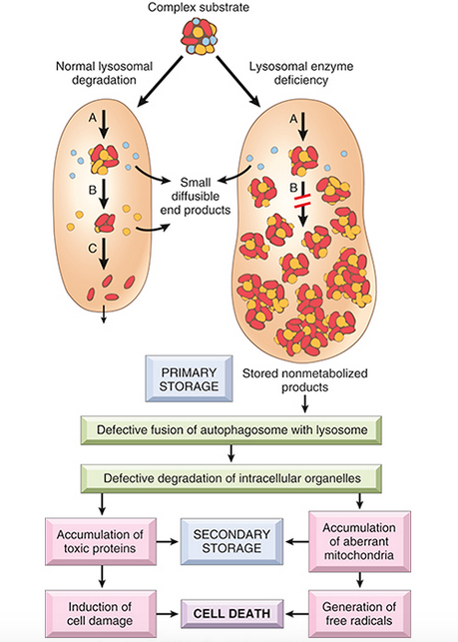
Pathogenesis of lysosomal storage diseases. In this example, a complex substrate is normally degraded by a series of lysosomal enzymes into soluble end products ( A, B and C). If there is a deficiency or malfunction of one of the enzymes (e.g., B), catabolism is incomplete, and insoluble intermediates accumulate in the lysosomes. In addition to this primary storage, secondary storage and toxic effects result from defective autophagy.

Slide 16
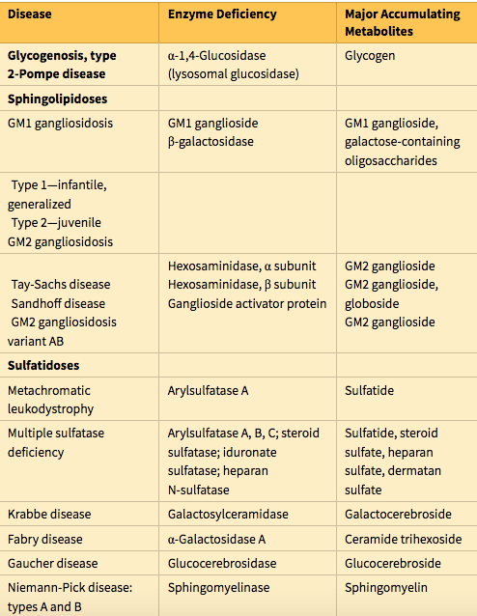

Slide 17
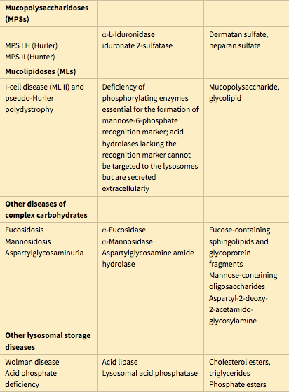

Slide 18
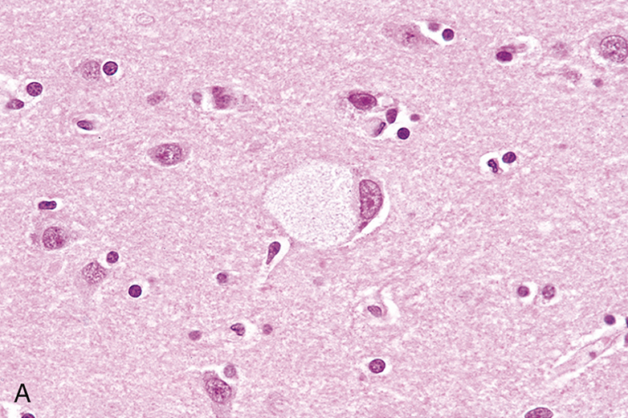
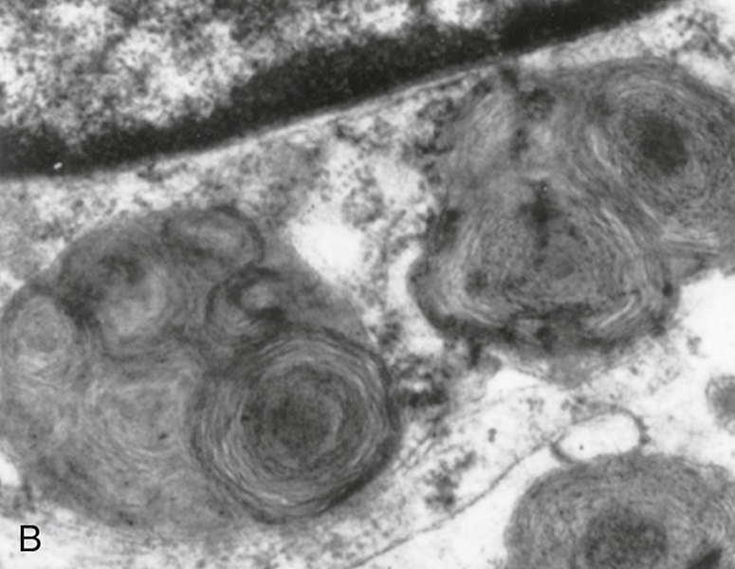
Ganglion cells in Tay-Sachs disease. (A) Under the light microscope, a large neuron has obvious lipid vacuolation. (B) A portion of a neuron under the electron microscope shows prominent lysosomes with whorled configurations just below part of the nucleus.

Slide 19
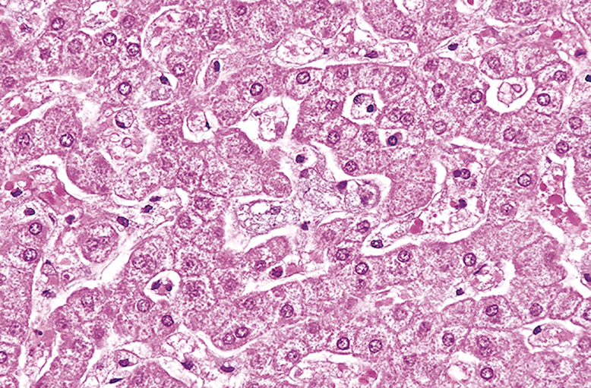
Niemann-Pick disease in liver. The hepatocytes and Kupffer cells have a foamy, vacuolated appearance resulting from deposition of lipids

Slide 20
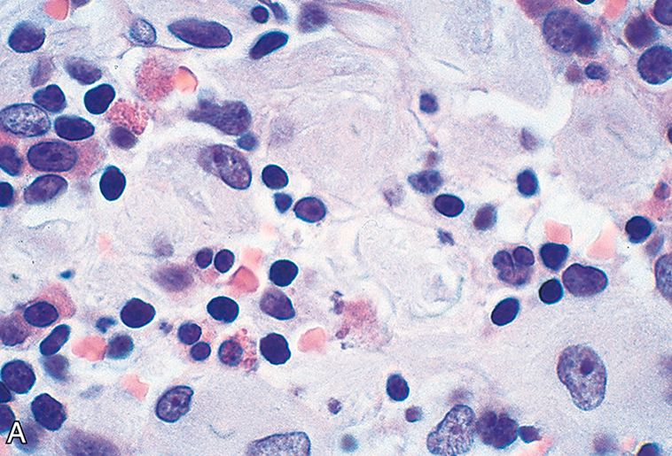
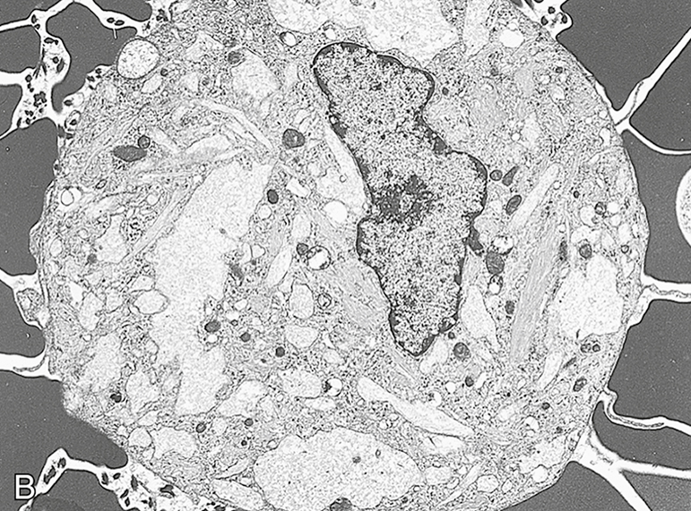
Gaucher disease involving the bone marrow. (A) Gaucher cells with abundant lipid-laden “wrinkled” cytoplasm. (B) Electron micrograph of Gaucher cells with elongated distended lysosomes.

Slide 21
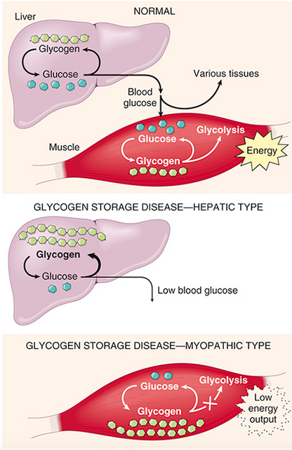
(Top) A simplified scheme of normal glycogen metabolism in the liver and skeletal muscles. (Middle) The effects of an inherited deficiency of hepatic enzymes involved in glycogen metabolism. (Bottom) The consequences of a genetic deficiency in the enzymes that metabolize glycogen in skeletal muscles.

Slide 22
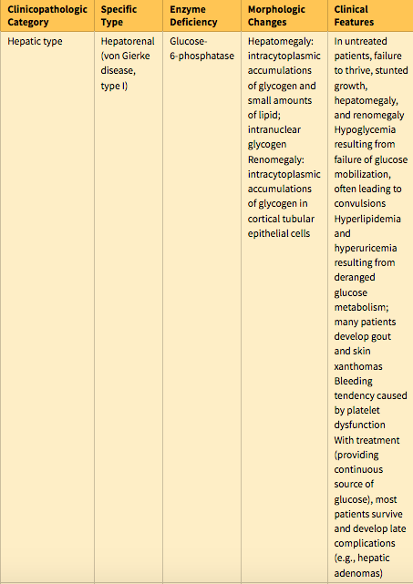

Slide 23
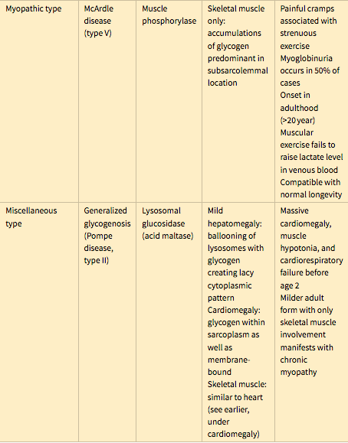

Slide 24
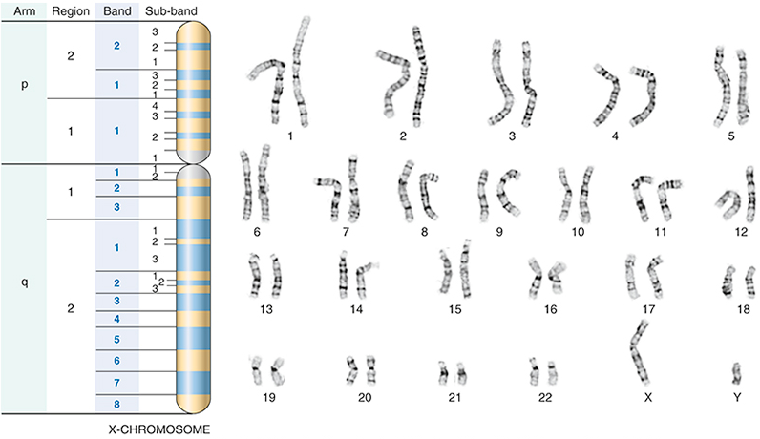
G-banded karyotype from a normal male (46,XY). Also shown is the banding pattern of the X-chromosome with nomenclature of arms, regions, bands, and subbands.

Slide 25
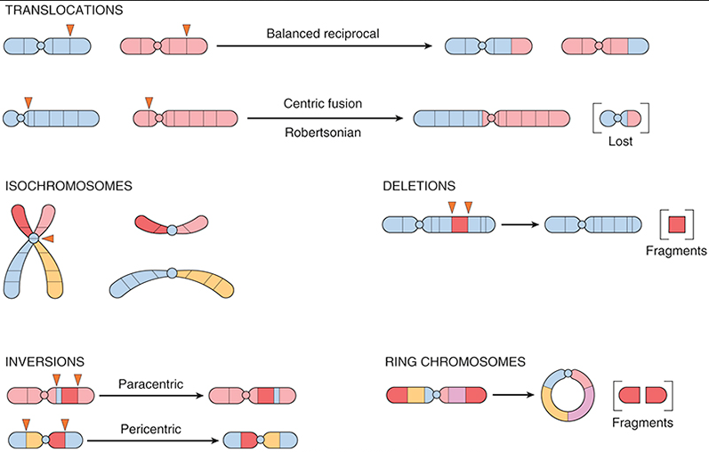
Types of chromosomal rearrangements

Slide 26
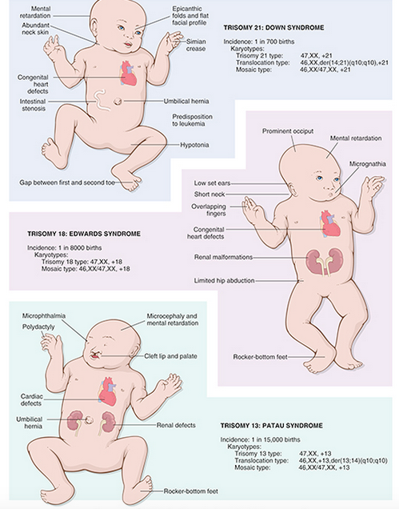

Slide 27
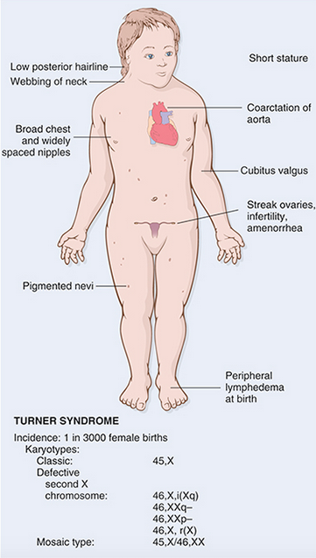

Slide 28
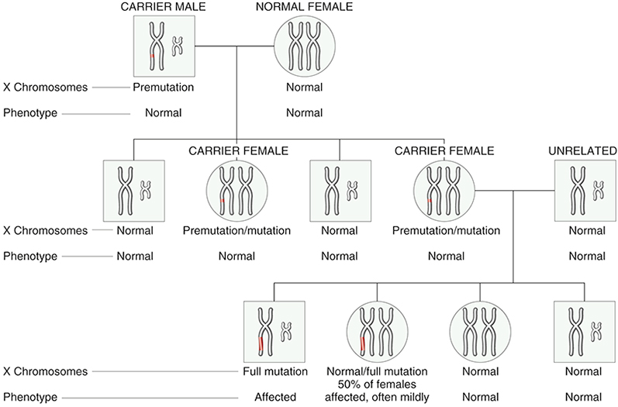
Fragile X pedigree. X and Y chromosomes are shown. Note that in the first generation, all sons are normal and all females are carriers (harbor a premutation). During oogenesis in the carrier female, premutation expands to full mutation; hence, in the next generation, all males who inherit the X with full mutation are affected. However, only 50% of females who inherit the full mutation are affected, and often only mildly.

Slide 29
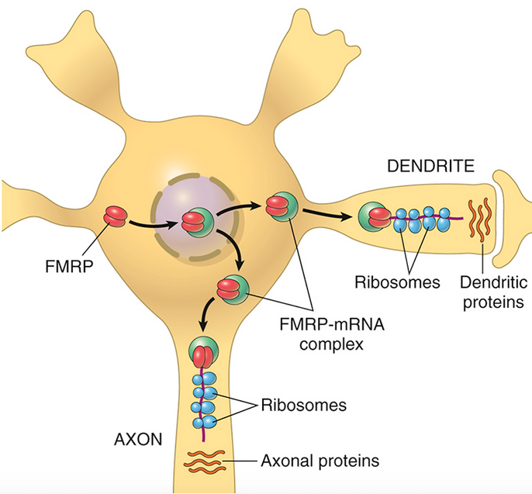
A model for the action of familial mental retardation protein (FMRP) in neurons. FMRP plays a critical role in regulating the translation of axonal proteins from bound RNAs. These locally produced proteins, in turn, play diverse roles in the microenvironment of the synapse.

Slide 30
Sites of expansion and the affected sequence in selected diseases caused by nucleotide repeat mutations. UTR, Untranslated region. *Although not strictly a trinucleotide-repeat disease, progressive myoclonus epilepsy is caused, like others in this group, by a heritable DNA expansion. The expanded segment is in the promoter region of the gene

Slide 31
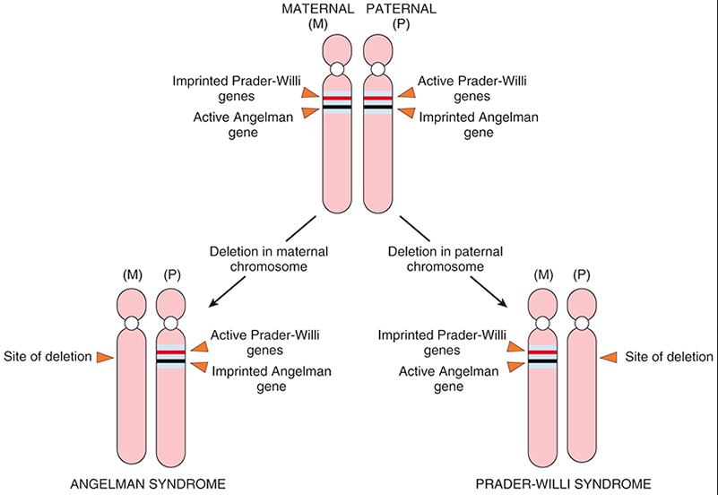
Genetics of Angelman and Prader-Willi syndromes

Slide 32
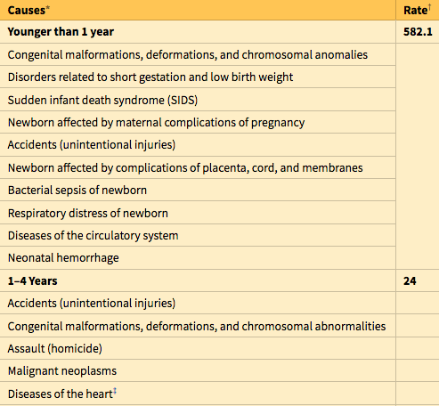
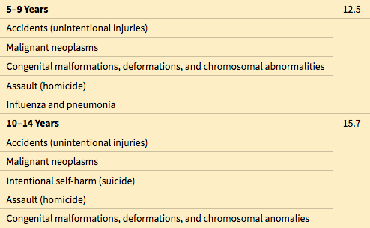
Pediatric Diseases
During each stage of development, infants and children are prey to a somewhat different group of diseases. Clearly, diseases of infancy (i.e., in the first year of life) pose the highest risk of death. During this phase, the neonatal period (the first 4 weeks of life) is unquestionably the most hazardous time.
Congenital Anomalies
Congenital anomalies are structural defects that are present at birth, although some, such as cardiac defects and renal anomalies, may not become clinically apparent until years later. Congenital anomalies are an important cause of infant mortality.

Slide 33
Malformations are primary errors of morphogenesis. In other words, there is an intrinsically abnormal developmental process. Malformations usually are multifactorial, rather than the result of a single gene or chromosomal defect. They may manifest in any of several patterns. In some presentations, such as congenital heart diseases, single body systems may be involved, whereas in others, multiple malformations involving many organs and tissues may coexist.
Disruptions result from secondary destruction of an organ or body region that was previously normal in development; thus, in contrast with malformations, disruptions arise from an extrinsic disturbance in morphogenesis. Amniotic bands, stemming from rupture of amnion with resultant formation of “bands” that encircle, compress, or attach to parts of the developing fetus, constitute the classic example of a disruption. A variety of environmental agents may cause disruptions. Disruptions are not heritable, of course, and thus are not associated with risk of recurrence in subsequent pregnancies.

Slide 34
Deformations, like disruptions, also represent an extrinsic disturbance of development rather than an intrinsic error of morphogenesis.
Deformations are common, affecting approximately 2% of newborn infants to various degrees. They are caused by localized or generalized compression of the growing fetus by abnormal biomechanical forces, leading eventually to a variety of structural abnormalities.
The most common cause of deformations is uterine constraint. Between weeks 35 and 38 of gestation, rapid increase in the size of the fetus outpaces the growth of the uterus, and the relative amount of amniotic fluid (which normally acts as a cushion) also decreases. Thus, even the normal fetus is subjected to some degree of uterine constraint. However, several variables increase the likelihood of excessive compression of the fetus, including maternal conditions such as first pregnancy, small uterus, malformed (bicornuate) uterus, and leiomyomas. Causes relating to the fetus, such as presence of multiple fetuses, oligohydramnios, and abnormal fetal presentation, also may be involved.

Slide 35
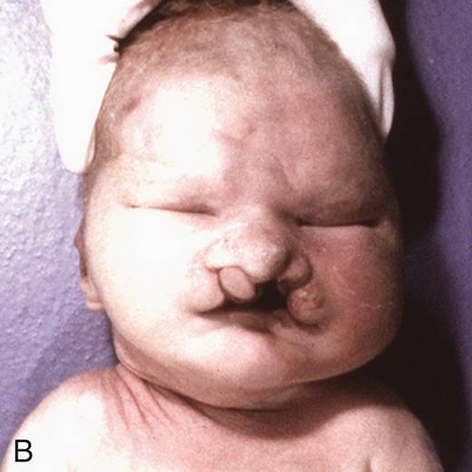
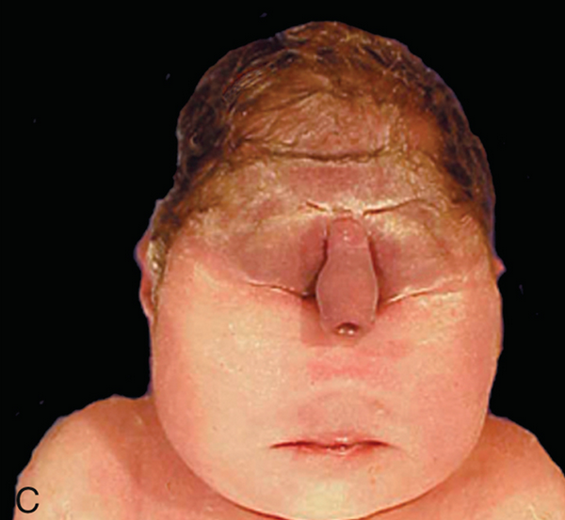
Examples of malformations. Malformations can range in severity from the incidental to the lethal. (A) Polydactyly (one or more extra digits) and syndactyly (fusion of digits) have little functional consequence when they occur in isolation. (B) Similarly, cleft lip, with or without associated cleft palate, is compatible with life when it occurs as an isolated anomaly; in this case, however, the child had an underlying malformation syndrome (trisomy 13) and expired because of severe cardiac defects. (C) Stillbirth associated with a lethal malformation, in which the midface structures are fused or ill-formed; in almost all cases, this degree of external dysmorphogenesis is associated with severe internal anomalies such as maldevelopment of the brain and cardiac defects.

Slide 36
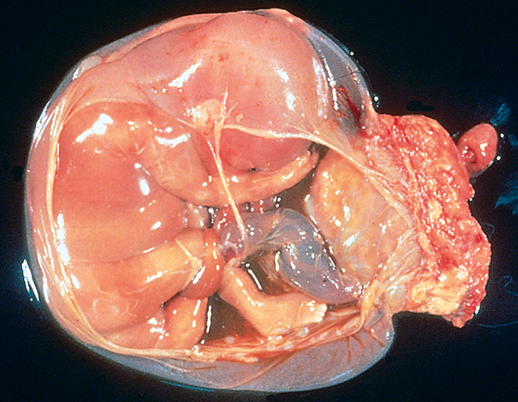
Disruption due to amniotic bands. In the specimen shown, the placenta is at the right, and the band of amnion extends from the top portion of the amniotic sac to encircle the leg of the fetus

Slide 37
Sequence refers to multiple congenital anomalies that result from secondary effects of a single localized aberration in organogenesis.
The initiating event may be a malformation, deformation, or disruption. An excellent example is the oligohydramnios (or Potter) sequence . Oligohydramnios (decreased amniotic fluid) may be caused by a variety of maternal, placental, or fetal abnormalities, including chronic leakage of amniotic fluid because of rupture of the amnion; uteroplacental insufficiency resulting from maternal hypertension or severe toxemia; and renal agenesis in the fetus (because fetal urine is a major constituent of amniotic fluid).
The fetal compression associated with oligohydramnios in turn results in a classic phenotype in the newborn infant consisting of flattened faces and positional abnormalities of the hands and feet. The hips may be dislocated. Growth of the chest wall and the lungs also is compromised, sometimes to such an extent that survival is not possible. If the embryologic connection between these defects and the initiating event is not recognized, a sequence may be mistaken for a malformation syndrome.

Slide 38
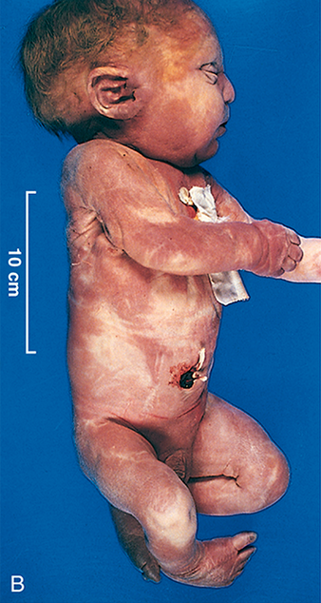
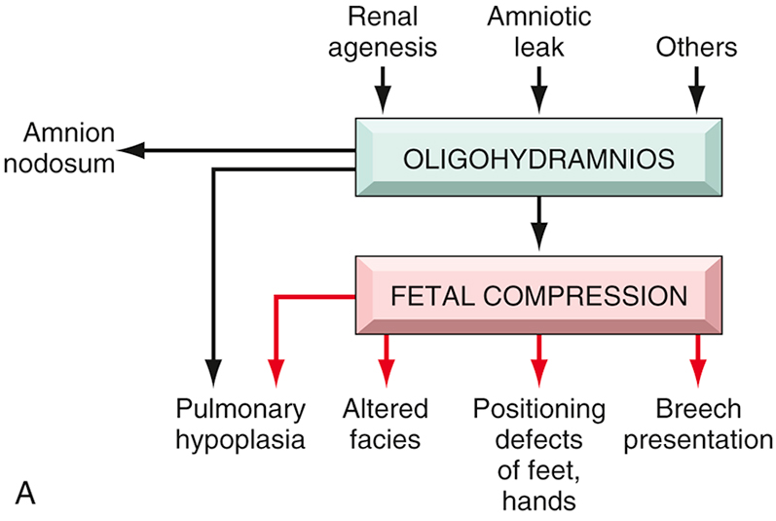
A) Pathogenesis of the oligohydramnios (Potter) sequence. (B) Infant with oligohydramnios (Potter) sequence. Note flattened facial features and deformed foot (talipes equinovarus).

Slide 39
Malformation syndrome refers to the presence of several defects that cannot be explained on the basis of a single localizing initiating error in morphogenesis. Syndromes most often arise from a single causative condition (e.g., viral infection or a specific chromosomal abnormality) that simultaneously affects several tissues.
In addition to these global definitions, some general terms are applied to organ-specific malformations. Agenesis refers to the complete absence of an organ or its anlage, whereas aplasia and hypoplasia indicate incomplete development and underdevelopment, respectively. Atresia describes the absence of an opening, usually of a hollow visceral organ or duct such as intestines and bile ducts.

Slide 40
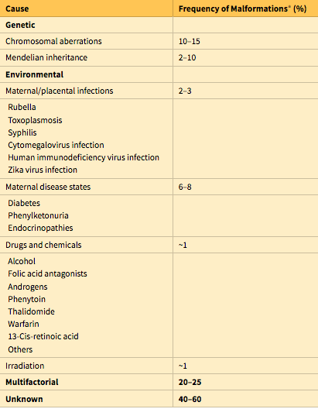

Slide 41
Pathogenesis
The pathogenesis of congenital anomalies is complex and still poorly understood, but two general principles are relevant regardless of the etiologic agent:
The timing of the prenatal teratogenic insult has an important impact on the occurrence and the type of anomaly produced. The intrauterine development of humans can be divided into two phases: (1) the embryonic period, occupying the first 9 weeks of pregnancy, and (2) the fetal period, terminating at birth.
In the early embryonic period (first 3 weeks after fertilization), an injurious agent damages either enough cells to cause death and abortion or only a few cells, presumably allowing the embryo to recover without developing defects. Between the third and the ninth weeks, the embryo is extremely susceptible to teratogenesis, with the peak sensitivity occurring between the fourth and the fifth weeks. During this period organs are being crafted out of the germ-cell layers.
The fetal period that follows organogenesis is marked chiefly by the further growth and maturation of the organs, with greatly reduced susceptibility to teratogenic agents. Instead, the fetus is susceptible to growth retardation or injury to already formed organs. It is therefore possible for a given agent to produce different anomalies if exposure occurs at different times of gestation.

Slide 42
2. The complex interplay between environmental teratogens and intrinsic genetic defects is exemplified by the fact that features of dysmorphogenesis caused by environmental insults often can be recapitulated by genetic defects in the pathways targeted by these teratogens. Some representative examples follow:
Cyclopamine is a plant teratogen. Pregnant sheep that feed on plants containing cyclopamine give birth to lambs that have severe craniofacial abnormalities including holoprosencephaly and cyclopia (single fused eye—hence the origin of the moniker cyclopamine). This compound is an inhibitor of Hedgehog signaling in the embryo, and, as stated previously, mutations of Hedgehog genes are present in subsets of fetuses with holoprosencephaly.
Valproic acid is an anti-epileptic and a recognized teratogen. Valproic acid disrupts expression of a family of highly conserved developmentally critical transcription factors known as homeobox (HOX) proteins. In vertebrates, HOX proteins have been implicated in the patterning of limbs, vertebrae, and craniofacial structures. Not surprisingly, mutations in the HOX gene family are responsible for congenital anomalies that mimic features observed in valproic acid embryopathy.

Slide 43
The vitamin A (retinol) derivative all-trans-retinoic acid is essential for normal development and differentiation, and its absence during embryogenesis results in a constellation of malformations affecting multiple organ systems, including the eyes, genitourinary system, cardiovascular system, diaphragm, and lungs.
Conversely, excessive exposure to retinoic acid also is teratogenic. Infants born to mothers treated with retinoic acid for severe acne have a predictable phenotype (retinoic acid embryopathy), including CNS, cardiac, and craniofacial defects, such as cleft lip and cleft palate. The last entity may stem from retinoic acid–mediated deregulation of components of the transforming growth factor-β (TGF-β) signaling pathway, which is involved in palatogenesis. Mice with knockout of the TGFB3 gene uniformly develop cleft palate, once again illustrating the functional relationship between teratogenic exposure and signaling pathways in the causation of congenital anomalies.

Slide 44
Perinatal Infections
Infections of the fetus and neonate may be acquired transcervically (ascending infections) or transplacentally (hematologic infections).
Transcervical, or ascending, infections are caused by spread of microbes from the cervicovaginal canal and may be acquired in utero or during birth. Most bacterial infections (e.g., α-hemolytic streptococcal infection) and a few viral infections (e.g., herpes simplex) are acquired in this manner. In general, the fetus acquires the infection by “inhaling” infected amniotic fluid into the lungs or by passing through an infected birth canal during delivery. Fetal infection usually is associated with inflammation of the placental membranes (chorioamnionitis) and inflammation of the umbilical cord (funisitis). This mode of spread is typical for pneumonia and, in severe cases, sepsis and meningitis.

Slide 45
Transplacental infections gain access to the fetal bloodstream by crossing the placenta via the chorionic villi, and may occur at any time during gestation or occasionally, as may be the case with hepatitis B and human immunodeficiency virus, at the time of delivery via maternal-to-fetal transfusion.
Most parasitic (e.g., toxoplasma, malaria) and viral infections, and a few bacterial infections (i.e., Listeria and Treponema), follow this mode of hematogenous transmission. The clinical manifestations of these infections are highly variable, depending largely on the gestational timing and the microorganism involved. The most important transplacental infections can be conveniently remembered by the acronym TORCH. The elements of the TORCH complex are Toxoplasma (T), rubella virus (R), cytomegalovirus (C), herpesvirus (H), and any of a number of other (O) microbes such as Treponema pallidum.
These agents are grouped together because they may evoke similar clinical and pathologic manifestations.

Slide 46
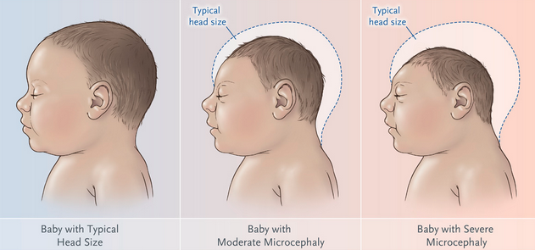
TORCH infections occurring early in gestation may cause chronic sequelae in the child, including growth restriction, mental retardation, cataracts, and congenital cardiac anomalies, whereas infections later in pregnancy result primarily in tissue injury accompanied by inflammation (encephalitis, chorioretinitis, hepatosplenomegaly, pneumonia, and myocarditis). More recently, Zika virus has emerged as another agent that can be transmitted by pregnant females to their offspring with devastating consequences such as microcephaly and brain damage

Slide 47
Prematurity and Fetal Growth Restriction
Prematurity is defined by a gestational age less than 37 weeks and is the second most common cause of neonatal mortality (second only to congenital anomalies).
As might be expected, infants born before completion of gestation also weigh less than normal (<2500 gm). The major risk factors for prematurity include preterm premature rupture of membranes; intrauterine infection leading to inflammation of the placental membranes (chorioamnionitis); structural abnormalities of the uterus, cervix, and placenta; and multiple gestation (e.g., twin pregnancy). Children born before completion of the full period of gestation have higher morbidity and mortality rates than full-term infants. The immaturity of organ systems in preterm infants makes them especially vulnerable to several important complications:

Slide 48
Respiratory distress syndrome, also called hyaline membrane disease
Necrotizing enterocolitis
Sepsis
Intraventricular and germinal matrix hemorrhage
Long-term sequelae, including developmental delay
Although birth weight is low in preterm infants, it usually is appropriate after adjustment for gestational age. By contrast, as many as one-third of infants who weigh less than 2500 gm are born at term and are therefore undergrown rather than immature. These small-for-gestational-age (SGA) infants suffer from fetal growth restriction. Fetal growth restriction may result from fetal, maternal, or placental abnormalities, although in many cases the specific cause is unknown.

Slide 49
Fetal abnormalities: This category consists of conditions that intrinsically reduce growth potential of the fetus despite an adequate supply of nutrients from the mother. Prominent among such fetal conditions are chromosomal disorders, congenital anomalies, and congenital infections. Chromosomal abnormalities may be detected in as many as 17% of fetuses evaluated for fetal growth restriction and in as many as 66% of fetuses with documented ultrasonographic malformations. Fetal infection should be considered in all growth-restricted neonates, with the TORCH group of infections (see earlier) being a common cause. When the causation is intrinsic to the fetus, fetal growth restriction is symmetric (i.e., affects all organ systems equally).

Slide 50
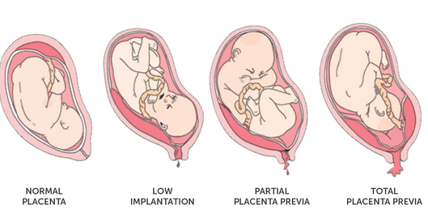
Placental abnormalities: Placental causes include any factor that compromises the uteroplacental blood supply. Examples include placenta previa (low implantation of the placenta), placental abruption (separation of placenta from the decidua by a retroplacental clot), or placental infarction. With placental (and maternal) abnormalities, the fetal growth restriction is asymmetric (i.e., the brain is spared relative to visceral organs such as the liver).

Slide 51
Maternal factors: This category comprises by far the most common causes of the growth deficit in SGA infants. Important examples are vascular diseases such as preeclampsia (“toxemia of pregnancy”) and chronic hypertension.
Another class of maternal diseases increasingly being recognized in the setting of fetal growth restriction is acquired or inherited diseases of hypercoagulability (i.e., thrombophilias).
The list of other maternal conditions associated with fetal growth restriction is long, but some of the avoidable influences are maternal narcotic abuse, alcohol intake, and heavy cigarette smoking (as noted previously, many of these same causes also are involved in the pathogenesis of congenital anomalies). Drugs causing fetal growth restriction in similar fashion include teratogens, such as the commonly administered anti-convulsant phenytoin (Dilantin), as well as nonteratogenic agents. Maternal malnutrition (in particular, prolonged hypoglycemia) also may affect fetal growth.

Slide 52
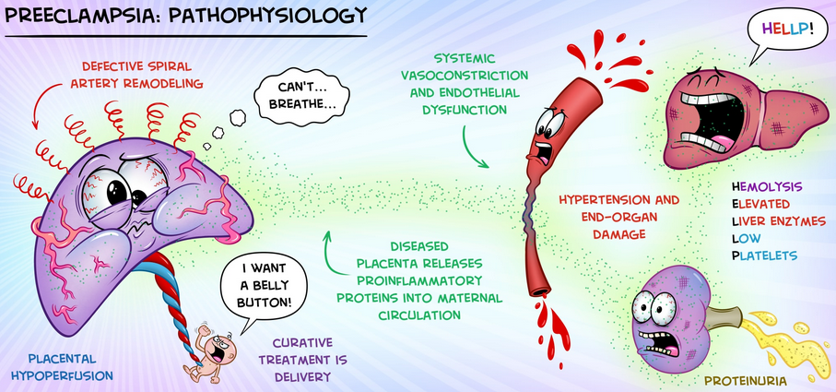

Slide 53
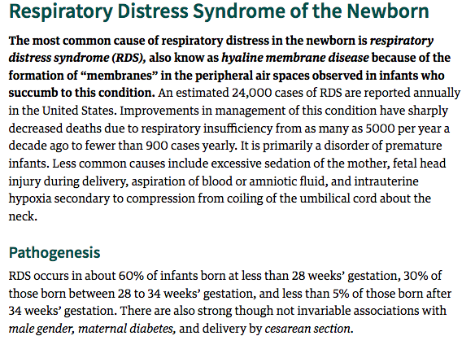

Slide 54
Pathogenesis
RDS occurs in about 60% of infants born at less than 28 weeks’ gestation, 30% of those born between 28 to 34 weeks’ gestation, and less than 5% of those born after 34 weeks’ gestation. There are also strong though not invariable associations with male gender, maternal diabetes, and delivery by cesarean section.
The fundamental defect in RDS is the inability of the immature lung to synthesize sufficient surfactant. Surfactant is a complex of surface-active phospholipids, principally dipalmitoylphosphatidylcholine (lecithin) and at least two groups of surfactant-associated proteins. The importance of surfactant-associated proteins in normal lung function can be gauged by the occurrence of severe respiratory failure in neonates with congenital deficiency of surfactant caused by mutations in the corresponding genes.

Slide 55
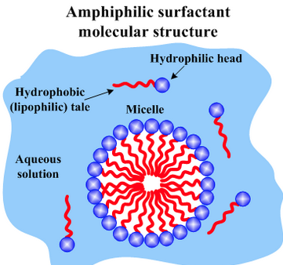
Surfactant is synthesized by type II pneumocytes and, with the healthy newborn’s first breath, rapidly coats the surface of alveoli, reducing surface tension and thus decreasing the pressure required to keep the alveoli open. In a lung deficient in surfactant, alveoli tend to collapse, and a relatively greater inspiratory effort is required with each breath to open the alveoli.
The infant rapidly tires from breathing and generalized atelectasis sets in. The resulting hypoxia sets into motion a sequence of events that leads to epithelial and endothelial damage and eventually to the formation of hyaline membranes. This classical picture of surfactant deficiency is greatly modified by surfactant treatment.

Slide 56
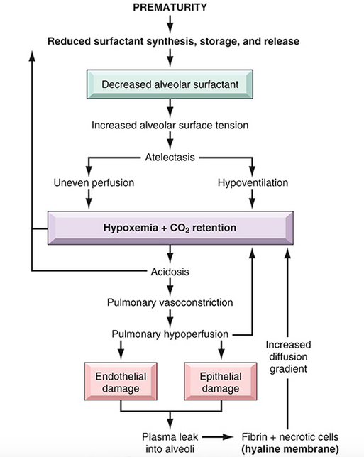

Slide 57
The lungs in infants with RDS are of normal size but are heavy and relatively airless. They have a mottled purple color, and on microscopic examination the tissue appears solid, with poorly developed, generally collapsed (atelectatic) alveoli. If the infant dies within the first several hours of life, only necrotic cellular debris will be present in the terminal bronchioles and alveolar ducts. Later in the course, characteristic eosinophilic hyaline membranes line the respiratory bronchioles, alveolar ducts, and random alveoli.
These “membranes” contain necrotic epithelial cells admixed with extravasated plasma proteins. There is a remarkable paucity of neutrophilic inflammatory reaction associated with these membranes. The lesions of hyaline membrane disease are never seen in stillborn infants or in live-born infants who die within a few hours of birth. If the infant with RDS dies after several days, evidence of reparative changes, including proliferation of type II pneumocytes and interstitial fibrosis, is seen.

Slide 58
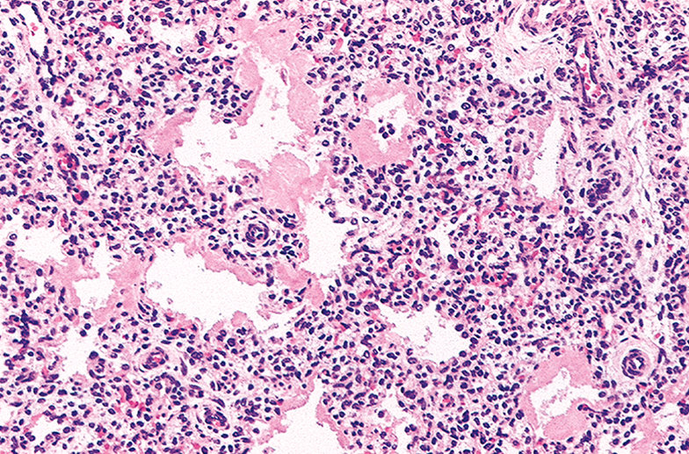
Hyaline membrane disease (hematoxylin-eosin stain). Alternating atelectasis and dilation of the alveoli can be seen. Note the eosinophilic thick hyaline membranes lining the dilated alveoli.

Slide 59
In uncomplicated cases, recovery begins to occur within 3 or 4 days. In affected infants, oxygen is required. Use of high concentrations of ventilator-administered oxygen for prolonged periods, however, is associated with two well-known complications: retrolental fibroplasia (also called retinopathy of prematurity) in the eyes; and bronchopulmonary dysplasia. Fortunately, both complications are now significantly less common as a result of gentler ventilation techniques, antenatal glucocorticoid therapy, and prophylactic surfactant treatments. Hence they are described briefly:
Retinopathy of prematurity has a two-phase pathogenesis. During the hyperoxic phase of RDS therapy (phase I), expression of the proangiogenic vascular endothelial growth factor (VEGF) is markedly decreased, causing endothelial cell apoptosis. VEGF levels rebound after return to relatively hypoxic room air ventilation (phase II), inducing retinal vessel proliferation (neovascularization) characteristic of the lesions in the retina.

Slide 60
The major abnormality in bronchopulmonary dysplasia is a striking decrease in alveolar septation (manifested as large, simplified alveolar structures) and a dysmorphic capillary configuration.
Multiple factors—hyperoxemia, hyperventilation, prematurity, inflammatory cytokines, and vascular maldevelopment—contribute to bronchopulmonary dysplasia and probably act additively or synergistically to promote injury.
Infants who recover from RDS also are at increased risk for developing a variety of other complications associated with preterm birth; most important among these are patent ductus arteriosus, intraventricular hemorrhage, and necrotizing enterocolitis. Thus, although technologic advances help save the lives of many infants with RDS, they also bring to the surface the exquisite fragility of the immature neonate.

Slide 61
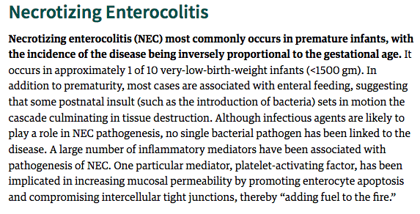

Slide 62
NEC typically involves the terminal ileum, cecum, and right colon, although any part of the small or large intestine may be involved. The involved segment typically is distended, friable, and congested, or it can be frankly gangrenous; intestinal perforation with accompanying peritonitis may be seen. On microscopic examination, mucosal or transmural coagulative necrosis, ulceration, bacterial colonization, and submucosal gas bubbles are all features associated with NEC. Evidence of reparative changes, such as granulation tissue and fibrosis, may be seen shortly after resolution of the acute episode.
The clinical course is fairly typical, with the onset of bloody stools, abdominal distention, and development of circulatory collapse. Abdominal radiographs often demonstrate gas within the intestinal wall (pneumatosis intestinalis). When detected early, NEC often can be managed conservatively, but many cases (20% to 60%) require operative intervention including resection of the necrotic segments of bowel. NEC is associated with high perinatal mortality; infants who survive often develop post-NEC strictures from fibrosis caused by the healing process.

Slide 63
Necrotizing enterocolitis. (A) At postmortem examination in a severe case, the entire small bowel was markedly distended and perilously thin (usually this appearance implies impending perforation). (B) The congested portion of the ileum corresponds to areas of hemorrhagic infarction and transmural necrosis. Submucosal gas bubbles (pneumatosis intestinalis) can be seen in several areas (arrows).

Slide 64
Sudden Infant Death Syndrome (SIDS)
According to the National Institute of Child Health and Human Development, SIDS is defined as “the sudden death of an infant under 1 year of age which remains unexplained after a thorough case investigation, including performance of a complete autopsy, examination of the death scene, and review of the clinical history.” It is important to emphasize that many cases of sudden death in infancy are found to have an anatomic or biochemical basis at autopsy

Slide 65
Pathogenesis
SIDS is multifactorial condition, with a mixture of contributing causes in a given case. Three interacting variables have been proposed: (1) a vulnerable infant, (2) a critical developmental period in homeostatic control, and (3) one or more exogenous stressors. According to this model, several factors make the infant vulnerable to sudden death during the critical developmental period (i.e., 1 month to 1 year). These vulnerability factors may be specific to the parents or the infant, whereas the exogenous stressor or stressors are attributable to the environment

Slide 66
Although numerous factors have been proposed to account for a vulnerable infant, the most compelling hypothesis is that SIDS reflects a delayed development of arousal and cardiorespiratory control. The brain stem and, in particular, the medulla oblongata play a critical role in the body’s “arousal” response to noxious stimuli such as episodic hypercarbia, hypoxia, and thermal stress encountered during sleep. The serotonergic (5-HT) system of the medulla is implicated in these “arousal” responses as well as regulation of other critical homeostatic functions such as respiratory drive, blood pressure, and upper airway reflexes. Abnormalities in serotonin-dependent signaling in the brain stem may be the underlying basis for SIDS in some infants.
Among the potential environmental causes, prone sleeping position, sleeping on soft surfaces, and thermal stress are possibly the most important modifiable risk factors for SIDS. Many studies have clearly shown increased risk for SIDS in infants who sleep in a prone position, prompting the American Academy of Pediatrics to recommend placing healthy infants on their backs when laying them down to sleep. This “Back to Sleep” campaign has resulted in substantial decreases in SIDS-related deaths since its inception in 1994. The prone position increases the infant’s vulnerability to one or more recognized noxious stimuli (hypoxia, hypercarbia, and thermal stress) during sleep. In addition, the prone position also is associated with decreased arousal responsiveness compared with the supine position

Slide 67
Fetal Hydrops
Fetal hydrops refers to the accumulation of edema fluid in the fetus during intrauterine growth. The causes of fetal hydrops are manifold.
In the past, hemolytic anemia caused by Rh blood group incompatibility between mother and fetus (immune hydrops) was the most common cause, but with the successful prophylaxis of this disorder during pregnancy, other causes of nonimmune hydrops have emerged as the principal culprits.
The fluid accumulation can be quite variable, ranging in degree from progressive, generalized edema of the fetus (hydrops fetalis), a usually lethal condition, to more localized and less marked edematous processes, such as isolated pleural and peritoneal effusions or postnuchal fluid collections (cystic hygroma), that often are compatible with life.

Slide 68
Hydrops fetalis. (A) Generalized accumulation of fluid in the fetus. (B) Fluid accumulation particularly prominent in the soft tissues of the neck. This condition has been termed cystic hygroma. Cystic hygromas are characteristically seen with, but not limited to, constitutional chromosomal anomalies such as 45,X karyotypes.

Slide 70
Immune Hydrops
Immune hydrops results from an antibody-induced hemolytic disease in the newborn that is caused by blood group incompatibility between mother and fetus. Such an incompatibility occurs when the fetus inherits red cell antigenic determinants from the father that are foreign to the mother.
The most common antigens to result in clinically significant hemolysis are the Rh and ABO blood group antigens. Of the numerous antigens included in the Rh system, only the D antigen is a major cause of Rh incompatibility. Fetal red cells may reach the maternal circulation during the last trimester of pregnancy, when the cytotrophoblast is no longer present as a barrier, or during childbirth itself (fetomaternal bleed).
The mother then becomes sensitized to the foreign antigen and produces antibodies that, in future pregnancies, can freely traverse the placenta to the fetus, in which they cause red cell destruction. With initiation of immune hemolysis, progressive anemia in the fetus leads to tissue ischemia, intrauterine cardiac failure, and peripheral pooling of fluid (edema). As discussed later, cardiac failure may be the final pathway by which edema occurs in many cases of nonimmune hydrops as well.

Slide 71
Nonimmune Hydrops
The major causes of nonimmune hydrops include those disorders associated with cardiovascular defects, chromosomal anomalies, and fetal anemia.
Structural cardiovascular defects and functional abnormalities (i.e., arrhythmias) may result in intrauterine cardiac failure and hydrops. Among the chromosomal anomalies, 45,X karyotype (Turner syndrome) and trisomies 21 and 18 are associated with fetal hydrops; the basis for this disorder usually is the presence of underlying structural cardiac anomalies, although in Turner syndrome there may be an abnormality of lymphatic drainage from the neck leading to postnuchal fluid accumulation (resulting in cystic hygromas).
Fetal anemias resulting from causes other than Rh or ABO incompatibility also may result in hydrops. In fact, in some parts of the world (e.g., Southeast Asia), severe fetal anemia caused by homozygous α-thalassemia probably is the most common cause of fetal hydrops.
Transplacental infection by parvovirus B19 is increasingly recognized as an important cause of fetal hydrops. The virus gains entry into erythroid precursors (normoblasts), where it replicates. The ensuing cellular injury leads to the death of the normoblasts and aplastic anemia. Parvoviral intranuclear inclusions can be seen within circulating and marrow erythroid precursors

Slide 72
Bone marrow from an infant infected with parvovirus B19. The arrows point to two erythroid precursors with large homogeneous intranuclear inclusions and a surrounding peripheral rim of residual chromatin.

Slide 73
Numerous islands of extramedullary hematopoiesis (small blue cells) are scattered among mature hepatocytes in this histologic preparation from an infant with nonimmune hydrops fetalis

Slide 74
Kernicterus. Severe hyperbilirubinemia in the neonatal period—for example, secondary to immune hydrolysis—results in deposition of bilirubin pigment (arrows) in the brain parenchyma. This occurs because the blood–brain barrier is less developed in the neonatal period than it is in adulthood. Infants who survive develop long-term neurologic sequelae.

Slide 75
Clinical Course
Early recognition of fetal hydrops is imperative, because even severe cases can sometimes be salvaged with timely therapy. Immune hydrops that results from Rh incompatibility can be predicted with reasonable certainty, because its severity correlates well with rapidly rising Rh antibody titers in the mother during pregnancy. Antenatal identification and management of the at-risk fetus have been facilitated by amniocentesis and the advent of chorionic villus and fetal blood sampling.
The direct anti-globulin test (direct Coombs test) using fetal cord blood yields a positive result if the red cells have been coated by maternal antibody. In addition, cloning of the RHD gene has resulted in efforts to determine fetal Rh status by sequencing cell free DNA in maternal blood. When identified, cases of severe intrauterine hemolysis may be treated by fetal intravascular transfusions via the umbilical cord and early delivery. Postnatally, phototherapy is helpful, because visible light converts bilirubin to readily excreted dipyrroles. As already discussed, in an overwhelming majority of cases, administration of RhIg to the mother can prevent the occurrence of immune hydrops in subsequent pregnancies. Group ABO hemolytic disease is more difficult to predict but is readily anticipated by awareness of the blood incompatibility between mother and father and by hemoglobin and bilirubin determinations in the vulnerable newborn. In fatal cases of fetal hydrops, a thorough postmortem examination is imperative to determine the cause and to exclude a potentially recurring cause such as a chromosomal abnormality.

Slide 77
Hemangiomas are the most common neoplasms of infancy. Both cavernous and capillary hemangiomas may be encountered, although the latter often are more cellular than in adults and thus may appear deceptively worrisome. In children, most hemangiomas are located in the skin, particularly on the face and scalp, where they produce flat to elevated, irregular, red-blue masses; the flat, larger lesions are referred to as port-wine stains. Hemangiomas may enlarge as the child ages, but in many instances they spontaneously regress. The vast majority of superficial hemangiomas have no more than a cosmetic significance; rarely, they may be the manifestation of a hereditary disorder associated with disease within internal organs, such as the von Hippel-Lindau syndrome. A subset of CNS cavernous hemangiomas can occur in the familial setting; affected families harbor mutations in one of three cerebral cavernous malformation (CCM) genes.
Lymphangiomas represent the lymphatic counterpart of hemangiomas. Microscopic examination shows cystic and cavernous spaces lined by endothelial cells and surrounded by lymphoid aggregates; the spaces usually contain pale fluid. They may occur on the skin but, more importantly, they also are encountered in the deeper regions of the neck, axilla, mediastinum, and retroperitoneum. Although histologically benign, they tend to increase in size after birth and may encroach on mediastinal structures or nerve trunks in axilla.

Slide 78
Congenital capillary hemangioma (A) at birth and (B) at 2 years of age after the lesion had undergone spontaneous regression.

Slide 80
Teratomas may occur as benign, well-differentiated cystic lesions (mature teratomas), as lesions of indeterminate potential (immature teratomas), or as unequivocally malignant teratomas (usually admixed with another germ cell tumor component such as an endodermal sinus tumor).
Sacrococcygeal teratomas are the most common teratomas of childhood, accounting for 40% or more of cases . In view of the overlap in the mechanisms underlying congenital malformations and oncogenesis, it is interesting that approximately 10% of sacrococcygeal teratomas are associated with congenital anomalies, primarily defects of the hindgut and cloacal region and other midline defects (e.g., meningocele, spina bifida) not believed to result from local effects of the tumor. Approximately 75% of these tumors are mature teratomas with a benign course, and about 12% are unmistakably malignant and lethal. The remainder are designated immature teratomas, and their malignant potential correlates with the amount of immature tissue elements present. Most of the benign teratomas are encountered in younger infants (4 months of age or younger), whereas children with malignant lesions tend to be somewhat older.

Slide 81
Sacrococcygeal teratoma. Note the size of the lesion compared with that of the infant.

Slide 82
Malignant Neoplasms
The organ systems involved most commonly by malignant neoplasms in infancy and childhood are the hematopoietic system, neural tissue, and soft tissues. This distribution is in sharp contrast with that in adults, in whom epithelial tumors of the lung, heart, prostate, and colon are the most common forms. Malignant neoplasms of infancy and childhood differ biologically and histologically from those in adults.

Slide 85
A) Neuroblastoma. This tumor is composed of small cells embedded in a finely fibrillar matrix (neuropil). A Homer-Wright pseudorosette (tumor cells arranged concentrically around a central core of neuropil) is seen in the upper right corner. (B) Ganglioneuromas, arising from spontaneous or therapy-induced maturation of neuroblastomas, are characterized by clusters of large ganglion cells with vesicular nuclei and abundant eosinophilic cytoplasm (arrow). Spindle-shaped Schwann cells are present in the background stroma.

Slide 86
Neuroblastoma International Staging System

Slide 87
(A) FISH using a fluorescein-labeled cosmid probe for N-myc on a tissue section containing neuroblastoma attached to the kidney. Note the neuroblastoma cells on the upper half of the photo with large areas of staining (yellow-green); this corresponds to amplified N-MYC in the form of homogeneously staining regions. Renal tubular epithelial cells in the lower half of the photograph show no nuclear staining and background (green) cytoplasmic staining. (B) A Kaplan-Meier survival curve of infants younger than 1 year of age with metastatic neuroblastoma. The 3-year event-free survival of infants whose tumors lacked MYCN amplification was 93%, whereas those with tumors that had MYCN amplification had only a 10% event-free survival.

Slide 89
Retinoblastoma. (A) Poorly cohesive tumor in retina is seen abutting the optic nerve. (B) Higher-power view showing Flexner-Wintersteiner rosettes (arrow) and numerous mitotic figures.

Slide 92
Wilms tumor in the lower pole of the kidney with the characteristic tan to gray color and well-circumscribed margins.

Slide 93
(A) Wilms tumor with tightly packed blue cells consistent with the blastemal component and interspersed primitive tubules, representing the epithelial component. (B) Focal anaplasia was present in other areas within this Wilms tumor, characterized by cells with hyperchromatic, pleomorphic nuclei, and an abnormal mitosis (center of field). Predominance of blastemal morphology and diffuse anaplasia are associated with specific molecular lesions.

Slide 98
FISH. (A) Interphase nucleus from a male patient with suspected trisomy 18. Three different fluorescent probes have been used in a “FISH cocktail”; the green probe hybridizes to the X chromosome centromere (one copy), the red probe to the Y chromosome centromere (one copy), and the aqua probe to the chromosome 18 centromere (three copies). (B) A metaphase spread in which two fluorescent probes have been used, one hybridizing to chromosome region 22q13 (green) and the other hybridizing to chromosome region 22q11.2 (red).
There are two 22q13 signals. One of the two chromosomes does not stain with the probe for 22q11.2, indicating a microdeletion in this region. This abnormality gives rise to the 22q11.2 deletion syndrome (DiGeorge syndrome).

Slide 99
Analysis of copy number variation via SNP cytogenomic array. Genomic DNA is labeled and hybridized to an array containing potentially millions of probe spots. Copy number is determined by overall intensity and genotype is determined by allelic ratio. The example shown is the p arm of chromosome 12 in a pediatric leukemia. Here, the normal areas (green) show neutral (diploid) DNA content and the zygosity plot shows the expected ratio of AA, AB, and BB SNP genotypes. The anomalous area (red) shows decreased overall intensity, and the zygosity plot shows loss of heterozygosity (the AB genotype); together, these findings indicate the presence of a deletion on one copy of chromosome 12p.

Slide 100
Allele-specific polymerase chain reaction (PCR) analysis for mutation detection in a heterogeneous sample containing an admixture of normal and mutant DNA. Nucleotides complementary to the mutant and wild-type nucleotides at the queried base position are labeled with different fluorophores such that incorporation into the resulting PCR product yields fluorescent signals of variable intensity in accordance with the ratio of mutant to wild-type DNA present.

Slide 101
Principle of next-generation sequencing. Several alternative approaches currently are available for “NextGen” sequencing, and one of the more commonly used platforms is illustrated. (A) Short fragments of genomic DNA (“template”) between 100 and 500 base pairs in length are immobilized on a solid phase platform such as a glass slide, using universal capture primers that are complementary to adapters that have previously been added to ends of the template fragments. The addition of fluorescently labeled complementary nucleotides, one per template DNA per cycle, occurs in a “massively parallel” fashion, at millions of templates immobilized on the solid phase at the same time. A four-color imaging camera captures the fluorescence emanating from each template location (corresponding to the specific incorporated nucleotide), following which the fluorescent dye is cleaved and washed away, and the entire cycle is repeated. (B) Powerful computational programs can decipher the images to generate sequences complementary to the template DNA at the end of one “run,” and these sequences are then mapped back to the reference genomic sequence, to identify alterations.

