Slide 1
General Pathology of Infectious Diseases

Slide 2
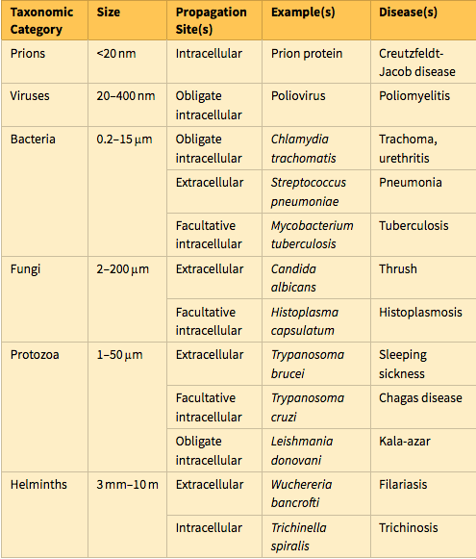

Slide 3
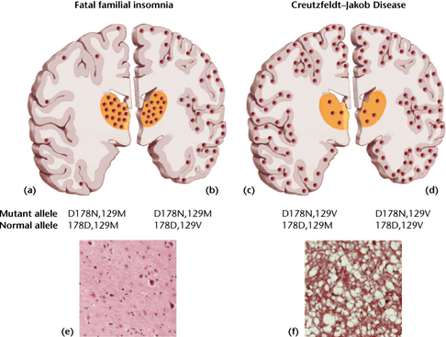
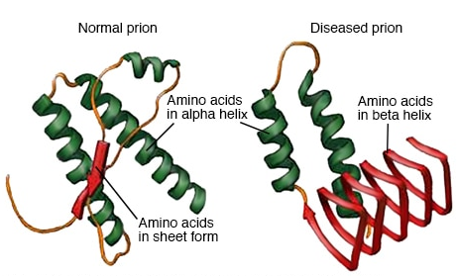
Prions are composed of abnormal forms of a host protein termed prion protein (PrP). These agents cause transmissible spongiform encephalopathies, including Kuru (associated with human cannibalism), hereditary or sporadic Creutzfeldt-Jakob disease (CJD), bovine spongiform encephalopathy (BSE) (better known as mad cow disease), and variant Creutzfeldt-Jakob disease (vCJD) (probably transmitted to humans through consumption of meat from BSE-infected cattle).

Slide 4
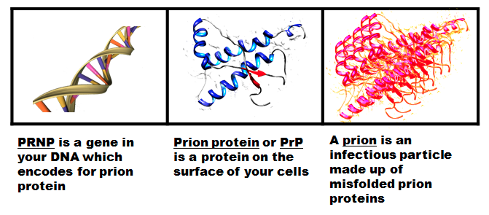
PrP is found normally in neurons. Diseases occur when the PrP undergoes a conformational change that confers resistance to proteases. The protease-resistant PrP promotes conversion of the normal protease-sensitive PrP to the abnormal form, explaining the transmissable nature of these diseases. CJD can be transmitted from person to person iatrogenically, by surgery, organ transplantation, or blood transfusion.

Slide 5
Viruses are obligate intracellular parasites that depend on the host cell’s metabolic machinery for their replication. They consist of a nucleic acid genome surrounded by a protein coat (called a capsid) that is sometimes encased in a lipid membrane. Viruses are classified by their nucleic acid genome (DNA or RNA, but not both), the shape of the capsid (icosahedral or helical), the presence or absence of a lipid envelope, their mode of replication, their preferred cell type for replication (called tropism), or the type of pathology they cause.

Slide 6
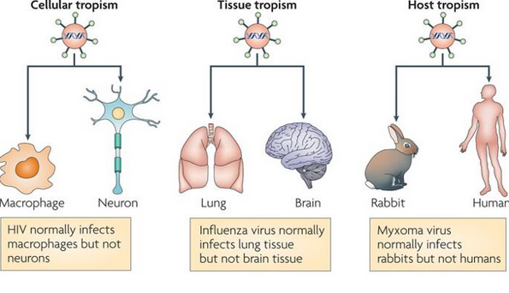

Slide 7
Some viral components and particles aggregate within infected cells and form characteristic inclusion bodies, which may be seen with the light microscope and are useful for diagnosis. For example, cytomegalovirus (CMV)-infected cells are enlarged and show a large eosinophilic nuclear inclusion and smaller basophilic cytoplasmic inclusions; herpes­viruses form a large nuclear inclusion surrounded by a clear halo; and both smallpox and rabies viruses form characteristic cytoplasmic inclusions. However, many viruses (e.g., poliovirus) do not produce inclusions.

Slide 8
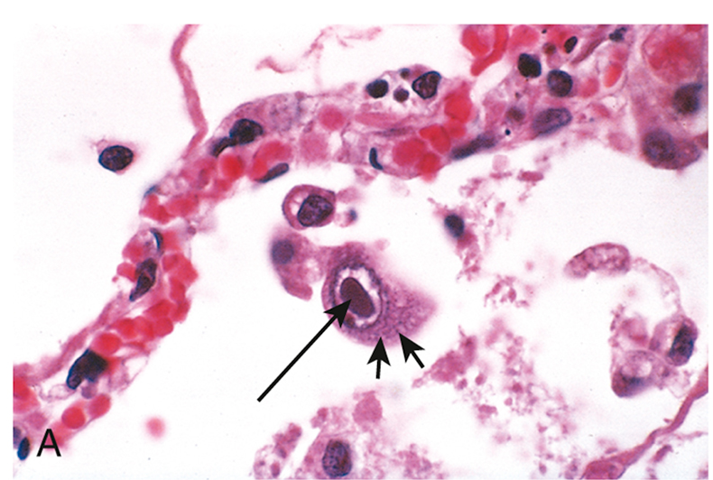
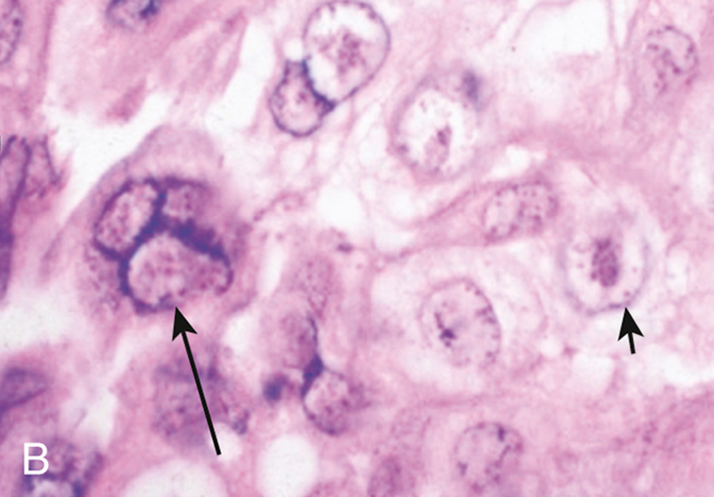
Examples of viral inclusions. (A) Cytomegalovirus infection in the lung. Infected cells show distinct nuclear (long arrow) and ill-defined cytoplasmic (short arrows) inclusions. (B) Varicella-zoster virus infection in the skin. Herpes simplex virus and varicella-zoster virus both cause characteristic cytopathologic changes, including fusion of epithelial cells, which produces multinucleate cells with molding of nuclei to one another (long arrow), and eosinophilic haloed nuclear inclusions (short arrow)

Slide 9
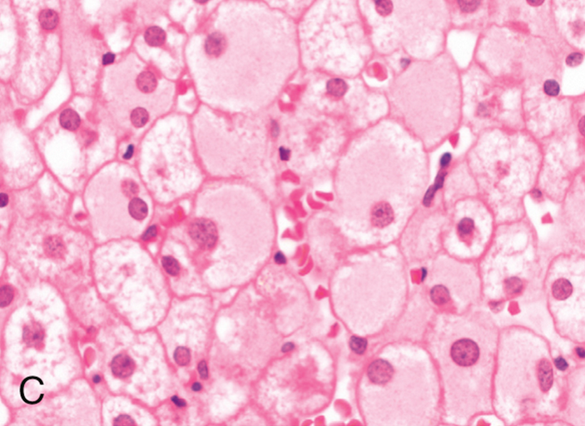
(C) Hepatitis B viral infection in liver. In chronic infections, infected hepatocytes show diffuse granular (“ground-glass”) cytoplasm, reflecting accumulated hepatitis B surface antigen (HBsAg).

Slide 10
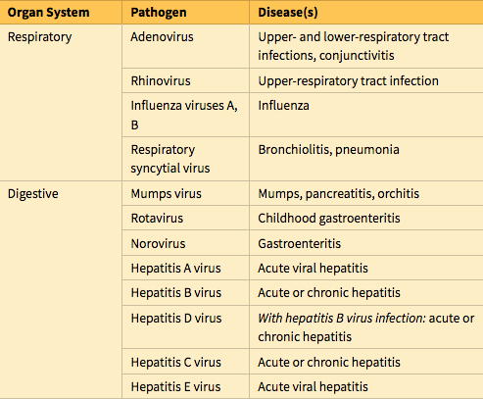

Slide 11
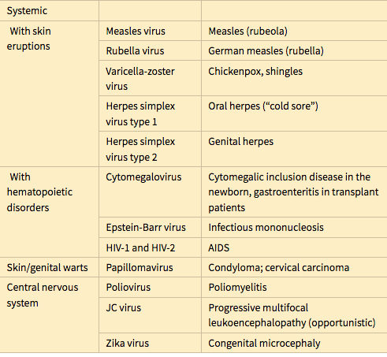

Slide 12
Bacteria are prokaryotes, meaning that they have a cell membrane but lack membrane-bound nuclei and other membrane-enclosed organelles.
Most bacteria are bounded by a cell wall consisting of peptidoglycan, a polymer of long sugar chains linked by peptide bridges surrounding the cell membrane. There are two common forms of cell wall structure: a thick wall that retains crystal-violet stain (gram-positive bacteria) and a thin cell wall surrounded by an outer membrane (gram-negative bacteria).

Slide 13
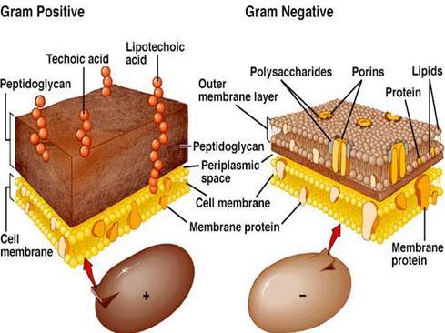
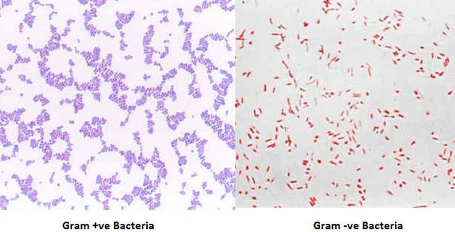

Slide 14
Bacteria are classified by Gram staining (positive or negative), shape (spherical, called cocci, or rod-shaped, called bacilli) , and their requirement for oxygen (aerobic or anaerobic). Motile bacteria have flagella, long helical filaments extending from the cell surface that rotate and move the bacteria. Some bacteria possess pili, another kind of surface projection that can attach bacteria to host cells or extracellular matrix. Bacteria synthesize their own DNA, RNA, and proteins, but they depend on the host for favorable growth conditions.

Slide 15
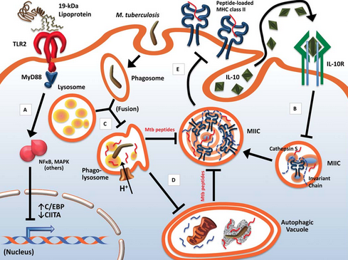
Many bacteria remain extracellular when they grow in the host, while others can survive and replicate both outside and inside of host cells (facultative intracellular bacteria such as mycobacteria), and some grow only inside host cells (obligate intracellular bacteria, such as rickettsia).

Slide 16
Molecules on the surface of gram-negative and gram-positive bacteria involved in the pathogenesis of infection.

Slide 17
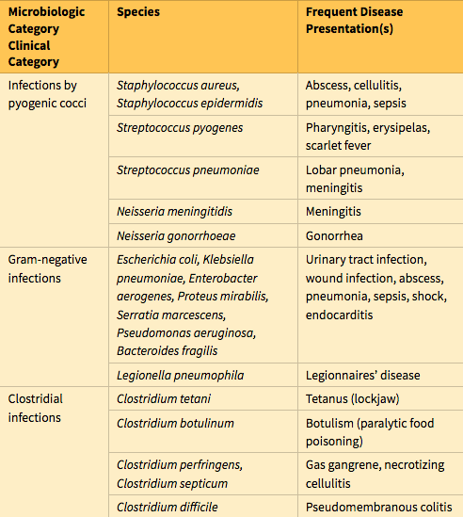

Slide 18
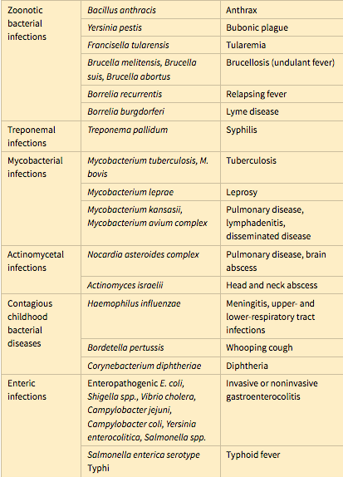

Slide 19
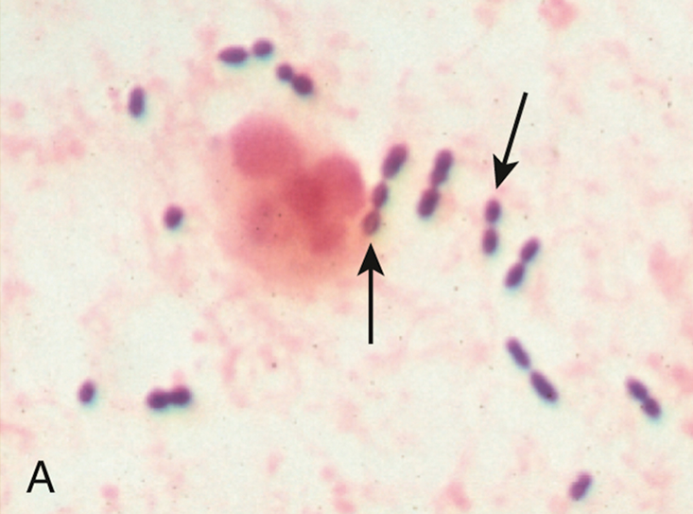
Bacterial morphologies. The bacteria are indicated by arrows. (A) Gram stain preparation of sputum from a patient with pneumonia. Gram-positive, elongated cocci in pairs and short chains (Streptococcus pneumoniae) and a neutrophil are evident.

Slide 20
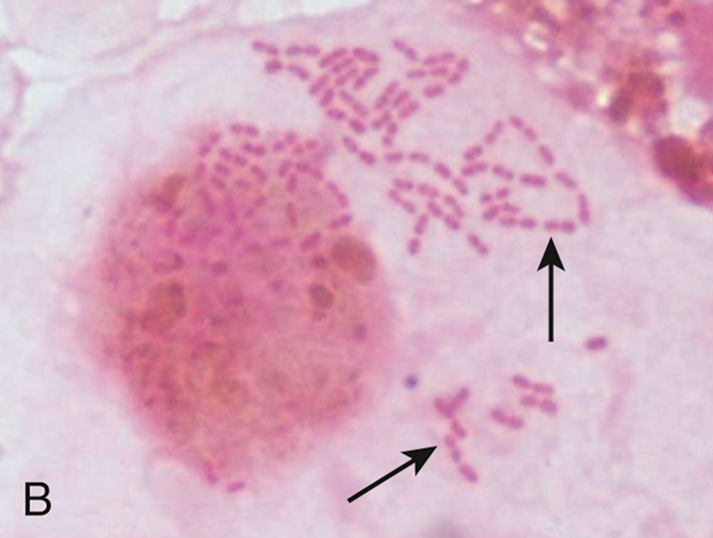
(B) Gram stain preparation of a bronchoalveolar lavage specimen showing gram-negative intracellular rods typical of members of Enterobacteriaceae such as Klebsiella pneumoniae or Escherichia coli.

Slide 21
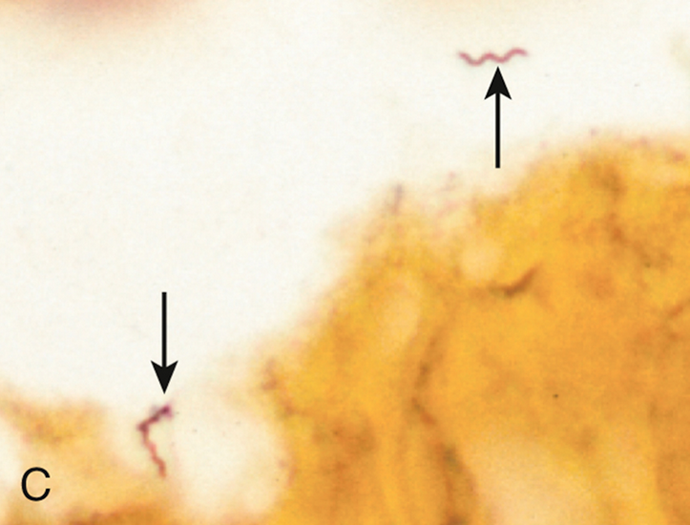
(C) Silver stain preparation of brain tissue from a patient with Lyme disease meningoencephalitis. Two helical spirochetes (Borrelia burgdorferi) are shown (arrows).

Slide 22
Fungi are eukaryotes with thick cell walls composed of complex carbohydrates such as beta-glucans, chitin, and mannosylated glycoproteins.
Calcofluor-white, a fluorescent stain that binds chitin, provides a useful way to identify fungi in patient specimens. Assays for beta-glucans in blood are used to diagnose disseminated fungal infections. Fungi can grow either as rounded yeast cells or as slender, filamentous hyphae. An important distinguishing characteristic is whether hyphae are septate (with cell walls separating individual cells) or aseptate.
Some of the most important pathogenic fungi exhibit thermal dimorphism; that is, they grow as hyphal forms at room temperature but as yeast forms at body temperature. Fungi may produce sexual spores or, more commonly, asexual spores called conidia. The latter are produced on specialized structures or fruiting bodies arising along the hyphal filament.

Slide 23
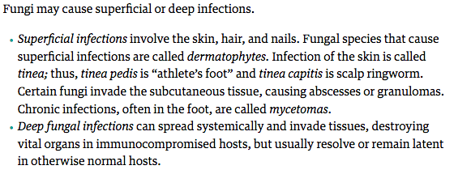

Slide 24
Fungi are divided into endemic and opportunistic species.
Endemic fungi are invasive species that are usually limited to particular geographic regions (e.g., Coccidioides in the southwestern United States, Histoplasma in the Ohio River Valley).
Opportunistic fungi (e.g., Candida, Aspergillus, Mucor, Cryptococcus), by contrast, are ubiquitous organisms that either colonize individuals or are encountered from environmental sources but do not cause severe disease in healthy individuals. In immunodeficient individuals, opportunistic fungi give rise to life-threatening invasive infections characterized by vascular occlusion, hemorrhage, and tissue necrosis, with little or no inflammatory response. Patients with AIDS are very susceptible to infection with the opportunistic fungus Pneumocystis jiroveci (previously called Pneumocystis carinii).

Slide 25
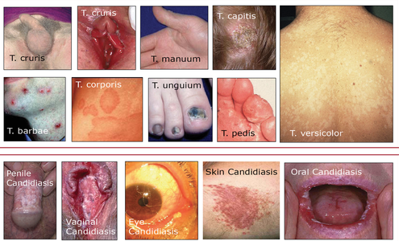

Slide 26
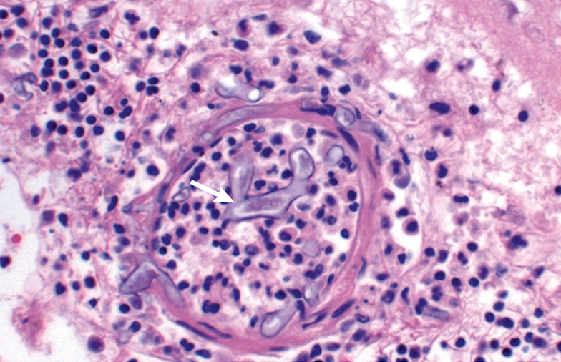
Meningeal blood vessels with angioinvasive Mucor species. Note the irregular width and near right-angle branching of the hyphae (arrow).

Slide 27
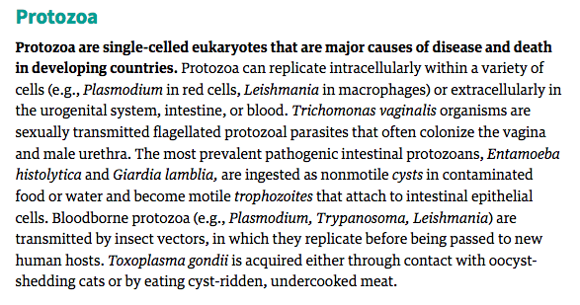

Slide 28
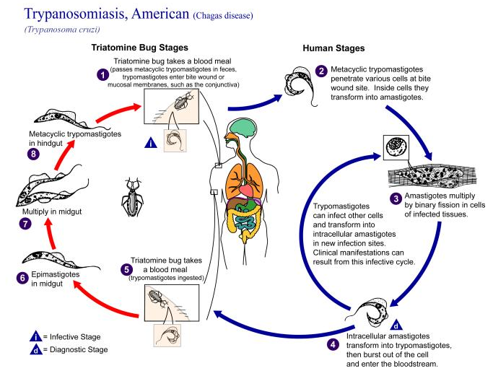
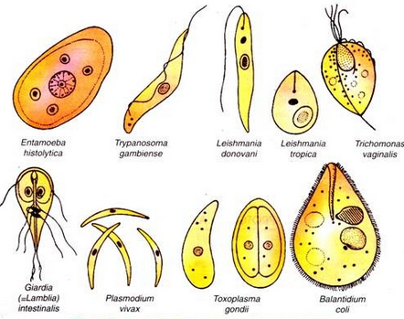

Slide 29
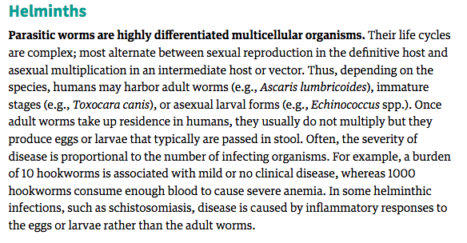

Slide 30
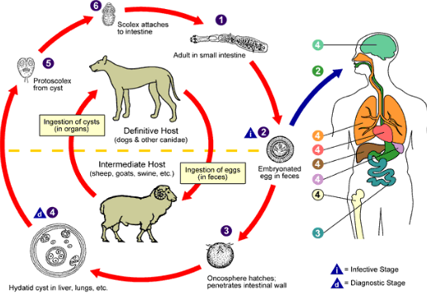

Slide 31
Helminths comprise three groups:
Roundworms (nematodes) are circular in cross-section and nonsegmented. Intestinal nematodes include A. lumbricoides, Strongyloides stercoralis, and hookworms. Nematodes that invade tissues include the filariae, such as Wuchereria bancrofti and Trichinella spiralis.
Tapeworms (cestodes) have a head (scolex) and a ribbon of multiple flat segments (proglottids). They adsorb nutrition through their tegument and do not have a digestive tract. They include the fish, beef, and pork tapeworms that make their home in the human intestine. The larvae that develop after ingestion of eggs of certain tapeworms can cause cystic disease within tissues (Echinoccus granulosus larvae cause hydatid cysts; pork tapeworm larvae produce cysts called cysticerci in many organs).
Flukes (trematodes) are leaf-shaped flatworms with prominent suckers that are used to attach to the host. They include liver and lung flukes and schistosomes.

Slide 32
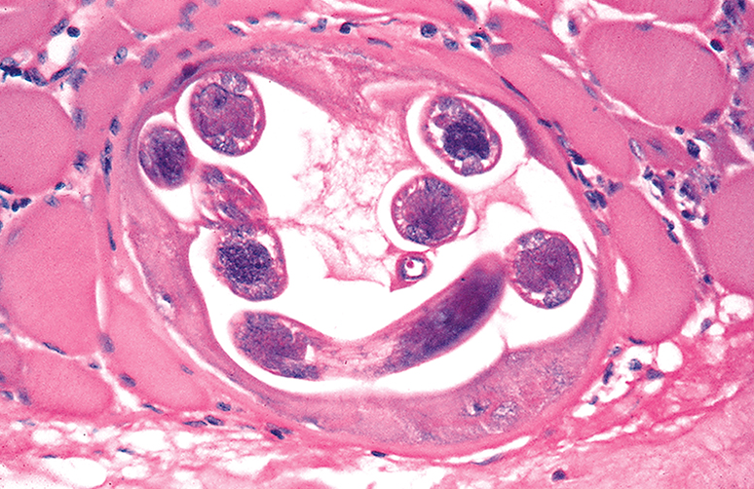
Coiled Trichinella spiralis larva within a skeletal muscle cell.

Slide 33
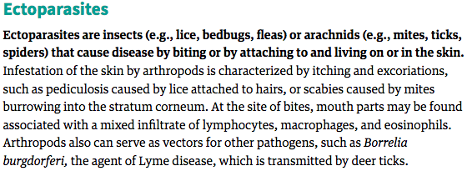
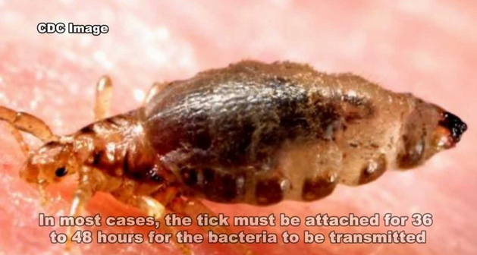

Slide 34
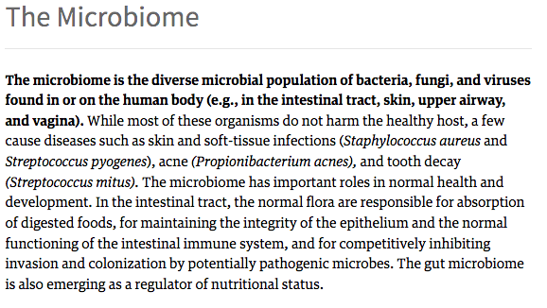

Slide 35
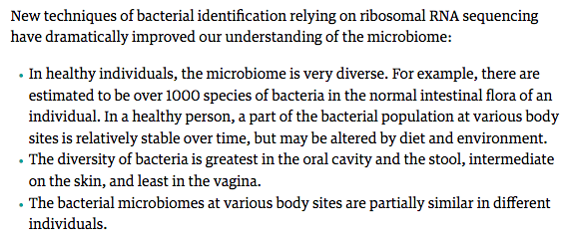

Slide 36
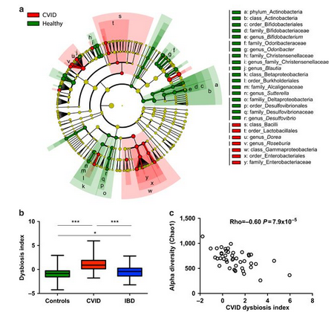

Slide 37
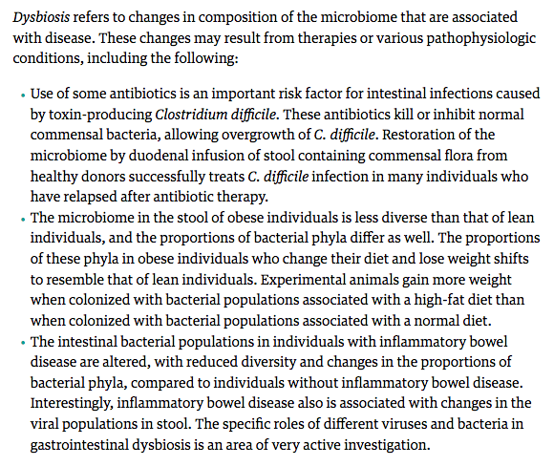

Slide 38
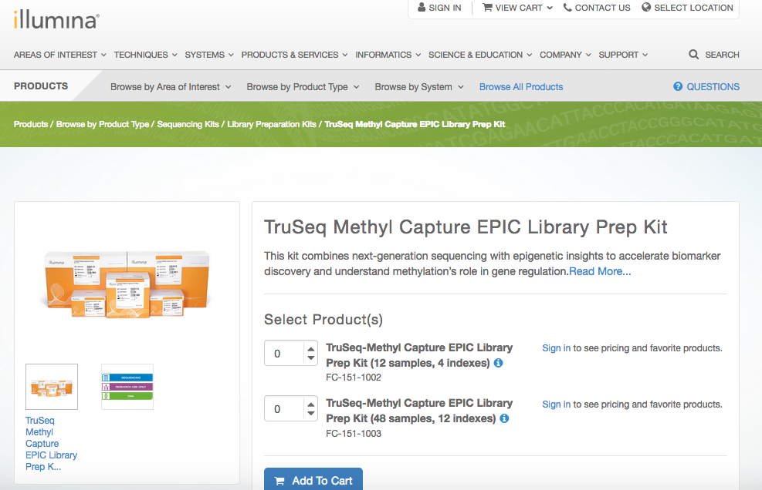

Slide 39
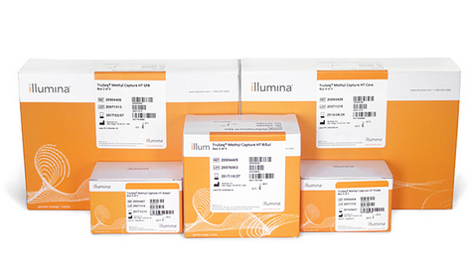
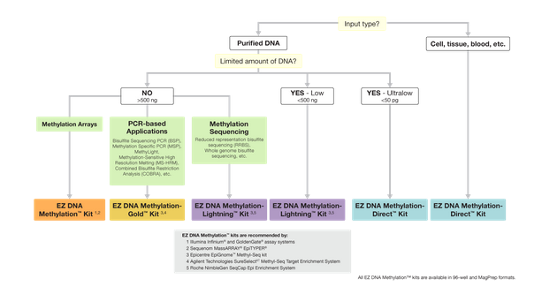

Slide 40
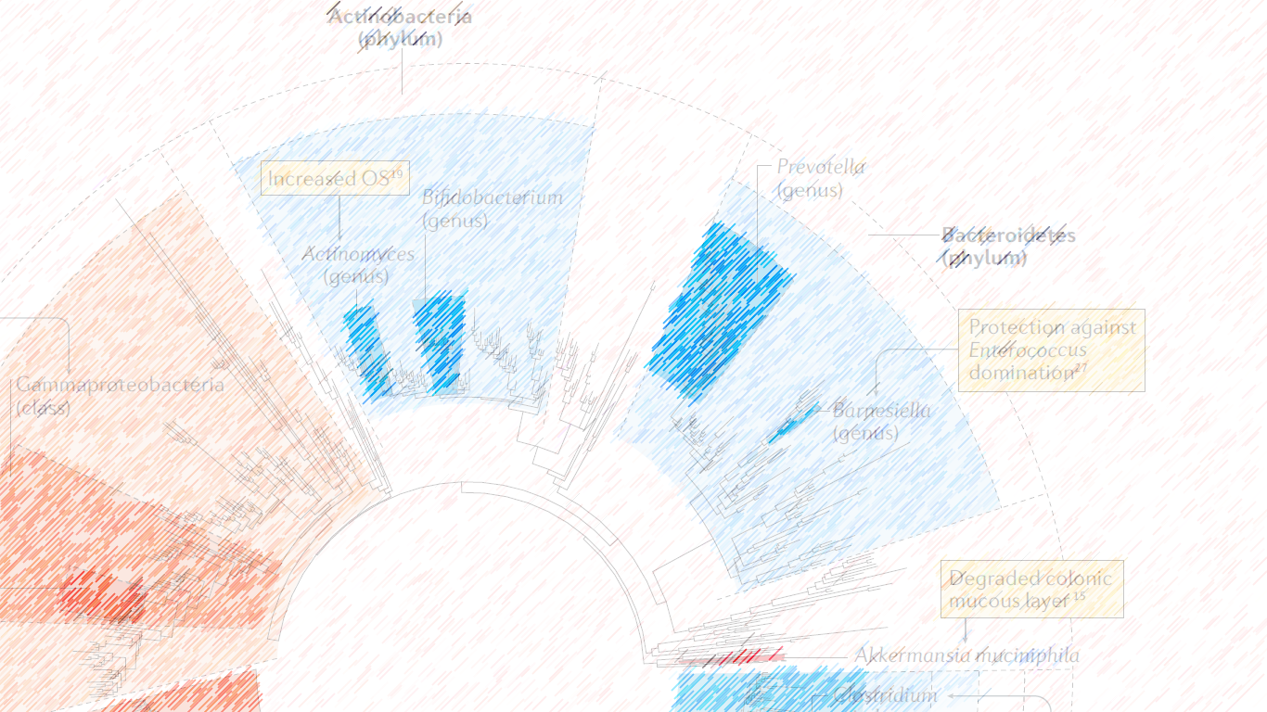
INTESTINAL MICROBIOTA KEY FACTOR IN THE CURE OF CANCER

Slide 41
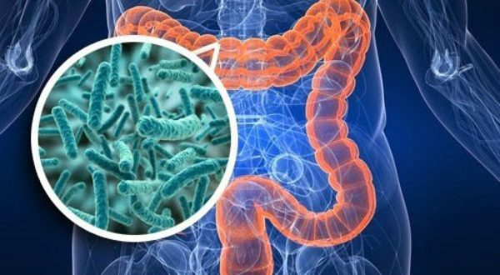
IMUNE SYSTEM
CANCER
ANTIBIOTICS
CHEMOTHERAPY

Slide 42
REFLECTION

Slide 43
Can the intestinal microbiota act positively or negatively against chemotherapeutic treatments?
Can the intestinal microbiota type be related to a higher mortality rate among patients undergoing the same chemotherapy treatment?

Slide 44
Does the change in the intestinal microbiota interfere with the action of the immune system or the action of the therapeutic drug? How is this possible ?

Slide 45
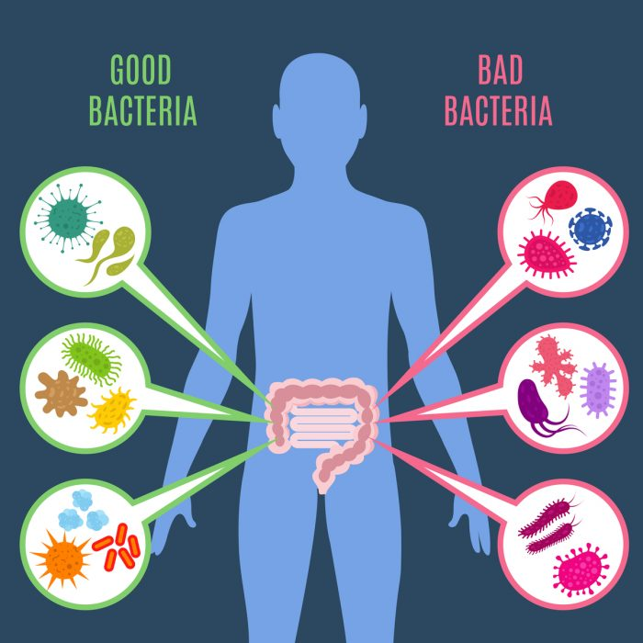
The knowledge of the patient's intestinal microbiota as well as a change in eating habits to intentionally change the intestinal microbiota would be an asset to medicine?

Slide 46
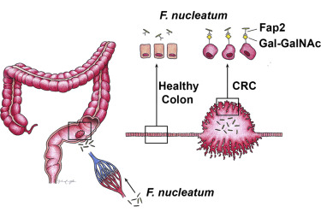
Colorectal cancer:
Association with local microbiota;
Metastases associated with bacterial : Fusobacterium, Bacteroides, Selenomonas e Prevotella;
Antibiotic treatment in Fusobacterium-positive mice decreased tumor development.
Fusobacterium:
Induces healthy cell autophagy;
Increases the resistance of tumor cells to chemotherapy.
ABED et al, 2016. Cell Host & Microbe

Slide 47
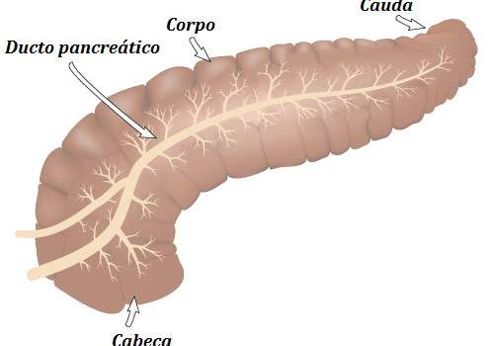
Proteobacteria:
Production of enzymes that degrade cytotoxic antineoplastic agents;
Hinders and make treatment difficult
They contribute to tumor growth; Mainly in pancreatic ductal adenocarcinoma.
High numbers of Gammaproteobacter bacteria, including Enterobacteriaceae, were found in cases that did not respond to treatment;
Abundance of Lachnospiraceae and Actinomycetaceae were associated with a higher number of favorable outcome.

Slide 48
Presence of Eubacterium limosum bacteria in the feces of individuals undergoing bone marrow transplantation reduces the likelihood of immune decline when compared to patients who do not have this bacterium in their microbiota.
Intestinal Microbiota and immuno-therapy
Low intestinal microbiota diversity was associated with higher mortality (52% of the study cases);
Greater diversity increases the expectations of improvement

Slide 49
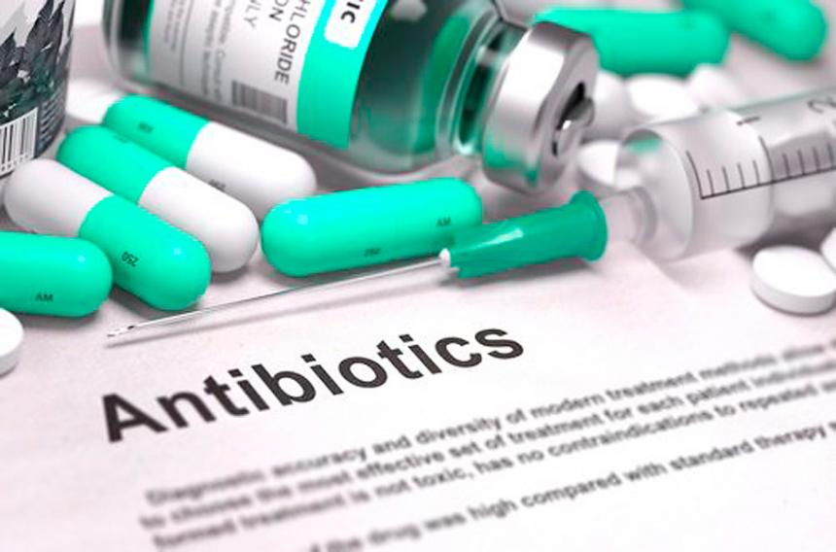
Therapy with Antibiotics
Vancomycin and Metronidazole = Resistant Enterococcus Vancomycin (VRE) and an increased risk of bacteremia by VRE or Gram-negative bacteria
Use of Ciprofloxacin and Levofloxacin has been associated with reduced risk of Gram-negative bacterial infections by reducing the risk of bacteremia;
Elimination of the commensal microbiota increases the risk of proliferation of opportunistic or pathogenic bacteria, increasing the risk of death.

Slide 51
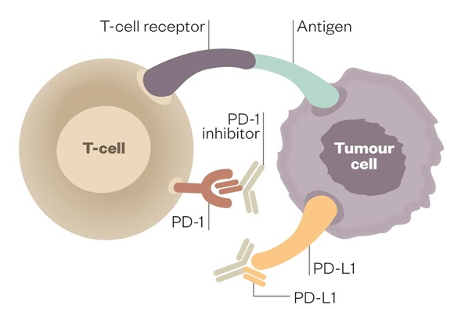
Intestinal Microbiota and immuno-therapy
Modulation of immunotherapy response with programmed cell death protein-blocking antibodies 1 (PD1) or its ligand (PDL1);
Failures were observed in PD1 or PDL1-directed immunotherapy when associated with broad-spectrum antibiotics.
Currently the therapy is combined with: chemotherapy, and / or radiotherapy and antibiotics.

Slide 52
Intestinal Microbiota and immuno-therapy
Transfer of the human intestinal microbiota to "avatars" mice demonstrated that they responded to therapy, a fact that did not occur in rats that did not receive it.
The use of broad-spectrum antibiotics in patients susceptible to bacteremia or sepsis reduces the diversity of the commensal microbiota, this fact could be minimized by transplanting fecal material from the patient or third parties;
However, there have been reports of viral infection and gastrointestinal anomalies, further studies and long-term follow-up are needed.

Slide 54
Phylogenetic tree of bacterial species typical of the intestine.
Blue indicates beneficial associations, while red shading indicates association with negative effects.

Slide 55
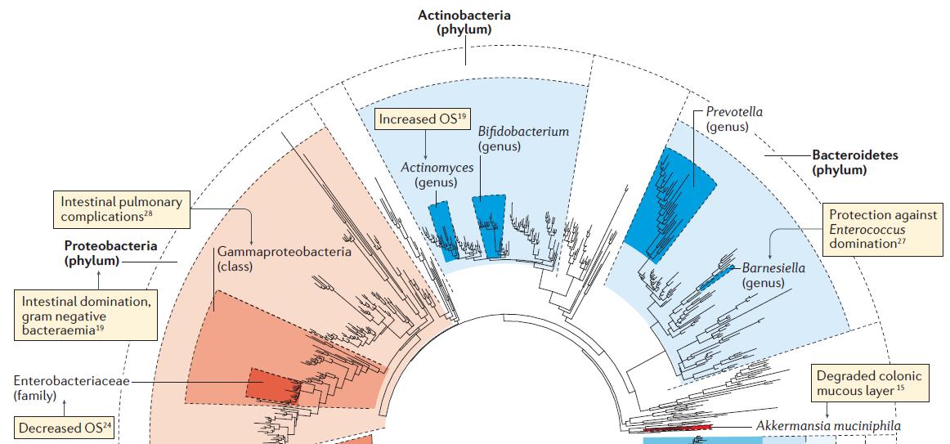

Slide 56
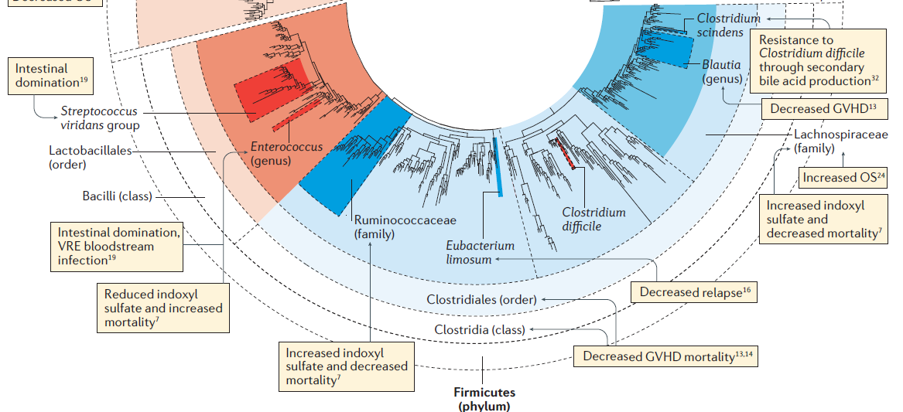

Slide 57
Some species and corelations to colorectal tumors...
Bifidobacterium Lactobacillus Ruminococcus Faecalibacterium spp. Roseburia
Treponema
Escherichia coli:
Pathogenic E. coli strains with a multi-enzymatic machinery for synthesizing a peptide-polyketide hybrid genotoxin named Colibactin (pks).
Epithelial proliferation and E. coli colonization density were significantly correlated in the mucosa distant from cancer and psk positive cancer specimens showed higher levels of DNA damage than its negative counterparts, supporting potential causal link.
Bacteroides fragilis:
Small proportion of fecal microbiota (0.5% e 1%);
Enterotoxigenic subtype (ETBF): toxin (BFT) which binds to a specific colonic epithelial receptor activating a signaling pathways:
Cell proliferation;
Release proinflammatory mediators
Induction of DNA damage
ETBF: Tumor formation in experimental animals
Bacteria metabolites amino acids are increased and fatty acids are decreased throughout colonic carcinogenesis
Fusobacteria
Alistipes
Porphyromonadaceae
Coriobacteridae
Staphylococcaceae
Akkermansia spp.
Methanobacteriales

Slide 58
Interactions between colorectal cancer risk factors and gut microbiome
Promotes and maintains colonic epithelial health (barrier function)
Obese and lean individuals:
Different gut microbiota.
Low energy diet increase gene richness.
Dietary fiber and resistant starch: Stimulate-> short chain fatty acids (SCFA)
Suppress colonic cancer:
Inhibiting intestinal inflammation,
Modulating immune response,
Regulating DNA methylation for proliferation,
diminishing oxidative DNA damage.
Lean animals:
Obese microbiome
increase in body adiposity in a diet dependent manner
A study from Ireland: athletes with higher microbial diversity
Alcoholics: greater abundance of Proteobacteria or its family Enterobacteriaceae
Smoking cessation increase some Firmicutes and decreasing some Bacteroidetes and Proteobacteria.
Mice models

Slide 59
Interactions between colorectal cancer and gut microbiome

Slide 60
Allogeneic stem cell transplant (allo-HSCT) , graft-versus-host disease (GVHD) and gut microbiota
One of the earliest demonstrations of the role of the gut microbiota in response and toxicity to cancer therapy
Fecal samples -> loss of bacterial diversity and stability, and dominance of Enterococcus, Streptococcus, and various Proteobacteria (Holler et al., 2014; Taur et al., 2012).
Health-promoting bacteria such as Faecalibacterium and Ruminococcus were reduced (Biagi et al., 2015).
Association with differences in long-term survival: lower diversity of gut with shortened overall survival and higher mortality rates, compared with those with a high diversity of gut microbiota (Taur et al., 2014).
SHONO, Yusuke; VAN DEN BRINK, Marcel RM. Gut microbiota injury in allogeneic haematopoietic stem cell transplantation. Nature Reviews Cancer, 2018.

Slide 61
Strategies focused on the microbiota
Antibiotics
Restricted spectrum spares anaerobic anti-inflammatory bacteria; shorter duration
Prebiotics
compounds indigestible for us - increases bacterial metabolites
Probiotics
FMT - Fecal mictobiota transplantation - of the donor, relative or voluntary donor.
Post-biotics
Provide the advantageous metabolites produced by the intestinal microbiota

Slide 63
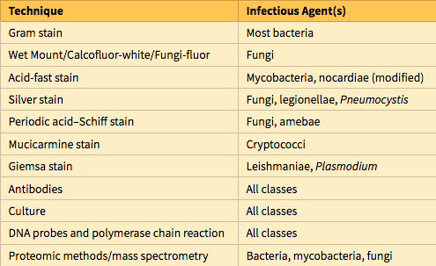
Techniques for Identifying Infectious Agents

Slide 64
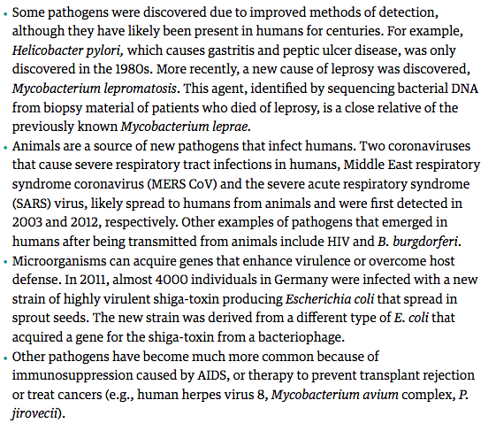
Re-emerging or emerging diseases

Slide 65
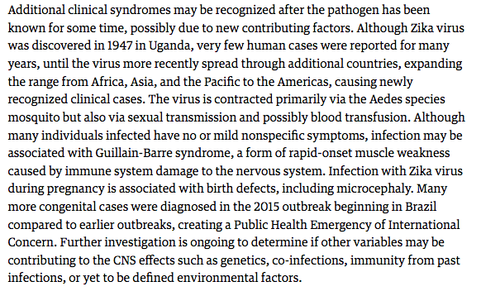

Slide 66
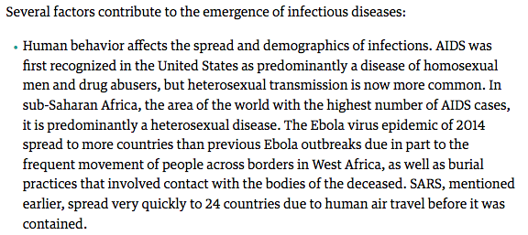

Slide 67
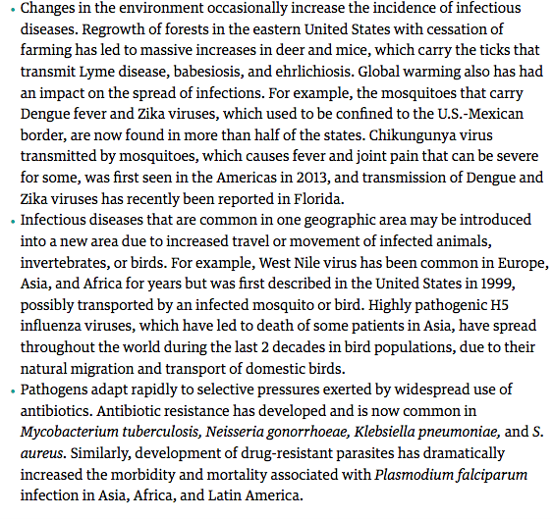

Slide 68
Agents of Bioterrorism
Sadly, the anthrax attacks in the United States in 2001 transformed the theoretical threat of bioterrorism into reality. The Centers for Disease Control and Prevention (CDC) has evaluated the danger microorganisms pose as weapons on the basis of the efficiency with which disease can be transmitted, how difficult the microorganisms are to produce and distribute, what can be done to defend against them, and the extent to which they are likely to alarm the public and produce widespread fear. Based on these criteria, the CDC has ranked bioweapons into three categories, designated A, B, and C

Slide 69
Routes of Entry of Microbes
Microbes can enter the host through breaches in the skin, by inhalation or ingestion, or by sexual transmission. The first defenses against infection are intact skin and mucosal surfaces, which provide physical barriers and produce anti-microbial substances. In general, respiratory, gastrointestinal, or genitourinary tract infections that occur in otherwise healthy individuals are caused by relatively virulent microorganisms that are capable of damaging or penetrating intact epithelial barriers. By contrast, most skin infections in healthy individuals are caused by less virulent organisms that breach the skin through damaged sites

Slide 71
Routes of entry and dissemination of microbes.
To enter the body, microbes penetrate epithelial or mucosal barriers. Infection may remain localized at the site of entry or spread to other sites in the body. Most common microbes (selected examples are shown) spread through the lymphatics or bloodstream (either freely or within inflammatory cells). However, certain viruses and bacterial toxins also may travel through nerves.

Slide 76
Urine. Urine is the usual mode of exodus from the human host for only a few organisms, including S. haematobium, which grows in the veins of the bladder and releases eggs that reach the urine.
Genital tract. Sexually transmitted infections (STIs) spread from the urethra, vagina, cervix, rectum, or oral pharynx. Organisms that cause STIs depend on direct contact for person-to-person spread because these pathogens cannot survive in the environment. Transmission of STIs often is by asymptomatic individuals who do not realize that they are infected. Infection with one STI increases the risk for additional STIs, mainly because the risk factors are the same for all STIs.

Slide 79
Viruses can directly damage host cells by entering them and replicating at the host’s expense. The manifestations of viral infection are largely determined by the tropism of the virus for specific tissues and cell types. Tropism is influenced by a number of factors.
Host receptors for viruses. Viruses are coated with surface proteins that bind with high specificity to particular host cell surface proteins. Entry of many viruses into cells commences with binding to normal host cell receptors. For example, HIV glycoprotein gp120 binds to CD4 and CXCR4 and CCR5 on T cells and macrophages. Host proteases may be needed to enable binding of virus to host cells; for instance, a host protease cleaves and activates the influenza virus hemagglutinin.
Specificity of transcription factors. The ability of the virus to replicate inside particular cell types depends on the presence of lineage-specific transcription factors that recognize viral enhancer and promoter elements. For example, the JC virus, which causes leukoencephalopathy replicates only in oligodendroglia in the CNS because the promoter and enhancer DNA sequences regulating viral gene expression are active in glial cells, but not in neurons or endothelial cells.
Physical characteristics of tissues. Host environment and temperature can contribute to tissue tropism. For example, enteroviruses replicate in the intestine in part because they can resist inactivation by acids, bile, and digestive enzymes. Rhinoviruses infect cells only within the upper-respiratory tract because they replicate optimally at the lower temperatures characteristic of this site.

Slide 80
Direct cytopathic effects. Viruses can kill cells by preventing synthesis of critical host macromolecules, by producing degradative enzymes and toxic proteins, or by inducing apoptosis. For example, poliovirus blocks synthesis of host proteins by inactivating cap-binding protein. HSV produces proteins that inhibit synthesis of cellular DNA and mRNA and other proteins that degrade host DNA. Viral replication also can trigger apoptosis of host cells by cell-intrinsic mechanisms, such as perturbations of the endoplasmic reticulum during virus assembly, which can activate caspases that mediate apoptosis.
Anti-viral immune responses. Viral proteins on the surface of host cells may be recognized by the immune system, and lymphocytes may attack virus-infected cells. Cytotoxic T lymphocytes (CTLs) are important for defense against viral infections, but CTLs also can be responsible for tissue injury. Hepatitis B infection causes CTL-mediated destruction of infected hepatocytes, a normal response that is attempting to clear the infection.
Transformation of infected cells. Different oncogenic viruses (e.g., HPV, EBV) can stimulate cell growth and survival by a variety of mechanisms, including hijacking the control of cell cycle machinery, anti-apoptotic strategies, and insertional mutagenesis (in which the insertion of viral DNA into the host genome alters the expression of nearby host genes).

Slide 84
Bacterial Adherence to Host Cells
Bacterial surface molecules that bind to host cells or extracellular matrix are called adhesins. Diverse surface structures are involved in adhesion of various bacteria . S. pyogenes has protein F and teichoic acid projecting from its cell wall that bind to fibronectin on the surface of host cells and in the extracellular matrix. Other bacteria have filamentous proteins called pili on their surfaces. Stalks of pili are structurally conserved, whereas amino acids on the tips of the pili vary and determine the binding specificity of the bacteria. Strains of E. coli that cause urinary tract infections uniquely express a specific P pilus that binds to a Gal(α1–4)Gal moiety expressed on uroepithelial cells. Pili on N. gonorrhoeae bacteria mediate adherence of the bacteria to host cells and also are targets of the host antibody response. Antigenic variation affecting the antigens expressed in the pili is an important mechanism by which N. gonorrhoeae escapes the immune response.

Slide 85
Bacterial endotoxin is a lipopolysaccharide (LPS) that is a component of the outer membrane of gram-negative bacteria. LPS is composed of a long-chain fatty acid anchor, termed lipid A, connected to a core sugar chain, both of which are very similar in all gram-negative bacteria. Attached to the core sugar is a variable carbohydrate chain (O antigen), which is used to serotype strains of bacteria to aid in diagnosis.
Lipid A binds to CD14 on the surface of host leukocytes, and the complex then binds to Toll-like receptor 4, a pattern recognition receptor of the innate immune system that transmits signals to promote cell activation and inflammatory responses. Responses to LPS can be both beneficial and harmful to the host. The response is beneficial in that LPS activates protective immunity through induction of important cytokines and chemoattractants (chemokines), as well as increased expression of costimulatory molecules, which enhance T-lymphocyte activation. However, high levels of LPS play an important role in septic shock, disseminated intravascular coagulation, and acute respiratory distress syndrome, mainly through induction of excessive levels of cytokines such as tumor necrosis factor

Slide 86
Exotoxins are secreted proteins that cause cellular injury and disease. They can be classified into broad categories by their mechanism and site of action.
Enzymes. Bacteria secrete enzymes (proteases, hyaluronidases, coagulases, fibrinolysins) that act on their respective substrates in vitro, but their role in disease is understood in only a few cases. For example, exfoliative toxins are proteases produced by S. aureus that cleave proteins known to hold keratinocytes together, causing the epidermis to detach from the deeper skin.
A-B toxins: Toxins that alter intracellular signaling or regulatory pathways. The two-component toxins have an active (A) component with enzymatic activity and a binding (B) component that binds cell surface receptors and delivers the A protein into the cell cytoplasm. The effect of these toxins depends on the binding specificity of the B domain and the cellular pathways affected by the A domain. A-B toxins are made by many bacteria including Bacillus anthracis, V. cholerae, and Corynebacterium diphtheriae. The mechanism of action of the A-B anthrax toxin is well understood. Anthrax toxin has two alternate A components, edema factor (EF) and lethal factor (LF), which enter cells following binding to the B component, and each A component mediates specific pathologic effects.

Slide 87
Superantigens stimulate very large numbers of T lymphocytes by binding to conserved portions of the T cell receptor, leading to massive T lymphocyte proliferation and cytokine release. The high levels of cytokines lead to capillary leak and the systemic inflammatory response syndrome. Superantigens made by S. aureus and S. pyogenes cause toxic shock syndrome.
Neurotoxins produced by Clostridium botulinum and Clostridium tetani inhibit release of neurotransmitters, resulting in paralysis. These toxins do not kill neurons; instead, the A domains cleave proteins involved in secretion of neurotransmitters at the synaptic junction. Tetanus and botulism can result in death from respiratory failure due to paralysis of the chest and diaphragm muscles.
Enterotoxins affect the gastrointestinal tract causing varied effects, including nausea and vomiting (S. aureus), voluminous watery diarrhea (V. cholerae), and bloody diarrhea (C. difficile)

Slide 88
Mechanism of anthrax exotoxin action. The B subunit, also called protective antigen, binds a cell-surface receptor, is cleaved by a host protease, and forms a heptamer. Three A subunits of edema factor (EF) or lethal factor (LF) bind to the B heptamer, enter the cell, and are released into the cytoplasm. EF binds calcium and calmodulin to form an adenylate cyclase that increases intracellular cAMP, which causes efflux of water and interstitial edema. LF is a protease that destroys mitogen-activated protein kinase kinases (MAPKKs), leading to cell death. cAMP, cyclic adenosine monophosphate. Note that each B subunit binds either EF or LF, but not both (as shown for simplicity).

Slide 89
Injurious Effects of Host Immune Responses
The host immune response to microbes can sometimes be the cause of tissue injury. A few examples of types and mechanisms of injury are as follows:
Granulomatous inflammation. Infection with M. tuberculosis results in a delayed hypersensitivity response and the formation of granulomas, which sequester the bacilli and prevent its spread, but also produce tissue damage (caseous necrosis) and fibrosis.
T-cell–mediated inflammation. Damage from HBV and HCV infection of hepatocytes is due mainly to the immune response to the infected liver cells and not to cytopathic effects of the virus.
Innate immune inflammation. Pattern recognition receptors bind to pathogen-associated molecular patterns (PAMPS) and to damage-associated molecular patterns (DAMPS) released from damaged host cells, activating the immune system and leading to inflammation.

Slide 90
Humoral immunity. Poststreptococcal glomerulonephritis can develop after infection with S. pyogenes. It is caused by antibodies that bind to streptococcal antigens and form immune complexes, which deposit in renal glomeruli and produce nephritis.
Chronic inflammatory diseases. In the development of inflammatory bowel disease an important early event may be compromise of the intestinal epithelial barrier, which enables the entry of both pathogenic and commensal microbes and their interactions with local immune cells, resulting in inflammation. The cycle of inflammation and epithelial injury may be an important component of the disease, with microbes playing the central role.
Cancer. Viruses, such as HBV and HCV, and bacteria, such as H. pylori, that are not known to carry or to activate oncogenes are associated with cancers, presumably because these microbes trigger chronic inflammation with subsequent tissue regeneration, which provides fertile ground for the development of cancer.

Slide 91
Immune Evasion by Microbes
Not surprisingly, microorganisms have developed many means to resist and evade the immune system. These mechanisms of escaping the immune response are important determinants of microbial virulence and pathogenicity.
Antigenic variation. Neutralizing antibodies against microbial antigens block the ability of microbes to infect cells and recruit immune cells to kill pathogens. To escape recognition, microbes use many strategies that involve genetic mechanisms for generating antigenic variation. The low fidelity of viral RNA polymerases (HIV and influenza virus) and reassortment of viral genomes (influenza viruses) create viral antigenic variation. Borrelia species switch their surface antigens via gene rearrangement. Trypanosoma species have many genes for their major surface antigen, VSG, and vary the expression of this surface protein. There are more than 90 different serotypes of S. pneumoniae, each with a different capsular polysaccharide.

Slide 92
Modification of surface proteins. Host cationic anti-microbial peptides, including defensins, cathelicidins, and thrombocidins, provide important initial defenses against invading microbes. These peptides bind the bacterial membrane and form pores, killing the bacterium by osmotic lysis. Bacterial pathogens (Shigella spp., S. aureus) avoid killing by making surface molecules that resist binding of anti-microbial peptides, or that inactivate or downregulate anti-microbial peptides.
Overcoming antibodies and complement. Host defense includes coating of bacteria with antibodies or the complement protein C3b (opsonization) to facilitate phagocytosis by macrophages. However, the facultative intracellular pathogen M. tuberculosis subverts the complement response by activating the alternative complement pathway in the extracellular environment, and complement products coat the bacteria, resulting in uptake of the organism by monocytes; by this means, the organism reaches its site of replication. Many bacteria (such as Shigella, enteroinvasive E. coli, M. tuberculosis, M. leprae, S. enterica serotype Typhi) use the inside of cells as a “hideout” that allows them to escape from antibodies and complement. Listeria monocytogenes can manipulate the cell cytoskeleton to spread directly from cell to cell, thus allowing the bacteria to evade immune defenses.

Slide 94
Resisting phagocytosis and bacterial killing in phagosomes. Phagocytosis and killing of bacteria by neutrophils and macrophages constitute a critical host defense against extracellular bacteria. The carbohydrate capsule on the surface of many bacteria that cause pneumonia or meningitis (S. pneumoniae, Neisseria meningitidis, H. influenzae) makes them more virulent by preventing phagocytosis of the organisms by neutrophils. Surface proteins that inhibit phagocytosis include proteins A (S. aureus) and M (S. pyogenes). Macrophages usually kill bacteria by fusion of the phagosome with the lysosome to form a phagolysosome. M. tuberculosis blocks fusion of the lysosome with the phagosome, allowing the bacteria to proliferate unchecked within the macrophage. Legionella produces a pore-forming protein called listeriolysin O and two phospholipases that degrade the phagosome membrane, allowing the bacteria to escape into the cytoplasm and avoid destruction in the macrophage. Legionella also secretes proteins that modulate small GTPases, master regulators of intracellular signaling to modify trafficking. Also, many bacteria make proteins that kill phagocytes, prevent their migration, or diminish their oxidative burst.
Escaping the inflammasome. The activation of the cytosolic inflammasome is one pathway of innate immune responses to microbes. It is stimulated by microbial products and culminates in the activation of caspases, which induce the secretion of the pro-inflammatory cytokines IL-1 and IL-18 and induce a form of cell death called pyroptosis. Both inflammation and cell death limit microbial virulence and replication. Some bacteria, such as Yersinia and Salmonella, express virulence proteins that inhibit the formation of the mature inflammasome, suppress caspase activation, block signaling pathways that are required for inflammasome activation, or limit the access of other bacterial proteins to the inflammasome. All these mechanisms serve to disable various components of this host anti-microbial defense reaction.

Slide 95
Disruption of interferon pathways. Viruses have developed a large number of strategies to combat interferons (IFNs), which are mediators of early antiviral defense. Some viruses produce soluble homologues of IFN receptors that bind to and block the actions of secreted IFNs, or produce proteins that inhibit intracellular JAK/STAT signaling downstream of IFN receptors. RIG-I (RNA helicase retinoic acid inducible gene I protein) is a host cytoplasmic pattern recognition receptor for intracellular double-stranded RNA viruses. RIG-I inhibits signaling by this receptor, thus blocking the downstream IFN pathway and overcoming this host defense. Some viruses encode within their genomes homologs of cytokines, chemokines, or their receptors that act as competitive antagonists to inhibit immune responses. Finally, viruses have developed strategies to block apoptosis, which may give the viruses time to replicate, persist, or transform the infected host cell.
Decreased T-cell recognition: DNA viruses (e.g., HSV, CMV, and EBV) can bind to or alter the localization of major histocompatibility complex (MHC) class I proteins, impairing peptide presentation to CD8+ cytotoxic T cells. Although downregulation of MHC class I molecules might cause virus-infected cells to be targets for NK cells, herpesviruses also express MHC class I homologuess that act as decoys that engage inhibitory receptors of NK cells. Herpesviruses can target MHC class II molecules for degradation, impairing antigen presentation to CD4+ helper T cells. Viruses also can infect leukocytes to directly compromise their function (e.g., HIV infects CD4+ T cells, macrophages, and dendritic cells).

Slide 96
Mechanisms of Antigenic variation

Slide 99
Which mononuclear cell predominates within the inflammatory lesion depends on the host immune response to the organism. Thus, lymphocytes predominate in HBV infection , whereas plasma cells are common in the primary and secondary lesions of syphilis. The presence of these lymphoid cells reflects cell-mediated immune responses against the pathogen or pathogen-infected cells.
Granulomatous inflammation is a distinctive form of mononuclear inflammation usually evoked by infectious agents that resist eradication, but nevertheless are capable of stimulating strong T-cell–mediated immunity (e.g., M. tuberculosis, Histoplasma capsulatum, schistosome eggs). Granulomatous inflammation is characterized by accumulation of activated macrophages called epithelioid cells, which may fuse to form giant cells. In some cases, there is a central area of caseous necrosis.

Slide 100
Mononuclear and granulomatous inflammation. (A) Acute viral hepatitis characterized by a predominantly lymphocytic infiltrate. (B) Secondary syphilis in the dermis with perivascular lymphoplasmacytic infiltrate and endothelial proliferation.

Slide 101
(C) Granulomatous inflammation in response to tuberculosis. Note the zone of caseation (asterisk), which normally forms the center of the granuloma, with a surrounding rim of activated epithelioid macrophages, some of which have fused to form giant cells (arrows); this in turn is surrounded by a zone of activated T lymphocytes. This high-magnification view highlights the histologic features; the granulomatous response typically takes the form of a three-dimensional sphere with the offending organism in the central area.

Slide 102
Cytopathic-Cytoproliferative Reaction
Cytopathic-cytoproliferative reactions usually are produced by viruses. The lesions are characterized by cell necrosis or cellular proliferation, usually with sparse inflammatory cells.
Some viruses replicate within cells and make viral aggregates that are visible as inclusion bodies (e.g., herpesviruses or adenovirus) or induce cells to fuse and form multinucleated cells called polykaryons (e.g., measles virus or herpesviruses).
Focal cell damage in the skin may cause epithelial cells to become detached, forming blisters. Some viruses can cause epithelial cells to proliferate (e.g., venereal warts caused by HPV or the umbilicated papules of molluscum contagiosum caused by poxviruses). Finally, viruses can contribute to the development of malignant neoplasms

Slide 104
Chronic Inflammation and Scarring
Many infections elicit chronic inflammation, which can either resolve with complete healing or lead to extensive scarring.
Sometimes an exuberant scarring response is the major cause of dysfunction. For example, schistosome eggs cause “pipestem” fibrosis of the liver or fibrosis of the bladder wall. M. tuberculosis causes constrictive fibrous pericarditis. Chronic HBV infection may cause cirrhosis of the liver, in which dense fibrous septa surround nodules of regenerating hepatocytes.
Schistosoma haematobium infection of the bladder with numerous calcified eggs and extensive scarring.

Slide 106
Patients with antibody, complement, or neutrophil defects may acquire severe local bacterial infections that do not elicit any significant neutrophilic infiltrate.
In these patients, the identity of the causative organism determined by culture or special stains may not have been predicted from histology. Although many viral cytopathic effects (e.g., cell fusion or inclusions) may still be present, viral infections in immunocompromised hosts may not engender the anticipated mononuclear inflammatory response. In patients with AIDS who have no helper T cells and cannot mount normal cellular responses, organisms that would otherwise cause granulomatous inflammation (e.g., M. avium complex) fail to do so.

Slide 107
In the absence of appropriate T-cell–mediated immunity, granulomatous host response does not occur. Mycobacterium avium infection in a duodenal biopsy from a patient with AIDS, showing massive intracellular macrophage infection with acid-fast organisms (filamentous and pink in this acid-fast stain preparation). The intracellular bacteria persist and even proliferate within macrophages, because there are inadequate T cells to mount a granulomatous response. AIDS, acquired immunodeficiency syndrome.

