Slide 1




ZIKA VIRUS
Pandemic and public health issues
Natural history of flavivirus related diseases
Molecular mechanisms at the basis of the disease
Sergio Crovella
sergio.crovella@burlo.trieste.it
Skype:thecrovels

Slide 2
Zika virus natural history and geographical distribution
Zika virus (ZIKV) is an arthropod-borne Flavivirus related to Dengue virus (DENV), Japanese Encephalitis virus (JEV), Usutu virus (USUV) and West Nile virus (WNV).
ZIKV was first isolated in 1947 in the Zika Forest (Uganda) from a febrile rhesus macaque and was also found circulating in Aedes africanus mosquitoes. A series of serological studies performed on human serum samples in Uganda, showed the presence of neutralising antibodies against ZIKV, therefore providing the first evidence that the virus can infect humans. Indeed, the first 3 cases of infection have been reported in Nigeria in 1954.
Serosurveillance studies demonstrate that from the beginning of the 21st century, the virus expanded throughout Africa, Asia, Oceania, the South Pacific and the Americas, triggering a pandemic that led to 48 countries reporting active ZIKV transmission by 2017. Prior to this expansion, there was little scientific research on this virus. Nevertheless, the many associated reports highlighting that the virus might cause abnormalities of the central nervous system, attracted the attention of the scientific community.

Slide 3

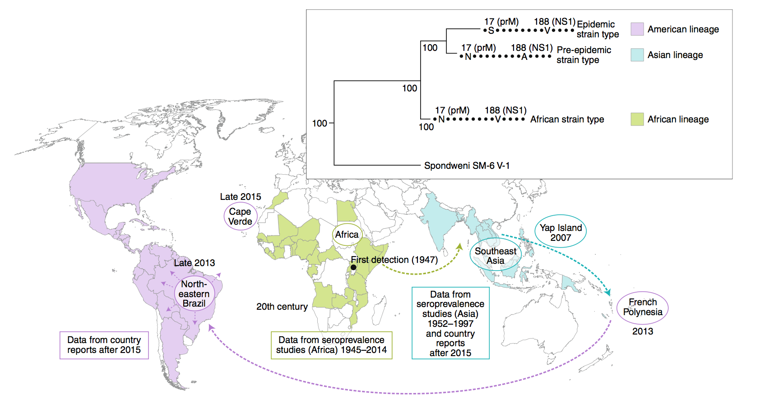
Emergence and evolution of ZIKV vector-borne transmission
Surveillance studies identified the development of human immunisation towards ZIKV in at least 25 African countries from 1945 to 2014.
1
1
Gutiérrez-Bugallo G. et al., 2019. Nature Ecology & Evolution. doi: https://doi.org/10.1038/s41559-019-0836-z

Slide 4
Emergence and evolution of ZIKV vector-borne transmission
Immune people were also identified in 7 Asian territories between 1952 to1997. Symptomatic ZIKV infection is no longer considered as limited to sporadic cases or small clusters of patients. Pattern change in 2007 where the first documented ZIKV outbreaks occurred in Yap (Federated states of Micronesia) where ≈73% of the population were infected and symptomatic disease developed in ≈18% of infected population. Major outbreak in 2013 in French Polynesia involving ≈100,000 infected people providing the first evidence of severe diseases (Guillan-Barré syndrome) associated to ZIKV infection.
2
2

Slide 5
Emergence and evolution of ZIKV vector-borne transmission
From Asian territories, the virus spread out through the South Pacific to the Americas where a it lead to a massive epidemic and congenital microcephaly was first associated with maternal ZIKV infection.
3
3

Slide 6

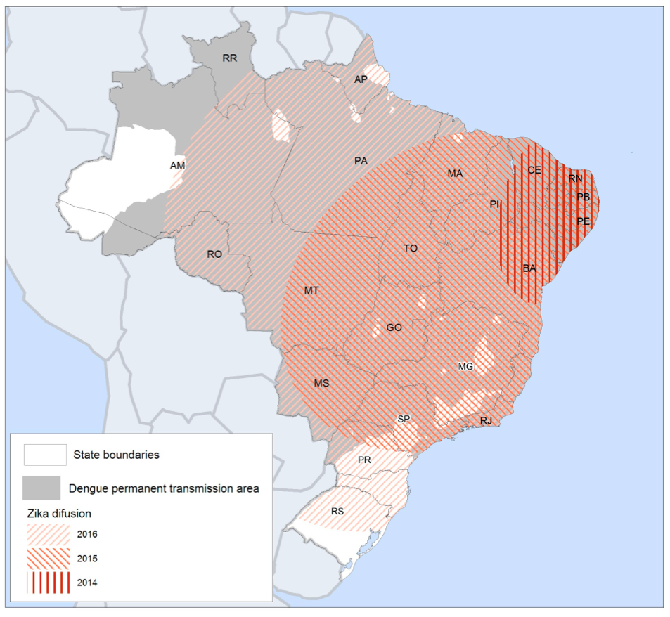
ZIKV emergence and spread in Brazil
First reports issued in December 2014.
Laboratory confirmation of ZIKV spread in May 2015. First identification in the Northeast region -Pernambuco (PE), Rio Grande do Norte (RN), Bahia (BA)-, followed by a progressive spread in other states of the Central-Western and Southeastern territories.
In November 2015, the Ministry of Health
declared a national public health emergency.
Declaration of ZIKV infection a public health
emergency of international concern by
the World Health Organisation (WHO).
≈ 440,000-1,300,000 persons
have been infected.
Lowe, R. et al., 2018. Int J Environ Res Public Health; doi: 10.3390/ijerph15010096

Slide 7

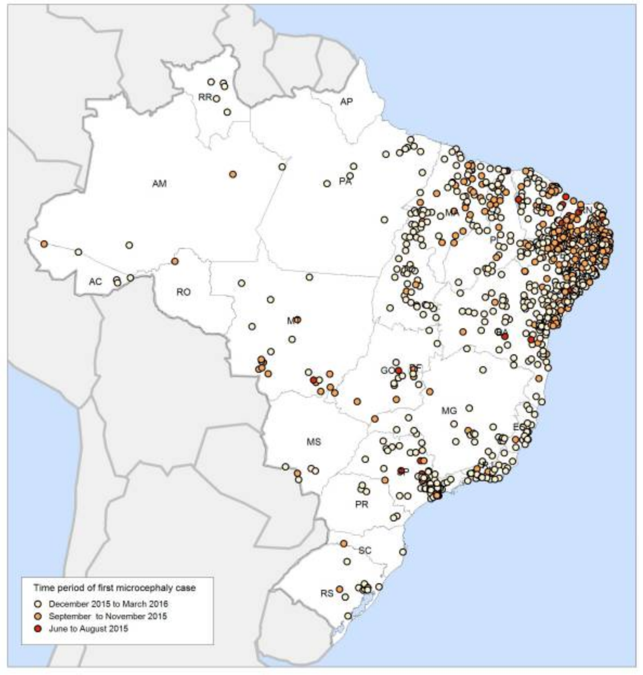
What has emerged from the Brazilian epidemic?
Other than the typically mild, self-limited and non-specific symptoms associated to ZIKV infection, Brazilian outbreak revealed new building evidences associated to adverse outcomes associated to viral infection:
Sharp increment in the number of neonates born with microcephaly, rare condition linked to incomplete brain development, and other congenital malformations in the central nervous system
Possible link between ZIKV and infection during pregnancy
Spatial distribution of microcephaly seems to follow ZIKV spread paths
Lowe, R. et al., 2018. Int J Environ Res Public Health; doi: 10.3390/ijerph15010096

Slide 8
What has emerged from the Brazilian epidemic?
Other than the typically mild, self-limited and non-specific symptoms associated to ZIKV infection, Brazilian outbreak revealed new building evidences associated to adverse outcomes associated to viral infection:
2. Increased cases of adults with manifestations of severe neurologic sequelae following infection including: meningitis, meniningoencephalitis and Guillain-Barré syndrome.
Note: Guillain-Barré syndrome has been registered also in Colombia, El Salvador, Venezuela, Suriname and French Polynesia during outbreaks. A strong correlation with viral infection has been advanced, however only ZIKV has been laboratory confirmed in only a couple of cases.
3. Peculiar non-neurologic outcomes including: hypotension, hearing loss and genitourinary symptomatology.

Slide 9

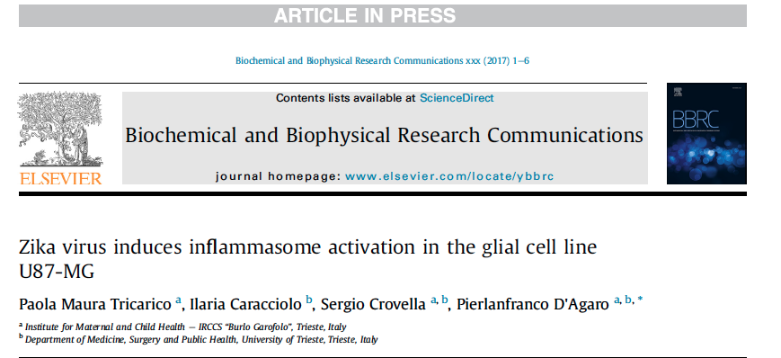
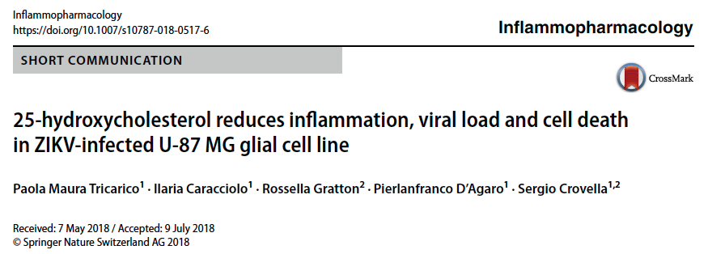
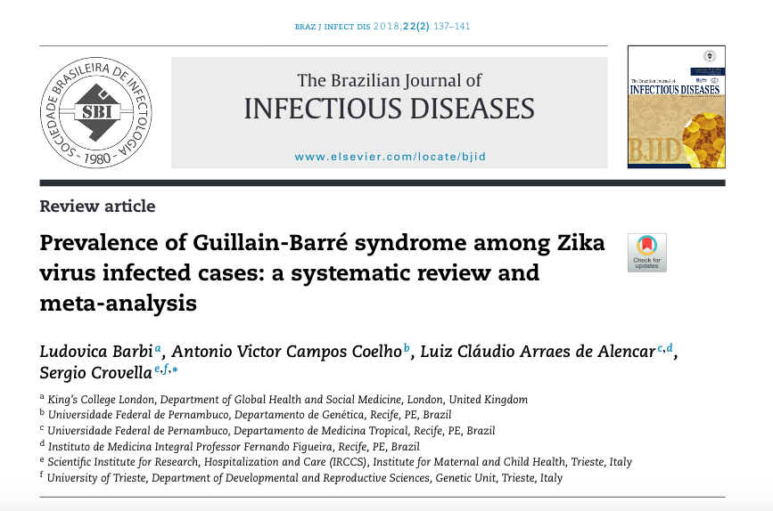

Slide 10
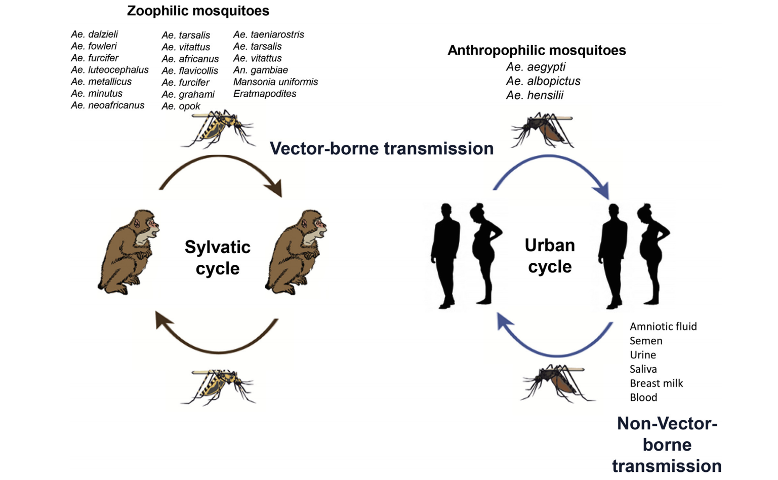
Modes of transmission of ZIKV
Boyer, S. et al., 2018. Microbes and Infection; doi: 10.1016/j.micinf.2018.01.006

Slide 11
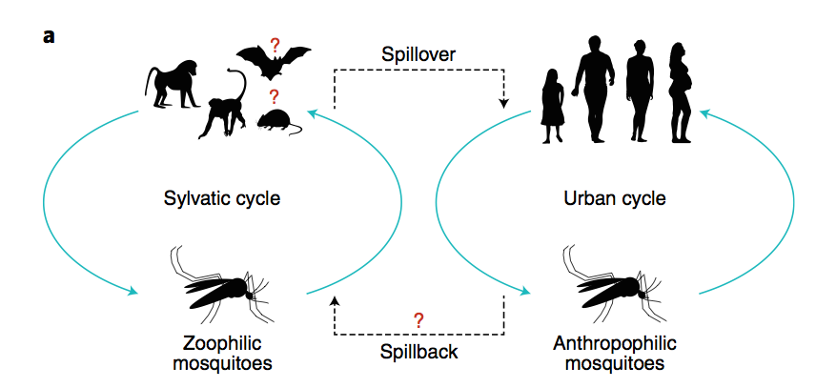
Modes of transmission of ZIKV
Vector-borne transmission comprise a:
sylvatic cycle with viral circulation between non-human primates (NHPs) and zoophilic mosquitoes (Aedes genus).
urban cycle with humans as reservoir and amplification hosts and anthropophilic mosquitoes as vectors.
Gutiérrez-Bugallo G. et al., 2019. Nature Ecology & Evolution. doi: https://doi.org/10.1038/s41559-019-0836-z

Slide 12
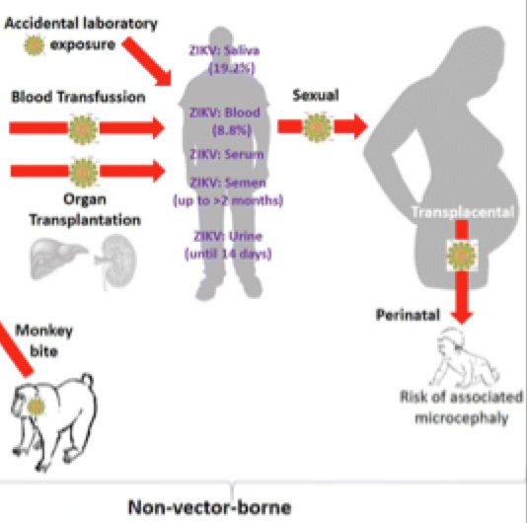
Modes of transmission of ZIKV
Non-Vector-borne transmission involves human-to-human transmission including:
intrauterine, intrapartum, sexual transmission.
Possible viral transmission by blood transfusion, animal bite, organ transplantation and laboratory exposure have been described.

Slide 13
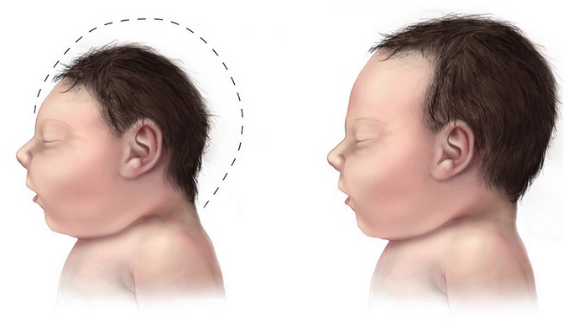
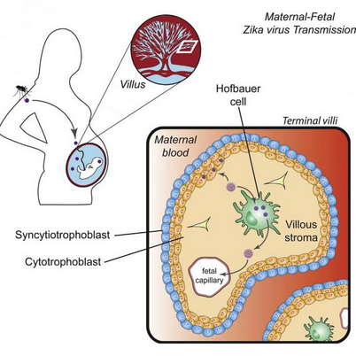
Mother-to-child transmission
Intrauterin transmission supported by laboratory evidences:
viral RNA has been detected by reverse transcription PCR (RT-PCR) in the amniotic fluid of two mothers presenting symptoms of ZIKV infection during pregnancy. Both women delivered neonates with microcephaly.
ZIKV RNA has also been registered in tissues of foetuses of women infected by the virus during pregnancy and in the brains of two live-born babies born with microcephaly who died >20 hours after birth.
Intrapartum transmission supported by laboratory evidences:
2 newborns found to be viremic with ZIKV >4 days after being born to infected mothers.
Detection of viral RNA, but not of culturable virus, in breast milk.

Slide 14

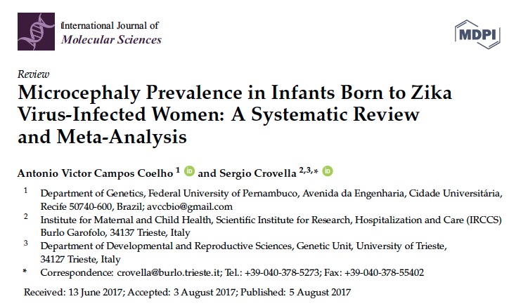
Mother-to-child transmission and microcephaly

Slide 15
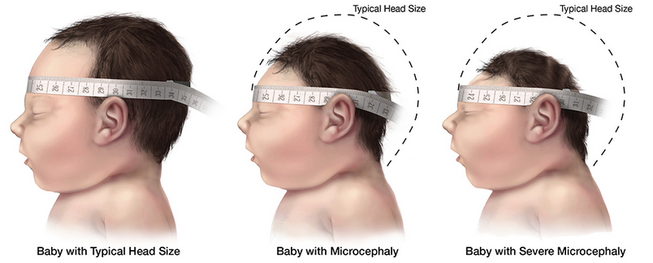
Mother-to-child transmission and microcephaly
During the last outbreak of ZIKV in Brazil, reports of infants born with microcephaly have significantly increased (>3800 cases, 20 cases/10 000 live births against 0,5 cases/10 000 live births as previously described).
These data may be in part artefactual due to previous underreporting of microcephaly cases and by confounding other risk factors for microcephaly.
Systematic surveillance for microcephaly was previously undertaken.
The baseline rate of microcephaly in Brazil is unknown.
Nevertheless, available evidences suggest that the infection during the first trimester of pregnancy, period in which the central nervous system of the foetus is being formed, is associated to a higher risk of microcephaly, miscarriages and perinatal death.

Slide 16
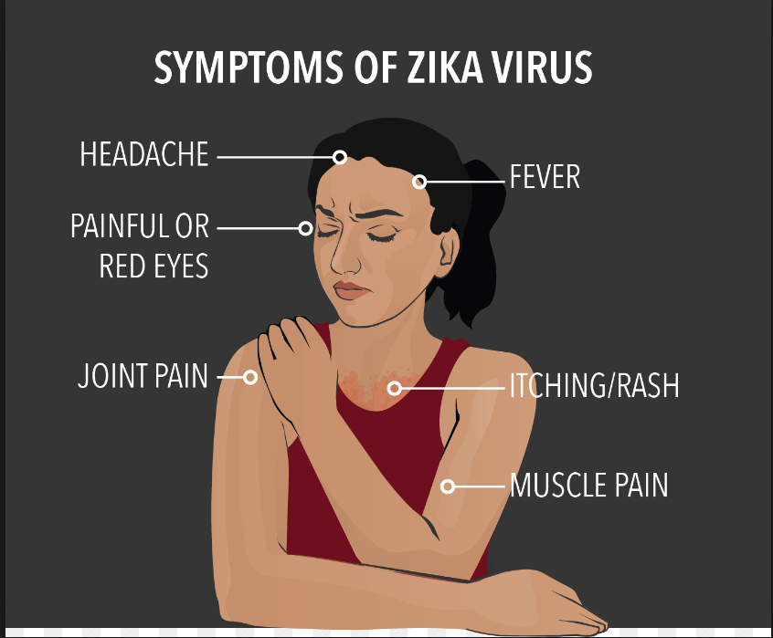
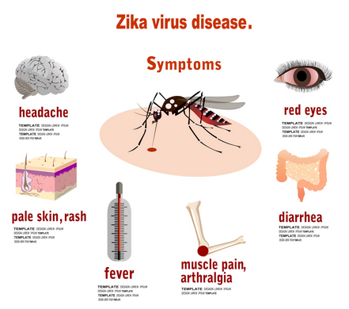
Clinical manifestations

Slide 17
Clinical manifestations
In human hosts, the incubation period following the mosquito bite to the onset of clinical symptoms is of ≈ 3-12 days.
In 80% of cases ZIKV infection is asymptomatic.
All ages are susceptible (4 days- 74 years) with slight preponderance in females.
Clinical diagnosis is may be confounding due the similarity of clinical manifestations of other arboviruses (i.g. DENV, CHIKV).

Slide 18

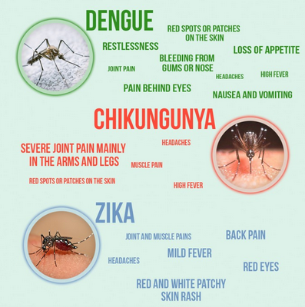
Laboratory diagnosis of ZIKV infection
General laboratory findings to confirm ZIKV infection are critical and often difficult comprehension.
Complete blood count is often normal. In the case of abnormal blood counts, there are no reported changes specifically associated to ZIKV (i.g. mild lymphopenia; mild neutropenia; mild-to-moderate trombocytopenia).
ZIKV induces an inflammatory response in infected cases which is characterised by a mild increment in inflammatory marker production (C-reactive protein, fibrinogen, ferritin). Serum located hydrogenase or liver enzymes can also be present following infection.
These symptoms are associated and found in many other viral infections (DENV, CHIKV) and therefore none of these laboratory alterations can reliably diagnose ZIKV infection from other infections!

Slide 19
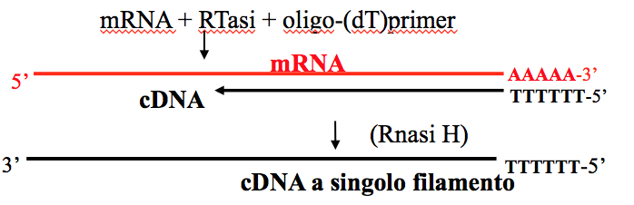
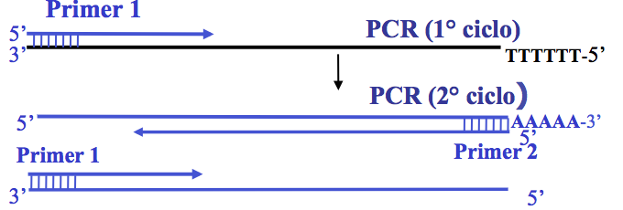
Laboratory diagnosis of ZIKV infection
Depending on the purpose of the investigation, laboratory detection of ZIKV can be performed following different routes.
Molecular detection: highly sensitive and specific
→Molecular detection of viral RNA:
Reverse- transcriptase Polymerase Chain Reaction (RT-PCR).
Lanciotti, RS. et al., 1992. J Clin Microbiol; 30:545-551.

Slide 20
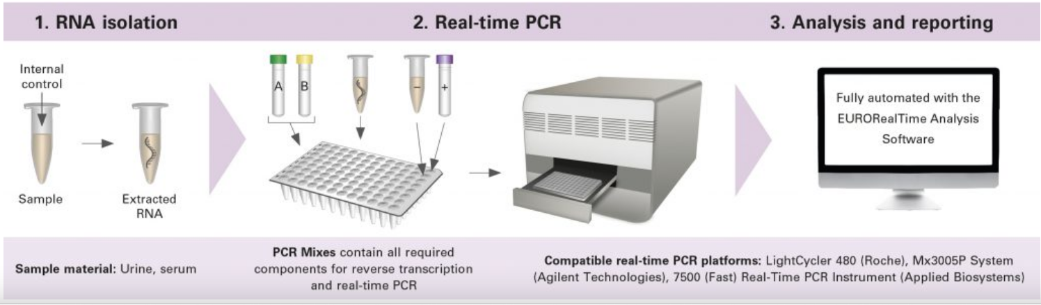
Laboratory diagnosis of ZIKV infection
Depending on the purpose of the investigation, laboratory detection of ZIKV can be performed following different routes.
Molecular detection:
→Molecular detection of viral RNA:
b. Real time PCR: combines a standard PCR amplification with a fluorescent probe to detect the amplified product during the same reaction in real time.
https://www.euroimmunblog.com/eurorealtime-zika-virus-the-first-real-time-pcr-test-from-euroimmun/

Slide 21
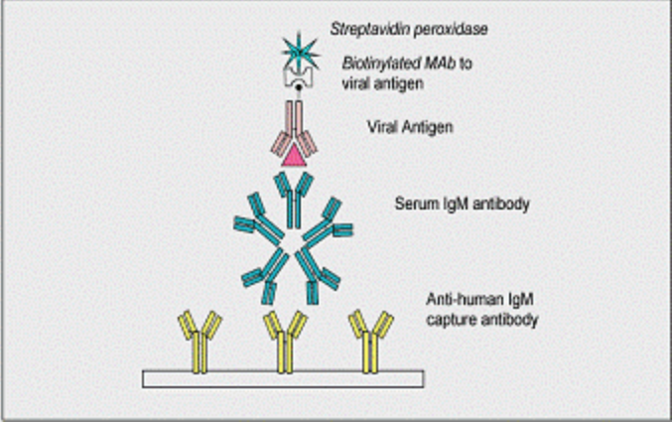

Laboratory diagnosis of ZIKV infection
Depending on the purpose of the investigation, laboratory detection of ZIKV can be performed following different routes.
2. Sierologial diagnosis for the detection of anti-ZIKV antibodies (on serum samples). Not recommended during the acute phase. Necessary diagnosis to overcome a limit of molecular diagnosis→ short periods of viremia can negatively affect RNA detection.
b. Different tests performed: ELISA, Plaque Reduction Neutralisation test (PRNT), complement fixation, immunofluorescence assay (IF).
1. Immunoglobulin M (IgM): IgM-capture ELISA.
2. PRNT (Plaque Reduction Neutralization Tests) confirmation.

Slide 22
Recent developments in anti-ZIKV treatments
No specific nor approved treatments or vaccines to counteract ZIKV infection are yet available.
The management is not resolutive but supportive and includes rest, analgesics, antipyretics and fluids.
Non-steroidal anti-inflammatory drugs and aspirin should not be administered until the infection from DENV is excluded because of the possible risk of hemorrhage in dengue patients.
Measures of prevention against mosquitoes bites and towards individual prevention (i.g. wearing long pants, light coloured clothing, use insect repellents and bed nets) specifically during the peak biting time of Aedes (early morning and late afternoon).
Social/community-level strategies to target mosquitoes breeding through the elimination of potential egg-laying sites by using insecticides or drying the environments.
Periodic foetal ultrasounds should be assessed in order examine foetal anatomy and growth every 3-4 weeks in pregnant women with positive or uncertain positivity to ZIKV.

Slide 23

What has to be done…
In spite of many efforts conducted over the last years aimed at developing preventive treatments or vaccines able to limit viral internalisation and propagation, few results have been so far achieved.
There is the necessity to deeply unravel ZIKV biology in order to identify potential molecular targets to hit and modulate to achieve an effective therapeutic intervention.

Slide 24
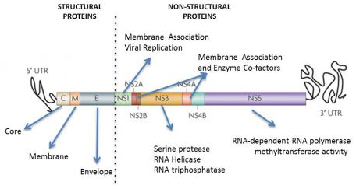
Who is ZIKV?
ZIKV possesses a positive-sense single stranded RNA genome –ssRNA(+)- of 11 kb. Viral genome possesses 2 non-coding regions (3’-UTR and 5’-UTR) that flank a open reading frame (ORF) which encodes for 3 structural proteins (membrane precursor prM; envelope E glycoprotein; core C) and 7 non-structural proteins (NS1, NS2A, NS2B, NS3, NS4A, NS4B, NS5).
Non-structural proteins have been seen to play a pivotal role in assisting viral pathogenesis and propagation by mediating viral entry and promotion of viral replication and propagation.

Slide 25
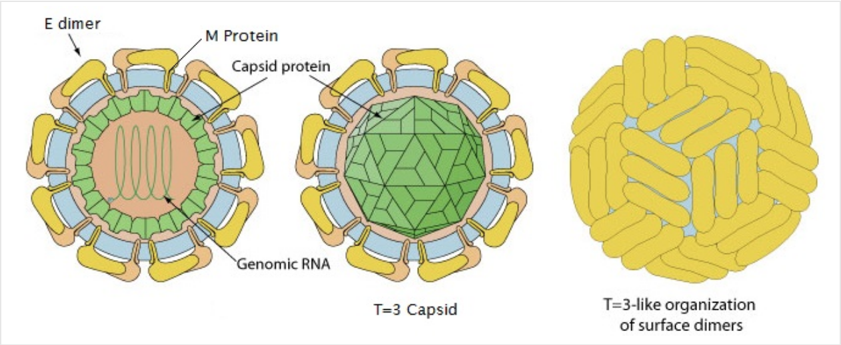
Virion structure
Virion structure. ZIKV is a 50 nm icosaedral and enveloped virus. Protein C, basic dimeric protein that binds to the genome to form the nucleocapsid which is further wrapped around a lipid bilayer derived from the host cell.
The viral membrane (envelope) is decorated by two transmembrane viral glycoproteins, prM/M and E, playing major roles during the viral entry processes.
Protein E is the receptor-binding protein and the fusion protein. PrM acts as a chaperone of E to prevent premature fusion.
https://laboratoryinfo.com/zika-virus-structure-epidemiology-pathogenesis-symptoms-laboratory-diagnosis-and-prevention/

Slide 26
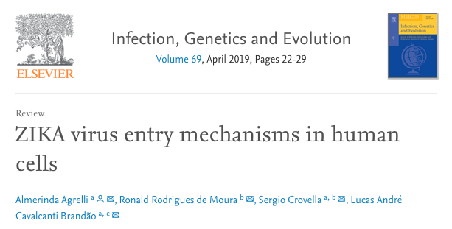
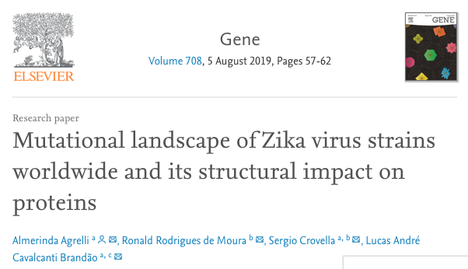

Slide 27
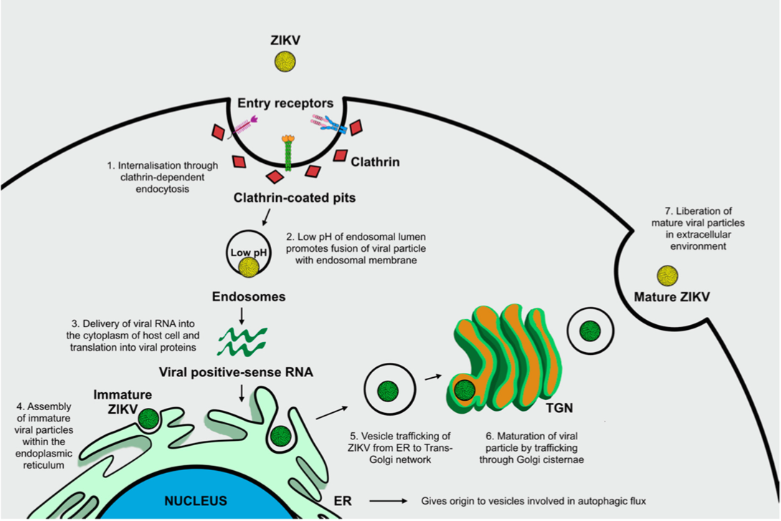
ZIKV: infectious cycle
Gratton, R. et al. 2019. Int J Mol Sci. doi: https://doi.org/10.3390/ijms20051048

Slide 28
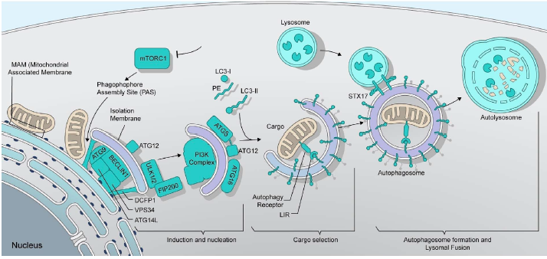
Autophagy in ZIKV infection: a possible therapeutic target to counteract viral replication

Slide 29

What is autophagy?
Autophagy is a strictly regulated cellular degradative pathway involving the delivery of cytoplasmic cargos for lysosomal degradation and subsequent recycling of the resulting macromolecular constituents.
Autophagy removes damaged or long-living organelles (peroxisomes, mitochondria, ER) and redundant proteins through the lysosome machinery. It is known to occur virtually at basal levels in every living cell in the organism, but it can be rapidly upregulated to respond to unfavorable stress signals by generating energy for cellular homeostasis maintenance.

Slide 30
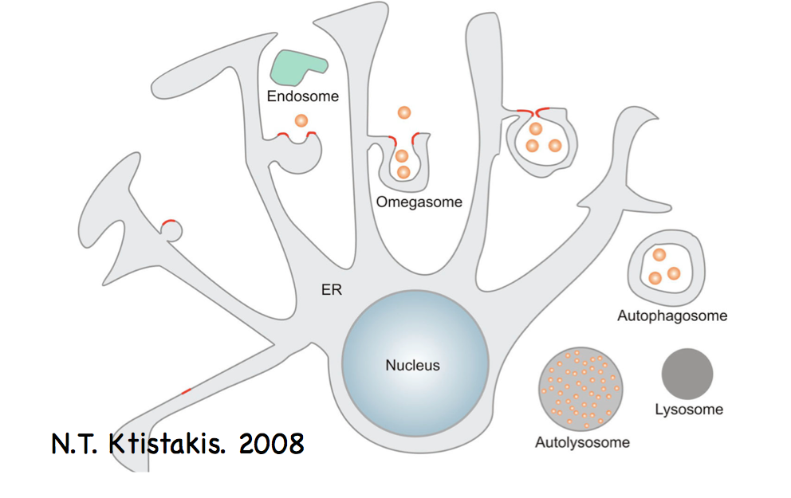
Autophagy in eukaryotic cells
The initial steps include phagophore or pre-autophagosome formation, an isolation membrane able to enclose and fuse its edges forming an autophagosome, which is a double-membrane partition that includes cytoplasmic material. Autophagosomes then fuse with lysosomes forming autolysosome or degradative autophagosomes, compartments where sequestered intra-autophagosomal components are degraded by lysosomal hydroxilases.

Slide 31
Autophagy in eukaryotic cells
1A/1B light-chain 3 (LC3) plays a central role in autophagy. An activated form of LC3 goes to autophagosomal membranes promoting membrane elongation. Following fusion of autophagosomes and lysosomes, LC3-II is still retained in the membrane and is itself degraded with autophagosomal components by lysosome hydroxilases.
LC3-II interacts with a class of autophagy adaptors known as sequestosome-1/p62-like receptors (SLRs), which are pathogen recognition receptors (PRRs) cable of selectively targeting diverse microorganisms towards selective autophagic degradation mainly via ubiquitin-signaling of invasive microorganisms. SLRs are able to pack ubiquinated microbial components, while the interaction with LC3 promotes the delivery of packed substrates towards the autophagic route.

Slide 32
Role of autophagy in the immune responses against invading microorganisms
Autophagy is correlated to immune functions and can be seen as a primordial form of innate immunity counteracting invading microorganisms.
The principle defense mechanism is given via the recognition of viral-conserved pathogen-associated molecular patterns (PAMPs) by cytosolic or membrane-bound PRRs. This is followed by the transduction of intracellular signals culminating in the stimulation of innate immune responses, principally including the activation of transcription factors that regulate the synthesis of inflammatory cytokines.
During the progressive mounting of this innate response, autophagy constitutes an integrated, valid, and immediate option by exerting a direct immune function.

Slide 33
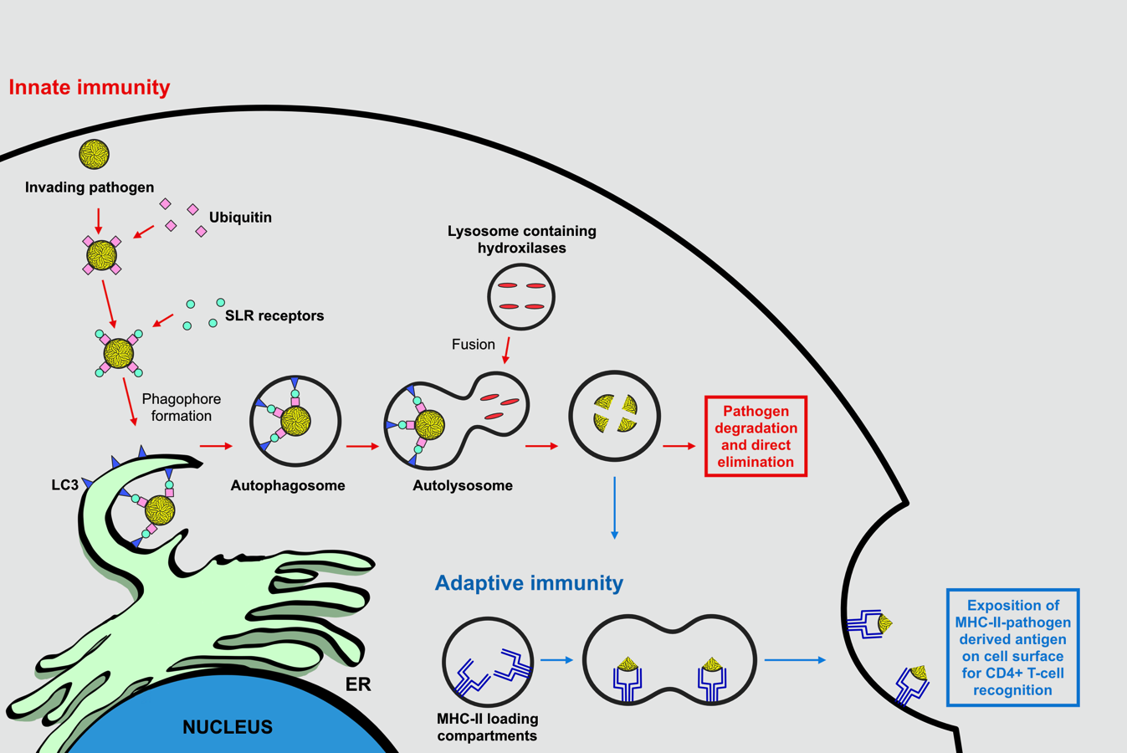
Role of autophagy in the immune responses against invading microorganisms
Gratton, R. et al. 2019. Int J Mol Sci. doi: https://doi.org/10.3390/ijms20051048

Slide 34
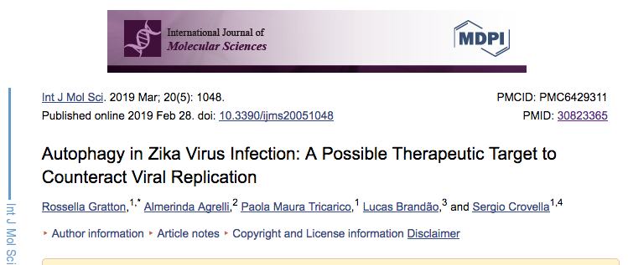

Slide 35
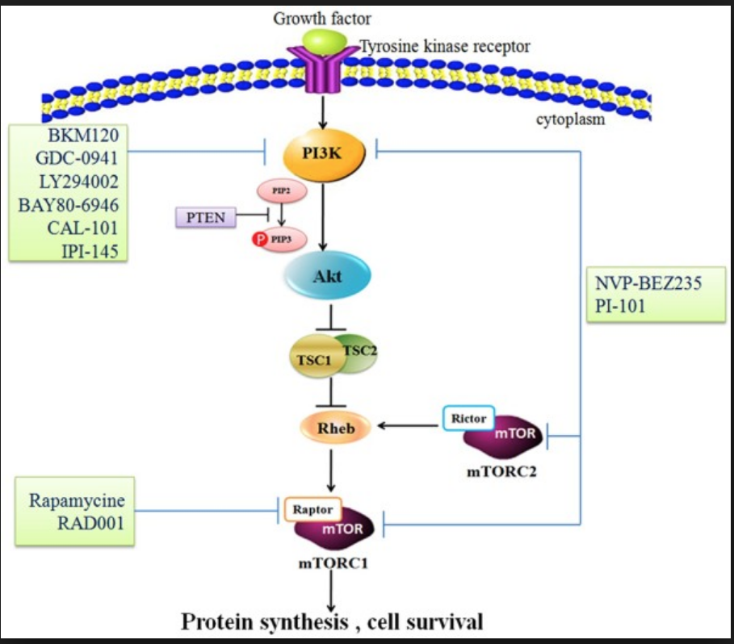
Master regulators of autophagy:PI3K/Akt pathway and mTOR
Autophagy is sensitive to a great variety of stimuli that are transduced by different cellular effectors. In the presence of unfavorable stress conditions, the activation of autophagic flux assures energy supplies and molecular building blocks to sustain cellular proliferation and survival.
Viruses can trigger many of these stresses in the host cell during different stages of their replication cycle. Viral binding to target receptors, as well as viral intracellular replication, are the best described events during viral infection known to elicit stress responses and subsequent stimulation of autophagy.

Slide 36

Flavivirus infection and autophagy
As a fundamental part of the immune system, autophagy plays a crucial role in sensing the presence of viruses and mediating their elimination. It is thought that the consumption of intracellular nutrients caused by a competition between the invading virus and the host cells’ metabolism constitutes one of the principal danger signals in the eukaryotic cell used to recognize infection and mount an appropriate antiviral immune response through the activation of autophagy.
It is not surprising that several viruses have evolved mechanisms to exploit and subvert autophagic machinery, directly or indirectly, to promote their replication and propagation.
In fact, Flaviviruses can hijack the autophagic response in order to enhance their own replication and facilitate the establishment of infection. Therefore, unraveling the role of autophagy during Flavivirus infection might have implications for better understanding viral pathogenesis and aid the identification of potential therapeutic targets.

Slide 37

Flavivirus infection and autophagy: pro-viral or anti-viral role?
Japanese encephalitis virus (JEV)
JEV-induced autophagy exerts a crucial role in promoting viral replication
The enhancement of viral progression following administration of autophagy inducers (e.g., rapamycin), and the suppression of viral growth after the administration of autophagy inhibitors (e.g., 3-methyladenine).
Recent findings suggest that autophagic vesicles do not constitute a source of membrane compartments used by JEV to sustain its replication, but rather that viral-activated autophagy (lipidation of LC3) is capable of promoting the initial stages of infection, specifically the JEV entry process.
The accumulation of autophagosomes is thought to enhance viral replication though the mechanisms underlining this process are not fully understood.

Slide 38
Flavivirus infection and autophagy: pro-viral or anti-viral role?
2. West Nile virus (WNV)
Autophagy does not seem to play a pro-viral role, since this cellular process is supposedly not required for the activation and advancement of the viral life cycle
Different experimental evidences support the presence of an upregulation of autophagy upon WNV infection, associated with an augmented lipidation and aggregation of LC3.
Inhibition of autophagy by the depletion of essential autophagy Atg proteins is not associated to an alteration of WNV replication in infected cells therefore suggesting that a functional autophagy pathway is not required for WNV infectious particle production.

Slide 39
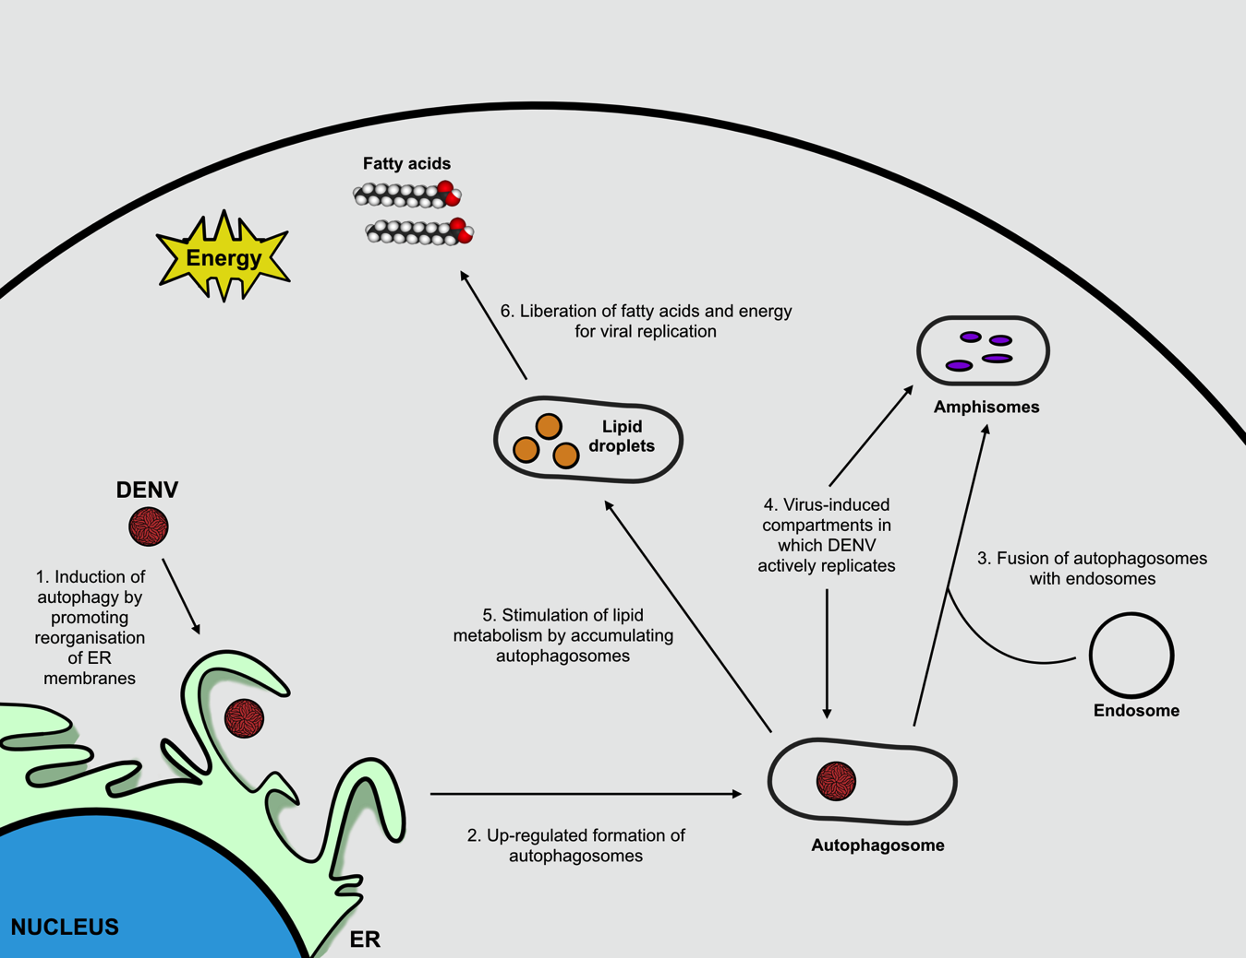
Flavivirus infection and autophagy: pro-viral or anti-viral role?
3. Dengue virus (DENV): DENV is known to induce autophagy and this process possesses a pro-viral activity.
Gratton, R. et al. 2019. Int J Mol Sci. doi: https://doi.org/10.3390/ijms20051048

Slide 40
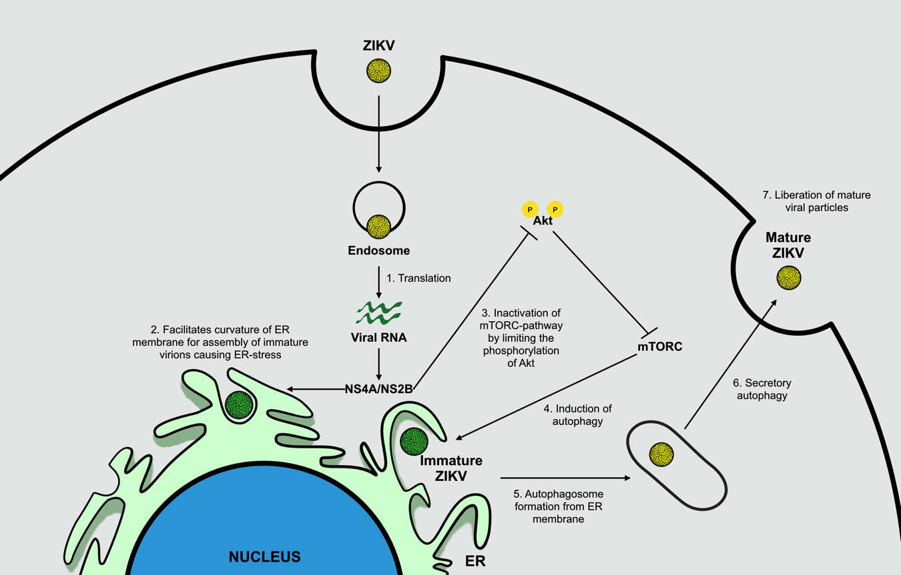
Flavivirus infection and autophagy: pro-viral or anti-viral role?
4. Zika virus (ZIKV): ZIKV is known to induce autophagy and this process possesses a pro-viral activity.
Gratton, R. et al. 2019. Int J Mol Sci. doi: https://doi.org/10.3390/ijms20051048

Slide 41

Targeting autophagy to limit ZIKV infection: a perspective approach
Compound testing and drug design to block receptor binding, endosomal fusion, viral replication, and release from host cells is of contingent need to make rapid progress in the development of novel therapies that might work efficiently to fight ZIKV .

Slide 42
Targeting autophagy to limit ZIKV infection: a perspective approach
Chloroquine (CQ): has recently been seen to counteract ZIKV infection in different in vivo and in vitro models.
FDA-approved antimalarial compound with high tolerability, low cost, and immunomodulatory properties for which no substantiated reports indicate an association between drug administration and fetal harm or risk during pregnancy.
CQ is a weak base cable of reaching intracellular compartments, and is concentrated within acidic organelles including lysosomes, Golgi vesicles and endosomes.
CQ acts by increasing the pH acidic organelles, therefore, disrupting the activity of several enzymes (e.g., acidic hydroxylases) and inhibiting protein post-translational modifications.

Slide 43
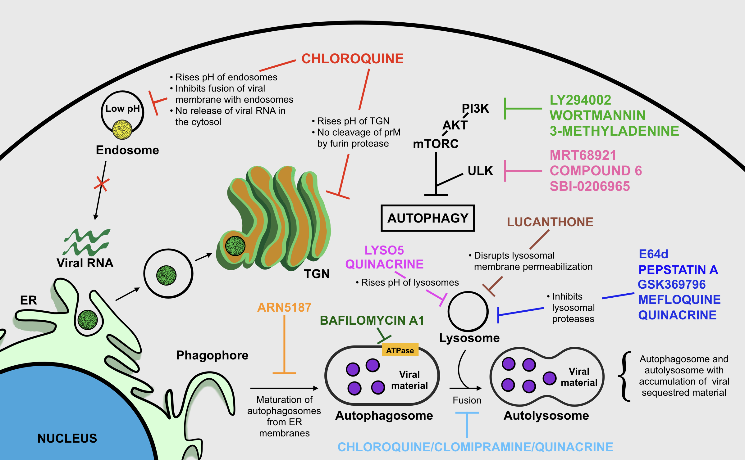
Targeting autophagy to limit ZIKV infection: a perspective approach
Chloroquine (CQ): has recently been seen to counteract ZIKV infection in different in vivo and in vitro models.
Gratton, R. et al. 2019. Int J Mol Sci. doi: https://doi.org/10.3390/ijms20051048

Slide 44
Targeting autophagy to limit ZIKV infection: a perspective approach
2. Lysosomotropic agents might be tested to reveal a possible anti-ZIKV activity and they include: Lys05, a bivalent aminoquinoline that causes a significant augmentation in lysosomal pH; ARN5187, autophagosome maturation blocker; and Quinacrine, anti-malarial drug acting as inhibitor of endosome/lysosome acidification.
Gratton, R. et al. 2019. Int J Mol Sci. doi: https://doi.org/10.3390/ijms20051048

Slide 45
Targeting autophagy to limit ZIKV infection: a perspective approach
3. Catalytic inhibitors of ULK kinase: MRT68921, Compound 6, and SBI-0206965, even if at the very early stages of drug discovery, seem promising in targeting the autophagic process.
Gratton, R. et al. 2019. Int J Mol Sci. doi: https://doi.org/10.3390/ijms20051048

Slide 46
Targeting autophagy to limit ZIKV infection: a perspective approach
4. Inhibitors of later stages of autophagy→ degradation of autophagosome content by lysosome enzymes: Pepstatin A and E64d, inhibitors of lysosomal proteases; clomipramine, a FDA-approved drug for psychiatric disorders, which possesses an active metabolite (desmethylclomipramine) known to block autophagosome–lysosome fusion; lucanthone, disrupts lysosomal membrane permeabilization; Bafilomycin A1, inhibitor of the V-ATPase, which leads to the disruption of autolysosome acidification and to autophagosome-lysosome fusion; Quinacrine, prevents the fusion of autophagosomes and lysosomes; Quinacrine, Mefloquine, and GSK369796, inhibit the activity of the lysosomal cathepsin B presumably by direct binding to the enzyme.
Gratton, R. et al. 2019. Int J Mol Sci. doi: https://doi.org/10.3390/ijms20051048

Slide 47
Targeting autophagy to limit ZIKV infection: a perspective approach
5. PI3K/Akt/mTORC signaling pathway: wortmannin, a microbial product and inhibitor of the early stages of autophagy by blocking PI3K; 3-methyladenine, widely used to inhibit autophagy in vitro; LY294002, the first synthetic inhibitor of PI3K.
Gratton, R. et al. 2019. Int J Mol Sci. doi: https://doi.org/10.3390/ijms20051048

Slide 48

In conclusion…
ZIKV infection still constitutes an ongoing challenge that requires strict surveillance and attention.
There is the necessity to unravel ZIKV biology and the mechanisms involved in virus–host cell interactions in order to develop potential vaccines, therapies, and prophylactic regimes to counteract viral infection since they are not yet available.
Recent findings support the assumption that autophagy might represent a potential target for therapeutic purposes.
Understanding the specific molecular details of how ZIKV is able to engage autophagy will certainly clarify the roles of autophagic flux in viral replication and progression, and may help to assess effective therapeutics to potentially treat disease and control virus infection.

Slide 49
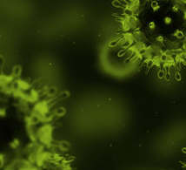
Precision Diagnosis in Arbovirus infections
Arboviruses are a viral group that includes hundreds of viruses.that are transmitted predominantly by arthropods, most often mosquitoes and ticks. Arboviruses are often kept in complex cycles involving vertebrates, as mammals or birds, and hematophagous vectors.
Most of these viruses belong to the families Togaviridae (genus Alphavirus), Flaviviridae (genus Flavivirus) and Bunyaviridae (genus Orthobunyavirus).
Some representatives of these families such as Mayaro (MAYV), Dengue (DENV), Yellow Fever (Yellow Fever - YFV), Rocio viruses (ROCV) and Oropouche (OROV) by 2015 accounted for over 95% of arbovirus cases in Brazil.

Slide 50
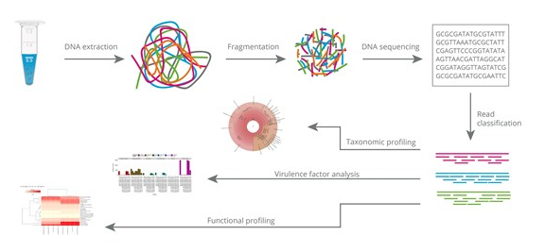
Development of metagenomic-based diagnostic platform for Acute Febrile Syndrome related to arboviruses

Slide 51
Multicenter Network for the development of the project of Precision Diagnosis of Arboviruses.

Slide 52

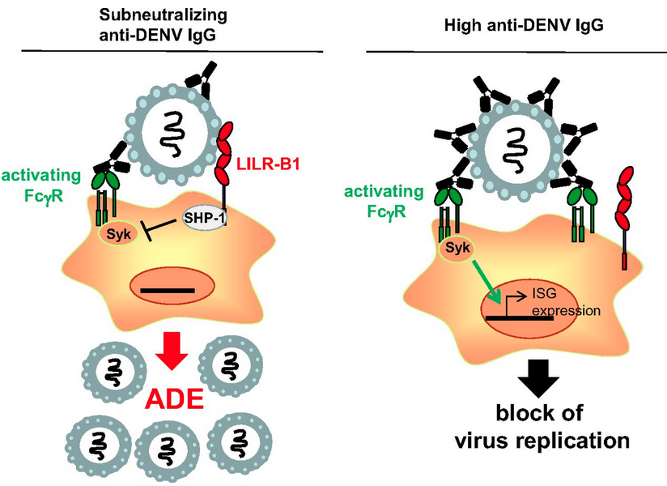
Currently, it is estimated that there are more than 545 species of Arboviruses, of which over 150 related to diseases in humans, the majority being zoonotic.
The precision diagnosis becomes complex, its access limited and, in certain situations, presents high false positive rates and cross reactions. This is partly due to genomic similarity and
among the viruses in this group.
In addition, in humans, the recurrent immune response (or by
previous infections) against these viruses can lead to the antibody-facilitating phenomenon (Antibody dependent enhancement, ADE), which causes antigen recognition cross-reactions and results in more aggressive infections, with unusual (and more severe) clinical consequences, making the diagnostic process even more difficult.

Slide 53

To further increase the complexity of these Arboviral infections, the signs and symptoms that patients present are quite similar to each other and among other viral infections, which ends up interfering with the accurate clinical diagnosis.
One of the main Clinical manifestations of arboviruses in humans may range from febrile illness undifferentiated, moderate or severe.

Slide 54


Our Brazilian project aims
(1) to validate a Diagnostic Platform for Metagenomic Precision (PDPM) focused on a Pan-Arboviral approach, initially focused on patients with acute febrile syndrome
(2) implement PDPM in Pernambuco Network of Laboratories (RPEL), managed by the Central Laboratory of Public Health (LACEN) “Dr. Milton Bezerra Sobral ” linked to the Executive Health Surveillance Secretariat of the Pernambuco State Health Secretariat.
Our precision diagnostic platform will have the automated potential to isolate and identify viral species and lineages using next generation sequencing (NGS) technology
it will be possible to establish viral variants and lineages to map precisely the natural history of Arbovirus infections, outlining epidemiological measures tailored upon the origin and spread of Arboviruses

Slide 55
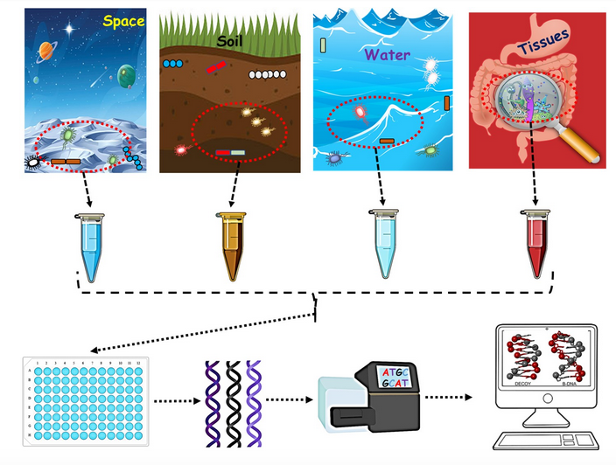
Metagenomics has emerged in recent decades as a fruit of the post-genomic era, and today represents an important field of applied research in allowing complex samples to be analyzed in a unique to the precision diagnostic process.
The traditional process of pathogen diagnosis (including viral) involves the detection of specific anti-pathogen antibodies (serology) or antigens and molecular identification of microbial nucleic acids (DNA or RNA), most commonly via PCR.
Although most molecular assays reach only a limited number of pathogens using specific primers or probes, metagenomic approaches characterize the entire DNA or RNA present in a sample, allowing analysis of the entire microbiome as well as the human host genome or transcriptome in patient samples.
In fact, Metagenomics approaches have been applied for decades to characterize various niches, from marine environments toxic soils, arthropod disease vectors and human microbiomes, identify infections in remains, discover new viral pathogens and characterize the human viroma in healthy and sick and forensic applications.

Slide 56
Metagenomics can detect all potential pathogens - bacteria, viruses fungi and parasites - in one sample and at the same time interrogate host responses, taking great potential utility in the diagnosis of infectious diseases (Chiu, et al, 2019).
So our platform, even if it is aimed at accurate diagnosis of Arboviruses, is flexible and for the diagnosis of other viral infectious disorders such as measles, rubella or bacteria, such as tuberculosis.
It also allows complete identification of new infectious agents not yet endemic and facilitates the containment of outbreaks and epidemics.
There's a lot techniques aimed at implementing metagenoma applied to viral diagnosis, but the use of NGS scaled and increased the robustness of the analysis. Thus, metagenomas performed by NGS (mNGS) have high precision and accuracy, which can be routinely used in clinical practice.
One of the first application models was established in 2014 for the diagnosis of neuroleptospirosis in a 14-year-old child. severely ill with meningoencephalitis. mNGS provided clinically applicable information, complete diagnosis, appropriate targeted antibiotic treatment and eventual recovery of the patient (Wilson, et al. 2014).

Slide 57
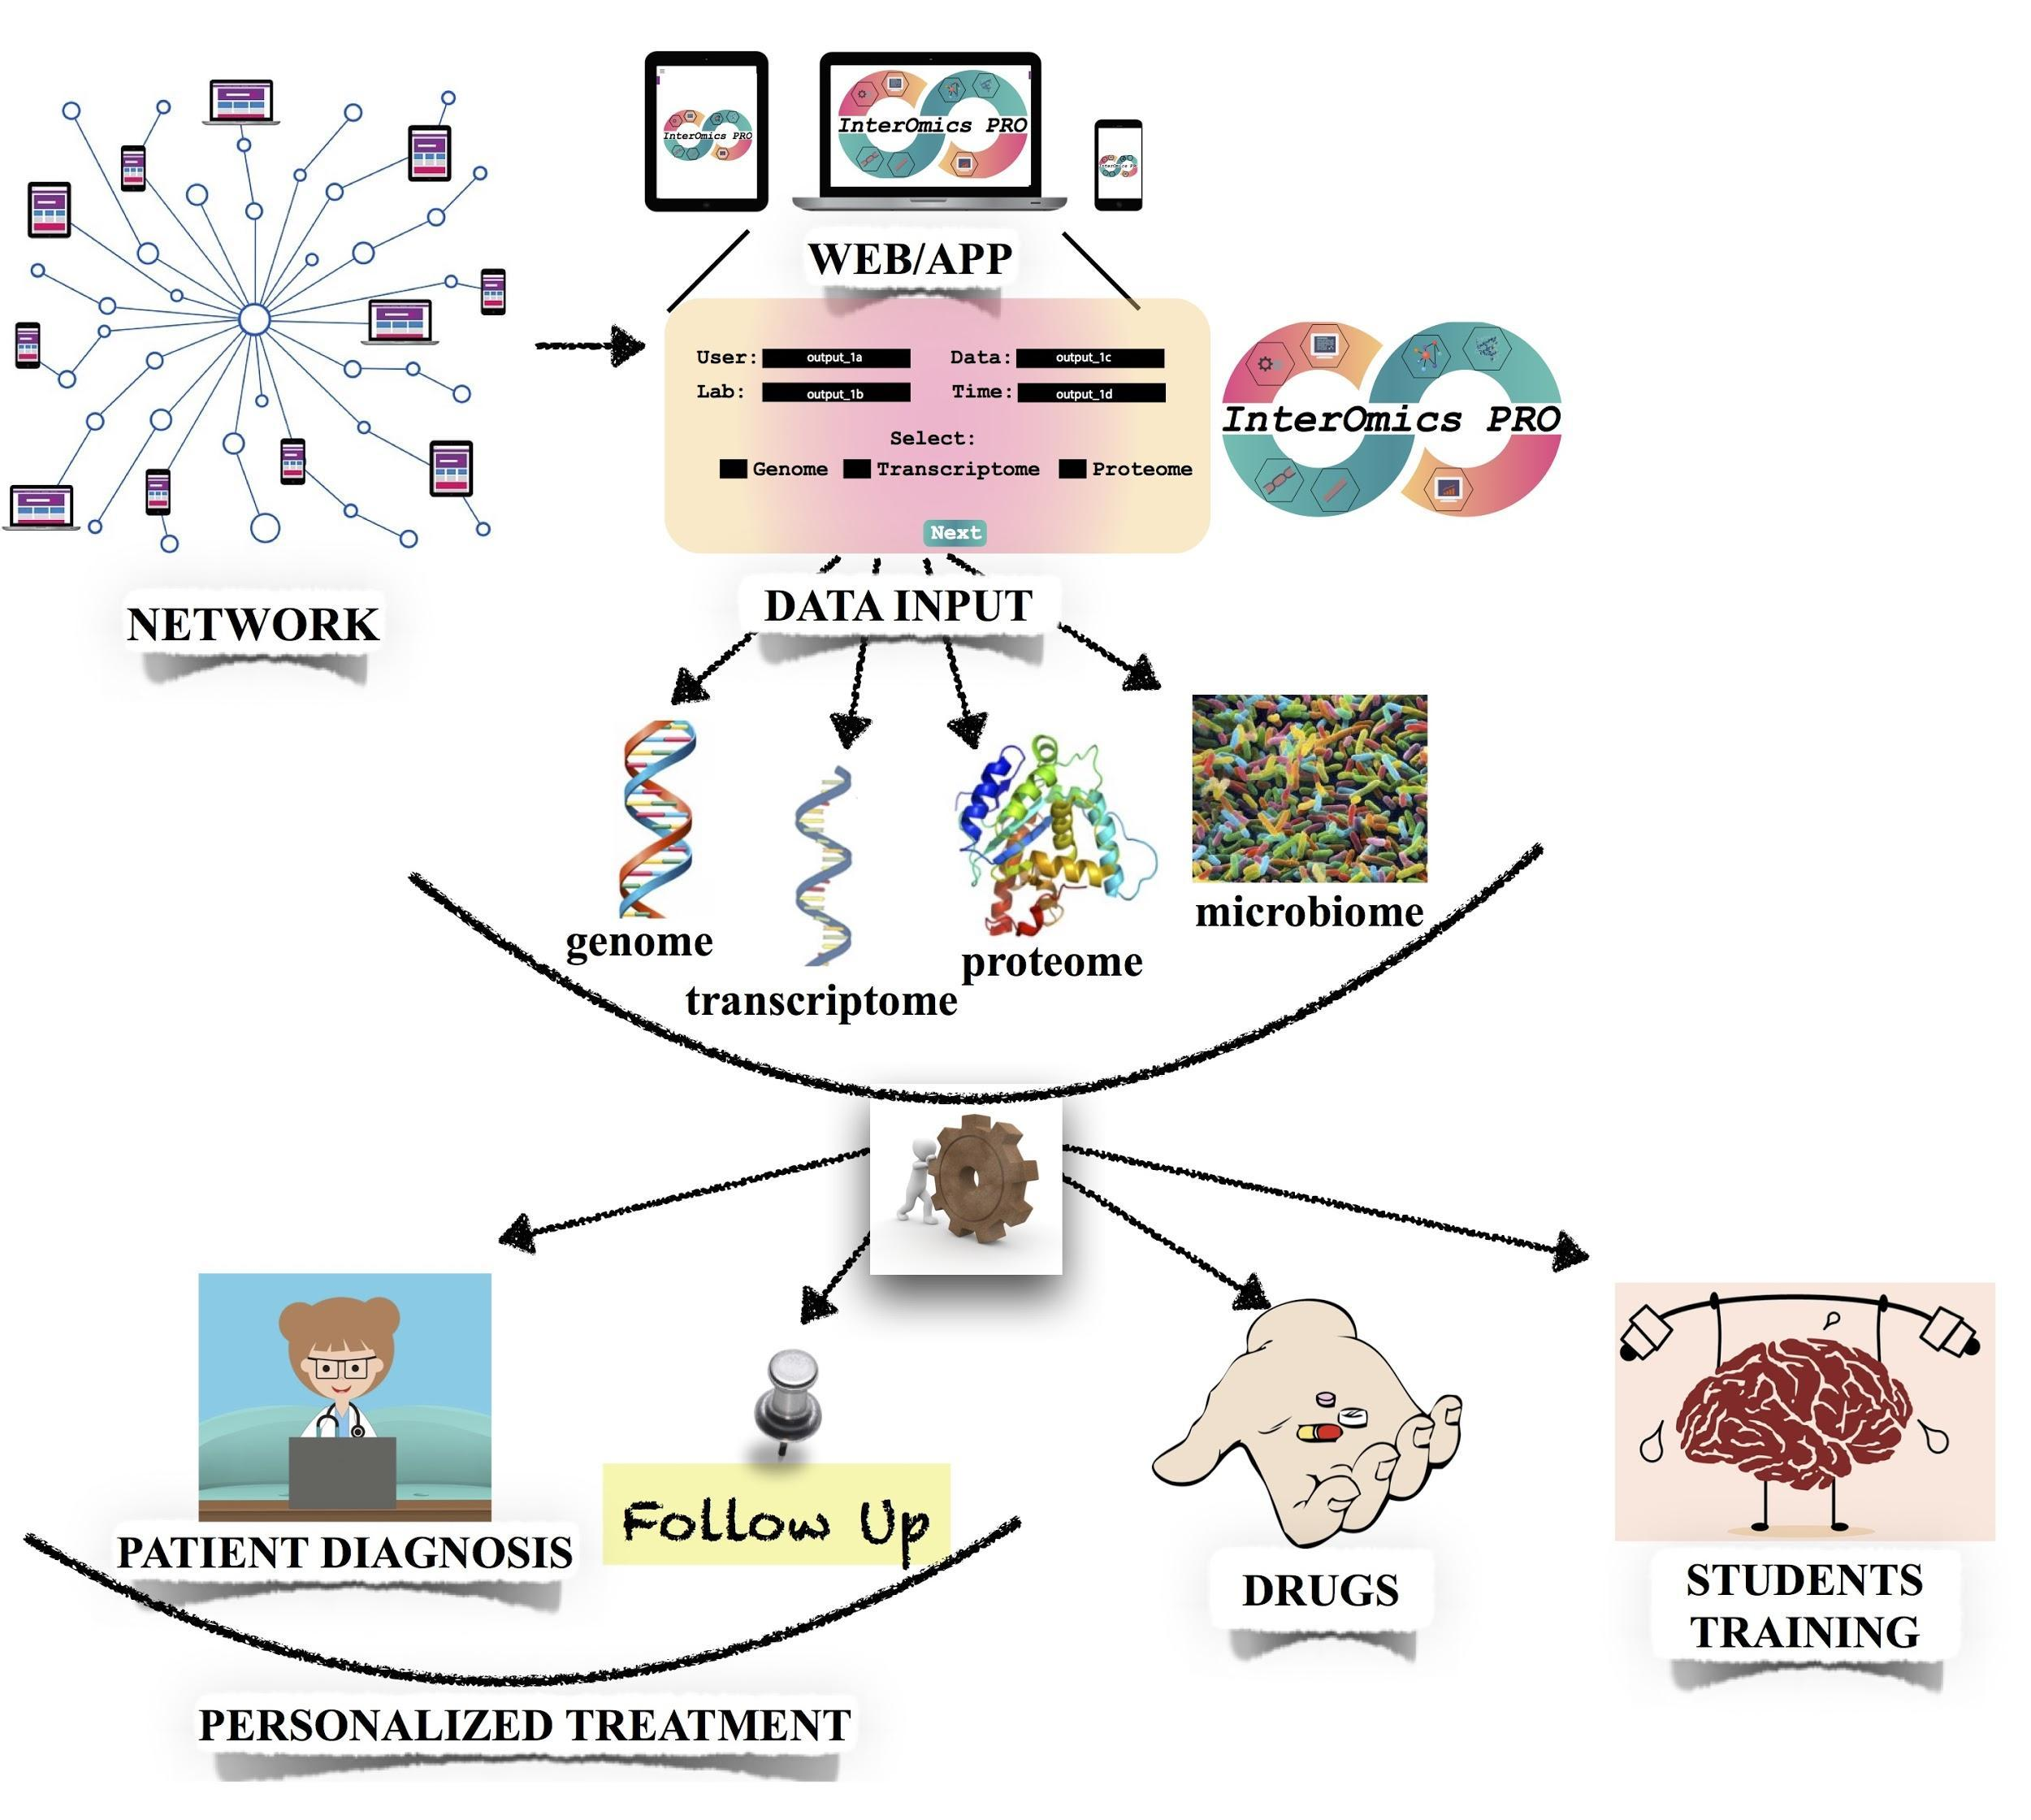
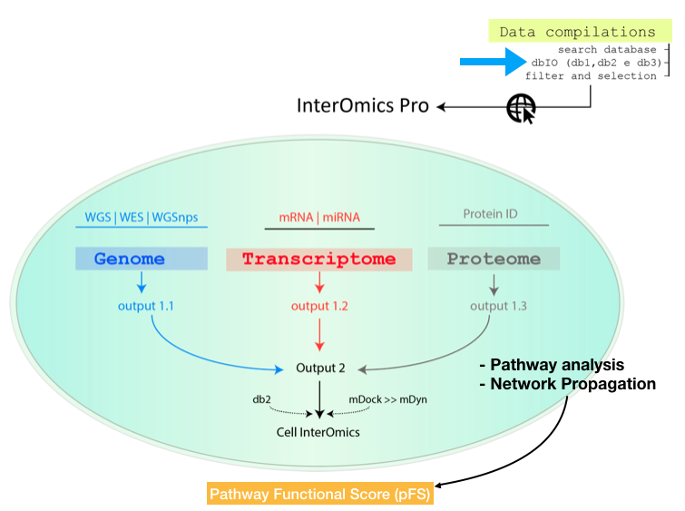
BioHub, a high-throughput platform for OMICs data analysis and integration

Slide 58



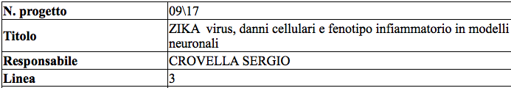

Slide 59
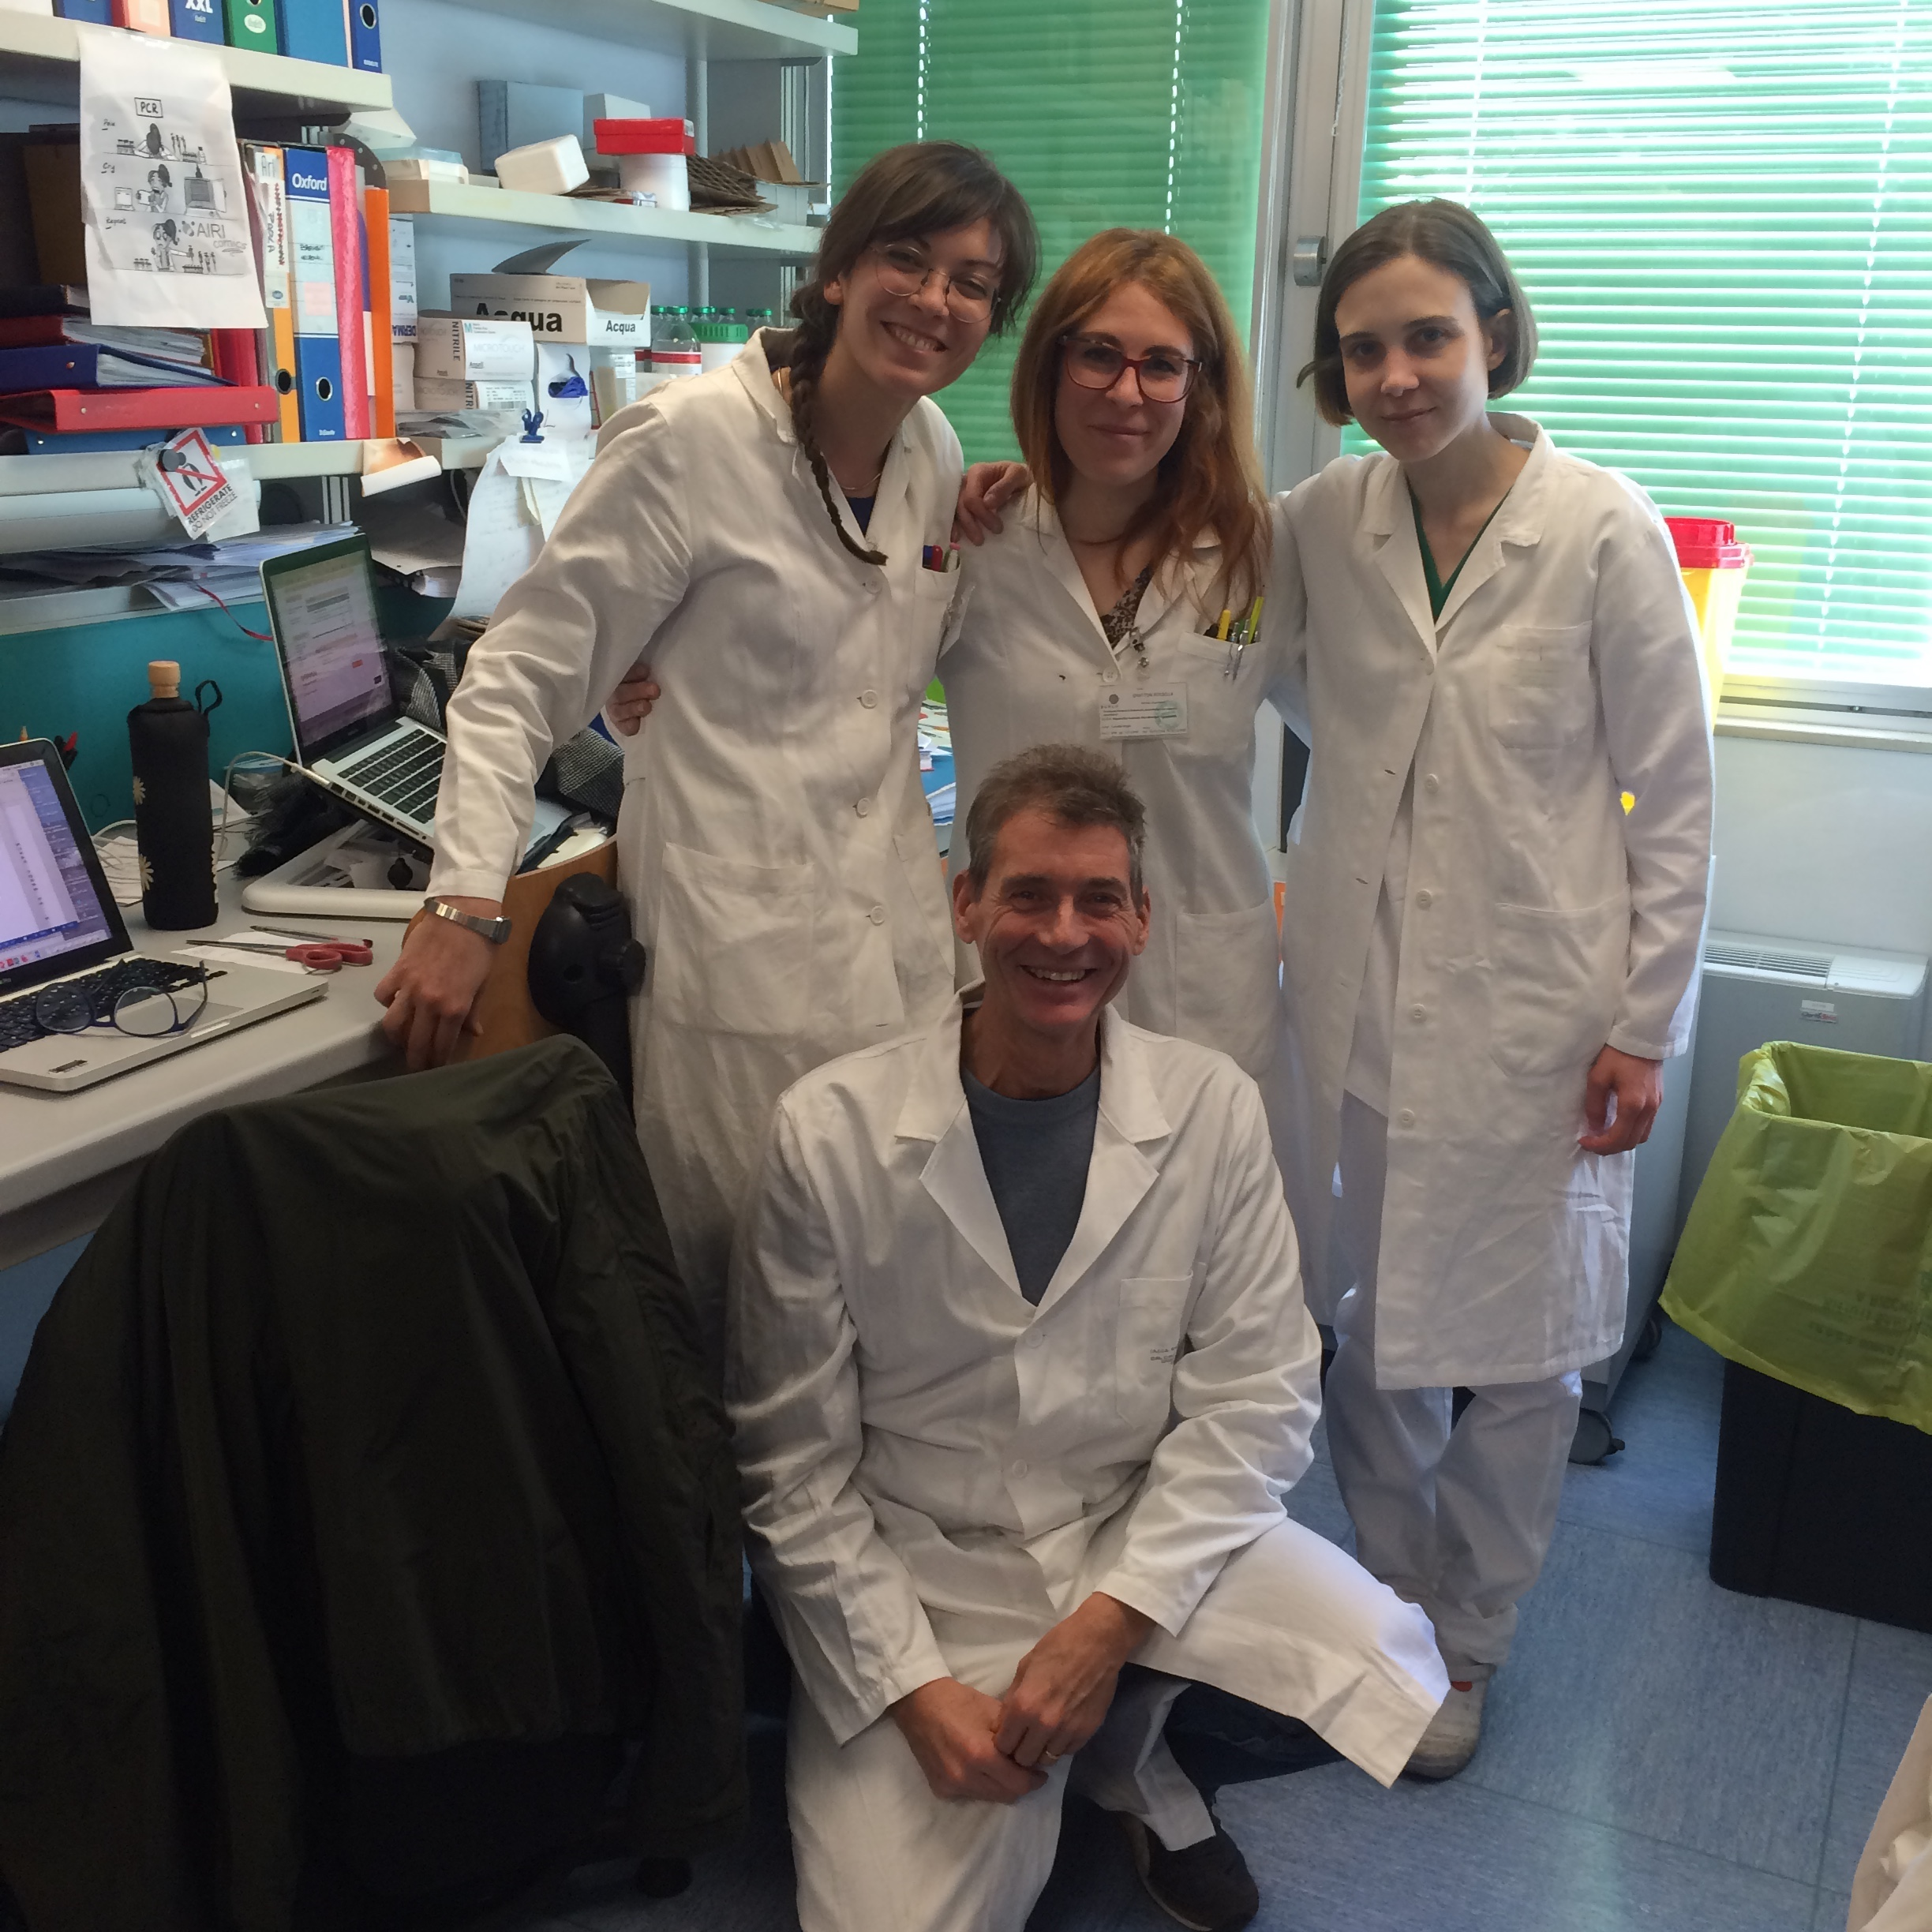




Thank you for your attention!
IRCCS Burlo Garofolo (Trieste)
Prof. Sergio Crovella
Dott.ssa Paola Maura Tricarco
Dott. Rossella Gratton
Dott.ssa Luisa Zupin
UFPE Dept. Pathology (Recife)
Prof. Lucas Brandao
Dr. Ronald Moura
Dr. Almerinda Angrelli

Slide 60
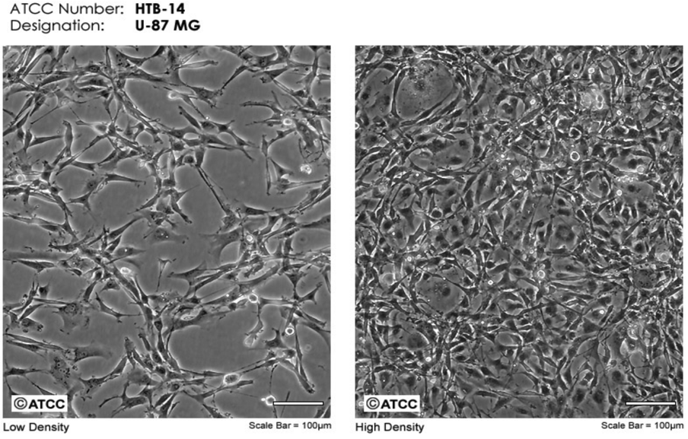
U-87 MG: human glioblastoma cell line. Constitutes a widely accepted and robust model mimicking the glial component involved in the immune response in the central nervous system.
ZIKV, MRS ZKV CTA 723 strain, kindly provided by the Italian “Istituto Superiore di Sanità”.

Slide 61
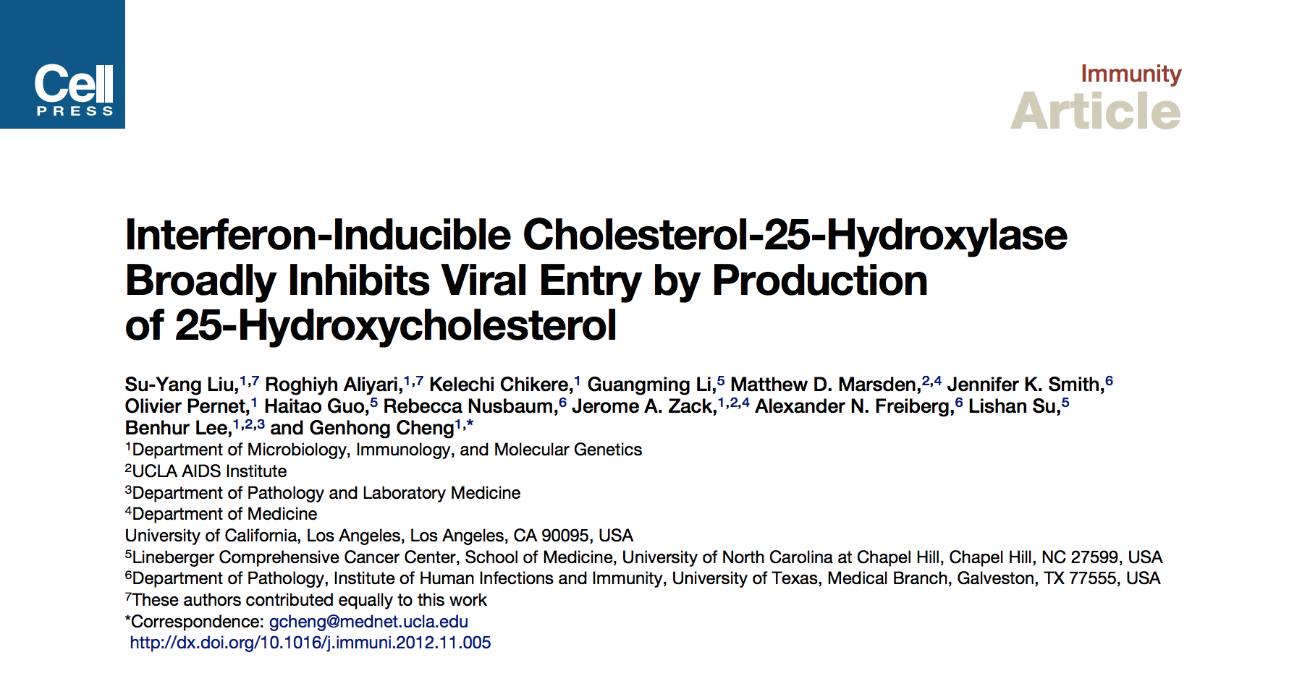
Drug discovery and compound testing
25-Hydroxycholesterol (25-HC) treatment in cultured cells broadly inhibits growth of enveloped viruses (VSH, HSV, HIV, MHV68, EBOV). The compound has been seen to suppresses viral growth by blocking membrane fusion between virus and cell. Indeed, the compound is thought to alter membrane structures and prevents invagination of the plasma membrane and subsequent viral entry but it does not effect the cell-binding capability of ZIKV.

Slide 62
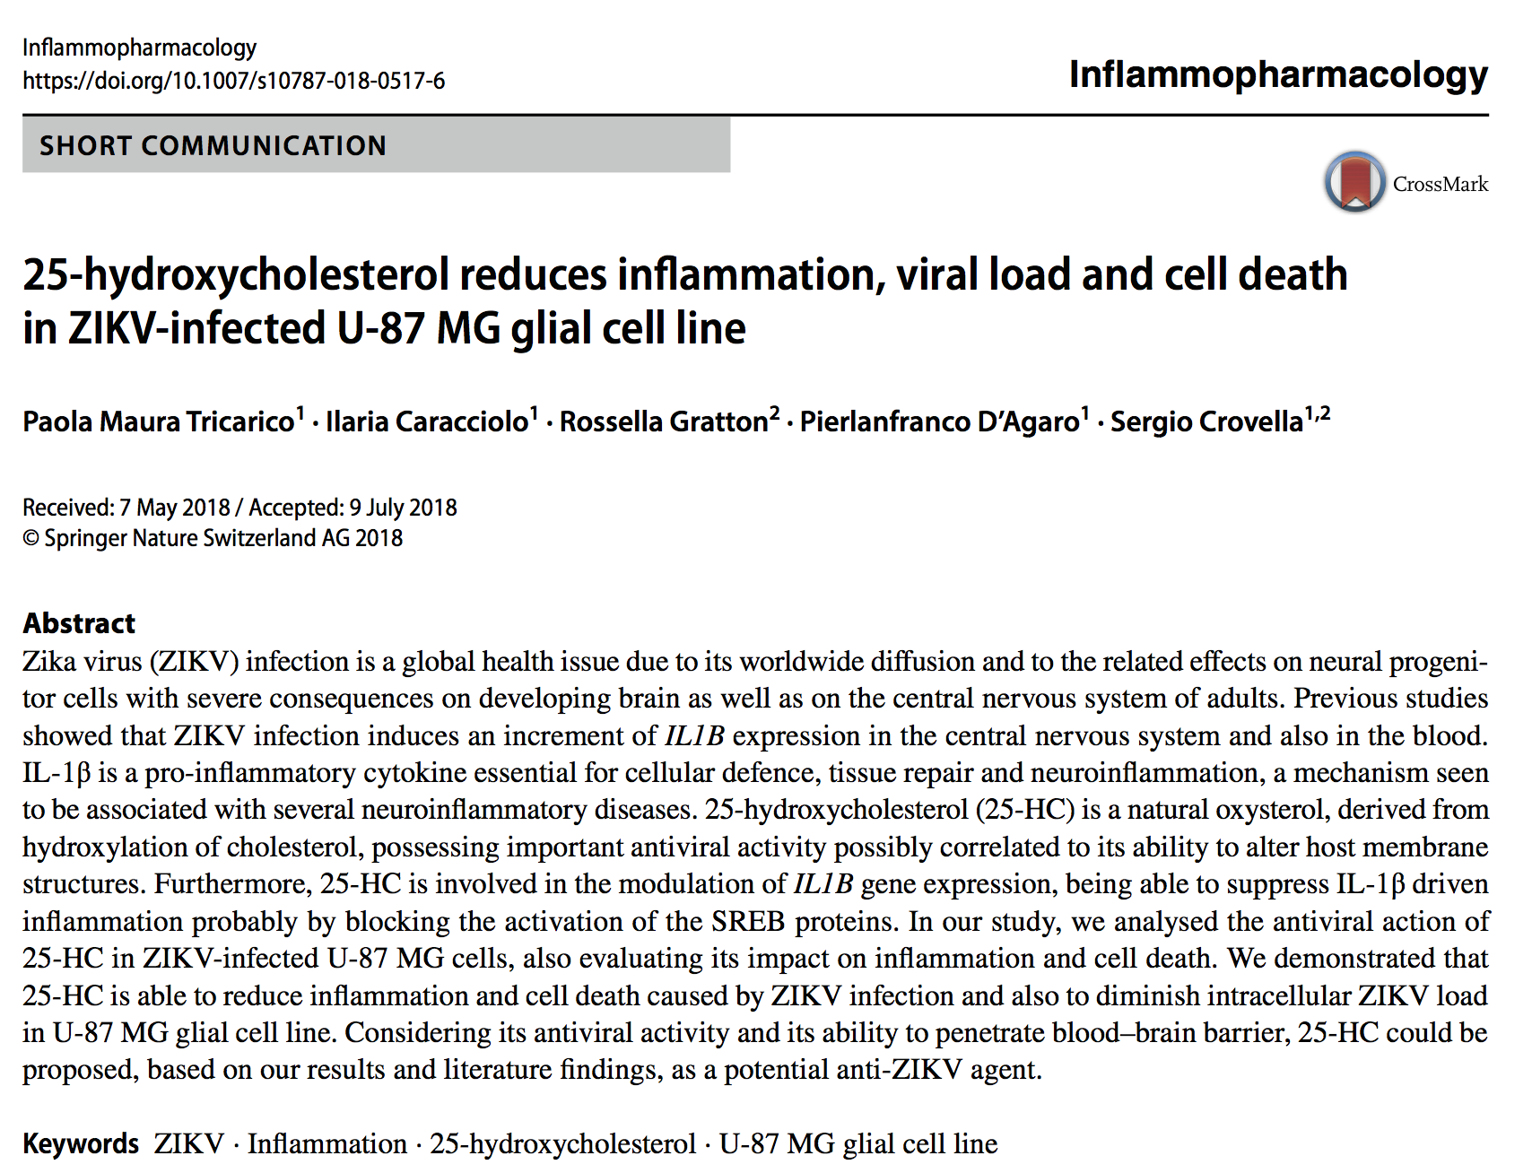
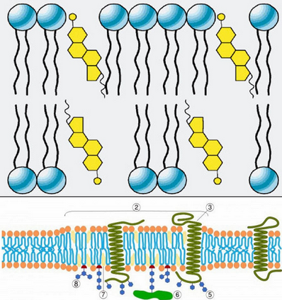
25-HC: protective effect on ZIKV-infected U-87 MG cells
25-HC is an oxysterol already seen to have an antiviral and anti-inflammatory acitivity.
25-HC is able to increase cell viability following ZIKV infection, diminish intracellular viral load rescue virus-mediated inflammation in U87-MG cell line.

Slide 63
Results and discussion

Slide 64
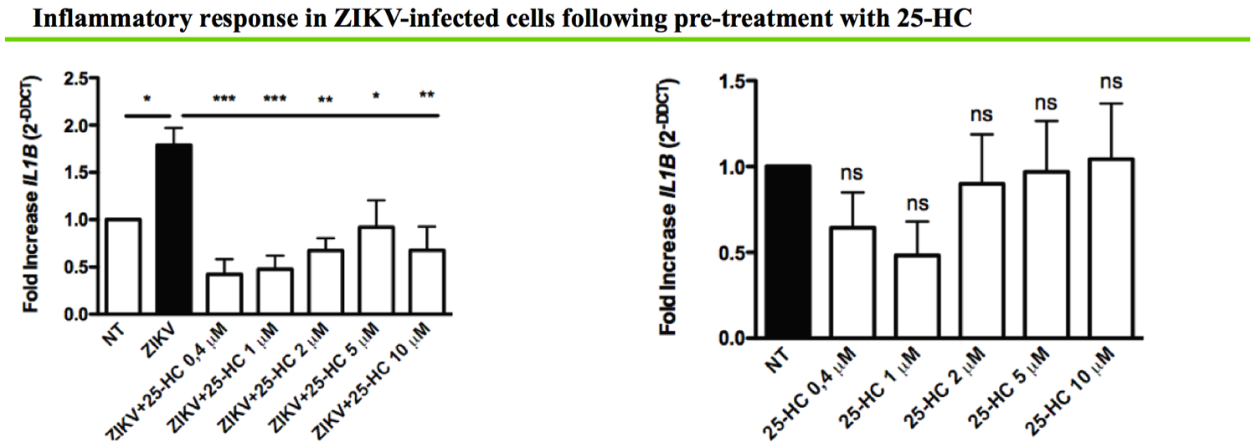
Results and discussion

Slide 65
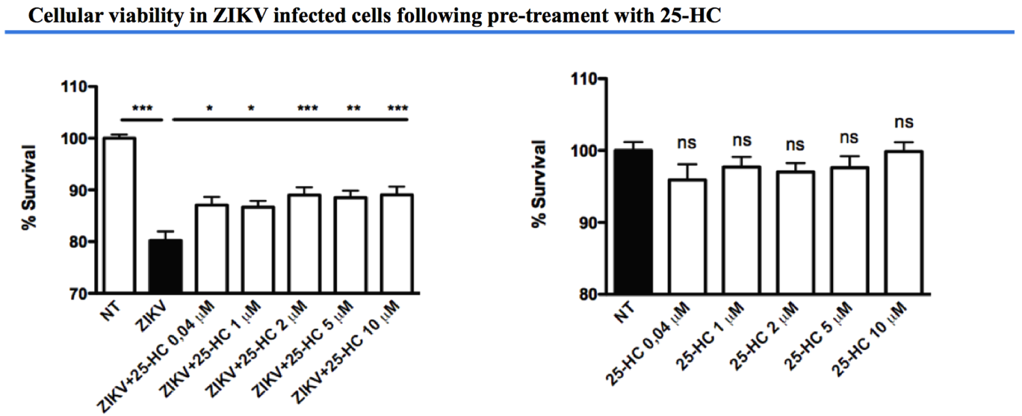
Results and discussion

Slide 66
Conclusions
25-HC has the ability to reduce flavivirus infection by restricting its entry and inhibiting inflammation originated by ZIKV infection. In our work, we confirmed the antiviral action of 25-HC. Indeed, as a consequence of ZIKV entry inhibition, we observed a reduction of viral replication and, for the first time, a rescue in virus-mediated inflammation as a consequence of the anti-inflammatory effect of 25-HC.
We speculate the presence of a dual mechanism underlying 25-HC activity in U-87 MG cells:
1. inhibition of viral entry: we show that at the highest concentration 25-HC is able to decrease ZIKV load.
2. decrement of inflammatory response: probably by blocking the activation of SREBP proteins involved in regulation of cholesterol biosynthesis and inflammosome activation.
Therefore, taking into account that 25-HC is not toxic, is able to penetrate the blood-brain barrier and to rescue neuroinflammation, further testing of this compound should be implemented in order to develop a potential anti-ZIKV agent.

Slide 67
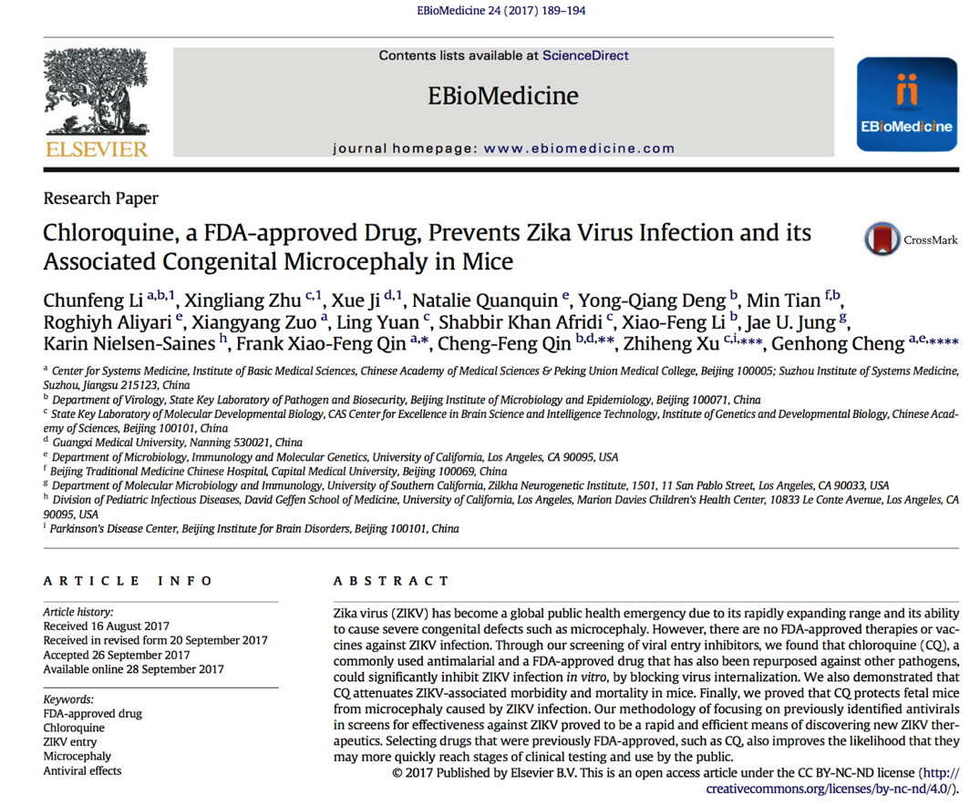
Compound testing: Chloroquine
Chloroquine (CQ) as crucial autophagic inhibitor, the compound able to alter cellular redox homeostasis and it also acts by raising the pH levels of endosomes.

Slide 68
Preliminary results…

Slide 69
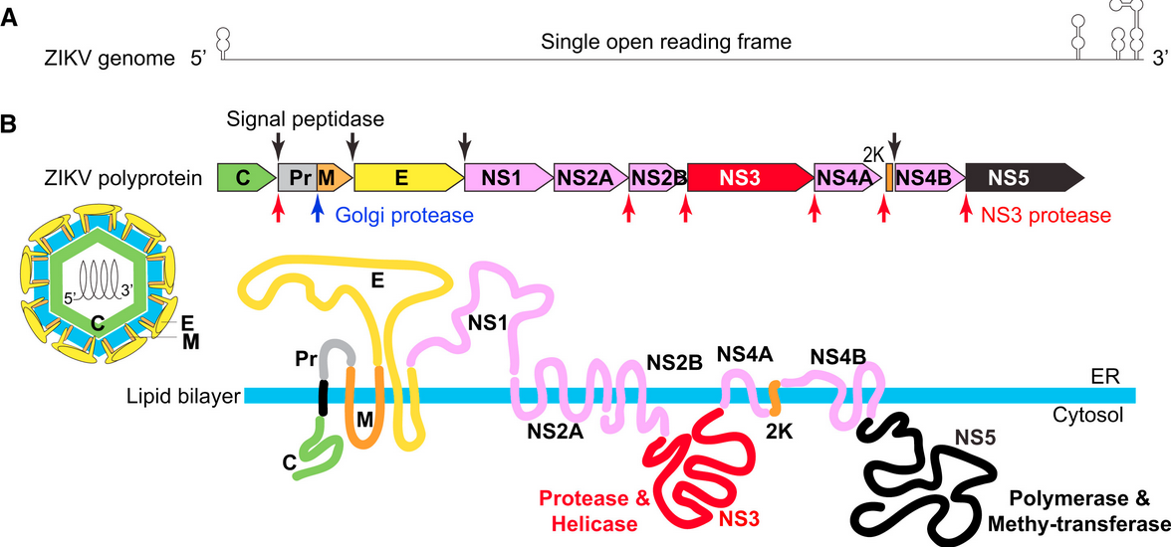
Viral genome and proteins: processing and products
Schematic rapresentation of ZIKV genome. 5’-UTR and 3’-UTR present secondary structure essential for genome stability and for the promotion of viral replication flanking one single ORF.
Processing strategy and viral protein products. The ORF encodes for a polyprotein precursor which is co-translationally and/or post-translationally cleaved by viral proteases (NS3), host signal peptidase and an unknown host protease. Flavivirus infected cells undergo extensive remodelling of ER membranes to form membranous replication factories (RFs). ZIKV induces the formation of vesicle packets, designed as sites for viral RNA replication. Transcription and replication occur on ER membranes. Viral assembly develops on ER membranes. The virion buds at the ER levels and then through the secretory pathway is excreted in the extracellular environment.
Ming, G-L. et al., 2016. Cell Stem Cell. doi: 10.1016/j.stem.2016.11.014.

Slide 70
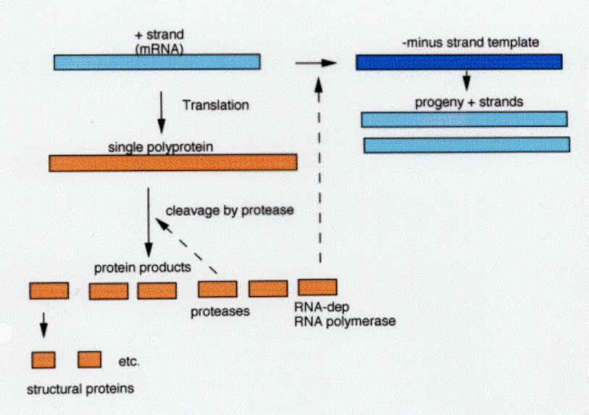
Replication of ssRNA (+) genome
NS5
NS5

Slide 71
Modes of viral internalisation in human cells
ZIKV is able to infect specific cells types including fibroblasts, immature dendritic cells, epidermal keratinocytes, cells of the placenta (trophloblasts) and stem-cell-derived human neural progenitor cells.
To support the sexual transmission of ZIKV, a study conducted in mice showed that cells of the reproductive tract (i.g. Sertoli cells, spermatogonia, sperms and Lyedig cells) are susceptible to ZIKV infection.
These findings hold for an extensive set of cells susceptible to ZIKV infection and therefore a robust number of receptors involved in viral entry process.

Slide 72
ZIKV entry mechanisms in human cells
RECEPTOR BINDING: the first step in the infectious cell entry of ZIKV involve the binding of viral envelope glycoprotein E to a cellular receptor.
Viral envelope glycoprotein E mediates the recognition of the host cell and promotes membrane fusion by receptor-mediated endocytosis.
Specifically, the molecules used by ZIKV during the entry process depend on the pattern of proteins expressed on the lattice of the viral particle and it therefore seems dependent on the degree of particle maturation.
Infectious particles released by a host cells comprise a population of heterogeneous infectious viruses which expose particles able to
offer a variety of possible receptor interaction sites!

Slide 73


ZIKV entry mechanisms in human cells
The main reported mechanism by which Flavivruses infiltrate host cells is chlatrin-mediated endocitosys.
Specifically, chlatrin-mediated endocytosis is a vesicular trafficking process that transports cargo molecules from the cell surface inwards and generally occurs in specialised sites where a coated pit is assembled in order to concentrate proteins for internalisation.

Slide 74

ZIKV entry mechanisms in human cells
Following the release of membrane coating, the endocytic vesicle carrying the virus fuses with late endosome.
The low pH of endosimic compartments induces changes in envelope conformation, membrane fusion and release of genomic RNA in the cytosol.
This process is named after the most abundant protein found in the coated pits, chlatrin. This mechanisms is involved in diverse cellular processes including nutrient uptake, cells signalling and cell adhesion. However the same mechanism has been seen to be exploited by Flaviviruses, including ZIKV, to enter host cell.

Slide 75

Attachment factors and entry receptors
To allow viral internalisation, both recognition and receptor binding are crucial and a combination of diverse molecules are implied in assessing these processes. To better characterise the modes of ZIKV internalisation is necessary to distinguish between attachment factors and entry receptors.
Attachment factors→ molecular components which only retain viral particles on cell surface.
Entry receptors→ interactions between receptors- ligands result in virus uptake. These receptors promote endocytosis and accompany the virus in the intracelluar environment.
Entry starts with binding to attachment factors and is followed by interactions with one or more receptors!
Individual interaction ligand-receptor are generally weak but it is the contact with multiple receptors to augment the binding avidity and renders the interaction stronger.

Slide 76
Crucial factors to allow viral internalisation:
Viral E glycoprotein
Cellular adhesion factors
Cellular entry receptors

Slide 77

E glycoprotein
The surface of ZIKV is generally covered by numerous homodimers of E glycoprotein (E)₂.
E glycoprotein possesses 4 domains: stem trans-membrane domain and domains I, II, III.
Stem trans-membrane domain→ is responsible for membrane anchoring
Domains I, II, III→β-strand surface.
Agrelli, A. et al. 2019. Infect Genet Evol. doi: 10.1016/j.meegid.2019.01.018

Slide 78

E glycoprotein
DI→ bridge between DII and DIII; contains the glicosylation site which protrudes from viral surface on a loop of ≈150 a.a. Differences in the loop dimension occur not only between different Flaviviruses but also between ZIKV strains. Variations in this region might influence infectivity.
DII→ contains the fusion loop (FL) implied in the interaction with host cell membrane during membrane fusion. Exposed at neutral pH. Most conserved region in Flaviviruses.
DIII→ receptor binding site.
Agrelli, A. et al. 2019. Infect Genet Evol. doi: 10.1016/j.meegid.2019.01.018

Slide 79

1. C-type lectin receptors
In ZIKV, receptor-binding is primarily mediated by interaction between N-glycans conjugated to protein E with C-type lectin receptors (CLRs) from the host cell. Usually highly expressed in myeloid cells, monocytes, macrophages and dendritic cells.
These receptors recognise carbohydrates in pathogens as pathogen associated molecular patterns (PAMPs) and functionally act as pathogen recognition receptors (PRRs), interiorising pathogens in endosomes, thus initiating the process of antigen presentation and elimination.
The most implicated CLRs in Flavivirus entry are DC-SIGN, L-SIGN, MMR and CLEC5A.
Agrelli, A. et al. 2019. Infect Genet Evol. doi: 10.1016/j.meegid.2019.01.018

Slide 80

1. C-type lectin receptors
DC-SIGN (Dendrtic cell-specific intracellular adhesion molecule-3-grabbing non-integrin) and L-SIGN (Liver/lymphnode-specific intracellular adhesion molecule-3-grabbing non-integrin): through their carbohydrates recognition domains (CRDs), they have been shown to permit ZIKV entry in host cells.
CLECA5 (C-type lectin member 5A): expressed in monocytes and macrophages. Has been shown to promote DENV entry into host cells.
MMR (Macrophage mannose receptor): proposed to be a functional entry receptor for Flaviviruses. Expressed in macrophages but it can also be found in lymph nodes and endothelial cells of liver, kidney cells and in some populations of DCs (all relevant to Flavivirus infection).
MMRs have been shown to bind to protein E of the 4 DENV serotypes, and was so proposed as DENV internalisation receptor in human primary macrophages, since anti-MMR polyclonal antibodies inhibit viral infcetion
Agrelli, A. et al. 2019. Infect Genet Evol. doi: 10.1016/j.meegid.2019.01.018

Slide 81



2. Entry mediated by negatively charged lipids
Different in vitro studies conducted on various Flavivirues (including ZIKV) highlighted that entry processes might be mediated by interactions that do not involve protein E.
They occur between negatively charged lipids, such as phosphatydilserine (PS), located on viral membrane.
These anionic lipids are known to bind cellular lipid receptors belonging to 2 distinct families: TAM (Receptor Tyrosine Kinase: TYRO3, AXL, MER); TIM (T-cell immunoglobulin mucin: (TIM1, TIM3, TIM4).
Physiological function of TAM and TIM receptors: recognised negatively charged lipids located on apoptotic cells triggering endocytosis by phagocytic cells.
Live cell
Apoptotic cell
Julian, l. et al. 2015. Cell Health and Cytoskeleton. doi: http://doi.org/10.2147/CHC.S57893

Slide 82

2. Entry mediated by negatively charged lipids
TIM receptors→ binds directly PS.
TAM receptors→ binds indirectly PS through a process requiring Gas6 or PROS as bridging molecules.
Localisation of TIM receptors→ immune cells, especially T-cells.
Localisation of TAM receptors→ macrophages, neuronal cells (Purkinje, dentate gyrus cells, neural progenitor cells).
This process of “kidnapping” has also been identified in a large variety of viruses and is known as “apoptotic mimicry”.
During the early steps of ZIKV morphogenesis, viral particle gems from the ER, therefore the viral membrane ends up reflecting the ER membrane composition, which has PS on the luminal leaflet (external).
Agrelli, A. et al. 2019. Infect Genet Evol. doi: 10.1016/j.meegid.2019.01.018

Slide 83

3. prM as possible entry receptor
The maturation of Flaviviruses from immature particles (prM, E, C) to mature particles (M, E, C) occurs by exploiting the secretory pathway of an infected cell.
Acidic endosomal environment induces an irreversible conformational change in protein E which transitions from a homodimeric to a homotrimeric structure leading to membrane fusion and genomic release.
Immature particles budding from the ER exhibit 180 prM-E heterotrimers associated in 60 trimeric projections (prM-E)₃.
The low pH of Golgi network induces further conformational changes resulting in the exposition of the cleaving site of prM by furin.
Agrelli, A. et al. 2019. Infect Genet Evol. doi: 10.1016/j.meegid.2019.01.018

Slide 84

3. prM as possible entry receptor
The maturation of Flaviviruses from immature particles (prM, E, C) to mature particles (M, E, C) occurs by exploiting the secretory pathway of an infected cell.
B. Fully mature particles display E (E)₂ and M (M)₂ homodimers after complete cleavage by furin, secretion from host cells and dissociation of the “pr” portion in the neutral pH of extracellular medium.
Agrelli, A. et al. 2019. Infect Genet Evol. doi: 10.1016/j.meegid.2019.01.018

Slide 85

3. prM as possible entry receptor
The maturation of Flaviviruses from immature particles (prM, E, C) to mature particles (M, E, C) occurs by exploiting the secretory pathway of an infected cell.
C. Heterogeneous particle structure due to an inefficient cleavage of prM. In this heterogenoeus architecture ZIKV exposes both mature and immature moieties.
Heterogeneity in viral structure seems to be crucial to allow apoptotic mimicry for viral entry because PS becomes available.
Agrelli, A. et al. 2019. Infect Genet Evol. doi: 10.1016/j.meegid.2019.01.018

Slide 86

3. prM as possible entry receptor
Current studies suggest that ZIKV produces an ensemble of structurally different virions circulating in an organism, contributing to virus dissemination and tissue tropism.
Considering that apoptotic mimicry is a widely used mechanism in ZIKV entry and prM has also been shown to be able to mediate this process, the release of immature particles may be advantageous for the virus as it would increase the range of ZIKV susceptible cells.
Thus, the degree of viral particle maturation and the amount of prM, E and PS exposed on the surface of the virus seem to be determinant in ZIKV entry mechanism in cells, and appear to safeguard viral evolutionary processes of infectivity.
Agrelli, A. et al. 2019. Infect Genet Evol. doi: 10.1016/j.meegid.2019.01.018

