Slide 1
Preferenze tra scooter a benzina e scooter elettrici

Slide 2
Slides di introduzione ed informazione

Slide 3
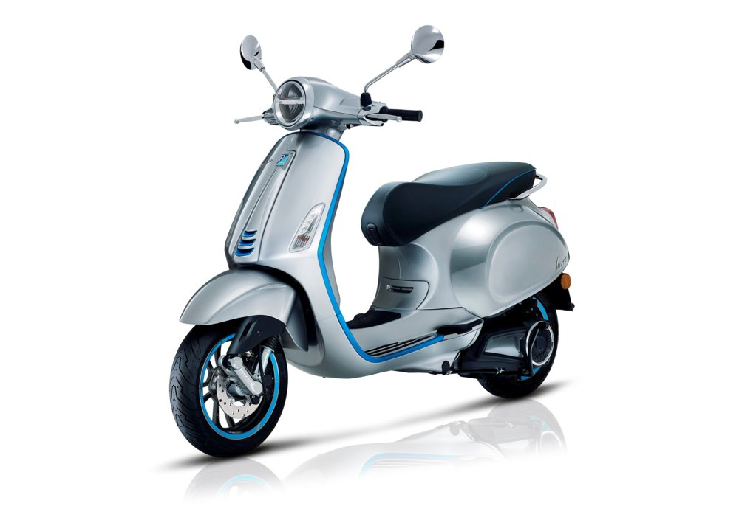
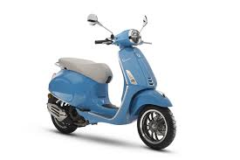
Vespa Piaggio: elettrica vs benzina
 | VESPA
 | E-scooter | ICE-Scooter
Purchase Price | € 6,390 | € 2,400
Fuel Economy (fuel cost per 100 km) | 0.8 €/100km | 4.79 €/100km
E-scooter driving range | 100 km | 267 km
Power | 4 kW | 2.4 kW
Circulation tax + Insurance Premium | € 125 | € 250
Removable/swappable battery | no
Manufacturer Country | Europe | Europe

Slide 4
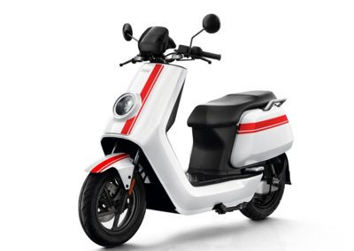
NIU NGT – e-scooter batteria estraibile
 | NIU NGT e-scooter
Purchase Price | € 4,499
Fuel Economy (fuel cost per 100 km) | 0.5 €/100km
E-scooter driving range | 150 km
Power | 3 kW
Circulation tax + Insurance Premium | € 125
Removable/swappable battery | Yes
Manufacturer Country | China

Slide 5
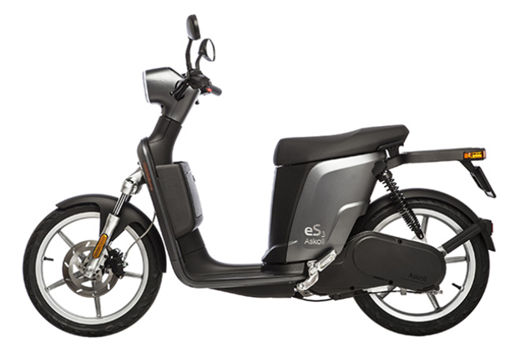
Askoll eS3 – e-scooter
 | Askoll eS3 e-scooter
Purchase Price | € 3,590
Fuel Economy (fuel cost per 100 km) | 0.46 €/100km
E-scooter driving range | 96 km
Power | 3.3 kW
Circulation tax + Insurance Premium | € 125
Removable/swappable battery | no
Manufacturer Country | Europe

Slide 6
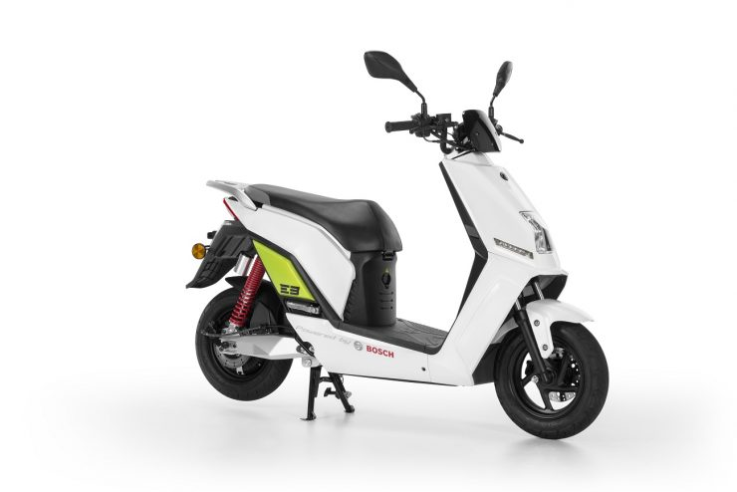
Lifan E3 – e-scooter batteria estraibile
 | Lifan E3 e-scooter
Purchase Price | € 1,990
Fuel Economy (fuel cost per 100 km) | 0.33 €/100km
E-scooter driving range | 80 km
Power | 1.9 kW
Circulation tax + Insurance Premium | € 125
Removable/swappable battery | Yes
Manufacturer Country | China

Slide 7
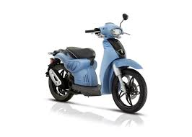
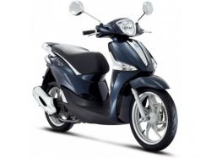
I ciclomotori più venduti in Italia...
Piaggio Liberty 50 4T 3V
Aprilia Scarabeo 50 2T
https://www.motociclismo.it/mercato-delle-due-ruote-classifiche-vendita-moto-e-scooter-2019-ad-agosto-bmw-r-1250-gs-davanti-a-honda-africa-twin-e-benelli-trk-502-73302

Slide 8
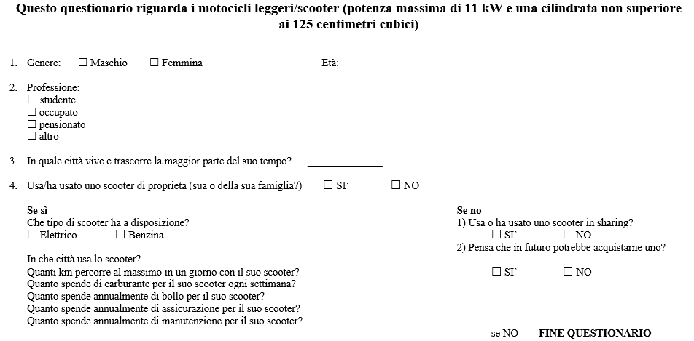
Il questionario

Slide 9
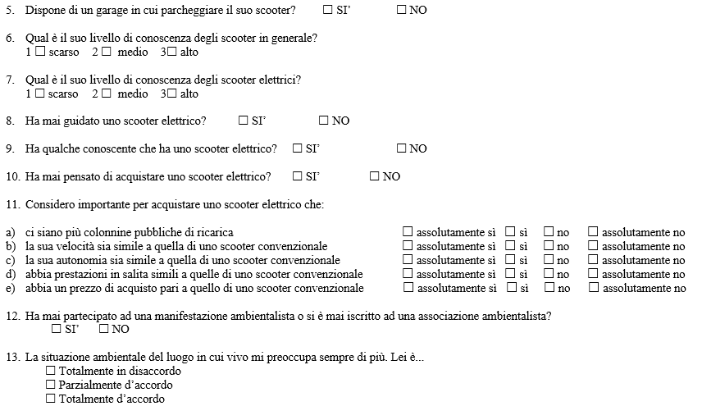
Il questionario

Slide 10
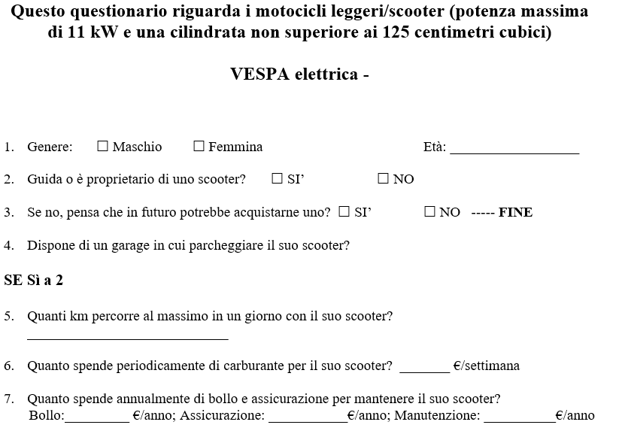

Slide 11
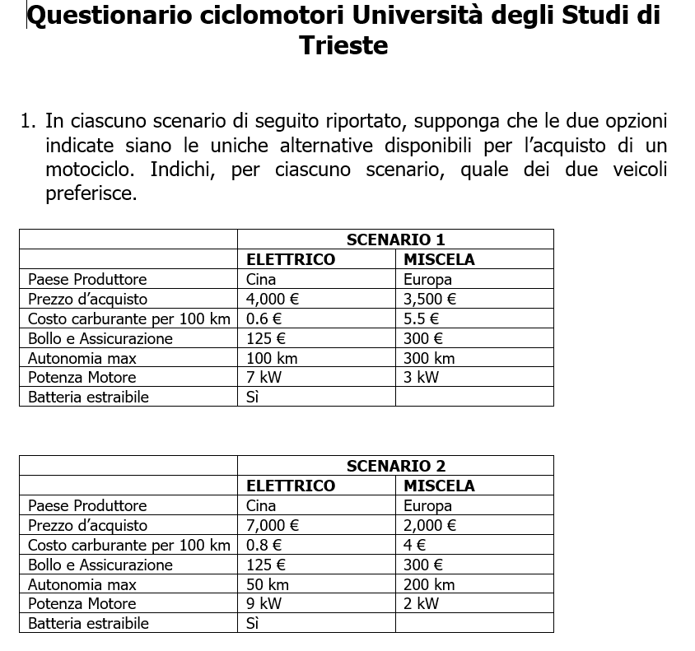

Slide 12
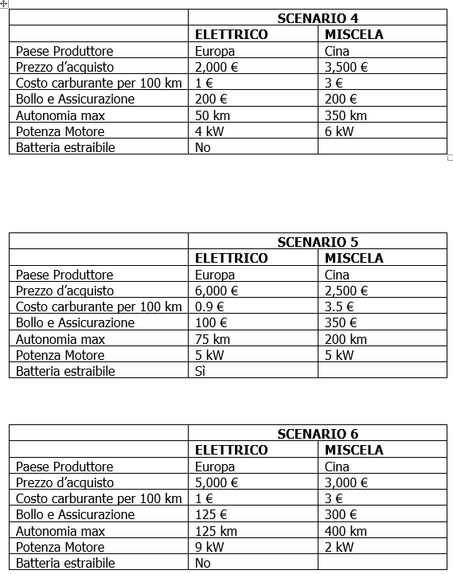
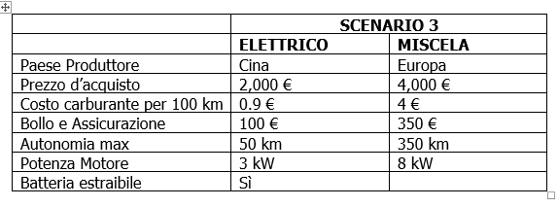

Slide 13
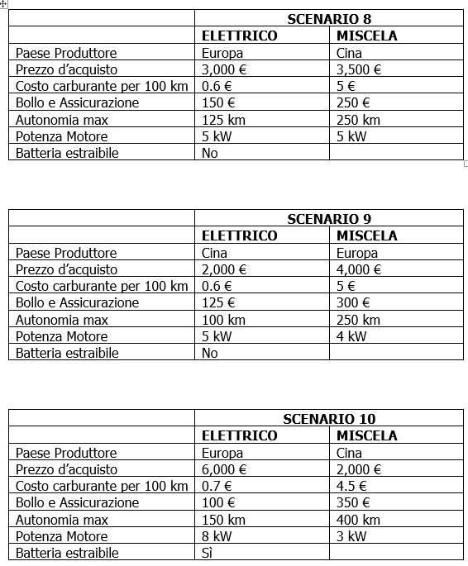
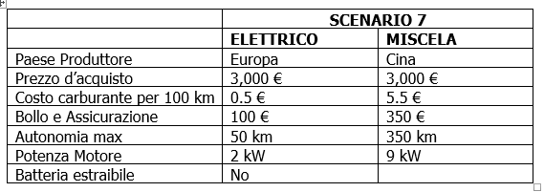

Slide 14
In English

Slide 15
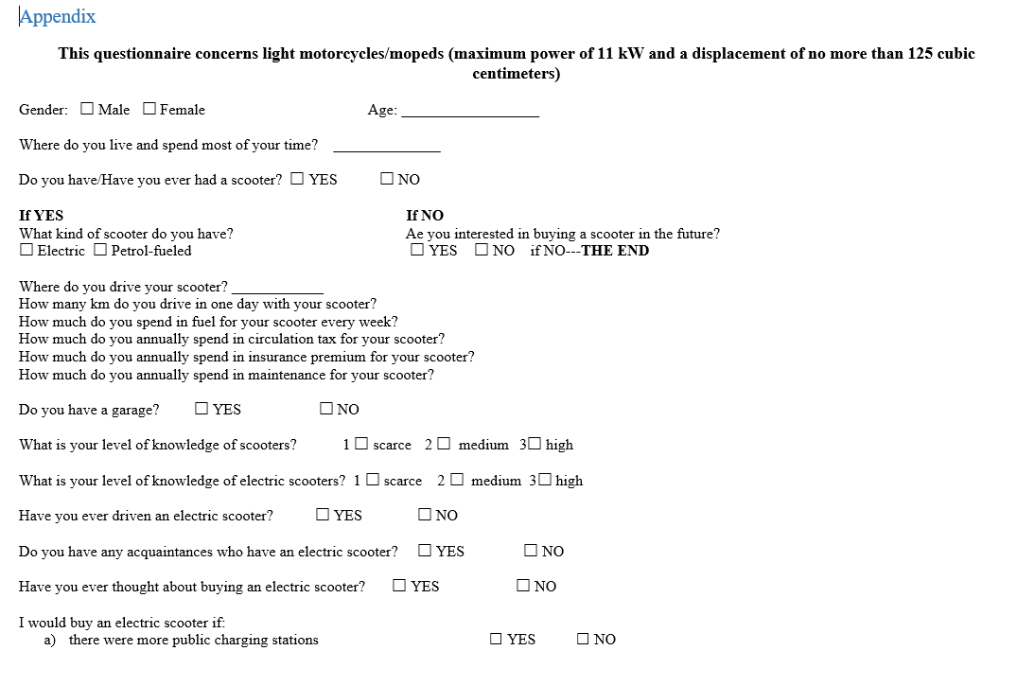

Slide 16
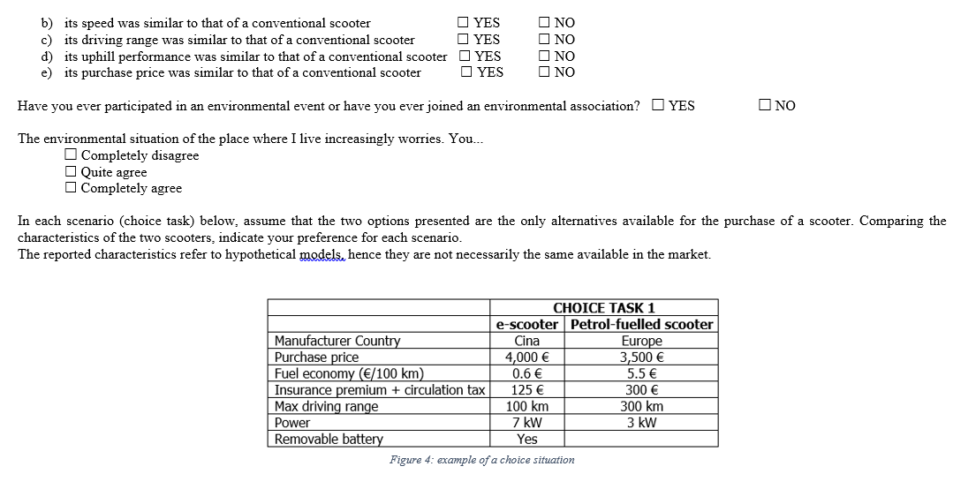

Slide 17
In Google Forms

Slide 18
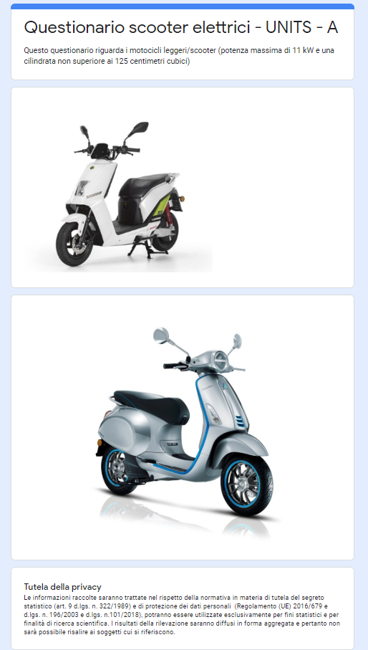
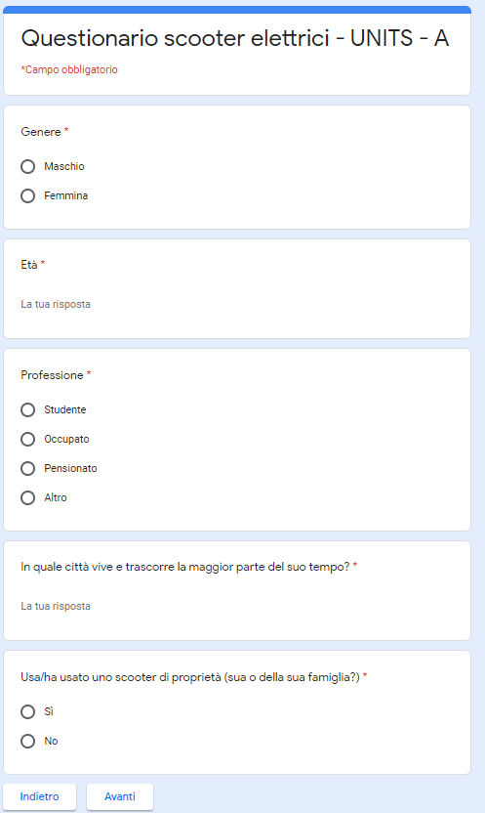
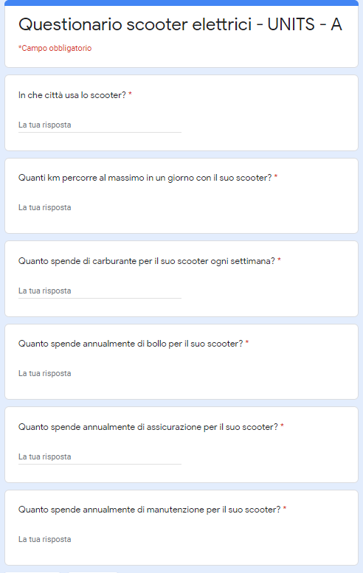

Slide 19
