Slide 1
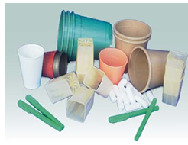


Green chemistry: integrating sustainable processes with renewable products

Slide 2
Green chemistry
The chemistry sector, its impact on economy and society
Evolution of chemistry to meet environmental urgencies

Slide 3
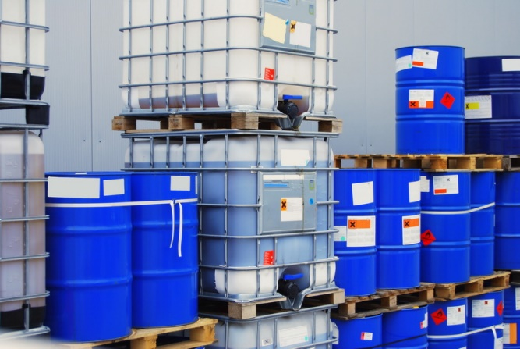
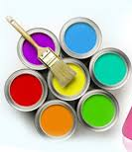

What chemical industry produces: definitions
Commodities:
A basic good used in commerce that is interchangeable with other commodities of the same type. Most often used as inputs in the production of other goods or services. The quality of a given commodity may differ slightly, but must meet specified minimum standards.
Specialty chemicals
low volume–high value products that constitute raw materials for the production of pharmaceuticals, auxiliaries for industry, crop protection and pigments among others.
Consumer chemicals
products such as detergents, perfumes and cosmetics sold directly to consumers.

Slide 4
Chemistry is the manufacturing sector that delivers products with the highest added value in Europe
15% of EU GDP
20% of global production
Italy:
-ranked 10 globally
-ranked 3 in EU (excellence in fine chemistry and specialty chemistry)
During economic crisis of 2008-2009 the world consumption of chemical products has increased by +3.9% per year
Projections: +4.5% growth in 2011-2020.
L’Industria chimica in cifre, Federchimica, 2014.

Slide 5
  Centralità di Ricerca e Innovazione
Imprese con R&S
interna in Italia
(% sul totale imprese)
Imprese con R&S
interna in Europa
(% sul totale imprese)
Numero di imprese con R&S interna
nella chimica europea
42%
Germania
1.278
42%
Chimica
Italia
683
Spagna
548
Francia
541
Olanda
224
18%
Industria
Manifatturiera
Note: imprese con più di 10 addetti
Fonte: Eurostat - Community Innovation Survey, 2014

Slide 6
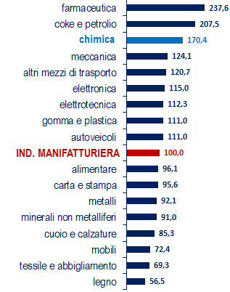
  Dall’elevata produttività maggiore difesa dai concorrenti emergenti
Valore aggiunto per addetto
(indice manifattura =100)
Innovazione
basata sulla ricerca
+
Impianti e tecnologie
complesse
+
Intensità
di capitale
Elevata qualifica e produttività
consentono
maggiori remunerazioni
Fonte: Federchimica su Istat, 2015
Notes:
Aggiornato i dati con quelli forniti da Juliette

Slide 7
Industria chimica leader in Sostenibilità economica e competitività
ISCO - Indicatore sintetico di competitività ISTAT
(indice industria manifatturiera =100, anno 2015)
Bevande
Farmaceutica
CHIMICA
Apparecchiature elettriche
Macchinari
Altri mezzi di trasporto
Gomma e plastica
Altre manifatture
Autoveicoli
Elettronica
Carta
Pelle
MANIFATTURA
Metallurgia
Alimentari
Mobili
Tessile
Prodotti in metallo
Abbigliamento
Minerali non metalliferi
Prodotti petroliferi
Stampa
Legno
Riparazione e manutenzione macchinari
Fonte: Istat

Slide 8
Chimica come infrastruttura tecnologica
Industria estrattiva
Materie prime inorganiche
Materie prime organiche
Industria petrolifera
Processo
chimico
Energia
Aria
Acqua
Chimica
di base e fine
Processo
chimico
Chimica delle specialità
Beni intermedi
Gomma/plastica
Tessile/cuoio
Mobile
Auto
Carta
Metalli
Meccanica
Alimentare
Costruzioni
Agricoltura
Consumo
Servizi

Slide 9

Infrastruttura tecnologica per il Made in Italy
La chimica
è il turbo del Made in Italy
Biella - Prato
tessile
Como
seta
Brianza - Alto Livenza
arredamento
Premana
forbici
Milano - Varese
plastica
Bergamo
bottoni
Innovazione
Sassuolo
ceramica
Castel Goffredo
calze da donna
Vigevano
calzature
Verona - Alpi Apuane
marmi
Personalizzazione
Rossano Veneto
selle per biciclette
Cadore
ottica
Pesaro
cucine
Solofra Arzignano - S.Croce
concia
Specializzazione
Vicenza - Arezzo
oreficeria
Montebelluna
calzature sportive
Rimini - Forlì - Pesaro
mobili
Bologna
imballaggio
Flessibilità
Fermo
footwear
Le Murge
divani

Slide 10
Specializzazione italiana
nella Chimica fine e delle specialità
Quota della Chimica a valle
(% sul totale del valore della produzione)
Saldo commerciale
della Chimica fine e delle specialità
(milioni di euro)
Italia
57%
UE
45%
2007
2009
2011
2013
2015
2017
Fonte: Istat, Eurostat, anno 2015
Note: la chimica a valle comprende la chimica fine, specialistica e per il consumo

Slide 11
Da Chimica 1.0 a Chimica 4.0
Chimica 1.0 Chimica del Carbone
Chimica 2.0 Petrolchimica
Chimica 3.0 Specialità e Globalizzazione
Chimica 4.0 Digitalizzazione? Economia circolare?
Bioeconomia?

Slide 12
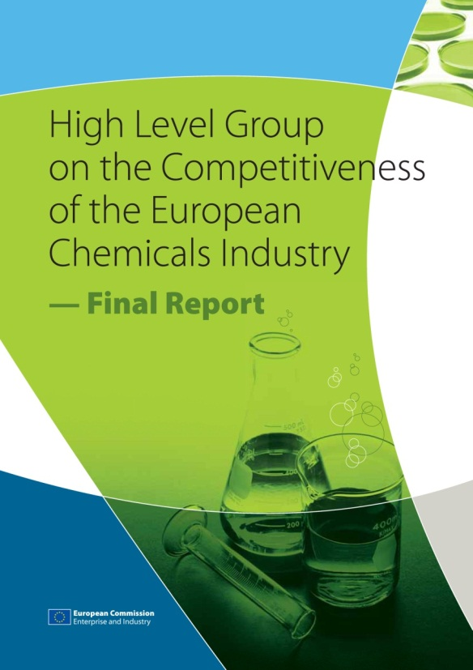
“European Chemicals Industry,
Enabler of a Sustainable Future”
Sostenibilità alimentare
Nuove esigenze connesse all’invecchiamento
Cambiamento climatico
Uso più efficiente delle risorse
«Le principali sfide dell’umanità
richiedono nuove soluzioni
molte delle quali possono essere implementate
solo grazie a nuovi materiali e sostanze»

Slide 13









Tanta Chimica negli obiettivi ONU

Slide 14
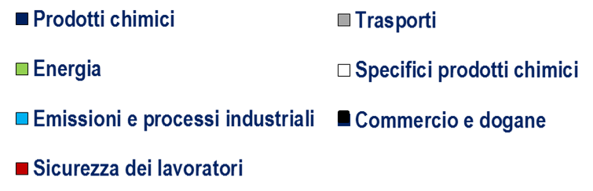
  Crescente costo
  della regolamentazione
Costi della regolamentazione
per l’industria chimica europea
Costi della regolamentazione
per l’industria chimica europea
(indici 2004=100)
(%, media 2004-2014)
% sul valore
aggiunto
% sul risultato
lordo di gestione
Fonte: CCA Report, «Cumulative Cost Assestement for the EU Chemical Industry», Technopolis Group, 2015

Slide 15
https://ec.europa.eu/growth/sectors/chemicals/reach_en
REACH is the European Regulation on Registration, Evaluation, Authorisation and Restriction of Chemicals. It entered into force in 2007, replacing the former legislative framework for chemicals in the EU.
REACH shifts the responsibility from public authorities to industry with regards to assessing and managing the risks posed by chemicals and providing appropriate safety information for their users. It impacts on a wide range of companies across many sectors beyond the chemical industry. It requires new forms of cooperation among companies, enhancing communication along the supply chain.
Objectives of REACH
The main aims of REACH are to ensure a high level of protection for human health and the environment.

Slide 16
NO DATA NO MARKET!
Register information in the data-base of the European Chemical Agency

Slide 17



Sostenibilita: dall’innovazione di processo all’innovazione di prodotto
1 tonnellata di CO₂ emessa
per la produzione chimica
evita 2,6 tonnellate
di gas serra
da parte dei clienti industriali
o dei consumatori finali
-80% emissioni in acqua
dal 1989
-95% emissioni in aria
dal 1989
-62% emissioni di gas serra
dal 1990
Fonte: Federchimica - Responsible Care ®, ENEA – ODYSSEE Project, ISPRA, Istat, ICCA - McKinsey
Notes:
Beyond any prejudice, chemical industry gives a fundamental contribute in terms of environmental sustainability.
Not only it has drastically reduced its emissions in the last 25 years, but it also helps to reduce emissions of downstream users: every 1 tons of CO2 emitted for chemical production prevents 2,6 tons of greenhouse gas emitted from industrial customers or end users.

Slide 18

Production of waste by various branches of chemical industry
Industry | Product scale (t/year) | Kg waste / Kg product (E factor)
Oil refining | 10⁶-10⁸ | <<0.1
Bulk chemicals | 10⁴ - 10⁶ | 1-5
Fine chemicals | 10- 10⁴ | 5 - 50
Pharma | 1- 10³ | 25 - > 100
Sheldon R.A., Green Chemistry, 2007, 9, 1273-1283.
CHEMISTRY ENVOROMENTAL IMPACT!

Slide 20

http://www.sheldon.nl/bi/EFactor.aspx
Environmental quotient, EQ,
EQ = Environmental Factor × Q
What is important is the environmental impact of this waste, not just its amount. One kg of sodium chloride is obviously not equivalent to one kg of a chromium salt.
EQ, is obtained by multiplying the E factor with an arbitrarily assigned unfriendliness quotient, Q. For example, one could arbitrarily assign a Q value of 1 to NaCl and, say, 100-1000 to a heavy metal salt, such as chromium, depending on its toxicity, ease of recycling, etc. The magnitude of Q is obviously debatable and difficult to quantify but, importantly, ‘quantitative assessment’ of the environmental impact of chemical processes is, in principle, possible.

Slide 21
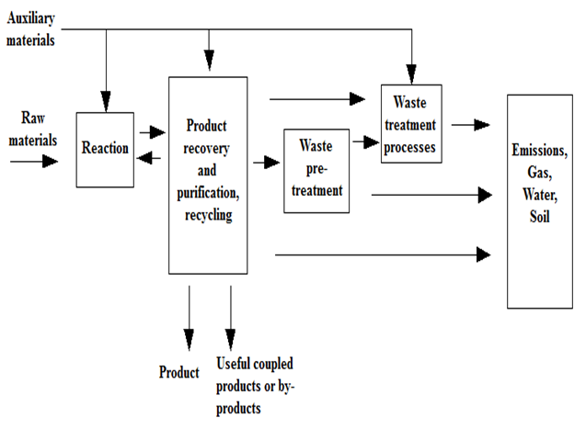
The efficiency and sustainability of a process depend on all steps taken as a whole
Steps of an industrial chemical process

Slide 22
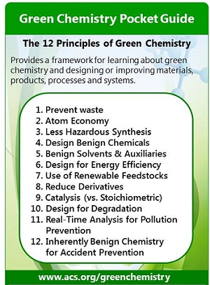
12 Principles of Green Chemistry
Developed by Paul Anastas and John Warner:
the list outlines an early conception of what would make a greener chemical, process, or product.
Anastas, P. T.; Warner, J. C. Green Chemistry: Theory and Practice, Oxford University Press: New York, 1998, p.30. B

Slide 23
Prevention
It is better to prevent waste than to treat or clean up waste after it has been created.
Atom Economy
Synthetic methods should be designed to maximize the incorporation of all materials used in the process into the final product.
Less Hazardous Chemical Syntheses
Wherever practicable, synthetic methods should be designed to use and generate substances that possess little or no toxicity to human health and the environment.
Designing Safer Chemicals
Chemical products should be designed to affect their desired function while minimizing their toxicity.
Anastas, P. T.; Warner, J. C. Green Chemistry: Theory and Practice, Oxford University Press: New York, 1998, p.30. B

Slide 24
Prevention
It is better to prevent waste than to treat or clean up waste after it has been created.
Atom Economy
Synthetic methods should be designed to maximize the incorporation of all materials used in the process into the final product.
Less Hazardous Chemical Syntheses
Wherever practicable, synthetic methods should be designed to use and generate substances that possess little or no toxicity to human health and the environment.
Designing Safer Chemicals
Safer Solvents and Auxiliaries
The use of auxiliary substances (e.g., solvents, separation agents, etc.) should be made unnecessary wherever possible and innocuous when used.
Design for Energy Efficiency
Energy requirements of chemical processes should be recognized for their environmental and economic impacts and should be minimized. If possible, synthetic methods should be conducted at ambient temperature and pressure.
Use of Renewable Feedstocks
A raw material or feedstock should be renewable rather than depleting whenever technically and economically practicable.
Reduce Derivatives
Unnecessary derivatization (use of blocking groups, protection/ deprotection, temporary modification of physical/chemical processes) should be minimized or avoided if possible, because such steps require additional reagents and can generate waste.
Catalysis
Catalytic reagents (as selective as possible) are superior to stoichiometric reagents.
Design for Degradation
Chemical products should be designed so that at the end of their function they break down into innocuous degradation products and do not persist in the environment.
Real-time analysis for Pollution Prevention
Analytical methodologies need to be further developed to allow for real-time, in-process monitoring and control prior to the formation of hazardous substances.
Inherently Safer Chemistry for Accident Prevention
Substances and the form of a substance used in a chemical process should be chosen to minimize the potential for chemical accidents, including releases, explosions, and fires.
Anastas, P. T.; Warner, J. C. Green Chemistry: Theory and Practice, Oxford University Press: New York, 1998, p.30. By permission of Oxford University Press.

Slide 25
Prevention
It is better to prevent waste than to treat or clean up waste after it has been created.
Atom Economy
Synthetic methods should be designed to maximize the incorporation of all materials used in the process into the final product.
Less Hazardous Chemical Syntheses
Wherever practicable, synthetic methods should be designed to use and generate substances that possess little or no toxicity to human health and the environment.
Designing Safer Chemicals
Safer Solvents and Auxiliaries
The use of auxiliary substances (e.g., solvents, separation agents, etc.) should be made unnecessary wherever possible and innocuous when used.
Design for Energy Efficiency
Energy requirements of chemical processes should be recognized for their environmental and economic impacts and should be minimized. If possible, synthetic methods should be conducted at ambient temperature and pressure.
Use of Renewable Feedstocks
A raw material or feedstock should be renewable rather than depleting whenever technically and economically practicable.
Reduce Derivatives
Unnecessary derivatization (use of blocking groups, protection/ deprotection, temporary modification of physical/chemical processes) should be minimized or avoided if possible, because such steps require additional reagents and can generate waste.
Catalysis
Catalytic reagents (as selective as possible) are superior to stoichiometric reagents.
Real-time analysis for Pollution Prevention
Analytical methodologies need to be further developed to allow for real-time, in-process monitoring and control prior to the formation of hazardous substances.
Inherently Safer Chemistry for Accident Prevention
Substances and the form of a substance used in a chemical process should be chosen to minimize the potential for chemical accidents, including releases, explosions, and fires.
Anastas, P. T.; Warner, J. C. Green Chemistry: Theory and Practice, Oxford University Press: New York, 1998, p.30. By permission of Oxford University Press.

Slide 26
Prevention
It is better to prevent waste than to treat or clean up waste after it has been created.
Atom Economy
Synthetic methods should be designed to maximize the incorporation of all materials used in the process into the final product.
Less Hazardous Chemical Syntheses
Wherever practicable, synthetic methods should be designed to use and generate substances that possess little or no toxicity to human health and the environment.
Designing Safer Chemicals
Safer Solvents and Auxiliaries
The use of auxiliary substances (e.g., solvents, separation agents, etc.) should be made unnecessary wherever possible and innocuous when used.
Design for Energy Efficiency
Energy requirements of chemical processes should be recognized for their environmental and economic impacts and should be minimized. If possible, synthetic methods should be conducted at ambient temperature and pressure.
Use of Renewable Feedstocks
A raw material or feedstock should be renewable rather than depleting whenever technically and economically practicable.
Reduce Derivatives
Unnecessary derivatization (use of blocking groups, protection/ deprotection, temporary modification of physical/chemical processes) should be minimized or avoided if possible, because such steps require additional reagents and can generate waste.
Catalysis
Catalytic reagents (as selective as possible) are superior to stoichiometric reagents.
Design for Degradation
Chemical products should be designed so that at the end of their function they break down into innocuous degradation products and do not persist in the environment.
Real-time analysis for Pollution Prevention
Analytical methodologies need to be further developed to allow for real-time, in-process monitoring and control prior to the formation of hazardous substances.
Inherently Safer Chemistry for Accident Prevention
Substances and the form of a substance used in a chemical process should be chosen to minimize the potential for chemical accidents, including releases, explosions, and fires.
Anastas, P. T.; Warner, J. C. Green Chemistry: Theory and Practice, Oxford University Press: New York, 1998, p.30. By permission of Oxford University Press.

Slide 27
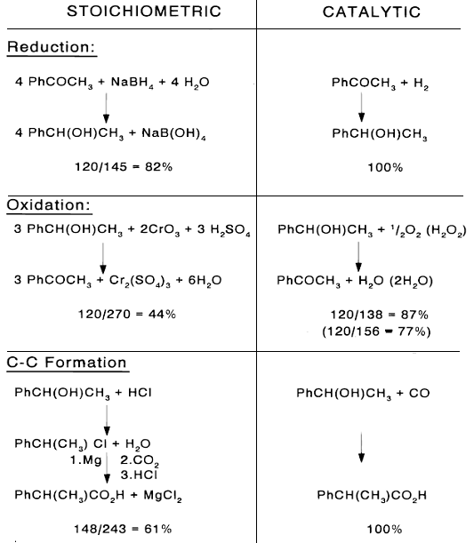
Comparison between stoichiometric and catalytic reactions
Atom Utilisation: catalyst is regenerated

Slide 28
The cell:
The most complex and efficient
chemical laboratory
at low environmental impact
Chemicals
Materials
Drugs
Fuels
Sugar
Fats
Aminoacids
Etc…
bioconversion

Slide 30
Insoluble immobilized industrial enzyme

Slide 31
Some comparison between chemical and biocatalyzed processes

Slide 32
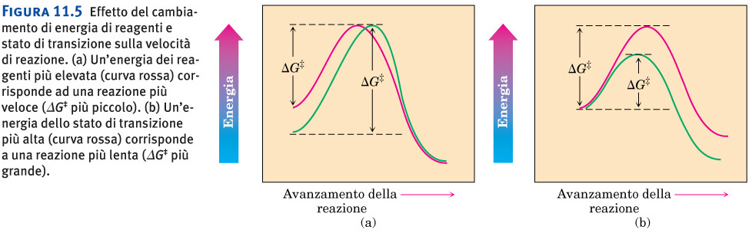
Chemical vs enzymatic reactions:
Peptides and proteins are hydrolyzed chemically at very harsh conditions:
Options:
a)Aqueous HCl 6M, 100 °C for several hours
b)Sodium hydroxide
Increasing the energy of the system: Highly active reactants

Slide 33
Enzymes make reactions happen at mild teperature and pH
Decreasing energy by stabilization: CATALYSIS

Slide 34
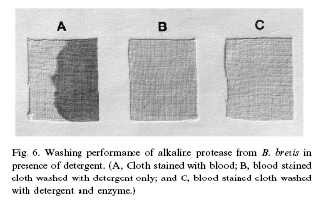

Subtilisine from Bacillus specie: digests proteins under mild conditions
In 2002 produced 900 tons for additives in detergents
A serine protease
Also known as Subtilisin Carlsberg

Slide 35
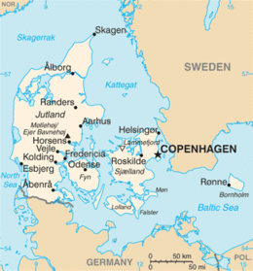
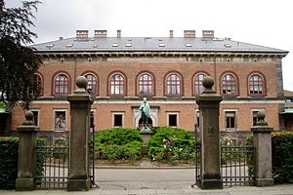
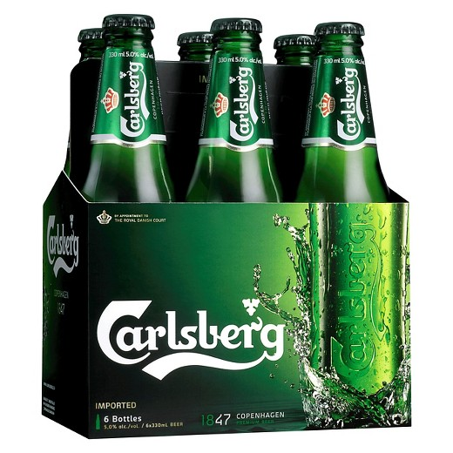
Why traditions matter!
“Jacobson specifically wanted a laboratory that expanded science for the benefit of society,” Its charter declares that “the principal task of The Carlsberg Laboratory shall be to develop as complete a scientific basis as possible for malting, brewing and fermenting operations.” And on the wall of the building’s central grand staircase, the following mantra is inscribed in gold leaf: “No result of the Laboratory’s activities which is of theoretical or practical importance shall be kept secret.”
Carlsberg Foundation was founded in 1876 and owns 30.3% of the shares in Carlsberg Group and has 74.2% of the voting power.
A statue of company founder Jacobson. C. Carlsberg stands outside the Carlsberg Laboratory in Valby, Copenhagen.

Slide 36




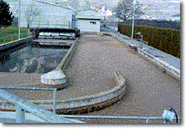




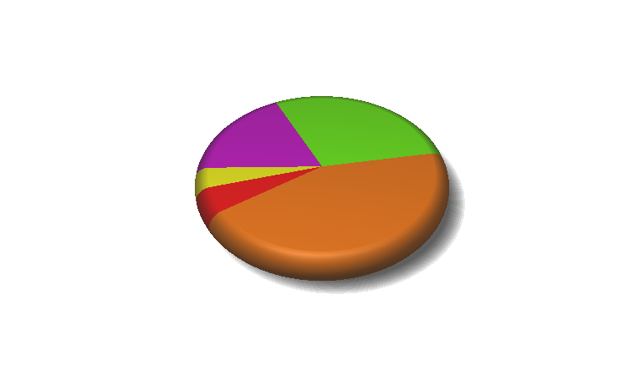
World leaders in enzymes & microorganisms
Technical enzymes
Food enzymes
Feed enzymes
Microorganisms
Biocatalysis
Small part to increase
DK
Others
Genencor
Research
20%
25%
Production
4%
Sales offices
BASF
6%
45%
DSM
Novozymes

Slide 37
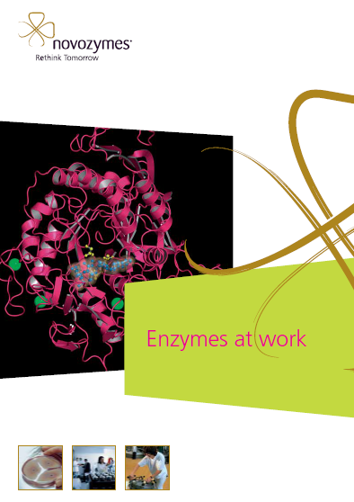
The global market for enzymes was estimated at about 4.5 bln dollar in 2012 and is expected to grow at almost 8 bln dollar in 2020. Europe is the world leader in key industrial biotechnologies such as enzyme technologies, with Novozymes from Denmark holding a market share of >45% worldwide.
Source. Festel G., Detzel C. and Maas R., Industrial Biotechnology – Markets and industry structure, Journal of Commercial Biotechnology, Volume 18, No. 1, 2012
http://www.novozymes.com

Slide 38
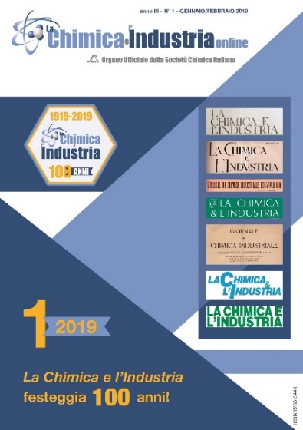


Slide 41
Figura 11.5 Effetto del cambiamento di energia di reagenti e stato di transizione sulla velocità di reazione. (a) Un’energia dei reagenti più elevata (curva rossa) corrisponde ad una reazione più veloce (DG‡ più piccolo). (b) Un’energia dello stato di transizione più alta (curva rossa) corrisponde a una reazione più lenta (DG‡ più grande).
How can we accelerate chemical reactions?
-using more reactive substrates (high energy, low selectivity, side products)
-decreasing the energy of the transformation path through stabilization of the highest energy state.
Increasing the energy of the system: Highly active reactants
Decreasing energy by stabilization: CATALYSIS

Slide 42
How can enzyme hydolyse the peptide bond at room temperature and neutral pH?
Why enzymes are more efficient than «chemists»??
Enzymatic reaction

Slide 43
A serine protease mechanism .
NHR²
H₂NR²
Nu
Acyl-enzyme intermediate
Chemical reaction

Slide 44
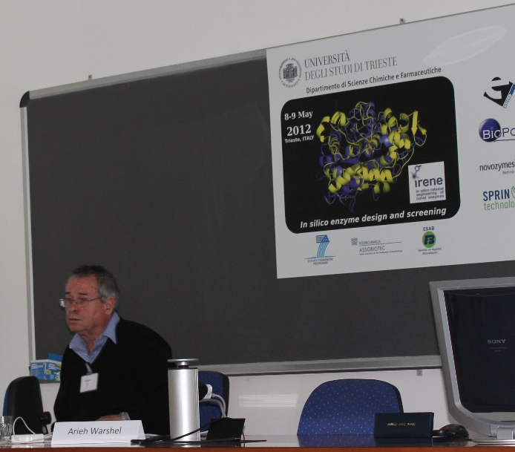
«……the catalytic power of enzymes is largely due to the preorganized electrostatic environment of their active site»
A Warshel et al, Chem Rev,
2006, 106, 3210.
Nobel laureate for chemistry 2013

Slide 45
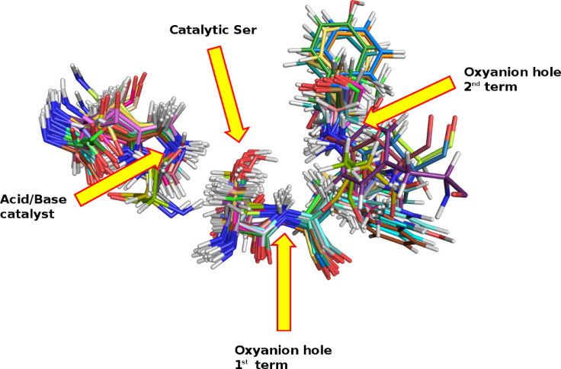
Serine Hydrolase enzymes active sites:
pre-organized reaction environments
Oxyanion hole
The energy cost is paid during the protein/enzyme synthesis
Nature does not save matter: differentiation and selection
Stabilizes the tetrahedral intermediate

Slide 46
A serine protease mechanism: pre-organized reaction environment
Acyl-enzyme intermediate
+
H₂NR²
Ser
able to decrease the energy of the transition state of the rate determining step
Oxyanion hole
Stabilizes oxyanion of the intermediate
Chemical reaction

Slide 47
A serine protease mechanism: different synthetic routes by changing the nucleophile .
H₂NR²

Slide 48
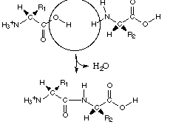
Serin hydrolases can catalyze the synthesis of peptide bond by changing the nucleophile and working under dry conditions
+ H2O

Slide 49
Enzymatic synthesis of Aspartame in industry
Moving from natural to non-natural substrates:
industrial synthesis of dipeptide Aspartame
T
h
e
r
m
o
l
y
s
i
n
H
O
,
p
H
=
6
-
2
7
Mild conditions: no racemization, less side products

Slide 50
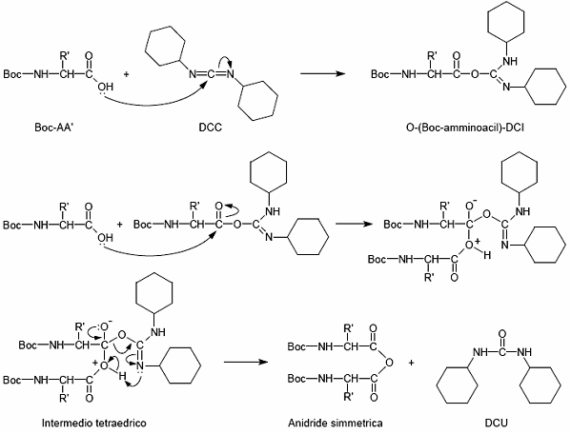
Meccanismo di formazione dell’anidride simmetrica a partire dall’O-acilisourea
Chemical routes for the synthesis of peptide bonds:
Amino and carboxy groups must be protected
Acyl group must be activated!! Promotes racemization!!!
Organic
solvent
Urea,
Side product

Slide 51
Major biotransformations at industrial scale 1.
Fine-pharma chemistry

Slide 52
In some cases biocatalyst is the ONLY option

Slide 53
Use of whole cells for the production of acrylamide
Production of acrylamide by hydration of acrylonitrile using whole bacterial cells (Pseudomonas chloraphis, Rhodococcus rhodochrous).
industrial scale > 30,000 tonnes / year
Yields >99%
formation of by-products ( acrylic acid ) completely avoided
Cell density
time

Slide 54
Penicillin G amidase in the hydrolysis of Pen G to 6-APA (precursor of semi-sintetic beta-lactam antibiotics (41% of the whole antibiotic market)
Antibiotici beta-lattamici: penicilline
Natural product (secondary methabolite) abtained through fermentation: not used any longer for terapeutic use
Allergenic, degraded when administered by os, narrow spectrum
Penicillina G
Ampicillin
Semisiynthetic antiobitic: next generation

Slide 55
Penicillin G amidase in the hydrolysis of Pen G to 6-APA (precursor of semi-sintetic beta-lactam antibiotics
Penicillin G amidase:PGA
Chemical process
T <-50°C
Enzymatic process
Market: 10 - 30 tons of immobilized/insoluble PGA consumed per year

Slide 56
Why biocatalysis? The drivers
Economy
Regulations
Selective + Sustainable
Reduction of process costs
65% of energy saving
Reduction of wastes (1/5)
50% reduction of cost for beta-lactam antibiotics production

Slide 57
Annexes

Slide 58
I dodici principi della chimica verde
1. La prevenzione alla produzione di rifiuti risulta essere più conveniente rispetto al trattare o detossificare i rifiuti dopo che essi siano stati formati.
2. I metodi di sintesi dovrebbero essere messi a punto in modo da poter permettere il massimo utilizzo dei materiali impiegati, consentendo così rese elevate dei prodotti desiderati.
3. Per quanto possibile, le metodologie di sintesi dovrebbero essere ideate per usare o generare sostanze che abbiano minima o nessuna tossicità per la salute umana e l’ambiente.
4. I prodotti chimici devono essere progettati per mantenere l’efficacia della funzione, riducendone la tossicità.
5. L’uso di sostanze ausiliarie deve essere reso innocuo o non necessario.
6. Il fabbisogno energetico dovrebbe essere valutato secondo l'impatto ambientale ed economico, riducendolo al minimo. I metodi di sintesi devono essere condotti a temperatura e pressione ambiente.

Slide 59
I dodici principi della chimica verde
7. Una materia prima rinnovabile dovrebbe essere preferita ad una non rinnovabile, qualora questo sia tecnicamente ed economicamente possibile.
8. Bisognerebbe ridurre i prodotti secondari laddove possibile.
9. I catalizzatori (il più selettivi possibile) risultano essere migliori rispetto i classici reagenti stechiometrici.
10. I prodotti chimici devono essere progettati in modo tale che al termine della loro funzione non persistano nell’ambiente e diano prodotti di degradazione innocui.
11. Le metodologie analitiche devono essere sviluppate per impedire in tempo reale, durante i processi di controllo, la formazione di sostanze nocive.
12. Il tipo di sostanza e lo stato della sostanza, usati durante i processi chimici, devono essere scelti in modo da ridurre il rischio di incidenti, come rilasci, esplosioni ed incendi.

Slide 60
L'utilizzo dei solventi organici costituisce un ulteriore problema nell'ambito della chimica verde:
I solventi non sempre riescono ad essere riciclati. L'impiego di questi in processi costituiti da reazioni multi-stadio causa solitamente delle contaminazioni crociate
i solventi sono le sostanze che contribuiscono maggiormente all'ottenimento di valori elevati di E. Factor durante i processi di lavorazione
i solventi costituiscono, nelle sintesi chimiche, l'80% della massa totale delle sostanze coinvolte
L'acqua è un buon solvente, essendo non tossica, non infiammabile, disponibile su larga scala ed economica. Nelle reazioni in cui vengono utilizzati i catalizzatori, grazie alla presenza dell'acqua, si possono associare dei sistemi bifasici acquosi. Il catalizzatore risiede nella fase acquosa, mentre il prodotto si trova nella fase organica. In questo modo il catalizzatore può essere recuperato e riciclato attraverso una semplice separazione di fase.
OBIETTIVO: USARE ACQUA O SISTEMI CONCENTRATI E POSSIBILMENTE «bulk» senza solvente

