Slide 1

Roberta Gefter
English Literature III 2019-2020.
Literary modernity: the novel from Modernism to postmodernism and back to tradition:

Slide 2
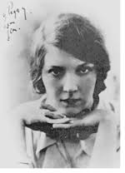
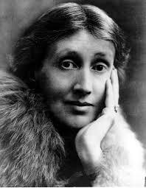
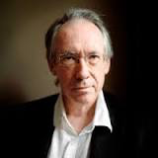
Literary modernity: the novel from Modernism topostcolonialism, postmodernism and back to tradition?

Slide 3
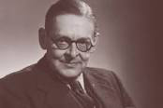

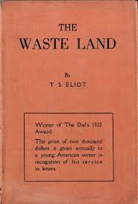
The Modernist masters

Slide 4
The legacy of Modernism
What was the impact of Modernism?
What were the connections between the arts?
What were the continuities between Modernism, the return to realism and Postmodernism?
How does Modernism anticipate Postmodernism?

Slide 5
modernism and its legacy and breakups in postmodern and contemporary literature.
a specific focus 
the metaliterary, intertextual dimension of twentieth century literary politics,
and the rhetorical strategies with which
they drew from the idea of tradition, the cultural past and the literary canon

Slide 7
The Complexity of Modernism…and of much of «20th C. literary art
Composition VII Vasily Kandinsky, 1912

Slide 8
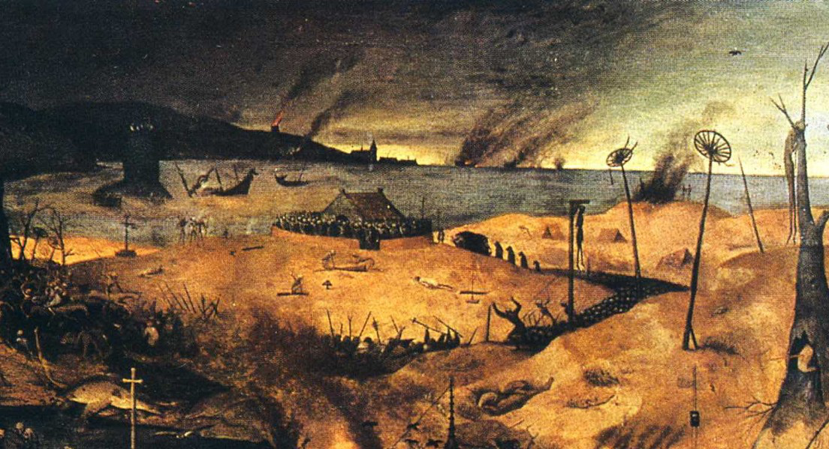
T.S.Eliot’s The WASTE LAND one of the most important works of literature of the 20° century

Slide 9
FOR EZRA POUND
IL MIGLIOR FABBRO
I. The Burial of the Dead
April is the cruellest month, breeding
Lilacs out of the dead land, mixing
Memory and desire, stirring
Dull roots with spring rain.
Winter kept us warm, covering
Earth in forgetful snow, feeding
A little life with dried tubers.
Summer surprised us, coming over the Starnbergersee
With a shower of rain; we stopped in the colonnade,
And went on in sunlight, into the Hofgarten,
And drank coffee, and talked for an hour.
Bin gar keine Russin, stamm’ aus Litauen, echt deutsch.
And when we were children, staying at the arch-duke’s,
My cousin’s, he took me out on a sled,
And I was frightened. He said, Marie,
Marie, hold on tight. And down we went.
In the mountains, there you feel free.
I read, much of the night, and go south in the winter.

