Slide 1
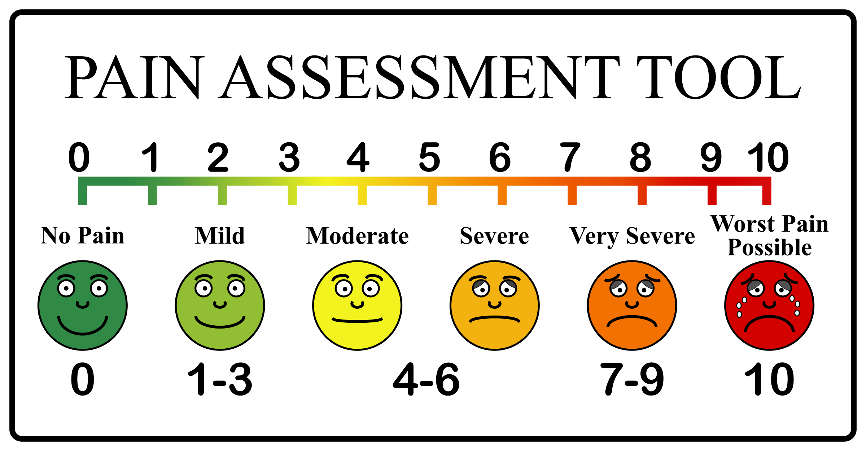
PAIN
v 3.1
Main sources of figures:
Purves et al., NEUROSCIENZE, Zanichelli

Slide 2
OVERVIEW
definition of pain
nociceptive pain
skin nociceptors
hyperalgesia and allodynia
pathways of pain
aspects of pain perception
spinal and descending control of pain sensation
referred pain

Slide 3
DEFINITION
nociception
Pain "is an unpleasant sensory and emotional experience associated with tissue damage, whether actual or potential, or described in terms of damage”
IASP (International Association for the Study of Pain - 1986)

Slide 4
DEFINIZIONE
nociception
emotion
Pain "is an unpleasant sensory and emotional experience associated with tissue damage, whether actual or potential, or described in terms of damage”
IASP (International Association for the Study of Pain - 1986)

Slide 5
NOCICEPTIVE PAIN
degeneration,
neoplasia
trauma
infection
degenerative pain,
neoplastic pain
traumatic pain
edema
muscle contraction
spasm
lesion, compression
inflammation
immune messangers
spastic pain
neuropatic pain
inflammatory pain
PAIN

Slide 6
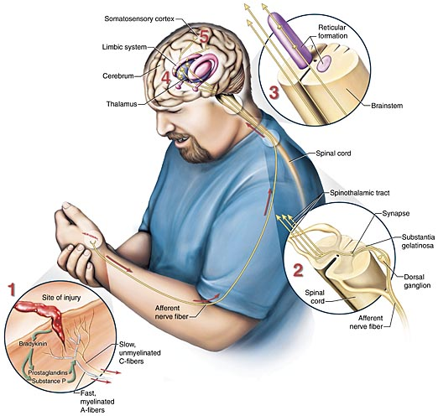
NOCICEPTIVE PAIN

Slide 7
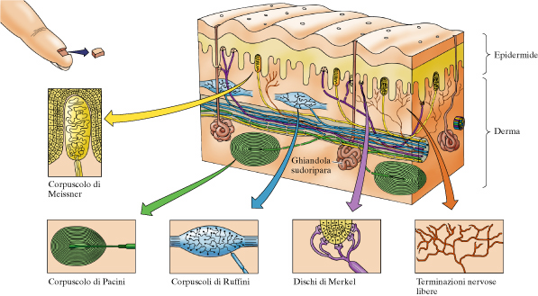
NOCICEPTION
Perception of pain (nociception) does not depend on the excessive stimulation of receptors of the other sensory modalities, but on specific receptors and pathways.
Da: Purves et al NEUROSCIENZE Zanichelli

Slide 8
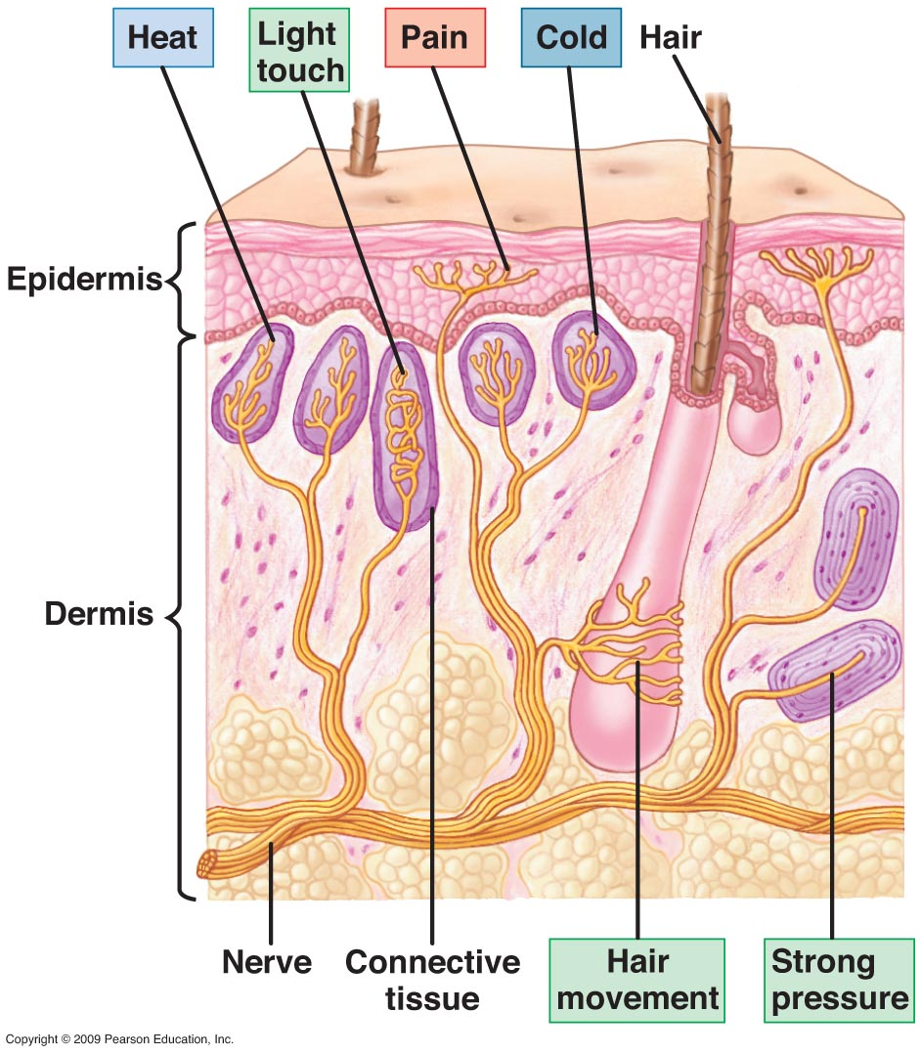

Slide 9
CLASSIFICATION OF NERVE FIBERS
Mixed nerve | Function | Diameter (μm) | Velocity of conduction (m/sec) | Dorsal root
A-alfa | Proprioception: spindles (muscle contraction) and Golgi tendon organs (muscle tension) Motors for scheletal muscles | 12-20 | 70-120 | IA, IB
A-beta | Touch, pressure, vibration | 6-12 | 40-70 | II
A-gamma | Motors for spindles | 3-6
A-delta | Pain (mecanic and termic stimuli) | 2-3 | 12-36 | III
B | Preganglionic (Autonomic Nervosus System) | <3 | 2-12 | III
C | Pain (polimodal/chemoceptive), postganglionic of theAutonomic Nervous System | 0,3-1,3 | 0,5-2 | IV
Notes:
9

Slide 10
PRIMARY PAIN (fast, acute): fibres Aδ fibres, about 20 m/s.
Mechanical- and meccano-thermal receptors
SECONDARY PAIN (slow, dense or burning): C fibers, about 2 m/s.Polymodal receptors (mechanical, thermal and chemical)
Da: Purves et al NEUROSCIENZE Zanichelli

Slide 11
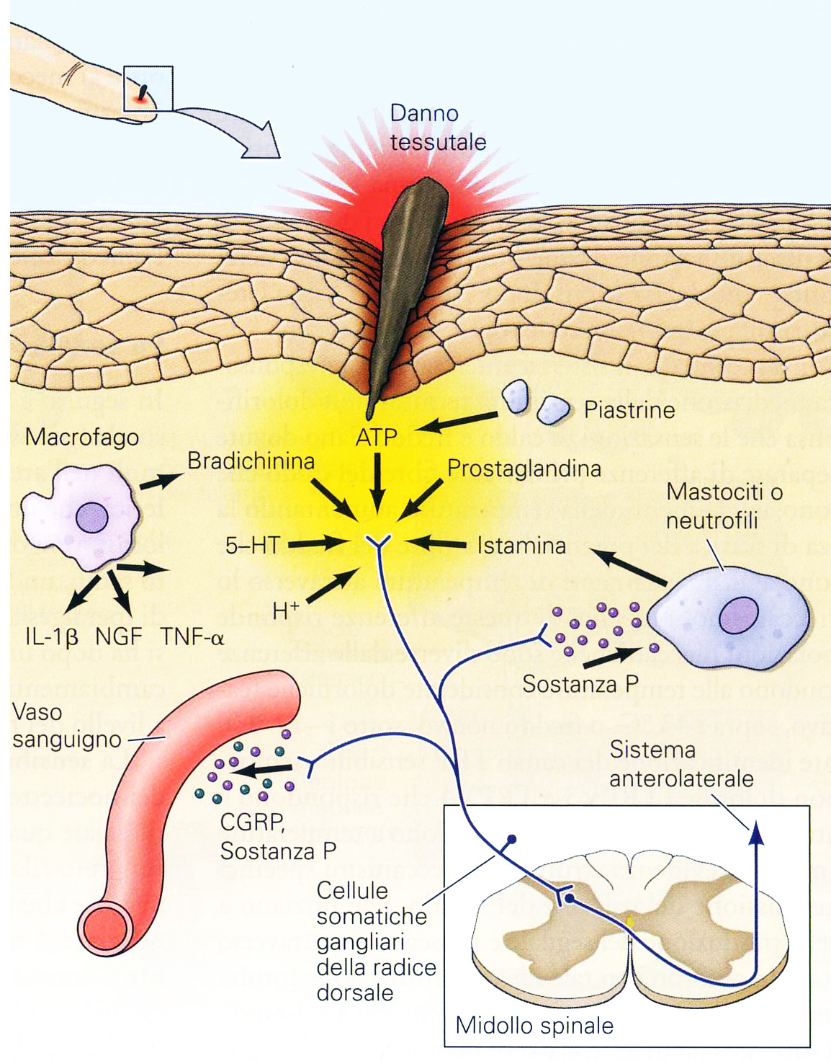
BASIC MECHANISMS, HYPERALGESIA AND ALLODINIA
HYPERALGESIA: increased sensitivity to feeling a painful stimulus
ALLODINIA: pain caused by a stimulus that normally is not able to cause a painful sensation
Substance P: edema
CGRP (Calcitonin Gene Related Peptide): vasodilatation and edema
K⁺
ciclossigenasys
Aspirin
inhibits
Substance
Potassium
Prostaglandins
Leukotrienes
Serotonin
Bradykinin
Histamine
Substance P
Source
Damaged cells
Damaged cells
Damaged cells
Platelets
Plasma
Mastcells
Afferent fibers
Modified from Purves et al., Neuroscienze

Slide 12
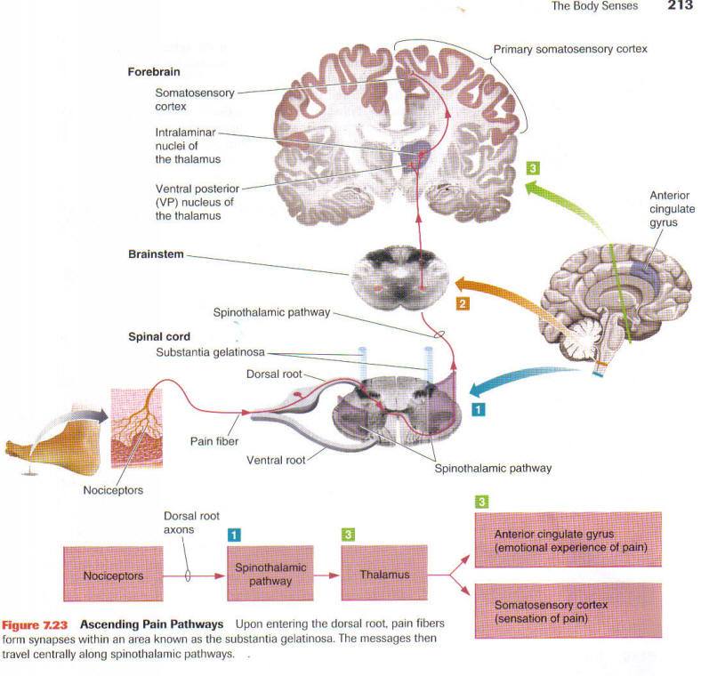
MAIN PATHWAYS OF PAIN SENSITIVITY

Slide 13
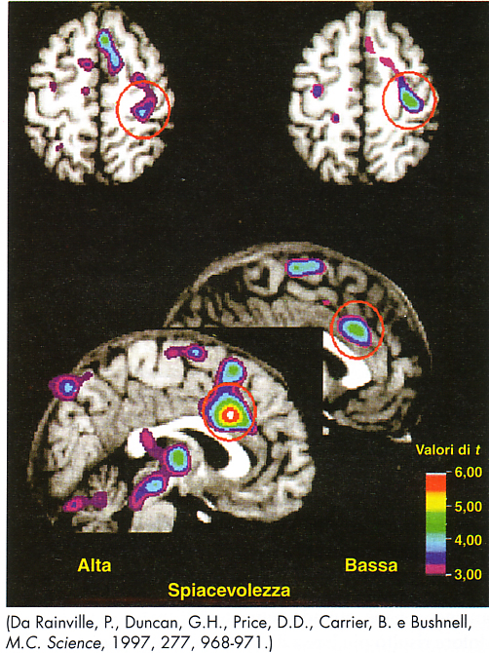
CORTICAL LOCALIZATION OF PAIN
Control
Hypnotic analgesia
Primary somatosensory cortex.
Not influenced by hypnotic analgesia: sensory components of pain stimulation
Anterior cingulate cortex.
Reduced activation with hypnotic analgesia: emotional components of pain stimulation

Slide 14
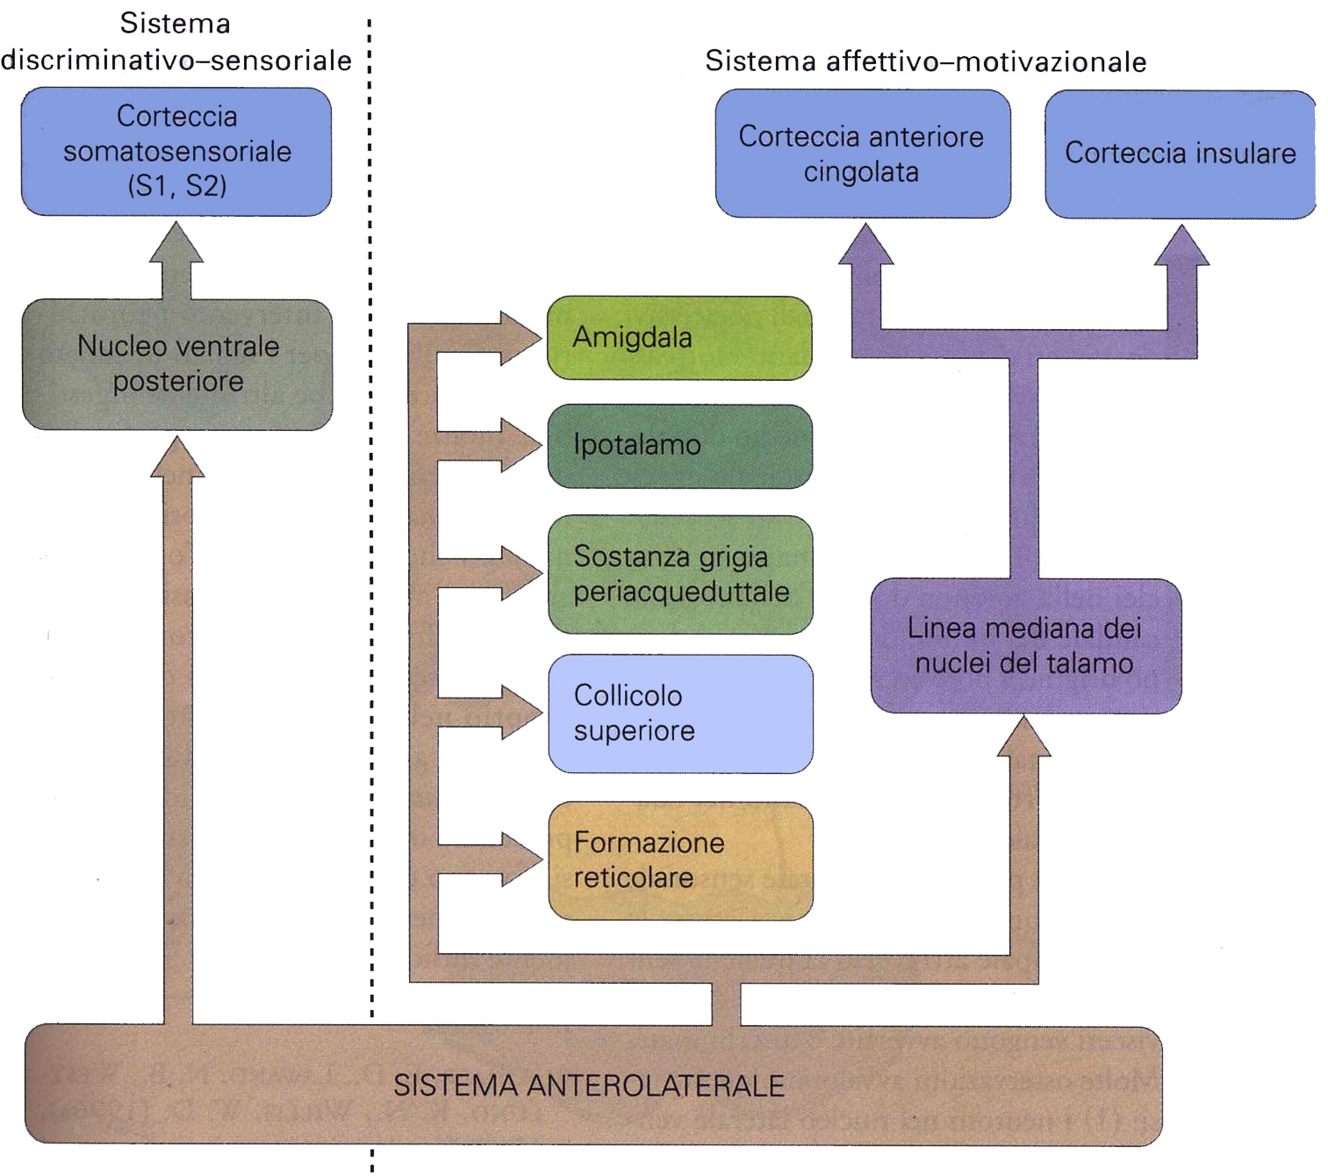
DIFFERENT ASPECTS OF PAIN PERCEPTION
LONG TERM EMOTIONAL CONSEQUENCES
PROMPT EMOTIONAL CONSEQUENCES
NOCICEPTION
Corteccia prefrontale
LIMBIC SYSTEM
The anterolateral system (spino-thalamic) provides nociceptive information to different parts of the brain, midbrain and diencephalon, which contribute to the different aspects of pain perception: those responsible for sensory discrimination (nociception) and those responsible for affective and motivational responses (limbic system)
Modified from Purves et al., Neuroscienze

Slide 15
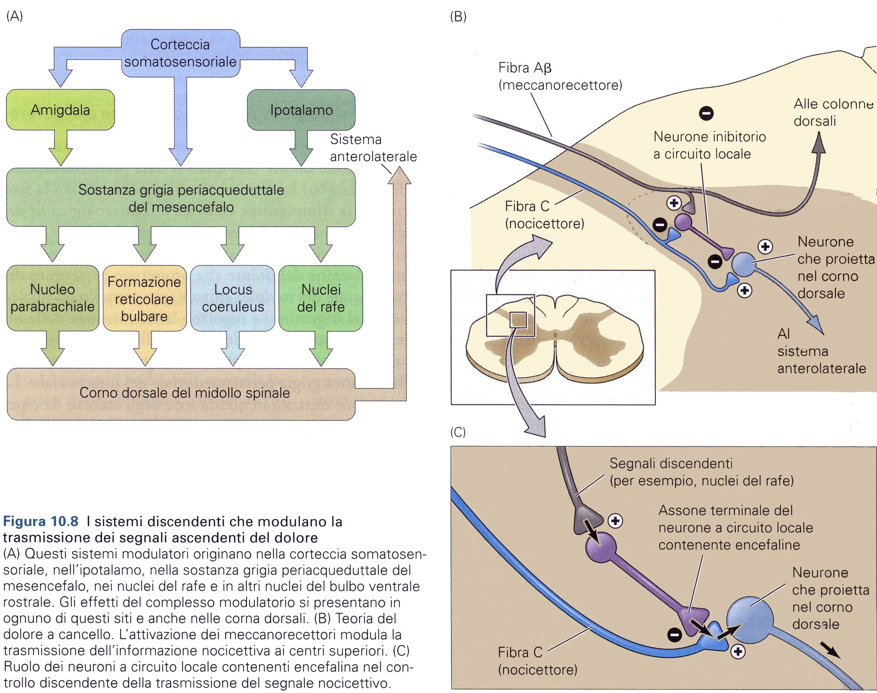
CENTRAL CONTROL OF PAIN PERCEPTION: NERVOUS (GATE CONTROL)
Modified from Purves et al., Neuroscienze

Slide 16
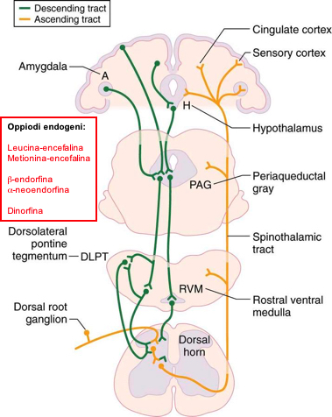
CENTRAL CONTROL OF PAIN PERCEPTION: HUMORAL
Modified from Purves et al., Neuroscienze

Slide 17
CENTRAL CONTROL OF PAIN
- periacqueductal gray
- rostral region of medulla oblongata
POMC
Endogenous opioids:
Leucine-enkephalin
Methionine-enkephalin
endorfine
endorfine-dynorphin

Slide 18
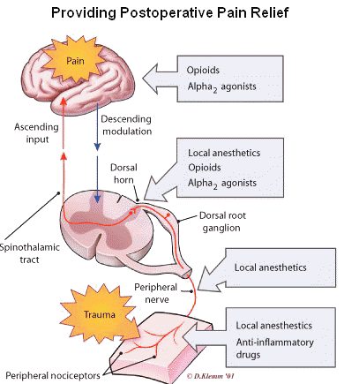

Slide 19
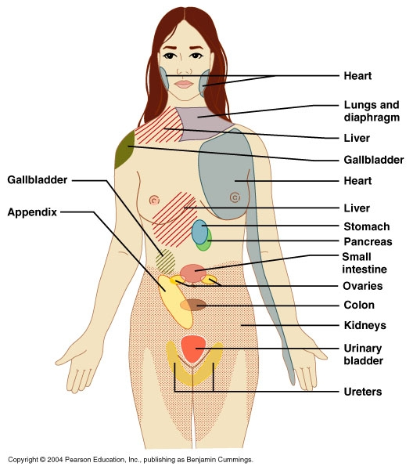
REFERRED PAIN

Slide 20
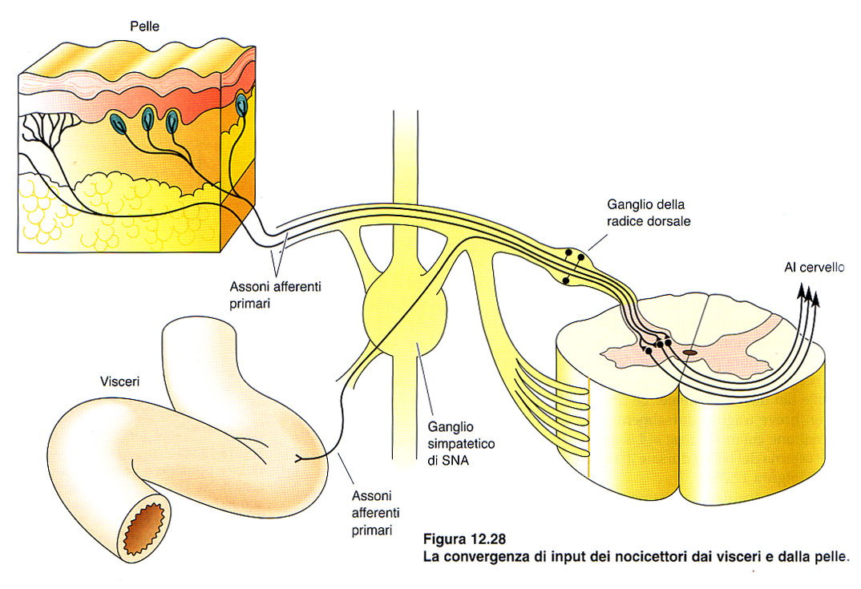
REFERRED PAIN

