Slide 1
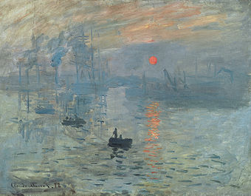
The precursors in the arts: French Impressionism

Slide 2
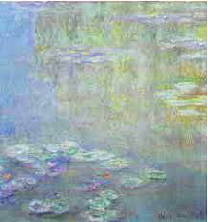
The precursors in the arts: French Impressionism (Monet)

Slide 3
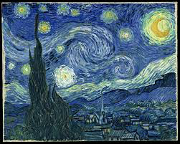
The precursors in the arts: French Impressionism (Van Gogh, Starry Night 1889)

Slide 4
Impression(ism) and subjectivity
He was silent for a while. Marlow was silent for a while.“... No, it is impossible; it is impossible to convey the life-sensation of any given epoch of one’s existence—that which makes its truth, its meaning—its subtle and penetrating essence. It is impossible. We live, as we dream—alone....” “No, it’s impossible. It’s impossible to tell anyone what it feels like to be you. It’s impossible. We live the same way that we dream—alone.”
Joseph Conrad, Heart of Darkness

Slide 5
Modernism: some defining features:
-focus on the city
- celebration and fear of technology
-technical experimentalism with radical stylistic innovation; - language as no longer a transparent medium to “represent” the world
- a distrust of empiricism and rationalism (pillars of the 18th and 19th century)
- focus on social, spiritual, personal collapse
-history evoked and represented through symbolism and mythology.

Slide 6
Modernism: some defining features:
* ANTI-HISTORICISM
*PRIMACY OF THE INDIVIDUAL OVER THE SOCIAL
*SELF-REFERENTIALITY
*ART AS SELF CONTAINED rather than REPRESENTATONAL, REFERENTIAL
*DISCORDANCE /DISCONTINUITY FRAGMENTATION VS VICTORIAN HARMONY AND ORDER
*AESTHETICS Vs MORALITY (already initiated by Pater and Aestheticism)
* Cultural ELITISM (Eliot, Joyce)
*SEXUAL HETERODOXY which questions the nuclear family
*ANDROGINY VS GENDER NORMATIVITY
*FLUIDITY AND INDETERMINACY (IN COMMON WITH écriture féminine) AND A MASCULINE MYSTIQUE

Slide 7
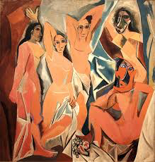
Reality as no longer whole: anti-representationalism➔ CUBISM
1907 PICASSO LES DEMOISELLES D’AVIGNON

Slide 8
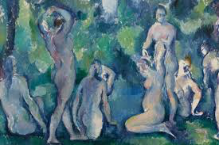
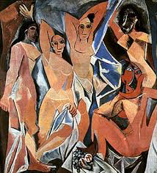
CE’ZANNE 1895/PICASSO 1907

Slide 9
Modernism and anti-representationalism
19th century literature’s dominant modes had been
a poetics of mimesis, verisimilitude and realism
modernism mostly rejected them and favoured:
increased sophistication, mannerism,
profound introversion, technical display,
scepticism
anti- representationalism
cultural allusiveness

Slide 10
Modernism and anti-representationalism
rejection of several of the fundamentals of classic realism:
the reliable narrator
the representation of a fixed, stable self
history as a progressive, linear process
bourgeois politics
‘closure’, the tying up of all narrative strands.
a new perception of the function of art as not aimed to “mirror” reality
art as the negative knowledge of the actual world - art itself as fundamentally modernist in its essence it must be distant from reality it is distance which gives its special power!

Slide 11
Modernism as a literature of crisis
THE STARTING POINT AS THE CRISIS OF BELIEF
THAT PERVADES 20TH C WESTERN CULTURE
after Bergson, Nietzsche, Freud: with the advent of psychoanalysis
the teleological search for God had been replaced by
the epistemological search for (self)knowledge
“After such knowledge, what forgiveness?” (T.S.ELIOT, “Gerontion”)

Slide 12
Modernism as a literature of crisis
ORDER/CHAOS: Henry JAMES, Joseph CONRAD, E.M. FORSTER
ALL SHARE THE IDEAL
OF FASHIONING CHAOS INTO AN ORDER OF SOME KIND
modernism's deep awareness of A CRISIS IN COMMUNICATION
evident in both poetry and fiction
see Eliot's poetry, the role of the narrator Conrad - Woolf - F.M.Ford -Forster
the frustration of interpretation and the UNRELIABILITY OF THE TEXT!

Slide 13
modernity can be both celebratory and apocalyptic
modernism has thus been seen as
an aesthetic and cultural reaction against late modernity and modernisation which displays several contradictions:
creativity and despair
a radical aesthetics
technical experimentation
Spatiality and rhythm
rather than chronological sequentiality
scepticism towards the idea of a central human subject
inquiry into the uncertainty of reality

Slide 14
Modernism and the crisis of communication
THE CRISIS OF THE SELF IN MODERNIST WRITING IS ALSO A CRISIS OF DISCOURSE
the frustration of interpretation and the UNRELIABILITY OF THE TEXT!
antecedents:
Laurence Sterne (Tristram Shandy)
the Romance (Wuthering Heights)
Conrad: It is impossible, it is impossible...
Eliot I can connect nothing with nothing
as in Henry James, the individual conscience
becomes the filtering medium and object of narration

Slide 15
HOD a

