Slide 1
MOLECULAR DIAGNOSIS IN MEDICINE
Sergio Crovella PhD
Department of Genetics
Federal University of Pernambuco, Recife (Brazil)
crovelser@gmail.com

Slide 2
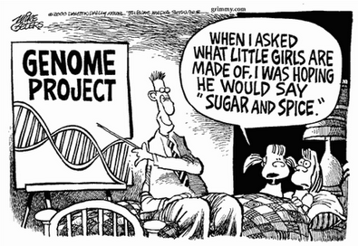
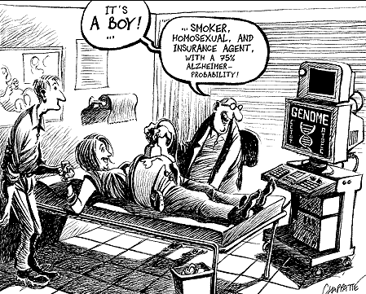
Many tools for Molecular Diagnosis
How many? How can I use them? When should I use a specific test? Which are the costs/benefits? Appropriate criteria of choice

Slide 3
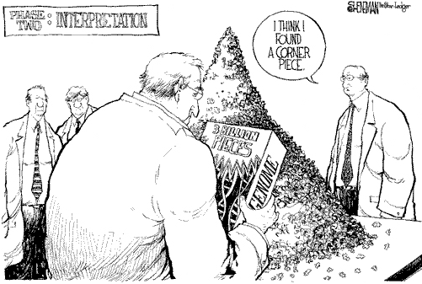
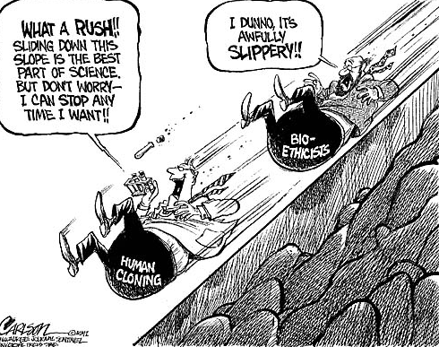
We are now in the OMICs ERA

Slide 4
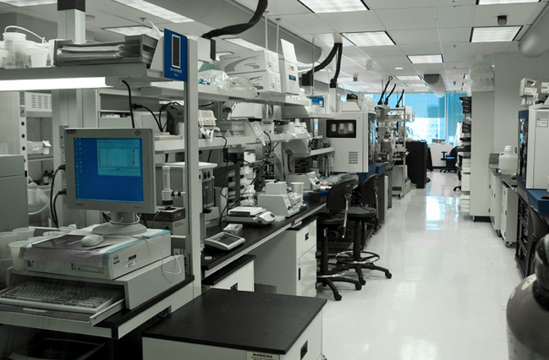
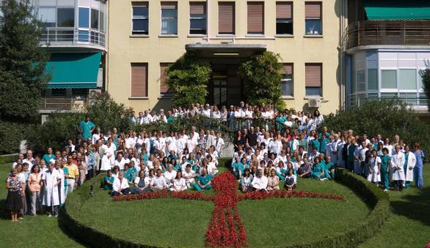
A private-public diagnostic experience
From the Human Genome Assembly to a regional diagnostic center: different objectives different tools

Slide 5
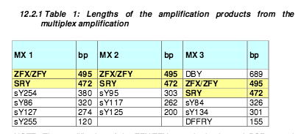
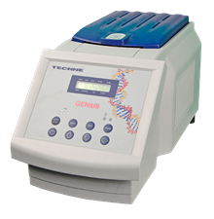
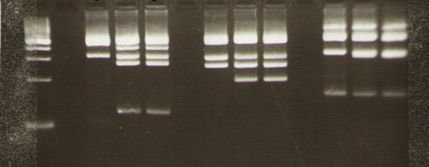
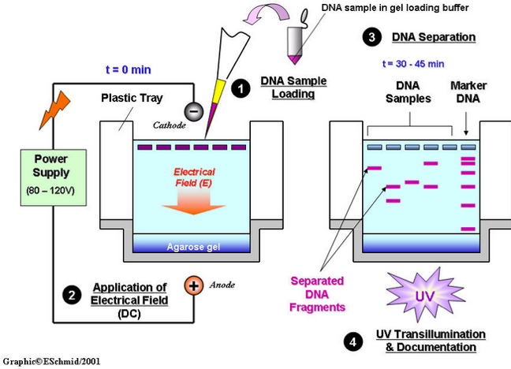
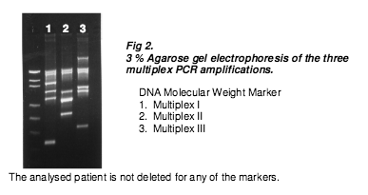
Molecular Diagnosis of Mendelian Hereditary Diseases
Multiplex PCR based diagnosis
Micro-deletions of Y chromosome (SRY) related to male infertility

Slide 6
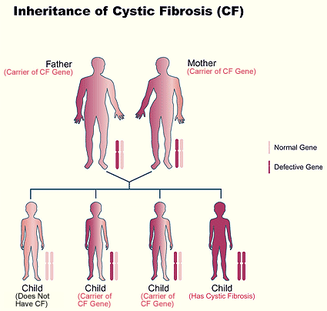
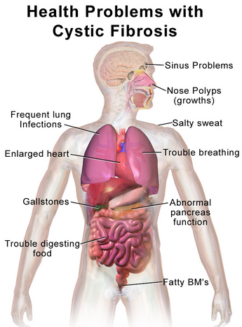
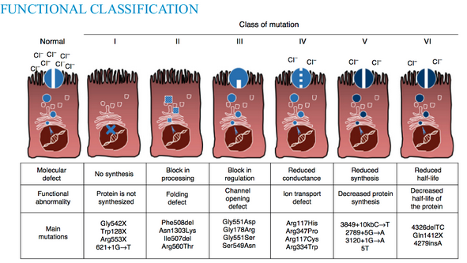
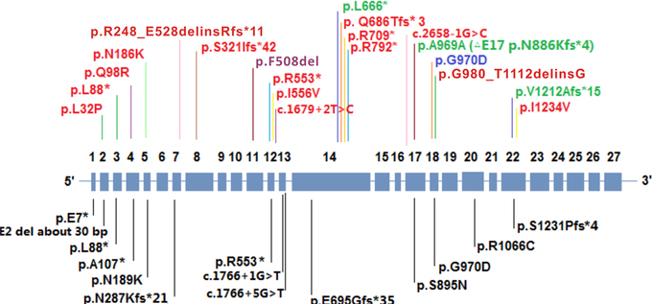
CYSTIC FIBROSIS DIAGNOSIS

Slide 7
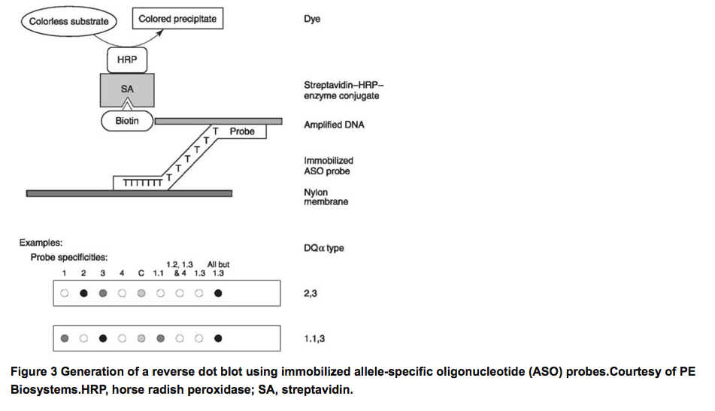
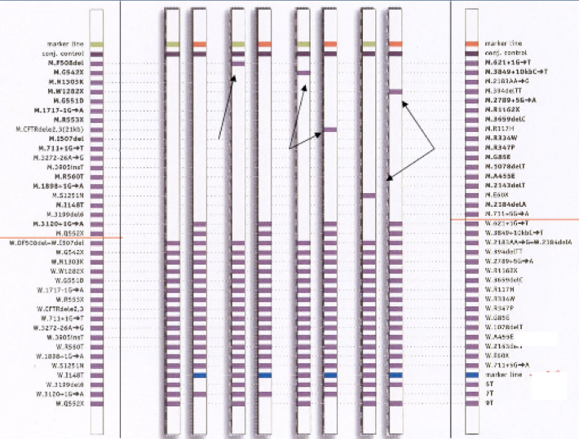
Reverse Dot Blot
Mutated
probes
Normal
probes

Slide 8
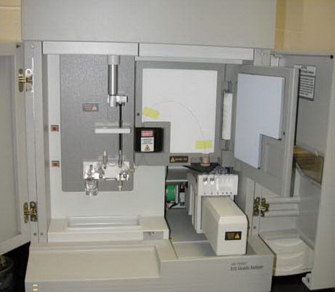
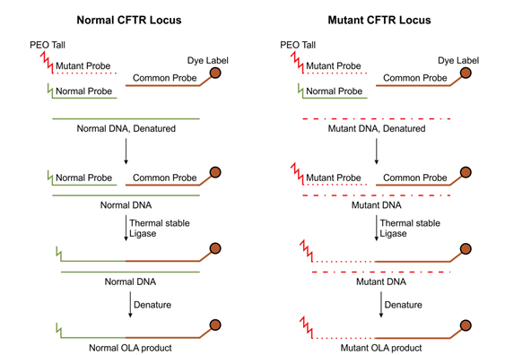
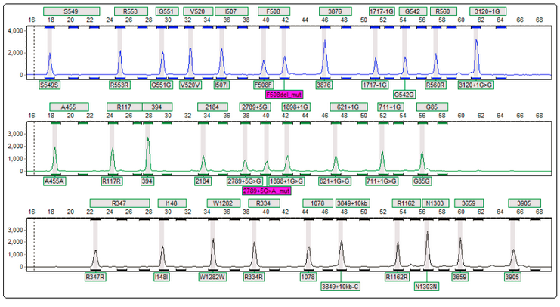
Oligonucleotide Ligation Assay (OLA) for CFTR Mutations

Slide 9
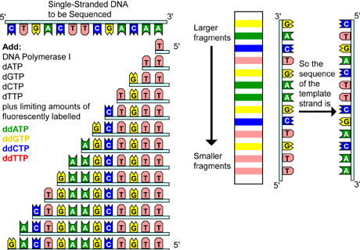
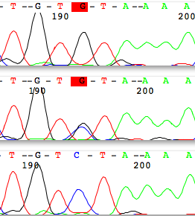
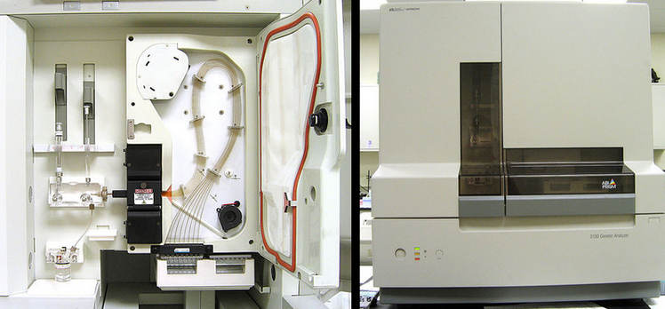
Direct Sequencing
N

Slide 10
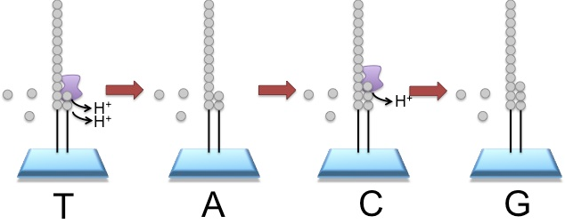
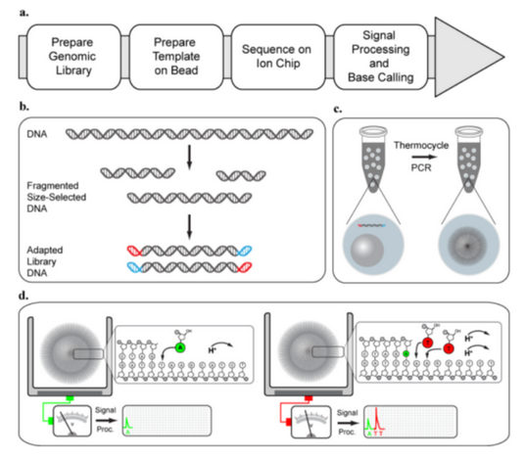
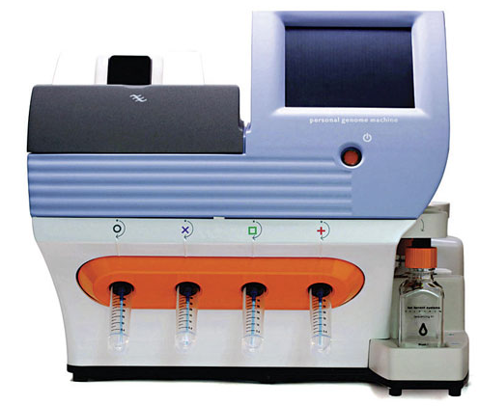
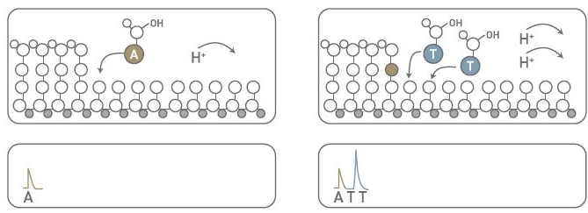
Ion Torrent Technology

Slide 12
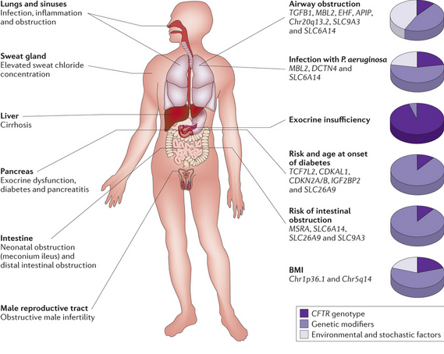
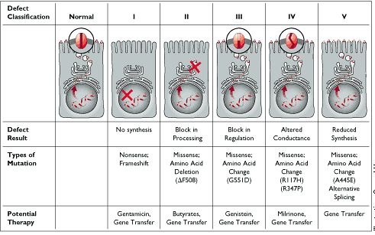
CYSTIC FIBROSIS MODIFIER GENES

Slide 13
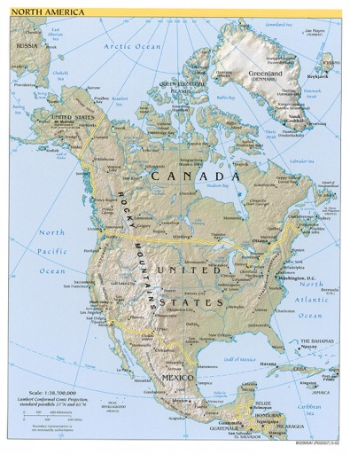
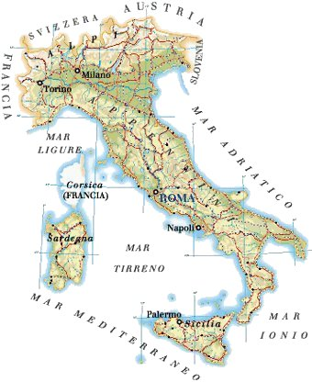
The aim of our study was to identify modifier genes of CF lung phenotype using two different molecular approaches:
1) investigation of the role of innate immune response genes analyzing a series of very well clinically characterized DF508 homozygous CF patients coming from USA (CF North America Consortium on modifier genes)
2) identification of new genes using a group of Italian DF508 homozygous CF patients, which are characterized by a more homogeneous genetic background as compared to the above mentioned series of American patients.

Slide 14
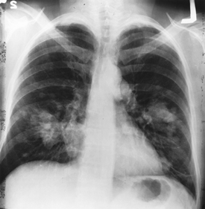
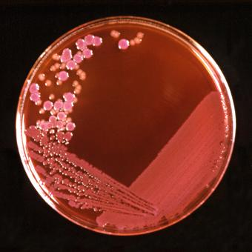
Patients
Patients have been selected according to the following criteria:
1) diagnosis after neonatal screening and followed since birth in the center or diagnosis after symptoms
2) complete clinical history available in the computerized database
3) at least two visits yearly since diagnosis
4) availability of at least two yearly throat swabs and/or sputum cultures for microbiological ascertainment
5) at least one chest X ray/year
6) at least one respiratory function test/year after the age of 10 years including FEV₁. Based on the CF databases, reporting the clinical history and including FEV₁ (% predicted) at different ages, the severity of lung disease will be assessed by following exactly the criteria utilized by Drumm (New Engl J Med 2005; 353: 1443-53)

Slide 15
Illumina Golden Gate Assay
Allele specific primer extension and ligation reaction – Not hybridization
SNP interrogation occurs before amplification using genomic DNA as template
Highly multiplexed genotyping of many loci simultaneously using universal PCR primers
Robust assay, tolerant of poor template quality

Slide 16
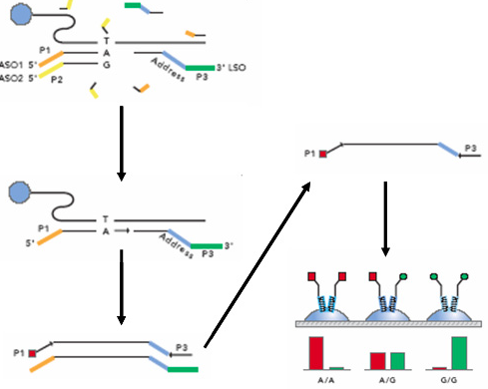
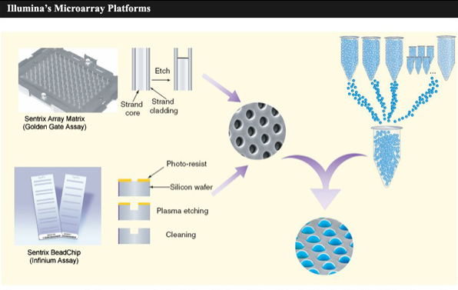
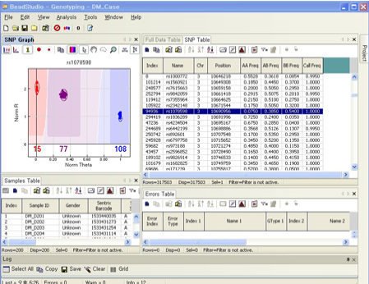
768 SNPs from 149 genes of innate immunity have been analyzed by using the Illumina Golden-Gate Genotyping protocol
SNPs selection:
non-synonymous coding SNPs
Tag SNPs, which represent a subset of SNPs capturing most of the haplotype diversity of each haplotype block or gene-specific region

Slide 17
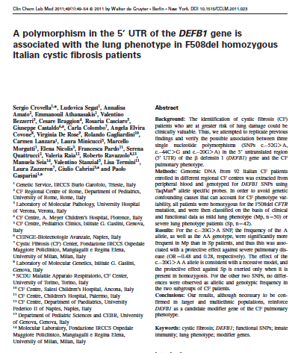
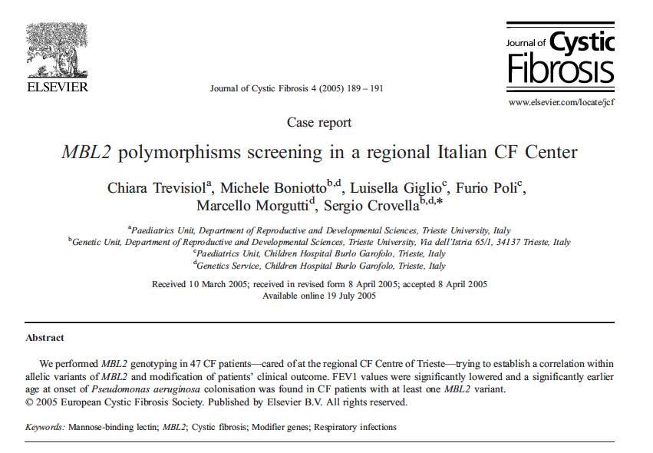
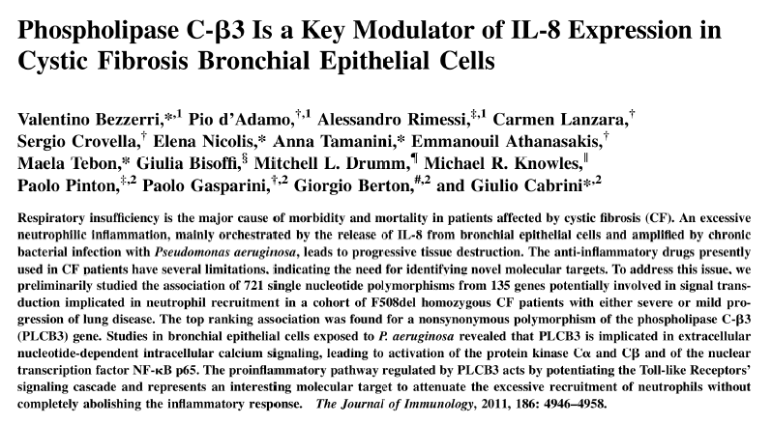

Slide 18
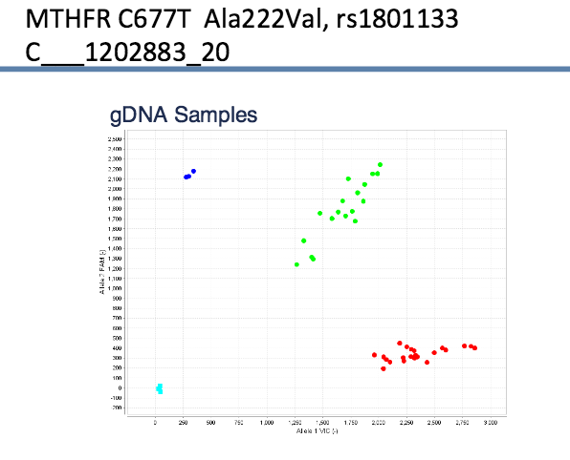
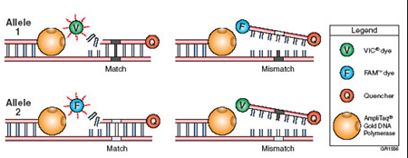
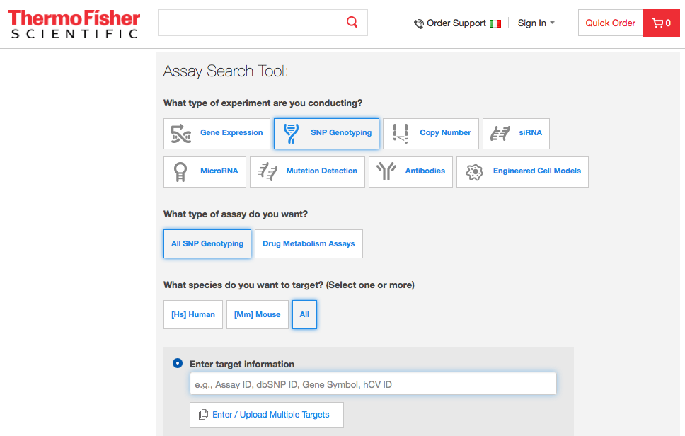
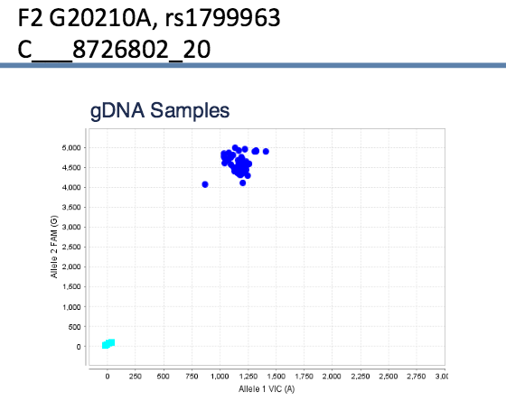
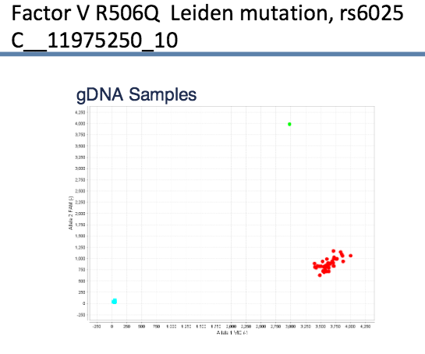
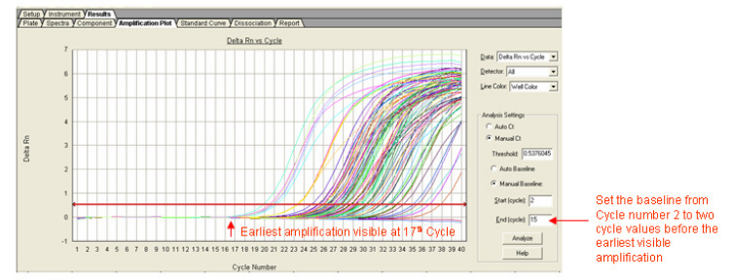
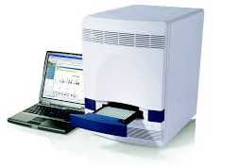
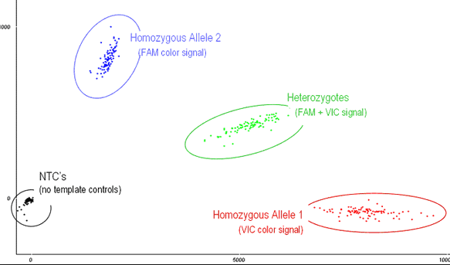
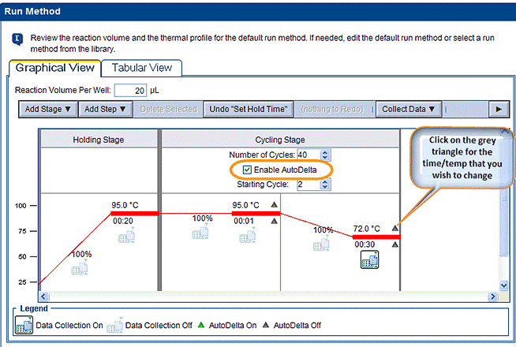
Single base Mutation Detection: Coagulation Factors

Slide 19
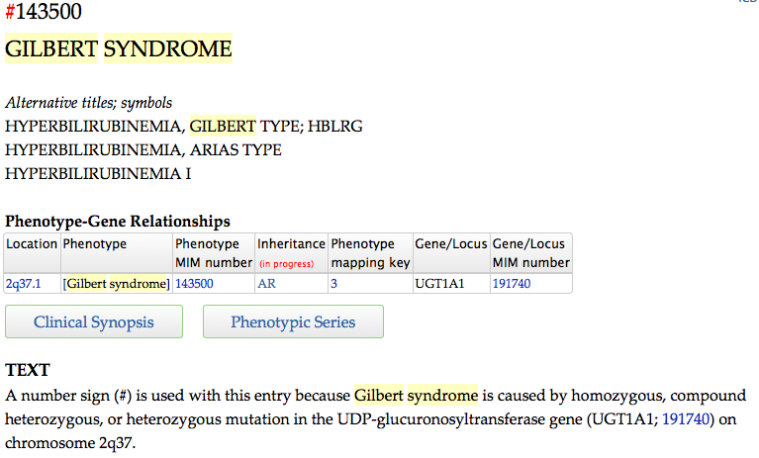
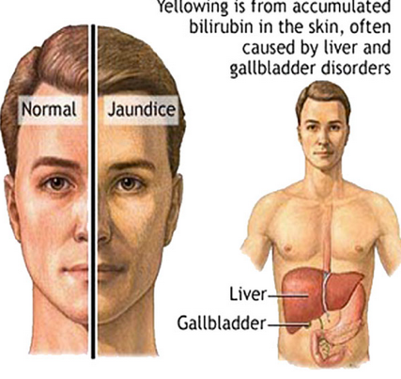
Molecular Diagnosis of Gilbert Syndrome

Slide 20
DHPLC: Denaturing high performance liquid chromatography

Slide 21
Molecular Diagnosis of Primary Hyperoxaluria Type 1

Slide 22
Melting Teperature Assay (MTA)

Slide 23
MBL2 genotyping
MBL is a mannose binding protein that plays a pivotal role in innate immunity acting as a opsonine or activating the complement systems.
Characterized by multiple carbohydrate-recognition domains, MBL binds to sugar groups displayed on the surfaces of a wide range of microorganisms providing first-line defence.
MBL also activates the complement system through a distinctive third pathway, independent of both antibody and the C1 complex.

Slide 24
MBL deficiency, largely explained by three single point mutations in codons 52, 54 and 57 (mutated allele 0 vs. wild tipe A allele) of exon 1 in the MBL2 gene can greatly impair the activity of innate immunity.
Also three polymorphisms in the promoter region of MBL2 are responsible for reduced expression of the MBL protein: the P/Q, H/L and X/Y allele (at positions +4, −550, −221 respectively).

Slide 25
MBL2 POLYMORPHSMS AND ETHNICITY
MBL2 haplotype frequencies have been shown to differ in various populations. Variant A (wild type) is found in association with four different promoter haplotypes, HYPA, LYQA, LYPA and LXPA.
The B, C and D variant exon 1 alleles are in linkage disequilibrium with three different promoter haplotypes, LYPB, LYQC and HYPD.

Slide 26
MBL2 MTA

Slide 27
Many studies published with relative low reagents costs

Slide 28
HLA-Class II TYPING

Slide 29
HLA and celiac disease risk

Slide 30
Molecular HLA typing. When?
40% of the general population with DQ2 or DQ8
Suggested as exclusion tool in the follow up of celiac patients relatives

Slide 32
Type 1 Diabetes Genetic Susceptibility
DR4
DQ8
DQ7

Slide 33
In situ PCR for rare targets detection

Slide 35
Genomic Evolution

Slide 36
Databases mining

