Slide 1


FORENSIC SCIENCE: ALTERNATIVE APPLICATIONS
SERGIO CROVELLA
DEPARTMENT OF GENETICS
FEDERAL UNIVERSITY OF PERNAMBUCO
RECIFE (BRAZILE)
crovelser@gmail.com

Slide 2
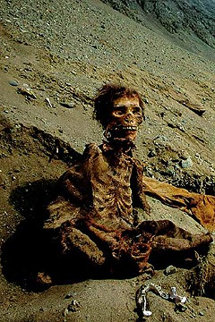
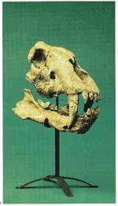
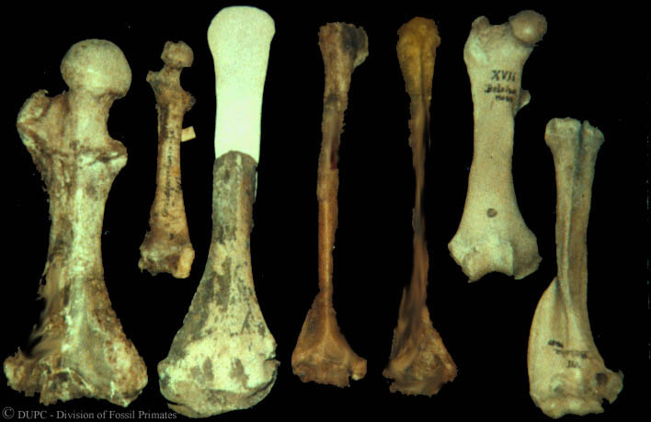
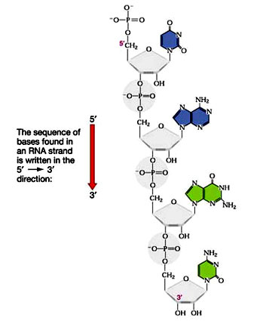
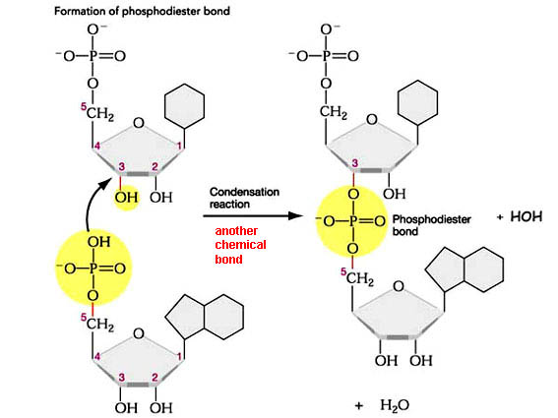
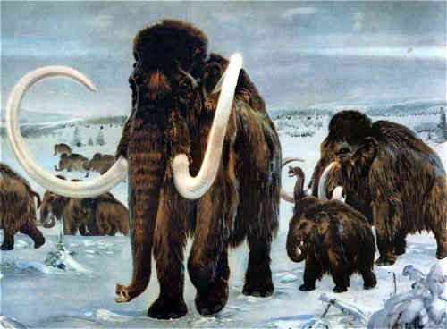
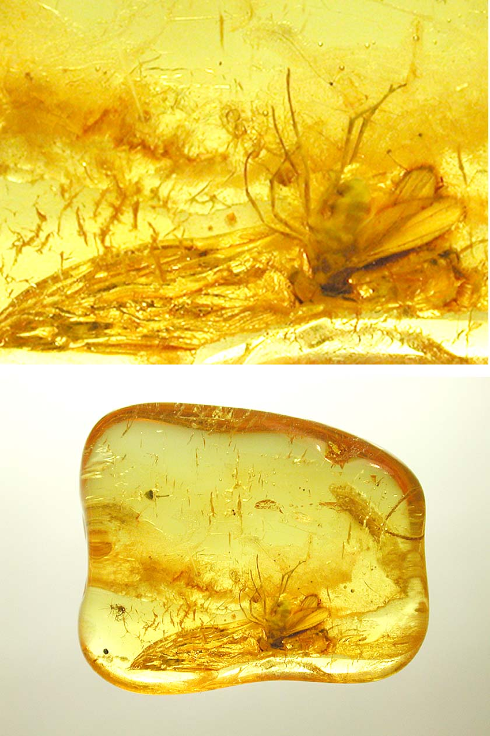
HOW ROBUST IS DNA?

Slide 3
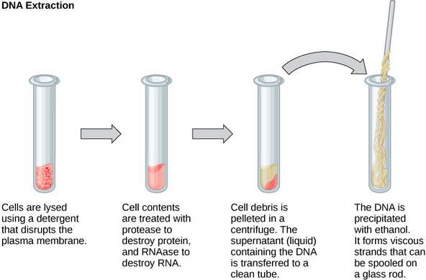
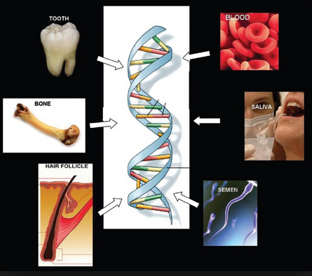
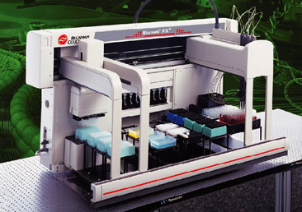
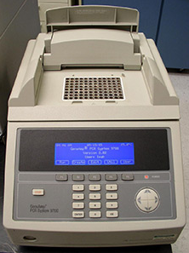
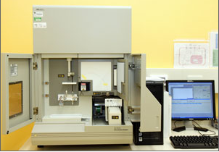
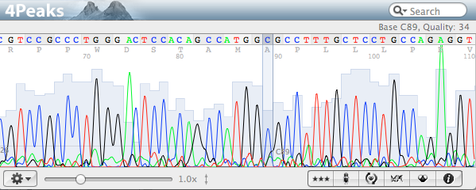
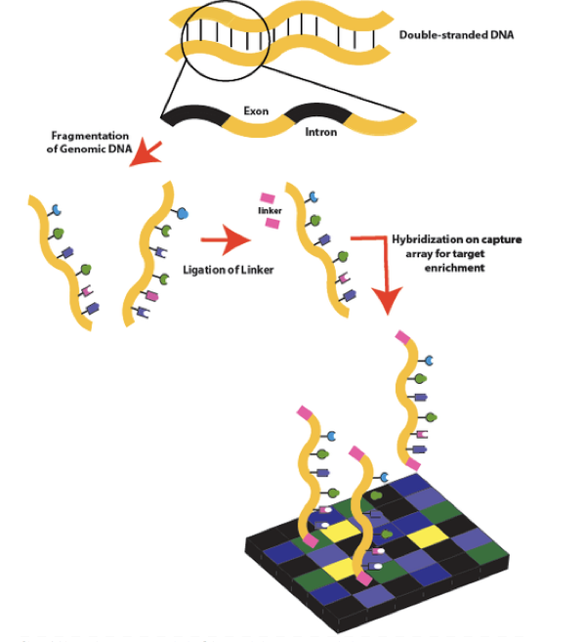
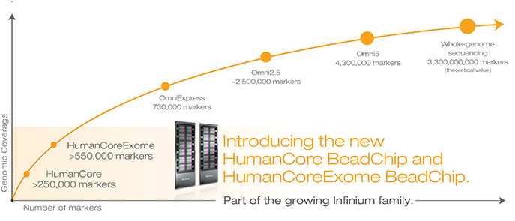
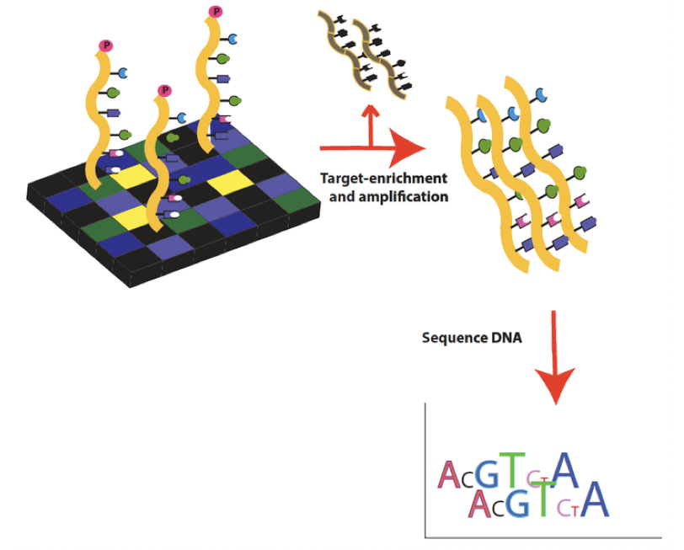
THE PRESENT: HUMAN DISEASES GENETIC TESTING

Slide 4
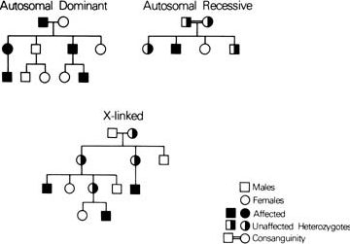
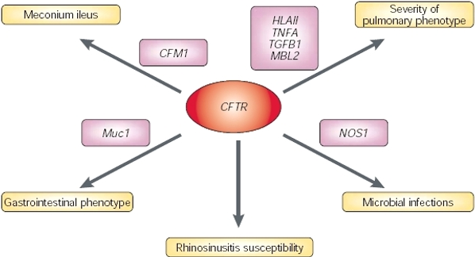

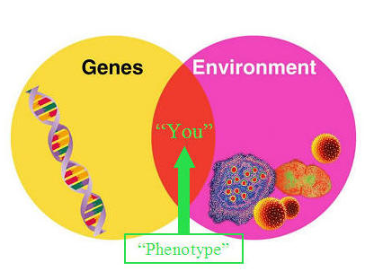

Slide 5
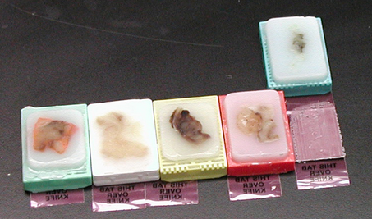


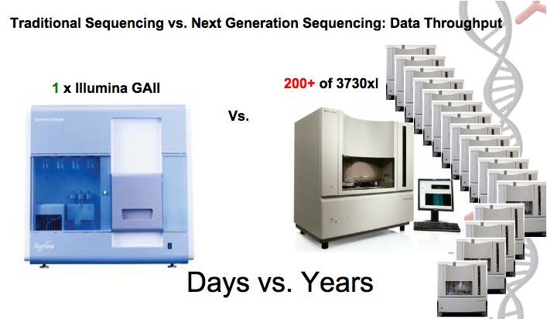
DNA EXTRACTION FROM OLD PARAFFIN EMBEDDED LUNG TISSUES

Slide 6
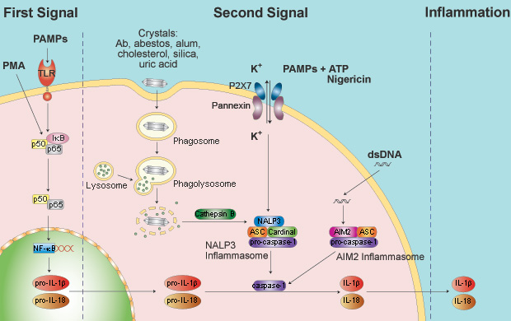
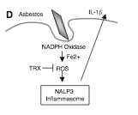
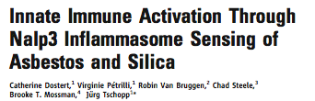
Inflammasome and Asbestsos: NALP3 SENSING ASBESTOS

Slide 7

134 Italian patients with diagnosis of mesothelioma due (MMAE, n=69) or not (MMAF, n=65) to asbestos, 256 healthy Italian blood donors and 101 Italian healthy subjects exposed to asbestos (HCAE) were genotyped for NLRP1(rs2670660 and rs12150220) and NLRP3 (rs35829419 and rs10754558) polymorphisms.
While NLRP3 SNPs were not associated to mesothelioma, the NLRP1 rs12150220 allele T was significantly more frequent in MMAE (0.55) than in HCAE (0.41) (p=0.011; OR=1.79) suggesting a predisponent effect of this allele on the development of mesothelioma, independently from asbestos exposure. This effect was amplified when the NLRP1 rs2670660 allele is combined with the NLRP1 rs12150220 allele (p=0.004; OR=0.52).

Slide 8
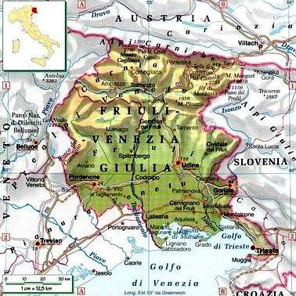
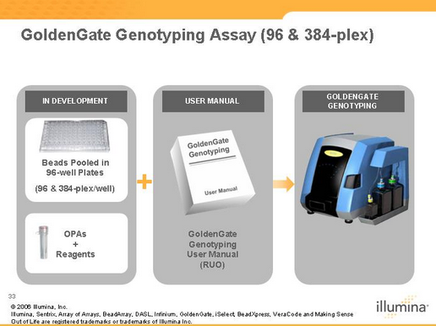
IRON METABOLISIM GENES AND MESOTHELIOMA
DCYTB (enterocyte membrane ferro-reductase)
DMT1 (enterocyte divalent metal transporter;)
SCARA5 (recettore della ferritina, many cells) rs: 61737287; 61737291; 17058207; 61737296; 61737292; 17058374
Ferroportina (Channel Fe3+Esporta ferro dalle cellule)
Hepcidin (HAMP) (peptide hormone, ferroportin-inhibitor which binds and targets it to lysosomes)
HFE (favours plasma absorption of iron since inhibits Hepcidin synthesis))
Ceruloplasmina (plasma ferro-oxidase) oxidizes Fe+3
Hephaestin (membrane bound ferro-oxidase) oxidizes Fe+3
Transferrin (binds Fe+3)
Transferrin receptor (endocytoses transferrin-Fe+3) rs: 41298067; 41295879; 9852079; 57726969; 41295849; 34490397; 41303529; 41301381; 3817672;
Ferritin light chain (FTL) rs: 11553205; 1153266; 11553243; 11553206;11553240; 11553262; 11553260; 11553225; 17851905; 17851422; 11553219; 11553209;11553236; 1803580; 1803578.
Ferritin heavy chain (FTH) (stores Fe+3) rs: 1064740; 11554842; 1049351; 1049336; 11554886;11554858.

Slide 9
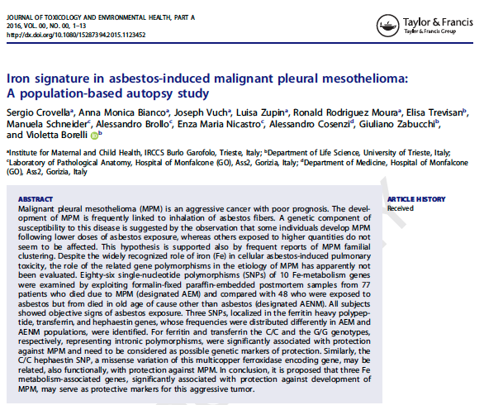

Slide 10
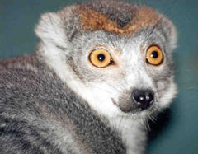
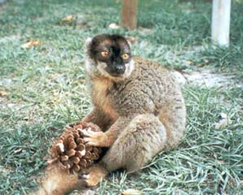
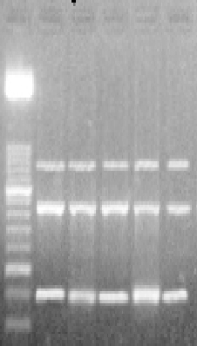
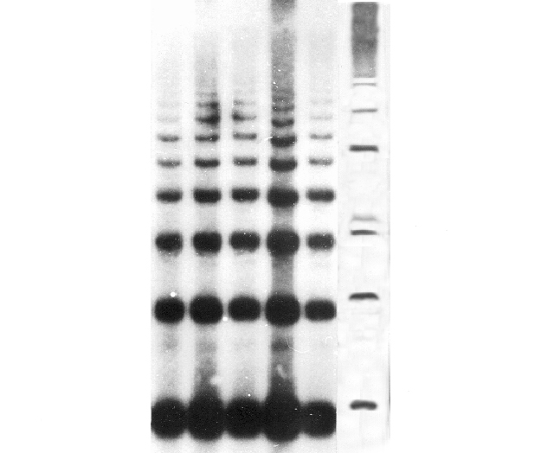
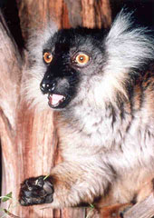
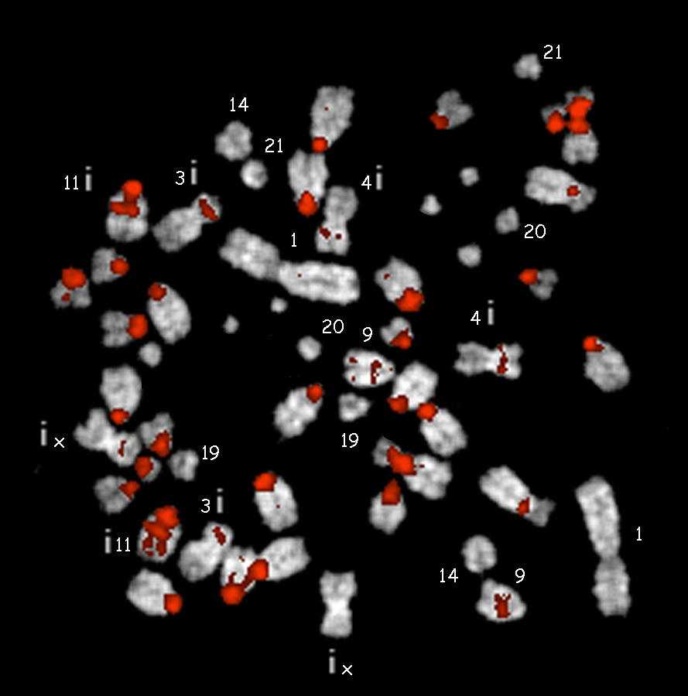
THE PAST…PHD PROGRAM IN MOLECULAR ANTHROPOLOGY STRASBOURG FRANCE

Slide 11
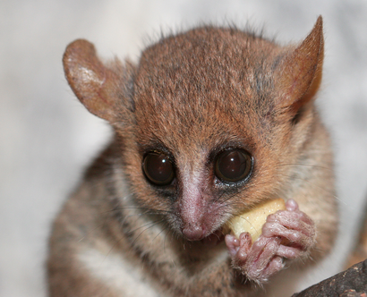
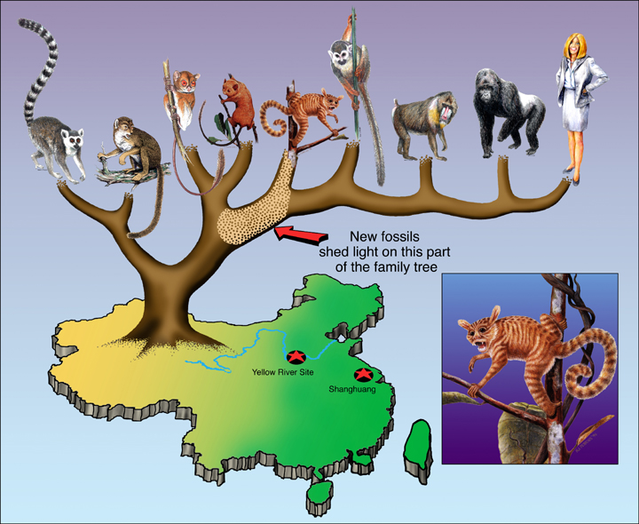
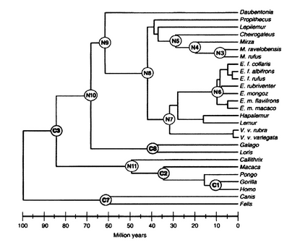
MOLECULAR EVOLUTION AND PHYLOGENESIS OF MALAGASY LEMURS

Slide 12
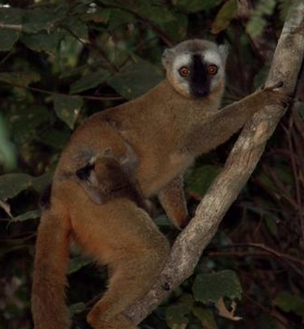
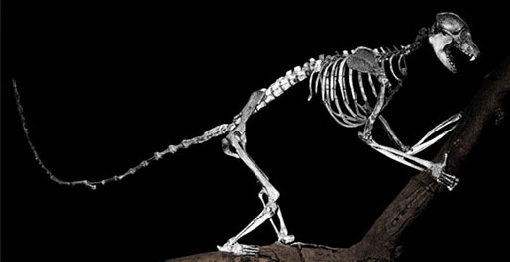
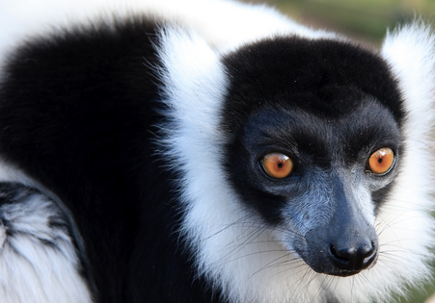
CLASSIFICATION OF PACHYLEMUR INSIGNIS AN EXTINT SUBFOSSIL LEMUR
ANCIENT DNA
LOOKING FOR A
SOLUTION
?

Slide 13
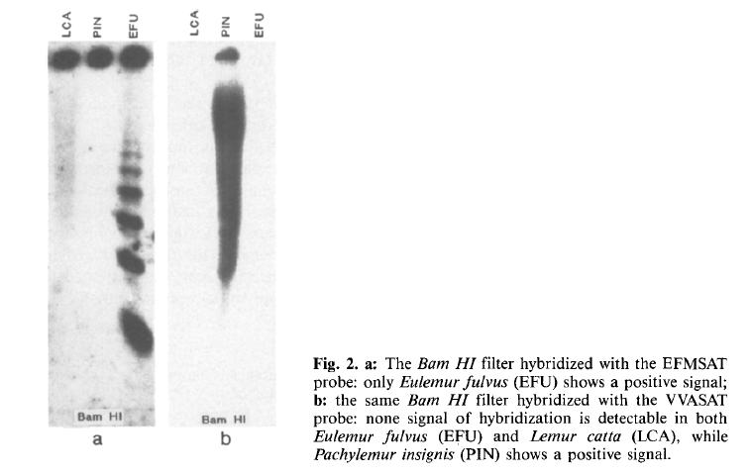
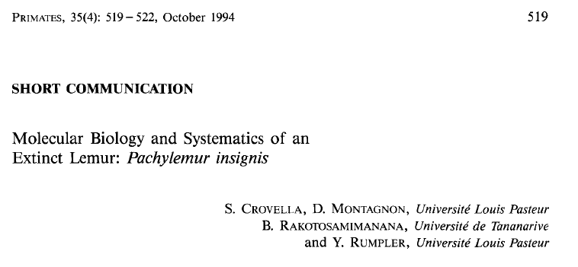
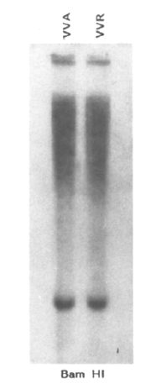
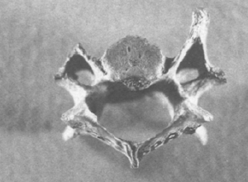


Slide 14
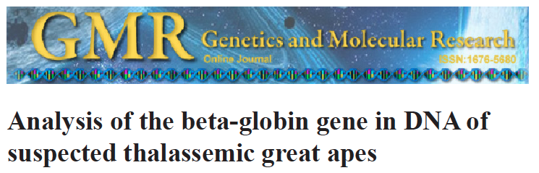
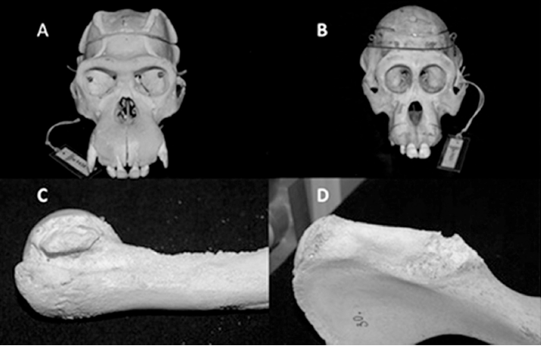

Slide 15
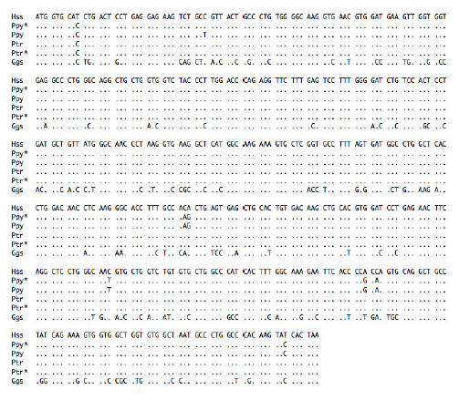
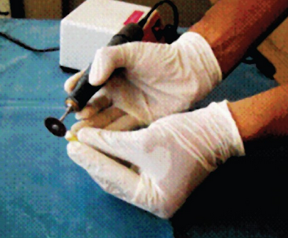
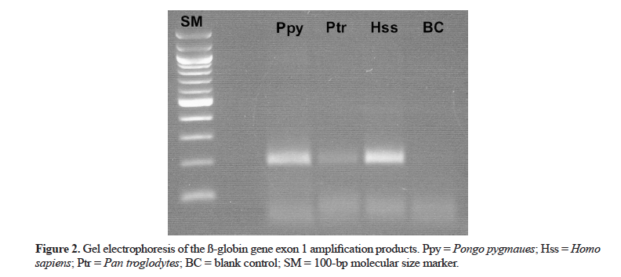
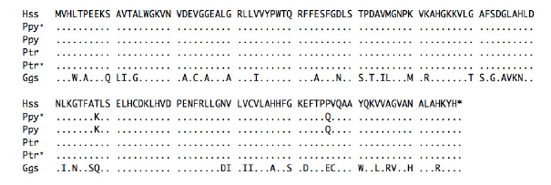
DNA EXTRACTION FROM TOOTH LESS DESTRUCTIVE TECHNIQUE
NO BETA THALASSEMIA MUTATION FOUND

Slide 16

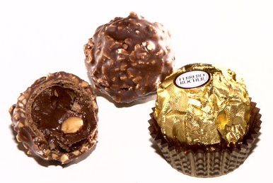

NUTELLA’S STORY RAPD-PCR AND IDENTIFICATION OF NUTS PROFILES
SAME NUTS?

Slide 17

RAPD-PCR Random Amplified Polymorphic DNA
RAPD markers are decamer (10 nucleotide length) DNA fragments from PCR amplification of random segments of genomic DNA with single primer of arbitrary nucleotide sequence and which are able to differentiate between genetically distinct individuals, although not necessarily in a reproducible way. It is used to analyse the genetic diversity of an individual by using random primers.

Slide 18




NUTS PROFILING: GEOGRAPHIC
ORIGIN IDENTIFICATION

Slide 19

Microchimerism and autoimmune diseases
Microchimerism is the presence of a small number of cells that originate from another individual and are therefore genetically distinct from the cells of the host individual.
This phenomenon may be related to certain types of autoimmune diseases; however, the mechanisms responsible for this relationship are unclear.

Slide 20

Fetal cell microchimerism
In humans (and perhaps in all Placentals) the most common form is fetomaternal microchimerism (also known as fetal cell microchimerism or fetal chimerism) whereby cells from a fetus pass through the placenta and establish cell lineages within the mother.
Fetal cells have been documented to persist and multiply in the mother for several decades.
The exact phenotype of these cells is unknown, although several different cell types have been identified, such as various immune lineages, mesenchymal stem cells, and placental-derived cells

Slide 21




Slide 22



Slide 23



Slide 24




Introduction of Human Forensic Kits in Autoimmune diseases clinical practice

