Slide 1





Host Genome Analysis in HIV positive patients treated with DC immunovaccine
SERGIO CROVELLA PhD
crovelser@gmail.com
Department of Genetics
Federal University of Pernambuco
Recife (Brazil)

Slide 2
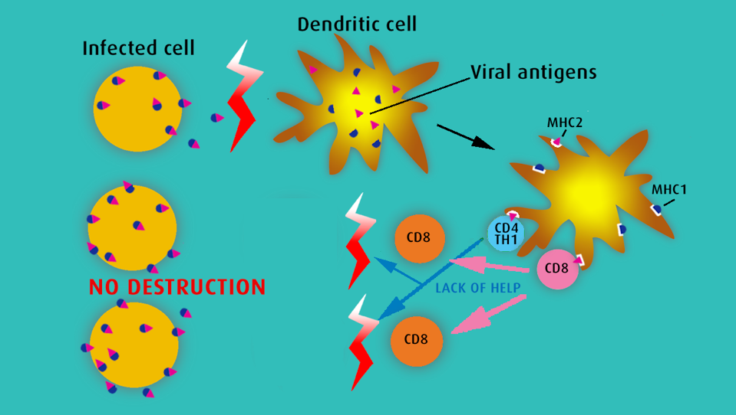
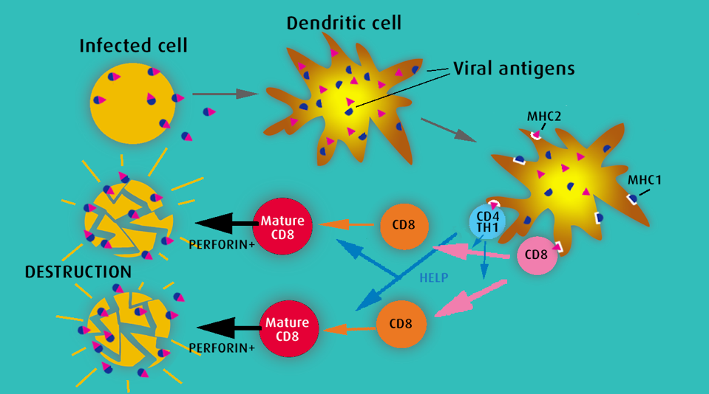
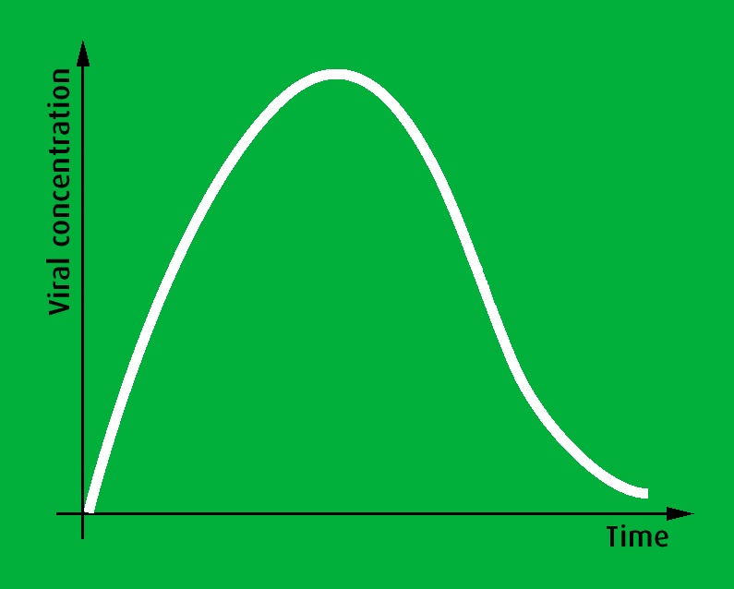
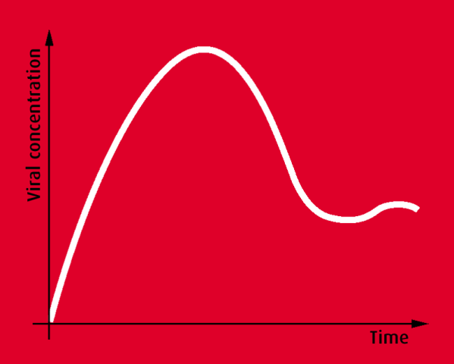
Innate immunity genes and patients response to Denditric cell-based HIV immuno-treatment

Slide 3


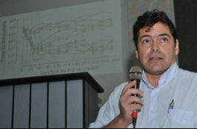




First Phase I study involving autologous DC cells pulsed with inactivated HIV

Slide 4
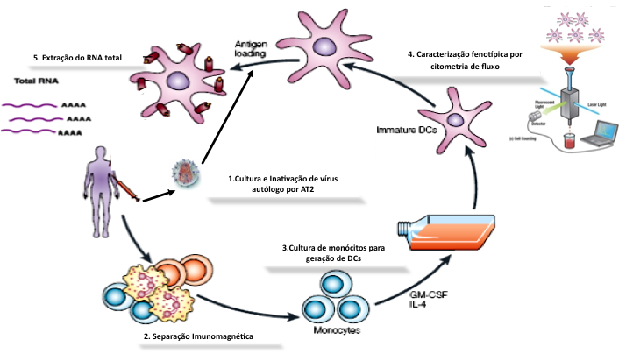
Characteristics of the 18 patients
Age: 18 to 41 years (median 25)
Gender/contamination :male/homosex. 2; female/heterosex. 16.
Seropositive for 13 to 65 ms (median 24.5)
Never treated:15 pts /Treated during pregnancy for 3 ms: 3 pts
CD4 T-cells : 270 -1.009/µl ( median,523)
Plasma viral load: 11.000 to 300.000/ml (geometric mean, 48.400; median, 37.600)

Slide 5
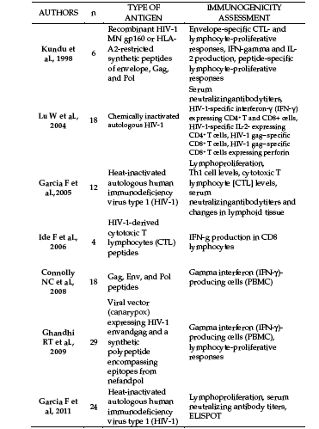


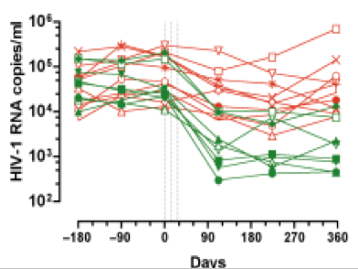
evolution of plasma viral loads

Slide 6


Slide 7
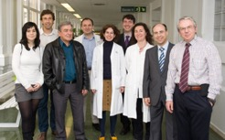
García F, Routy JP. Challenges in dendritic cells-based therapeutic vaccination in HIV-1 infection Workshop in dendritic cell-based vaccine clinical trials in HIV-1. Vaccine. 2011 Sep 2;29(38):6454-63.
García in 2011 reported the results of consensus meeting held at Barcelona in 2010, aimed at analyzing therapeutic immunization strategies used by different research groups employing autologous monocyte-derived DCs (MD-DCs) pulsed in vitro with autologous virus or different viral antigens .
It is interesting to note that all variables concerning the distinct steps of the immune-vaccine preparation, clinical trial design and immunological monitoring of vaccinated patients, have been deeply considered, proving interesting findings useful for criteria unification of therapeutic vaccine studies in the future.

Slide 8
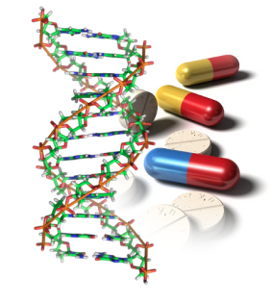
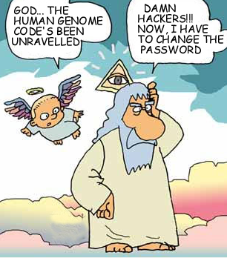
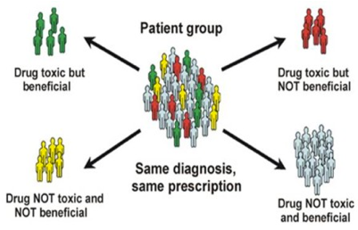
However, within all the variables considered, the host genome and its influence on the response to therapeutic vaccines have never been considered

Slide 9


Slide 10
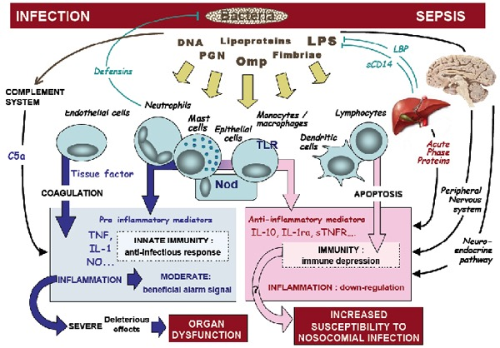
We studied the “innate immune genome” of weak/transient responders (WTR) and durable responders (DR) HIV infected patients, enrolled in the study of Lu et al. in order to understand the reasons of the success or not of the DC vaccine and its relationships with the host innate immunity genome

Slide 11
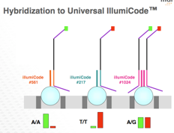
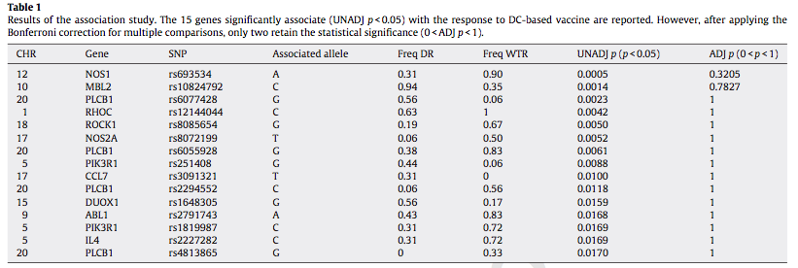
SNPs selection: SNPBrowser, HapMap, QuickSNP, Tagger
Illumina's GoldenGate Assay
149 INNATE IMMUNITY genes, 768 SNPs
1) non-synonymous coding SNPs (nsSNPs), that include a group of SNPs having the highest impact on phenotype due to their potential to directly affect the structure, function and interactions of expressed protein
2) Tag SNPs, which represent a subset of SNPs capturing most of the haplotype diversity of each haplotype block or gene-specific region.

Slide 12
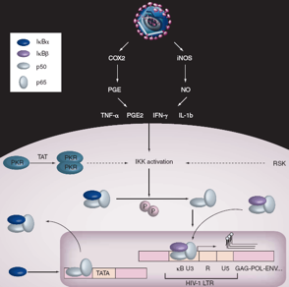
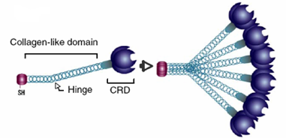
NOS1 Nitric Oxide (NO) is a pro-inflammatory and antiviral molecule, produced by monocytes and DCs during HIV infection
MBL role in HIV infection is still debated, since high levels of serum MBL are usually associated with a good virological response, but some authors also showed that MBL enhances HIV replication, hypothetically through the induction of TNF-α.

Slide 13


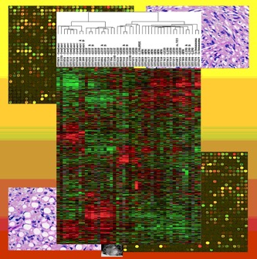
QUESTIONS…
NOS1 and MBL2 SNPs distribution in different ethnic groups
Association with susceptibility to HIV infection?
Functional SNPs?

Slide 14
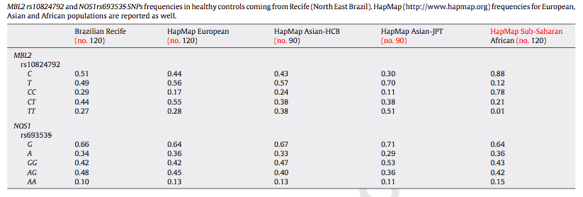
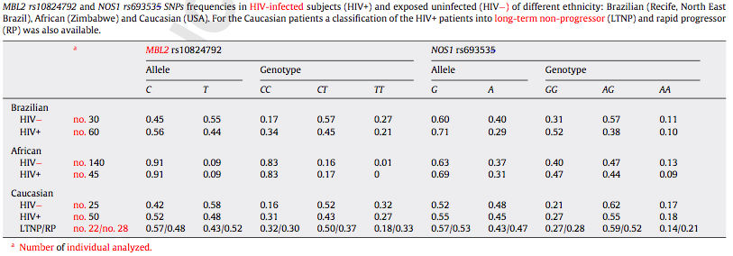

Slide 15
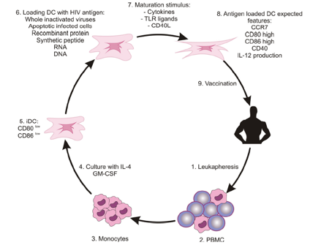
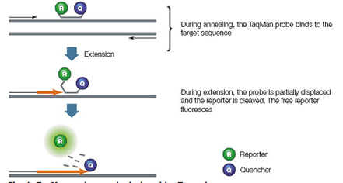
RT quantitative PCR experiments did not reveal MBL2 mRNA local production by monocytes and DCs, thus excluding an autocrine action of MBL on the process of DCs maturation
NOS1 expression was not found in monocytes but only in mature DCs indicating that NOS1 production may be related to the process of DCs maturation

Slide 16
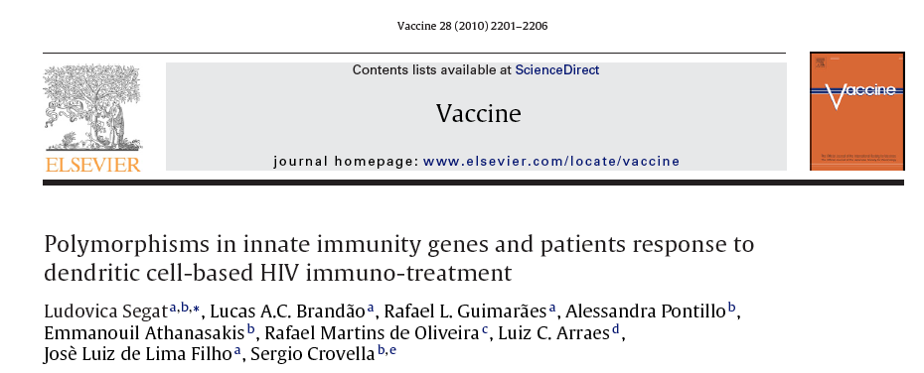



NOS1 Expression in DC from GR HIV infected patients
Dia 6
2hs
48hs
T0
T1
T2

Slide 17
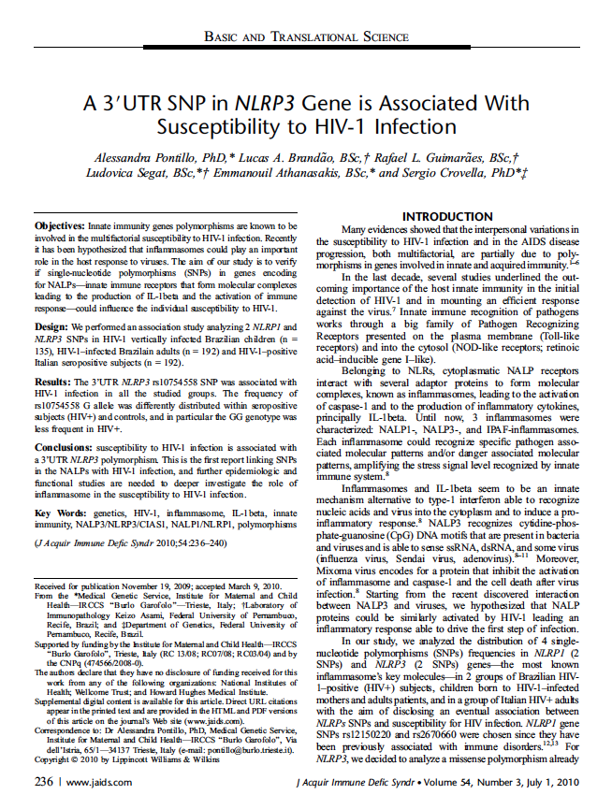
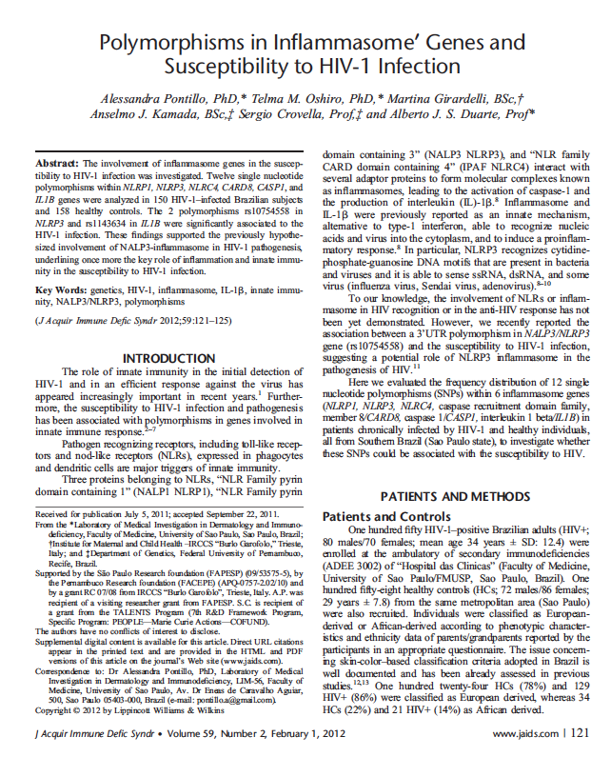
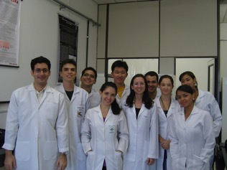

HIV and inflammasome

Slide 18
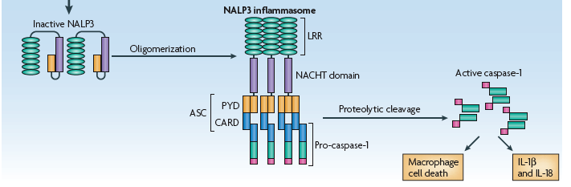
Inflammasome and HIV in DC
NALP3-inflammasome is an innate mechanism, alternative to type-1 interferon, able to recognize nucleic acids and viruses into cytoplasm and to induce pro-inflammatory response.
We hypothesized the involvement of inflammasome in the early defence against HIV-1 and in the fully maturation of dendritic cells
We evaluated the response of dendritic cells pulsed with HIV-1 in terms of inflammasome activation in healthy donors.
Moreover inflammasome response to HIV was evaluated in HIV infected subjects

Slide 19
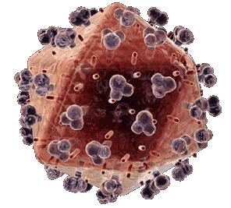
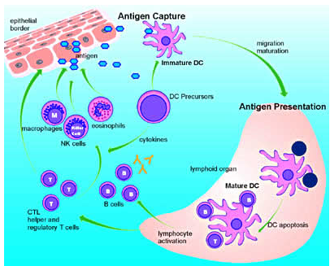
Monocyte-derived dendritic cells isolated from 20 healthy subjects (HC-DC) and 20 HIV-1 infected patients (HIV-DC) were pulsed with alditrithiol-2-inactivated HIV-1

Slide 20
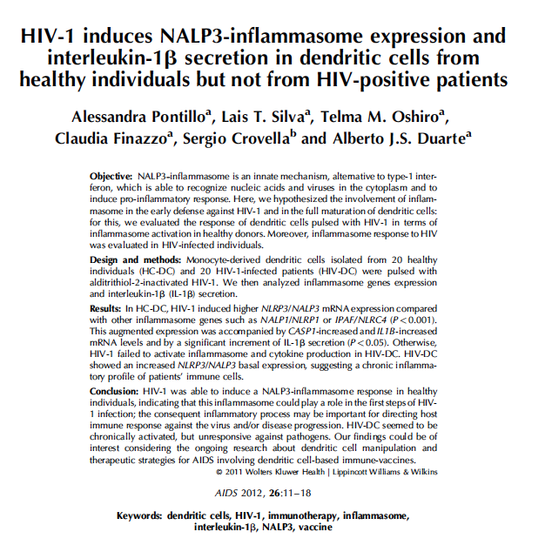
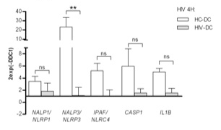
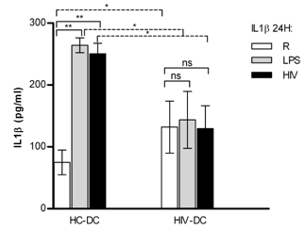
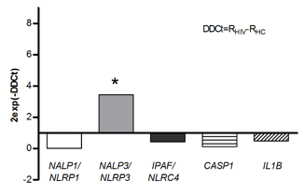
In HC-DC, HIV-1 induced higher NLRP3/NALP3 mRNA expression compared to other inflammasome genes such as NALP1/NLRP1 or IPAF/NLRC4 (p<0.001)
This augmented expression was accompanied by CASP1 and IL1B increased mRNA levels and by a significant increment of IL-1β secretion (p<0.05).
Otherwise HIV-1 failed to activate inflammasome and cytokine production in HIV-DC.

Slide 21

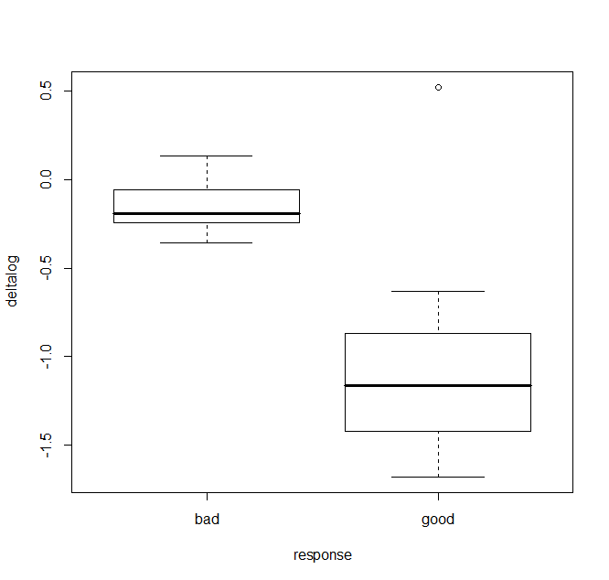
viral load’s Δlog criterium
Exact Wilcoxon rank sum test
P = 0.002828

Slide 22
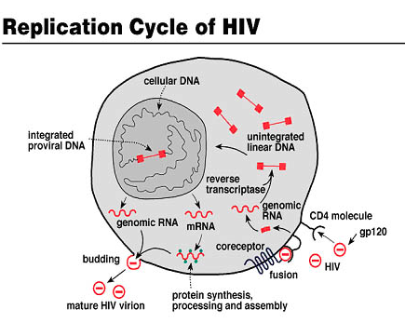

HIV replication restriction factors
BIAS FOR PATIENTS SELECTION?
CV 11.000
vs
CV 300.000

Slide 23
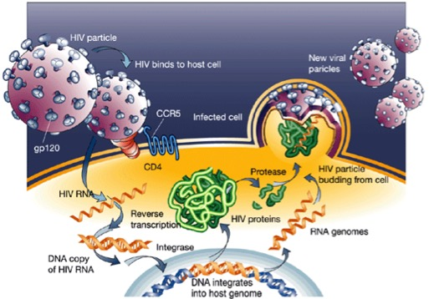
Do genetic factors involved in AIDS progression could affect the response to therapeutic DC vaccine?
To evaluate the impact of host anti-HIV restriction factors in the efficacy of phase I therapeutic DC vaccine, we analysed the 18 HIV+ patients for selected polymorphisms in HIV-1 infection and/or with progression to AIDS susceptibility genes.
APOBEC3G, CCL4, CCL5, CCR5, CUL5, CXCR6, HLA-C, IFNG, PARD3B, Prox1, SDF-1, TRIM5, ZNRD1

Slide 24
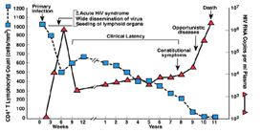
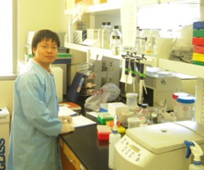
PATIENTS CLASSIFICATION AFTER DC IMMUNE-THERAPY
Good responder (GR; >90% PVL decrease by 1 year) (n=8)
Weak or transient responder (WTR; low (<90%) PVL decrease by 1 year) (n=10)
according to the classification applied by Lu et al.

Slide 25
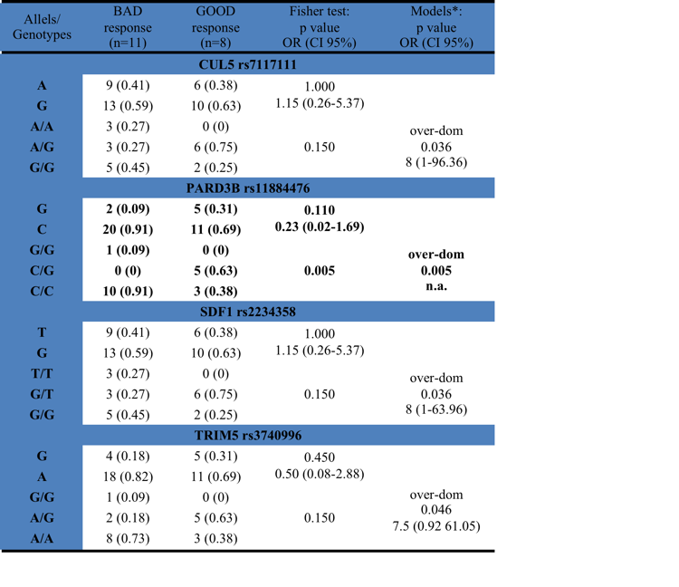
The rs11884476 polymorphism in PARD3B was associated with good response to the immune treatment according to an over-dominant model (C/G vs C/C+G/G; p=6.5exp-3), being C/G more frequent in good responder than in bad ones (5/8 vs 0/10).

Slide 26
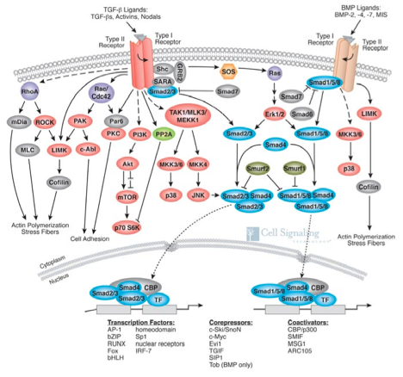
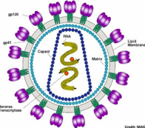
rs11884476 is an intronic variant, with unknown functional effect, previously associated with better prognostic and delayed AIDS. PARD3B gene product interacts with TGFß signalling proteins SMAD, directly binding HIV-1 proteins Tat and gp120.
PARD3

Slide 27
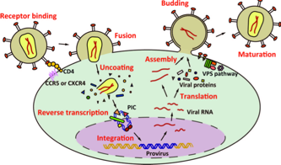
As increasing levels of TGFß are typically detected during HIV-1 replication and progression to AIDS, rs11884476 variant could affect PARD3B-SMAD interaction resulting in TGFß signalling down-regulation, leading to better control of AIDS progression.
Reducing production of TGFß is recommended in HIV vaccine design due to its immunomodulatory function on DC activation, suggesting that polymorphisms in PARD3B could affect both AIDS progression as well as DC-mediated lymphocytes activation.
rs11884476
SMAD
PARD3
TGFß signalling
better control of viral replication
TGFß

Slide 28
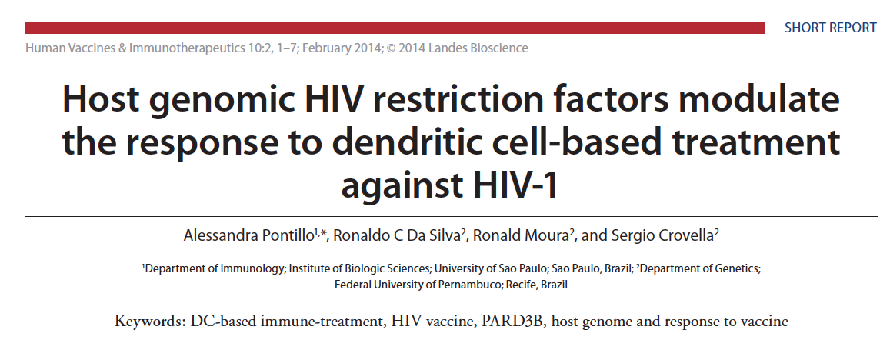

Slide 29


Slide 30





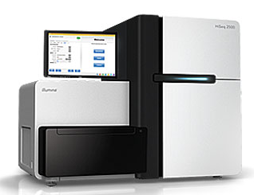
Exome-CHIPS the new frontier

Slide 31
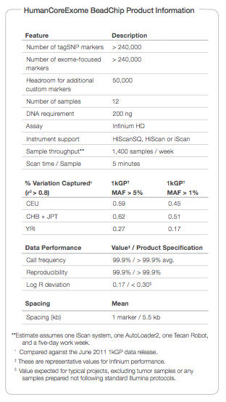
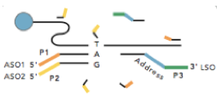

Exome-Analisys
CHIPS Illumina

Slide 32





WHOLE EXOME ANALYSIS ILLUMINA CHIPS
PHASE I PATIENTS

Slide 33
Workflow
Recalling rare variants in Illumina Infinium HumanExome BeadChip.
How to do this?
Gene-centered analysis of exome.
SNP-centered analysis of exome.
Network analysis
Network analysis

Slide 34


Zcall: Used to recall SNPs genotyping by considering also very rare variants lost in the Illumina call because of low fluorenscence
Remove bad smaples using PLINK.
Find new μ and σ for this data set.
Generate a logistic regression model.
Recall the genotypes using the new thresholds.
Derive the new thresholds for genotyping

Slide 35
Workflow
Recalling rare variants in Illumina Infinium HumanExome BeadChip.
How to do this?
Gene-centered analysis of exome.
SNP-centered analysis of exome.
Network analysis
Network analysis

Slide 36

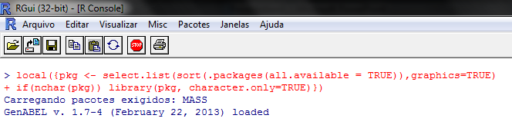
*ABEL packages: consider LD between SNPs
RegionABEL package.
Thanks to Dr. Nicola Pirastu.

Slide 37
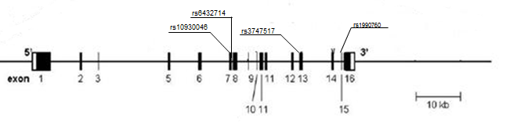
Gene-based analysis
All common variations within a candidate gene are considered jointly.

Slide 38

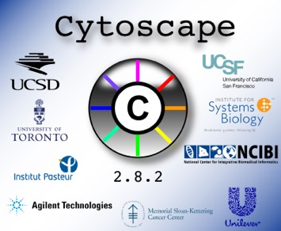
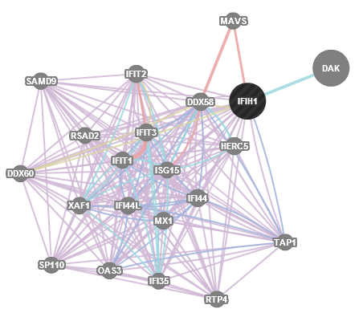

Cytoscape, GeneMANIA and Panther

Slide 39
SNP-based analysis
Gene-based analysis
Gene | chromosome | p-value
CNOT1 | 16 | 0.00003
CNTN4 | 3 | 0.00011
N4BP2L2 | 13 | 0.00035
MANEA | 6 | 0.00041
OR4E2 | 14 | 0.00055
NHSL1 | 6 | 0.00058
MTA1 | 14 | 0.00100
FAIM | 3 | 0.00110
FGFR2 | 10 | 0.00142
ZNF292 | 6 | 0.00165
marker | Chromosome | gene | P-value
rs7578326 | 2 | intergenic | 0.0002
rs2943641 | 2 | intergenic | 0.0007
rs7188697 | 16 | CNOT1 | 0.0008
rs8093763 | 18 | intergenic | 0.0008
rs16880691 | 4 | intergenic | 0.0008
rs5982533 | 25 | ZCCHC16 | 0.0011
rs1195382 | 25 | intergenic | 0.0012
rs2951916 | 6 | LOC100288170 | 0.0014
rs2943650 | 2 | intergenic | 0.0014
rs1708504 | 3 | intergenic | 0.0018
CNOT1: CCR4-NOT transcription complex subunit 1
CNOT1 codifies for the core subunit of the CCR4–NOT deanylase complex, which is involved in control of gene expression through transcriptional regulation and mRNA decay.

Slide 40
Markers of CNOT1 in Illumina exome
marker | change | mutation
exm1245811 | [T/C] | Missense_N2204S
exm1245814 | [A/C] | Missense_V2152G
exm1245844 | [T/C] | Missense_N1734S
exm1245846 | [A/C] | Missense_S1703A
exm1245853 | [G/C] | Missense_A1625G
exm1245868 | [A/G] | Missense_A1480V
exm1245883 | [A/C] | Silent,Missense_N1515K
exm1245886 | [A/G] | Silent,Missense_W1505R
exm1245887 | [G/C] | Silent,Missense_C1493S
exm1245889 | [T/C] | Silent,Missense_R1487K
exm1245948 | [T/C] | Missense_S767G,Missense_S767G
exm1245958 | [T/C] | Missense_N679S,Missense_N679S
exm1245971 | [T/C] | Missense_M547I,Missense_M547I
exm1245973 | [T/C] | Missense_I509V,Missense_I509V
exm1245988 | [T/C] | Missense_R299Q,Missense_R299Q
exm1245992 | [T/C] | Missense_S253N,Missense_S253N
exm1246010 | [A/G] | Synonymous_F144F,Synonymous_F144F
exm1246013 | [A/G] | Missense_A79V,Missense_A79V
rs7188697 | [A/G] | Silent,Silent
Monomorphic.
19 markers

Slide 41
Distribution of the polymorphic markes among the patients
 |  | GR |  | BR
exm1245886 |  | n | Freq. | n | Freq.
 | A | 16 | 1.00 | 19 | 0.95
 | G | 0 | 0.00 | 1 | 0.05
 | AA | 8 | 1.00 | 9 | 0.90
 | AG | 0 | 0.00 | 1 | 0.10
 | GG | 0 | 0.00 | 0 | 0.00
exm1245887 |  | n | Freq. | n | Freq.
 | G | 0 | 0.00 | 1 | 0.05
 | C | 16 | 1.00 | 19 | 0.95
 | GG | 0 | 0.00 | 0 | 0.00
 | GC | 0 | 0.00 | 1 | 0.10
 | CC | 8 | 1.00 | 9 | 0.90
exm1245988 |  | n | Freq. | n | Freq.
 | T | 0 | 0.00 | 1 | 0.05
 | C | 16 | 1.00 | 19 | 0.95
 | TT | 0 | 0.00 | 0 | 0.00
 | TC | 0 | 0.00 | 1 | 0.10
 | CC | 8 | 1.00 | 9 | 0.90
rs7188697 |  | n | Freq. | n | Freq.
 | A | 16 | 1.00 | 10 | 0.50
 | G | 0 | 0.00 | 10 | 0.50
 | AA | 8 | 1.00 | 1 | 0.10
 | AG | 0 | 0.00 | 8 | 0.80
 | GG | 0 | 0.00 | 1 | 0.10
Statistically associated.
Intron 3

Slide 42
CNOT1: Significant marker
Single Locus Table
rs7188697 | WTR | GR | OR (CI 95%) | P value
Allele | n=20 (Freq.) | n=16 (Freq.)
A | 10 (0.5) | 16 (1) | Ref.
G | 10 (0.5) | 0 (0) | 33.00 (1.74-624.66) | 0.0031*
Codominant | n=10 (Freq.) | n=8 (Freq.)
A/A | 1 (0.1) | 8 (1) | Ref. | 0.0007*
A/G | 8 (0.8) | 0 (0) | 96.33 (3.42-2715.42) | 0.0015*
G/G | 1 (0.1) | 0 (0) | 17.00 (0.46-648.24) | 0.4292
Dominant
A/A | 1 (0.1) | 8 (1) | Ref.
A/G + G/G | 9 (0.9) | 0 (0) | 107.66 (3.85-3013.31) | 0.0009*
Recessive
A/A + A/G | 9 (0.9) | 8 (1) | Ref.
G/G | 1 (0.1) | 0 (0) | 2.68 (0.09 -75.12) | 0.9084
Overdominant
A/A + G/G | 2 (0.2) | 8 (1) | Ref.
A/G | 8 (0.8) | 0 (0) | 57.80 (2.39-1392.38) | 0.0035*

Slide 43

CNOT1 is involved in immunologic processes
When performing a Panther-based analysis CNOT-1 (Panther code PTHR13162:SF8CC, CCR4-NOT transcription complex subunit 1) has been classified in the Gene Ontology as transcription factor activity.

Slide 44



Slide 45

CNOT 1 functions
TTP
CNOT1 has been reported to play an important role in exhibiting enzymatic activity of the CCR4-NOT complex, so it is fundamental for the control of mRNA deadenylation and mRNA decay.
CNOT1 has been recently described as involved in the regulation of inflammatory processes mediated by TrisTetraprolin (TTP)
CNOT-1

Slide 46


TTP plays a role in HIV-1 infection by binding the HIV-1 AU rich-sequences thus destabilizing the mRNA of cytokines and chemokines in activated CD4(+) T cells.
If TTP is silenced by siRNA in a latently HIV-1 infected cell line, this silencing contributes to augmented HIV-1 production.
Maeda et al. demonstrated that TTP plays an important role in the regulation of HIV-1 replication and increases splicing by direct binding to AU-rich sequence of HIV-1 RNAs.

Slide 47

The CNOT1 rs7188697 genotypes also correlated with PVL changes in the 18 HIV+ patients, since only individuals with A/A genotype showed significant reduction of PVL

Slide 48


Slide 49


Slide 50





Phase II Study SP
EVALUATION OF RESPONSE TO THE VACCINE
Coupling with MacroArray results
viral load’s Δlog

Slide 51

Expression signature
1
Peripheral blood
monocytes
In vitro manipulation expression signature
3
Response
expression signature
2
AT-HIV
Monocyte-
derived
DC
Peripheral blood
monocytes
Mature
DC
4
Correlation between response to treatment and expression profile

Slide 52

In vitro manipulation expression signature
HIV pulse
Cytokines
Monocytes-derived DC (GM-CSF + IL-4)
RNA isolation, RT-PCR, pre- amplification
Analysis
RT2 Profiler Array
(Host response to HIV)

Slide 53
In vitro manipulation expression signature
17 HIV+ individuals submitted to immune treatment
6 individuals analysed
for in vitro manipulation
3 HIV+
Low Plasma Viral Load
3 HIV+
High Plasma Viral Load
Patients classifyied by PVL
Clinical trial is still on-going
Notes:
Nessa apresentação preliminar de dados, serão mostrados os resultados referentes ao perfil de expresão gênica da manipulação in vitro de 6 pacientes,os quais foi possível ter acesso a amostras Como os resultados de bom ou mau respondedor ainda não foram concluídos e a resposta a vacina é avaliada pela combinação de vários fatores foi tomada a decisão de avaliar a expressão de DC in vitro utilizando-se a classificação de alta e baixa carga viral. Para o acompanhamento (perfil de expressão antes e depois da vacina e genotipagem), um banco de material genético está sendo montado.

Slide 54
In vitro manipulation expression signature
Patient age/sex | PVL (copies/ml; log) | CD4+ count (cells/µl) | Group
27/M | 5003; 3.7 | 500 | Low PVL
23/M | 1342; 3.1 | 684 | Low PVL
39/M | 1237:3.1 | 500 | Low PVL
40/M | 21420; 4.3 | 566 | High PVL
35/M | 38295; 4.6 | 500 | High PVL
24/M | 24530; 4.4 | 569 | High PVL
PVL < 4 log
PVL > 4 log

Slide 55


Gene expression profile in immunotherapy preparation
 | 1 | 2 | 3 | 4 | 5 | 6
APEX1
APOBEC3G
BAD
BANF1
BAX
BCL2
CASP3
CASP8
CBX5
CCL2
CCL4
CCL8
CCNT1
CCR2
CCR3
CCR4
CCR5
CD209
CD74
CDK7
CDK9
CDKN1A
CEBPB
COPS6
CR2
CREBBP
CX3CL1
CXCL12
CXCR4
EP300
FCAR
FOS
GADD45A
HCK
HMGA1
HTATSF1
IFNA1
IFNB1
IL10
IL12B
IL1B
IL8
IRF1
IRF2
LTBR
MAP3K5
MBL2
NFKBIA
PPIA
PRDX1
PTK2B
RBL2
SELL
SERPINA1
SERPINC1
SLPI
SMARCB1
STAT1
STAT3
TFCP2
TGFB1
TNF
TNFSF10
TRIM5
TSG101
VPS4A
XPO1
YY1
Immunotherapy product varies
in different HIV+ subjects?
Nr of differently expressed genes
(≠ FC) High vs Low PVL HIV+
 | Mo | iDC | 4h | 14h | 24h | 48h
Up FC>4 | 24 | 4 | 4 | 5 | 6 | 28
Down FC<-4 | 6 | 12 | 9 | 14 | 10 | 1
tot | 30 | 16 | 13 | 19 | 16 | 29
immunotherapy (DC) preparation
RNA isolation
in different
time-points
Primary cells
are different
Final cells
too!
84-genes array (anti-HIV host response)
High PVL
(n=3)
vs
Low PVL
(n=3)
Difference in gene
expression (log₂FC)

Slide 56
Gene expression profile in immunotherapy preparation
Differently expressed genes
(≠ FC, p-value)
High vs Low PVL HIV+
gene | FC ratio | t test
SERPINC1 | 161,24 | 0,418
CX3CL1 | 86,14 | 0,423
HMGA1 | 71,80 | 0,420
SELL | 56,43 | 0,398
CDK9 | 48,06 | 0,383
APOBEC3G | 44,48 | 0,401
IFNB1 | 39,34 | 0,428
GADD45A | 31,65 | 0,360
CCNT1 | 30,07 | 0,414
APEX1 | 29,64 | 0,403
CREBBP | 28,64 | 0,415
CBX5 | 26,93 | 0,398
CCR4 | 23,62 | 0,114
XCL1 | 21,11 | 0,436
PTK2B | 19,36 | 0,413
MAP3K5 | 19,13 | 0,423
CCR3 | 16,87 | 0,291
HCK | 15,66 | 0,310
TNFRSF1B | 12,49 | 0,421
PPIA | 11,65 | 0,423
CXCR4 | 7,06 | 0,335
PRDX1 | 6,80 | 0,442
CCL2 | 6,56 | 0,457
CASP3 | 5,82 | 0,439
CCL8 | 5,54 | 0,489
IL12B | 5,09 | 0,329
EP300 | 4,84 | 0,482
IL8 | 4,64 | 0,486
STAT3 | 4,32 | 0,395
IL1B | 4,09 | 0,523
CDKN1A | -1,96 | 0,040
CD74 | -3,80 | 3,69 E-04
IRF2 | -4,00 | 0,076
BAD | -4,00 | 0,085
IFNA1 | -4,54 | 0,069
RBL2 | -4,54 | 0,061
CCL3 | -4,70 | 0,038
CASP8 | -4,70 | 0,059
LTBR | -5,00 | 0,038
TSG101 | -5,26 | 0,040
IRF1 | -5,26 | 0,039
SERPINA1 | -6,25 | 0,030
CCR5 | -6,25 | 0,028
CXCL12 | -11,11 | 0,005
MBL2 | -50,00 | 7,05 E-06
down
up
CEPBP
gene | FC | t test
SLPI | 21,64 | 0,002
CXCL12 | 19,16 | 0,003
CR2 | 18,53 | 0,003
MBL2 | 18,06 | 0,003
IFNA1 | 15,33 | 0,005
FCAR | 14,89 | 0,003
HMGA1 | 12,45 | 0,005
CCR3 | 12,17 | 0,008
IFNB1 | 11,97 | 0,008
IL10 | 11,42 | 0,002
IL12B | 10,87 | 0,007
CCL8 | 10,69 | 0,010
CX3CL1 | 9,58 | 0,013
PPIA | 9,00 | 3,10 E-04
SERPINC1 | 8,41 | 0,017
BAD | 7,82 | 0,001
SELL | 7,61 | 0,003
BANF1 | 7,02 | 0,001
CDK7 | 6,80 | 0,001
TFCP2 | 5,43 | 0,010
CCR2 | 5,40 | 0,041
TNFSF10 | 5,33 | 0,002
TRIM5 | 5,26 | 0,004
CCR4 | 4,53 | 0,063
PRDX1 | 4,39 | 0,004
CCNT1 | 4,05 | 0,007
CEBPB | -3,57 | 9,15 E-05
IL8 | -4,30 | 0,506
CD209 | -5,26 | 0,501
PPIA
down
up
MBL2
CD74
CXCL12
CDKN1A
FC>4;p<0.05
FC>4; p ns
FC<-4; p<0.05
FC<4; p ns
-4<FC<4;; p<0.05
-4<FC<4; p ns

Slide 57

Gene expression profile in immunotherapy preparation
48h DC
monocytes
Function | FDR
chemokine-mediated signaling pathway | 6.32e-13
response to virus | 6.32e-13
cytokine receptor binding | 6.32e-13
leukocyte migration | 2.39e-12
cell chemotaxis | 1.95e-11
inflammatory response | 2.72e-11
regulation of lymphocyte activation | 6.56e-8
T cell activation | 1.8e-7
SERPINC1
CX3CL1
HMGA1
SELL
CDK9
APOBEC3G
IFNB1
GADD45A
CCNT1
APEX1
CREBBP
CBX5
CCR4
XCL1
PTK2B
MAP3K5
CCR3
HCK
TNFRSF1B
PPIA
CXCR4
PRDX1
CCL2
CASP3
CCL8
IL12B
EP300
IL8
STAT3
IL1B
CDKN1A
CD74
IRF2
BAD
IFNA1
RBL2
CCL3
CASP8
LTBR
TSG101
IRF1
SERPINA1
CCR5
CXCL12
MBL2
SLPI
CXCL12
CR2
MBL2
IFNA1
FCAR
HMGA1
CCR3
IFNB1
IL10
IL12B
CCL8
CX3CL1
PPIA
SERPINC1
BAD
SELL
BANF1
CDK7
TFCP2
CCR2
TNFSF10
TRIM5
CCR4
PRDX1
CCNT1
CEBPB
IL8
CD209
Function | FDR
cytokine receptor binding | 6.94e-10
cytokine activity | 4.62e-9
response to virus (IFN!!) | 6.83e-9
cell chemotaxis | 9.6e-9
regulation of viral process | 6.92e-8
chemokine receptor binding | 2.71e-7
leukocyte migration | 2.83e-7
leukocyte chemotaxis | 1.03e-5
Low PVL HIV+ 48h DC
Better DC activation (it affects treatment?)
Function | FDR
regulation of extrinsic apoptotic signaling pathway in absence of ligand | 7.93e-10
regulation of apoptotic signaling pathway | 1.29e-9
positive regulation of cysteine-type endopeptidase activity involved in apoptotic process | 1.05e-7
positive regulation of endopeptidase activity | 1.95e-7
regulation of I-kappaB kinase/NF-kappaB signaling | 1.08e-5
ubiquitin protein ligase binding | 3.51e-5
Low PVL HIV+ monocytes
Better control virus infection
(quite obvious?)

Slide 58


Slide 59


García F, Climent N, Guardo AC, Gil C, León A, Autran B, Lifson JD, Martínez-Picado J, Dalmau J, Clotet B, Gatell JM, Plana M, Gallart T; DCV2/MANON07-ORVACS Study Group.
A dendritic cell-based vaccine elicits T cell responses associated with control of HIV-1 replication. Sci Transl Med. 2013 Jan 2;5(166):166ra2

Slide 60




BOPE Travel to Barcelona

Slide 61






EXOME ANALYSIS DNAs FROM DC HIV VACCINE WORLD CONSORTIUM: ONGOING COLLABORATION WITH DR. FELIPE GARCIA, IDIBAPS BARCELONA

Slide 62


Recife good versus bad responders gene-based approach
Gene | Chr | GeneStart | GeneEnd | p
CNOT1 | 16 | 58519951 | 58629886 | 0.00004
CNTN4 | 3 | 2098813 | 3057956 | 0.00016
OR4E2 | 14 | 21665083 | 21666024 | 0.00055
XIRP2 | 2 | 1.67E+08 | 1.67E+08 | 0.00118
FGFR2 | 10 | 1.21E+08 | 1.22E+08 | 0.00123
NAGK | 2 | 71064344 | 71079805 | 0.00252
MYOF | 10 | 93306429 | 93482317 | 0.00275
PCDHB3 | 5 | 1.41E+08 | 1.41E+08 | 0.00299
IL13 | 5 | 1.33E+08 | 1.33E+08 | 0.00366
CFH | 1 | 1.97E+08 | 1.97E+08 | 0.00400
Previous results
Double checked and
CONFIRMED

Slide 63
Meta-analysis
We conducted a meta-analysis of phase II (Barcelona) and Recife GWAS data in order to increase sample size and provide a pooled or global result. It is important to notice that we are not considering the differences between the vaccine protocols. We are only considering the genome and the final outcome (good and poor responders).
Recife
8 GR
10 BR
Barcelona Phase II:
7 GR
8 BR
Meta-analysis:
15 GR
18 BR
+
=

Slide 64

Meta-analysis using Recife and Barcelona Phase II GWAS data

Slide 65



Slide 66


SNP rs7935564 (A/G) of TRIM22 gene, encoding for the Tripartite Motif Containing 22 (TRIM22) protein. This cytoplasmic interferon-induced protein has antiviral role against HIV infection by inhibiting viral replication, especially in monocyte-derived macrophages, as dendritic cells

Slide 67


The rs7935564 SNP is a non-synonymous mutation changing an Asparagine residue (Asn) with Aspartic acid (Asp) residue at codon 155, localized in the Coiled Coil region, playing a structural role in the protein.

Slide 68



Slide 69

TRIM22 rs7935564 in LD with the SNPs reported?
UNFORTUNATELY
NOT ☹
Kelly JN, Barr SD.
In silico analysis of functional single nucleotide polymorphisms in the human TRIM22 gene.
PLoS One. 2014 Jul 1;9(7):e101436.
Singh R, Patel V, Mureithi MW, Naranbhai V, Ramsuran D, Tulsi S, Hiramen K, Werner L, Mlisana K, Altfeld M, Luban J, Kasprowicz V, Dheda K, Abdool Karim SS, Ndung'u. T. TRIM5α and TRIM22 are differentially regulated according to HIV-1 infection phase and compartment. J Virol. 2014 Apr;88(8):4291-303.
Pereira NZ, Cardoso EC, Oliveira LM, de Lima JF, Branco AC, Ruocco RM, Zugaib M, de Oliveira Filho JB, Duarte AJ, Sato MN. Upregulation of innate antiviral restricting factor expression in the cord blood and decidual tissue of HIV-infected mothers. PLoS One. 2013 Dec 18;8(12):e84917.
Ghezzi S, Galli L, Kajaste-Rudnitski A, Turrini F, Marelli S, Toniolo D, Casoli C, Riva A, Poli G, Castagna A, Vicenzi E. Identification of TRIM22 single nucleotide polymorphisms associated with loss of inhibition of HIV-1 transcription and advanced HIV-1 disease. AIDS. 2013 Sep 24;27(15):2335-44.

Slide 70


TRIM22 DOUBLE CHECK IN HIV-1 POSITIVE PATIENTS
With the aim of verifying the impact of TRIMM22 rs7935564 polymorphism in the susceptibility to HIV-1 infection and disease progression, as well as the influence of ethnicity in the distribution of allelic and genotype frequencies, we genotyped three populations from Italy, Brazil and Zambia
Among Brazilian children, the A/G genotype was more frequent among HIV-1 positive children respect to A/A genotype more represented among children HIV-1 exposed but not infected (P=0.03, OR=0.34, CI=0.10-1.00)
Considering Zambian children, allele and genotype frequencies were similar among HIV-1 exposed but not infected individuals and HIV-1 positive subjects and the same frequencies were detected also in the HIV-1 positive subgroups (classified according to mother to child HIV-1 mode of transmission in intrauterine, intrapartum and postpartum transmission).

Slide 71


In the Italian group, TRIMM 22 rs7935564 polymorphism frequencies were not different confronting HIV-1 positive and HIV-1 exposed but not infected individuals.
Instead comparing LTNP with SP the A allele and A/A genotype were more frequent among SP respect to G allele and G/G genotype more represented among LTNP (allele: P=0.02, OR=3.90, CI=1.05-18.08 genotype: P=0.03, OR=1nf, CI=0.87-inf).
The same results were obtained when LTNP and RP were considered (allele P=0.02, OR=5.02, CI=1.14-27.21, genotype: P=0.02, OR=inf, CI=1.01-inf).

Slide 72



Slide 73








THANK YOU!!!

