Slide 1
NGS and Bioinformatics
Dr. Ronald Moura
ronaldmoura1989@gmail.com
https://www.linkedin.com/in/ronald-moura-660017178/

Slide 2
“The number of transistors in a dense integrated circuit doubles about every two years”.
Gordon Moore

Slide 3
Human Genome Project
https://web.ornl.gov/sci/techresources/Human_Genome/project/journals.shtml
Notes:
In October 2018, the GRC still indicated 514 gaps, most of which are annotated as "stalled" or "under investigation/review", so it seems they will not be resolved any time soon

Slide 4
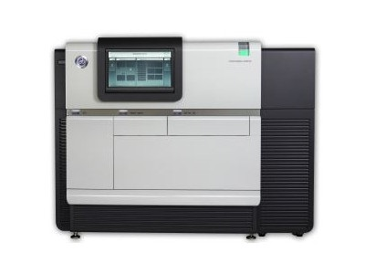
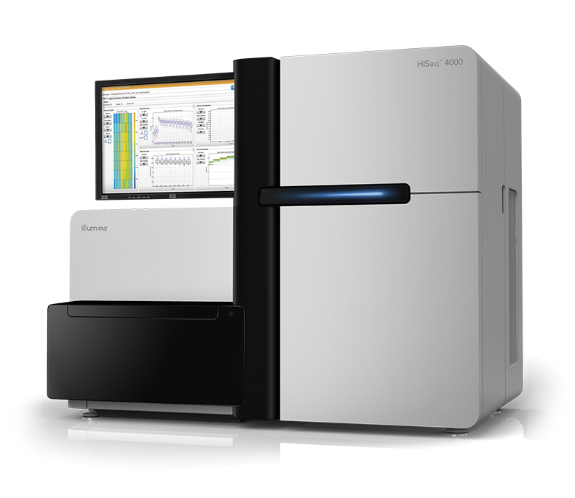
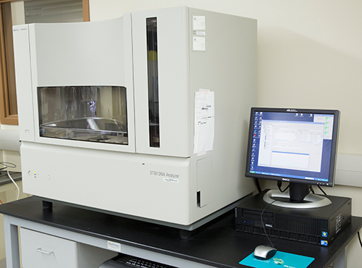
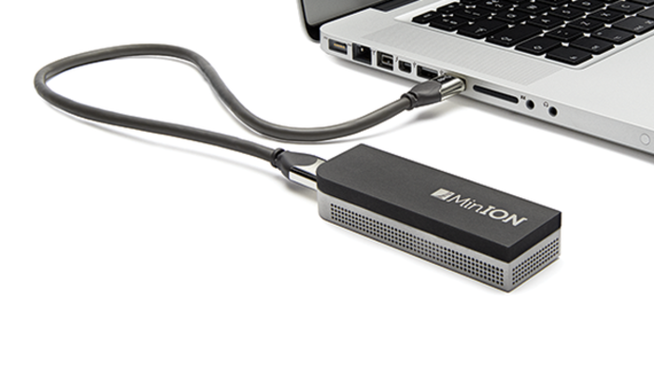
Sequencing Generations
Sanger sequencing
Illumina Sequencing
PacBio Sequencing
NanoPore Sequencing

Slide 5
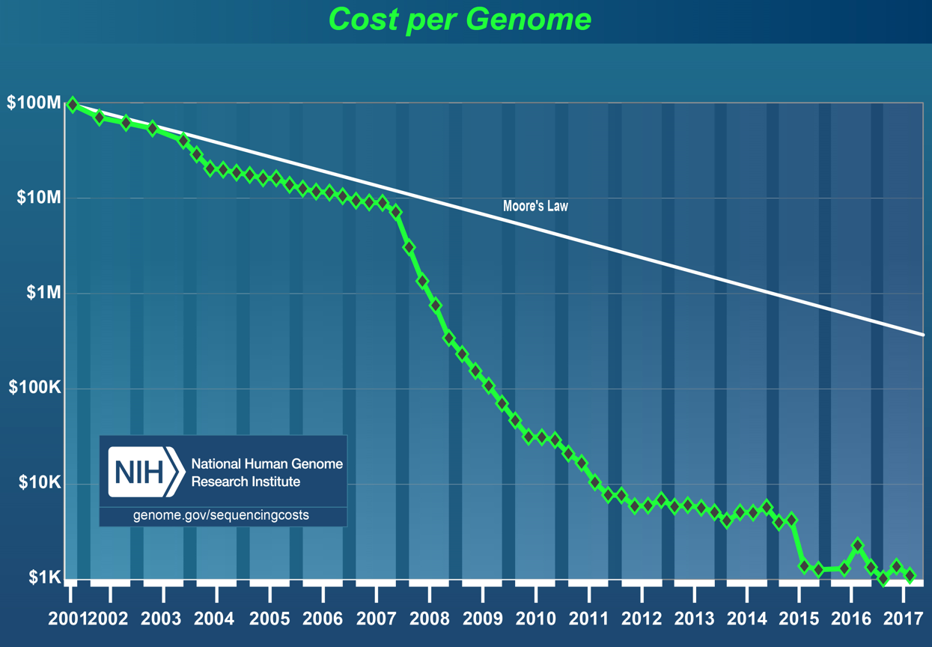
https://www.genome.gov/27541954/dna-sequencing-costs-data/
Notes:
Em 2001, o custo era de US$ 95,263,072. Em 2017, o custo era de US$ 1,121

Slide 6
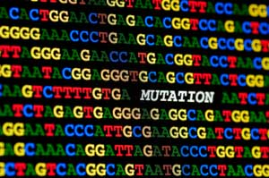
The NGS approach
Whole-genome Sequencing (WGS);
Whole-exome Sequencing (WES);
Targeted Sequencing;
Epigenomics;
Transcriptomics.

Slide 7
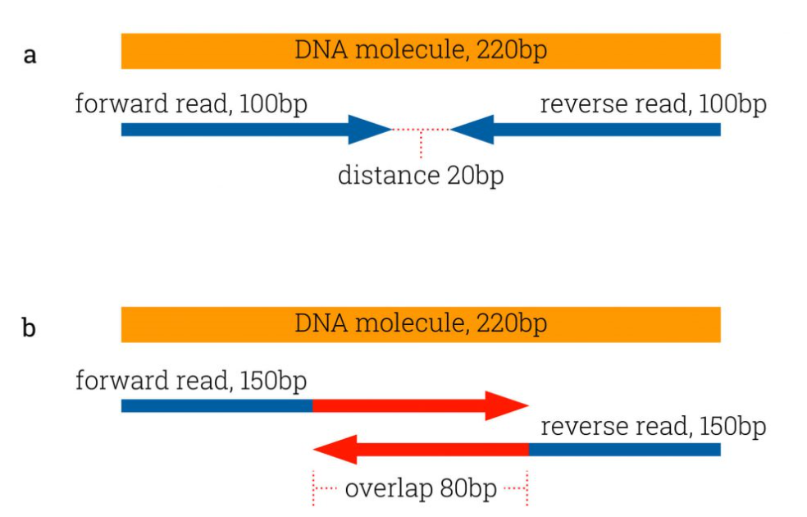
Some key concepts
Read Length:
75, 100, 150 base pairs.
Single and pair-ended Reading:
Solving structural rearrangements.
Coverage or Deapth:
30x, 50x, 100x, 150x.
Notes:
“However, the average size of human coding exons is only 160bp. Including flanking intronic regions of diagnostic significance (e.g., due to splice variants) of about 30bp at either side, the average target of interest is about 220 bp long.” (https://www.cegat.de/en/services/research-exome/choosing-the-right-read-length-for-diagnostic-sequencing/)
https://systemsbiology.columbia.edu/genome-sequencing-defining-your-experiment

Slide 8
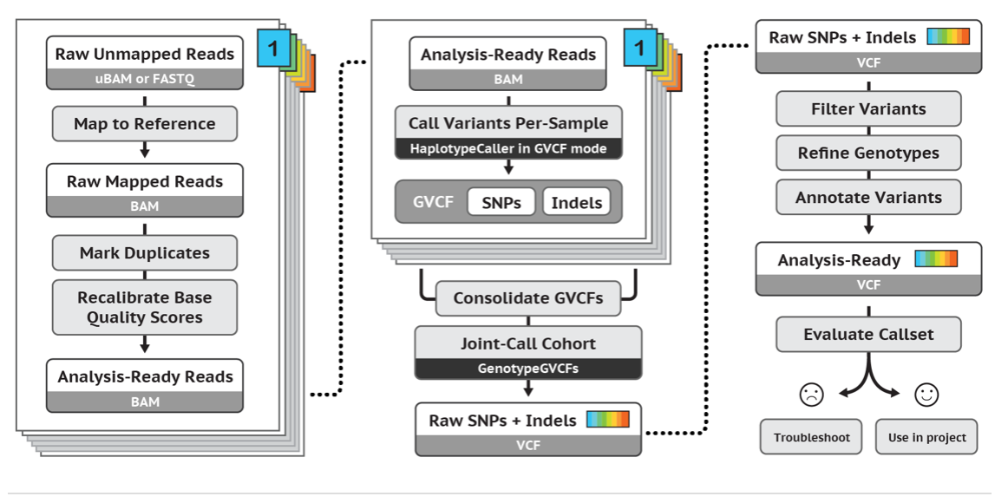
Bioinformatics for NGS
GATK
Notes:
https://genestack-user-tutorials.readthedocs.io/tutorials/WES_data_analysis/

Slide 9
Bioinformatics for NGS
Reference genomes:
Species with reference genomes
Arabidopsis thaliana | Mus musculus (Mouse)
Bacillus_cereus strain ATCC 10987 | Mycobacterium tuberculosis strain H37Rv.EB1
Bacillus_subtilis strain 168 | Oryza sativa japonica (Rice)
Bos taurus (Cow) | Pan troglodytes (Chimpanzee)
Caenorhabditis elegans | PhiX
Canis familiaris (Dog) | Pseudomonas aeruginosa strain PAO1
Danio rerio (Zebrafish) | Rattus norvegicus (Rat)
Drosophila melanogaster | Rhodobacter sphaeroides strain 2.4.1
Enterobacteriophage lambda | Saccharomyces cerevisiae (Yeast)
Equus caballus (Horse) | Schizosaccharomyces pombe
Escherichia coli strain K12, DH10B | Sorangium cellulosum strain So_ce_56
Escherichia coli strain K12, MG1655 | Sorghum bicolor
Gallus gallus (Chicken) | Staphylococcus aureus strain NCTC 8325
Glycine max | Sus scrofa (Pig)
Homo sapiens | Zea mays (Corn)
Macaca mulatta

Slide 10
Bioinformatics for NGS
GATK

Slide 11
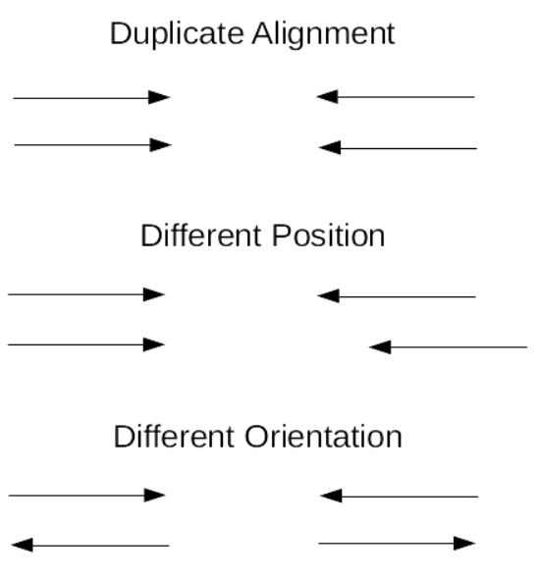
Bioinformatics for NGS
Base Quality Score Recalibration (BQSR)
Notes:
http://www.htslib.org/algorithms/duplicate.html
https://gatkforums.broadinstitute.org/gatk/discussion/44/base-quality-score-recalibration-bqsr

Slide 12
Bioinformatics for NGS
GATK

Slide 13
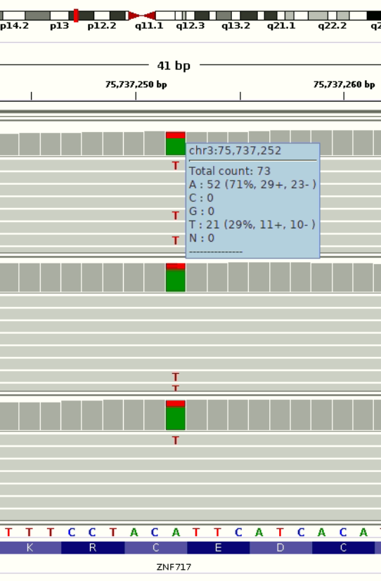
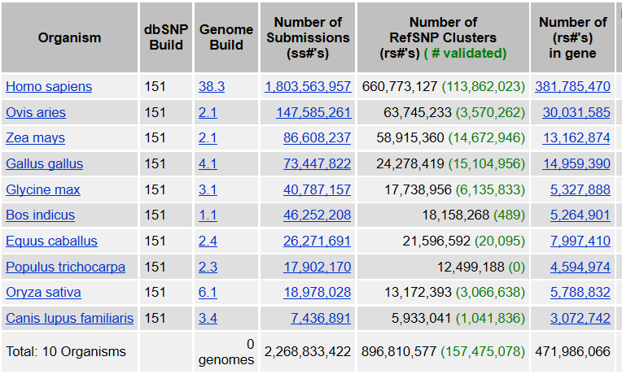
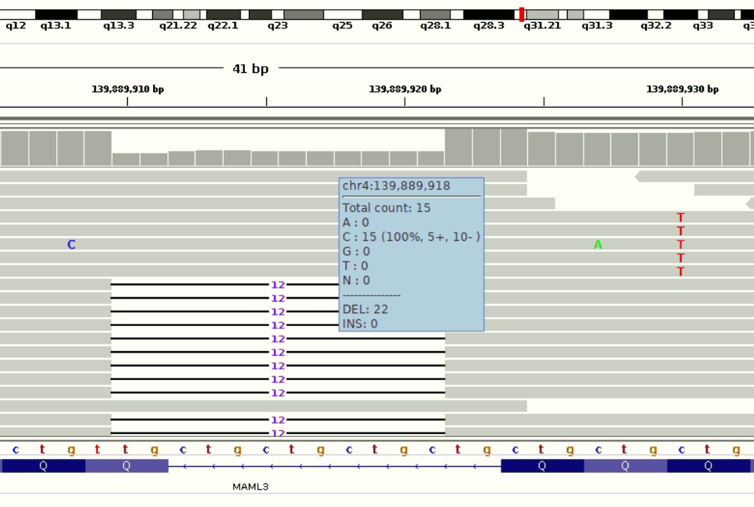
Bioinformatics for NGS
dbSNP 151
Notes:
SLE 15:45403247 SPATA5L1
AUT 4:139889910 MAML3
ZNF717 3:75737252

Slide 14
Bioinformatics for NGS
GATK

Slide 15
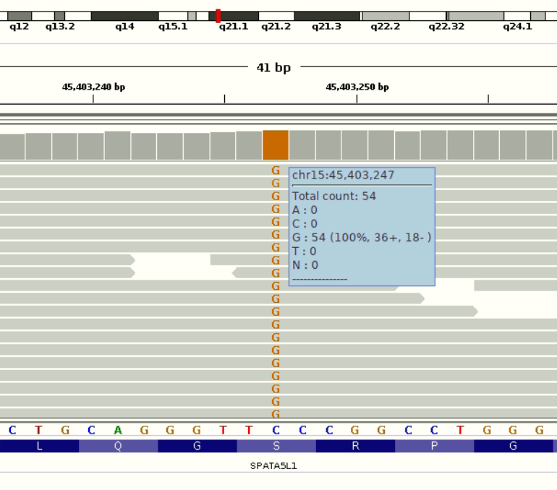
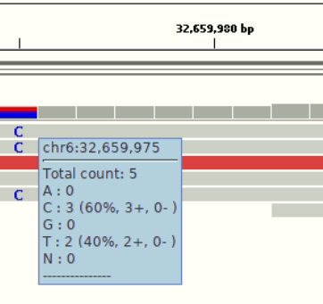
Bioinformatics for NGS
Minimum Base Coverage: 10x
Minimum variant frequency: 20%
Required variant count: 3
Sufficient variant count: 5
Notes:
http://resources.qiagenbioinformatics.com/manuals/clcgenomicsworkbench/650/Significance_variant.html

Slide 16
Bioinformatics for NGS
GATK

Slide 17
Bioinformatics for NGS
Gene-based annotation:
Gene name, a.a. changes, splicing sites, etc.
Region-based annotation:
Chromosome band, transcription fator binding-site, segmental duplication, etc.
Filter-based annotation:
Presence on dbSNP, allele frequencies, damaging effect to protein, etc.

Slide 18
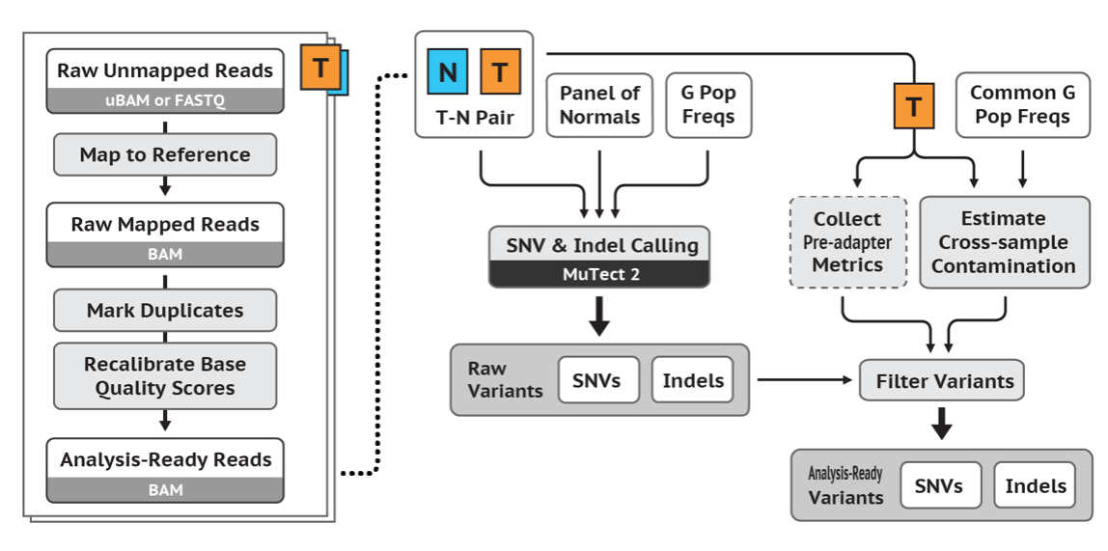
Bioinformatics for NGS
Protocol for cancer samples:

Slide 19
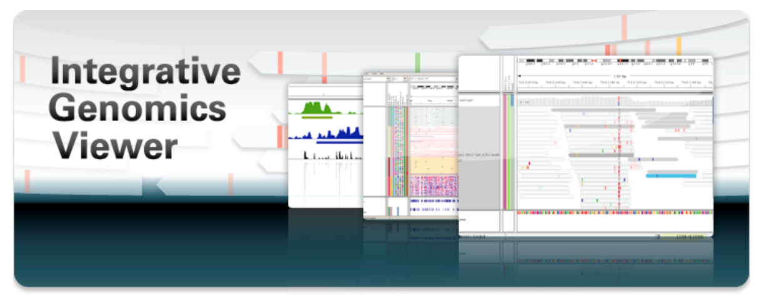
IGV

Slide 20
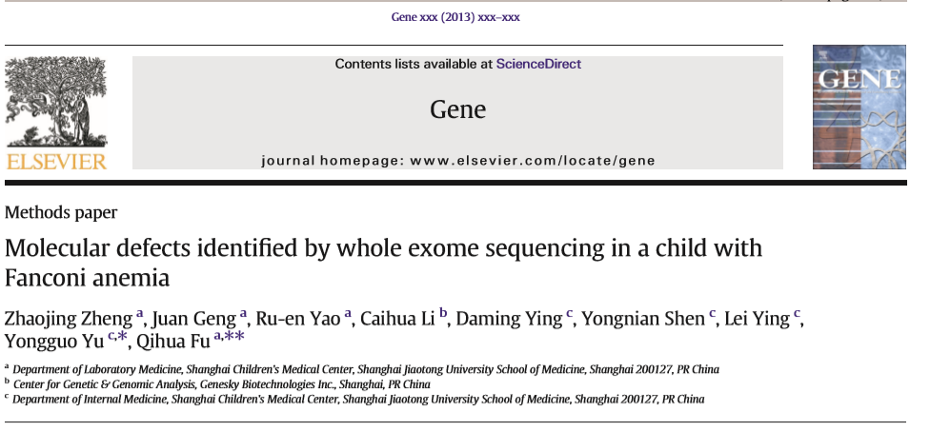
NGS in practice

Slide 21
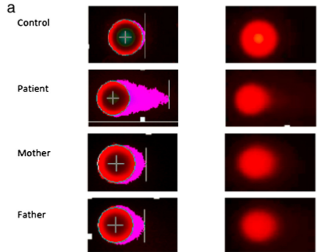
NGS in practice
Four years-old, male patient;
Diagnosed with Fanconi Anemia;
Complementation group was not identified.

Slide 22
NGS in practice
Whole-exome sequencing;
Pair-ended 100 bp;
Filter strategy:
Minimum coverage of 10 reads;
Variant detection frequency of at least 20%;
All dbSNP and silent mutation were excluded;
Low-frequencies and truncating mutation in FA genes were considered pathogenic;
Unreported non-synonymous variants were analyzed for protein damaging effects;
Validation using Sanger sequencing.

Slide 23
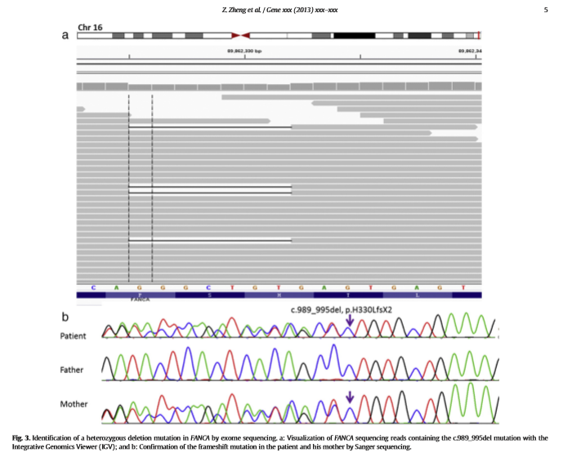
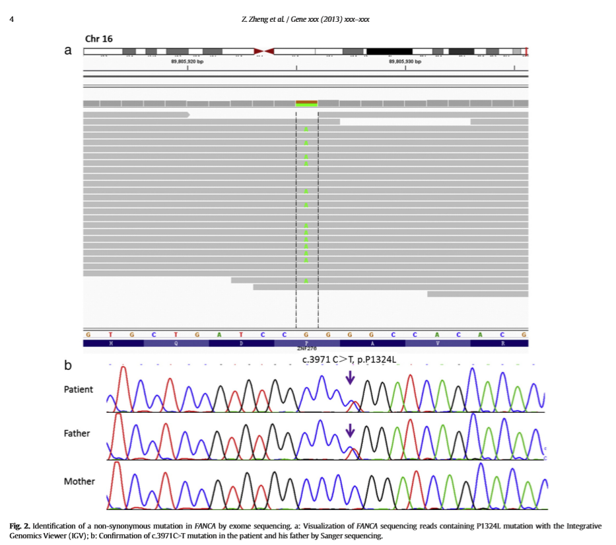
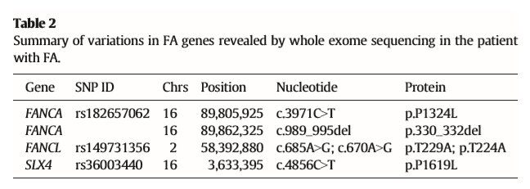
NGS in practice
The 10x coverage was achieved by 89.70% of the targets;
65,108 SNVs were found, being 9,429 in coding regions;

Slide 24
Familia Sardenha
ZNF717
Notes:
HS5 – HS73
HS7 – HS80
HS8 – HS71
HS9 – HS74

Slide 25
