Slide 1



Biomolecular Analyses for Tailored Medicine in Acne iNversa
Sergio Crovella
IRCCS Burlo Garofolo
Trieste
Italy
sergio.crovella@burlo.trieste.it

Slide 2
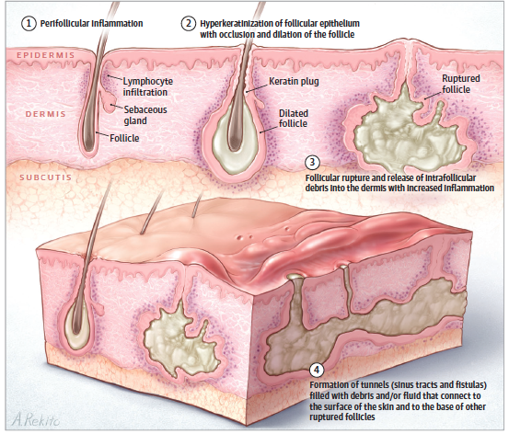
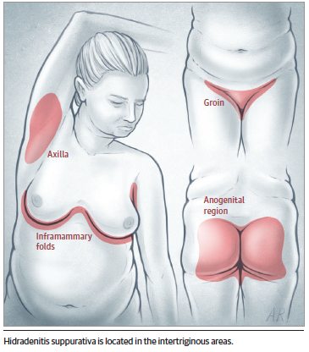
Hidradenitis suppurativa (HS) or Acne Inversa is relatively common, with the prevalence of 0.05%to 4.10%, yet many patients receive inadequate treatment.

Slide 3
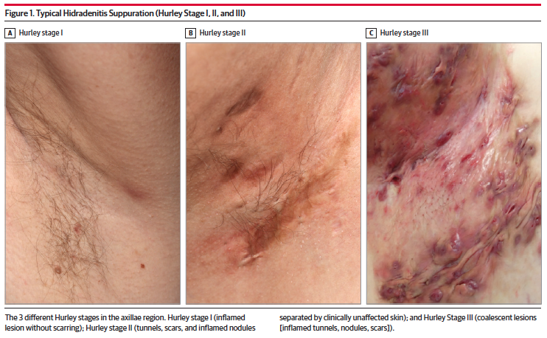

Slide 4
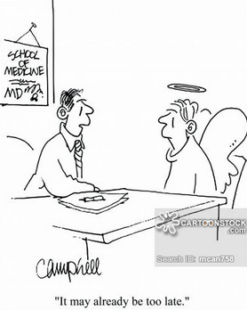
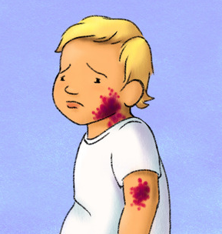
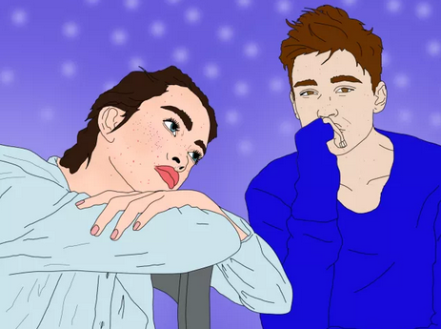
SOCIAL ISSUES
7 years delayed diagnosis
and treatment

Slide 5
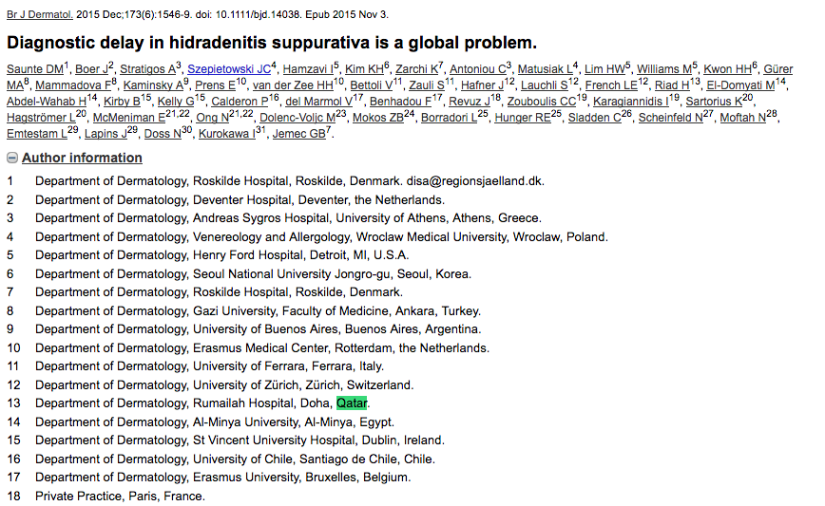

Slide 6
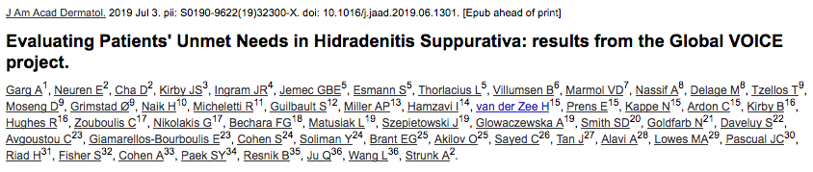

Slide 7
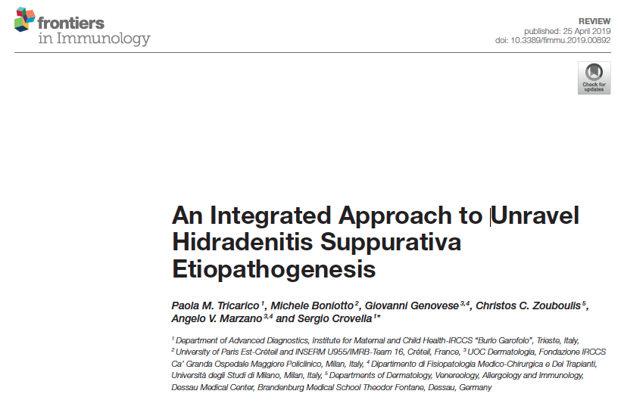
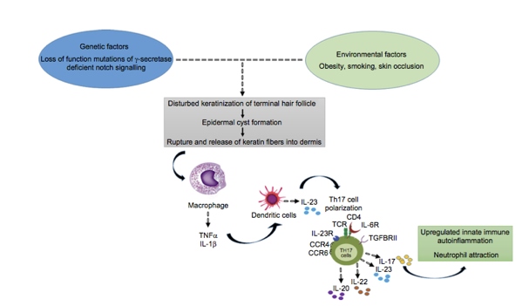
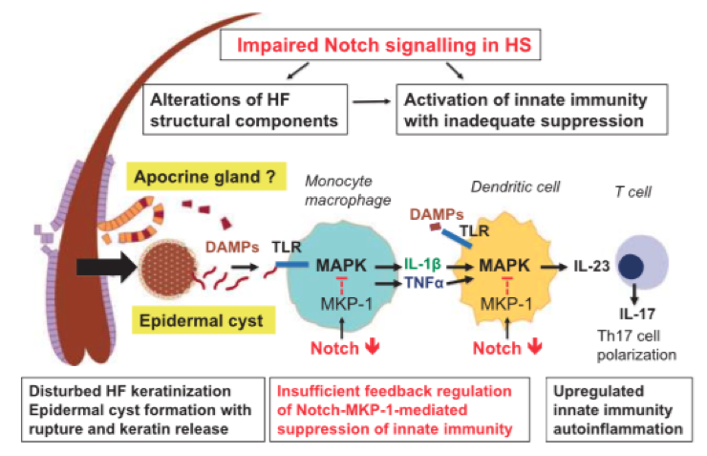
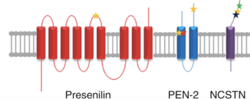
HS: etio-pathogenesis to be unraveled

Slide 8
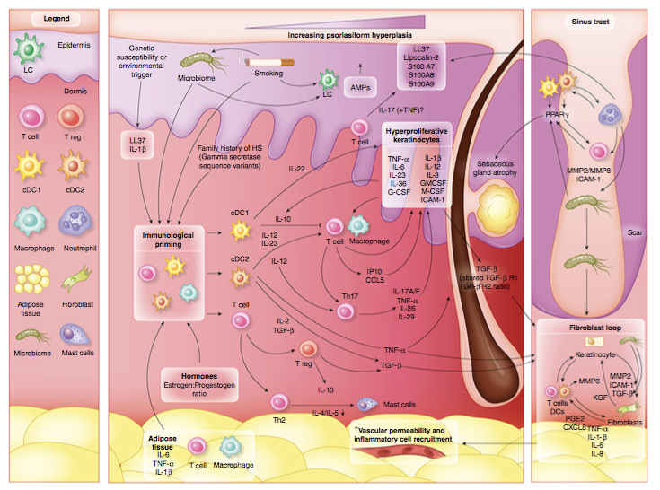

Slide 9
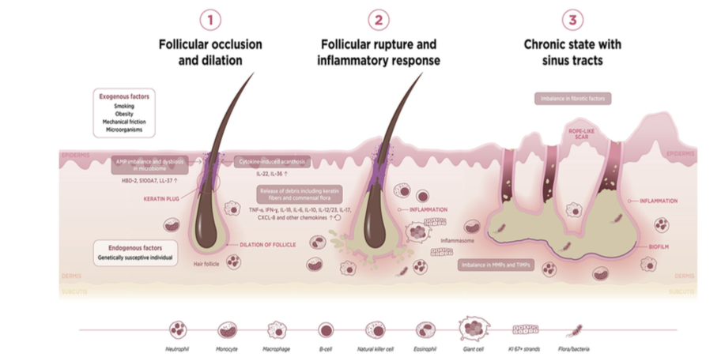

Slide 10


identify genetic variants associated with AI susceptibility, severity and response to treatment
design in vivo and in vitro models for investigations on the main biological pathways affected by AI and testing the impact of genetic variants on immune and cutaneous cell biology
produce an holistic health records HHR to complement medical record by developing a smartphone application to remotely monitor the physical and psychological wellbeing of patients and advise them on physical activity and dietary and smoking habits
propose novel stratification methods that clinicians can use to assess severity, choose the therapy and follow the outcome

Slide 11
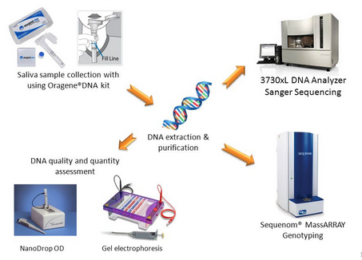
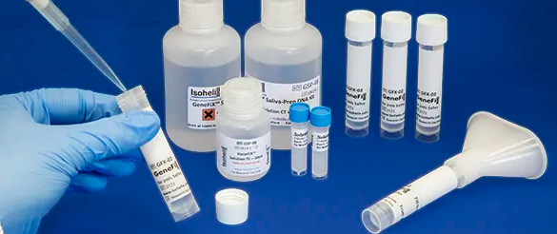
NON INVASIVE DNA EXTRACTION FROM SALIVA

Slide 12
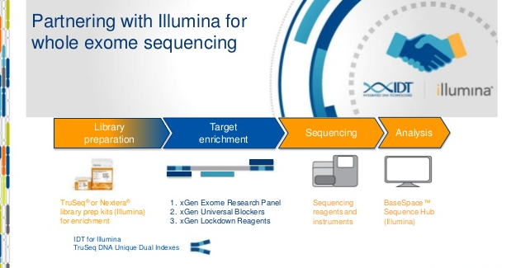

Slide 13
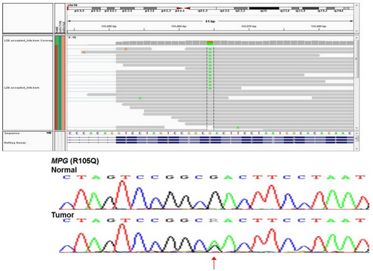
SANGER SEQUENCING VALIDATION AND MUTATION CONFIRMATION

Slide 14
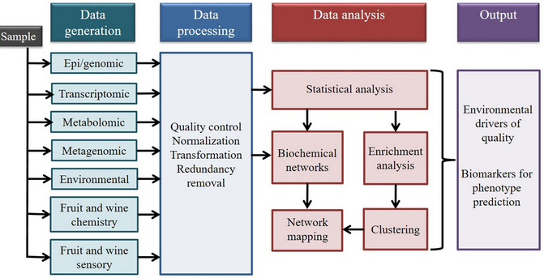
IT DATA INTEGRATION (CLINICS, BIOLOGY, GENETICS, DRUGS, DIET ETC.

Slide 15
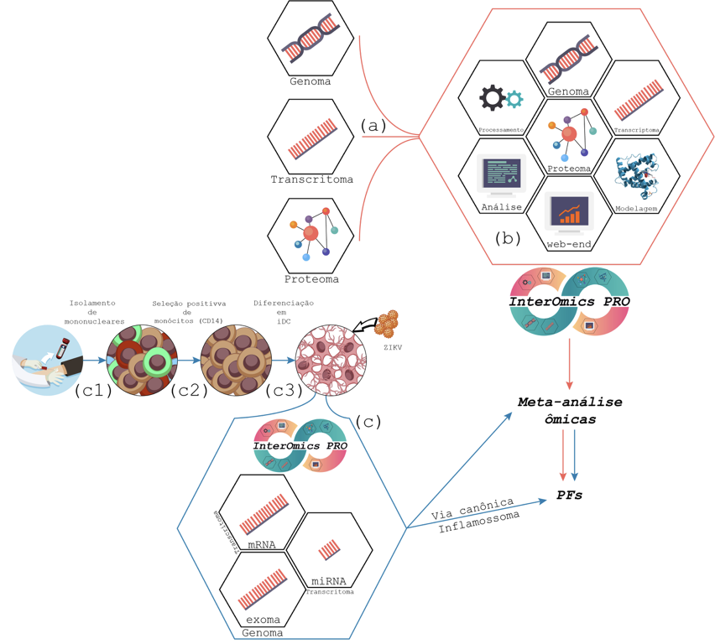
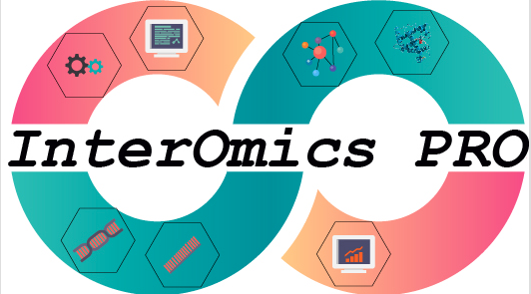
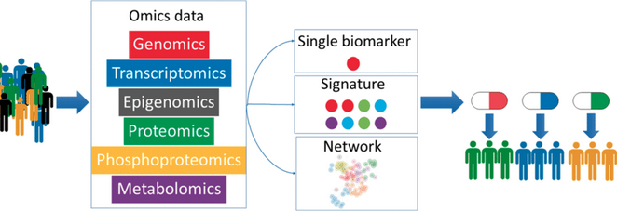
INTEROMICS: AN INTEGRATED APPROACH
FOR TAILORED MEDICINE

Slide 16
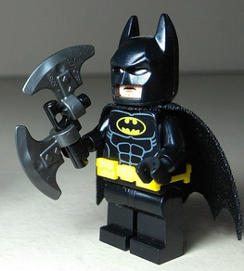
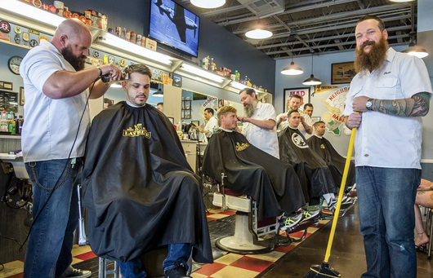
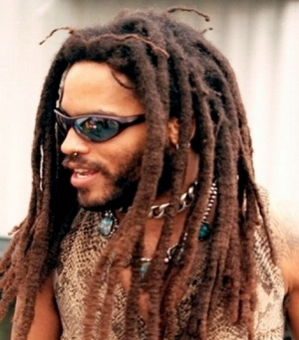

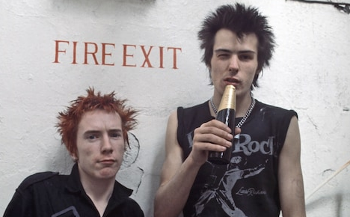
NON-INVASIVE PATIENTS
SAMPLING.
STEM CELLS DERIVED
FROM HAIRS

Slide 17

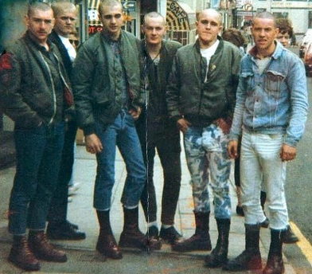
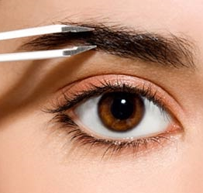

Slide 18
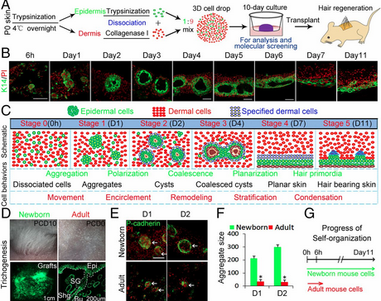
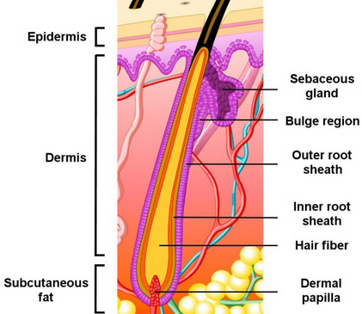
From patients’ hairs to SKIN ORGANOIDS

Slide 19
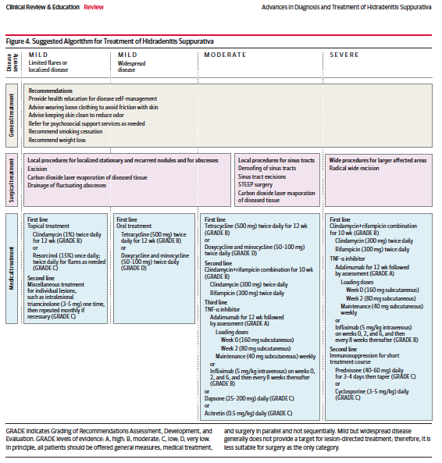
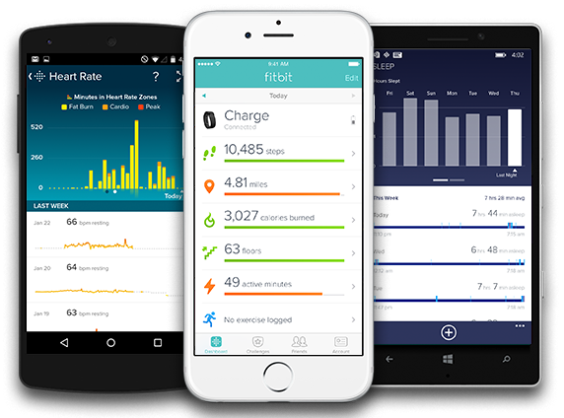


Slide 20
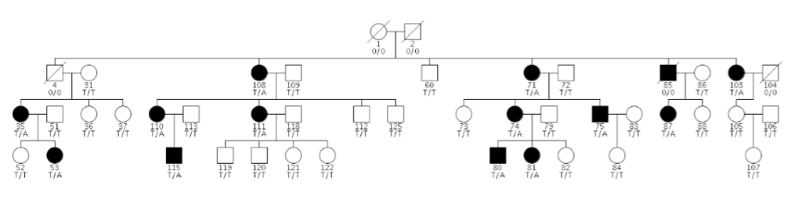

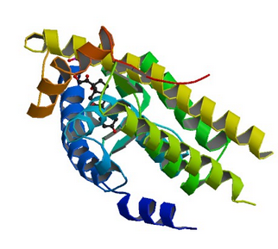
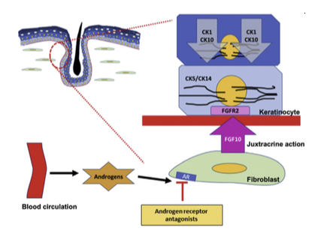
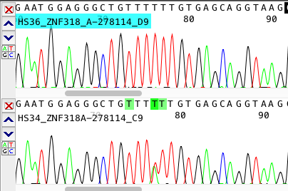
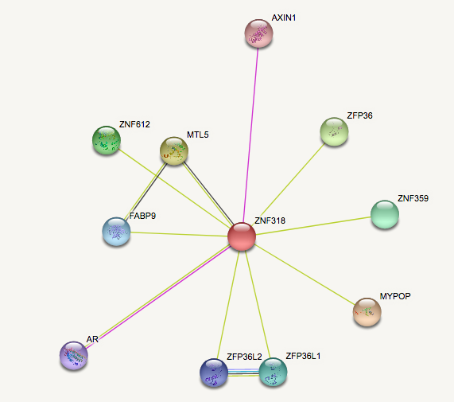
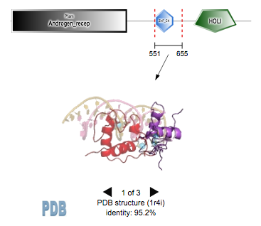

Slide 21
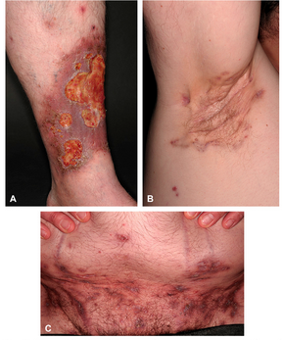
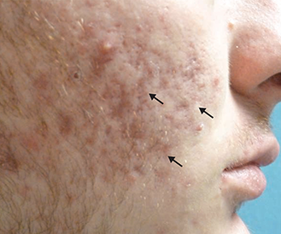

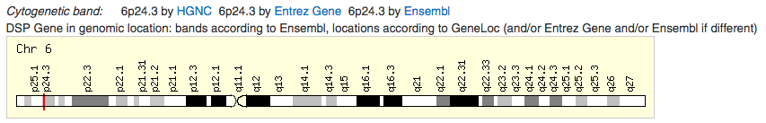
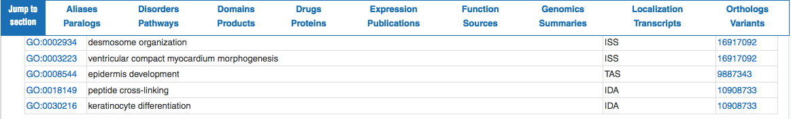
Pyoderma gangrenosum, acne, and suppurative hidradenitis (PASH)

Slide 22
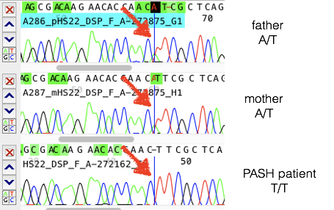
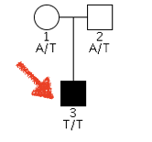
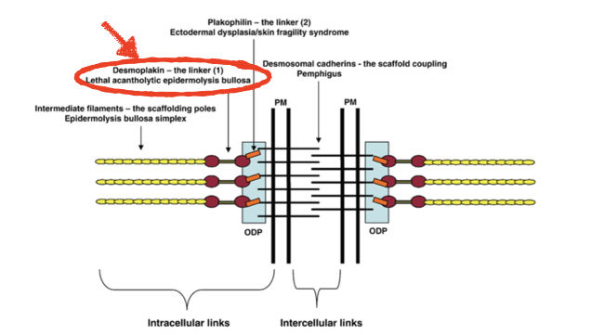
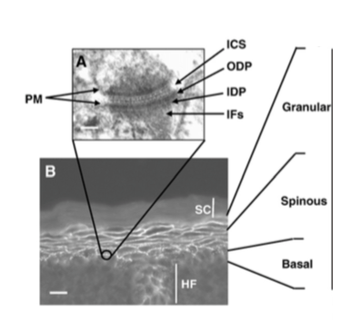

Slide 23

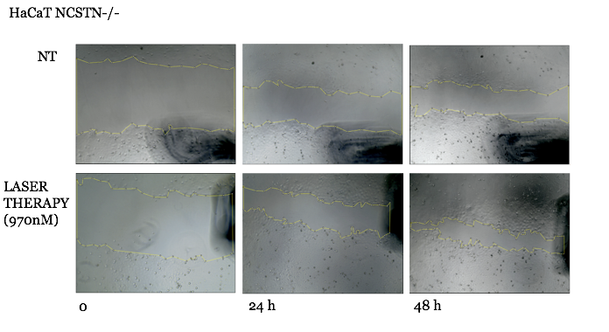
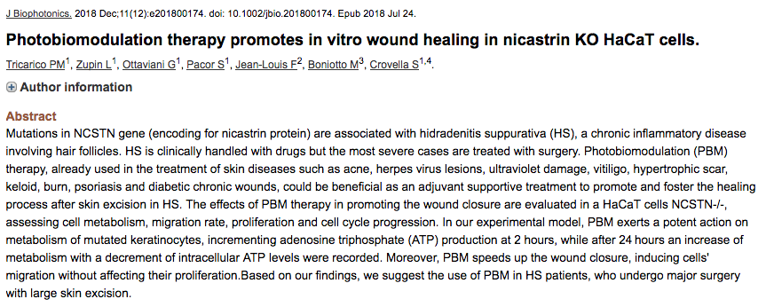
Laser therapy and wound healing: a cell model

Slide 24
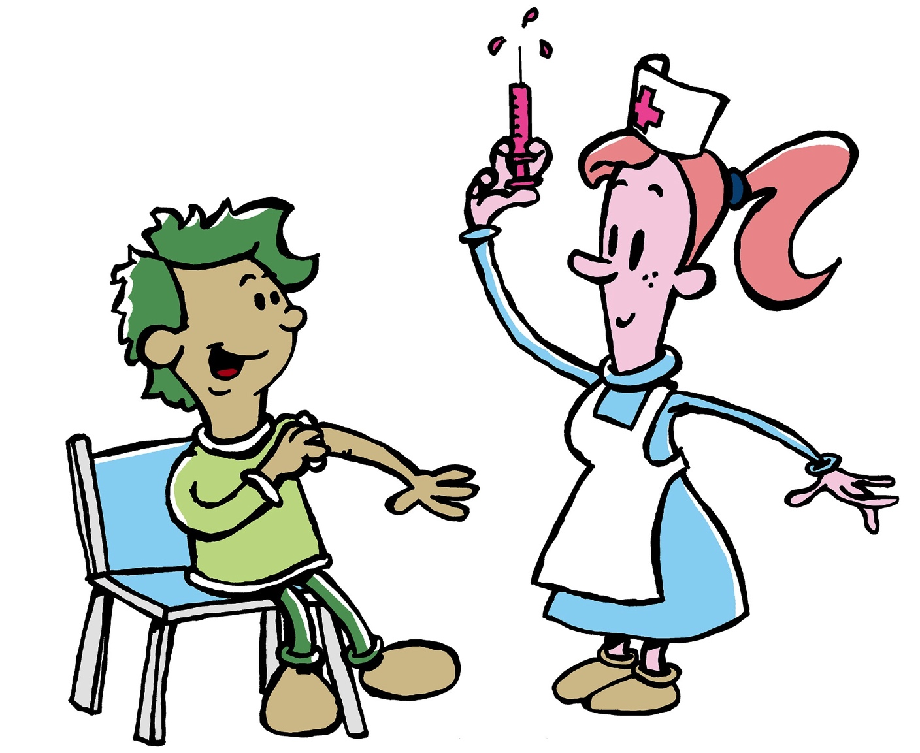
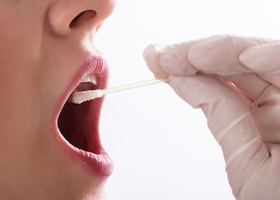



















Biomolecular Analyses for Tailored Medicine in Acne iNversa
Development of
e-gibalec for mobility and lifestyle coaching
Patient recruitment
Collection biological sample
Genetic of AI and syndromic AI
Clinical follow-up
1, 2, 3, 7
1, 2, 3, 7
1, 7
2, 3, 7
6
in vitro cells and organoids models
and human immunocompetent
skin model
Data collection and analysis
Affected biological pathways in AI
4, 5
6
4, 5
4
Partners
1
5
2
6
Test of potential therapeutics
Animal models
4, 5
4, 5
3
7

Slide 25


















Najlepša hvala!
Laboratory of InterOMICS
fOr Personalized
E-Health

