Slide 4
Models of Magma Evolution
Batch Melting
  The melt remains resident until at some point it is released and moves upward
  Equilibrium melting process with variable % melting

Slide 6
Models of Magma Evolution
Batch Melting
  C_{L} = trace element concentration in the liquid
  C_{O} = trace element concentration in the original rock before melting began
  F = wt fraction of melt produced = melt/(melt + rock)
C
1
L
=
E1
C
D_{i}
(1
−
F)
+
F
O

Slide 7
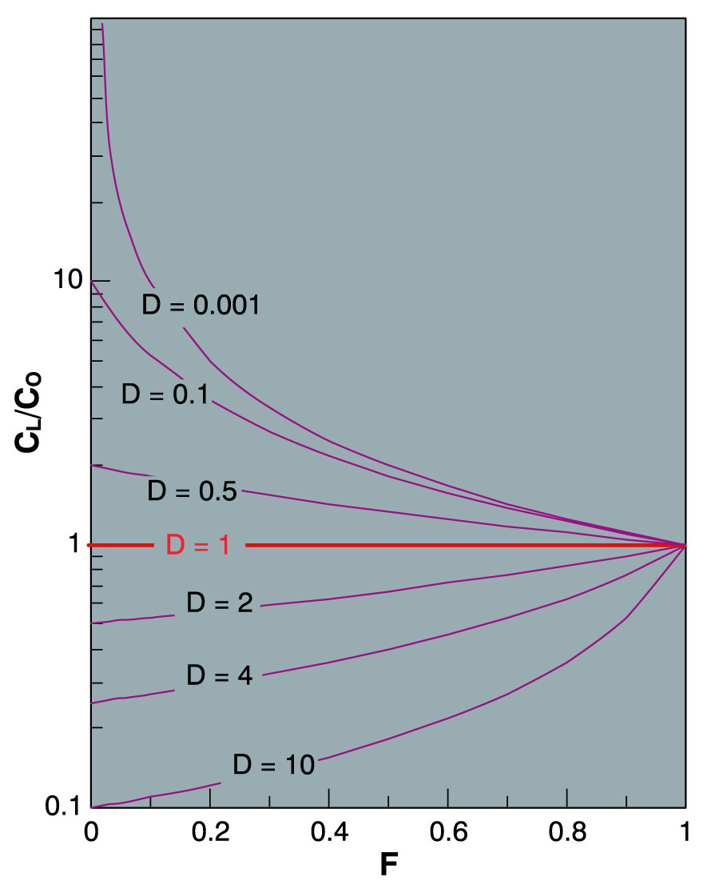
Batch Melting
A plot of C_{L}/C_{O} vs. F for various values of D_{i} using E1
  D_{i} = 1.0
Variation in the relative concentration of a trace element in a liquid vs. source rock as a fiunction of D and the fraction melted, using equation (9-5) for equilibrium batch melting. From Winter (2001) An Introduction to Igneous and Metamorphic Petrology. Prentice Hall.
Notes:
D = 1.0 No fractionation so C_{L}/C_{O} = 1 for all values of F

Slide 8
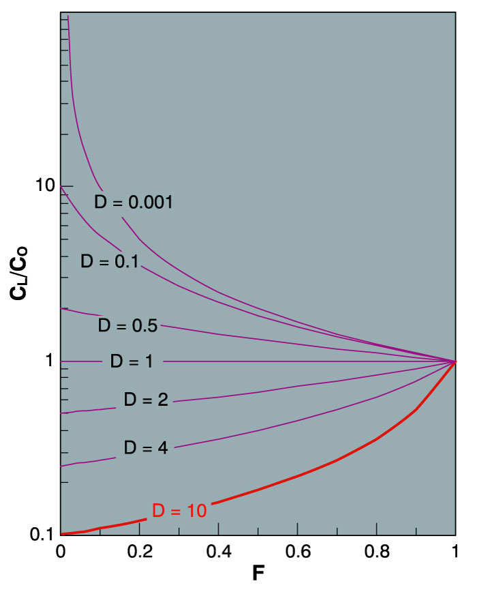
  D_{i} » 10 (compatible element)
  Very low concentration in melt
  Especially for low % melting (low F)
Variation in the relative concentration of a trace element in a liquid vs. source rock as a fiunction of D and the fraction melted, using equation (9-5) for equilibrium batch melting. From Winter (2001) An Introduction to Igneous and Metamorphic Petrology. Prentice Hall.
Notes:
Values of F > 0.4 unlikely for batch melting since greater amounts should separate and rise

Slide 9
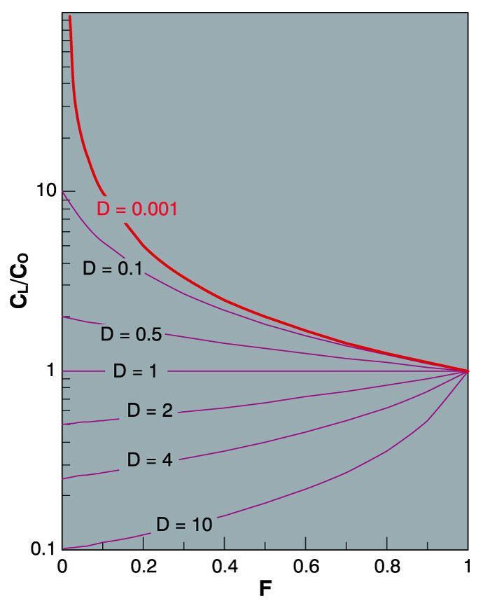
Highly incompatible elements
  Greatly concentrated in the initial small fraction of melt produced by partial melting
  Subsequently diluted as F increases
Variation in the relative concentration of a trace element in a liquid vs. source rock as a fiunction of D and the fraction melted, using equation (9-5) for equilibrium batch melting. From Winter (2001) An Introduction to Igneous and Metamorphic Petrology. Prentice Hall.
Notes:
Highly incompatible elements are greatly concentrated in the initial small fraction of melt that is produced by partial melting, and subsequently get diluted as F increases

Slide 10
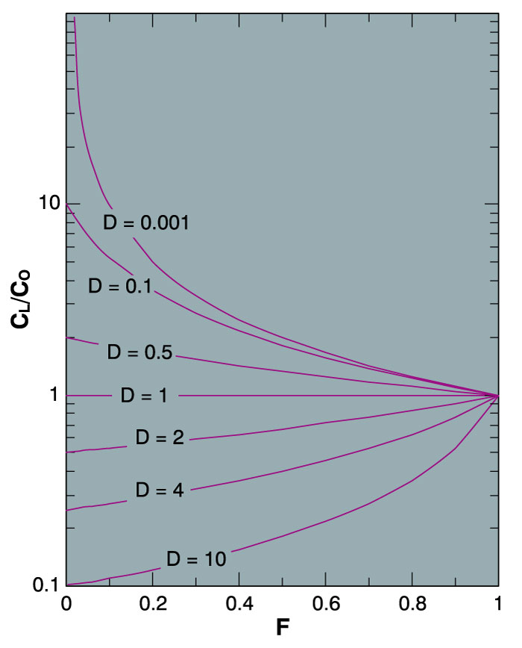
As F → 1 the concentration of every trace element in the liquid = the source rock (C_{L}/C_{O} → 1)
    As F → 1
    C_{L}/C_{O} → 1
C
1
L
=
C
D_{i}
(1
−
F)
+
F
O
1 = tutto fuso = 100% F
Variation in the relative concentration of a trace element in a liquid vs. source rock as a fiunction of D and the fraction melted, using equation (9-5) for equilibrium batch melting. From Winter (2001) An Introduction to Igneous and Metamorphic Petrology. Prentice Hall.
Notes:
All -> 1.0 because all of the source is melted

Slide 11
For very incompatible elements as D_{i} → 0
equation E1 reduces to:
  E2
C
1
L
=
C
D_{i}
(1
−
F)
+
F
O
C
1
L
=
C
F
O
If we know the concentration of a very incompatible element in both a magma and the source rock, we can determine the fraction of partial melt produced

Slide 12
Worked Example of Batch Melting: Rb and Sr
Basalt with the mode:
1. Convert to weight % minerals (W_{ol} W_{cpx} etc.)
Table 9-2
. Conversion from mode to
weight percent
Mineral
Mode
Density
Wt prop
Wt%
ol
15
3.6
54
0.18
cpx
33
3.4
112.2
0.37
plag
51
2.7
137.7
0.45
Sum
303.9
1.00
Notes:
Suppose that a source rock with a mode of 51% plagioclase, 33% clinopyroxene, and 18% olivine undergoes batch melting

Slide 13
Worked Example of Batch Melting: Rb and Sr
Basalt with the mode:
1. Convert to weight % minerals (W_{ol} W_{cpx} etc.)
2. Use equation eq. 9-4: D_{i} = Σ W_{A} D_{i}
and the table of D values for Rb and Sr in each mineral to calculate the bulk distribution coefficients: D_{Rb} = 0.045 and D_{Sr} = 0.848
Table 9-2
. Conversion from mode to
weight percent
Mineral
Mode
Density
Wt prop
Wt%
ol
15
3.6
54
0.18
cpx
33
3.4
112.2
0.37
plag
51
2.7
137.7
0.45
Sum
303.9
1.00
Notes:
Rb is incompatible and Sr only slightly so, but near unity

Slide 14
3. Use the batch melting equation
to calculate C_{L}/C_{O} for various values of F
Table 9-3
. Batch Fractionation Model for
Rb and Sr
C
L
/C
O
= 1/(D(1-F)+F)
D
Rb
D
Sr
F
0.045
0.848
Rb/Sr
0.05
9.35
1.14
8.19
0.1
6.49
1.13
5.73
0.15
4.98
1.12
4.43
0.2
4.03
1.12
3.61
0.3
2.92
1.10
2.66
0.4
2.29
1.08
2.11
0.5
1.89
1.07
1.76
0.6
1.60
1.05
1.52
0.7
1.39
1.04
1.34
0.8
1.23
1.03
1.20
0.9
1.10
1.01
1.09
From Winter (2001) An Introduction to Igneous and Metamorphic Petrology. Prentice Hall.

Slide 15
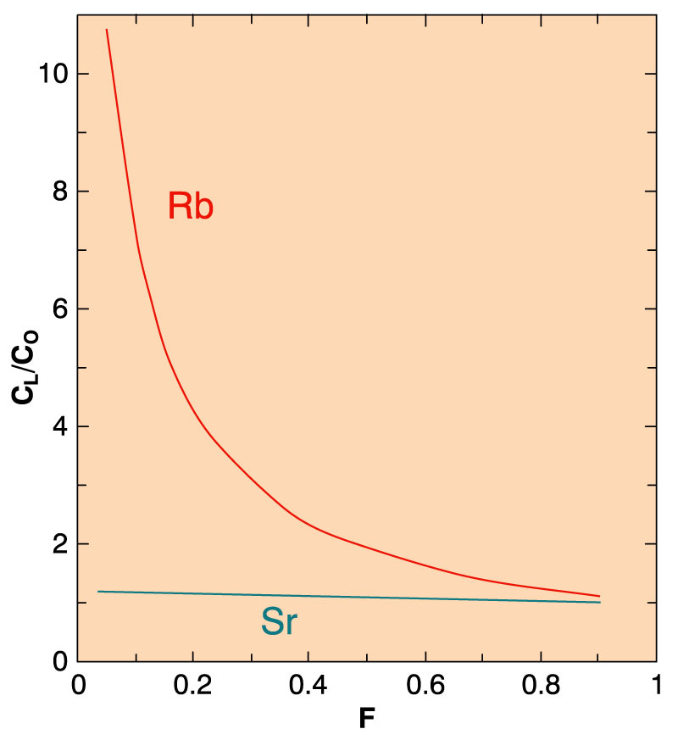
4. Plot C_{L}/C_{O} vs. F for each element
Change in the concentration of Rb and Sr in the melt derived by progressive batch melting of a basaltic rock consisting of plagioclase, augite, and olivine. From Winter (2001) An Introduction to Igneous and Metamorphic Petrology. Prentice Hall.
Notes:
Results:
Incompatible element Rb (no K minerals) strongly concentrated in the early small melt proportions (low F)
Thus → a sensitive measure of the progress of fractional crystallization (at least until rock half melted)
As melting proceeds, the incompatible element is gradually diluted by more compatible ones
Since D(Sr) is close to 1.0, the ratio Rb/Sr vs. F is nearly the same as Rb alone
Any ratio of incompatible to compatible element should then be sensitive to the degree of partial melting (at least in the initial stages).
Important for Rb/Sr isotopic systems
Note that can create a series of melts from a single source each with diff Rb/Sr

Slide 16
A questo punto posso provare ad utilizzare diverse possibili sorgenti reali
E metterli a confronto con i magmi primari
Immaginiamo un grafico Cl (Zr/Y) vs F
Cl(Zr/Y)
Magma primario vero o calcolato
Fusione della peridotite usando i valori per gli incompatibili di Sun &McDonough 1995
0
=F = 1

