Slide 1
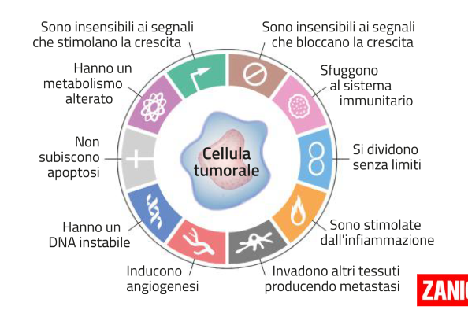

Slide 4
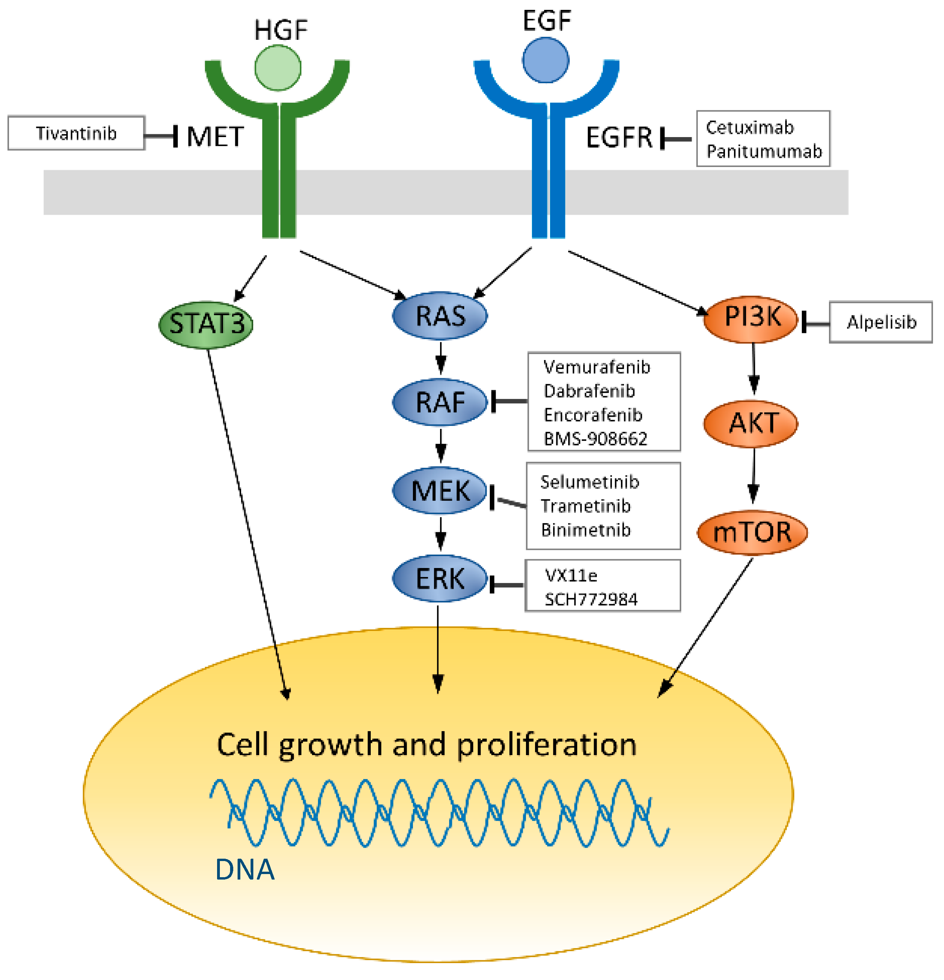

Slide 5
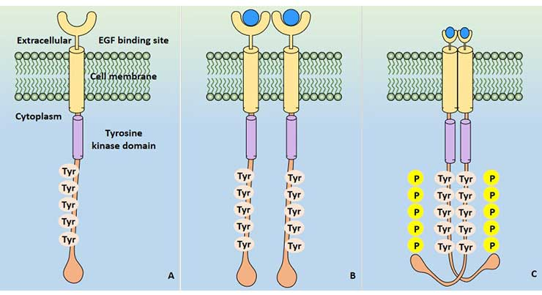

Slide 6
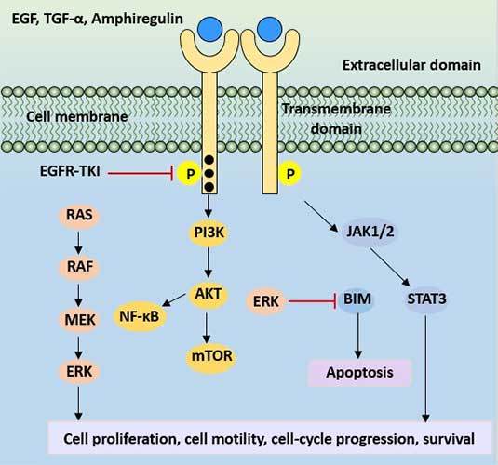

Slide 8
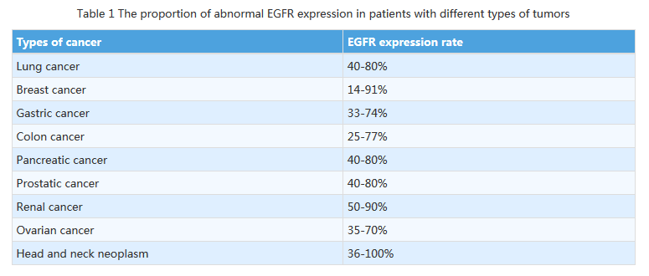

Slide 9
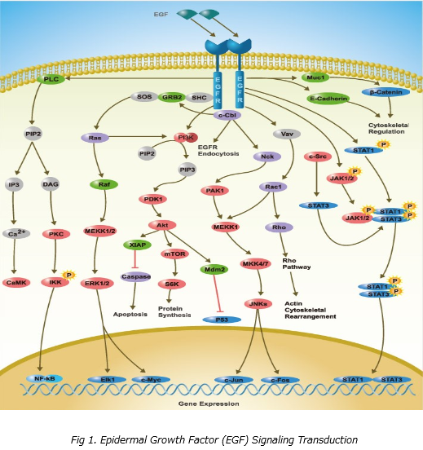

Slide 10
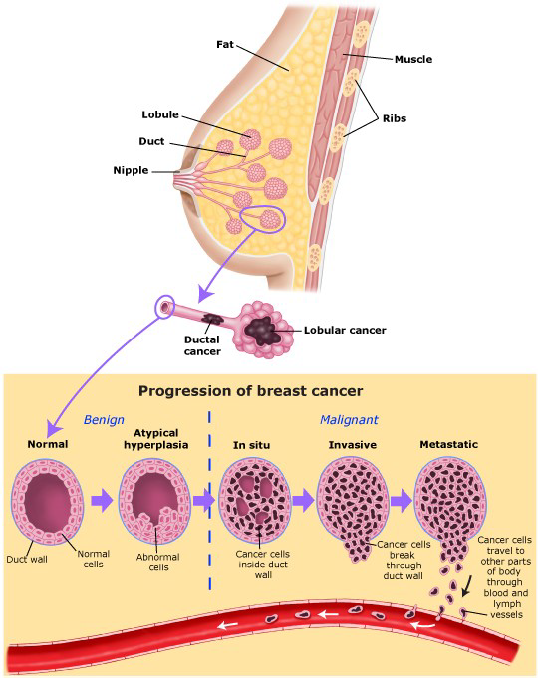

Slide 11
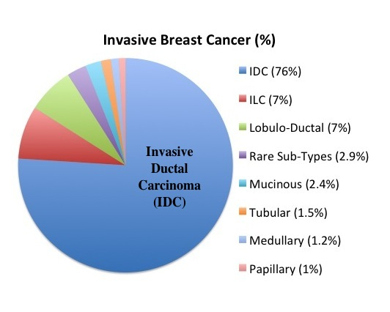

Slide 12
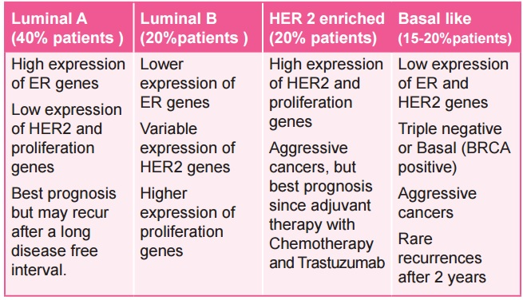

Slide 13
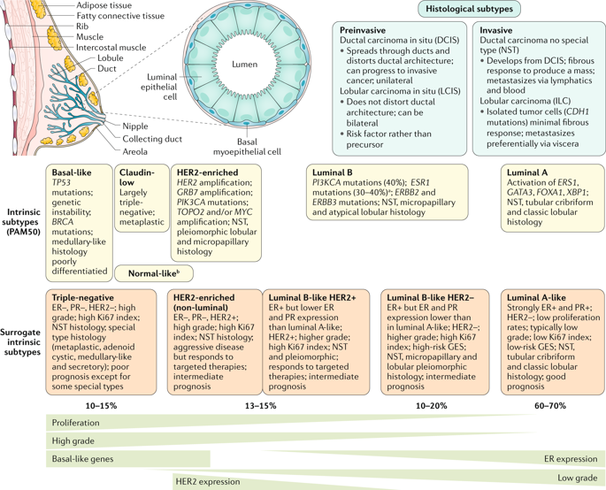

Slide 16
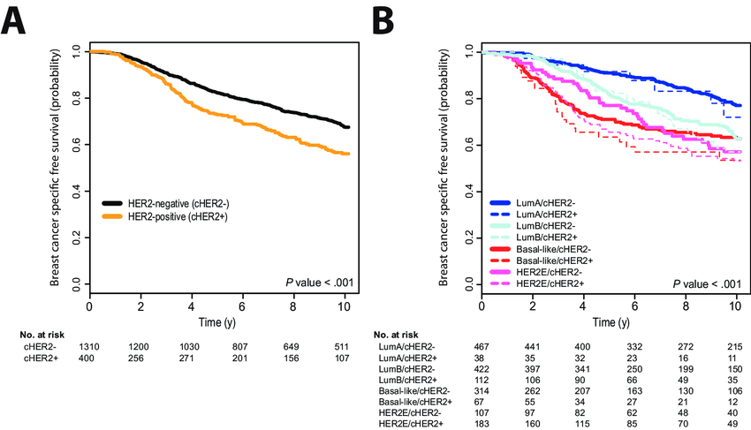
Prat A, 2014

Slide 17
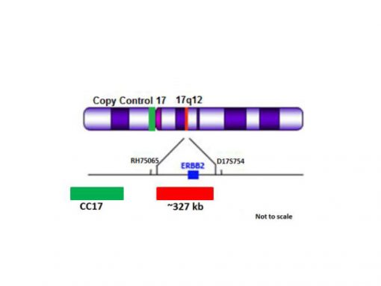
ERBB2

Slide 18
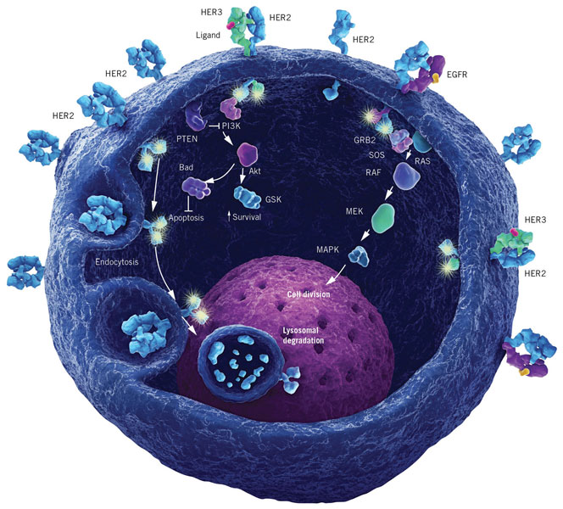

Slide 19
HER2 Overexpression in Breast Cancer
HER2 is overexpressed in ~ 25% of breast cancers
Normal (1x)
~ 25,000-50,000 HER2receptors
Overexpressed HER2 (10-100x)
up to ~ 2,000,000 HER2 receptors
Pegram MD, et al. Cancer Treat Res. 2000;103:57-75.
Ross JS, et al. Am J Clin Pathol. 1999;112(suppl 1):S53-S71.
Slamon DJ, et al. Science. 1987;235:177-182.
Excessive cellular division
Notes:
The HER2 subtype of breast cancer, defined by amplification of the HER2 gene, represents 20% to 25% of breast cancers, and this number is relatively consistent worldwide. When the HER2 gene is amplified, the number of HER2 receptors expressed in the cell increases. As shown in the upper left-hand corner of this slide, a normal cell or a breast cancer cell without the HER2 alteration typically expresses 20,000-50,000 receptors per cell-surface membrane. However, as shown in the center of this slide, HER2 amplification in a tumor cell results in a commensurate overexpression of the receptor and the expression of 2 million or more HER2 receptors per cell in some patients. In general, there is a 2 log increase in the number of receptors displayed on tumor cells when the HER2 alteration is present, which has several phenotypic consequences. Compared with a HER2-normal cell, a HER2-overexpressing cell:
Has a significantly increased growth rate (as shown in the bottom right-hand corner of this slide)
Has a significantly increased ability to form tumors in experimental mice
Displays an increased ability to form metastatic deposits in animal models owing to an increase in cellular motility
Begins to secrete high levels of vascular endothelial growth factor (VEGF) to support metastatic growth
When making therapeutic decisions, it is important to keep in mind that HER2-overexpressing cells are frequently estrogen receptor and progesterone receptor positive, like in the case patient’s tumor. Although estrogen receptor– and progesterone receptor–positive breast cancers are likely responsive to hormonal therapy, response rates decrease significantly with hormonal therapy alone when the HER2 alteration is present.
1. Rowinsky. Annu Rev Med. 2004;55:433.
2. Slamon et al. Science. 1987;235:177.
3. Pegram et al. Cancer Treat Res. 2000;103:57.

Slide 20
HER2 Overexpression Shortens Survival
HER2 oncogene amplification
HER2 oncoprotein overexpression
Shortened survival
Median Survival From First Diagnosis
HER2 overexpressing 3 yrs HER2 normal 6-7 yrs
Slamon DJ, et al. Science. 1987;235:177-182. Slamon DJ, et al. Science. 1989;244:707-712.
Slamon DJ, et al. Science. 1987;235:177-182.
Slamon DJ, et al. Science. 1989;244:707-712.
Notes:
Women with breast cancer cells harboring the HER2 amplification and the associated pathologic overexpression of the HER2 receptor have a much shorter survival. The data on this slide were among the first to show that HER2-positive tumors behave differently clinically.

Slide 22
Trastuzumab mechanisms of action

Slide 24
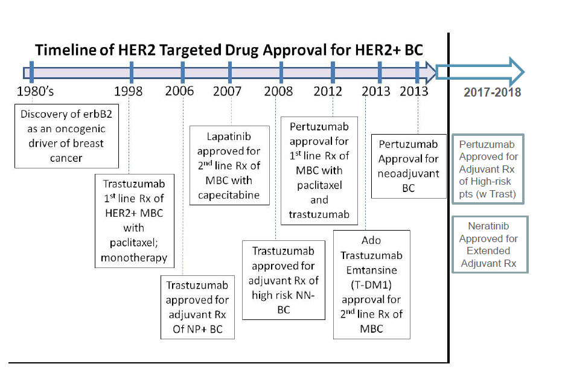

Slide 25
Trastuzumab resistance mechanisms

Slide 26
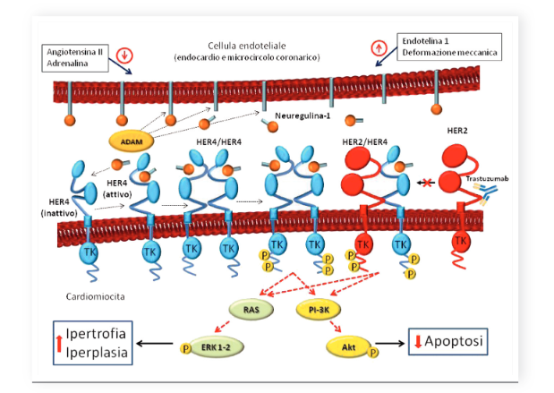
ERBB2 e 4 sono essenziali durante lo sviluppo fetale (regolando l’accrescimento del muscolo cardiaco) e nel cuore adulto in quanto esercitano un’azione di protezione dall’insulto cardiotossico

Slide 27
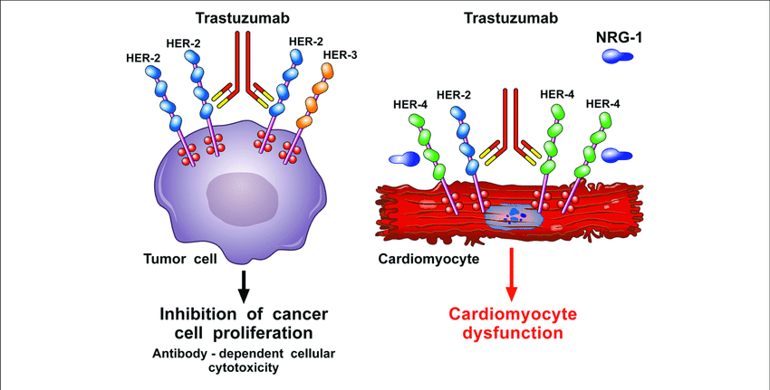

Slide 30
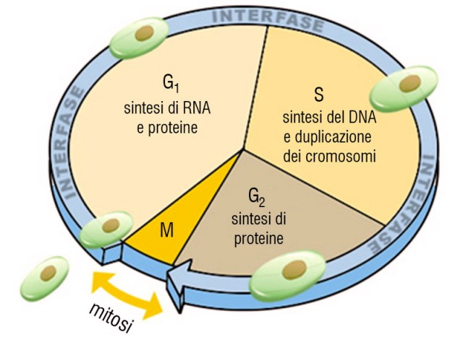

Slide 43
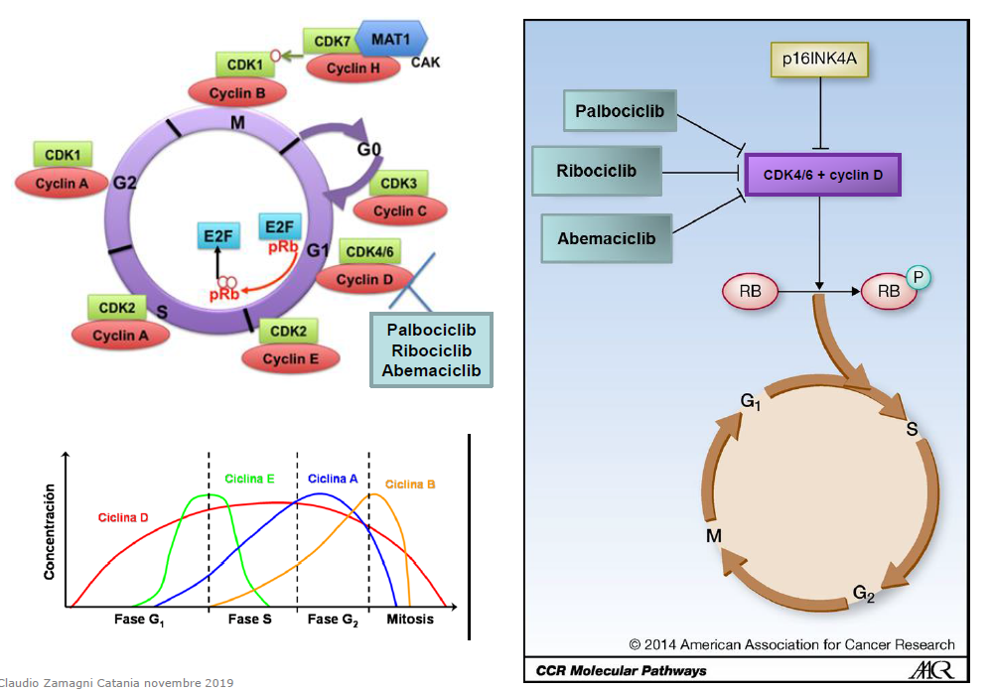

Slide 44
