Slide 1
Precision Medicine: presente o futuro dell’oncologia?

Slide 2
Question
Personalised Medicine = Precision Medicine??

Slide 3
True or False?
When I offer a treatment to a patient, I take into account his/her individual characteristics.
By doing this, you are practicing:
PERSONALIZED MEDICINE

Slide 4
Towards the Personalised Medicine

Slide 5
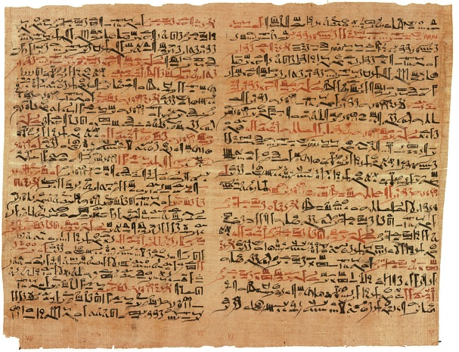
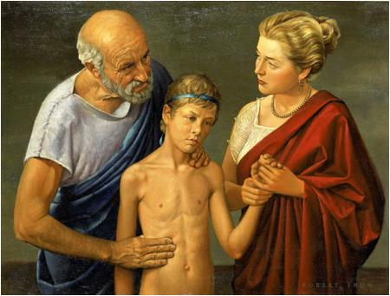
The progress of medical research
has been slow for millennia
Medicine began 45 centuries ago with the Egyptians and the Babylonians. Yet, until the 20th century, physicians could only use their unaided senses to examine patients
The Greeks and Romans perfected ancient medicine, beginning early anatomical dissections
However, from the 2nd century AD dissecting human bodies was forbidden. All we thought we understood about the inner workings of our bodies derived from the dissection of dead animals
Hedwin Smith Papyrus describing brain surgery
Hippocrates examining a young patient

Slide 6
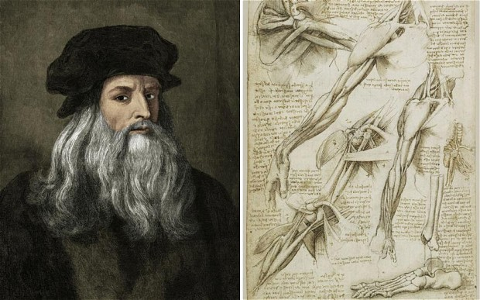
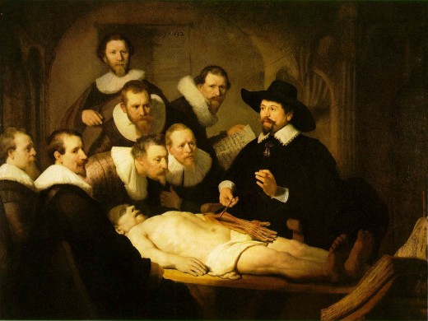
The first revolution: human anatomy
Leonardo da Vinci (1452-1519) jump-started medical science after a long slumber by re-introducing the study of human anatomy through cadaver dissection. For the first time since Roman times, we began learning about the inside of a human body, but remained limited to the resolution of unaided senses

Slide 7
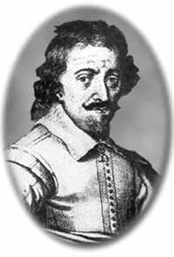
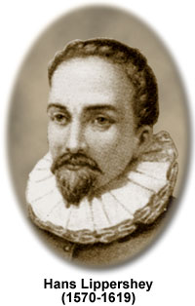
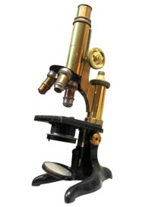
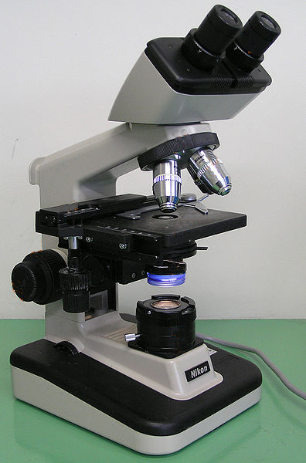
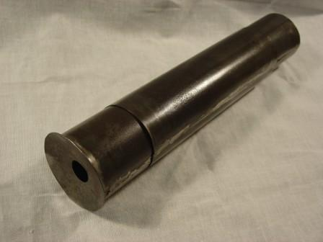
The second revolution: microscopy
A century after Leonardo, the microscope enabled us to observe normal and diseased tissues at the cellular level for the first time in history
Zacharias Janssen (1585-1632)
Hans Lippershey
(1570-1619)

Slide 8
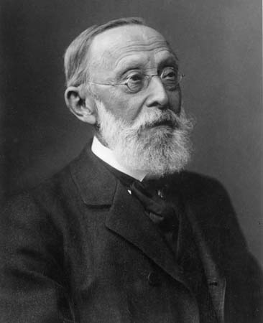
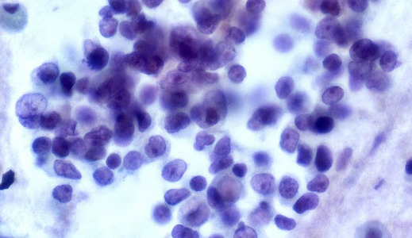
Microscopy brought us pathology
Using the microscope, Rudolf Virchow built his revolutionary theory of the cell as the unit of life and disease:
All living organisms are made of cells
Cells only derive from other cells
Cells are subject to external stresses which damage them, causing disease
Developing this theory took nearly 200 years of microscopy
To this day, most pathology is done by microscopic examination of diseased tissue
Rudolf Virchow
(1821-1902)

Slide 9
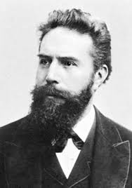
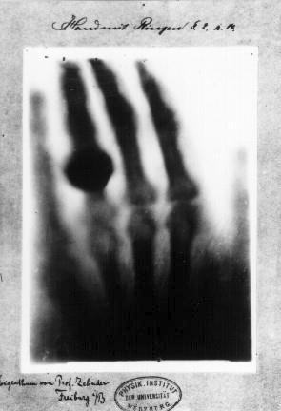
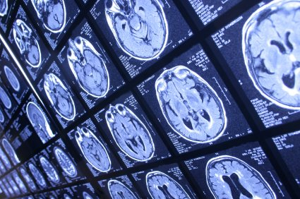
The third revolution: radiology
While pathology improved our ability to look at the cellular pictures of disease, radiology enabled us to look inside living patients
To date, radiology and related imaging techniques (CT, PET, MRI) are essential to diagnosis
Wilhelm Conrad Roentgen (1845-1923)

Slide 10
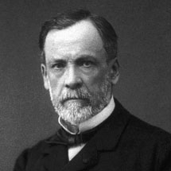
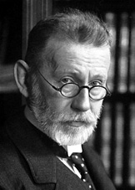
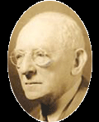
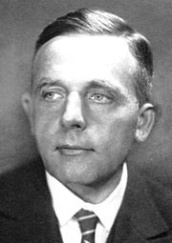
Beyond observation, the fourth revolution: biochemistry
For all the observing we could do, organs and cells weren’t small enough to reveal the molecular mechanisms of disease
Medical science needed to go deeper: to the level of molecules
The application of chemistry to living cells produced biochemistry and elucidated metabolism
Today’s clinical chemistry panels and targeted drugs are the product of a century of biochemistry
Louis Pasteur
(1822-1895)
Paul Ehrlich
(1854-1915)
Carl Neuberg
(1877-1956)
Otto Warburg
(1883-1970)

Slide 11
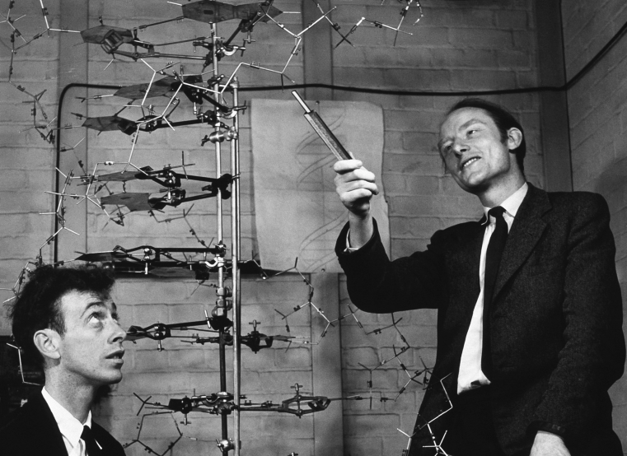
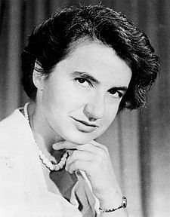
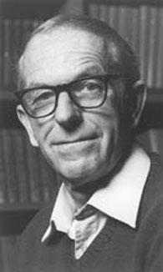
The fifth revolution:
the molecular genetics
James Watson (1928-), Francis Crick (1916-2004)
Rosalind Franklin (1920-1958)
Fred Sanger (1918-2013)
Structure of DNA: the double helix
Routine sequencing of DNA/RNA
made possible!

Slide 12
Cancer Care:
1990s
A Transformative 25 Years
Our Path Forward
Notes:
Today we’ll talk through:
A quick snapshot of cancer care 20 years ago
Major advances of the last two decades that made today’s standards of care possible
3) We’ll also look at the road ahead – the major challenges and opportunities that we have to meet to make the next 20 years just as transformative

Slide 13
Cancer Care 20 Years Ago
Cancer treated primarily based on histology, location and size; few biomarkers
Roughly 200 fewer treatment options than today
Three basic treatment modalities
Limited supportive care options
Notes:
As you can see, tremendous change has occurred…
A note regarding the 200 fewer treatments bullet: This figure is based on the following list of the almost 200 new FDA oncology indications approved since 1996: https://www.centerwatch.com/drug-information/fda-approved-drugs/therapeutic-area/12/oncology)

Slide 14
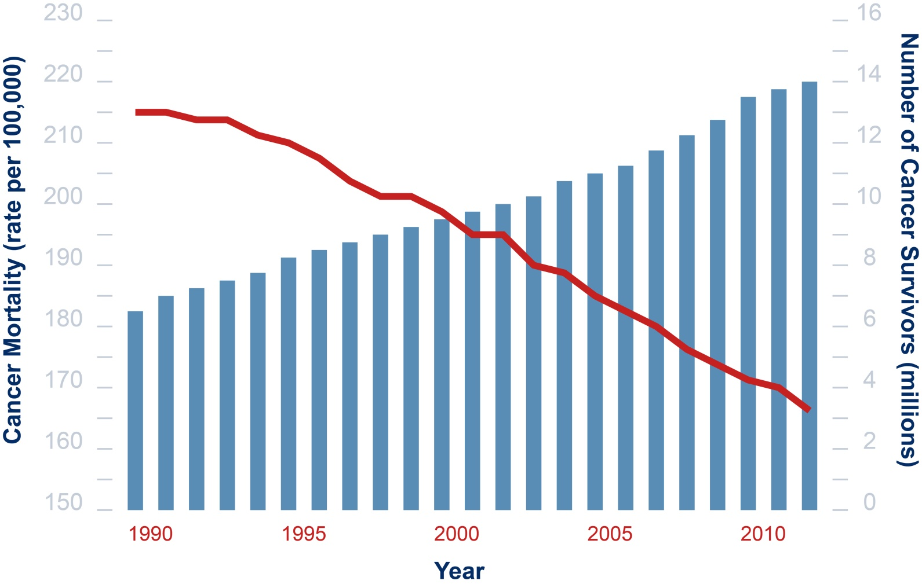
Since the 1990s:
Mortality Down, Survivorship Up
In the United States…
Sources: US Mortality Files, National Center for Health Statistics, CDC. DeSantis C, Chunchieh L, Mariotto AB, et al. (2014). Cancer Treatment and Survivorship Statistics, 2014. CA: A Cancer Journal for Clinicians.
Notes:
This graph illustrates how much progress has been achieved in a relatively well-resourced country: the United States
It’s pulled from ASCO’s CancerProgress.Net, a website we created to document and recognize progress achieved in cancer research
The website features an interactive timeline of hundreds of cancer research milestones from the past 100 years

Slide 15
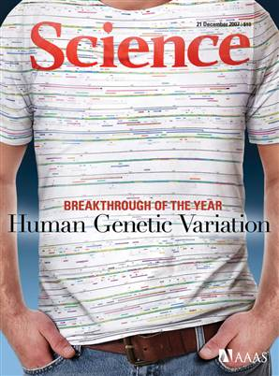
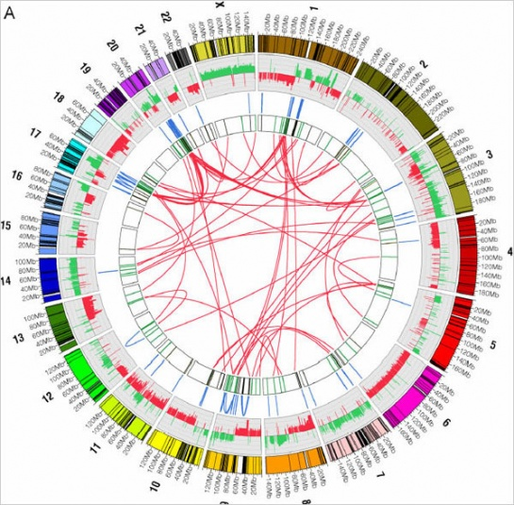

Science Serving Patients
Germline Variation
Somatic
Mutation
Personalized Care

Slide 16
……… VERSUS PERSONALISED MEDICINE
Truly “Personalized” medicine would individualize treatment for each patient, changing not only types of agents but doses and regimens based on purely individual characteristics

Slide 17

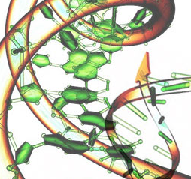

Cancer Genomics
Advent of the “personalised medicine” era
But cancer’s biology is far more complex than we had imagined
2000
2005
2010-2014
Hallmarks of Cancer published
The Cancer Genome Atlas (TCGA) launches
Genetic subtypes of glioblastoma, gastric and other cancers identified via TCGA research
Notes:
Rapid growth in our understanding of cancer’s biology has been fundamental to success.
2000 - Hallmarks of Cancer – pivotal paper set the stage for precision medicine era to come, guiding development of new cancer treatments
2005 - TCGA launch – TCGA quickly sought to decode the genomes of some of the most complex cancers - glioblastoma, ovarian and lung cancers
2010-2014 - TCGA exceeded its initial goals in several cancers. Its findings have been translated into clinical advances
Glioblastoma – Uncovered genetic aberrations that defined clear glioblastoma subtypes (Classical, Mesenchymal, and Proneural). These subtypes directly link to response to aggressive chemotherapy. (Verhaak, RG et al. Cancer Cell. 2010 Jan 19;17(1):98-110.)
Gastric cancer - Uncovered four genetic subtypes that will also help guide treatment and research (TCGA Research Network. Nature 513, 202–209 (11 September 2014) )
Challenge:
We’ve identified and developed effective treatments for the handful of cancers driven by simple, single gene mutations
The next generation of therapies must tackle more complex cancers and factor in challenges like epigenetic modification of gene expression and role of microRNA in controlling gene expression

Slide 18
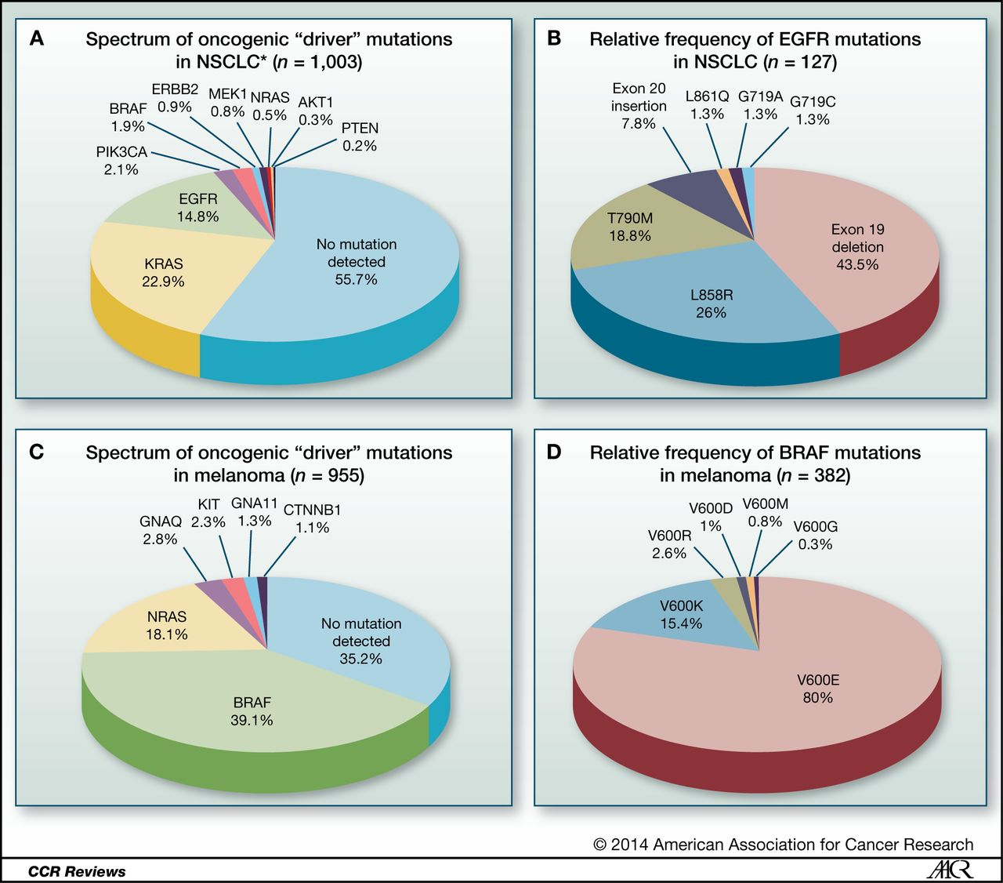
Common Cancers Now Collections
of Rare Cancers
Catherine B. Meador et al. Clin Cancer Res 2014;20:2264-2275
Notes:
Routine molecular subtyping of NSCLCs and melanomas. Frequency of mutations identified by SNaPshot genotyping through Vanderbilt's PCMI from July 2010 to August 2013. A, frequency of lung cancer–associated
mutations. 34 lung tumor specimens contained multiple mutations in the genes listed. *, ALK FISH performed separately. B, spectrum of mutations identified in EGFR. 27 lung tumor specimens contained multiple mutations in
EGFR. C, frequency of melanoma-associated mutations. A total of 23 melanoma specimens contained multiple mutations in the genes listed. D, spectrum of mutations identified in BRAF. One melanoma specimen contained
multiple mutations in BRAF. N, number of tested specimens containing at least one mutation in the genes listed. Frequencies are listed as percentages of total mutations identified.

Slide 19
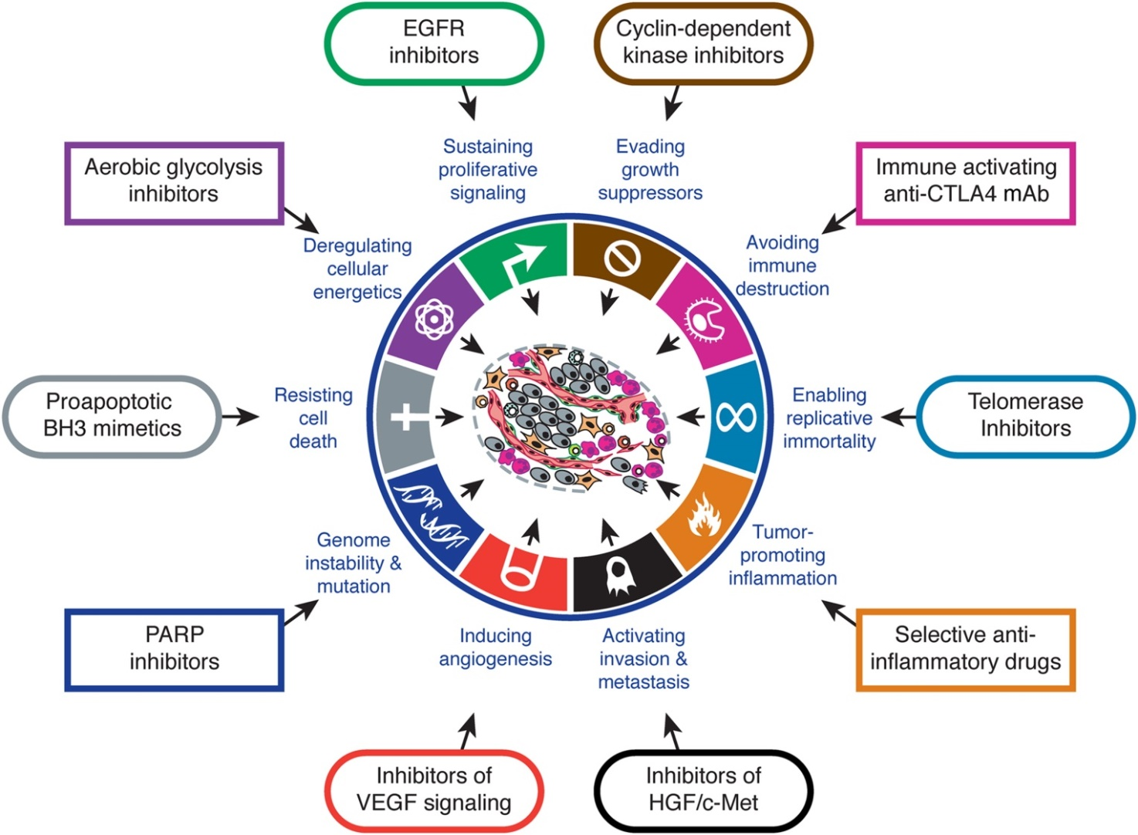
Hallmarks of Cancer:
Therapeutic Implications
Cell 2011 144, 646-674DOI: (10.1016/j.cell.2011.02.013)
Notes:
Therapeutic Targeting of the Hallmarks of Cancer
Drugs that interfere with each of the acquired capabilities necessary for tumor growth and progression have been developed and are in clinical trials or in some cases approved for clinical use in treating certain forms of
human cancer. Additionally, the investigational drugs are being developed to target each of the enabling characteristics and emerging hallmarks depicted in Figure 3, which also hold promise as cancer therapeutics. The drugs
listed are but illustrative examples; there is a deep pipeline of candidate drugs with different molecular targets and modes of action in development for most of these hallmarks.

Slide 20
Personalised Medicine
A form of medicine that uses information about a person’s genes, proteins to diagnose, and treat disease, NCI, 2011
Personalized Medicine in Cancer Requires:
1- Identification of genetic alterations that drive carcinogenesis
2 - Treatment with drugs that can effectively inhibit the
function of the genetic alterations
Consistent use of molecularly targeted therapy
Current definition:
Use of therapeutic agents that target any biological abnormality that is associated with carcinogenesis

Slide 21
The “Magic Bullet” idea
Paul Ehrlich coined the term “Magische Kugel” (magic bullet) to indicate a highly specific agent that would only kill one organism
The original magic bullet was Salvarsan, a syphilis therapeutic
Paul Ehrlich
(1854-1915)

Slide 22
The “Magic Bullet” idea
Although this concept is useful to describe drugs with high specificity (e.g. a monoclonal antibody-drug conjugate, or a targeted kinase inhibitor), it has had unintended consequences
By analogy with infectious diseases, the public (and many physicians and scientists) developed the concept that someday, a “magic bullet” could be found that cures all cancers, exploiting a common weakness of all cancer cells
This erroneous concept is still widespread and internet memes propagate it
http://www.cancertreatmentwatch.org/q/conspiracy.shtml

Slide 23
Mutations in cancer
Gate keeper mutations: transforms normal cell into tumor cell
Rb in retinoblastoma
APC in colon cancer
Driver mutations: confers growth advantage to tumor cell
HER2 in breast cancer
KRAS in colon cancer
Passenger mutations: accidental mutation not conferring
growth advantage to tumor cell
Any gene
Also driver gene

Slide 24
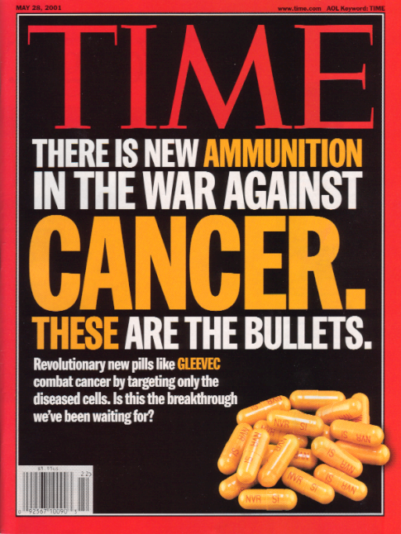
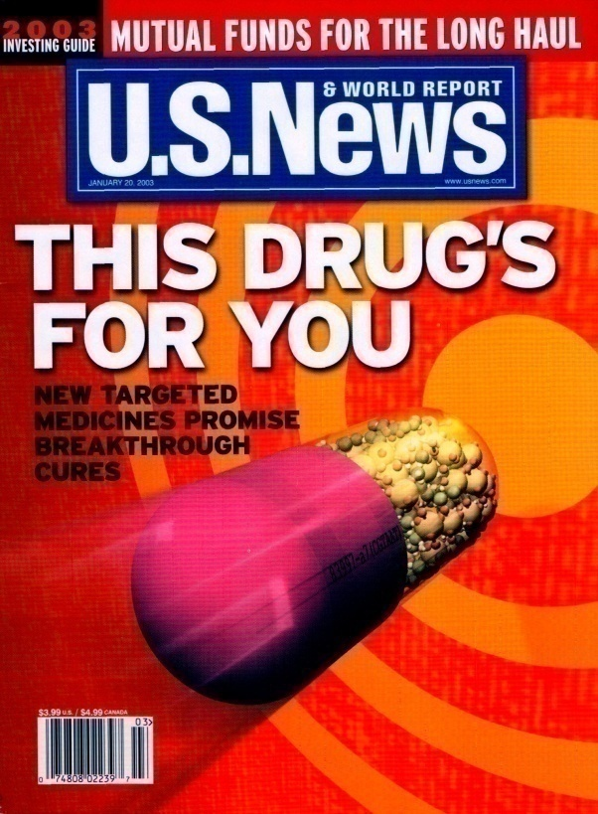
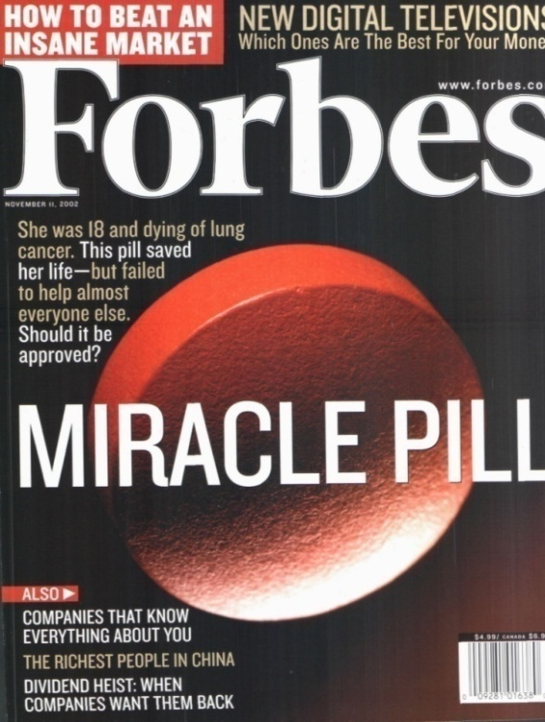
The Rise of Targeted Therapy in the Personalised Medicine Era

Slide 25
The “Magic Bullet” idea
Unfortunately, given what we know today about cancer, the likelihood that a magic cure will ever be found is…
0 or maybe 1
Cancers are so diverse, heterogeneous and mutable that the approach based on looking for a magic bullet is conceptually absurd. Modern cancer therapeutic research is going in the opposite direction, namely, towards individualized, multimodality treatment strategies based on an analysis of individual tumors = The Personalised Medicine
However, the future in cancer therapeutics is Precision Medicine.

Slide 26
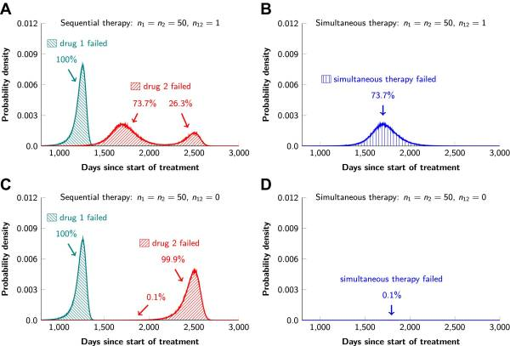
Bozic I, 2013

Slide 27
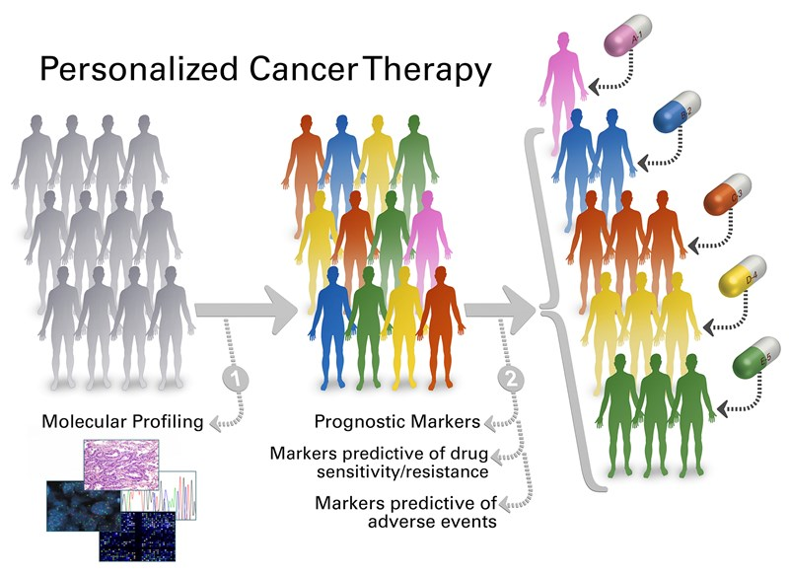

Slide 28
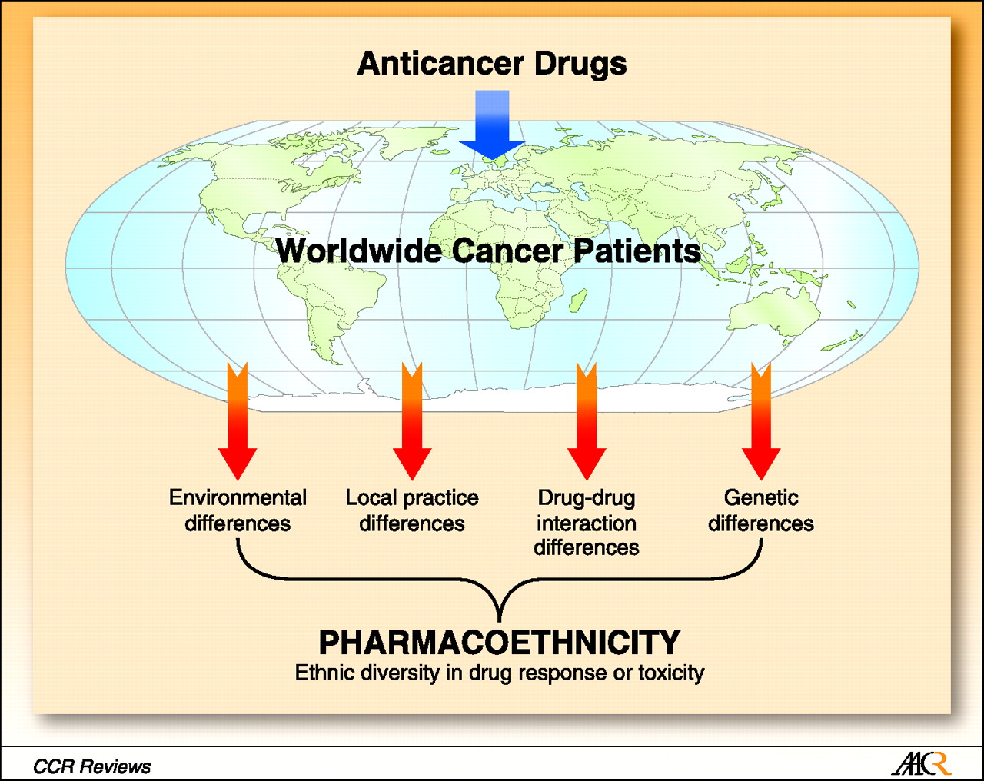
Ethnic Diversity in Drug Effects
O'Donnell P H , Dolan M E Clin Cancer Res 2009;15:4806-4814
Notes:
Pharmacoethnicity, or ethnic diversity in drug response or toxicity, results from the combined interaction of many factors, principally differences in environment, local practice habit and regulatory control differences, drug
drug interaction differences, and genetic differences. Pharmacoethnicity impacts global drug development and anticancer drug efficacy because the safe, tolerable, or therapeutic doses may differ among populations on the
basis of ethnic factors. The importance of studying pharmacogenetics and pharmacogenomics as factors in pharmacoethnicity is becoming increasingly apparent. See also refs. (1, 2). World map courtesy of
http://english.freemap.jp/ and used with permission under the Creative Commons Attribution 3.0 License.

Slide 29
Personalized cancer treatment
GENE | MECHANISM | TARGETED THERAPY
APC | Inactivating mutation | -----------
TP53 | Inactivating mutation | -----------
EGFR | Activating point mutations Gene Amplification Ligands Overexpression Overexpression nuclear EGFR | Cetuximab, panitumumab erlotinib, gefitinib, afatinib
KRAS | Activating point mutations | Tipifarnib, lonafarnib
BRAF | Activating point mutations | Dabrafenib, sorafenib,vemurafenib,
NRAS | Activating point mutations | MEK162
PIK3CA | Activating point mutations

Slide 30
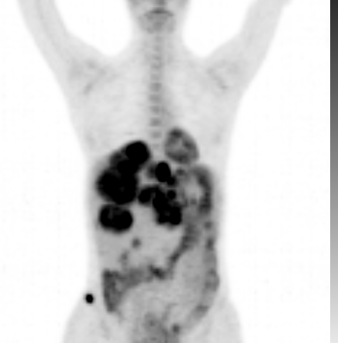
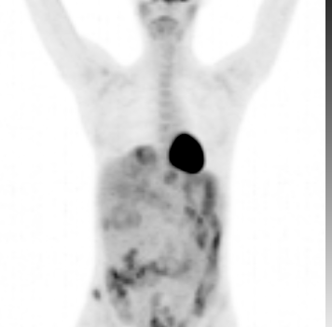
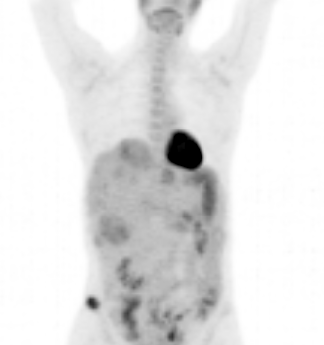
Personalized cancer treatment
Normal
Heart
Resistant
GIST
Baseline:
cKIT+ve-GIST resistant
to Imatinib
After 1 week
of Sunitinib
Therapy
After 2 months
of Sunitinib
Therapy
Notes:
GC – patient #32

Slide 31
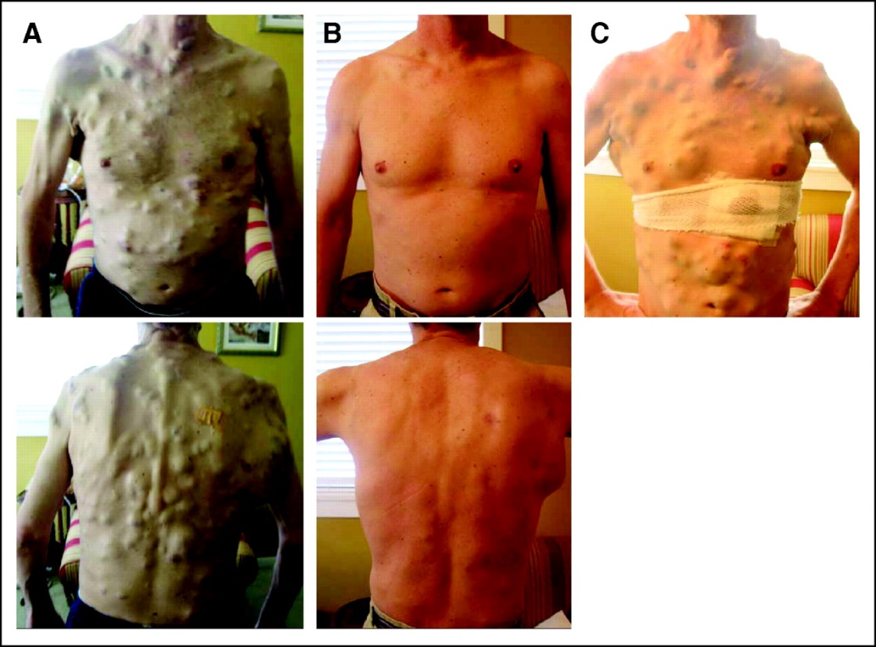
Personalized cancer treatment
But precision medicine has brought new complexity – and challenges
Photographs were taken:
Before initiation of vemurafenib
After 15 weeks of therapy
with vemurafenib
At relapse, after 23 weeks of therapy.
Source: Wagle, N et al. Dissecting Therapeutic Resistance to RAF Inhibition in Melanoma by Tumor Genomic Profiling. JCO August 1, 2011 vol. 29 no. 22 3085-3096
Notes:
Precision medicine is bringing better care, but bigger challenges than we ever anticipated -- as we see here with rapid success and then rapid resistance with melanoma immunotherapies
Need to deepen understanding of tumor heterogeneity, treatment resistance, and better pinpoint the most important cancer-driving mutations
Need to refine our treatment approaches - identify combinations of targeted therapies that more comprehensively fight cancer and prevent development of treatment resistance
We also have a long way to go still with many other common cancers – brain, pancreatic and bladder – where success has been slower
Health IT technologies – including rapid-learning tools like ASCO’s CancerLinQ – can help us tackle some of these challenges, and help clinicians keep up with the rapidly evolving science.

Slide 32
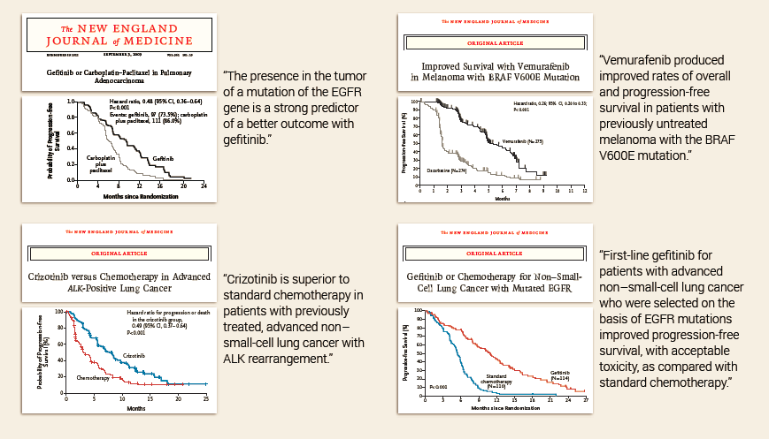
Targeted Therapy Superior to Chemotherapy
Gefitinib
Vemurafenib
In Biomarker Selected Populations
Crizotinib
Gefitinib

Slide 33
Metastatic Lung Cancer
61 yo F non-smoker with recurrent, metastatic non-small cell lung cancer (NSCLC)
64 yo F non-smoker newly diagnosed with non-small cell lung cancer (NSCLC)
Tumors tested negative for (EGFR, KRAS, ALK)
NGS testing pursued.
Activating mutations in the ERBB2 gene - encodes the HER2 protein, a well-known breast cancer biomarker
Clinical Relevance
FDA Approved Therapy: None approved to target ERBB2/HER2 for NSCLC
Drugs targeting ERBB2/Her2 are approved for treatment of breast cancer and are being tested in clinical trials.
Drug targeting both Egfr and Her2 (afatinib) approved in EGFR-mutant NSCLC
ERBB2^{YVMA}
ERBB2^{YVMA}
Clinical Impact – Case 1
Treated with Herceptin Off-Label
The patient has been progression free for > 5 years
Clinical Impact – Case 2
Treated with radiation and SOC.
Progressive disease with development of CNS metastases
Switched to TDM1
Stable disease for approximately 3 yrs

Slide 34
Frequent cancers include high number of very rare genomic segments
(whole genome sequencing breast cancers)
Stephens, Nature, 2012

Slide 35
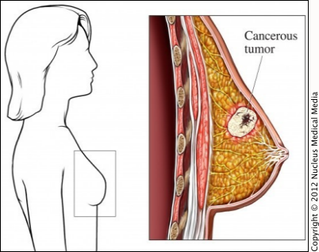
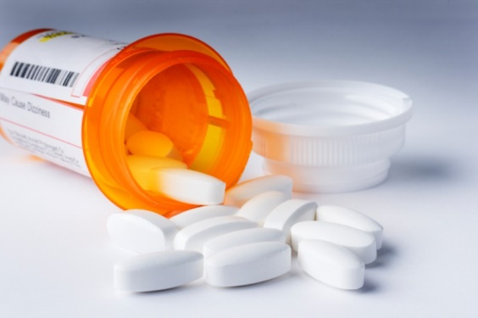
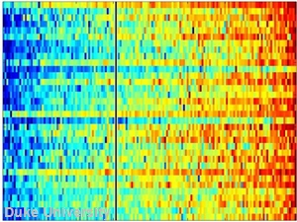
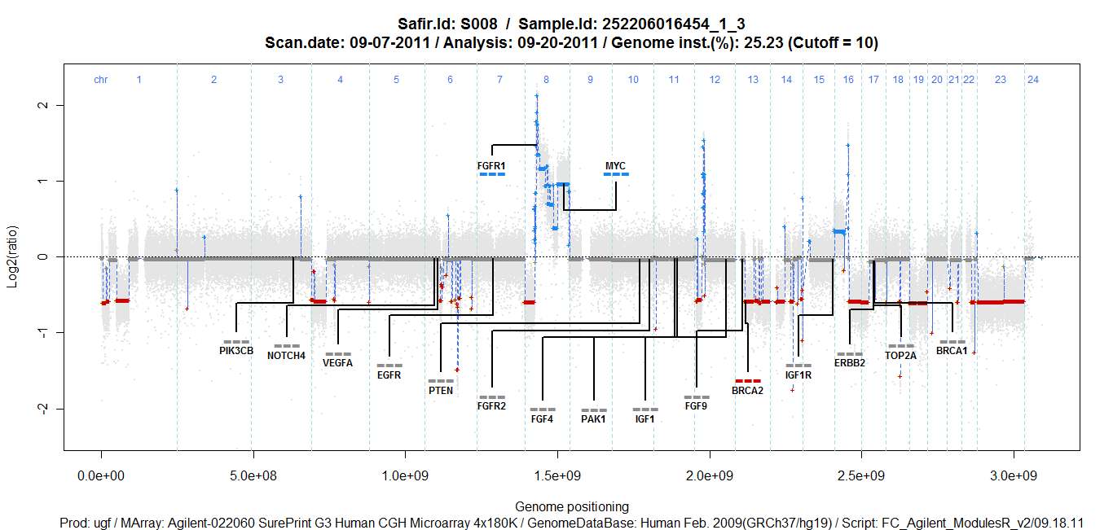
Personalised Medicine
Concept: Identify the targets to be treated in each patient
Clinical evidence
What is the optimal
Biotechnology ?
Therapy matched to genomic alteration
Molecular analysis
What is the optimal
Algorithm ?
Target identification
Andre, ESMO, 2012

Slide 36
Stratified medicine
Drug development or implementation in a strate defined by a molecular alteration
FGFR1 amplification: 10% of breast cancer

Slide 37
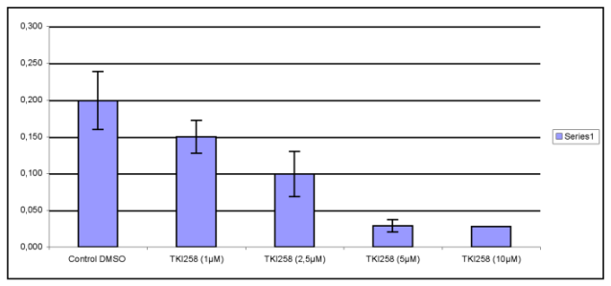
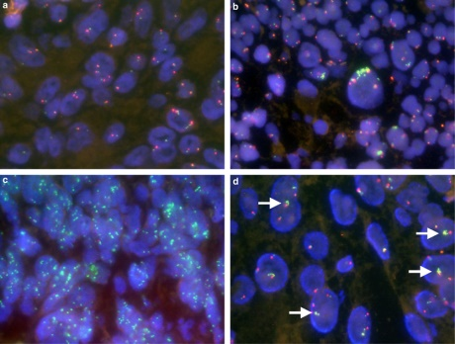
Translational research to feed stratified medicine
FGFR1: amplification in 10% BC
FGFR1 inhibitors present
higher sensitivity
on FGFR1-amplified CC
Set-up genomic test
(FISH)
Run phase II trial
Testing the FGFR1
Inh in patients with
FGFR1 amp BC

Slide 38
Research and medical questions related to personalised medicine
How to facilitate translation of discoveries ?
Develop translational research units
How to set-up a molecular assay for stratified medicine ?
Develop genomic units for clinical use
How to optimally run trials of personalised medicine ?
Set-up molecular screening programs

Slide 39
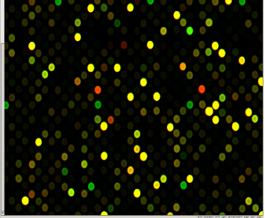
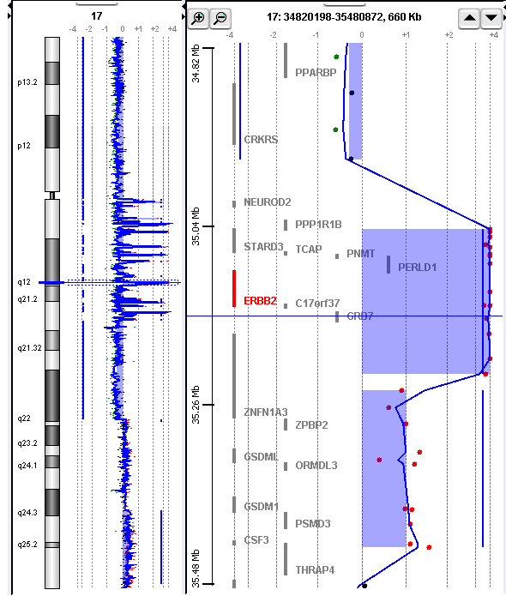
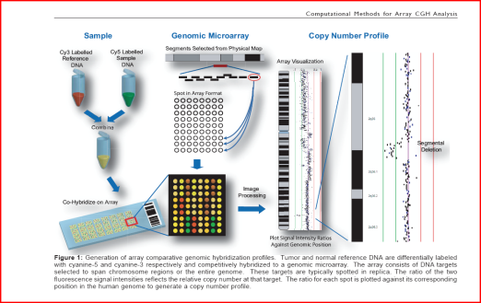
Molecular screening programs: to identify patients eligible for trials
Molecular screening with High Throughput Genomics
Trial A
Trial B
Target
identification
Trial C
IF
Progressive
disease
Trial D
Trial E
Trial F
Andre, Delaloge, Soria, J Clin Oncol, 2011
Notes:
39

Slide 40
Ongoing molecular screening or personalized medicine programs in France
Sponsor
Pilot study
1st generation trials
No NGS NGS
Randomized trials
SAFIR01
SAFIR02
breast
Unified
Database:
Pick-up
the winner
targets
Unicancer
SAFIR02
lung
Gustave
Roussy
preSAFIR
(Arnedos,
EJC, 2012)
WINTHER
MOSCATO
(Hollebecque,
ASCO 2013)
Profiler
MOST
L Berard
Lyon
2nd generation
Algorithm for
Personalized
medicine
SHIVA
(Letourneau
AACR 2013)
Curie
Institute
Overall : >2 000 planned patients (all tumor types), >800 already included
Breast Cancer: > 1 000 planned, >70 already treated
Goal: To generate optimal algorithm for individualized therapy

Slide 41
Evolution:
GENOMIC DISEASES ARE BECOMING TO RARE OR COMPLEX TO ALLOW DRUG DEVELOPMENT IN GENOMIC SEGMENTS
Are we going to make a drug development
for this AKT1 mut / FGFR1 amp segment ?
How to move forward ?
Stephens, Nature, 2012

Slide 42
Solution to improve outcome with targeted therapies in the genomic era:
Test the algorithm not the drug

Slide 43
SAFIR02: Study Design
Biopsy metastatic site:
Next generation sequencing
Array CGH
10 Targeted therapy
According to
51 Molecular alterations
R
Target defined by 1st generation
Virtual cell (CCLE)
Her2-negative metastatic breast cancer
no more than 1 line chemotherapy
Chemotherapy
6-8 cycles
metastatic NSCLC no more than 1 line chemotherapy
EGFRwt / ALKwt
No PD
No alteration
Followed up but not included

Slide 44
Conclusion:
Genomic/Personalised Medicine for Cancer Patients
Target identification for personalised medicine
Large scale screening and implementation new technologies
Integration of new drugs (eg. DNA repair, immunology) in personalized medicine
Understanding mechanisms of resistance

Slide 45


Slide 46
Long term perspective
2018-2020
2013
2015
1st generation
trials
database
2nd
generation
algorithm
2nd
generation
trials
Integration
of
database
PRECISION
MEDICINE
Targeting
oncogenic
drivers
Integration of
other systems:
DNA repair
Immunology
metabolism
WE ARE HERE

