Slide 1
Question
Personalised Medicine = Precision Medicine

Slide 2
PRECISION MEDICINE
DEFINITION:
  An emerging approach for disease treatment and prevention that takes into account individual variability in genes, environment, and lifestyle merged with clinical-social-administrative data (big-data) for each person .

Slide 3
NO

Slide 4
Towards the Precision Medicine

Slide 5
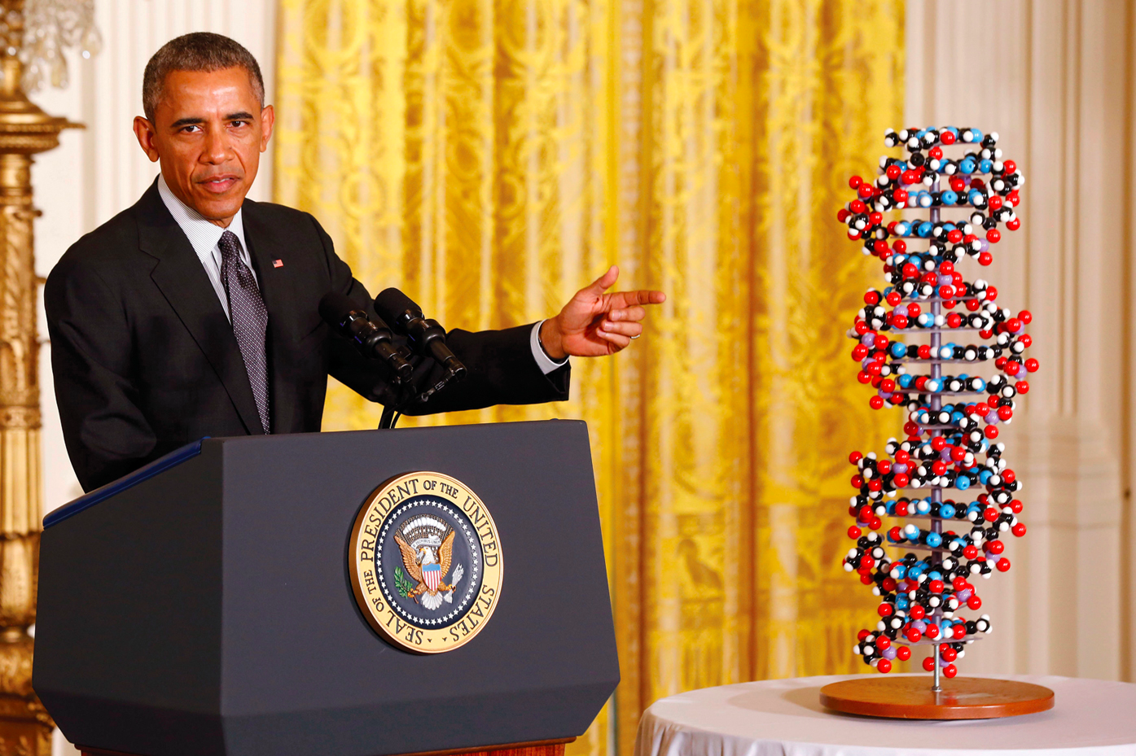
State of the Union, January 20, 2015
“Tonight, I’m launching a new Precision Medicine Initiative to bring us closer
to curing diseases like cancer and diabetes – and to give all of us access
to the personalized information we need to keep ourselves
and our families healthier.”
  President Barak Obama

Slide 6
From MAGIC BULLETS TO RATIONAL COMBINATIONs FOR PRECISION MEDICINE
THE EVOLUTION OF CANCER DRUG DEVELOPMENT

Slide 7
The traditional “Clinical Trial and Error” drug development is highly inefficient
The development of a novel medical intervention (new drug, device, test) that is reasonably SAFE and EFFECTIVE is extremely difficult and expensive: on average, it requires 14 years and $2 billion, not including the basic research that generates the initial concept
This traditional “trial and error” process has a 95% failure rate, in large part because it is based on incomplete and often partially incorrect scientific knowledge
Clinical and basic investigators operate in parallel silos with significant language barriers
Neither industry nor academia can bridge this gap alone

Slide 8
Medical Research Workflow:
Traditional Vs. Translational
Basic
Science
In vitro/animal models. Study design informed by knowledge of disease process in humans and applicability considerations
Incremental improvement in clinically relevant biological knowledge
Applied
Science
Mechanism-based screening and potency assays
Identification of lead drug candidate based on best available biological and clinical information, clinically relevant models
Clinical Science
Phase 1-3 clinical trials
Endpoints based on target biology, biologically informative studies
Mechanism-based combinations
Delivery to patients/communities
Real world clinical use of new intervention
Post-marketing studies (rare side effects, genetic variability in safety/efficacy)
Safety
Efficacy

Slide 9
The translational process is based on cyclical, recursive information transfer
Research
Team
Lab
Data
Bed
side
Data

Slide 10
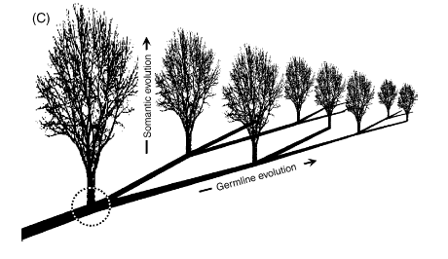
Genetic, epigenetic,
genomic, and
cytogenetic changes
Your somatic cell lineages
YOU
SOMATIC
EVOLUTION
birth
YOUR KIDS
GERMLINE EVOLUTION

Slide 11
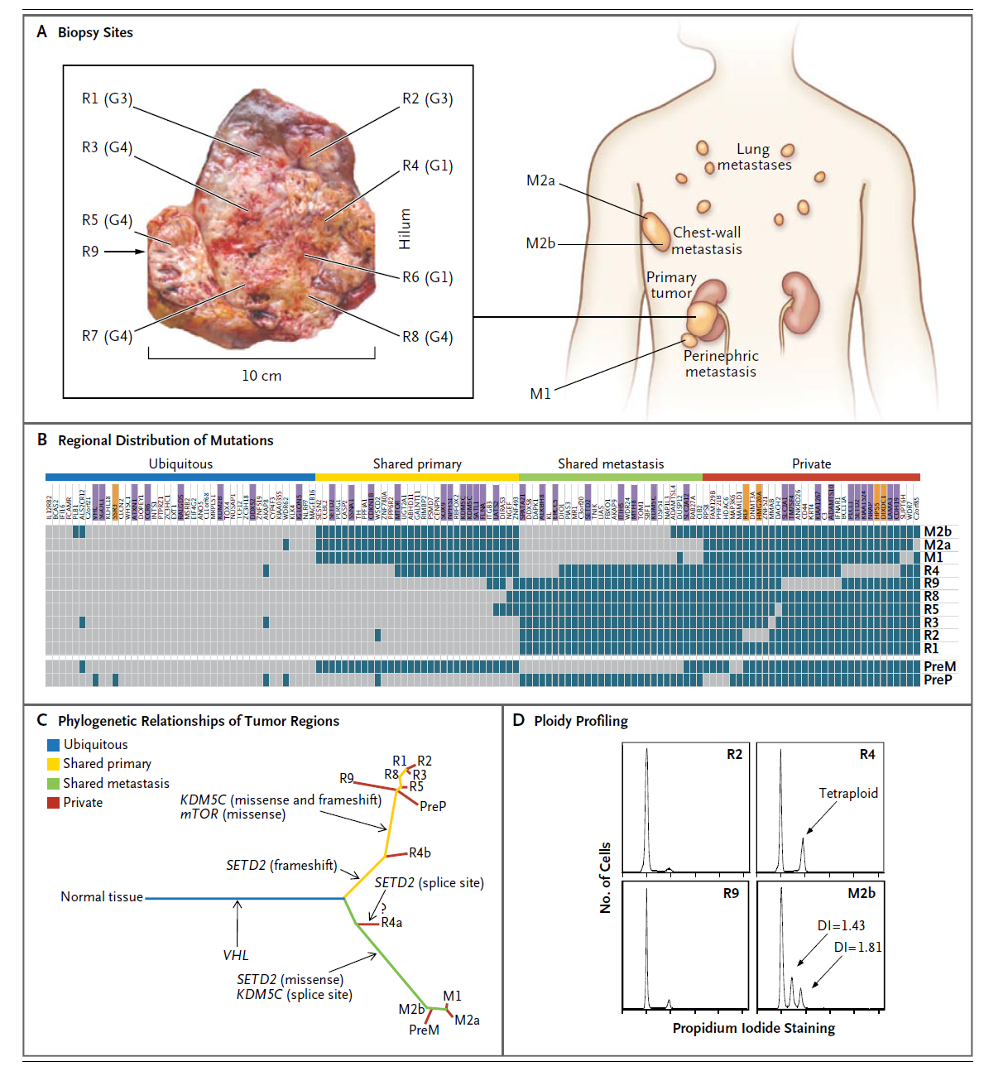
Intratumor heterogeneity, genomics and precision medicine
GE: Good / Poor Prognostic signatures differs by region

Slide 12
Treatment inducing Resistance
TREATMENT
RELAPSE
EGFR | KRAS | WILD

Slide 13
The curative potential of immunotherapy
Ipilimumab long-term survival data
Pooled OS data for 1,861 patients treated with ipilimumab in phase II and III studies
Is melanoma
an unicum?
Schadendorf D JCO 2015

Slide 14
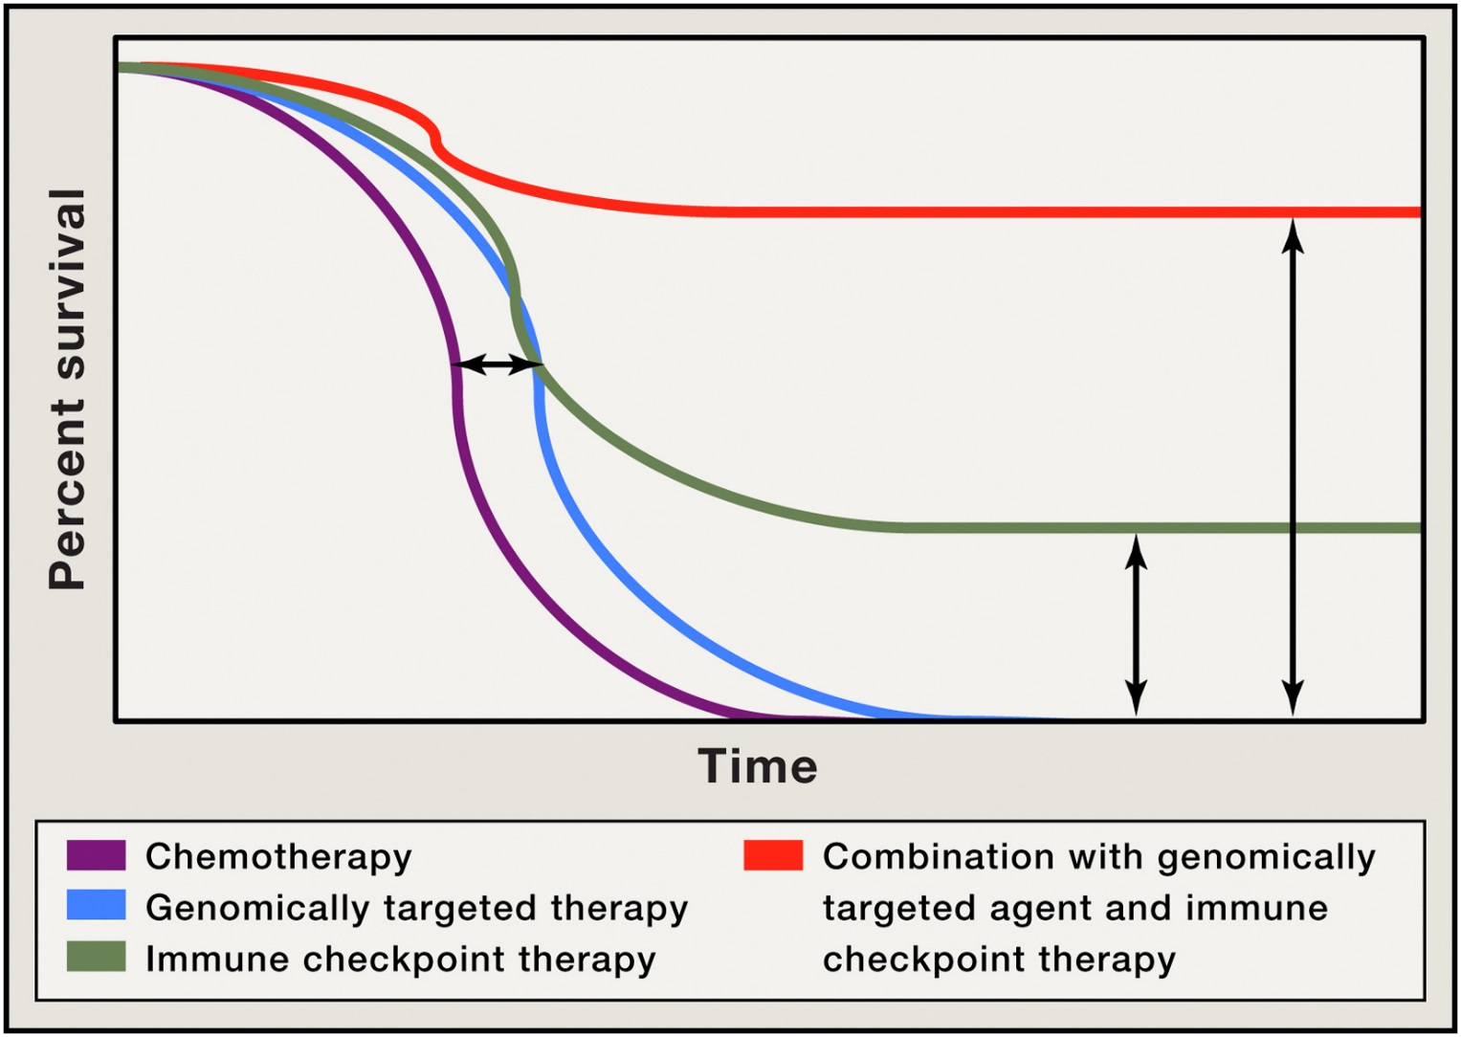
Figure 2
Rational, Adaptive Combinations based on bio-clinical data analysis are more likely to deliver curative results
Cell 2015 161, 205-214DOI: (10.1016/j.cell.2015.03.030)
Notes:
Improved Overall Survival as a Result of Combination Therapy
Depiction of Kaplan-Meier survival curve with genomically targeted agents (blue line) as compared to standard therapies (purple line), indicating an improvement in median overall survival but lack of durable responses; improved median overall survival and durable responses in a fraction of patients treated with immune checkpoint therapy (green line); possibility for improved median overall survival with durable responses for the majority of patients in the setting of combination treatment with genomically targeted agents and immune checkpoint therapy (red line).

Slide 15
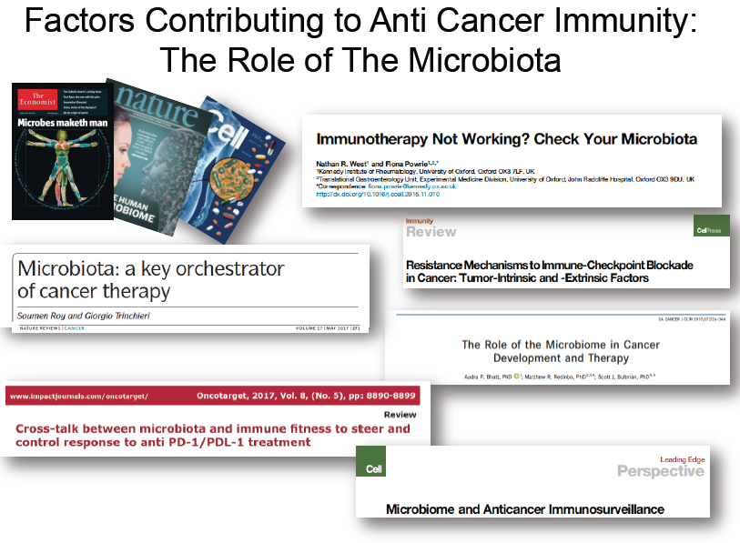

Slide 16
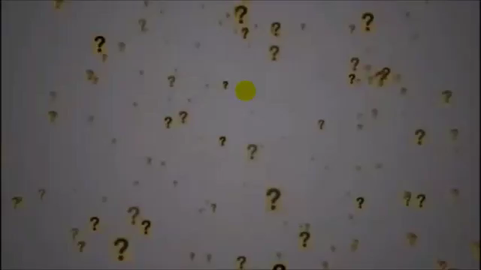

Slide 17
The game is changing:
The exponential revolution

Slide 18
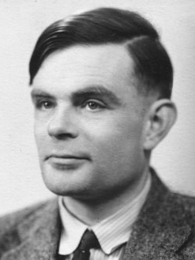


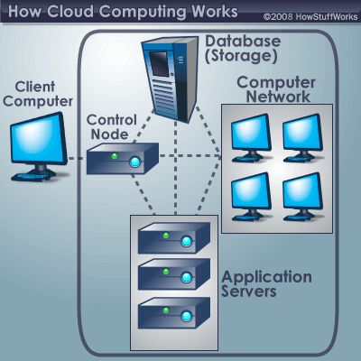
Informatics unlocks the ability to analyze massive datasets
Alan Turing
(1912-1954)
Steve Jobs
(1955-2011)
Bill Gates
(1955-)
Mainframe
digital computers
1940s-50s
Personal computers
1980s
Cloud computing
2010s
INTERNET

Slide 19
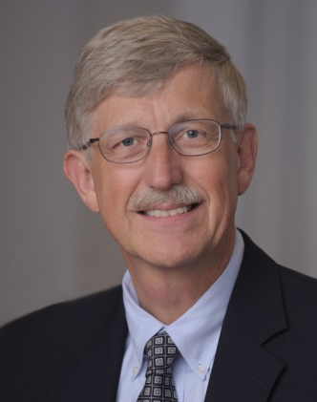
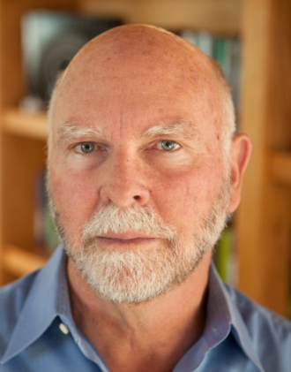
Molecular genetics + bioinformatics = genomics
Francis Collins
(1950-)
Craig Venter
(1946-)
Sequence of the human genome

Slide 20
Precision Medicine
What is Precision Medicine:
“An emerging approach for disease treatment and prevention that takes into account individual variability in genes, environment, and lifestyle for each person.“*
  Enables physicians to tailor medical treatment for each patient
  Supports the development of molecularly targeted drugs based on biologic pathways
  Identifies at-risk populations for targeted prevention prior to disease onset
Key Drivers of Precision Medicine:
Genomic Sequencing Technologies
  Rapid drop in sequencing costs
  First human genome cost $2.7B
  Currently ~$1,000 / genome with the promise of the $100 genome in near future
Genomic Data and Analytic Capabilities
  Creation of large genomic datasets
  Advanced analytics to identify novel disease associations and treatment strategies
*NIH - https://ghr.nlm.nih.gov/primer/precisionmedicine/definition

Slide 21
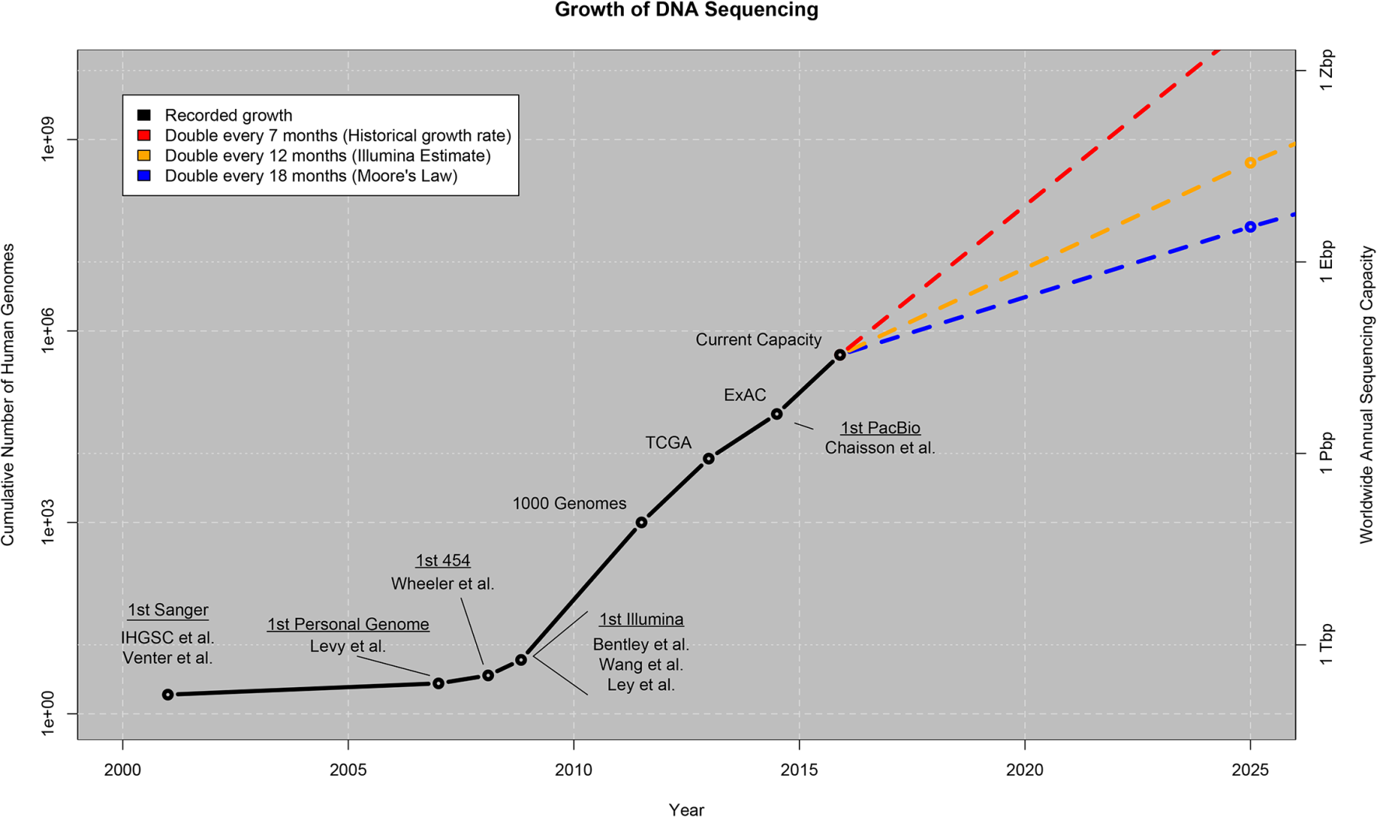
Genomic Sequence Data is Rapidly Growing
Estimated 100m – 2B genomes sequenced by 2025
Genomic Data
Raw Whole Genome ~3B base pairs
~30x + coverage
~100 gigabytes
Whole Genome ~3B base pairs
~700 megabytes
Whole Exome ~30M base pairs
~7 gigabytes
Variant Call File ~3M Variants
~125 megabytes
Currently ~250,000 genomes sequenced
Stephens et al. 2015
This wealth of genomic information can be applied to multiple groups (patients, providers, payers, and life sciences) to realize the promise of precision medicine

Slide 22
Genomics-BioInformatics is bringing about a revolution in the diagnosis and prognosis of disease similar to the introduction of pathology, radiology or biochemistry
History
Physical
Imaging
Pathology
Clinical Chemistry
Genomics
BioInformatics
“Precision Medicine:
diagnosis, prognosis, prevention, treatment based on multi-data”

Slide 23
The data barrier
1 single human genome sequence = approx. 3.7 billion bp = 4 TB
Each needs to be read multiple times (30-500X) in short overlapping stretches which are then aligned to compile “the sequence”
Now this needs to be compared to a “reference” human genome to distinguish “normal” from “variant”
Then the possible consequences of each variation need to be predicted
Multiply all this by the number of patients you wish to study
Then correlate this data with clinical, environmental, epidemiological variables…. before you can draw any meaningful conclusions

Slide 24
“Big Data” analytics are the hidden backbone of precision medicine
Class discovery: e.g., identification of patient populations with similar characteristics
  Reclassification of patients based on molecular variables correlated with clinical measures
  Multicenter clinical trial design, “basket” trials
Class comparison: comparing clinical outcomes or disease prevalence based on multiple variables with large N
  Molecular and classical epidemiology
Class prediction: predicting clinical outcomes from genomics, non-genomic datasets
Identification of actionable trends in health care
  Adverse events in specific patient groups
  Resource usage

Slide 25
Challenges for Precision Medicine -1
Data ontology must be homogeneous and carefully thought out. Need “flexible standardization” for cooperative studies
  EHR mining, natural language search algorithms needed
For genomic datasets (WES, WGS) we DON’T know the phenotypic effect of most genetic variants we discover
  Variants of Unknown Significance (VUS), silent mutations. Different mutations in the same gene can and do have different biological consequences
  Genes work in networks, not in isolation: pathway discovery and pathway annotation are improving but remain somewhat imprecise
  We still need basic science to improve our models to make accurate predictions
  Heterogeneous cell populations require deconvolution or single cell omics

Slide 26
Challenges for Precision Medicine -2
Computationally intensive
  Data storage capacity, cloud computing
  Data transfer speeds
Privacy concerns
  Data security is essential (separate servers for outside-facing apps and databases)
  Need for encryption - GPID
  Consent needed for use of PHI. Standard consents

Slide 27
Challenges for Precision Medicine -3
Patient selection
  Who needs? what tests?
  Role of specialists in medical genomics
Result interpretation and explanation
  “What do these results mean?” Need to communicate results in an accurate, understandable way that takes into account patient and family concerns
  Role of genetics counselors

Slide 28
Long term perspective
2018-2020
2013
2015
1st generation
trials
database
2nd
generation
algorithm
2nd
generation
trials
Integration
of
database
PRECISION
MEDICINE
Targeting
oncogenic
drivers
Integration of
other systems:
DNA repair
Immunology
metabolism
WE ARE HERE

Slide 29
