Slide 1
Expression and purification of recombinant proteins

Slide 2
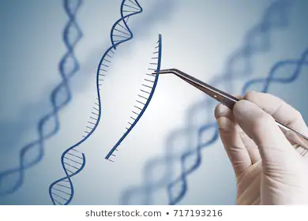
Recombinant protein: protein prudeced from the expression of recombinant DNA.
Recombinant DNA: «Recombinant DNA Technology is defined by the Encyclopedia Britannica as “the joining together of DNA molecules from different organisms and inserting it into a host organism to produce new genetic combinations that are of value to science, medicine, agriculture and industry.”» Sciencedirect.com

Slide 3
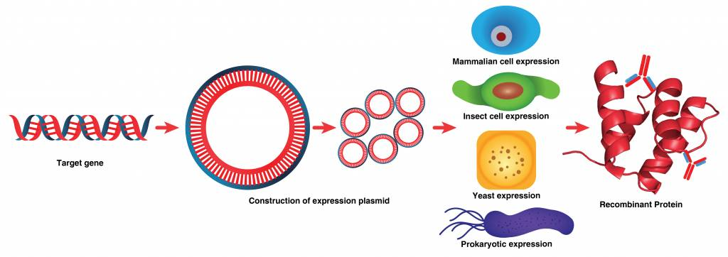
Flow work
Cloning
Expression in host
Purification of the target protein

Slide 4





Know your target protein!!
Informations about sequence, genome, litterature
Free online tools for allignment (Lalign) or protein parameters evaluation (Protparam)
BLAST: find similar sequences
Database of all known protein strucutres
Informations about proteins

Slide 5
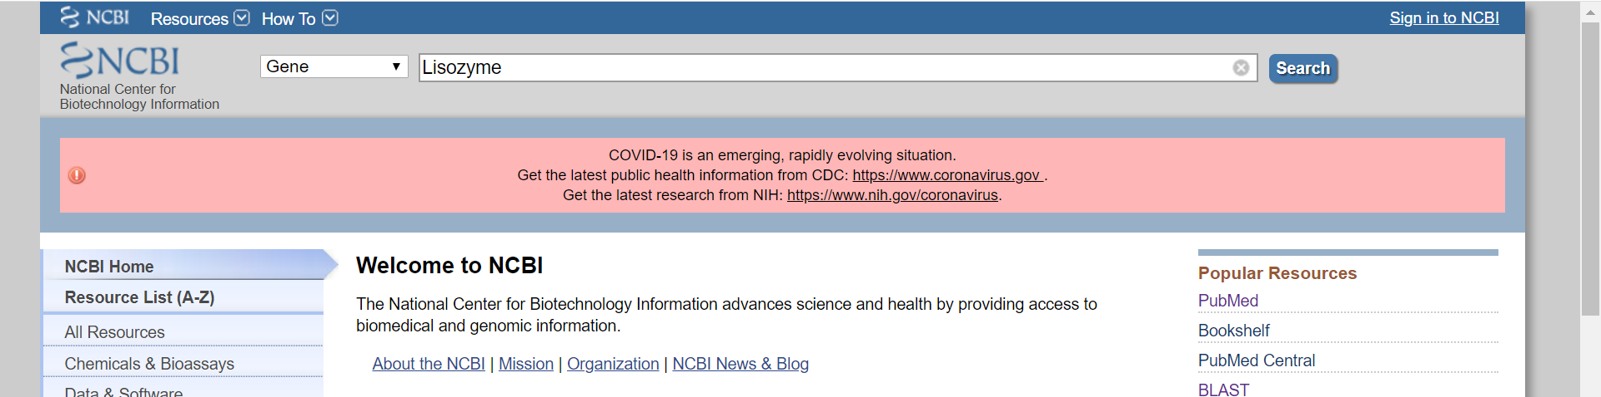
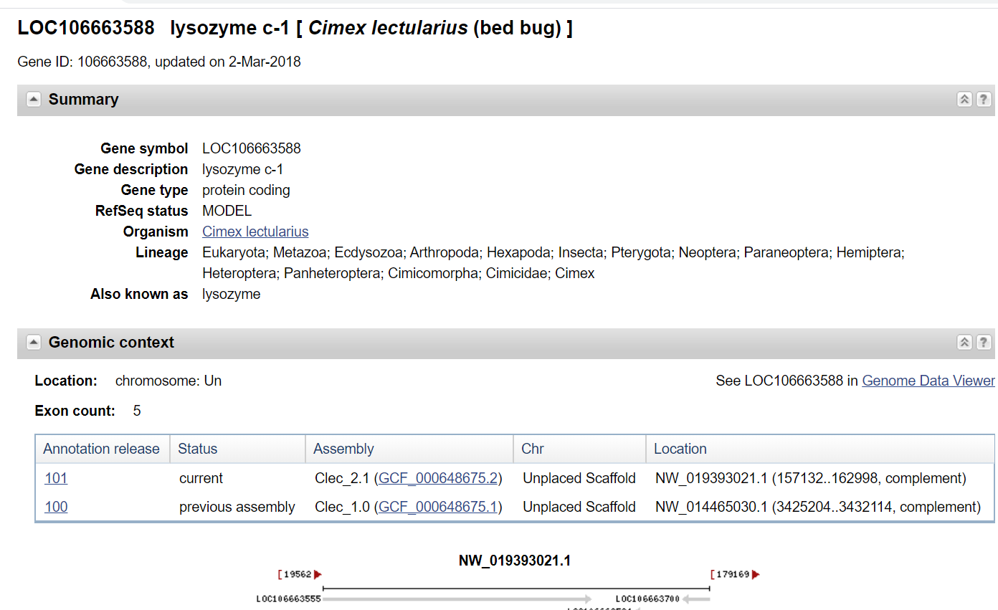
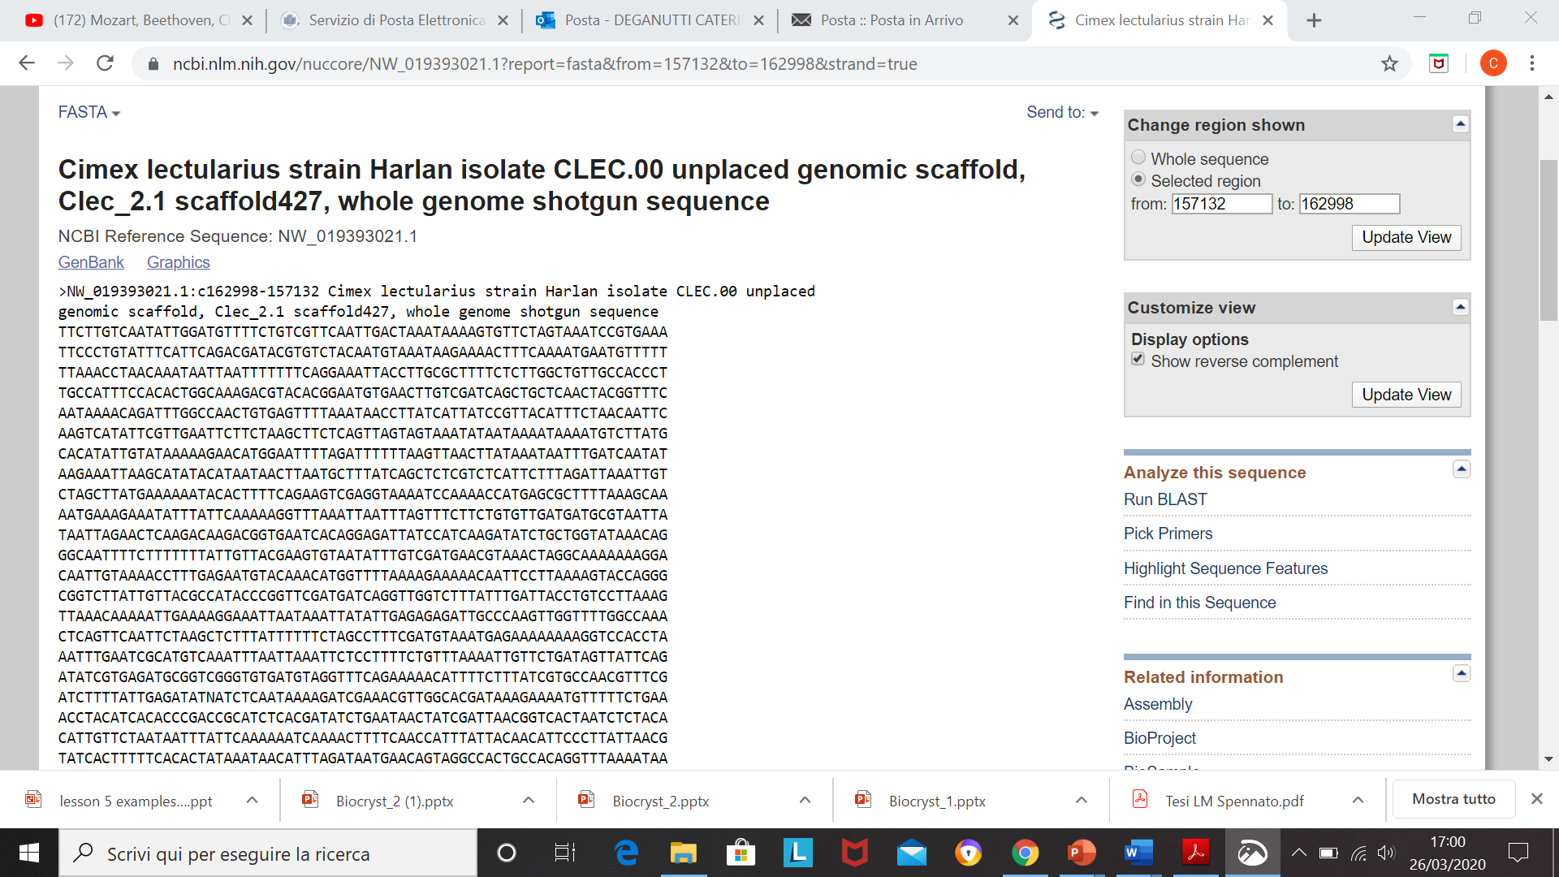
https://www.ncbi.nlm.nih.gov/
Gene or protein
Informations about gene or protein
Fasta: nucleotides or aminoacidic sequences

Slide 6
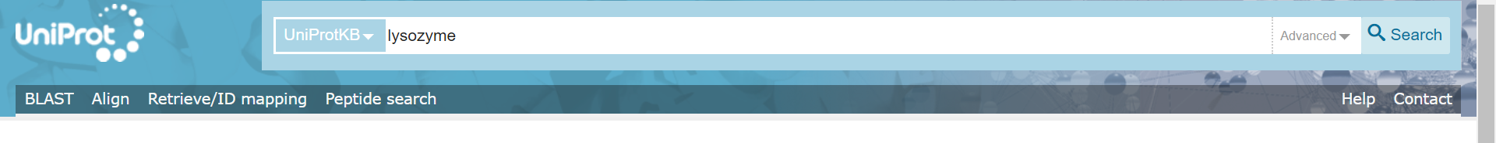
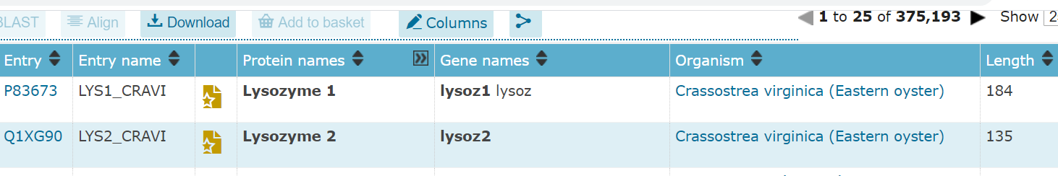
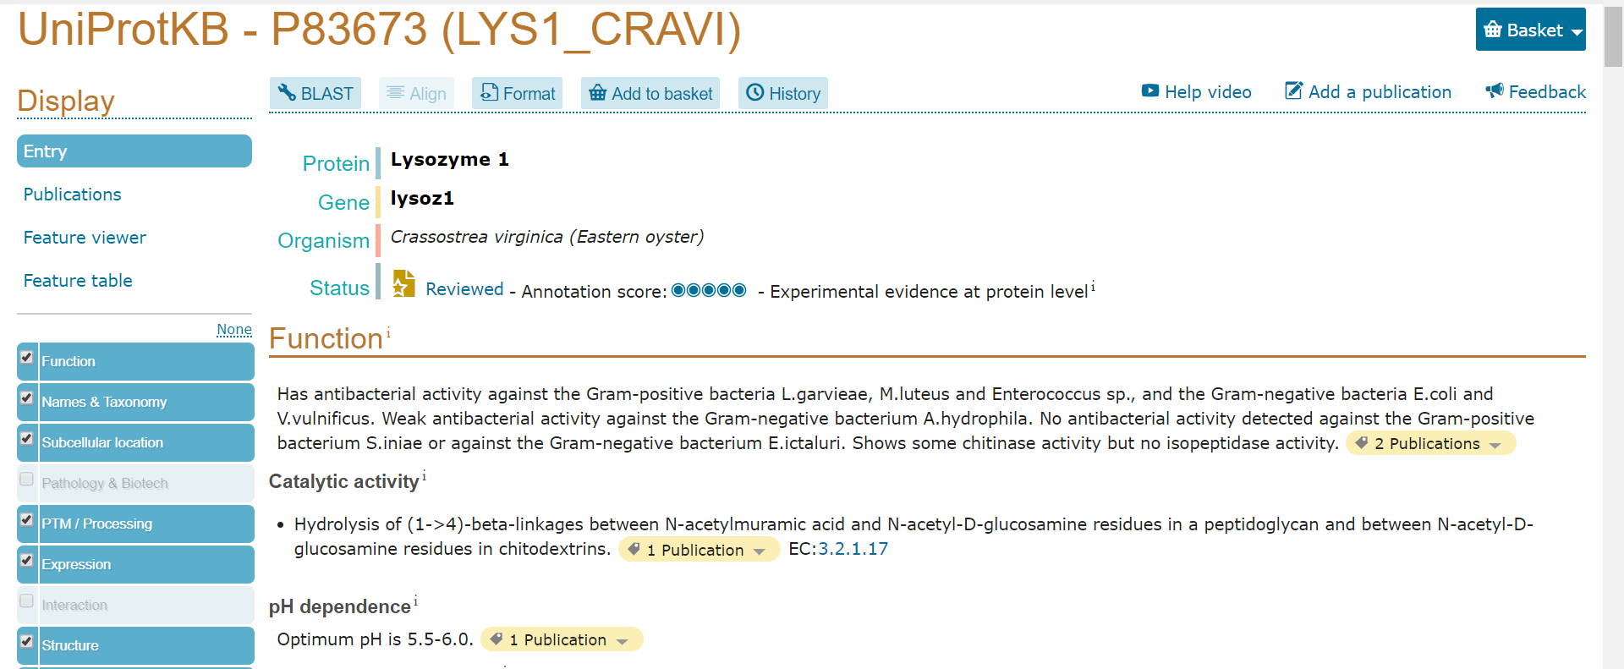
https://www.uniprot.org/
CODE
NAME
GENE NAME
ORGANISM
INFORMATIONS:
Protein, gene, organism, function, reaction, ligand, taxonomy, cellular location, PTM, FASTA, 3D structures, similar proteins

Slide 7
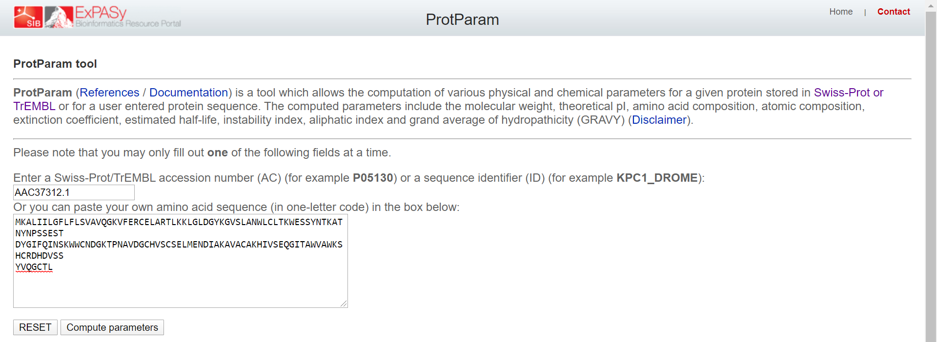
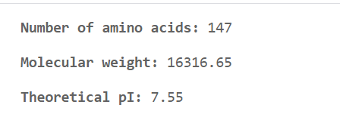
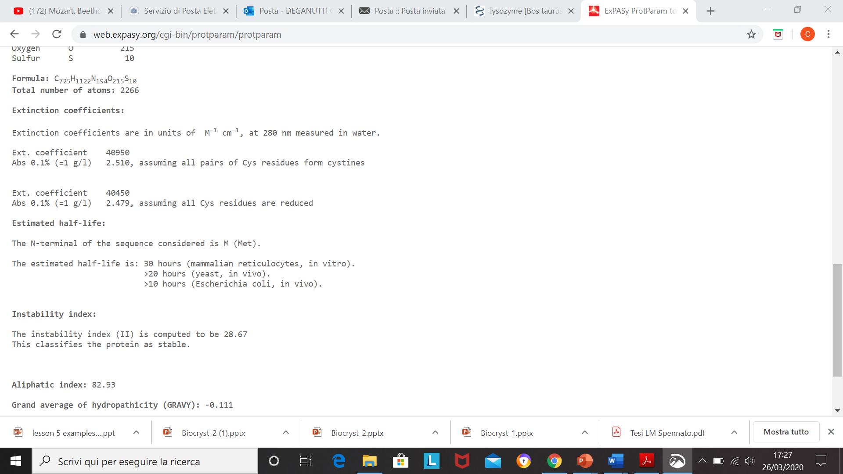
https://web.expasy.org/
CODE
or
FASTA SEQUENCE
MW, pI
Extinction coefficient (conc determination)
STABILITY
HYDROPHATICITY
(- non polar, + polar)

Slide 8
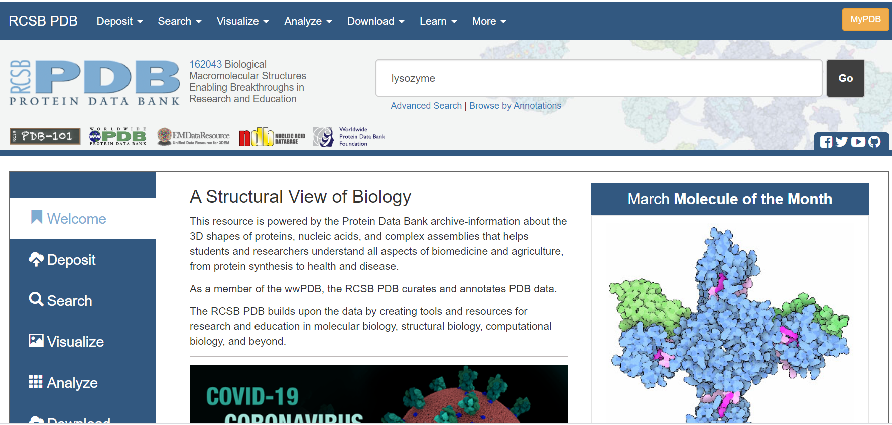
https://www.rcsb.org/
X-Ray crystallography
Database of released protein structures
NMR
Cryo-EM

Slide 9
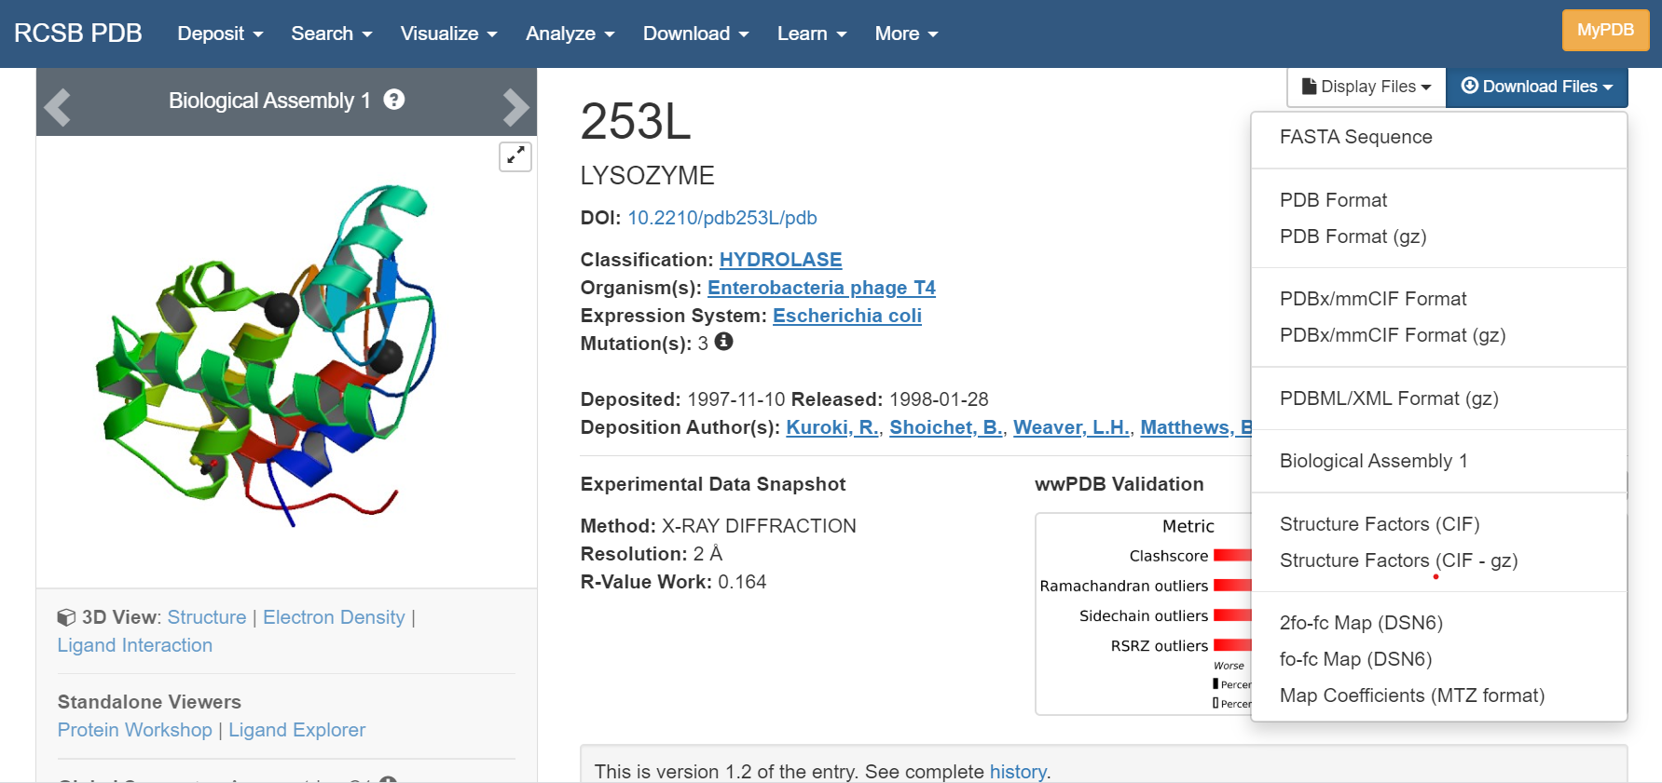
File PDB: «The Protein Data Bank (PDB) format provides a standard representation for macromolecular structure data»
CODE of the STRUCTURE (not of the protein)
3D view: allows for visualization of the 3D protein structure (no other programs required)
Other informations: Pubblication (DOI), Ligands, Structure parameters, Solution parameters

Slide 10
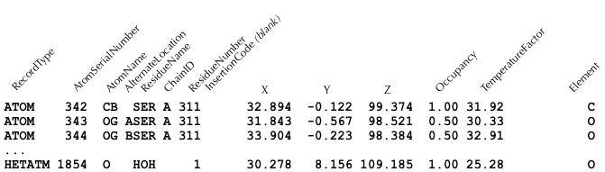
Informations in the PDB format are spacial coordinates for each atom in the protein
https://docs.eyesopen.com/toolkits/python/oechemtk/biopolymers.html

Slide 11
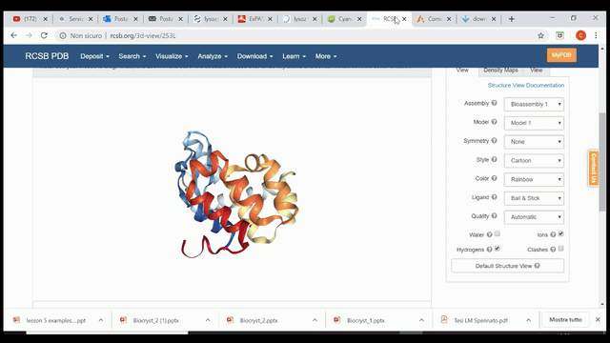

Slide 12
Cloning
Molecular cloning: techniques that allow for isolation and amplification of genes that code for proteins, and their further insertion into vectors for propagation.
Pay attention to the code of the host organism!! → difference in triplets lecture!

Slide 13
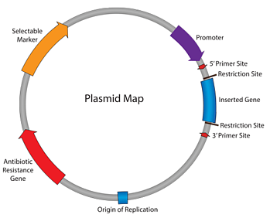
Choice of the plasmid
ORIGIN OF REPLICATION: (ori) sequence in a genome at which replication is initiated. Controls replication and number of copies (Low-High copy).
ANTIBIOTIC RESISTANCE
SELECTABLE MARKER: gene that confers a trait suitable for artificial selection
PROMOTER: region where gene transcription is initiated, controlling the binding of RNA polymerase
RESTRICTION SITE: nucleotide sequence specifically recognized by endonuclease enzymes (or restriction enzymes) that cut DNA at or near the restriction sites
5’ and 3’ PRIMER SITES: region of primers binding during amplification of the DNA using the PCR technique
Possibility to add TAGS at the N or C terminus of your protein
3
4
6
5
6
2
1
Plasmids are specific for each organism!

Slide 14
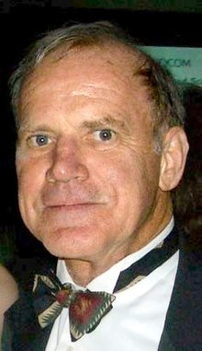
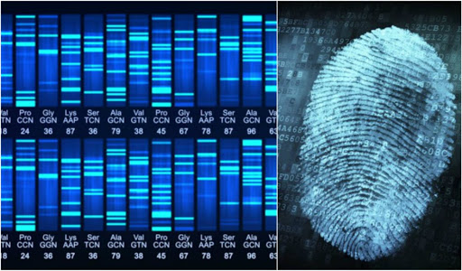
PCR
Polymerase Chain Reaction (PCR)
Molecular biology technique that allows amplification of a specific DNA fragment. Discovered by Kary Mullis in 1983 (Nobel Prize in 1993). The reaction is based on the use of a thermostable DNA polymerase that synthesizes new DNA sequences in the 5’→3’ direction starting from a template.
From a single DNA fragment to billions of copies.
Crime scene
Suspects
1
2
3
4
5
Kary Banks Mullis
(USA 1944-2019)

Slide 15
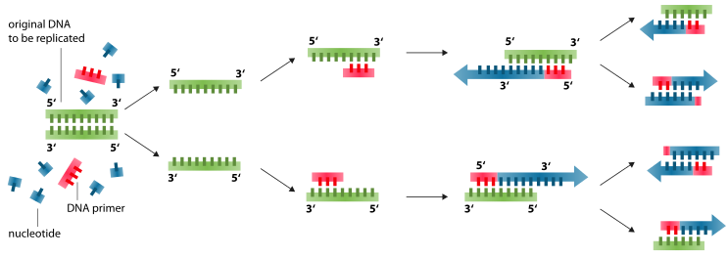
PCR
YOU NEED
TEMPLATE: DNA with the target sequence that encodes for your protein
PRIMERS: short fragments (20-30 nucleotides) of single strand nucleic acids, designed to be complementary to the 3’ end of the target sequence on the template.
DNA POLYMERASE: thermostable DNA polymerase (Thermus aquaticus)
TERMOCYCLER: thermal block where the reaction mixture is inserted, that raises and lowers the temperature according to a program.
1
2
3
CYCLE
DENATURATION: the solution is heated to 95-98°C in order to separate the double stranded DNA
ANNEALING: primers pair to the target DNA sequences according to their melting point temperature (45-65°C)
ELONGATION: temperature is raised to 72°C to allow identification of the primers by the DNA polymerase and subsequent addition of nucleotides to a new developing DNA strand
At each cycle, DNA is doubled. Usually 25-35 cycles.
Final step of elongation at 72°C to ensure full elongation of all strands.

Slide 16
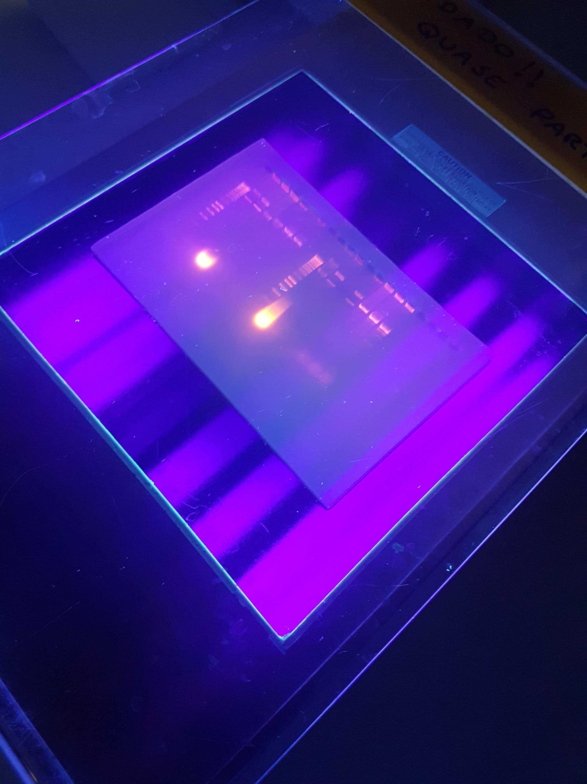
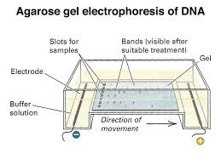
PCR
Agarose gel electrophoresis: allows to control plasmids and PCR products
UV visible dye

Slide 17

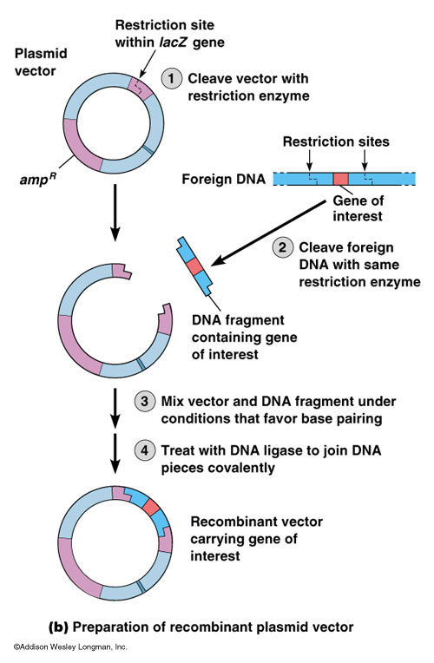
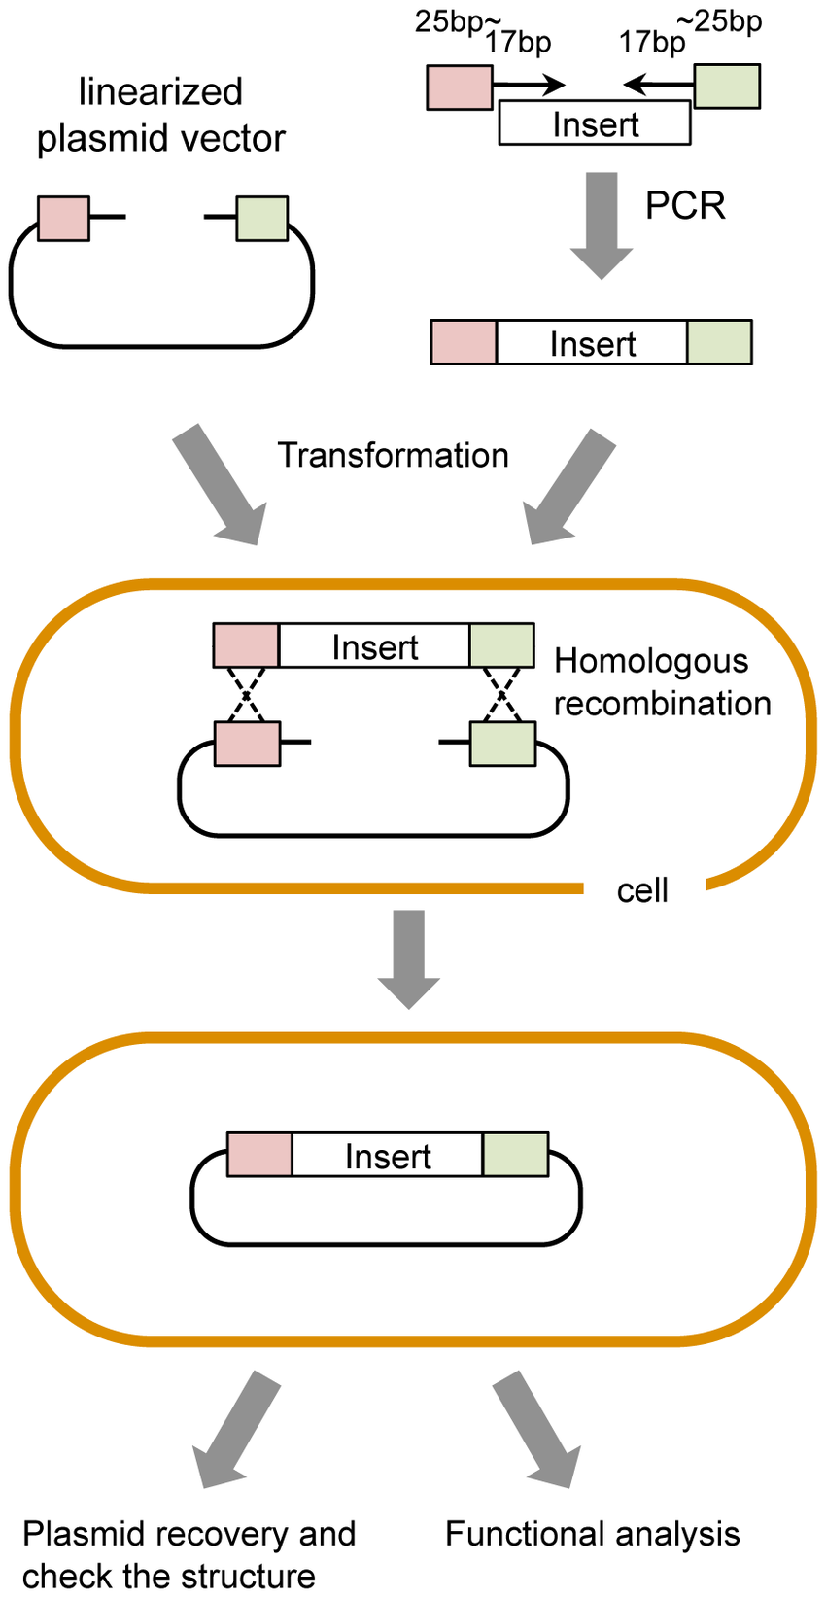
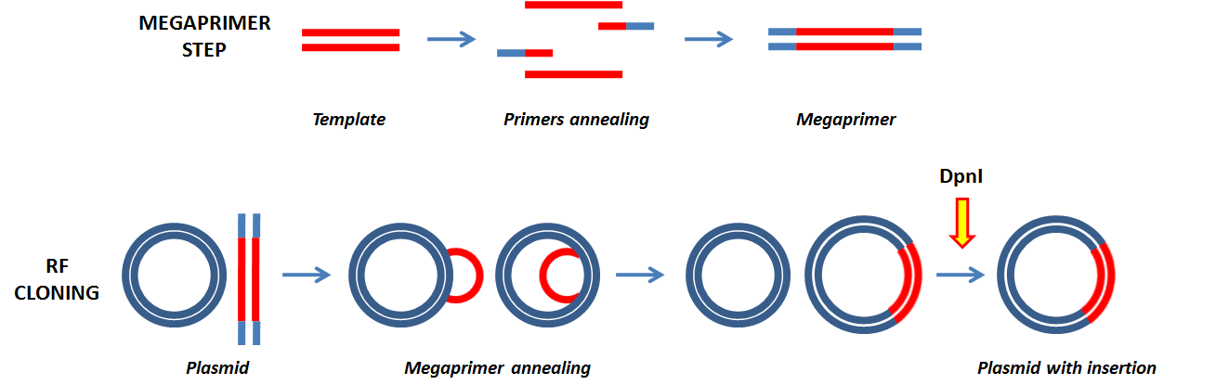
Different cloning methods
Restriction enzymes
Homologous recombination
RF cloning
van den Ent F, Lowe J (2006), J Biochem Biophys Methods
Chino A. et al. (2010), PLoS ONE

Slide 18
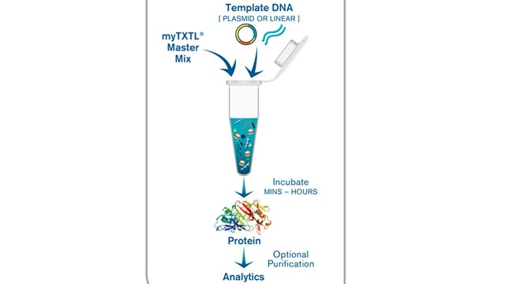
Hosts for protein expression
BACTERIA (mainly E. coli):
Cheap and fast
High protein expression levels
No PTM
Only for small proteins
YEAST (S. cerevisiae, P. pastoris):
Cheap
Good protein expression levels
Some PTM
No antibiotic selection
BACULOVIRUS-INSECT CELLS (Drosophila):
Expensive
Good protein expression levels
PTM
No antibiotic selection
MAMMALIAN (CHO, Hela):
Expensive and long
Low protein expression levels
PTM
No antibiotic selection
CELL-FREE EXPRESSION SYSTEM:
Expensive

Slide 19
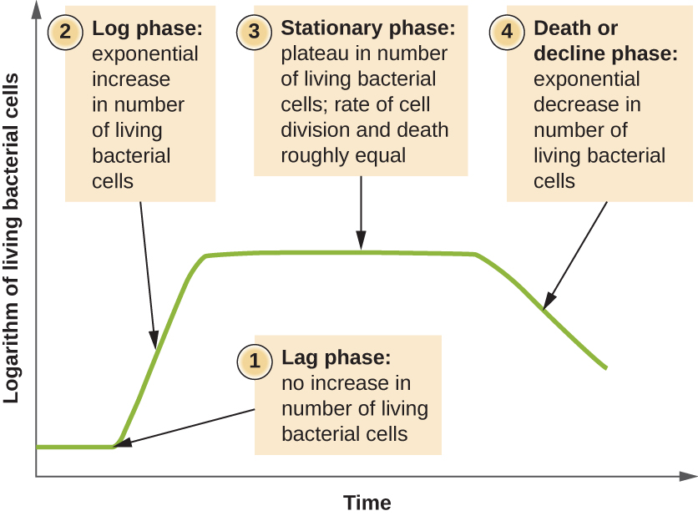
When should I induce protein expression?
Protein induction
Measured throught the OD₆₀₀ parameter (optical density of the culture at 600 nm)

Slide 20
Lag, Log, stationary phase and death
OD₆₀₀ value is the same of the stationary phase (contribution of dead cells)
1) LAG PHASE: before exponential growth
Inoculated cells could be damaged
Cells must adapt to the new medium
Production of ribosomes and enzymes
Slow cell replication
2) LOG PHASE: exponential growth
Fast cell replication, increase of the biomass
Fast consumption of nutrients, included oxygen
Possible production of heath and foam
Possible modifications in pH, rheology,
3) STATIONARY PHASE: living cells = dead cells
Nutrients are ending, so as oxygen
Release of substances such as toxins
Possible production of secondary metabolites
Cell replication is no more logaritmic
3) DEATH PHASE: living cells << dead cells
Nutrients are exhausted, so as oxygen
Decrease of cell
Possible cellular auto-lysis
No cell replication

Slide 21
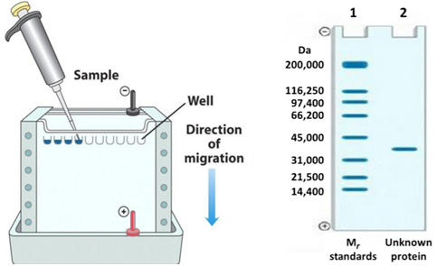
SDS-PAGE
Control for the presence of the target protein.
Sodium-Dodecyl-Sulfate PolyAcrylamide Gel Electrophoresis:
Denaturation of the sample in presence of SDS (boiling, urea)
Loading on a polyacrylamide gel
Run
Staining (Coomassie blue)
Stacking gel
Running gel
Separation of all the proteins in a sample according only to their molecular weight.

Slide 22
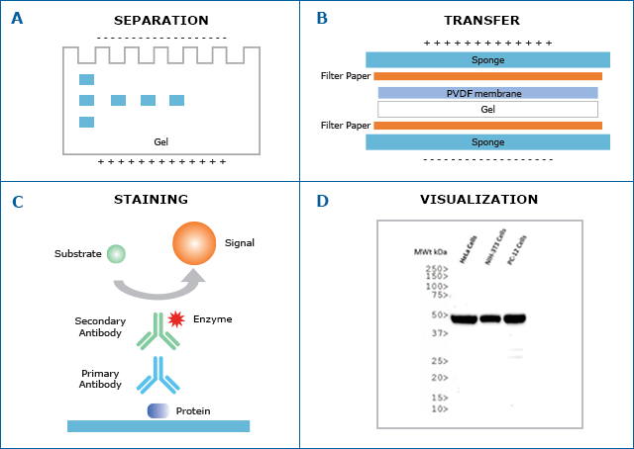
Western-blot
Identification of the target protein between the bulk in the sample.
SDS-PAGE of the sample
Blot on a Polyvinylidene difluoride (PVDF) or nitrocellulose membrane
Incubation with primary and secondary antibody (against tags or specific proteic sequences)
The secondary antibody has a molecule for its visualization (eg staining or luminescence)

Slide 23

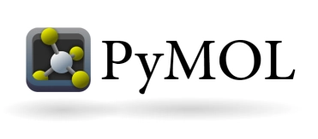
Some useful programs
“Highly extensible program for interactive visualization and analysis of molecular structures and related data, including density maps, supramolecular assemblies, sequence alignments, docking results, trajectories, and conformational ensembles” (from Chimera webpage)
Molecular visualization program that produces 3D images of small molecules and macromolecules such as proteins.

Slide 24
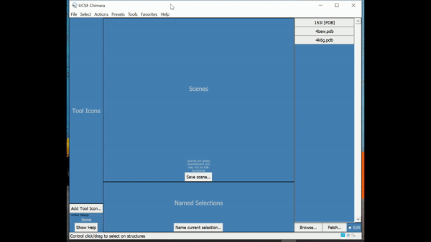
https://www.cgl.ucsf.edu/chimera/download.html
Open a PDB file

Slide 25
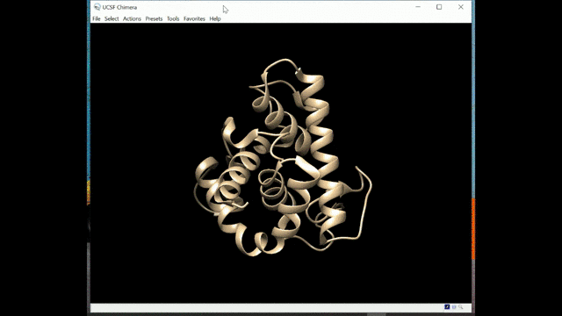
https://www.cgl.ucsf.edu/chimera/download.html
Color the protein

Slide 26
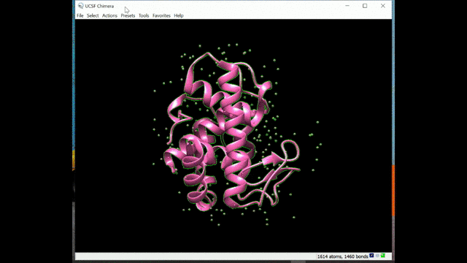
https://www.cgl.ucsf.edu/chimera/download.html
Color different residues

Slide 27
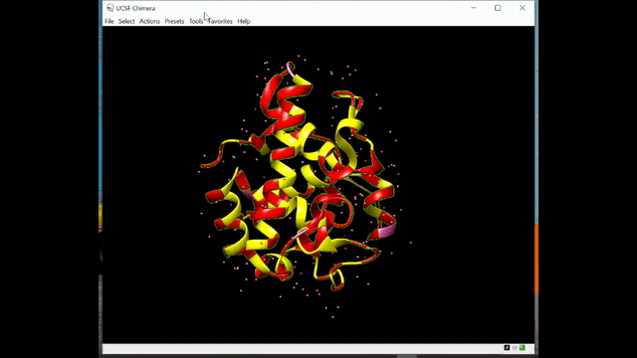
https://www.cgl.ucsf.edu/chimera/download.html
Show surface

Slide 28
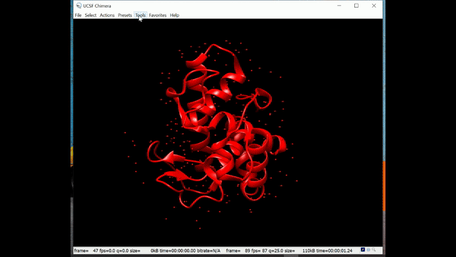
https://www.cgl.ucsf.edu/chimera/download.html
Make a video

Slide 29
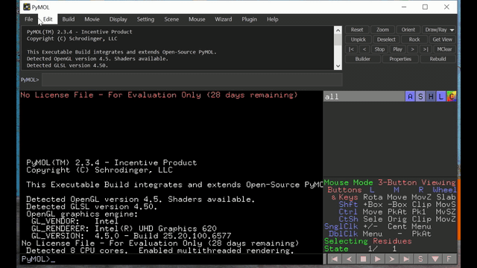
https://pymol.org/2/
Open PDB file and color the protein

Slide 30
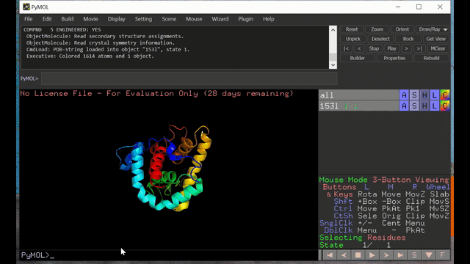
https://pymol.org/2/
Color according to hydrophobicity and see water molecules

Slide 31
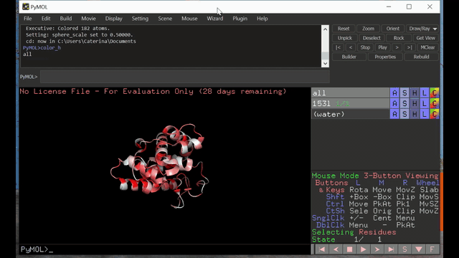
https://pymol.org/2/
Show surface, cell and symmetry

