Slide 1
IEEE TRANSACTIONS ON VISUALIZATION AND COMPUTER GRAPHICS, VOL. 20, NO. 12, DECEMBER 2014 2211 1077-2626 © 2014 IEEE.
The Persuasive Power of Data Visualization
Anshul Vikram Pandey, Anjali Manivannan, Oded Nov, Margaret Satterthwaite, and Enrico Bertini,
visualization has been used extensively to inform users. However, little research has been done to examine the effects of data visualization in influencing users or in making a message more persuasive. In this study, we present experimental research to fill this gap and present an evidence-based analysis of persuasive visualization. We built on persuasion research from psychology and user interfaces literature in order to explore the persuasive effects of visualization. In this experimental study we define the circumstances under which data visualization can make a message more persuasive, propose hypotheses, and perform quantitative and qualitative analyses on studies conducted to test these hypotheses. We compare visual treatments with data presented through barcharts and linecharts on the one hand, treatments with data presented through tables on the other, and then evaluate their persuasiveness. The findings represent a first step in exploring the effectiveness of persuasive visualization

Slide 2
Ai partecipanti viene dato un un paragrafo introduttivo, poi un questionario di attitudine con il quale vengono classificati in una di 3 posizioni:
NP polarizzati negativamente
NWP neutrali
PP polarizzati positivamente
Scala lickert 7 punti Fino a che punto sei d’accordo che… abbassare le tasse federali aumenta I lavori?

Slide 3
VG I videogame violenti non aumenta la violenza giovanile)
A video game is an electronic game that involves human interaction with a user interface to generate visual feedback on a video device. Controversies over video games center on debates around video game content and the potential for it to negatively impact player attitude and behavior. Since the early 1980s, video games have become part of the political discourse with advocates emphasizing their nature as an expressive medium (protected under the freedom of speech laws of many countries), and detractors promoting various theories that video games are harmful for society and thus subject to legislative oversight and restrictions.
Sources : Wikipedia

Slide 5
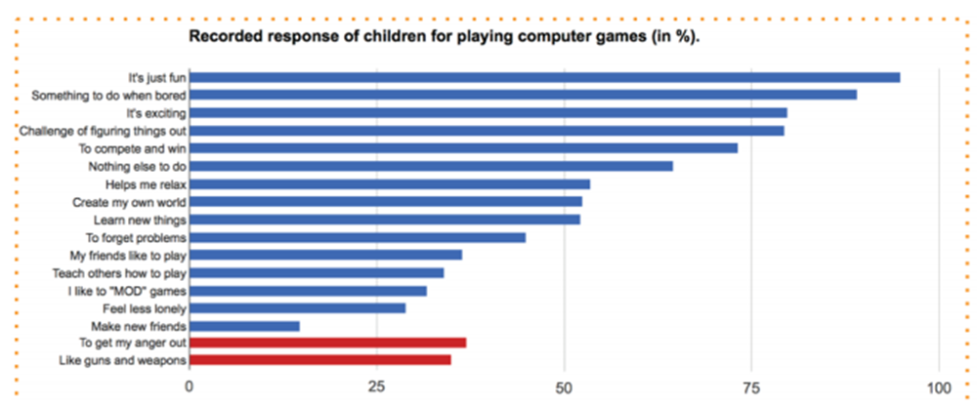

Slide 6
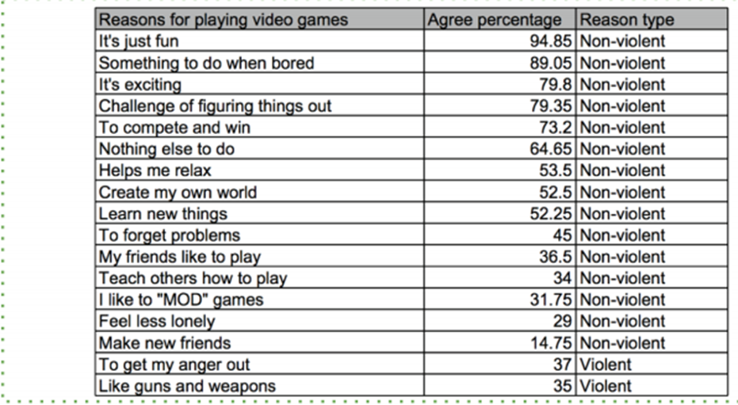

Slide 7
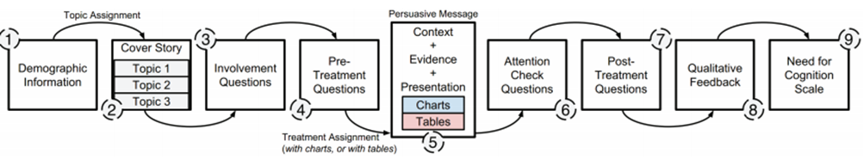

Slide 8
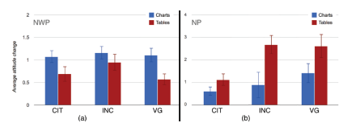
Per i soggetti molto polarizzati sono più efficaci le tabelle
Per i soggetti poco polarizzati sono più efficaci i grafici a barre

