Slide 1
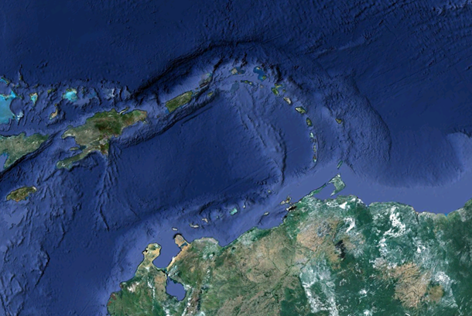
TERRE DI PIRATI

Slide 2
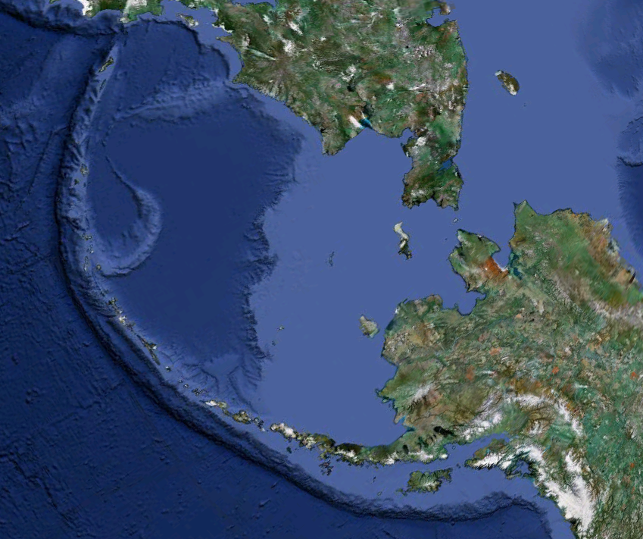
DI ESQUIMESI

Slide 3
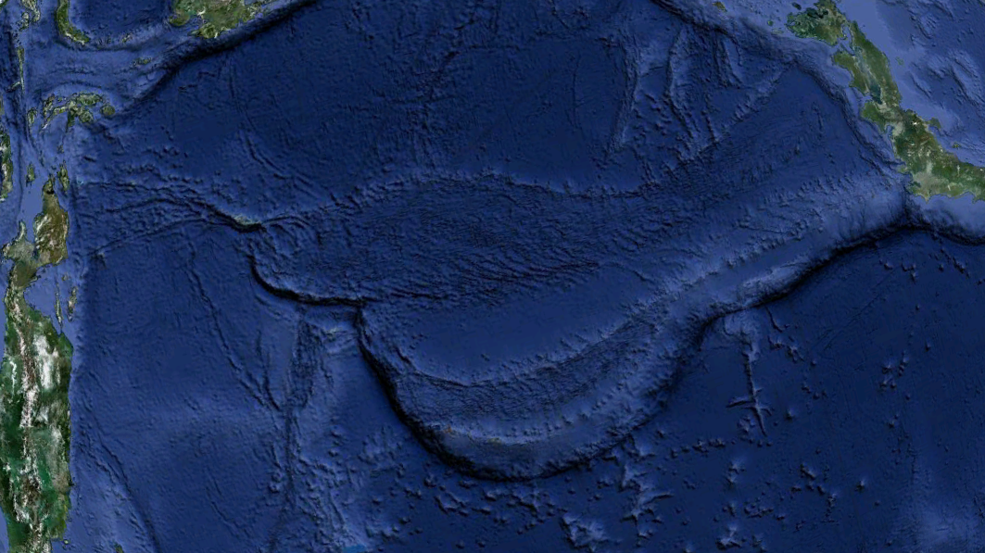

Slide 4
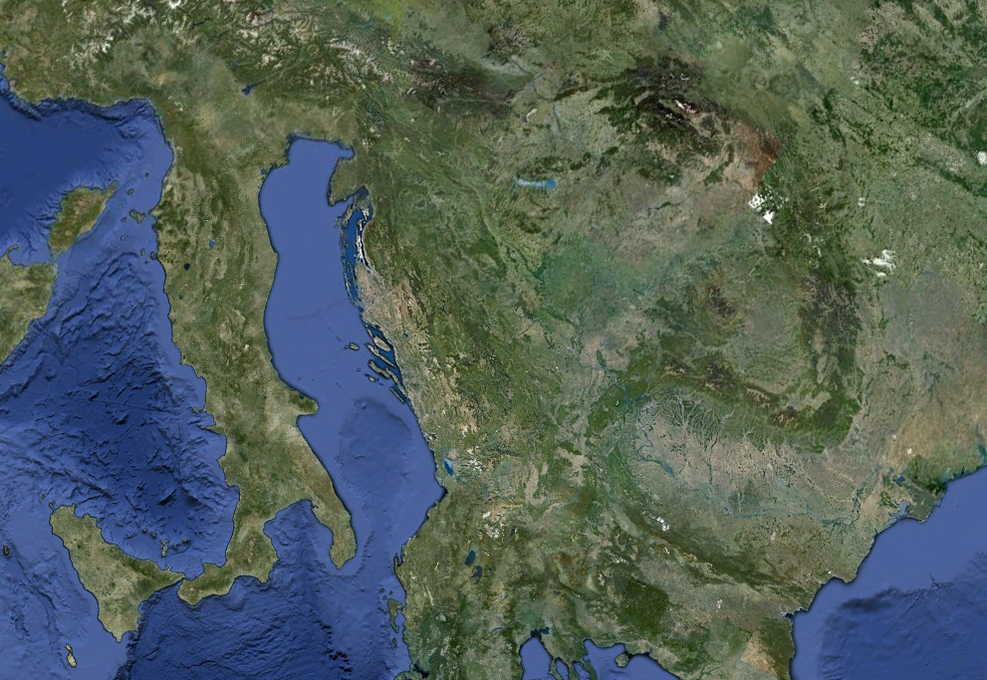

Slide 5
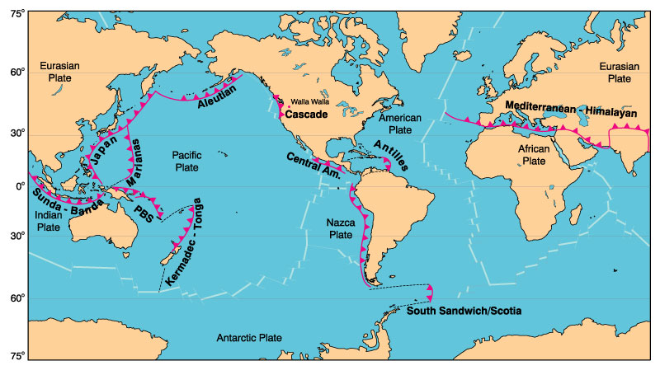

Slide 6
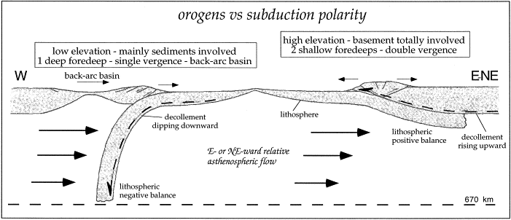

Slide 7
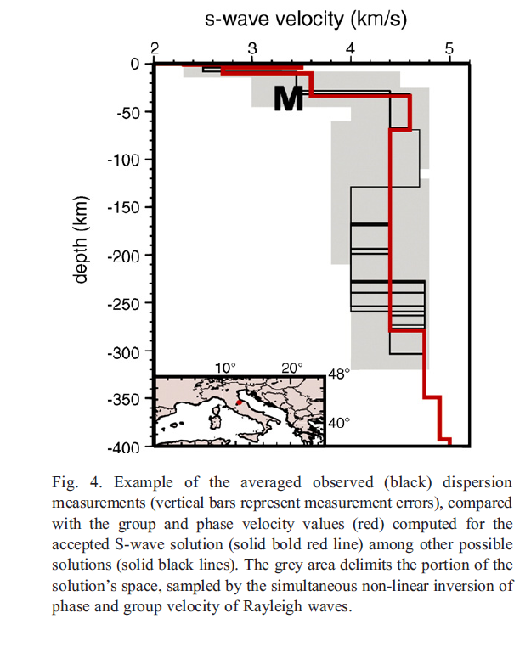
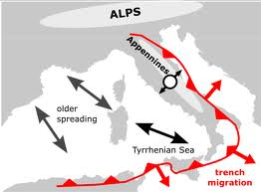

Slide 8
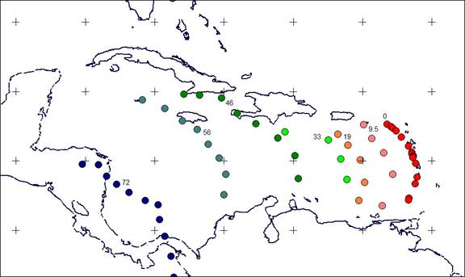

Slide 10
Attenzione
La presenza di basalti ricchi in Alluminio o addirittura di
HAL BASALTS (Al2O3 > 19wt%) non vuole dire necessariamente
subduzione
A tale proposito……
DERIVATION OF APOLLO 14 HIGH-AL BASALTS FROM DISTINCT SOURCE REGIONS AT DISCRETE TIMES: NEW CONSTRAINTS.
C. R. Neal1, C.-Y. Shih2, Y. Reese3, L. E. Nyquist4, and G. Y. Kramer1, 1Dept. Of Civil Eng. & Geological Sciences, University of Notre Dame, Notre Dame, IN 46556, USA (neal.1@nd.edu), 2Mail Code JE-23, ESCG/Jacobs, Houston, TX 77058, 3Mail Code JE-23, ESCG/Muniz Engineering, Houston, TX 77058, 4Mail Code KR, NASA Johnson Space Center, Houston, TX 77058.

Slide 11
SUBDUZIONE : SISTEMA-ARCO ISOLA

Slide 12
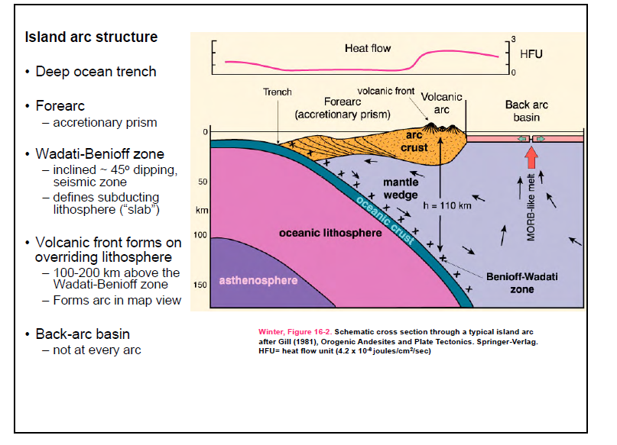
The arc magma paradox. Why is there magmatic activity in regions where cold lithospheric
slabs are being subducted into the mantle?

Slide 13
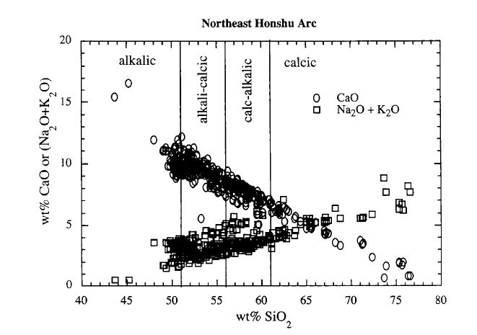

Slide 14
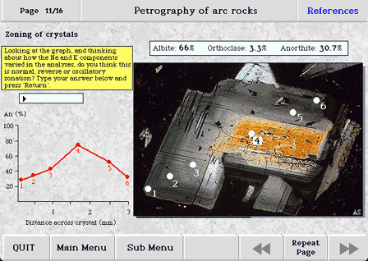
REVERSE - ZONING in plagioclase

Slide 15
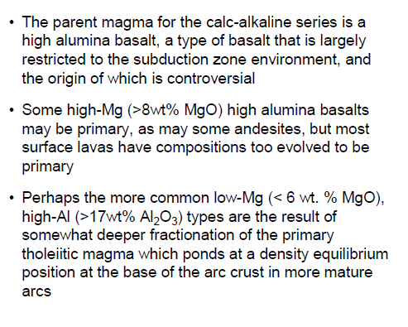
Riguardo al punto 1….pubblicazione italica

Slide 16
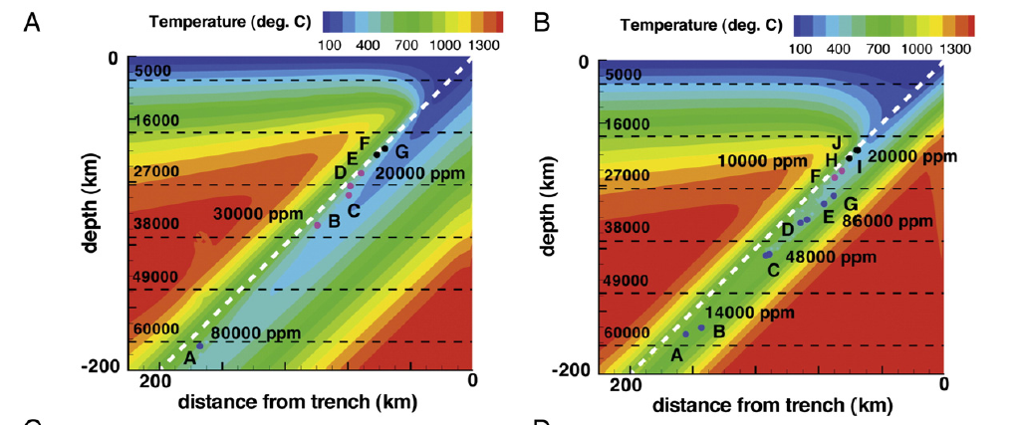
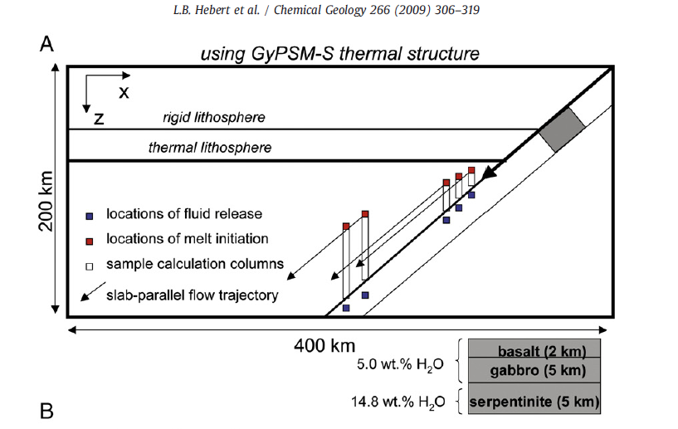
Sommatoria
fluidi in ppm

Slide 17
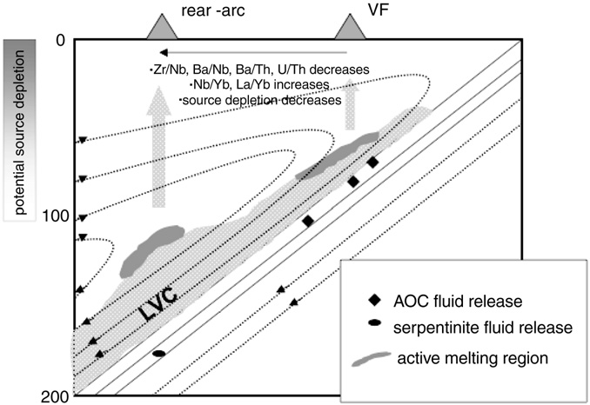

Slide 18
SOURCE
A model is presented wherein continuous arc magmatism and production of Garnet pyroxenites in continental arcs is periodically punctuated by a delamination event and an associated magmatic pulse every ~10-30 Ma. The recycling flux of arc pyroxenite is estimated to be no more than ~5-15 % that of oceanic crust recycling by subduction. Delaminated pyroxenites have the necessary trace-element compositions to yield time-integrated isotopic compositions similar to those inferred to exist as reservoirs in the mantle. Because of their low melting temperatures, such pyroxenites may be preferentially melted, possibly forming a component of some hotspot magmas.

Slide 19
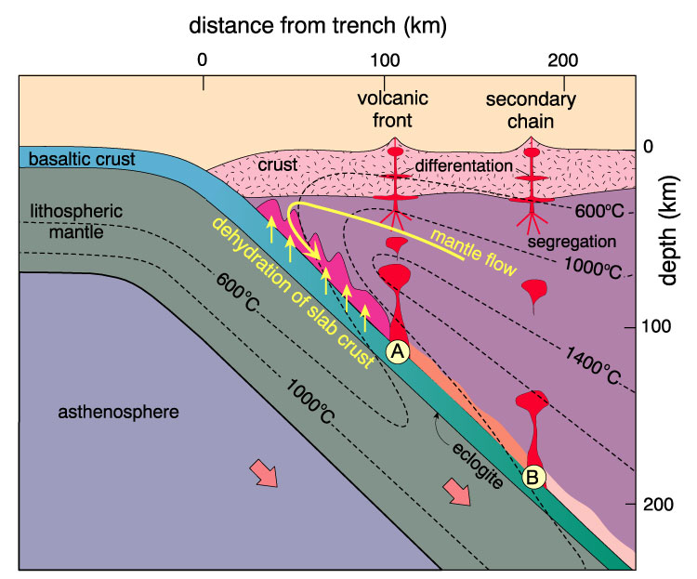

Slide 20
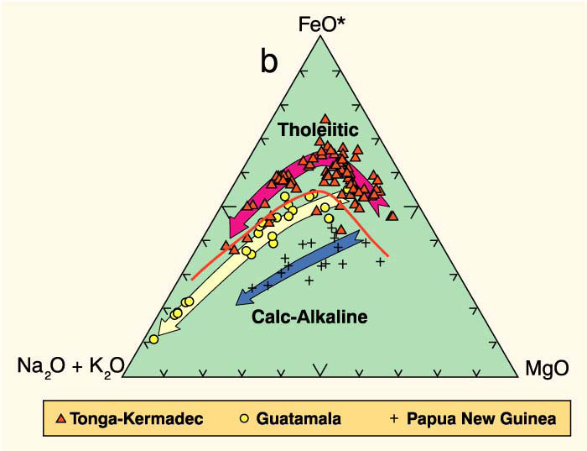

Slide 21
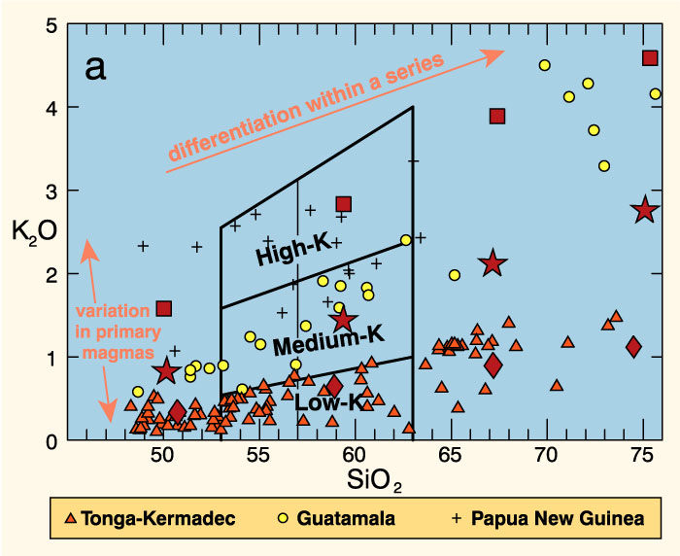

Slide 22
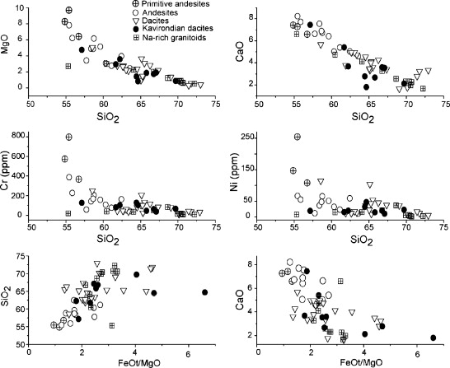
HIGH Mg Andesiti e Boniniti

Slide 23
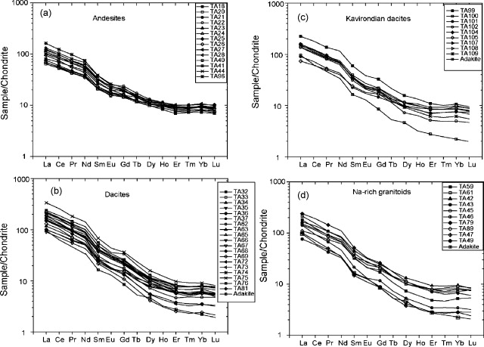

Slide 24
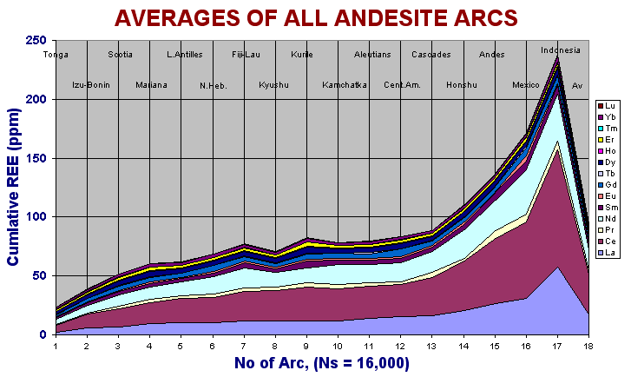

Slide 25
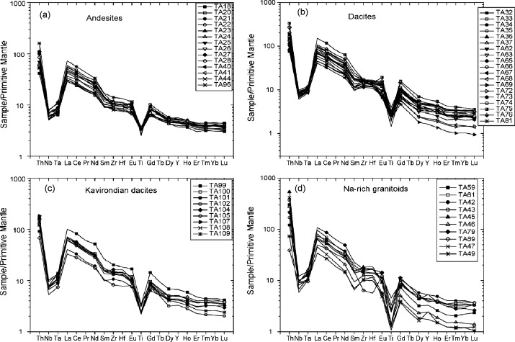

Slide 26
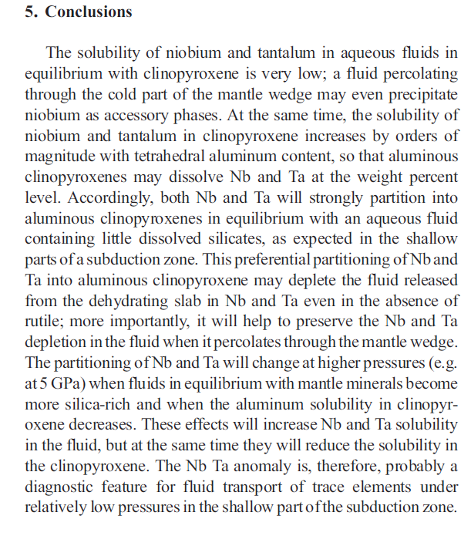
Earth and Planetary Science Letters 267 (2008) 290–300

Slide 27
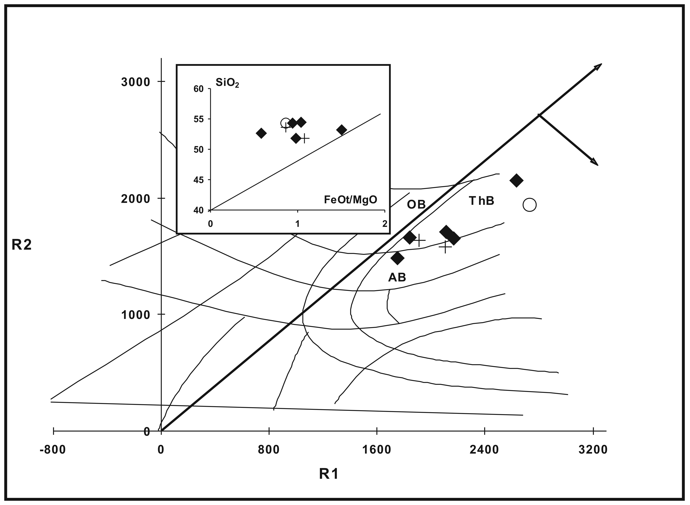
Boninites

Slide 28
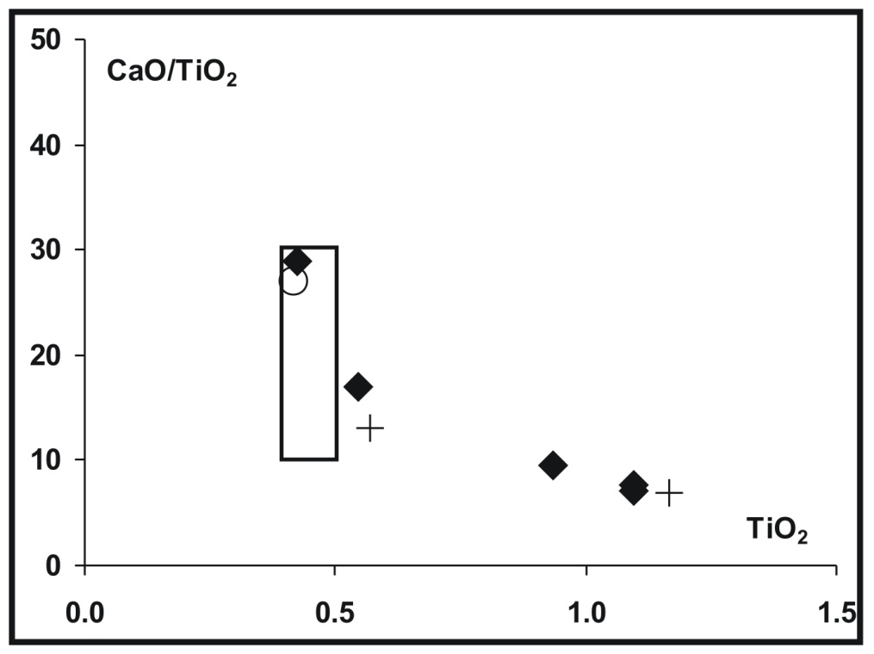
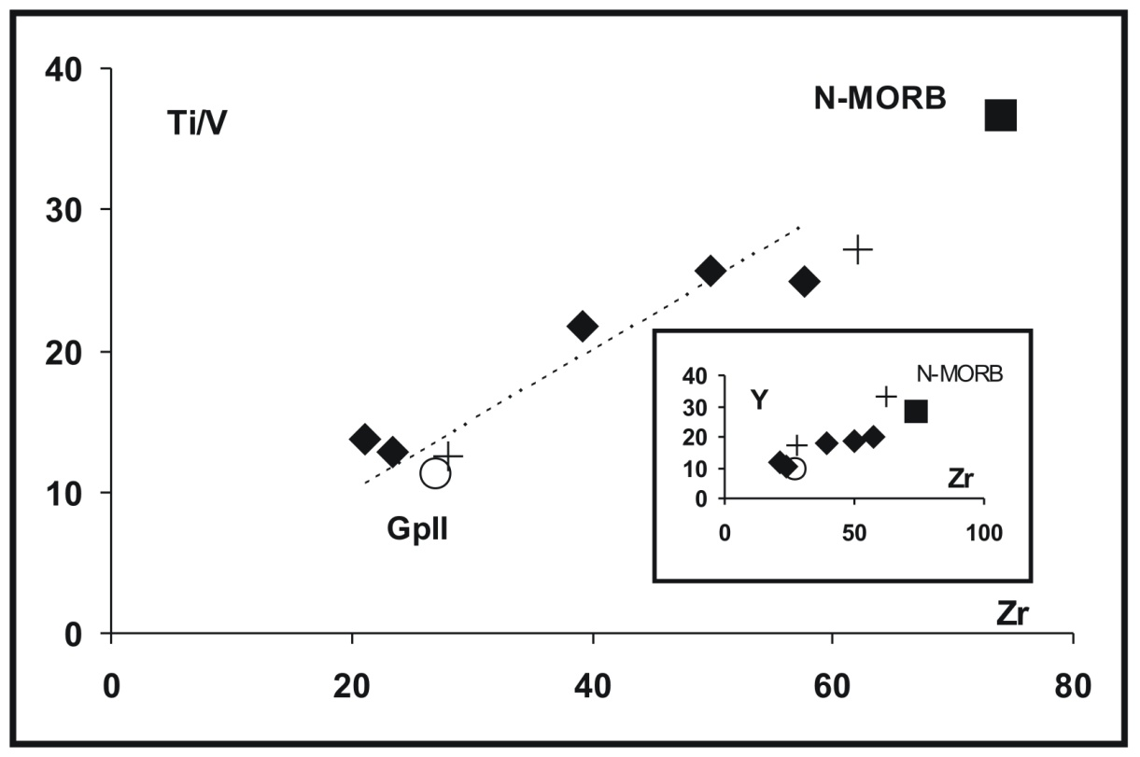

Slide 29
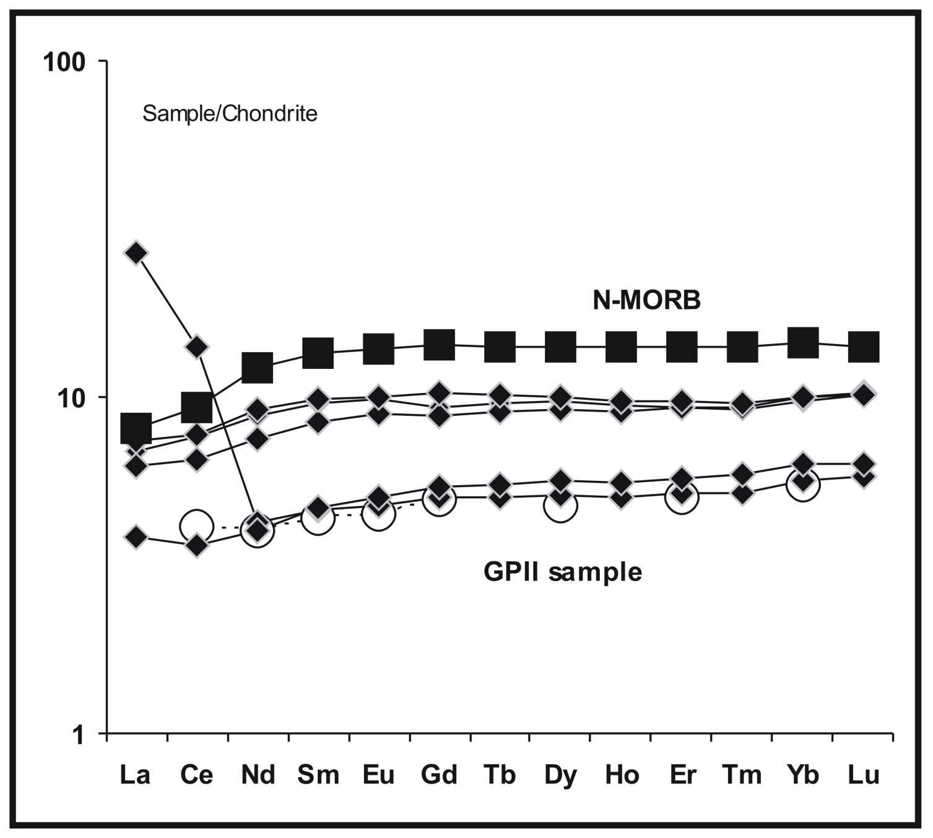

Slide 30
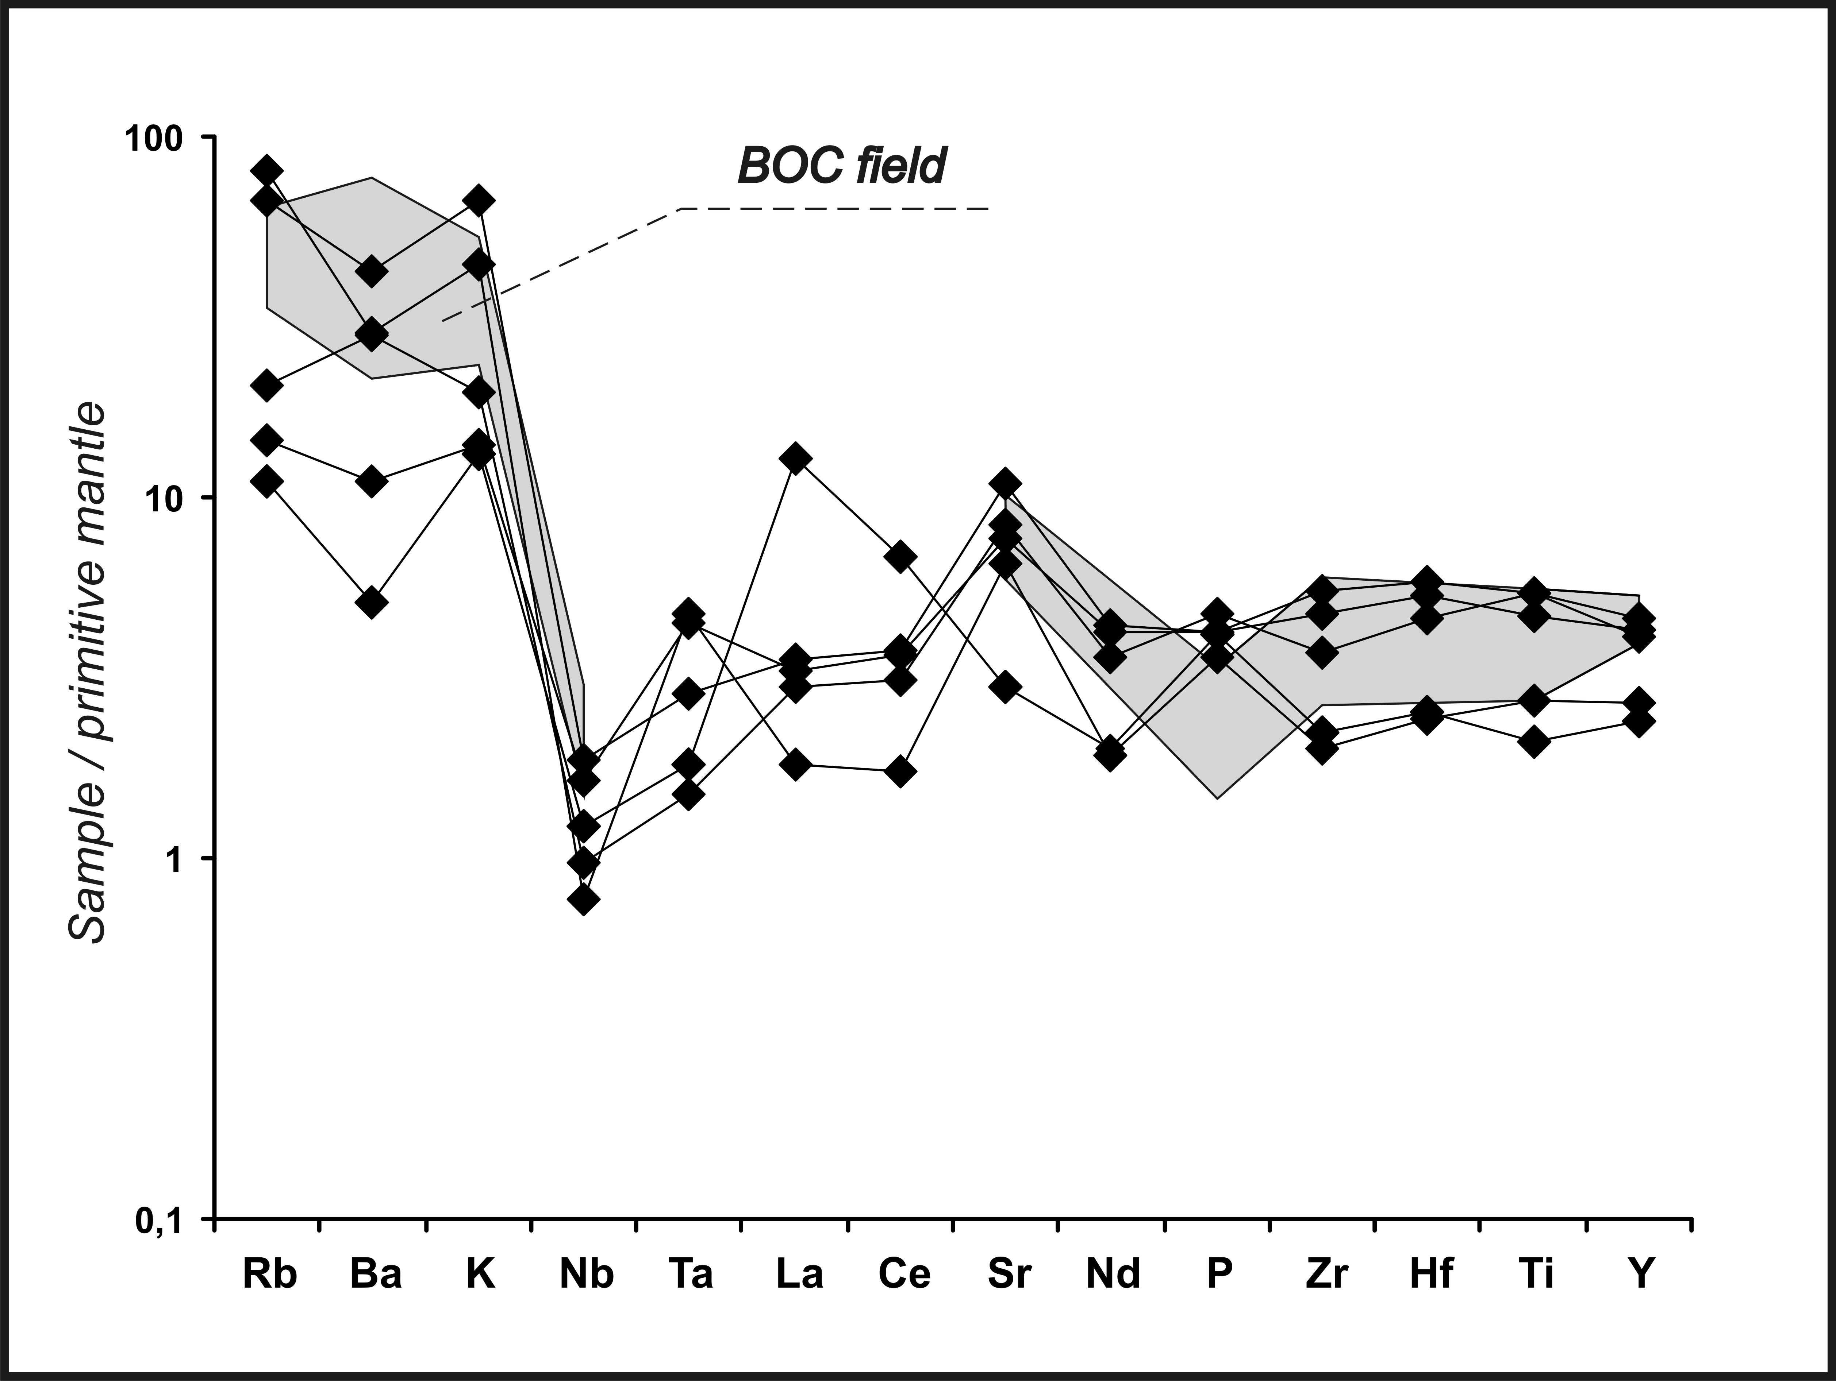
LILE
HFSE + REE

Slide 31
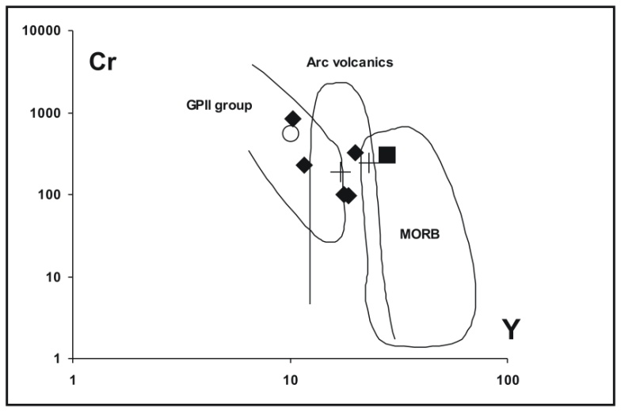
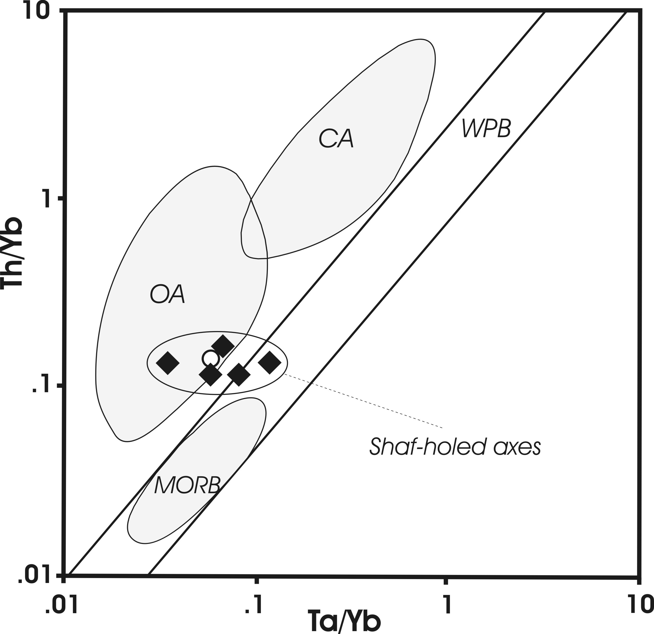
Diagrammi tettonomagmatici

Slide 32
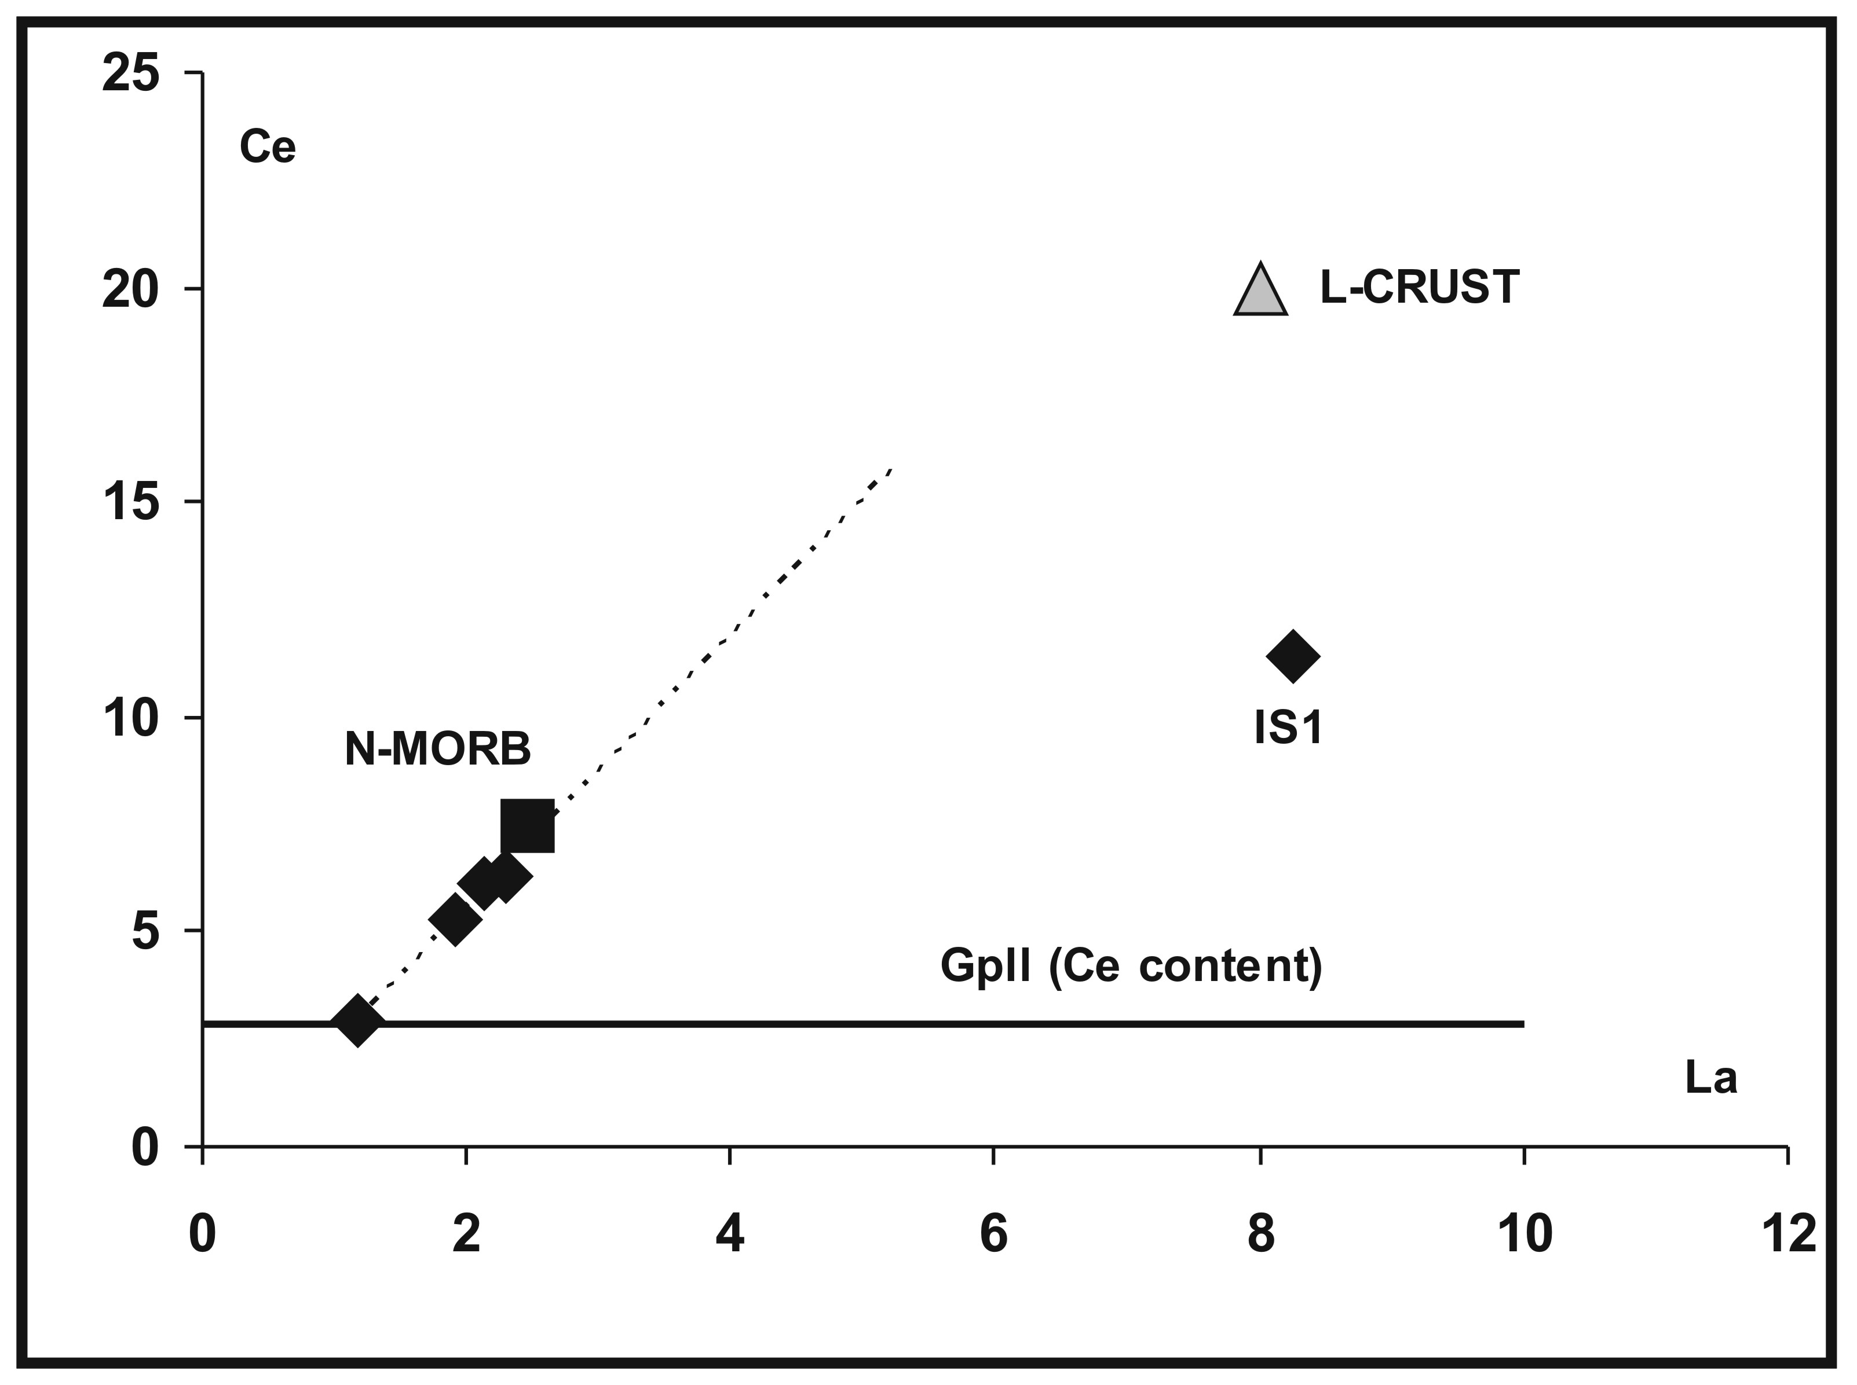

Slide 33
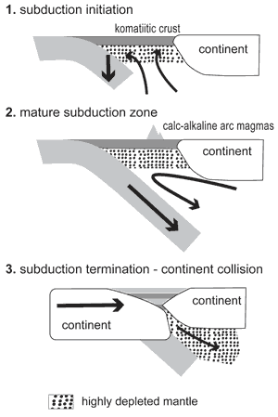
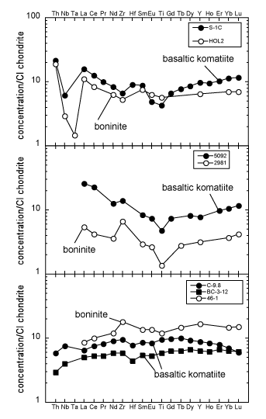
Komatiti di Gorgona

Slide 34
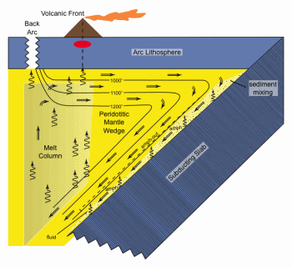
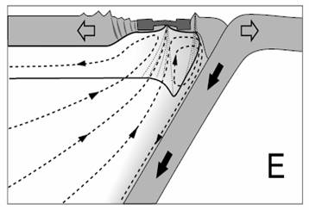
Mantello Soffice

Slide 35
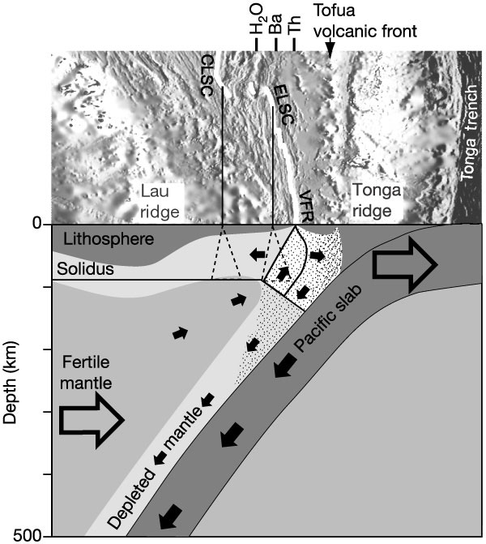

Slide 36
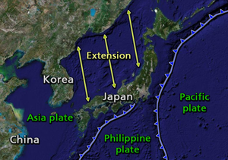
Chemical Systematics and Hydrous Melting of the Mantle
in Back-Arc Basins
Retro ARCO ( back arc)
These ridges erupt basalts that are similar to those erupted from the mid-ocean ridges; the main difference is that back-arc basin basalts are often very rich in magmatic water (typically 1-1.5 weight % H₂O), whereas mid-ocean ridge basalt magmas are very dry (typically <0.3 weight % H₂O).
Geophysical Monograph Series 166
Copyright 2006 by the American Geophysical Union

Slide 37
(1) Water profoundly influences the solidus temperature, and therefore the depth at which melting begins and the extent of melting for a given temperature and chemical composition of other elements (e.g., Burnham and Davis [1974]; Hirth and Kohlstedt [1996]; Gaetani and Grove [1998]; Cushman et al. [2004]).
(2) Water has an influence on the stability of igneous phases, and suppresses the appearance of plagioclase more than the ferro-magnesian minerals. This significantly influences the path of differentiation (e.g., Green and Ringwood [1967]; Sinton and Fryer
[1987]; Sisson and Grove [1993]; Danyushevsky [2001]).
(3) Water correlates well with incompatible trace elements. Addition of water to an environment implies the addition of many other elements that accompany water, and hence water contents and source composition
are inevitably coupled (e.g., Schilling et al. [1980]; Stolper and Newman [1994]; Asimow et al. [2004]).

Slide 38
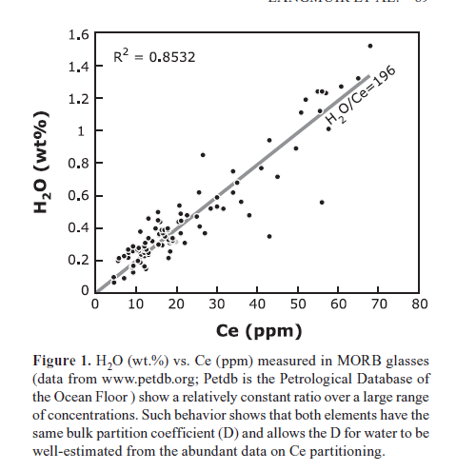

Slide 39
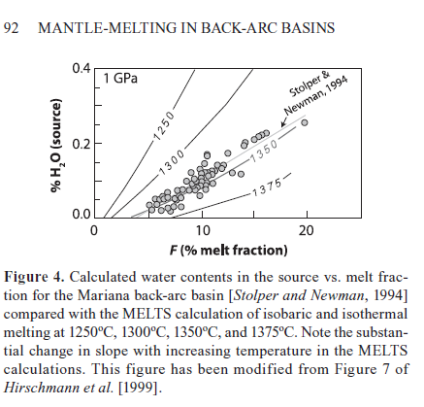
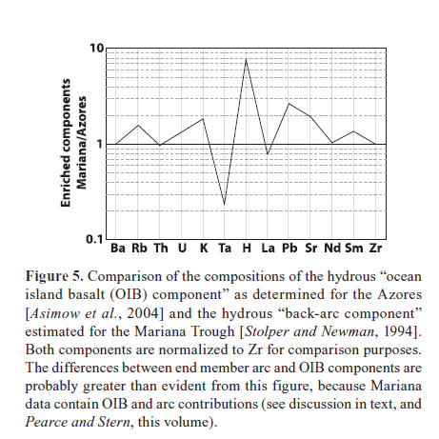
Earth science: A back-arc in time
Nature Volume: 469, Date published, (13 January 2011) DOI:
doi:10.1038/469170a Published online 12 January 2011

Slide 40
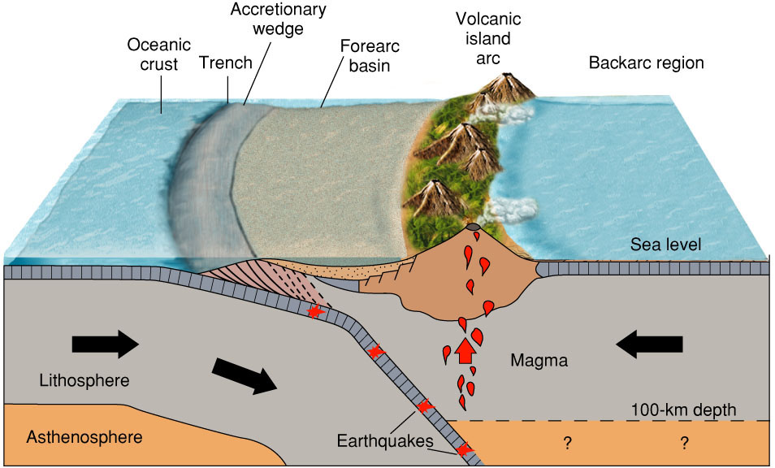

Slide 41
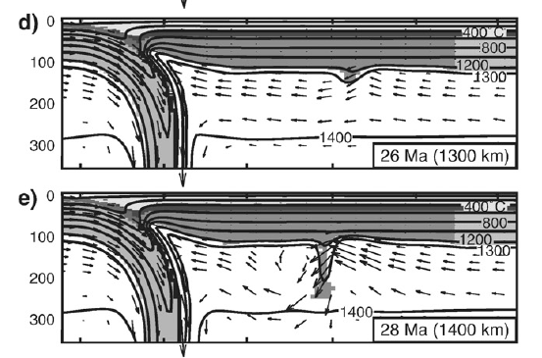
SISTEMA ARCO-FOSSA

Slide 42
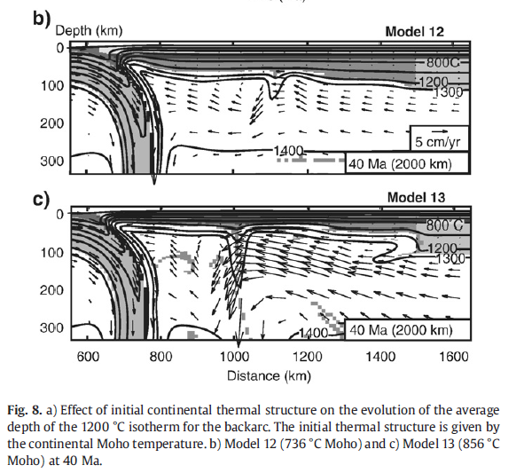

Slide 43
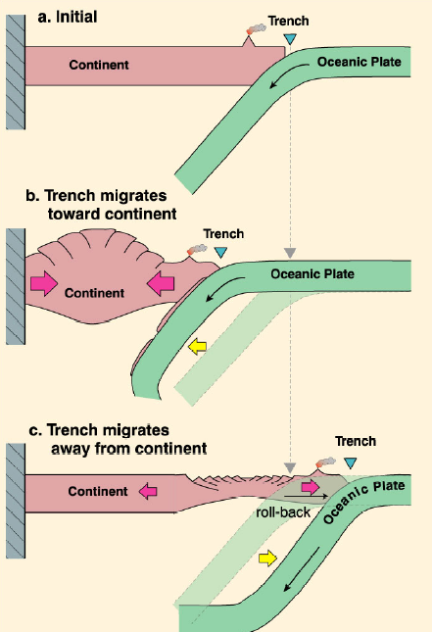

Slide 44
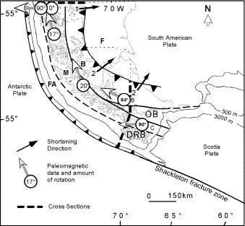

Slide 45
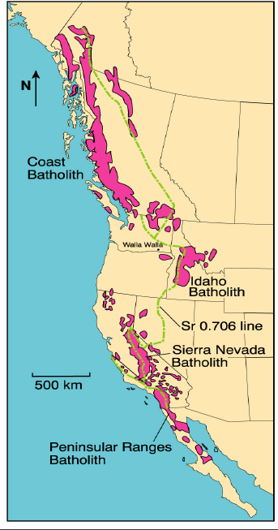
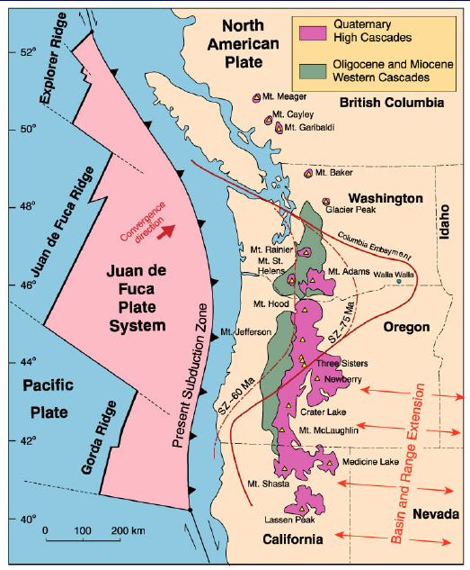

Slide 46
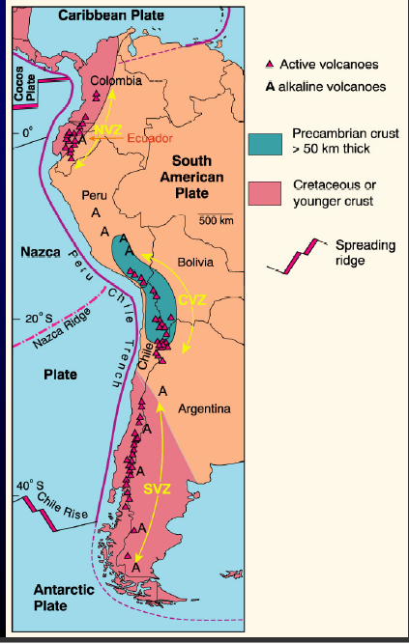
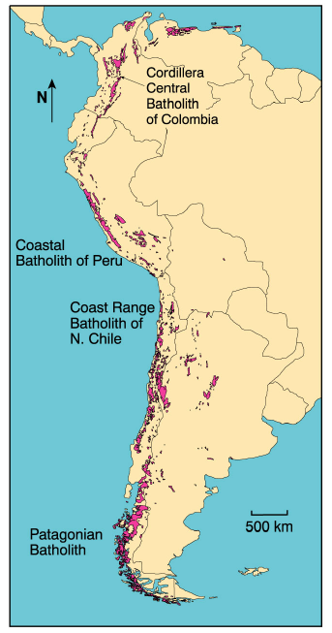

Slide 49
Muovendosi dalla fossa verso il continente aumenta il contenuto in K
Fino alle Shoshoniti (dalla tribù degli indiani shoshoni – Nord America)

Slide 50
AFM and K₂O vs. SiO₂ diagrams (including Hi-K, Med.-K and Low-K types of Gill, 1981; see Figs. 16-4 and 16-6) for volcanics from the (a) northern, (b) central and (c) southern volcanic zones of the Andes. Open circles in the NVZ and SVZ are alkaline rocks. Data from Thorpe et al. (1982,1984), Geist (personal communication), Deruelle (1982), Davidson (personal communication), Hickey et al. (1986), López-Escobar et al. (1981), Hörmann and Pichler (1982). Winter (2001) An Introduction to Igneous and Metamorphic Petrology. Prentice Hall.

Slide 51
MORB-normalized spider diagram (Pearce, 1983) for selected Andean volcanics. NVZ (6 samples, average SiO₂ = 60.7, K₂O = 0.66, data from Thorpe et al. 1984; Geist, pers. comm.). CVZ (10 samples, ave. SiO₂ = 54.8, K₂O = 2.77, data from Deruelle, 1982; Davidson, pers. comm.; Thorpe et al., 1984). SVZ (49 samples, average SiO₂ = 52.1, K₂O = 1.07, data from Hickey et al. 1986; Deruelle, 1982; López-Escobar et al. 1981). Winter (2001) An Introduction to Igneous and Metamorphic Petrology. Prentice Hall.

Slide 52
Figure 17.6. Sr vs. Nd isotopic ratios for the three zones of the Andes. Data from James et al. (1976), Hawkesworth et al. (1979), James (1982), Harmon et al. (1984), Frey et al. (1984), Thorpe et al. (1984), Hickey et al. (1986), Hildreth and Moorbath (1988), Geist (pers. comm), Davidson (pers. comm.), Wörner et al. (1988), Walker et al. (1991), deSilva (1991), Kay et al. (1991), Davidson and deSilva (1992). Winter (2001) An Introduction to Igneous and Metamorphic Petrology. Prentice Hall.

Slide 53
Schematic cross section of the Coastal batholith of Peru. The shallow flat-topped and steep-sided “bell-jar”-shaped plutons are stoped into place. Successive pulses may be nested at a single locality. The heavy line is the present erosion surface. From Myers (1975) Geol. Soc. Amer. Bull., 86, 1209-1220.

Slide 54
Chondrite-normalized REE abundances for the Linga and Tiybaya super-units of the Coastal batholith of Peru and associated volcanics. From Atherton et al. (1979) In M. P. Atherton and J. Tarney (eds.), Origin of Granite Batholiths: Geochemical Evidence. Shiva. Kent. Winter (2001) An Introduction to Igneous and Metamorphic Petrology. Prentice Hall.

Slide 55
Initial ⁸⁷Sr/⁸⁶Sr ranges for three principal segments of the Coastal batholith of Peru (after Beckinsale et al., 1985) in W. S Pitcher, M. P. Atherton, E. J. Cobbing, and R. D. Beckensale (eds.), Magmatism at a Plate Edge. The Peruvian Andes. Blackie. Glasgow, pp. 177-202. . b. ²⁰⁷Pb/²⁰⁴Pb vs. ²⁰⁶Pb/²⁰⁴Pb data for the plutons (after Mukasa and Tilton, 1984) in R. S. Harmon and B. A. Barreiro (eds.), Andean Magmatism: Chemical and Isotopic Constraints. Shiva. Nantwich, pp. 235-238. ORL = Ocean Regression Line for depleted mantle sources (similar to oceanic crust). Winter (2001) An Introduction to Igneous and Metamorphic Petrology. Prentice Hall.

Slide 56
Isotopic age vs. distance across (a) the Western Cordillera of Peru (Cobbing and Pitcher, 1983 in J. A. Roddick (ed.), Circum-Pacific Plutonic Terranes. Geol. Soc. Amer. Memoir, 159. pp. 277-291) and (b) the Peninsular Ranges batholith of S. California/Baja Mexico (Walawander et al. 1990 In J. L. Anderson (ed.), The Nature and Origin of Cordilleran Magmatism. Geol. Soc. Amer. Memoir, 174. pp. 1-8).

