Slide 1
Important industrial processes
Process | Products
Reforming | Syn-gas (H₂+CO+CO₂) from HC
Water Gas Shift | H₂ purification
Haber- Bosch | Ammonia synthesis
Fisher-Tropsch | Synthetic fuel from syn-gas
Methanol | Methanol from syn-gas
MTO | Olefins from methanol
HDS & HDN | Fuel purification
Hydrogenation | Fuel upgrading
Hydrocacking | Fuel upgrading
TWC | Exhaust purification

Slide 2
Ammonia synthesis
Haber-Bosch process
T = 450°C, P = 100-300bar
T = 300 °C
T = 400 °C
T = 500 °C
X_{NH3}
Pressure

Slide 3
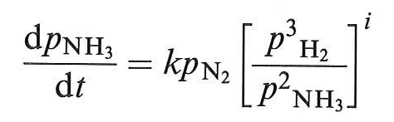
Ammonia synthesis
Catalysts: BASF-S6-10
Fe₃O₄ + Al₂O₃ + CaO + K₂O
Under reaction conditions, Fe₃O₄ is reduced to Fe.
Al₂O₃ and CaO have a structural effect, maintaining the surface area.
K₂O has an electronic effect lowering E_{att}.
i = 0.50 - 0.67

Slide 4
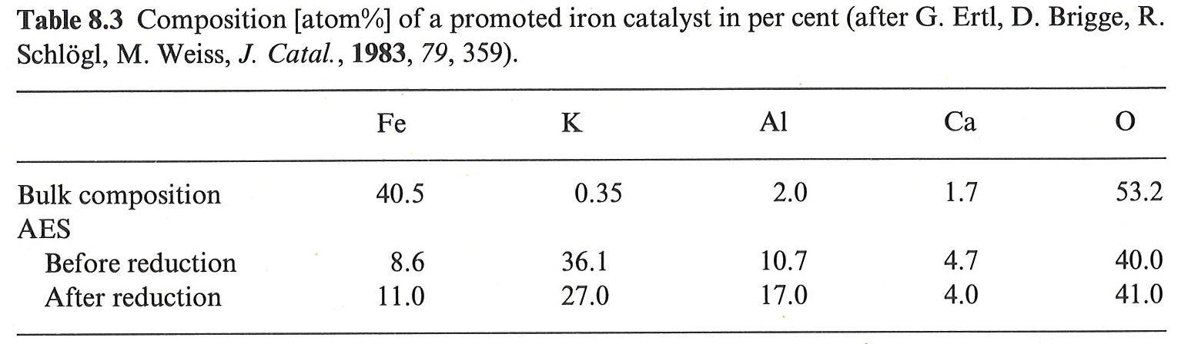
Ammonia synthesis
Surface composition of the catalyst

Slide 5
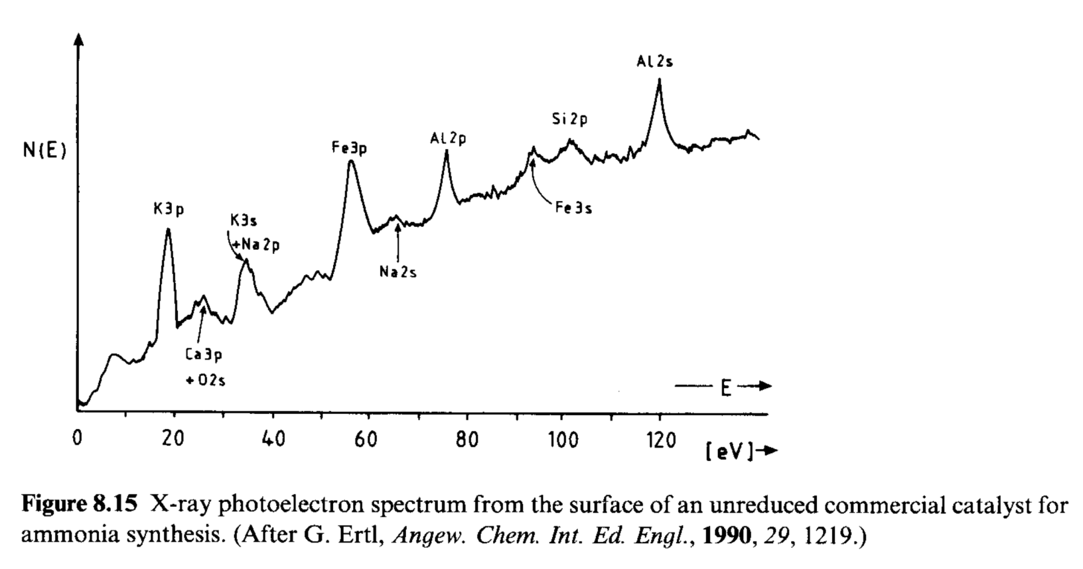
Ammonia synthesis
Surface composition of the catalyst

Slide 6
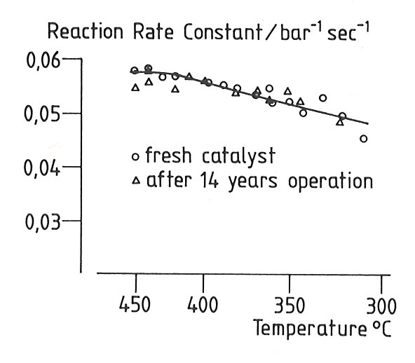
Ammonia synthesis
Extreme stability of the catalyst
At the operative temperature, the catalyst is in a “quasi liquid” form, allowing constant regeneration of the surface.

Slide 7
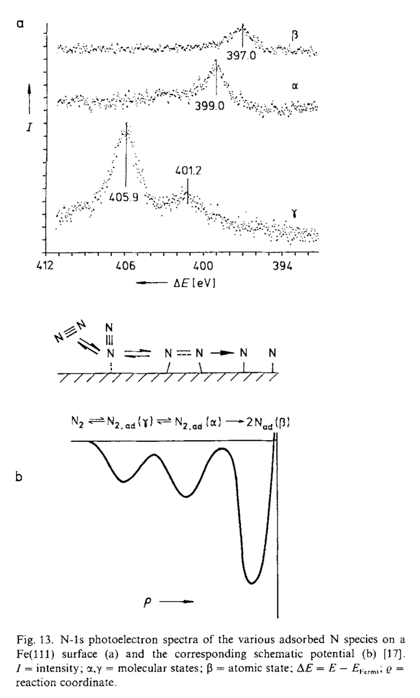
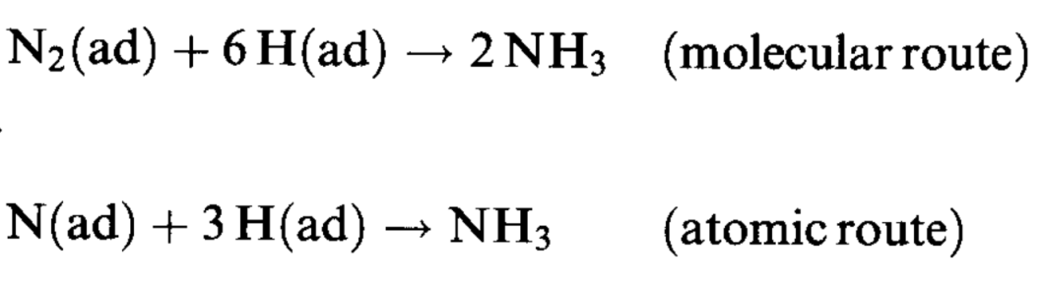
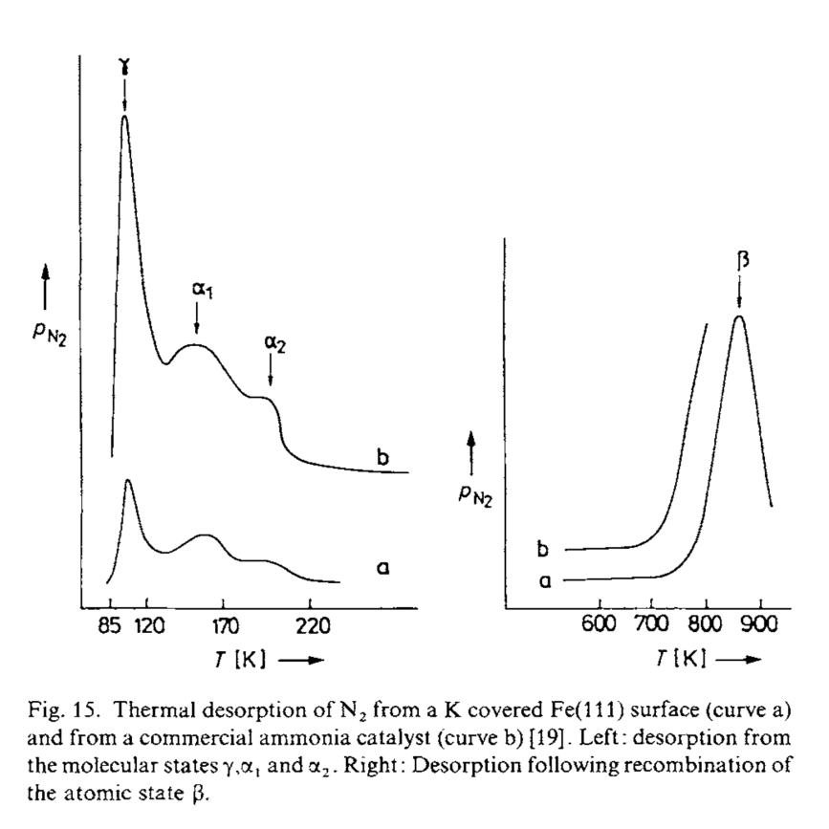
Ammonia synthesis
Atomic or molecular route?
β
α
γ
γ
α
β

Slide 8
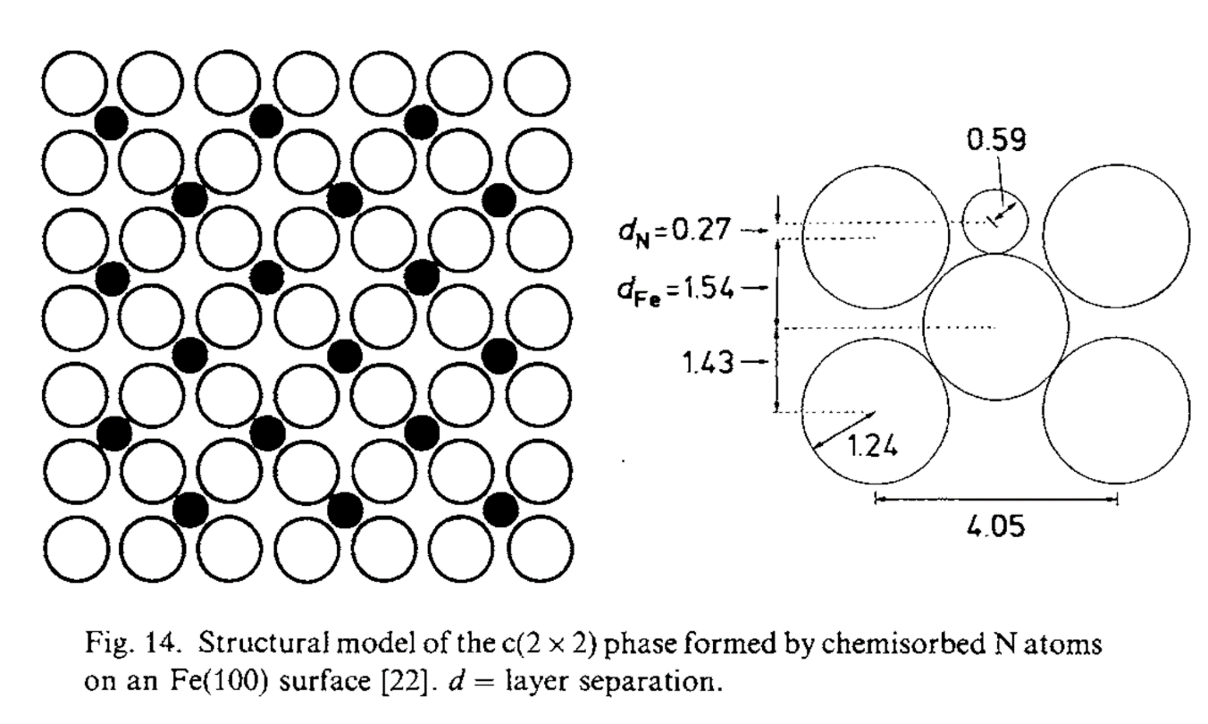
Ammonia synthesis
Atomic or molecular route?

Slide 9
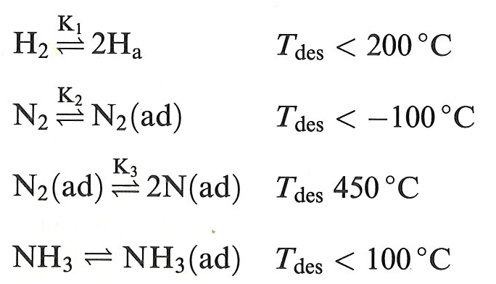
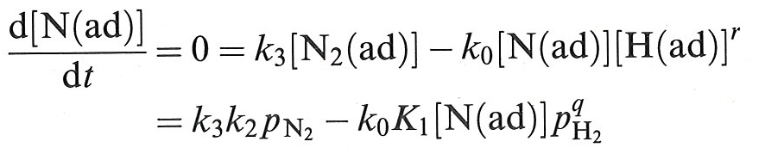
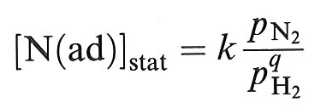
Ammonia synthesis
It is possible to measure N_{(ad)}
Molecular route:
the surface would necessarily be saturated with N_{(ad)} under steady-state conditions, since there would exist no channel through which this species could be removed.
Atomic route:
The steady-state concentration of N_{(ad)} is:
N_{(ad)} should decrease as p_{H2} increases.

Slide 10
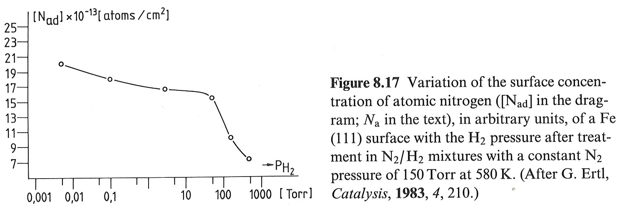
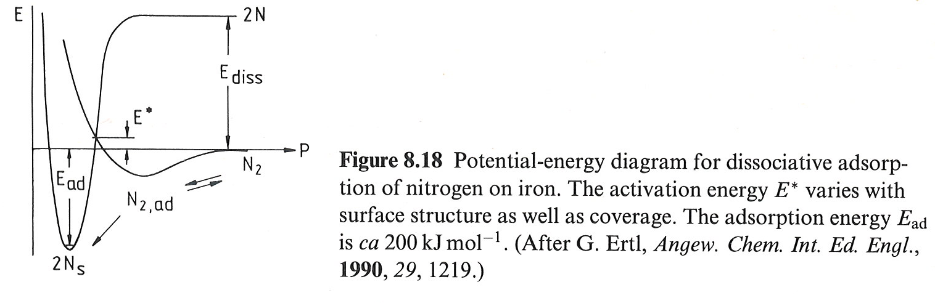
Ammonia synthesis
The reaction proceeds through the atomic route and formation of N_{(ad)} in the rate determining step.

Slide 11
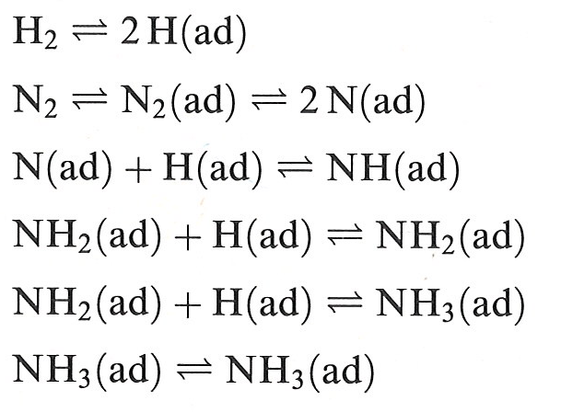
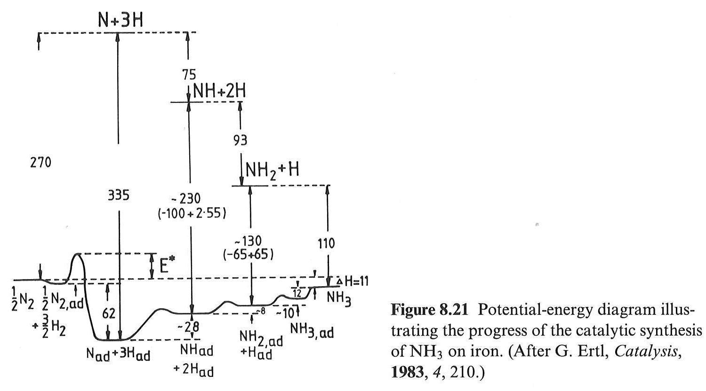
Ammonia synthesis
Reaction steps
Potential energy diagram

Slide 12
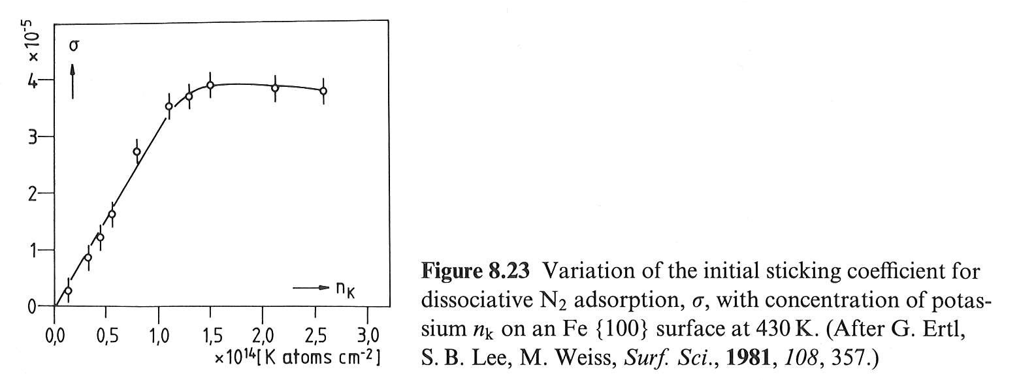
Ammonia synthesis
Effect of K
K increases the sticking coefficient for N₂.

Slide 13
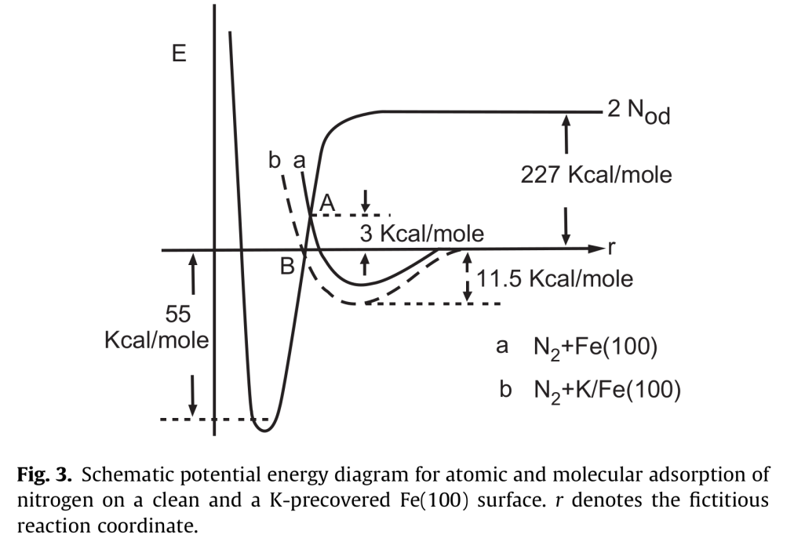
Ammonia synthesis
Effect of K
N
To favor N₂ dissociation, back-donation must be promoted.
N
π*
σ
Promoter (K)
Poison
K
Fe
N₂
Fe

Slide 14
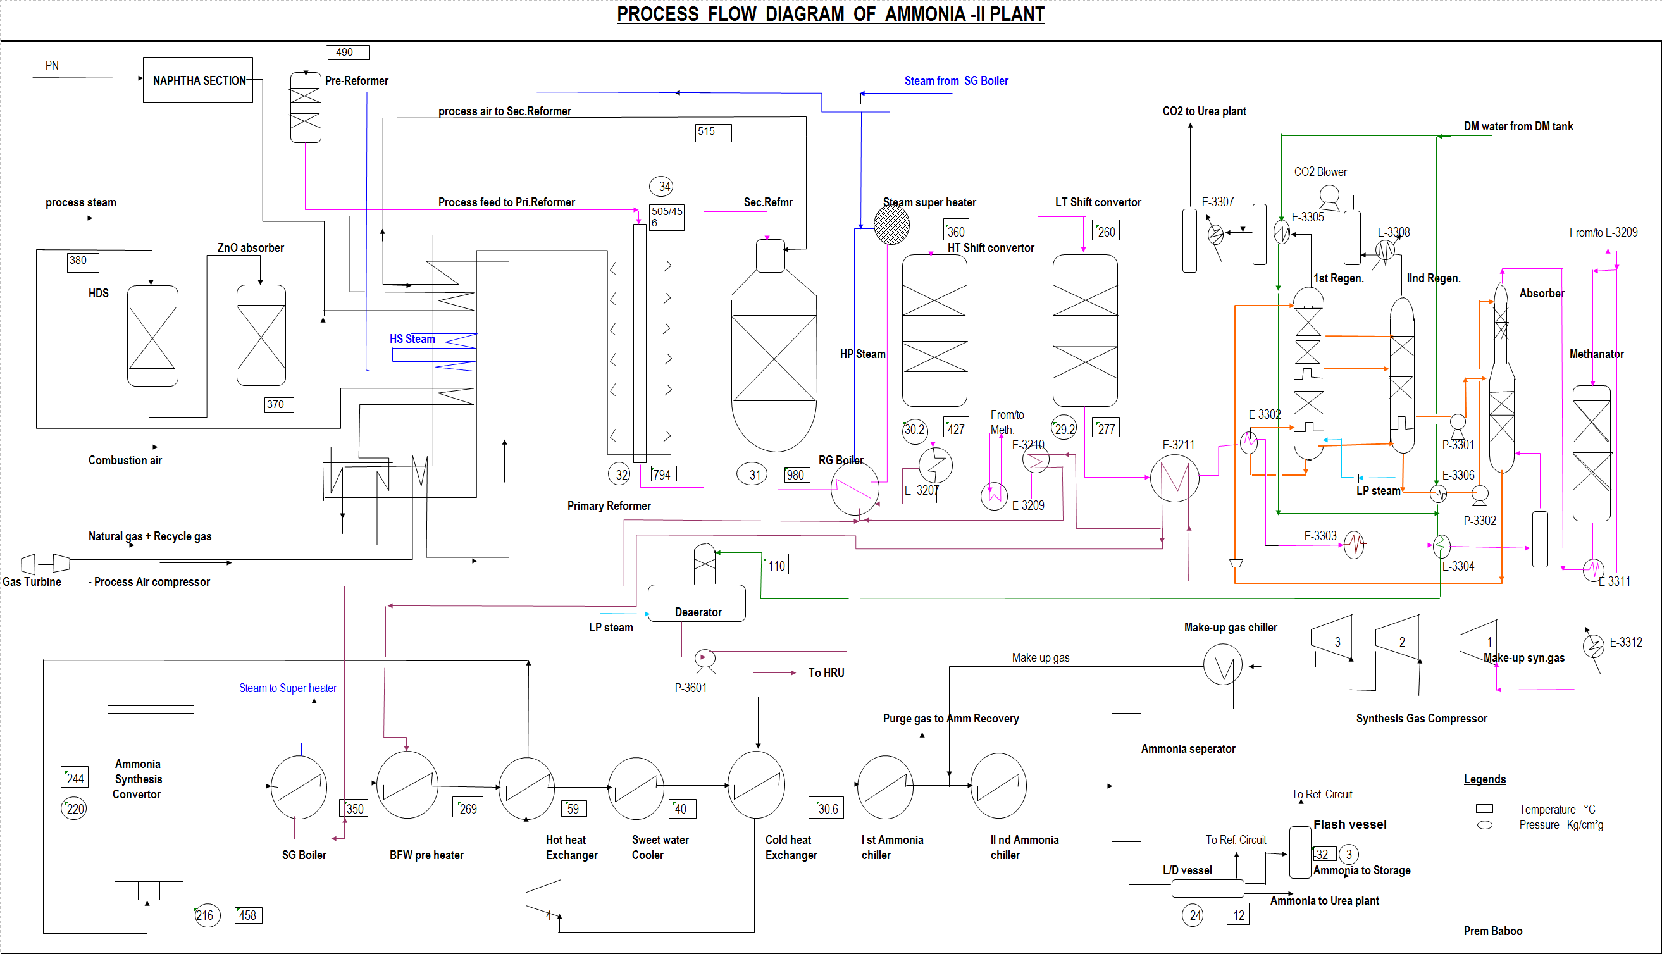

Slide 15
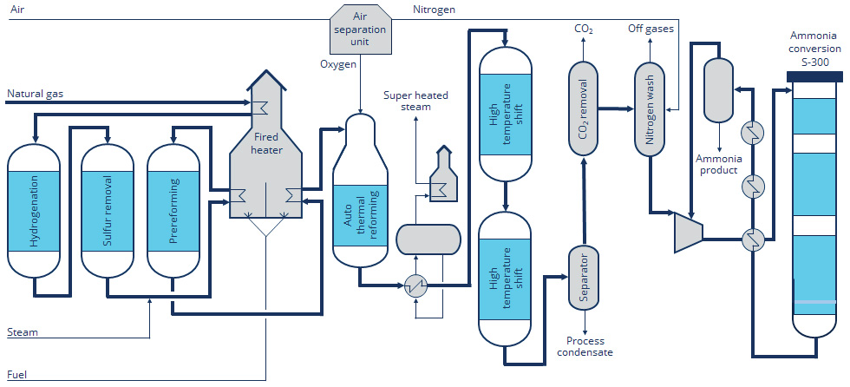
Plant for Ammonia Synthesis

Slide 16
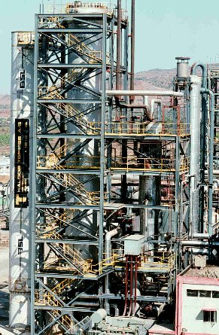
Reactor for Ammonia Synthesis
The catalyst beds in a reactor for production of 1500 t NH₃/day are, in round numbers, 100 m³ and contain 250 t of catalyst.

Slide 17




Reactor for Ammonia Synthesis
The reactor may contain 2 catalyst beds and 2 internal heat exchangers inside a pressure shell:
First bed
Upper heat
exchanger
Second bed
Lower heat
exchanger

Slide 18
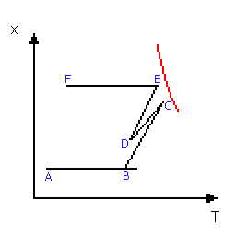
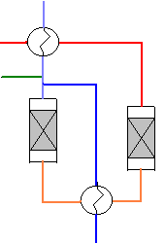
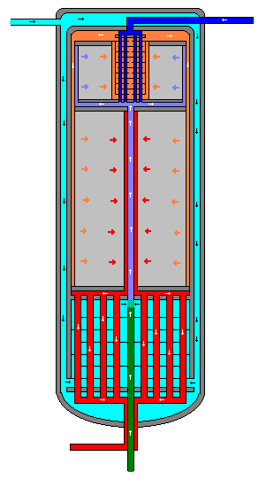
Reactor for Ammonia Synthesis
A: The main flow (pale blue) first flows along the pressure shell and cools it. The gas is then heated in the lower heat exchanger and quench gas (green) is added.
B: In the first bed, both the temperature and the concentration increases. At the outlet from the first bed, the state of the gas is very near equilibrium (red curve).
C: The gas is cooled in the upper heat exchanger and the third inlet gas stream (dark blue) is added. This inlet stream was preheated in the upper heat exchanger.
D:In the second bed, both the temperature and the concentration increases.
E: The gas is cooled in the lower heat exchanger and leaves the reactor as the outlet stream (red).

Slide 19
Methanol from syn-gas
CO
HCHO
CO₂
CH₃COOH
Syn-gas
CH₃OH
H₂
Fuels (FT Synthesis)
H₂O
Additives (MTBE)
Catalyst: Cu/ZnO/Al₂O₃
T = 250 – 300 °C
P = 50 – 100 atm
Efficiency = 99%

Slide 20
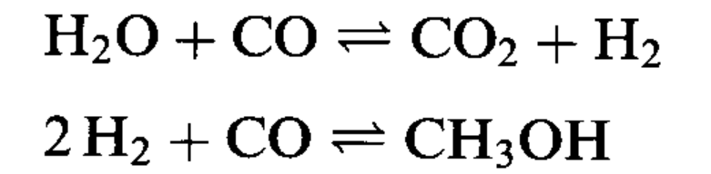
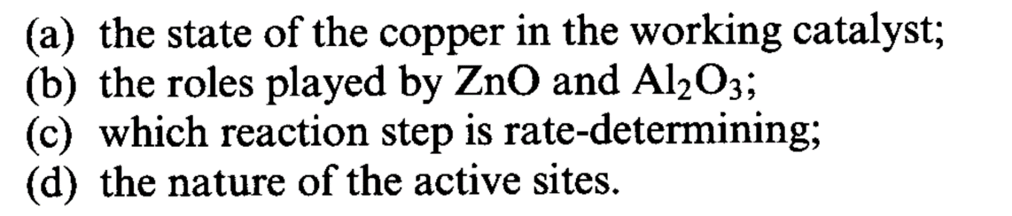
Methanol from syn-gas
Where does methanol come from?
Catalyst:
Cu/ZnO/Al₂O₃

Slide 21
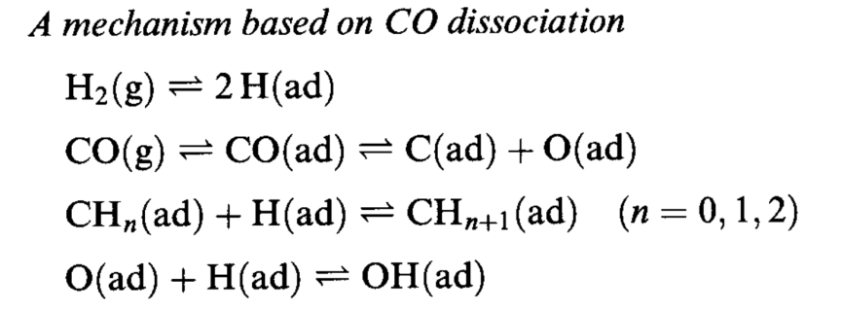
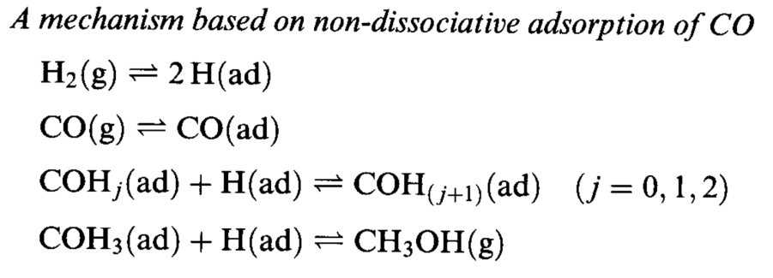
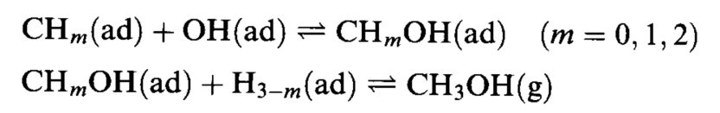
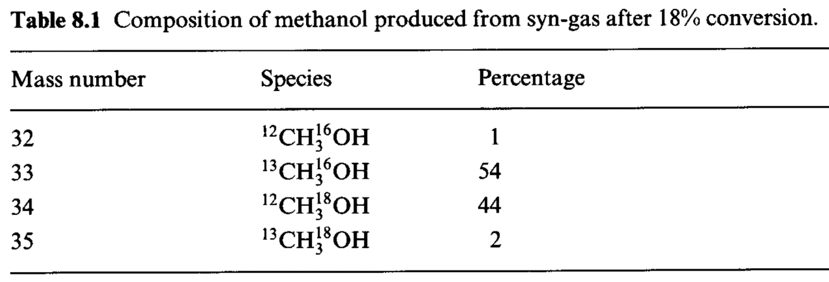
CO is not dissociated
¹³C¹⁶O + ¹²C¹⁸O + H₂
CH₃OH
Notes:
Bassa resa

Slide 22
Role of CO₂: main source of CH₃OH
CO
¹⁴CO₂
H₂
¹⁴CH₃OH
The amounts of ¹⁴CO is negligible.
Methanol is produced from CO₂ and no scrambling with CO takes place
Notes:
Resa aumenta se viene aggiunta H2O e/o CO2

Slide 23
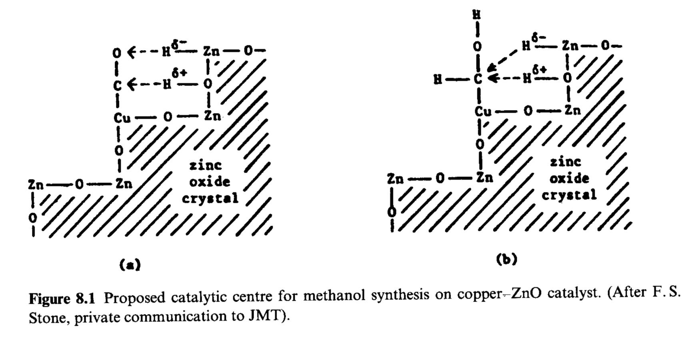
The state of copper in the working catalyst
Auger / XPS / UV-vis
Cu(I)
BUT …. Characterization techniques are employed under conditions far from the real working conditions of the catalyst.

Slide 24
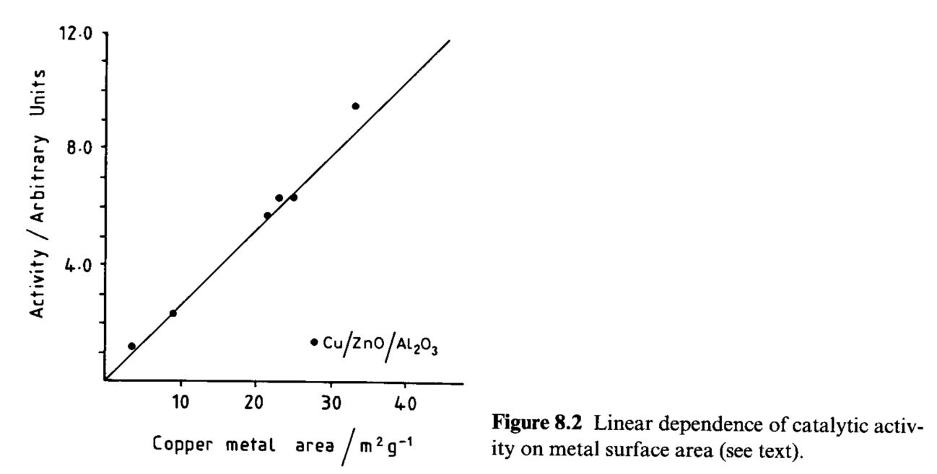
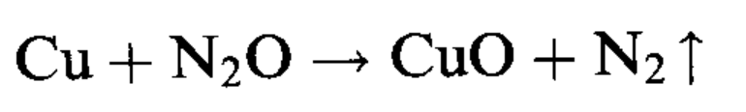
The state of copper in the working catalyst
Later….
The surface of Cu in real-life catalyst is in a dynamic state, in which the most part of Cu(0) with partially oxidized Cu(I) formed by O_{ads} and OH_{ads}.

Slide 25
The role of ZnO and Al₂O₃
Al₂O₃ increases surface area of the catalyst.
ZnO increases surface area and dispersion of Cu(0) species involved in the rate determining step and stops any sulphur impurity, increase longevity of the catalyst.

Slide 26
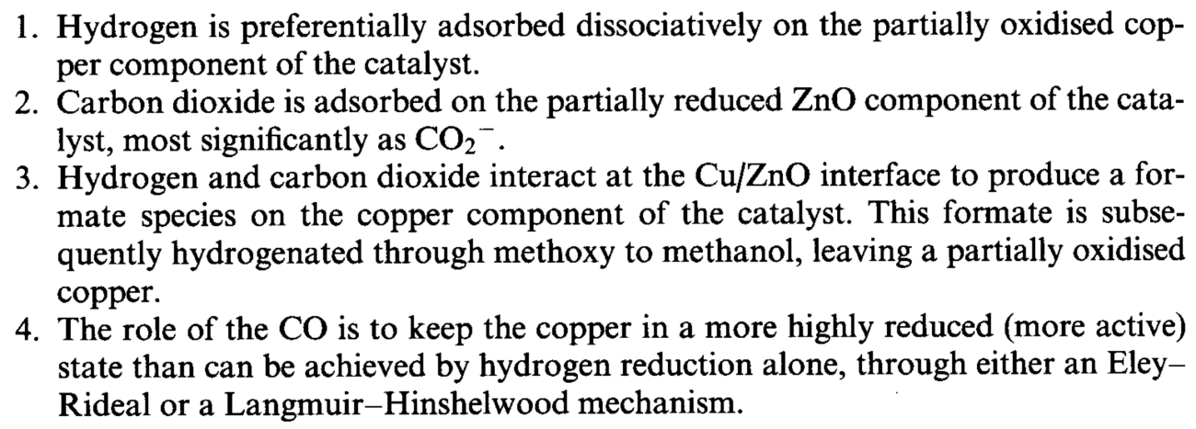
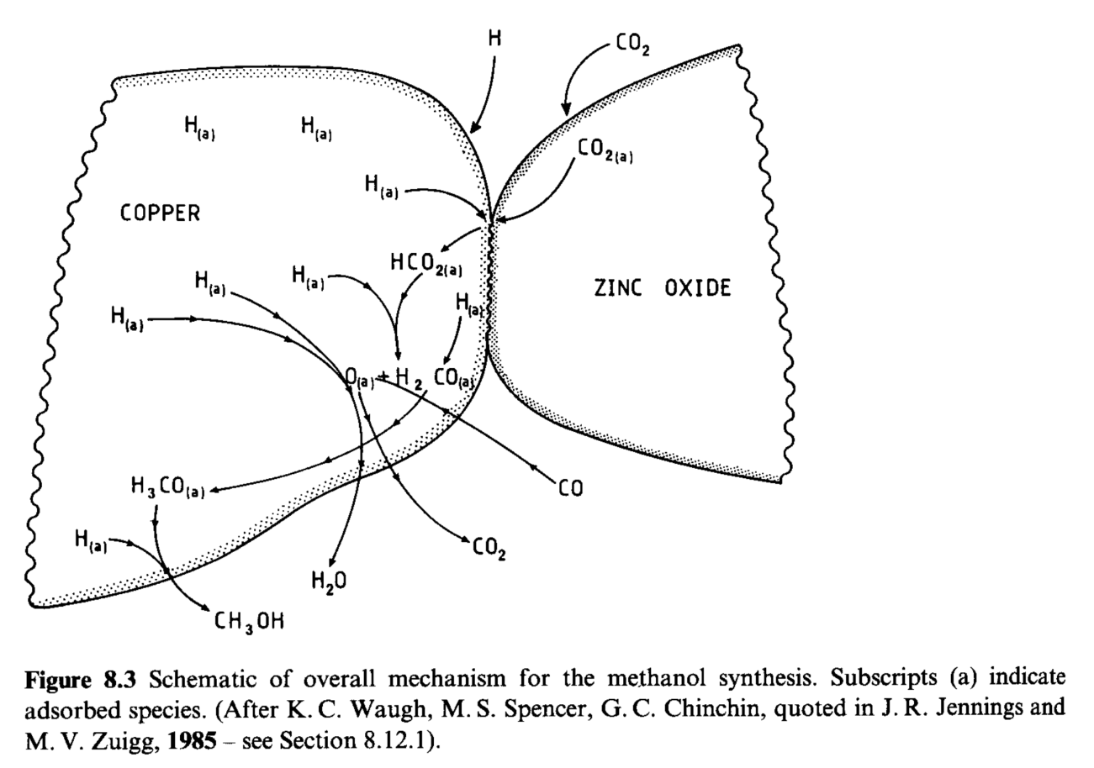
Views on the mechanism of the reaction
Notes:
Non accordo assoluto su quale sia il reale funzionamento del catalizzatore. TPR, TPD, IR etc. suggeriscono che….

Slide 27
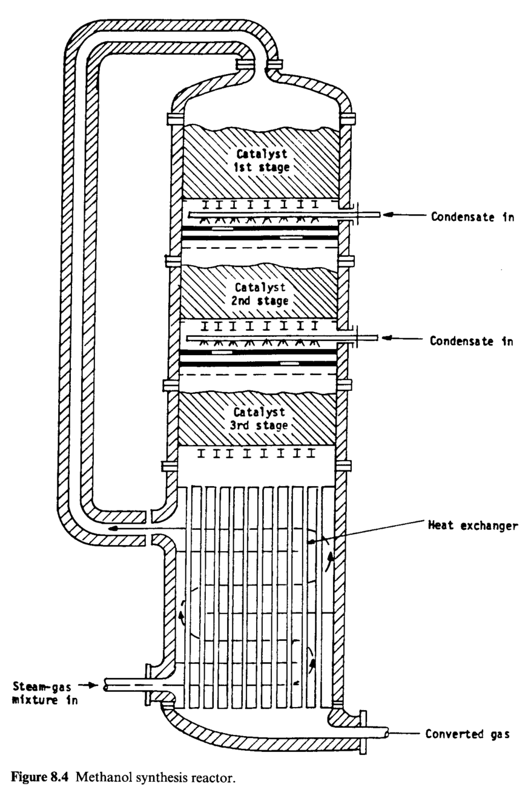
The reactor
Methanol synthesis is exothermic
Equilibrium favored by high pressure

Slide 28
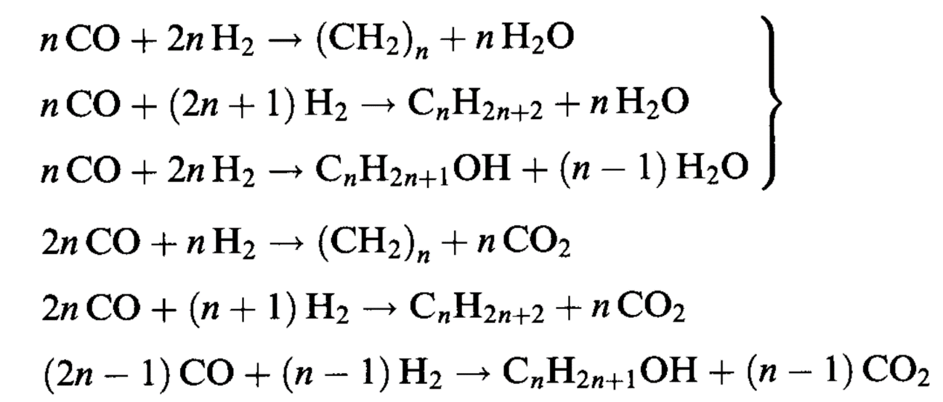
Fischer-Tropsch process
Syn-gas
Hydrocarbons
Germany: World War II
USA: 1950s
South Africa: SASOL I (1)955) & SASOL II (1980)
South African Synthetic Oil Ltd.
All exothermic reactions

Slide 29
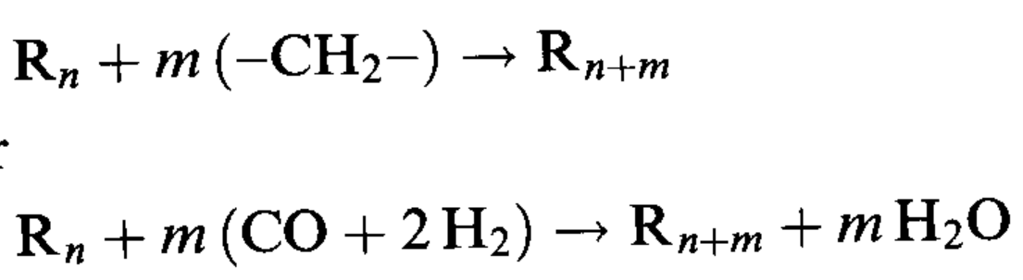
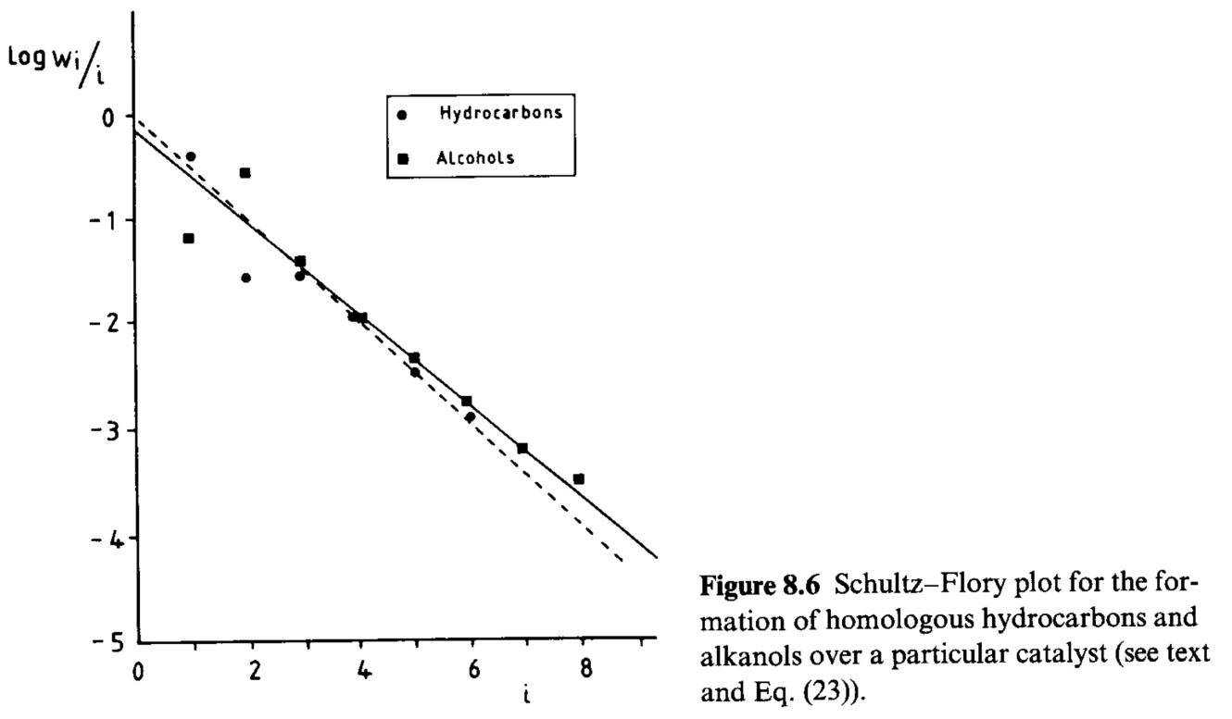
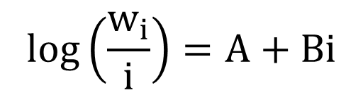
Fischer-Tropsch process
The process can be considered as a polymerazion of –CH₂– units, even if they are not present initially.
$$log\left(\frac{w_{i}}{i}\right)=A+Bi$$

Slide 30
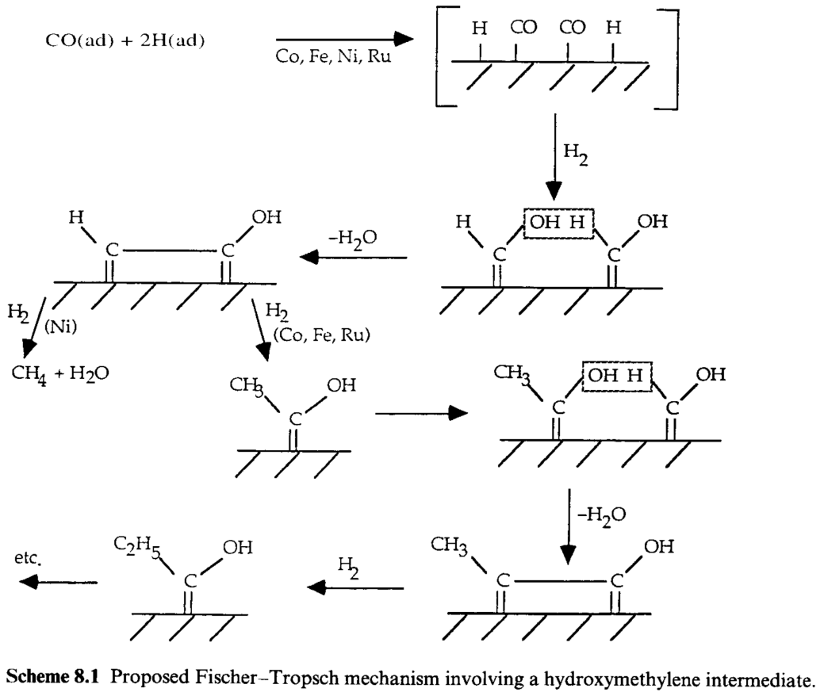
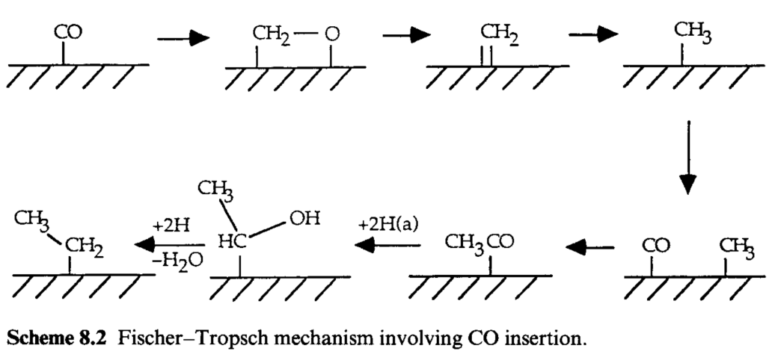
Fischer-Tropsch process: suggested mechanisms
Hydroxymethylene intermediate
CO insertion mechanism

Slide 31
Fischer-Tropsch process: suggested mechanisms
Hydroxymethylene intermediate
Never detected by experimental techniques
CO insertion mechanism

Slide 32
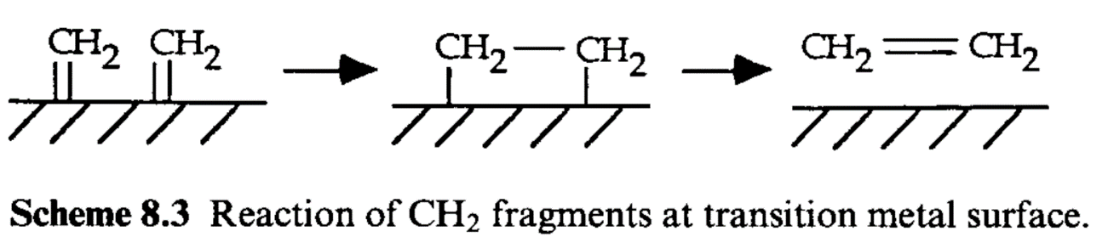
Fischer-Tropsch process: first step requires CO dissociation
All the metals that promotes FT synthesis also dissociates CO easily to its elemental components. In FT process, it is later converted into CH_{ads} and CH_{2ads} (confirmed by ¹³C NMR and HREELS).
Mechanicistic studies using diazomethane CH₂N₂
It forms adsorbed CH₂ immediately when in contact with metal surface
CH₂N₂ in inter gas flow
Dimerization & desorption
No polymerization
Notes:
Co, Ni, Fe, Pd, Ru

Slide 33
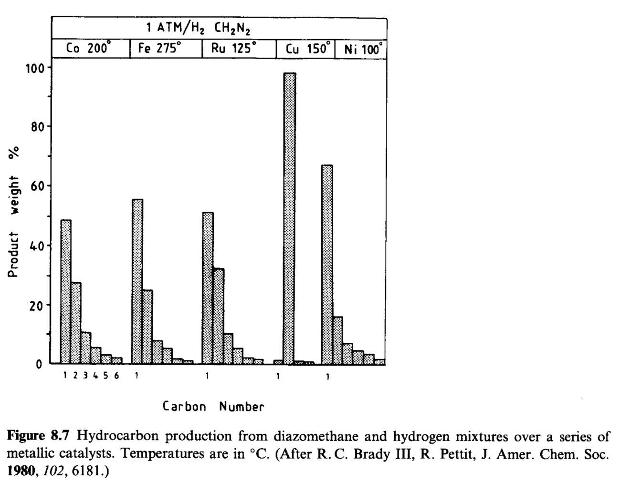
Fischer-Tropsch process: first step requires CO dissociation
Mechanicistic studies using diazomethane CH₂N₂
CH₂N₂ + H₂ vs CO + H₂
Notes:
Cu non è in grado di dissociare H2: quindi formazione di H è fondamentale per la produzione di idrocarburi.

Slide 34
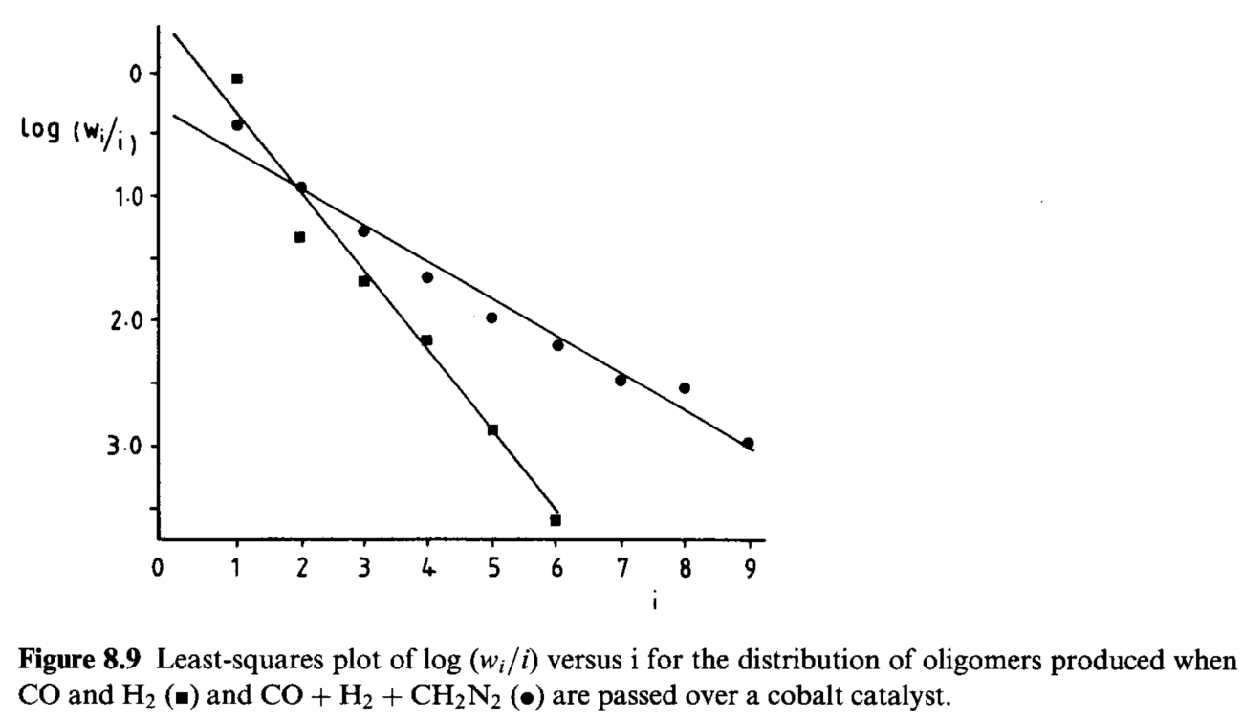
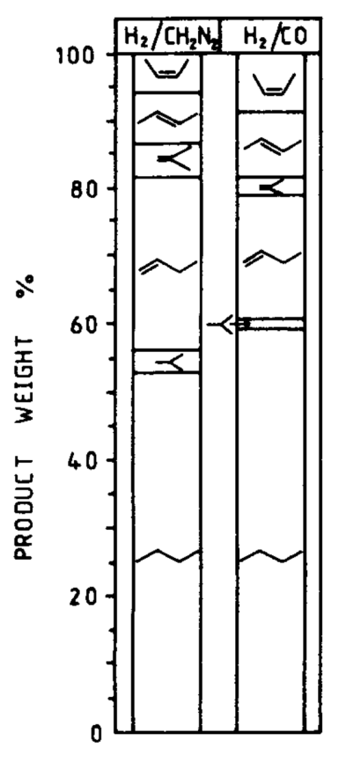
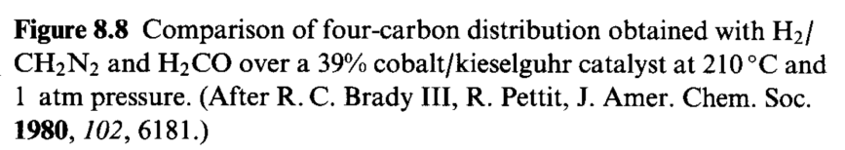
Fischer-Tropsch process: first step requires CO dissociation
Mechanicistic studies using diazomethane CH₂N₂
CH₂N₂ + H₂ vs CO + H₂

Slide 35
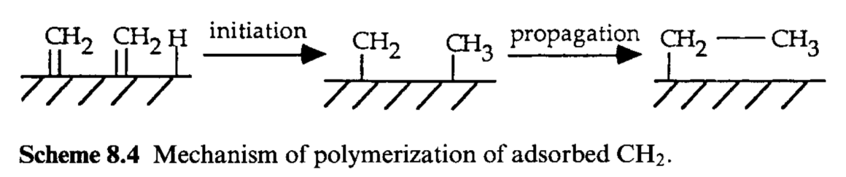
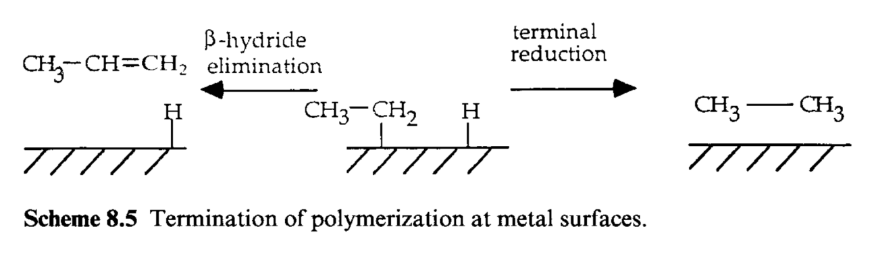
Fischer-Tropsch process: first step requires CO dissociation
Mechanicistic studies using diazomethane CH₂N₂
CH₂N₂ + H₂ vs CO + H₂

Slide 36
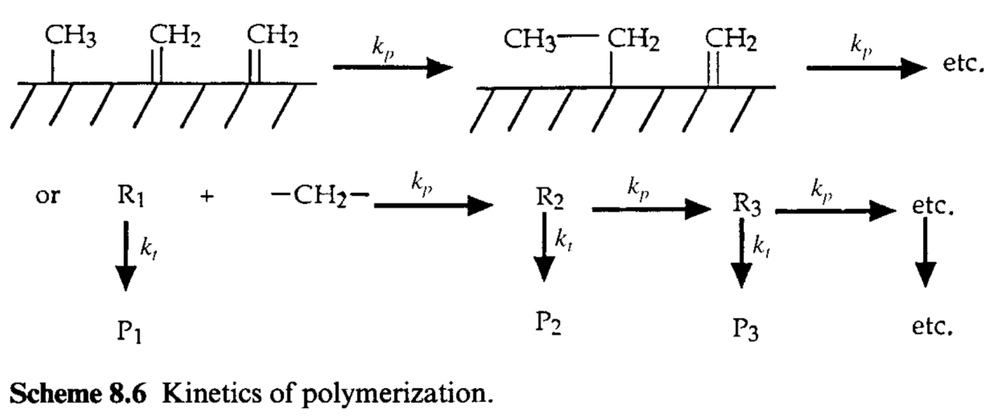
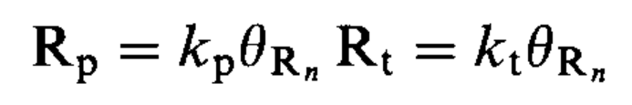
Fischer-Tropsch process
Schultz – Flory distribution
Propagation
Termination
(β-hydride elimination + terminal reduction)
Notes:
Rn = frammento alchilico di lunghezza n
Pn = prodotto di lunghezza n
kp e kt siano indipendenti da n

Slide 37




Fischer-Tropsch process
Schultz – Flory distribution
$$α=\frac{k_{p}}{k_{p}+k_{t}}$$
The distribution of products concentrations is governed by:
${Cp}_{n+1}=α$ ${Cp}_{n}$
A succession of i steps will occur with probability $α^{i}$. The chance to obtain the product P_{i} is proportional to $α^{i}$ or, in other words,
$${\frac{w_{i}}{i}=K α}^{i}$$
$$log\left(\frac{w_{i}}{i}\right)=log K+i logα$$
Notes:
Rn = frammento alchilico di lunghezza n
Pn = prodotto di lunghezza n
kp e kt siano indipendenti da n

Slide 38


Fischer-Tropsch process

Slide 39

Fischer-Tropsch process
Notes:
CO si adsorbe e si dissocia.
H2 si adsorbe e si dissocia.
O adsorbito viene rimosso come H2O o CO2, liberando i siti per adsorbimento di altro CO.
CHx formati polimerizzano per dare i prodotti

Slide 40

Fischer-Tropsch process
The real mechanism is more complicated, considering that a complex mixture of products is obtained, comprising alkanes, alkenes, alcohols and aldehydes.

Slide 41

Fischer-Tropsch process
The catalyst composition must be tuned to manipulate $α=\frac{k_{p}}{k_{p}+k_{t}}$
Active phase with high $k_{p}$: long C chains
Active phase with high $k_{t}$: short C Chains
SASOL Process:
Oxygenated synthesis
Catalyst:
Fe₂O₃ + CuO + K₂SiO₃
Catalyst:
Rh-based material
Main products: Alcohols, mainly ethanol
Fe + Cu + K₂O + SiO₂
Catalyst for FT
Stabilizer for texture
Promoter for Fe₂O₃ reduction
????

Slide 42
Fischer-Tropsch process
The catalyst composition must be tuned to manipulate $α=\frac{k_{p}}{k_{p}+k_{t}}$
Active phase with high $k_{p}$: long C chains
Active phase with high $k_{t}$: short C Chains
SASOL Process:
Oxygenated synthesis
Catalyst:
Fe₂O₃ + CuO + K₂SiO₃
Catalyst:
Rh-based material
Main products: Alcohols, mainly ethanol
Fe + Cu + K₂O + SiO₂
Catalyst for FT
Stabilizer for texture
Promoter for Fe₂O₃ reduction
Promoter for CO dissociation

Slide 43


Fischer-Tropsch process: SASOL I & II
FEED
H₂ 43%, CO 43%, CH₄ 12%, CO₂ 1%, N₂ balance
Fluidized bed reactor
320-360°C, 25bar
High space velocity
Products: C5-C11 (gasoline)
Fixed bed reactor
220-350°C, 30bar
Low space velocity
Products: C1-C35 (waxes 45%, diesel & gasoline 32%)

