Slide 1

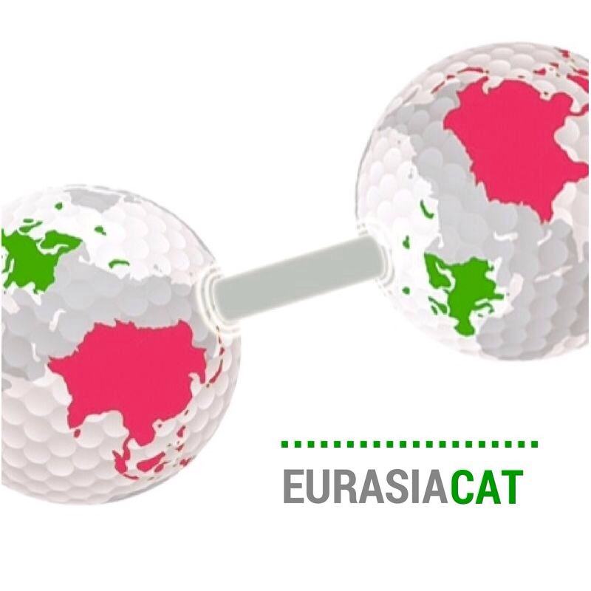

Phases and stresses in materials science and technology: a spectroscopic approach
Valter SERGO
DIA, Dipartimento di Ingegneria ed Architettura
Università di Trieste
sergo@units.it
University of Macau
February 2018

Slide 2
Outline
Technological issues tackled
-) Stresses in Silicon-based microcircuits;
-) Aging of Perovskite-based capacitors;
-) Phases and stresses in ceramic materials: Hyp Joint Prostheses;
-) Stresses in Low-temperature Co-fired Ceramic for electronic applications;
-) Delamination of Thermal Barrier Coatings on Turbine blades for aerospace industry;
-) Residual stresses and toughness in ceramic nano composites;
  Techniques
  Raman spectroscopy
  Fluorescence spectroscopy
  Instrumentation

Slide 3

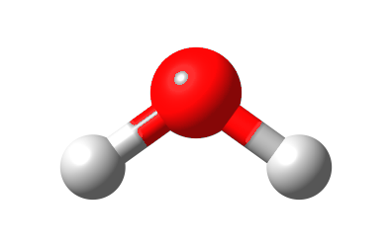


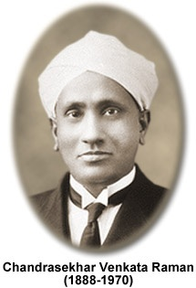

Origin of the Raman effect: molecular vibrations
excited state
polychromatic
radiation
transmitted
radiation
absorption
(IR )
ground state
monochromatic
radiation
scattered
radiation
excited state
scattering
(Raman)
ground state

Slide 4



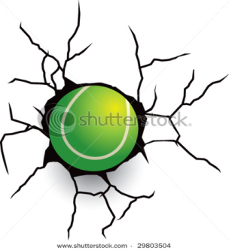

“Elastic” and “inelastic” scattering
elastic process
sample
molecules
incident
photons
scattered
photons
no energy is
exchanged
Ei
Ei = Ef
Ef
elastic
inelastic process
inelastic
energy is
exchanged!
Ei
Ei >Ef
Ef

Slide 5
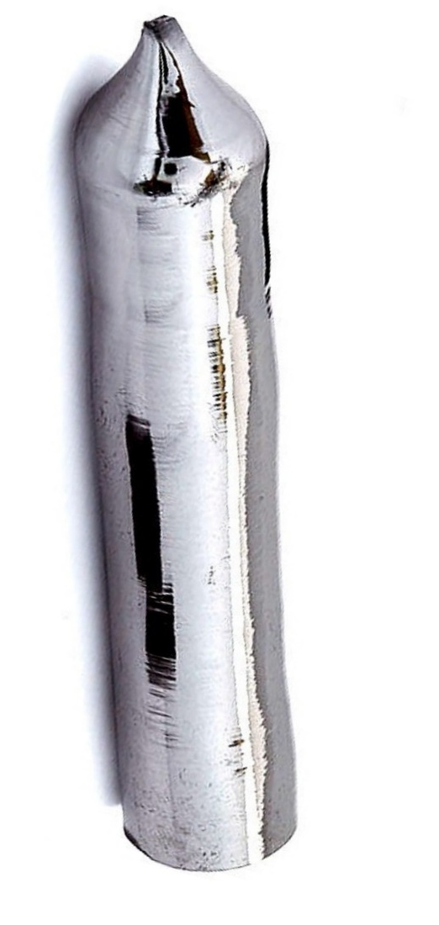
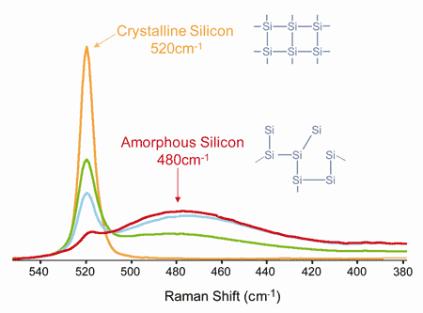
The Raman Effect:
light “shifted” by vibrations
laser
hν₀
h(ν₀±ν_{i})
Data courtesy of Thermo Fisher Scientific, www.thermo.com/dxr.

Slide 6
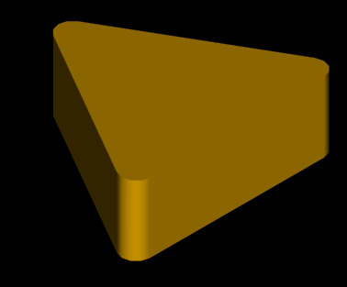
Typical set-up for Raman microscopy
(back-scattered configuration);
-lateral (spatial) resolution ≈1 μm
-spectral resolution ≈ 1cm⁻¹
514 nm Notch
filter
Diffraction
grating
To the PC
TEC cooled
CCD camera
Microscope
objective
Beam
expander
Ar ion laser
514 nm, 20 mW
Sample

Slide 7
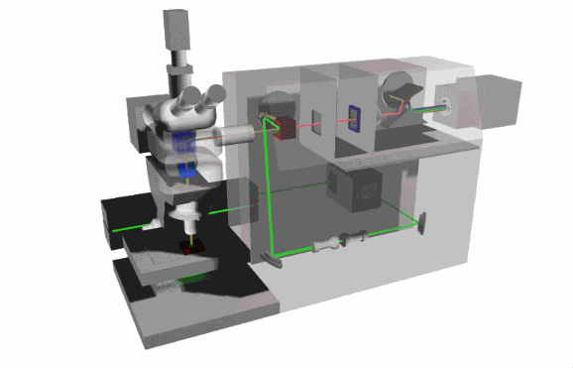
Schematic

Slide 8
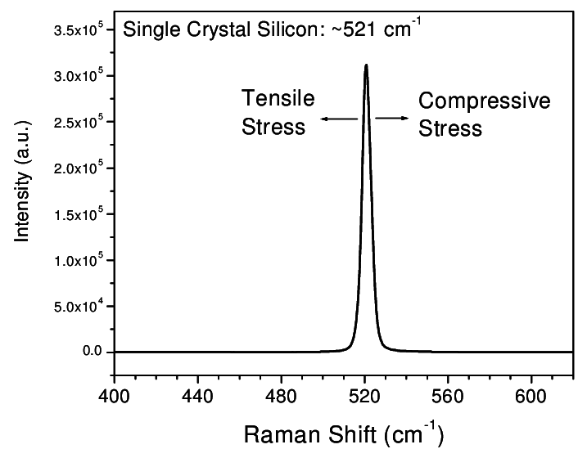
Raman spectrum of Silicon: peak position is stress dependent:
We can retrieve stress from frequency shifts

Slide 9
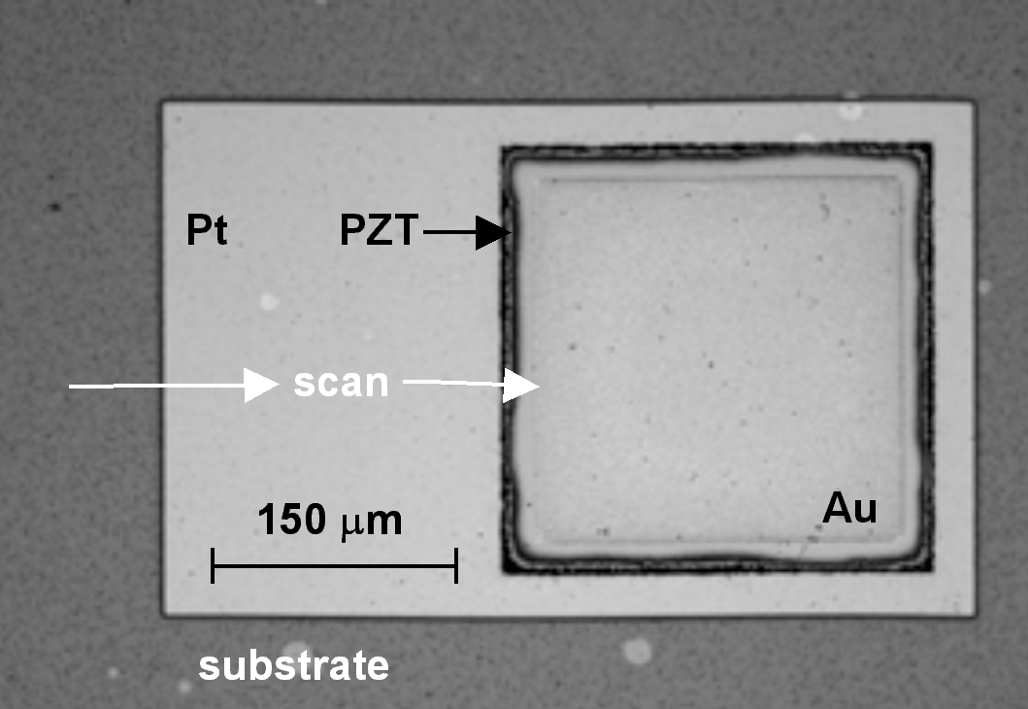
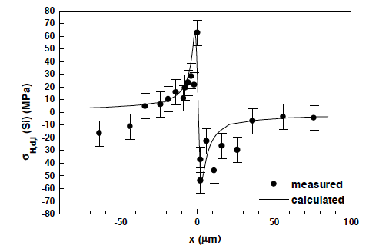
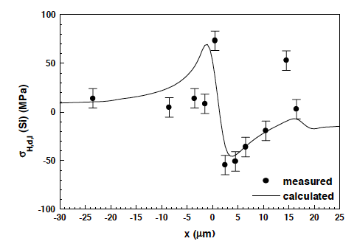
Stress in the silicon wafer induced by the deposition and etching sequence
Pyro-sensor developed by Siemens
(collaboration with Dr R. Krawietz and Prof. W. Pompe, Technical University of Dresden)
R. Krawietz, W. Pompe, V. Sergo, Cryst. Res. Technol., 35 (4) 449-460 (2000).

Slide 10
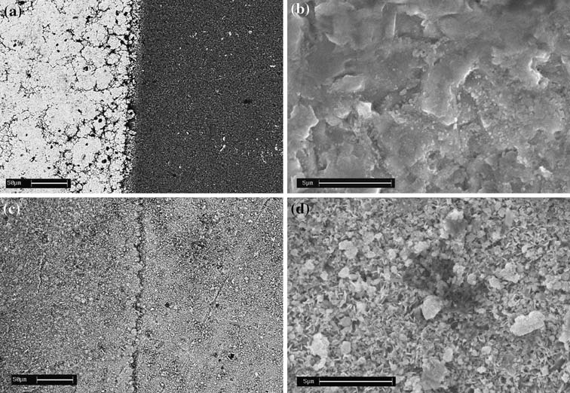
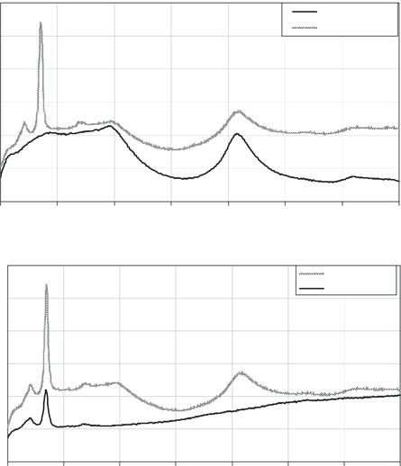
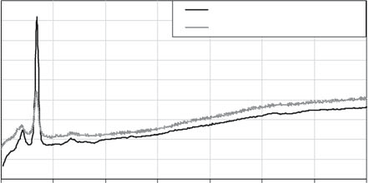
Sn-containing
New electrode
New BaTiO3
capacitor
Raman spectrum of New BaTiO3
Aged electrode
Aged capacitor
Ubiquitous SnO
Raman spectrum of SnO after aging

Slide 11
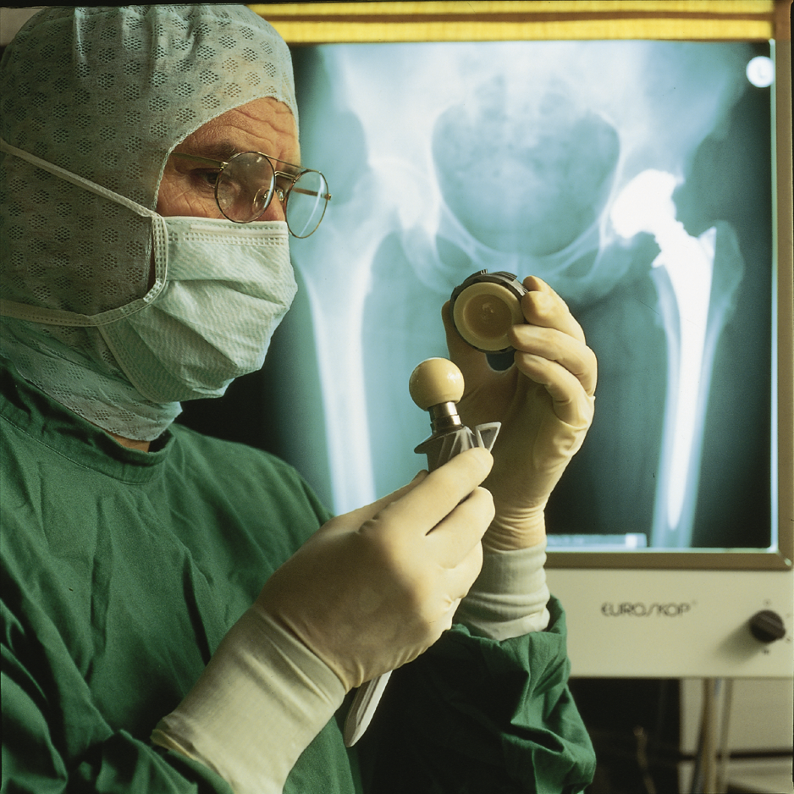
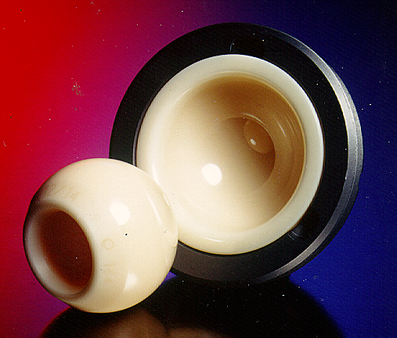
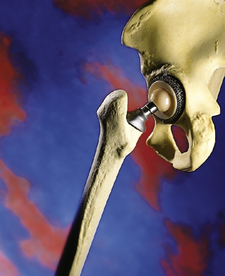
Ceramic hip joint prostheses

Slide 12
NB: The material is ZIRCONIUM OXIDE, ZrO₂.
100 cm³ of tetragonal ZrO₂ expand to give 105 cm³ of monoclinic- ZrO₂
(5% transformation strain)
CUBIC
2100°C>T>2800°C (T.F.)
TETRAGONAL
1100°C>T>2100°C (T.F.)
MONOCLINIC
1100°C>T> Room Temp.
Cooling

Slide 13
First consequence:The transformation toughening of ZrO₂
At the crack tip, tetragonal ZrO₂ particles transform to monoclinic; they try to expand and, consequently,
EXERT A CLOSING PRESSURE ON THE ADVANCING CRACK!!
Monoclinic ZrO₂
Tetragonal ZrO₂

Slide 14
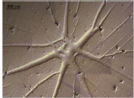

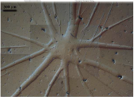
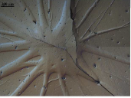
2nd consequence: pseudo-plasticity
Stress, MPa
500 Mpa
Strain
Stress, MPa
600 Mpa
Strain
Stress, MPa
700 Mpa
Strain

Slide 15
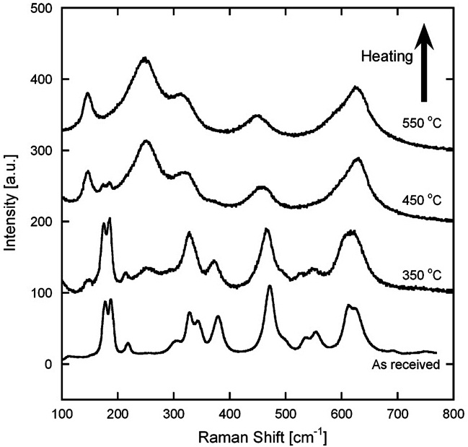
Raman spectroscopy of zirconia
Stress-induced band shift
Purely tetragonal (t) (peaks at 147 and 265 cm⁻¹)
Purely monoclinic (m) (peaks at 181 and 190 cm⁻¹)
Lughi and Clarke
Acta Materialia 2007
Notes:
SLIDE 4. INTRODUCTION – zirconia spectra
Raman spectroscopy is perfect for this task. It is a powerful technique and is able to distinguish different crystal structures of the same composition. This is a typical Raman spectra of zirconia with different monoclinic and tetragonal phase content. This figure was lifted from one of the papers of Prof. Lughi. Here, the bottommost curve represents zirconia in purely monoclinic phase, where a characteristic doublet at 181 cm⁻¹ and 190 cm⁻¹ is observed. The topmost curve, which is a purely tetragonal phase zirconia, has prominent peaks at 147 cm⁻¹ and 265 cm⁻¹ while the monoclinic doublet is suppressed. Intermediate curves are that of zirconia with mixed concentrations , where we find all four peaks simultaneously present. Clearly, the peak intensities at the four characteristic wavenumbers are related to the monoclinic and tetragonal phases concentrations. To determine the volume concentration of the monoclinic phase, first, we take a single spectra of the sample. We then determine the intensities at the characteristic peaks. This equation gives the exact value of Vm, where we need 3 monoclinic peaks and 1 tetragonal peak.
Take note, however, that this procedure only works when large concentrations of monoclinic phase are present in the sample. It is necessary to have a detectable peak to perform the fitting.

Slide 16
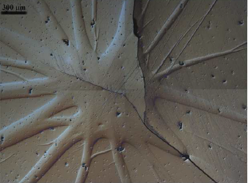
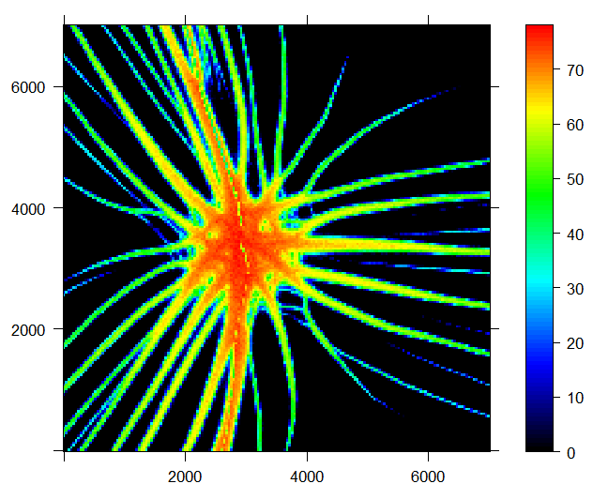
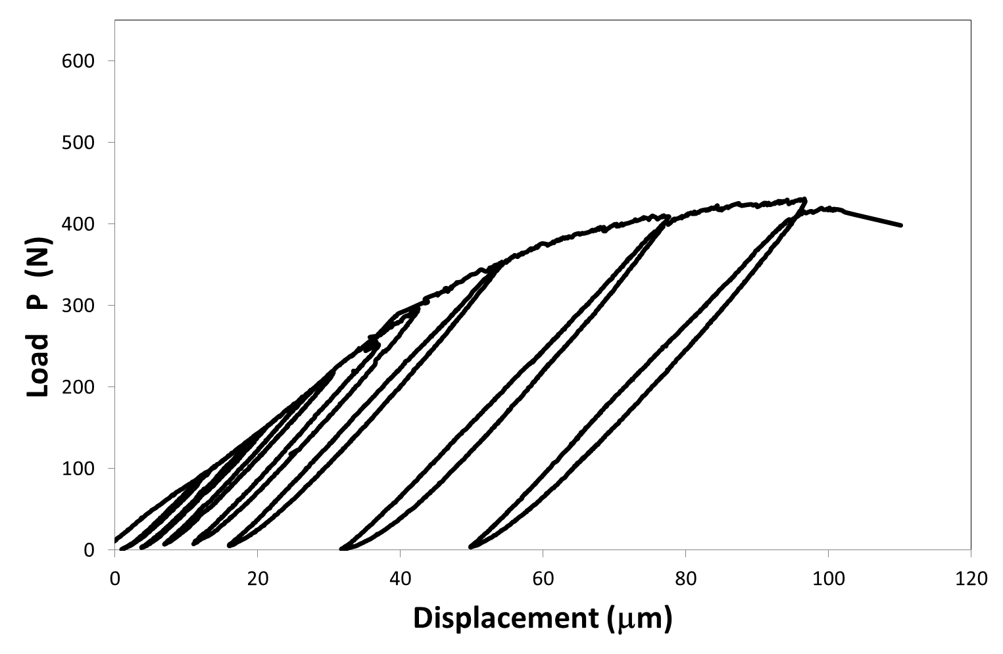
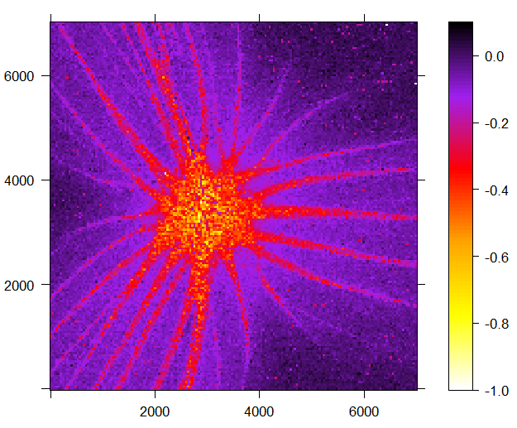
Monoclinic content %
Stress GPa

Slide 17
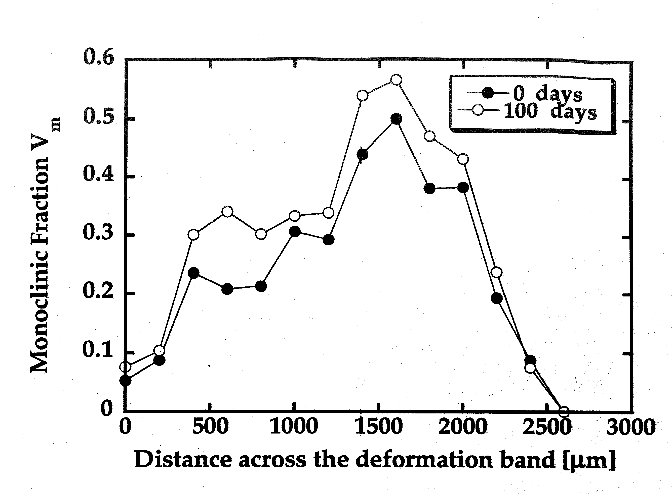
Monoclinic fraction increases more rapidly if there is already
some monoclinic, even at room temperature!
a frightening kinetics!
Sergo and Clarke, J Am Ceram Soc, 1995

Slide 18
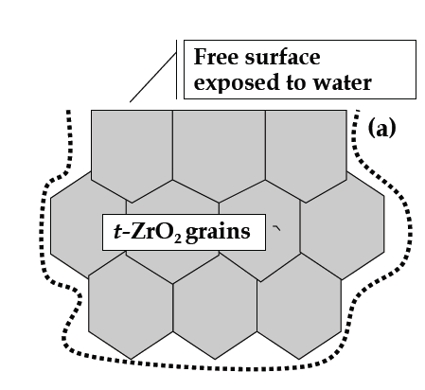
TETRAGONAL
1100°C>T>2100°C (T.F.)
Aging problem of zirconia
Surface
Degradation!
M-ZrO2 grain
MONOCLINIC
1100°C>T> Room Temp.

Slide 19
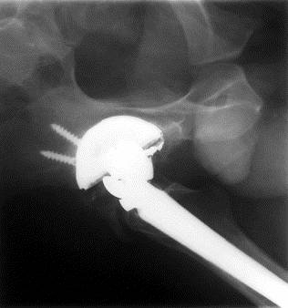
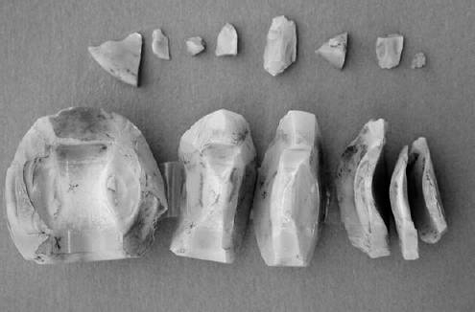
Fracture of zirconia ball heads for hip joint prostheses:
the Prozyr® affaire
St. Gobain Desmarquest reported 162 known failures requiring revision, and that 9,051 heads were involved in the affected batches. Of those 9,051 heads involved, it is unknown how many have already been implanted. The company recalled several batches by production numbers and, due to a class action, filed for bankruptcy and disappeared.

Slide 20
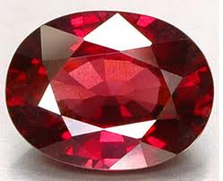

Slide 21
Typical fluorescence spectrum of Al₂O₃
(ruby red, due to substitutional Cr³⁺ ions)
Compression
Tension

Slide 22
Fluorescence Piezo-spectroscopy
Best technique for alumina-based materials: TGO under TBC’s, ball heads for hip-joint prostheses, cutting tools, sapphire fibers-reinforced composites, etc.
≈18000 cm⁻¹
(green absorption band)
tension
Non-radiative transitions (IC)
14938 cm⁻¹
Energy
Gradient: 7.6 cm⁻¹/GPa
<
R2 14430 cm⁻¹
R1 14400 cm⁻¹
Radiative transitions (typical ruby lines)
compression
0.38 cm⁻¹
0.00 cm⁻¹

Slide 23
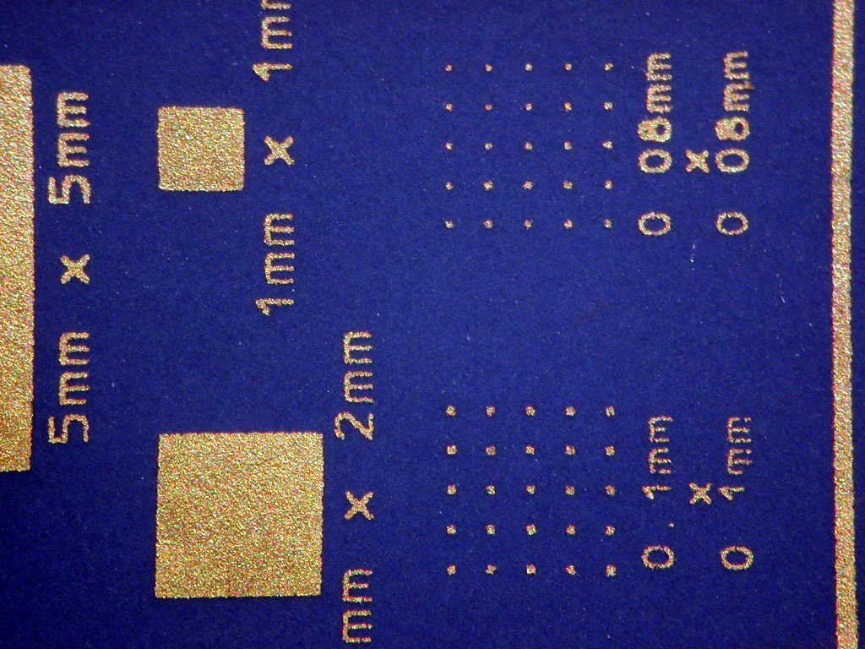
Low Temperature Co-fired Ceramics
METAL PAD
METAL PAD 1mmx1mm
METAL PAD 2mmx2mm

Slide 24
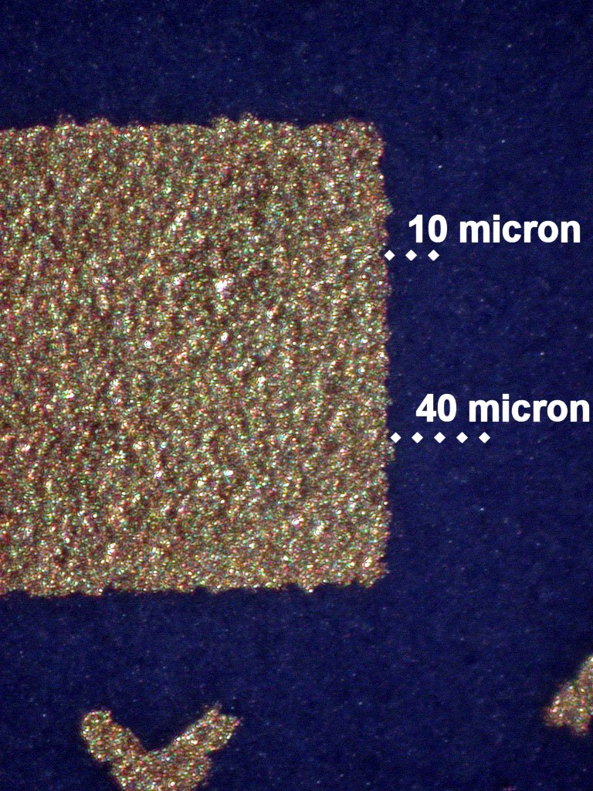
Metal pad (1mmx1mm)

Slide 25
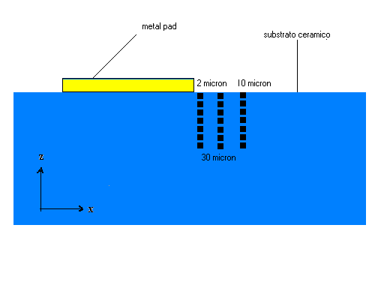
In depth stress analysis
Confocality mode

Slide 26
RISULTs
50
2 micron
0
4 micron
-50
6 micron
stress(MPa)
8 micron
-100
10 micron
-150
28
24
20
-200
16
12
8
Depth (micron)
4
0
10 micron
8 micron
6 micron
4 micron
2 micron

Slide 27
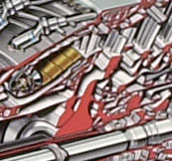
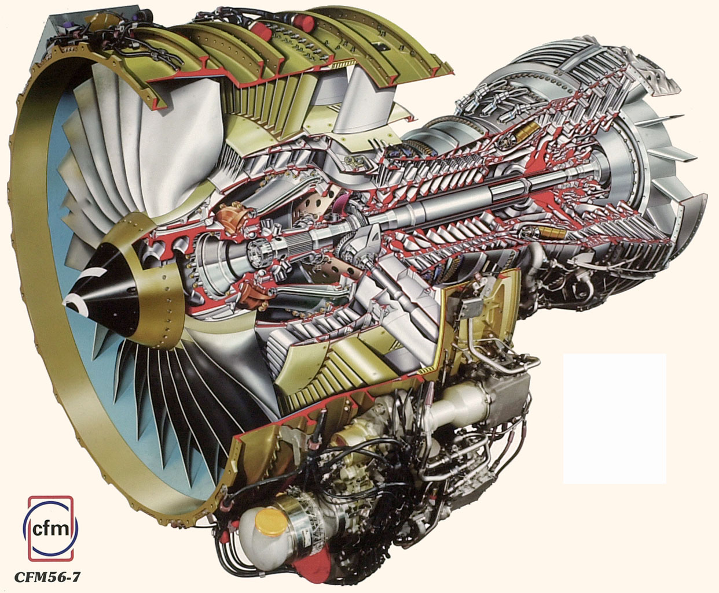
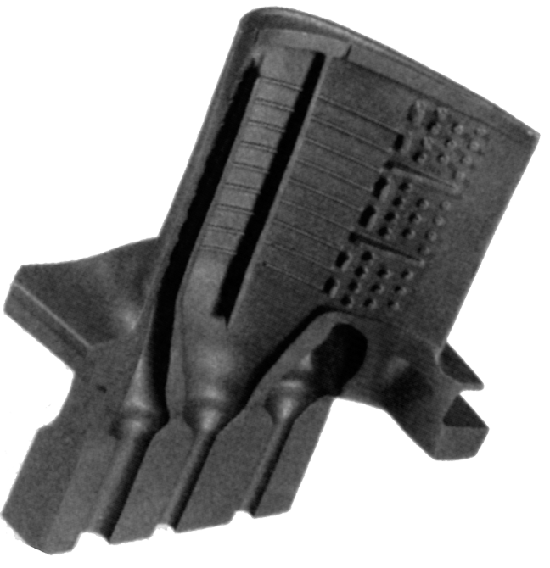
Gas Turbine Engine
Courtesy of D. R. Clarke

Slide 28
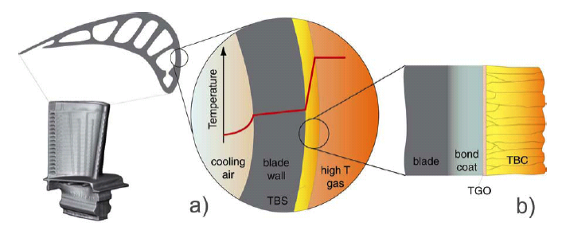
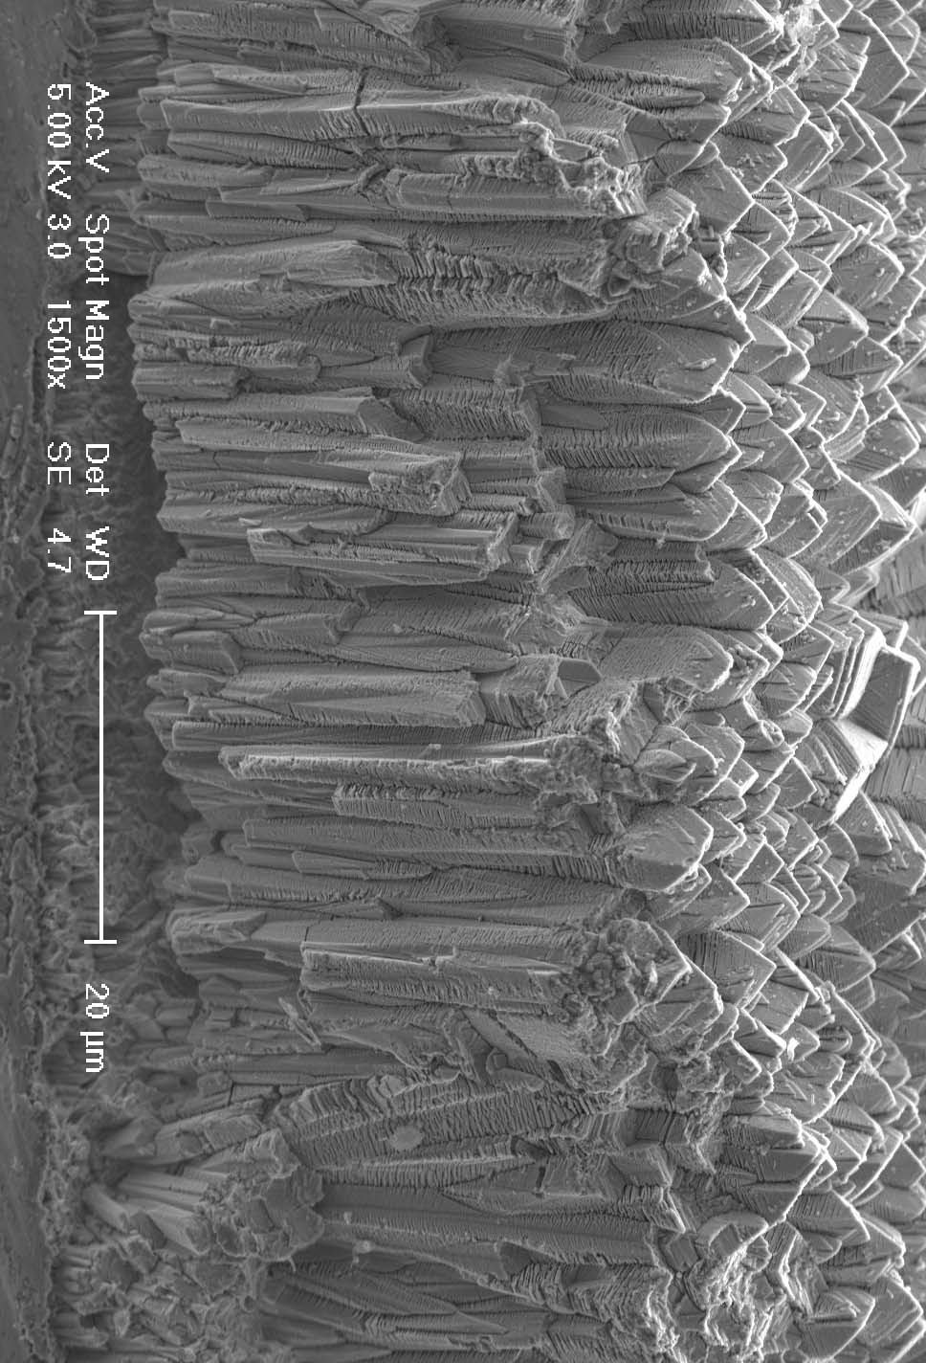
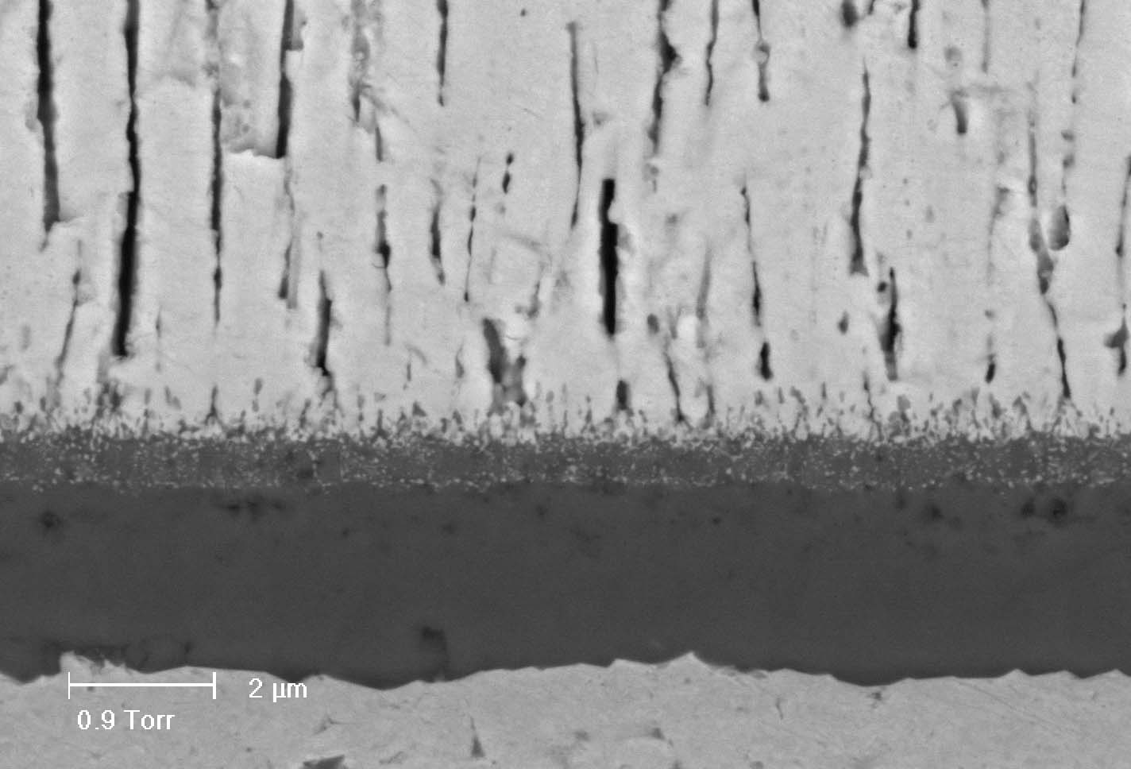
Thermal Barrier Coatings
LOW MAG SEM
HIGH MAG SEM

Slide 29
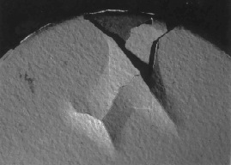
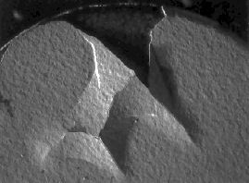
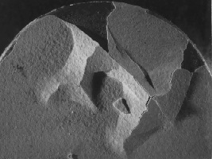
Monitoring the catastrophic failure of Thermal Barrier Coatings, TBC’s
Initial situation, 0 days
After 2 days
During the propagation of the spall, the stress in the
TGO changes, and this change can be monitored
through the zirconia TBC...
-) V. Sergo and D. R. Clarke, J. Am. Ceram. Soc., 81 (12) 3237-42 (1998).
-) D. R. Clarke, V. Sergo and M-Y. He, in
"Elevated Temperature Coatings: Science and Technology III".
Edited by J. M. Hampikan and N.B. Dahotre, pp. 67-78 (1999).
After 7 days

Slide 30
Typical experimental spectrum from TGO underneath TBC
Stress-free
Stressed

Slide 31
Stress evolution in the TGO during sub-critical crack propagation
2 days
7 days
TGO
Bond coat
Ni Alloy

Slide 32
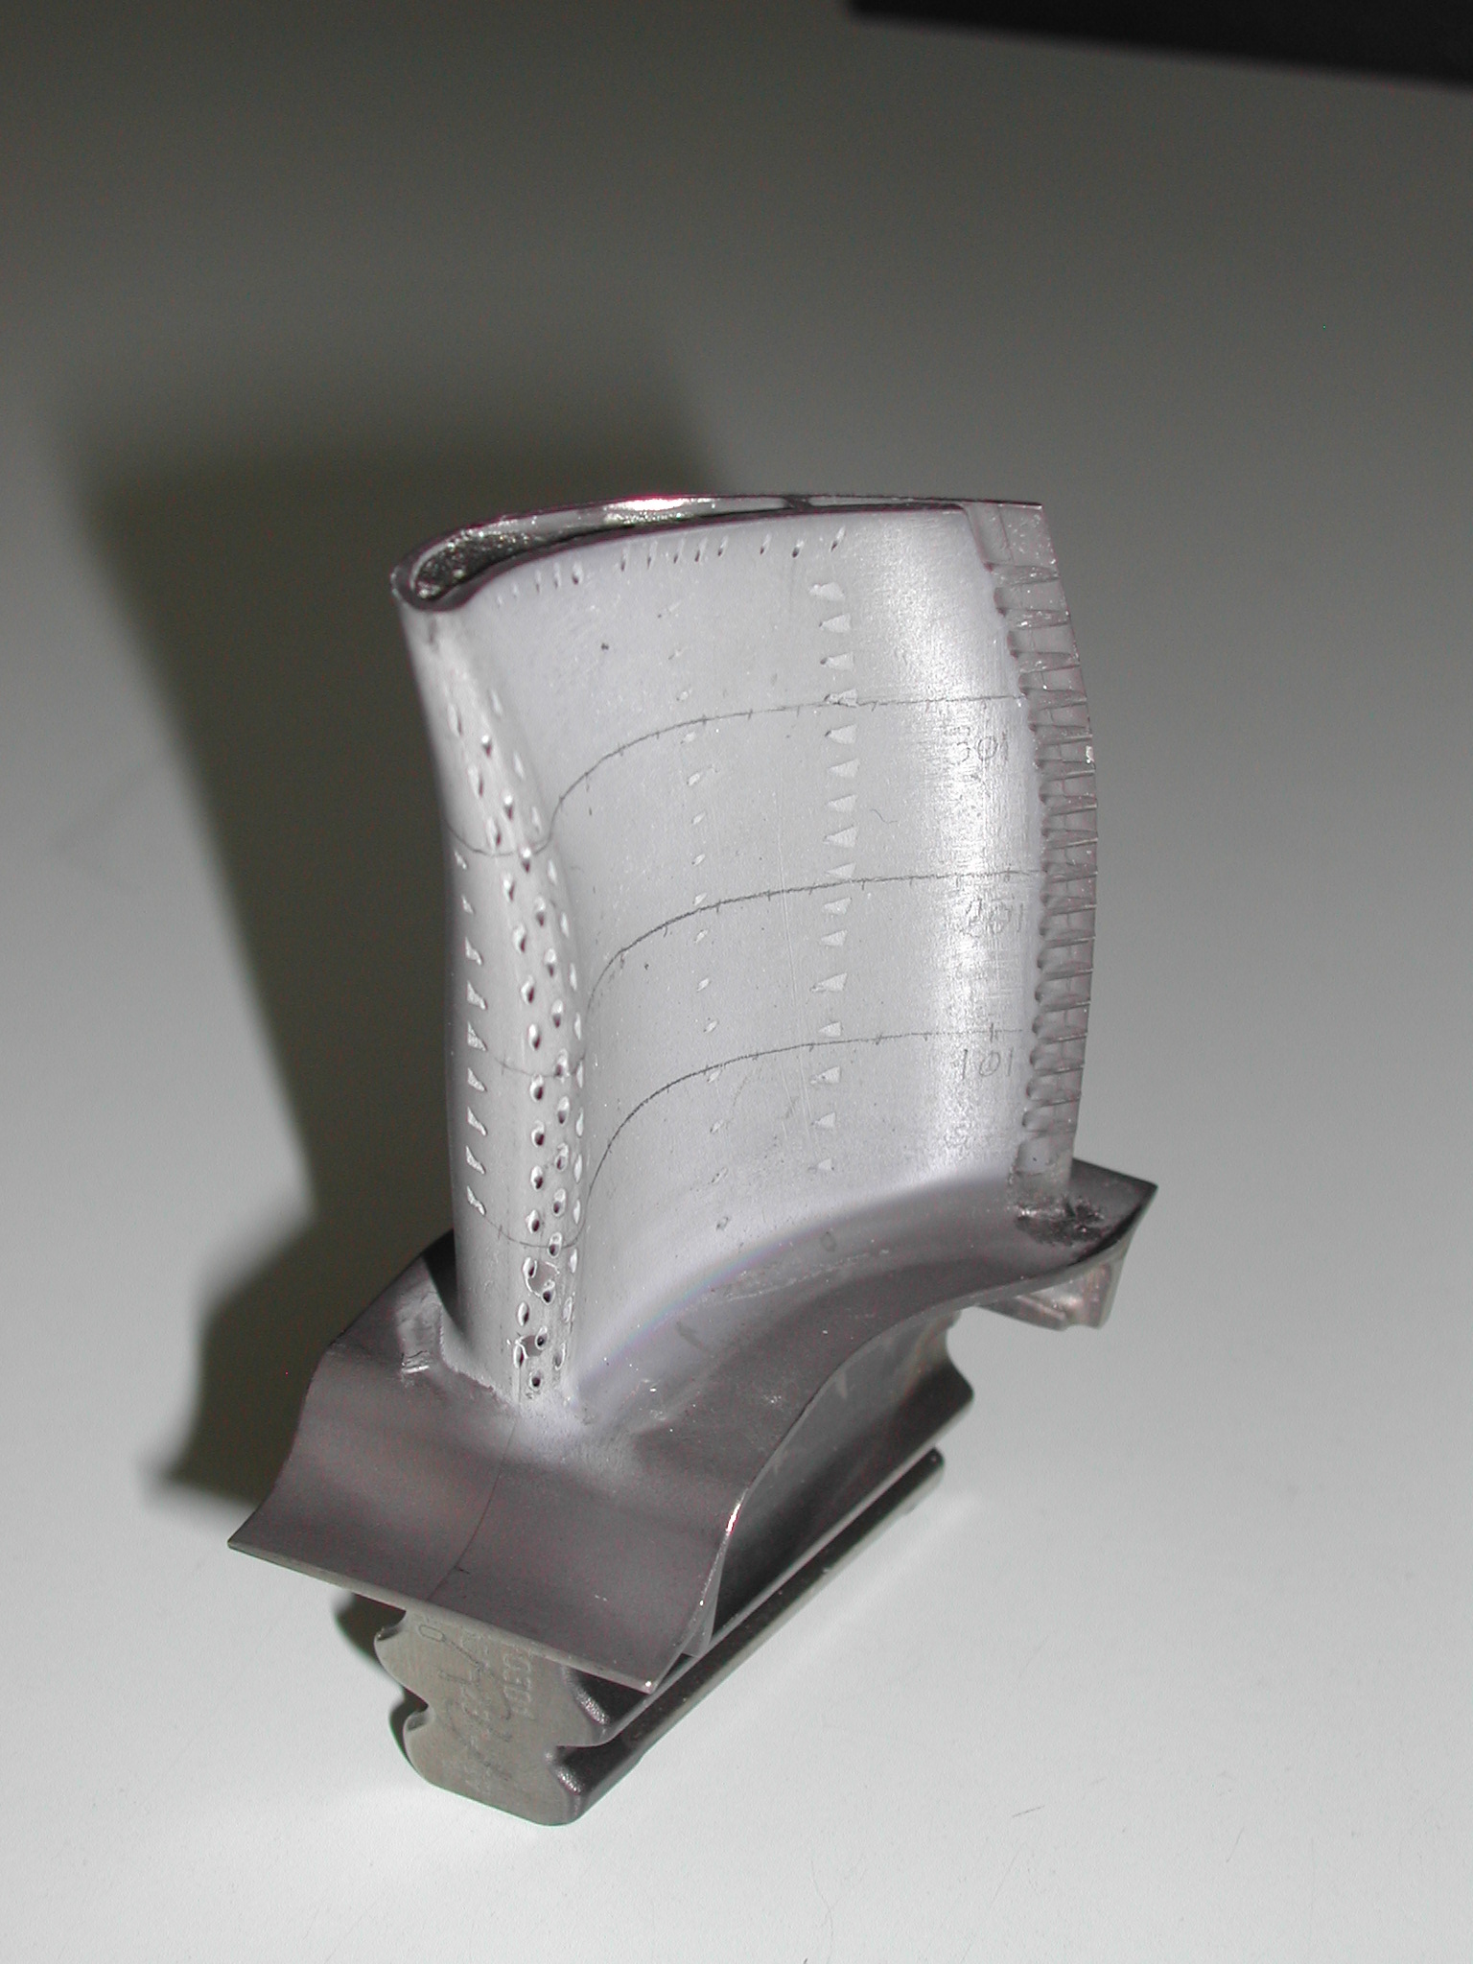
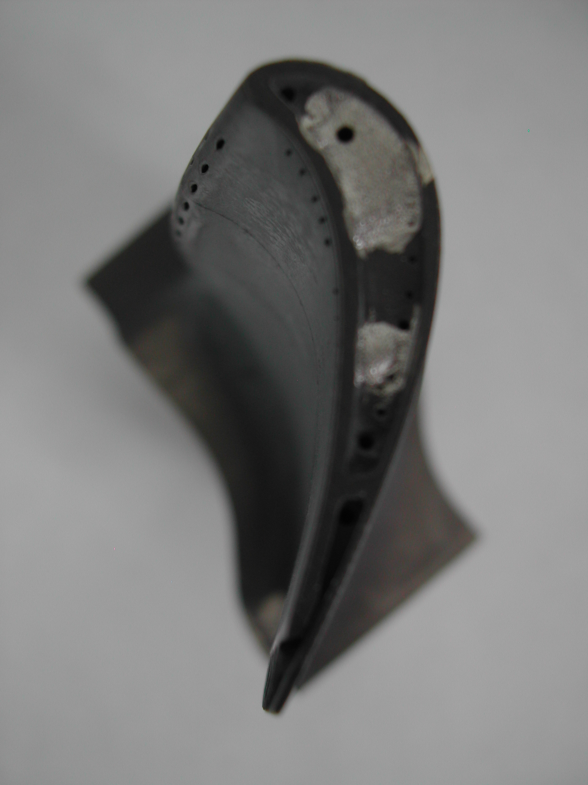
Mapping of stresses through the TBC on Turbine blades
J. Nichka et al., Surface and Coatings Technology, 163-164 (2003) 87-94

Slide 33
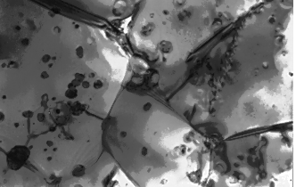
Nanocomposite Al₂O₃/SiC
-Milestone in ceramic nanocomposites, claimed (Niiahara, J.Jpn.Soc. Powder and Powder Metall.,37 (1990)) to have exceptional fracture resistance…
100 nm

Slide 34
…but irrespective of the combination of Thermal Expansion Coefficients and Elastic moduli of the matrix/dispersoids, there is no significant variation in residual stress and, hence, no relevant increase of the fracture tougheness K_{Ic}
Pezzotti, Sergo, Ota, Sbaizero, Muraki, Nishida, Sakai
Award for the best publication of 1996 issued by the Japanese Ceramic Society
Fracture stress [Mpa]

Slide 35
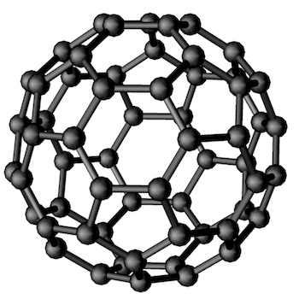
Standardization of Fullerene spectra
Figure 6. Typical Raman spectrum of a fullerene nanofiber showing the Raman active modes. The inset picture shows a zoom in the region of the A_{g}(2) band, where the red line (full line) is for a polymerized C₆₀ in comparison with the blue (dashed line) for a non-polymerized material.
https://doi.org/10.1051/metrology/20150014004

Slide 36
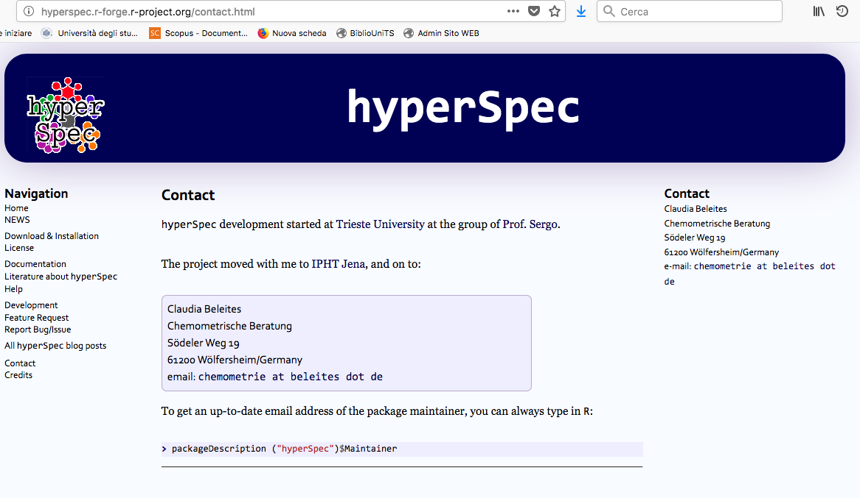
Free software for spectral data analysis at website:
HyperSpec.r-forge.r-project.org

Slide 37
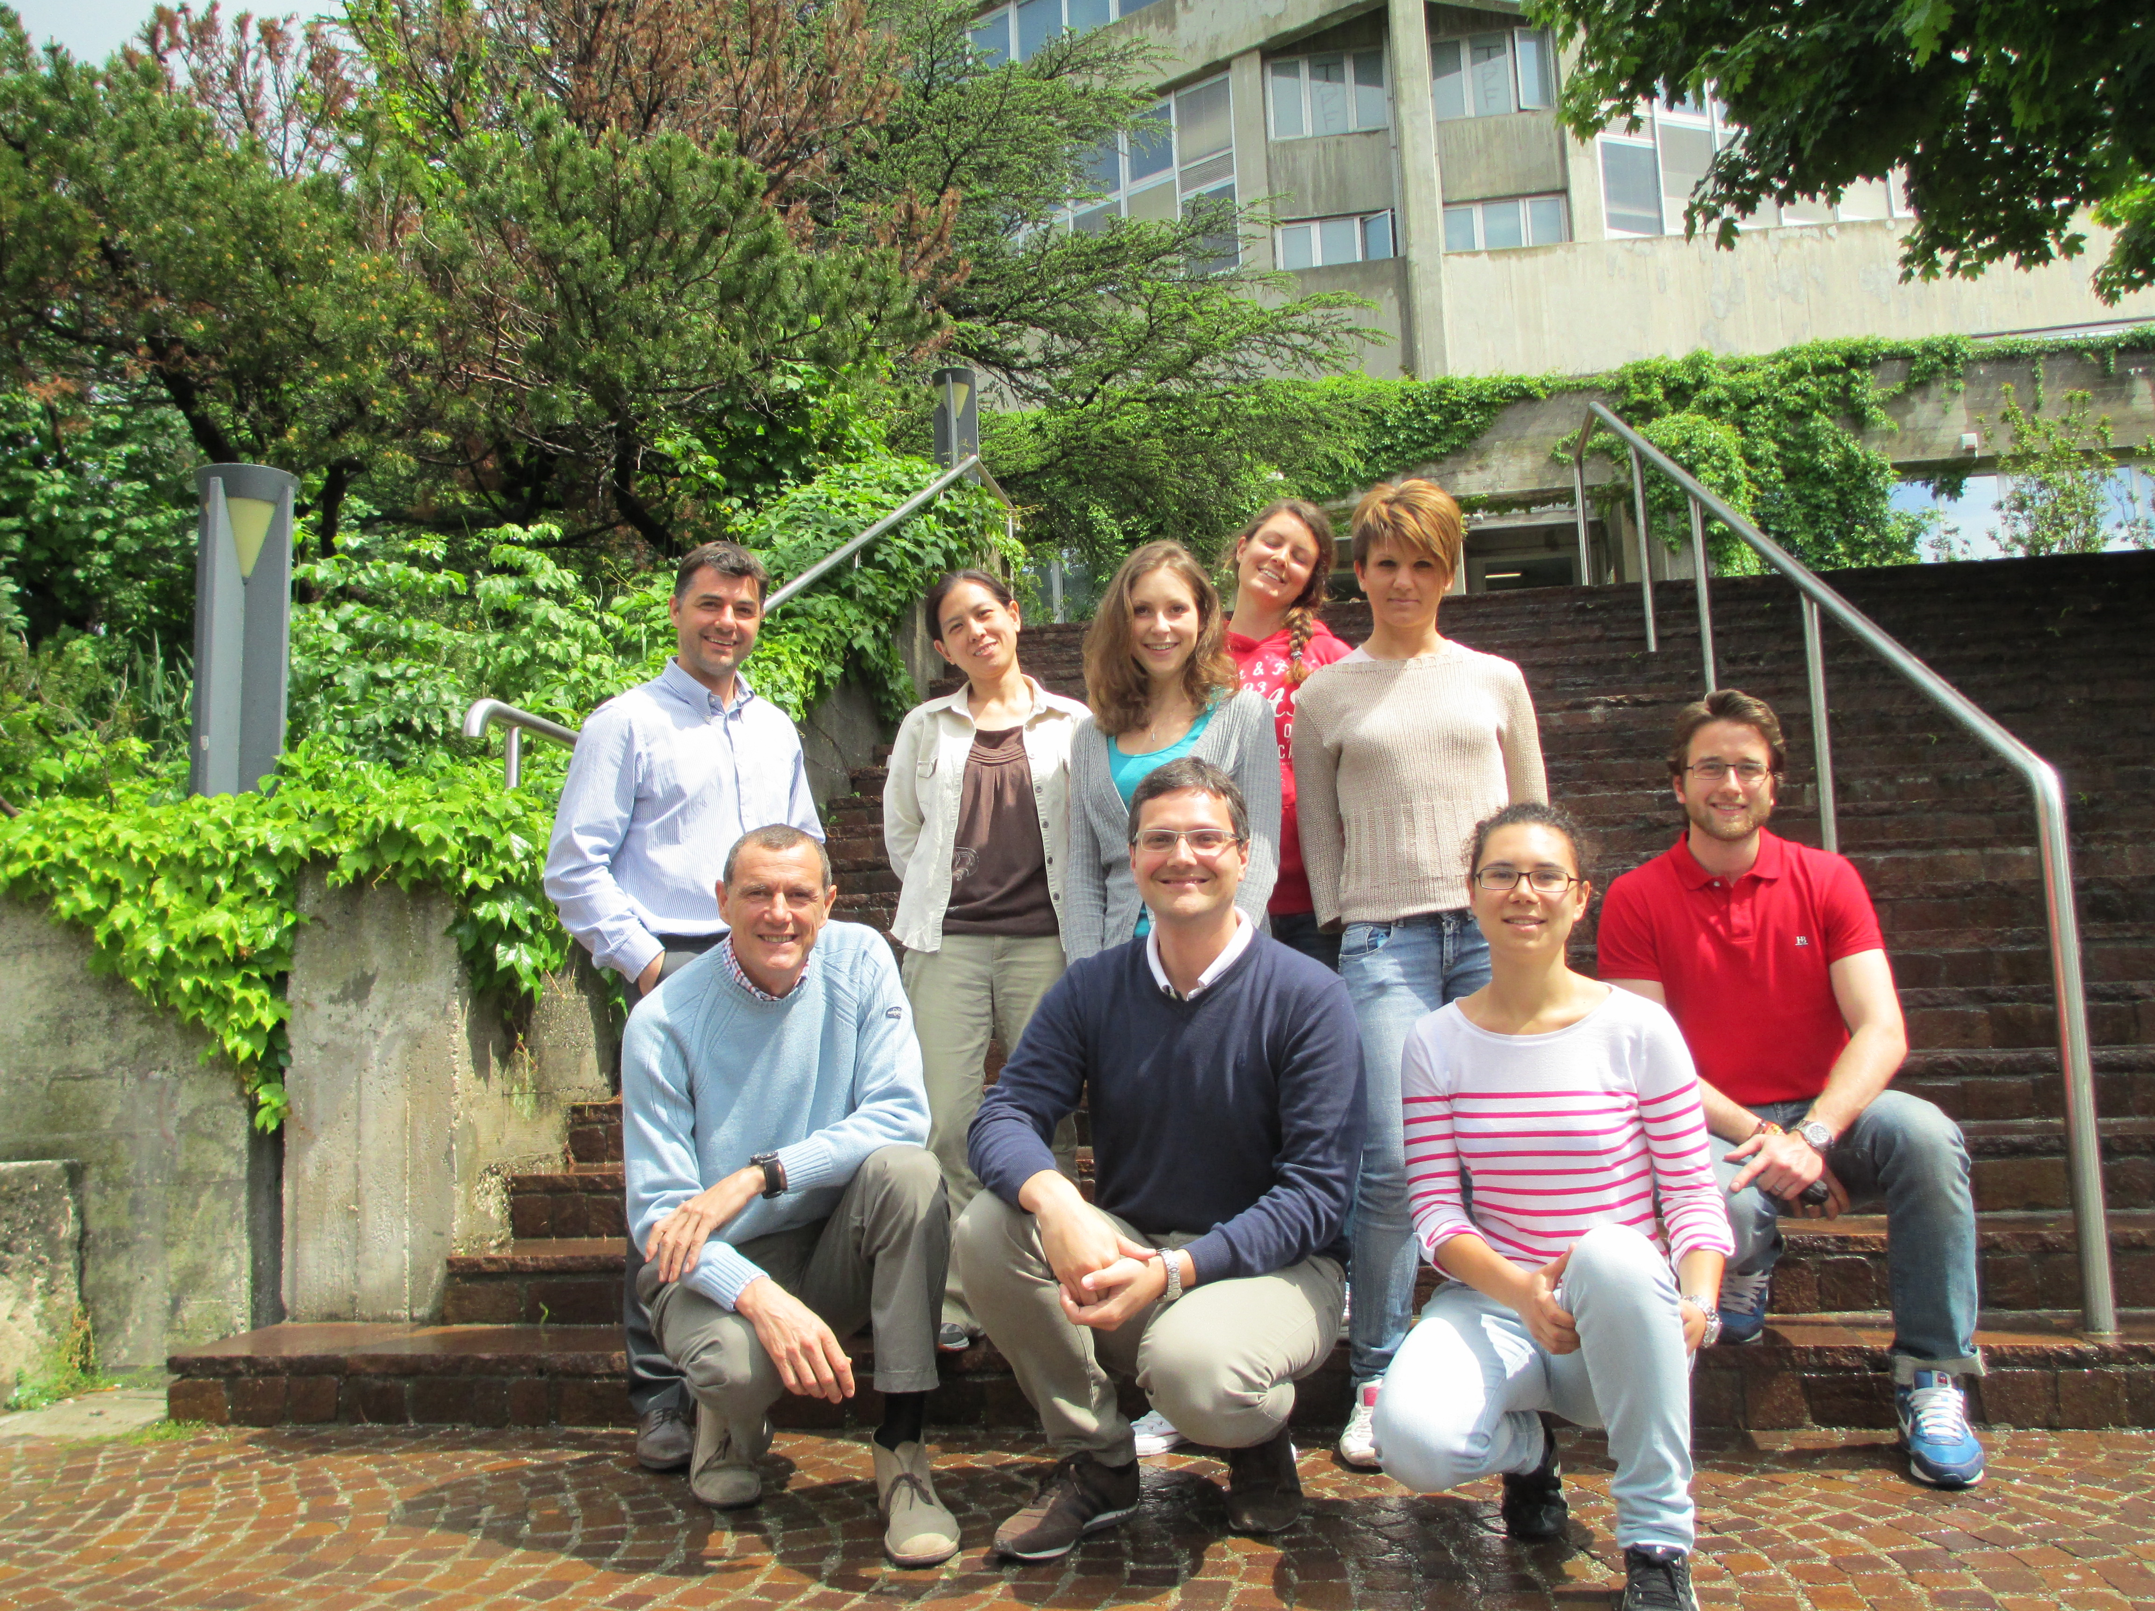
…and that’s all, volks!

Slide 38
Each band shifts differently under stress: i.e. it has its own Piezo-Spectroscopic coefficient (reported here is the case of t-zirconia (in tension).
H. Tomaszewski, J. Strzeszewski L. Adamowicz and V. Sergo, J. Am. Ceram. Soc., 85 (11) 2855-57 (2002).

Slide 39
Auto catalytic t-m transformation!!
Sergo et al, J Am Ceram Soc, 1995

Slide 40
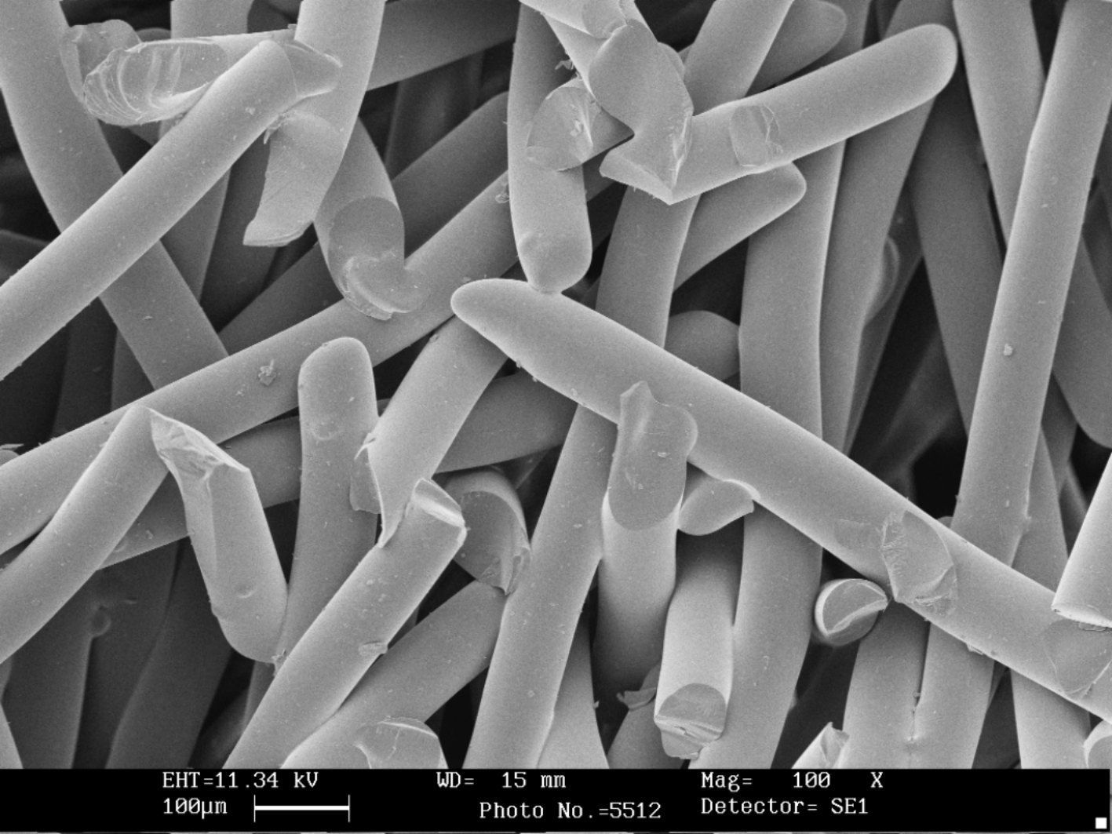

BIOACTIVE GLASS LWR (Large Working Range):
 | Na₂O | K₂O | MgO | CaO | B₂O₃ | P₂O₅ | SiO₂
Mol % | 12,1 | 10,1 | 5,0 | 14,8 | 0,9 | 0,9 | 56,2
Starting from fibers (75 μm in diameter and 3 mm long), three-dimensional porous scaffolds are obtained by sintering.
Subsequently scaffolds are immersed in Simulated Body Fluid (SBF) to monitor possible formation of hydroxil-carbonate-apatite (HCA).
Scaffold after 3 weeks of immersion in SBF at 37°C (no stirring))
Pristine scaffold

Slide 41

Raman Spectral evolution of scaffolds treated in SBF at 37°C for different times
ν₁: 962 cm⁻¹ symmetric stretching vibration of P-O: FORMATION OF HYDROXYAPATITE!
V. Sergo et al., Journal of Applied Biomaterials & Biomechanics 2006; Vol. 4 no. 2: 102-109
Best contribution award , International meeting of Biomaterials Societies, Ischia 2005:

