Slide 1
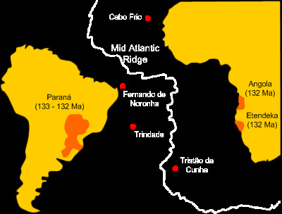

Slide 2
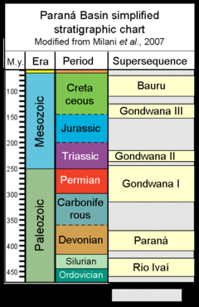
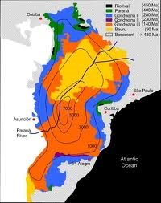

Slide 3
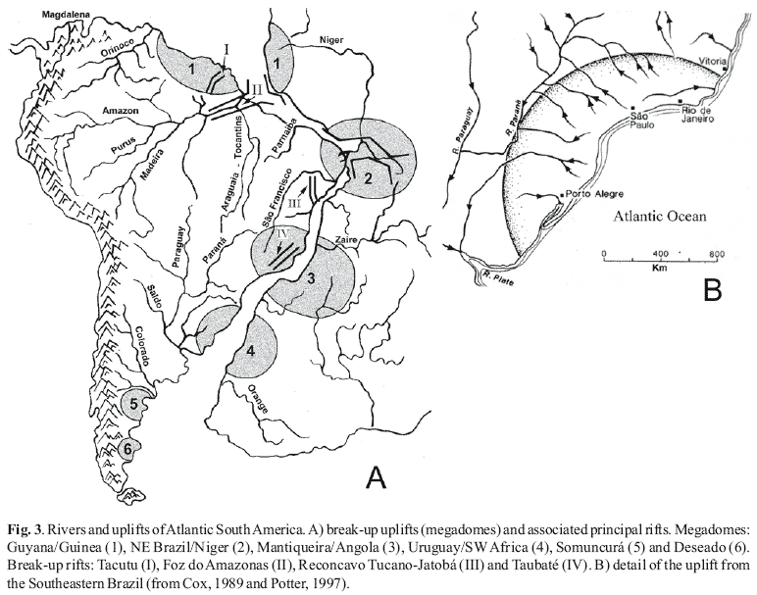
Fernando de Norona
Cabo Frio
Trinidade
Tristan da C.

Slide 4
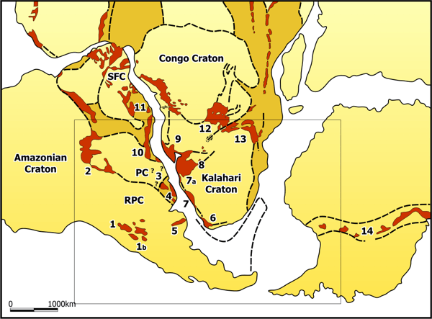
Figure 1: Research area indicated on a pre-drift reassembly of Gondwana, modified after Porada (1989). PC: Paraná Craton, RPC: Río de la Plata Craton; SFC: Sao Francisco Craton. Red areas: Neoproterozoic to Early Palaeozoic belts and deposits. 1: Sierras Pampeanas Belt, 1b: Cordillera Frontal Metamorphic Belt, 2: Paraguay Belt, 3: Dom Feliciano Belt, 4: Arroyo del Soldado Group, 5: Tandilia System, 6: Saldania Belt, 7: Gariep Belt, 7a: Nama Group, 8: Damara Belt, 9: Kaoko Belt, 10: Ribeira Belt, 11: Ara?uaí Belt, 12: Lufilian Belt, 13: Zambezi Belt, 14: Transantarctic Belt (only the most significant units for the present project have been indicated)

Slide 5
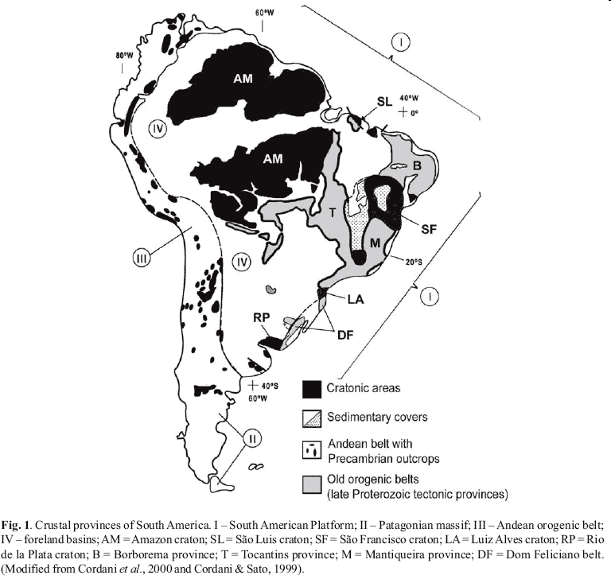
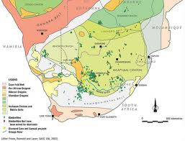

Slide 6
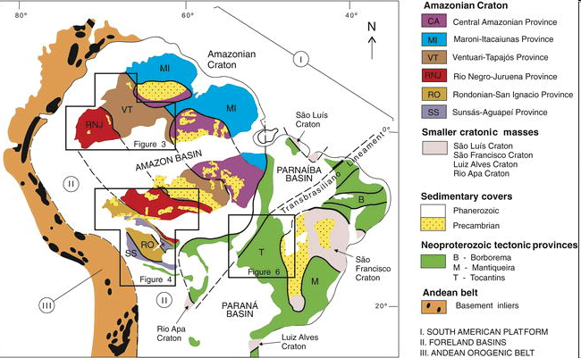

Slide 7
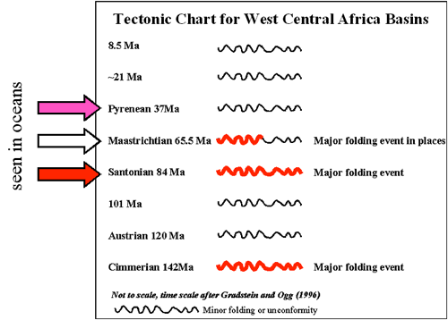
Generalised tectonic Chart for West Central Africa based on extensive geological and seismic interpretation. The arrows show the tectonic events seen in the fabric of the ocean crust.

Slide 8
Colorado/Patagonia moved with respect to Paraná until ~132
Ma, and dextral movements between Paraná and Amazonia ceased at around 126 Ma: after which
time South America became a single rigid plate.
Torsvik et al., 2009

Slide 9
24 Paraná-Etendeka continental flood basalt(C) event Peate, 1997^{[65]}
Location: South America (Brazil, Paraguay), Africa (Namibia, Angola)
Size: 2,000,000 sq. km. Peate, 1997^{[65]}, 1,800,000 sq. km. (South America portion); 250,000 sq. km. (African portion)
Age: mainly 0.134-0.129 Ga; some earlier magmatism (0.138-0.135 Ga) (continues to present as Tristan da Cunha hotspot)
SOUTH AMERICA
VOLCANIC ROCKS: Paraná Peate, 1997^{[65]}, including: high-Ti/Y types, Urubici; Pitanga, Paranapanema, & Ribeira groups; and low-Ti/Y types, Gramado, & Esmeralda groups; South Atlantic volcanic margins Eldholm and Coffin, 2000^{[40]}; Maranhao high-Ti Fodor et al., 1990^{[66]}.
DIKES: Ponta Grossa, SE trending Piccirillo et al., 1990^{[67]}; Paraguay, SE trending Druecker and Gay, 1987^{[68]} Stewart et al., 1996^{[69]}; Cerá-Mirim & Sardiñha (A 131.2±0.8 to 130.1±0.4 Ma, ^{[70]}); rift parallel younger dikes (A 128-120 Ma) comprising: Santos-Rio de Janeiro, ENE trending; & Florianópolis, NNE trending Raposo et al., 1998^{[71]}.
SILLS: Peate, 1997^{[65]}.
AFRICA
VOLCANIC ROCKS: Etendeka (A 133-131 Ma Renne et al., 1996^{[72]}), including: Tafelkop (Namibia); Kwanza (Angola) A 131.9±1.6 & 131.6±1.4 Ma Marzoli et al., 1999a^{[73]}; Benue Trough (ne. Nigeria) A 138-130 Ma Maluski et al., 1995^{[74]} Maluski et al., 1995^{[74]}.
DIKES: Horingbaai, NW & N trending, A 125-120 Ma Renne et al., 1997^{[75]} Namibia, 1988^{[76]} Duncan et al., 1990^{[77]};?Morro-Velmo, E trending Peate, 1997^{[65]}; Hentjesbay-Outjo, NNE-ENE arcuate swarm Vietor and Weber, 1999^{[78]}; Kwanza, N trending, A 126.1±1.4 Ma Marzoli et al., 1999a^{[73]}.
SILLS: Huab; Tafelberg; Regional dolerites (sills?); Horingbaai dolerites (sills?) Peate, 1997^{[65]}.
OTHER INTRUSIONS: Damaraland intrusions.
LIP Commission

Slide 10
Dyke swarms associated with the P-E province indicate that the lavas originally covered a greater
area than is preserved today and have two orientations: NW-SE (present orientation) and coastparallel.
NW-SE-oriented dolerite dykes from Brazil, Angola, Eastern Paraguay and Namibia suggest failed rifts or inversions (Jackson et al. 2000).
Offshore, a large package of basalts flows and sills have been interpreted from seismic data and/or drilled on the South American margin in 3the Jacuipe, Espírito Santo, Campos, Santos and Pelotas Basins (Fig. 3b), and they continue southward to the Falkland escarpment and offshore South Africa and Namibia…..Early Cretaceous (130-123 Ma) basalts from the onshore Espírito Santo Basin are intercalated with
terrigenous sedimentary rocks.
Isolated
reflectors in offshore Angola and Cameroon have also been interpreted as volcanic rocks or seaward dipping reflectors (Jackson et al. 2000; Mohriak et al. 2000), but this latter assessment has not been confirmed

Slide 11
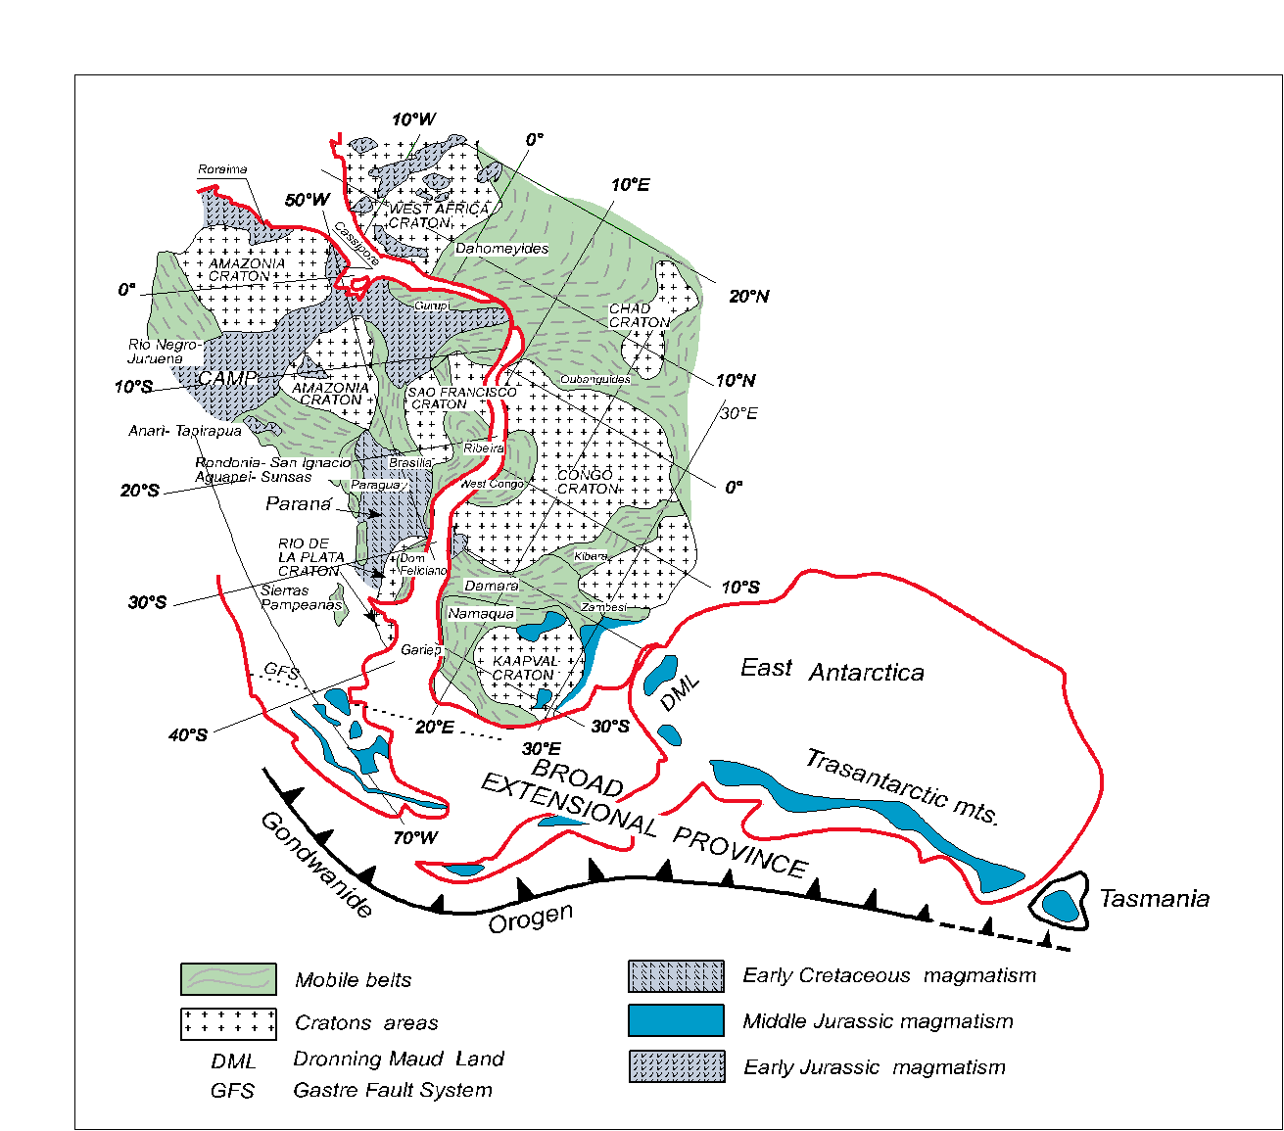
Evento “PARANA’’ Thol.
Formazione Serra Geral
Espinacho dykes
Sardinha volcanics
Etendeka effusivo
Kwanza basin (Angola)
Cearà Mirim
Messum –Erongo

Slide 12
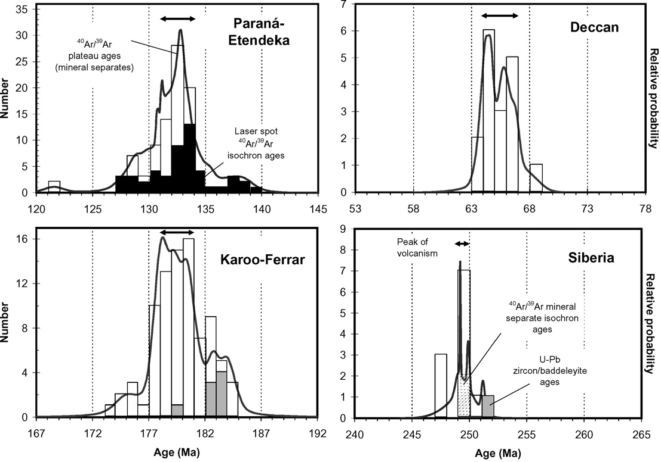
S.A. Gibson, R.N. Thompson J.A. Day Earth and Planetary Science Letters 251 (2006) 1–17
per David S. Thiede* and Paulo M. Vasconcelos 134.9 –134.2 (geology aprile 2010); 4 inversioni polarità – 140ka

Slide 13
Pre e syn tholeiitic alkaline magmatism
A) Pre-tholeiitic, i.e. 139-137 Ma (Early Cretaceous) potassic alkaline complexes occur in Angola (Moçamedes Arch; Alberti et al., 1999 and references therein), Namibia (Milner et al.,
1995) and eastern Bolivia (Velasco complexes, Ar/Ar plateau age Comin-Chiaramonti et al.,
2005b).
B) Syntholeiitic, i.e. 129 ± 2 Ma (Early Cretaceous) potassic alkaline magmatism occurs in
Brazil (Santa Catarina State, Ponta Grossa Arch), Uruguay and Angola (Alberti et al., 1999;
Ruberti et al., 2005a,b). In Namibia the alkaline rock types slightly post-date (129-123 Ma) the main PAE eruptive phase (Stewart et al., 1996; Peate, 1997; Hawkesworth et al., 1999).
These first two events are generally represented by “low-Ti” potassic rocks (cf. Gibson et al.,
1995a,b).

Slide 14
The new paleomagnetic data combined with existing data from the northern PMP allowed the calculation of a paleomagnetic pole at 71.4° E and 83.0° S (N = 92; α₉₅=2.4°; k = 39). This pole is in good agreement with poles for central and southern PMP, which are slightly older than the northern PMP, as well as for the contemporaneous Central Alkaline Province (Paraguay)
Ernesto et al., Journal of Geodynamics
Volume 28, Issues 4-5, 12 November 1999, Pages 321-340

Slide 15
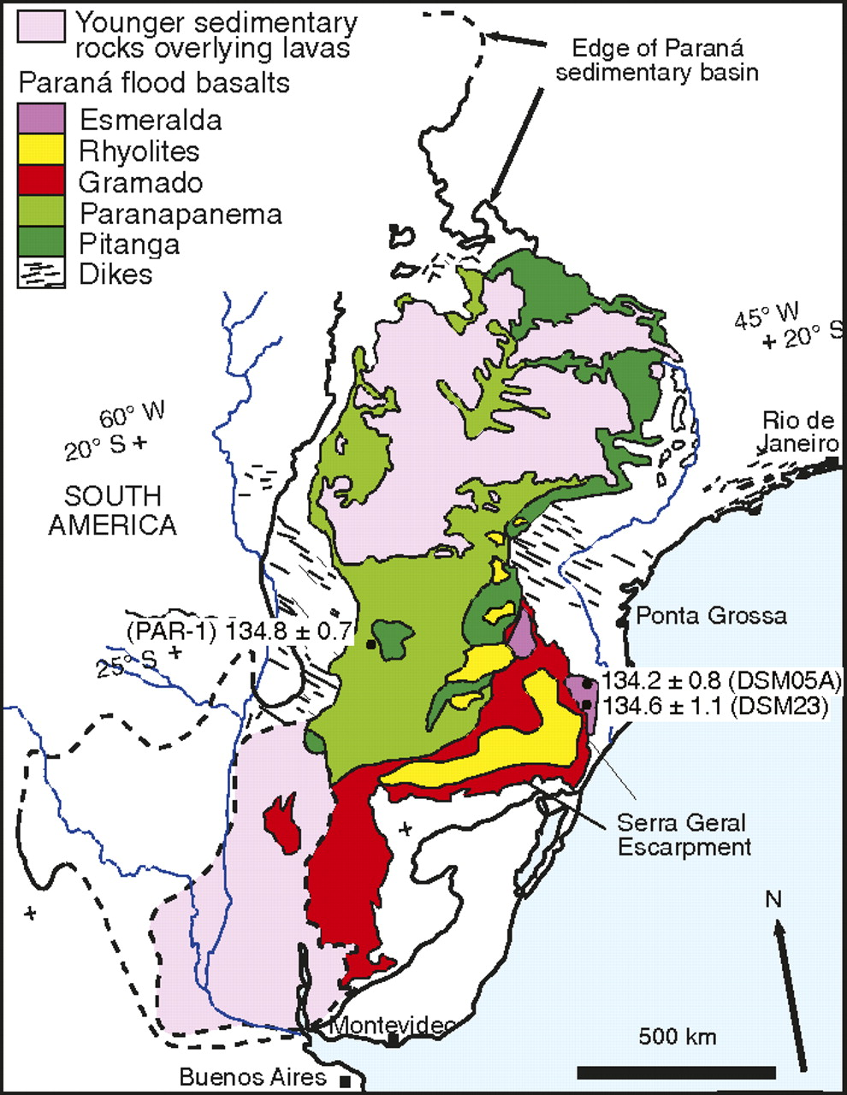
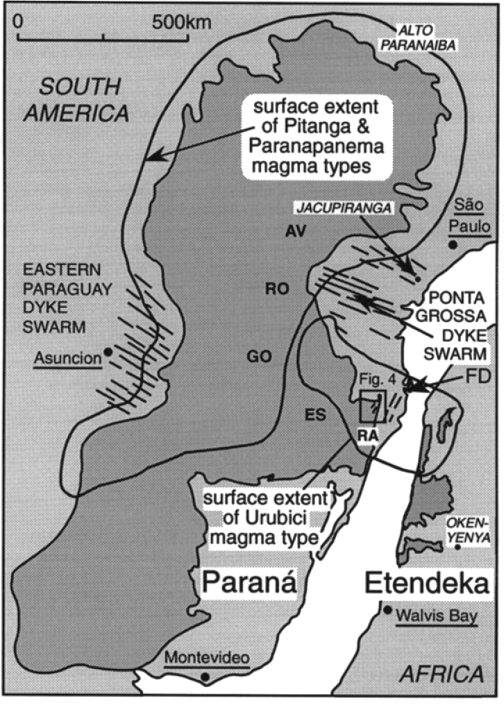
HTi
LTi

Slide 16
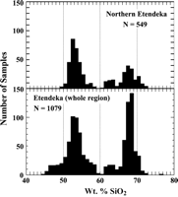
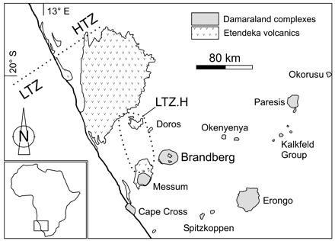
Paranà-Etendeka L.I.P.
Modified by a D.Peat file (1997)
Generalized geological map of central western Namibia showing the location of Cretaceous granitic complexes. Frindt et al. / Chemical Geology 206 (2004) 43–71
Bimodal composition of Paranà lava flows. D.Peat (1997)

Slide 17
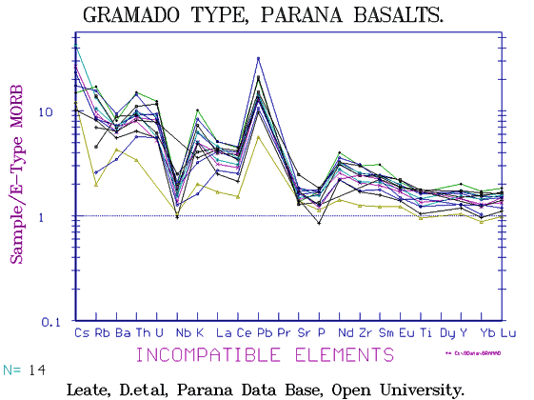
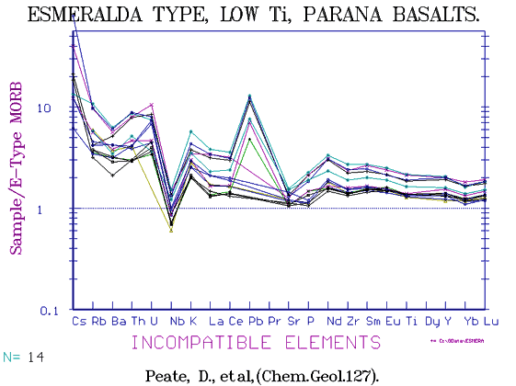
Lti Basalts

Slide 18
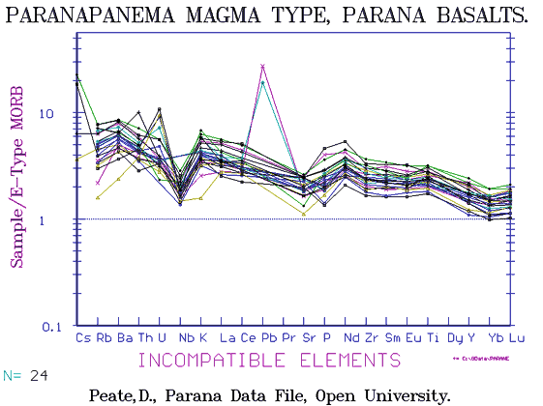
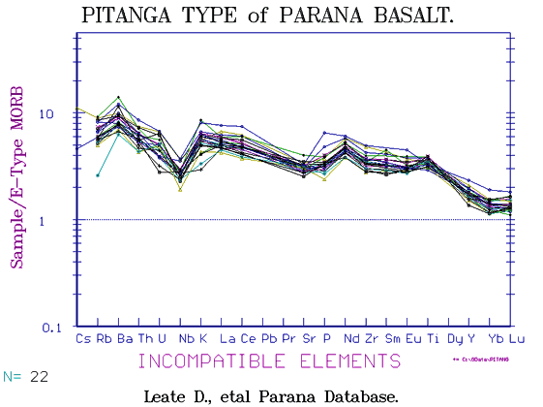
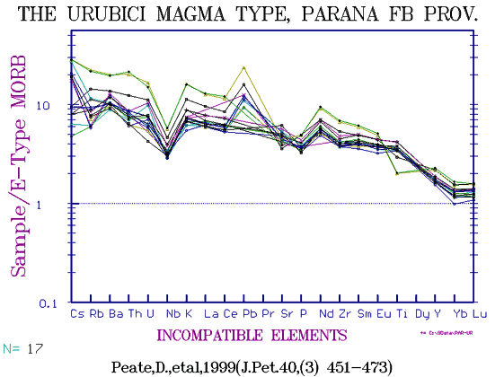
Hti Basalts

Slide 19
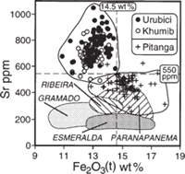
Fino a 1200ppm per espinhaco dykes
HTi basalts:Paranà-CAMP
LTi Parana Basalts

Slide 20
The phlogopite was shown to be stable in lherzolite up to about 6 GPa or 180 km depth
phlogopite would begin to break down gradually and to produce garnet and fluid at about 5 GPa or 150 km depth.
However, phlogopite could survive to at least 240 km depth…..H2O and K2O could be transported to 240 km depth by phlogopite
Stability of phlogopite is sensitive to change of the thermal state of continental lithosphere. For example, if a thermal gradient increases from the surface heat flow of 40 mWm⁻² to 44 mWm⁻², then phlogopite in the region of 170 - 200 km depths are melted out
If once phlogopite has been formed in the lower part of the subcontinental lithosphere, a metasomatic agent of fluid or hydrous silicate melt could be produced by decomposition of phlogopite on athermal event which raises temperature. These metasomatic agents would induce volcanism or metasomatized peridotites in the shallower parts of the subcontinental lithosphere.
Earth and Planetary Science Letters, 1996: Kiminori Sato, Tomoo Katsura and Eiji Ito

Slide 21
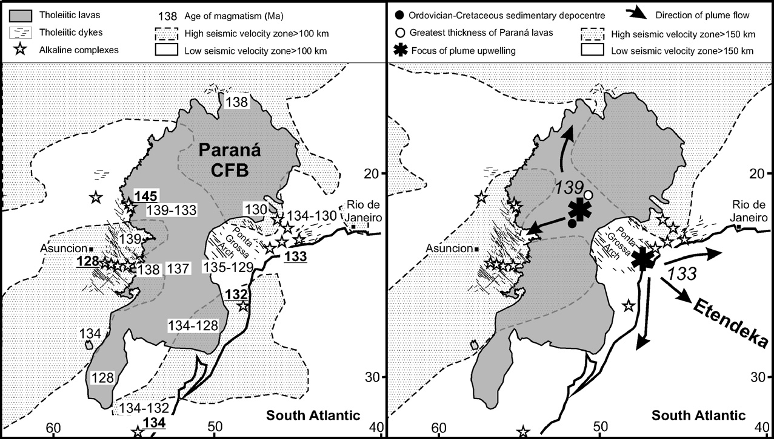
S.A. Gibson et al., 2006

Slide 22
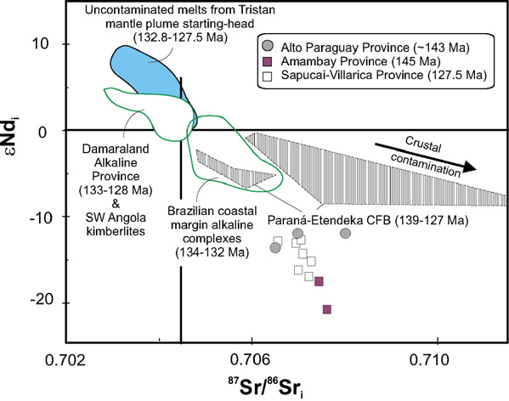
Earth and Planetary Science Letters 251 (2006) 1–17
S.A. Gibson, R.N. Thompson, J.A. Day
1) Localised melting of metasomatised lithosphere
by conductive heating associated with the impact
of the Tristan plume on the base of the subcratonic
lithosphere. 1° Alkaline magmatism – (No more Phlogopite).
2) Lithospheric extension focused on a pre-existing
region of thin lithosphere, 6Myr after plume impact
(tholeiites)
3) Major lithospheric extension and rapid melt production
10 Myr after plume impact
(thol. + alakaline)
Espinhaco HTi Thol.
132Ma
reconstructions of plate motions suggest that the centre of the present-day Tristan plume was located beneath the eastern margin of the Paraná sedimentary basin, near the Ponta Grossa ‘Arch’, at 130 Ma

Slide 23
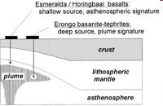
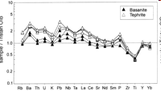
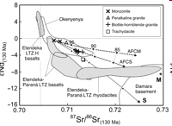

Slide 24
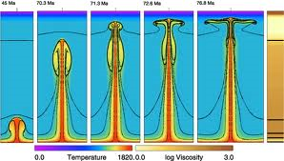
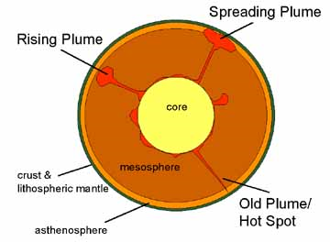
Superplume – hot spot

Slide 25
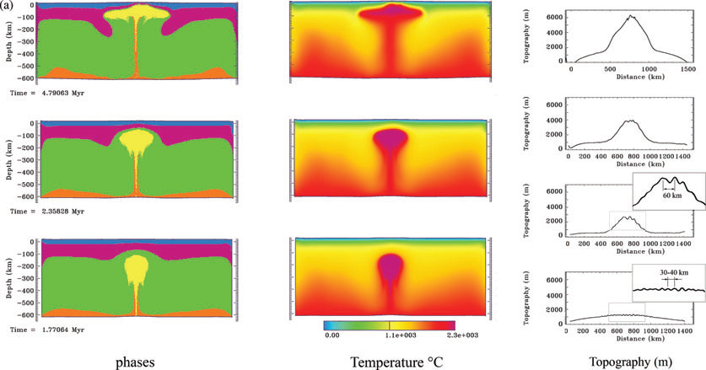
Geophys. J. Int. (2009) 178, 1691–1722
Evgueni Burov and Sierd Cloetingh
Young Lithosphere

Slide 26
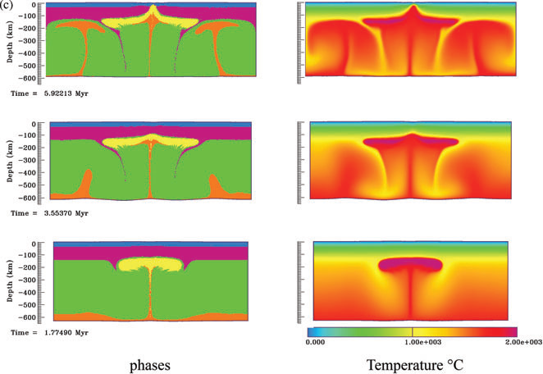
Geophys. J. Int. (2009) 178, 1691–1722
Evgueni Burov and Sierd Cloetingh
Plume and very oldy lithosphere (more than 300 Ma). Whole mantle convection concept, 1700 ◦C at 650 km

Slide 27
Geoffrey F. Davies
JOURNAL OF GEOPHYSICAL RESEARCH, VOL. 99, NO. B8, PP. 15,709-15,722, 1994
Thermomechanical erosion of the lithosphere by mantle plumes
A plume tail is likely to cause rapid local thinning, reducing the lithosphere thickness substantially within a few million years.
The theory predicts that thin continental lithosphere may be further thinned sufficiently by a plume tail to cause crustal melting within about 20 m.y

Slide 28
Evento “PARANA’’ Thol.
Formazione Serra Geral
Espinacho dykes
Sardinha volcanics
Etendeka effusivo
Kwanza basin (Angola)
Cearà Mirim
Messum –Erongo

Slide 29
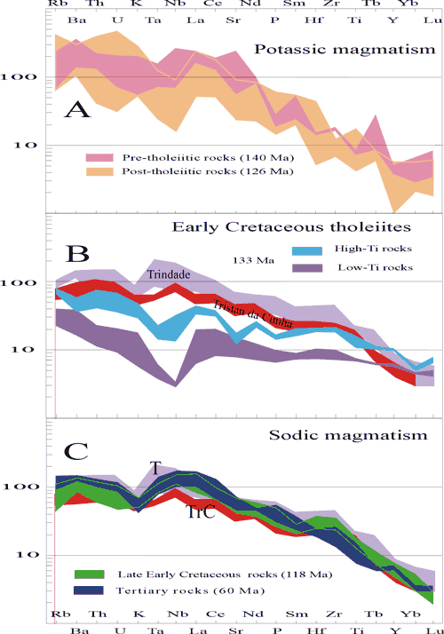

Slide 30
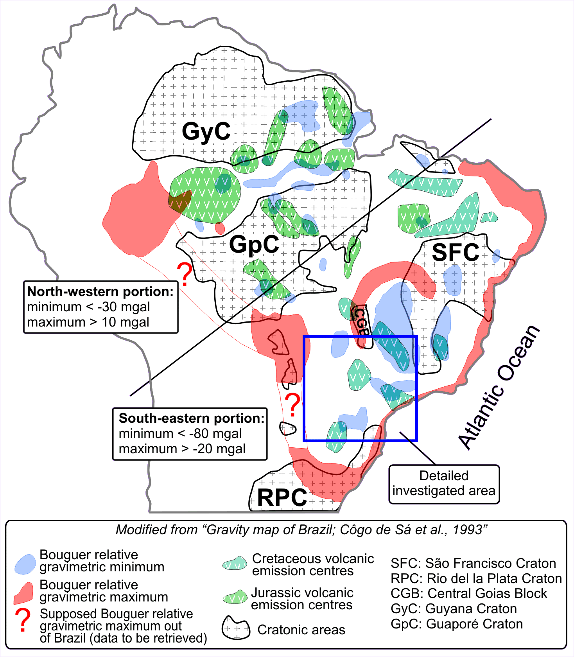

Slide 31
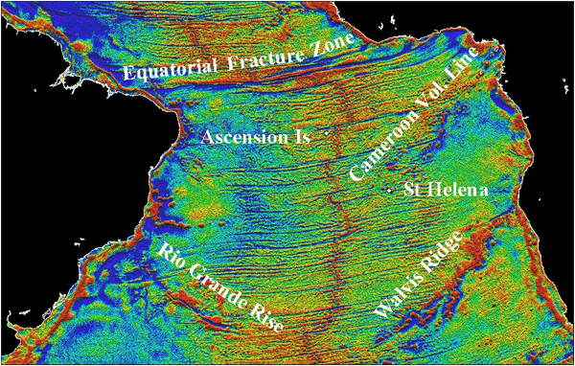
J. Derek Fairhead1,2 & Marjorie Wilson1 2004
Tristan da Cunha
Sea-floor spreading and deformation processes in the South Atlantic Ocean: Are hot spots needed? The proposed models for the volcanic evolution of the South Atlantic could be considered to be radically different to the model proposed by ‘hotspot’ enthusiasts.
Il magmatismo di Tristan da Cunha è potassico

Slide 32
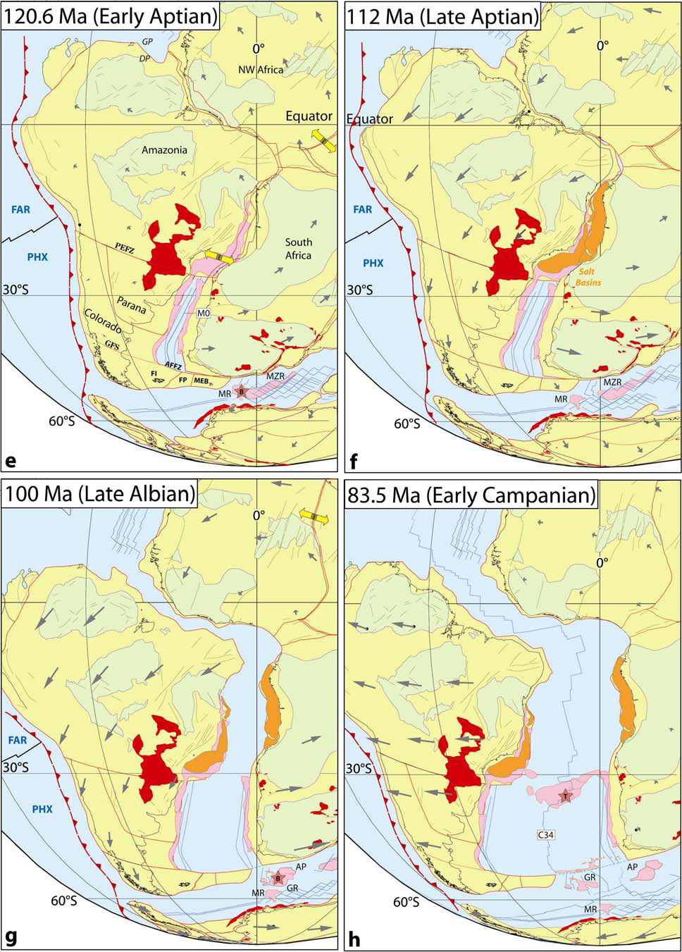
Trond H. Torsvik, Sonia Rousse, Cinthia Labails, Mark A. Smethurst. 2009

Slide 33
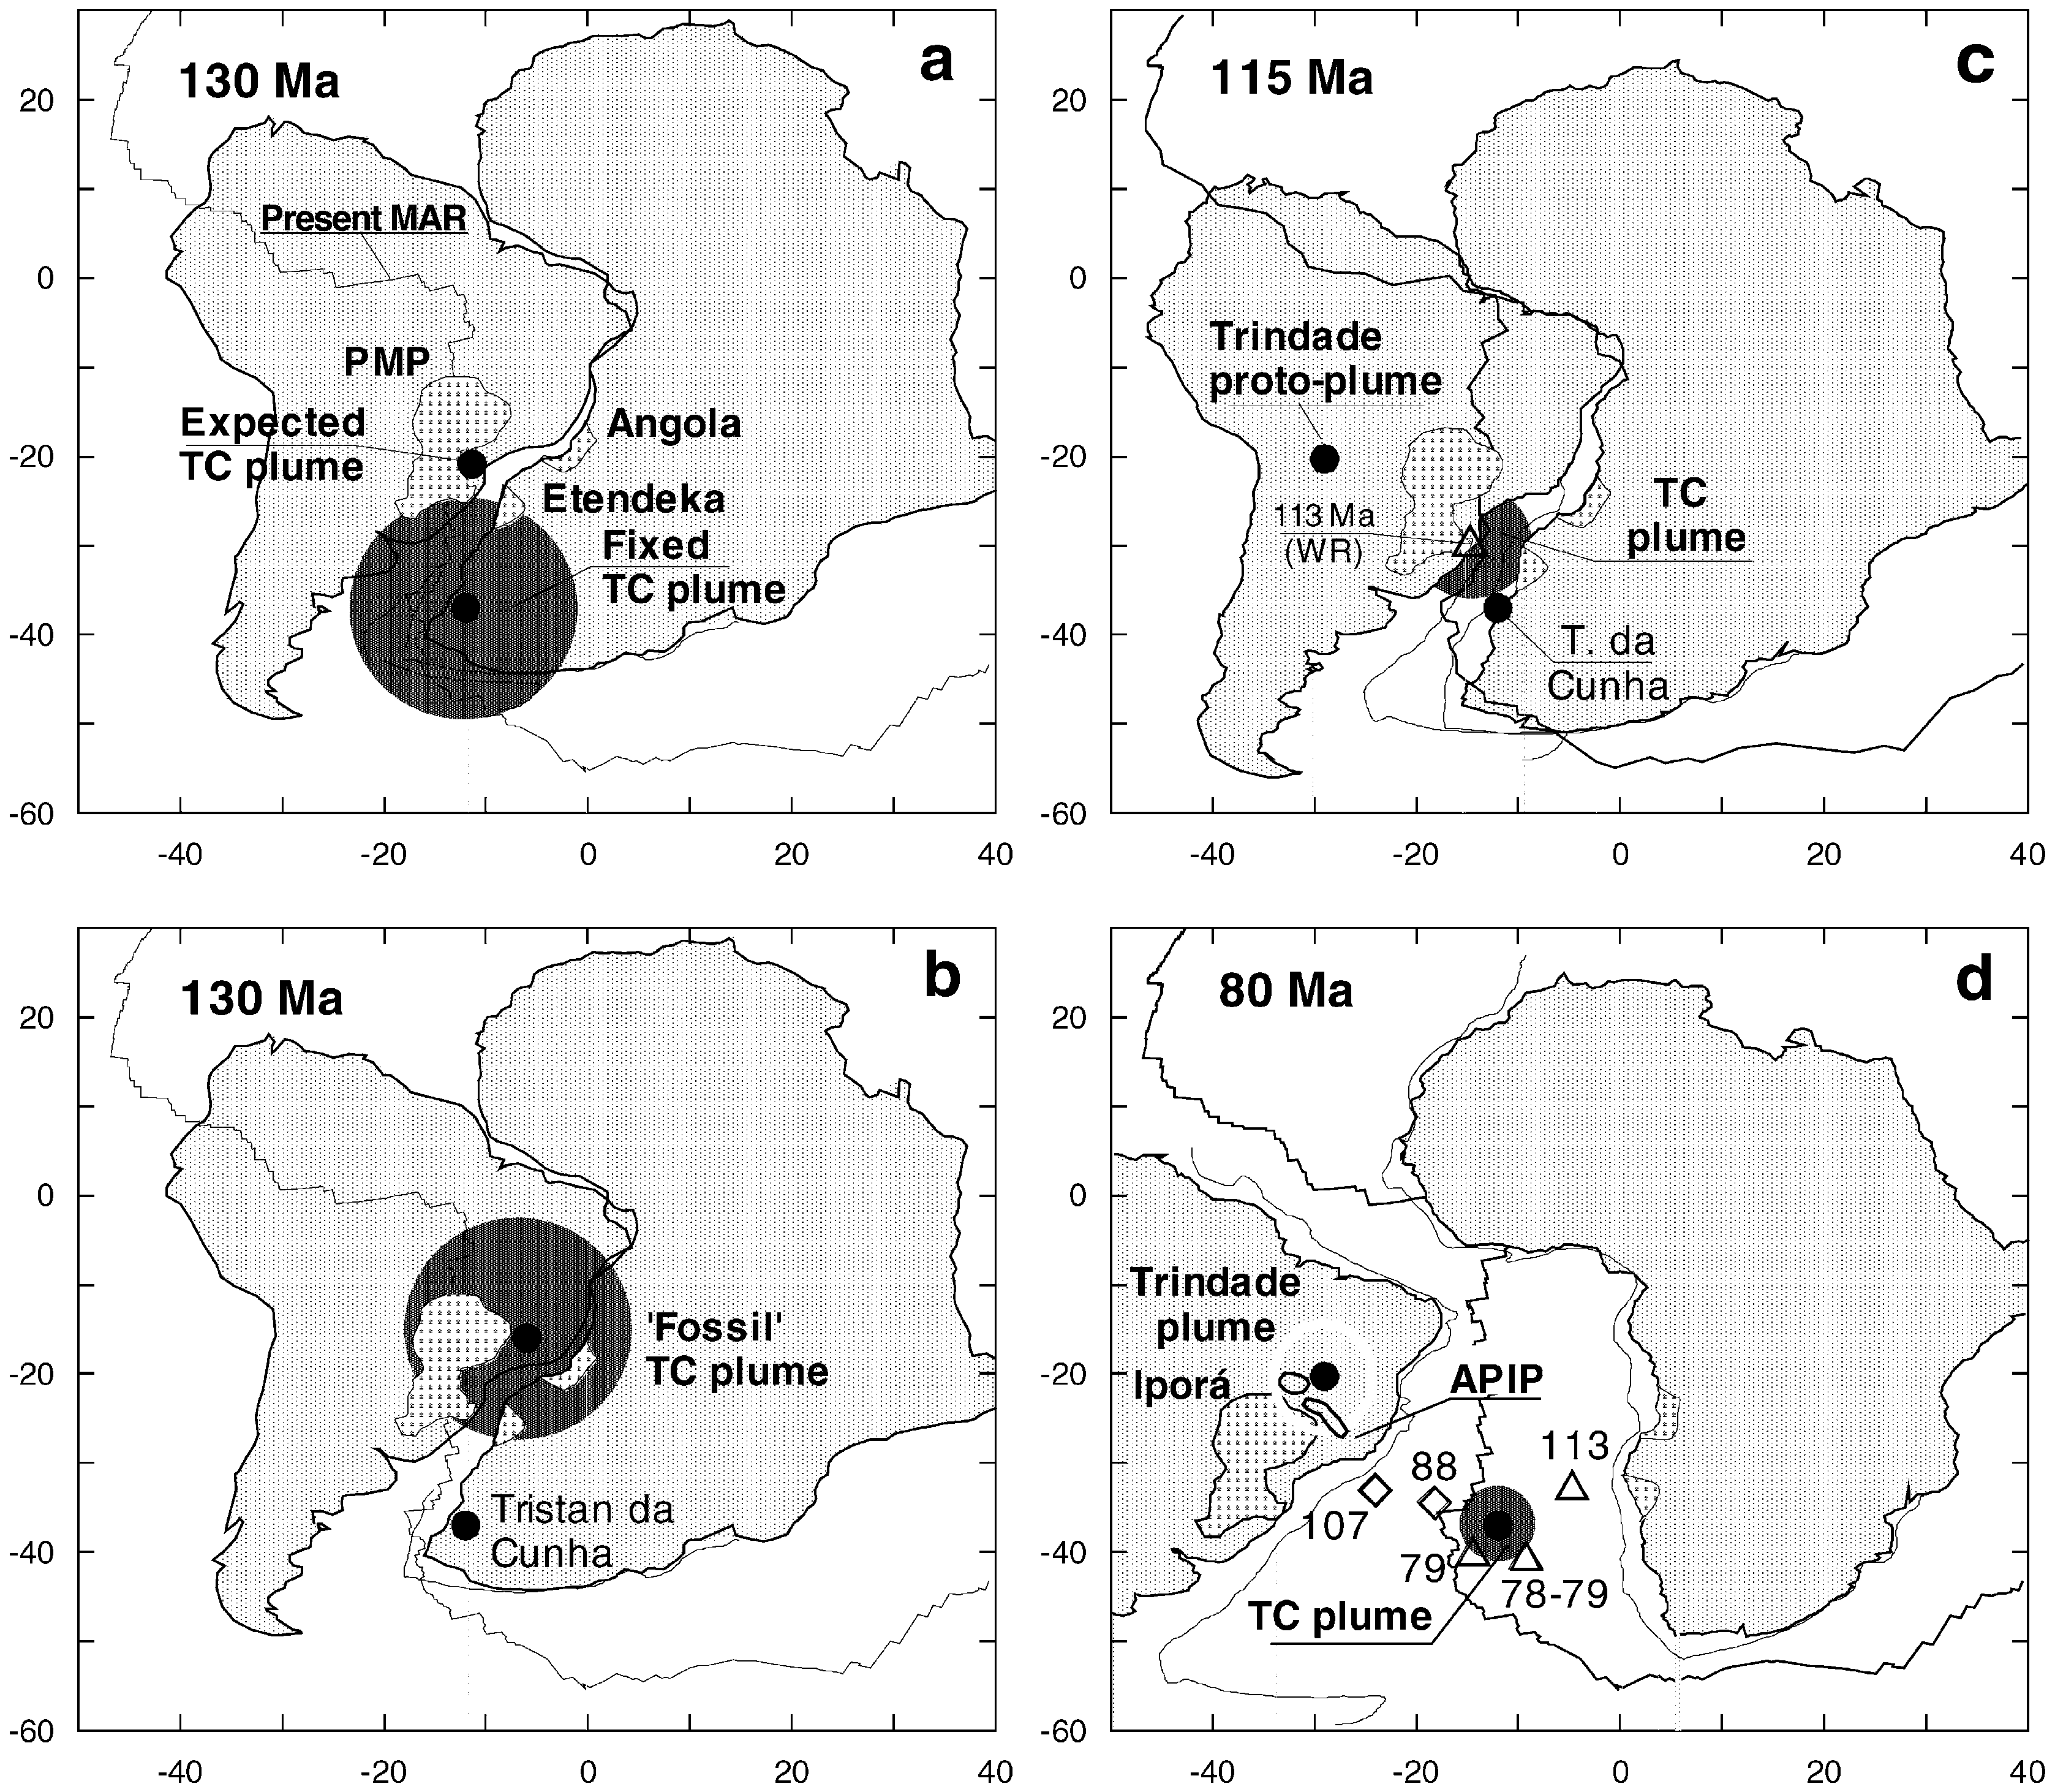
M. Ernesto, L.S. Marques, E.M. Piccirillo, E.C. Molina, N. Ussami a, Comin-Chiaramonti, G. Bellieni
Paleomagnetic reconstructions demonstrate that the Tristan da Cunha (TC) plume, ……
Was located 1000 km south of the Paraná Province at the time of the magma eruptions
Journal of Volcanology and Geothermal Research 118 (2002)

Slide 34
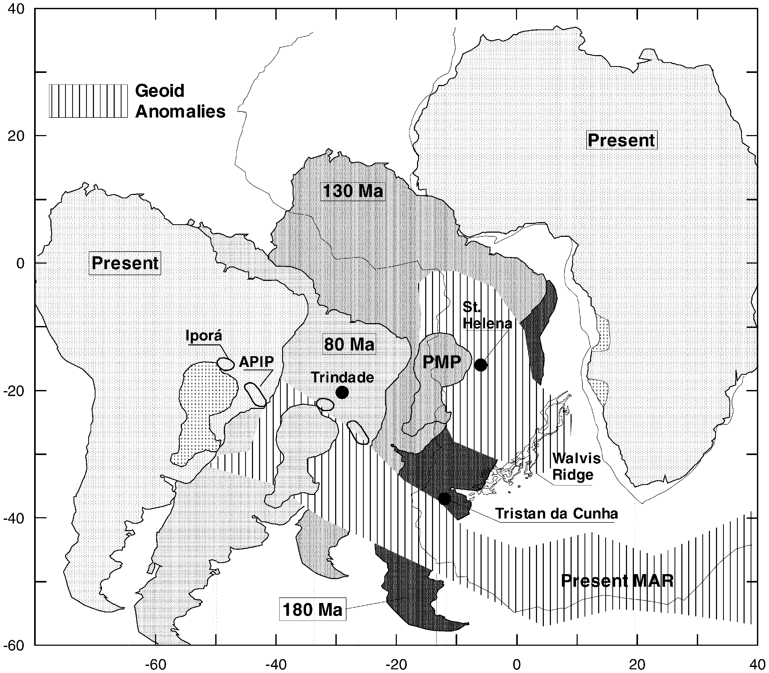
The Parana Province was above the NW-SE geoid/mantle thermal anomaly located on the western African plate.… .
Therefore, the area corresponding to the PMP remained quasi -stationary over a mantle thermal anomaly for about 50 Ma (from approximately 180 to 130 Ma).

Slide 35
Plume+ SCLM+ subduzione
In the Cretaceous igneous suites of southern Africa and South America, the SCLM has been credited as the dominant, or even only source for a remarkable range of magma compositions.
………………….
The above listing highlights the extreme range of magma compositions, and their wide range of isotopic compositions, advocated as originating in the SCLM. Also of note is the wide range in scale of magma generation that is believed to have taken place in the SCLM, from smaller volume carbonatites to flood basalt sequences exceeding 10⁶ km³ in volume, all within the Jurassic–Late Cretaceous time period. We seriously question whether constraints exist to justify the ability of SCLM to be compositionally diverse enough, in sufficient volumes, to act as the source of all the magmas in question.
The data presented in this paper add nothing new to arguments supporting the major role of the SCLM in Paraná–Etendeka magmatism. Instead, we offer an alternative model for debate, one that explores a sub-lithospheric origin for the mafic magmas. This specifically involves interaction between the Tristan plume, convecting asthenosphere, and a component derived from subducted material stored in (or above) the Transition Zone. Interpretations are, however, potentially complicated by variable degrees of SCLM and crustal interaction that are likely to have occurred.

Slide 36
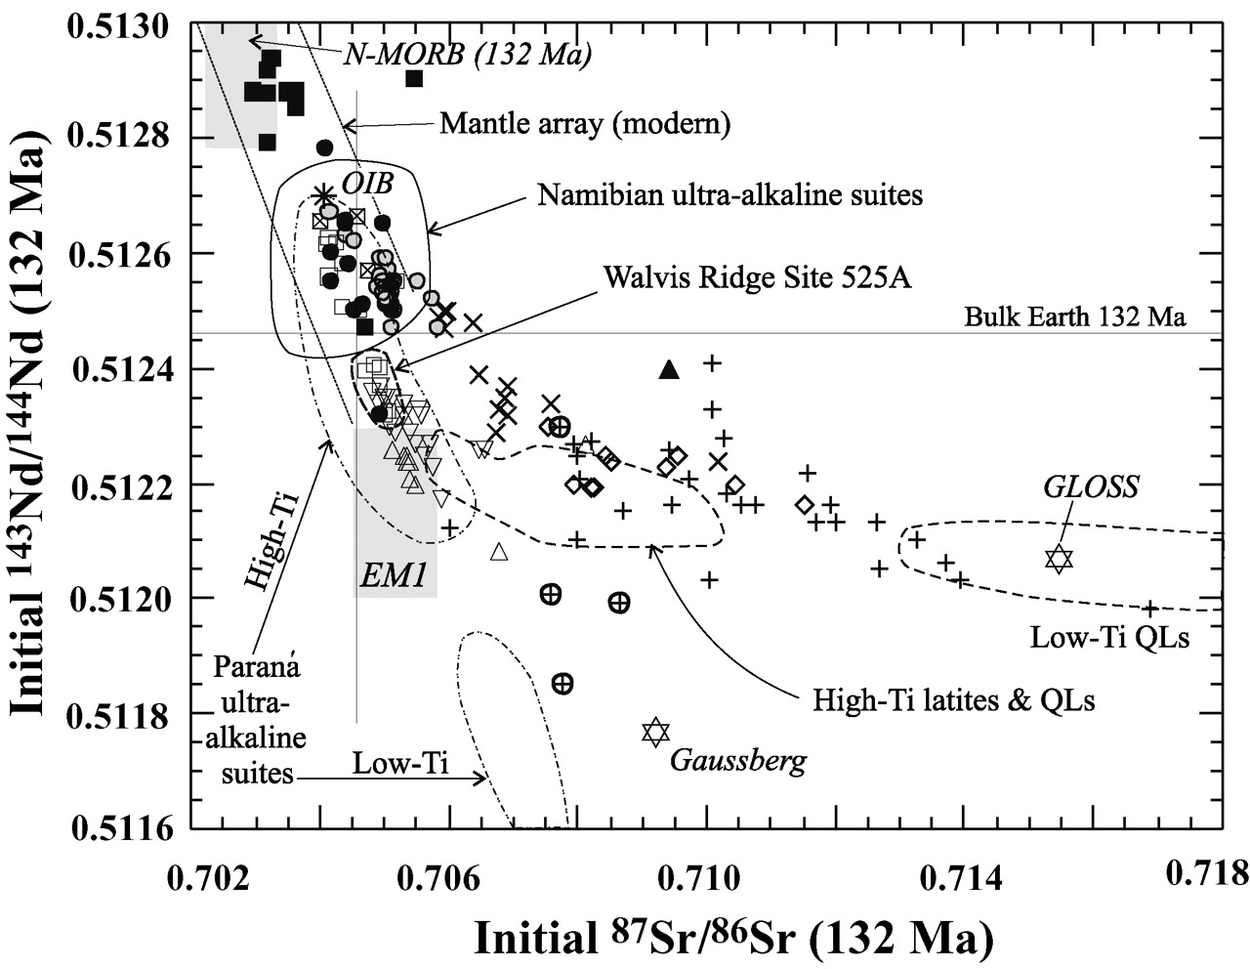

Initial (132 Ma) Nd–Sr isotopic compositions of the Etendeka and equivalent Paraná basalts, Walvis Ridge and Tristan, the fields of the Namibian and Paraná ultra-alkaline suites, and the fields of the high-Ti (extending from the Khumib compositions) and low-Ti (in part) silicic series.
EWART A et al. J. Petrology 2004;45:59-105
© Oxford University Press 2004; all rights reserved
Notes:
Initial (132 Ma) Nd–Sr isotopic compositions of the Etendeka and equivalent Paraná basalts, Walvis Ridge and Tristan, the fields of the Namibian and Paraná ultra-alkaline suites, and the fields of the high-Ti (extending from the Khumib compositions) and low-Ti (in part) silicic series. The postulated EM1 composition is after Zindler & Hart (1986). Symbols, model compositions and data sources as in Fig. 10 key and caption.

Slide 37
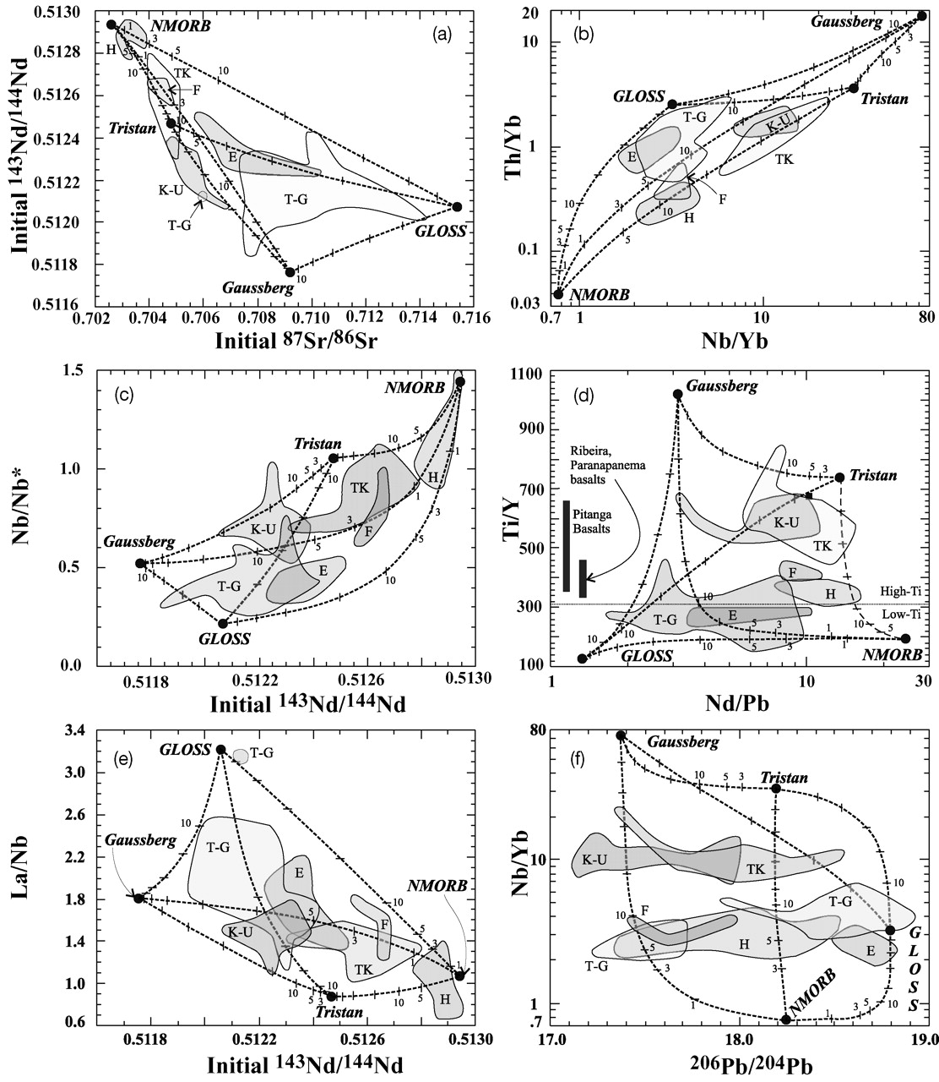
Trace element and isotopic plots to illustrate the proposed multiple mixing model (see text) of mafic magma genesis in the Etendeka and the Paraná, involving sub-lithospheric mixing between plume-derived magma (Tristan), depleted asthenospheric mantle magma (N-MORB), and the Gaussberg magma composition (an inferred product of ancient subducted sediment remelting; Murphy et al., 2002).

Slide 38
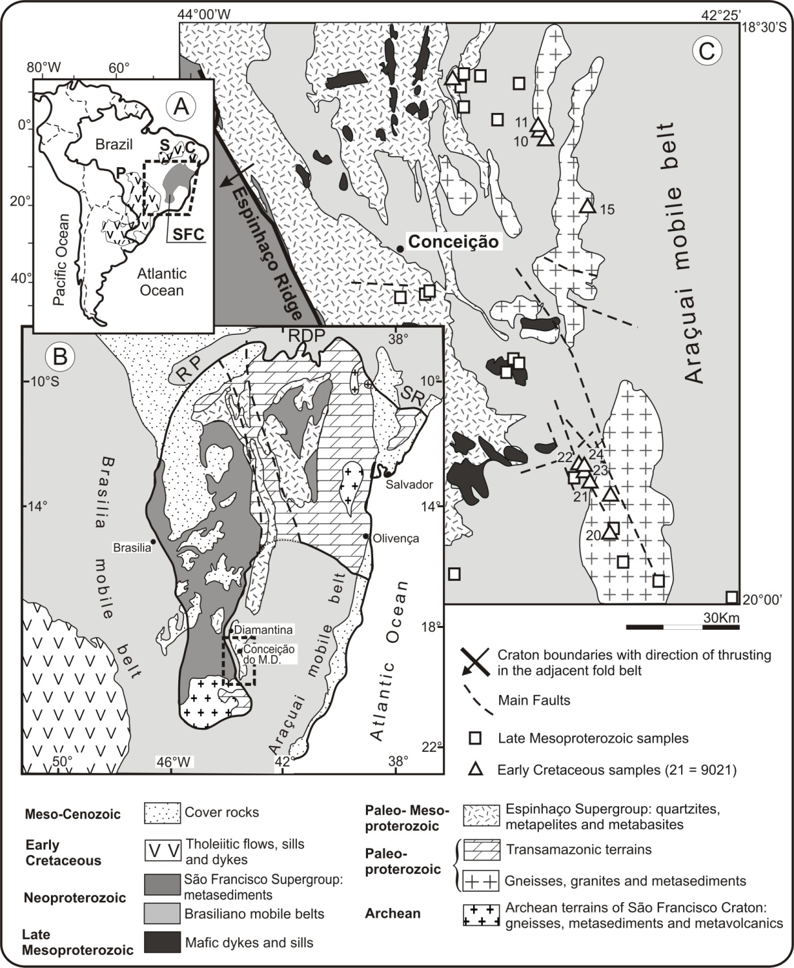

Slide 39
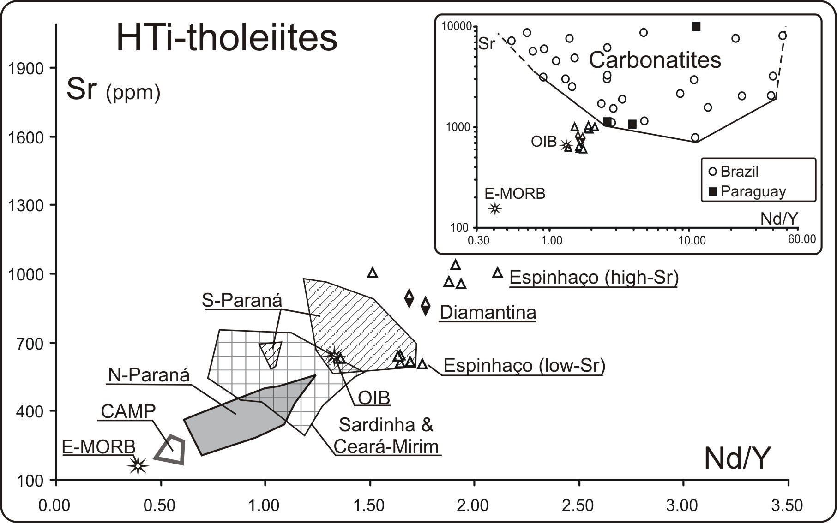

Slide 40
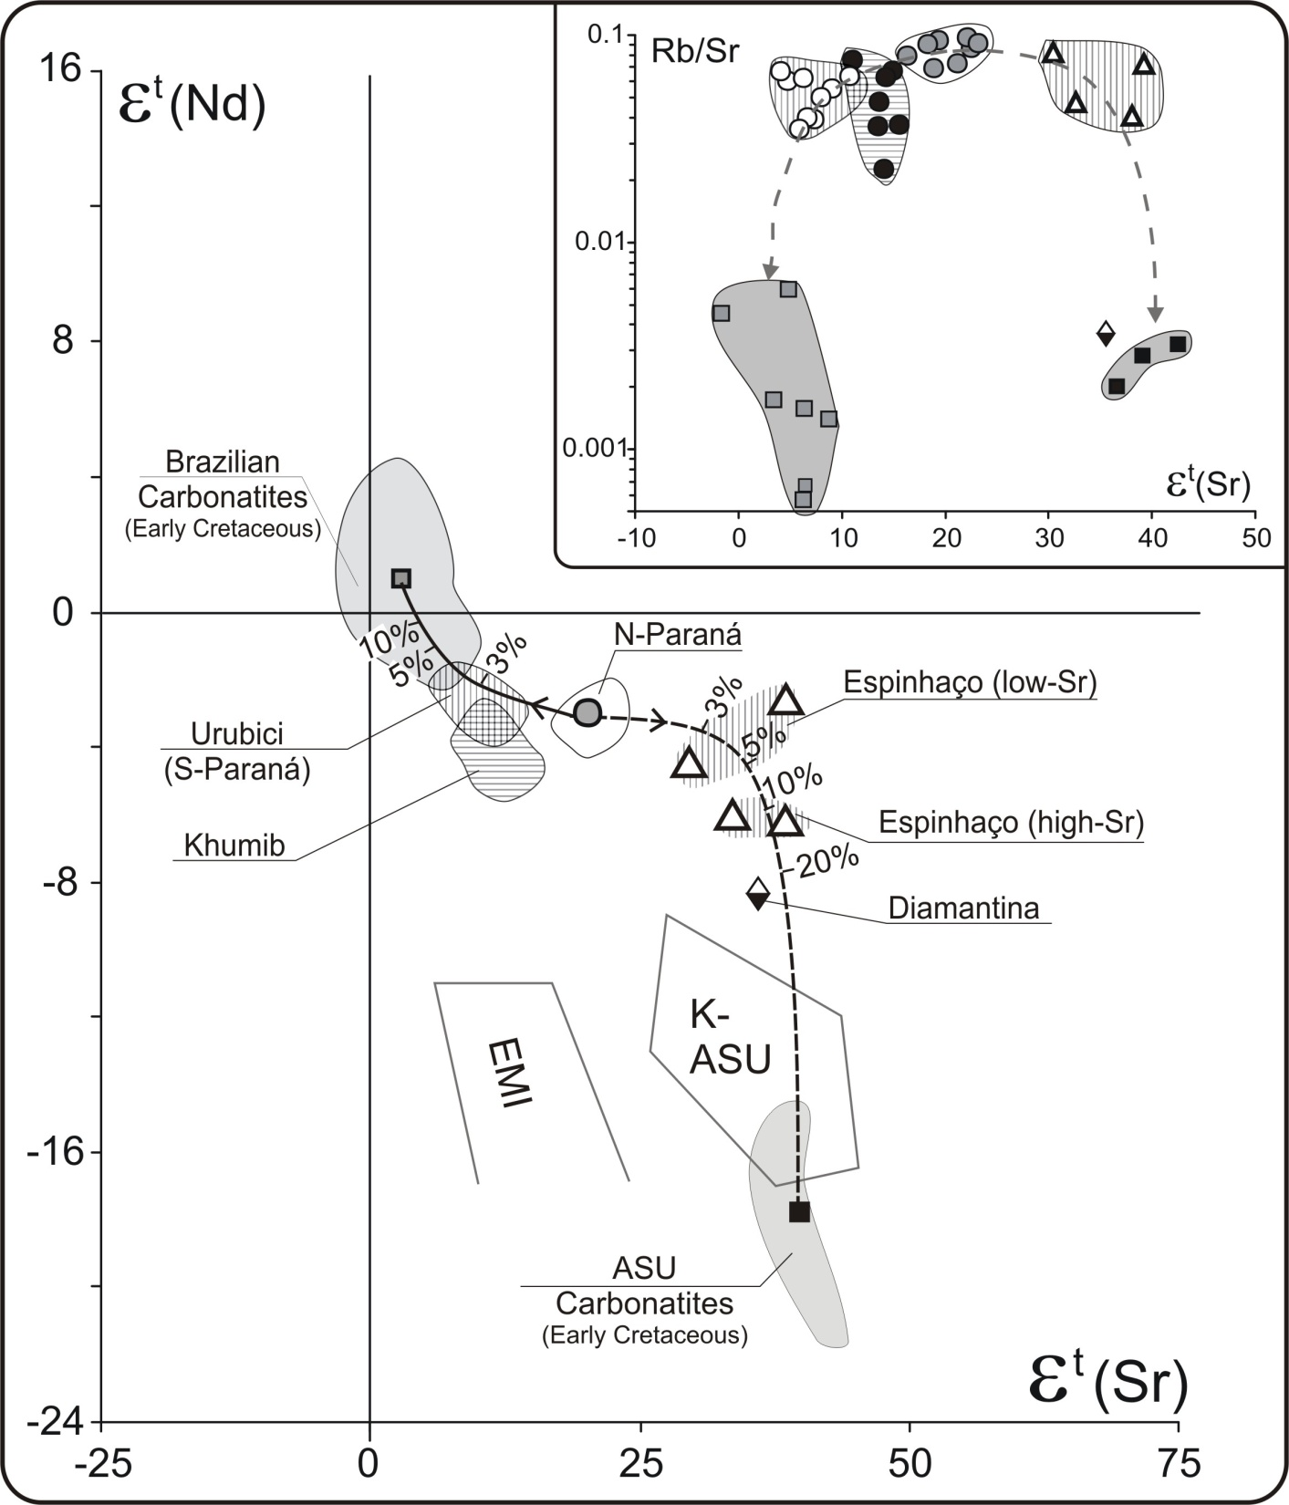

Slide 41
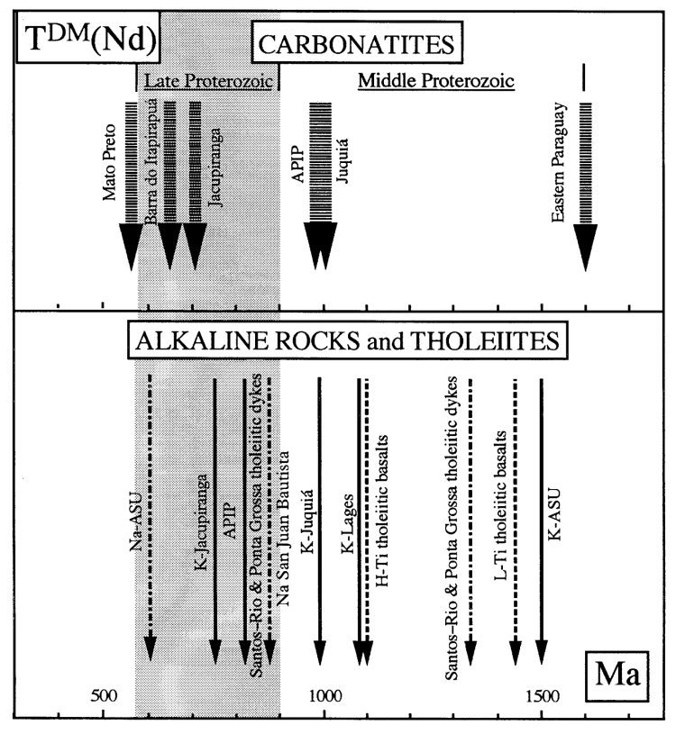
T_{DM} (Nd) model ages (Fig. 12) show that most alkaline rocks, carbonatites and nephelinites from SE Brazil and Paraguay range from 0·5 to 1·1 Ga. This range is virtually the same as that for high-Ti Paraná tholeiites. On the other hand, only K-ASU and carbonatites from eastern Paraguay yielded T_{DM} of early Middle Proterozoic age, as did most of the low-Ti Paraná tholeiites, including Santos-Rio de Janeiro and Ponta Grossa tholeiitic dykes.

Slide 43
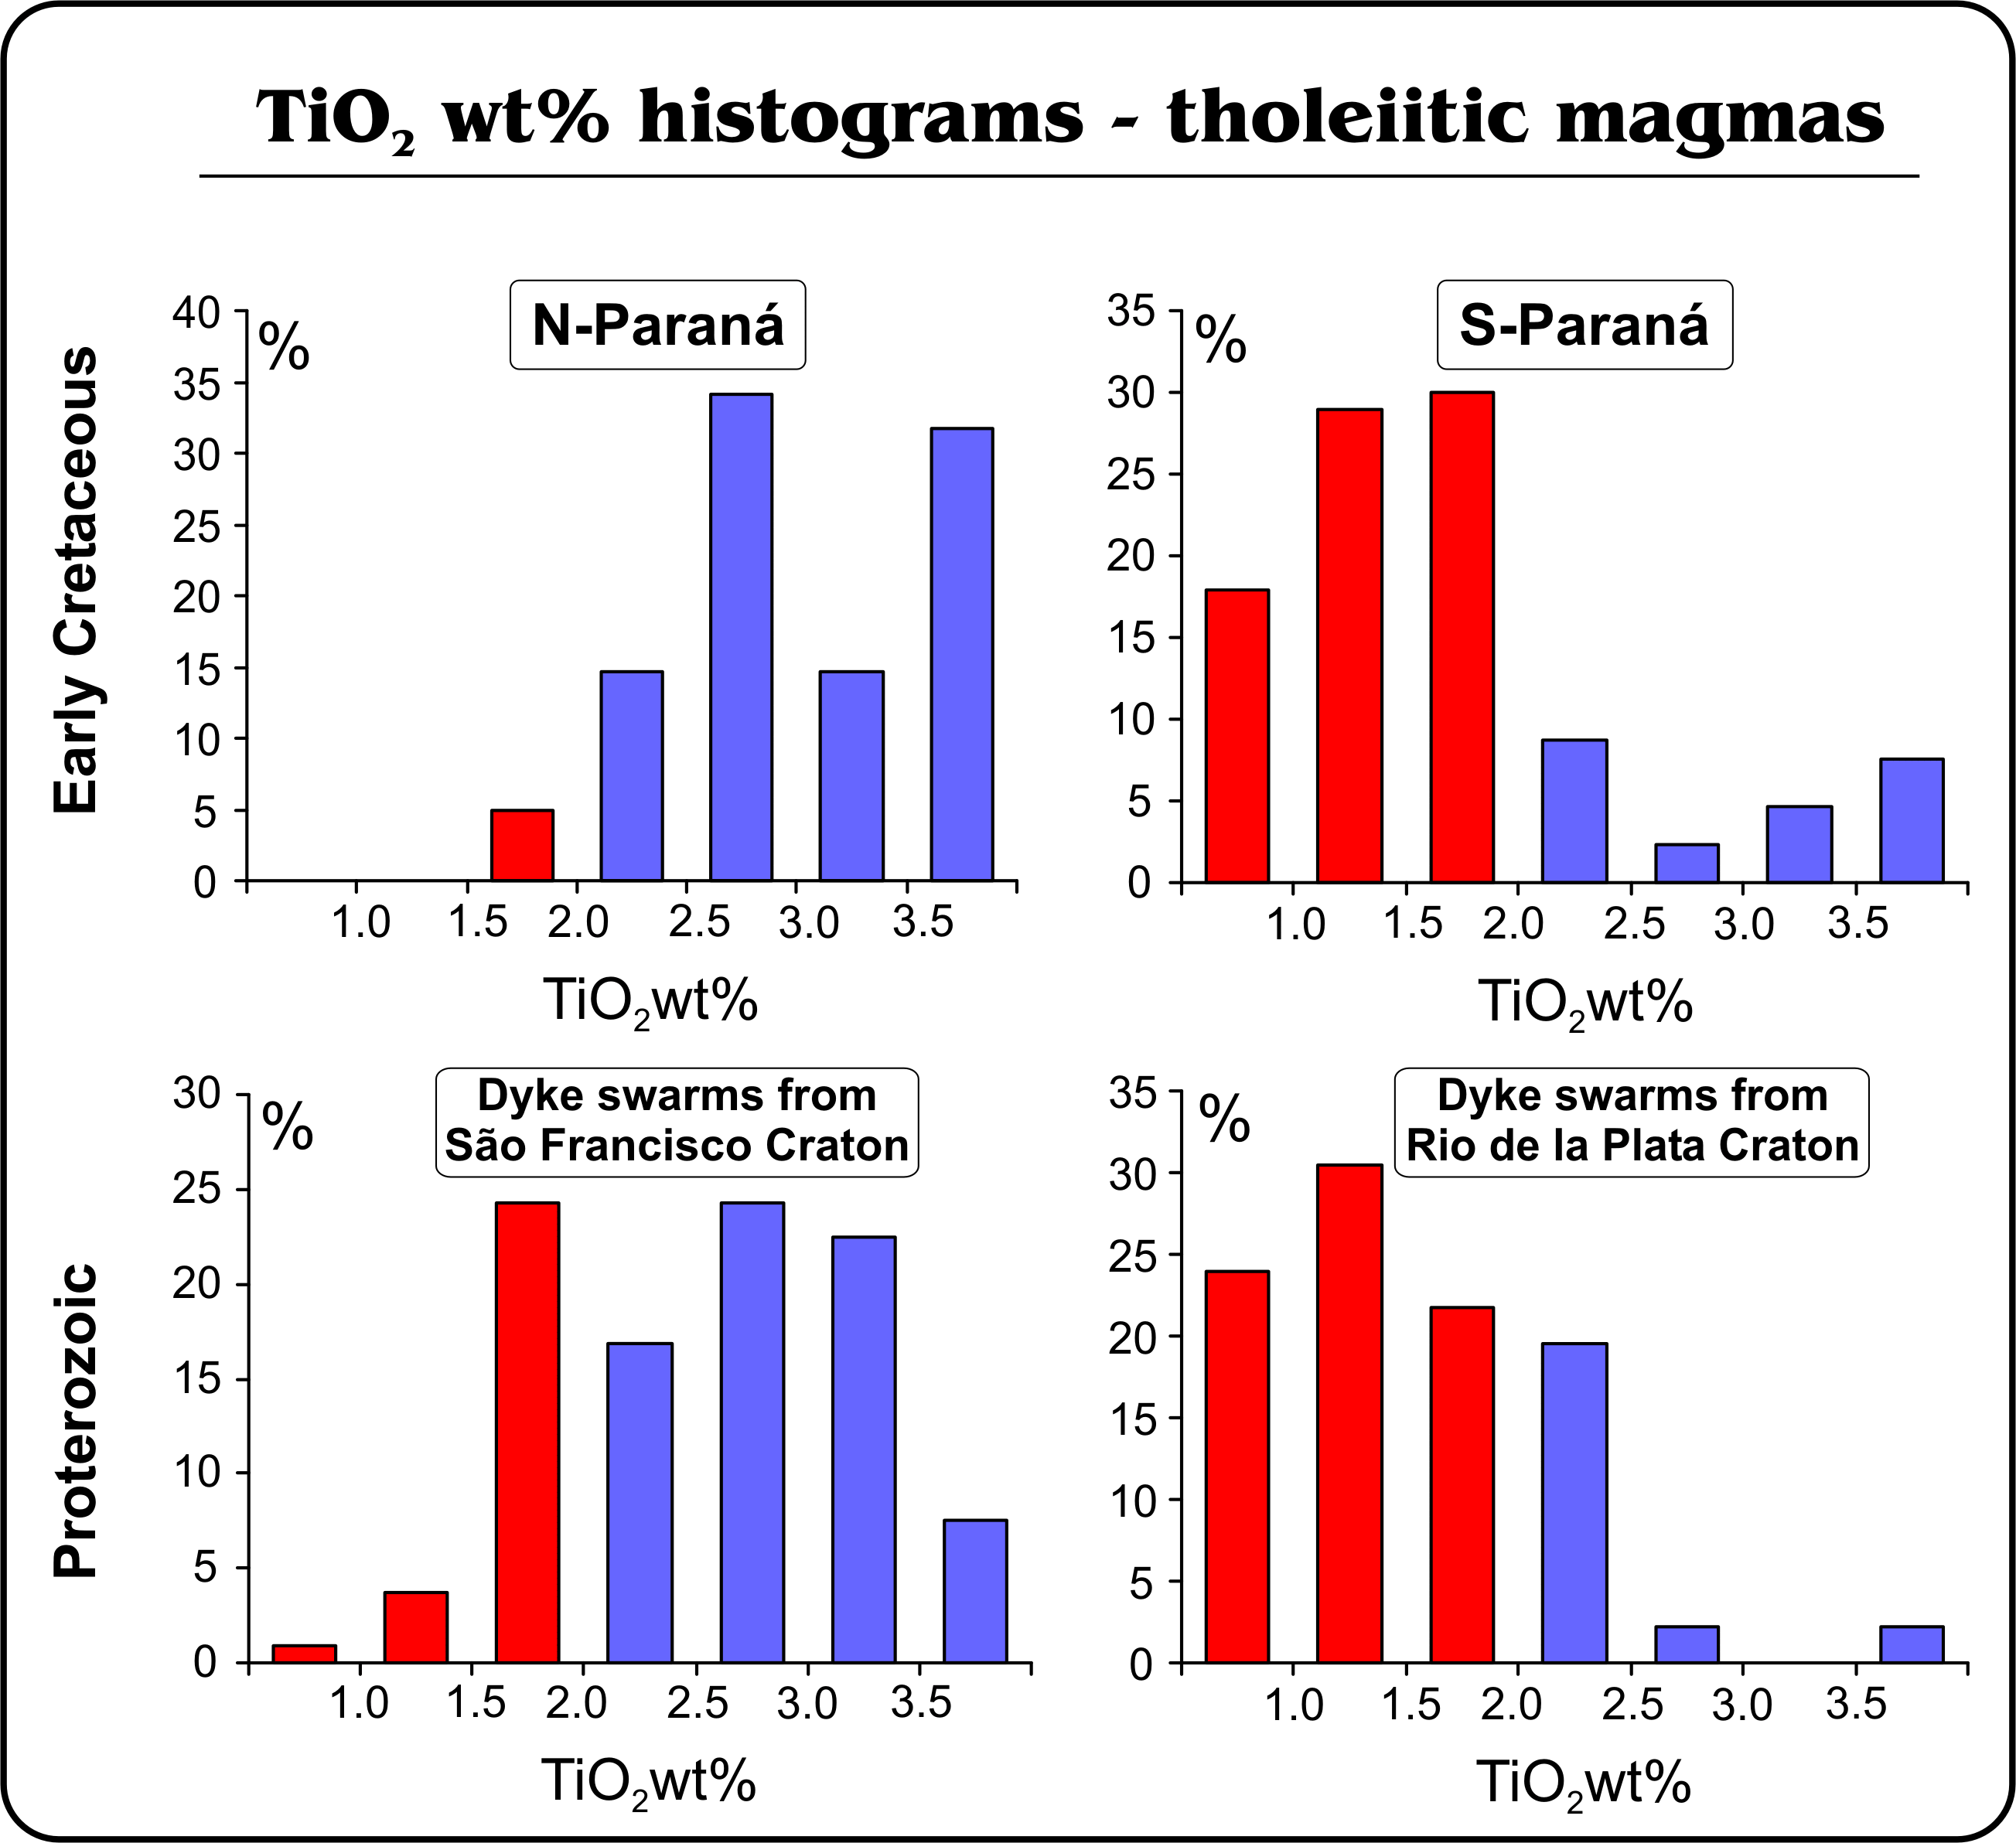

Slide 44
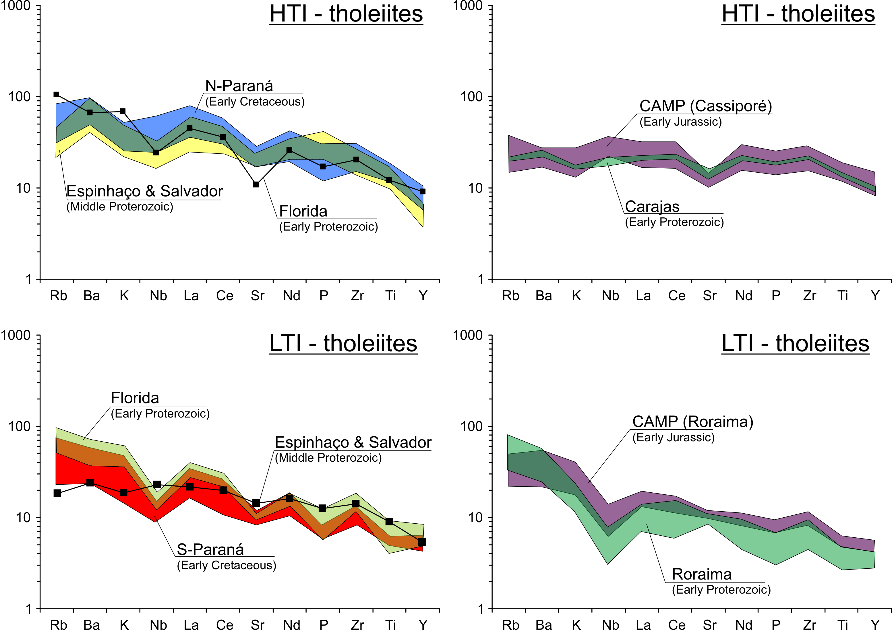

Slide 45
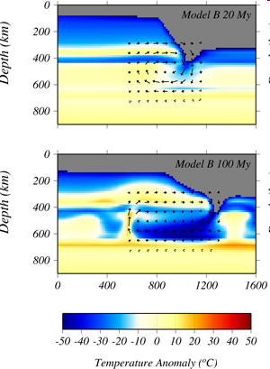
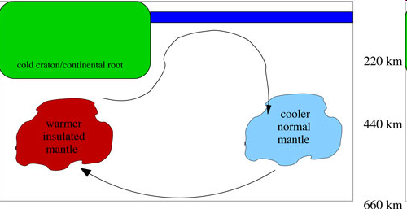
Edge-Driven Convection Hypothesis
King & Anderson 2000-2001

Slide 47
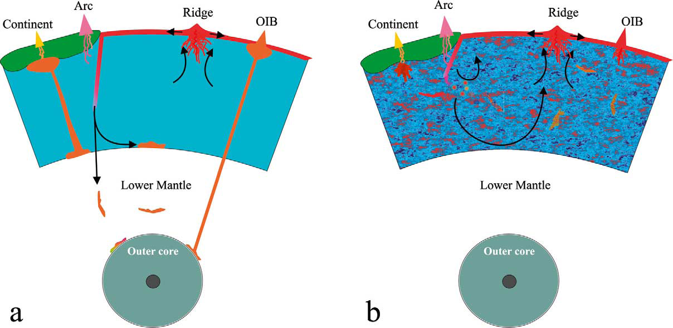
Earth and Planetary Science Letters 217 (2003) 123-139
The statistical upper mantle assemblage
Anders Meibom, Don L. Anderson
Anderson, 1994a. D.L. Anderson , The sublithospheric mantle as the source of continental flood basalts: the case against the continental lithosphere and plume head reservoirs. Earth Planet. Sci. Lett. 123

Slide 48
CAMP vs PARANA’
CAMP in south America

Slide 49
CAMP vs PARANA’
CAMP in South America

