Slide 1

Density Functional Theory Formalism and Applications
Mauro Stener
Dipartimento di Scienze Chimiche e Farmaceutiche
Università degli Studi di Trieste
Via L. Giorgieri 1, 34127 TRIESTE
E-mail: stener@units.it
XIII-EM-TCCM-European Master in Theoretical Chemistry and Computational Modelling 13th International Intensive Course, Perugia (I), 3rd – 28th September 2018

Slide 2
Summary
THEORY - DFT Review of DFT basic theory and equations
THEORY - TDDFT with the aim to underline what is general from Linear Response formalism.
COMPUTATIONAL - Some numerical aspects of the implementation in the ADF code, most important computational choices, how to assign spectral features. New TDDFT algorithm.
APPLICATIONS:
4.a. Plasmons in metal clusters.
4.b. Core electron excitations (NEXAFS).

Slide 3
Electron Density
Take a system with only 1 electron, the electron density at point r₀ is:
This can be interpreted as the action of a density operator:
Extension to N-electrons:

Slide 4
Electron Density
Now consider in general a N-electron antisymmetric wavefunction, X₁=x₁,y₁,z₁,ω₁: ‘hidden’ spin coordinate

Slide 5
Electron Density
Now consider in general a N-electron antisymmetric wavefunction, X₁=x₁,y₁,z₁,ω₁: ‘hidden’ spin coordinate

Slide 6
Density Functional Theory (DFT)
P. Hohenberg and W. Kohn, Phys. Rev. 136 (1964) B864
Nobel Prize for chemistry 1998
Description of the electronic structure of the Ground State
In Ab-initio - the N-electron system is described by the wave-function:
Cartesian coord. Spin Coord.
In DFT - the N-electron system is described by the Electron Density ρ:

Slide 7
Functional: a function application:
More recent formalization: M. Levy, Proc. Natl. Acad. Sci. (USA) 76 (1979) 6062.
N-electrons, non-relativistic, Born Oppenheimer approximation (atomic units):
general, in practice electron-nucleus interaction

Slide 8
Definition of the functional F[ρ]
Ψ: N-electron antisymmetric wave-function
Ψ
ρ
⋅

Slide 9
Variational theorem:
Demonstration 1)

Slide 10
Demonstration 2)
But from 1) also:
The idea is to minimize E[ρ] with respect to ρ, this furnishes the GS density and energy. Formal, not practical.

Slide 11
Minimization of E[ρ]
Recall that:
This allows to define energy functionals:
Eventually, the next expression must be minimized:
Direct approach: Thomas-Fermi, functionals are approximated (electron gas) and the density is varied in order to reach the minimum of E[ρ].

Slide 12
Kohn-Sham approach
Fictius system of non-interacting electrons (V_{ee}=0), but with the same density as the real systems of interacting electrons.
This term must be chosen in order to have the same density as the real system
Spin-orbitals
Spatial-orbitals

Slide 13
Kohn-Sham approach
Interacting system:
J[ρ] is the classical electrostatic interaction:
Finally, E_{XC}[ρ] is defined as follows:
E_{XC}[ρ] not known, but small wrt other terms, approximated by models (electron gas)

Slide 14
Kohn-Sham approach
Minimize:
With the constrain:
Functional derivative
For the interacting system:
Equal: we impose the same solution (ρ)!
For the non-interacting system:

Slide 15
Kohn-Sham equations
KS equations
h_{KS} depends from the density (ρ) so a Self Consistent Field (SCF) procedure must be employed to solve the KS equations, like in Hartree Fock

Slide 16
Functional derivative
Differential:
Linear in δρ
Extension of the concept of exact differential:

Slide 17
Functional derivative:examples

Slide 18
Functional derivative:examples
Local Density Approximation (LDA):

Slide 19
Local Density Approx. (LDA)
Models can be used to approximate ε_{X} and ε_{C} : in LDA the Uniform Electron Gas is employed.
In LDA ε_{X} is analytic:
Slater (1951) suggested the Xα method, an approximation of HF with local exchange:
In LDA the ε_{C} term can be obtained from Statistical Mechanics calculations (Quantum Monte Carlo), such calculations furnish ε_{C} which can be fitted with very complicated analytical expressions:

Slide 20
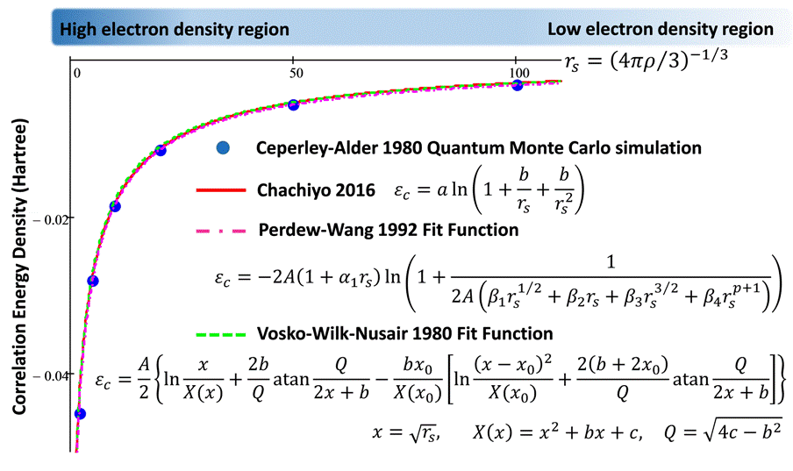
ε_{C} in LDA

Slide 21
DFT: the Kohn-Sham (KS) method
The electron density ρ can be extracted from the KS reference system solving the KS equations:
SCF iterative solution

Slide 22
Kohn-Sham (KS) results:
ϕ_{i} molecular orbitals and their energies ε_{i} are obtained.
The potential is local (at variance with HF)
V_{XC} must be approximated in practice (LDA, GGA, …)
Total energy E[ρ] and one-electron local operator properties (gradients for example) of the systems can be calculated from density

Slide 23
E_{XC} functional choice
Functional accuracy can be improved:
LDA (good geometries, bad energies)
GGA: also is considered (improved energies)
Hybrids: non-local Fock exchange (best compromise B3LYP)
Asymptotic corrections (LB94,…) (R. van Leeuwen and E. J. Baerends, PRA 49 (1994) 2421)
Meta GGA: dependence KE density:
Common V_{XC} choices do not obey to correct asymptotic –1/r behavior (long-range exchange), this feature is important to obtain accurate excitation energies and intensities in TDDFT

Slide 24
Kieron Burke, “Perspective on density functional theory” JCP 136 (2012) 150901

Slide 25
DFT: numerical considerations
Molecules: LCAO formulation. The KS eigenfunctions are the molecular orbitals: linear combination of basis functions
The problem to obtain KS eigenvalues and eigenfunctions, in LCAO is reduced to a Generalized Diagonalization:
Input:
Output:

Slide 26
DFT: numerical considerations
Two different philosophies to build the H_{KS} matrix:
Numerical integration (ADF code), STO basis set
Analytical integration (Gaussian …) GTO basis set
ADF: computational scheme
- Density fitting
a_{m} are obtained imposing:
With the constrain:

Slide 27
ADF: computational scheme
- Density fitting allows computational economy in the calculation of the coulomb matrix elements:

Slide 28
Comments:
DFT: the variational theorem is formal, not directly used!
KS: a fictious non-interacting system is introduced to calculate the GS density, this allows to work out the Kohn-Sham equations, which are implemented in computer DFT codes, useful in practice!
E_{XC}: unknown term, must be approximated by suitable models.
Implementation: standard LCAO formalism, molecular orbitals and basis set.

